Slide 1
Tuberculosis (TB) Disease in the United States 1993–2023*
U.S. Centers for Disease Control and Prevention
Division of Tuberculosis Elimination
National Center for HIV, Viral Hepatitis, STD, and TB Prevention
National Tuberculosis Surveillance System
*Data updated as of July 17, 2024
Notes:
Tuberculosis in the United States—National Tuberculosis Surveillance System, Highlights from 2023. This slide set was prepared by the Division of Tuberculosis Elimination, National Center for HIV, Viral Hepatitis, STD, and TB Prevention (NCHHSTP), Centers for Disease Control and Prevention (CDC), U.S. Department of Health and Human Services (HHS). It provides recent trends and highlights of data collected through the National Tuberculosis Surveillance System (NTSS) for 2023.
Since 1953, through the cooperation of state and local health departments, CDC has collected information on newly reported cases of tuberculosis (TB) disease in the United States. Each individual TB case report (Report of Verified Case of Tuberculosis, or RVCT) is submitted electronically to CDC. The data for this slide set are based on TB case reports for 1993–2023 received by CDC as of July 17, 2024. All case counts and rates for years 1993–2022 have been updated, and data from 2023 have been added.

Slide 2
Progress Towards TB Elimination, United States, 1982–2023
26,673 TB cases in 1992
Incidence rate: 10.4 per 100,000
9,633 TB cases in 2023
Incidence rate: 2.9 per 100,000
Notes:
This graph shows the annual number of TB cases in the United States for each year during 1982–2023, and the TB elimination threshold goal of <1 case per 1,000,000 (1 million) persons, which is approximately 335 cases per year for the current U.S. population. In 1992, 26,673 cases were reported in the United States, with an incidence rate of 10.4 cases per 100,000 persons. TB cases and incidence rates have declined substantially since 1992, but the annual rate of decline has been inadequate to achieve TB elimination goals. TB cases and incidence rates declined considerably in 2020, coinciding with the COVID-19 pandemic. TB cases subsequently rose in 2021 and 2022 but remained lower than prepandemic levels. In 2023, 9,633 cases were reported, with an incidence rate of 2.9 cases per 100,000 persons, representing a 15.6% increase in case count and 15.0% increase in incidence rate compared with 2022, and a return to case counts last observed in 2013. Renewed progress toward TB elimination is needed.

Slide 3
TB Cases and Incidence Rates, United States, 1993–2023
9,633 TB cases in 2023
Incidence rate: 2.9 per 100,000
Notes:
During 2023, the United States reported 9,633 TB cases, an incidence rate of 2.9 cases per 100,000 persons. Except for 2015, the U.S. TB case count and incidence rate declined every year during 1993 to 2020. Since the sharp decline in 2020 associated with the COVID-19 pandemic, the annual incidence rate has increased every year. The case count and incidence rate in 2023 exceeds the case count and rate in 2019, the year prior to the COVID-19 pandemic.

Slide 4
TB Incidence Rates and Annual Percent Change in Rate, United States, 2010–2023
*Annual percent change in rate based on unrounded data
Notes:
The top graph shows incidence rates (cases per 100,000 persons) since 2010. The bottom graph shows annual percentage change in incidence rate, with any value >0 representing an increase from the previous year and any value <0 representing a decrease from the previous year.
The incidence rate increased by 15% from 2022 (2.5 cases per 100,000 persons) to 2023 (2.9 cases per 100,000 persons), which is 6% greater than the TB incidence in 2019.

Slide 5
TB-Related Deaths* and Mortality Rates, United States, 1993–2022
565 TB-related deaths in 2022
Mortality rate: 0.2 per 100,000
*National Vital Statistics System Underlying Cause of Death (based on deaths reported through 2022)
Notes:
The National Vital Statistics System (NVSS) reported 565 TB-related deaths (0.2 deaths per 100,000 persons) where TB was the underlying cause of death for 2022, the most recent year for which data are available. This represents a 6.1% decrease in deaths and a 6.5% decrease in the mortality rate compared with 2021.
It is important to note that under current NVSS guidance, deaths caused by TB among persons with comorbid HIV infections are classified with HIV as the underlying cause of death, not TB, and are not included here.
National Vital Statistics System accessed from CDC WONDER as of June 25, 2024: https://wonder.cdc.gov/

Slide 6
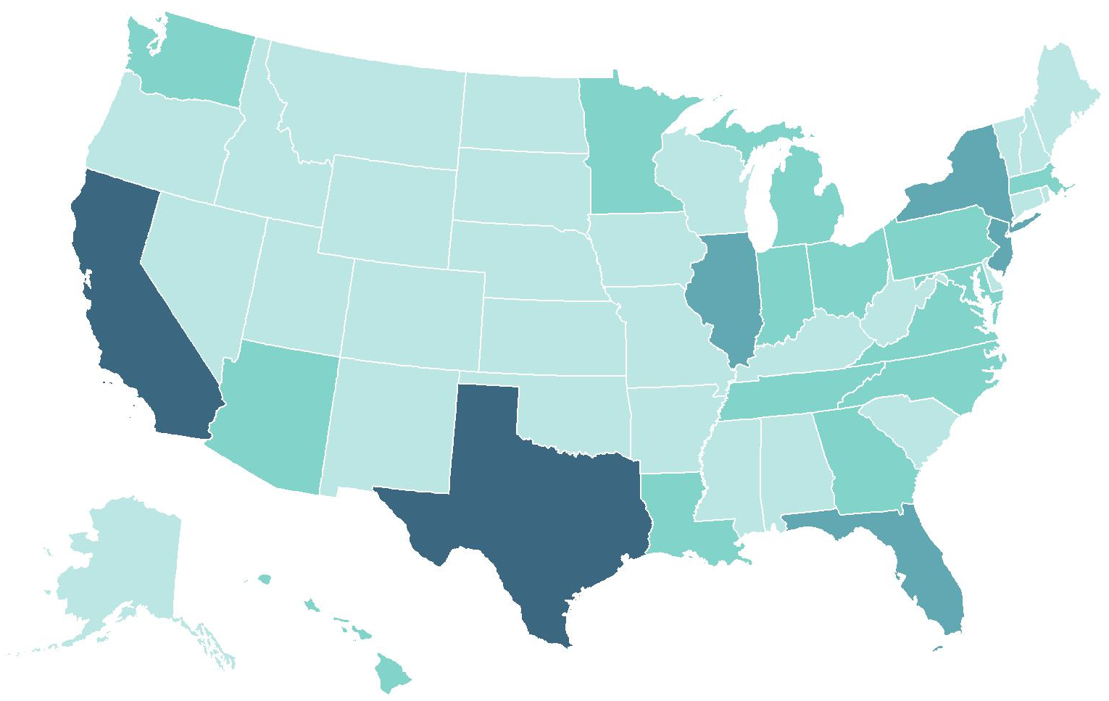
TB Cases and Percentages by Reporting Area,
United States, 2023 (N=9,633)
New York*
9% (n=894)
California 22% (n=2,112)
Florida
6% (n=624)
Number of TB cases
≤99
Texas
13% (n=1,242)
100–299
300–999
≥1000
* Includes New York City
Notes:
As in past years, four U.S. states combined reported half (50.6%) of all U.S. TB cases in 2023: California (21.9%, n=2,112), Texas (12.9%, n=1,242), New York state (including New York City, 9.3%, n=894) and Florida (6.5%, n=624). These states are also the most populous states in the United States, but only represent about a third of the total U.S. population.
Note: ranges were determined based on the Jenks Natural Breaks method, then rounded to the nearest 100.

Slide 7
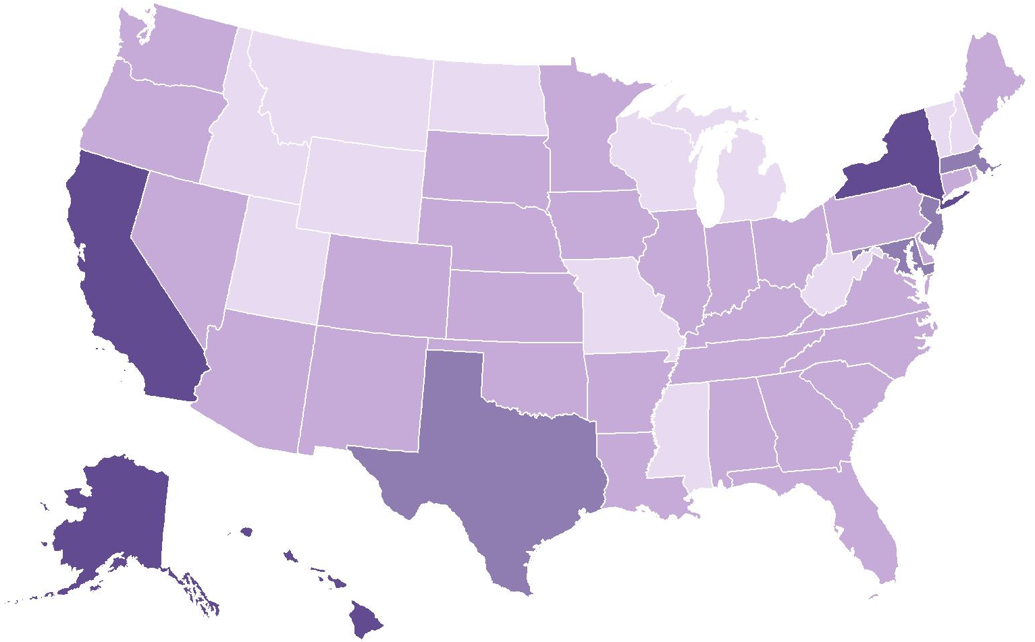
TB Incidence Rates* by Reporting Area, United States, 2023
New York
4.6†
Massachusetts
3.2
New Jersey
3.7
California
5.4
Maryland
3.3
District of Columbia
4.0
Incidence rate
Alaska
10.5
Hawaii
8.1
<1.5
1.5–<2.9
Texas
4.1
2.9–<4.5
*Cases per 100,000 persons
†Includes New York City
≥4.5
Notes:
Eight states and the District of Columbia had incidence rates higher than the national rate of 2.9 cases per 100,000 persons in 2023. Alaska had the highest rate (10.5), followed by Hawaii (8.1), California (5.4), New York (including New York City, 4.6), Texas (4.1), District of Columbia (4.0), New Jersey (3.7), Maryland (3.3), and Massachusetts (3.2).
Note: New York City, which is a distinct reporting area, had an incidence rate of 8.3 cases per 100,000 persons. When New York City was analyzed separately, the remainder of New York state had an incidence rate of 1.9 cases per 100,000 persons.

Slide 8
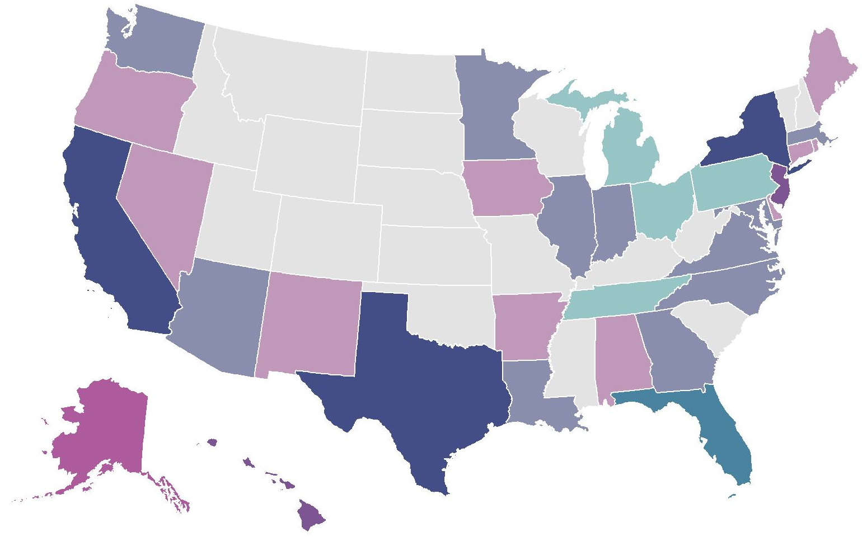
TB Cases and Incidence Rates*
by Reporting Area, United States, 2023
100–499
≤99
≥500
≥3.4
1.7–<3.4
<1.7
Incidence rate*
Case count
*Cases per 100,000 persons
Notes:
This map shows each state shaded based on two scales, one representing TB case counts and one representing incidence rates, overlaid. Case counts reflect the overall burden of testing, treating, and preventing TB in each jurisdiction, but the incidence provides a clearer picture of epidemiologic risk by jurisdiction. The lighter shades represent lower values and darker shades represent higher values on each measure.
States with low case count and low incidence rate, such as Idaho, are shown in light grey. (n=18)
States with low case count but medium incidence rate, such as Nevada, are shown in light pink. (n=10)
States with low case count but high incidence rate, such as Alaska and District of Columbia, are shown in magenta. (n=2)
States with medium case count but low incidence rate, such as Ohio, are shown in light teal. (n=4)
States with medium case count and medium incidence rate, such as Georgia, are shown in light indigo (the middle of the color key). (n=11)
States with medium case count and high incidence rate, such as Hawaii, are shown in purple. (n=2)
None of the states had a high case count but low incidence rate, so turquoise is not found on the map.
Florida was the only state with high case count and medium incidence rate, shown in teal. (n=1)
States with high case count and high incidence rate, such as California, are shown in dark indigo. (n=3)

Slide 9
TB Incidence Rates* by U.S.-Affiliated Pacific Islands, 2023
Northern Mariana Islands
42.9
Guam
26.6
Republic of Marshall Islands
503.7
Republic of Palau
77.9
Federated States of Micronesia
179.4
American Samoa
11.2
*Cases per 100,000 persons
Notes:
Among the U.S.-Affiliated Pacific Islands, incidence rates (cases per 100,000 persons) ranged from 11.2 (American Samoa, n=5) to 503.7 (Republic of the Marshall Islands, n=210).

Slide 10
TB Cases and Incidence Rates by Origin of Birth,* United States, 1993–2023
*Persons born in the United States, certain U.S. territories, or elsewhere to at least one U.S. citizen parent are categorized as U.S.-born. All other persons are categorized as non-U.S.–born.
Notes:
Most reported TB cases occurred among non-U.S.–born persons (n=7,299, 75.8%); 2,292 (23.8%) cases occurred among U.S.-born persons, and 42 (0.4%) cases were reported with an unknown origin of birth. The percentage of cases among non-U.S.–born persons has gradually increased over time in the past decade, from 65.1% in 2013 to 75.8% in 2023. Compared with 2022, the incidence rate in 2023 among non-U.S.–born persons increased from 13.1 to 15.0 cases per 100,000 persons, while the rate for U.S.-born increased by 7.5% when using unrounded numbers.

Slide 11
TB Incidence Rates by Origin of Birth,* United States, 2011–2023
15% increase from 2022 to 2023
8% increase from 2022 to 2023
*Persons born in the United States, certain U.S. territories, or elsewhere to at least one U.S. citizen parent are categorized as U.S.-born. All other persons are categorized as non-U.S.–born.
Notes:
Incidence rates for U.S.-born persons are shown in the left figure in purple, and incidence rates for non-U.S.–born persons are shown on the right figure in blue. Note that the scale of the y-axes for these figures are different.
Among both U.S.-born and non-U.S.–born persons, TB incidence rates declined during 2011 to 2020 and increased in 2021. In 2023, the incidence rates of both groups increased. The incidence rate among non-U.S.–born persons increased by 14.6% from 13.1 cases per 100,000 persons to 15.0 cases per 100,000 persons. The incidence rate among U.S.-born persons was 0.8 cases per 100,000 persons both years, increasing by 7.5% from 2022 to 2023 when using unrounded numbers.

Slide 12
TB Incidence Rates and Percentages by Origin of Birth,* United States, 2023 (N=9,633)
Origin of birth unknown, <1%
U.S.-born, 24%
(Rate: 0.8 per 100,000)
$$–$$
Non-U.S.–born 76%
(Rate: 15.0 per 100,000)
*Persons born in the United States, certain U.S. territories, or elsewhere to at least one U.S. citizen parent are categorized as U.S.-born. All other persons are categorized as non-U.S.–born.
Notes:
In 2023, 7,299 (75.8%) cases occurred among non-U.S.–born persons and 2,292 (23.8%) cases among U.S.-born persons. The TB incidence rate among non-U.S.–born persons of 15.0 per 100,000 persons was 18 times the rate of 0.8 per 100,000 persons among U.S.-born persons (using unrounded rates).

Slide 13
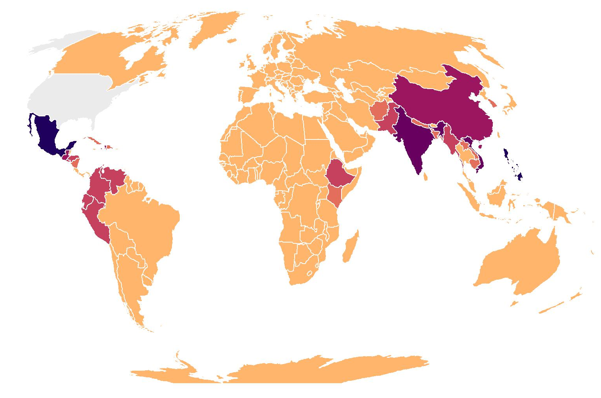
TB Cases by Countries of Birth Among Non-U.S.–Born* Persons,
United States, 2023 (N=7,299)
China
5% (n=341)
Mexico
17% (n=1,263)
Philippines
11% (n=838)
Vietnam
6% (n=456)
India
8% (n=574)
N/A
0 - 49
50 - 99
100 - 249
250 - 399
400 - 599
600 +
*Persons born in the United States, certain U.S. territories, or elsewhere to at least one U.S. citizen parent are categorized as U.S.-born. All other persons are categorized as non-U.S.–born.
Notes:
In 2023, the five most common countries of birth among non-U.S.–born persons with TB disease were the same as in previous years. These countries of birth accounted for almost half (47.6%) of U.S. TB disease cases among non-U.S.–born persons: Mexico (17.3%), Philippines (11.5%), India (7.9%), Vietnam (6.2%), and China (4.7%).

Slide 14
Percentage of TB Cases Among Non-U.S.–Born* Persons by Years Since Arrival in the United States Prior to Diagnosis, 2023 (N=7,299)
*Persons born in the United States, certain U.S. territories, or elsewhere to at least one U.S. citizen parent are categorized as U.S.-born. All other persons are categorized as non-U.S.–born.
Notes:
This slide shows the percentage of TB cases among non-U.S.–born persons by number of years since initial arrival in the United States prior to diagnosis. In 2023, 37.4% of non-U.S.–born persons with TB were diagnosed within 5 years of arrival in the United States, with more than half of those occurring within the first year after arrival. Nearly one-third (30.4%) were diagnosed after being in the United States for at least 20 years.

Slide 15
Percentage of TB Cases Among Non-U.S.–Born* Persons by Years in the United States Prior to Diagnosis, 2010–2023
*Persons born in the United States, certain U.S. territories, or elsewhere to at least one U.S. citizen parent are categorized as U.S.-born. All other persons are categorized as non-U.S.–born.
Notes:
Since 2010, persons who have lived in the United States for at least 20 years prior to TB diagnosis have comprised the greatest percentage of cases among non-U.S.–born persons, compared to those who have lived in the United States for less than 1 year, 1–4 years, 5–9 years, and 10–19 years. The percentages of persons who were diagnosed 1–4 years, 5–9 years, or 10–19 years after arrival remained relatively consistent during 2010–2023, with the percentages fluctuating within 5%. However, the percentage of cases that occurred among persons who were diagnosed within 1 year of arrival dropped from 13.5% in 2019 to 9.8% in 2020 and then increased to 16.9% in 2022 and 22.4% in 2023.

Slide 16
TB Cases by Race/Ethnicity,* United States, 2011–2023
Other race
Multiple race
Native Hawaiian or Other Pacific Islander
American Indian or Alaska Native
White
Black or African American
Hispanic or Latino
Asian
*Persons who identified as Hispanic or Latino were categorized as "Hispanic," regardless of self-reported race. Persons who did not identify as Hispanic or Latino were categorized by self-reported race; if more than one race was reported, the person was categorized as "Multiple race.” “Other race” was first reported as a new race category in 2023.
Note: The increase in numbers and percentages of persons identified as "Multiple race" might be related to changes in processing and transmission of race data for 2023 cases as compared to previous years.
Notes:
This graph shows overall TB case counts since 2011 by race/ethnicity. Compared with 2022, the number of cases in 2023 decreased among Native Hawaiian or Other Pacific Islanders (2022: 156; 2023: 147) and American Indian or Alaska Native persons (2022: 114; 2022: 108). The case count in all other racial/ethnicity groups (except Other race, first reported in 2023) increased from 2022 to 2023. The largest increase was seen among Hispanic or Latino persons (2022: 2,834; 2023: 3,546; increase of 25.1%), followed by Black or African American persons (2022: 1,322; 2023: 1,697; increase of 28.4%), and persons who identified as more than one race (2022: 132; 2023: 200; increase of 51.5%).

Slide 17
Percentage of TB Cases by Race/Ethnicity,* United States, 2011–2023
Other race
Multiple race
Native Hawaiian or Other Pacific Islander
American Indian or Alaska Native
White
Black or African American
Hispanic or Latino
Asian
*Persons who identified as Hispanic or Latino were categorized as “Hispanic,” regardless of self-reported race. Persons who did not identify as Hispanic or Latino were categorized by self-reported race; if more than one race was reported, the person was categorized as “Multiple race.” “Other race” was first reported as a new race category in 2023.
Note: The increase in numbers and percentages of persons identified as "Multiple race" might be related to changes in processing and transmission of race data for 2023 cases as compared to previous years.
Notes:
This 100% stacked bar chart shows percentage distributions over time by race/ethnicity.
Despite the decline in overall number of TB cases in 2020 and the subsequent increases from 2021 through 2023, the distribution of race/ethnicity among persons with TB disease was relatively consistent from 2011 to 2021. Starting in 2022, the proportion of TB cases among Hispanic and Latino persons increased from 30.6% in 2021 to 34.0% in 2022 and 36.8% in 2023.

Slide 18
Percentage of TB Cases by Race/Ethnicity,* United States, 2023 (N=9,633)
*Persons who identified as Hispanic or Latino were categorized as "Hispanic," regardless of self-reported race. Persons who did not identify as Hispanic or Latino were categorized by self-reported race; if more than one race was reported, the person was categorized as "Multiple race.“
Note: The increase in numbers and percentages of persons identified as "Multiple race" might be related to changes in processing and transmission of race data for 2023 cases as compared to previous years.
Notes:
This bar chart shows the percentage of TB cases by race/ethnicity for 2023. Hispanic or Latino persons were the most common race/ethnicity group among all cases (36.8%), followed by Non-Hispanic Asian persons (30.0%), non-Hispanic Black or African American persons (17.6%), and non-Hispanic White persons (9.3%). All other non-Hispanic race groups (American Indian or Alaska Native persons, Native Hawaiian or Other Pacific Islander persons, persons who identify with more than one race, persons who identify as Other race) and those with unknown or missing race/ethnicity information each represented 1–2% of cases.

Slide 19
TB Incidence Rates by Race/Ethnicity,* United States, 2011–2023
Native Hawaiian or Other Pacific Islander
Asian
Hispanic or Latino
American Indian or Alaska Native
Black or African American
Multiple race
White
*Persons who identified as Hispanic or Latino were categorized as "Hispanic," regardless of self-reported race. Persons who did not identify as Hispanic or Latino were categorized by self-reported race; if more than one race was reported, the person was categorized as "Multiple race.” Population data for “Other race” were not available.
Note: The increase in numbers and percentages of persons identified as "Multiple race" might be related to changes in processing and transmission of race data for 2023 cases as compared to previous years.
Notes:
TB incidence rates (cases per 100,000 persons) vary by race/ethnicity groups. In 2023, Native Hawaiian or Other Pacific Islander persons had the highest rate (22.6), followed by Asian persons (14.0). Rates among Hispanic or Latino persons and American Indian or Alaska Native persons were 5.4 and 4.4, respectively. The rate for Hispanic or Latino persons increased from 4.4 in 2022 to 5.4 in 2023 while the rate for Black or African American persons increased from 3.1 in 2022 to 4.0 in 2023. The rate for persons who identify with more than one race increased from 1.7 in 2022 to 2.4 in 2023; still, persons who identify as more than one race and White persons (0.5) had the lowest rates in 2023. Based on unrounded numbers, rates decreased in 2023 compared with 2022 for Native Hawaiian or Other Pacific Islander persons, Asian persons, and American Indian or Alaska Native persons.

Slide 20
TB Cases Among U.S.-Born* Persons by Race/Ethnicity,† United States, 2011–2023
Other race
Multiple race
Native Hawaiian or Other Pacific Islander
American Indian or Alaska Native
White
Black or African American
Hispanic or Latino
Asian
*Persons born in the United States, certain U.S. territories, or elsewhere to at least one U.S. citizen parent are categorized as U.S.-born. All other persons are categorized as non-U.S.–born.
†Persons who identified as Hispanic or Latino were categorized as "Hispanic," regardless of self-reported race. Persons who did not identify as Hispanic or Latino were categorized by self-reported race; if more than one race was reported, the person was categorized as "Multiple race.“ “Other race” was first reported as a new race category in 2023.
Note: The increase in numbers and percentages of persons identified as "Multiple race" might be related to changes in processing and transmission of race data for 2023 cases as compared to previous years.
Notes:
In 2023, among U.S.-born persons, the greatest number of cases were among Black or African American persons (n=751), Hispanic or Latino persons (n=626), and White persons (n=587).

Slide 21
TB Incidence Rates Among U.S.-Born* Persons by Race/Ethnicity,† United States, 2011–2023
Native Hawaiian or
Other Pacific Islander
American Indian or
Alaska Native
Black or African American
Hispanic or Latino
Asian
Multiple race
White
*Persons born in the United States, certain U.S. territories, or elsewhere to at least one U.S. citizen parent are categorized as U.S.-born. All other persons are categorized as non-U.S.–born.
†Persons who identified as Hispanic or Latino were categorized as "Hispanic," regardless of self-reported race. Persons who did not identify as Hispanic or Latino were categorized by self-reported race; if more than one race was reported, the person was categorized as "Multiple race.“ Population data for “Other race” were not available.
Note: The increase in numbers and percentages of persons identified as "Multiple race" might be related to changes in processing and transmission of race data for 2023 cases as compared to previous years.
Notes:
Since 2011, the highest TB incidence rates (cases per 100,000 persons) among U.S.-born persons have occurred among Native Hawaiian or Other Pacific Islander persons and American Indian or Alaska Native persons. That pattern continued in 2023 with incidence rates of 6.1 among Native Hawaiian or Other Pacific Islander persons and 4.0 among American Indian or Alaska Native persons. The rates among Native Hawaiian or Other Pacific Islander persons and American Indian or Alaska Native persons have greater year-to-year variability than all other groups because of low case counts and smaller population sizes.
Incidence rates among U.S.-born persons have declined or remained relatively steady over time among Black or African American persons, Hispanic or Latino persons, Asian persons, White persons, and persons who identify with more than one race. Since 2020, the incidence rate of Hispanic or Latino persons has increased, from 1.2 cases per 100,000 persons in 2020 to 1.5 cases per 100,000 persons in 2023, similar to the rate in 2019. White persons and persons who identify with more than one race continue to have the lowest rates among all race groups.

Slide 22
TB Cases Among Non-U.S.–Born* Persons by Race/Ethnicity,† United States, 2011–2023
Other race
Multiple race
Native Hawaiian or Other Pacific Islander
American Indian or Alaska Native
White
Black or African American
Hispanic or Latino
Asian
*Persons born in the United States, certain U.S. territories, or elsewhere to at least one U.S. citizen parent are categorized as U.S.-born. All other persons are categorized as non-U.S.–born.
†Persons who identified as Hispanic or Latino were categorized as "Hispanic," regardless of self-reported race. Persons who did not identify as Hispanic or Latino were categorized by self-reported race; if more than one race was reported, the person was categorized as "Multiple race.“ “Other race” was first reported as a new race category in 2023.
Note: The increase in numbers and percentages of persons identified as "Multiple race" might be related to changes in processing and transmission of race data for 2023 cases as compared to previous years.
Notes:
The number of TB cases reported among non-U.S.–born persons increased from 2022 (n=6,183) to 2023 (n=7,299). Over 75% of non-U.S.–born cases occurred among Hispanic or Latino persons (n=2,899) and Asian persons (n=2,769). During 2011 to 2021 the distribution of the number of TB cases by race/ethnicity among non-U.S.–born persons was relatively consistent.
Starting in 2022, the proportion of TB cases among non-U.S.–born Hispanic and Latino persons increased from 32.7% in 2021 to 36.8% in 2022 and 39.7% in 2023, surpassing Asian persons (37.9%) as the racial/ethnic group with the highest proportion. The proportion of TB cases among non-U.S.–born Black and African American persons (12.9%) also increased in 2023 compared with 2022 and 2021 but was less than the proportion in 2020 (13.2%). Other race and persons who identify with more than one race had the lowest number of cases for 2023. The bars do not appear for Multiple race and American Indian or Alaskan Native in the graph for certain years due to the small number of cases among these groups.

Slide 23
TB Incidence Rates Among Non-U.S.–Born* Persons by Race/Ethnicity,† United States, 2011–2023
Multiple race
Native Hawaiian or Other Pacific Islander
Asian
Black or African American
Hispanic or Latino
White
*Persons born in the United States, certain U.S. territories, or elsewhere to at least one U.S. citizen parent are categorized as U.S.-born. All other persons are categorized as non-U.S.–born.
†Persons who identified as Hispanic or Latino were categorized as "Hispanic," regardless of self-reported race. Persons who did not identify as Hispanic or Latino were categorized by self-reported race; if more than one race was reported, the person was categorized as "Multiple race.” Population data for “Other race” were not available.
Note: The increase in numbers and percentages of persons identified as "Multiple race" might be related to changes in processing and transmission of race data for 2023 cases as compared to previous years.
Notes:
In 2023, among non-U.S.–born persons, persons who identify with more than one race had the highest incidence rate (64.6 cases per 100,000 persons), followed by Native Hawaiian or Other Pacific Islander persons (31.2) and Asian persons (22.3). The rates among Native Hawaiian or Other Pacific Islander persons and persons who identify with more than one race have greater year-to-year variability than all other groups because of low case counts and smaller populations. White persons have the lowest incidence rates among all race/ethnicity groups of non-U.S.–born persons.

Slide 24
TB Incidence Rates Among Non-U.S.–Born and U.S.-Born* Persons by Race/Ethnicity,† United States, 2011–2023
Non-U.S.–born§
U.S.–born
*Persons born in the United States, certain U.S. territories, or elsewhere to at least one U.S. citizen parent are categorized as U.S.-born. All other persons are categorized as non-U.S.–born.
†Persons who identified as Hispanic or Latino were categorized as "Hispanic," regardless of self-reported race. Persons who did not identify as Hispanic or Latino were categorized by self-reported race; if more than one race was reported, the person was categorized as "Multiple race." Population data for “Other race” were not available.
§Non-U.S-born American Indian/Alaska Native are not displayed because some years have zero cases, which cannot be displayed in a log-scale graph.
Notes:
These figures show TB incidence rates by race/ethnicity among non-U.S.–born persons and U.S.-born persons, separately on the log scale. Non-U.S.–born American Indian or Alaska Native persons did not have any reported TB cases in years 2012, 2014, 2015, 2016, 2019, 2020, and 2022; therefore, their data are not presented in the non-U.S.–born graph since zeros cannot be displayed on the log scale.
For all race/ethnicity groups, incidence rates are higher among non-U.S.–born persons compared with U.S.-born persons.
Compared with 2022, TB incidence rates in 2023 remained steady or increased for all race/ethnicity groups for both U.S.-born and non-U.S.–born persons, except among U.S.-born American Indian or Alaska Native persons (2022: 4.6; 2023: 4.0), U.S.-born Asian persons (2022: 1.6; 2023: 1.3), U.S.-born Native Hawaiian or Other Pacific Islander persons (2022: 6.4; 2023: 6.1), and non-U.S.–born Asian persons (2022: 22.7; 2023: 22.3).
Note: The increase in numbers and percentages of persons identified as "Multiple race" might be related to changes in processing and transmission of race data for 2023 cases as compared to previous years.

Slide 25
Percentage* of TB Cases by Origin† and Race/Ethnicity,§ United States, 2023
Non-U.S.–born persons
(N=7,299)
U.S.-born persons
(N=2,292)
Hispanic or Latino
Asian
Black or
African American
White
Multiple race
Native Hawaiian or
Other Pacific Islander
Other race
American Indian or
Alaska Native
*Percentages are rounded.
†Persons born in the United States, certain U.S. territories, or elsewhere to at least one U.S. citizen parent are categorized as U.S.-born. All other persons are categorized as non-U.S.–born.
§Persons who identified as Hispanic or Latino were categorized as "Hispanic," regardless of self-reported race. Persons who did not identify as Hispanic or Latino were categorized by self-reported race; if more than one race was reported, the person was categorized as "Multiple race.”
Notes:
The distribution of race/ethnicity among persons with TB disease continued to differ markedly by origin of birth in 2023. Almost 40% of the TB cases reported among non-U.S.–born persons occurred among Hispanic persons (39.7%), followed by Asian persons (37.9%), Black or African American persons (12.9%), and White persons (4.2%). Among U.S.-born persons with TB disease, Black or African American persons represented the largest percentage of cases (32.8%), followed by Hispanic or Latino persons (27.3%), White persons (25.6%), and Asian persons (4.8%).
Note: The increase in numbers and percentages of persons identified as "Multiple race" might be related to changes in processing and transmission of race data for 2023 cases as compared to previous years.

Slide 26
TB Incidence Rates* by Origin† and Race/Ethnicity,§ United States, 2023
Non-U.S.–born persons
(N=7,299)
U.S.-born persons
(N=2,292)
Multiple race
Native Hawaiian or
Other Pacific Islander
Asian
Black or
African American
Hispanic or Latino
American Indian or Alaska Native
White
*Cases per 100,000 persons
†Persons born in the United States, certain U.S. territories, or elsewhere to at least one U.S. citizen parent are categorized as U.S.-born. All other persons are categorized as non-U.S.–born.
§Persons who identified as Hispanic or Latino were categorized as "Hispanic," regardless of self-reported race. Persons who did not identify as Hispanic or Latino were categorized by self-reported race; if more than one race was reported, the person was categorized as "Multiple race.”
Note: The increase in numbers and percentages of persons identified as "Multiple race" might be related to changes in processing and transmission of race data for 2023 cases as compared to previous years.
Notes:
During 2023, TB incidence rates (cases per 100,000 persons), were higher for every race and ethnicity group among non-U.S.-born persons compared to U.S.-born persons. Among non-U.S.–born persons with TB disease, persons who identify with more than one race had the highest incidence rate (64.6) followed by Native Hawaiian or Other Pacific Islander persons (31.2), Asian persons (22.3), Black or African American persons (18.6), Hispanic or Latino persons (13.0), American Indian or Alaska Native persons (8.2) and White persons (3.8). Population data for “Other race” were not available.
Among U.S.-born persons with TB disease, Native Hawaiian or Other Pacific Islander persons had the highest incidence rate (6.1), followed by American Indian or Alaska Native persons (4.0), Black or African American persons (2.1), Hispanic or Latino persons (1.5), Asian persons (1.3). Persons who identify with more than one race (0.5) and White persons (0.3) had the lowest rates.

Slide 27
TB Cases by Age Group, United States, 1993–2023
Notes:
Every age group saw an increase in cases in 2023 compared with 2022 with those in the 25-44 age group having the largest increase in number of cases (2022: 2,453; 2023: 3,011) followed by age 65 and older (2022: 2,252; 2023: 2,528) and age 45-64 (2022: 2,420; 2023: 2,605). The percent increase in cases from 2022 to 2023 was 44.2% among those in the 5–14 age group, 22.7% in the 25–44 age group and 21.0% in the 15–24 age group.

Slide 28
Percentage of TB Cases by Age Group, United States, 2023 (N=9,633*)
*This total includes two TB cases with missing or unknown age. Percentages do not add up to 100% due to rounding.
Notes:
This bar chart shows the percentage of TB cases by age group for 2023. The largest percentage of TB cases occurred among persons 25 to 44 years old (31.3%), followed by persons 45 to 64 years old (27.0%), persons 65 years old or greater (26.2%), and persons 15 to 24 years old (10.6%). Less than 5% of all TB cases occurred among persons 0 to 14 years old. There were two TB cases with missing or unknown age data, and as such the percentages do not add up to 100%.

Slide 29
TB Incidence Rates by Age Group, United States, 1993–2023
Notes:
This graph displays the TB incidence rates (cases per 100,000 persons) by age group on a log scale. Incidence rates are higher among adults than children less than 15 years old. Among persons aged 15 years and older, the incidence rates increase with age. In 2023, persons 65 years or older had the highest TB incidence rate (4.3), and children aged 5 to 14 years had the lowest rate (0.6). Incidence increased in 2023 compared with 2022 for all age groups.

Slide 30
TB Cases Among U.S.-Born* Persons by Age Group, United States, 1994–2023
*Persons born in the United States, certain U.S. territories, or elsewhere to at least one U.S. citizen parent are categorized as U.S.-born. All other persons are categorized as non-U.S.–born.
Notes:
This graph shows the number of cases among U.S.-born persons by age group per year from 1994 to 2023. Among U.S.-born persons, all age groups except those 15–24 years of age and 45–64 years of age experienced an increase in cases in 2023 compared with 2022.

Slide 31
TB Incidence Rates* Among U.S.-Born† Persons by Age Group, United States, 1994–2023
*Population Source: U.S. Census Bureau, Current Population Survey Basic Monthly: https://data.census.gov/mdat/
†Persons born in the United States, certain U.S. territories, or elsewhere to at least one U.S. citizen parent are categorized as U.S.-born. All other persons are categorized as non-U.S.–born.
Notes:
This graph displays the TB incidence rates (cases per 100,000 persons) among U.S.-born persons, by age group, on a log scale. Since 1994, each age group among U.S.-born persons has experienced a steady decrease of at least 67% in incidence rate. The 65 years or older age group experienced a decline of more than 93% (1994: 14.2; 2023: 1.0). Incidence rates were steady or increased in 2023 compared with 2022 for all age groups less than 15 years of age, and the 5 to 14 years age group experienced an increase of 33%. All age groups greater than or equal to 15 years experienced an increase in incidence in 2023 compared with 2022, except for age group 15 to 24 years.

Slide 32
TB Cases Among Non-U.S.–Born* Persons by Age Group, United States, 1994–2023
* Persons born in the United States, certain U.S. territories, or elsewhere to at least one U.S. citizen parent are categorized as U.S.-born. All other persons are categorized as non-U.S.–born.
Notes:
During 1994 to 2023, the number of TB cases among non-U.S.–born persons for each age group under 45 years of age decreased, while the number of TB cases for those 45 years of age and above increased. The total number of TB cases by age group among non-U.S.–born persons increased from 2022 to 2023.
In 2023, people aged 25–44 years had the highest number (n=2,439) of TB cases, followed by those aged ≥65 years and those aged 45–64 years (n=1,990 and n=1,974, respectively). Children 0–4 years of age had the lowest number (n=30) of TB cases.

Slide 33
TB Incidence Rates* Among Non-U.S.–Born† Persons by Age Group, United States, 1994–2023
* Population Source: U.S. Census Bureau, Current Population Survey Basic Monthly: https://data.census.gov/mdat/
† Persons born in the United States, certain U.S. territories, or elsewhere to at least one U.S. citizen parent are categorized as U.S.-born. All other persons are categorized as non-U.S.–born.
Notes:
This graph displays the TB incidence rates (cases per 100,000 persons) among non-U.S.–born persons, by age group, on a log scale. From 1994 through 2023, each age group among non-U.S.–born persons has experienced a 50% or greater decline in incidence rate, other than the group for those aged 15 to 24 years, which experienced a decrease of 43%. The age group for those aged 0-4 years experienced a decline at more than 84% (1994: 57.3; 2023: 9.0). Compared with 2022, the incidence rate for 2023 decreased by 24% for non-U.S.–born persons aged 0 to 4 years from 11.8 to 9.0. For all other age groups among non-U.S.–born persons, incidence rates increased from 2022 to 2023. Persons aged 5 to 14 years experienced an increase of 65% from 2022 to 2023 (2022: 3.2, 2023: 5.3).

Slide 34
Percentage of TB Cases by Sex and Age Group, United States, 2023
Males (N=5,999)
Age group
Females (N=3,625)
0–4 years (N=231)
5–14 years (N=235)
15–24 years (N=1,021)
25–44 years (N=3,009)
45–64 years (N=2,604)
≥65 years (N=2,524)
Notes:
As in previous years, males continued to represent the majority (62.3%) of persons with TB disease overall. Based on unrounded numbers, the percentage was greater for males compared with females for all age groups.

Slide 35
Pediatric* TB Cases by Origin of Birth,† United States, 1993–2023
* Children aged less than 15 years
† Persons born in the United States, certain U.S. territories, or elsewhere to at least one U.S. citizen parent are categorized as U.S.-born. All other persons are categorized as non-U.S.–born.
Notes:
In contrast to overall U.S. TB cases, for which over three quarters of cases were among non-U.S.–born persons, only 129 (27.7%) of 465 cases in children less than 15 years old occurred among non-U.S.–born persons in 2023. The percentage of non-U.S.–born persons among pediatric cases has fluctuated between 20% and 30% since 1993.

Slide 36
Pediatric TB Incidence Rates* by Origin of Birth,† United States, 1994–2023
* Population Source: U.S. Census Bureau, Current Population Survey Basic Monthly: https://data.census.gov/mdat/
† Persons born in the United States, certain U.S. territories, or elsewhere to at least one U.S. citizen parent are categorized as U.S.-born. All other persons are categorized as non-U.S.–born.
Notes:
In 2023, the majority (72.3%) of children less than 15 years old with TB disease were U.S.-born, however, the incidence rate (cases per 100,000 persons) was higher among non-U.S.–born children compared with U.S.-born children. For children aged 0 to 4 years old, the incidence rate among non-U.S.–born children (9.0) was more than 8 times the rate among U.S.-born children (1.1). For children aged 5 to 14 years, the incidence rate among non-U.S.–born children (5.3) was more than 13 times the rate among U.S.-born children (0.4).

Slide 37
Percentage of TB Cases by Site of Disease, United States, 2023
* Persons might have more than one extrapulmonary site of disease.
Notes:
The vast majority of TB cases had pulmonary TB only (69.8%), 18.0% had extrapulmonary TB only, and 11.4% had both pulmonary and extrapulmonary TB. There were a total of 3,179 extrapulmonary sites of disease. Among these, lymphatic (27.1%) and pleural (23.1%) sites of disease were the most common, followed by bone and joint (8.8%), peritoneal (5.7%), meningeal (5.7%), genitourinary (4.1%), and laryngeal (0.6%). “Other” (24.9%) includes all other extrapulmonary sites of disease (e.g., ocular, hepatic).

Slide 38
Percentage of TB Cases* by Initial Drug Regimen, United States, 1993–2023
HRZE†
RPT-MOX§
Other 4+ drug regimen¶
* Persons alive at diagnosis with initial drug regimen information.
† H, isoniazid; R, rifampin; Z, pyrazinamide; E, ethambutol.
§ Daily 4-month regimen with rifapentine, isoniazid, pyrazinamide, and moxifloxacin, first recommended by CDC in 2022. ¶ A drug regimen with at least four drugs, other than HRZE and RPT-MOX.
Notes:
Since 2002, the percentage of patients started on HRZE, the standard initial four-drug regimen of isoniazid, rifampin, pyrazinamide, and ethambutol, has remained above 80%. RPT-MOX is a daily 4-month regimen with rifapentine, isoniazid, pyrazinamide, and moxifloxacin, first recommended by CDC in 2022. During 2022 and 2023, less than 1% of TB cases were among patients started on RPT-MOX. The RPT-MOX column color is pink but may be hard to see due to the percentages being less than 1%. In some situations, including known or suspected drug resistance or a clinical contraindication to the standard initial therapy, a different four-drug regimen could be clinically appropriate. The percentage of patients on an initial drug regimen of four or more drugs other than the CDC recommended regimens of HRZE or RPT-MOX has increased from 4.3% in 2002 to 11.6% in 2023. Use of initial regimens with less than four drugs has represented <7% of reported cases, each year since 2011.

Slide 39
Percentage of TB Cases* by Initial Drug Regimen, United States, 2023 (N=9,334)
Other 4+ drug regimen†, 12%
RPT-MOX¶, <1%
* Persons alive at diagnosis with initial drug regimen information.
† A drug regimen with at least four drugs, other than HRZE and RPT-MOX.
¶ Daily 4-month regimen with rifapentine, isoniazid, pyrazinamide, and moxifloxacin, first recommended by CDC in 2022.
§ H, isoniazid; R, rifampin; Z, pyrazinamide; E, ethambutol.
Notes:
Of the 9,334 people diagnosed with TB in 2023 who were prescribed TB therapy, 82.6% started on the standard TB regimen, isoniazid, rifampin, pyrazinamide, and ethambutol (HRZE), 11.6% started on a four-drug regimen other than HRZE, and 5.4% started on a regimen of less than four drugs, including persons who were not prescribed any drugs. Less than 1% of people with TB were prescribed RPT-MOX, a daily 4-month regimen with rifapentine, isoniazid, pyrazinamide, and moxifloxacin, first recommended by CDC in 2022.

Slide 40
Percentage of TB Cases by Method of Treatment Administration,* United States, 1993–2021†
DOT§ only
DOT and SAT§
*Persons on an initial drug therapy with at least one drug.
†Most recent year for which data are complete.
§DOT=directly observed therapy; SAT=self-administered therapy.
Notes:
The percentage of persons with TB disease receiving at least a portion of their medication by directly observed therapy (DOT) has risen from 35.4% in 1993 to 94.0% in 2021, the most recent year with data available. DOT includes both in person and electronic (video call or other electronic method).

Slide 41
Percentage of TB Cases* by Method of Treatment Administration, United States, 2021† (N=7,536)
*Persons on an initial drug therapy with at least one drug. †Most recent year for which data are complete.
Notes:
During 2021, the most recent year for which treatment completion data are available, 64.8% of patients were administered treatment exclusively by directly observed therapy (DOT), 4.6% solely by self-administered therapy (SAT), and 29.2% by a combination of DOT and SAT.

Slide 42
Percentage of TB Cases* by Completion of TB Therapy, United States, 1993–2021†
National Goal:§
95%
*Persons alive at diagnosis who started TB therapy and for whom therapy <1 year was indicated.
†Most recent year for which data are complete.
§National goal: for 95% of patients with newly diagnosed TB disease for whom ≤12 months of treatment is indicated to complete treatment within 12 months.
Notes:
The national goal is for 95% of patients to complete treatment within 12 months if a treatment duration of ≤12 months is indicated. Although the percentage of eligible patients completing therapy within 1 year has risen from 63.4% in 1993 to 86.8% in 2021, the United States is still short of the 95% goal. While the percentage of eligible patients that completed therapy within 1 year has been relatively stable since 2009, 2021 had the lowest percentage of patients who completed therapy since 2008.

Slide 43
TB Cases Resistant to Isoniazid* by Origin of Birth,† United States, 1993–2023
*Starting in 2023, information on drug resistance included results of molecular drug susceptibility testing in addition to growth-based susceptibility testing for isoniazid and rifampin. An isolate is considered resistant to isoniazid or rifampin if either the growth-based test or molecular test detects resistance.
†Persons born in the United States, certain U.S. territories, or elsewhere to at least one U.S. citizen parent are categorized as U.S.-born. All other persons are categorized as non-U.S.–born.
Notes:
In 2023, 588 TB cases were reported as resistant to isoniazid among persons with a known origin of birth. While this is a 61% decrease from 1993 (n=1,516), the number of isoniazid-resistant TB cases increased from 2022 to 2023 among persons with a known origin of birth.

Slide 44
Number and Percentage of Multidrug-Resistant (MDR)* TB Cases† by History of TB, United States, 1993–2023
*Starting in 2023, information on drug resistance included results of molecular drug susceptibility testing in addition to growth-based susceptibility testing for isoniazid and rifampin. An isolate is considered resistant to isoniazid or rifampin if either the growth-based test or molecular test detects resistance.
†Excludes persons with unknown origin of birth.
Notes:
Multidrug-resistant (MDR) TB is defined as TB resistant to at least isoniazid and rifampin. The overall MDR case count was 100 in 2023 compared with 99 in 2022. Since 1996, the percentage of all MDR cases occurring among persons with no previous history of TB disease (i.e., primary MDR TB) has remained below 1.5%.

Slide 45
Percentage of HIV Coinfection by Origin of Birth Among Persons with TB,* United States, 2011–2023
* Persons alive at diagnosis with HIV test results
Notes:
Coinfection with HIV is a major risk factor for progression of latent TB infection to TB disease. Among 9,403 persons who were alive at TB diagnosis in 2023, HIV status was known for 89.2% (n=8,387). Among the persons with TB and a known HIV status, the percentage of HIV coinfection decreased from 7.5% in 2011 to 4.9% in 2023 for all persons, from 10.7% in 2011 to 5.9% in 2023 for U.S.-born persons, and from 5.7% in 2011 to 4.6% in 2023 for non-U.S.–born persons. The percentage of HIV coinfection among all three groups has been relatively stable since 2018.

Slide 46
Percentage of Selected Risk Factors Among Persons with TB by Origin of Birth,* United States, 2023
* Persons born in the United States, certain U.S. territories, or elsewhere to at least one U.S. citizen parent are categorized as U.S.-born. All other persons are categorized as non-U.S.–born.
Notes:
Among all reported medical risk factors for TB disease, diabetes mellitus (23.4%) was reported most frequently by all persons with TB, followed by non-HIV immunosuppression (6.2%), viral hepatitis (3.3%), end stage renal disease (2.6%), TNF-α inhibitors (1.2%), and post-organ transplantation (0.8%). Diabetes mellitus was more common among non-U.S.–born persons (25.6%), compared with U.S.-born persons (16.3%).

Slide 47
Percentage of Social and Behavioral Risk Factors Among Persons Aged ≥15 Years with TB, United States, 2023
Current or former smoker*
Excess alcohol use†
Noninjecting drug use†
Experiencing homelessness†
Resident of a correctional facility*
Resident of a long-term care facility*
Injecting drug use†
* At the time of TB diagnosis
† Within past 12 months prior to TB diagnosis
Notes:
Among persons who had risk factor information available and were at least 15 years of age, the most common social risk factor reported was current or former tobacco smoking (31.2%), followed by excess alcohol use (7.9%), noninjecting drug use (7.8%), experiencing homelessness (5.9%), resident of a correctional facility (3.6%), resident of a long-term care facility (1.4%) and injecting drug use (1.1%). Persons residing in congregate settings, such as homeless shelters, correctional facilities, and long-term care facilities, are at higher risk of being infected with TB bacteria than the general population.

Slide 48
Among Incarcerated Persons* with TB, Percentages of Cases by Correctional Facility Type: United States, 2023 (N=324)
*At time of TB diagnosis for those ages ≥15 years
Notes:
This slide shows the number of TB cases among people who were reported to be residing in a correctional facility at the time of TB diagnosis and the percentages of those in local jail, federal prison, state prison, or other correctional facility. Of the 324 TB cases among residents of a correctional facility at the time of TB diagnosis, most (53.7%) were in other type of correctional facility, 23.5% were in local jail, 11.7% in federal prison, and 9.9% were in state prison. Other type of correctional facility includes Immigration and Customs Enforcement detention centers, Indian reservation facilities (e.g., tribal jails), military stockades and jails, federal park police facilities, police lockups (temporary holding facilities for persons who have not been formally charged in court), or other correctional facilities that are not included in the other specific choices.

Slide 49
Percentage of TB Cases by Status and Cause of Death, United States, 2021*
Dead at diagnosis
(N=258)
Died after diagnosis
(N=623)†
TB cause of death
TB not cause
of death
Unknown cause of death
*Most recent year for which data are complete
†Three deaths were related to TB therapy.
Notes:
In 2021, the most recent year for which complete data are available, 881 (11.2%) deaths were reported. Of the 881 deaths reported, 258 (29.3%) were deaths at the time of TB diagnosis, and 623 (70.7%) were deaths after diagnosis (i.e., during treatment). TB was reported as the cause of death for 34.5% (n=89) of persons who were dead at diagnosis and 44.6% (n=278) of persons who died after diagnosis.

Slide 50
TB Genotyping in the United States
wgMLST* allele pattern
Isolates† with allele patterns >99.7% identical
(roughly no more
than 7 loci different)
Isolates with allele patterns <99.7% identical to any other isolate
Clustered
Not Clustered
MTBC§ followed by
6-digit number
Example: MTBC005634
wgMLSType
MTBCunique
*wgMLST, whole-genome multilocus sequence typing.
†Isolate is a sample of tuberculosis bacteria cultured from a patient's clinical specimen.
§MTBC, Mycobacterium tuberculosis Complex.
For more information on WGS, visit: https://www.cdc.gov/tb/php/genotyping/whole-genome-sequencing.html
Notes:
This slide depicts the assignment of wgMLSType. Isolates from patients (in the United States, its territories, and U.S.-affiliated Pacific islands) with whole genome sequencing based allele patterns that are ≥99.7% identical are assigned a numbered whole-genome multilocus sequence type or wgMLSType. Isolates with allele patterns <99.7% identical are assigned a wgMLSType of “MTBCunique.” An isolate designated as MTBCunique might be assigned to a numbered wgMLSType if it matches one or more isolates’ allele pattern by ≥99.7% in the future.
For more information on WGS, visit: https://www.cdc.gov/tb/php/genotyping/whole-genome-sequencing.html.

Slide 51
Number of County-based TB Genotype Clusters* by Cluster Size, United States, 2021–2023
* Clusters have two or more cases with matching whole-genome multilocus sequence type (wgMLSType) within a county during the specified 3-year period.
Notes:
This slide shows the number of county-based TB genotype clusters by the size of the clusters. A genotype cluster has two or more cases with matching wgMLSType within a county during the specified 3-year period. During 2021 to 2023, there were 758 two-case clusters, 172 three-case clusters, 64 four-case clusters, 29 five-case clusters, 29 six-case clusters, 12 seven-case clusters, 6 eight-case clusters, 6 nine-case clusters, and 34 clusters with 10 or more TB cases. The total number of clusters was 1,110 during 2021 to 2023 compared with 987 during 2020 to 2022. The number of clusters with 6 or more cases was 87 during 2021 to 2023 compared with 73 during 2020 to 2022.

Slide 52
TB Genotype Clusters* by TB GIMS† Alert Levels,§ United States, 2021–2023 (N=1,110)
* Clusters have two or more cases with matching whole-genome multilocus sequence type (wgMLSType) within a county during the specified 3-year period.
† TB GIMS, Tuberculosis Genotyping Information Management System.
§ Alert levels are based on a log-likelihood ratio (LLR), which calculates the geographical concentration of a genotype in a county compared to the rest of the country during a 3-year period. TB GIMS generates alert level notifications based on this statistic: “No alert” is indicated if LLR is between 0–<4, “medium” is for LLR of 4–<10 and “high” alert is for clusters with LLR ≥10.
Notes:
Clusters are classified into alert levels based on a log-likelihood ratio (LLR) calculation. Clusters with an LLR of 4–<10 are classified as a medium alert level, and clusters with an LLR ≥10 are classified as a high alert level. At the cluster level, 52.1% (n=578) of 1,110 clusters identified nationally during 2021 to 2023 were either medium- (44.7%, n=496) or high-level alerts (7.4%, n=82). During 2020–2022, 56.1% (n=554) of 987 clusters were categorized as medium- or high-level alerts.

Slide 53
Percentage of Clustered TB Cases in No Alert and Alert Genotype Clusters* by Origin of Birth,† United States, 2021–2023
No alert§
(N=1,246)
Alert¶
(N=2,125)
*Clusters have two or more cases with matching whole-genome multilocus sequence type (wgMLSType) within a county during the specified 3-year period.
†Cases with unknown origin of birth not shown (n=13).
§No alert indicates the case was in a cluster with a log-likelihood ratio (LLR) of <4.
¶Alert indicates the case was in a cluster with an LLR of ≥4.
Notes:
A greater percentage of clustered cases in no alert clusters were non-U.S.–born (59.3%, n=739) whereas most clustered cases in alerted clusters were U.S.-born (58.9%, n=1,251). Alerted clusters are concerning for recent transmission and may require further assessment. No alert clusters are not reviewed by CDC for potential follow up.

Slide 54
Percentage of Clustered TB Cases in Alerted Clusters* by Age Group, United States, 2021–2023
*Clusters have two or more cases with matching whole-genome multilocus sequence type (wgMLSType) within a county during the specified 3-year period. Alert indicates the case was in a cluster with a log-likelihood ratio (LLR) of ≥4.
Notes:
Alerted clusters have a higher concentration of a genotype in the county or county equivalent than non-alerted clusters, and alerted clusters are reviewed by CDC staff for possible programmatic follow-up.
The percent of clustered cases in alerted clusters is higher among younger age groups than older. Of the 113 cases that occurred among persons 0 to 4 years old and were in a cluster, 77.0% (n=87) were in a cluster that alerted, compared with 58.4% (n=247) of the 423 cases in persons 65 years or older who were in a cluster. The higher percentage of children aged less than 15 years in an alerted cluster is consistent with TB in children being most often due to recent transmission.

Slide 55
Percentage of Clustered TB Cases in Alerted Clusters* by Race/Ethnicity,† United States, 2021–2023
*Clusters have two or more cases with matching whole-genome multilocus sequence type (wgMLSType) within a county during the specified 3-year period. Alert indicates the case was in a cluster with a log-likelihood ratio (LLR) of ≥4.
†Persons who identified as Hispanic or Latino were categorized as "Hispanic," regardless of self-reported race. Persons who did not identify as Hispanic or Latino were categorized by self-reported race; if more than one race was reported, the person was categorized as "Multiple race.“ Due to “Other race” being first reported as a new race category in 2023, information for “Other race” was not included in this slide.
Notes:
After considering that only 58 cases reported more than one race and excluding 18 cases with unknown or missing race, the percentages of clustered cases in an alerted cluster were identified among American Indian or Alaska Native persons (98.0%, n=144), Black or African American persons (74.2%, n=598), and Native Hawaiian or Other Pacific Islander persons (73.0%, n=108), compared with all clustered cases in an alerted cluster (63.0%, n=2,131).

Slide 56
Percentage of Clustered TB Cases in Alerted Clusters* by Selected Risk Factors, United States, 2021–2023
*Clusters have two or more cases with matching whole-genome multilocus sequence type (wgMLSType) within a county during the specified 3-year period. Alert indicates the case was in a cluster with a log-likelihood ratio (LLR) of ≥4.
Notes:
The percentages of clustered cases in an alert among persons reporting injecting drug use was 69.6% (n=55) and excess alcohol use was 68.9% (n=352) compared with 63.0% (n=2,131) among all clustered cases in an alerted cluster. The percentages of clustered cases in an alert among persons living with HIV were 59.8% (n=122) and 53.4% (n=202) among persons experiencing homelessness.

Slide 57
Division of Tuberculosis Elimination
National Center for HIV, Viral Hepatitis, STD, and TB Prevention
Centers for Disease Control and Prevention
1600 Clifton Road NE
Atlanta, GA 30329
Phone: 404-639-8120
E-mail: tbinfo@cdc.gov
Internet Address: http://www.cdc.gov/tb/
The findings and conclusions in this report are those of the authors and do not necessarily represent the official position of the Centers for Disease Control and Prevention.

