Slide 1
Sexually Transmitted Infections
Surveillance 2022
Women and Infants​
Notes:
This slide set was prepared by the Division of STD Prevention, National Center for HIV, Viral Hepatitis, STD, and TB Prevention (NCHHSTP), Centers for Disease Control and Prevention (CDC). These slides display trends for STIs in the United States through 2022. Data presented include case notifications provided to CDC through the National Notifiable Diseases Surveillance System (NNDSS) and data collected through projects and programs that monitor STIs in various settings, including the STD Surveillance Network (SSuN), and the Gonococcal Isolate Surveillance Project (GISP).
For more information on data sources, data collection and reporting practices, and case definitions, please see the Technical Notes, available at https://www.cdc.gov/std/statistics/2022/technical-notes.htm.
All data points for figures presented in these slides are available at https://www.cdc.gov/std/statistics/2022/data.zip.
NOTE: This slide set is in the public domain. You may reproduce these slides without permission; however, citation as to source is appreciated.
Centers for Disease Control and Prevention. Sexually Transmitted Infections Surveillance 2022. Atlanta: U.S. Department of Health and Human Services; 2024.
You are also free to adapt and revise these slides; however, you must remove the CDC name and logo if changes are made.

Slide 2
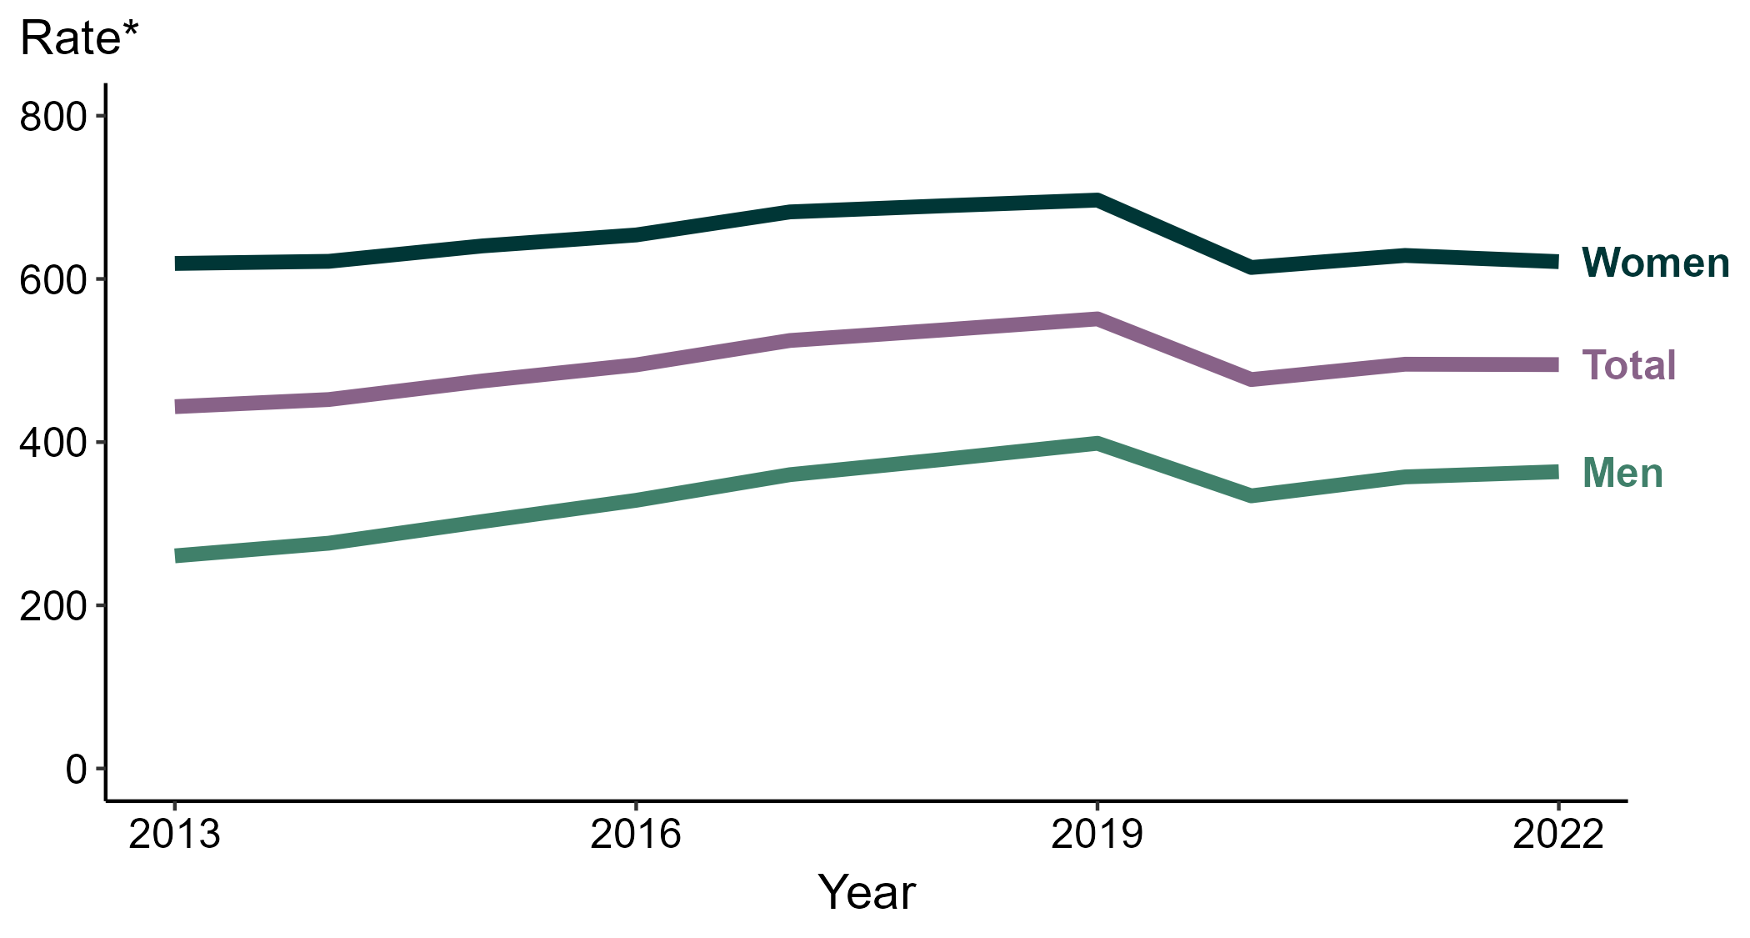
Chlamydia — Rates of Reported Cases by Sex, United States, 2013–2022
* Per 100,000
Notes:
During 2021 to 2022, the rate of reported chlamydia among men increased 1.8% (from 357.4 to 363.7 per 100,000) and the rate among women decreased 1.2% (from 628.8 to 621.2 per 100,000).
Over the last five years, the rate of reported chlamydia among men decreased 4.0% (from 378.9 to 363.7 per 100,000) and the rate among women decreased 9.9% (from 689.6 to 621.2 per 100,000). Over the last 10 years, the rate among men increased 39.6% (from 260.6 to 363.7 per 100,000) and the rate among women did not change substantially (<1.0% change; from 619.0 to 621.2 per 100,000).
This report includes data from years that coincide with the COVID-19 pandemic, which introduced uncertainty and difficulty in interpreting STI surveillance data. See Impact of COVID-19 on STIs for more information.
See Technical Notes (https://www.cdc.gov/std/statistics/2022/technical-notes.htm) for information on chlamydia case reporting. Table A1 (https://www.cdc.gov/std/statistics/2022/tables/a1.htm) provides information on unknown, missing, or invalid values of select variables.
Data for all figures are available at https://www.cdc.gov/std/statistics/2022/data.zip. The file “CT - Rates by Sex (US and Terr 2013-2022).xlsx” contains the data for the figure presented on this slide.

Slide 3
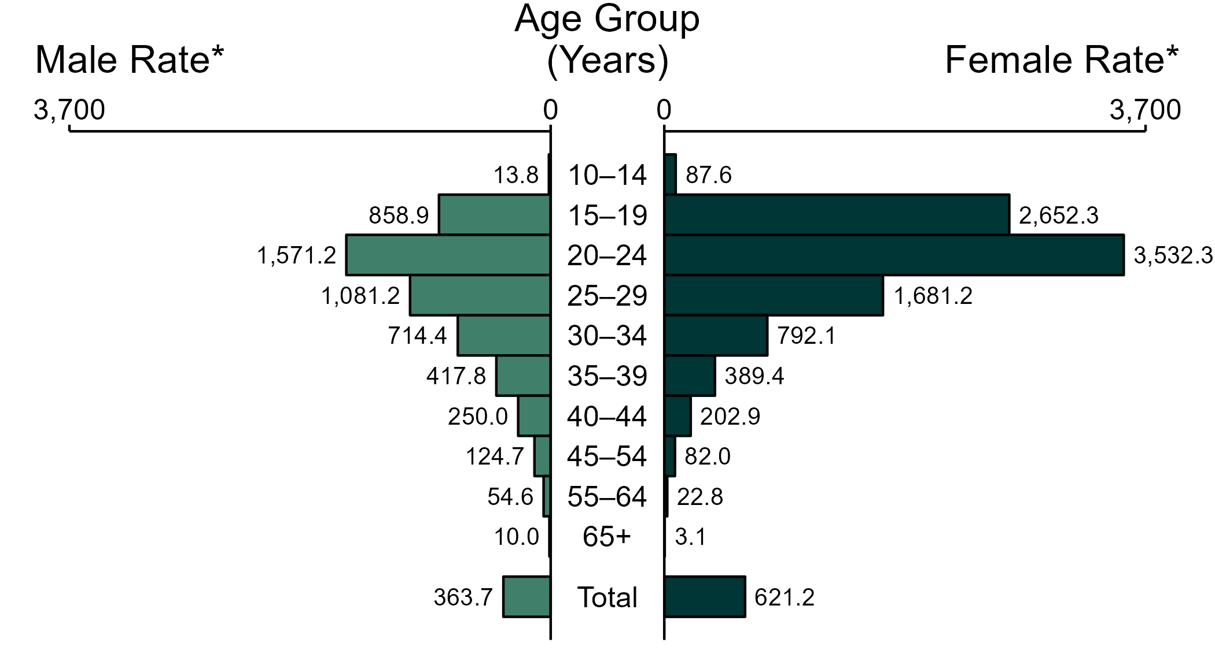
Chlamydia — Rates of Reported Cases by Age Group and Sex, United States, 2022
* Per 100,000
NOTE: Total includes cases of all ages, including those with unknown age.
Notes:
In 2022, the rate of reported chlamydia was higher among women (621.2 per 100,000) compared to men (363.7 per 100,000).
Among women, those aged 20 to 24 years had the highest rate of reported cases of chlamydia (3,532.3 per 100,000), followed by women aged 15 to 19 years (2,652.3 per 100,000) and women aged 25 to 29 years (1,681.2 per 100,000). Among men, those aged 20 to 24 years also had the highest rate of reported cases of chlamydia (1,571.2 per 100,000), followed by men aged 25 to 29 years (1,081.2 per 100,000) and men aged 15 to 19 years (858.9 per 100,000).
This report includes data from years that coincide with the COVID-19 pandemic, which introduced uncertainty and difficulty in interpreting STI surveillance data. See Impact of COVID-19 on STIs for more information.
See Technical Notes (https://www.cdc.gov/std/statistics/2022/technical-notes.htm) for information on chlamydia case reporting. Table A1 (https://www.cdc.gov/std/statistics/2022/tables/a1.htm) provides information on unknown, missing, or invalid values of select variables.
Data for all figures are available at https://www.cdc.gov/std/statistics/2022/data.zip. The file “CT - Rates by Age Group and Sex (US 2022).xlsx” contains the data for the figure presented on this slide.

Slide 4
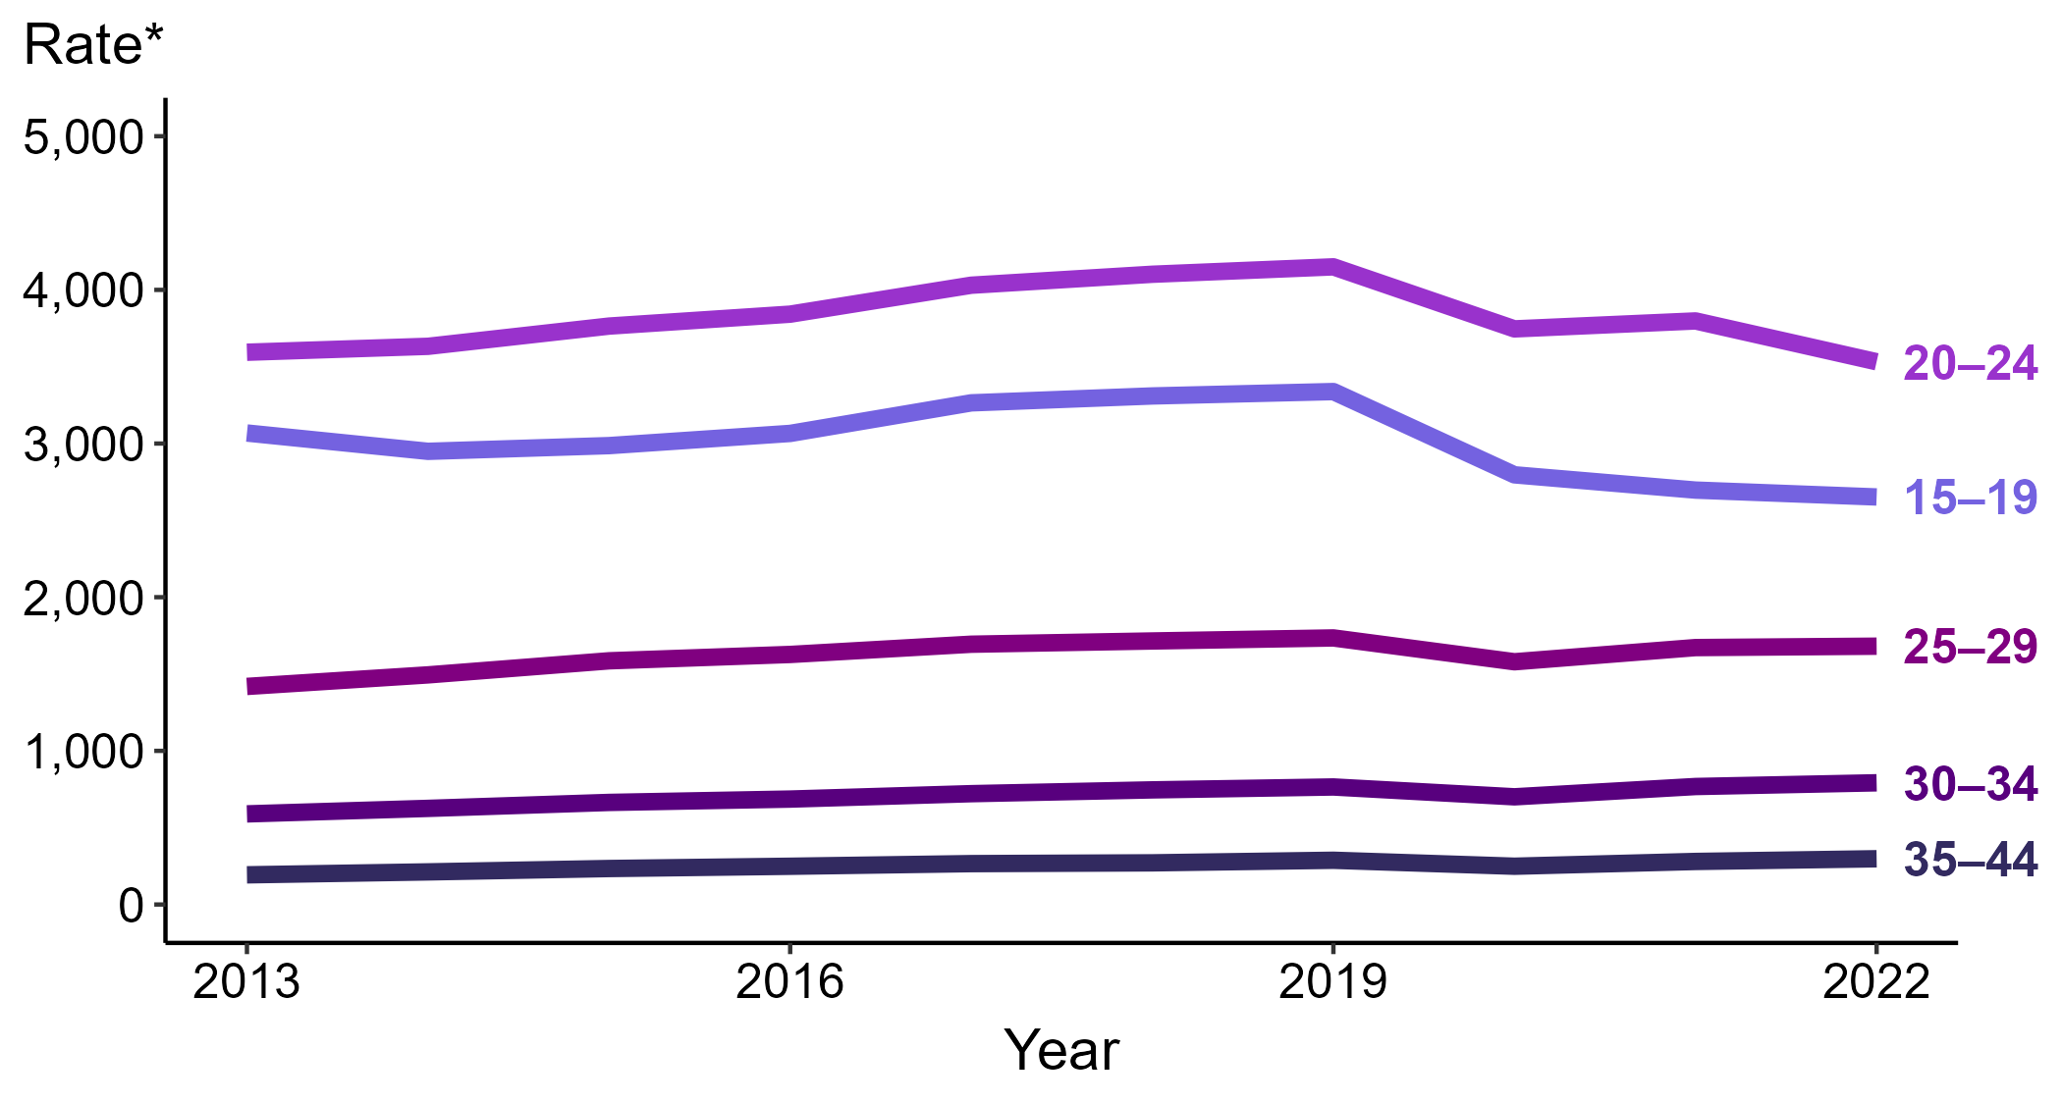
Chlamydia — Rates of Reported Cases Among Women Aged 15–44 Years by Age Group, United States, 2013–2022
* Per 100,000
Notes:
Among women aged 15 to 44 years in 2022, those aged 20 to 24 years had the highest rate of reported cases of chlamydia (3,532.3 cases per 100,000; 7.0% decrease from 2021), followed by those aged 15 to 19 years (2,652.3 cases per 100,000; 1.7% decrease from 2021), those aged 25 to 29 years (1,681.2 cases per 100,000; <1.0% change from 2021), those aged 30 to 34 years (792.1 cases per 100,000; 3.2% increase from 2021), and those aged 35 to 44 years (297.7 cases per 100,000; 6.3% increase from 2021).
This report includes data from years that coincide with the COVID-19 pandemic, which introduced uncertainty and difficulty in interpreting STI surveillance data. See Impact of COVID-19 on STIs for more information.
See Technical Notes (https://www.cdc.gov/std/statistics/2022/technical-notes.htm) for information on chlamydia case reporting. Table A1 (https://www.cdc.gov/std/statistics/2022/tables/a1.htm) provides information on unknown, missing, or invalid values of select variables.
Data for all figures are available at https://www.cdc.gov/std/statistics/2022/data.zip. The file “CT - Rates Women 15-44 Years by Age Group (US 2013-2022).xlsx” contains the data for the figure presented on this slide.

Slide 5
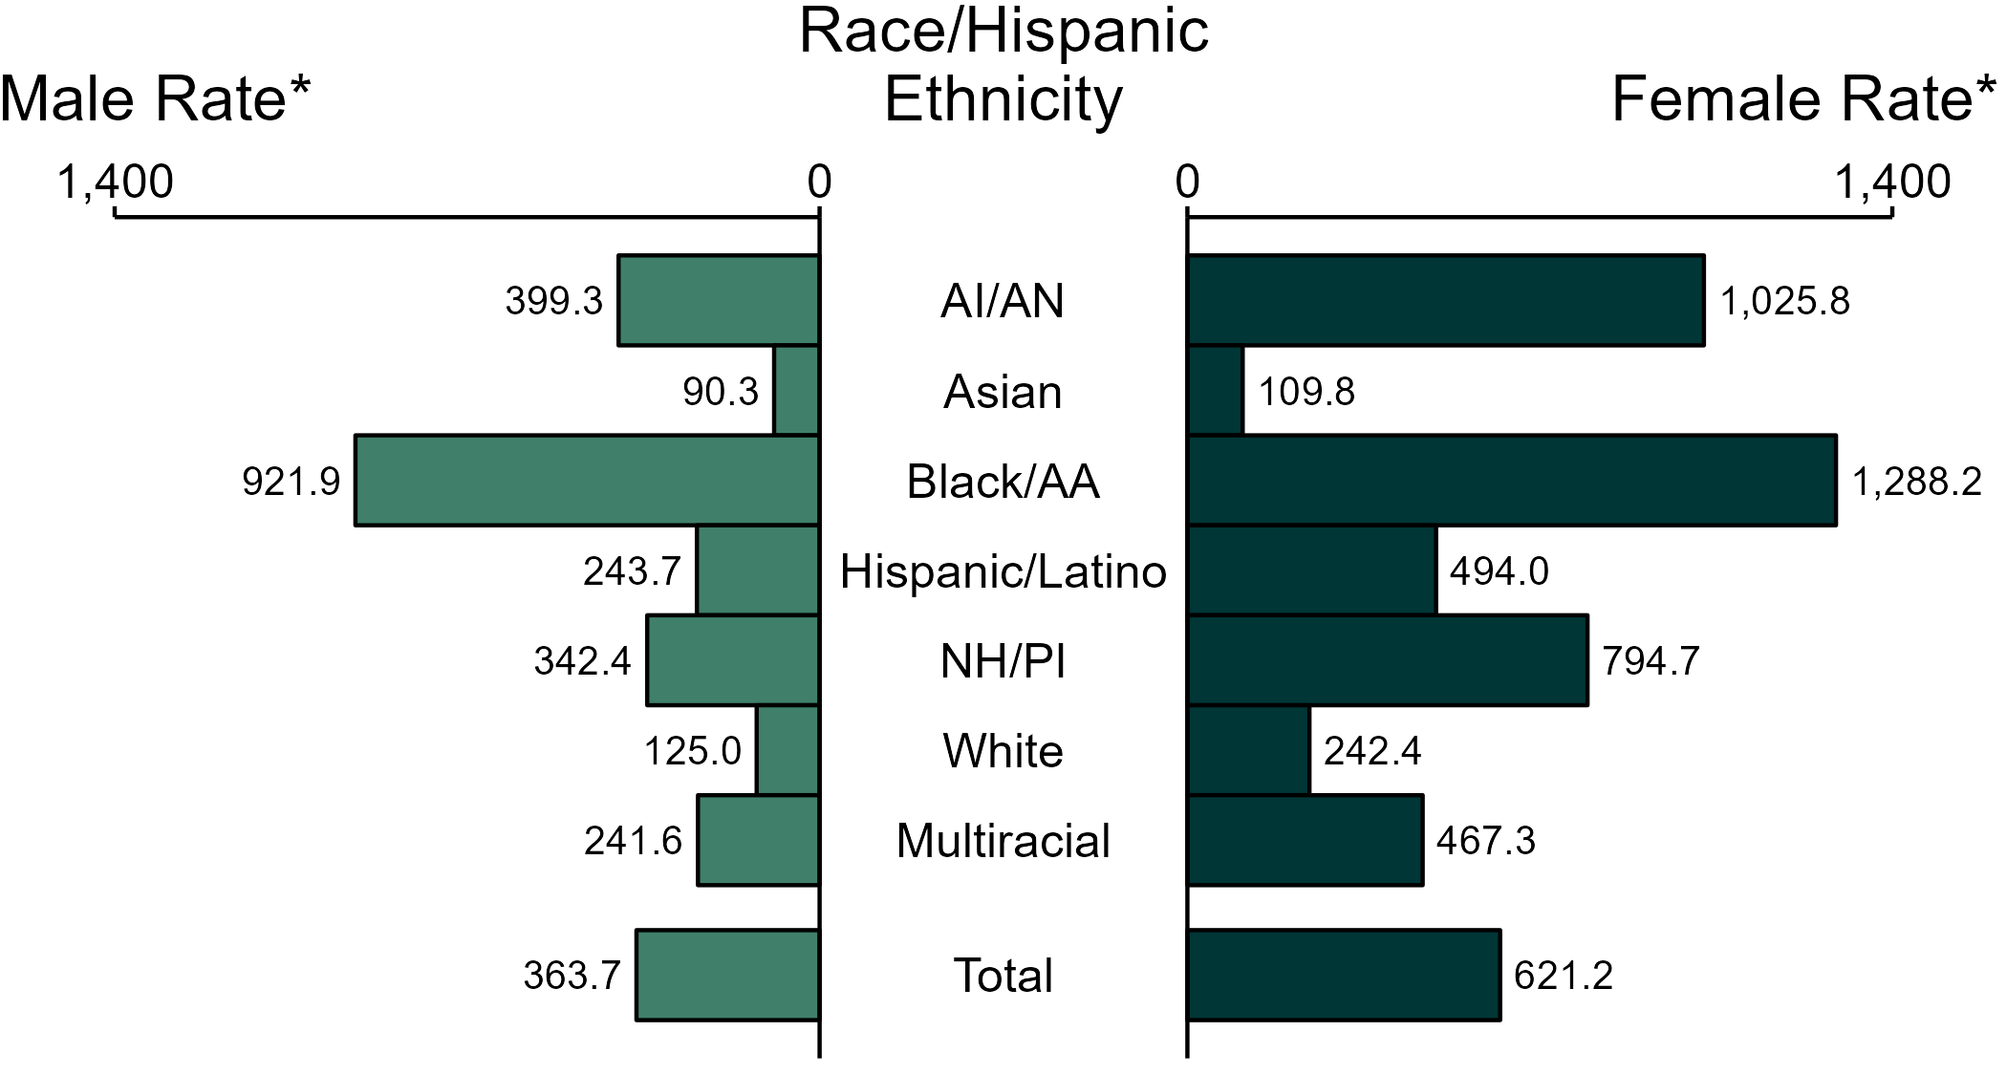
Chlamydia — Rates of Reported Cases by Race/Hispanic Ethnicity and Sex, United States, 2022
* Per 100,000
ACRONYMS: AI/AN = American Indian or Alaska Native; Black/AA = Black or African American; NH/PI = Native Hawaiian or other Pacific Islander
NOTE: Total includes all cases including those with unknown race/Hispanic ethnicity.
Notes:
In 2022, the rate of reported chlamydia was higher among women (621.2 per 100,000) compared to men (363.7 per 100,000).
Among women, non-Hispanic Black or African American women had the highest rate of reported cases of chlamydia (1,288.2 per 100,000), followed by non-Hispanic American Indian or Alaska Native women (1,025.8 per 100,000) and non-Hispanic Native Hawaiian or other Pacific Islander women (794.7 per 100,000). Among men, non-Hispanic Black or African American men also had the highest rate of reported cases of chlamydia (921.9 per 100,000), followed by non-Hispanic American Indian or Alaska Native men (399.3 per 100,000) and non-Hispanic Native Hawaiian or other Pacific Islander men (342.4 per 100,000).
Using non-Hispanic White persons as the referent category, the greatest relative racial disparity in rates of reported chlamydia across both sexes was observed among non-Hispanic Black or African American men, with a rate ratio of 7.4 times that of non-Hispanic White men. Among women, the greatest relative disparity was observed among non-Hispanic Black or African American women as well, with a rate 5.3 times that of non-Hispanic White women.
This report includes data from years that coincide with the COVID-19 pandemic, which introduced uncertainty and difficulty in interpreting STI surveillance data. See Impact of COVID-19 on STIs for more information.
See Technical Notes (https://www.cdc.gov/std/statistics/2022/technical-notes.htm) for information on chlamydia case reporting, race/Hispanic ethnicity categorization, and reporting of race/Hispanic ethnicity for STI cases. Table A1 (https://www.cdc.gov/std/statistics/2022/tables/a1.htm) provides information on unknown, missing, or invalid values of select variables.
Data for all figures are available at https://www.cdc.gov/std/statistics/2022/data.zip. The file “CT - Rates by Race Hispanic Ethnicity and Sex (US 2022).xlsx” contains the data for the figure presented on this slide.

Slide 6
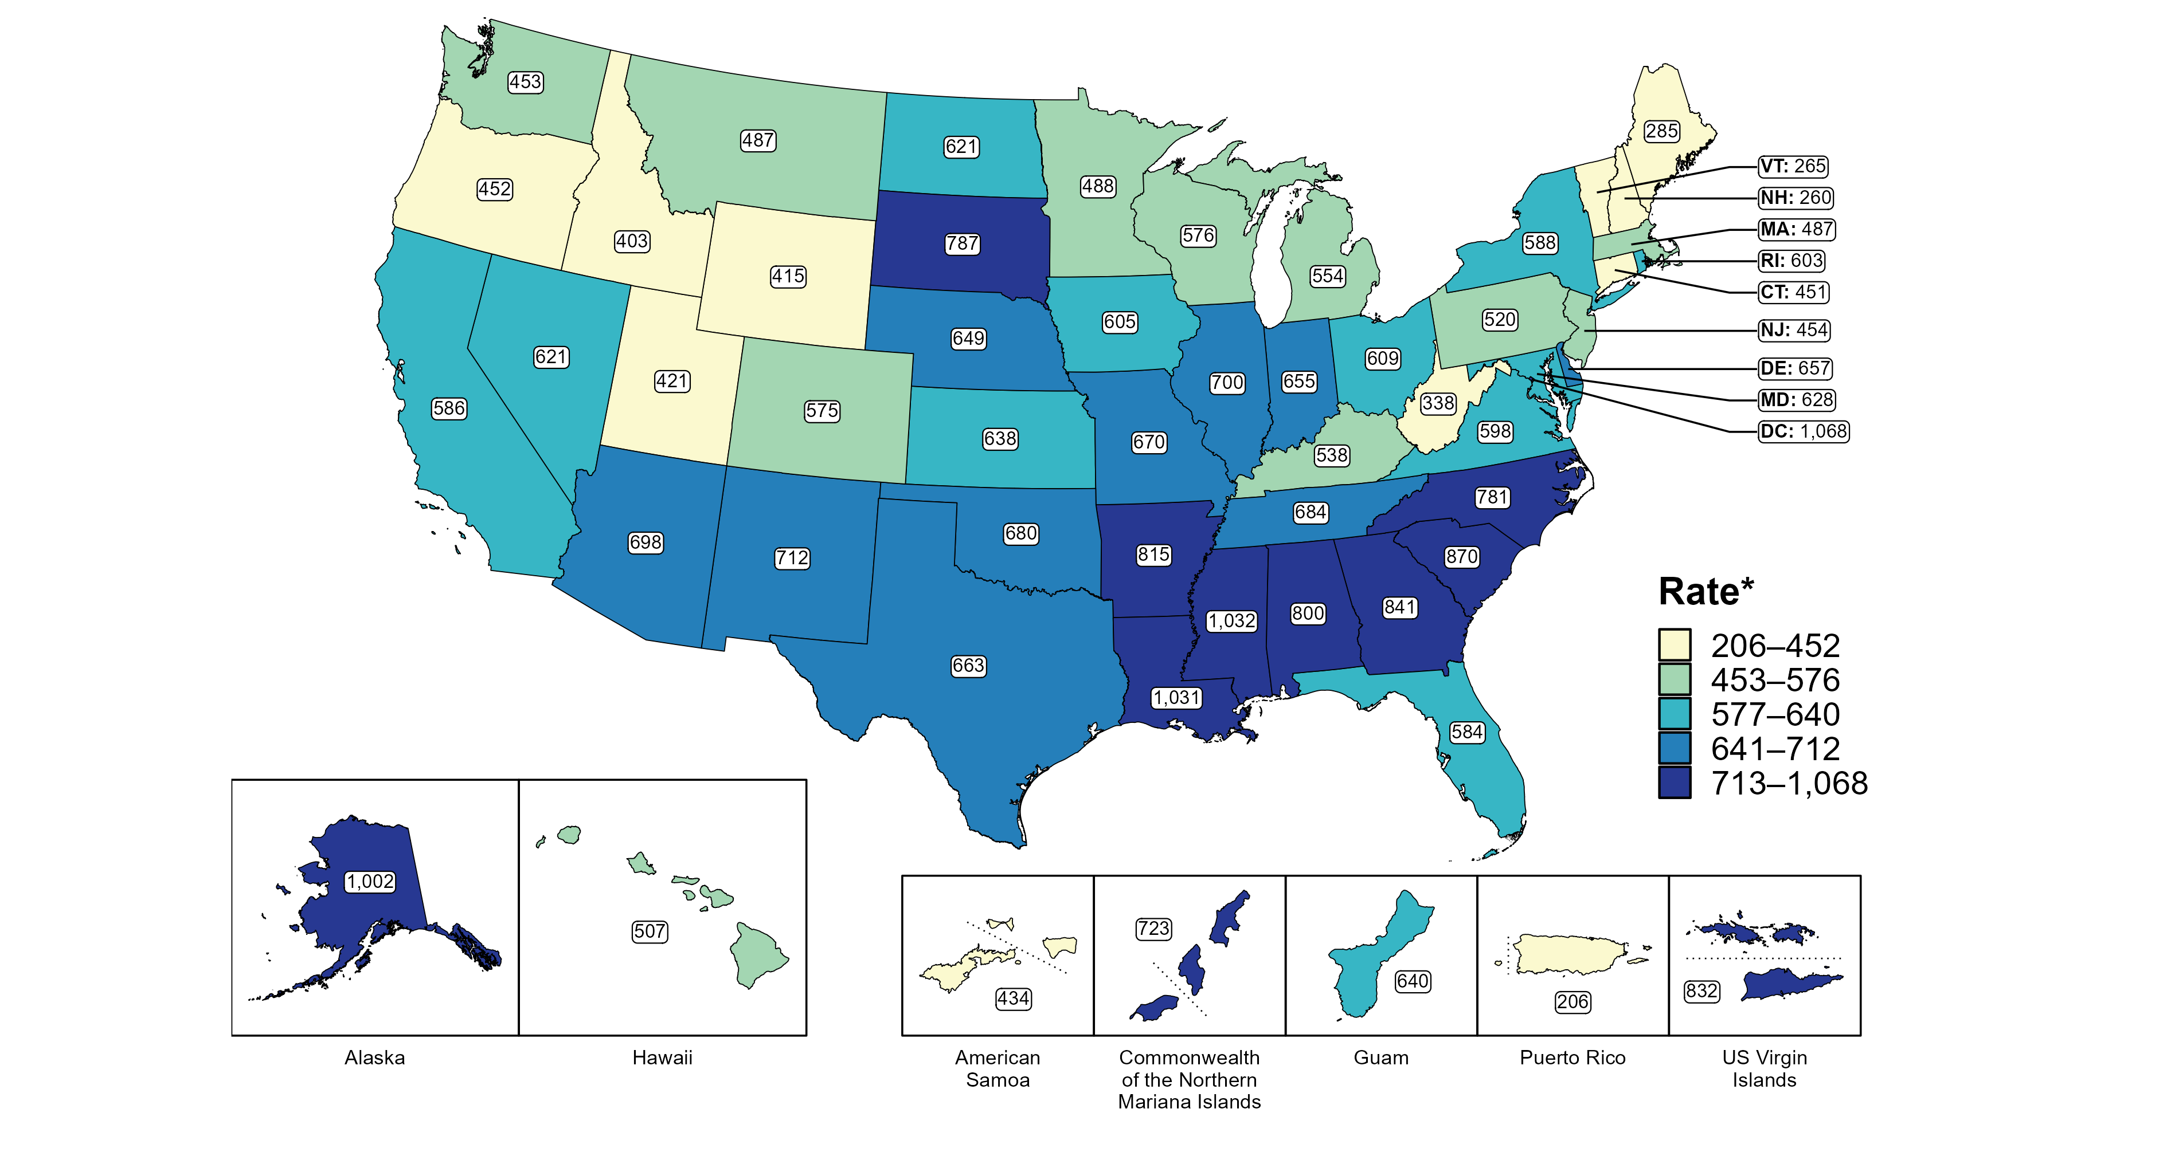
Chlamydia — Rates of Reported Cases Among Women by Jurisdiction, United States and Territories, 2022
* Per 100,000
Notes:
In 2022, rates of reported chlamydia among women ranged by state from 260 cases per 100,000 women in New Hampshire to 1,032 cases per 100,000 women in Mississippi. The rate of reported chlamydia in the District of Columbia was 1,068 per 100,000 women.
Among US territories, rates of reported chlamydia ranged from 206 cases per 100,000 women in Puerto Rico to 832 cases per 100,000 women in the US Virgin Islands.
This report includes data from years that coincide with the COVID-19 pandemic, which introduced uncertainty and difficulty in interpreting STI surveillance data. See Impact of COVID-19 on STIs for more information.
See Technical Notes (https://www.cdc.gov/std/statistics/2022/technical-notes.htm) for information on chlamydia case reporting and on interpreting reported rates in US territories. Table A1 (https://www.cdc.gov/std/statistics/2022/tables/a1.htm) provides information on unknown, missing, or invalid values of select variables.
Data for all figures are available at https://www.cdc.gov/std/statistics/2022/data.zip. The file “CT - Rates Women by Jurisdiction (US and Terr 2022).xlsx” contains the data for the figure presented on this slide.

Slide 7
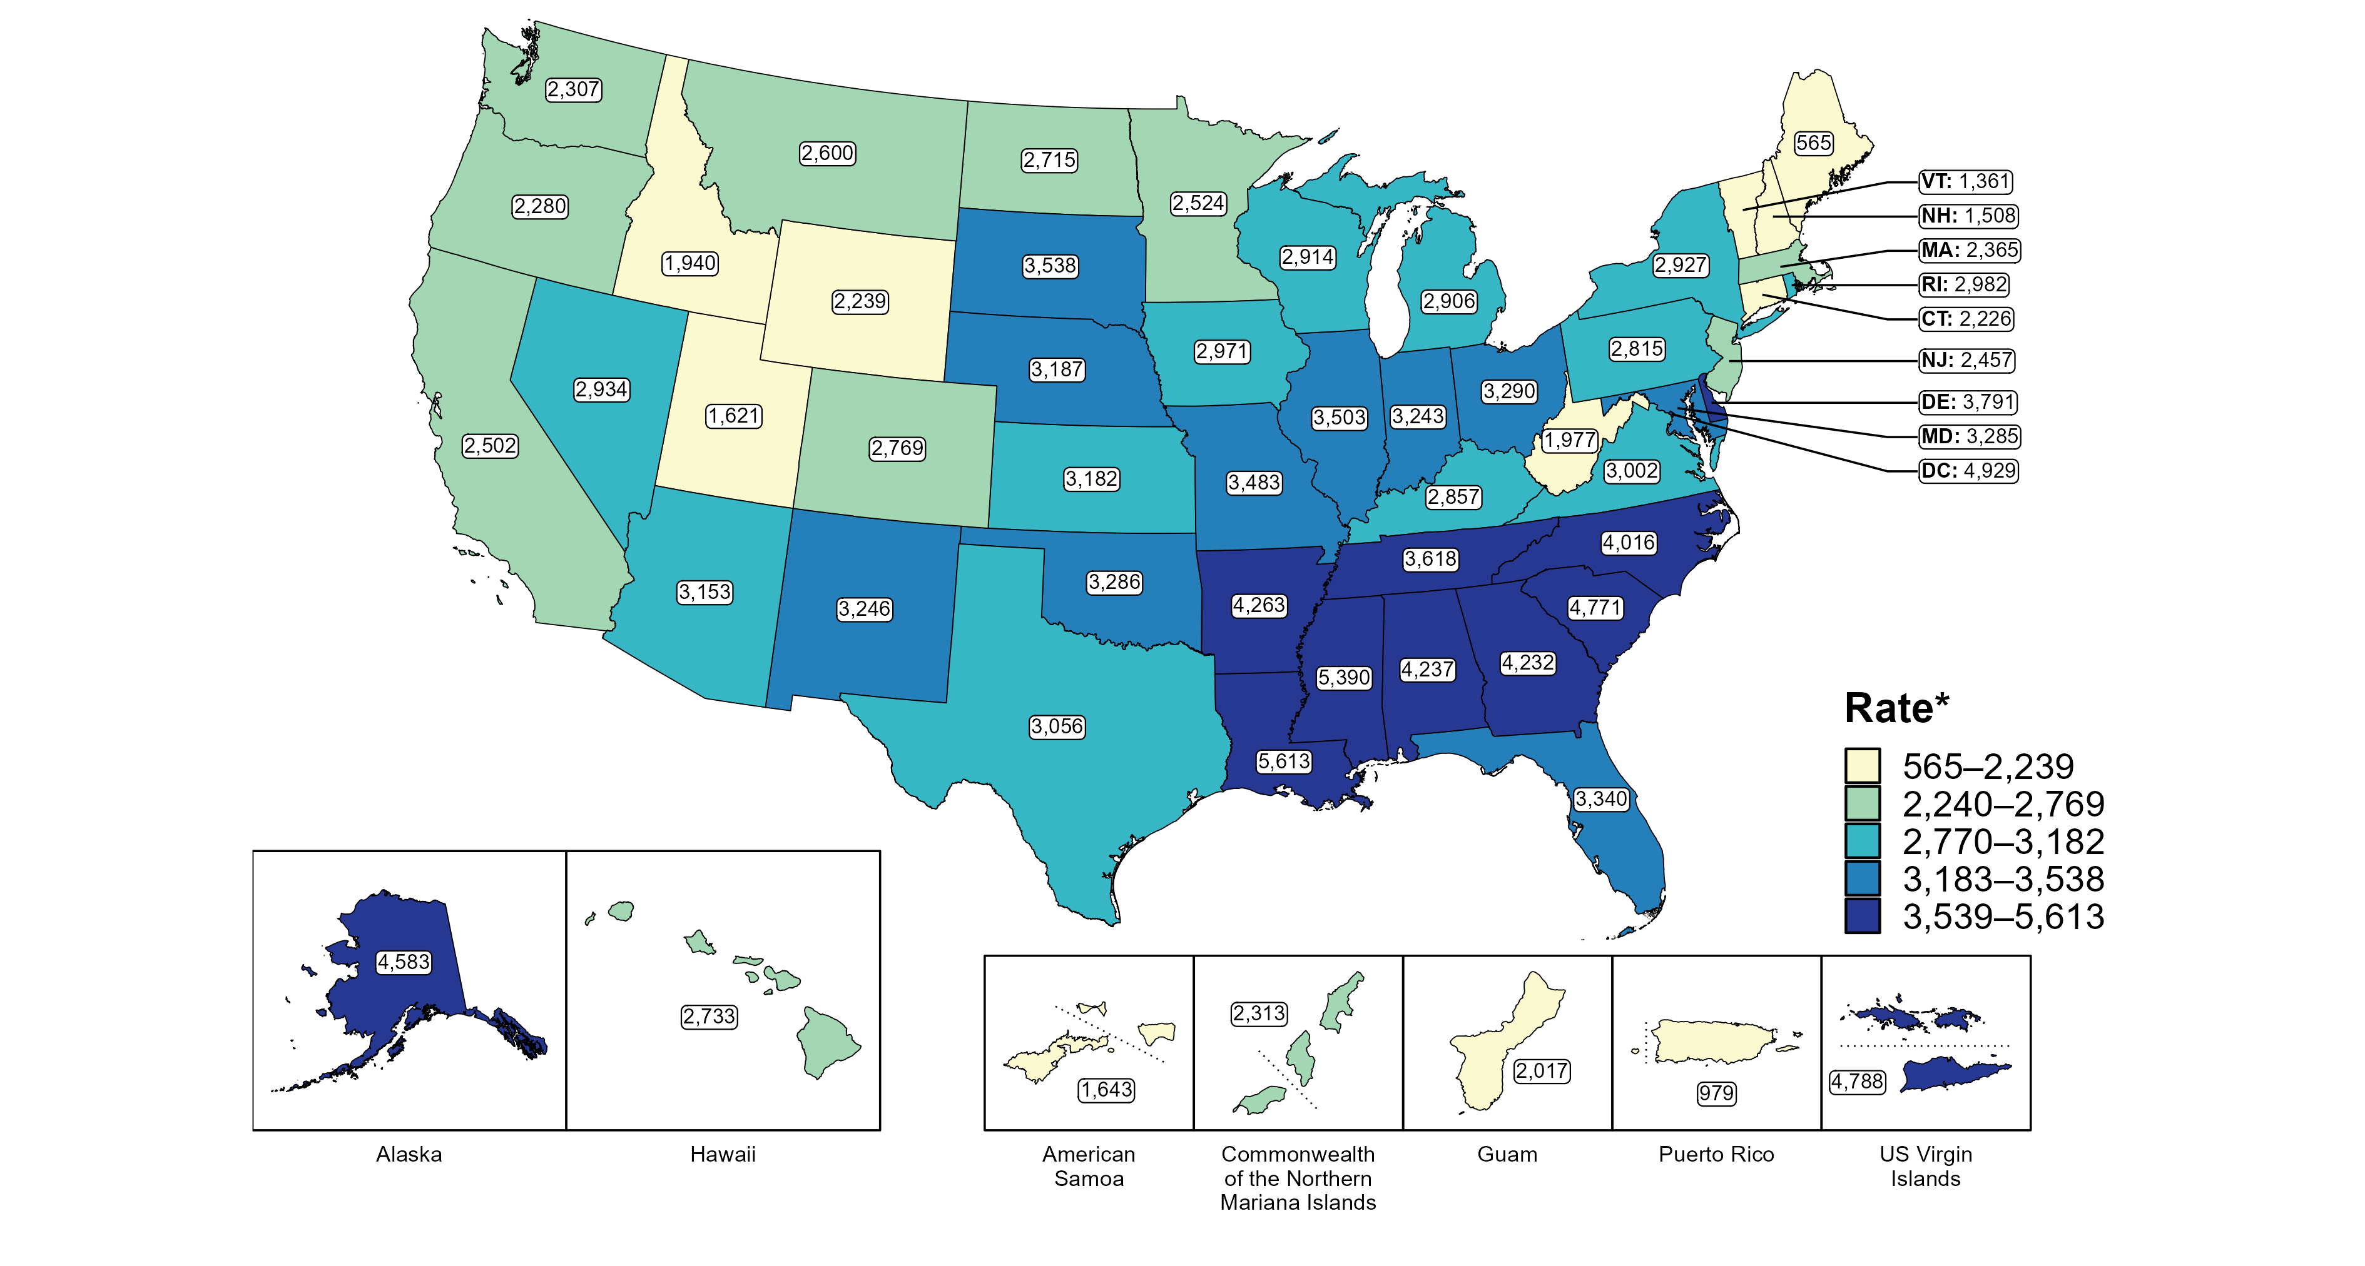
Chlamydia — Rates of Reported Cases Among Women Aged 15–24 Years by Jurisdiction, United States and Territories, 2022
* Per 100,000
Notes:
In 2022, rates of reported chlamydia among women aged 15 to 24 years ranged by state from 565 cases per 100,000 women aged 15 to 24 years in Maine to 5,613 cases per 100,000 women aged 15 to 24 years in Louisiana. The rate of reported chlamydia in the District of Columbia was 4,929 per 100,000 women aged 15 to 24 years.
Among US territories, rates of reported chlamydia ranged from 979 cases per 100,000 women aged 15 to 24 years in Puerto Rico to 4,788 cases per 100,000 women aged 15 to 24 years in the US Virgin Islands.
This report includes data from years that coincide with the COVID-19 pandemic, which introduced uncertainty and difficulty in interpreting STI surveillance data. See Impact of COVID-19 on STIs for more information.
See Technical Notes (https://www.cdc.gov/std/statistics/2022/technical-notes.htm) for information on chlamydia case reporting and on interpreting reported rates in US territories. Table A1 (https://www.cdc.gov/std/statistics/2022/tables/a1.htm) provides information on unknown, missing, or invalid values of select variables.
Data for all figures are available at https://www.cdc.gov/std/statistics/2022/data.zip. The file “CT - Rates Women 15-24 Years by Jurisdiction (US and Terr 2022).xlsx” contains the data for the figure presented on this slide.

Slide 8
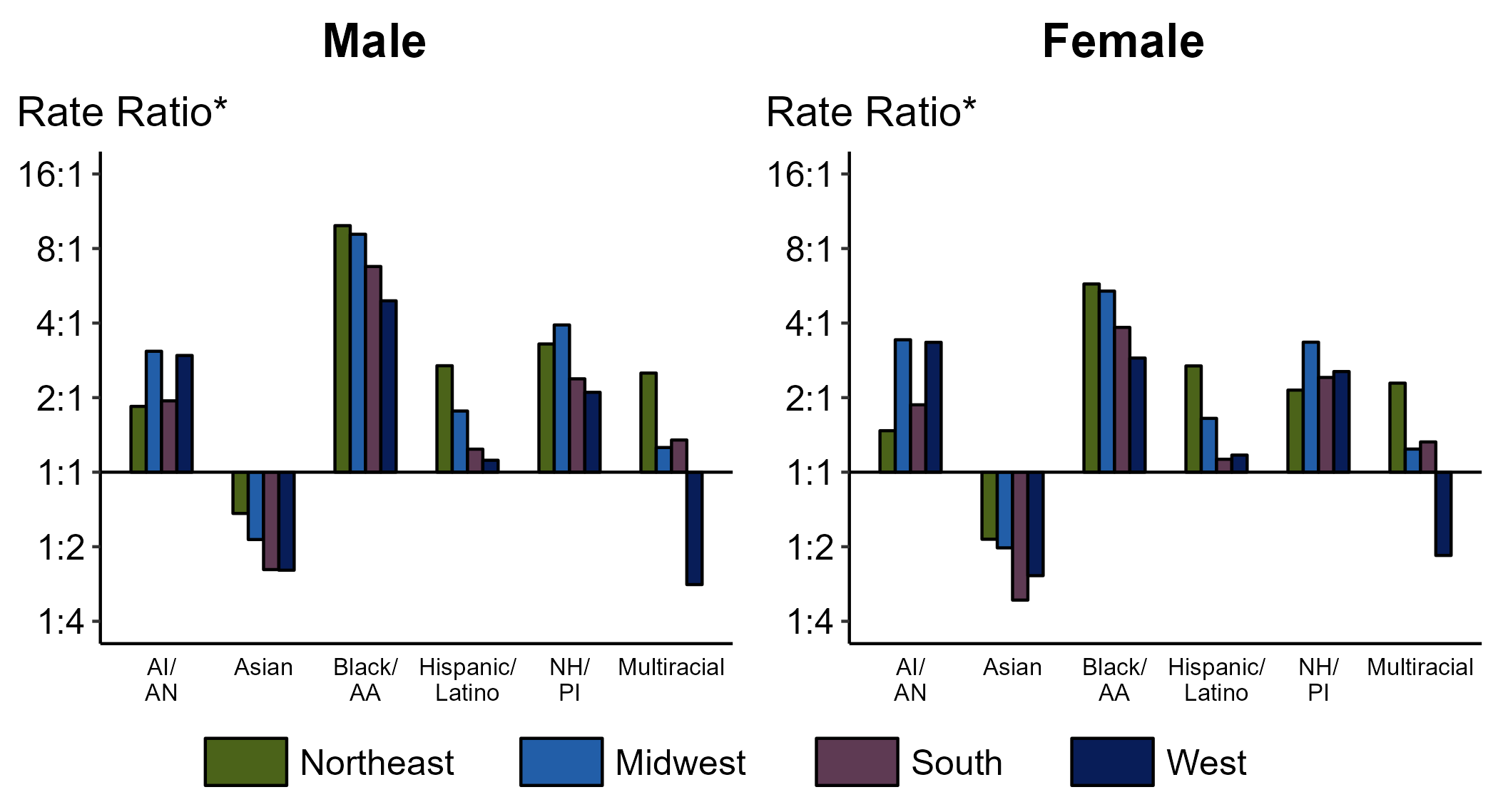
Chlamydia — Ratios of Rates of Reported Cases Among Persons Aged 15–24 Years by Sex, Race/Hispanic Ethnicity, and Region, United States, 2022
* For the rate ratios, non-Hispanic White persons are the referent population. Y-axis is log scale.
ACRONYMS: AI/AN = American Indian or Alaska Native; Black/AA = Black or African American; NH/PI = Native Hawaiian or other Pacific Islander
Notes:
Among men and women aged 15-24 years, rate ratios of rates of reported chlamydia by race/Hispanic ethnicity (using non-Hispanic White persons as the referent population) varied by region in 2022. Among men aged 15-24 years, the greatest rate ratio was in the Northeast where the rate of reported chlamydia among non-Hispanic Black men was 9.9 times the rate among non-Hispanic White men. Among women aged 15-24 years, the greatest rate ratio was in the Northeast where the rate of reported chlamydia among non-Hispanic Black women was 5.8 times the rate among non-Hispanic White women.
This report includes data from years that coincide with the COVID-19 pandemic, which introduced uncertainty and difficulty in interpreting STI surveillance data. See Impact of COVID-19 on STIs for more information.
See Technical Notes (https://www.cdc.gov/std/statistics/2022/technical-notes.htm) for information on chlamydia case reporting, race/Hispanic ethnicity categorization, and reporting of race/Hispanic ethnicity for STI cases. Table A1 (https://www.cdc.gov/std/statistics/2022/tables/a1.htm) provides information on unknown, missing, or invalid values of select variables.

Slide 9
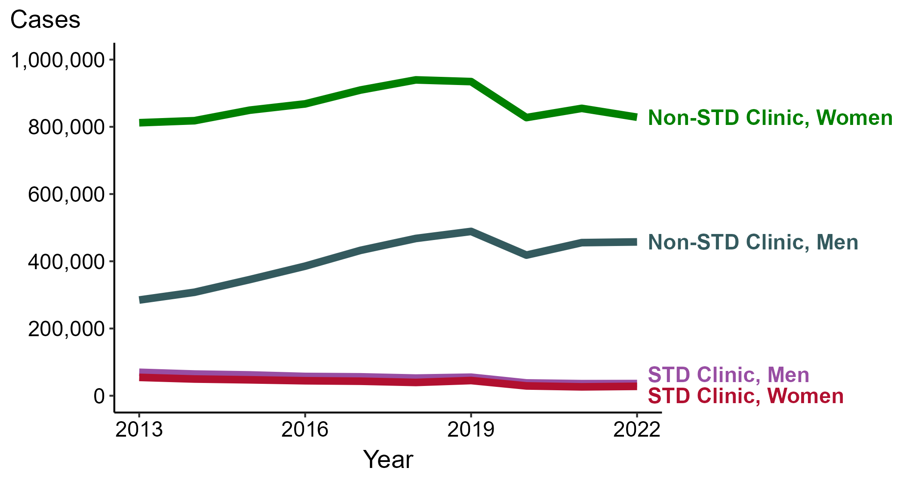
Chlamydia — Reported Cases by Reporting Source and Sex, United States, 2013–2022
NOTE: During 2013 to 2022, the proportion of all cases with unknown reporting source was 15.3%, from a low of 12.7% (n = 178,273) in 2013 to a high of 17.9% (n = 295,170) in 2022.
Notes:
During 2021 to 2022, the number of chlamydia cases reported from STD clinics did not change substantially (<1.0% change) among men (35,913 to 36,135 cases) and increased 5.8% among women (26,395 to 27,930 cases), while the number of cases reported from non-STD clinics did not change substantially (<1.0% change) among men (455,459 to 457,559 cases) and decreased 3.1% among women (854,917 to 828,629 cases).
During a ten-year period (2013 to 2022), the number of chlamydia cases reported from STD clinics decreased 48.1% among men (69,680 to 36,135 cases) and decreased 48.8% among women (54,590 to 27,930 cases), while the number of cases reported from non-STD clinics increased 60.7% among men (284,722 to 457,559 cases) and increased 2.0% among women (812,153 to 828,629 cases).
This report includes data from years that coincide with the COVID-19 pandemic, which introduced uncertainty and difficulty in interpreting STI surveillance data. See Impact of COVID-19 on STIs for more information.
See Technical Notes (https://www.cdc.gov/std/statistics/2022/technical-notes.htm) for information on chlamydia case reporting. Table A1 (https://www.cdc.gov/std/statistics/2022/tables/a1.htm) provides information on unknown, missing, or invalid values of select variables.
Data for all figures are available at https://www.cdc.gov/std/statistics/2022/data.zip. The file “CT - Cases by Reporting Source and Sex (US 2013-2022).xlsx” contains the data for the figure presented on this slide.

Slide 10
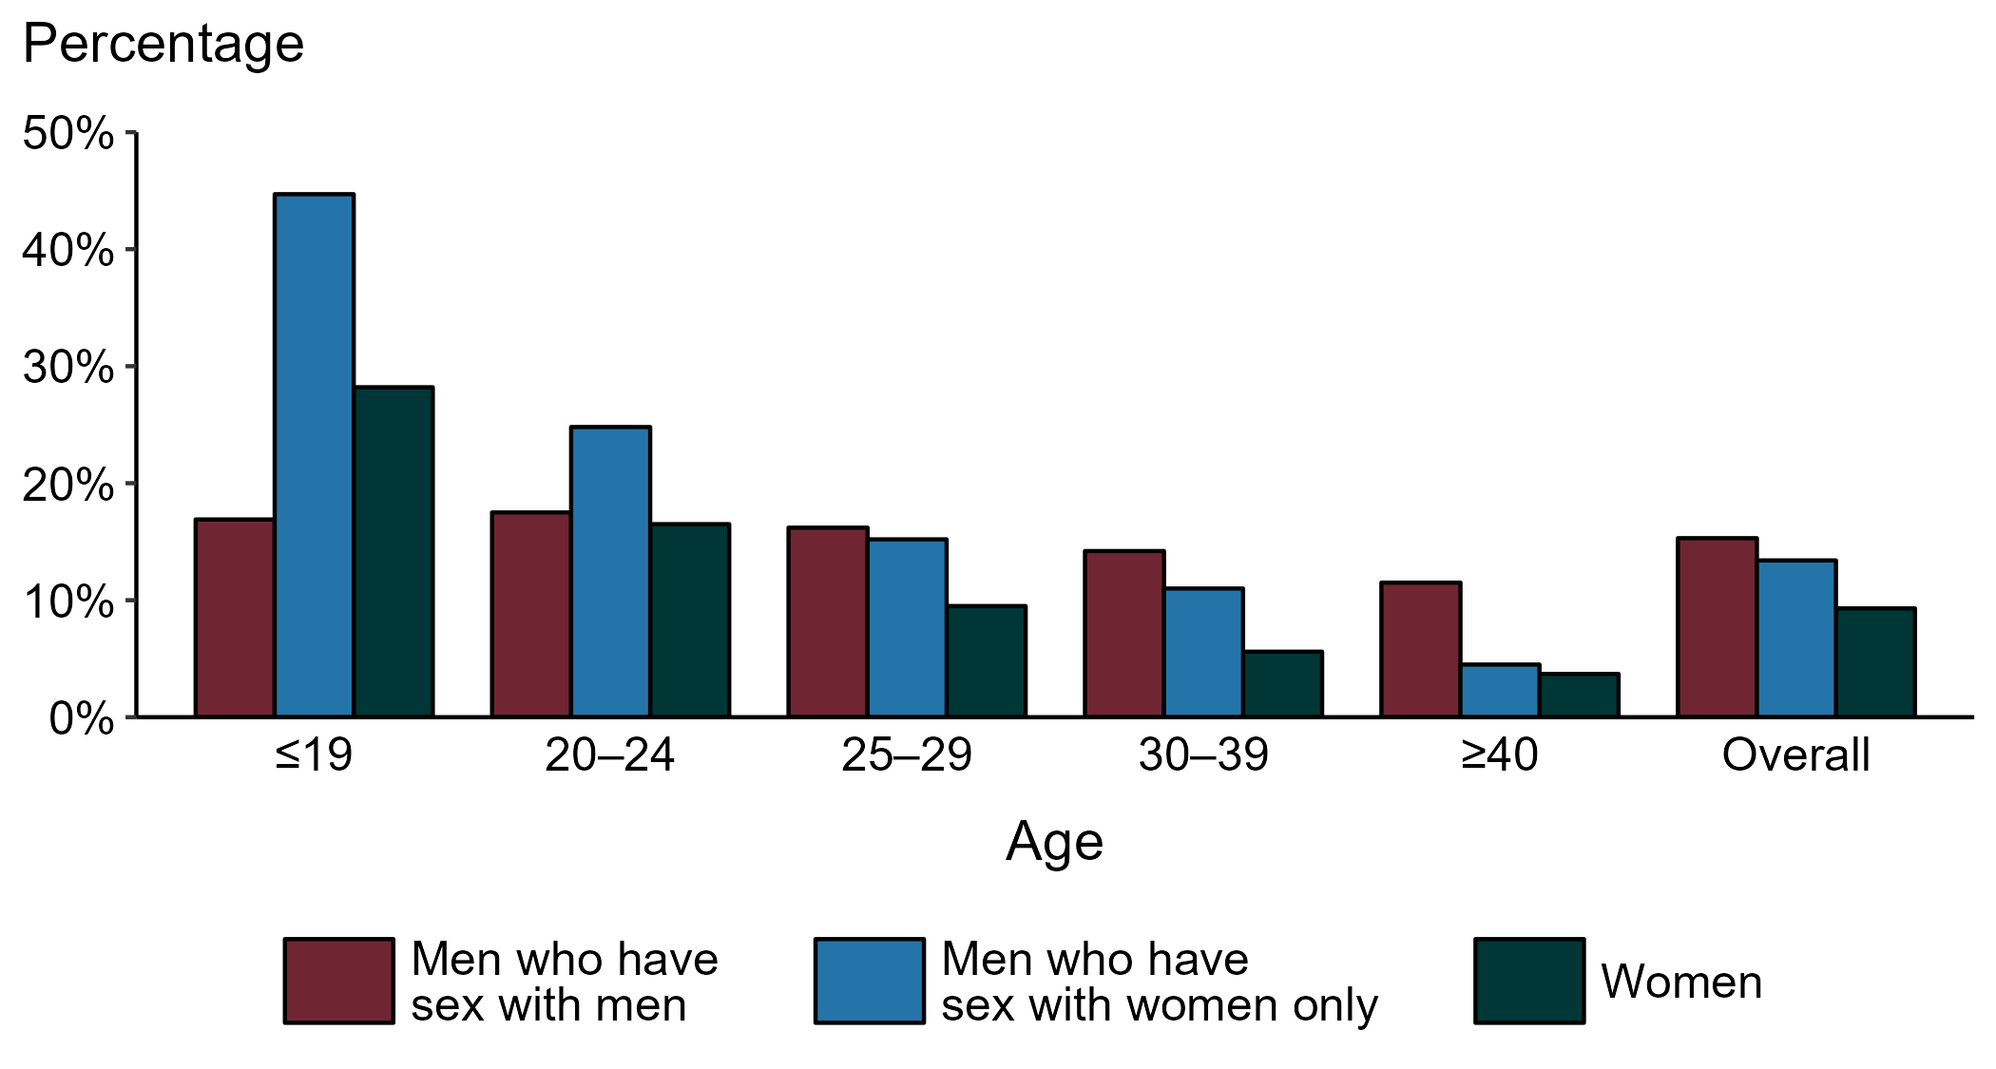
Chlamydia — Proportion of STD Clinic Patients Testing Positive by Age Group, Sex, and Sex of Sex Partners, STD Surveillance Network (SSuN), 2022
NOTE: Results are based on 49,665 unique patients in 10 participating jurisdictions (Baltimore City, California [excluding San Francisco], Columbus, Florida, Indiana, Multnomah County, New York City, Philadelphia, San Francisco, and Washington) with known sex of sex partners attending SSuN STD clinics who were tested ≥1 times for chlamydia in 2022.
Notes:
Among patients accessing care in participating STD clinics in the STD Surveillance Network (SSuN) who were tested for chlamydia in 2022 and had known sexual orientation or sex of sex partners, 15.3% of gay, bisexual and other men who have sex with men (MSM), 13.4% of men who have sex with women only (MSW), and 9.3% of women were found to be positive. The proportion testing positive for chlamydia varied by sex and sex of sex partners, as well as by age group. The highest proportion of patients testing positive were MSW aged 19 years and younger (44.7%). Of note, adolescent patients represent a relatively small subgroup of the clinic population and changes in the number of events in the numerator or a small denominator may lead to substantial fluctuations from year to year. Hence, data should be interpreted with caution.
This report includes data from years that coincide with the COVID-19 pandemic, which introduced uncertainty and difficulty in interpreting STI surveillance data. See Impact of COVID-19 on STIs for more information.
See Technical Notes (https://www.cdc.gov/std/statistics/2022/technical-notes.htm) for information on SSuN methodology.

Slide 11
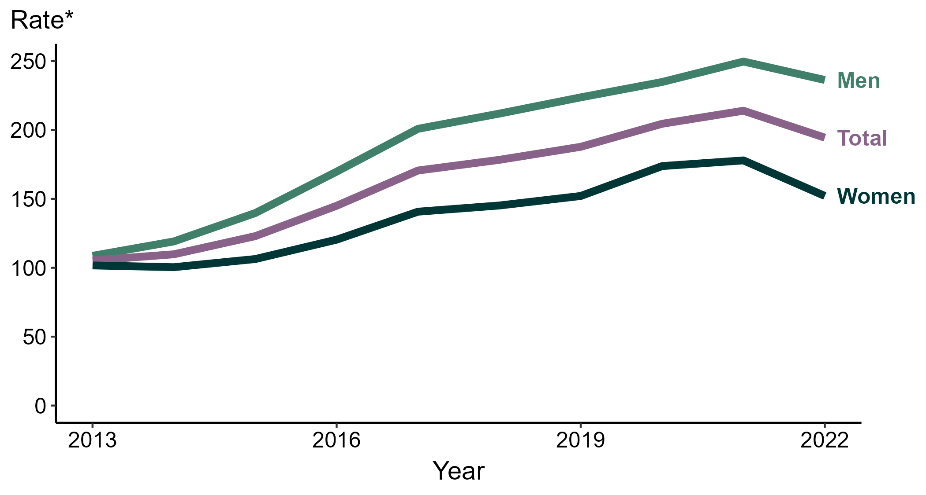
Gonorrhea — Rates of Reported Cases by Sex, United States, 2013–2022
* Per 100,000
Notes:
During 2021 to 2022, the rate of reported gonorrhea among men decreased 5.4% (from 249.7 to 236.3 per 100,000) and the rate among women decreased 14.5% (from 177.9 to 152.1 per 100,000).
Over the last five years, the rate of reported gonorrhea among men increased 11.5% (from 211.9 to 236.3 per 100,000) and the rate among women increased 4.8% (from 145.2 to 152.1 per 100,000). Over the last 10 years, the rate among men increased 117.4% (from 108.7 to 236.3 per 100,000) and the rate among women increased 49.6% (from 101.7 to 152.1 per 100,000).
This report includes data from years that coincide with the COVID-19 pandemic, which introduced uncertainty and difficulty in interpreting STI surveillance data. See Impact of COVID-19 on STIs for more information.
See Technical Notes (https://www.cdc.gov/std/statistics/2022/technical-notes.htm) for information on gonorrhea case reporting. Table A1 (https://www.cdc.gov/std/statistics/2022/tables/a1.htm) provides information on unknown, missing, or invalid values of select variables.
Data for all figures are available at https://www.cdc.gov/std/statistics/2022/data.zip. The file “GC - Rates by Sex (US 2013-2022).xlsx” contains the data for the figure presented on this slide.

Slide 12
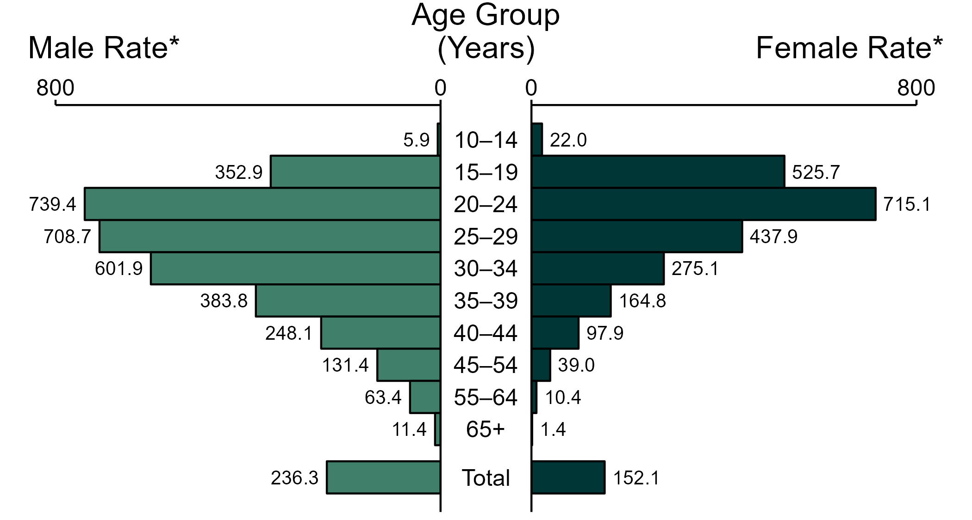
Gonorrhea — Rates of Reported Cases by Age Group and Sex, United States, 2022
* Per 100,000
NOTE: Total includes cases of all ages, including those with unknown age.
Notes:
In 2022, the rate of reported gonorrhea was higher among men (236.3 per 100,000) compared to women (152.1 per 100,000).
Among men, those aged 20 to 24 years had the highest rate of reported cases of gonorrhea (739.4 per 100,000), followed by men aged 25 to 29 years (708.7 per 100,000) and men aged 30 to 34 years (601.9 per 100,000). Among women, those aged 20 to 24 years also had the highest rate of reported cases of gonorrhea (715.1 per 100,000), followed by women aged 15 to 19 years (525.7 per 100,000) and women aged 25 to 29 years (437.9 per 100,000).
This report includes data from years that coincide with the COVID-19 pandemic, which introduced uncertainty and difficulty in interpreting STI surveillance data. See Impact of COVID-19 on STIs for more information.
See Technical Notes (https://www.cdc.gov/std/statistics/2022/technical-notes.htm) for information on gonorrhea case reporting. Table A1 (https://www.cdc.gov/std/statistics/2022/tables/a1.htm) provides information on unknown, missing, or invalid values of select variables.
Data for all figures are available at https://www.cdc.gov/std/statistics/2022/data.zip. The file “GC - Rates by Age Group and Sex (US 2022).xlsx” contains the data for the figure presented on this slide.

Slide 13
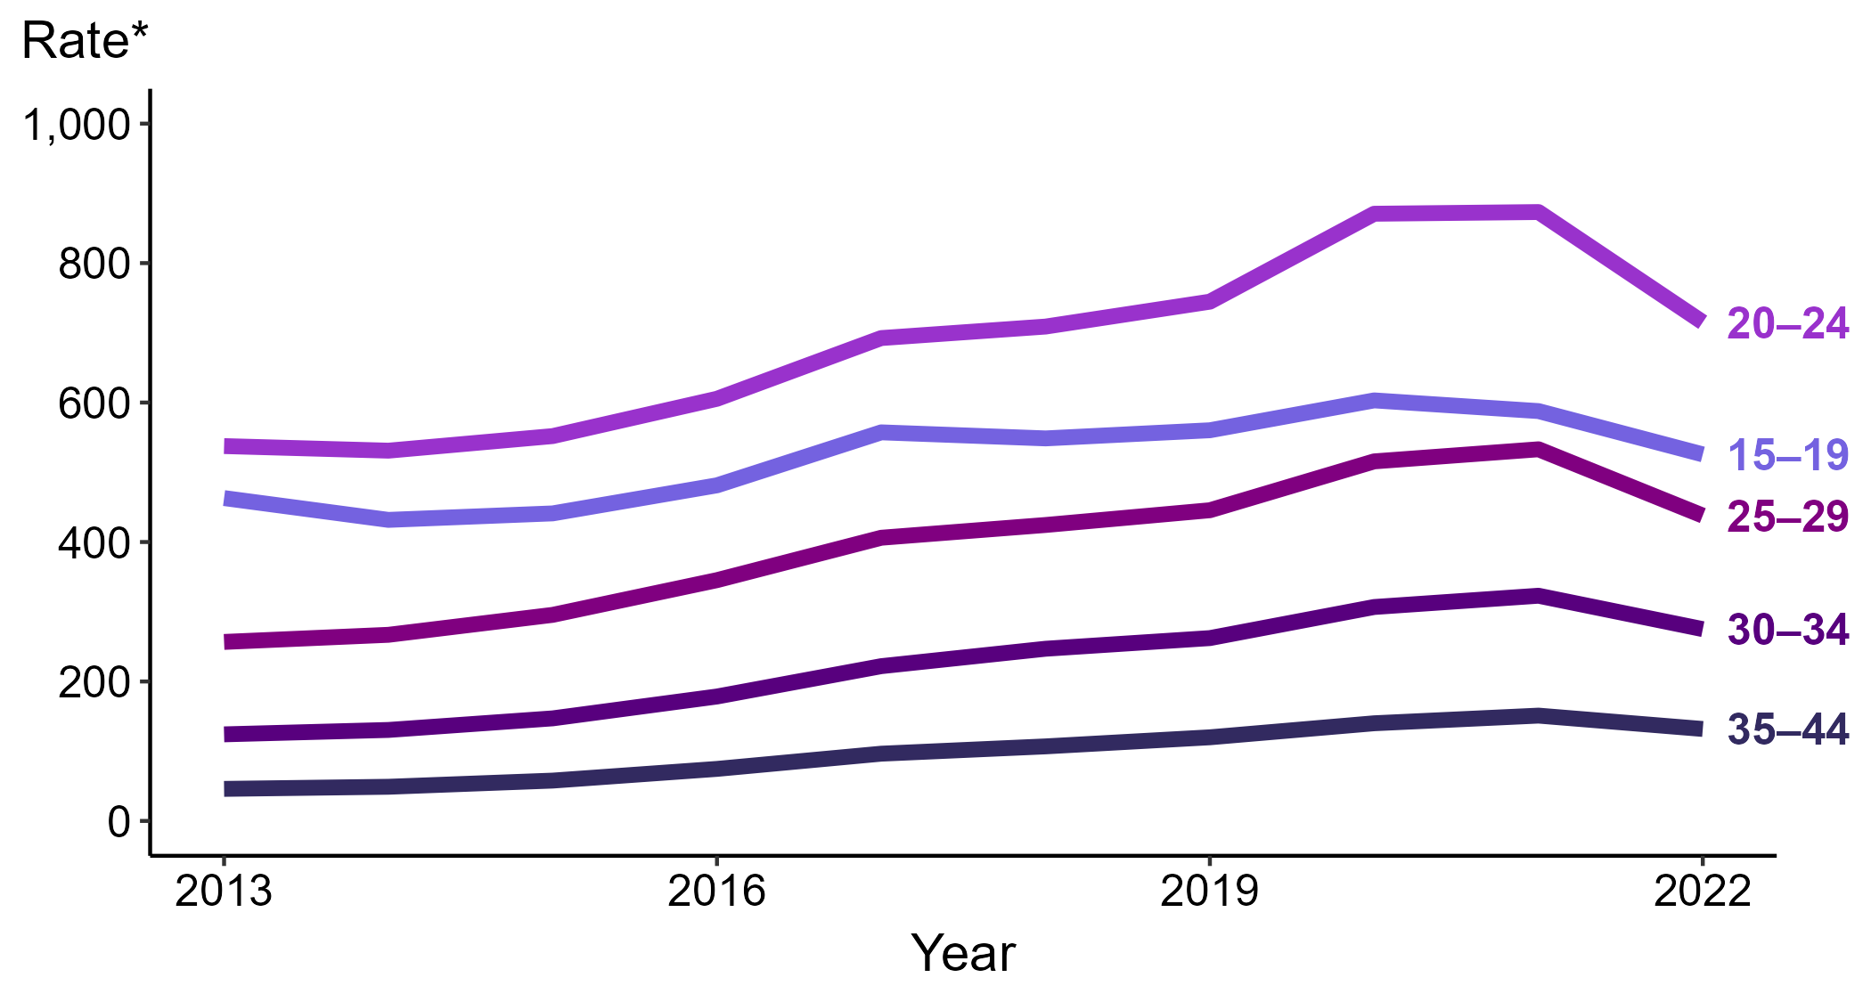
Gonorrhea — Rates of Reported Cases Among Women Aged 15–44 Years by Age Group, United States, 2013–2022
* Per 100,000
Notes:
Among women aged 15 to 44 years in 2022, those aged 20 to 24 years had the highest rate of reported cases of gonorrhea (715.1 cases per 100,000; 18.1% decrease from 2021), followed by those aged 15 to 19 years (525.7 cases per 100,000; 10.6% decrease from 2021), those aged 25 to 29 years (437.9 cases per 100,000; 17.8% decrease from 2021), those aged 30 to 34 years (275.1 cases per 100,000; 14.8% decrease from 2021), and those aged 35 to 44 years (131.9 cases per 100,000; 12.6% decrease from 2021).
This report includes data from years that coincide with the COVID-19 pandemic, which introduced uncertainty and difficulty in interpreting STI surveillance data. See Impact of COVID-19 on STIs for more information.
See Technical Notes (https://www.cdc.gov/std/statistics/2022/technical-notes.htm) for information on gonorrhea case reporting. Table A1 (https://www.cdc.gov/std/statistics/2022/tables/a1.htm) provides information on unknown, missing, or invalid values of select variables.
Data for all figures are available at https://www.cdc.gov/std/statistics/2022/data.zip. The file “GC - Rates Women 15-44 Years by Age Group (US 2012-2022).xlsx” contains the data for the figure presented on this slide.

Slide 14
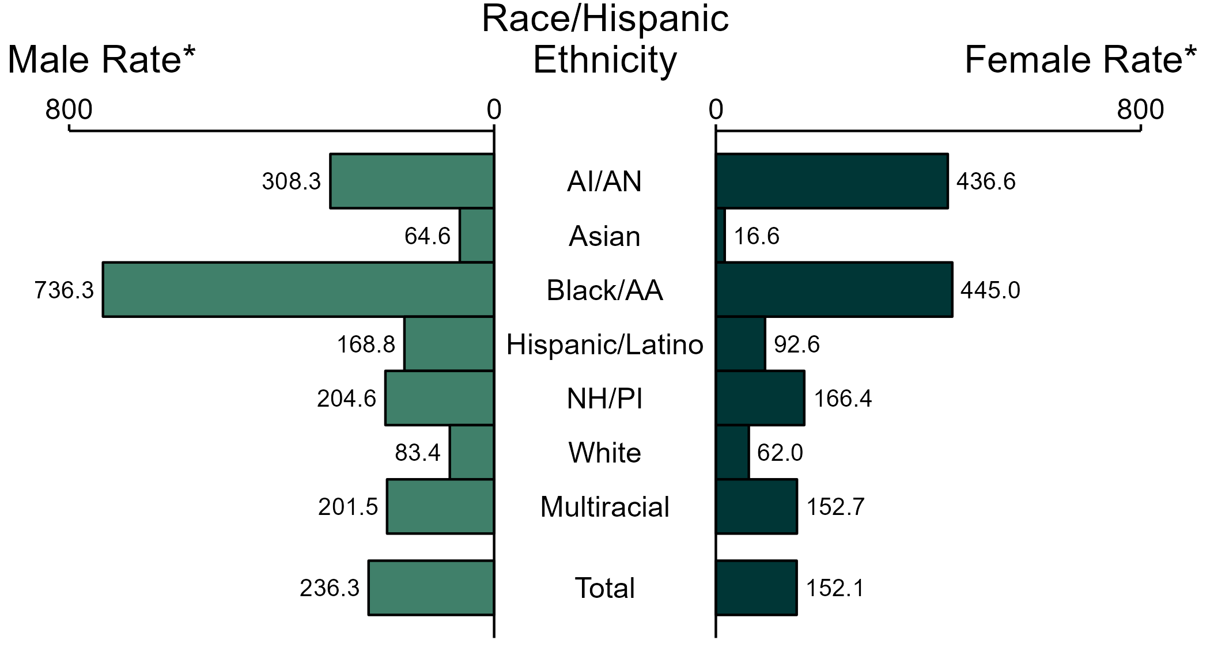
Gonorrhea — Rates of Reported Cases by Race/Hispanic Ethnicity and Sex, United States, 2022
* Per 100,000
ACRONYMS: AI/AN = American Indian or Alaska Native; Black/AA = Black or African American; NH/PI = Native Hawaiian or other Pacific Islander
NOTE: Total includes all cases including those with unknown race/Hispanic ethnicity.
Notes:
In 2022, the rate of reported gonorrhea was higher among men (236.3 per 100,000) compared to women (152.1 per 100,000).
Among men, non-Hispanic Black or African American men had the highest rate of reported cases of gonorrhea (736.3 per 100,000), followed by non-Hispanic American Indian or Alaska Native men (308.3 per 100,000) and non-Hispanic Native Hawaiian or other Pacific Islander men (204.6 per 100,000). Among women, non-Hispanic Black or African American women also had the highest rate of reported cases of gonorrhea (445.0 per 100,000), followed by non-Hispanic American Indian or Alaska Native women (436.6 per 100,000) and non-Hispanic Native Hawaiian or other Pacific Islander women (166.4 per 100,000).
Using non-Hispanic White persons as the referent category, the greatest relative racial disparity in rates of reported gonorrhea across both sexes was observed among non-Hispanic Black or African American men, with a rate ratio of 8.8 times that of non-Hispanic White men. Among women, the greatest relative disparity was observed among non-Hispanic Black or African American women as well, with a rate 7.2 times that of non-Hispanic White women.
This report includes data from years that coincide with the COVID-19 pandemic, which introduced uncertainty and difficulty in interpreting STI surveillance data. See Impact of COVID-19 on STIs for more information.
See Technical Notes (https://www.cdc.gov/std/statistics/2022/technical-notes.htm) for information on gonorrhea case reporting, race/Hispanic ethnicity categorization, and reporting of race/Hispanic ethnicity for STI cases. Table A1 (https://www.cdc.gov/std/statistics/2022/tables/a1.htm) provides information on unknown, missing, or invalid values of select variables.
Data for all figures are available at https://www.cdc.gov/std/statistics/2022/data.zip. The file “GC - Rates by Race Hispanic Ethnicity and Sex (US 2022).xlsx” contains the data for the figure presented on this slide.

Slide 15
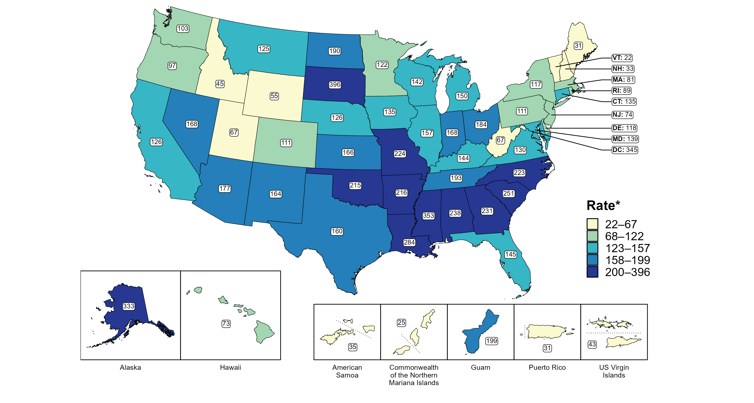
Gonorrhea — Rates of Reported Cases Among Women by Jurisdiction, United States and Territories, 2022
* Per 100,000
Notes:
In 2022, rates of reported gonorrhea among women ranged by state from 22 cases per 100,000 women in Vermont to 396 cases per 100,000 women in South Dakota. The rate of reported gonorrhea in the District of Columbia was 345 per 100,000 women.
Among US territories, rates of reported gonorrhea ranged from 25 cases per 100,000 women in the Commonwealth of the Northern Mariana Islands to 199 cases per 100,000 women in Guam.
This report includes data from years that coincide with the COVID-19 pandemic, which introduced uncertainty and difficulty in interpreting STI surveillance data. See Impact of COVID-19 on STIs for more information.
See Technical Notes (https://www.cdc.gov/std/statistics/2022/technical-notes.htm) for information on gonorrhea case reporting and on interpreting reported rates in US territories. Table A1 (https://www.cdc.gov/std/statistics/2022/tables/a1.htm) provides information on unknown, missing, or invalid values of select variables.
Data for all figures are available at https://www.cdc.gov/std/statistics/2022/data.zip. The file “GC - Rates Women by Jurisdiction (US and Terr 2022).xlsx” contains the data for the figure presented on this slide.

Slide 16
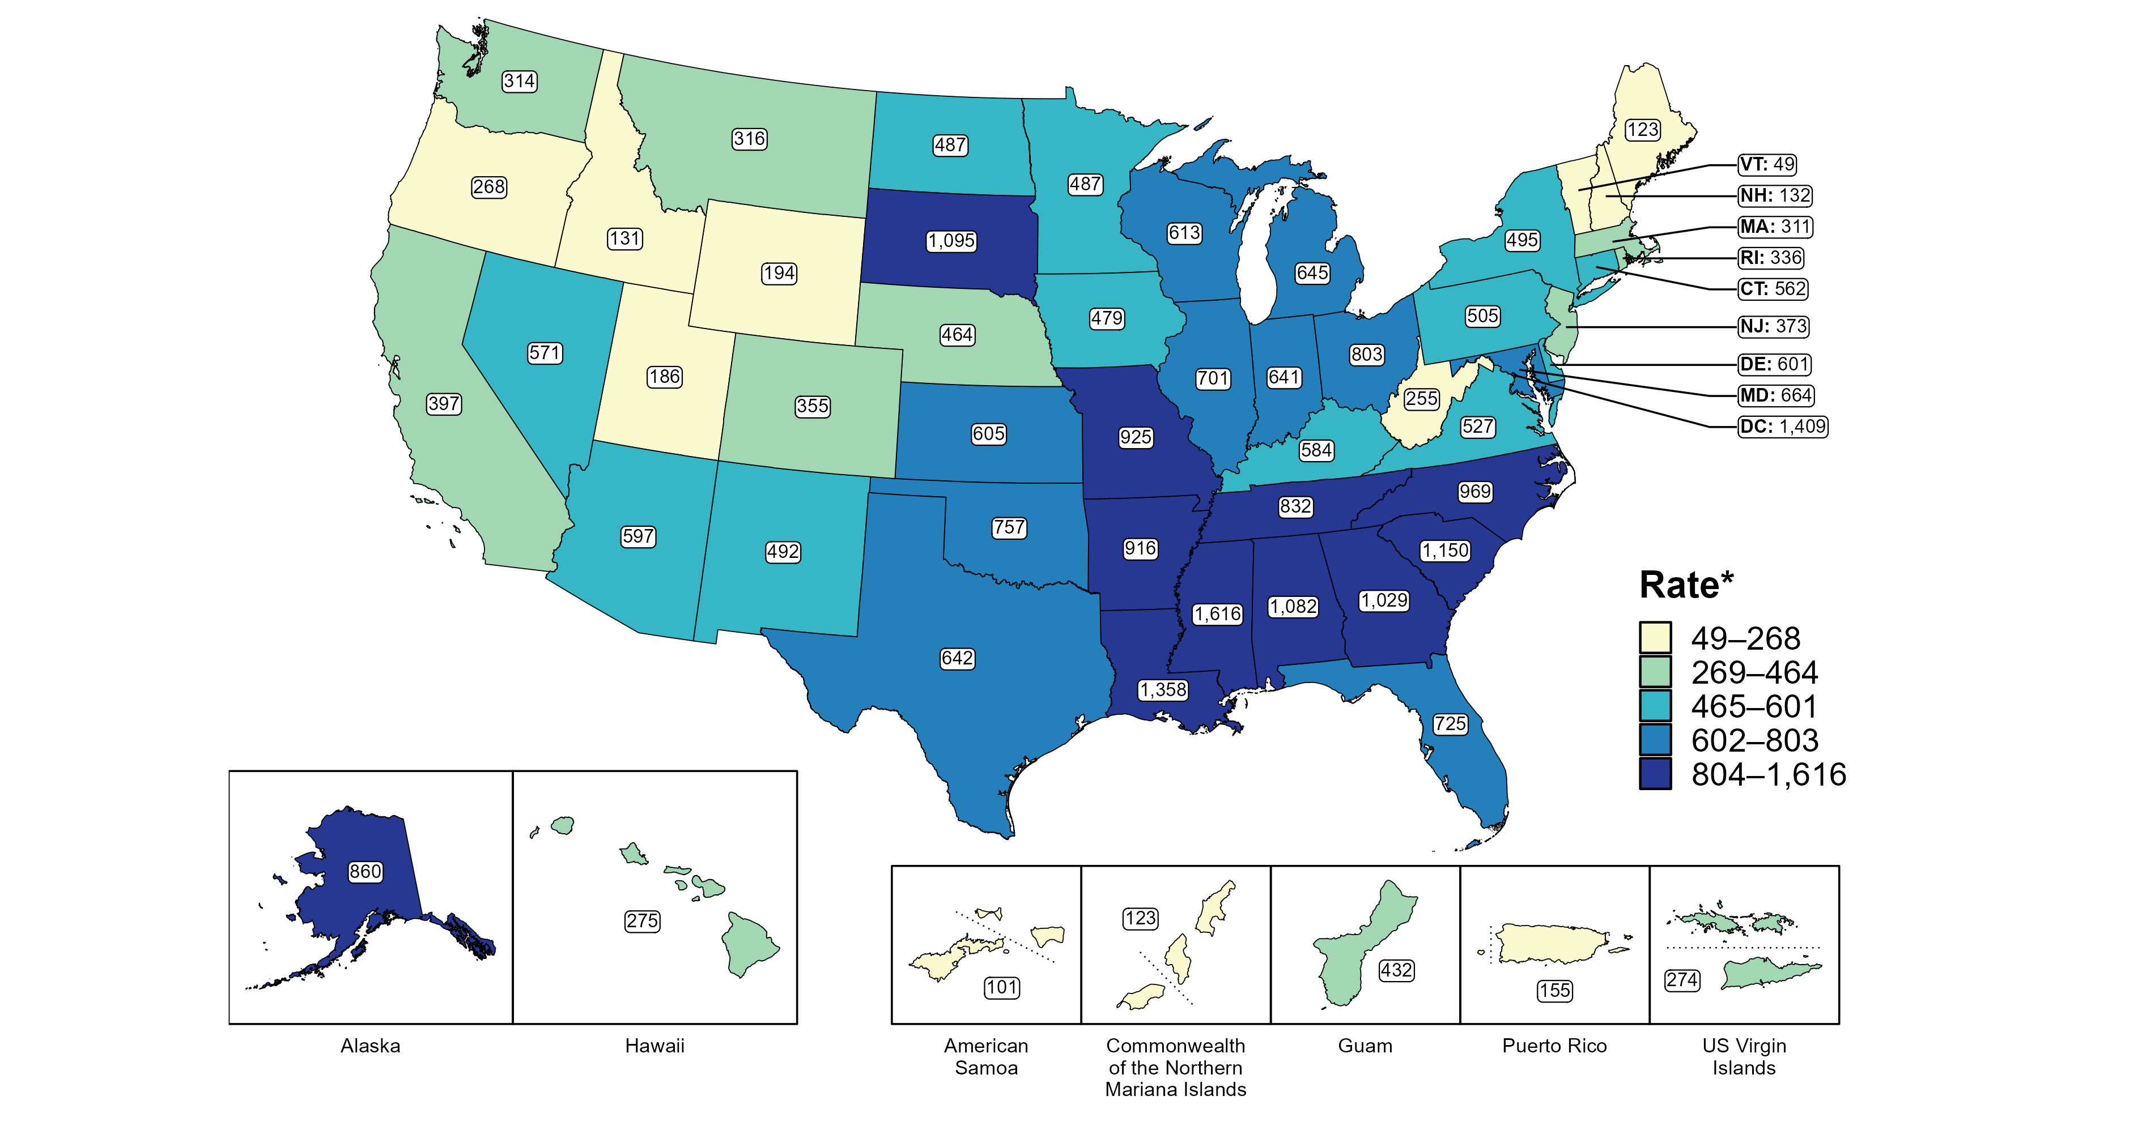
Gonorrhea — Rates of Reported Cases Among Women Aged 15–24 Years by Jurisdiction, United States and Territories, 2022
* Per 100,000
Notes:
In 2022, rates of reported gonorrhea among women aged 15 to 24 years ranged by state from 49 cases per 100,000 women aged 15 to 24 years in Vermont to 1,616 cases per 100,000 women aged 15 to 24 years in Mississippi. The rate of reported gonorrhea in the District of Columbia was 1,409 per 100,000 women aged 15 to 24 years.
Among US territories, rates of reported gonorrhea ranged from 101 cases per 100,000 women aged 15 to 24 years in American Samoa to 432 cases per 100,000 women aged 15 to 24 years in Guam.
This report includes data from years that coincide with the COVID-19 pandemic, which introduced uncertainty and difficulty in interpreting STI surveillance data. See Impact of COVID-19 on STIs for more information.
See Technical Notes (https://www.cdc.gov/std/statistics/2022/technical-notes.htm) for information on gonorrhea case reporting and on interpreting reported rates in US territories. Table A1 (https://www.cdc.gov/std/statistics/2022/tables/a1.htm) provides information on unknown, missing, or invalid values of select variables.
Data for all figures are available at https://www.cdc.gov/std/statistics/2022/data.zip. The file “GC - Rates Women 15-24 Years by Jurisdiction (US and Terr 2022).xlsx” contains the data for the figure presented on this slide.

Slide 17
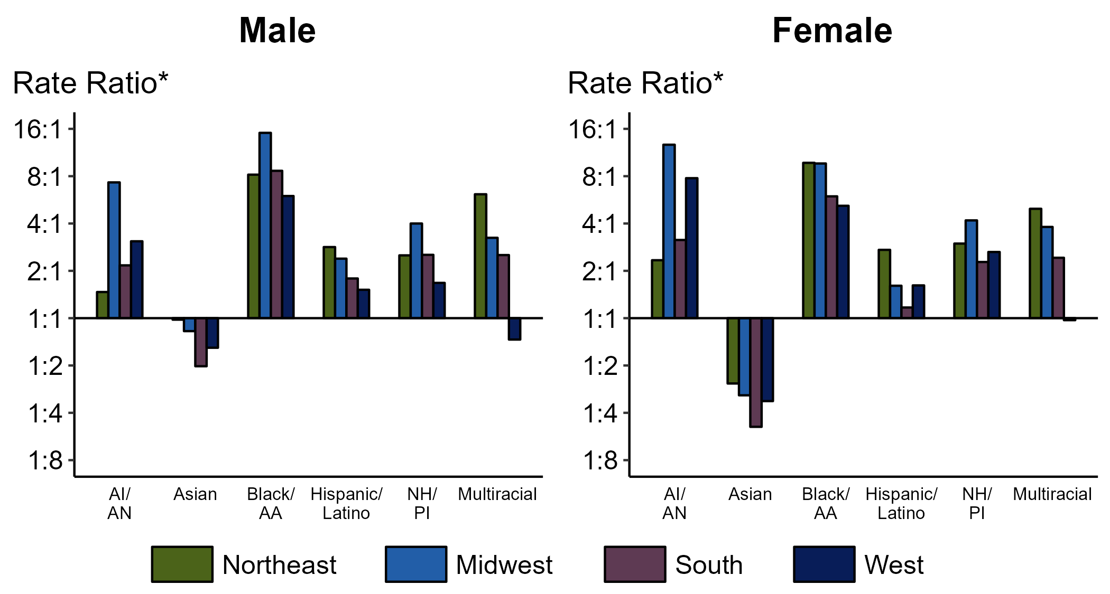
Gonorrhea — Ratios of Rates of Reported Cases by Sex, Race/Hispanic Ethnicity, and Region, United States, 2022
* For the rate ratios, non-Hispanic White persons are the referent population. Y-axis is log scale.
ACRONYMS: AI/AN = American Indian or Alaska Native; Black/AA = Black or African American; NH/PI = Native Hawaiian or other Pacific Islander
Notes:
Among men and women, rate ratios of rates of reported gonorrhea by race/Hispanic ethnicity (using non-Hispanic White persons as the referent population) varied by region in 2022. Among men, the greatest rate ratio was in the Midwest where the rate of gonorrhea among non-Hispanic Black men was 15.1 times the rate among non-Hispanic White men. Among women, the greatest rate ratio was in the Midwest where the rate of gonorrhea among non-Hispanic American Indian or Alaska Native women was 12.7 times the rate among non-Hispanic White women.
This report includes data from years that coincide with the COVID-19 pandemic, which introduced uncertainty and difficulty in interpreting STI surveillance data. See Impact of COVID-19 on STIs for more information.
See Technical Notes (https://www.cdc.gov/std/statistics/2022/technical-notes.htm) for information on gonorrhea case reporting and reporting of race/Hispanic ethnicity for STI cases. Table A1 (https://www.cdc.gov/std/statistics/2022/tables/a1.htm) provides information on unknown, missing, or invalid values of select variables.

Slide 18
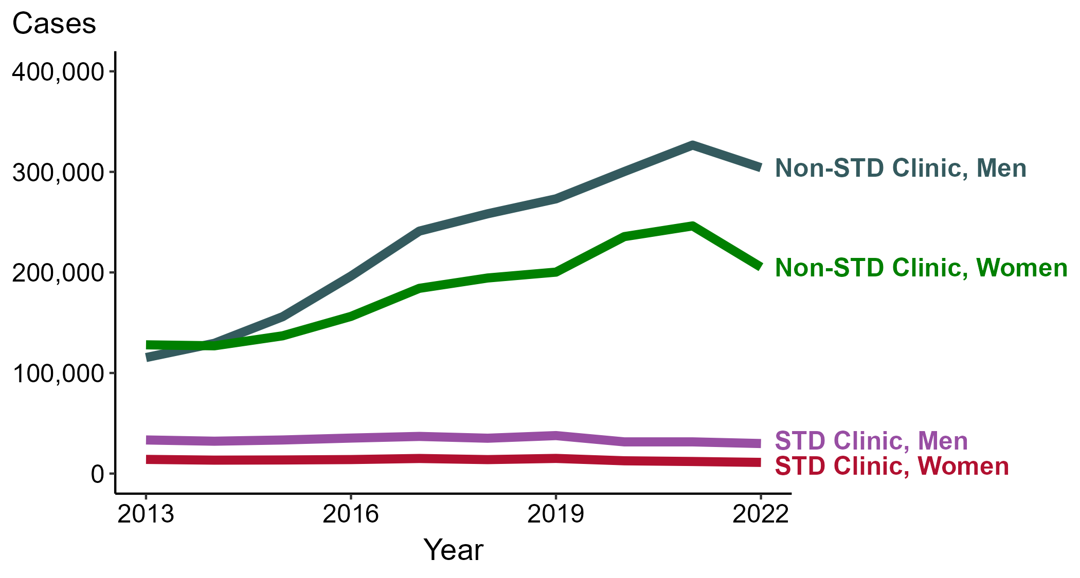
Gonorrhea — Reported Cases by Reporting Source and Sex, United States, 2013–2022
NOTE: During 2013 to 2022, the proportion of all cases with unknown reporting source was 13.9%, from a low of 12.5% (n = 41,579) in 2013 to a high of 14.8% (n = 96,035) in 2022.
Notes:
During 2021 to 2022, the number of gonorrhea cases reported from STD clinics decreased 5.3% among men (31,512 to 29,849 cases) and decreased 7.4% among women (11,990 to 11,104 cases), while the number of cases reported from non-STD clinics decreased 6.9% among men (326,647 to 304,166 cases) and decreased 16.7% among women (246,270 to 205,253 cases).
During a ten-year period (2013 to 2022), the number of gonorrhea cases reported from STD clinics decreased 10.7% among men (33,408 to 29,849 cases) and decreased 21.1% among women (14,076 to 11,104 cases), while the number of cases reported from non-STD clinics increased 163.7% among men (115,359 to 304,166 cases) and increased 60.3% among women (128,016 to 205,253 cases).
This report includes data from years that coincide with the COVID-19 pandemic, which introduced uncertainty and difficulty in interpreting STI surveillance data. See Impact of COVID-19 on STIs for more information.
See Technical Notes (https://www.cdc.gov/std/statistics/2022/technical-notes.htm) for information on gonorrhea case reporting. Table A1 (https://www.cdc.gov/std/statistics/2022/tables/a1.htm) provides information on unknown, missing, or invalid values of select variables.
Data for all figures are available at https://www.cdc.gov/std/statistics/2022/data.zip. The file “GC - Cases by Reporting Source and Sex (US 2013-2022).xlsx” contains the data for the figure presented on this slide.

Slide 19
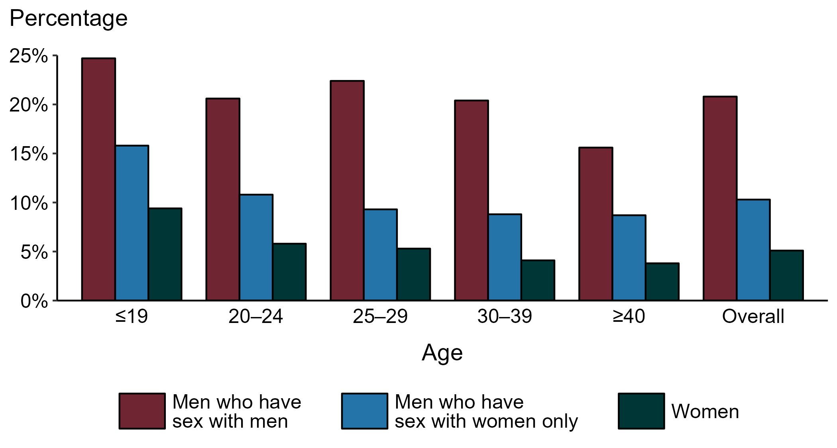
Gonorrhea — Proportion of STD Clinic Patients Testing Positive by Age Group, Sex, and Sex of Sex Partners, STD Surveillance Network (SSuN), 2022
NOTE: Results are based on 49,726 unique patients in 10 participating jurisdictions (Baltimore City, California [excluding San Francisco], Columbus, Florida, Indiana, Multnomah County, New York City, Philadelphia, San Francisco, and Washington) with known sex of sex partners attending SSuN STD clinics who were tested ≥1 times for gonorrhea in 2022.
Notes:
Among patients accessing care in participating STD clinics in the STD Surveillance Network (SSuN) who were tested for gonorrhea in 2022, 20.8% of gay, bisexual, and other men who have sex with men (MSM), 10.3% of men who have sex with women only (MSW), and 5.1% of women were positive. The proportion of STD clinic patients who tested positive for gonorrhea varied by sex and sex of sex partners, as well as by age group. MSM were noted to have higher proportions of testing positive in all age groups when compared to women and MSW. Of note, adolescent patients represent a relatively small subgroup of the clinic population and changes in the number of events in the numerator or a small denominator may lead to substantial fluctuations from year to year. Hence, data should be interpreted with caution.
This report includes data from years that coincide with the COVID-19 pandemic, which introduced uncertainty and difficulty in interpreting STI surveillance data. See Impact of COVID-19 on STIs for more information.
See Technical Notes (https://www.cdc.gov/std/statistics/2022/technical-notes.htm) for information on SSuN methodology.

Slide 20
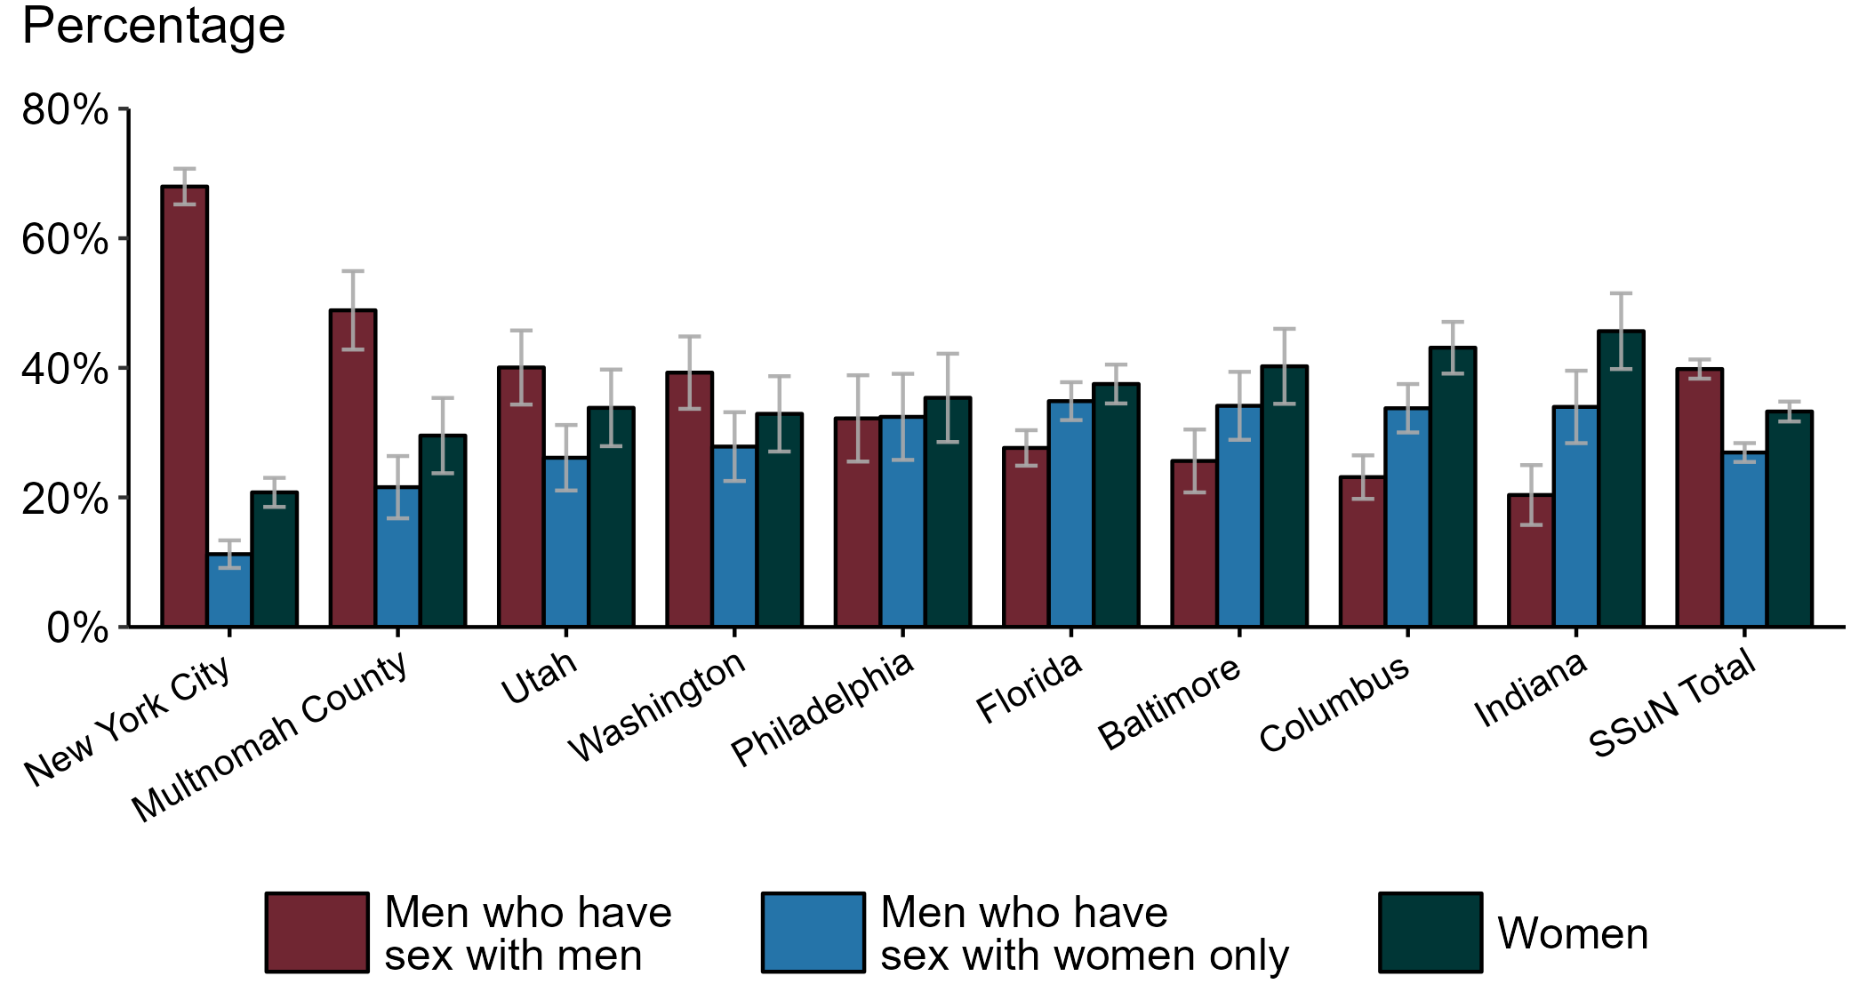
Gonorrhea — Estimated Proportion of Cases by Sex and Sex of Sex Partners and Jurisdiction, STD Surveillance Network (SSuN), 2022
NOTE: Estimate based on weighted analysis of data on sex of sex partners obtained from interviews (n=4,992) conducted among a random sample of gonorrhea cases reported to participating SSuN jurisdictions during January to December 2022. Includes nine SSuN sites reporting completed case investigations in 2022 for at least 2% of all reported cases.
Notes:
In 2022, New York City had the highest proportion of gonorrhea cases reported among gay, bisexual, and other men who have sex with men (MSM) among SSuN jurisdictions meeting the inclusion threshold, Indiana had the highest proportion of gonorrhea cases reported among women, and Florida had the highest proportion of gonorrhea cases reported among men who have sex with women only. Overall, the proportion of gonorrhea estimated to be attributed to MSM was 39.8% in 2022.
This report includes data from years that coincide with the COVID-19 pandemic, which introduced uncertainty and difficulty in interpreting STI surveillance data. See Impact of COVID-19 on STIs for more information.
See Technical Notes (https://www.cdc.gov/std/statistics/2022/technical-notes.htm) for information on SSuN methodology.

Slide 21
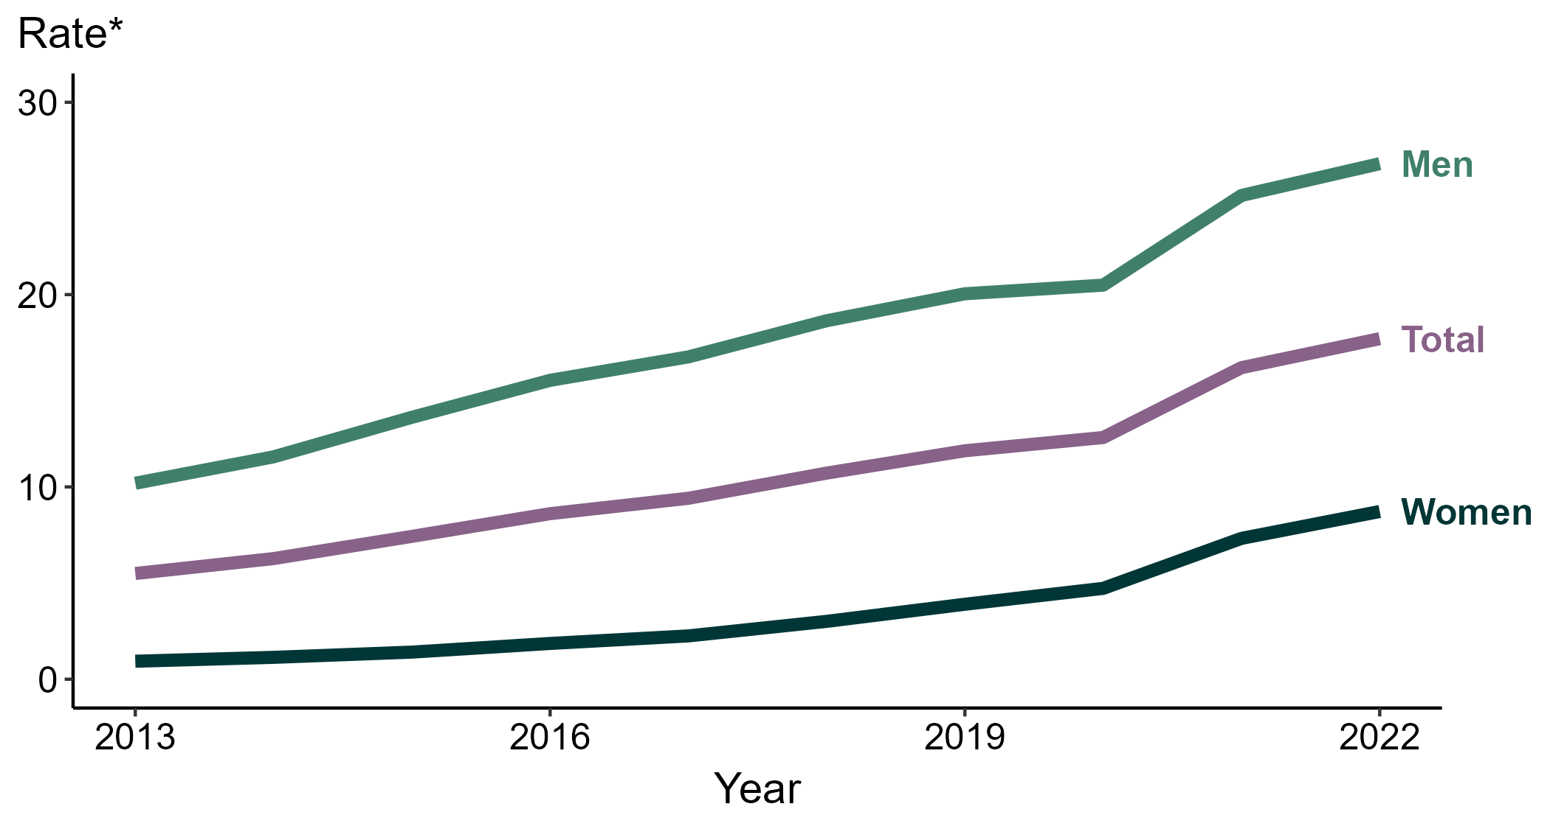
Primary and Secondary Syphilis — Rates of Reported Cases by Sex, United States, 2013–2022
* Per 100,000
Notes:
During 2021 to 2022, the rate of reported primary and secondary syphilis among women increased 19.2% (from 7.3 to 8.7 per 100,000) and the rate among men increased 6.3% (from 25.2 to 26.8 per 100,000).
Over the last five years, the rate of reported primary and secondary syphilis among women increased 190.0% (from 3.0 to 8.7 per 100,000) and the rate among men increased 44.1% (from 18.6 to 26.8 per 100,000). Over the last 10 years, the rate among women increased 866.7% (from 0.9 to 8.7 per 100,000) and the rate among men increased 162.7% (from 10.2 to 26.8 per 100,000).
This report includes data from years that coincide with the COVID-19 pandemic, which introduced uncertainty and difficulty in interpreting STI surveillance data. See Impact of COVID-19 on STIs for more information.
See Technical Notes (https://www.cdc.gov/std/statistics/2022/technical-notes.htm) for information on syphilis case reporting. Table A1 (https://www.cdc.gov/std/statistics/2022/tables/a1.htm) provides information on unknown, missing, or invalid values of select variables.
Data for all figures are available at https://www.cdc.gov/std/statistics/2022/data.zip. The file “PS Syphilis - Rates by Sex (US 2013-2022).xlsx” contains the data for the figure presented on this slide.

Slide 22
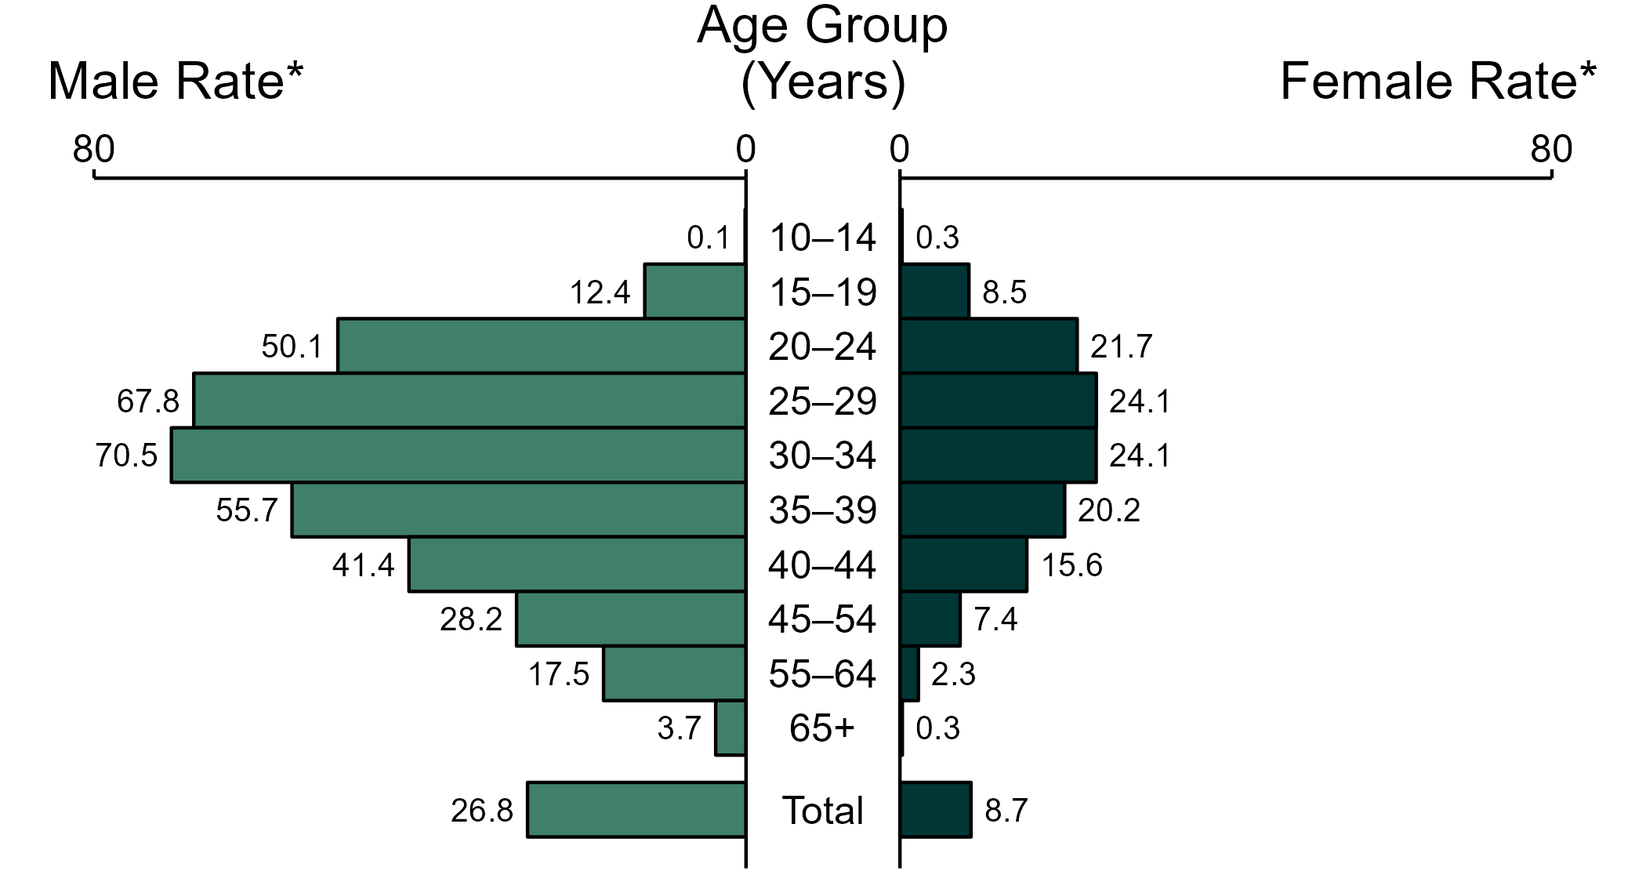
Primary and Secondary Syphilis — Rates of Reported Cases by Age Group and Sex, United States, 2022
* Per 100,000
NOTE: Total includes cases of all ages, including those with unknown age.
Notes:
In 2022, the rate of reported primary and secondary (P&S) syphilis was higher among men (26.8 per 100,000) compared to women (8.7 per 100,000).
Among men, those aged 30 to 34 years had the highest rate of reported cases of P&S syphilis (70.5 per 100,000), followed by men aged 25 to 29 years (67.8 per 100,000) and men aged 35 to 39 years (55.7 per 100,000). Among women, those aged 25 to 29 years and 30 to 34 years had the highest rate of reported cases of P&S syphilis (24.1 per 100,000), followed by women aged 20 to 24 years (21.7 per 100,000) and women aged 35 to 39 years (20.2 per 100,000).
This report includes data from years that coincide with the COVID-19 pandemic, which introduced uncertainty and difficulty in interpreting STI surveillance data. See Impact of COVID-19 on STIs for more information.
See Technical Notes (https://www.cdc.gov/std/statistics/2022/technical-notes.htm) for information on syphilis case reporting. Table A1 (https://www.cdc.gov/std/statistics/2022/tables/a1.htm) provides information on unknown, missing, or invalid values of select variables.
Data for all figures are available at https://www.cdc.gov/std/statistics/2022/data.zip. The file “PS Syphilis - Rates by Age Group and Sex (US 2022).xlsx” contains the data for the figure presented on this slide.

Slide 23
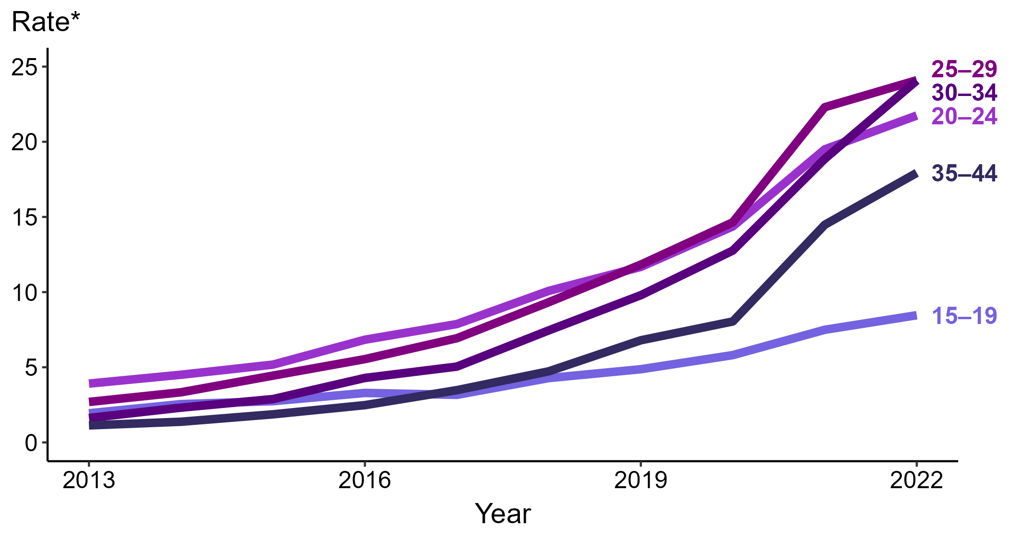
Primary and Secondary Syphilis — Rates of Reported Cases Among Women Aged 15–44 Years by Age Group, United States, 2013–2022
* Per 100,000
Notes:
Among women aged 15 to 44 years in 2022, those aged 25 to 29 years and 30 to 34 years had the highest rate of reported cases of primary and secondary syphilis (24.1 cases per 100,000; 8.1% increase for those aged 25 to 29 and 27.5% increase for those aged 30 to 34 from 2021), followed by those aged 20 to 24 years (21.7 cases per 100,000; 11.3% increase from 2021), those aged 35 to 44 years (17.9 cases per 100,000; 23.4% increase from 2021), and those aged 15 to 19 years (8.5 cases per 100,000; 13.3% increase from 2021).
This report includes data from years that coincide with the COVID-19 pandemic, which introduced uncertainty and difficulty in interpreting STI surveillance data. See Impact of COVID-19 on STIs for more information.
See Technical Notes (https://www.cdc.gov/std/statistics/2022/technical-notes.htm) for information on syphilis case reporting. Table A1 (https://www.cdc.gov/std/statistics/2022/tables/a1.htm) provides information on unknown, missing, or invalid values of select variables.
Data for all figures are available at https://www.cdc.gov/std/statistics/2022/data.zip. The file “PS Syphilis - Rates Women 15-44 Years by Age Group (US 2013-2022).xlsx” contains the data for the figure presented on this slide.

Slide 24
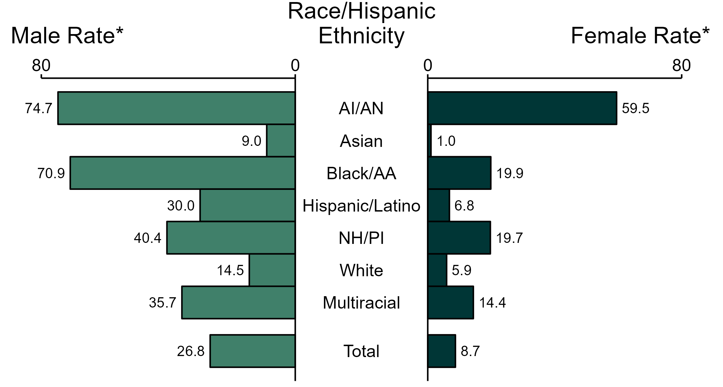
Primary and Secondary Syphilis — Rates of Reported Cases by Race/Hispanic Ethnicity and Sex, United States, 2022
* Per 100,000
ACRONYMS: AI/AN = American Indian or Alaska Native; Black/AA = Black or African American; NH/PI = Native Hawaiian or other Pacific Islander
NOTE: Total includes all cases including those with unknown race/Hispanic ethnicity.
Notes:
In 2022, the rate of reported primary and secondary syphilis was higher among men (26.8 per 100,000) compared to women (8.7 per 100,000).
Among men, non-Hispanic American Indian or Alaska Native men had the highest rate of reported cases of primary and secondary syphilis (74.7 per 100,000), followed by non-Hispanic Black or African American men (70.9 per 100,000) and non-Hispanic Native Hawaiian or other Pacific Islander men (40.4 per 100,000). Among women, non-Hispanic American Indian or Alaska Native women also had the highest rate of reported cases of primary and secondary syphilis (59.5 per 100,000), followed by non-Hispanic Black or African American women (19.9 per 100,000) and non-Hispanic Native Hawaiian or other Pacific Islander women (19.7 per 100,000).
Using non-Hispanic White persons as the referent category, the greatest relative racial disparity in rates of reported primary and secondary syphilis across both sexes was observed among non-Hispanic American Indian or Alaska Native women, with a rate ratio of 10.0 times that of non-Hispanic White women. Among men, the greatest relative disparity was observed among non-Hispanic American Indian or Alaska Native men as well, with a rate 5.2 times that of non-Hispanic White men.
This report includes data from years that coincide with the COVID-19 pandemic, which introduced uncertainty and difficulty in interpreting STI surveillance data. See Impact of COVID-19 on STIs for more information.
See Technical Notes (https://www.cdc.gov/std/statistics/2022/technical-notes.htm) for information on syphilis case reporting, race/Hispanic ethnicity categorization, and reporting of race/Hispanic ethnicity for STI cases. Table A1 (https://www.cdc.gov/std/statistics/2022/tables/a1.htm) provides information on unknown, missing, or invalid values of select variables.
Data for all figures are available at https://www.cdc.gov/std/statistics/2022/data.zip. The file “PS Syphilis - Rates by Race Hispanic Ethnicity and Sex (US 2022).xlsx” contains the data for the figure presented on this slide.

Slide 25
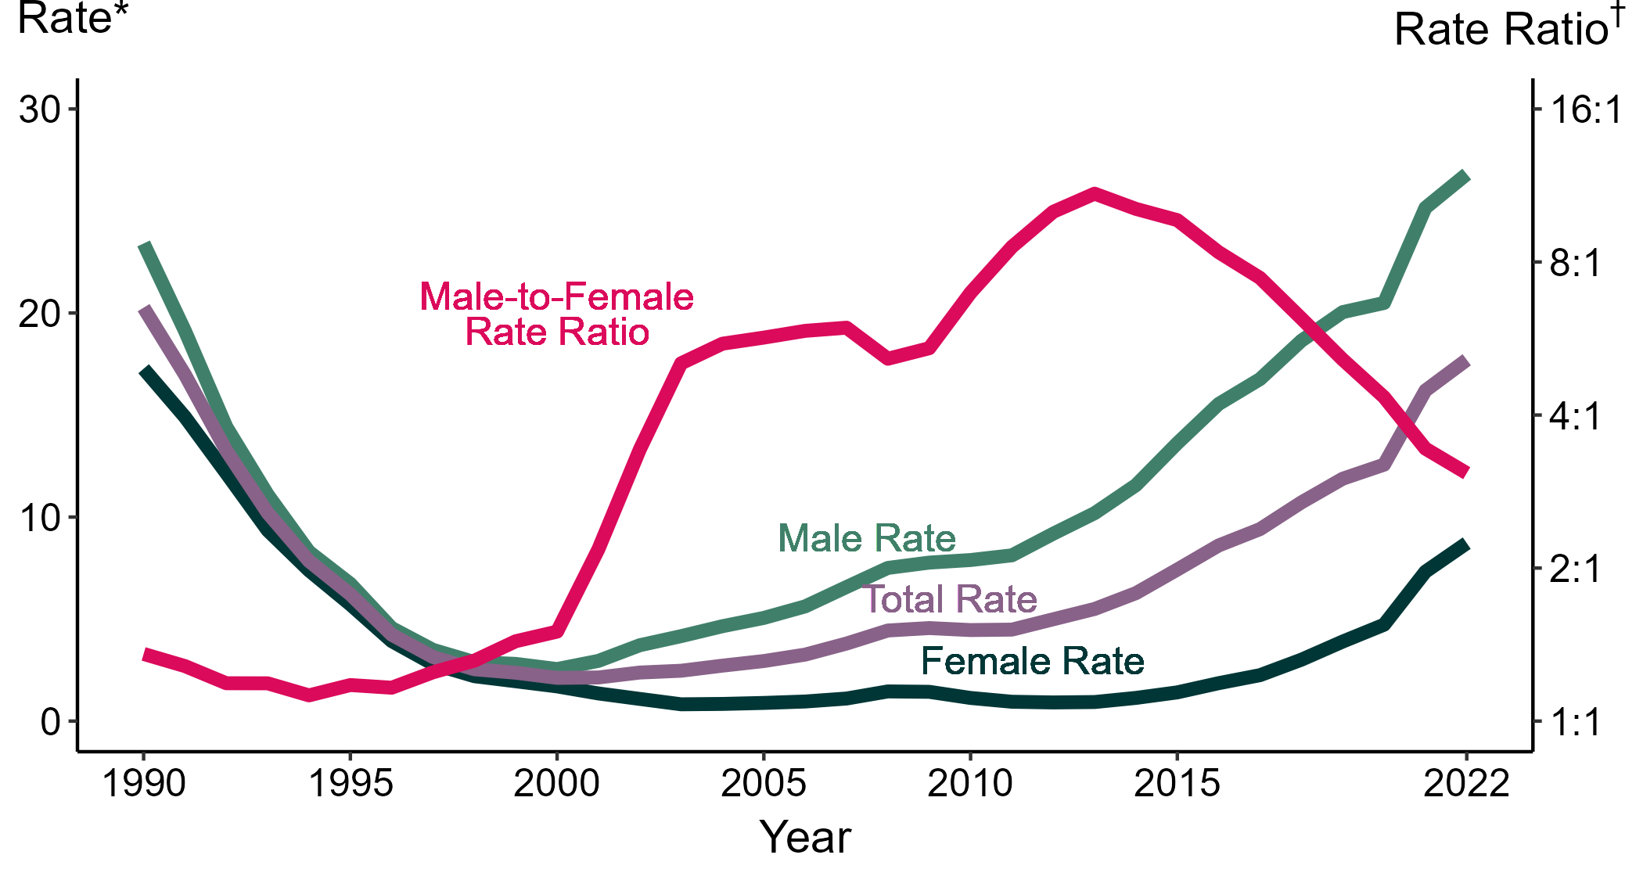
Primary and Secondary Syphilis — Rates of Reported Cases by Sex and Male-to-Female Rate Ratios, United States, 1990–2022
* Per 100,000
† Log scale
Notes:
Although the male-to-female rate ratio for primary and secondary syphilis increased from 1990 to 2013, the rate ratio has declined in recent years due to the increasing rate of syphilis among women. During 2018 to 2022, the rate of primary and secondary syphilis among women nearly tripled (3.0 per 100,000 in 2018 to 8.7 per 100,000 in 2022).
This report includes data from years that coincide with the COVID-19 pandemic, which introduced uncertainty and difficulty in interpreting STI surveillance data. See Impact of COVID-19 on STIs for more information.
See Technical Notes (https://www.cdc.gov/std/statistics/2022/technical-notes.htm) for information on syphilis case reporting.
Data for all figures are available at https://www.cdc.gov/std/statistics/2022/data.zip. The file “PS Syphilis - Rates by Sex and Male-to-Female Rate Ratios (US 1990-2022).xlsx” contains the data for the figure presented on this slide.

Slide 26
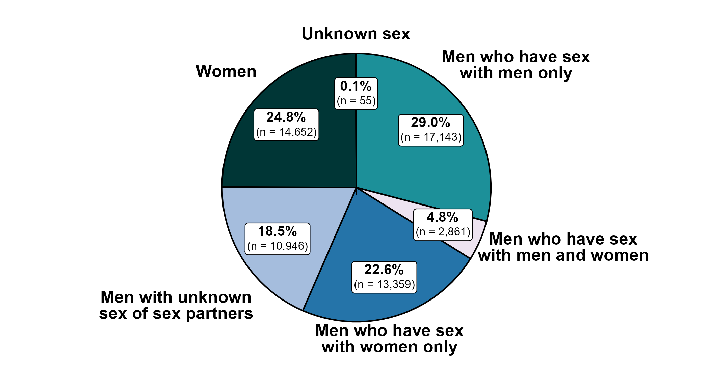
Primary and Secondary Syphilis — Distribution of Cases by Sex and Sex of Sex Partners, United States, 2022
Notes:
Of 59,016 reported primary and secondary syphilis cases in 2022, 29.0% were among men who have sex with men only. Men who have sex with men only combined with men who have sex with both men and women accounted for 33.9% of all primary and secondary syphilis cases, 45.1% of all male primary and secondary syphilis cases, and 60.0% of male primary and secondary syphilis cases with information on sex of sex partners. (Note that percentages in figure and text may not sum as expected due to rounding.)
This report includes data from years that coincide with the COVID-19 pandemic, which introduced uncertainty and difficulty in interpreting STI surveillance data. See Impact of COVID-19 on STIs for more information.
See Technical Notes (https://www.cdc.gov/std/statistics/2022/technical-notes.htm) for information on syphilis case reporting.
Data for all figures are available at https://www.cdc.gov/std/statistics/2022/data.zip. The file “PS Syphilis - Distribution by Sex and Sex of Sex Partners (US 2022).xlsx” contains the data for the figure presented on this slide.

Slide 27
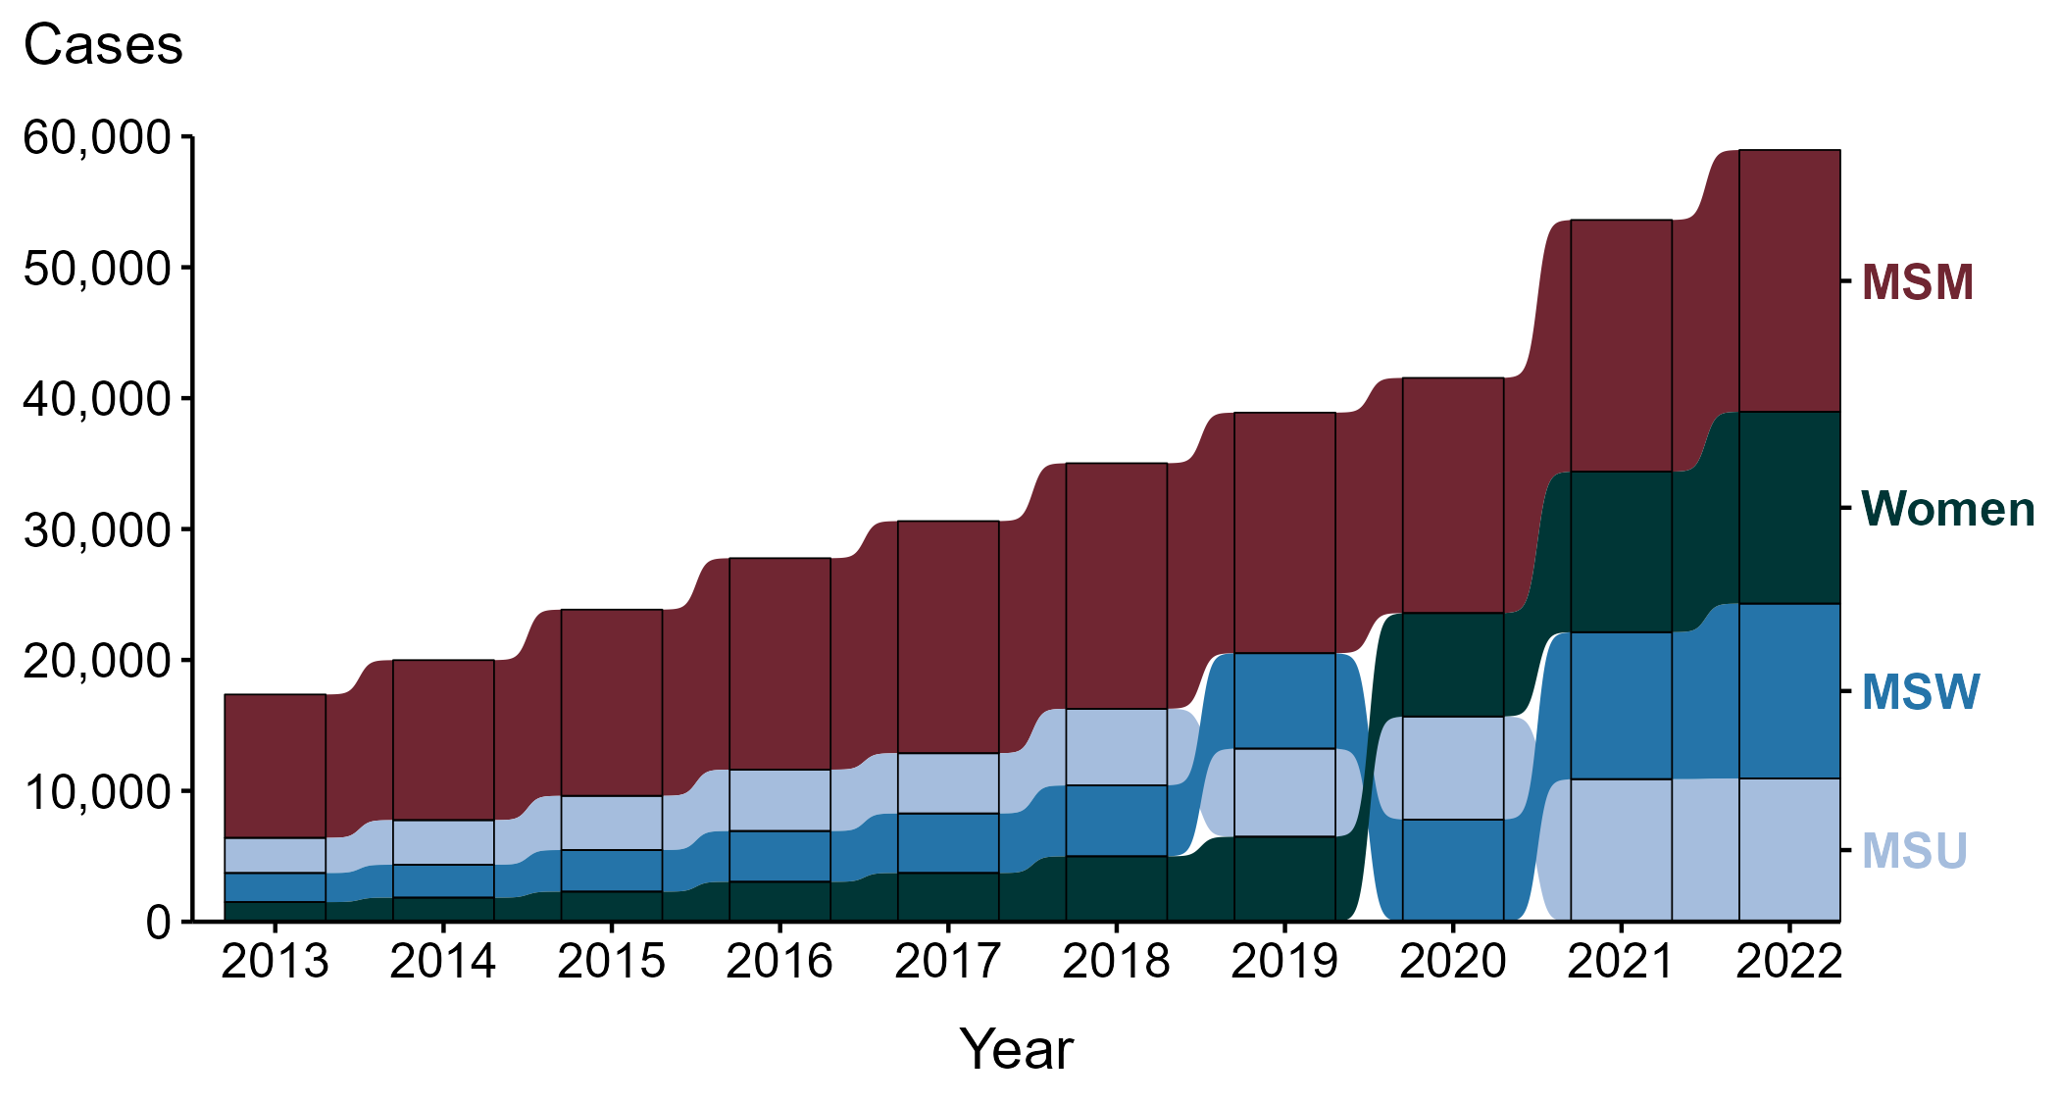
Primary and Secondary Syphilis — Reported Cases by Sex and Sex of Sex Partners, United States, 2013–2022
ACRONYMS: MSM = Men who have sex with men; MSU = Men with unknown sex of sex partners; MSW = Men who have sex with women only
Notes:
During the period from 2013 to 2022, a plurality (47.7%) of primary and secondary syphilis cases were among men who have sex with men (MSM; 165,642 cases).
During 2021 to 2022, the number of cases among MSM increased 4.0% (19,229 in 2021 to 20,004 in 2022), while the number of cases did not change substantially (<1.0% change) among men with unknown sex of sex partners (MSU; 10,892 in 2021 to 10,946 in 2022), increased 19.0% among men who have sex with women only (MSW; 11,228 in 2021 to 13,359 in 2022), and increased 19.5% among women (12,265 in 2021 to 14,652 in 2022).
During the five-year period from 2018 to 2022, the number of cases among MSM increased 6.6% (18,760 in 2018 to 20,004 in 2022), while the number of cases increased 86.9% among MSU (5,858 in 2018 to 10,946 in 2022), 146.7% among MSW (5,416 in 2018 to 13,359 in 2022), and 193.3% among women (4,995 in 2018 to 14,652 in 2022).
During the 10-year period from 2013 to 2022, the number of cases among MSM increased 82.6% (10,954 in 2013 to 20,004 in 2022), while the number of cases increased 307.4% among MSU (2,687 in 2013 to 10,946 in 2022), 501.8% among MSW (2,220 in 2013 to 13,359 in 2022), and 876.8% among women (1,500 in 2013 to 14,652 in 2022).
This report includes data from years that coincide with the COVID-19 pandemic, which introduced uncertainty and difficulty in interpreting STI surveillance data. See Impact of COVID-19 on STIs for more information.
See Technical Notes (https://www.cdc.gov/std/statistics/2022/technical-notes.htm) for information on syphilis case reporting. Table A1 (https://www.cdc.gov/std/statistics/2022/tables/a1.htm) provides information on unknown, missing, or invalid values of select variables.
Data for all figures are available at https://www.cdc.gov/std/statistics/2022/data.zip. The file “PS Syphilis - Cases by Sex and Sex of Sex Partners (US 2013-2022).xlsx” contains the data for the figure presented on this slide.

Slide 28
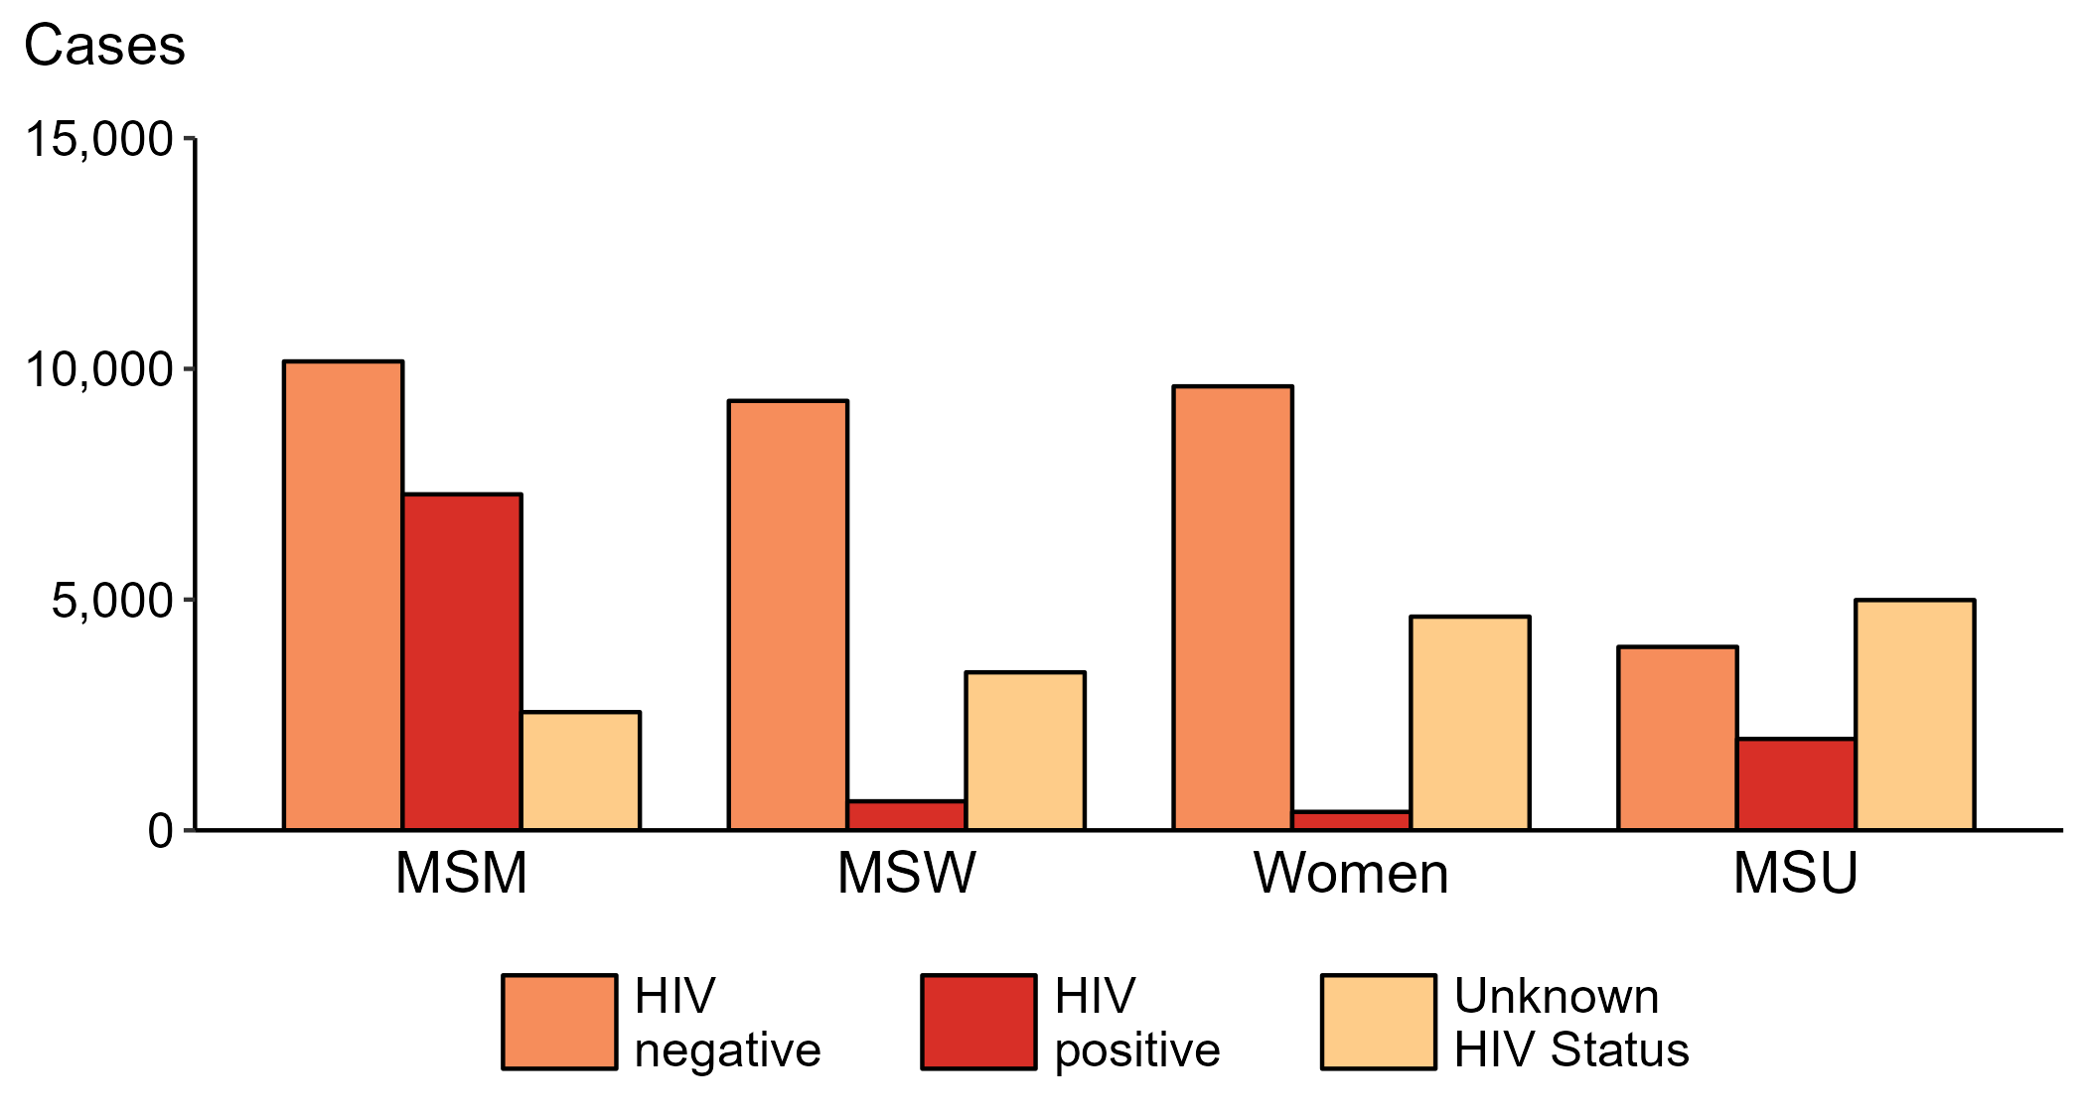
Primary and Secondary Syphilis — Reported Cases by Sex, Sex of Sex Partners, and HIV Status, United States, 2022
ACRONYMS: MSM = Men who have sex with men; MSW = Men who have sex with women only; MSU = Men with unknown sex of sex partners
Notes:
Among primary and secondary syphilis cases with reported HIV status, 41.7% of cases among men who have sex with men were HIV positive, compared with 33.3% of cases among men with unknown sex of sex partners, 6.3% of cases among men who have sex with women only, and 4.0% of cases among women.
For this figure, HIV status is categorized as reported by jurisdictions. Jurisdictions determine HIV status using multiple sources, including self-report, match with HIV registry, and available test results. Cases reported with a missing or unknown status are categorized as having an unknown HIV status.
This report includes data from years that coincide with the COVID-19 pandemic, which introduced uncertainty and difficulty in interpreting STI surveillance data. See Impact of COVID-19 on STIs for more information.
See Technical Notes (https://www.cdc.gov/std/statistics/2022/technical-notes.htm) for information on syphilis case reporting. Table A1 (https://www.cdc.gov/std/statistics/2022/tables/a1.htm) provides information on unknown, missing, or invalid values of select variables.
Data for all figures are available at https://www.cdc.gov/std/statistics/2022/data.zip. The file “PS Syphilis - Cases by Sex Sex of Sex Partners and HIV Status (US 2013-2022).xlsx” contains the data for the figure presented on this slide.

Slide 29
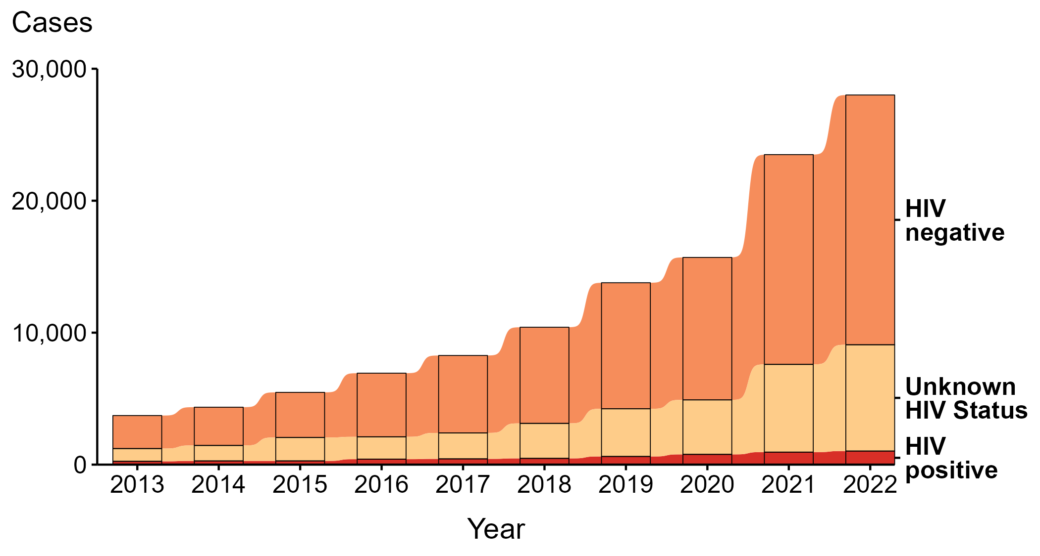
Primary and Secondary Syphilis — Reported Cases Among Women and Men Who Have Sex with Women Only by HIV Status, United States, 2013–2022
Notes:
During 2013 to 2022, the majority (68.2%) of primary and secondary syphilis cases among women and men who have sex with women only (MSW) were among persons reported as HIV negative.
During 2021 to 2022, the number of cases among women and MSW who were reported as HIV negative increased 19.1% (from 15,897 in 2021 to 18,927 in 2022), the number who were reported with unknown HIV status increased 21.2% (from 6,648 in 2021 to 8,055 in 2022), and the number who were reported as HIV positive increased 8.5% (from 948 in 2021 to 1,029 in 2022).
During 2013 to 2022, the number of cases among women and MSW who were reported as HIV negative increased 656.2% (from 2,503 in 2013 to 18,927 in 2022), the number who were reported with unknown HIV status increased 733.0% (from 967 in 2013 to 8,055 in 2022), and the number who were reported as HIV positive increased 311.6% (from 250 in 2013 to 1,029 in 2022).
For this figure, HIV status is categorized as reported by jurisdictions. Jurisdictions determine HIV status using multiple sources, including self-report, match with HIV registry, and available test results. Cases reported with a missing or unknown status are categorized as having an unknown HIV status.
This report includes data from years that coincide with the COVID-19 pandemic, which introduced uncertainty and difficulty in interpreting STI surveillance data. See Impact of COVID-19 on STIs for more information.
See Technical Notes (https://www.cdc.gov/std/statistics/2022/technical-notes.htm) for information on syphilis case reporting. Table A1 (https://www.cdc.gov/std/statistics/2022/tables/a1.htm) provides information on unknown, missing, or invalid values of select variables.
Data for all figures are available at https://www.cdc.gov/std/statistics/2022/data.zip. The file “PS Syphilis - Cases Women and MSW by HIV Status (US 2013-2022).xlsx” contains the data for the figure presented on this slide.

Slide 30
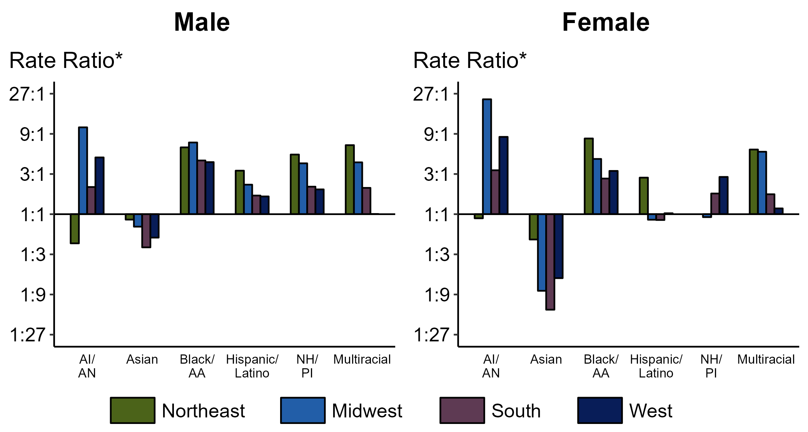
Primary and Secondary Syphilis — Ratios of Rates of Reported Cases by Sex, Race/Hispanic Ethnicity, and Region, United States, 2022
* For the rate ratios, non-Hispanic White persons are the referent population. Y-axis is log scale.
ACRONYMS: AI/AN = American Indian or Alaska Native; Black/AA = Black or African American; NH/PI = Native Hawaiian or other Pacific Islander
Notes:
Among men and women, rate ratios of rates of reported primary and secondary syphilis by race/Hispanic ethnicity (using non-Hispanic White persons as the referent population) varied by region in 2022. Among men, the greatest rate ratio was in the Midwest where the rate of reported primary and secondary syphilis among non-Hispanic American Indian or Alaska Native men was 10.8 times the rate among non-Hispanic White men. Among women, the greatest rate ratio was in the Midwest where the rate of reported primary and secondary syphilis among non-Hispanic American Indian or Alaska Native women was 23.2 times the rate among non-Hispanic White women.
This report includes data from years that coincide with the COVID-19 pandemic, which introduced uncertainty and difficulty in interpreting STI surveillance data. See Impact of COVID-19 on STIs for more information.
See Technical Notes (https://www.cdc.gov/std/statistics/2022/technical-notes.htm) for information on syphilis case reporting, race/Hispanic ethnicity categorization, and reporting of race/Hispanic ethnicity for STI cases. Table A1 (https://www.cdc.gov/std/statistics/2022/tables/a1.htm) provides information on unknown, missing, or invalid values of select variables.

Slide 31
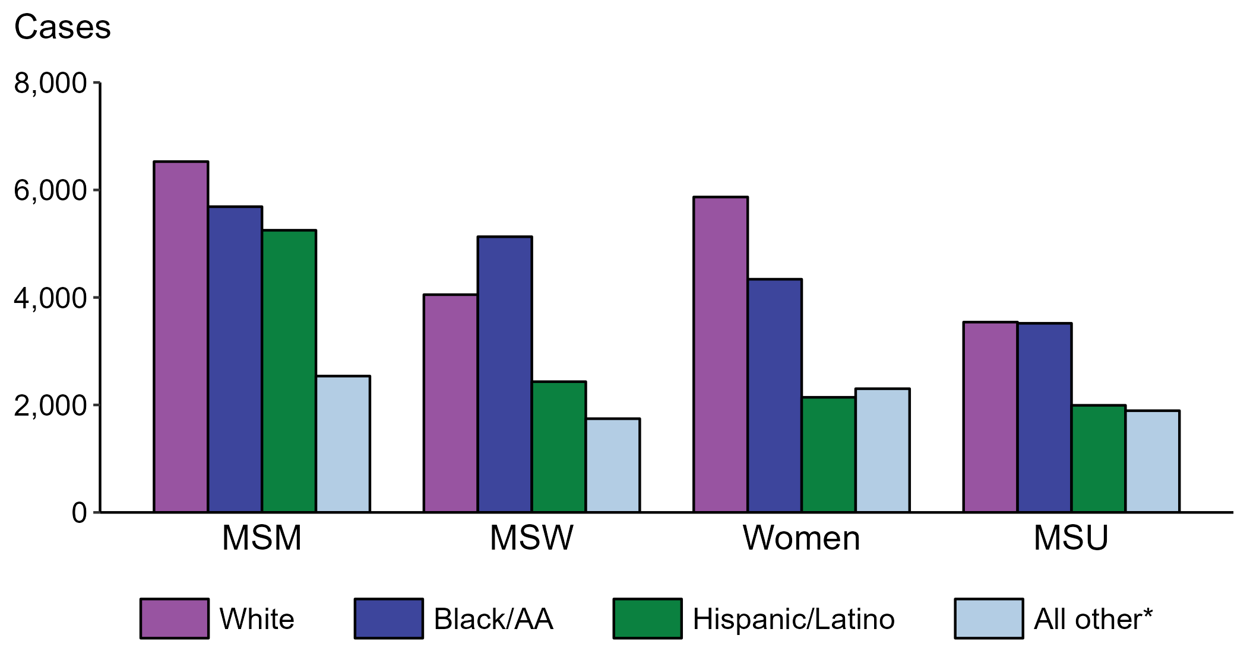
Primary and Secondary Syphilis — Reported Cases by Sex, Sex of Sex Partners, and Race/Hispanic Ethnicity, United States, 2022
* Includes persons with unknown race who were not reported with Hispanic ethnicity.
ACRONYMS: MSM = Men who have sex with men; MSW = Men who have sex with women only; MSU = Men with unknown sex of sex partners
Notes:
Within each of the four race/Hispanic ethnicity groups displayed, men who have sex with men (MSM) accounted for the highest proportion of primary and secondary (P&S) syphilis cases. Of P&S syphilis cases among MSM, 32.6% were non-Hispanic White, 28.4% were non-Hispanic Black or African American, 26.2% were Hispanic or Latino, and 12.7% were another known or unknown race and not reported to be Hispanic or Latino.
This report includes data from years that coincide with the COVID-19 pandemic, which introduced uncertainty and difficulty in interpreting STI surveillance data. See Impact of COVID-19 on STIs for more information.
See Technical Notes (https://www.cdc.gov/std/statistics/2022/technical-notes.htm) for information on syphilis case reporting, race/Hispanic ethnicity categorization, and reporting of race/Hispanic ethnicity for STI cases. Table A1 (https://www.cdc.gov/std/statistics/2022/tables/a1.htm) provides information on unknown, missing, or invalid values of select variables.
Data for all figures are available at https://www.cdc.gov/std/statistics/2022/data.zip. The file “PS Syphilis - Cases by Sex Sex of Sex Partners and Race Hispanic Ethnicity (US 2022) .xlsx” contains the data for the figure presented on this slide.

Slide 32
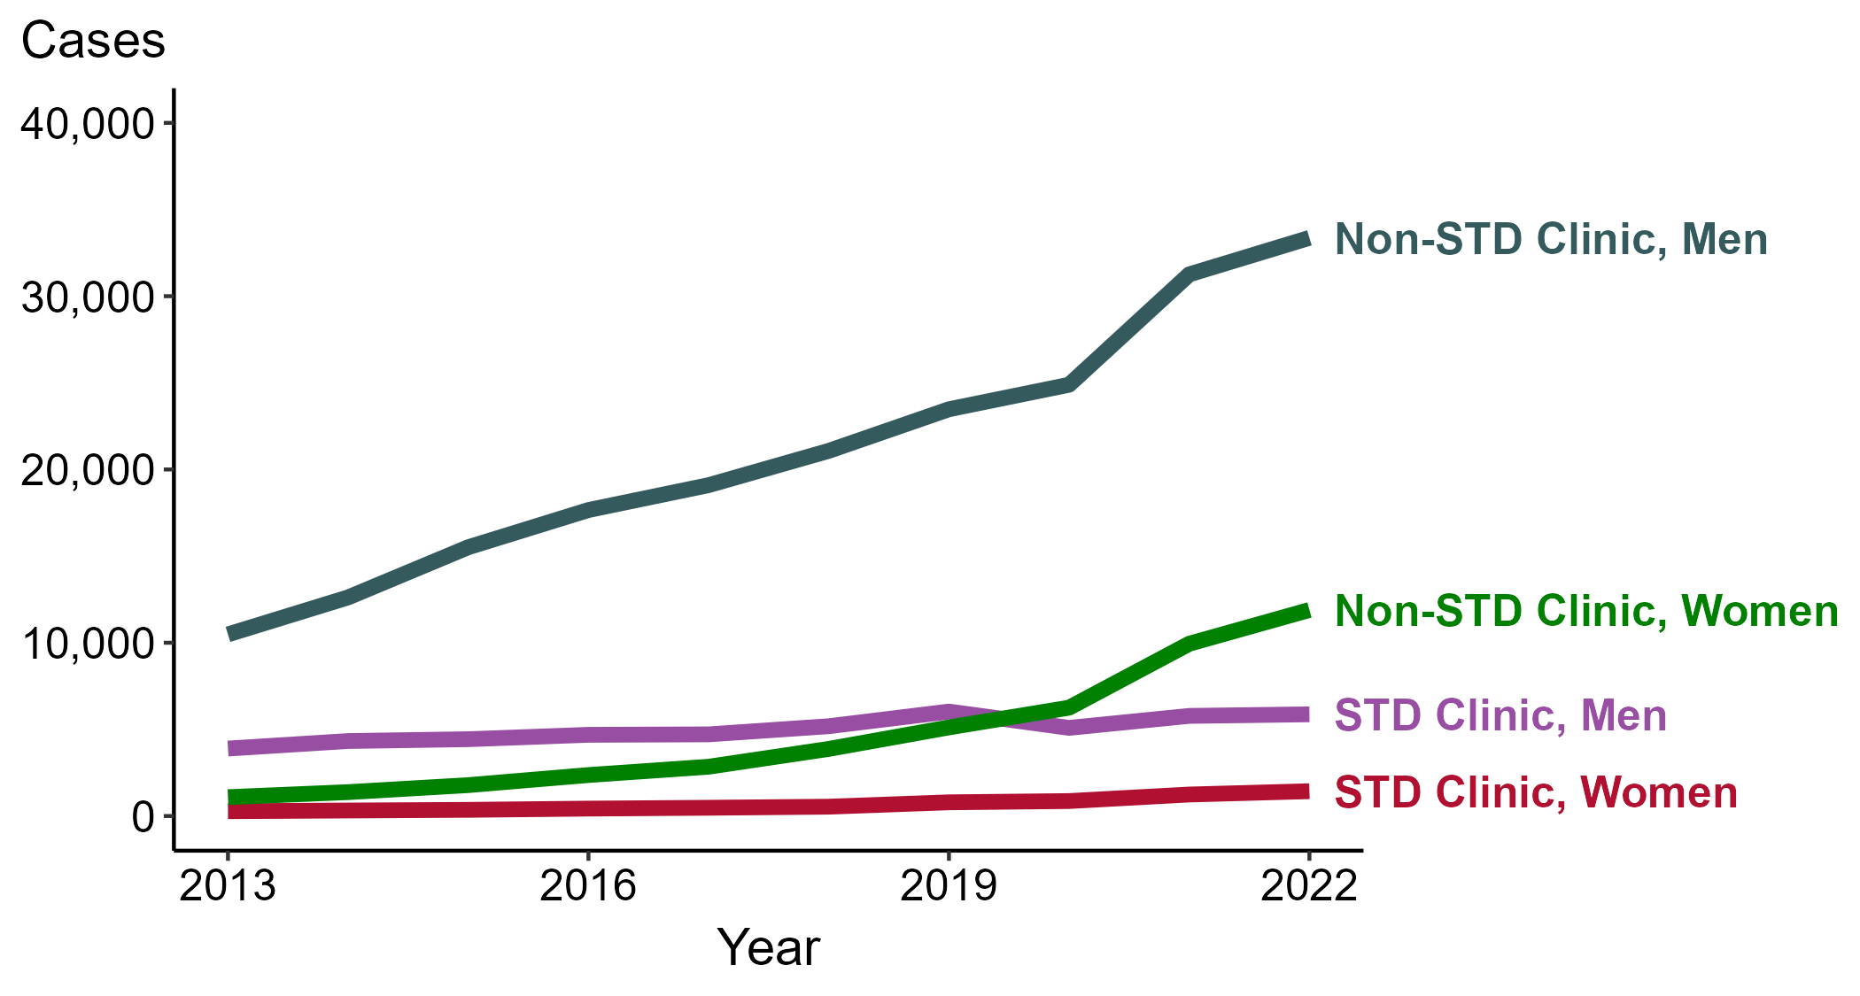
Primary and Secondary Syphilis — Reported Cases by Reporting Source and Sex, United States, 2013–2022
NOTE: During 2013 to 2022, the proportion of all cases with unknown reporting source was 10.1%, from a low of 6.8% (n = 1,350) in 2014 to a high of 12.5% (n = 4,386) in 2018.
Notes:
During 2021 to 2022, the number of primary and secondary (P&S) syphilis cases reported from STD clinics increased 1.6% among men (5,778 to 5,869 cases) and increased 15.4% among women (1,241 to 1,432 cases), while the number of cases reported from non-STD clinics increased 6.7% among men (31,258 to 33,365 cases) and increased 19.6% among women (9,943 to 11,891 cases).
During a ten-year period (2013 to 2022), the number of P&S syphilis cases reported from STD clinics increased 50.7% among men (3,894 to 5,869 cases) and increased 415.1% among women (278 to 1,432 cases), while the number of cases reported from non-STD clinics increased 218.3% among men (10,482 to 33,365 cases) and increased 991.9% among women (1,089 to 11,891 cases).
This report includes data from years that coincide with the COVID-19 pandemic, which introduced uncertainty and difficulty in interpreting STI surveillance data. See Impact of COVID-19 on STIs for more information.
See Technical Notes (https://www.cdc.gov/std/statistics/2022/technical-notes.htm) for information on syphilis case reporting. Table A1 (https://www.cdc.gov/std/statistics/2022/tables/a1.htm) provides information on unknown, missing, or invalid values of select variables.
Data for all figures are available at https://www.cdc.gov/std/statistics/2022/data.zip. The file “PS Syphilis - Cases by Reporting Source and Sex (US 2013-2022).xlsx” contains the data for the figure presented on this slide.

Slide 33
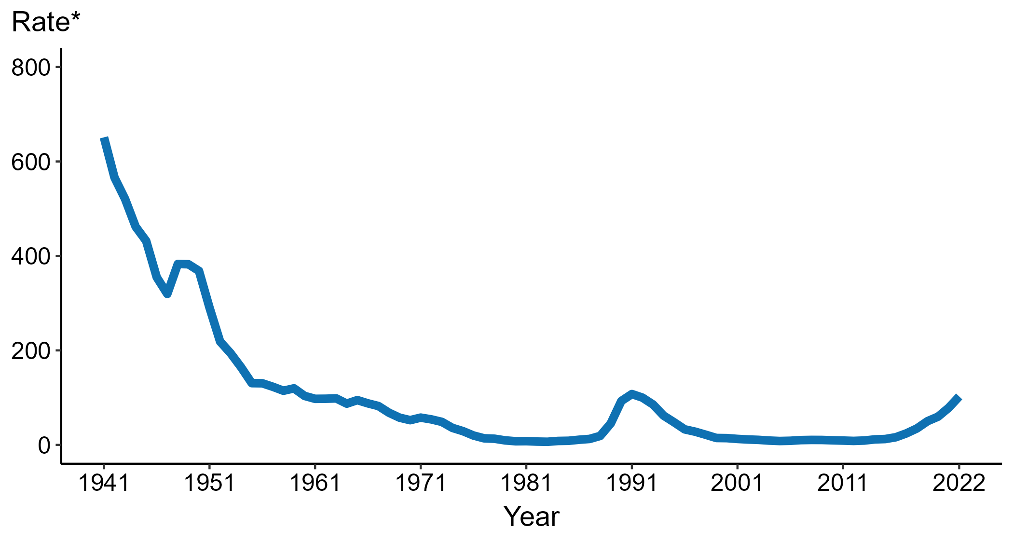
Congenital Syphilis — Rates of Reported Cases by Year of Birth, United States, 1941–2022
* Per 100,000 live births
Notes:
Data collection for congenital syphilis began in 1941, and congenital syphilis was made a nationally notifiable condition in 1944. There was a significant change in the congenital syphilis case definition in the 1990s and rates before versus after the case definition change should be interpreted with caution.
In 2022, there were a total of 3,755 cases of congenital syphilis reported for a rate of 102.5 per 100,000 live births.
During 2021 to 2022, the rate of reported congenital syphilis increased 30.6% (from 78.5 to 102.5 per 100,000 live births).
This report includes data from years that coincide with the COVID-19 pandemic, which introduced uncertainty and difficulty in interpreting STI surveillance data. See Impact of COVID-19 on STIs for more information.
See Technical Notes (https://www.cdc.gov/std/statistics/2022/technical-notes.htm) for information on syphilis case reporting, including changes in case definitions.
Data for all figures are available at https://www.cdc.gov/std/statistics/2022/data.zip. The file “CS - Rates by Year of Birth (US 1941-2022).xlsx” contains the data for the figure presented on this slide.

Slide 34
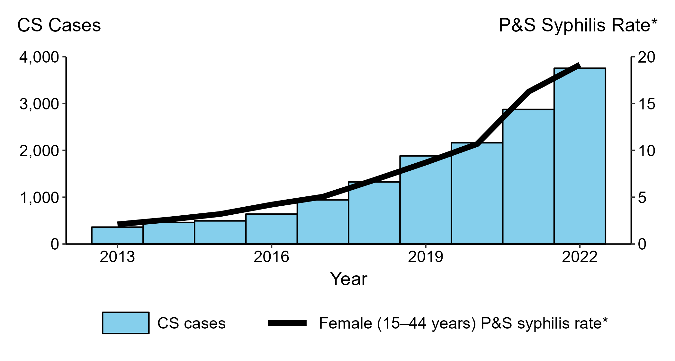
Congenital Syphilis — Reported Cases by Year of Birth and Rates of Reported Cases of Primary and Secondary Syphilis Among Women Aged 15–44 Years, United States, 2013–2022
* Per 100,000
ACRONYMS: CS = Congenital syphilis; P&S Syphilis = Primary and secondary syphilis
Notes:
In 2022, there were a total of 3,755 cases of congenital syphilis reported for a rate of 102.5 per 100,000 live births.
During 2021 to 2022, the number of cases of congenital syphilis increased 30.6% (2,875 to 3,755 cases), concurrent with a 17.2% increase (16.3 to 19.1 per 100,000) in the rate of primary and secondary syphilis among women aged 15 to 44 years.
During 2013 to 2022, the number of cases of congenital syphilis increased 937.3% (362 to 3,755 cases), concurrent with a 809.5% increase (2.1 to 19.1 per 100,000) in the rate of primary and secondary syphilis among women aged 15 to 44 years.
This report includes data from years that coincide with the COVID-19 pandemic, which introduced uncertainty and difficulty in interpreting STI surveillance data. See Impact of COVID-19 on STIs for more information.
See Technical Notes (https://www.cdc.gov/std/statistics/2022/technical-notes.htm) for information on syphilis case reporting.
Data for all figures are available at https://www.cdc.gov/std/statistics/2022/data.zip. The file “CS - Cases by Year of Birth and PS Syphilis Rates Women 15-44 (US 2013-2022).xlsx” contains the data for the figure presented on this slide.

Slide 35
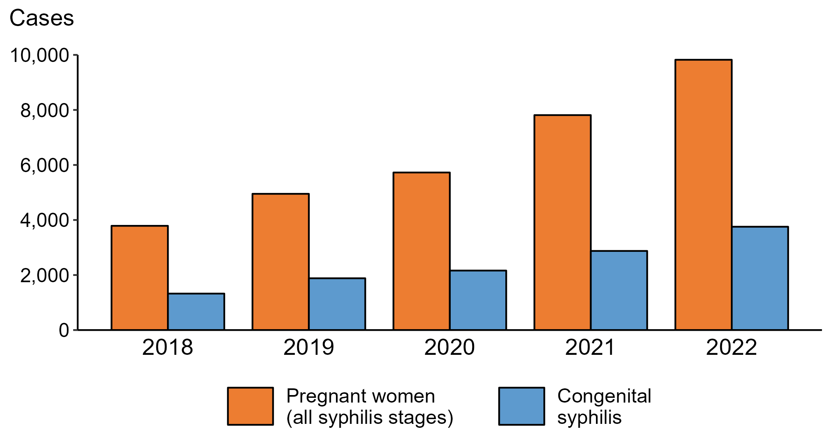
Syphilis— Reported Cases of Syphilis (All Stages) among Pregnant Women and Reported Cases of Congenital Syphilis by Year of Birth, United States, 2018–2022
Notes:
In 2022, there were a total of 3,755 cases of congenital syphilis reported for a rate of 102.5 per 100,000 live births.
During 2021 to 2022, the number of women reported with syphilis (all stages) who were pregnant increased 25.7% (from 7,812 in 2021 to 9,823 in 2022). During the same time period, the number of reported cases of congenital syphilis increased 30.6% (from 2,875 in 2021 to 3,755 in 2022).
During 2018 to 2022, the number of women reported with syphilis (all stages) who were pregnant increased 159.3% (from 3,788 in 2018 to 9,823 in 2022). During the same time period, the number of reported cases of congenital syphilis increased 183.4% (from 1,325 in 2018 to 3,755 in 2022).
This report includes data from years that coincide with the COVID-19 pandemic, which introduced uncertainty and difficulty in interpreting STI surveillance data. See Impact of COVID-19 on STIs for more information.
See Technical Notes (https://www.cdc.gov/std/statistics/2022/technical-notes.htm) for information on syphilis case reporting.
Data for all figures are available at https://www.cdc.gov/std/statistics/2022/data.zip. The file “CS and Syphilis - Cases Pregnant Women and CS Cases by Year of Birth (US 2018-2022).xlsx” contains the data for the figure presented on this slide.

Slide 36
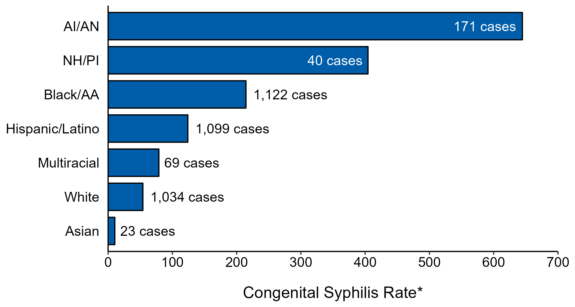
Congenital Syphilis — Case Counts and Rates of Reported Cases by Race/Hispanic Ethnicity of Mother, United States, 2022
* Per 100,000 live births
NOTE: In 2022, a total of 197 congenital syphilis cases (5.2%) had missing, unknown, or other race and were not reported to be of Hispanic ethnicity.
ACRONYMS: AI/AN = American Indian or Alaska Native; Black/AA = Black or African American; NH/PI = Native Hawaiian or other Pacific Islander
Notes:
In 2022, there were a total of 3,755 cases of congenital syphilis reported for a rate of 102.5 per 100,000 live births.
In 2022, rates of congenital syphilis were highest among mothers who were non-Hispanic American Indian or Alaska Native (644.7 per 100,000 live births), followed by mothers who were non-Hispanic Native Hawaiian or other Pacific Islander (404.4 per 100,000 live births) and mothers who were non-Hispanic Black or African American (214.5 per 100,000 live births). The greatest number of reported cases was among mothers who were non-Hispanic Black or African American (1,122 cases), followed by mothers who were Hispanic or Latino and of any race(s) (1,099 cases) and mothers who were non-Hispanic White (1,034 cases).
This report includes data from years that coincide with the COVID-19 pandemic, which introduced uncertainty and difficulty in interpreting STI surveillance data. See Impact of COVID-19 on STIs for more information.
See Technical Notes (https://www.cdc.gov/std/statistics/2022/technical-notes.htm) for information on syphilis case reporting, race/Hispanic ethnicity categorization, and reporting of race/Hispanic ethnicity for STI cases.
Data for all figures are available at https://www.cdc.gov/std/statistics/2022/data.zip. The file “CS - Counts and Rates by Race Hispanic Ethnicity of Mother (US 2022).xlsx” contains the data for the figure presented on this slide.

Slide 37
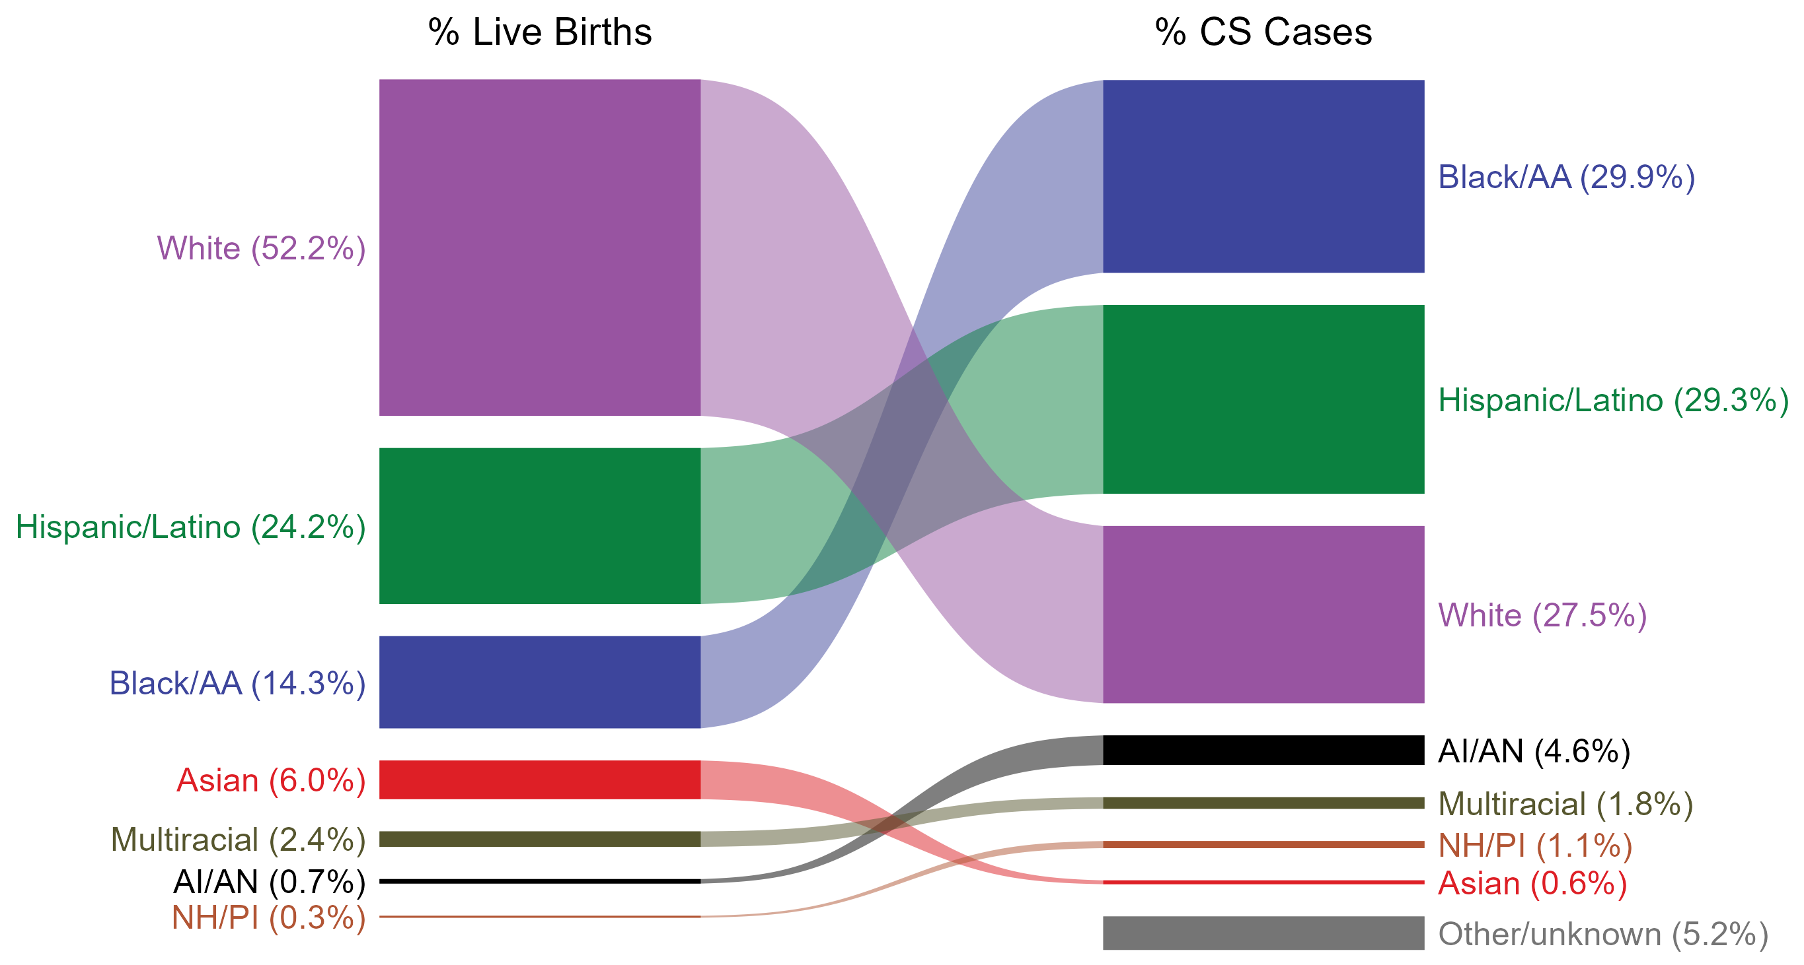
Congenital Syphilis — Total Live Births and Reported Cases by Race/Hispanic Ethnicity of Mother, United States, 2022
NOTE: In 2022, a total of 197 congenital syphilis cases (5.2%) had missing, unknown, or other race and were not reported to be of Hispanic ethnicity. These cases are included in the “other/unknown” category.
ACRONYMS: AI/AN = American Indian or Alaska Native; Black/AA = Black or African American; NH/PI = Native Hawaiian or other Pacific Islander
Notes:
In 2022, there were a total of 3,755 cases of congenital syphilis reported for a rate of 102.5 per 100,000 live births.
The percentages of congenital syphilis cases by race/Hispanic ethnicity of mother were disproportionate to the percentages among live births in the United States in 2022. The greatest absolute disparity was observed among non-Hispanic Black or African American mothers, who represented 29.9% of reported congenital syphilis cases (n = 1,122; 29.9% of congenital syphilis cases with reported race or Hispanic ethnicity of mother) despite being 14.3% of the live births, or 15.6% more cases than would be expected based on their proportion of live births. The greatest relative disparity was among non-Hispanic American Indian or Alaska Native mothers, who represented 4.6% of reported congenital syphilis cases (n = 171; 4.6% of congenital syphilis cases with reported race or Hispanic ethnicity of mother) despite being 0.7% of live births, or a burden 6.6 times what would be expected based on their proportion of live births. Additionally, Hispanic or Latino mothers of any race(s) and non-Hispanic Native Hawaiian or other Pacific Islander mothers were also overrepresented among congenital syphilis cases relative to their proportion of live births.
This report includes data from years that coincide with the COVID-19 pandemic, which introduced uncertainty and difficulty in interpreting STI surveillance data. See Impact of COVID-19 on STIs for more information.
See Technical Notes (https://www.cdc.gov/std/statistics/2022/technical-notes.htm) for information on syphilis case reporting, race/Hispanic ethnicity categorization, and reporting of race/Hispanic ethnicity for STI cases.
Data for all figures are available at https://www.cdc.gov/std/statistics/2022/data.zip. The file “CS - Live Births and Cases by Race Hispanic Ethnicity of Mother (US 2022).xlsx” contains the data for the figure presented on this slide.

Slide 38
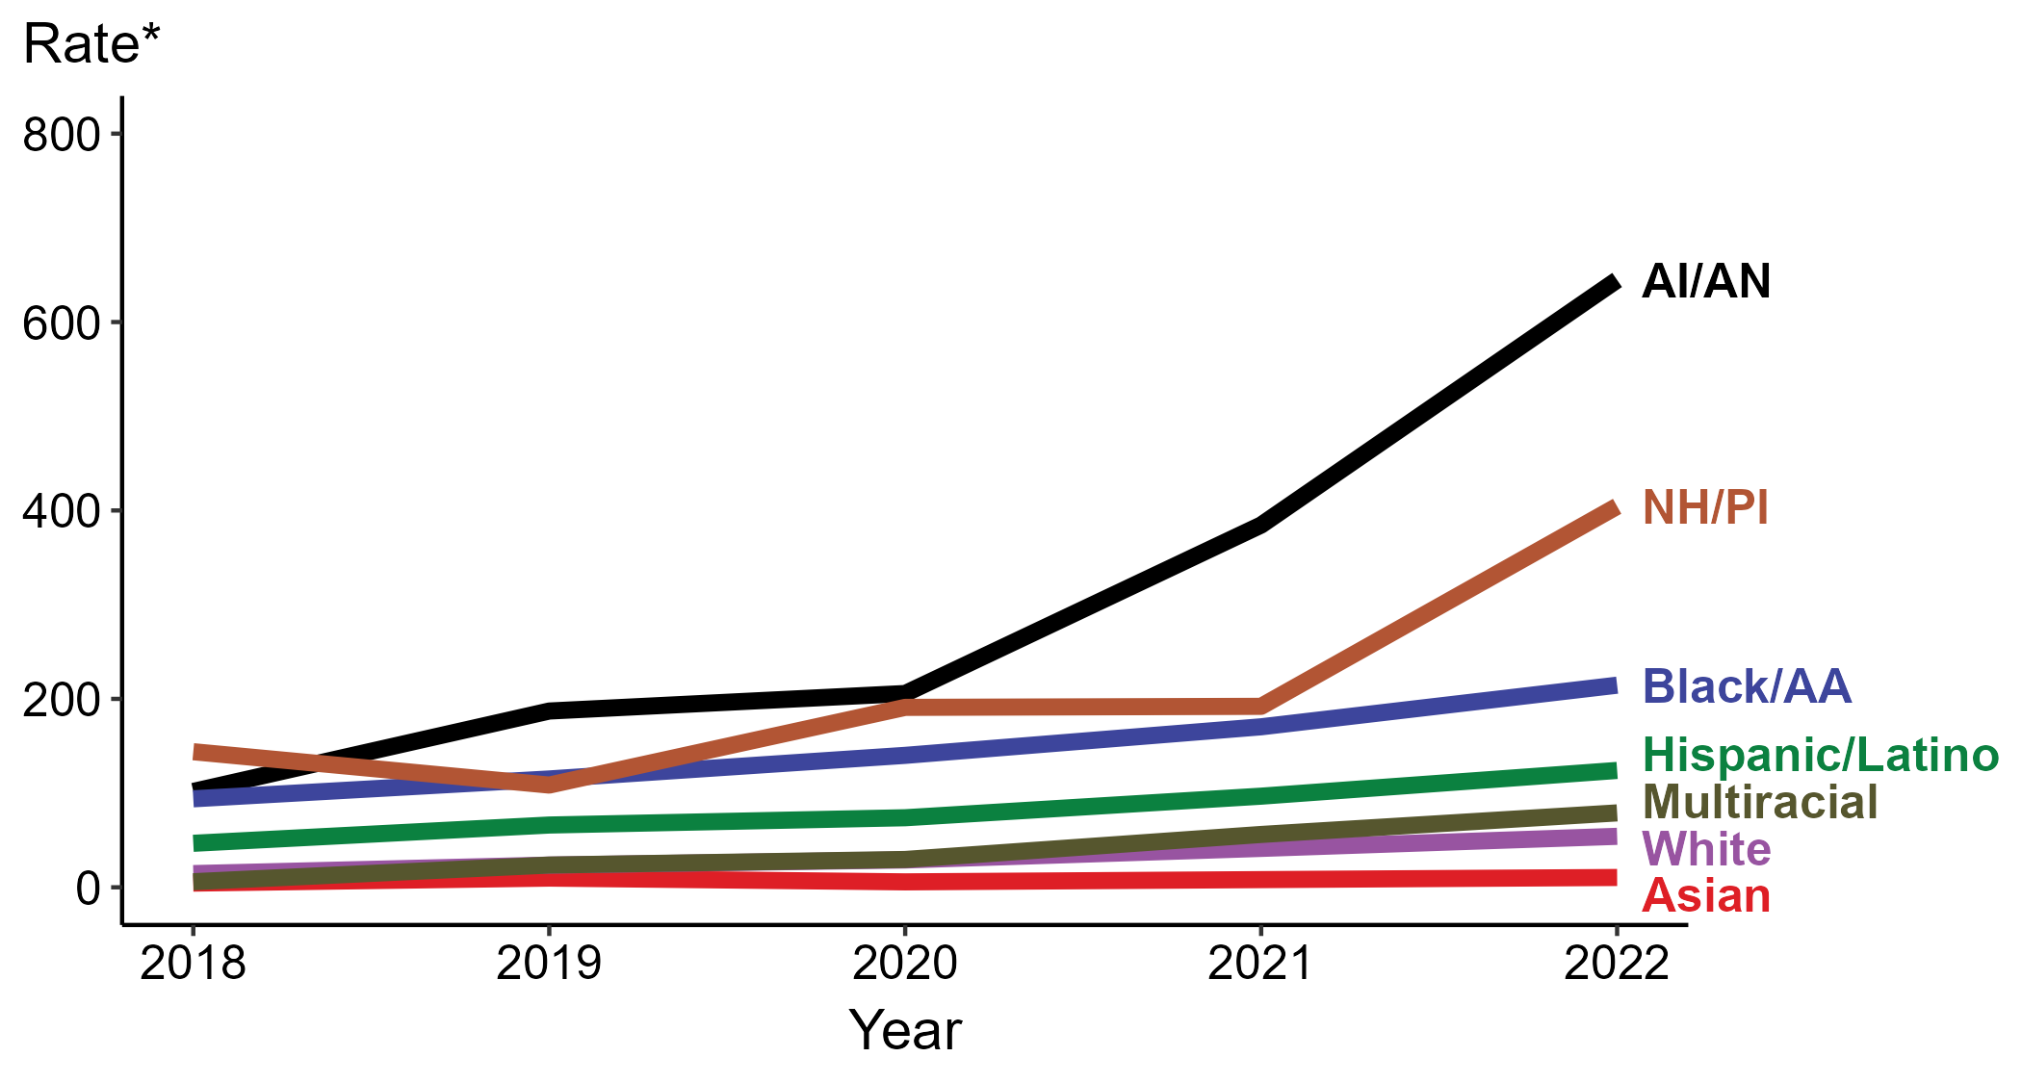
Congenital Syphilis — Rates of Reported Cases by Year of Birth, Race/Hispanic Ethnicity of Mother, United States, 2018–2022
* Per 100,000 live births
ACRONYMS: AI/AN = American Indian or Alaska Native; Black/AA = Black or African American; NH/PI = Native Hawaiian or other Pacific Islander
Notes:
In 2022, there were a total of 3,755 cases of congenital syphilis reported for a rate of 102.5 per 100,000 live births.
In 2022, the highest rate of reported cases of congenital syphilis per 100,000 live births was among mothers who were non-Hispanic American Indian or Alaska Native (644.7), followed by mothers who were non-Hispanic Native Hawaiian or other Pacific Islander (404.4).
During 2021 to 2022, the greatest increase in rate of reported cases of congenital syphilis per 100,000 live births was among mothers who were non-Hispanic Native Hawaiian or other Pacific Islander (192.1 to 404.4; 110.5% increase). Mothers who were non-Hispanic and of multiple races had the greatest five-year increase in rate of congenital syphilis (5.9 to 79.0; 1,239.0% increase from 2018).
There were no decreases in the rate of reported cases of congenital syphilis per 100,000 live births among any race or Hispanic ethnicity group during 2021 to 2022. There were also no decreases in the rate of congenital syphilis among any race or Hispanic ethnicity group during 2018 to 2022.
This report includes data from years that coincide with the COVID-19 pandemic, which introduced uncertainty and difficulty in interpreting STI surveillance data. See Impact of COVID-19 on STIs for more information.
See Technical Notes (https://www.cdc.gov/std/statistics/2022/technical-notes.htm) for information on syphilis case reporting, race/Hispanic ethnicity categorization, and reporting of race/Hispanic ethnicity for STI cases.
Data for all figures are available at https://www.cdc.gov/std/statistics/2022/data.zip. The file “CS - Rates by Race Hispanic Ethnicity of Mother (US 2022).xlsx” contains the data for the figure presented on this slide.

Slide 39
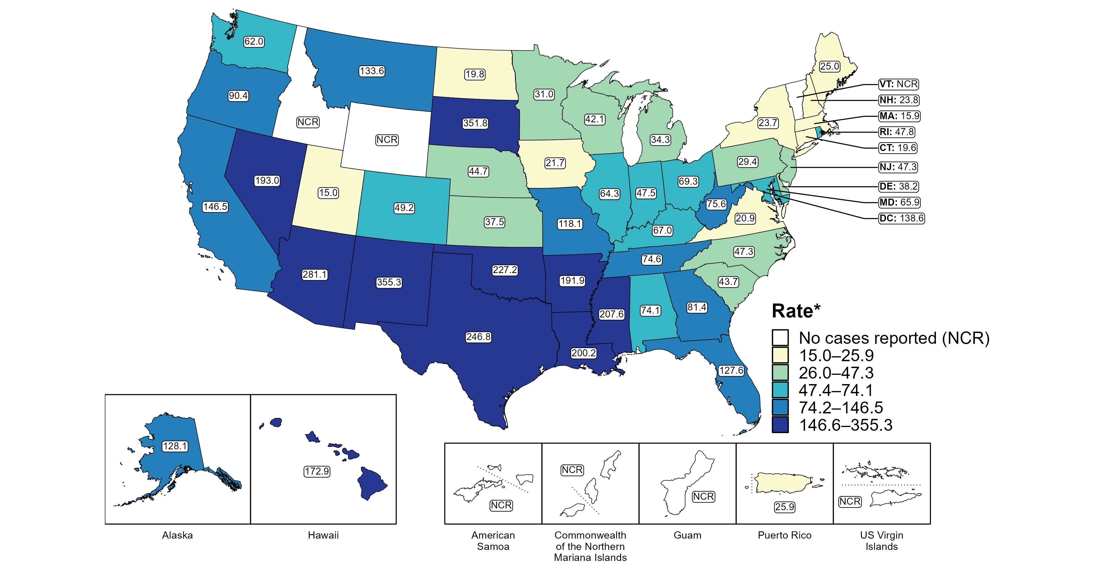
Congenital Syphilis — Rates of Reported Cases by Jurisdiction, United States and Territories, 2022
* Per 100,000 live births
Notes:
In 2022, there were a total of 3,755 cases of congenital syphilis reported among states and the District of Columbia (DC) for a rate of 102.5 per 100,000 live births. Rates of reported congenital syphilis among states reporting any cases ranged from 15.0 cases per 100,000 live births in Utah to 355.3 cases per 100,000 live births in New Mexico. No cases of congenital syphilis were reported in Idaho, Vermont, or Wyoming. The rate of reported congenital syphilis in DC was 138.6 per 100,000 live births.
Including data from US territories, there were a total of 3,760 cases of congenital syphilis reported for a rate of 101.9 per 100,000 live births in 2022. Among US territories, only Puerto Rico reported any congenital syphilis cases, with a rate of 25.9 reported cases per 100,000 live births. No cases of congenital syphilis were reported in American Samoa, Guam, the Commonwealth of the Northern Mariana Islands, or the US Virgin Islands.
This report includes data from years that coincide with the COVID-19 pandemic, which introduced uncertainty and difficulty in interpreting STI surveillance data. See Impact of COVID-19 on STIs for more information.
See Technical Notes (https://www.cdc.gov/std/statistics/2022/technical-notes.htm) for information on syphilis case reporting and on interpreting reported rates in US territories.
Data for all figures are available at https://www.cdc.gov/std/statistics/2022/data.zip. The file “CS - Rates by Jurisdiction (US and Terr 2022).xlsx” contains the data for the figure presented on this slide.
Note: the interpretative text on this slide was updated on April 2, 2024 to correct a data error. No changes were made to the figure or the underlying data file.

Slide 40
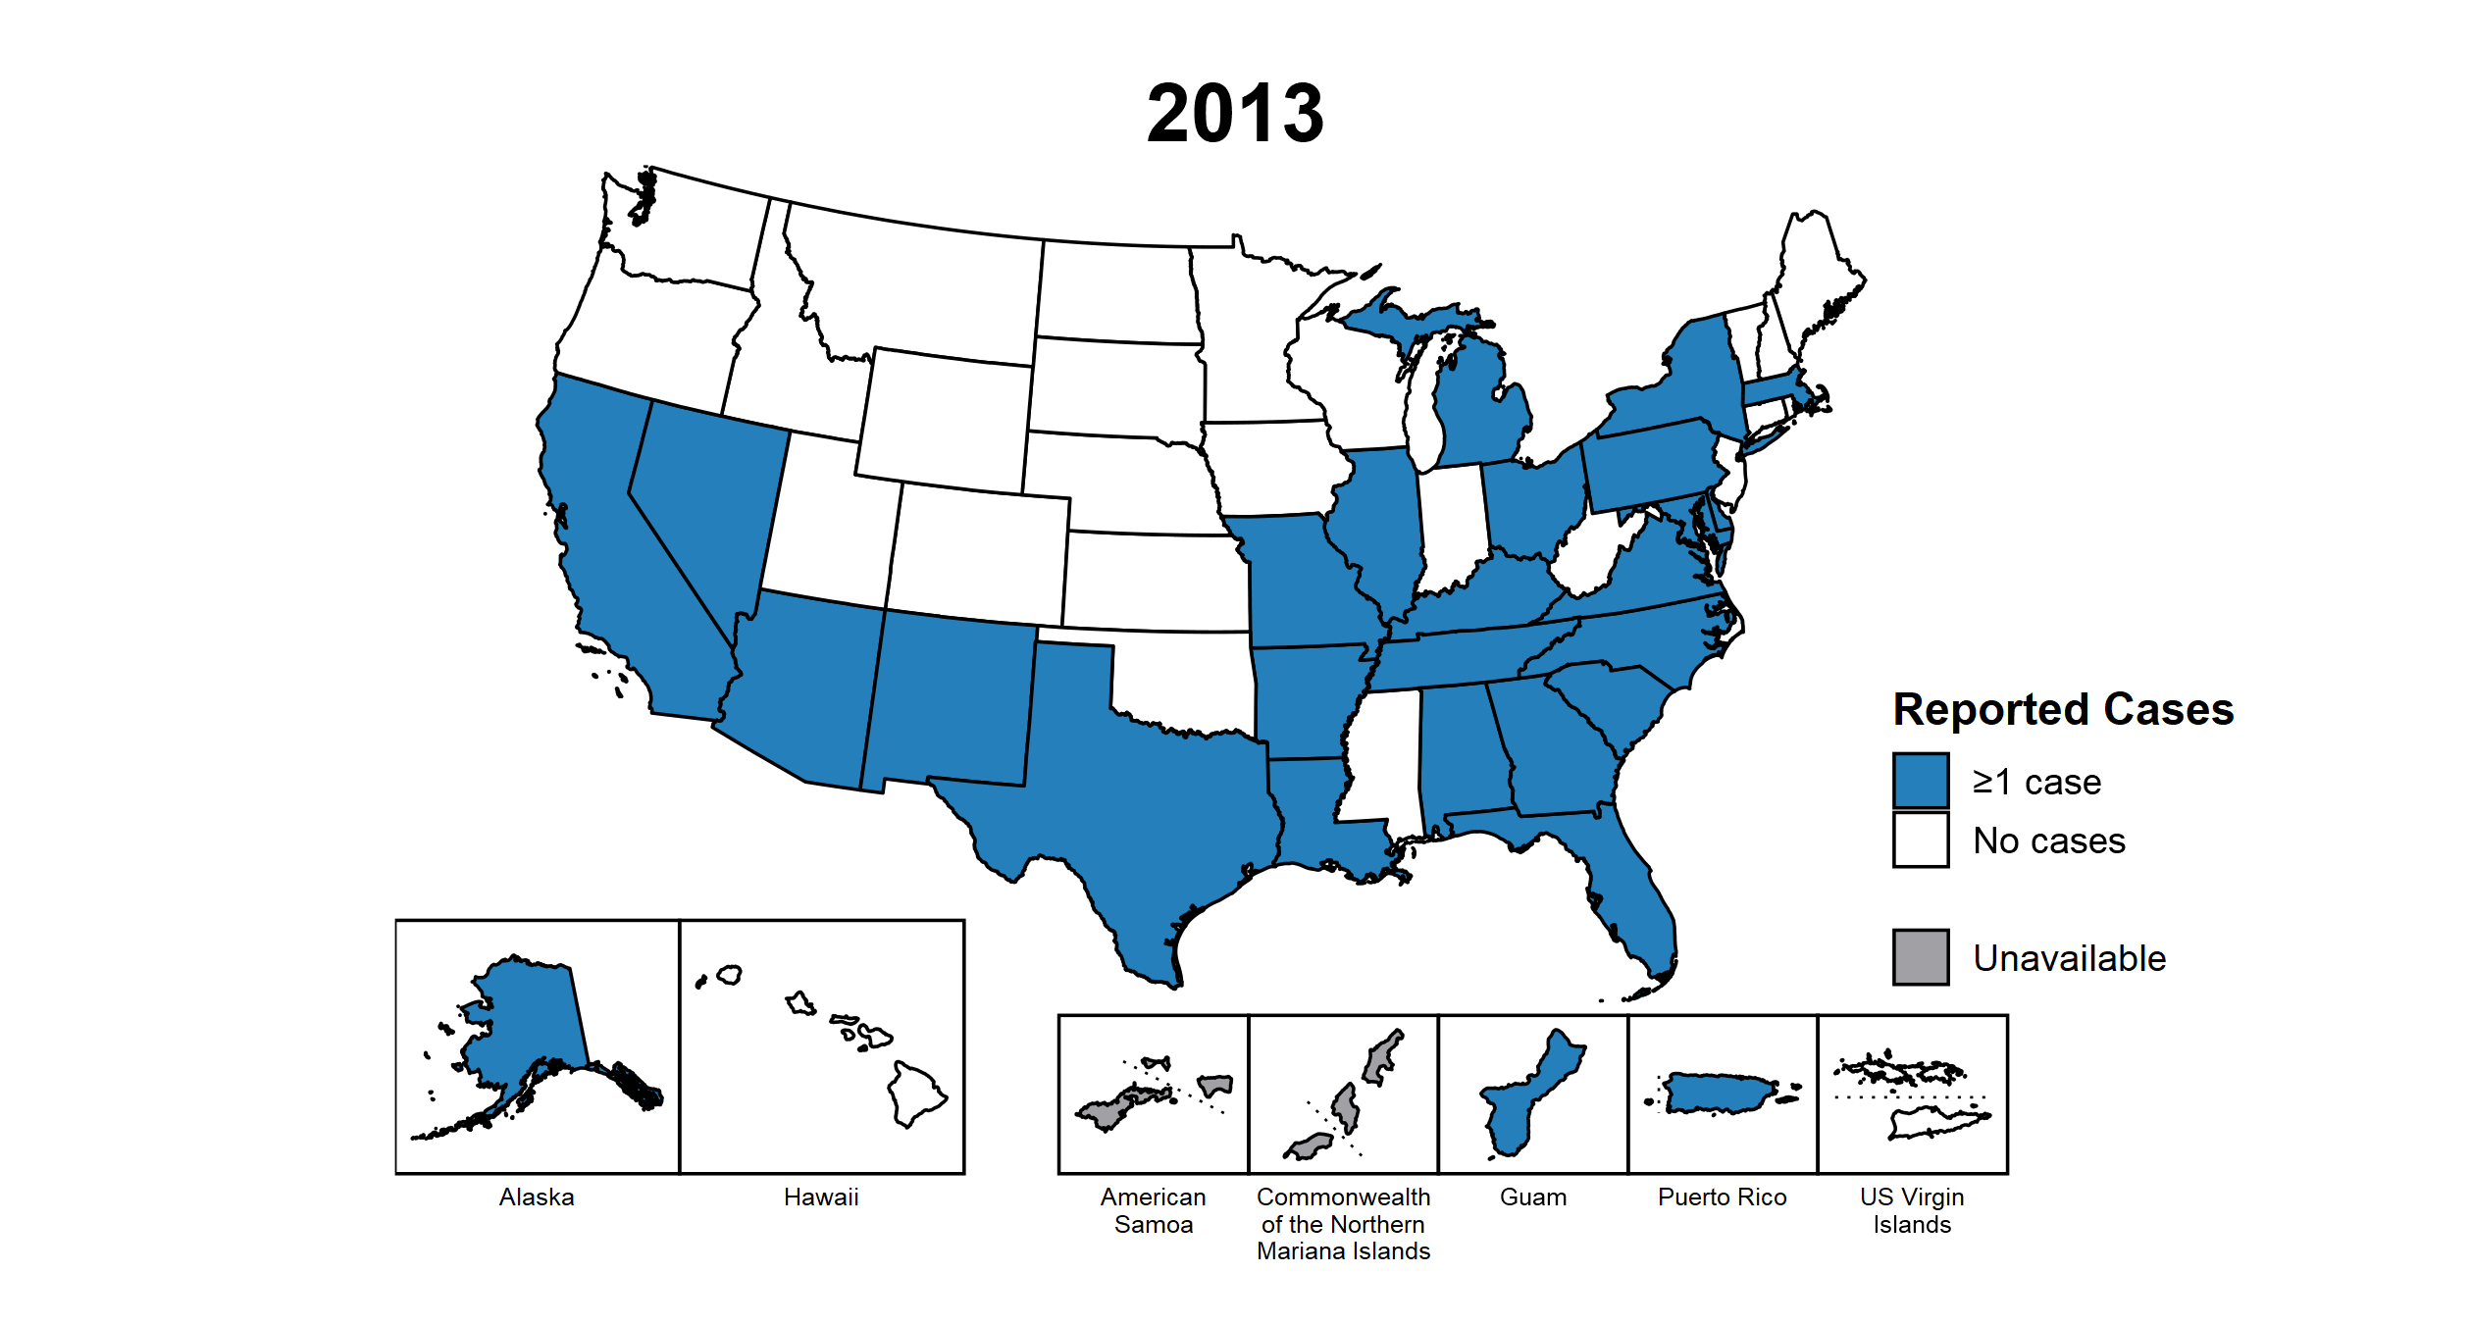
Congenital Syphilis — Reported Cases by Year of Birth and Jurisdiction, United States and Territories, 2013–2022
Notes:
This slide contains an animated figure that will play when the slide is in presentation mode. A static version of the figure that displays maps from the first and last years of the range is available as a separate slide.
In 2022, there were a total of 3,755 cases of congenital syphilis reported among states and the District of Columbia (DC) for a rate of 102.5 per 100,000 live births. Including data from US territories, there were a total of 3,760 cases of congenital syphilis reported for a rate of 101.9 per 100,000 live births.
In 2013, 25 states, DC, and two US territories (51.9% of areas with available data) reported one or more cases of congenital syphilis. This increased to 47 states, DC, and one US territory (87.5% of areas with available data) in 2022.
American Samoa and the Commonwealth of the Northern Mariana Islands began reporting data on congenital syphilis cases to CDC in 2018; data are not available for those areas prior to that year. In addition, data on reported congenital syphilis cases in 2018 are not available for the US Virgin Islands. Due to a network security incident in December 2021, the Maryland Department of Health could not finalize their 2021 STI case notification data. Data for 2021 from Maryland have been suppressed for this figure; however, they are included in national and regional case counts and rates displayed in other figures.
This report includes data from years that coincide with the COVID-19 pandemic, which introduced uncertainty and difficulty in interpreting STI surveillance data. See Impact of COVID-19 on STIs for more information.
See Technical Notes (https://www.cdc.gov/std/statistics/2022/technical-notes.htm) for information on syphilis case reporting and on interpreting reported rates in US territories.
Data for all figures are available at https://www.cdc.gov/std/statistics/2022/data.zip. The file “CS - Cases by Year of Birth and Jurisdiction (US and Terr, 2013-2022).xlsx” contains the data for the figure presented on this slide.
Note: the interpretative text on this slide was updated on April 2, 2024 to correct a data error. No changes were made to the figure or the underlying data file.

Slide 41
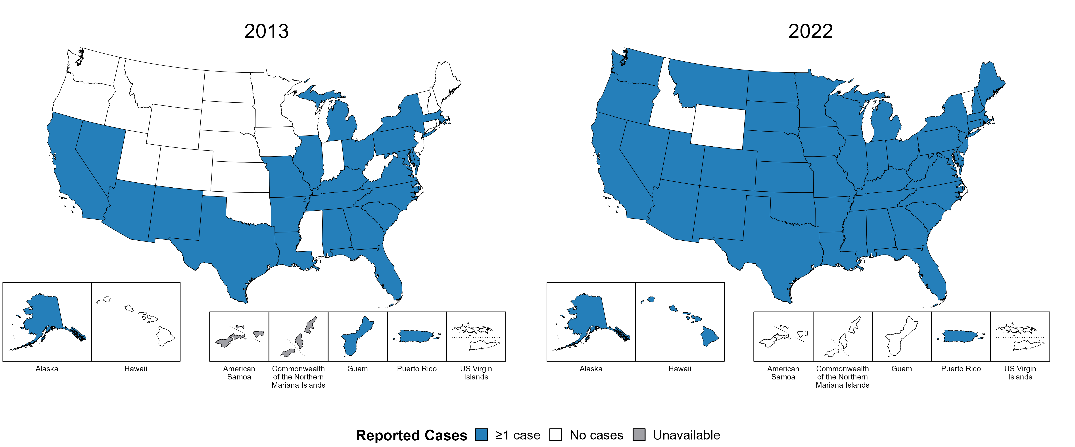
Congenital Syphilis — Reported Cases by Year of Birth and Jurisdiction, United States and Territories, 2013 and 2022
Notes:
In 2022, there were a total of 3,755 cases of congenital syphilis reported among states and the District of Columbia (DC) for a rate of 102.5 per 100,000 live births. Including data from US territories, there were a total of 3,760 cases of congenital syphilis reported for a rate of 101.9 per 100,000 live births.
In 2013, 25 states, DC, and two US territories (51.9% of areas with available data) reported one or more cases of congenital syphilis. This increased to 47 states, DC, and one US territory (87.5% of areas with available data) in 2022.
American Samoa and the Commonwealth of the Northern Mariana Islands began reporting data on congenital syphilis cases to CDC in 2018; data are not available for those areas prior to that year.
This report includes data from years that coincide with the COVID-19 pandemic, which introduced uncertainty and difficulty in interpreting STI surveillance data. See Impact of COVID-19 on STIs for more information.
See Technical Notes (https://www.cdc.gov/std/statistics/2022/technical-notes.htm) for information on syphilis case reporting and on interpreting reported rates in US territories.
Data for all figures are available at https://www.cdc.gov/std/statistics/2022/data.zip. The file “CS - Cases by Year of Birth and Jurisdiction (US and Terr, 2013 and 2022).xlsx” contains the data for the figure presented on this slide.
Note: the interpretative text on this slide was updated on April 2, 2024 to correct a data error. No changes were made to the figure or the underlying data file.

Slide 42
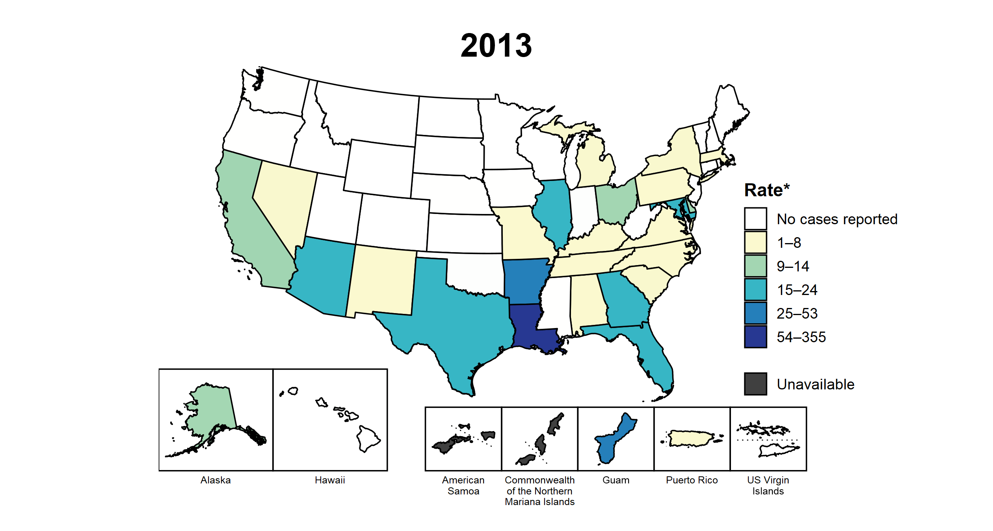
Congenital Syphilis — Rates of Reported Cases by Year of Birth and Jurisdiction, United States and Territories, 2013–2022
* Per 100,000 live births
Notes:
This slide contains an animated figure that will play when the slide is in presentation mode. A static version of the figure that displays maps from the first and last years of the range is available as a separate slide.
In 2022, there were a total of 3,755 cases of congenital syphilis reported among states and the District of Columbia (DC) for a rate of 102.5 per 100,000 live births. Including data from US territories, there were a total of 3,760 cases of congenital syphilis reported for a rate of 101.9 per 100,000 live births.
In 2013, two states and one US territory (5.6% of areas with available data) had a rate of reported congenital syphilis greater than or equal to 25 cases per 100,000 live births. This increased to 39 states, DC, and one US territory (73.2% of areas with available data) in 2022. During 2021 to 2022, rates of reported congenital syphilis among live births increased in 39 states and DC.
American Samoa and the Commonwealth of the Northern Mariana Islands began reporting data on congenital syphilis cases to CDC in 2018; data are not available for those areas prior to that year. In addition, data on reported congenital syphilis cases in 2018 are not available for the US Virgin Islands. Due to a network security incident in December 2021, the Maryland Department of Health could not finalize their 2021 STI case notification data. Data for 2021 from Maryland have been suppressed for this figure; however, they are included in national and regional case counts and rates displayed in other figures.
This report includes data from years that coincide with the COVID-19 pandemic, which introduced uncertainty and difficulty in interpreting STI surveillance data. See Impact of COVID-19 on STIs for more information.
See Technical Notes (https://www.cdc.gov/std/statistics/2022/technical-notes.htm) for information on syphilis case reporting and on interpreting reported rates in US territories.
Data for all figures are available at https://www.cdc.gov/std/statistics/2022/data.zip. The file “CS - Rates by Year of Birth and Jurisdiction (US and Terr, 2013-2022).xlsx” contains the data for the figure presented on this slide.
Note: the interpretative text on this slide was updated on April 2, 2024 to correct a data error. No changes were made to the figure or the underlying data file.

Slide 43
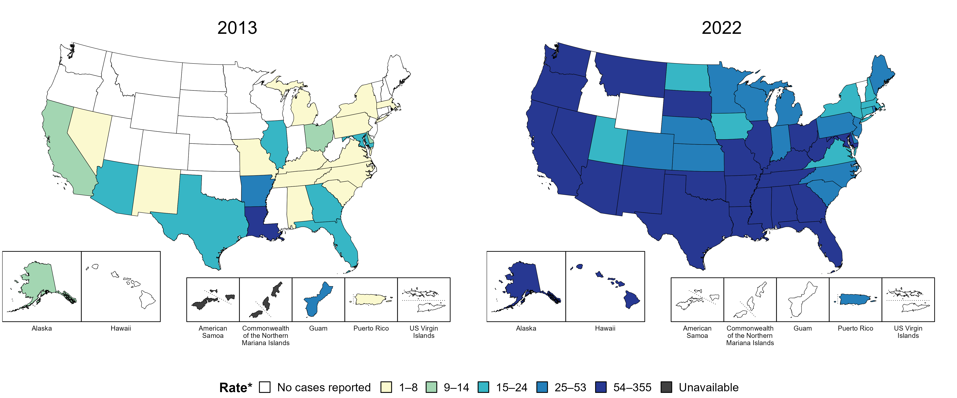
Congenital Syphilis — Rates of Reported Cases by Year of Birth and Jurisdiction, United States and Territories, 2013 and 2022
* Per 100,000 live births
Notes:
In 2022, there were a total of 3,755 cases of congenital syphilis reported among states and the District of Columbia (DC) for a rate of 102.5 per 100,000 live births. Including data from US territories, there were a total of 3,760 cases of congenital syphilis reported for a rate of 101.9 per 100,000 live births.
In 2013, two states and one US territory (5.6% of areas with available data) had a rate of reported congenital syphilis greater than or equal to 25 cases per 100,000 live births. This increased to 39 states, DC, and one US territory (73.2% of areas with available data) in 2022.
American Samoa and the Commonwealth of the Northern Mariana Islands began reporting data on congenital syphilis cases to CDC in 2018; data are not available for those areas prior to that year.
This report includes data from years that coincide with the COVID-19 pandemic, which introduced uncertainty and difficulty in interpreting STI surveillance data. See Impact of COVID-19 on STIs for more information.
See Technical Notes (https://www.cdc.gov/std/statistics/2022/technical-notes.htm) for information on syphilis case reporting and on interpreting reported rates in US territories.
Data for all figures are available at https://www.cdc.gov/std/statistics/2022/data.zip. The file “CS - Rates by Year of Birth and Jurisdiction (US and Terr 2013 and 2022).xlsx” contains the data for the figure presented on this slide.
Note: the interpretative text on this slide was updated on April 2, 2024 to correct a data error. No changes were made to the figure or the underlying data file.

Slide 44
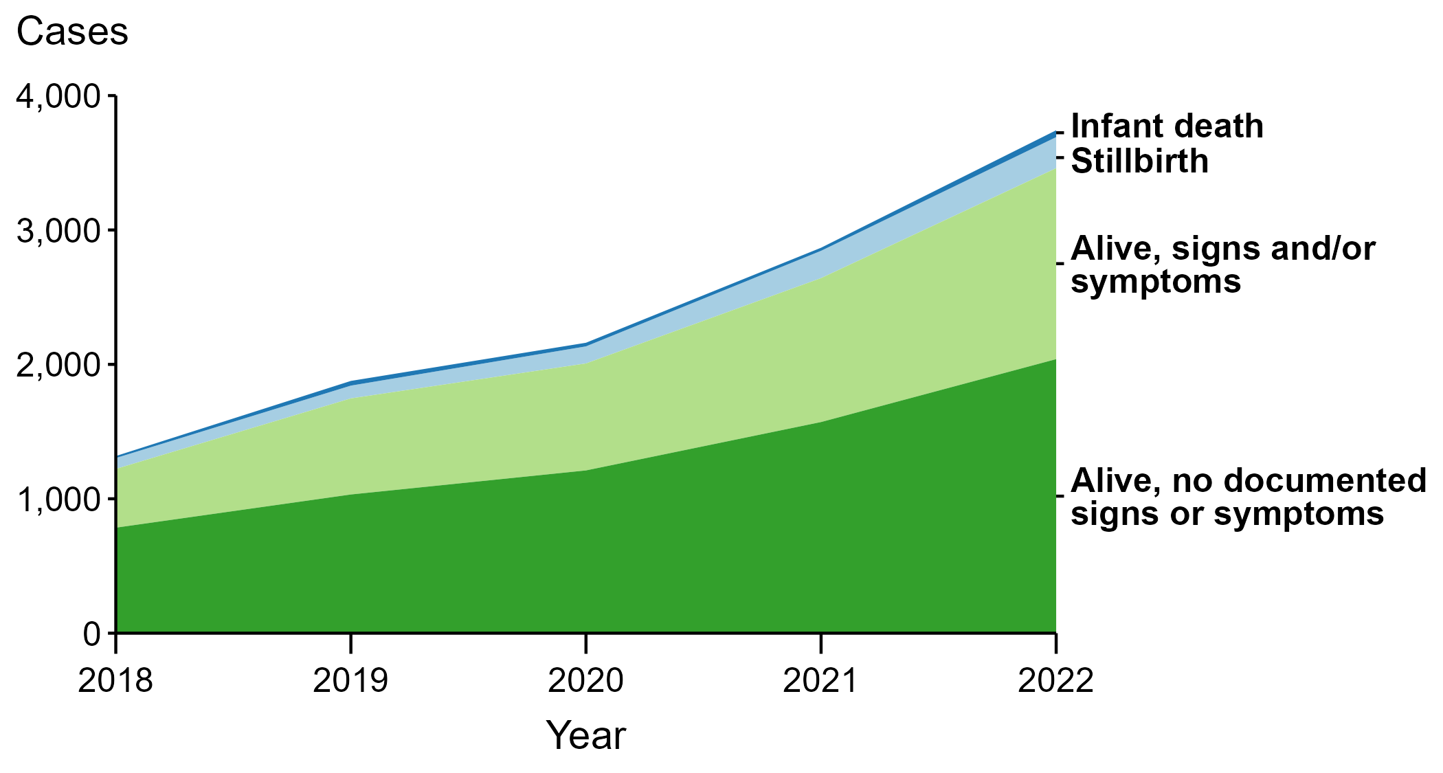
Congenital Syphilis — Reported Cases by Vital Status and Clinical Signs and Symptoms* of Infection, United States, 2018–2022
* Infants with signs and/or symptoms of congenital syphilis have documentation of at least one of the following: long bone changes consistent with congenital syphilis, snuffles, condylomata lata, syphilitic skin rash, pseudoparalysis, hepatosplenomegaly, edema, jaundice due to syphilitic hepatitis, reactive CSF-VDRL, elevated CSF WBC or protein values, or evidence of direct detection of T. pallidum.
NOTE: Of the 11,999 congenital syphilis cases reported during 2018 to 2022, 33 (0.3%) did not have sufficient information to be categorized.
Notes:
In 2022, there were a total of 3,755 cases of congenital syphilis reported for a rate of 102.5 per 100,000 live births.
In 2022, 51 congenital syphilis cases (1.4%) were infant deaths, 231 cases (6.2%) were stillbirths, 1,421 cases (37.8%) were born alive with congenital syphilis-related signs or symptoms, 2,039 cases (54.3%) were born alive with no documented congenital syphilis-related signs or symptoms, and 13 cases (0.3%) were missing information on vital status.
In 2022, there were 282 congenital syphilis-related deaths (231 stillbirths and 51 infant deaths), an increase of 24.8% from 2021 (226 in 2021 to 282 in 2022) and an increase of 193.8% from 2018 (96 in 2018 to 282 in 2022).
The number of infants reported with congenital syphilis who were born alive with congenital syphilis-related signs and symptoms increased 32.7% from 2021 to 2022 (1,071 in 2021 to 1,421 in 2022) and increased 225.2% from 2018 to 2022 (437 in 2018 to 1,421 in 2022).
This report includes data from years that coincide with the COVID-19 pandemic, which introduced uncertainty and difficulty in interpreting STI surveillance data. See Impact of COVID-19 on STIs for more information.
See Technical Notes (https://www.cdc.gov/std/statistics/2022/technical-notes.htm) for information on syphilis case reporting.
Data for all figures are available at https://www.cdc.gov/std/statistics/2022/data.zip. The file “CS - Cases by Vital Status and Clinical Signs and Symptoms (US 2018-2022).xlsx” contains the data for the figure presented on this slide.

Slide 45
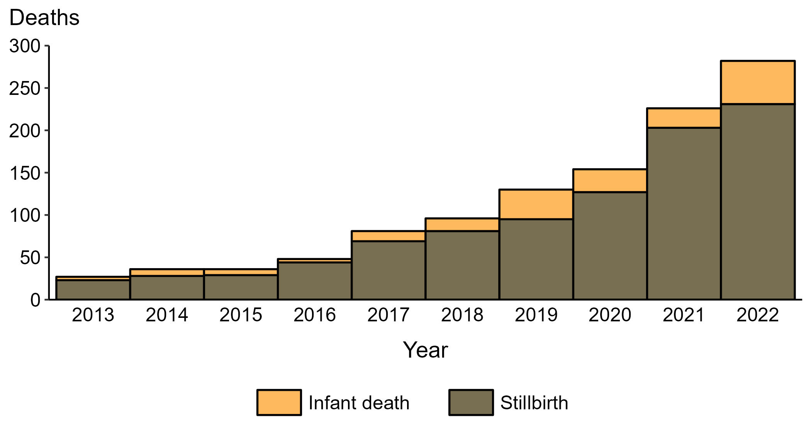
Congenital Syphilis — Reported Stillbirths and Infant Deaths, United States, 2013–2022
Notes:
In 2022, there were a total of 3,755 cases of congenital syphilis reported for a rate of 102.5 per 100,000 live births.
In 2022, 231 congenital syphilis-related stillbirths were reported, an increase of 13.8% since 2021 and an increase of 904.3% since 2013.
In 2022, 51 congenital syphilis-related infant deaths were reported, an increase of 121.7% since 2021 and an increase of 1,175.0% since 2013.
This report includes data from years that coincide with the COVID-19 pandemic, which introduced uncertainty and difficulty in interpreting STI surveillance data. See Impact of COVID-19 on STIs for more information.
See Technical Notes (https://www.cdc.gov/std/statistics/2022/technical-notes.htm) for information on syphilis case reporting.
Data for all figures are available at https://www.cdc.gov/std/statistics/2022/data.zip. The file “CS - Reported Stillbirths and Infant Deaths (US 2013-2022).xlsx” contains the data for the figure presented on this slide.

Slide 46
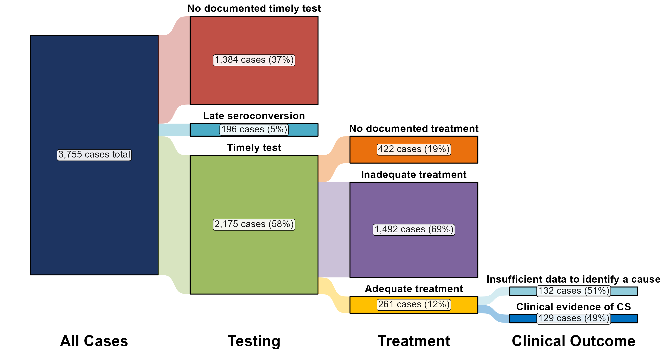
Congenital Syphilis — Distribution of Receipt of Testing and Treatment by Pregnant Persons with a Congenital Syphilis Outcome, United States, 2022
Notes:
In 2022, there were a total of 3,755 cases of congenital syphilis reported for a rate of 102.5 per 100,000 live births.
In 2022, the most common missed prevention opportunity among birthing parents of infants with congenital syphilis was inadequate treatment (n = 1,492; 39.7%), followed by no documented timely test (n = 1,319; 35.1%).
This report includes data from years that coincide with the COVID-19 pandemic, which introduced uncertainty and difficulty in interpreting STI surveillance data. See Impact of COVID-19 on STIs for more information.
See Technical Notes (https://www.cdc.gov/std/statistics/2022/technical-notes.htm) for information on syphilis case reporting and methodology for missed prevention opportunity categorization.
Data for all figures are available at https://www.cdc.gov/std/statistics/2022/data.zip. The file “CS - Receipt of Testing and Treatment by Pregnant Person with CS Outcome (US 2022).xlsx” contains the data for the figure presented on this slide.

Slide 47
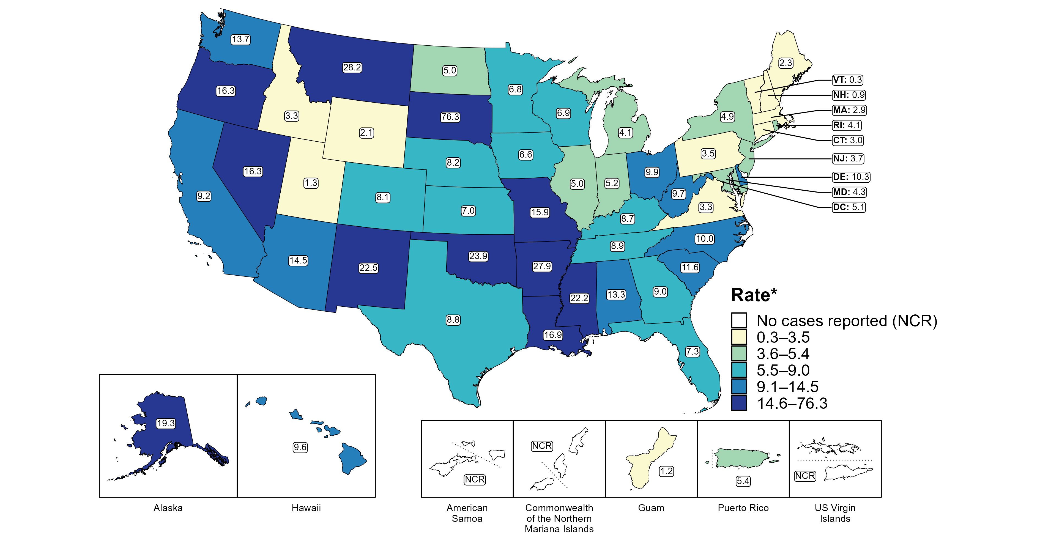
Primary and Secondary Syphilis — Rates of Reported Cases Among Women by State, United States and Territories, 2022
* Per 100,000
Notes:
In 2022, rates of reported primary and secondary (P&S) syphilis among women ranged by state from 0.3 cases per 100,000 women in Vermont to 76.3 cases per 100,000 women in South Dakota. The rate of reported P&S syphilis in the District of Columbia was 5.1 per 100,000 women.
Among US territories reporting any cases, rates of reported P&S syphilis ranged from 1.2 cases per 100,000 women in Guam to 5.4 cases per 100,000 women in Puerto Rico. No cases of P&S syphilis were reported in American Samoa, the Commonwealth of the Northern Mariana Islands, or the US Virgin Islands.
This report includes data from years that coincide with the COVID-19 pandemic, which introduced uncertainty and difficulty in interpreting STI surveillance data. See Impact of COVID-19 on STIs for more information.
See Technical Notes (https://www.cdc.gov/std/statistics/2022/technical-notes.htm) for information on syphilis case reporting and on interpreting reported rates in US territories. Table A1 (https://www.cdc.gov/std/statistics/2022/tables/a1.htm) provides information on unknown, missing, or invalid values of select variables.
Data for all figures are available at https://www.cdc.gov/std/statistics/2022/data.zip. The file “PS Syphilis - Rates Women by Jurisdiction (US and Terr 2022).xlsx” contains the data for the figure presented on this slide.

Slide 48
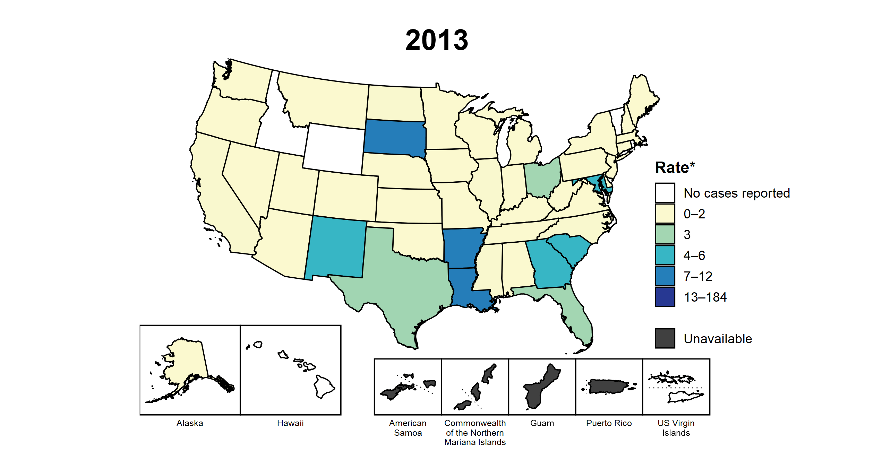
Primary and Secondary Syphilis — Rates of Reported Cases Among Women Aged 15–44 Years by Jurisdiction, United States and Territories, 2013–2022
* Per 100,000
Notes:
This slide contains an animated figure that will play when the slide is in presentation mode. A static version of the figure that displays maps from the first and last years of the range is available as a separate slide.
In 2013, three states and the District of Columbia (DC; 7.7% of areas with available data) had a rate of reported primary and secondary syphilis greater than or equal to 7 cases per 100,000 women aged 15 to 44 years. This increased to 43 states, DC, and one US territory (80.4% of areas with available data) in 2022. During 2021 to 2022, rates of reported primary and secondary syphilis among women aged 15 to 44 years increased in 35 states and two territories.
American Samoa and the Commonwealth of the Northern Mariana Islands began reporting data on primary and secondary syphilis cases to CDC in 2018; data are not available for those areas prior to that year. In addition, data on reported primary and secondary syphilis cases in 2018 are not available for the US Virgin Islands. Furthermore, population estimates by age and sex were not available for all territories for all years. Due to a network security incident in December 2021, the Maryland Department of Health could not finalize their 2021 STI case notification data. Data for 2021 from Maryland have been suppressed for this figure; however, they are included in national and regional case counts and rates displayed in other figures.
This report includes data from years that coincide with the COVID-19 pandemic, which introduced uncertainty and difficulty in interpreting STI surveillance data. See Impact of COVID-19 on STIs for more information.
See Technical Notes (https://www.cdc.gov/std/statistics/2022/technical-notes.htm) for information on syphilis case reporting and on interpreting reported rates in US territories. Table A1 (https://www.cdc.gov/std/statistics/2022/tables/a1.htm) provides information on unknown, missing, or invalid values of select variables.
Data for all figures are available at https://www.cdc.gov/std/statistics/2022/data.zip. The file “PS Syphilis - Rates Women 15-44 Years by Jurisdiction (US and Terr 2013-2022).xlsx” contains the data for the figure presented on this slide.

Slide 49
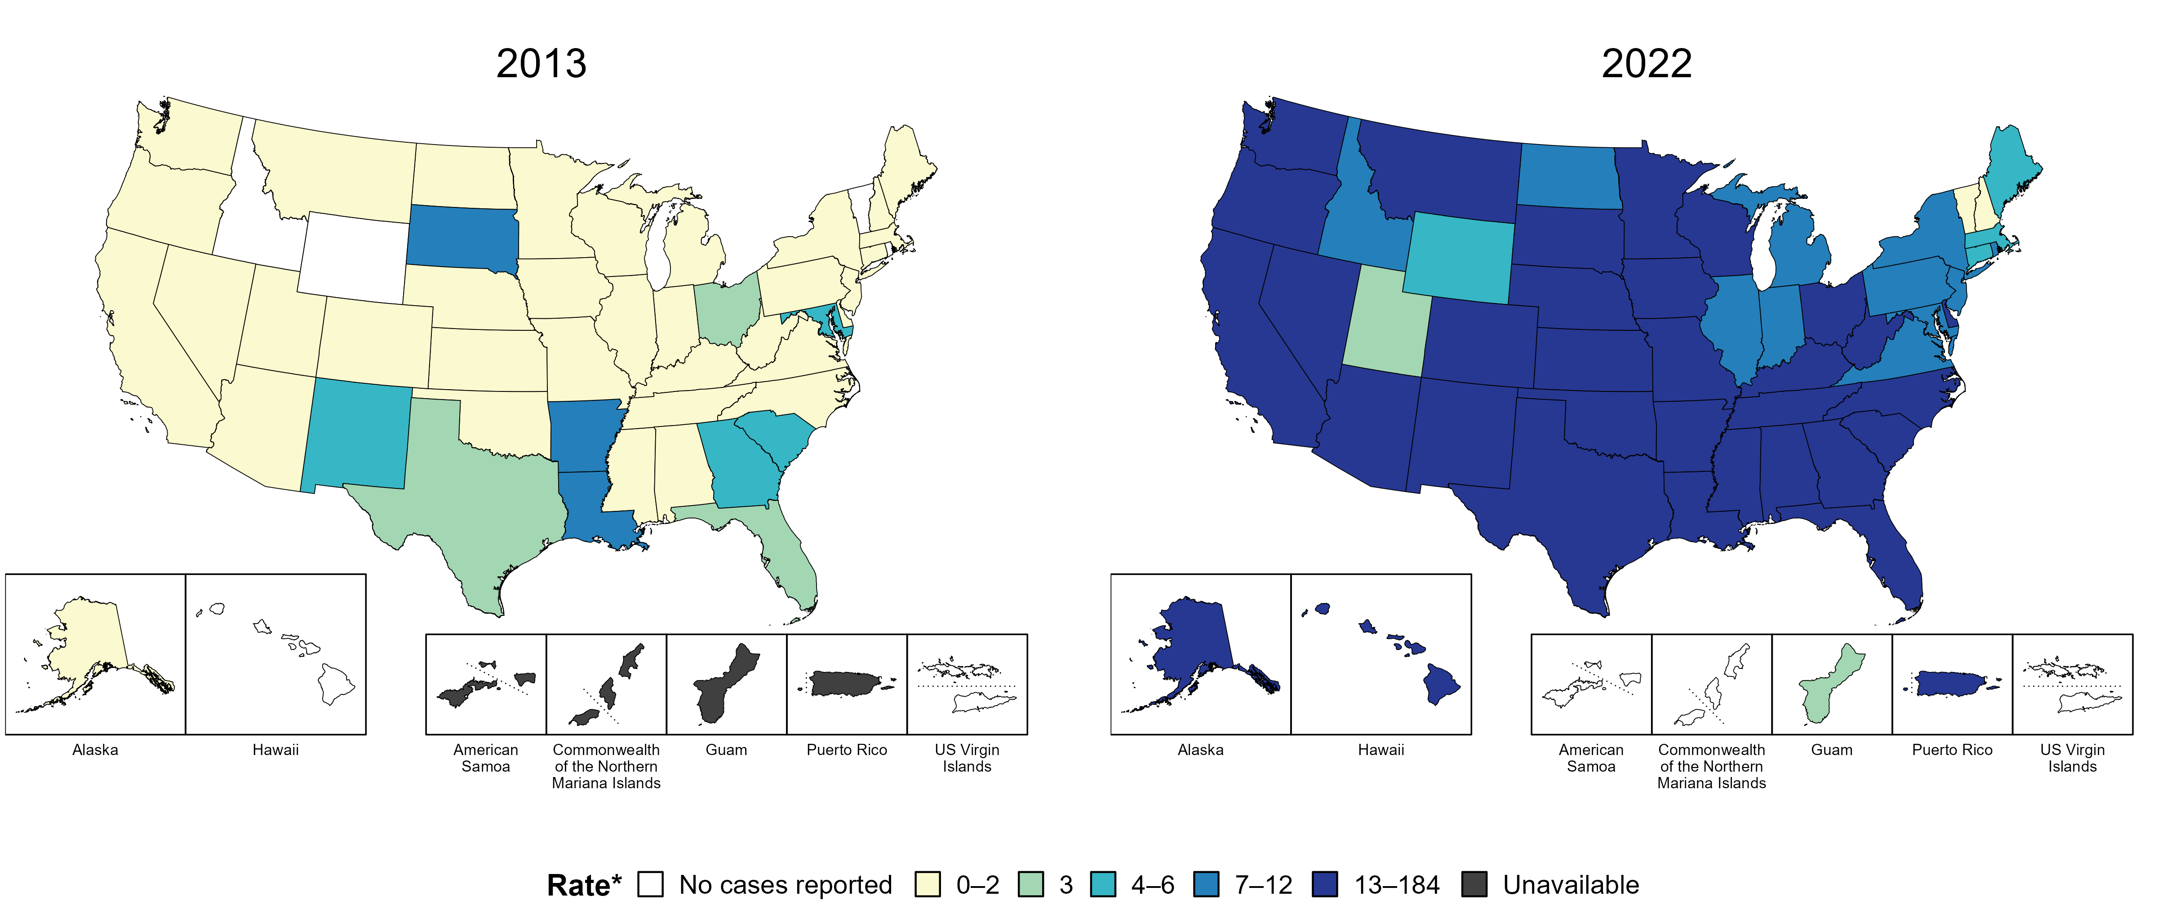
Primary and Secondary Syphilis — Rates of Reported Cases Among Women Aged 15–44 Years by Jurisdiction, United States and Territories, 2013 and 2022
* Per 100,000
Notes:
In 2013, three states and the District of Columbia (DC; 7.7% of areas with available data) had a rate of reported primary and secondary syphilis greater than or equal to 7 cases per 100,000 women aged 15 to 44 years. This increased to 43 states, DC, and one US territory (80.4% of areas with available data) in 2022.
American Samoa and the Commonwealth of the Northern Mariana Islands began reporting data on primary and secondary syphilis cases to CDC in 2018; data are not available for those areas prior to that year. Additionally, population estimates by age and sex were not available for all territories for both years.
This report includes data from years that coincide with the COVID-19 pandemic, which introduced uncertainty and difficulty in interpreting STI surveillance data. See Impact of COVID-19 on STIs for more information.
See Technical Notes (https://www.cdc.gov/std/statistics/2022/technical-notes.htm) for information on syphilis case reporting and on interpreting reported rates in US territories. Table A1 (https://www.cdc.gov/std/statistics/2022/tables/a1.htm) provides information on unknown, missing, or invalid values of select variables.
Data for all figures are available at https://www.cdc.gov/std/statistics/2022/data.zip. The file “PS Syphilis - Rates Women15-44 Years by Jurisdiction (US and Terr 2013 and 2022).xlsx” contains the data for the figure presented on this slide.

Slide 50
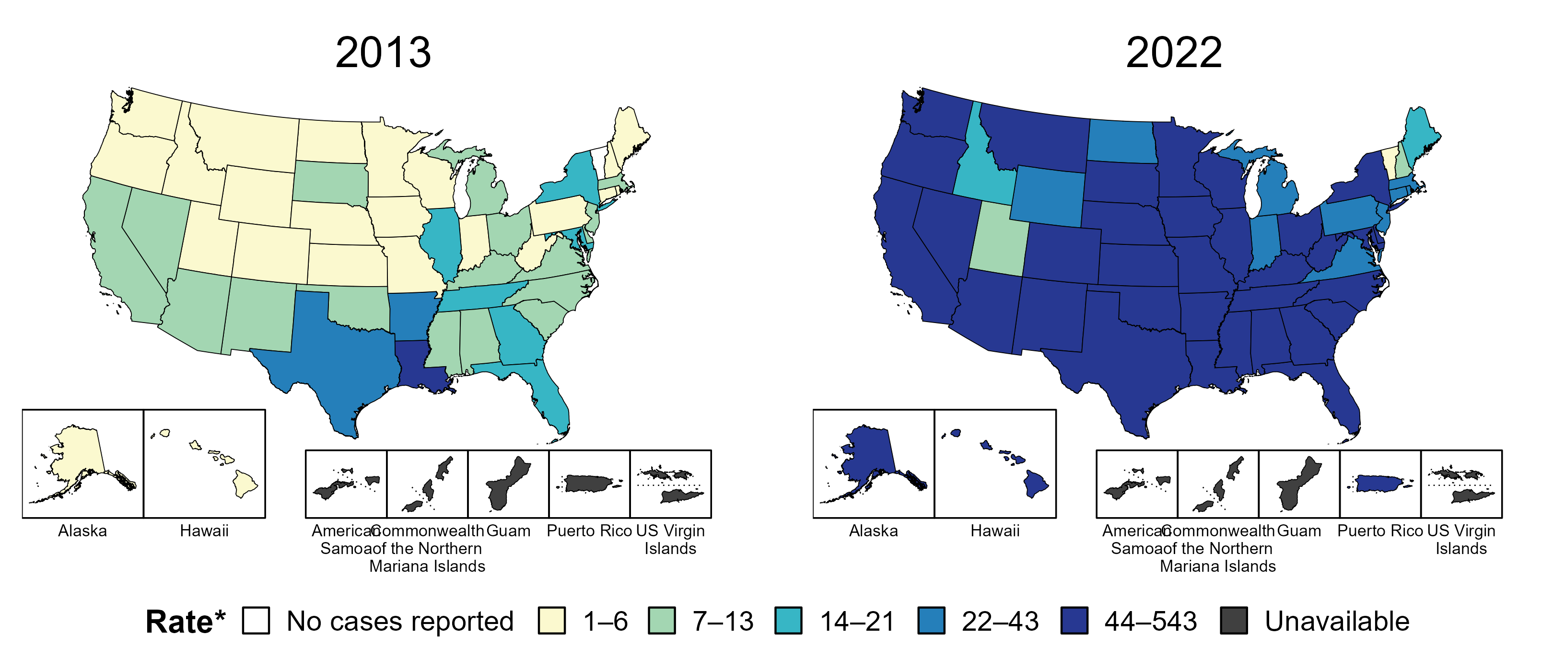
Syphilis (All Stages) — Rates of Reported Cases Among Women Aged 15–44 Years by Jurisdiction, United States and Territories, 2013 and 2022
* Per 100,000
Notes:
In 2013, three states and the District of Columbia (DC; 7.8% of areas with available data) had a rate of reported syphilis (all stages) greater than or equal to 22 cases per 100,000 women aged 15 to 44 years. This increased to 45 states, DC, and one US territory (90.4% of areas with available data) in 2022.
Data on reported cases of syphilis other than primary and secondary syphilis are not available by age and sex for American Samoa, the Commonwealth of the Northern Mariana Islands, Guam, and the US Virgin Islands. Additionally, population estimates by age and sex were not available for all territories for both years.
This report includes data from years that coincide with the COVID-19 pandemic, which introduced uncertainty and difficulty in interpreting STI surveillance data. See Impact of COVID-19 on STIs for more information.
See Technical Notes (https://www.cdc.gov/std/statistics/2022/technical-notes.htm) for information on syphilis case reporting and on interpreting reported rates in US territories. Table A1 (https://www.cdc.gov/std/statistics/2022/tables/a1.htm) provides information on unknown, missing, or invalid values of select variables.
Data for all figures are available at https://www.cdc.gov/std/statistics/2022/data.zip. The file “Syphilis - Rates Women 15-44 Years by Jurisdiction (US and Terr 2013 and 2022).xlsx” contains the data for the figure presented on this slide.

Slide 51
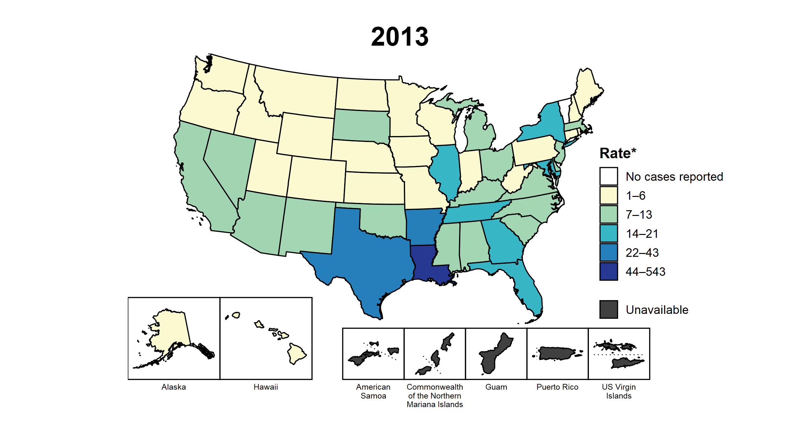
Syphilis (All Stages) — Rates of Reported Cases Among Women Aged 15–44 Years by Jurisdiction, United States and Territories, 2013–2022
* Per 100,000
Notes:
This slide contains an animated figure that will play when the slide is in presentation mode. A static version of the figure that displays maps from the first and last years of the range is available as a separate slide.
In 2013, three states and the District of Columbia (DC; 7.8% of areas with available data) had a rate of reported syphilis (all stages) greater than or equal to 22 cases per 100,000 women aged 15 to 44 years. This increased to 45 states, DC, and one US territory (90.4% of areas with available data) in 2022. During 2021 to 2022, rates of reported syphilis (all stages) among women aged 15 to 44 years increased in 46 states, DC, and one territory.
Data on reported cases of syphilis other than primary and secondary syphilis are not available by age and sex for American Samoa, the Commonwealth of the Northern Mariana Islands, Guam, and the US Virgin Islands. Additionally, population estimates by age and sex were not available for all territories for all years. Due to a network security incident in December 2021, the Maryland Department of Health could not finalize their 2021 STI case notification data. Data for 2021 from Maryland have been suppressed for this figure; however, they are included in national and regional case counts and rates displayed in other figures.
This report includes data from years that coincide with the COVID-19 pandemic, which introduced uncertainty and difficulty in interpreting STI surveillance data. See Impact of COVID-19 on STIs for more information.
See Technical Notes (https://www.cdc.gov/std/statistics/2022/technical-notes.htm) for information on syphilis case reporting and on interpreting reported rates in US territories.
Data for all figures are available at https://www.cdc.gov/std/statistics/2022/data.zip. The file “Syphilis - Rates Women 15-44 Years by Jurisdiction (US and Terr 2013-2022).xlsx” contains the data for the figure presented on this slide.

Slide 52
Syphilis (All Stages) — Reported Cases Among Women Aged 15–44 Years by County, United States, 2018–2022
Notes:
In 2018, 1,395 (45.0%) of US counties with available data reported at least one case of syphilis (all stages) among women of reproductive age (15–44 years), increasing to 2,115 (68.4%) of counties with available data in 2022. During 2021 to 2022, the number of counties increased from 1,908 (62.0% of counties with available data) in 2021 to 2,115 (68.4% of counties with available data) in 2022.
Due to a network security incident in December 2021, the Maryland Department of Health could not finalize their 2021 STI case notification data. Data for 2021 from Maryland have been suppressed for this figure; however, they are included in national and regional case counts and rates displayed in other figures. In 2022, Connecticut adopted nine planning regions as county-equivalent geographic units; as STI case notification data were not available in the new county-equivalent units for 2022, data for Connecticut have been suppressed for this figure. Per current re-release guidelines for stratified, county-level STI case notification data, data for Idaho have been suppressed in this figure.
Note that boundaries for counties and county-equivalent areas change over time and may differ between years depicted in this figure.
This report includes data from years that coincide with the COVID-19 pandemic, which introduced uncertainty and difficulty in interpreting STI surveillance data. See Impact of COVID-19 on STIs for more information.
See Technical Notes (https://www.cdc.gov/std/statistics/2022/technical-notes.htm) for information on syphilis case reporting. Table A1 (https://www.cdc.gov/std/statistics/2022/tables/a1.htm) provides information on unknown, missing, or invalid values of select variables.
Data for all figures are available at https://www.cdc.gov/std/statistics/2022/data.zip. The file “Syphilis - Cases Women 15-44 Years by County (US 2018-2022).xlsx” contains the data for the figure presented on this slide.

Slide 53
Syphilis (All Stages) — Reported Cases Among Women Aged 15–44 Years by County, United States, 2018 and 2022
Notes:
In 2018, 1,395 (45.0%) of US counties with available data reported at least one case of syphilis (all stages) among women of reproductive age (15–44 years), increasing to 2,115 (68.4%) of counties with available data in 2022.
In 2022, Connecticut adopted nine planning regions as county-equivalent geographic units; as STI case notification data were not available in the new county-equivalent units for 2022, data for Connecticut have been suppressed for this figure. Per current re-release guidelines for stratified, county-level STI case notification data, data for Idaho have been suppressed in this figure.
Note that boundaries for counties and county-equivalent areas change over time and may differ between years depicted in this figure.
This report includes data from years that coincide with the COVID-19 pandemic, which introduced uncertainty and difficulty in interpreting STI surveillance data. See Impact of COVID-19 on STIs for more information.
See Technical Notes (https://www.cdc.gov/std/statistics/2022/technical-notes.htm) for information on syphilis case reporting. Table A1 (https://www.cdc.gov/std/statistics/2022/tables/a1.htm) provides information on unknown, missing, or invalid values of select variables.
Data for all figures are available at https://www.cdc.gov/std/statistics/2022/data.zip. The file “Syphilis - Cases Women 15-44 Years by County (US 2018 and 2022).xlsx” contains the data for the figure presented on this slide.

Slide 54
Primary and Secondary Syphilis — Rates of Reported Cases Among Women Aged 15–44 Years by County, United States, 2022
* Per 100,000
NOTE: The Healthy People 2030 target for the rate of primary and secondary syphilis in women aged 15–44 years is 4.6 per 100,000.
Notes:
One goal of Healthy People 2030 is to reduce the rate of syphilis in women to 4.6 per 100,000. In 2022, 1,403 counties (45.6% of counties with available data) had a rate of primary and secondary syphilis among 15-44 year old women greater than 4.6 per 100,000. During the same year, 76.1% of the US population resided in these counties.
In 2022, Connecticut adopted nine planning regions as county-equivalent geographic units; as STI case notification data were not available in the new county-equivalent units for 2022, data for Connecticut have been suppressed for this figure. Per current re-release guidelines for stratified, county-level STI case notification data, data for Idaho have been suppressed in this figure.
This report includes data from years that coincide with the COVID-19 pandemic, which introduced uncertainty and difficulty in interpreting STI surveillance data. See Impact of COVID-19 on STIs for more information.
See Technical Notes (https://www.cdc.gov/std/statistics/2022/technical-notes.htm) for information on syphilis case reporting. Table A1 (https://www.cdc.gov/std/statistics/2022/tables/a1.htm) provides information on unknown, missing, or invalid values of select variables.
Data for all figures are available at https://www.cdc.gov/std/statistics/2022/data.zip. The file “PS Syphilis - Rates Women 15-44 Years by County (US 2022).xlsx” contains the data for the figure presented on this slide.

Slide 55
Reference Map of US Census Regions

