Slide 1
Sexually Transmitted Infections
Surveillance 2022
Sexual and Gender Minorities
Notes:
This slide set was prepared by the Division of STD Prevention, National Center for HIV, Viral Hepatitis, STD, and TB Prevention (NCHHSTP), Centers for Disease Control and Prevention (CDC). These slides display trends for STIs in the United States through 2022. Data presented include case notifications provided to CDC through the National Notifiable Diseases Surveillance System (NNDSS) and data collected through projects and programs that monitor STIs in various settings, including the STD Surveillance Network (SSuN), and the Gonococcal Isolate Surveillance Project (GISP).
For more information on data sources, data collection and reporting practices, and case definitions, please see the Technical Notes, available at https://www.cdc.gov/std/statistics/2022/technical-notes.htm.
All data points for figures presented in these slides are available at https://www.cdc.gov/std/statistics/2022/data.zip.
NOTE: This slide set is in the public domain. You may reproduce these slides without permission; however, citation as to source is appreciated.
Centers for Disease Control and Prevention. Sexually Transmitted Infections Surveillance 2022. Atlanta: U.S. Department of Health and Human Services; 2024.
You are also free to adapt and revise these slides; however, you must remove the CDC name and logo if changes are made.

Slide 2
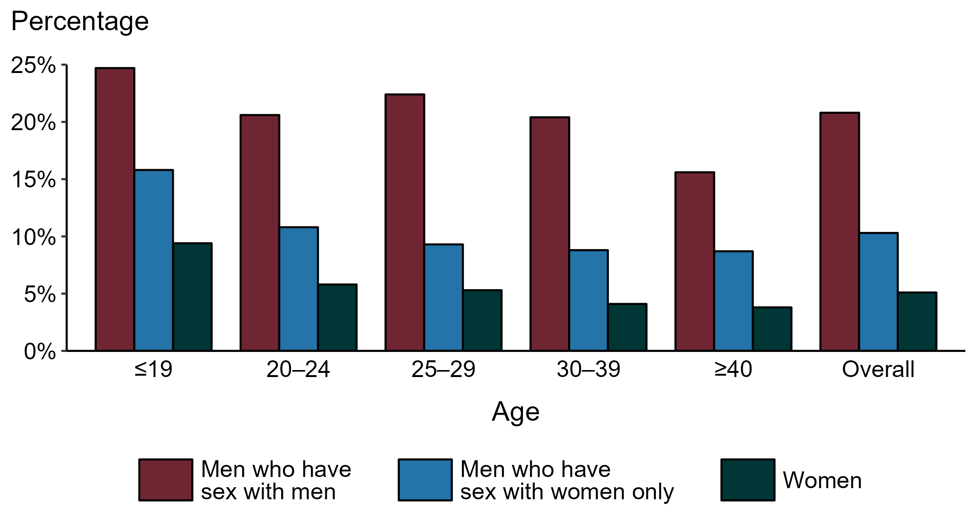
Gonorrhea — Proportion of STD Clinic Patients Testing Positive by Age Group, Sex, and Sex of Sex Partners, STD Surveillance Network (SSuN), 2022
NOTE: Results are based on 49,726 unique patients in 10 participating jurisdictions (Baltimore City, California [excluding San Francisco], Columbus, Florida, Indiana, Multnomah County, New York City, Philadelphia, San Francisco, and Washington) with known sex of sex partners attending SSuN STD clinics who were tested ≥1 times for gonorrhea in 2022.
Notes:
Among patients accessing care in participating STD clinics in the STD Surveillance Network (SSuN) who were tested for gonorrhea in 2022, 20.8% of gay, bisexual, and other men who have sex with men (MSM), 10.3% of men who have sex with women only (MSW), and 5.1% of women were positive. The proportion of STD clinic patients who tested positive for gonorrhea varied by sex and sex of sex partners, as well as by age group. MSM were noted to have higher proportions of testing positive in all age groups when compared to women and MSW. Of note, adolescent patients represent a relatively small subgroup of the clinic population and changes in the number of events in the numerator or a small denominator may lead to substantial fluctuations from year to year. Hence, data should be interpreted with caution.
This report includes data from years that coincide with the COVID-19 pandemic, which introduced uncertainty and difficulty in interpreting STI surveillance data. See Impact of COVID-19 on STIs for more information.
See Technical Notes (https://www.cdc.gov/std/statistics/2022/technical-notes.htm) for information on SSuN methodology.

Slide 3
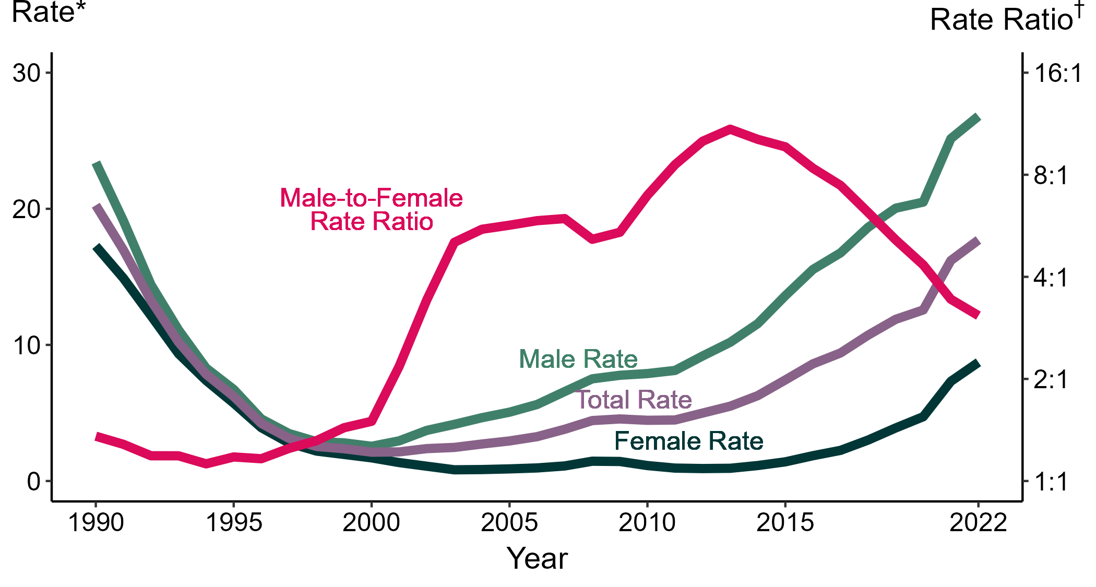
Primary and Secondary Syphilis — Rates of Reported Cases by Sex and Male-to-Female Rate Ratios, United States, 1990–2022
* Per 100,000
† Log scale
Notes:
Although the male-to-female rate ratio for primary and secondary syphilis increased from 1990 to 2013, the rate ratio has declined in recent years due to the increasing rate of syphilis among women. During 2018 to 2022, the rate of primary and secondary syphilis among women nearly tripled (3.0 per 100,000 in 2018 to 8.7 per 100,000 in 2022).
This report includes data from years that coincide with the COVID-19 pandemic, which introduced uncertainty and difficulty in interpreting STI surveillance data. See Impact of COVID-19 on STIs for more information.
See Technical Notes (https://www.cdc.gov/std/statistics/2022/technical-notes.htm) for information on syphilis case reporting.
Data for all figures are available at https://www.cdc.gov/std/statistics/2022/data.zip. The file “PS Syphilis - Rates by Sex and Male-to-Female Rate Ratios (US 1990-2022).xlsx” contains the data for the figure presented on this slide.

Slide 4
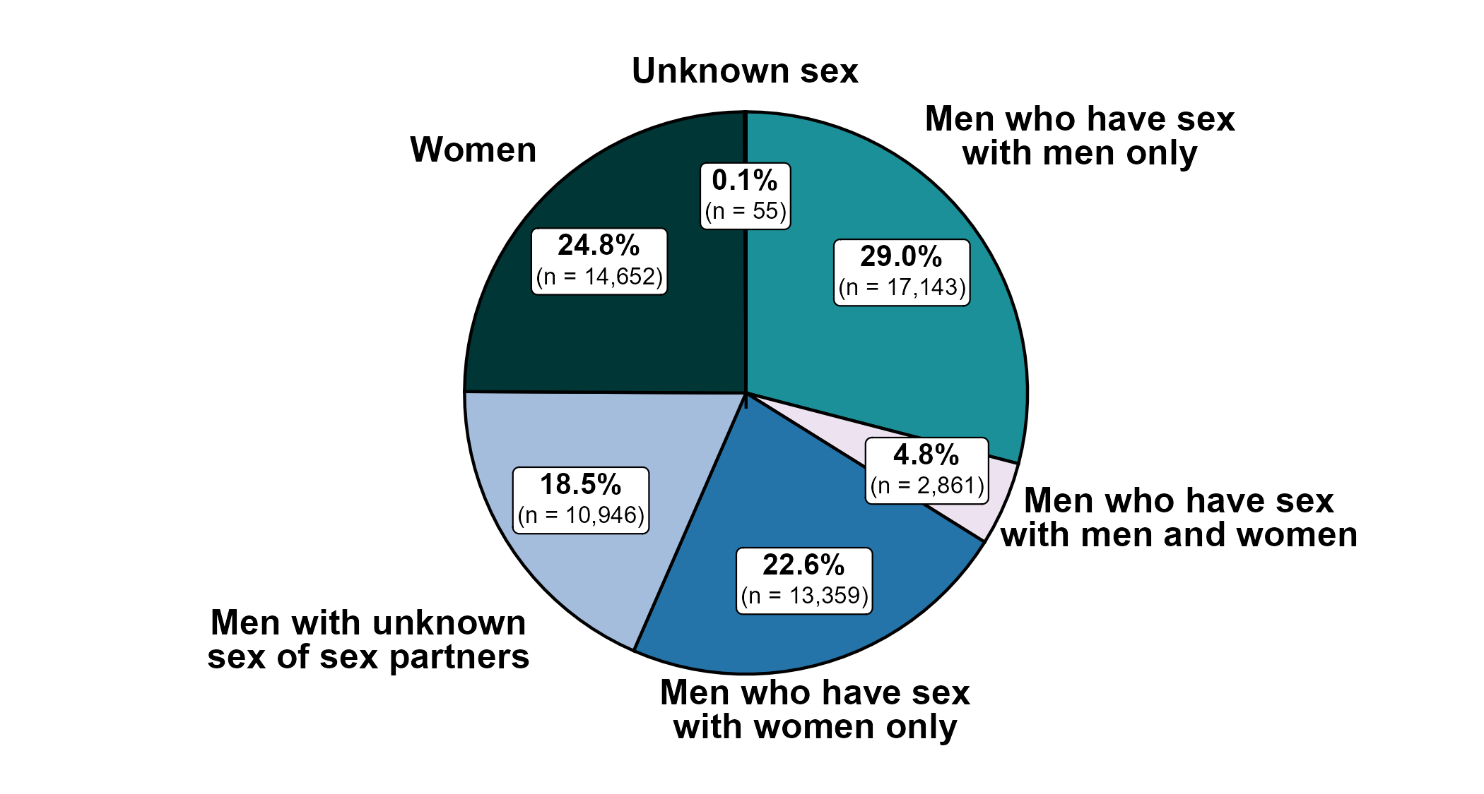
Primary and Secondary Syphilis — Distribution of Cases by Sex and Sex of Sex Partners, United States, 2022
Notes:
Of 59,016 reported primary and secondary syphilis cases in 2022, 29.0% were among men who have sex with men only. Men who have sex with men only combined with men who have sex with both men and women accounted for 33.9% of all primary and secondary syphilis cases, 45.1% of all male primary and secondary syphilis cases, and 60.0% of male primary and secondary syphilis cases with information on sex of sex partners. (Note that percentages in figure and text may not sum as expected due to rounding.)
This report includes data from years that coincide with the COVID-19 pandemic, which introduced uncertainty and difficulty in interpreting STI surveillance data. See Impact of COVID-19 on STIs for more information.
See Technical Notes (https://www.cdc.gov/std/statistics/2022/technical-notes.htm) for information on syphilis case reporting.
Data for all figures are available at https://www.cdc.gov/std/statistics/2022/data.zip. The file “PS Syphilis - Distribution by Sex and Sex of Sex Partners (US 2022).xlsx” contains the data for the figure presented on this slide.

Slide 5
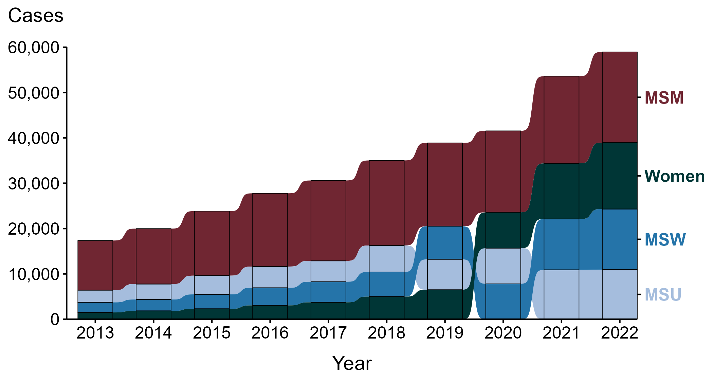
Primary and Secondary Syphilis — Reported Cases by Sex and Sex of Sex Partners, United States, 2013–2022
ACRONYMS: MSM = Men who have sex with men; MSU = Men with unknown sex of sex partners; MSW = Men who have sex with women only
Notes:
During the period from 2013 to 2022, a plurality (47.7%) of primary and secondary syphilis cases were among men who have sex with men (MSM; 165,642 cases).
During 2021 to 2022, the number of cases among MSM increased 4.0% (19,229 in 2021 to 20,004 in 2022), while the number of cases did not change substantially (<1.0% change) among men with unknown sex of sex partners (MSU; 10,892 in 2021 to 10,946 in 2022), increased 19.0% among men who have sex with women only (MSW; 11,228 in 2021 to 13,359 in 2022), and increased 19.5% among women (12,265 in 2021 to 14,652 in 2022).
During the five-year period from 2018 to 2022, the number of cases among MSM increased 6.6% (18,760 in 2018 to 20,004 in 2022), while the number of cases increased 86.9% among MSU (5,858 in 2018 to 10,946 in 2022), 146.7% among MSW (5,416 in 2018 to 13,359 in 2022), and 193.3% among women (4,995 in 2018 to 14,652 in 2022).
During the 10-year period from 2013 to 2022, the number of cases among MSM increased 82.6% (10,954 in 2013 to 20,004 in 2022), while the number of cases increased 307.4% among MSU (2,687 in 2013 to 10,946 in 2022), 501.8% among MSW (2,220 in 2013 to 13,359 in 2022), and 876.8% among women (1,500 in 2013 to 14,652 in 2022).
This report includes data from years that coincide with the COVID-19 pandemic, which introduced uncertainty and difficulty in interpreting STI surveillance data. See Impact of COVID-19 on STIs for more information.
See Technical Notes (https://www.cdc.gov/std/statistics/2022/technical-notes.htm) for information on syphilis case reporting. Table A1 (https://www.cdc.gov/std/statistics/2022/tables/a1.htm) provides information on unknown, missing, or invalid values of select variables.
Data for all figures are available at https://www.cdc.gov/std/statistics/2022/data.zip. The file “PS Syphilis - Cases by Sex and Sex of Sex Partners (US 2013-2022).xlsx” contains the data for the figure presented on this slide.

Slide 6
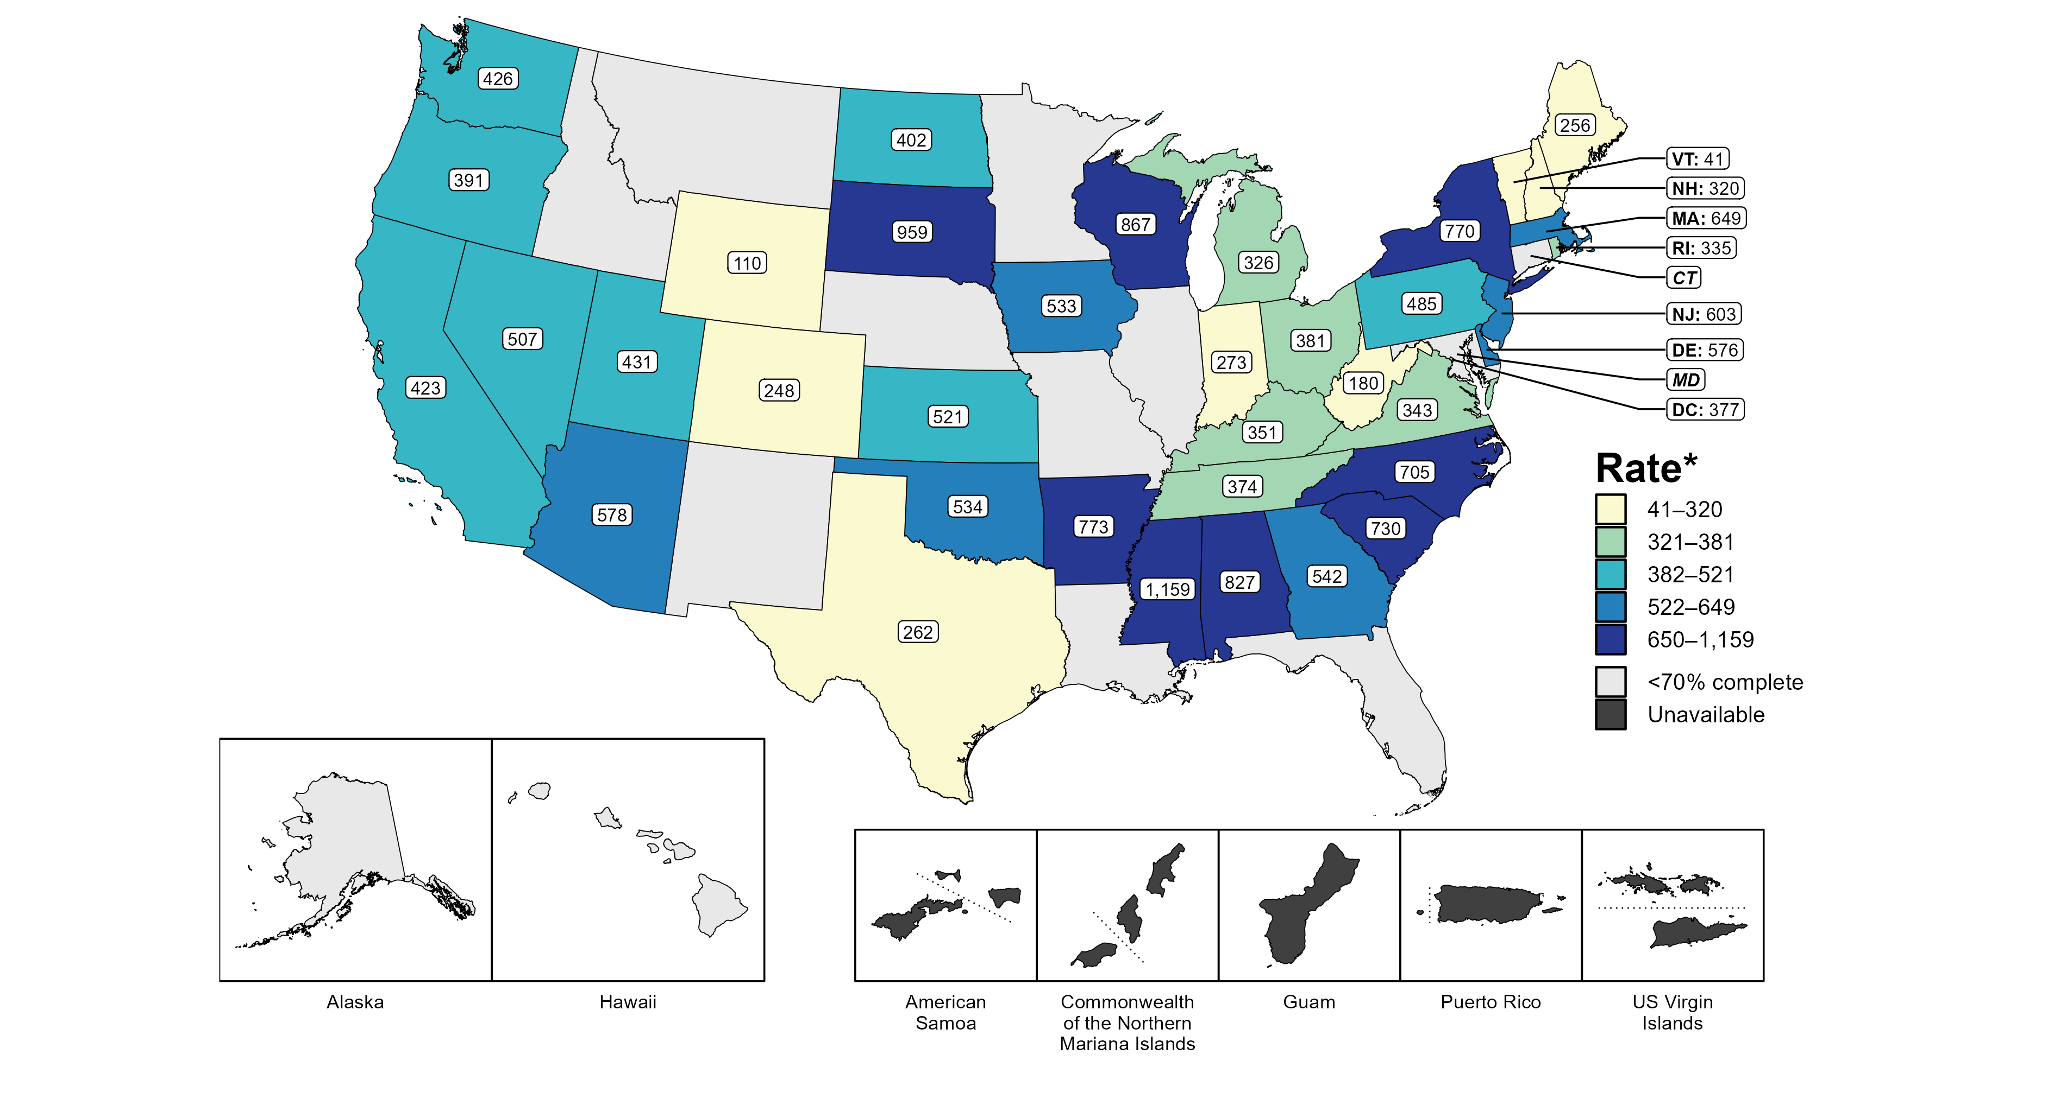
Primary and Secondary Syphilis — Estimated Rates of Reported Cases Among MSM by State, 37 States and the District of Columbia, 2022
* Per 100,000
NOTE: Figure displays rates for states reporting ≥70% completeness of sex of sex partners data for male primary and secondary syphilis cases in 2022. Population estimates for MSM in US territories are unavailable.
ACRONYMS: MSM = Men who have sex with men; MSW = Men who have sex with women only
Notes:
In 2022, 37 states and the District of Columbia (DC) provided data to classify at least 70% of male primary and secondary syphilis cases as men who have sex with men (MSM) or men who have sex with women only. Among the states, estimated rates of primary and secondary syphilis cases in MSM ranged from 41 per 100,000 in Vermont to 1,159 per 100,000 in Mississippi. The estimated rate in DC was 377 per 100,000.
This report includes data from years that coincide with the COVID-19 pandemic, which introduced uncertainty and difficulty in interpreting STI surveillance data. See Impact of COVID-19 on STIs for more information.
See Technical Notes (https://www.cdc.gov/std/statistics/2022/technical-notes.htm) for information on syphilis case reporting and information on estimating MSM population sizes for rate denominators. Table A1 (https://www.cdc.gov/std/statistics/2022/tables/a1.htm) provides information on unknown, missing, or invalid values of select variables.
Data for all figures are available at https://www.cdc.gov/std/statistics/2022/data.zip. The file “PS Syphilis - Rates MSM by Jurisdiction (US 2022).xlsx” contains the data for the figure presented on this slide.

Slide 7
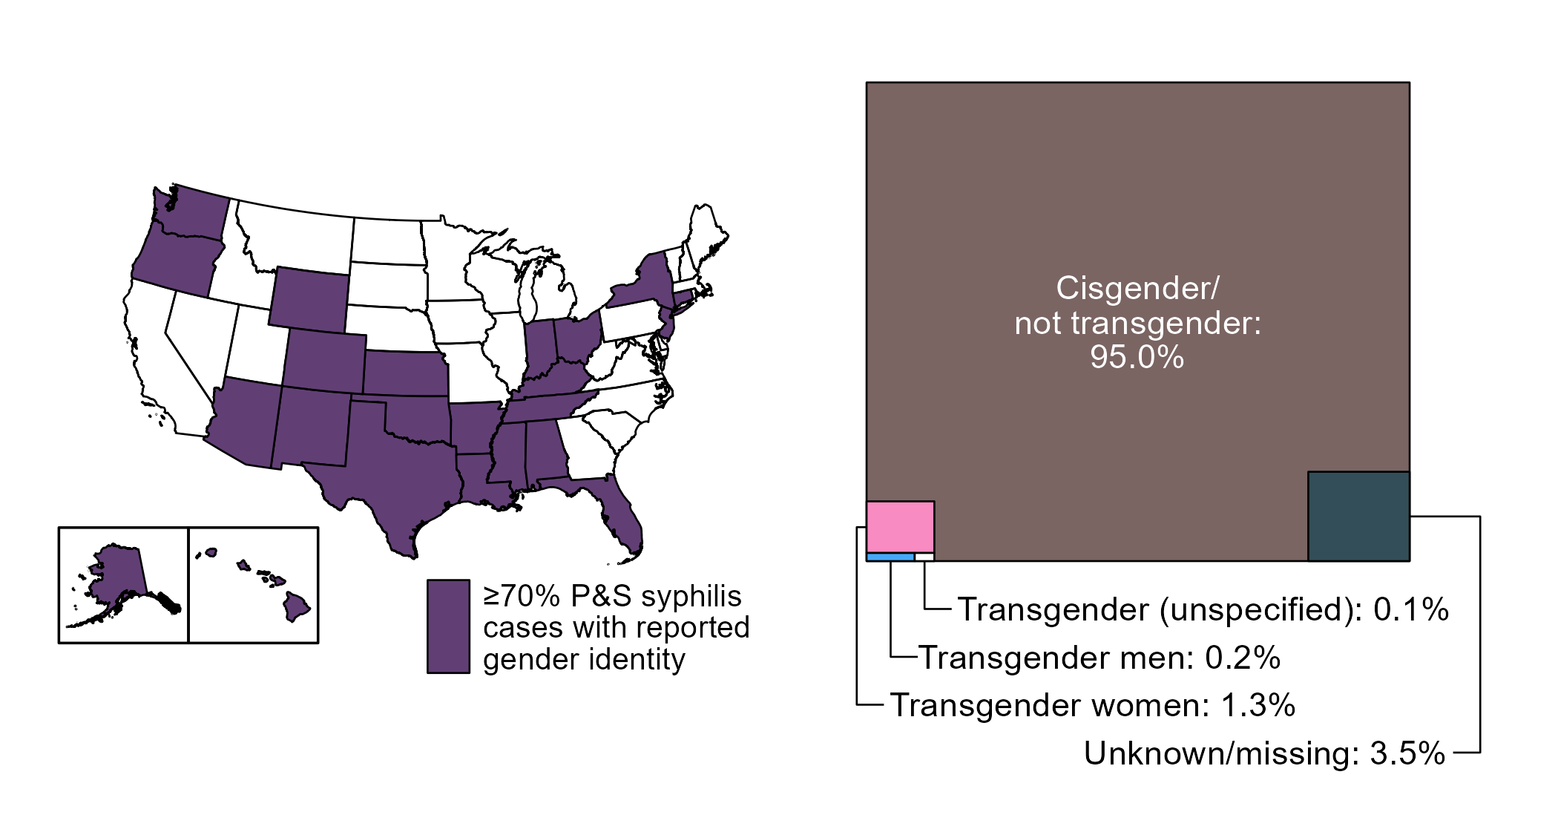
Primary and Secondary Syphilis — Distribution of Cases by Gender Identity, 23 States* and the District of Columbia, 2022
* States reporting gender identity for ≥70% reported primary and secondary syphilis cases in 2022; in 2022, 31 states and the District of Columbia reported on gender identity for primary and secondary syphilis cases
ACRONYMS: P&S syphilis = Primary and secondary syphilis
Notes:
Starting in 2018, jurisdictions were able to provide gender identity for reported cases of primary and secondary syphilis; however, not all jurisdictions have been able to report complete data. To minimize bias due to missing data, this figure displays data from states with ≥70% complete information on gender identity for primary and secondary syphilis cases. As reporting of gender identity improves, case counts and distribution of cases by gender identity will become more representative of the US.
In 2022, 23 states and the District of Columbia reported gender identity for ≥70% of reported primary and secondary syphilis cases. In those areas, 32,530 total cases were reported, of which 95.0% were reported with cisgender (i.e., not transgender) identity, 3.5% were reported with missing or unknown gender identity, and 1.6% were reported with transgender identity, specifically as transgender women (1.3%), transgender men (0.2%), and unspecified transgender identity (0.1%).
This report includes data from years that coincide with the COVID-19 pandemic, which introduced uncertainty and difficulty in interpreting STI surveillance data. See Impact of COVID-19 on STIs for more information.
See Technical Notes (https://www.cdc.gov/std/statistics/2022/technical-notes.htm) for information on syphilis case reporting and collection of gender identity.
Data for all figures are available at https://www.cdc.gov/std/statistics/2022/data.zip. The file “PS Syphilis - Distribution by Gender Identity in Reporting Jurisdictions (US 2022).xlsx” contains the data for the figure presented on this slide.

Slide 8
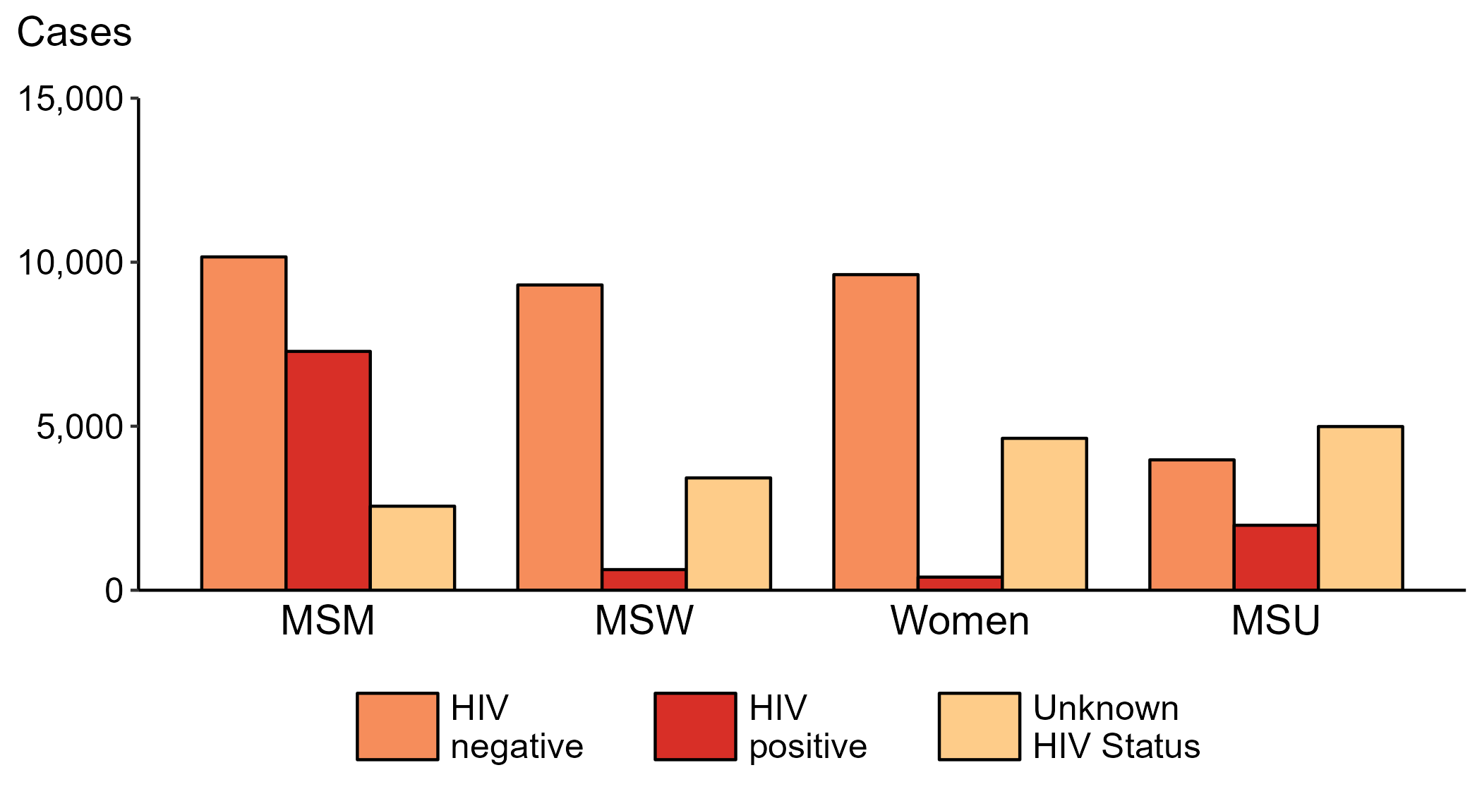
Primary and Secondary Syphilis — Reported Cases by Sex, Sex of Sex Partners, and HIV Status, United States, 2022
ACRONYMS: MSM = Men who have sex with men; MSW = Men who have sex with women only; MSU = Men with unknown sex of sex partners
Notes:
Among primary and secondary syphilis cases with reported HIV status, 41.7% of cases among men who have sex with men were HIV positive, compared with 33.3% of cases among men with unknown sex of sex partners, 6.3% of cases among men who have sex with women only, and 4.0% of cases among women.
For this figure, HIV status is categorized as reported by jurisdictions. Jurisdictions determine HIV status using multiple sources, including self-report, match with HIV registry, and available test results. Cases reported with a missing or unknown status are categorized as having an unknown HIV status.
This report includes data from years that coincide with the COVID-19 pandemic, which introduced uncertainty and difficulty in interpreting STI surveillance data. See Impact of COVID-19 on STIs for more information.
See Technical Notes (https://www.cdc.gov/std/statistics/2022/technical-notes.htm) for information on syphilis case reporting. Table A1 (https://www.cdc.gov/std/statistics/2022/tables/a1.htm) provides information on unknown, missing, or invalid values of select variables.
Data for all figures are available at https://www.cdc.gov/std/statistics/2022/data.zip. The file “PS Syphilis - Cases by Sex Sex of Sex Partners and HIV Status (US 2013-2022).xlsx” contains the data for the figure presented on this slide.

Slide 9
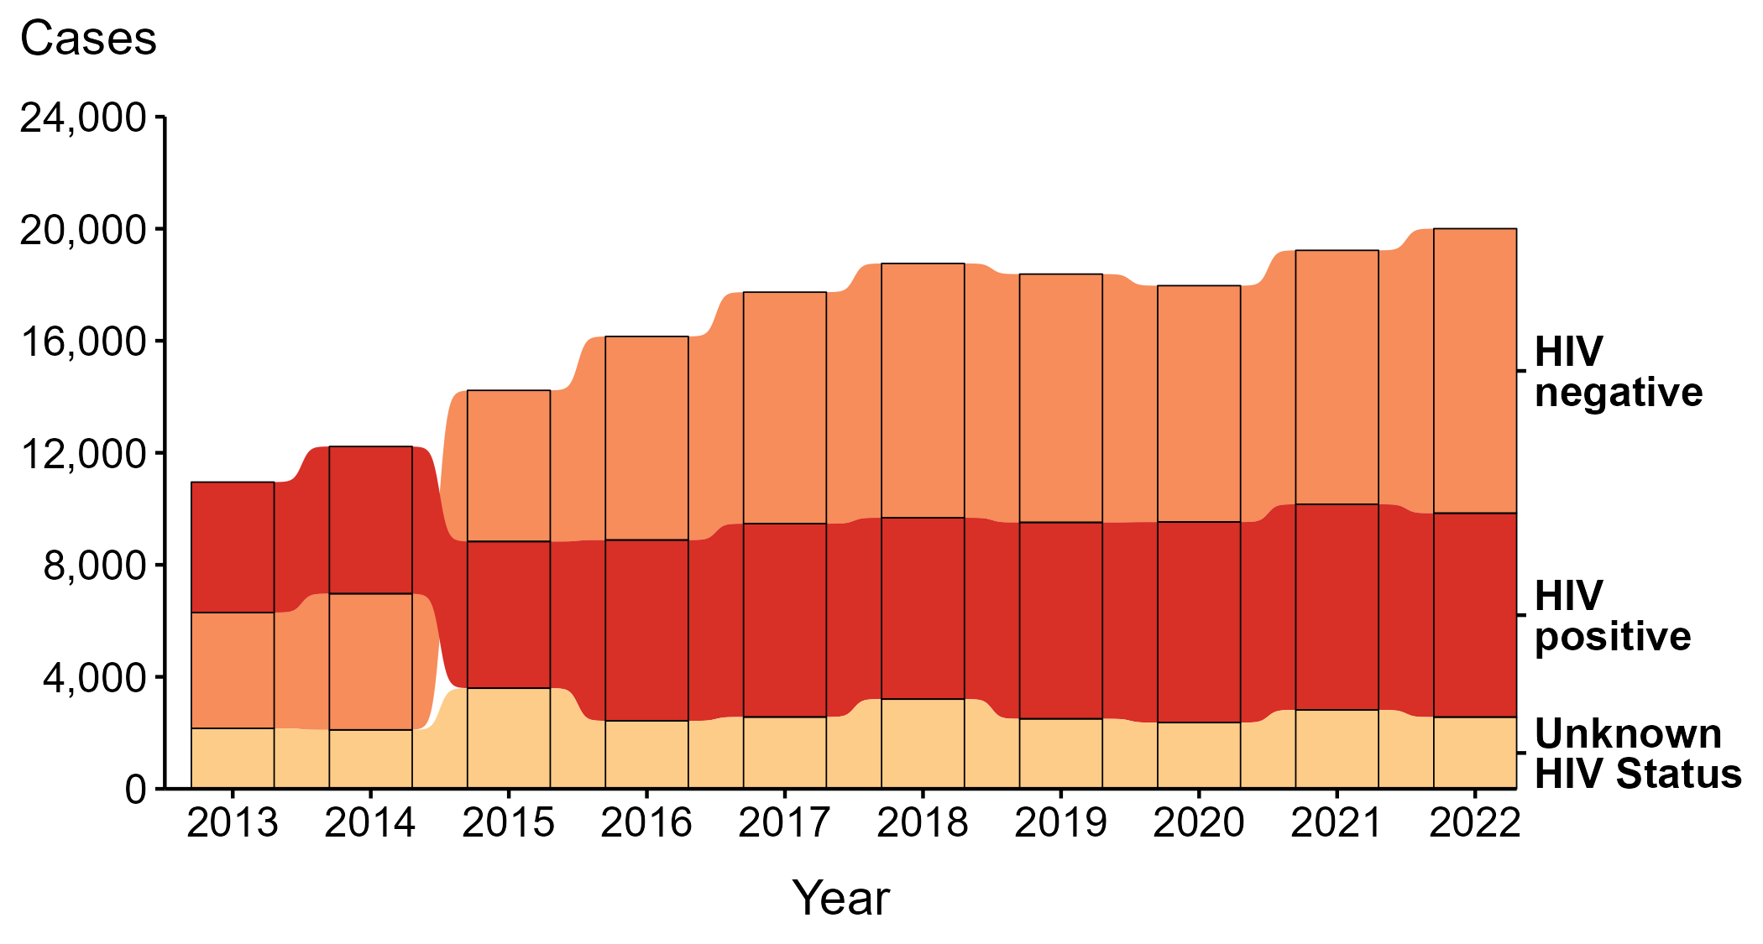
Primary and Secondary Syphilis — Reported Cases Among Men Who Have Sex with Men by HIV Status, United States, 2013–2022
Notes:
During 2013 to 2022, a plurality (45.6%) of primary and secondary syphilis cases among men who have sex with men (MSM) were among persons reported as HIV negative.
During 2021 to 2022, the number of cases among MSM who were reported as HIV negative increased 12.1% (from 9,068 in 2021 to 10,161 in 2022), the number who were reported as HIV positive did not change substantially (<1.0% change) (from 7,345 in 2021 to 7,281 in 2022), and the number who were reported with unknown HIV status decreased 9.0% (from 2,816 in 2021 to 2,562 in 2022).
During 2013 to 2022, the number of cases among MSM who were reported as HIV negative increased 145.6% (from 4,137 in 2013 to 10,161 in 2022), the number who were reported as HIV positive increased 56.3% (from 4,659 in 2013 to 7,281 in 2022), and the number who were reported with unknown HIV status increased 18.7% (from 2,158 in 2013 to 2,562 in 2022).
Since 2015, the number of primary and secondary syphilis cases among MSM who are HIV negative has surpassed the number of cases among those who are HIV positive.
For this figure, HIV status is categorized as reported by jurisdictions. Jurisdictions determine HIV status using multiple sources, including self-report, match with HIV registry, and available test results. Cases reported with a missing or unknown status are categorized as having an unknown HIV status.
This report includes data from years that coincide with the COVID-19 pandemic, which introduced uncertainty and difficulty in interpreting STI surveillance data. See Impact of COVID-19 on STIs for more information.
See Technical Notes (https://www.cdc.gov/std/statistics/2022/technical-notes.htm) for information on syphilis case reporting. Table A1 (https://www.cdc.gov/std/statistics/2022/tables/a1.htm) provides information on unknown, missing, or invalid values of select variables.
Data for all figures are available at https://www.cdc.gov/std/statistics/2022/data.zip. The file “PS Syphilis - Cases MSM by HIV Status (US 2013-2022).xlsx” contains the data for the figure presented on this slide.

Slide 10
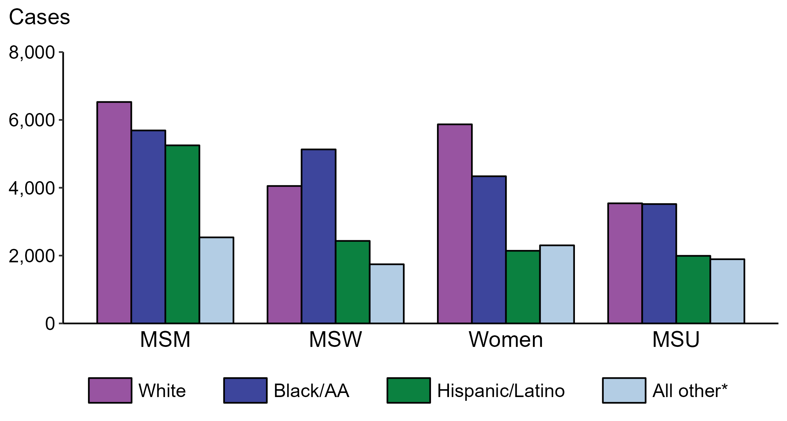
Primary and Secondary Syphilis — Reported Cases by Sex, Sex of Sex Partners, and Race/Hispanic Ethnicity, United States, 2022
* Includes persons with unknown race who were not reported with Hispanic ethnicity.
ACRONYMS: MSM = Men who have sex with men; MSW = Men who have sex with women only; MSU = Men with unknown sex of sex partners
Notes:
Within each of the four race/Hispanic ethnicity groups displayed, men who have sex with men (MSM) accounted for the highest proportion of primary and secondary (P&S) syphilis cases. Of P&S syphilis cases among MSM, 32.6% were non-Hispanic White, 28.4% were non-Hispanic Black or African American, 26.2% were Hispanic or Latino, and 12.7% were another known or unknown race and not reported to be Hispanic or Latino.
This report includes data from years that coincide with the COVID-19 pandemic, which introduced uncertainty and difficulty in interpreting STI surveillance data. See Impact of COVID-19 on STIs for more information.
See Technical Notes (https://www.cdc.gov/std/statistics/2022/technical-notes.htm) for information on syphilis case reporting, race/Hispanic ethnicity categorization, and reporting of race/Hispanic ethnicity for STI cases. Table A1 (https://www.cdc.gov/std/statistics/2022/tables/a1.htm) provides information on unknown, missing, or invalid values of select variables.
Data for all figures are available at https://www.cdc.gov/std/statistics/2022/data.zip. The file “PS Syphilis - Cases by Sex Sex of Sex Partners and Race Hispanic Ethnicity (US 2022) .xlsx” contains the data for the figure presented on this slide.

Slide 11
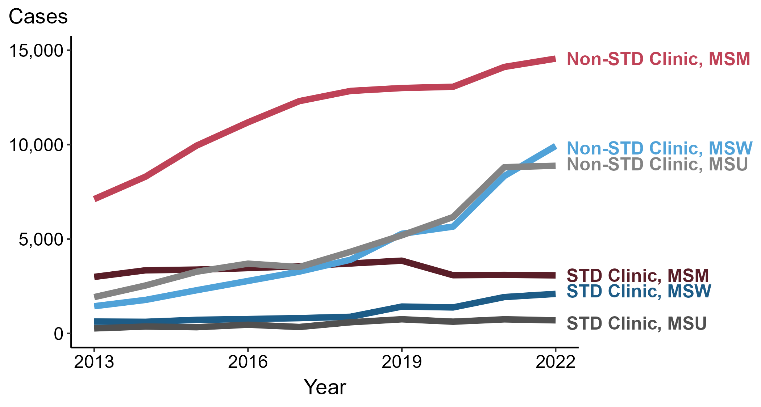
Primary and Secondary Syphilis — Reported Cases among Men by Reporting Source and Sex of Sex Partners, United States, 2013–2022
NOTE: During 2013 to 2022, the proportion of all male cases with unknown reporting source was 10.2%, from a low of 6.6% (n = 1,201) in 2014 to a high of 12.6% (n = 3,777) in 2018.
ACRONYMS: MSM = Men who have sex with men; MSW = Men who have sex with women only; MSU = Men with unknown sex of sex partners
Notes:
During 2021 to 2022, the number of primary and secondary (P&S) syphilis cases reported from STD clinics did not change substantially (<1.0% change) among men who have sex with men (MSM; 3,102 to 3,077 cases), increased 8.7% among men who have sex with women only (MSW; 1,928 to 2,096 cases), and decreased 7.0% among men with unknown sex of sex partners (MSU; 748 to 696 cases). Concurrently, the number of cases reported from non-STD clinics increased 3.1% among MSM (14,115 to 14,555 cases), increased 19.1% among MSW (8,337 to 9,929 cases), and did not change substantially (<1.0% change) among MSU (8,806 to 8,881 cases).
During a ten-year period (2013 to 2022), the number of P&S syphilis cases reported from STD clinics increased 2.7% among MSM (2,995 to 3,077 cases), 232.7% among MSW (630 to 2,096 cases), and 158.7% among MSU (269 to 696 cases). Over the same period, the number of cases reported from non-STD clinics increased 104.6% among MSM (7,114 to 14,555 cases), 588.1% among MSW (1,443 to 9,929 cases), and 361.4% among MSU (1,925 to 8,881 cases).
This report includes data from years that coincide with the COVID-19 pandemic, which introduced uncertainty and difficulty in interpreting STI surveillance data. See Impact of COVID-19 on STIs for more information.
See Technical Notes (https://www.cdc.gov/std/statistics/2022/technical-notes.htm) for information on syphilis case reporting. Table A1 (https://www.cdc.gov/std/statistics/2022/tables/a1.htm) provides information on unknown, missing, or invalid values of select variables.
Data for all figures are available at https://www.cdc.gov/std/statistics/2022/data.zip. The file “PS Syphilis - Cases Men by Reporting Source and Sex of Sex Partners (US 2013-2022).xlsx” contains the data for the figure presented on this slide.

Slide 12
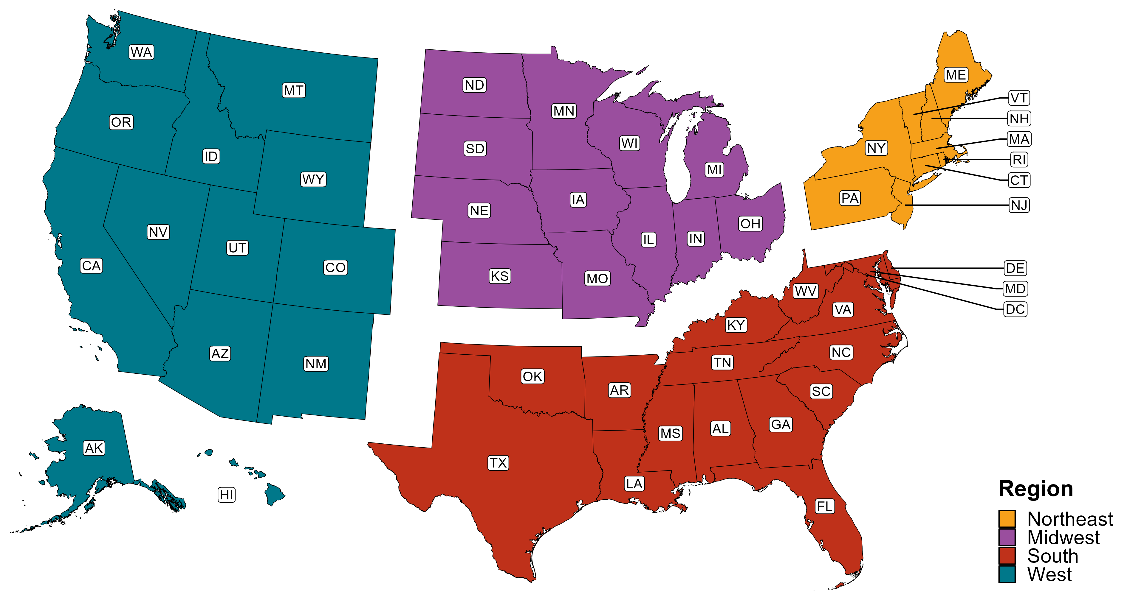
Reference Map of US Census Regions

