Slide 1
Sexually Transmitted Infections
Surveillance 2022
Racial and Ethnic Minorities
Notes:
This slide set was prepared by the Division of STD Prevention, National Center for HIV, Viral Hepatitis, STD, and TB Prevention (NCHHSTP), Centers for Disease Control and Prevention (CDC). These slides display trends for STIs in the United States through 2022. Data presented include case notifications provided to CDC through the National Notifiable Diseases Surveillance System (NNDSS) and data collected through projects and programs that monitor STIs in various settings, including the STD Surveillance Network (SSuN), and the Gonococcal Isolate Surveillance Project (GISP).
For more information on data sources, data collection and reporting practices, and case definitions, please see the Technical Notes, available at https://www.cdc.gov/std/statistics/2022/technical-notes.htm.
All data points for figures presented in these slides are available at https://www.cdc.gov/std/statistics/2022/data.zip.
NOTE: This slide set is in the public domain. You may reproduce these slides without permission; however, citation as to source is appreciated.
Centers for Disease Control and Prevention. Sexually Transmitted Infections Surveillance 2022. Atlanta: U.S. Department of Health and Human Services; 2024.
You are also free to adapt and revise these slides; however, you must remove the CDC name and logo if changes are made.

Slide 2
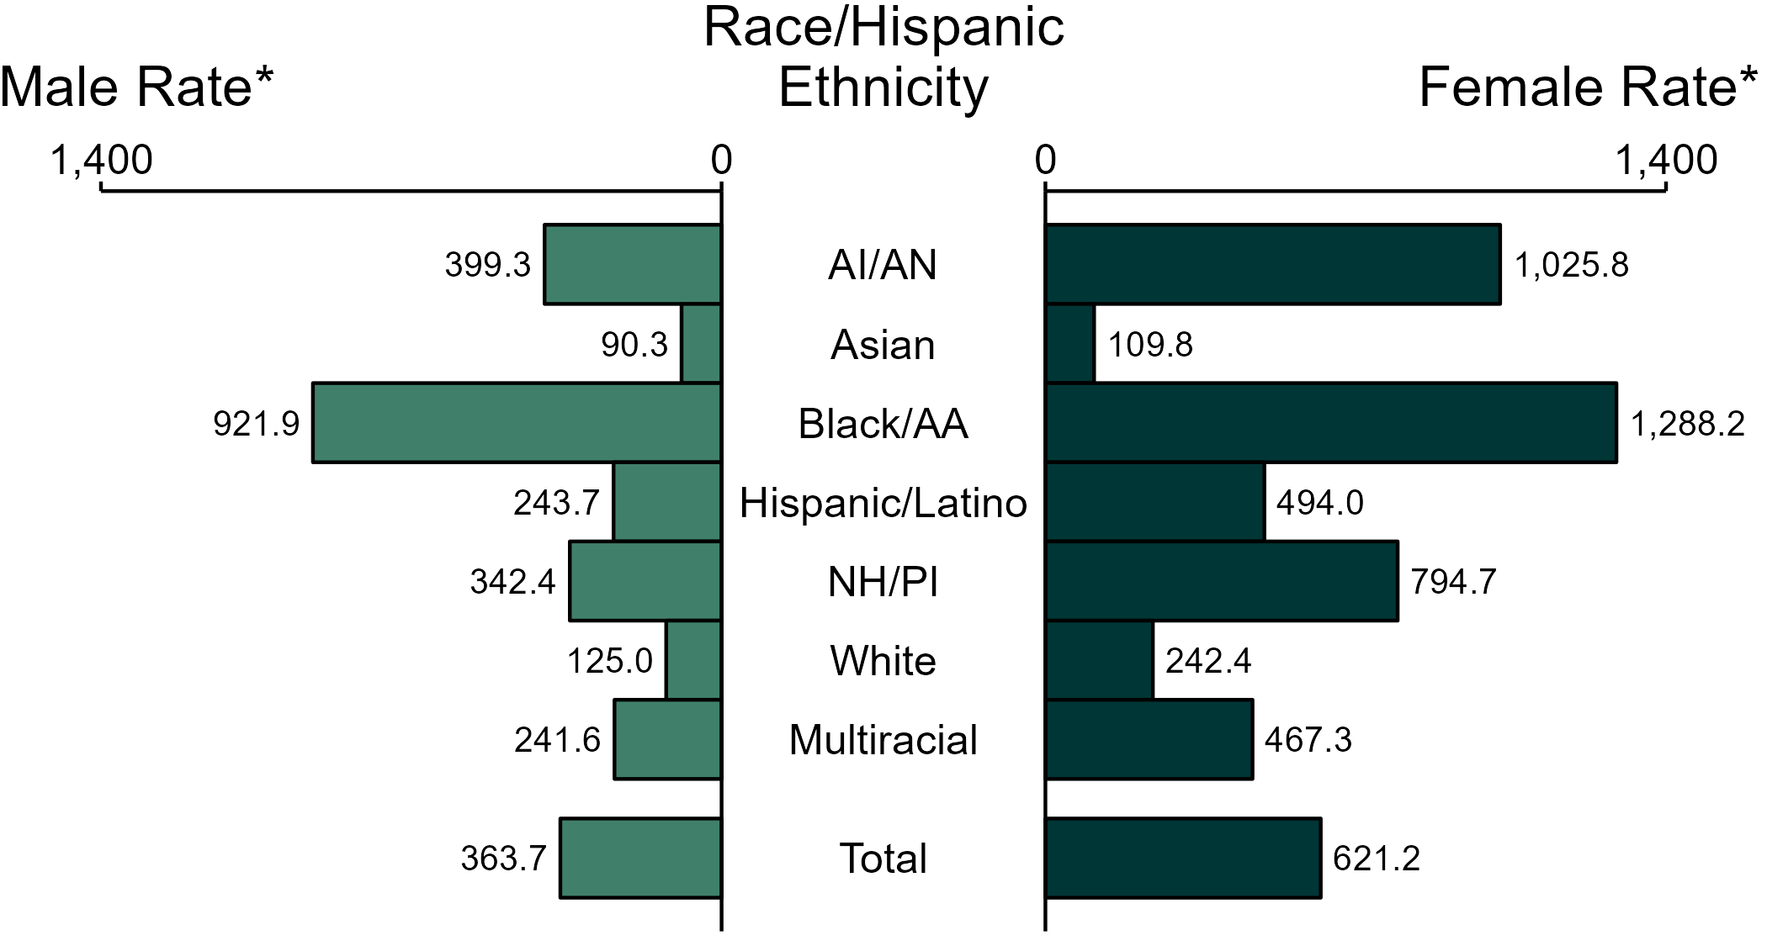
Chlamydia — Rates of Reported Cases by Race/Hispanic Ethnicity and Sex, United States, 2022
* Per 100,000
ACRONYMS: AI/AN = American Indian or Alaska Native; Black/AA = Black or African American; NH/PI = Native Hawaiian or other Pacific Islander
NOTE: Total includes all cases including those with unknown race/Hispanic ethnicity.
Notes:
In 2022, the rate of reported chlamydia was higher among women (621.2 per 100,000) compared to men (363.7 per 100,000).
Among women, non-Hispanic Black or African American women had the highest rate of reported cases of chlamydia (1,288.2 per 100,000), followed by non-Hispanic American Indian or Alaska Native women (1,025.8 per 100,000) and non-Hispanic Native Hawaiian or other Pacific Islander women (794.7 per 100,000). Among men, non-Hispanic Black or African American men also had the highest rate of reported cases of chlamydia (921.9 per 100,000), followed by non-Hispanic American Indian or Alaska Native men (399.3 per 100,000) and non-Hispanic Native Hawaiian or other Pacific Islander men (342.4 per 100,000).
Using non-Hispanic White persons as the referent category, the greatest relative racial disparity in rates of reported chlamydia across both sexes was observed among non-Hispanic Black or African American men, with a rate ratio of 7.4 times that of non-Hispanic White men. Among women, the greatest relative disparity was observed among non-Hispanic Black or African American women as well, with a rate 5.3 times that of non-Hispanic White women.
This report includes data from years that coincide with the COVID-19 pandemic, which introduced uncertainty and difficulty in interpreting STI surveillance data. See Impact of COVID-19 on STIs for more information.
See Technical Notes (https://www.cdc.gov/std/statistics/2022/technical-notes.htm) for information on chlamydia case reporting, race/Hispanic ethnicity categorization, and reporting of race/Hispanic ethnicity for STI cases. Table A1 (https://www.cdc.gov/std/statistics/2022/tables/a1.htm) provides information on unknown, missing, or invalid values of select variables.
Data for all figures are available at https://www.cdc.gov/std/statistics/2022/data.zip. The file “CT - Rates by Race Hispanic Ethnicity and Sex (US 2022).xlsx” contains the data for the figure presented on this slide.

Slide 3
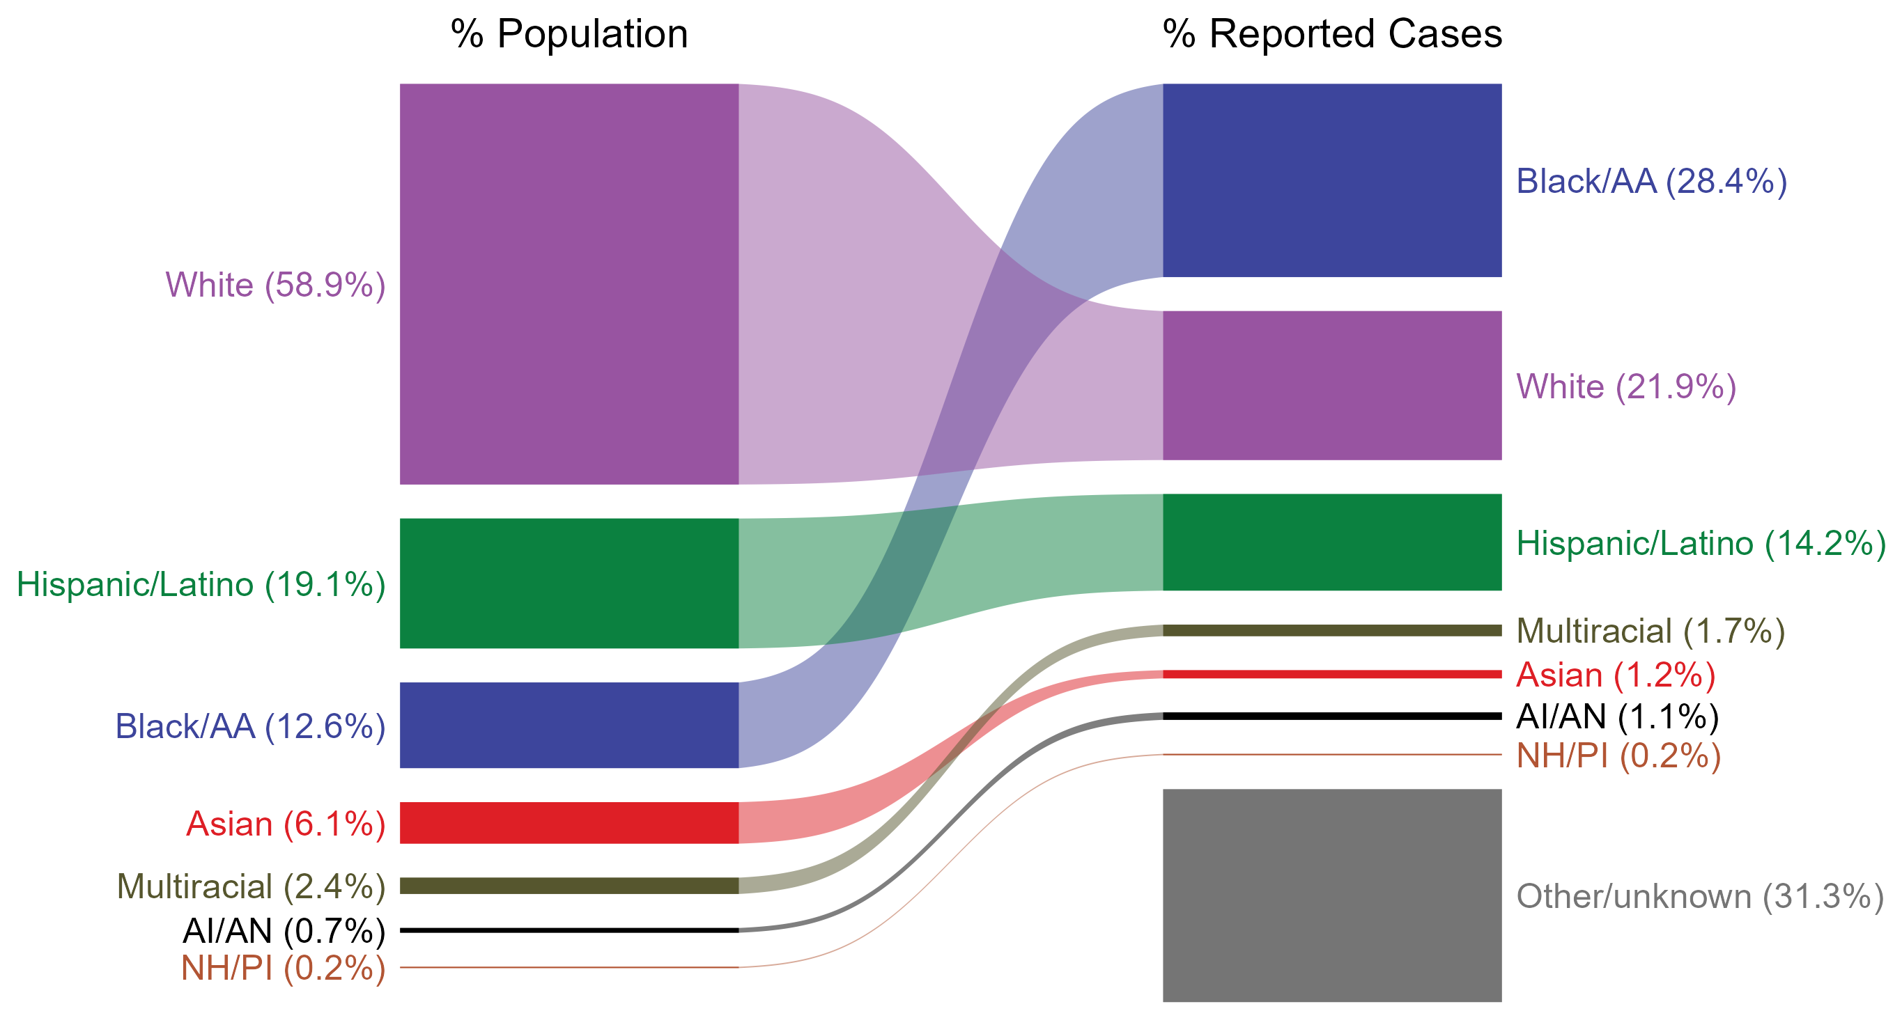
Chlamydia — Total Population and Reported Cases by Race/Hispanic Ethnicity, United States, 2022
* Per 100,000
NOTE: In 2022, a total of 515,552 chlamydia cases (31.3%) had missing, unknown, or other race and were not reported to be of Hispanic ethnicity. These cases are included in the “other/unknown” category.
ACRONYMS: AI/AN = American Indian or Alaska Native; Black/AA = Black or African American; NH/PI = Native Hawaiian or other Pacific Islander
Notes:
The percentages of chlamydia cases by race/Hispanic ethnicity were disproportionate to the percentages among the total population of the United States in 2022. The greatest absolute and relative disparities were observed among non-Hispanic Black or African American persons, who represented 28.4% of reported chlamydia cases (n = 468,384; 41.3% of chlamydia cases with reported race or Hispanic ethnicity) despite being 12.6% of the US population. This is means that the burden of chlamydia among non-Hispanic Black or African American persons was 15.8% greater than — or 2.3 times — what would be expected based on their proportion of the population. Additionally, non-Hispanic American Indian or Alaska Native persons were also overrepresented among chlamydia cases relative to their proportion of the population.
This report includes data from years that coincide with the COVID-19 pandemic, which introduced uncertainty and difficulty in interpreting STI surveillance data. See Impact of COVID-19 on STIs for more information.
See Technical Notes (https://www.cdc.gov/std/statistics/2022/technical-notes.htm) for information on chlamydia case reporting, race/Hispanic ethnicity categorization, and reporting of race/Hispanic ethnicity for STI cases.
Data for all figures are available at https://www.cdc.gov/std/statistics/2022/data.zip. The file “CT - Population and Cases by Race Hispanic Ethnicity (US 2022).xlsx” contains the data for the figure presented on this slide.

Slide 4
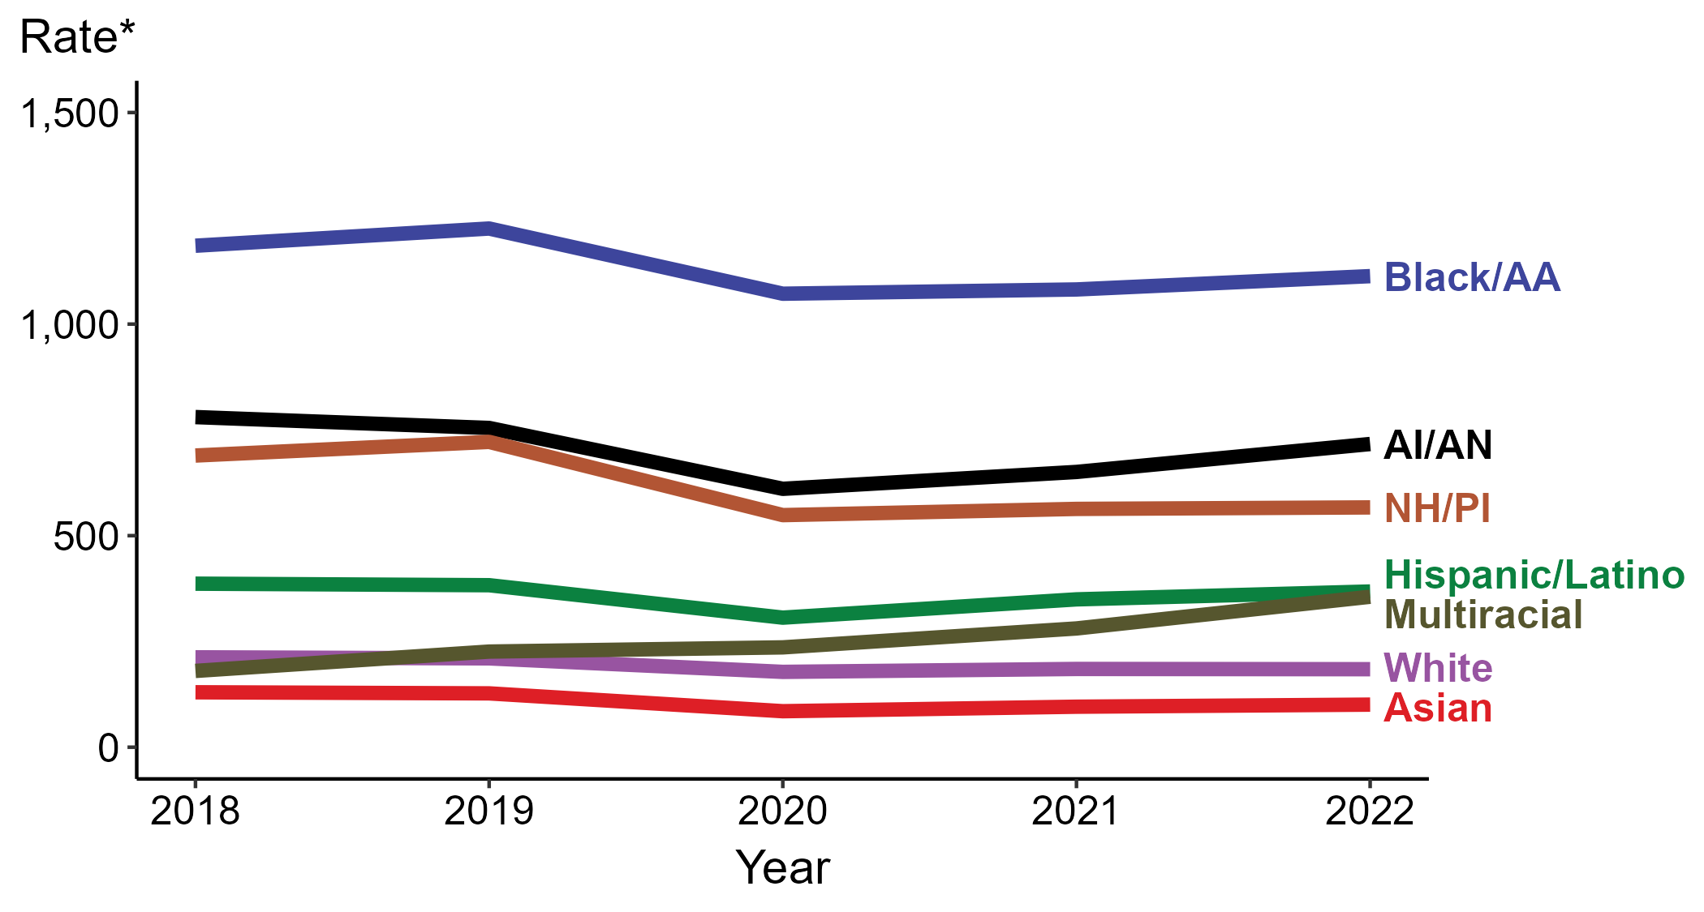
Chlamydia — Rates of Reported Cases by Race/Hispanic Ethnicity, United States, 2018–2022
* Per 100,000
ACRONYMS: AI/AN = American Indian or Alaska Native; Black/AA = Black or African American; NH/PI = Native Hawaiian or other Pacific Islander
Notes:
In 2022, the highest rate of reported chlamydia cases per 100,000 persons was among non-Hispanic Black or African American persons (1,113.3), followed by non-Hispanic American Indian or Alaska Native persons (716.6).
During 2021 to 2022, the greatest increase in rate of reported chlamydia cases per 100,000 persons was among non-Hispanic persons of multiple races (280.7 to 355.6; 26.7% increase). Non-Hispanic persons of multiple races also had the only five-year increase in rate of reported chlamydia (180.3 to 355.6; 97.2% increase from 2018).
There were no substantial (≥1.0%) decreases in the rate of reported chlamydia cases per 100,000 persons among any race or Hispanic ethnicity group during 2021 to 2022. Non-Hispanic Asian persons had the greatest five-year decrease in rate of reported chlamydia (129.8 to 100.6; 22.5% decrease from 2018).
This report includes data from years that coincide with the COVID-19 pandemic, which introduced uncertainty and difficulty in interpreting STI surveillance data. See Impact of COVID-19 on STIs for more information.
See Technical Notes (https://www.cdc.gov/std/statistics/2022/technical-notes.htm) for information on chlamydia case reporting, race/Hispanic ethnicity categorization, and reporting of race/Hispanic ethnicity for STI cases. Table A1 (https://www.cdc.gov/std/statistics/2022/tables/a1.htm) provides information on unknown, missing, or invalid values of select variables.
Data for all figures are available at https://www.cdc.gov/std/statistics/2022/data.zip. The file “CT - Rates by Race Hispanic Ethnicity (US 2018-2022).xlsx” contains the data for the figure presented on this slide.

Slide 5
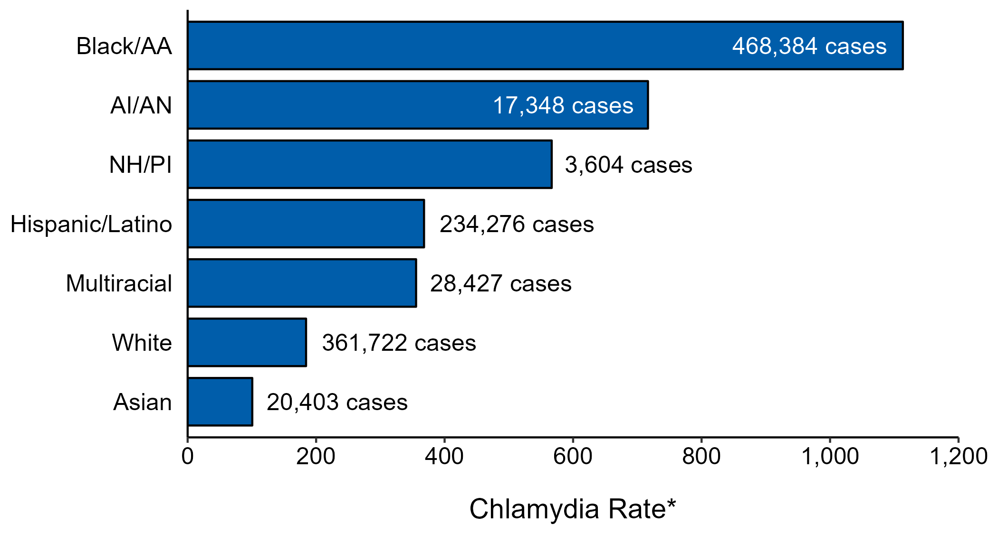
Chlamydia — Case Counts and Rates of Reported Cases by Race/Hispanic Ethnicity, United States, 2022
* Per 100,000 population
NOTE: In 2022, a total of 515,552 chlamydia cases (31.3%) had missing, unknown, or other race and were not reported to be of Hispanic ethnicity. These cases are not shown in this plot.
ACRONYMS: AI/AN = American Indian or Alaska Native; Black/AA = Black or African American; NH/PI = Native Hawaiian or other Pacific Islander
Notes:
In 2022, rates of chlamydia were highest among non-Hispanic Black or African American persons (1,113.3 per 100,000), followed by non-Hispanic American Indian or Alaska Native persons (716.6 per 100,000) and non-Hispanic Native Hawaiian or other Pacific Islander persons (566.7 per 100,000). The greatest number of reported chlamydia cases was among non-Hispanic Black or African American persons (468,384 cases), followed by non-Hispanic White persons (361,722 cases) and Hispanic or Latino persons of any race(s) (234,276 cases).
This report includes data from years that coincide with the COVID-19 pandemic, which introduced uncertainty and difficulty in interpreting STI surveillance data. See Impact of COVID-19 on STIs for more information.
See Technical Notes (https://www.cdc.gov/std/statistics/2022/technical-notes.htm) for information on chlamydia case reporting and reporting of race/Hispanic ethnicity for STI cases.
Data for all figures are available at https://www.cdc.gov/std/statistics/2022/data.zip. The file “CT - Cases and Rates by Race Hispanic Ethnicity (US 2022).xlsx” contains the data for the figure presented on this slide.

Slide 6
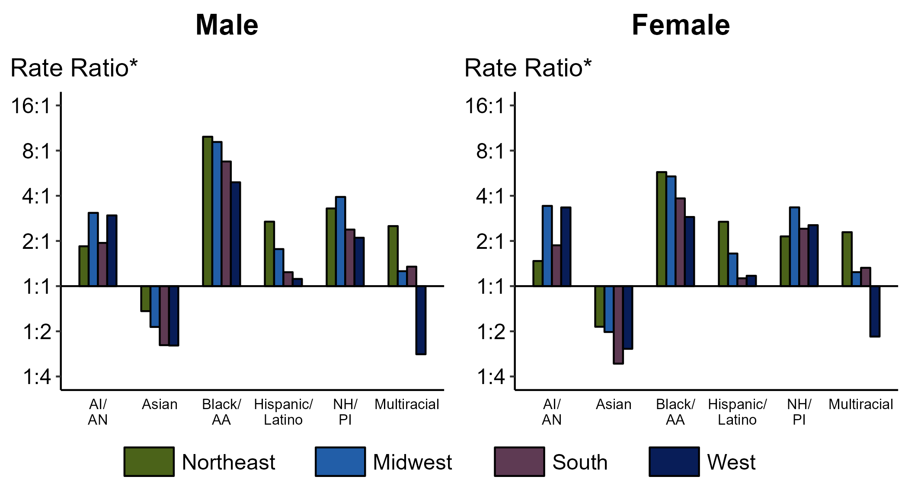
Chlamydia — Ratios of Rates of Reported Cases Among Persons Aged 15–24 Years by Sex, Race/Hispanic Ethnicity, and Region, United States, 2022
* For the rate ratios, non-Hispanic White persons are the referent population. Y-axis is log scale.
ACRONYMS: AI/AN = American Indian or Alaska Native; Black/AA = Black or African American; NH/PI = Native Hawaiian or other Pacific Islander
Notes:
Among men and women aged 15-24 years, rate ratios of rates of reported chlamydia by race/Hispanic ethnicity (using non-Hispanic White persons as the referent population) varied by region in 2022. Among men aged 15-24 years, the greatest rate ratio was in the Northeast where the rate of reported chlamydia among non-Hispanic Black men was 9.9 times the rate among non-Hispanic White men. Among women aged 15-24 years, the greatest rate ratio was in the Northeast where the rate of reported chlamydia among non-Hispanic Black women was 5.8 times the rate among non-Hispanic White women.
This report includes data from years that coincide with the COVID-19 pandemic, which introduced uncertainty and difficulty in interpreting STI surveillance data. See Impact of COVID-19 on STIs for more information.
See Technical Notes (https://www.cdc.gov/std/statistics/2022/technical-notes.htm) for information on chlamydia case reporting, race/Hispanic ethnicity categorization, and reporting of race/Hispanic ethnicity for STI cases. Table A1 (https://www.cdc.gov/std/statistics/2022/tables/a1.htm) provides information on unknown, missing, or invalid values of select variables.

Slide 7
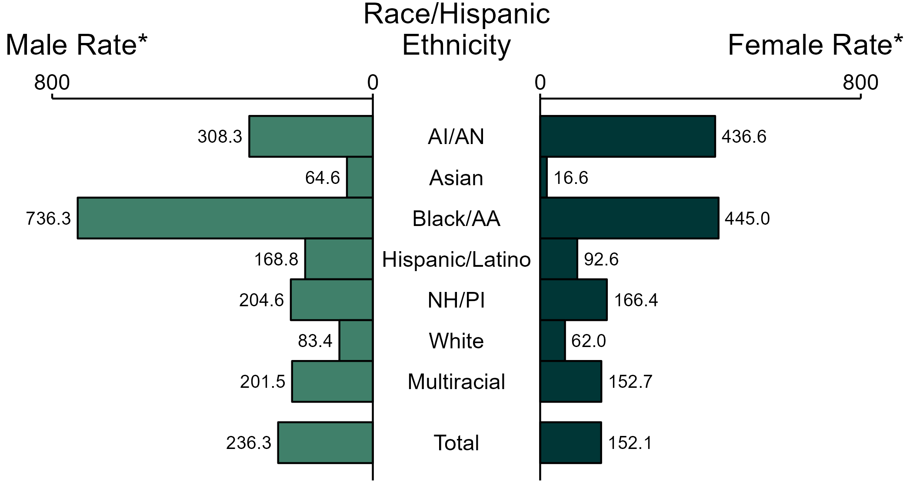
Gonorrhea — Rates of Reported Cases by Race/Hispanic Ethnicity and Sex, United States, 2022
* Per 100,000
ACRONYMS: AI/AN = American Indian or Alaska Native; Black/AA = Black or African American; NH/PI = Native Hawaiian or other Pacific Islander
NOTE: Total includes all cases including those with unknown race/Hispanic ethnicity.
Notes:
In 2022, the rate of reported gonorrhea was higher among men (236.3 per 100,000) compared to women (152.1 per 100,000).
Among men, non-Hispanic Black or African American men had the highest rate of reported cases of gonorrhea (736.3 per 100,000), followed by non-Hispanic American Indian or Alaska Native men (308.3 per 100,000) and non-Hispanic Native Hawaiian or other Pacific Islander men (204.6 per 100,000). Among women, non-Hispanic Black or African American women also had the highest rate of reported cases of gonorrhea (445.0 per 100,000), followed by non-Hispanic American Indian or Alaska Native women (436.6 per 100,000) and non-Hispanic Native Hawaiian or other Pacific Islander women (166.4 per 100,000).
Using non-Hispanic White persons as the referent category, the greatest relative racial disparity in rates of reported gonorrhea across both sexes was observed among non-Hispanic Black or African American men, with a rate ratio of 8.8 times that of non-Hispanic White men. Among women, the greatest relative disparity was observed among non-Hispanic Black or African American women as well, with a rate 7.2 times that of non-Hispanic White women.
This report includes data from years that coincide with the COVID-19 pandemic, which introduced uncertainty and difficulty in interpreting STI surveillance data. See Impact of COVID-19 on STIs for more information.
See Technical Notes (https://www.cdc.gov/std/statistics/2022/technical-notes.htm) for information on gonorrhea case reporting, race/Hispanic ethnicity categorization, and reporting of race/Hispanic ethnicity for STI cases. Table A1 (https://www.cdc.gov/std/statistics/2022/tables/a1.htm) provides information on unknown, missing, or invalid values of select variables.
Data for all figures are available at https://www.cdc.gov/std/statistics/2022/data.zip. The file “GC - Rates by Race Hispanic Ethnicity and Sex (US 2022).xlsx” contains the data for the figure presented on this slide.

Slide 8
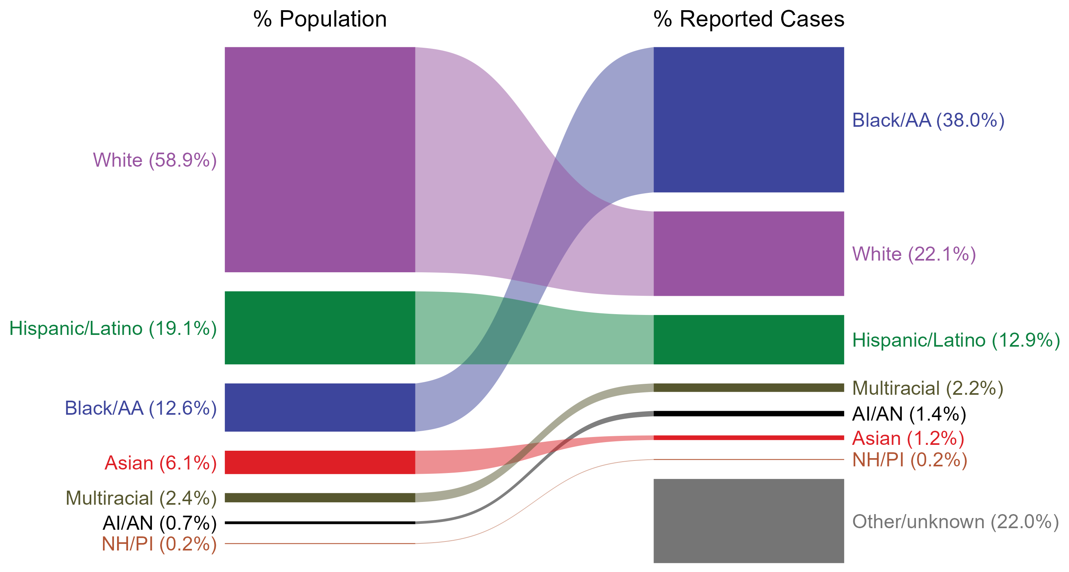
Gonorrhea — Total Population and Reported Cases by Race/Hispanic Ethnicity, United States, 2022
* Per 100,000
NOTE: In 2022, a total of 142,317 gonorrhea cases (22.0%) had missing, unknown, or other race and were not reported to be of Hispanic ethnicity. These cases are included in the “other/unknown” category.
ACRONYMS: AI/AN = American Indian or Alaska Native; Black/AA = Black or African American; NH/PI = Native Hawaiian or other Pacific Islander
Notes:
The percentages of gonorrhea cases by race/Hispanic ethnicity were disproportionate to the percentages among the total population of the United States in 2022. The greatest absolute and relative disparities were observed among non-Hispanic Black or African American persons, who represented 38.0% of reported gonorrhea cases (n = 246,480; 48.7% of gonorrhea cases with reported race or Hispanic ethnicity) despite being 12.6% of the US population. This is means that the burden of gonorrhea among non-Hispanic Black or African American persons was 25.4% greater than — or 3.0 times — what would be expected based on their proportion of the population. Additionally, non-Hispanic American Indian or Alaska Native persons were also overrepresented among gonorrhea cases relative to their proportion of the population.
This report includes data from years that coincide with the COVID-19 pandemic, which introduced uncertainty and difficulty in interpreting STI surveillance data. See Impact of COVID-19 on STIs for more information.
See Technical Notes (https://www.cdc.gov/std/statistics/2022/technical-notes.htm) for information on gonorrhea case reporting, race/Hispanic ethnicity categorization, and reporting of race/Hispanic ethnicity for STI cases.
Data for all figures are available at https://www.cdc.gov/std/statistics/2022/data.zip. The file “GC - Population and Cases by Race Hispanic Ethnicity (US 2022).xlsx” contains the data for the figure presented on this slide.

Slide 9
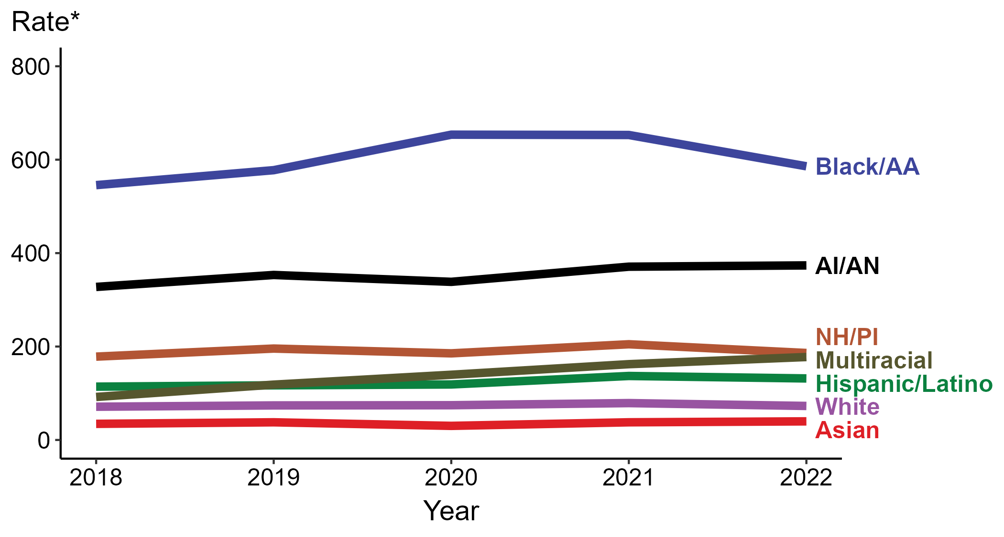
Gonorrhea — Rates of Reported Cases by Race/Hispanic Ethnicity, United States, 2018–2022
* Per 100,000
ACRONYMS: AI/AN = American Indian or Alaska Native; Black/AA = Black or African American; NH/PI = Native Hawaiian or other Pacific Islander
Notes:
In 2022, the highest rate of reported gonorrhea cases per 100,000 persons was among non-Hispanic Black or African American persons (585.9), followed by non-Hispanic American Indian or Alaska Native persons (373.7).
During 2021 to 2022, the greatest increase in rate of reported gonorrhea cases per 100,000 persons was among non-Hispanic persons of multiple races (162.2 to 177.5; 9.4% increase). Non-Hispanic persons of multiple races also had the greatest five-year increase in rate of reported gonorrhea (92.1 to 177.5; 92.7% increase from 2018).
During 2021 to 2022, the greatest decrease in rate of reported gonorrhea cases per 100,000 persons was among non-Hispanic Black or African American persons (652.9 to 585.9; 10.3% decrease). There were no decreases in the rate of reported gonorrhea among any race or Hispanic ethnicity group during 2018 to 2022.
This report includes data from years that coincide with the COVID-19 pandemic, which introduced uncertainty and difficulty in interpreting STI surveillance data. See Impact of COVID-19 on STIs for more information.
See Technical Notes (https://www.cdc.gov/std/statistics/2022/technical-notes.htm) for information on gonorrhea case reporting, race/Hispanic ethnicity categorization, and reporting of race/Hispanic ethnicity for STI cases. Table A1 (https://www.cdc.gov/std/statistics/2022/tables/a1.htm) provides information on unknown, missing, or invalid values of select variables.
Data for all figures are available at https://www.cdc.gov/std/statistics/2022/data.zip. The file “GC - Rates by Race Hispanic Ethnicity (US 2018-2022).xlsx” contains the data for the figure presented on this slide.

Slide 10
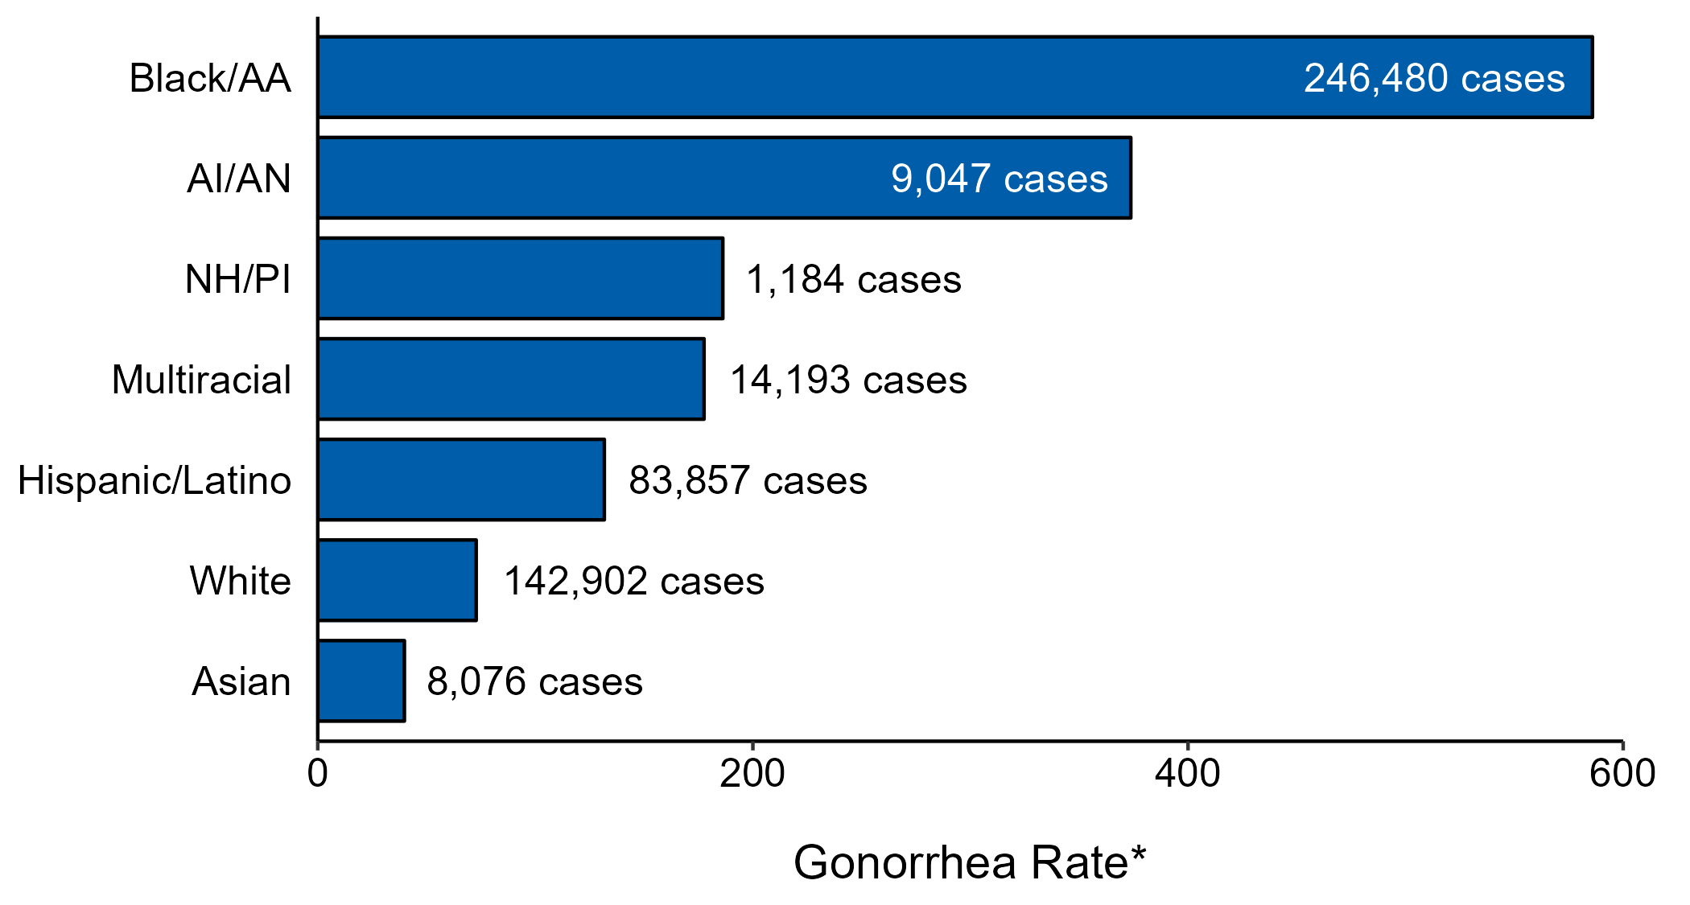
Gonorrhea — Case Counts and Rates of Reported Cases by Race/Hispanic Ethnicity, United States, 2022
* Per 100,000 population
NOTE: In 2022, a total of 142,317 gonorrhea cases (22%) had missing, unknown, or other race and were not reported to be of Hispanic ethnicity. These cases are not shown in this plot.
ACRONYMS: AI/AN = American Indian or Alaska Native; Black/AA = Black or African American; NH/PI = Native Hawaiian or other Pacific Islander
Notes:
In 2022, rates of gonorrhea were highest among non-Hispanic Black or African American persons (585.9 per 100,000), followed by non-Hispanic American Indian or Alaska Native persons (373.7 per 100,000) and non-Hispanic Native Hawaiian or other Pacific Islander persons (186.2 per 100,000). The greatest number of reported gonorrhea cases was among non-Hispanic Black or African American persons (246,480 cases), followed by non-Hispanic White persons (142,902 cases) and Hispanic or Latino persons of any race(s) (83,857 cases).
This report includes data from years that coincide with the COVID-19 pandemic, which introduced uncertainty and difficulty in interpreting STI surveillance data. See Impact of COVID-19 on STIs for more information.
See Technical Notes (https://www.cdc.gov/std/statistics/2022/technical-notes.htm) for information on gonorrhea case reporting and reporting of race/Hispanic ethnicity for STI cases.
Data for all figures are available at https://www.cdc.gov/std/statistics/2022/data.zip. The file “GC - Cases and Rates by Race Hispanic Ethnicity (US 2022).xlsx” contains the data for the figure presented on this slide.

Slide 11
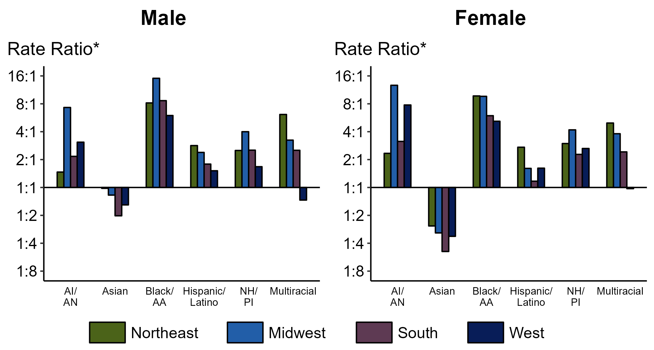
Gonorrhea — Ratios of Rates of Reported Cases by Sex, Race/Hispanic Ethnicity, and Region, United States, 2022
* For the rate ratios, non-Hispanic White persons are the referent population. Y-axis is log scale.
ACRONYMS: AI/AN = American Indian or Alaska Native; Black/AA = Black or African American; NH/PI = Native Hawaiian or other Pacific Islander
Notes:
Among men and women, rate ratios of rates of reported gonorrhea by race/Hispanic ethnicity (using non-Hispanic White persons as the referent population) varied by region in 2022. Among men, the greatest rate ratio was in the Midwest where the rate of gonorrhea among non-Hispanic Black men was 15.1 times the rate among non-Hispanic White men. Among women, the greatest rate ratio was in the Midwest where the rate of gonorrhea among non-Hispanic American Indian or Alaska Native women was 12.7 times the rate among non-Hispanic White women.
This report includes data from years that coincide with the COVID-19 pandemic, which introduced uncertainty and difficulty in interpreting STI surveillance data. See Impact of COVID-19 on STIs for more information.
See Technical Notes (https://www.cdc.gov/std/statistics/2022/technical-notes.htm) for information on gonorrhea case reporting and reporting of race/Hispanic ethnicity for STI cases. Table A1 (https://www.cdc.gov/std/statistics/2022/tables/a1.htm) provides information on unknown, missing, or invalid values of select variables.

Slide 12
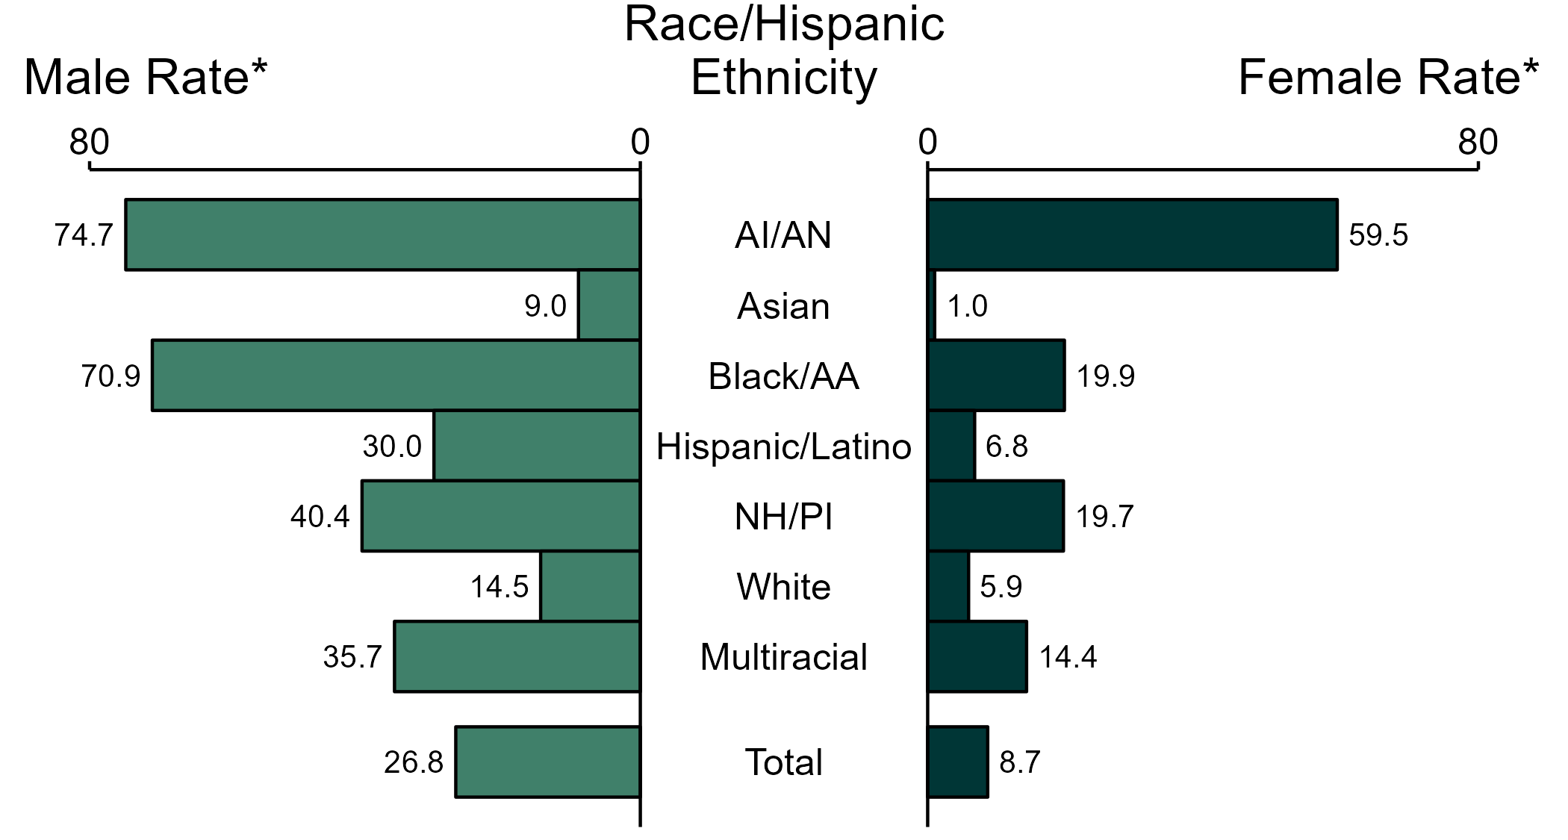
Primary and Secondary Syphilis — Rates of Reported Cases by Race/Hispanic Ethnicity and Sex, United States, 2022
* Per 100,000
ACRONYMS: AI/AN = American Indian or Alaska Native; Black/AA = Black or African American; NH/PI = Native Hawaiian or other Pacific Islander
NOTE: Total includes all cases including those with unknown race/Hispanic ethnicity.
Notes:
In 2022, the rate of reported primary and secondary syphilis was higher among men (26.8 per 100,000) compared to women (8.7 per 100,000).
Among men, non-Hispanic American Indian or Alaska Native men had the highest rate of reported cases of primary and secondary syphilis (74.7 per 100,000), followed by non-Hispanic Black or African American men (70.9 per 100,000) and non-Hispanic Native Hawaiian or other Pacific Islander men (40.4 per 100,000). Among women, non-Hispanic American Indian or Alaska Native women also had the highest rate of reported cases of primary and secondary syphilis (59.5 per 100,000), followed by non-Hispanic Black or African American women (19.9 per 100,000) and non-Hispanic Native Hawaiian or other Pacific Islander women (19.7 per 100,000).
Using non-Hispanic White persons as the referent category, the greatest relative racial disparity in rates of reported primary and secondary syphilis across both sexes was observed among non-Hispanic American Indian or Alaska Native women, with a rate ratio of 10.0 times that of non-Hispanic White women. Among men, the greatest relative disparity was observed among non-Hispanic American Indian or Alaska Native men as well, with a rate 5.2 times that of non-Hispanic White men.
This report includes data from years that coincide with the COVID-19 pandemic, which introduced uncertainty and difficulty in interpreting STI surveillance data. See Impact of COVID-19 on STIs for more information.
See Technical Notes (https://www.cdc.gov/std/statistics/2022/technical-notes.htm) for information on syphilis case reporting, race/Hispanic ethnicity categorization, and reporting of race/Hispanic ethnicity for STI cases. Table A1 (https://www.cdc.gov/std/statistics/2022/tables/a1.htm) provides information on unknown, missing, or invalid values of select variables.
Data for all figures are available at https://www.cdc.gov/std/statistics/2022/data.zip. The file “PS Syphilis - Rates by Race Hispanic Ethnicity and Sex (US 2022).xlsx” contains the data for the figure presented on this slide.

Slide 13
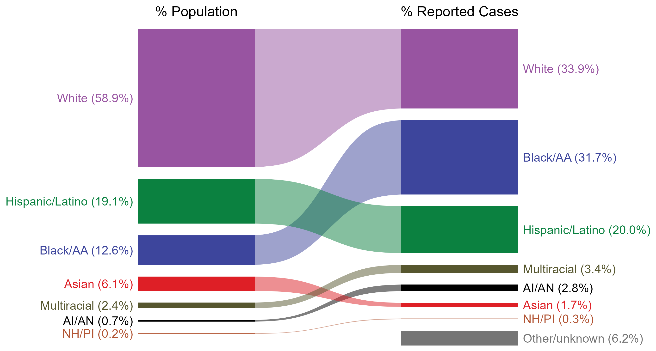
Primary and Secondary Syphilis — Total Population and Reported Cases by Race/Hispanic Ethnicity, United States, 2022
* Per 100,000
NOTE: In 2022, a total of 3,686 primary and secondary (P&S) syphilis cases (6.2%) had missing, unknown, or other race and were not reported to be of Hispanic ethnicity. These cases are included in the “other/unknown” category.
ACRONYMS: AI/AN = American Indian or Alaska Native; Black/AA = Black or African American; NH/PI = Native Hawaiian or other Pacific Islander
Notes:
The percentages of primary and secondary (P&S) syphilis cases by race/Hispanic ethnicity were disproportionate to the percentages among the total population of the United States in 2022. The greatest absolute disparity was observed among non-Hispanic Black or African American persons, who represented 31.7% of reported P&S syphilis cases (n = 18,696; 33.8% of P&S syphilis cases with reported race or Hispanic ethnicity) despite being 12.6% of the US population, or 19.1% more cases than would be expected based on their proportion of the population. The greatest relative disparity was among non-Hispanic American Indian or Alaska Native persons, who represented 2.8% of reported P&S syphilis cases (n = 1,623; 2.9% of P&S syphilis cases with reported race or Hispanic ethnicity) despite being 0.7% of the US population, or a burden 4.0 times what would be expected based on their proportion of the population. Additionally, non-Hispanic Native Hawaiian or other Pacific Islander persons, non-Hispanic persons of multiple races, and Hispanic or Latino persons of any race(s) were also overrepresented among P&S syphilis cases relative to their proportion of the population.
This report includes data from years that coincide with the COVID-19 pandemic, which introduced uncertainty and difficulty in interpreting STI surveillance data. See Impact of COVID-19 on STIs for more information.
See Technical Notes (https://www.cdc.gov/std/statistics/2022/technical-notes.htm) for information on syphilis case reporting, race/Hispanic ethnicity categorization, and reporting of race/Hispanic ethnicity for STI cases.
Data for all figures are available at https://www.cdc.gov/std/statistics/2022/data.zip. The file “PS Syphilis - Population and Cases by Race Hispanic Ethnicity (US 2022).xlsx” contains the data for the figure presented on this slide.

Slide 14
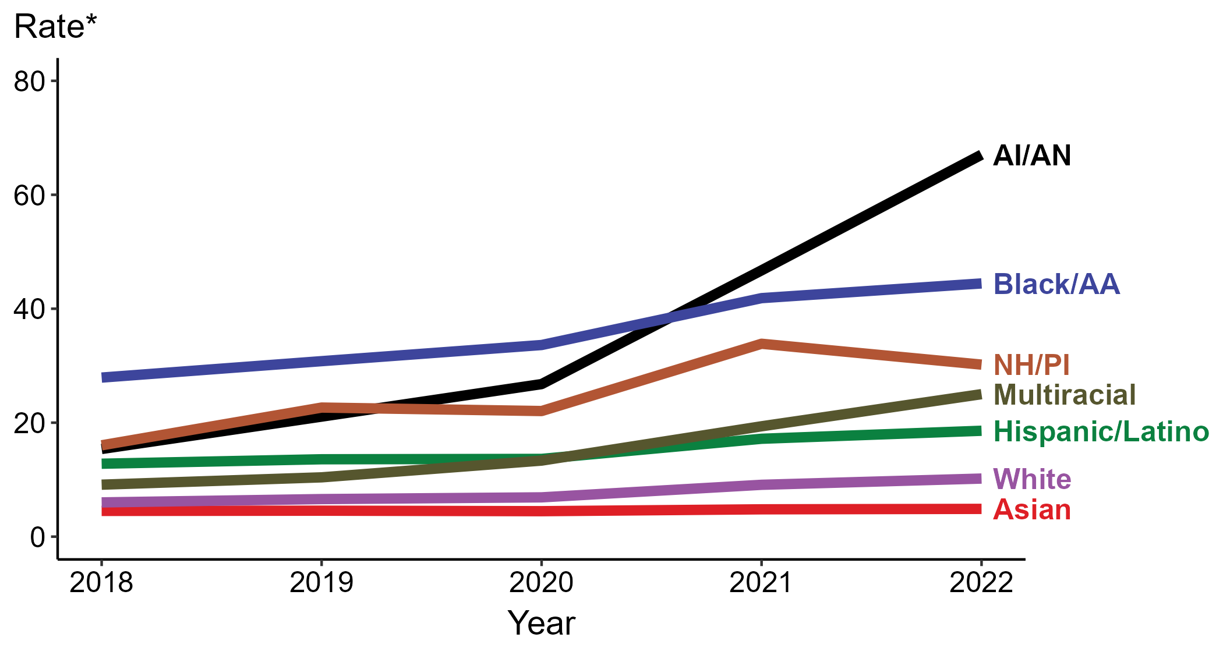
Primary and Secondary Syphilis — Rates of Reported Cases by Race/Hispanic Ethnicity, United States, 2018–2022
* Per 100,000
ACRONYMS: AI/AN = American Indian or Alaska Native; Black/AA = Black or African American; NH/PI = Native Hawaiian or other Pacific Islander
Notes:
In 2022, the highest rate of reported primary and secondary syphilis cases per 100,000 persons was among non-Hispanic American Indian or Alaska Native persons (67.0), followed by non-Hispanic Black or African American persons (44.4).
During 2021 to 2022, the greatest increase in rate of reported primary and secondary syphilis cases per 100,000 persons was among non-Hispanic American Indian or Alaska Native persons (46.7 to 67.0; 43.5% increase). Non-Hispanic American Indian or Alaska Native persons also had the greatest five-year increase in rate of reported primary and secondary syphilis (15.4 to 67.0; 335.1% increase from 2018).
During 2021 to 2022, the only decrease in rate of reported primary and secondary syphilis cases per 100,000 persons was among non-Hispanic Native Hawaiian or other Pacific Islander persons (33.9 to 30.2; 10.9% decrease). There were no decreases in the rate of reported primary and secondary syphilis among any race or Hispanic ethnicity group during 2018 to 2022.
This report includes data from years that coincide with the COVID-19 pandemic, which introduced uncertainty and difficulty in interpreting STI surveillance data. See Impact of COVID-19 on STIs for more information.
See Technical Notes (https://www.cdc.gov/std/statistics/2022/technical-notes.htm) for information on syphilis case reporting, race/Hispanic ethnicity categorization, and reporting of race/Hispanic ethnicity for STI cases. Table A1 (https://www.cdc.gov/std/statistics/2022/tables/a1.htm) provides information on unknown, missing, or invalid values of select variables.
Data for all figures are available at https://www.cdc.gov/std/statistics/2022/data.zip. The file “PS Syphilis - Rates by Race Hispanic Ethnicity (US 2018-2022).xlsx” contains the data for the figure presented on this slide.

Slide 15
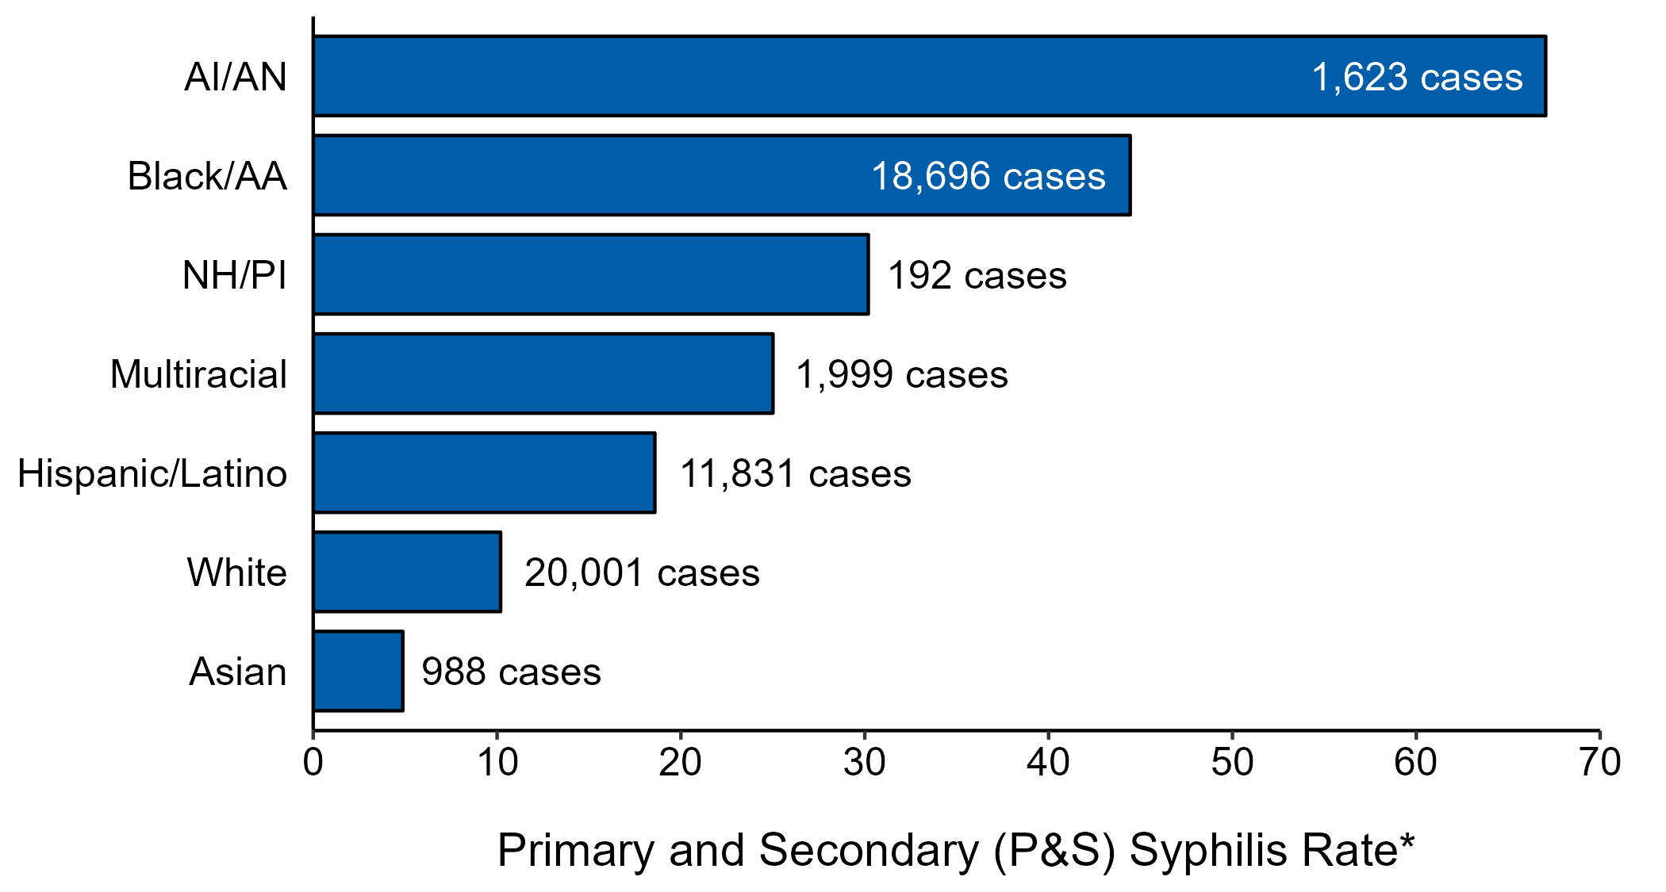
Primary and Secondary Syphilis — Case Counts and Rates of Reported Cases by Race/Hispanic Ethnicity, United States, 2022
* Per 100,000 population
NOTE: In 2022, a total of 3,686 P&S syphilis cases (6.2%) had missing, unknown, or other race and were not reported to be of Hispanic ethnicity. These cases are not shown in this plot.
ACRONYMS: AI/AN = American Indian or Alaska Native; Black/AA = Black or African American; NH/PI = Native Hawaiian or other Pacific Islander
Notes:
In 2022, rates of primary and secondary (P&S) syphilis were highest among non-Hispanic American Indian or Alaska Native persons (67.0 per 100,000), followed by non-Hispanic Black or African American persons (44.4 per 100,000) and non-Hispanic Native Hawaiian or other Pacific Islander persons (30.2 per 100,000). The greatest number of reported P&S syphilis cases was among non-Hispanic White persons (20,001 cases), followed by non-Hispanic Black or African American persons (18,696 cases) and Hispanic or Latino persons of any race(s) (11,831 cases).
This report includes data from years that coincide with the COVID-19 pandemic, which introduced uncertainty and difficulty in interpreting STI surveillance data. See Impact of COVID-19 on STIs for more information.
See Technical Notes (https://www.cdc.gov/std/statistics/2022/technical-notes.htm) for information on syphilis case reporting and reporting of race/Hispanic ethnicity for STI cases.
Data for all figures are available at https://www.cdc.gov/std/statistics/2022/data.zip. The file “PS Syphilis - Cases and Rates by Race Hispanic Ethnicity (US 2022).xlsx” contains the data for the figure presented on this slide.

Slide 16
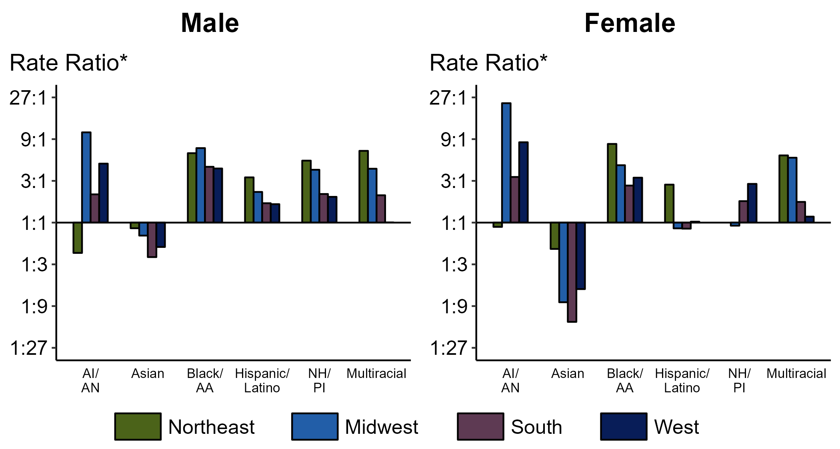
Primary and Secondary Syphilis — Ratios of Rates of Reported Cases by Sex, Race/Hispanic Ethnicity, and Region, United States, 2022
* For the rate ratios, non-Hispanic White persons are the referent population. Y-axis is log scale.
ACRONYMS: AI/AN = American Indian or Alaska Native; Black/AA = Black or African American; NH/PI = Native Hawaiian or other Pacific Islander
Notes:
Among men and women, rate ratios of rates of reported primary and secondary syphilis by race/Hispanic ethnicity (using non-Hispanic White persons as the referent population) varied by region in 2022. Among men, the greatest rate ratio was in the Midwest where the rate of reported primary and secondary syphilis among non-Hispanic American Indian or Alaska Native men was 10.8 times the rate among non-Hispanic White men. Among women, the greatest rate ratio was in the Midwest where the rate of reported primary and secondary syphilis among non-Hispanic American Indian or Alaska Native women was 23.2 times the rate among non-Hispanic White women.
This report includes data from years that coincide with the COVID-19 pandemic, which introduced uncertainty and difficulty in interpreting STI surveillance data. See Impact of COVID-19 on STIs for more information.
See Technical Notes (https://www.cdc.gov/std/statistics/2022/technical-notes.htm) for information on syphilis case reporting, race/Hispanic ethnicity categorization, and reporting of race/Hispanic ethnicity for STI cases. Table A1 (https://www.cdc.gov/std/statistics/2022/tables/a1.htm) provides information on unknown, missing, or invalid values of select variables.

Slide 17
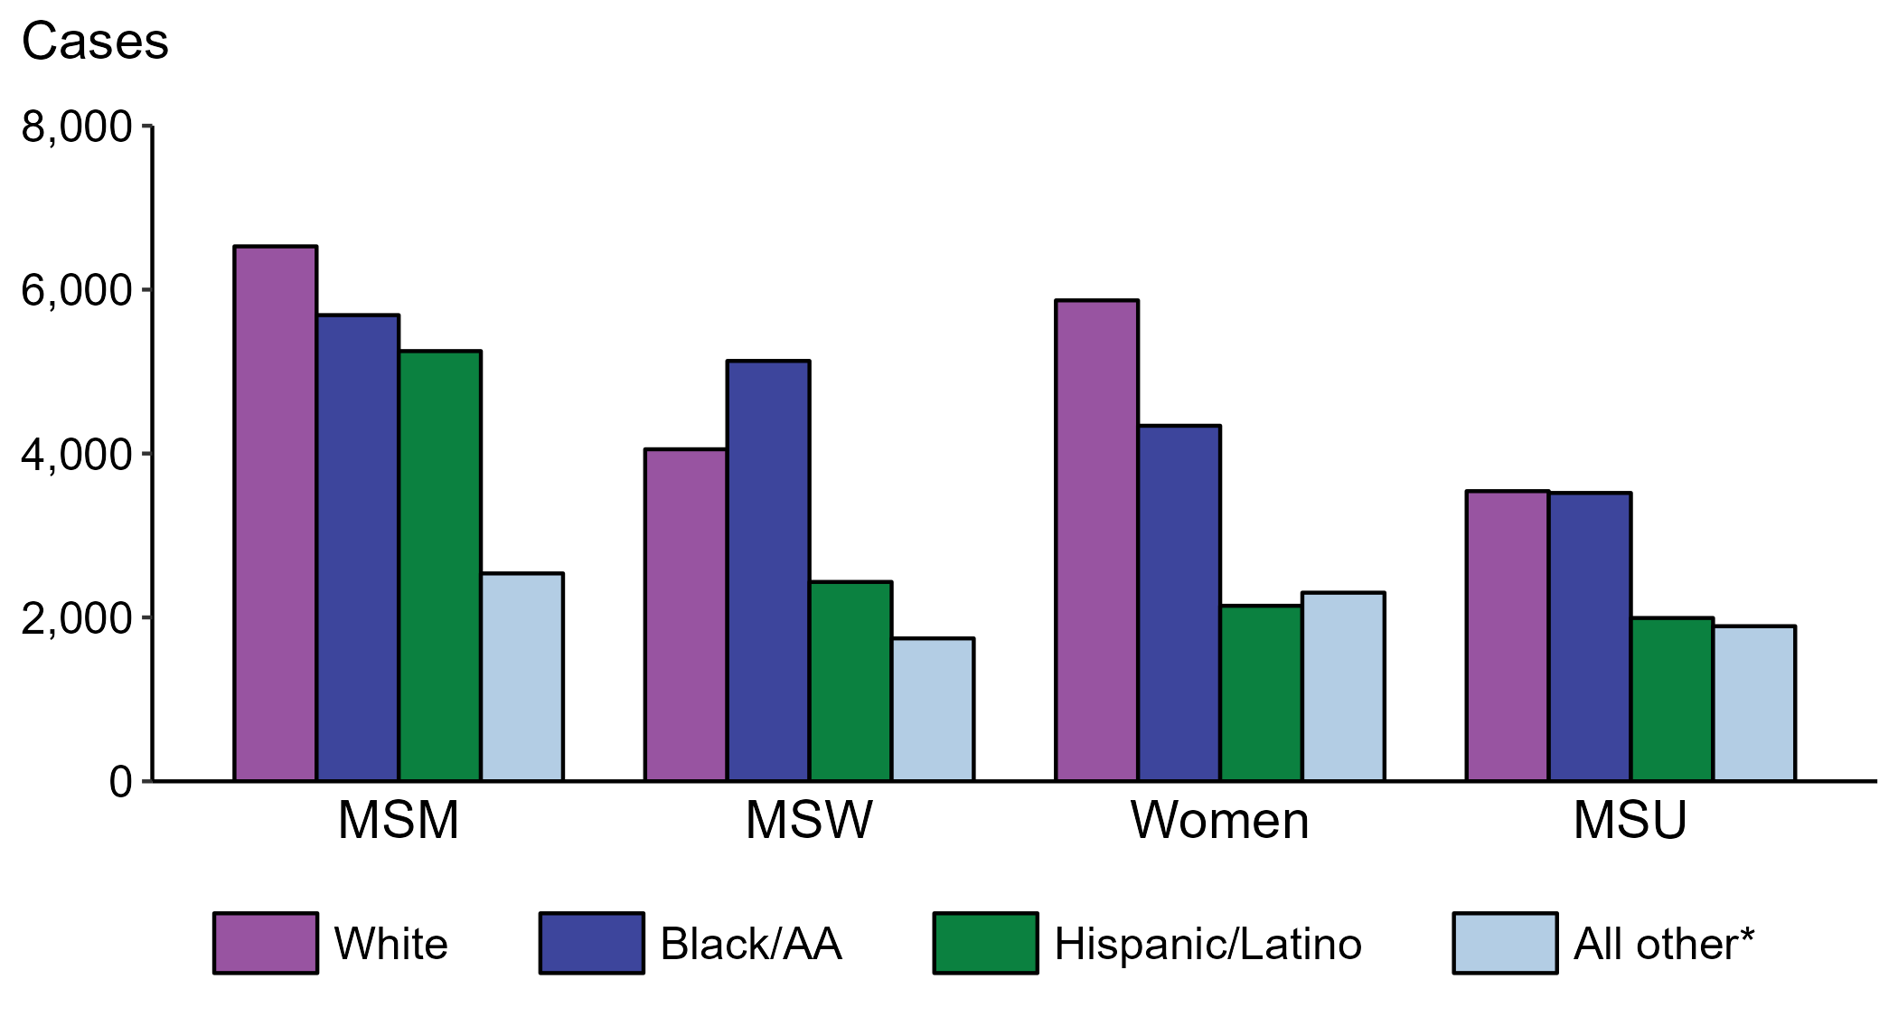
Primary and Secondary Syphilis — Reported Cases by Sex, Sex of Sex Partners, and Race/Hispanic Ethnicity, United States, 2022
* Includes persons with unknown race who were not reported with Hispanic ethnicity.
ACRONYMS: MSM = Men who have sex with men; MSW = Men who have sex with women only; MSU = Men with unknown sex of sex partners
Notes:
Within each of the four race/Hispanic ethnicity groups displayed, men who have sex with men (MSM) accounted for the highest proportion of primary and secondary (P&S) syphilis cases. Of P&S syphilis cases among MSM, 32.6% were non-Hispanic White, 28.4% were non-Hispanic Black or African American, 26.2% were Hispanic or Latino, and 12.7% were another known or unknown race and not reported to be Hispanic or Latino.
This report includes data from years that coincide with the COVID-19 pandemic, which introduced uncertainty and difficulty in interpreting STI surveillance data. See Impact of COVID-19 on STIs for more information.
See Technical Notes (https://www.cdc.gov/std/statistics/2022/technical-notes.htm) for information on syphilis case reporting, race/Hispanic ethnicity categorization, and reporting of race/Hispanic ethnicity for STI cases. Table A1 (https://www.cdc.gov/std/statistics/2022/tables/a1.htm) provides information on unknown, missing, or invalid values of select variables.
Data for all figures are available at https://www.cdc.gov/std/statistics/2022/data.zip. The file “PS Syphilis - Cases by Sex Sex of Sex Partners and Race Hispanic Ethnicity (US 2022) .xlsx” contains the data for the figure presented on this slide.

Slide 18
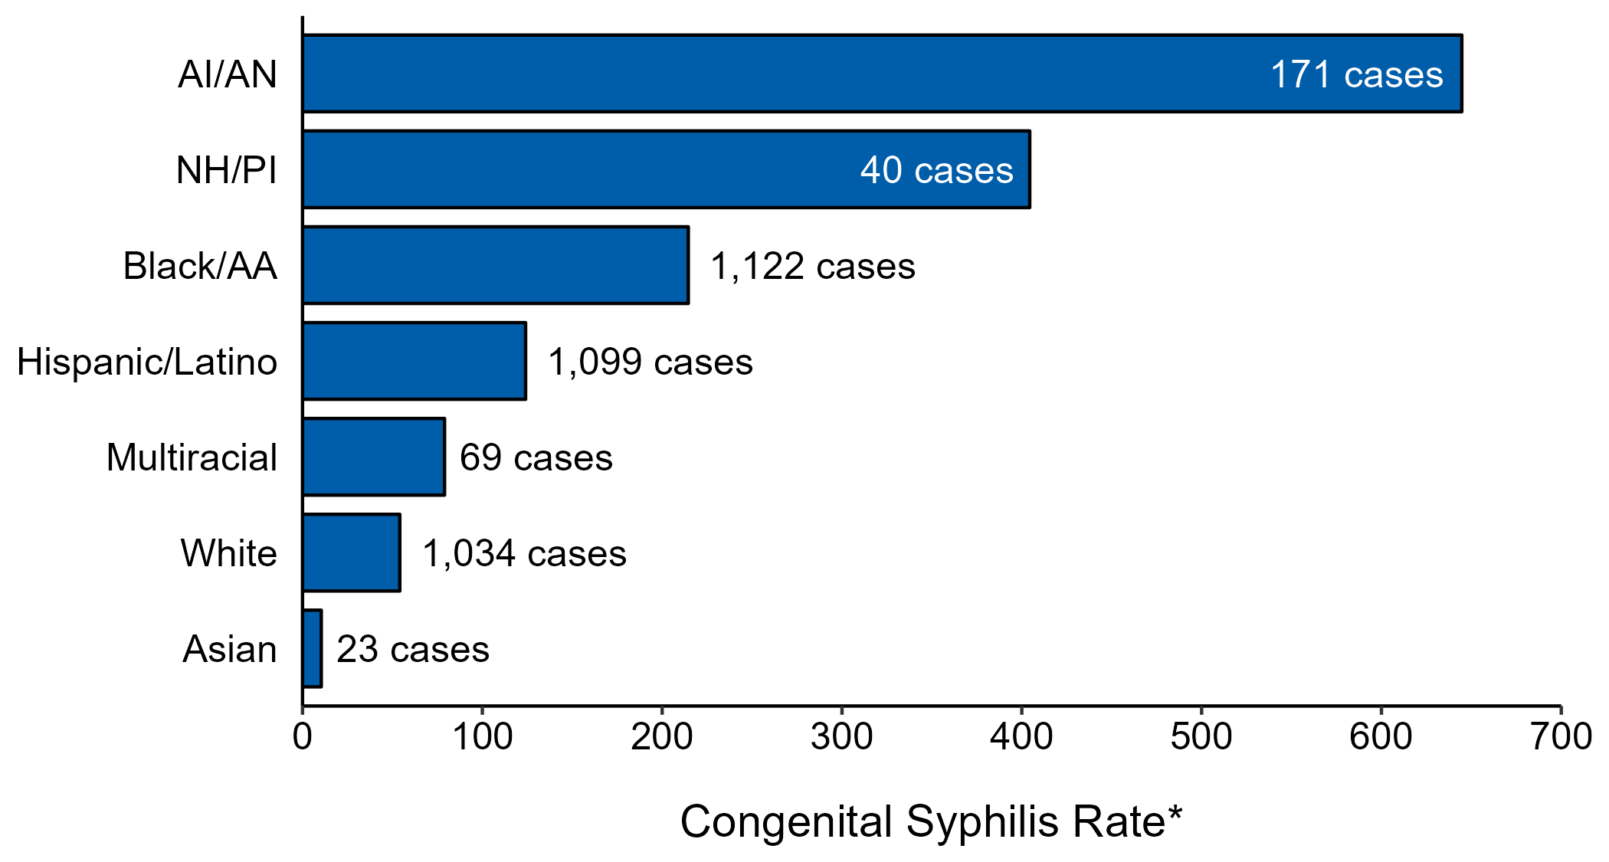
Congenital Syphilis — Case Counts and Rates of Reported Cases by Race/Hispanic Ethnicity of Mother, United States, 2022
* Per 100,000 live births
NOTE: In 2022, a total of 197 congenital syphilis cases (5.2%) had missing, unknown, or other race and were not reported to be of Hispanic ethnicity.
ACRONYMS: AI/AN = American Indian or Alaska Native; Black/AA = Black or African American; NH/PI = Native Hawaiian or other Pacific Islander
Notes:
In 2022, there were a total of 3,755 cases of congenital syphilis reported for a rate of 102.5 per 100,000 live births.
In 2022, rates of congenital syphilis were highest among mothers who were non-Hispanic American Indian or Alaska Native (644.7 per 100,000 live births), followed by mothers who were non-Hispanic Native Hawaiian or other Pacific Islander (404.4 per 100,000 live births) and mothers who were non-Hispanic Black or African American (214.5 per 100,000 live births). The greatest number of reported cases was among mothers who were non-Hispanic Black or African American (1,122 cases), followed by mothers who were Hispanic or Latino and of any race(s) (1,099 cases) and mothers who were non-Hispanic White (1,034 cases).
This report includes data from years that coincide with the COVID-19 pandemic, which introduced uncertainty and difficulty in interpreting STI surveillance data. See Impact of COVID-19 on STIs for more information.
See Technical Notes (https://www.cdc.gov/std/statistics/2022/technical-notes.htm) for information on syphilis case reporting, race/Hispanic ethnicity categorization, and reporting of race/Hispanic ethnicity for STI cases.
Data for all figures are available at https://www.cdc.gov/std/statistics/2022/data.zip. The file “CS - Counts and Rates by Race Hispanic Ethnicity of Mother (US 2022).xlsx” contains the data for the figure presented on this slide.

Slide 19
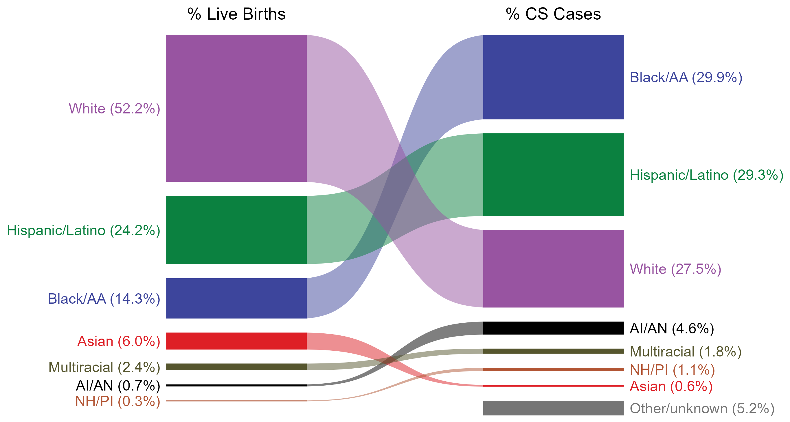
Congenital Syphilis — Total Live Births and Reported Cases by Race/Hispanic Ethnicity of Mother, United States, 2022
NOTE: In 2022, a total of 197 congenital syphilis cases (5.2%) had missing, unknown, or other race and were not reported to be of Hispanic ethnicity. These cases are included in the “other/unknown” category.
ACRONYMS: AI/AN = American Indian or Alaska Native; Black/AA = Black or African American; NH/PI = Native Hawaiian or other Pacific Islander
Notes:
In 2022, there were a total of 3,755 cases of congenital syphilis reported for a rate of 102.5 per 100,000 live births.
The percentages of congenital syphilis cases by race/Hispanic ethnicity of mother were disproportionate to the percentages among live births in the United States in 2022. The greatest absolute disparity was observed among non-Hispanic Black or African American mothers, who represented 29.9% of reported congenital syphilis cases (n = 1,122; 29.9% of congenital syphilis cases with reported race or Hispanic ethnicity of mother) despite being 14.3% of the live births, or 15.6% more cases than would be expected based on their proportion of live births. The greatest relative disparity was among non-Hispanic American Indian or Alaska Native mothers, who represented 4.6% of reported congenital syphilis cases (n = 171; 4.6% of congenital syphilis cases with reported race or Hispanic ethnicity of mother) despite being 0.7% of live births, or a burden 6.6 times what would be expected based on their proportion of live births. Additionally, Hispanic or Latino mothers of any race(s) and non-Hispanic Native Hawaiian or other Pacific Islander mothers were also overrepresented among congenital syphilis cases relative to their proportion of live births.
This report includes data from years that coincide with the COVID-19 pandemic, which introduced uncertainty and difficulty in interpreting STI surveillance data. See Impact of COVID-19 on STIs for more information.
See Technical Notes (https://www.cdc.gov/std/statistics/2022/technical-notes.htm) for information on syphilis case reporting, race/Hispanic ethnicity categorization, and reporting of race/Hispanic ethnicity for STI cases.
Data for all figures are available at https://www.cdc.gov/std/statistics/2022/data.zip. The file “CS - Live Births and Cases by Race Hispanic Ethnicity of Mother (US 2022).xlsx” contains the data for the figure presented on this slide.

Slide 20
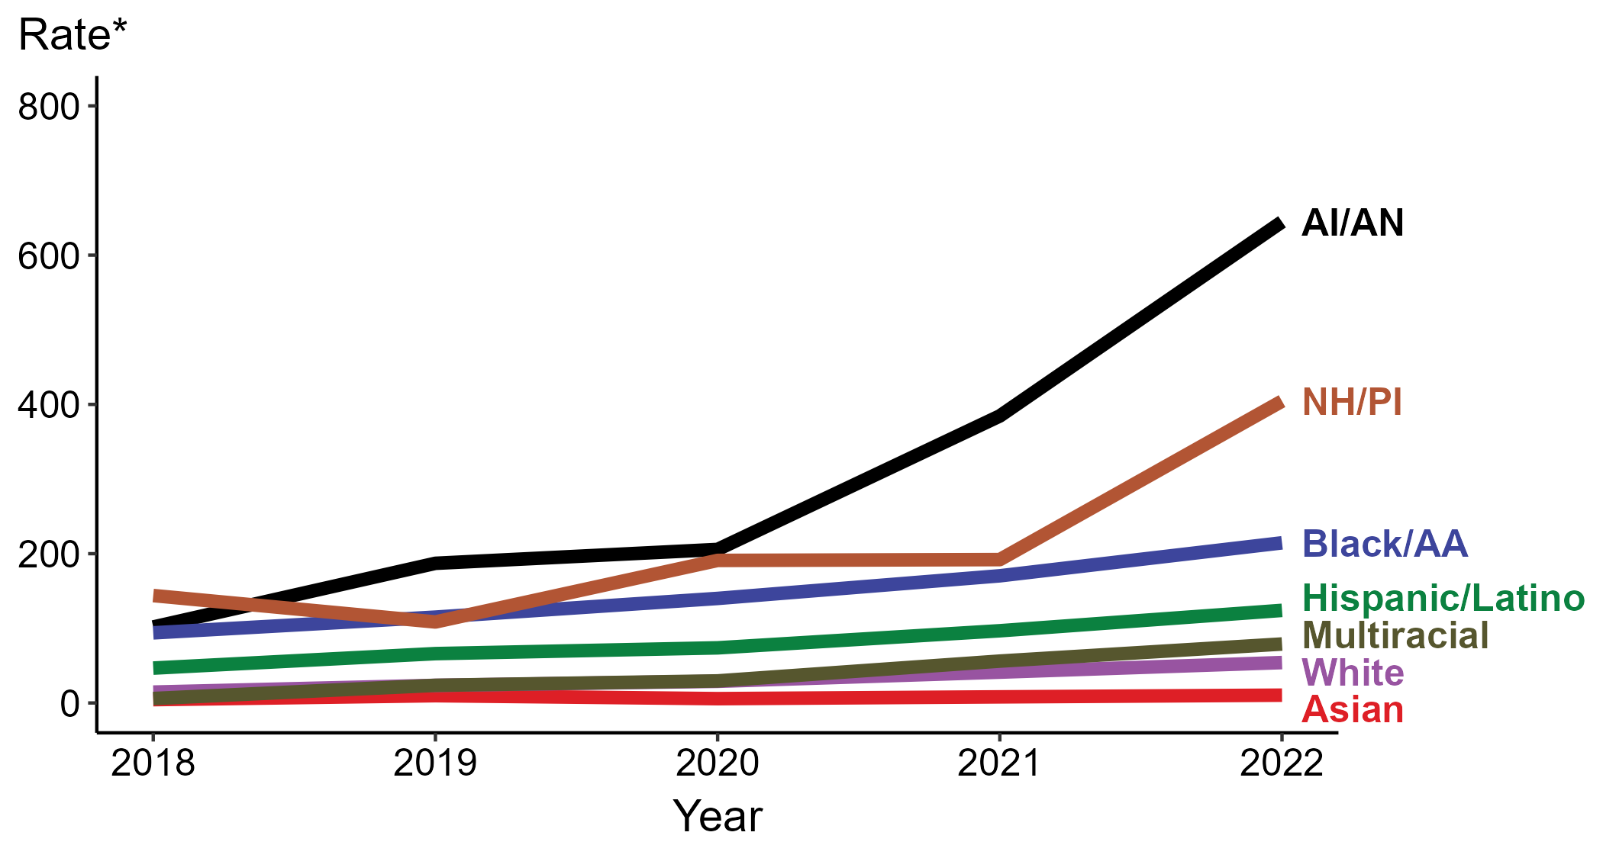
Congenital Syphilis — Rates of Reported Cases by Year of Birth, Race/Hispanic Ethnicity of Mother, United States, 2018–2022
* Per 100,000 live births
ACRONYMS: AI/AN = American Indian or Alaska Native; Black/AA = Black or African American; NH/PI = Native Hawaiian or other Pacific Islander
Notes:
In 2022, there were a total of 3,755 cases of congenital syphilis reported for a rate of 102.5 per 100,000 live births.
In 2022, the highest rate of reported cases of congenital syphilis per 100,000 live births was among mothers who were non-Hispanic American Indian or Alaska Native (644.7), followed by mothers who were non-Hispanic Native Hawaiian or other Pacific Islander (404.4).
During 2021 to 2022, the greatest increase in rate of reported cases of congenital syphilis per 100,000 live births was among mothers who were non-Hispanic Native Hawaiian or other Pacific Islander (192.1 to 404.4; 110.5% increase). Mothers who were non-Hispanic and of multiple races had the greatest five-year increase in rate of congenital syphilis (5.9 to 79.0; 1,239.0% increase from 2018).
There were no decreases in the rate of reported cases of congenital syphilis per 100,000 live births among any race or Hispanic ethnicity group during 2021 to 2022. There were also no decreases in the rate of congenital syphilis among any race or Hispanic ethnicity group during 2018 to 2022.
This report includes data from years that coincide with the COVID-19 pandemic, which introduced uncertainty and difficulty in interpreting STI surveillance data. See Impact of COVID-19 on STIs for more information.
See Technical Notes (https://www.cdc.gov/std/statistics/2022/technical-notes.htm) for information on syphilis case reporting, race/Hispanic ethnicity categorization, and reporting of race/Hispanic ethnicity for STI cases.
Data for all figures are available at https://www.cdc.gov/std/statistics/2022/data.zip. The file “CS - Rates by Race Hispanic Ethnicity of Mother (US 2022).xlsx” contains the data for the figure presented on this slide.

Slide 21
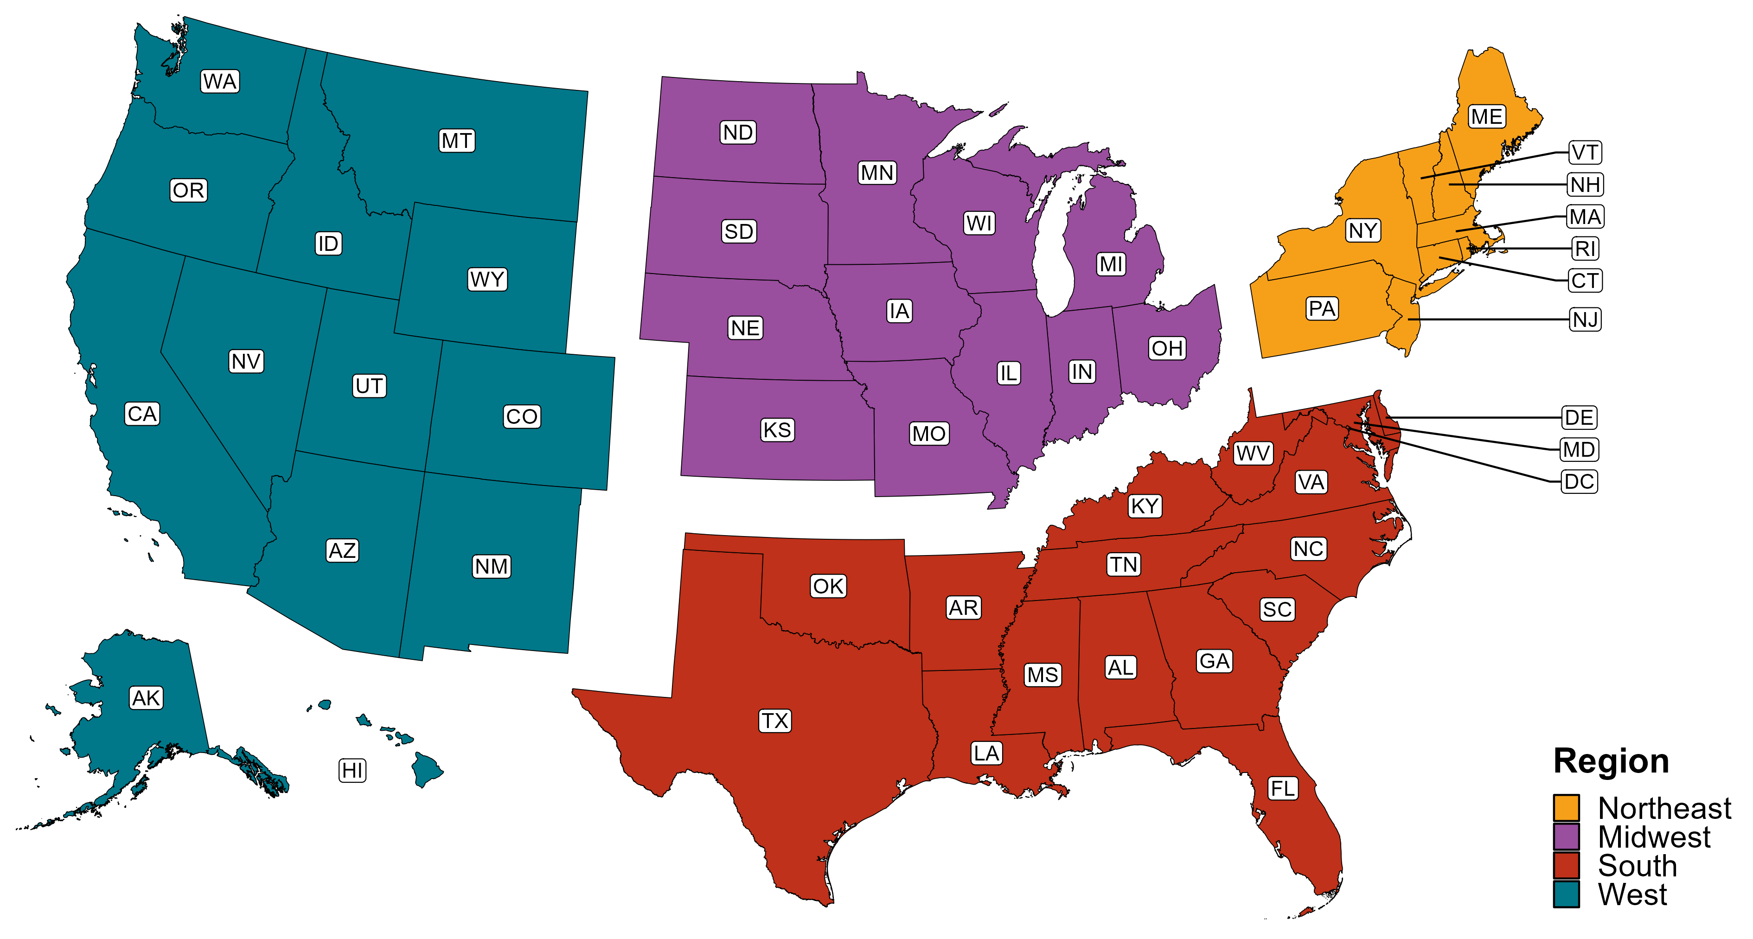
Reference Map of US Census Regions

