Slide 1
Sexually Transmitted Infections
Surveillance 2022
Notes:
This slide set was prepared by the Division of STD Prevention, National Center for HIV, Viral Hepatitis, STD, and TB Prevention (NCHHSTP), Centers for Disease Control and Prevention (CDC). These slides display trends for STIs in the United States through 2022. Data presented include case notifications provided to CDC through the National Notifiable Diseases Surveillance System (NNDSS) and data collected through projects and programs that monitor STIs in various settings, including the STD Surveillance Network (SSuN), and the Gonococcal Isolate Surveillance Project (GISP).
For more information on data sources, data collection and reporting practices, and case definitions, please see the Technical Notes, available at https://www.cdc.gov/std/statistics/2022/technical-notes.htm.
All data points for figures presented in these slides are available at https://www.cdc.gov/std/statistics/2022/data.zip.
NOTE: This slide set is in the public domain. You may reproduce these slides without permission; however, citation as to source is appreciated.
Centers for Disease Control and Prevention. Sexually Transmitted Infections Surveillance 2022. Atlanta: U.S. Department of Health and Human Services; 2024.
You are also free to adapt and revise these slides; however, you must remove the CDC name and logo if changes are made.

Slide 2
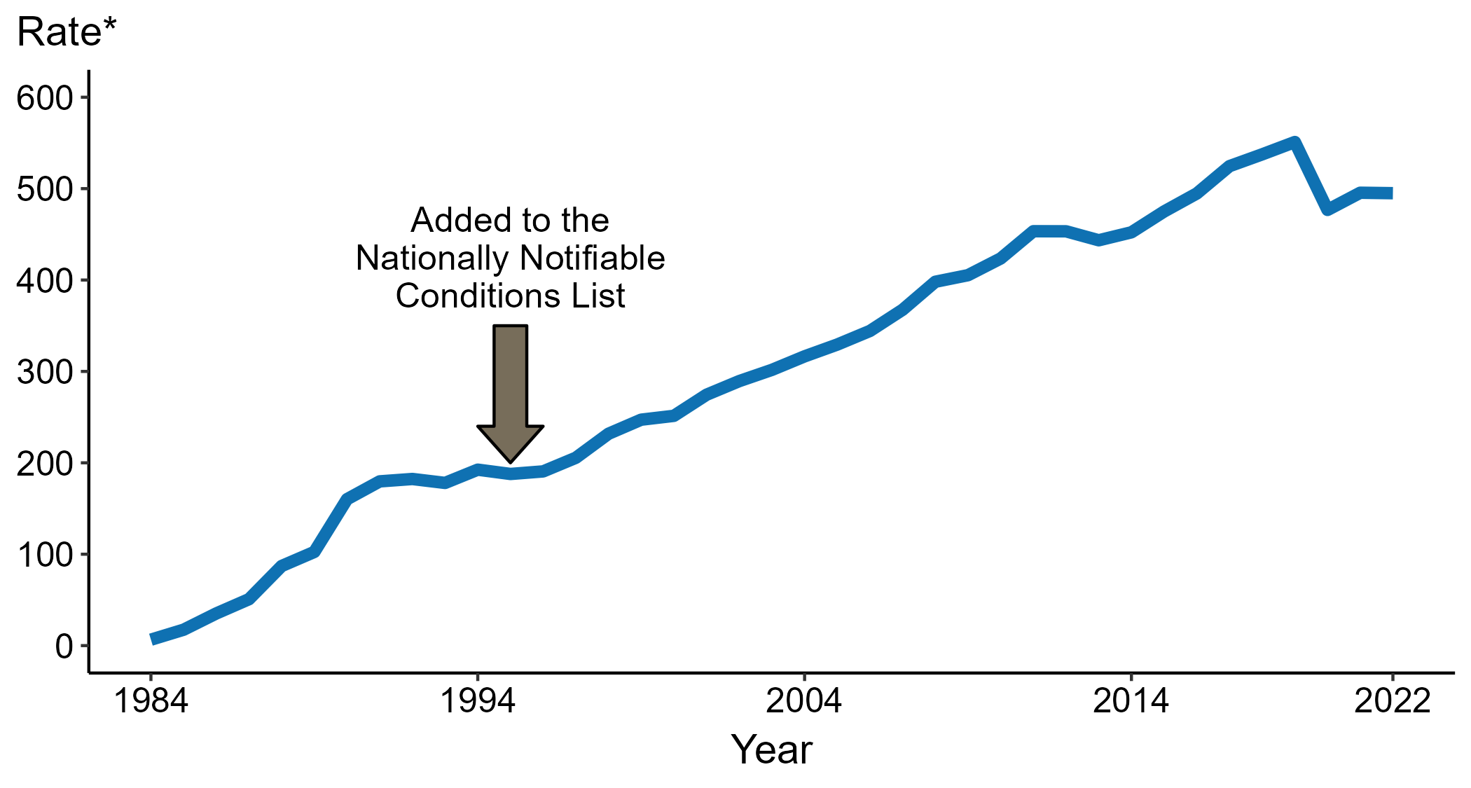
Chlamydia — Rates of Reported Cases by Year, United States, 1984–2022
* Per 100,000
Notes:
Data collection for chlamydia began in 1984 and chlamydia was made a nationally notifiable condition in 1995; however, chlamydia was not reportable in all 50 states and the District of Columbia until 2000. Steady increases in chlamydia case rates beginning in 1996 are due, in part, to improved reporting, increased screening, and the use of more sensitive diagnostic tests.
In 2022, a total of 1,649,716 cases of chlamydia were reported in the United States. During 2021 to 2022, the rate of reported chlamydia did not change substantially (<1.0% change; from 495.5 to 495.0 per 100,000).
This report includes data from years that coincide with the COVID-19 pandemic, which introduced uncertainty and difficulty in interpreting STI surveillance data. See Impact of COVID-19 on STIs for more information.
See Technical Notes (https://www.cdc.gov/std/statistics/2022/technical-notes.htm) for information on chlamydia case reporting.
Data for all figures are available at https://www.cdc.gov/std/statistics/2022/data.zip. The file “CT - Rates by Year (US 1984-2022).xlsx” contains the data for the figure presented on this slide.

Slide 3
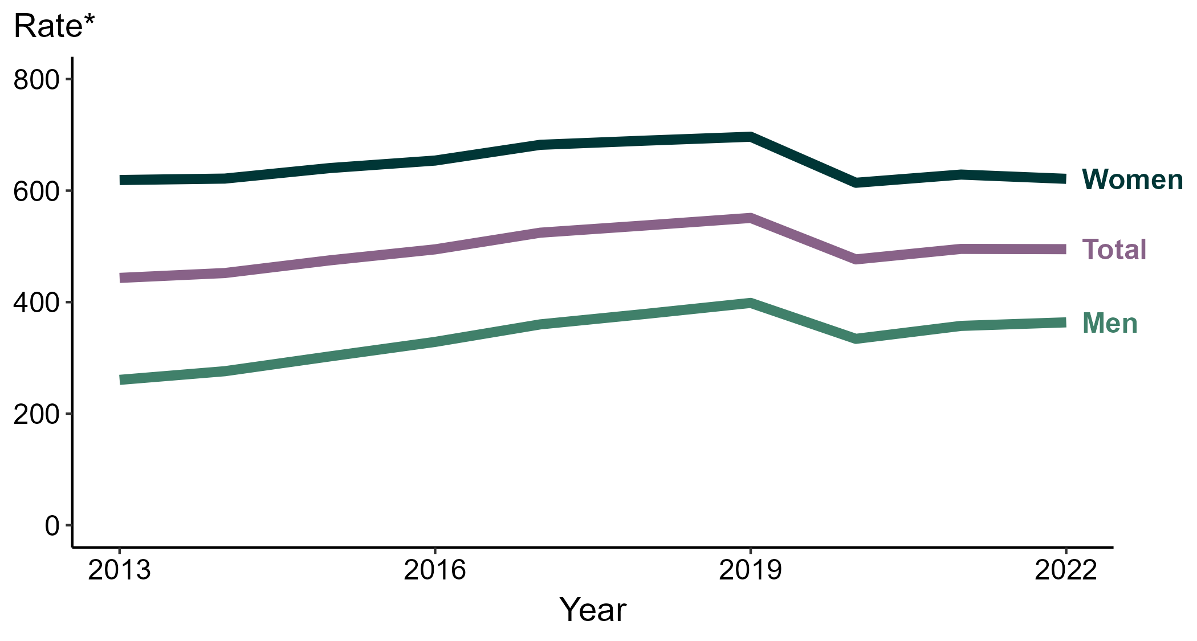
Chlamydia — Rates of Reported Cases by Sex, United States, 2013–2022
* Per 100,000
Notes:
During 2021 to 2022, the rate of reported chlamydia among men increased 1.8% (from 357.4 to 363.7 per 100,000) and the rate among women decreased 1.2% (from 628.8 to 621.2 per 100,000).
Over the last five years, the rate of reported chlamydia among men decreased 4.0% (from 378.9 to 363.7 per 100,000) and the rate among women decreased 9.9% (from 689.6 to 621.2 per 100,000). Over the last 10 years, the rate among men increased 39.6% (from 260.6 to 363.7 per 100,000) and the rate among women did not change substantially (<1.0% change; from 619.0 to 621.2 per 100,000).
This report includes data from years that coincide with the COVID-19 pandemic, which introduced uncertainty and difficulty in interpreting STI surveillance data. See Impact of COVID-19 on STIs for more information.
See Technical Notes (https://www.cdc.gov/std/statistics/2022/technical-notes.htm) for information on chlamydia case reporting. Table A1 (https://www.cdc.gov/std/statistics/2022/tables/a1.htm) provides information on unknown, missing, or invalid values of select variables.
Data for all figures are available at https://www.cdc.gov/std/statistics/2022/data.zip. The file “CT - Rates by Sex (US and Terr 2013-2022).xlsx” contains the data for the figure presented on this slide.

Slide 4
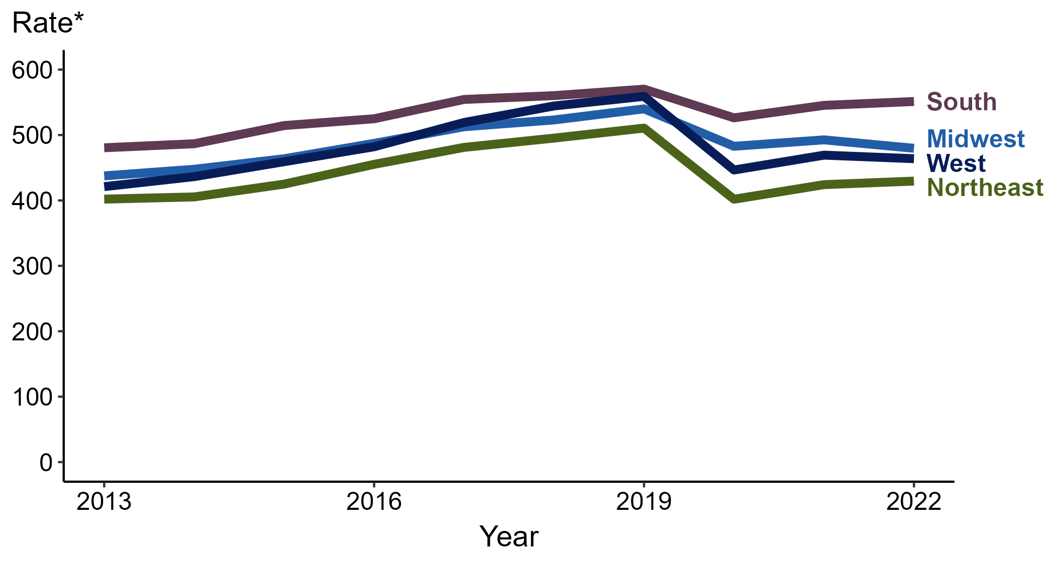
Chlamydia — Rates of Reported Cases by Region, United States, 2013–2022
* Per 100,000
Notes:
In 2022, the South had the highest rate of reported chlamydia (551.2 cases per 100,000; 1.1% increase from 2021), followed by the Midwest (479.7 cases per 100,000; 2.6% decrease from 2021), the West (463.8 cases per 100,000; 1.2% decrease from 2021), and the Northeast (429.5 cases per 100,000; 1.3% increase from 2021).
There were no substantial increases (≥1.0%) in the rate of reported cases of chlamydia in any region during the five-year period from 2018 to 2022. The South had the greatest 10-year increase in rates of reported cases of chlamydia (480.5 to 551.2 per 100,000; 14.7% increase from 2013).
This report includes data from years that coincide with the COVID-19 pandemic, which introduced uncertainty and difficulty in interpreting STI surveillance data. See Impact of COVID-19 on STIs for more information.
See Technical Notes (https://www.cdc.gov/std/statistics/2022/technical-notes.htm) for information on chlamydia case reporting.
Data for all figures are available at https://www.cdc.gov/std/statistics/2022/data.zip. The file “CT - Rates by Region (US 2013-2022).xlsx” contains the data for the figure presented on this slide.

Slide 5
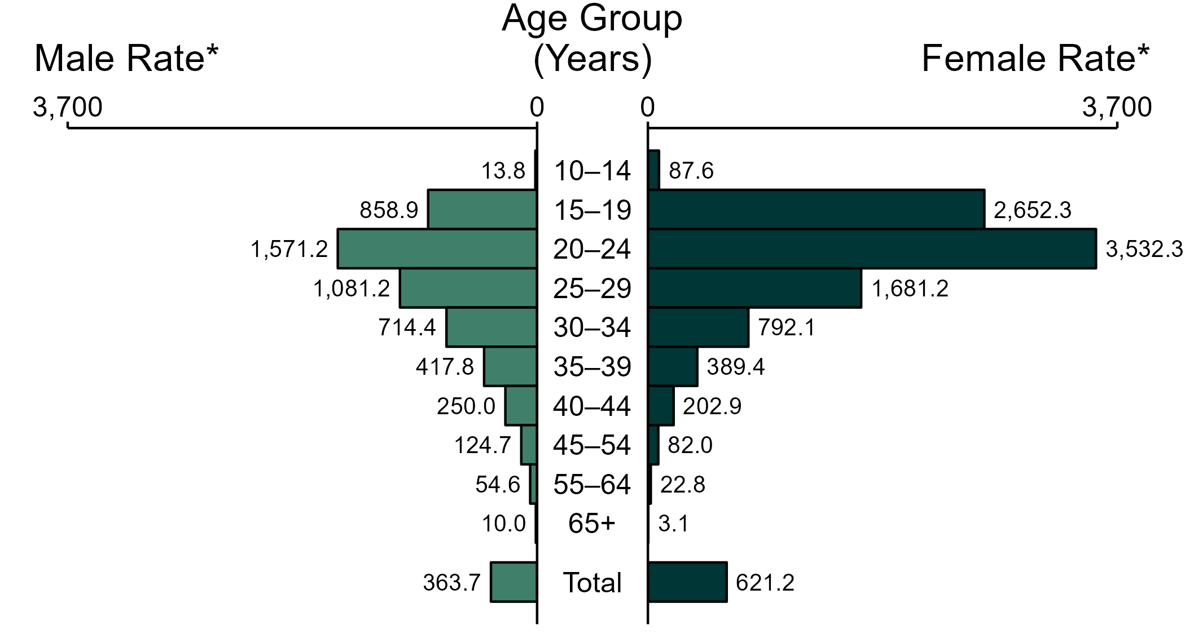
Chlamydia — Rates of Reported Cases by Age Group and Sex, United States, 2022
* Per 100,000
NOTE: Total includes cases of all ages, including those with unknown age.
Notes:
In 2022, the rate of reported chlamydia was higher among women (621.2 per 100,000) compared to men (363.7 per 100,000).
Among women, those aged 20 to 24 years had the highest rate of reported cases of chlamydia (3,532.3 per 100,000), followed by women aged 15 to 19 years (2,652.3 per 100,000) and women aged 25 to 29 years (1,681.2 per 100,000). Among men, those aged 20 to 24 years also had the highest rate of reported cases of chlamydia (1,571.2 per 100,000), followed by men aged 25 to 29 years (1,081.2 per 100,000) and men aged 15 to 19 years (858.9 per 100,000).
This report includes data from years that coincide with the COVID-19 pandemic, which introduced uncertainty and difficulty in interpreting STI surveillance data. See Impact of COVID-19 on STIs for more information.
See Technical Notes (https://www.cdc.gov/std/statistics/2022/technical-notes.htm) for information on chlamydia case reporting. Table A1 (https://www.cdc.gov/std/statistics/2022/tables/a1.htm) provides information on unknown, missing, or invalid values of select variables.
Data for all figures are available at https://www.cdc.gov/std/statistics/2022/data.zip. The file “CT - Rates by Age Group and Sex (US 2022).xlsx” contains the data for the figure presented on this slide.

Slide 6
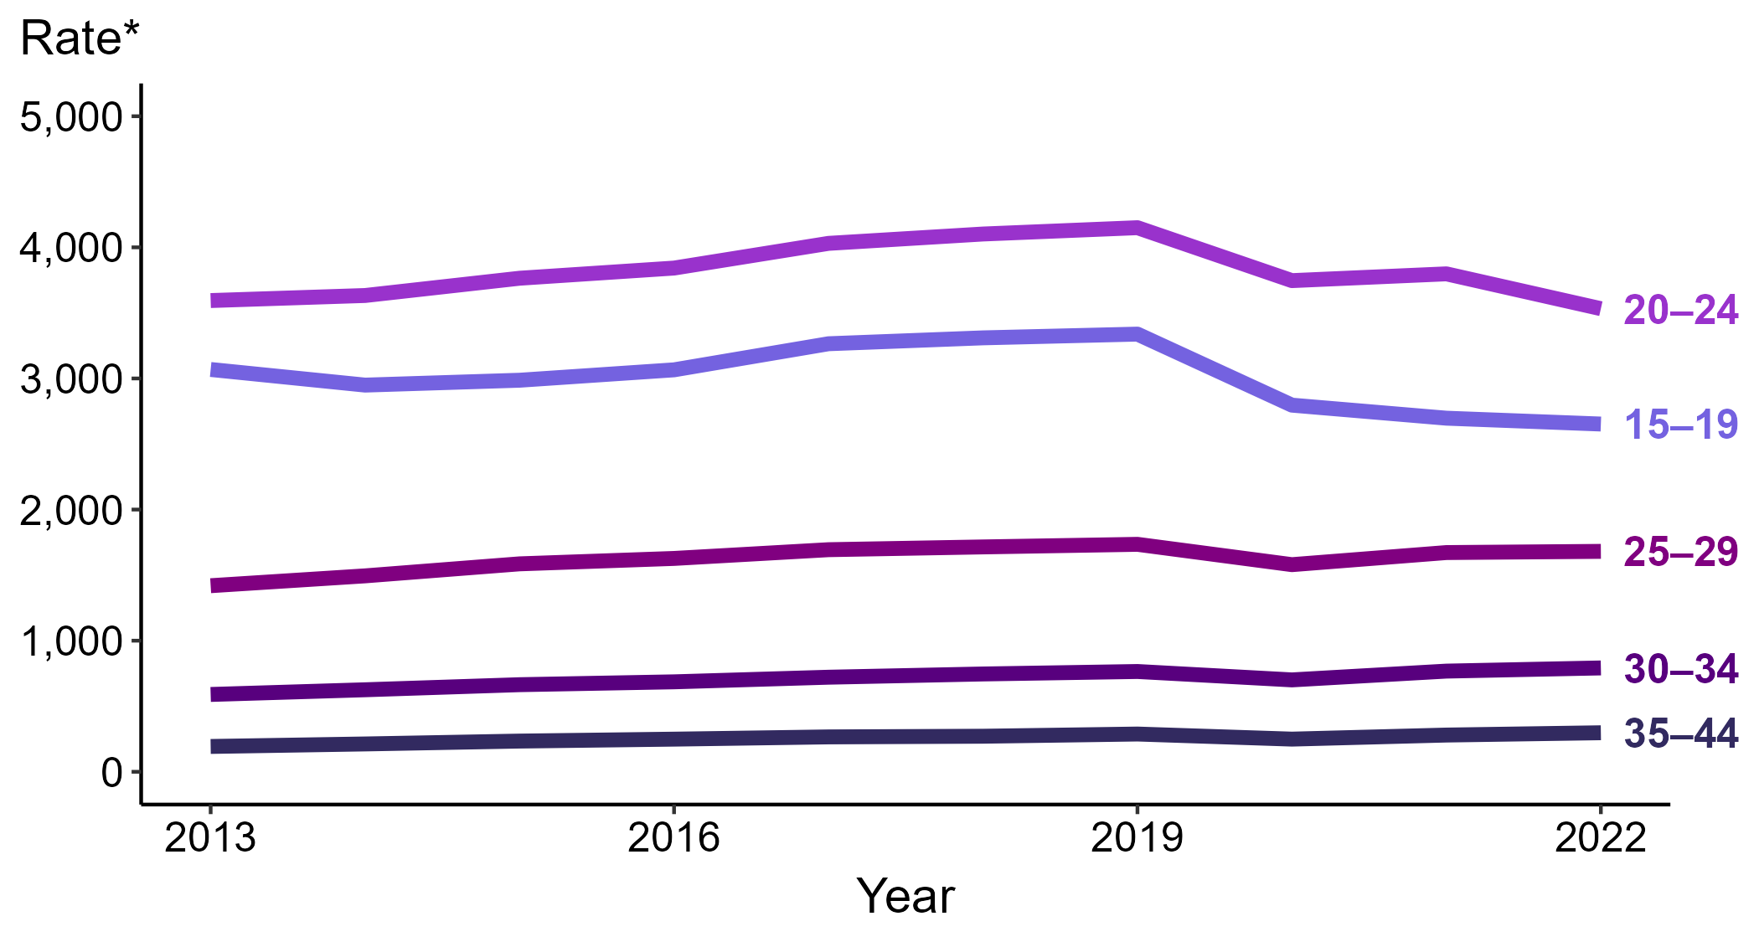
Chlamydia — Rates of Reported Cases Among Women Aged 15–44 Years by Age Group, United States, 2013–2022
* Per 100,000
Notes:
Among women aged 15 to 44 years in 2022, those aged 20 to 24 years had the highest rate of reported cases of chlamydia (3,532.3 cases per 100,000; 7.0% decrease from 2021), followed by those aged 15 to 19 years (2,652.3 cases per 100,000; 1.7% decrease from 2021), those aged 25 to 29 years (1,681.2 cases per 100,000; <1.0% change from 2021), those aged 30 to 34 years (792.1 cases per 100,000; 3.2% increase from 2021), and those aged 35 to 44 years (297.7 cases per 100,000; 6.3% increase from 2021).
This report includes data from years that coincide with the COVID-19 pandemic, which introduced uncertainty and difficulty in interpreting STI surveillance data. See Impact of COVID-19 on STIs for more information.
See Technical Notes (https://www.cdc.gov/std/statistics/2022/technical-notes.htm) for information on chlamydia case reporting. Table A1 (https://www.cdc.gov/std/statistics/2022/tables/a1.htm) provides information on unknown, missing, or invalid values of select variables.
Data for all figures are available at https://www.cdc.gov/std/statistics/2022/data.zip. The file “CT - Rates Women 15-44 Years by Age Group (US 2013-2022).xlsx” contains the data for the figure presented on this slide.

Slide 7
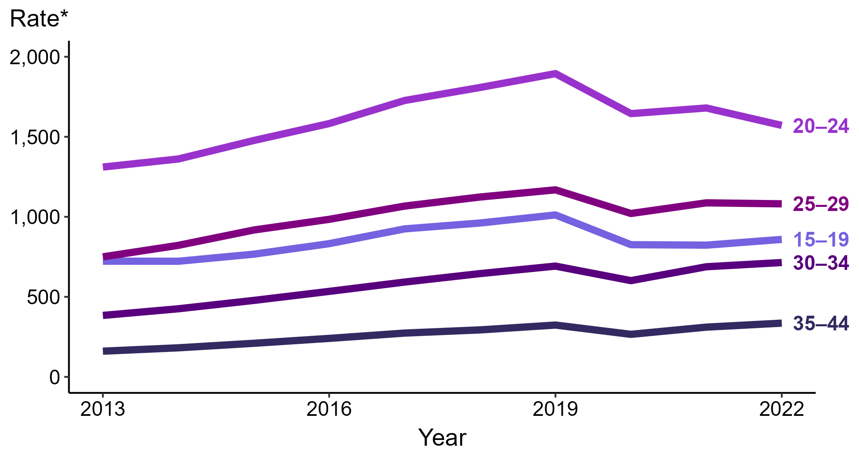
Chlamydia — Rates of Reported Cases Among Men Aged 15–44 Years by Age Group, United States, 2013–2022
* Per 100,000
Notes:
Among men aged 15 to 44 years in 2022, those aged 20 to 24 years had the highest rate of reported cases of chlamydia (1,571.2 cases per 100,000; 6.5% decrease from 2021), followed by those aged 25 to 29 years (1,081.2 cases per 100,000; <1.0% change from 2021), those aged 15 to 19 years (858.9 cases per 100,000; 4.4% increase from 2021), those aged 30 to 34 years (714.4 cases per 100,000; 3.8% increase from 2021), and those aged 35 to 44 years (335.7 cases per 100,000; 8.0% increase from 2021).
This report includes data from years that coincide with the COVID-19 pandemic, which introduced uncertainty and difficulty in interpreting STI surveillance data. See Impact of COVID-19 on STIs for more information.
See Technical Notes (https://www.cdc.gov/std/statistics/2022/technical-notes.htm) for information on chlamydia case reporting. Table A1 (https://www.cdc.gov/std/statistics/2022/tables/a1.htm) provides information on unknown, missing, or invalid values of select variables.
Data for all figures are available at https://www.cdc.gov/std/statistics/2022/data.zip. The file “CT - Rates Men 15-44 Years by Age Group (US 2013-2022).xlsx” contains the data for the figure presented on this slide.

Slide 8
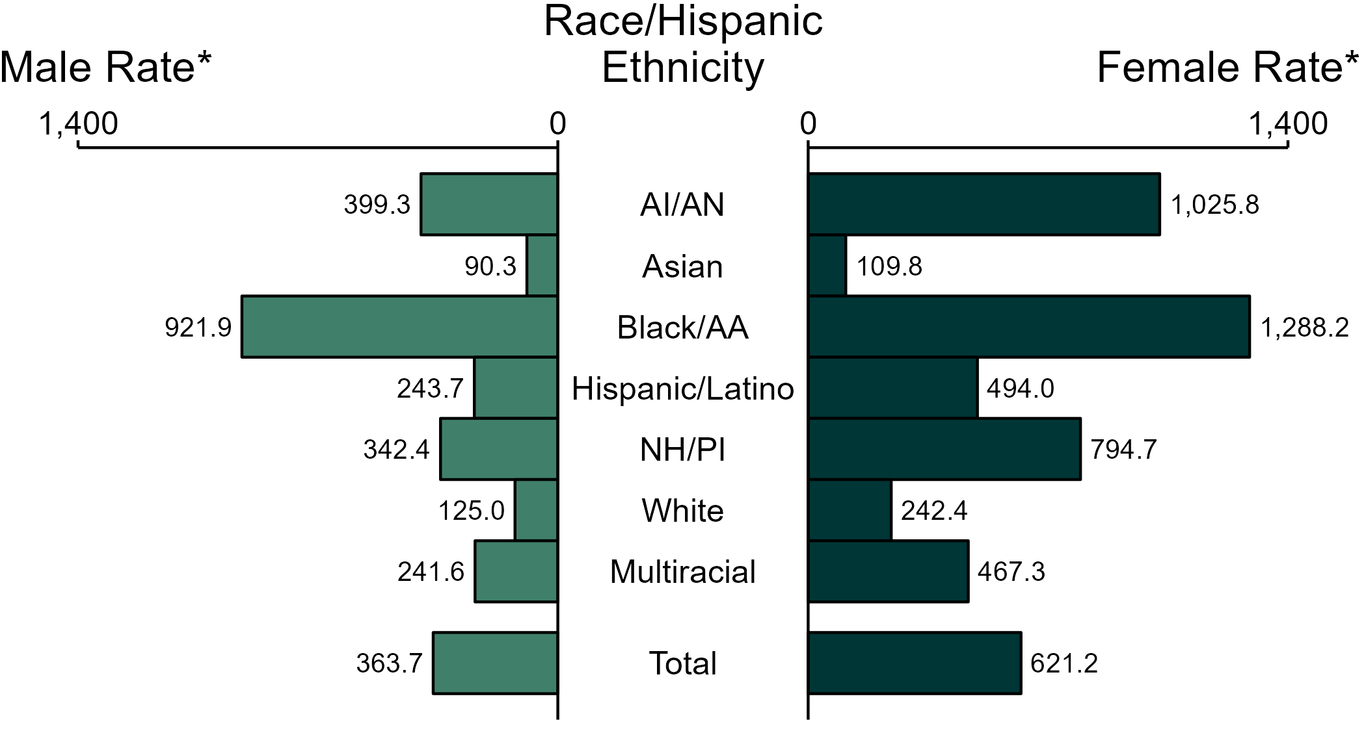
Chlamydia — Rates of Reported Cases by Race/Hispanic Ethnicity and Sex, United States, 2022
* Per 100,000
ACRONYMS: AI/AN = American Indian or Alaska Native; Black/AA = Black or African American; NH/PI = Native Hawaiian or other Pacific Islander
NOTE: Total includes all cases including those with unknown race/Hispanic ethnicity.
Notes:
In 2022, the rate of reported chlamydia was higher among women (621.2 per 100,000) compared to men (363.7 per 100,000).
Among women, non-Hispanic Black or African American women had the highest rate of reported cases of chlamydia (1,288.2 per 100,000), followed by non-Hispanic American Indian or Alaska Native women (1,025.8 per 100,000) and non-Hispanic Native Hawaiian or other Pacific Islander women (794.7 per 100,000). Among men, non-Hispanic Black or African American men also had the highest rate of reported cases of chlamydia (921.9 per 100,000), followed by non-Hispanic American Indian or Alaska Native men (399.3 per 100,000) and non-Hispanic Native Hawaiian or other Pacific Islander men (342.4 per 100,000).
Using non-Hispanic White persons as the referent category, the greatest relative racial disparity in rates of reported chlamydia across both sexes was observed among non-Hispanic Black or African American men, with a rate ratio of 7.4 times that of non-Hispanic White men. Among women, the greatest relative disparity was observed among non-Hispanic Black or African American women as well, with a rate 5.3 times that of non-Hispanic White women.
This report includes data from years that coincide with the COVID-19 pandemic, which introduced uncertainty and difficulty in interpreting STI surveillance data. See Impact of COVID-19 on STIs for more information.
See Technical Notes (https://www.cdc.gov/std/statistics/2022/technical-notes.htm) for information on chlamydia case reporting, race/Hispanic ethnicity categorization, and reporting of race/Hispanic ethnicity for STI cases. Table A1 (https://www.cdc.gov/std/statistics/2022/tables/a1.htm) provides information on unknown, missing, or invalid values of select variables.
Data for all figures are available at https://www.cdc.gov/std/statistics/2022/data.zip. The file “CT - Rates by Race Hispanic Ethnicity and Sex (US 2022).xlsx” contains the data for the figure presented on this slide.

Slide 9
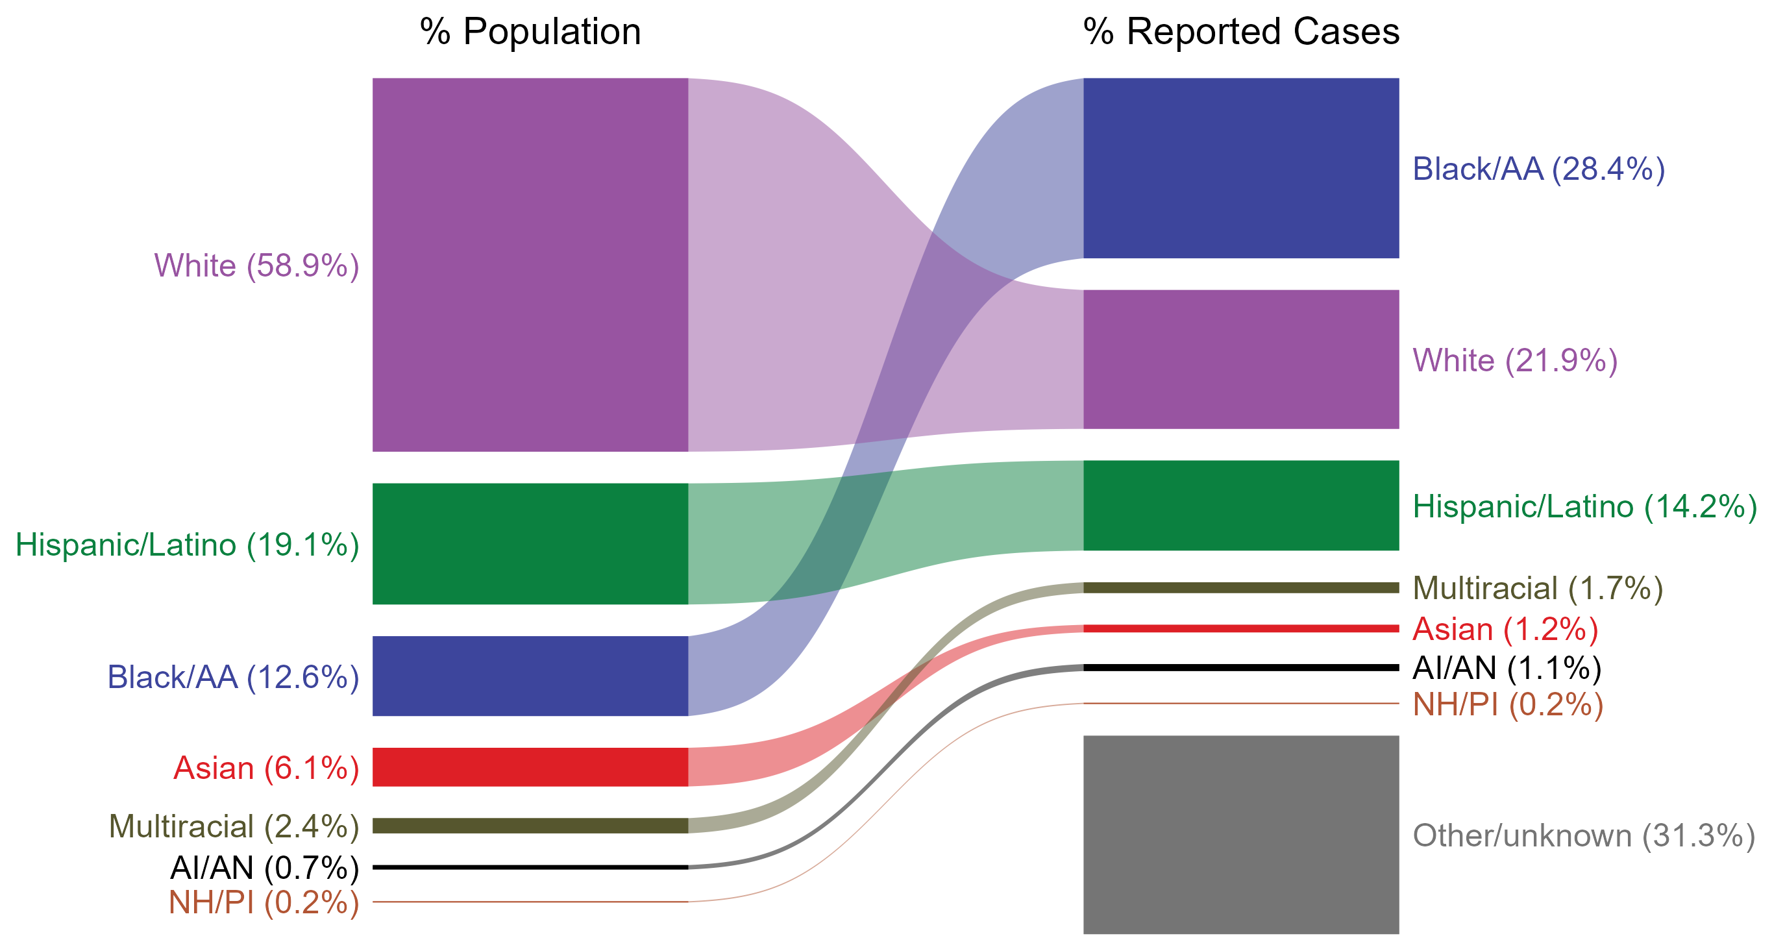
Chlamydia — Total Population and Reported Cases by Race/Hispanic Ethnicity, United States, 2022
* Per 100,000
NOTE: In 2022, a total of 515,552 chlamydia cases (31.3%) had missing, unknown, or other race and were not reported to be of Hispanic ethnicity. These cases are included in the “other/unknown” category.
ACRONYMS: AI/AN = American Indian or Alaska Native; Black/AA = Black or African American; NH/PI = Native Hawaiian or other Pacific Islander
Notes:
The percentages of chlamydia cases by race/Hispanic ethnicity were disproportionate to the percentages among the total population of the United States in 2022. The greatest absolute and relative disparities were observed among non-Hispanic Black or African American persons, who represented 28.4% of reported chlamydia cases (n = 468,384; 41.3% of chlamydia cases with reported race or Hispanic ethnicity) despite being 12.6% of the US population. This is means that the burden of chlamydia among non-Hispanic Black or African American persons was 15.8% greater than — or 2.3 times — what would be expected based on their proportion of the population. Additionally, non-Hispanic American Indian or Alaska Native persons were also overrepresented among chlamydia cases relative to their proportion of the population.
This report includes data from years that coincide with the COVID-19 pandemic, which introduced uncertainty and difficulty in interpreting STI surveillance data. See Impact of COVID-19 on STIs for more information.
See Technical Notes (https://www.cdc.gov/std/statistics/2022/technical-notes.htm) for information on chlamydia case reporting, race/Hispanic ethnicity categorization, and reporting of race/Hispanic ethnicity for STI cases.
Data for all figures are available at https://www.cdc.gov/std/statistics/2022/data.zip. The file “CT - Population and Cases by Race Hispanic Ethnicity (US 2022).xlsx” contains the data for the figure presented on this slide.

Slide 10
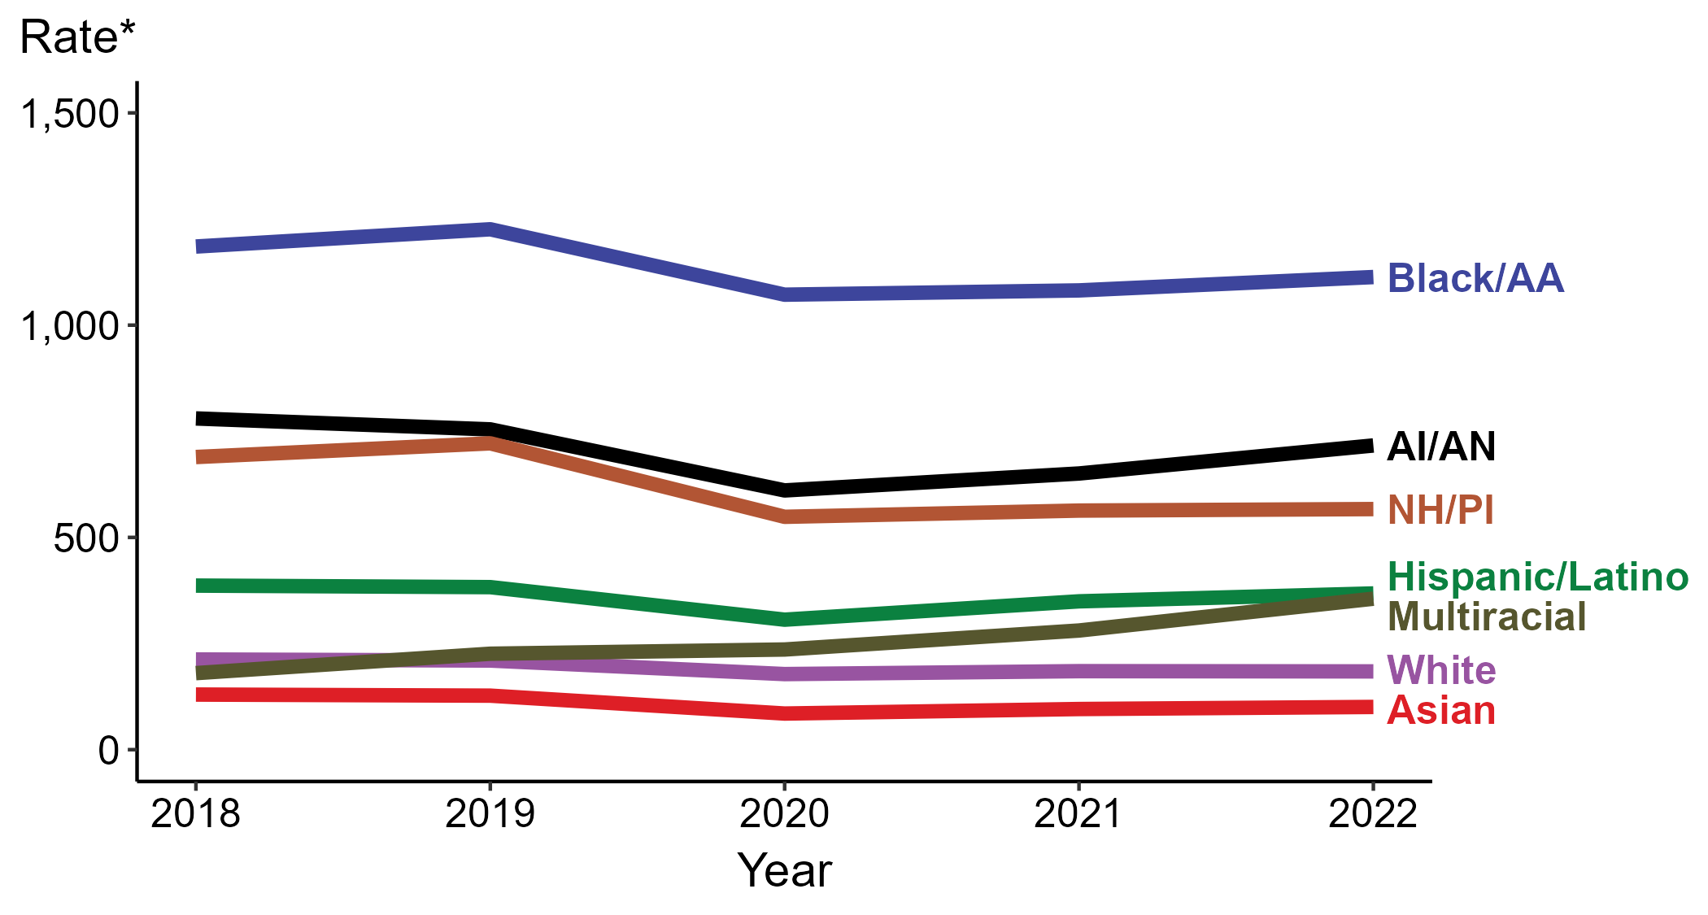
Chlamydia — Rates of Reported Cases by Race/Hispanic Ethnicity, United States, 2018–2022
* Per 100,000
ACRONYMS: AI/AN = American Indian or Alaska Native; Black/AA = Black or African American; NH/PI = Native Hawaiian or other Pacific Islander
Notes:
In 2022, the highest rate of reported chlamydia cases per 100,000 persons was among non-Hispanic Black or African American persons (1,113.3), followed by non-Hispanic American Indian or Alaska Native persons (716.6).
During 2021 to 2022, the greatest increase in rate of reported chlamydia cases per 100,000 persons was among non-Hispanic persons of multiple races (280.7 to 355.6; 26.7% increase). Non-Hispanic persons of multiple races also had the only five-year increase in rate of reported chlamydia (180.3 to 355.6; 97.2% increase from 2018).
There were no substantial (≥1.0%) decreases in the rate of reported chlamydia cases per 100,000 persons among any race or Hispanic ethnicity group during 2021 to 2022. Non-Hispanic Asian persons had the greatest five-year decrease in rate of reported chlamydia (129.8 to 100.6; 22.5% decrease from 2018).
This report includes data from years that coincide with the COVID-19 pandemic, which introduced uncertainty and difficulty in interpreting STI surveillance data. See Impact of COVID-19 on STIs for more information.
See Technical Notes (https://www.cdc.gov/std/statistics/2022/technical-notes.htm) for information on chlamydia case reporting, race/Hispanic ethnicity categorization, and reporting of race/Hispanic ethnicity for STI cases. Table A1 (https://www.cdc.gov/std/statistics/2022/tables/a1.htm) provides information on unknown, missing, or invalid values of select variables.
Data for all figures are available at https://www.cdc.gov/std/statistics/2022/data.zip. The file “CT - Rates by Race Hispanic Ethnicity (US 2018-2022).xlsx” contains the data for the figure presented on this slide.

Slide 11
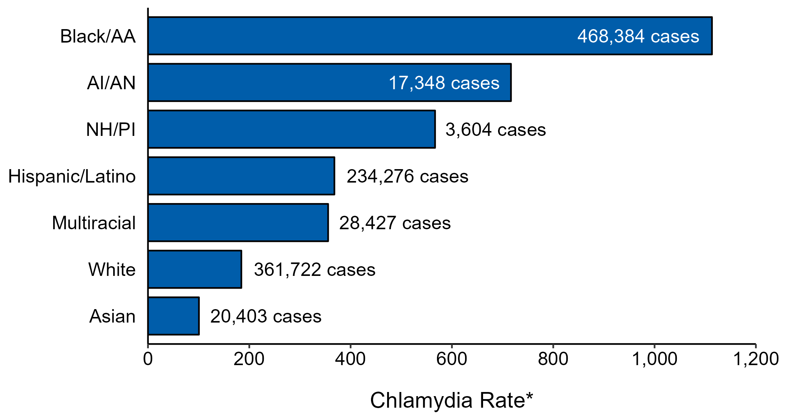
Chlamydia — Case Counts and Rates of Reported Cases by Race/Hispanic Ethnicity, United States, 2022
* Per 100,000 population
NOTE: In 2022, a total of 515,552 chlamydia cases (31.3%) had missing, unknown, or other race and were not reported to be of Hispanic ethnicity. These cases are not shown in this plot.
ACRONYMS: AI/AN = American Indian or Alaska Native; Black/AA = Black or African American; NH/PI = Native Hawaiian or other Pacific Islander
Notes:
In 2022, rates of chlamydia were highest among non-Hispanic Black or African American persons (1,113.3 per 100,000), followed by non-Hispanic American Indian or Alaska Native persons (716.6 per 100,000) and non-Hispanic Native Hawaiian or other Pacific Islander persons (566.7 per 100,000). The greatest number of reported chlamydia cases was among non-Hispanic Black or African American persons (468,384 cases), followed by non-Hispanic White persons (361,722 cases) and Hispanic or Latino persons of any race(s) (234,276 cases).
This report includes data from years that coincide with the COVID-19 pandemic, which introduced uncertainty and difficulty in interpreting STI surveillance data. See Impact of COVID-19 on STIs for more information.
See Technical Notes (https://www.cdc.gov/std/statistics/2022/technical-notes.htm) for information on chlamydia case reporting and reporting of race/Hispanic ethnicity for STI cases.
Data for all figures are available at https://www.cdc.gov/std/statistics/2022/data.zip. The file “CT - Cases and Rates by Race Hispanic Ethnicity (US 2022).xlsx” contains the data for the figure presented on this slide.

Slide 12
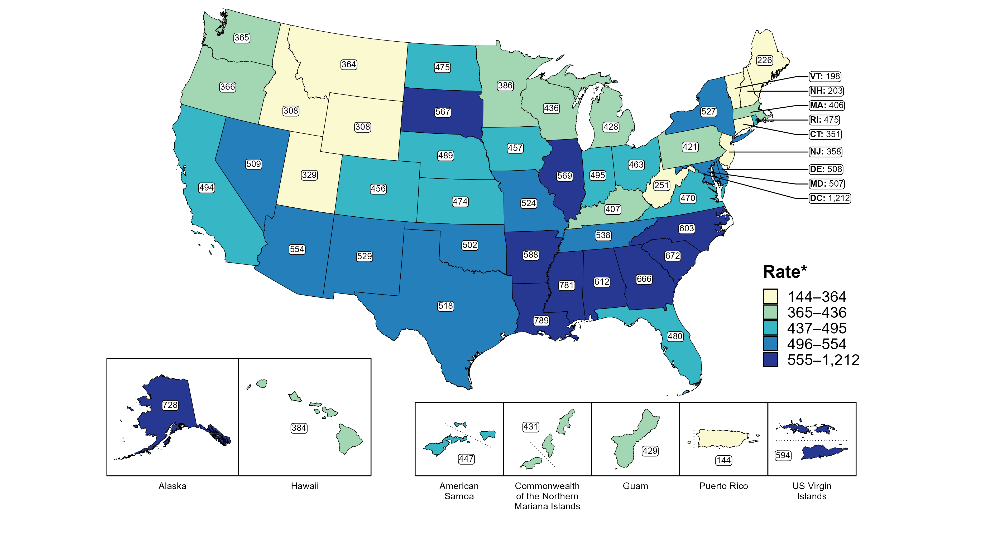
Chlamydia — Rates of Reported Cases by Jurisdiction, United States and Territories, 2022
* Per 100,000
Notes:
In 2022, rates of reported chlamydia ranged by state from 198 cases per 100,000 population in Vermont to 789 cases per 100,000 population in Louisiana. The rate of reported chlamydia in the District of Columbia was 1,212 per 100,000 population.
Among US territories, rates of reported chlamydia ranged from 144 cases per 100,000 population in Puerto Rico to 594 cases per 100,000 population in the US Virgin Islands.
This report includes data from years that coincide with the COVID-19 pandemic, which introduced uncertainty and difficulty in interpreting STI surveillance data. See Impact of COVID-19 on STIs for more information.
See Technical Notes (https://www.cdc.gov/std/statistics/2022/technical-notes.htm) for information on chlamydia case reporting and on interpreting reported rates in US territories.
Data for all figures are available at https://www.cdc.gov/std/statistics/2022/data.zip. The file “CT - Rates by Jurisdiction (US and Terr 2022).xlsx” contains the data for the figure presented on this slide.

Slide 13
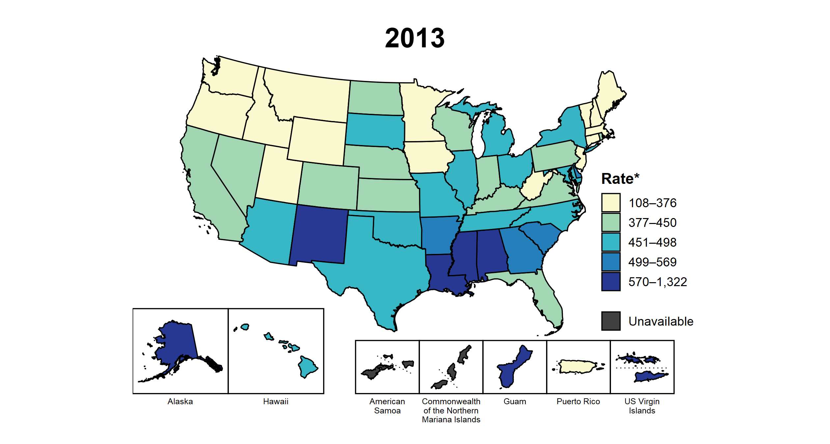
Chlamydia — Rates of Reported Cases by Jurisdiction, United States and Territories, 2013–2022
* Per 100,000
Notes:
This slide contains an animated figure that will play when the slide is in presentation mode. A static version of the figure that displays maps from the first and last years of the range is available as a separate slide.
In 2013, nine states, the District of Columbia (DC), and two US territories (22.2% of areas with available data) had a rate of reported chlamydia greater than or equal to 499 cases per 100,000 population. This increased to 20 states, DC, and one US territory (39.3% of areas with available data) in 2022. During 2021 to 2022, rates of reported chlamydia increased in 16 states, DC, and three territories.
American Samoa and the Commonwealth of the Northern Mariana Islands began reporting data on chlamydia cases to CDC in 2018; data are not available for those areas prior to that year. In addition, data on reported chlamydia cases in 2018 are not available for the US Virgin Islands. Due to a network security incident in December 2021, the Maryland Department of Health could not finalize their 2021 STI case notification data. Data for 2021 from Maryland have been suppressed for this figure; however, they are included in national and regional case counts and rates displayed in other figures.
This report includes data from years that coincide with the COVID-19 pandemic, which introduced uncertainty and difficulty in interpreting STI surveillance data. See Impact of COVID-19 on STIs for more information.
See Technical Notes (https://www.cdc.gov/std/statistics/2022/technical-notes.htm) for information on chlamydia case reporting and on interpreting reported rates in US territories.
Data for all figures are available at https://www.cdc.gov/std/statistics/2022/data.zip. The file “CT - Rates by Jurisdiction (US and Terr 2013-2022).xlsx” contains the data for the figure presented on this slide.

Slide 14
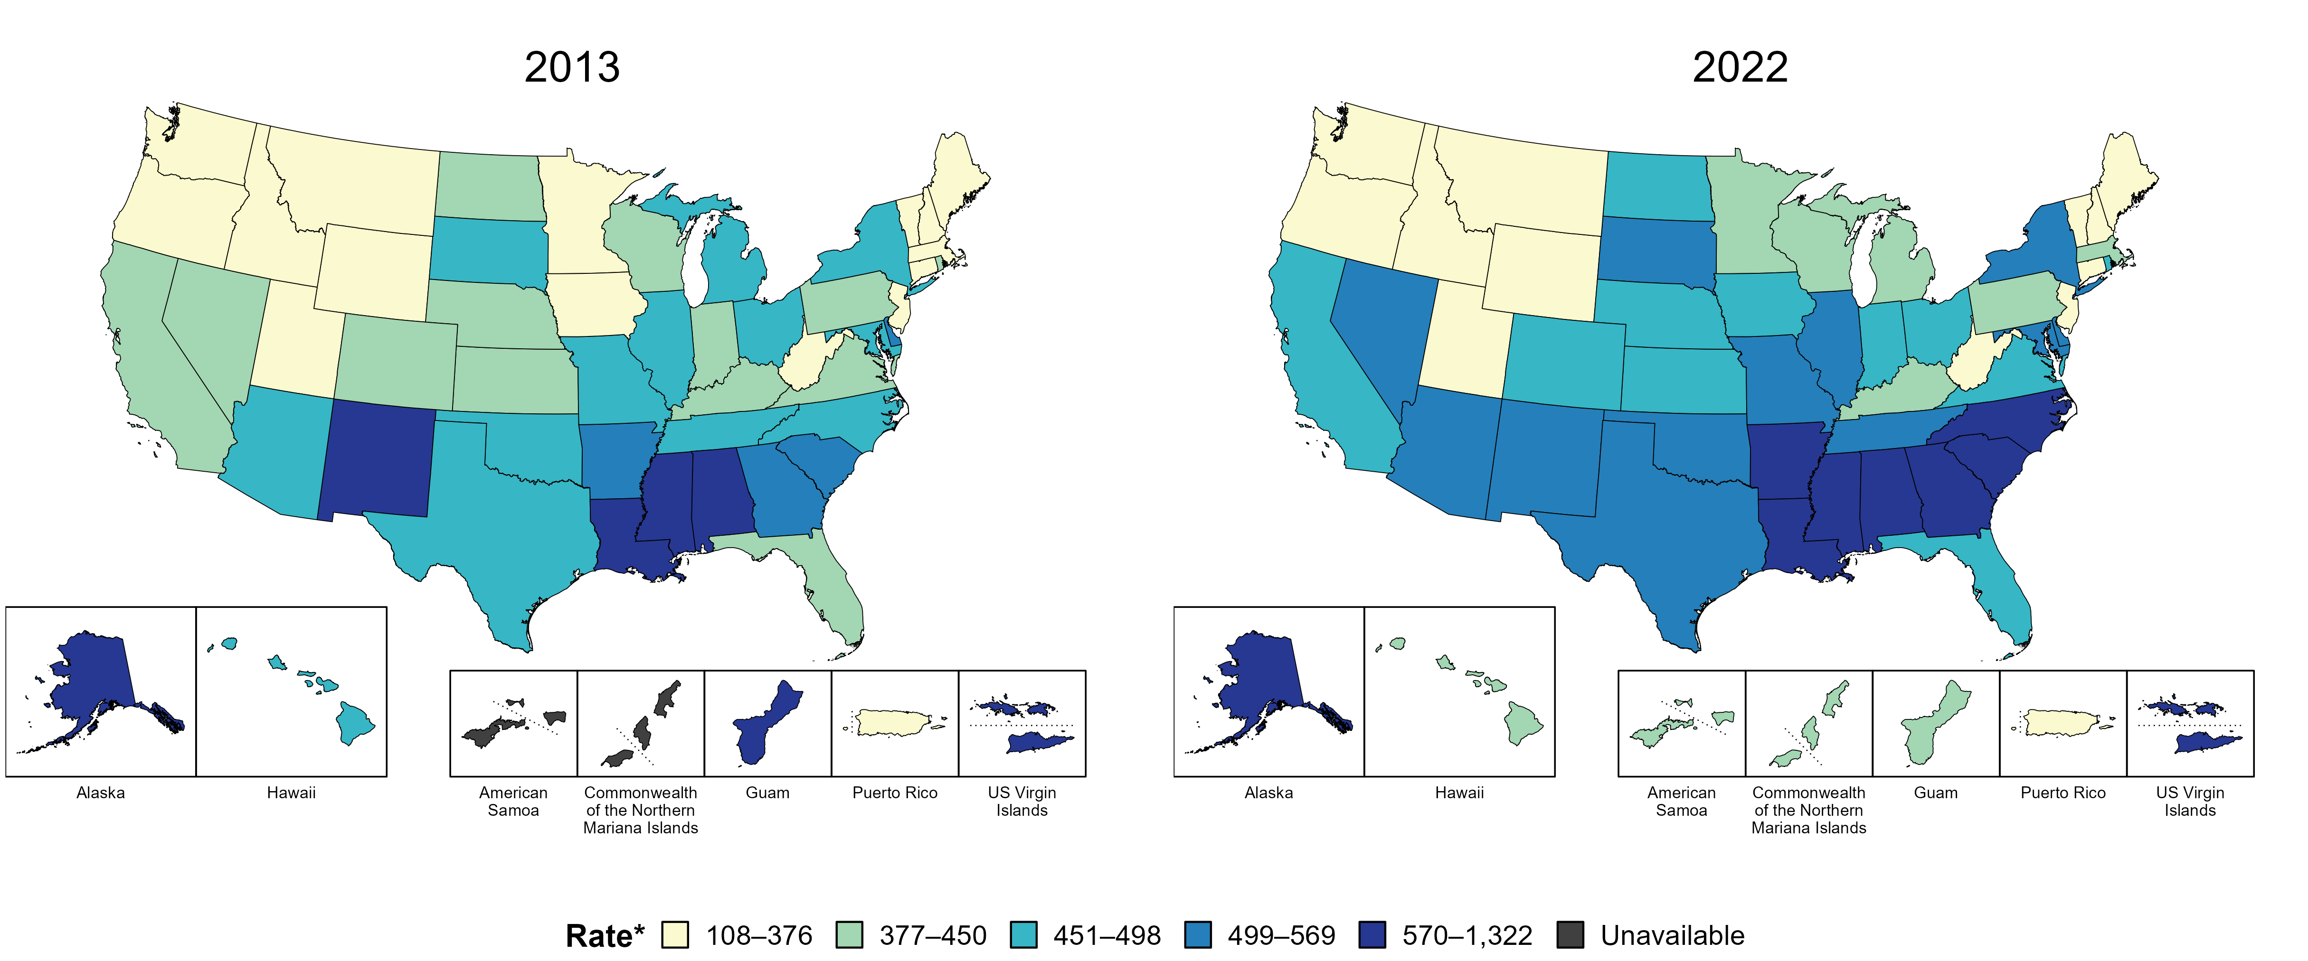
Chlamydia — Rates of Reported Cases by Jurisdiction, United States and Territories, 2013 and 2022
* Per 100,000
Notes:
In 2013, nine states, the District of Columbia (DC), and two US territories (22.2% of areas with available data) had a rate of reported chlamydia greater than or equal to 499 cases per 100,000 population. This increased to 20 states, DC, and one US territory (39.3% of areas with available data) in 2022.
American Samoa and the Commonwealth of the Northern Mariana Islands began reporting data on chlamydia cases to CDC in 2018; data are not available for those areas prior to that year.
This report includes data from years that coincide with the COVID-19 pandemic, which introduced uncertainty and difficulty in interpreting STI surveillance data. See Impact of COVID-19 on STIs for more information.
See Technical Notes (https://www.cdc.gov/std/statistics/2022/technical-notes.htm) for information on chlamydia case reporting and on interpreting reported rates in US territories.
Data for all figures are available at https://www.cdc.gov/std/statistics/2022/data.zip. The file “CT - Rates by Jurisdiction (US and Terr 2013 and 2022).xlsx” contains the data for the figure presented on this slide.

Slide 15
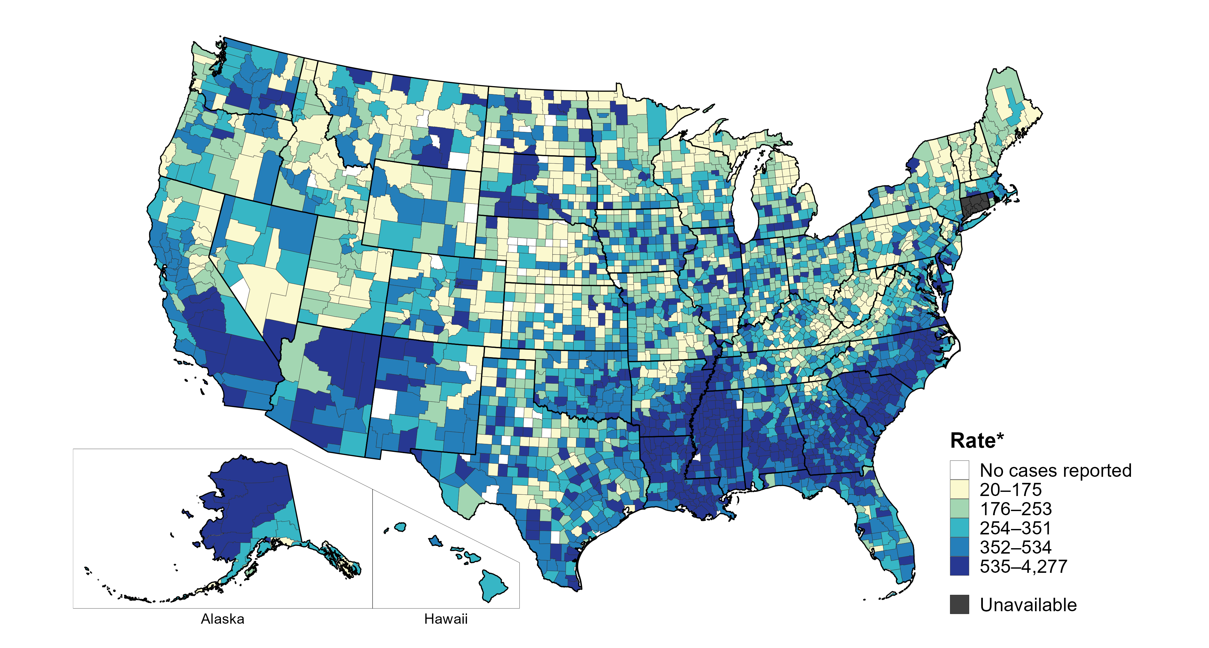
Chlamydia — Rates of Reported Cases by County, United States, 2022
* Per 100,000
Notes:
In 2022, 99% of counties and county equivalents with available data in the United States reported at least one case of chlamydia. Out of 3,135 counties and county equivalents with available data, 93 (3%) reported half of all cases of chlamydia.
In 2022, Connecticut adopted nine planning regions as county-equivalent geographic units; as STI case notification data were not available in the new county-equivalent units for 2022, data for Connecticut have been suppressed for this figure.
This report includes data from years that coincide with the COVID-19 pandemic, which introduced uncertainty and difficulty in interpreting STI surveillance data. See Impact of COVID-19 on STIs for more information.
See Technical Notes (https://www.cdc.gov/std/statistics/2022/technical-notes.htm) for information on chlamydia case reporting. Table A1 (https://www.cdc.gov/std/statistics/2022/tables/a1.htm) provides information on unknown, missing, or invalid values of select variables.
Data for all figures are available at https://www.cdc.gov/std/statistics/2022/data.zip. The file “CT - Rates by County (US 2022).xlsx” contains the data for the figure presented on this slide.

Slide 16
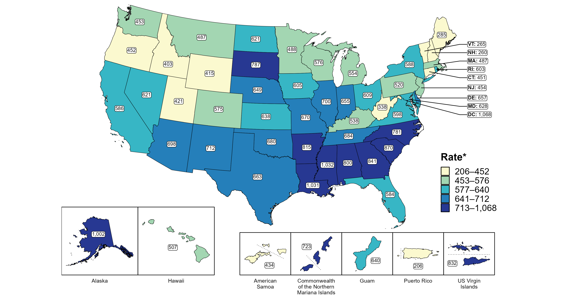
Chlamydia — Rates of Reported Cases Among Women by Jurisdiction, United States and Territories, 2022
* Per 100,000
Notes:
In 2022, rates of reported chlamydia among women ranged by state from 260 cases per 100,000 women in New Hampshire to 1,032 cases per 100,000 women in Mississippi. The rate of reported chlamydia in the District of Columbia was 1,068 per 100,000 women.
Among US territories, rates of reported chlamydia ranged from 206 cases per 100,000 women in Puerto Rico to 832 cases per 100,000 women in the US Virgin Islands.
This report includes data from years that coincide with the COVID-19 pandemic, which introduced uncertainty and difficulty in interpreting STI surveillance data. See Impact of COVID-19 on STIs for more information.
See Technical Notes (https://www.cdc.gov/std/statistics/2022/technical-notes.htm) for information on chlamydia case reporting and on interpreting reported rates in US territories. Table A1 (https://www.cdc.gov/std/statistics/2022/tables/a1.htm) provides information on unknown, missing, or invalid values of select variables.
Data for all figures are available at https://www.cdc.gov/std/statistics/2022/data.zip. The file “CT - Rates Women by Jurisdiction (US and Terr 2022).xlsx” contains the data for the figure presented on this slide.

Slide 17
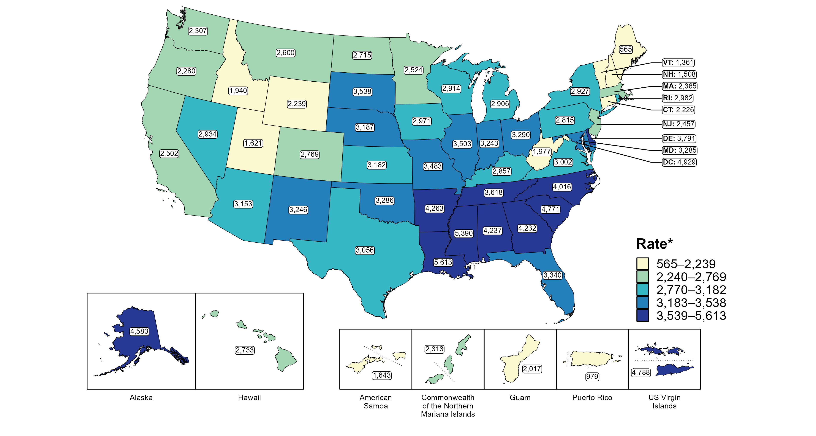
Chlamydia — Rates of Reported Cases Among Women Aged 15–24 Years by Jurisdiction, United States and Territories, 2022
* Per 100,000
Notes:
In 2022, rates of reported chlamydia among women aged 15 to 24 years ranged by state from 565 cases per 100,000 women aged 15 to 24 years in Maine to 5,613 cases per 100,000 women aged 15 to 24 years in Louisiana. The rate of reported chlamydia in the District of Columbia was 4,929 per 100,000 women aged 15 to 24 years.
Among US territories, rates of reported chlamydia ranged from 979 cases per 100,000 women aged 15 to 24 years in Puerto Rico to 4,788 cases per 100,000 women aged 15 to 24 years in the US Virgin Islands.
This report includes data from years that coincide with the COVID-19 pandemic, which introduced uncertainty and difficulty in interpreting STI surveillance data. See Impact of COVID-19 on STIs for more information.
See Technical Notes (https://www.cdc.gov/std/statistics/2022/technical-notes.htm) for information on chlamydia case reporting and on interpreting reported rates in US territories. Table A1 (https://www.cdc.gov/std/statistics/2022/tables/a1.htm) provides information on unknown, missing, or invalid values of select variables.
Data for all figures are available at https://www.cdc.gov/std/statistics/2022/data.zip. The file “CT - Rates Women 15-24 Years by Jurisdiction (US and Terr 2022).xlsx” contains the data for the figure presented on this slide.

Slide 18
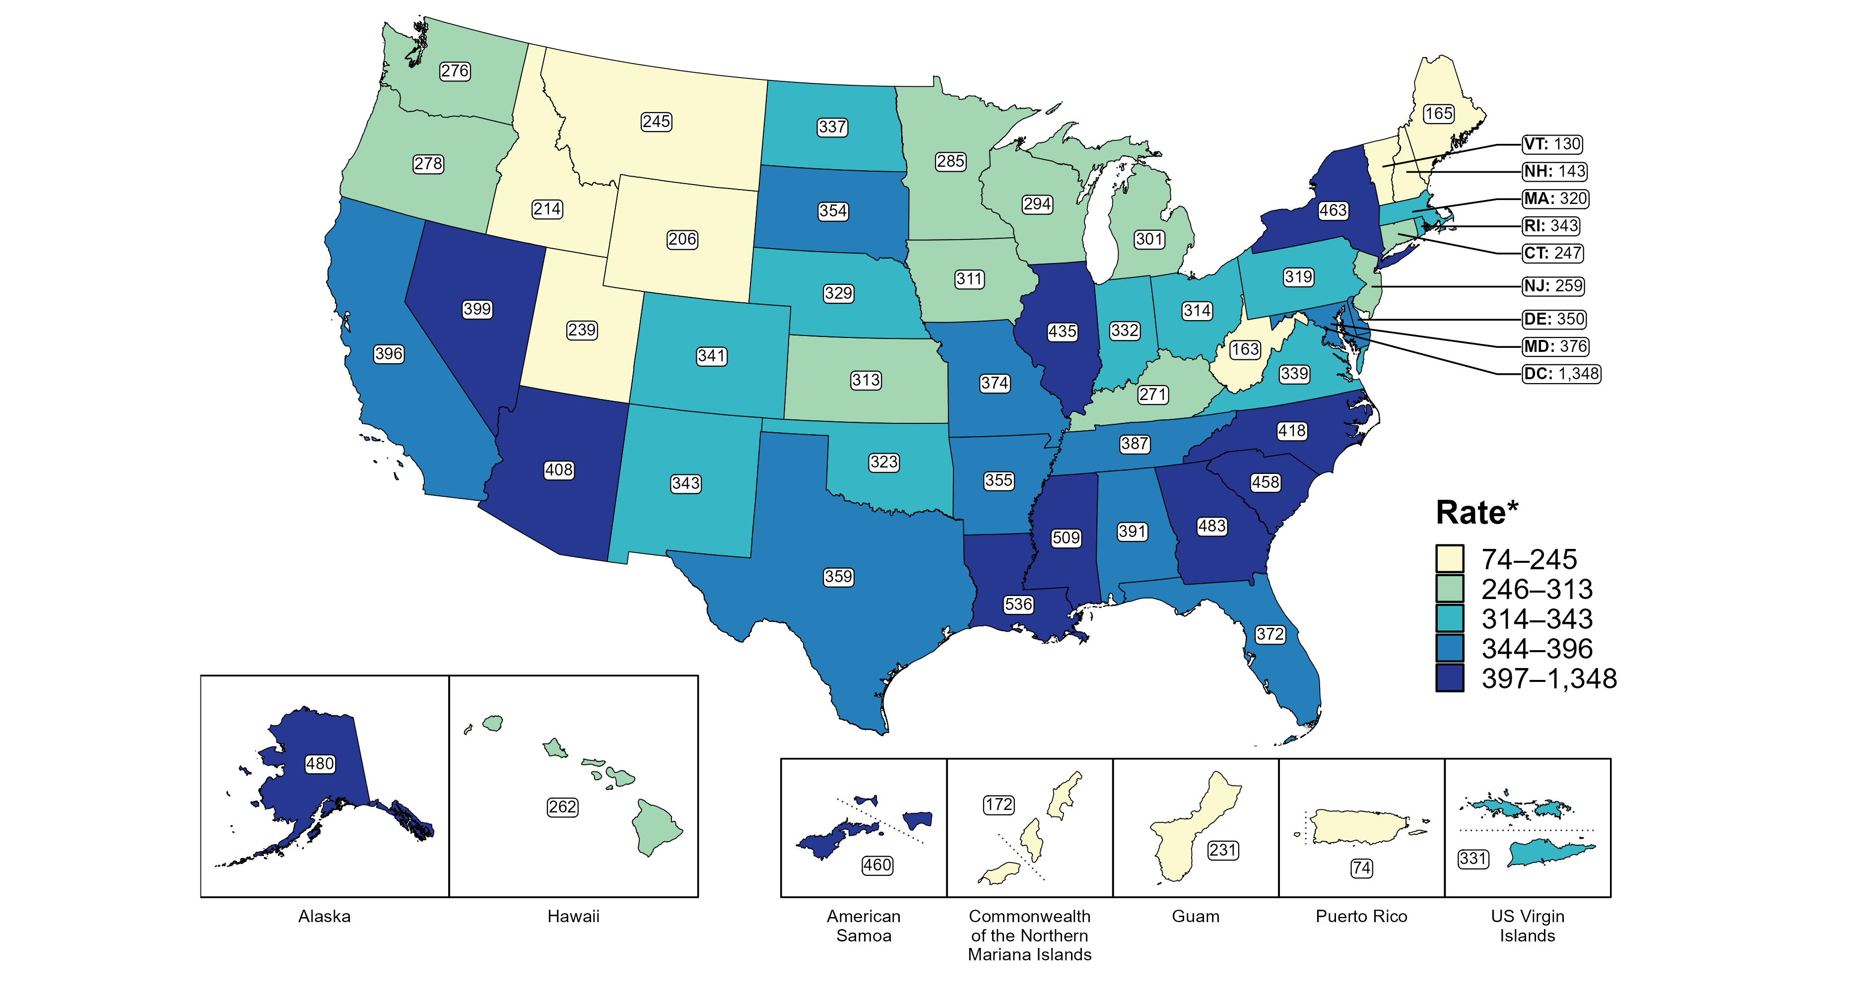
Chlamydia — Rates of Reported Cases Among Men by Jurisdiction, United States and Territories, 2022
*Per 100,000
Notes:
In 2022, rates of reported chlamydia among men ranged by state from 130 cases per 100,000 men in Vermont to 536 cases per 100,000 men in Louisiana. The rate of reported chlamydia in the District of Columbia was 1,348 per 100,000 men.
Among US territories, rates of reported chlamydia ranged from 74 cases per 100,000 men in Puerto Rico to 460 cases per 100,000 men in American Samoa.
This report includes data from years that coincide with the COVID-19 pandemic, which introduced uncertainty and difficulty in interpreting STI surveillance data. See Impact of COVID-19 on STIs for more information.
See Technical Notes (https://www.cdc.gov/std/statistics/2022/technical-notes.htm) for information on chlamydia case reporting and on interpreting reported rates in US territories. Table A1 (https://www.cdc.gov/std/statistics/2022/tables/a1.htm) provides information on unknown, missing, or invalid values of select variables.
Data for all figures are available at https://www.cdc.gov/std/statistics/2022/data.zip. The file “CT - Rates Men by Jurisdiction (US and Terr 2022).xlsx” contains the data for the figure presented on this slide.

Slide 19
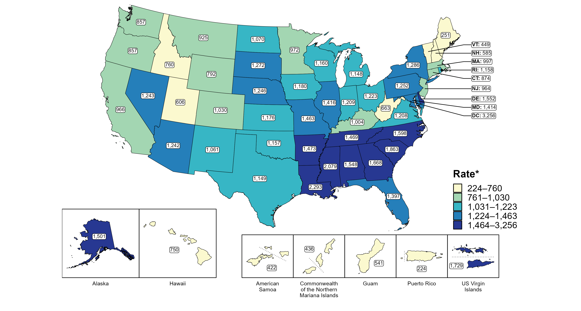
Chlamydia — Rates of Reported Cases Among Men Aged 15–24 Years by Jurisdiction, United States and Territories, 2022
* Per 100,000
Notes:
In 2022, rates of reported chlamydia among men aged 15 to 24 years ranged by state from 251 cases per 100,000 men aged 15 to 24 years in Maine to 2,293 cases per 100,000 men aged 15 to 24 years in Louisiana. The rate of reported chlamydia in the District of Columbia was 3,256 per 100,000 men aged 15 to 24 years.
Among US territories, rates of reported chlamydia ranged from 224 cases per 100,000 men aged 15 to 24 years in Puerto Rico to 1,729 cases per 100,000 men aged 15 to 24 years in the US Virgin Islands.
This report includes data from years that coincide with the COVID-19 pandemic, which introduced uncertainty and difficulty in interpreting STI surveillance data. See Impact of COVID-19 on STIs for more information.
See Technical Notes (https://www.cdc.gov/std/statistics/2022/technical-notes.htm) for information on chlamydia case reporting and on interpreting reported rates in US territories. Table A1 (https://www.cdc.gov/std/statistics/2022/tables/a1.htm) provides information on unknown, missing, or invalid values of select variables.
Data for all figures are available at https://www.cdc.gov/std/statistics/2022/data.zip. The file “CT - Rates Men 15-24 Years by Jurisdiction (US and Terr 2022).xlsx” contains the data for the figure presented on this slide.

Slide 20
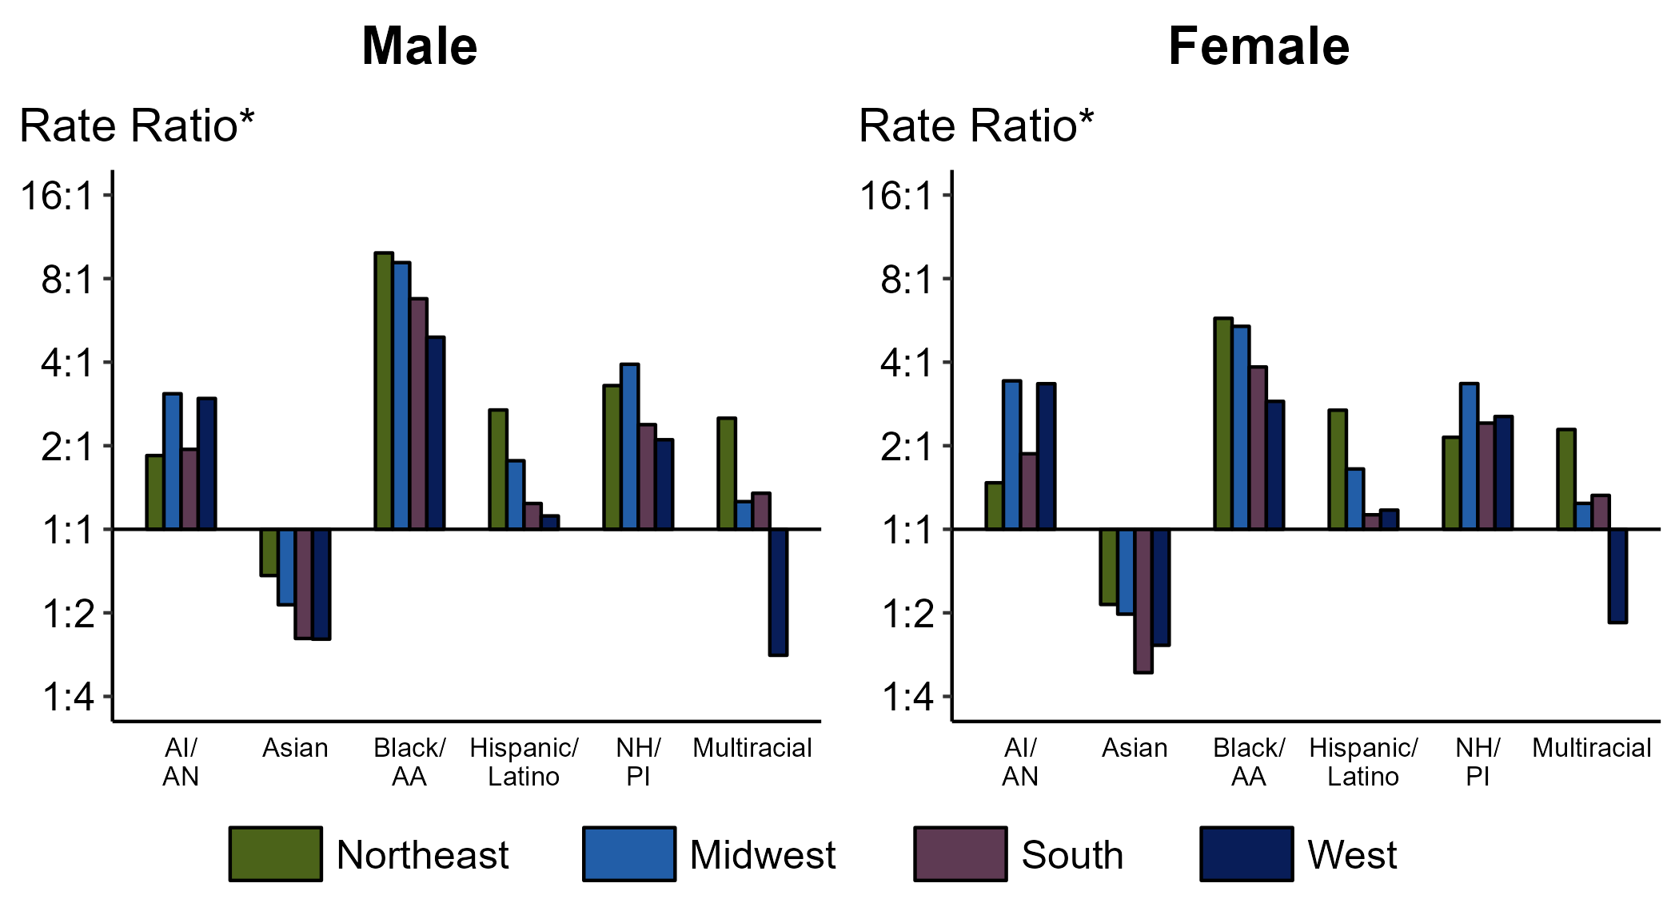
Chlamydia — Ratios of Rates of Reported Cases Among Persons Aged 15–24 Years by Sex, Race/Hispanic Ethnicity, and Region, United States, 2022
* For the rate ratios, non-Hispanic White persons are the referent population. Y-axis is log scale.
ACRONYMS: AI/AN = American Indian or Alaska Native; Black/AA = Black or African American; NH/PI = Native Hawaiian or other Pacific Islander
Notes:
Among men and women aged 15-24 years, rate ratios of rates of reported chlamydia by race/Hispanic ethnicity (using non-Hispanic White persons as the referent population) varied by region in 2022. Among men aged 15-24 years, the greatest rate ratio was in the Northeast where the rate of reported chlamydia among non-Hispanic Black men was 9.9 times the rate among non-Hispanic White men. Among women aged 15-24 years, the greatest rate ratio was in the Northeast where the rate of reported chlamydia among non-Hispanic Black women was 5.8 times the rate among non-Hispanic White women.
This report includes data from years that coincide with the COVID-19 pandemic, which introduced uncertainty and difficulty in interpreting STI surveillance data. See Impact of COVID-19 on STIs for more information.
See Technical Notes (https://www.cdc.gov/std/statistics/2022/technical-notes.htm) for information on chlamydia case reporting, race/Hispanic ethnicity categorization, and reporting of race/Hispanic ethnicity for STI cases. Table A1 (https://www.cdc.gov/std/statistics/2022/tables/a1.htm) provides information on unknown, missing, or invalid values of select variables.

Slide 21
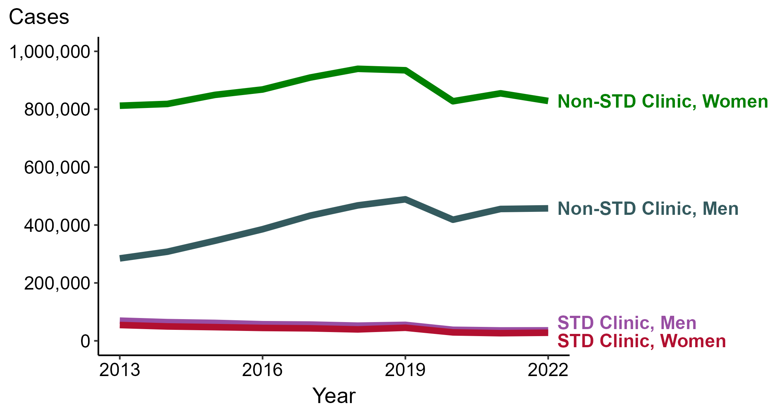
Chlamydia — Reported Cases by Reporting Source and Sex, United States, 2013–2022
NOTE: During 2013 to 2022, the proportion of all cases with unknown reporting source was 15.3%, from a low of 12.7% (n = 178,273) in 2013 to a high of 17.9% (n = 295,170) in 2022.
Notes:
During 2021 to 2022, the number of chlamydia cases reported from STD clinics did not change substantially (<1.0% change) among men (35,913 to 36,135 cases) and increased 5.8% among women (26,395 to 27,930 cases), while the number of cases reported from non-STD clinics did not change substantially (<1.0% change) among men (455,459 to 457,559 cases) and decreased 3.1% among women (854,917 to 828,629 cases).
During a ten-year period (2013 to 2022), the number of chlamydia cases reported from STD clinics decreased 48.1% among men (69,680 to 36,135 cases) and decreased 48.8% among women (54,590 to 27,930 cases), while the number of cases reported from non-STD clinics increased 60.7% among men (284,722 to 457,559 cases) and increased 2.0% among women (812,153 to 828,629 cases).
This report includes data from years that coincide with the COVID-19 pandemic, which introduced uncertainty and difficulty in interpreting STI surveillance data. See Impact of COVID-19 on STIs for more information.
See Technical Notes (https://www.cdc.gov/std/statistics/2022/technical-notes.htm) for information on chlamydia case reporting. Table A1 (https://www.cdc.gov/std/statistics/2022/tables/a1.htm) provides information on unknown, missing, or invalid values of select variables.
Data for all figures are available at https://www.cdc.gov/std/statistics/2022/data.zip. The file “CT - Cases by Reporting Source and Sex (US 2013-2022).xlsx” contains the data for the figure presented on this slide.

Slide 22
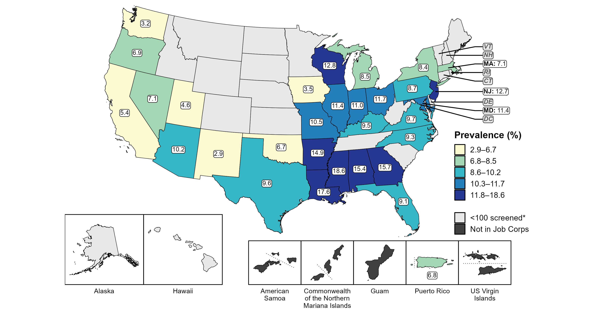
Chlamydia — Prevalence Among Women Aged 16–24 Years Entering Job Corps by State of Residence, United States and Territories, 2022
* Fewer than 100 women who resided in these states/areas and entered Job Corps were screened for chlamydia in 2022.
Notes:
In 2022, 30 states and one US territory screened at least 100 women entering Job Corps for chlamydia. The median state-specific chlamydia prevalence among this population in the 30 states was 9.5%, ranging from 2.9% in New Mexico to 18.6% in Mississippi. The prevalence in Puerto Rico was 6.8%.
This report includes data from years that coincide with the COVID-19 pandemic, which introduced uncertainty and difficulty in interpreting STI surveillance data. See Impact of COVID-19 on STIs for more information.
See Technical Notes (https://www.cdc.gov/std/statistics/2022/technical-notes.htm) for information on Jobs Corps methodology.
Data for all figures are available at https://www.cdc.gov/std/statistics/2022/data.zip. The file “CT - Prevalence Women 16-24 Years Entering Job Corps (US and Terr 2022).xlsx” contains the data for the figure presented on this slide.

Slide 23
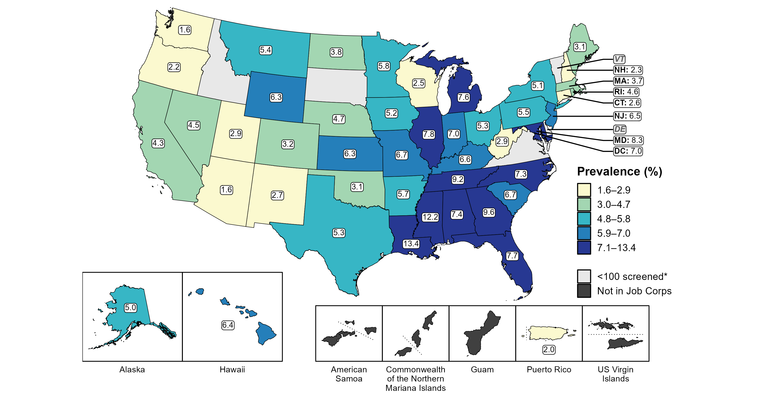
Chlamydia — Prevalence Among Men Aged 16–24 Years Entering Job Corps by State of Residence, United States and Territories, 2022
* Fewer than 100 men who resided in these states/areas and entered Job Corps were screened for chlamydia in 2022.
Notes:
In 2022, 46 states, the District of Columbia, and one US territory screened at least 100 men entering Job Corps for chlamydia. The median state-specific chlamydia prevalence among this population in the 46 states and the District of Columbia was 5.3%, ranging from 1.6% in Arizona and Washington to 13.4% in Louisiana. The prevalence in Puerto Rico was 2.0%.
This report includes data from years that coincide with the COVID-19 pandemic, which introduced uncertainty and difficulty in interpreting STI surveillance data. See Impact of COVID-19 on STIs for more information.
See Technical Notes (https://www.cdc.gov/std/statistics/2022/technical-notes.htm) for information on Jobs Corps methodology.
Data for all figures are available at https://www.cdc.gov/std/statistics/2022/data.zip. The file “CT - Prevalence Men 16-24 Years Entering Job Corps (US and Terr 2022).xlsx” contains the data for the figure presented on this slide.

Slide 24
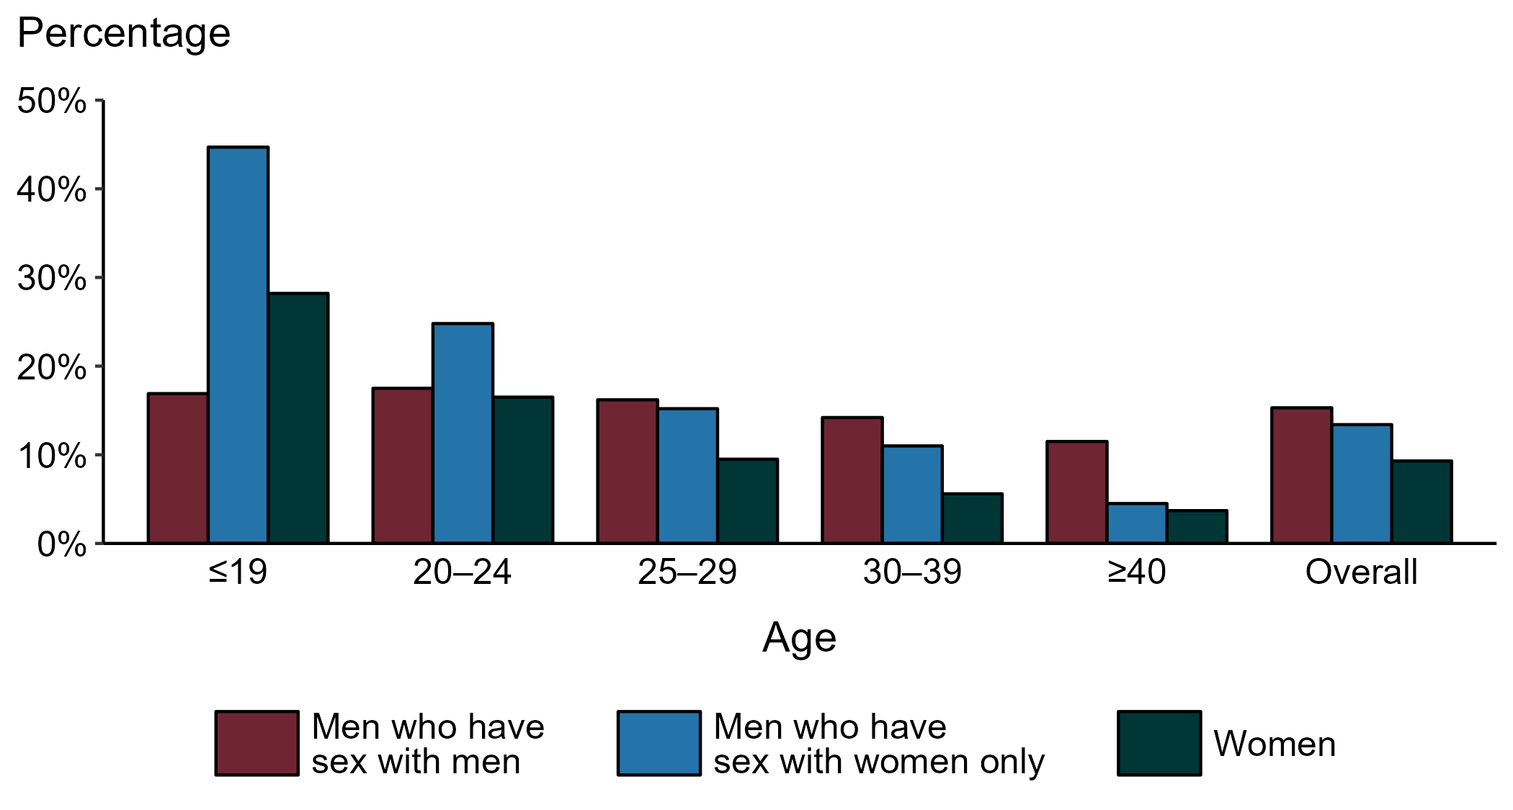
Chlamydia — Proportion of STD Clinic Patients Testing Positive by Age Group, Sex, and Sex of Sex Partners, STD Surveillance Network (SSuN), 2022
NOTE: Results are based on 49,665 unique patients in 10 participating jurisdictions (Baltimore City, California [excluding San Francisco], Columbus, Florida, Indiana, Multnomah County, New York City, Philadelphia, San Francisco, and Washington) with known sex of sex partners attending SSuN STD clinics who were tested ≥1 times for chlamydia in 2022.
Notes:
Among patients accessing care in participating STD clinics in the STD Surveillance Network (SSuN) who were tested for chlamydia in 2022 and had known sexual orientation or sex of sex partners, 15.3% of gay, bisexual and other men who have sex with men (MSM), 13.4% of men who have sex with women only (MSW), and 9.3% of women were found to be positive. The proportion testing positive for chlamydia varied by sex and sex of sex partners, as well as by age group. The highest proportion of patients testing positive were MSW aged 19 years and younger (44.7%). Of note, adolescent patients represent a relatively small subgroup of the clinic population and changes in the number of events in the numerator or a small denominator may lead to substantial fluctuations from year to year. Hence, data should be interpreted with caution.
This report includes data from years that coincide with the COVID-19 pandemic, which introduced uncertainty and difficulty in interpreting STI surveillance data. See Impact of COVID-19 on STIs for more information.
See Technical Notes (https://www.cdc.gov/std/statistics/2022/technical-notes.htm) for information on SSuN methodology.

Slide 25
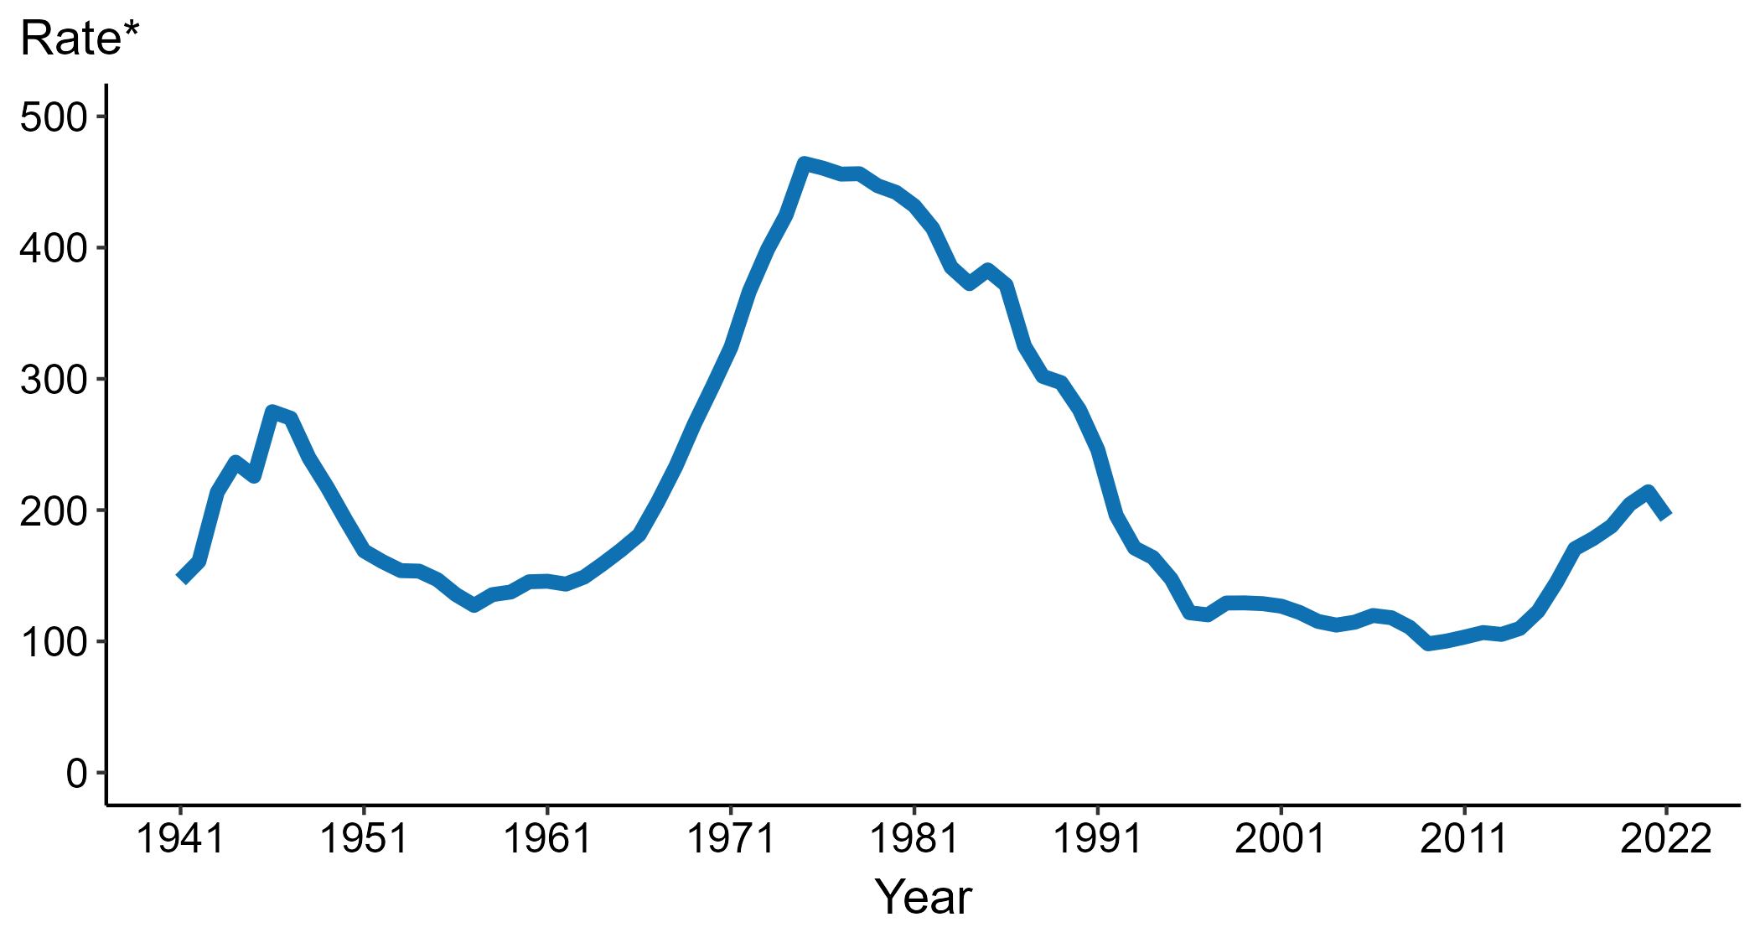
Gonorrhea — Rates of Reported Cases by Year, United States, 1941–2022
* Per 100,000
Notes:
Data collection for gonorrhea began in 1941 and gonorrhea was made a nationally notifiable condition in 1944. Steep declines in case rates in the 1940s and 1950s likely reflect expanded use of penicillin to treat infection.
In 2022, a total of 648,056 cases of gonorrhea were reported in the United States. During 2021 to 2022, the rate of reported gonorrhea decreased 9.2% (from 214.0 to 194.4 per 100,000).
This report includes data from years that coincide with the COVID-19 pandemic, which introduced uncertainty and difficulty in interpreting STI surveillance data. See Impact of COVID-19 on STIs for more information.
See Technical Notes (https://www.cdc.gov/std/statistics/2022/technical-notes.htm) for information on gonorrhea case reporting.
Data for all figures are available at https://www.cdc.gov/std/statistics/2022/data.zip. The file “GC - Rates by Year (US 1941-2022).xlsx” contains the data for the figure presented on this slide.

Slide 26
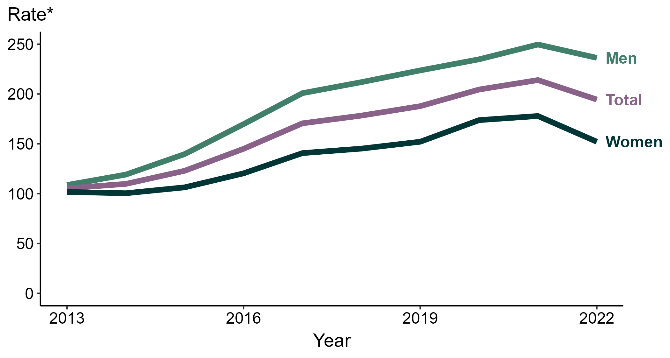
Gonorrhea — Rates of Reported Cases by Sex, United States, 2013–2022
* Per 100,000
Notes:
During 2021 to 2022, the rate of reported gonorrhea among men decreased 5.4% (from 249.7 to 236.3 per 100,000) and the rate among women decreased 14.5% (from 177.9 to 152.1 per 100,000).
Over the last five years, the rate of reported gonorrhea among men increased 11.5% (from 211.9 to 236.3 per 100,000) and the rate among women increased 4.8% (from 145.2 to 152.1 per 100,000). Over the last 10 years, the rate among men increased 117.4% (from 108.7 to 236.3 per 100,000) and the rate among women increased 49.6% (from 101.7 to 152.1 per 100,000).
This report includes data from years that coincide with the COVID-19 pandemic, which introduced uncertainty and difficulty in interpreting STI surveillance data. See Impact of COVID-19 on STIs for more information.
See Technical Notes (https://www.cdc.gov/std/statistics/2022/technical-notes.htm) for information on gonorrhea case reporting. Table A1 (https://www.cdc.gov/std/statistics/2022/tables/a1.htm) provides information on unknown, missing, or invalid values of select variables.
Data for all figures are available at https://www.cdc.gov/std/statistics/2022/data.zip. The file “GC - Rates by Sex (US 2013-2022).xlsx” contains the data for the figure presented on this slide.

Slide 27
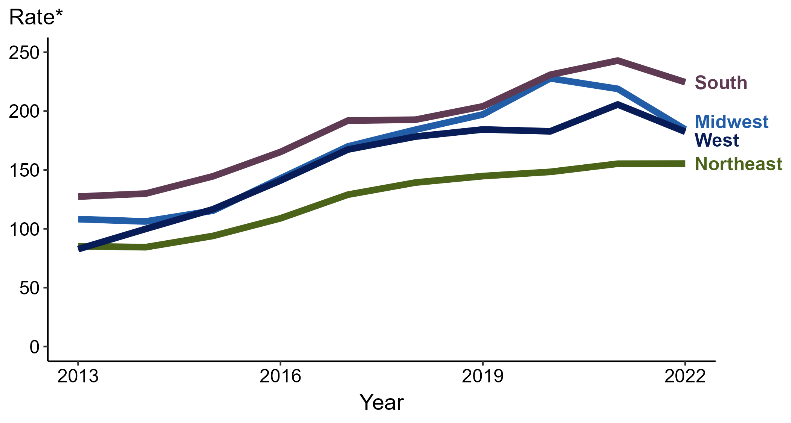
Gonorrhea — Rates of Reported Cases by Region, United States, 2013–2022
* Per 100,000
Notes:
In 2022, the South had the highest rate of reported gonorrhea (224.5 cases per 100,000; 7.6% decrease from 2021), followed by the Midwest (184.3 cases per 100,000; 15.8% decrease from 2021), the West (182.4 cases per 100,000; 11.3% decrease from 2021), and the Northeast (155.4 cases per 100,000; <1.0% change from 2021).
The South had the greatest five-year increase in rates of reported cases of gonorrhea (192.7 to 224.5 per 100,000; 16.5% increase from 2018). The West had the greatest 10-year increase in rates of reported cases of gonorrhea (82.7 to 182.4 per 100,000; 120.6% increase from 2013).
This report includes data from years that coincide with the COVID-19 pandemic, which introduced uncertainty and difficulty in interpreting STI surveillance data. See Impact of COVID-19 on STIs for more information.
See Technical Notes (https://www.cdc.gov/std/statistics/2022/technical-notes.htm) for information on gonorrhea case reporting.
Data for all figures are available at https://www.cdc.gov/std/statistics/2022/data.zip. The file “GC - Rates by Region (US 2013-2022).xlsx” contains the data for the figure presented on this slide.

Slide 28
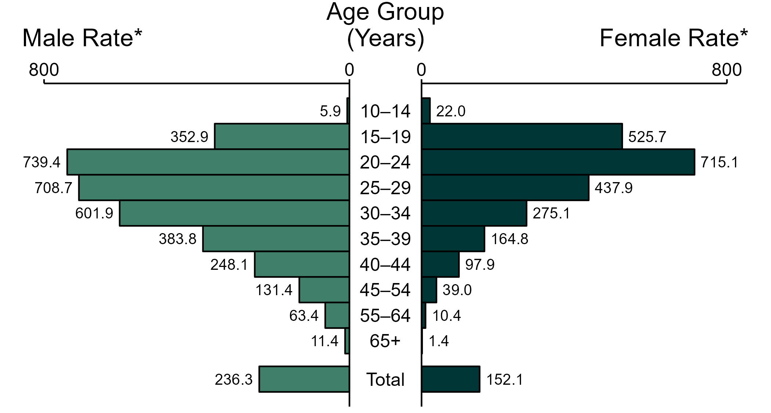
Gonorrhea — Rates of Reported Cases by Age Group and Sex, United States, 2022
* Per 100,000
NOTE: Total includes cases of all ages, including those with unknown age.
Notes:
In 2022, the rate of reported gonorrhea was higher among men (236.3 per 100,000) compared to women (152.1 per 100,000).
Among men, those aged 20 to 24 years had the highest rate of reported cases of gonorrhea (739.4 per 100,000), followed by men aged 25 to 29 years (708.7 per 100,000) and men aged 30 to 34 years (601.9 per 100,000). Among women, those aged 20 to 24 years also had the highest rate of reported cases of gonorrhea (715.1 per 100,000), followed by women aged 15 to 19 years (525.7 per 100,000) and women aged 25 to 29 years (437.9 per 100,000).
This report includes data from years that coincide with the COVID-19 pandemic, which introduced uncertainty and difficulty in interpreting STI surveillance data. See Impact of COVID-19 on STIs for more information.
See Technical Notes (https://www.cdc.gov/std/statistics/2022/technical-notes.htm) for information on gonorrhea case reporting. Table A1 (https://www.cdc.gov/std/statistics/2022/tables/a1.htm) provides information on unknown, missing, or invalid values of select variables.
Data for all figures are available at https://www.cdc.gov/std/statistics/2022/data.zip. The file “GC - Rates by Age Group and Sex (US 2022).xlsx” contains the data for the figure presented on this slide.

Slide 29
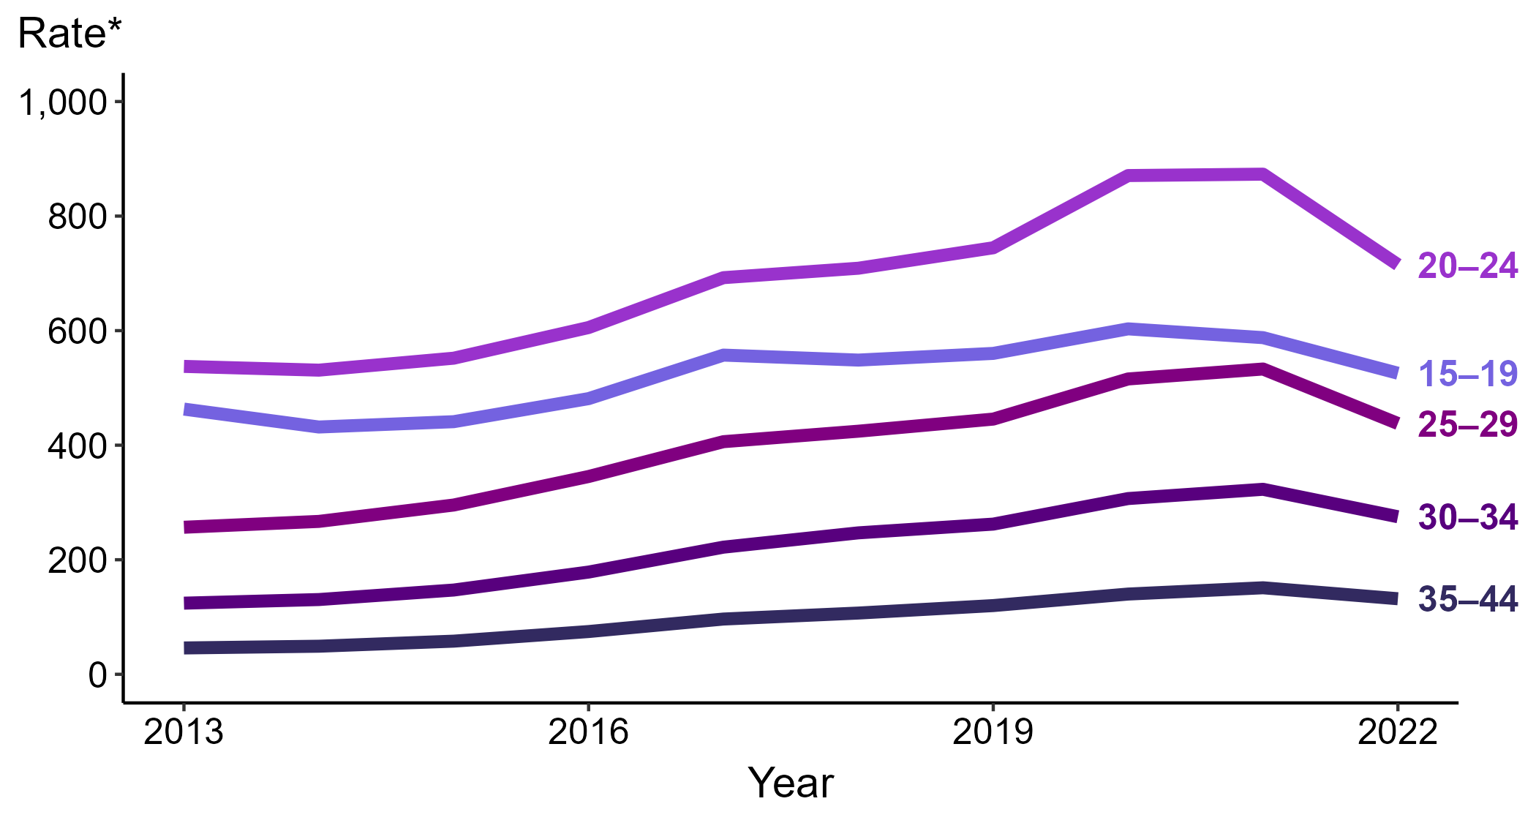
Gonorrhea — Rates of Reported Cases Among Women Aged 15–44 Years by Age Group, United States, 2013–2022
* Per 100,000
Notes:
Among women aged 15 to 44 years in 2022, those aged 20 to 24 years had the highest rate of reported cases of gonorrhea (715.1 cases per 100,000; 18.1% decrease from 2021), followed by those aged 15 to 19 years (525.7 cases per 100,000; 10.6% decrease from 2021), those aged 25 to 29 years (437.9 cases per 100,000; 17.8% decrease from 2021), those aged 30 to 34 years (275.1 cases per 100,000; 14.8% decrease from 2021), and those aged 35 to 44 years (131.9 cases per 100,000; 12.6% decrease from 2021).
This report includes data from years that coincide with the COVID-19 pandemic, which introduced uncertainty and difficulty in interpreting STI surveillance data. See Impact of COVID-19 on STIs for more information.
See Technical Notes (https://www.cdc.gov/std/statistics/2022/technical-notes.htm) for information on gonorrhea case reporting. Table A1 (https://www.cdc.gov/std/statistics/2022/tables/a1.htm) provides information on unknown, missing, or invalid values of select variables.
Data for all figures are available at https://www.cdc.gov/std/statistics/2022/data.zip. The file “GC - Rates Women 15-44 Years by Age Group (US 2012-2022).xlsx” contains the data for the figure presented on this slide.

Slide 30
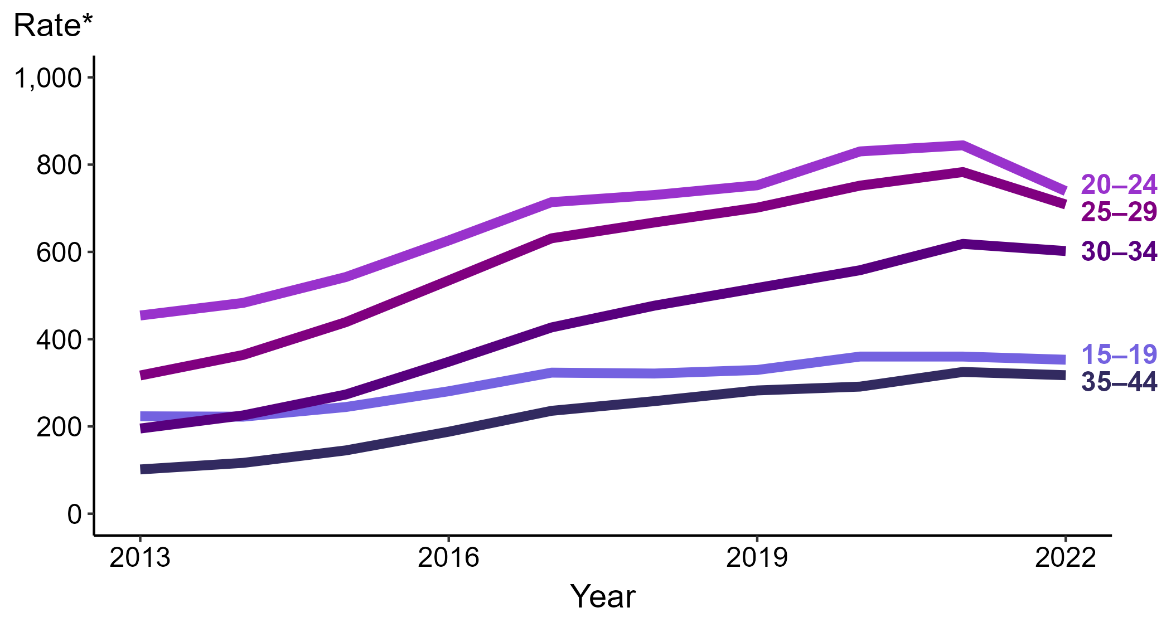
Gonorrhea — Rates of Reported Cases Among Men Aged 15–44 Years by Age Group, United States, 2013–2022
* Per 100,000
Notes:
Among men aged 15 to 44 years in 2022, those aged 20 to 24 years had the highest rate of reported cases of gonorrhea (739.4 cases per 100,000; 12.4% decrease from 2021), followed by those aged 25 to 29 years (708.7 cases per 100,000; 9.5% decrease from 2021), those aged 30 to 34 years (601.9 cases per 100,000; 2.7% decrease from 2021), those aged 15 to 19 years (352.9 cases per 100,000; 2.0% decrease from 2021), and those aged 35 to 44 years (317.4 cases per 100,000; 2.3% decrease from 2021).
This report includes data from years that coincide with the COVID-19 pandemic, which introduced uncertainty and difficulty in interpreting STI surveillance data. See Impact of COVID-19 on STIs for more information.
See Technical Notes (https://www.cdc.gov/std/statistics/2022/technical-notes.htm) for information on gonorrhea case reporting. Table A1 (https://www.cdc.gov/std/statistics/2022/tables/a1.htm) provides information on unknown, missing, or invalid values of select variables.
Data for all figures are available at https://www.cdc.gov/std/statistics/2022/data.zip. The file “GC - Rates Men 15-44 Years by Age Group (US 2012-2022).xlsx” contains the data for the figure presented on this slide.

Slide 31
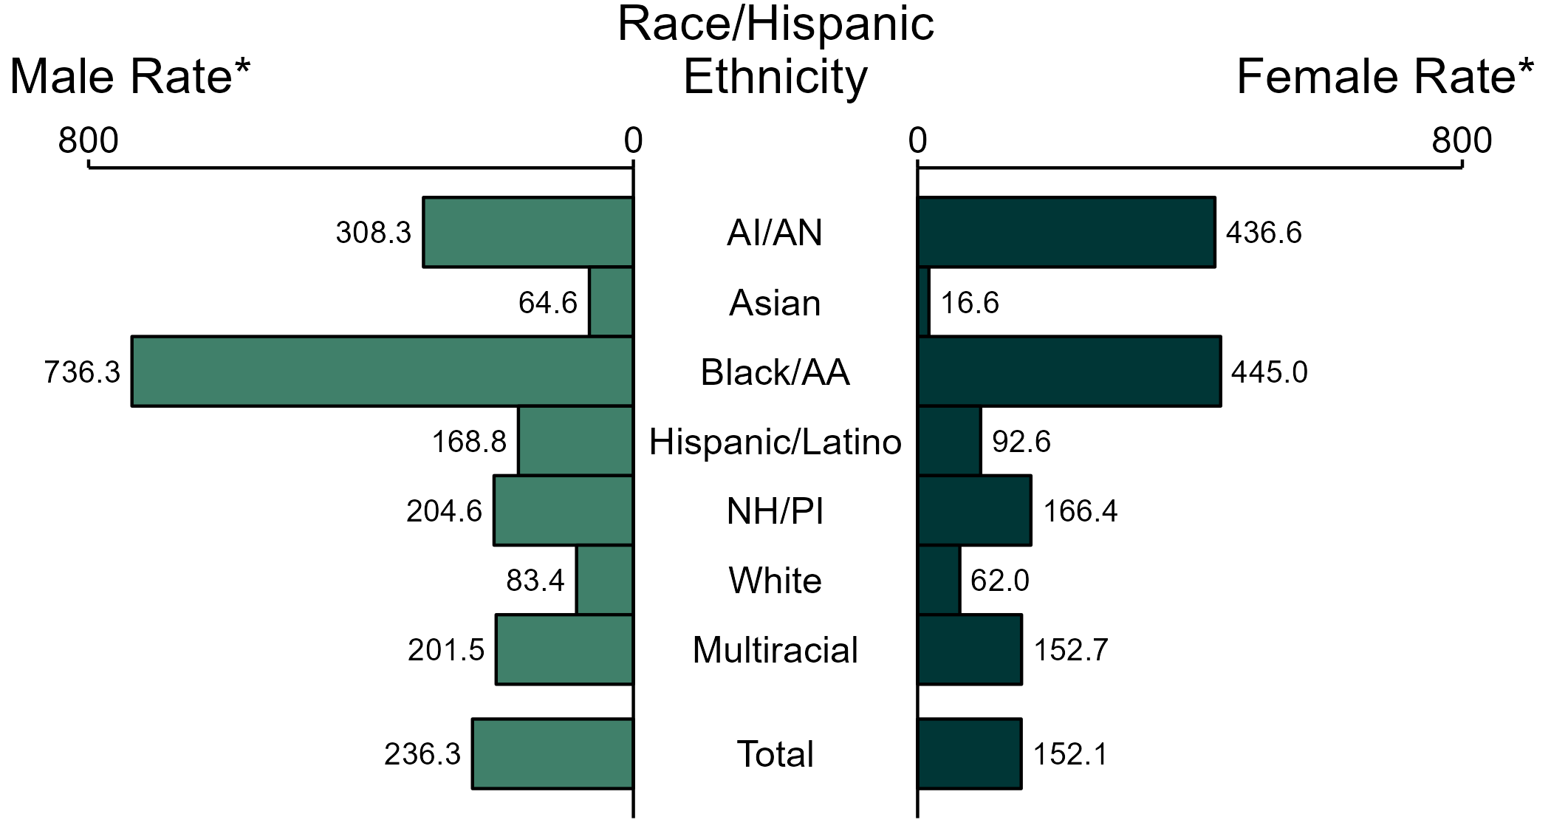
Gonorrhea — Rates of Reported Cases by Race/Hispanic Ethnicity and Sex, United States, 2022
* Per 100,000
ACRONYMS: AI/AN = American Indian or Alaska Native; Black/AA = Black or African American; NH/PI = Native Hawaiian or other Pacific Islander
NOTE: Total includes all cases including those with unknown race/Hispanic ethnicity.
Notes:
In 2022, the rate of reported gonorrhea was higher among men (236.3 per 100,000) compared to women (152.1 per 100,000).
Among men, non-Hispanic Black or African American men had the highest rate of reported cases of gonorrhea (736.3 per 100,000), followed by non-Hispanic American Indian or Alaska Native men (308.3 per 100,000) and non-Hispanic Native Hawaiian or other Pacific Islander men (204.6 per 100,000). Among women, non-Hispanic Black or African American women also had the highest rate of reported cases of gonorrhea (445.0 per 100,000), followed by non-Hispanic American Indian or Alaska Native women (436.6 per 100,000) and non-Hispanic Native Hawaiian or other Pacific Islander women (166.4 per 100,000).
Using non-Hispanic White persons as the referent category, the greatest relative racial disparity in rates of reported gonorrhea across both sexes was observed among non-Hispanic Black or African American men, with a rate ratio of 8.8 times that of non-Hispanic White men. Among women, the greatest relative disparity was observed among non-Hispanic Black or African American women as well, with a rate 7.2 times that of non-Hispanic White women.
This report includes data from years that coincide with the COVID-19 pandemic, which introduced uncertainty and difficulty in interpreting STI surveillance data. See Impact of COVID-19 on STIs for more information.
See Technical Notes (https://www.cdc.gov/std/statistics/2022/technical-notes.htm) for information on gonorrhea case reporting, race/Hispanic ethnicity categorization, and reporting of race/Hispanic ethnicity for STI cases. Table A1 (https://www.cdc.gov/std/statistics/2022/tables/a1.htm) provides information on unknown, missing, or invalid values of select variables.
Data for all figures are available at https://www.cdc.gov/std/statistics/2022/data.zip. The file “GC - Rates by Race Hispanic Ethnicity and Sex (US 2022).xlsx” contains the data for the figure presented on this slide.

Slide 32
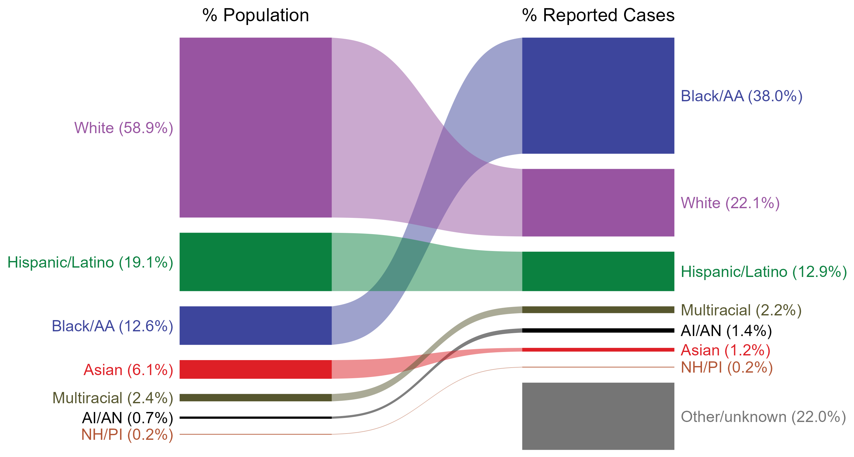
Gonorrhea — Total Population and Reported Cases by Race/Hispanic Ethnicity, United States, 2022
* Per 100,000
NOTE: In 2022, a total of 142,317 gonorrhea cases (22.0%) had missing, unknown, or other race and were not reported to be of Hispanic ethnicity. These cases are included in the “other/unknown” category.
ACRONYMS: AI/AN = American Indian or Alaska Native; Black/AA = Black or African American; NH/PI = Native Hawaiian or other Pacific Islander
Notes:
The percentages of gonorrhea cases by race/Hispanic ethnicity were disproportionate to the percentages among the total population of the United States in 2022. The greatest absolute and relative disparities were observed among non-Hispanic Black or African American persons, who represented 38.0% of reported gonorrhea cases (n = 246,480; 48.7% of gonorrhea cases with reported race or Hispanic ethnicity) despite being 12.6% of the US population. This is means that the burden of gonorrhea among non-Hispanic Black or African American persons was 25.4% greater than — or 3.0 times — what would be expected based on their proportion of the population. Additionally, non-Hispanic American Indian or Alaska Native persons were also overrepresented among gonorrhea cases relative to their proportion of the population.
This report includes data from years that coincide with the COVID-19 pandemic, which introduced uncertainty and difficulty in interpreting STI surveillance data. See Impact of COVID-19 on STIs for more information.
See Technical Notes (https://www.cdc.gov/std/statistics/2022/technical-notes.htm) for information on gonorrhea case reporting, race/Hispanic ethnicity categorization, and reporting of race/Hispanic ethnicity for STI cases.
Data for all figures are available at https://www.cdc.gov/std/statistics/2022/data.zip. The file “GC - Population and Cases by Race Hispanic Ethnicity (US 2022).xlsx” contains the data for the figure presented on this slide.

Slide 33
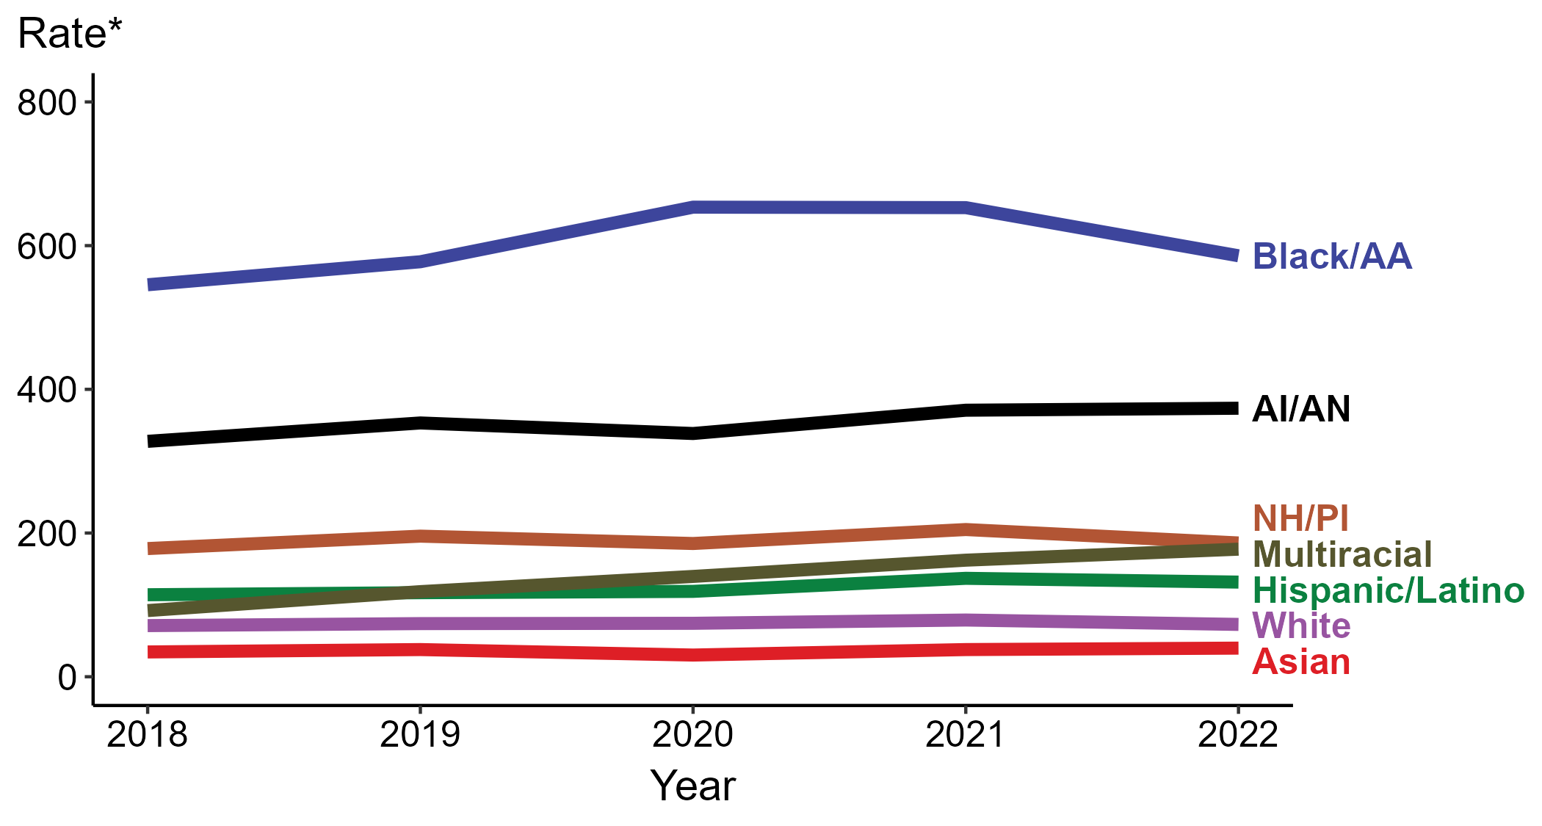
Gonorrhea — Rates of Reported Cases by Race/Hispanic Ethnicity, United States, 2018–2022
* Per 100,000
ACRONYMS: AI/AN = American Indian or Alaska Native; Black/AA = Black or African American; NH/PI = Native Hawaiian or other Pacific Islander
Notes:
In 2022, the highest rate of reported gonorrhea cases per 100,000 persons was among non-Hispanic Black or African American persons (585.9), followed by non-Hispanic American Indian or Alaska Native persons (373.7).
During 2021 to 2022, the greatest increase in rate of reported gonorrhea cases per 100,000 persons was among non-Hispanic persons of multiple races (162.2 to 177.5; 9.4% increase). Non-Hispanic persons of multiple races also had the greatest five-year increase in rate of reported gonorrhea (92.1 to 177.5; 92.7% increase from 2018).
During 2021 to 2022, the greatest decrease in rate of reported gonorrhea cases per 100,000 persons was among non-Hispanic Black or African American persons (652.9 to 585.9; 10.3% decrease). There were no decreases in the rate of reported gonorrhea among any race or Hispanic ethnicity group during 2018 to 2022.
This report includes data from years that coincide with the COVID-19 pandemic, which introduced uncertainty and difficulty in interpreting STI surveillance data. See Impact of COVID-19 on STIs for more information.
See Technical Notes (https://www.cdc.gov/std/statistics/2022/technical-notes.htm) for information on gonorrhea case reporting, race/Hispanic ethnicity categorization, and reporting of race/Hispanic ethnicity for STI cases. Table A1 (https://www.cdc.gov/std/statistics/2022/tables/a1.htm) provides information on unknown, missing, or invalid values of select variables.
Data for all figures are available at https://www.cdc.gov/std/statistics/2022/data.zip. The file “GC - Rates by Race Hispanic Ethnicity (US 2018-2022).xlsx” contains the data for the figure presented on this slide.

Slide 34
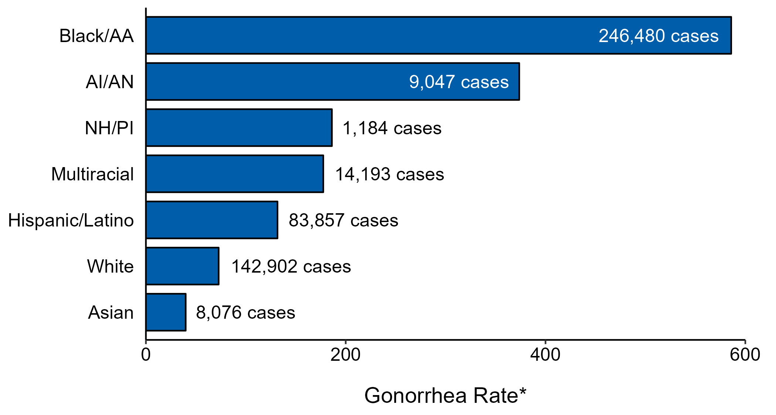
Gonorrhea — Case Counts and Rates of Reported Cases by Race/Hispanic Ethnicity, United States, 2022
* Per 100,000 population
NOTE: In 2022, a total of 142,317 gonorrhea cases (22%) had missing, unknown, or other race and were not reported to be of Hispanic ethnicity. These cases are not shown in this plot.
ACRONYMS: AI/AN = American Indian or Alaska Native; Black/AA = Black or African American; NH/PI = Native Hawaiian or other Pacific Islander
Notes:
In 2022, rates of gonorrhea were highest among non-Hispanic Black or African American persons (585.9 per 100,000), followed by non-Hispanic American Indian or Alaska Native persons (373.7 per 100,000) and non-Hispanic Native Hawaiian or other Pacific Islander persons (186.2 per 100,000). The greatest number of reported gonorrhea cases was among non-Hispanic Black or African American persons (246,480 cases), followed by non-Hispanic White persons (142,902 cases) and Hispanic or Latino persons of any race(s) (83,857 cases).
This report includes data from years that coincide with the COVID-19 pandemic, which introduced uncertainty and difficulty in interpreting STI surveillance data. See Impact of COVID-19 on STIs for more information.
See Technical Notes (https://www.cdc.gov/std/statistics/2022/technical-notes.htm) for information on gonorrhea case reporting and reporting of race/Hispanic ethnicity for STI cases.
Data for all figures are available at https://www.cdc.gov/std/statistics/2022/data.zip. The file “GC - Cases and Rates by Race Hispanic Ethnicity (US 2022).xlsx” contains the data for the figure presented on this slide.

Slide 35
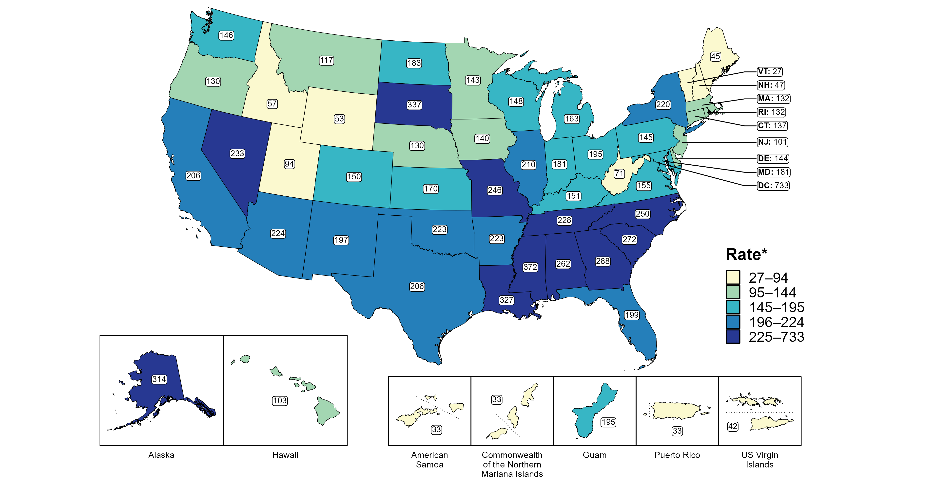
Gonorrhea — Rates of Reported Cases by Jurisdiction, United States and Territories, 2022
* Per 100,000
Notes:
In 2022, rates of reported gonorrhea ranged by state from 27 cases per 100,000 population in Vermont to 372 cases per 100,000 population in Mississippi. The rate of reported gonorrhea in the District of Columbia was 733 per 100,000 population.
Among US territories, rates of reported gonorrhea ranged from 33 cases per 100,000 population in American Samoa, the Commonwealth of the Northern Mariana Islands, and Puerto Rico to 195 cases per 100,000 population in Guam.
This report includes data from years that coincide with the COVID-19 pandemic, which introduced uncertainty and difficulty in interpreting STI surveillance data. See Impact of COVID-19 on STIs for more information.
See Technical Notes (https://www.cdc.gov/std/statistics/2022/technical-notes.htm) for information on gonorrhea case reporting and on interpreting reported rates in US territories.
Data for all figures are available at https://www.cdc.gov/std/statistics/2022/data.zip. The file “GC - Rates by Jurisdiction (US and Terr 2022).xlsx” contains the data for the figure presented on this slide.

Slide 36
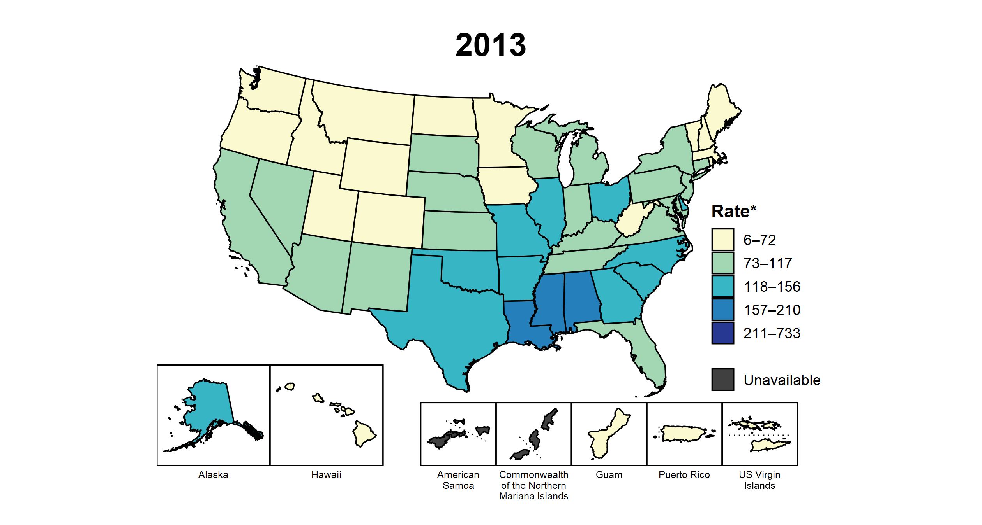
Gonorrhea — Rates of Reported Cases by Jurisdiction, United States and Territories, 2013–2022
* Per 100,000
Notes:
This slide contains an animated figure that will play when the slide is in presentation mode. A static version of the figure that displays maps from the first and last years of the range is available as a separate slide.
In 2013, three states and the District of Columbia (DC; 7.4% of areas with available data) had a rate of reported gonorrhea greater than or equal to 157 cases per 100,000 population. This increased to 26 states, DC, and one US territory (50.0% of areas with available data) in 2022. During 2021 to 2022, rates of reported gonorrhea increased in eight states, DC, and three territories.
American Samoa and the Commonwealth of the Northern Mariana Islands began reporting data on gonorrhea cases to CDC in 2018; data are not available for those areas prior to that year. In addition, data on reported gonorrhea cases in 2018 are not available for the US Virgin Islands. Due to a network security incident in December 2021, the Maryland Department of Health could not finalize their 2021 STI case notification data. Data for 2021 from Maryland have been suppressed for this figure; however, they are included in national and regional case counts and rates displayed in other figures.
This report includes data from years that coincide with the COVID-19 pandemic, which introduced uncertainty and difficulty in interpreting STI surveillance data. See Impact of COVID-19 on STIs for more information.
See Technical Notes (https://www.cdc.gov/std/statistics/2022/technical-notes.htm) for information on gonorrhea case reporting and on interpreting reported rates in US territories.
Data for all figures are available at https://www.cdc.gov/std/statistics/2022/data.zip. The file “GC - Rates by Jurisdiction (US and Terr 2013-2022).xlsx” contains the data for the figure presented on this slide.

Slide 37
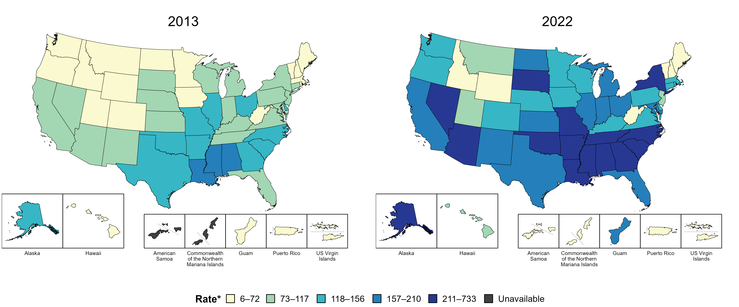
Gonorrhea — Rates of Reported Cases by Jurisdiction, United States and Territories, 2013 and 2022
* Per 100,000
Notes:
In 2013, three states and the District of Columbia (DC; 7.4% of areas with available data) had a rate of reported gonorrhea greater than or equal to 157 cases per 100,000 population. This increased to 26 states, DC, and one US territory (50.0% of areas with available data) in 2022.
American Samoa and the Commonwealth of the Northern Mariana Islands began reporting data on gonorrhea cases to CDC in 2018; data are not available for those areas prior to that year.
This report includes data from years that coincide with the COVID-19 pandemic, which introduced uncertainty and difficulty in interpreting STI surveillance data. See Impact of COVID-19 on STIs for more information.
See Technical Notes (https://www.cdc.gov/std/statistics/2022/technical-notes.htm) for information on gonorrhea case reporting and on interpreting reported rates in US territories.
Data for all figures are available at https://www.cdc.gov/std/statistics/2022/data.zip. The file “GC - Rates by Jurisdiction (US and Terr 2013 and 2022).xlsx” contains the data for the figure presented on this slide.

Slide 38
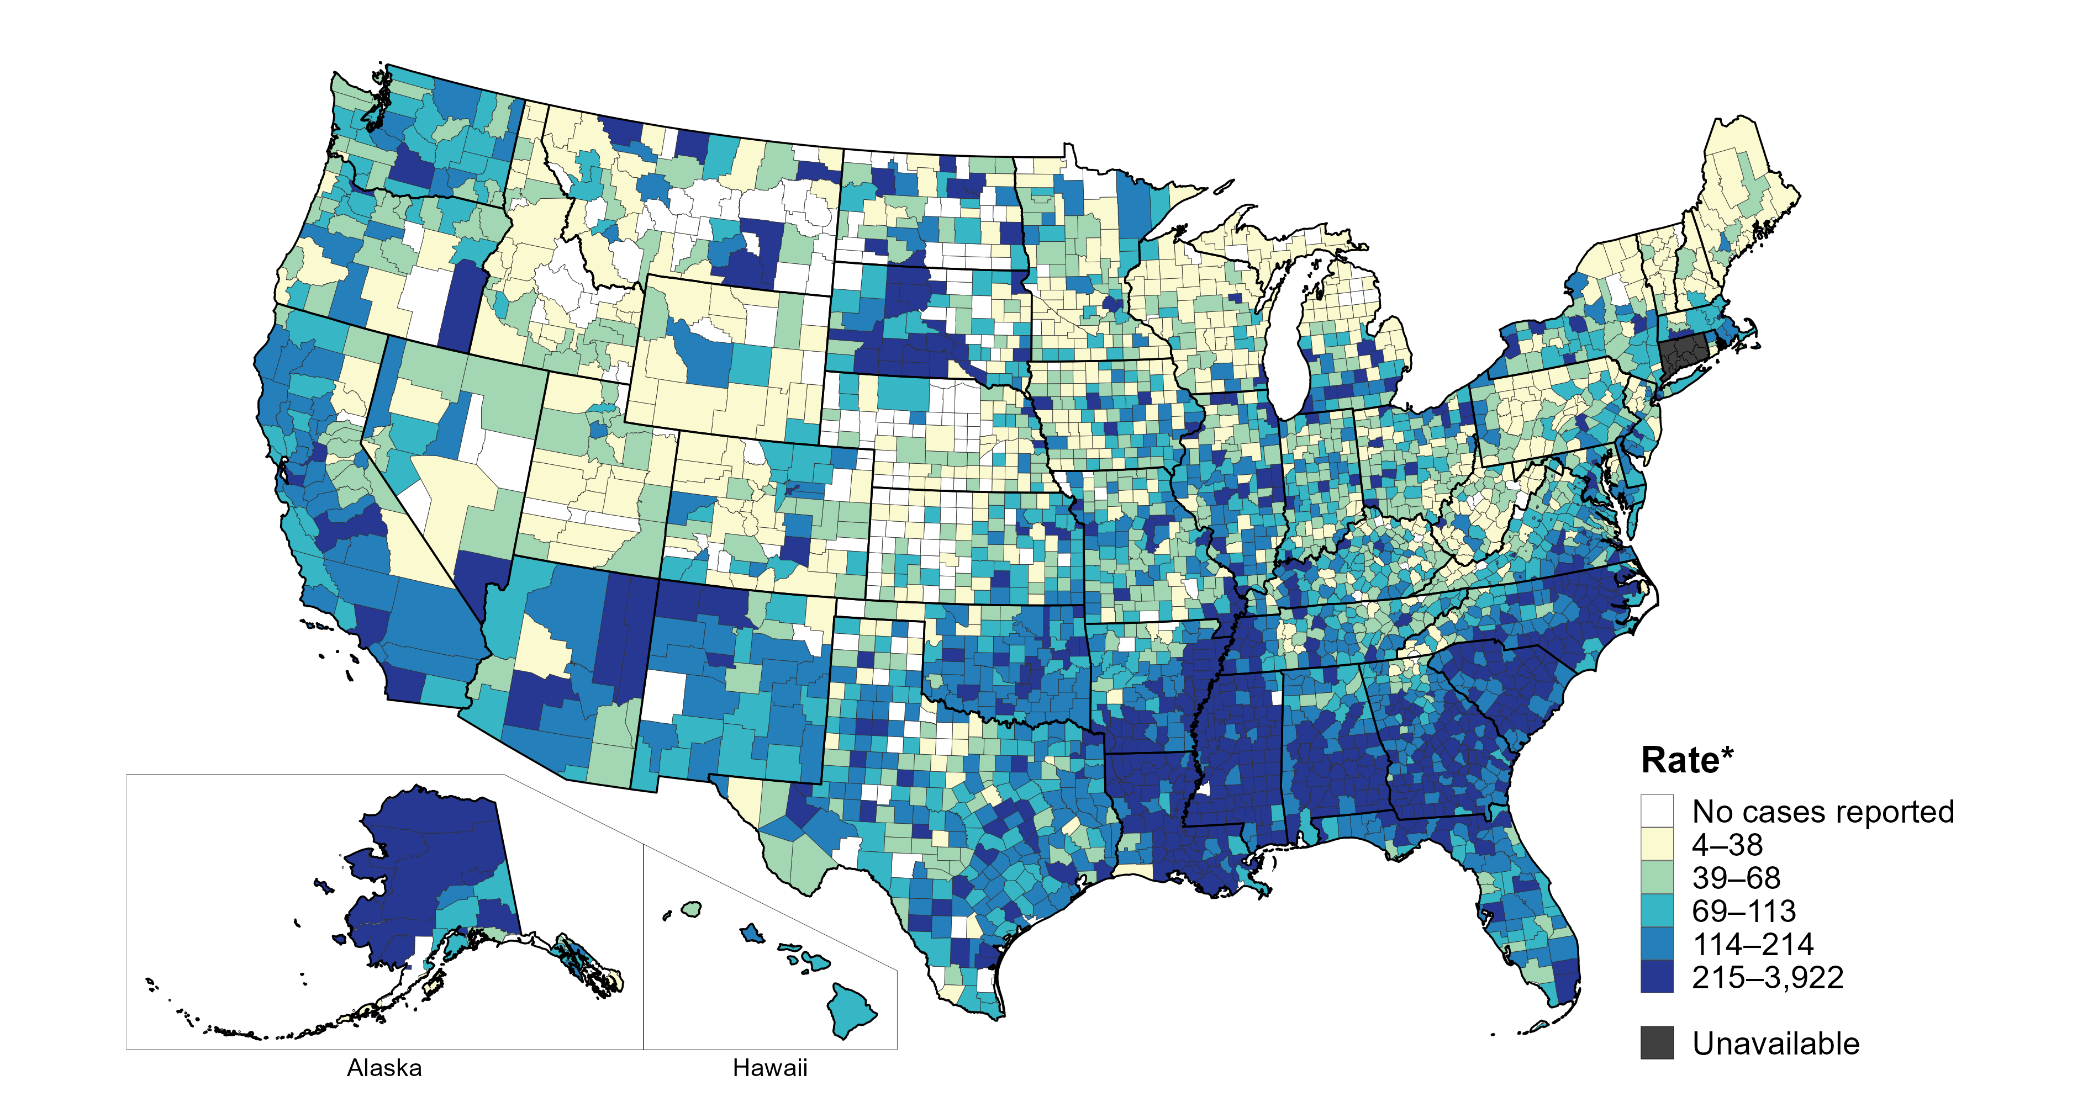
Gonorrhea — Rates of Reported Cases by County, United States, 2022
* Per 100,000
Notes:
In 2022, 93% of counties and county equivalents with available data in the United States reported at least one case of gonorrhea. Out of 3,135 counties and county equivalents with available data, 66 (2%) reported half of all cases of gonorrhea.
In 2022, Connecticut adopted nine planning regions as county-equivalent geographic units; as STI case notification data were not available in the new county-equivalent units for 2022, data for Connecticut have been suppressed for this figure.
This report includes data from years that coincide with the COVID-19 pandemic, which introduced uncertainty and difficulty in interpreting STI surveillance data. See Impact of COVID-19 on STIs for more information.
See Technical Notes (https://www.cdc.gov/std/statistics/2022/technical-notes.htm) for information on gonorrhea case reporting.
Data for all figures are available at https://www.cdc.gov/std/statistics/2022/data.zip. The file “GC - Rates by County (US 2022).xlsx” contains the data for the figure presented on this slide.

Slide 39
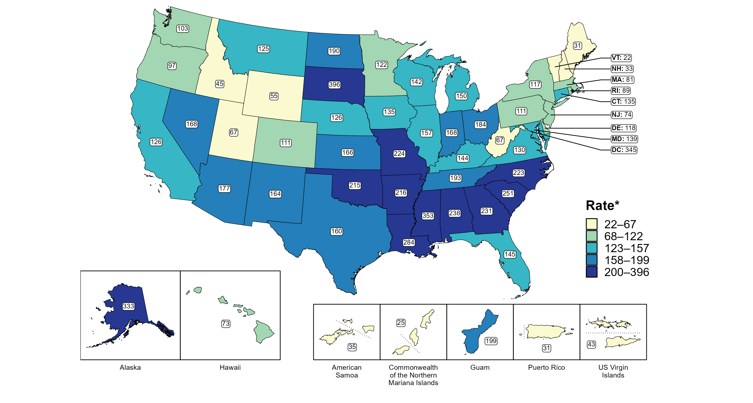
Gonorrhea — Rates of Reported Cases Among Women by Jurisdiction, United States and Territories, 2022
* Per 100,000
Notes:
In 2022, rates of reported gonorrhea among women ranged by state from 22 cases per 100,000 women in Vermont to 396 cases per 100,000 women in South Dakota. The rate of reported gonorrhea in the District of Columbia was 345 per 100,000 women.
Among US territories, rates of reported gonorrhea ranged from 25 cases per 100,000 women in the Commonwealth of the Northern Mariana Islands to 199 cases per 100,000 women in Guam.
This report includes data from years that coincide with the COVID-19 pandemic, which introduced uncertainty and difficulty in interpreting STI surveillance data. See Impact of COVID-19 on STIs for more information.
See Technical Notes (https://www.cdc.gov/std/statistics/2022/technical-notes.htm) for information on gonorrhea case reporting and on interpreting reported rates in US territories. Table A1 (https://www.cdc.gov/std/statistics/2022/tables/a1.htm) provides information on unknown, missing, or invalid values of select variables.
Data for all figures are available at https://www.cdc.gov/std/statistics/2022/data.zip. The file “GC - Rates Women by Jurisdiction (US and Terr 2022).xlsx” contains the data for the figure presented on this slide.

Slide 40
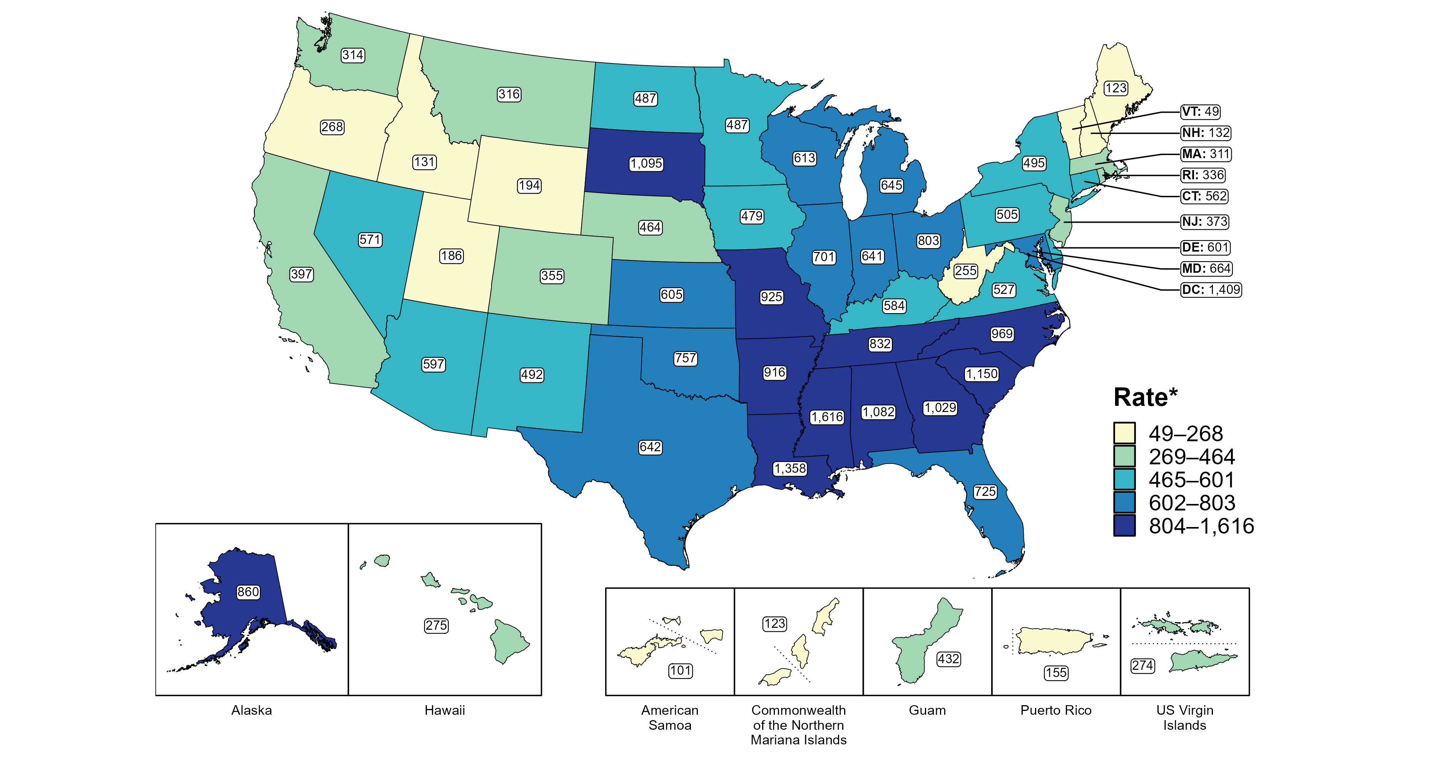
Gonorrhea — Rates of Reported Cases Among Women Aged 15–24 Years by Jurisdiction, United States and Territories, 2022
* Per 100,000
Notes:
In 2022, rates of reported gonorrhea among women aged 15 to 24 years ranged by state from 49 cases per 100,000 women aged 15 to 24 years in Vermont to 1,616 cases per 100,000 women aged 15 to 24 years in Mississippi. The rate of reported gonorrhea in the District of Columbia was 1,409 per 100,000 women aged 15 to 24 years.
Among US territories, rates of reported gonorrhea ranged from 101 cases per 100,000 women aged 15 to 24 years in American Samoa to 432 cases per 100,000 women aged 15 to 24 years in Guam.
This report includes data from years that coincide with the COVID-19 pandemic, which introduced uncertainty and difficulty in interpreting STI surveillance data. See Impact of COVID-19 on STIs for more information.
See Technical Notes (https://www.cdc.gov/std/statistics/2022/technical-notes.htm) for information on gonorrhea case reporting and on interpreting reported rates in US territories. Table A1 (https://www.cdc.gov/std/statistics/2022/tables/a1.htm) provides information on unknown, missing, or invalid values of select variables.
Data for all figures are available at https://www.cdc.gov/std/statistics/2022/data.zip. The file “GC - Rates Women 15-24 Years by Jurisdiction (US and Terr 2022).xlsx” contains the data for the figure presented on this slide.

Slide 41
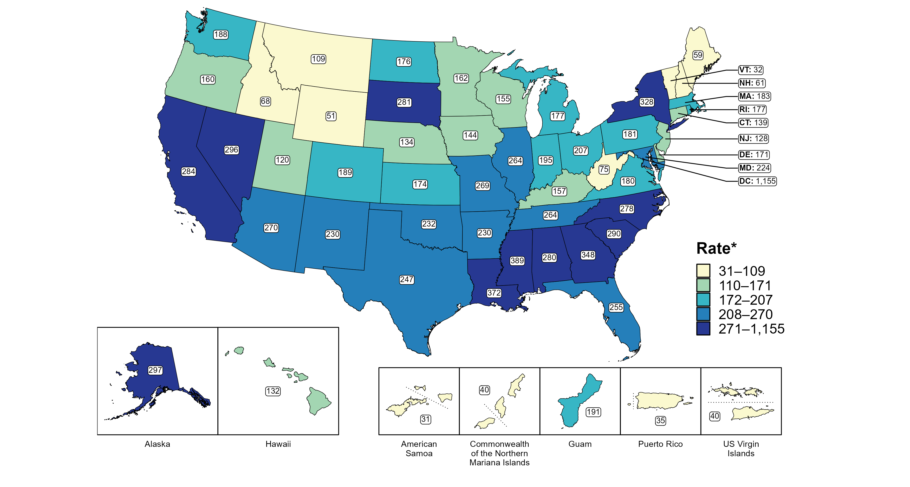
Gonorrhea — Rates of Reported Cases Among Men by State, United States and Territories, 2022
* Per 100,000
Notes:
In 2022, rates of reported gonorrhea among men ranged by state from 32 cases per 100,000 men in Vermont to 389 cases per 100,000 men in Mississippi. The rate of reported gonorrhea in the District of Columbia was 1,155 per 100,000 men.
Among US territories, rates of reported gonorrhea ranged from 31 cases per 100,000 men in American Samoa to 191 cases per 100,000 men in Guam.
This report includes data from years that coincide with the COVID-19 pandemic, which introduced uncertainty and difficulty in interpreting STI surveillance data. See Impact of COVID-19 on STIs for more information.
See Technical Notes (https://www.cdc.gov/std/statistics/2022/technical-notes.htm) for information on gonorrhea case reporting and on interpreting reported rates in US territories. Table A1 (https://www.cdc.gov/std/statistics/2022/tables/a1.htm) provides information on unknown, missing, or invalid values of select variables.
Data for all figures are available at https://www.cdc.gov/std/statistics/2022/data.zip. The file “GC - Rates Men by Jurisdiction (US and Terr 2022).xlsx” contains the data for the figure presented on this slide.

Slide 42
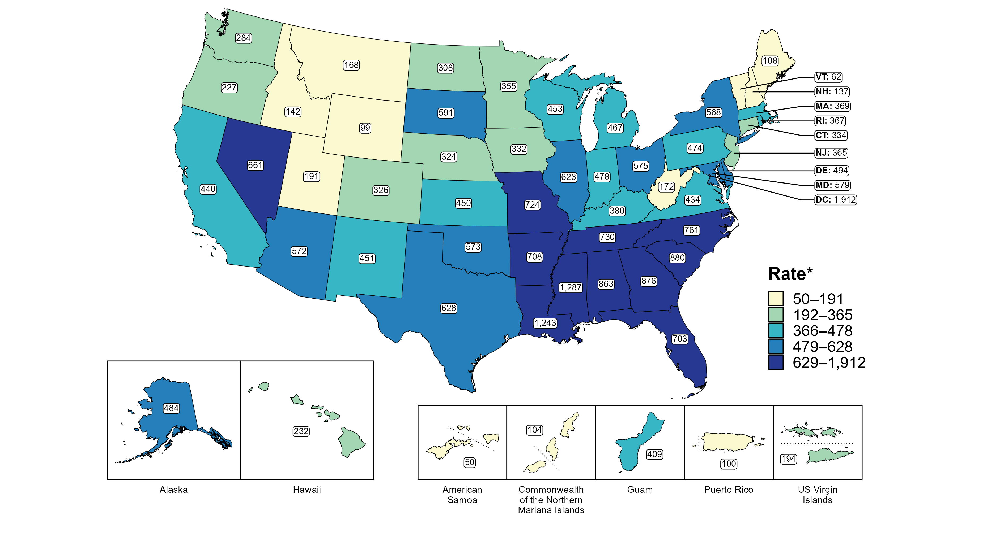
Gonorrhea — Rates of Reported Cases Among Men Aged 15–24 Years by Jurisdiction, United States and Territories, 2022
* Per 100,000
Notes:
In 2022, rates of reported gonorrhea among men aged 15 to 24 years ranged by state from 62 cases per 100,000 men aged 15 to 24 years in Vermont to 1,287 cases per 100,000 men aged 15 to 24 years in Mississippi. The rate of reported gonorrhea in the District of Columbia was 1,912 per 100,000 men aged 15 to 24 years.
Among US territories, rates of reported gonorrhea ranged from 50 cases per 100,000 men aged 15 to 24 years in American Samoa to 409 cases per 100,000 men aged 15 to 24 years in Guam.
This report includes data from years that coincide with the COVID-19 pandemic, which introduced uncertainty and difficulty in interpreting STI surveillance data. See Impact of COVID-19 on STIs for more information.
See Technical Notes (https://www.cdc.gov/std/statistics/2022/technical-notes.htm) for information on gonorrhea case reporting and on interpreting reported rates in US territories. Table A1 (https://www.cdc.gov/std/statistics/2022/tables/a1.htm) provides information on unknown, missing, or invalid values of select variables.
Data for all figures are available at https://www.cdc.gov/std/statistics/2022/data.zip. The file “GC - Rates Men 15-24 Years by Jurisdiction (US and Terr 2022).xlsx” contains the data for the figure presented on this slide.

Slide 43
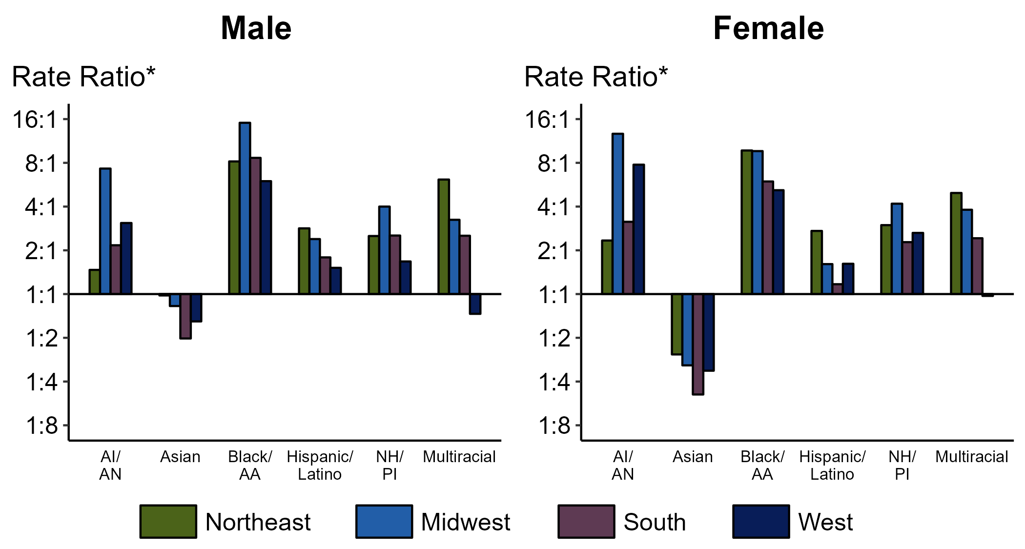
Gonorrhea — Ratios of Rates of Reported Cases by Sex, Race/Hispanic Ethnicity, and Region, United States, 2022
* For the rate ratios, non-Hispanic White persons are the referent population. Y-axis is log scale.
ACRONYMS: AI/AN = American Indian or Alaska Native; Black/AA = Black or African American; NH/PI = Native Hawaiian or other Pacific Islander
Notes:
Among men and women, rate ratios of rates of reported gonorrhea by race/Hispanic ethnicity (using non-Hispanic White persons as the referent population) varied by region in 2022. Among men, the greatest rate ratio was in the Midwest where the rate of gonorrhea among non-Hispanic Black men was 15.1 times the rate among non-Hispanic White men. Among women, the greatest rate ratio was in the Midwest where the rate of gonorrhea among non-Hispanic American Indian or Alaska Native women was 12.7 times the rate among non-Hispanic White women.
This report includes data from years that coincide with the COVID-19 pandemic, which introduced uncertainty and difficulty in interpreting STI surveillance data. See Impact of COVID-19 on STIs for more information.
See Technical Notes (https://www.cdc.gov/std/statistics/2022/technical-notes.htm) for information on gonorrhea case reporting and reporting of race/Hispanic ethnicity for STI cases. Table A1 (https://www.cdc.gov/std/statistics/2022/tables/a1.htm) provides information on unknown, missing, or invalid values of select variables.

Slide 44
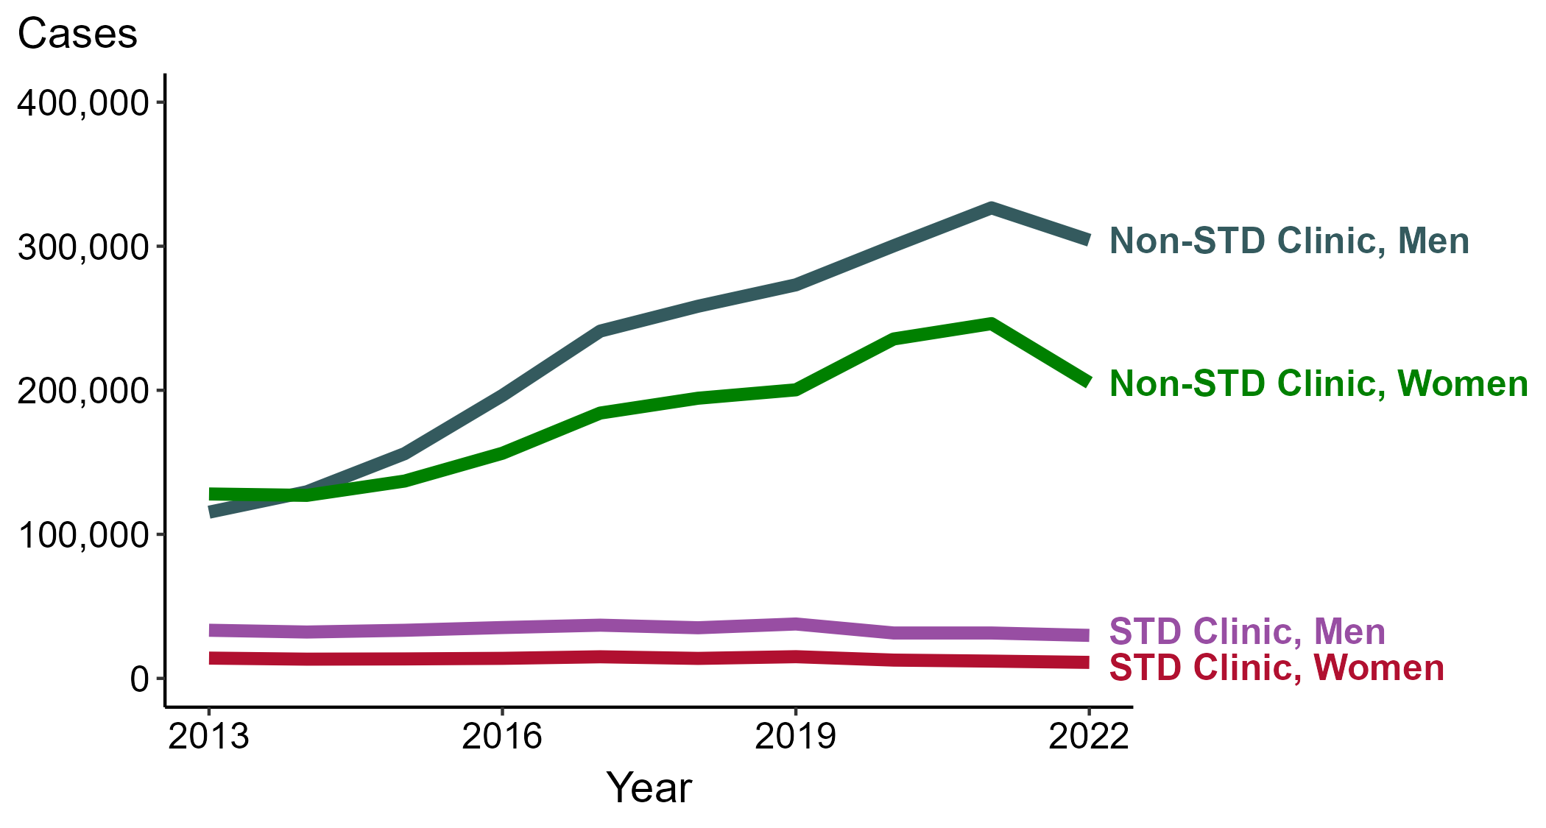
Gonorrhea — Reported Cases by Reporting Source and Sex, United States, 2013–2022
NOTE: During 2013 to 2022, the proportion of all cases with unknown reporting source was 13.9%, from a low of 12.5% (n = 41,579) in 2013 to a high of 14.8% (n = 96,035) in 2022.
Notes:
During 2021 to 2022, the number of gonorrhea cases reported from STD clinics decreased 5.3% among men (31,512 to 29,849 cases) and decreased 7.4% among women (11,990 to 11,104 cases), while the number of cases reported from non-STD clinics decreased 6.9% among men (326,647 to 304,166 cases) and decreased 16.7% among women (246,270 to 205,253 cases).
During a ten-year period (2013 to 2022), the number of gonorrhea cases reported from STD clinics decreased 10.7% among men (33,408 to 29,849 cases) and decreased 21.1% among women (14,076 to 11,104 cases), while the number of cases reported from non-STD clinics increased 163.7% among men (115,359 to 304,166 cases) and increased 60.3% among women (128,016 to 205,253 cases).
This report includes data from years that coincide with the COVID-19 pandemic, which introduced uncertainty and difficulty in interpreting STI surveillance data. See Impact of COVID-19 on STIs for more information.
See Technical Notes (https://www.cdc.gov/std/statistics/2022/technical-notes.htm) for information on gonorrhea case reporting. Table A1 (https://www.cdc.gov/std/statistics/2022/tables/a1.htm) provides information on unknown, missing, or invalid values of select variables.
Data for all figures are available at https://www.cdc.gov/std/statistics/2022/data.zip. The file “GC - Cases by Reporting Source and Sex (US 2013-2022).xlsx” contains the data for the figure presented on this slide.

Slide 45
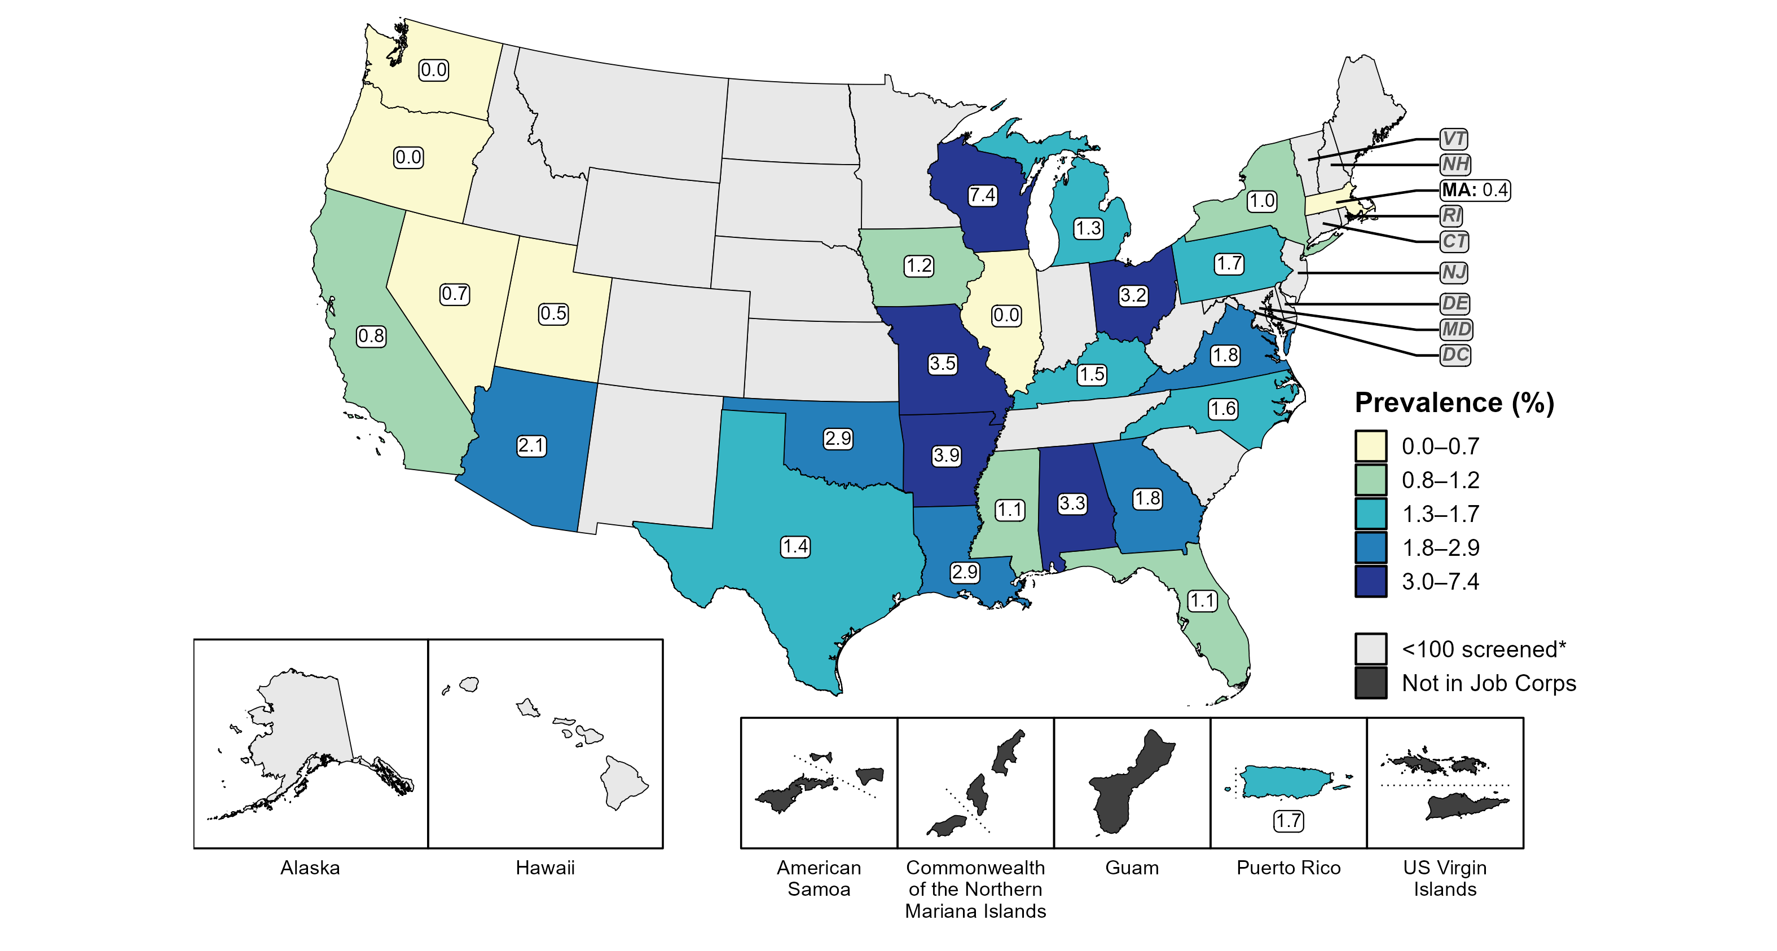
Gonorrhea — Prevalence Among Women Aged 16–24 Years Entering Job Corps by State of Residence, United States and Territories, 2022
* Fewer than 100 women who resided in these states/areas and entered Job Corps were screened for gonorrhea in 2022.
Notes:
In 2022, 26 states and one US territory screened at least 100 women entering Job Corps for gonorrhea. The median state-specific gonorrhea prevalence among this population in the 26 states was 1.4%, ranging from 0.0% in Illinois, Oregon, and Washington to 7.4% in Wisconsin. The prevalence in Puerto Rico was 1.7%.
This report includes data from years that coincide with the COVID-19 pandemic, which introduced uncertainty and difficulty in interpreting STI surveillance data. See Impact of COVID-19 on STIs for more information.
See Technical Notes (https://www.cdc.gov/std/statistics/2022/technical-notes.htm) for information on Jobs Corps methodology.
Data for all figures are available at https://www.cdc.gov/std/statistics/2022/data.zip. The file “GC - Prevalence Women 16-24 Years Entering Job Corps (US and Terr 2022).xlsx” contains the data for the figure presented on this slide.

Slide 46
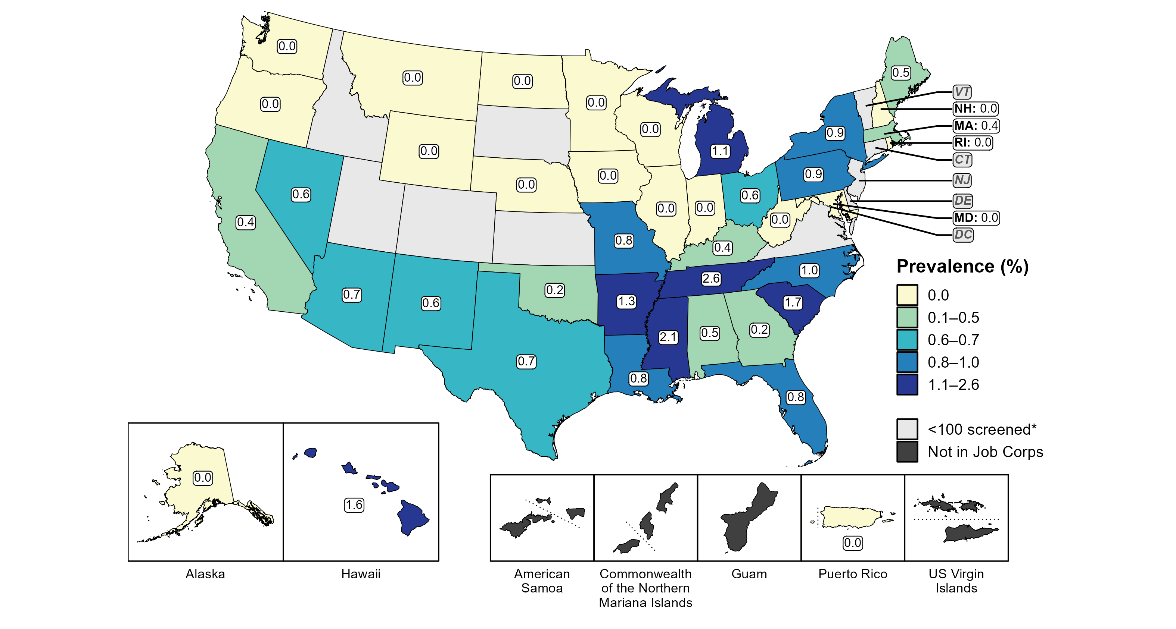
Gonorrhea — Prevalence Among Men Aged 16–24 Years Entering Job Corps by State of Residence, United States and Territories, 2022
* Fewer than 100 men who resided in these states/areas and entered Job Corps were screened for gonorrhea in 2022.
Notes:
In 2022, 40 states and one US territory screened at least 100 men entering Job Corps for gonorrhea. The median state-specific gonorrhea prevalence among this population in the 40 states was 0.4%, ranging from 0.0% in Alaska, Illinois, Indiana, Iowa, Maryland, Minnesota, Montana, Nebraska, New Hampshire, North Dakota, Oregon, Rhode Island, Washington, West Virginia, Wisconsin, and Wyoming to 2.6% in Tennessee. The prevalence in Puerto Rico was 0.0%.
This report includes data from years that coincide with the COVID-19 pandemic, which introduced uncertainty and difficulty in interpreting STI surveillance data. See Impact of COVID-19 on STIs for more information.
See Technical Notes (https://www.cdc.gov/std/statistics/2022/technical-notes.htm) for information on Jobs Corps methodology.
Data for all figures are available at https://www.cdc.gov/std/statistics/2022/data.zip. The file “GC - Prevalence Men 16-24 Years Entering Job Corps (US and Terr 2022).xlsx” contains the data for the figure presented on this slide.

Slide 47
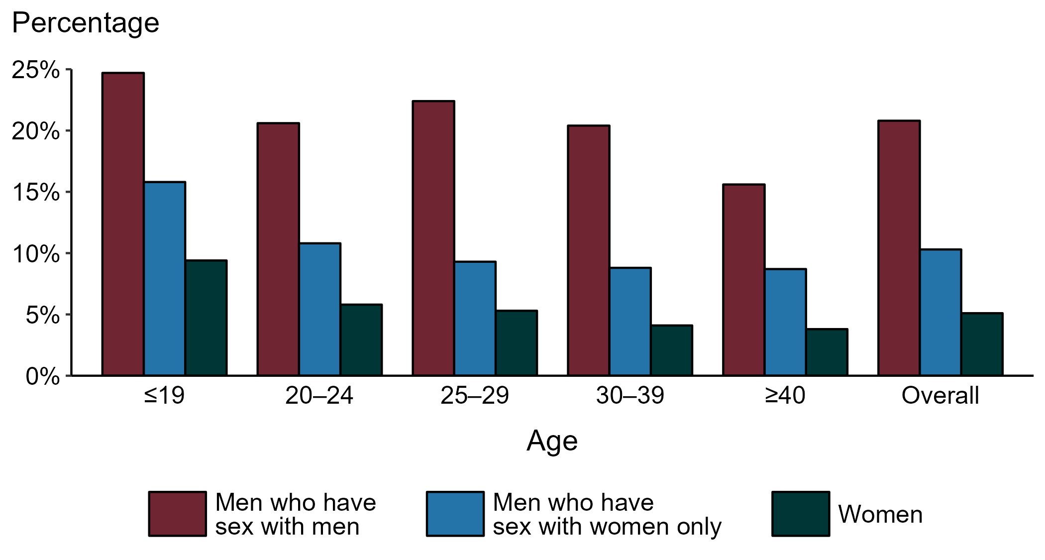
Gonorrhea — Proportion of STD Clinic Patients Testing Positive by Age Group, Sex, and Sex of Sex Partners, STD Surveillance Network (SSuN), 2022
NOTE: Results are based on 49,726 unique patients in 10 participating jurisdictions (Baltimore City, California [excluding San Francisco], Columbus, Florida, Indiana, Multnomah County, New York City, Philadelphia, San Francisco, and Washington) with known sex of sex partners attending SSuN STD clinics who were tested ≥1 times for gonorrhea in 2022.
Notes:
Among patients accessing care in participating STD clinics in the STD Surveillance Network (SSuN) who were tested for gonorrhea in 2022, 20.8% of gay, bisexual, and other men who have sex with men (MSM), 10.3% of men who have sex with women only (MSW), and 5.1% of women were positive. The proportion of STD clinic patients who tested positive for gonorrhea varied by sex and sex of sex partners, as well as by age group. MSM were noted to have higher proportions of testing positive in all age groups when compared to women and MSW. Of note, adolescent patients represent a relatively small subgroup of the clinic population and changes in the number of events in the numerator or a small denominator may lead to substantial fluctuations from year to year. Hence, data should be interpreted with caution.
This report includes data from years that coincide with the COVID-19 pandemic, which introduced uncertainty and difficulty in interpreting STI surveillance data. See Impact of COVID-19 on STIs for more information.
See Technical Notes (https://www.cdc.gov/std/statistics/2022/technical-notes.htm) for information on SSuN methodology.

Slide 48
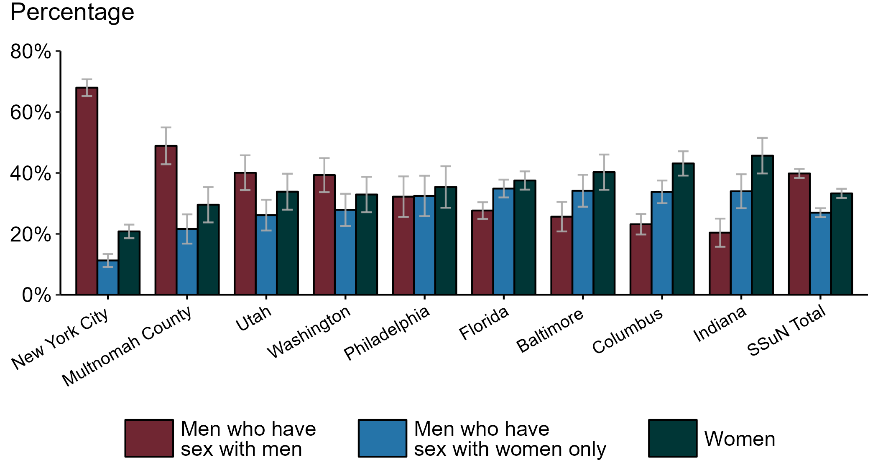
Gonorrhea — Estimated Proportion of Cases by Sex and Sex of Sex Partners and Jurisdiction, STD Surveillance Network (SSuN), 2022
NOTE: Estimate based on weighted analysis of data on sex of sex partners obtained from interviews (n=4,992) conducted among a random sample of gonorrhea cases reported to participating SSuN jurisdictions during January to December 2022. Includes nine SSuN sites reporting completed case investigations in 2022 for at least 2% of all reported cases.
Notes:
In 2022, New York City had the highest proportion of gonorrhea cases reported among gay, bisexual, and other men who have sex with men (MSM) among SSuN jurisdictions meeting the inclusion threshold, Indiana had the highest proportion of gonorrhea cases reported among women, and Florida had the highest proportion of gonorrhea cases reported among men who have sex with women only. Overall, the proportion of gonorrhea estimated to be attributed to MSM was 39.8% in 2022.
This report includes data from years that coincide with the COVID-19 pandemic, which introduced uncertainty and difficulty in interpreting STI surveillance data. See Impact of COVID-19 on STIs for more information.
See Technical Notes (https://www.cdc.gov/std/statistics/2022/technical-notes.htm) for information on SSuN methodology.

Slide 49
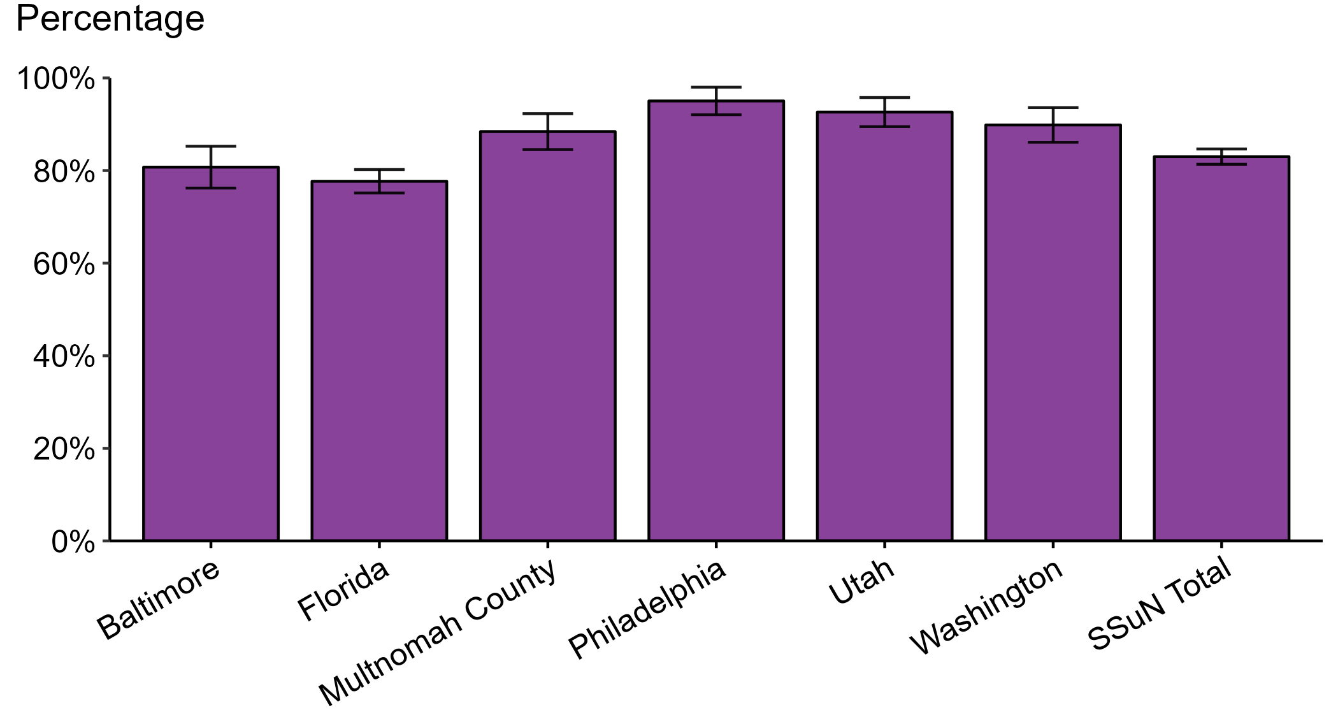
Gonorrhea — Estimated Proportion of Cases Treated with Recommended Regimen by Jurisdiction, STD Surveillance Network (SSuN), 2022
NOTE: Includes SSuN jurisdictions with treatment and dosage data ascertained for at least 80% of sampled, investigated cases. In 2022, the recommended treatment for uncomplicated gonorrhea was ceftriaxone 500 mg, intramuscular.
Notes:
In 2022, Philadelphia reported the highest estimated proportion of gonorrhea cases treated with the recommended regimen and Florida reported the lowest proportion of cases treated with the recommended regimen among jurisdictions participating in SSuN that met the inclusion criteria. Overall, the proportion of cases treated with the recommended regimen was 83.0% in 2022.
This report includes data from years that coincide with the COVID-19 pandemic, which introduced uncertainty and difficulty in interpreting STI surveillance data. See Impact of COVID-19 on STIs for more information.
See Technical Notes (https://www.cdc.gov/std/statistics/2022/technical-notes.htm) for information on SSuN methodology.

Slide 50
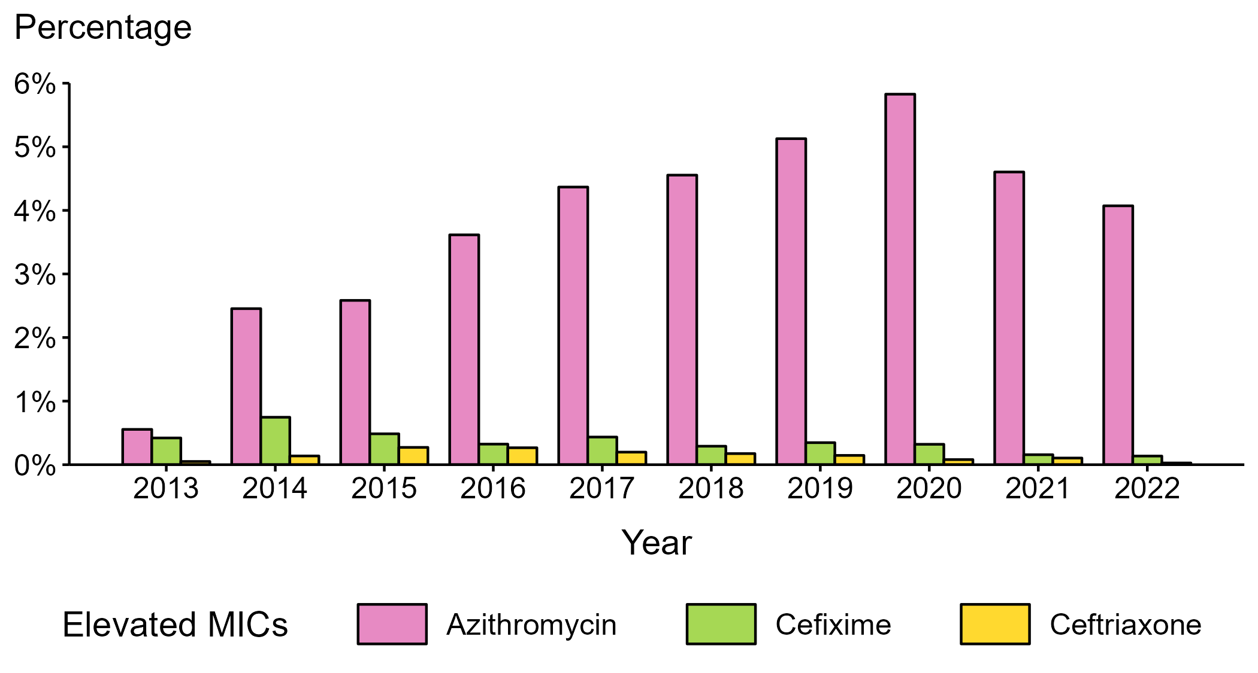
Neisseria gonorrhoeae — Percentage of Isolates with Elevated Minimum Inhibitory Concentrations (MICs) to Azithromycin, Cefixime, and Ceftriaxone, Gonococcal Isolate Surveillance Project (GISP), 2013–2022
NOTE: Elevated MICs = Azithromycin: ≥ 2.0 μg/mL; Cefixime: ≥ 0.25 μg/mL; Ceftriaxone: ≥ 0.125 μg/mL
Notes:
During 2013 to 2022, the percentage of Neisseria gonorrhoeae isolates collected in STD clinics participating in GISP that exhibited elevated ceftriaxone minimum inhibitory concentrations (MICs), defined as ≥ 0.125 µg/mL, ranged from <0.1% in 2022 to 0.3% in 2015. The percentage decreased over the period, from 0.1% in 2013 to <0.1% in 2022. The percentage of isolates with elevated cefixime MICs (≥ 0.25 µg/mL) ranged from 0.1% in 2022 to 0.7% in 2014, decreasing over the period from 0.4% in 2013 to 0.1% in 2022. In addition, the percentage of isolates with elevated azithromycin MICs (≥ 2.0 µg/mL) ranged from 0.6% in 2013 to 5.8% in 2020. Over the period, the percentage increased from 0.6% in 2013 to 4.1% in 2022.
This report includes data from years that coincide with the COVID-19 pandemic, which introduced uncertainty and difficulty in interpreting STI surveillance data. See Impact of COVID-19 on STIs for more information.
See Technical Notes (https://www.cdc.gov/std/statistics/2022/technical-notes.htm) for information on GISP methodology.
Data for all figures are available at https://www.cdc.gov/std/statistics/2022/data.zip. The file “NG - Percentage of Isolates with Elevated MICs (GISP 2013-2022) .xlsx” contains the data for the figure presented on this slide.

Slide 51
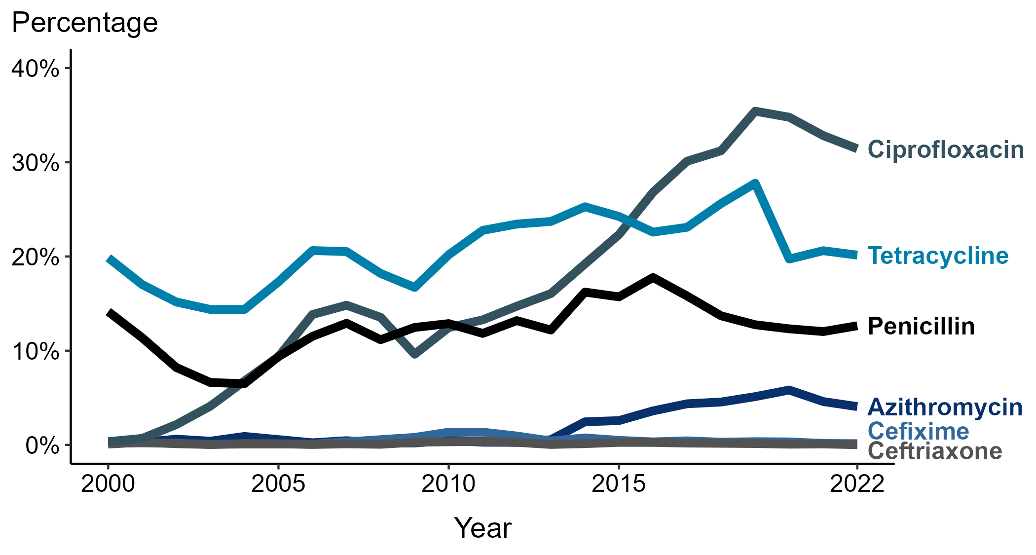
Neisseria gonorrhoeae — Prevalence of Tetracycline, Penicillin, or Ciprofloxacin Resistance* or Elevated Cefixime, Ceftriaxone, or Azithromycin Minimum Inhibitory Concentrations (MICs)†, by Year — Gonococcal Isolate Surveillance Project (GISP), 2000–2022
* Resistance: Ciprofloxacin: MIC ≥ 1.0 µg/mL; Penicillin: MIC ≥ 2.0 µg/mL or Beta-lactamase positive; Tetracycline: MIC ≥ 2.0 µg/mL
† Elevated MICs: Azithromycin: MIC ≥ 1.0 µg/mL (2000–2004); ≥ 2.0 µg/mL (2005–2022); Ceftriaxone: MIC ≥ 0.125 µg/mL; Cefixime: MIC ≥ 0.25 µg/mL
NOTE: Cefixime susceptibility was not tested in 2007 and 2008.
Notes:
In 2022, 31.4% of Neisseria gonorrhoeae isolates collected in STD clinics participating in GISP were resistant to ciprofloxacin, 20.1% to tetracycline, and 12.6% to penicillin.
This report includes data from years that coincide with the COVID-19 pandemic, which introduced uncertainty and difficulty in interpreting STI surveillance data. See Impact of COVID-19 on STIs for more information.
See Technical Notes (https://www.cdc.gov/std/statistics/2022/technical-notes.htm) for information on GISP methodology.
Data for all figures are available at https://www.cdc.gov/std/statistics/2022/data.zip. The file “NG - Prevalence of Resistance or Elevated MICs to Specific Antimicrobials by Year (GISP 2000-2022).xlsx” contains the data for the figure presented on this slide.

Slide 52
Resistance or Elevated Minimum Inhibitory Concentration (MIC) Patterns of Neisseria gonorrhoeae Isolates to Antimicrobials, Gonococcal Isolate Surveillance Project (GISP), 2022
* Susceptible category includes isolates with penicillin (or Beta-lactamase negative), tetracycline, and ciprofloxacin MIC values that are not considered resistant (i.e., susceptible and intermediate resistant) based on Clinical & Laboratory Standards Institute criteria and isolates with ceftriaxone, cefixime, and azithromycin MIC values that are not considered elevated based on GISP “alert” values.
NOTE: Elevated MIC = Ceftriaxone: MIC ≥ 0.125 μg/mL; Cefixime: MIC ≥ 0.25 μg/mL; Azithromycin: MIC ≥ 2.0 μg/mL. Resistance = Tetracycline: MIC ≥ 2.0 μg/mL; Ciprofloxacin: MIC ≥ 1.0 μg/mL; Penicillin: MIC ≥ 2.0 μg/mL or Beta-lactamase positive. In the figure, a filled circle reflects resistance or elevated MIC to a specific antimicrobial; only antimicrobial combinations with non-zero percentages are shown.
Notes:
In 2022, 52.6% of Neisseria gonorrhoeae isolates collected through GISP were susceptible to the six antimicrobials tested. Almost half (45.4%) were resistant to at least one of three antimicrobials (tetracycline, penicillin, or ciprofloxacin). An additional 2.0% of isolates were susceptible to those antimicrobials, but had elevated minimum inhibitory concentrations (MICs) to ceftriaxone, cefixime, or azithromycin. Overall, 10.3% of isolates demonstrated resistance or elevated MICs to two antimicrobials tested; 5.3% demonstrated resistance or elevated MICs to three antimicrobials tested; and <0.1% (one isolate) demonstrated resistance to four or more antimicrobials tested.
This report includes data from years that coincide with the COVID-19 pandemic, which introduced uncertainty and difficulty in interpreting STI surveillance data. See Impact of COVID-19 on STIs for more information.
See Technical Notes (https://www.cdc.gov/std/statistics/2022/technical-notes.htm) for information on GISP methodology.
Data for all figures are available at https://www.cdc.gov/std/statistics/2022/data.zip. The file “NG - Resistance or Elevated MIC Patterns of NG Isolates to Antimicrobials (GISP 2022).xlsx” contains the data for the figure presented on this slide.

Slide 53
Neisseria gonorrhoeae — Distribution of Ceftriaxone Minimum Inhibitory Concentrations (MICs) by Year, Gonococcal Isolate Surveillance Project (GISP), 2018–2022
Notes:
During 2018 to 2022, 65.5–70.5% of all tested Neisseria gonorrhoeae isolates collected in STD clinics participating in GISP had a ceftriaxone minimum inhibitory concentration value ≤0.008 µg/mL, and 99.8–99.9+% had a minimum inhibitory concentration value <0.125 µg/mL.
This report includes data from years that coincide with the COVID-19 pandemic, which introduced uncertainty and difficulty in interpreting STI surveillance data. See Impact of COVID-19 on STIs for more information.
See Technical Notes (https://www.cdc.gov/std/statistics/2022/technical-notes.htm) for information on GISP methodology.
Data for all figures are available at https://www.cdc.gov/std/statistics/2022/data.zip. The file “NG - Distribution of Ceftriaxone MICs by Year (GISP 2018-2022).xlsx” contains the data for the figure presented on this slide.

Slide 54
Neisseria gonorrhoeae — Distribution of Gentamicin Minimum Inhibitory Concentrations (MICs) by Year, Gonococcal Isolate Surveillance Project (GISP), 2018–2022
NOTE: Beginning in 2018, the antibiotic susceptibility testing range for gentamicin was expanded from MICs of 1 µg/mL–32 µg/mL in previous years to 0.25 µg/mL–64 µg/mL.
Notes:
During 2018 to 2022, 65.9–80.5% of all tested Neisseria gonorrhoeae isolates collected in STD clinics participating in GISP had a gentamicin minimum inhibitory concentration value of 8 µg/mL. In 2022, 0.2% of all tested Neisseria gonorrhoeae isolates had a gentamicin minimum inhibitory concentration above 16 µg/mL.
This report includes data from years that coincide with the COVID-19 pandemic, which introduced uncertainty and difficulty in interpreting STI surveillance data. See Impact of COVID-19 on STIs for more information.
See Technical Notes (https://www.cdc.gov/std/statistics/2022/technical-notes.htm) for information on GISP methodology.
Data for all figures are available at https://www.cdc.gov/std/statistics/2022/data.zip. The file “NG - Distribution of Gentamicin MICs by Year (GISP 2018-2022).xlsx” contains the data for the figure presented on this slide.

Slide 55
Distribution of Primary Antimicrobial Drugs Used to Treat Gonorrhea Among Participants, Gonococcal Isolate Surveillance Project (GISP), 1988–2022
NOTE: In 2022, Cefixime 800 mg (0.1%) and Ceftriaxone 1 g (0.2%) each represented less than one percent of primary antimicrobial drugs used to treat gonorrhea among GISP participants and may not be visible in this figure.
Notes:
In 2022, 97.0% of GISP participants were treated with ceftriaxone, 96.7% with 500 mg and 0.2% with 250 mg and 1 g, respectively. Participants treated with gentamicin 240 mg increased from 0.2% in 2015 to a maximum of 1.5% in 2016, 2019, and 2021, with 1.0% of patients treated with gentamicin in 2022. (Note that percentages in text may not sum as expected due to rounding.)
Results for 2022 are based on data obtained from participants in all participating GISP jurisdictions except for Pittsburgh due to missing data.
This report includes data from years that coincide with the COVID-19 pandemic, which introduced uncertainty and difficulty in interpreting STI surveillance data. See Impact of COVID-19 on STIs for more information.
See Technical Notes (https://www.cdc.gov/std/statistics/2022/technical-notes.htm) for information on GISP methodology.
Data for all figures are available at https://www.cdc.gov/std/statistics/2022/data.zip. The file “GC - Distribution of Primary Antimicrobial Drugs Used to Treat GC (GISP, 1988-2022).xlsx” contains the data for the figure presented on this slide.

Slide 56
Neisseria gonorrhoeae — Percentage of Urethral Isolates Obtained from MSM Attending STD Clinics, Gonococcal Isolate Surveillance Project (GISP), 1989–2022
ACRONYMS: MSM = Gay, bisexual, and other men who have sex with men
Notes:
Overall, the proportion of Neisseria gonorrhoeae isolates collected in selected STD clinics participating in GISP that were from gay, bisexual and other men who have sex with men increased steadily from 3.9% in 1989 to a high of 38.5% in 2017. In 2022, this proportion was 33.4%.
Results for 2022 are based on data obtained from participants in all participating GISP jurisdictions except for Pittsburgh due to missing data.
This report includes data from years that coincide with the COVID-19 pandemic, which introduced uncertainty and difficulty in interpreting STI surveillance data. See Impact of COVID-19 on STIs for more information.
See Technical Notes (https://www.cdc.gov/std/statistics/2022/technical-notes.htm) for information on GISP methodology.
Data for all figures are available at https://www.cdc.gov/std/statistics/2022/data.zip. The file “NG - Percentage of Urethral Isolates from MSM Attending STD Clinics (GISP, 1989-2022).xlsx” contains the data for the figure presented on this slide.

Slide 57
Neisseria gonorrhoeae — Percentage of Urethral Isolates with Elevated Minimum Inhibitory Concentrations (MICs) to Azithromycin* and Ceftriaxone† by Sex and Sex of Sex Partners, Gonococcal Isolate Surveillance Project (GISP), 2013–2022
* Elevated Azithromycin MIC: ≥ 2.0 µg/mL
† Elevated Ceftriaxone MIC: ≥ 0.125 μg/mL
Notes:
In 2022, the proportion of Neisseria gonorrhoeae isolates collected in GISP with elevated azithromycin minimum inhibitory concentrations (MICs) (≥ 2.0 µg/mL) was higher in isolates from gay, bisexual and other men who have sex with men (MSM) than from men who have sex with women only (MSW). For azithromycin, 6.2% of isolates from MSM had elevated MICs compared to 3.0% in MSW. For ceftriaxone, the proportion of isolates with elevated ceftriaxone MICs (≥ 0.125 µg/mL) was higher at 0.1% in MSM compared to 0.0% in MSW.
Results for 2022 are based on data obtained from participants in all participating GISP jurisdictions except for Pittsburgh due to missing data.
This report includes data from years that coincide with the COVID-19 pandemic, which introduced uncertainty and difficulty in interpreting STI surveillance data. See Impact of COVID-19 on STIs for more information.
See Technical Notes (https://www.cdc.gov/std/statistics/2022/technical-notes.htm) for information on GISP methodology.
Data for all figures are available at https://www.cdc.gov/std/statistics/2022/data.zip. The file “NG - Percentage of Urethral Isolates with Elevated MICs to AZM and CRO by Sex and Sex of Sex Partners (GISP 2013-2022).xlsx” contains the data for the figure presented on this slide.

Slide 58
Location of Participating Sentinel Sites and Regional Laboratories, Gonococcal Isolate Surveillance Project (GISP), 2022
NOTE: Baltimore and Seattle are both sentinel sites and regional laboratories.
Notes:
See Technical Notes (https://www.cdc.gov/std/statistics/2022/technical-notes.htm) for information on GISP methodology.

Slide 59
Syphilis — Rates of Reported Cases by Year, United States, 1941–2022
* Per 100,000
NOTE: Total syphilis includes all stages of syphilis and congenital syphilis
Notes:
Data collection for syphilis began in 1941, and syphilis was made a nationally notifiable condition in 1944. Rates of total syphilis include syphilis of all stages, including congenital syphilis. Steep declines in case rates in the 1940s and 1950s likely reflect expanded use of penicillin to treat infection. During 2011 to 2022, rates of total syphilis increased every year.
In 2022, a total of 207,255 cases of syphilis were reported in the United States. During 2021 to 2022, the rate of reported total syphilis increased 16.9% (from 53.2 to 62.2 per 100,000).
This report includes data from years that coincide with the COVID-19 pandemic, which introduced uncertainty and difficulty in interpreting STI surveillance data. See Impact of COVID-19 on STIs for more information.
See Technical Notes (https://www.cdc.gov/std/statistics/2022/technical-notes.htm) for information on syphilis case reporting and changes in the syphilis case definition over time.
Data for all figures are available at https://www.cdc.gov/std/statistics/2022/data.zip. The file “Syphilis - Rates by Year (US 1941-2022).xlsx” contains the data for the figure presented on this slide.

Slide 60
Syphilis — Rates of Reported Cases by Stage of Infection, United States, 1941–2022
* Per 100,000
Notes:
Data collection for syphilis began in 1941, and syphilis was made a nationally notifiable condition in 1944. Steep declines in case rates in the 1940s and 1950s likely reflect expanded use of penicillin to treat infection. During 2011 to 2022, rates of total syphilis increased every year.
In 2022, 59,016 cases of primary and secondary (P&S) syphilis, 56,913 cases of early non-primary non-secondary (ENPNS) syphilis, and 87,571 cases of unknown duration or late syphilis were reported in the United States. During 2021 to 2022, the rate of P&S syphilis increased 9.3% (from 16.2 to 17.7 per 100,000), the rate of ENPNS syphilis increased 9.6% (from 15.6 to 17.1 per 100,000), and the rate of unknown duration or late syphilis increased 27.7% (from 20.6 to 26.3 per 100,000).
This report includes data from years that coincide with the COVID-19 pandemic, which introduced uncertainty and difficulty in interpreting STI surveillance data. See Impact of COVID-19 on STIs for more information.
See Technical Notes (https://www.cdc.gov/std/statistics/2022/technical-notes.htm) for information on syphilis case reporting and changes in the syphilis case definition over time.
Data for all figures are available at https://www.cdc.gov/std/statistics/2022/data.zip. The file “Syphilis - Rates by Stage of Infection (US 1941-2022).xlsx” contains the data for the figure presented on this slide.

Slide 61
Syphilis — Rates of Reported Cases by Stage of Infection, United States, 2013–2022
* Per 100,000
NOTE: Includes all stages of syphilis and congenital syphilis
Notes:
In 2022, 207,255 total cases of syphilis, 59,016 cases of primary and secondary (P&S) syphilis, 56,913 cases of early non-primary non-secondary (ENPNS) syphilis, and 87,571 cases of unknown duration or late syphilis were reported in the United States.
During 2021 to 2022, the total rate of syphilis increased 16.9% (from 53.2 to 62.2 per 100,000), the rate of P&S syphilis increased 9.3% (from 16.2 to 17.7 per 100,000), the rate of ENPNS syphilis increased 9.6% (from 15.6 to 17.1 per 100,000), and the rate of unknown duration or late syphilis increased 27.7% (from 20.6 to 26.3 per 100,000).
During 2018 to 2022, the total rate of syphilis increased 76.7% (from 35.2 to 62.2 per 100,000), the rate of P&S syphilis increased 65.4% (from 10.7 to 17.7 per 100,000), the rate of ENPNS syphilis increased 44.9% (from 11.8 to 17.1 per 100,000), and the rate of unknown duration or late syphilis increased 113.8% (from 12.3 to 26.3 per 100,000).
This report includes data from years that coincide with the COVID-19 pandemic, which introduced uncertainty and difficulty in interpreting STI surveillance data. See Impact of COVID-19 on STIs for more information.
See Technical Notes (https://www.cdc.gov/std/statistics/2022/technical-notes.htm) for information on syphilis case reporting and changes in the syphilis case definition over time.
Data for all figures are available at https://www.cdc.gov/std/statistics/2022/data.zip. The file “Syphilis - Rates by Stage of Infection (US 2013-2022).xlsx” contains the data for the figure presented on this slide.

Slide 62
Primary and Secondary Syphilis — Rates of Reported Cases by Sex, United States, 2013–2022
* Per 100,000
Notes:
During 2021 to 2022, the rate of reported primary and secondary syphilis among women increased 19.2% (from 7.3 to 8.7 per 100,000) and the rate among men increased 6.3% (from 25.2 to 26.8 per 100,000).
Over the last five years, the rate of reported primary and secondary syphilis among women increased 190.0% (from 3.0 to 8.7 per 100,000) and the rate among men increased 44.1% (from 18.6 to 26.8 per 100,000). Over the last 10 years, the rate among women increased 866.7% (from 0.9 to 8.7 per 100,000) and the rate among men increased 162.7% (from 10.2 to 26.8 per 100,000).
This report includes data from years that coincide with the COVID-19 pandemic, which introduced uncertainty and difficulty in interpreting STI surveillance data. See Impact of COVID-19 on STIs for more information.
See Technical Notes (https://www.cdc.gov/std/statistics/2022/technical-notes.htm) for information on syphilis case reporting. Table A1 (https://www.cdc.gov/std/statistics/2022/tables/a1.htm) provides information on unknown, missing, or invalid values of select variables.
Data for all figures are available at https://www.cdc.gov/std/statistics/2022/data.zip. The file “PS Syphilis - Rates by Sex (US 2013-2022).xlsx” contains the data for the figure presented on this slide.

Slide 63
Primary and Secondary Syphilis — Rates of Reported Cases by Region, United States, 2013–2022
* Per 100,000
Notes:
In 2022, the West had the highest rate of reported primary and secondary (P&S) syphilis (21.2 cases per 100,000; 1.4% increase from 2021), followed by the South (19.3 cases per 100,000; 15.6% increase from 2021), the Midwest (14.7 cases per 100,000; 14.0% increase from 2021), and the Northeast (12.9 cases per 100,000; 3.2% increase from 2021).
The Midwest had the greatest five-year increase in rates of reported cases of P&S syphilis (7.1 to 14.7 per 100,000; 107.0% increase from 2018). The Midwest also had the greatest 10-year increase in rates of reported cases of P&S syphilis (4.0 to 14.7 per 100,000; 267.5% increase from 2013).
This report includes data from years that coincide with the COVID-19 pandemic, which introduced uncertainty and difficulty in interpreting STI surveillance data. See Impact of COVID-19 on STIs for more information.
See Technical Notes (https://www.cdc.gov/std/statistics/2022/technical-notes.htm) for information on syphilis case reporting.
Data for all figures are available at https://www.cdc.gov/std/statistics/2022/data.zip. The file “PS Syphilis - Rates by Region (US 2013-2022).xlsx” contains the data for the figure presented on this slide.

Slide 64
Primary and Secondary Syphilis — Rates of Reported Cases by Age Group and Sex, United States, 2022
* Per 100,000
NOTE: Total includes cases of all ages, including those with unknown age.
Notes:
In 2022, the rate of reported primary and secondary (P&S) syphilis was higher among men (26.8 per 100,000) compared to women (8.7 per 100,000).
Among men, those aged 30 to 34 years had the highest rate of reported cases of P&S syphilis (70.5 per 100,000), followed by men aged 25 to 29 years (67.8 per 100,000) and men aged 35 to 39 years (55.7 per 100,000). Among women, those aged 25 to 29 years and 30 to 34 years had the highest rate of reported cases of P&S syphilis (24.1 per 100,000), followed by women aged 20 to 24 years (21.7 per 100,000) and women aged 35 to 39 years (20.2 per 100,000).
This report includes data from years that coincide with the COVID-19 pandemic, which introduced uncertainty and difficulty in interpreting STI surveillance data. See Impact of COVID-19 on STIs for more information.
See Technical Notes (https://www.cdc.gov/std/statistics/2022/technical-notes.htm) for information on syphilis case reporting. Table A1 (https://www.cdc.gov/std/statistics/2022/tables/a1.htm) provides information on unknown, missing, or invalid values of select variables.
Data for all figures are available at https://www.cdc.gov/std/statistics/2022/data.zip. The file “PS Syphilis - Rates by Age Group and Sex (US 2022).xlsx” contains the data for the figure presented on this slide.

Slide 65
Primary and Secondary Syphilis — Rates of Reported Cases Among Women Aged 15–44 Years by Age Group, United States, 2013–2022
* Per 100,000
Notes:
Among women aged 15 to 44 years in 2022, those aged 25 to 29 years and 30 to 34 years had the highest rate of reported cases of primary and secondary syphilis (24.1 cases per 100,000; 8.1% increase for those aged 25 to 29 and 27.5% increase for those aged 30 to 34 from 2021), followed by those aged 20 to 24 years (21.7 cases per 100,000; 11.3% increase from 2021), those aged 35 to 44 years (17.9 cases per 100,000; 23.4% increase from 2021), and those aged 15 to 19 years (8.5 cases per 100,000; 13.3% increase from 2021).
This report includes data from years that coincide with the COVID-19 pandemic, which introduced uncertainty and difficulty in interpreting STI surveillance data. See Impact of COVID-19 on STIs for more information.
See Technical Notes (https://www.cdc.gov/std/statistics/2022/technical-notes.htm) for information on syphilis case reporting. Table A1 (https://www.cdc.gov/std/statistics/2022/tables/a1.htm) provides information on unknown, missing, or invalid values of select variables.
Data for all figures are available at https://www.cdc.gov/std/statistics/2022/data.zip. The file “PS Syphilis - Rates Women 15-44 Years by Age Group (US 2013-2022).xlsx” contains the data for the figure presented on this slide.

Slide 66
Primary and Secondary Syphilis — Rates of Reported Cases Among Men Aged 15–44 Years by Age Group, United States, 2013–2022
* Per 100,000
Notes:
Among men aged 15 to 44 years in 2022, those aged 30 to 34 years had the highest rate of reported cases of primary and secondary syphilis (70.5 cases per 100,000; 4.1% increase from 2021), followed by those aged 25 to 29 years (67.8 cases per 100,000; <1.0% change from 2021), those aged 20 to 24 years (50.1 cases per 100,000; 2.1% decrease from 2021), those aged 35 to 44 years (48.7 cases per 100,000; 9.7% increase from 2021), and those aged 15 to 19 years (12.4 cases per 100,000; 3.3% increase from 2021).
This report includes data from years that coincide with the COVID-19 pandemic, which introduced uncertainty and difficulty in interpreting STI surveillance data. See Impact of COVID-19 on STIs for more information.
See Technical Notes (https://www.cdc.gov/std/statistics/2022/technical-notes.htm) for information on syphilis case reporting. Table A1 (https://www.cdc.gov/std/statistics/2022/tables/a1.htm) provides information on unknown, missing, or invalid values of select variables.
Data for all figures are available at https://www.cdc.gov/std/statistics/2022/data.zip. The file “PS Syphilis - Rates Men 15-44 Years by Age Group (US 2013-2022).xlsx” contains the data for the figure presented on this slide.

Slide 67
Primary and Secondary Syphilis — Rates of Reported Cases by Race/Hispanic Ethnicity and Sex, United States, 2022
* Per 100,000
ACRONYMS: AI/AN = American Indian or Alaska Native; Black/AA = Black or African American; NH/PI = Native Hawaiian or other Pacific Islander
NOTE: Total includes all cases including those with unknown race/Hispanic ethnicity.
Notes:
In 2022, the rate of reported primary and secondary syphilis was higher among men (26.8 per 100,000) compared to women (8.7 per 100,000).
Among men, non-Hispanic American Indian or Alaska Native men had the highest rate of reported cases of primary and secondary syphilis (74.7 per 100,000), followed by non-Hispanic Black or African American men (70.9 per 100,000) and non-Hispanic Native Hawaiian or other Pacific Islander men (40.4 per 100,000). Among women, non-Hispanic American Indian or Alaska Native women also had the highest rate of reported cases of primary and secondary syphilis (59.5 per 100,000), followed by non-Hispanic Black or African American women (19.9 per 100,000) and non-Hispanic Native Hawaiian or other Pacific Islander women (19.7 per 100,000).
Using non-Hispanic White persons as the referent category, the greatest relative racial disparity in rates of reported primary and secondary syphilis across both sexes was observed among non-Hispanic American Indian or Alaska Native women, with a rate ratio of 10.0 times that of non-Hispanic White women. Among men, the greatest relative disparity was observed among non-Hispanic American Indian or Alaska Native men as well, with a rate 5.2 times that of non-Hispanic White men.
This report includes data from years that coincide with the COVID-19 pandemic, which introduced uncertainty and difficulty in interpreting STI surveillance data. See Impact of COVID-19 on STIs for more information.
See Technical Notes (https://www.cdc.gov/std/statistics/2022/technical-notes.htm) for information on syphilis case reporting, race/Hispanic ethnicity categorization, and reporting of race/Hispanic ethnicity for STI cases. Table A1 (https://www.cdc.gov/std/statistics/2022/tables/a1.htm) provides information on unknown, missing, or invalid values of select variables.
Data for all figures are available at https://www.cdc.gov/std/statistics/2022/data.zip. The file “PS Syphilis - Rates by Race Hispanic Ethnicity and Sex (US 2022).xlsx” contains the data for the figure presented on this slide.

Slide 68
Primary and Secondary Syphilis — Total Population and Reported Cases by Race/Hispanic Ethnicity, United States, 2022
* Per 100,000
NOTE: In 2022, a total of 3,686 primary and secondary (P&S) syphilis cases (6.2%) had missing, unknown, or other race and were not reported to be of Hispanic ethnicity. These cases are included in the “other/unknown” category.
ACRONYMS: AI/AN = American Indian or Alaska Native; Black/AA = Black or African American; NH/PI = Native Hawaiian or other Pacific Islander
Notes:
The percentages of primary and secondary (P&S) syphilis cases by race/Hispanic ethnicity were disproportionate to the percentages among the total population of the United States in 2022. The greatest absolute disparity was observed among non-Hispanic Black or African American persons, who represented 31.7% of reported P&S syphilis cases (n = 18,696; 33.8% of P&S syphilis cases with reported race or Hispanic ethnicity) despite being 12.6% of the US population, or 19.1% more cases than would be expected based on their proportion of the population. The greatest relative disparity was among non-Hispanic American Indian or Alaska Native persons, who represented 2.8% of reported P&S syphilis cases (n = 1,623; 2.9% of P&S syphilis cases with reported race or Hispanic ethnicity) despite being 0.7% of the US population, or a burden 4.0 times what would be expected based on their proportion of the population. Additionally, non-Hispanic Native Hawaiian or other Pacific Islander persons, non-Hispanic persons of multiple races, and Hispanic or Latino persons of any race(s) were also overrepresented among P&S syphilis cases relative to their proportion of the population.
This report includes data from years that coincide with the COVID-19 pandemic, which introduced uncertainty and difficulty in interpreting STI surveillance data. See Impact of COVID-19 on STIs for more information.
See Technical Notes (https://www.cdc.gov/std/statistics/2022/technical-notes.htm) for information on syphilis case reporting, race/Hispanic ethnicity categorization, and reporting of race/Hispanic ethnicity for STI cases.
Data for all figures are available at https://www.cdc.gov/std/statistics/2022/data.zip. The file “PS Syphilis - Population and Cases by Race Hispanic Ethnicity (US 2022).xlsx” contains the data for the figure presented on this slide.

Slide 69
Primary and Secondary Syphilis — Rates of Reported Cases by Race/Hispanic Ethnicity, United States, 2018–2022
* Per 100,000
ACRONYMS: AI/AN = American Indian or Alaska Native; Black/AA = Black or African American; NH/PI = Native Hawaiian or other Pacific Islander
Notes:
In 2022, the highest rate of reported primary and secondary syphilis cases per 100,000 persons was among non-Hispanic American Indian or Alaska Native persons (67.0), followed by non-Hispanic Black or African American persons (44.4).
During 2021 to 2022, the greatest increase in rate of reported primary and secondary syphilis cases per 100,000 persons was among non-Hispanic American Indian or Alaska Native persons (46.7 to 67.0; 43.5% increase). Non-Hispanic American Indian or Alaska Native persons also had the greatest five-year increase in rate of reported primary and secondary syphilis (15.4 to 67.0; 335.1% increase from 2018).
During 2021 to 2022, the only decrease in rate of reported primary and secondary syphilis cases per 100,000 persons was among non-Hispanic Native Hawaiian or other Pacific Islander persons (33.9 to 30.2; 10.9% decrease). There were no decreases in the rate of reported primary and secondary syphilis among any race or Hispanic ethnicity group during 2018 to 2022.
This report includes data from years that coincide with the COVID-19 pandemic, which introduced uncertainty and difficulty in interpreting STI surveillance data. See Impact of COVID-19 on STIs for more information.
See Technical Notes (https://www.cdc.gov/std/statistics/2022/technical-notes.htm) for information on syphilis case reporting, race/Hispanic ethnicity categorization, and reporting of race/Hispanic ethnicity for STI cases. Table A1 (https://www.cdc.gov/std/statistics/2022/tables/a1.htm) provides information on unknown, missing, or invalid values of select variables.
Data for all figures are available at https://www.cdc.gov/std/statistics/2022/data.zip. The file “PS Syphilis - Rates by Race Hispanic Ethnicity (US 2018-2022).xlsx” contains the data for the figure presented on this slide.

Slide 70
Primary and Secondary Syphilis — Case Counts and Rates of Reported Cases by Race/Hispanic Ethnicity, United States, 2022
* Per 100,000 population
NOTE: In 2022, a total of 3,686 P&S syphilis cases (6.2%) had missing, unknown, or other race and were not reported to be of Hispanic ethnicity. These cases are not shown in this plot.
ACRONYMS: AI/AN = American Indian or Alaska Native; Black/AA = Black or African American; NH/PI = Native Hawaiian or other Pacific Islander
Notes:
In 2022, rates of primary and secondary (P&S) syphilis were highest among non-Hispanic American Indian or Alaska Native persons (67.0 per 100,000), followed by non-Hispanic Black or African American persons (44.4 per 100,000) and non-Hispanic Native Hawaiian or other Pacific Islander persons (30.2 per 100,000). The greatest number of reported P&S syphilis cases was among non-Hispanic White persons (20,001 cases), followed by non-Hispanic Black or African American persons (18,696 cases) and Hispanic or Latino persons of any race(s) (11,831 cases).
This report includes data from years that coincide with the COVID-19 pandemic, which introduced uncertainty and difficulty in interpreting STI surveillance data. See Impact of COVID-19 on STIs for more information.
See Technical Notes (https://www.cdc.gov/std/statistics/2022/technical-notes.htm) for information on syphilis case reporting and reporting of race/Hispanic ethnicity for STI cases.
Data for all figures are available at https://www.cdc.gov/std/statistics/2022/data.zip. The file “PS Syphilis - Cases and Rates by Race Hispanic Ethnicity (US 2022).xlsx” contains the data for the figure presented on this slide.

Slide 71
Primary and Secondary Syphilis — Rates of Reported Cases by Jurisdiction, United States and Territories, 2022
* Per 100,000
Notes:
In 2022, rates of reported primary and secondary (P&S) syphilis ranged by state from 0.5 cases per 100,000 population in Vermont to 84.3 cases per 100,000 population in South Dakota. The rate of reported P&S syphilis in the District of Columbia was 40.3 per 100,000 population.
Among US territories reporting any cases, rates of reported P&S syphilis ranged from 1.2 cases per 100,000 population in Guam to 11.8 cases per 100,000 population in Puerto Rico. No cases of P&S syphilis were reported in American Samoa and the Commonwealth of the Northern Mariana Islands.
This report includes data from years that coincide with the COVID-19 pandemic, which introduced uncertainty and difficulty in interpreting STI surveillance data. See Impact of COVID-19 on STIs for more information.
See Technical Notes (https://www.cdc.gov/std/statistics/2022/technical-notes.htm) for information on syphilis case reporting and on interpreting reported rates in US territories.
Data for all figures are available at https://www.cdc.gov/std/statistics/2022/data.zip. The file “PS Syphilis - Rates by Jurisdiction (US and Terr 2022).xlsx” contains the data for the figure presented on this slide.

Slide 72
Primary and Secondary Syphilis — Rates of Reported Cases by Jurisdiction, United States and Territories, 2013–2022
* Per 100,000
Notes:
This slide contains an animated figure that will play when the slide is in presentation mode. A static version of the figure that displays maps from the first and last years of the range is available as a separate slide.
In 2013, three states, the District of Columbia (DC), and one US territory (9.3% of areas with available data) had a rate of reported primary and secondary syphilis greater than or equal to 8.8 cases per 100,000 population. This increased to 42 states, DC, and one US territory (78.6% of areas with available data) in 2022. During 2021 to 2022, rates of reported primary and secondary syphilis increased in 37 states, DC, and two territories.
American Samoa and the Commonwealth of the Northern Mariana Islands began reporting data on primary and secondary syphilis cases to CDC in 2018; data are not available for those areas prior to that year. In addition, data on reported primary and secondary syphilis cases in 2018 are not available for the US Virgin Islands. Due to a network security incident in December 2021, the Maryland Department of Health could not finalize their 2021 STI case notification data. Data for 2021 from Maryland have been suppressed for this figure; however, they are included in national and regional case counts and rates displayed in other figures.
This report includes data from years that coincide with the COVID-19 pandemic, which introduced uncertainty and difficulty in interpreting STI surveillance data. See Impact of COVID-19 on STIs for more information.
See Technical Notes (https://www.cdc.gov/std/statistics/2022/technical-notes.htm) for information on syphilis case reporting and on interpreting reported rates in US territories.
Data for all figures are available at https://www.cdc.gov/std/statistics/2022/data.zip. The file “PS Syphilis - Rates by Jurisdiction (US and Terr 2013-2022).xlsx” contains the data for the figure presented on this slide.

Slide 73
Primary and Secondary Syphilis — Rates of Reported Cases by Jurisdiction, United States and Territories, 2013 and 2022
* Per 100,000
Notes:
In 2013, three states, the District of Columbia (DC), and one US territory (9.3% of areas with available data) had a rate of reported primary and secondary syphilis greater than or equal to 8.8 cases per 100,000 population. This increased to 42 states, DC, and one US territory (78.6% of areas with available data) in 2022.
American Samoa and the Commonwealth of the Northern Mariana Islands began reporting data on primary and secondary syphilis cases to CDC in 2018; data are not available for those areas prior to that year.
This report includes data from years that coincide with the COVID-19 pandemic, which introduced uncertainty and difficulty in interpreting STI surveillance data. See Impact of COVID-19 on STIs for more information.
See Technical Notes (https://www.cdc.gov/std/statistics/2022/technical-notes.htm) for information on syphilis case reporting and on interpreting reported rates in US territories.
Data for all figures are available at https://www.cdc.gov/std/statistics/2022/data.zip. The file “PS Syphilis - Rates by Jurisdiction (US and Terr 2013 and 2022).xlsx” contains the data for the figure presented on this slide.

Slide 74
Primary and Secondary Syphilis — Rates of Reported Cases by County, United States, 2022
* Per 100,000
Notes:
In 2022, 70% of counties and county equivalents with available data in the United States reported at least one case of primary and secondary syphilis. Out of 3,135 counties and county equivalents with available data, 70 (2%) reported half of all cases of primary and secondary syphilis.
In 2022, Connecticut adopted nine planning regions as county-equivalent geographic units; as STI case notification data were not available in the new county-equivalent units for 2022, data for Connecticut have been suppressed for this figure.
This report includes data from years that coincide with the COVID-19 pandemic, which introduced uncertainty and difficulty in interpreting STI surveillance data. See Impact of COVID-19 on STIs for more information.
See Technical Notes (https://www.cdc.gov/std/statistics/2022/technical-notes.htm) for information on syphilis case reporting. Table A1 (https://www.cdc.gov/std/statistics/2022/tables/a1.htm) provides information on unknown, missing, or invalid values of select variables.
Data for all figures are available at https://www.cdc.gov/std/statistics/2022/data.zip. The file “PS Syphilis - Rates by County (US 2022).xlsx” contains the data for the figure presented on this slide.

Slide 75
Primary and Secondary Syphilis — Rates of Reported Cases by Sex and Male-to-Female Rate Ratios, United States, 1990–2022
* Per 100,000
† Log scale
Notes:
Although the male-to-female rate ratio for primary and secondary syphilis increased from 1990 to 2013, the rate ratio has declined in recent years due to the increasing rate of syphilis among women. During 2018 to 2022, the rate of primary and secondary syphilis among women nearly tripled (3.0 per 100,000 in 2018 to 8.7 per 100,000 in 2022).
This report includes data from years that coincide with the COVID-19 pandemic, which introduced uncertainty and difficulty in interpreting STI surveillance data. See Impact of COVID-19 on STIs for more information.
See Technical Notes (https://www.cdc.gov/std/statistics/2022/technical-notes.htm) for information on syphilis case reporting.
Data for all figures are available at https://www.cdc.gov/std/statistics/2022/data.zip. The file “PS Syphilis - Rates by Sex and Male-to-Female Rate Ratios (US 1990-2022).xlsx” contains the data for the figure presented on this slide.

Slide 76
Primary and Secondary Syphilis — Distribution of Cases by Sex and Sex of Sex Partners, United States, 2022
Notes:
Of 59,016 reported primary and secondary syphilis cases in 2022, 29.0% were among men who have sex with men only. Men who have sex with men only combined with men who have sex with both men and women accounted for 33.9% of all primary and secondary syphilis cases, 45.1% of all male primary and secondary syphilis cases, and 60.0% of male primary and secondary syphilis cases with information on sex of sex partners. (Note that percentages in figure and text may not sum as expected due to rounding.)
This report includes data from years that coincide with the COVID-19 pandemic, which introduced uncertainty and difficulty in interpreting STI surveillance data. See Impact of COVID-19 on STIs for more information.
See Technical Notes (https://www.cdc.gov/std/statistics/2022/technical-notes.htm) for information on syphilis case reporting.
Data for all figures are available at https://www.cdc.gov/std/statistics/2022/data.zip. The file “PS Syphilis - Distribution by Sex and Sex of Sex Partners (US 2022).xlsx” contains the data for the figure presented on this slide.

Slide 77
Primary and Secondary Syphilis — Reported Cases by Sex and Sex of Sex Partners, United States, 2013–2022
ACRONYMS: MSM = Men who have sex with men; MSU = Men with unknown sex of sex partners; MSW = Men who have sex with women only
Notes:
During the period from 2013 to 2022, a plurality (47.7%) of primary and secondary syphilis cases were among men who have sex with men (MSM; 165,642 cases).
During 2021 to 2022, the number of cases among MSM increased 4.0% (19,229 in 2021 to 20,004 in 2022), while the number of cases did not change substantially (<1.0% change) among men with unknown sex of sex partners (MSU; 10,892 in 2021 to 10,946 in 2022), increased 19.0% among men who have sex with women only (MSW; 11,228 in 2021 to 13,359 in 2022), and increased 19.5% among women (12,265 in 2021 to 14,652 in 2022).
During the five-year period from 2018 to 2022, the number of cases among MSM increased 6.6% (18,760 in 2018 to 20,004 in 2022), while the number of cases increased 86.9% among MSU (5,858 in 2018 to 10,946 in 2022), 146.7% among MSW (5,416 in 2018 to 13,359 in 2022), and 193.3% among women (4,995 in 2018 to 14,652 in 2022).
During the 10-year period from 2013 to 2022, the number of cases among MSM increased 82.6% (10,954 in 2013 to 20,004 in 2022), while the number of cases increased 307.4% among MSU (2,687 in 2013 to 10,946 in 2022), 501.8% among MSW (2,220 in 2013 to 13,359 in 2022), and 876.8% among women (1,500 in 2013 to 14,652 in 2022).
This report includes data from years that coincide with the COVID-19 pandemic, which introduced uncertainty and difficulty in interpreting STI surveillance data. See Impact of COVID-19 on STIs for more information.
See Technical Notes (https://www.cdc.gov/std/statistics/2022/technical-notes.htm) for information on syphilis case reporting. Table A1 (https://www.cdc.gov/std/statistics/2022/tables/a1.htm) provides information on unknown, missing, or invalid values of select variables.
Data for all figures are available at https://www.cdc.gov/std/statistics/2022/data.zip. The file “PS Syphilis - Cases by Sex and Sex of Sex Partners (US 2013-2022).xlsx” contains the data for the figure presented on this slide.

Slide 78
Primary and Secondary Syphilis — Estimated Rates of Reported Cases Among MSM by State, 37 States and the District of Columbia, 2022
* Per 100,000
NOTE: Figure displays rates for states reporting ≥70% completeness of sex of sex partners data for male primary and secondary syphilis cases in 2022. Population estimates for MSM in US territories are unavailable.
ACRONYMS: MSM = Men who have sex with men; MSW = Men who have sex with women only
Notes:
In 2022, 37 states and the District of Columbia (DC) provided data to classify at least 70% of male primary and secondary syphilis cases as men who have sex with men (MSM) or men who have sex with women only. Among the states, estimated rates of primary and secondary syphilis cases in MSM ranged from 41 per 100,000 in Vermont to 1,159 per 100,000 in Mississippi. The estimated rate in DC was 377 per 100,000.
This report includes data from years that coincide with the COVID-19 pandemic, which introduced uncertainty and difficulty in interpreting STI surveillance data. See Impact of COVID-19 on STIs for more information.
See Technical Notes (https://www.cdc.gov/std/statistics/2022/technical-notes.htm) for information on syphilis case reporting and information on estimating MSM population sizes for rate denominators. Table A1 (https://www.cdc.gov/std/statistics/2022/tables/a1.htm) provides information on unknown, missing, or invalid values of select variables.
Data for all figures are available at https://www.cdc.gov/std/statistics/2022/data.zip. The file “PS Syphilis - Rates MSM by Jurisdiction (US 2022).xlsx” contains the data for the figure presented on this slide.

Slide 79
Primary and Secondary Syphilis — Distribution of Cases by Gender Identity, 23 States* and the District of Columbia, 2022
* States reporting gender identity for ≥70% reported primary and secondary syphilis cases in 2022; in 2022, 31 states and the District of Columbia reported on gender identity for primary and secondary syphilis cases
ACRONYMS: P&S syphilis = Primary and secondary syphilis
Notes:
Starting in 2018, jurisdictions were able to provide gender identity for reported cases of primary and secondary syphilis; however, not all jurisdictions have been able to report complete data. To minimize bias due to missing data, this figure displays data from states with ≥70% complete information on gender identity for primary and secondary syphilis cases. As reporting of gender identity improves, case counts and distribution of cases by gender identity will become more representative of the US.
In 2022, 23 states and the District of Columbia reported gender identity for ≥70% of reported primary and secondary syphilis cases. In those areas, 32,530 total cases were reported, of which 95.0% were reported with cisgender (i.e., not transgender) identity, 3.5% were reported with missing or unknown gender identity, and 1.6% were reported with transgender identity, specifically as transgender women (1.3%), transgender men (0.2%), and unspecified transgender identity (0.1%).
This report includes data from years that coincide with the COVID-19 pandemic, which introduced uncertainty and difficulty in interpreting STI surveillance data. See Impact of COVID-19 on STIs for more information.
See Technical Notes (https://www.cdc.gov/std/statistics/2022/technical-notes.htm) for information on syphilis case reporting and collection of gender identity.
Data for all figures are available at https://www.cdc.gov/std/statistics/2022/data.zip. The file “PS Syphilis - Distribution by Gender Identity in Reporting Jurisdictions (US 2022).xlsx” contains the data for the figure presented on this slide.

Slide 80
Primary and Secondary Syphilis — Reported Cases by Sex, Sex of Sex Partners, and HIV Status, United States, 2022
ACRONYMS: MSM = Men who have sex with men; MSW = Men who have sex with women only; MSU = Men with unknown sex of sex partners
Notes:
Among primary and secondary syphilis cases with reported HIV status, 41.7% of cases among men who have sex with men were HIV positive, compared with 33.3% of cases among men with unknown sex of sex partners, 6.3% of cases among men who have sex with women only, and 4.0% of cases among women.
For this figure, HIV status is categorized as reported by jurisdictions. Jurisdictions determine HIV status using multiple sources, including self-report, match with HIV registry, and available test results. Cases reported with a missing or unknown status are categorized as having an unknown HIV status.
This report includes data from years that coincide with the COVID-19 pandemic, which introduced uncertainty and difficulty in interpreting STI surveillance data. See Impact of COVID-19 on STIs for more information.
See Technical Notes (https://www.cdc.gov/std/statistics/2022/technical-notes.htm) for information on syphilis case reporting. Table A1 (https://www.cdc.gov/std/statistics/2022/tables/a1.htm) provides information on unknown, missing, or invalid values of select variables.
Data for all figures are available at https://www.cdc.gov/std/statistics/2022/data.zip. The file “PS Syphilis - Cases by Sex Sex of Sex Partners and HIV Status (US 2013-2022).xlsx” contains the data for the figure presented on this slide.

Slide 81
Primary and Secondary Syphilis — Reported Cases Among Men Who Have Sex with Men by HIV Status, United States, 2013–2022
Notes:
During 2013 to 2022, a plurality (45.6%) of primary and secondary syphilis cases among men who have sex with men (MSM) were among persons reported as HIV negative.
During 2021 to 2022, the number of cases among MSM who were reported as HIV negative increased 12.1% (from 9,068 in 2021 to 10,161 in 2022), the number who were reported as HIV positive did not change substantially (<1.0% change) (from 7,345 in 2021 to 7,281 in 2022), and the number who were reported with unknown HIV status decreased 9.0% (from 2,816 in 2021 to 2,562 in 2022).
During 2013 to 2022, the number of cases among MSM who were reported as HIV negative increased 145.6% (from 4,137 in 2013 to 10,161 in 2022), the number who were reported as HIV positive increased 56.3% (from 4,659 in 2013 to 7,281 in 2022), and the number who were reported with unknown HIV status increased 18.7% (from 2,158 in 2013 to 2,562 in 2022).
Since 2015, the number of primary and secondary syphilis cases among MSM who are HIV negative has surpassed the number of cases among those who are HIV positive.
For this figure, HIV status is categorized as reported by jurisdictions. Jurisdictions determine HIV status using multiple sources, including self-report, match with HIV registry, and available test results. Cases reported with a missing or unknown status are categorized as having an unknown HIV status.
This report includes data from years that coincide with the COVID-19 pandemic, which introduced uncertainty and difficulty in interpreting STI surveillance data. See Impact of COVID-19 on STIs for more information.
See Technical Notes (https://www.cdc.gov/std/statistics/2022/technical-notes.htm) for information on syphilis case reporting. Table A1 (https://www.cdc.gov/std/statistics/2022/tables/a1.htm) provides information on unknown, missing, or invalid values of select variables.
Data for all figures are available at https://www.cdc.gov/std/statistics/2022/data.zip. The file “PS Syphilis - Cases MSM by HIV Status (US 2013-2022).xlsx” contains the data for the figure presented on this slide.

Slide 82
Primary and Secondary Syphilis — Reported Cases Among Women and Men Who Have Sex with Women Only by HIV Status, United States, 2013–2022
Notes:
During 2013 to 2022, the majority (68.2%) of primary and secondary syphilis cases among women and men who have sex with women only (MSW) were among persons reported as HIV negative.
During 2021 to 2022, the number of cases among women and MSW who were reported as HIV negative increased 19.1% (from 15,897 in 2021 to 18,927 in 2022), the number who were reported with unknown HIV status increased 21.2% (from 6,648 in 2021 to 8,055 in 2022), and the number who were reported as HIV positive increased 8.5% (from 948 in 2021 to 1,029 in 2022).
During 2013 to 2022, the number of cases among women and MSW who were reported as HIV negative increased 656.2% (from 2,503 in 2013 to 18,927 in 2022), the number who were reported with unknown HIV status increased 733.0% (from 967 in 2013 to 8,055 in 2022), and the number who were reported as HIV positive increased 311.6% (from 250 in 2013 to 1,029 in 2022).
For this figure, HIV status is categorized as reported by jurisdictions. Jurisdictions determine HIV status using multiple sources, including self-report, match with HIV registry, and available test results. Cases reported with a missing or unknown status are categorized as having an unknown HIV status.
This report includes data from years that coincide with the COVID-19 pandemic, which introduced uncertainty and difficulty in interpreting STI surveillance data. See Impact of COVID-19 on STIs for more information.
See Technical Notes (https://www.cdc.gov/std/statistics/2022/technical-notes.htm) for information on syphilis case reporting. Table A1 (https://www.cdc.gov/std/statistics/2022/tables/a1.htm) provides information on unknown, missing, or invalid values of select variables.
Data for all figures are available at https://www.cdc.gov/std/statistics/2022/data.zip. The file “PS Syphilis - Cases Women and MSW by HIV Status (US 2013-2022).xlsx” contains the data for the figure presented on this slide.

Slide 83
Primary and Secondary Syphilis — Reported Cases Among Men with Unknown Sex of Sex Partners by HIV Status, United States, 2013–2022
Notes:
During 2013 to 2022, a plurality (49.4%) of primary and secondary syphilis cases among men with unknown sex of sex partners (MSU) were among persons reported with unknown HIV status.
During 2021 to 2022, the number of cases among MSU who were reported with unknown HIV status increased 1.7% (from 4,906 in 2021 to 4,990 in 2022), the number who were reported as HIV negative increased 7.5% (from 3,696 in 2021 to 3,975 in 2022), and the number who were reported as HIV positive decreased 13.5% (from 2,290 in 2021 to 1,981 in 2022).
During 2013 to 2022, the number of cases among MSU who were reported with unknown HIV status increased 189.4% (from 1,724 in 2013 to 4,990 in 2022), the number who were reported as HIV negative increased 1,216.2% (from 302 in 2013 to 3,975 in 2022), and the number who were reported as HIV positive increased 199.7% (from 661 in 2013 to 1,981 in 2022).
For this figure, HIV status is categorized as reported by jurisdictions. Jurisdictions determine HIV status using multiple sources, including self-report, match with HIV registry, and available test results. Cases reported with a missing or unknown status are categorized as having an unknown HIV status.
This report includes data from years that coincide with the COVID-19 pandemic, which introduced uncertainty and difficulty in interpreting STI surveillance data. See Impact of COVID-19 on STIs for more information.
See Technical Notes (https://www.cdc.gov/std/statistics/2022/technical-notes.htm) for information on syphilis case reporting. Table A1 (https://www.cdc.gov/std/statistics/2022/tables/a1.htm) provides information on unknown, missing, or invalid values of select variables.
Data for all figures are available at https://www.cdc.gov/std/statistics/2022/data.zip. The file “PS Syphilis - Cases MSU by HIV Status (US 2013-2022).xlsx” contains the data for the figure presented on this slide.

Slide 84
Primary and Secondary Syphilis — Ratios of Rates of Reported Cases by Sex, Race/Hispanic Ethnicity, and Region, United States, 2022
* For the rate ratios, non-Hispanic White persons are the referent population. Y-axis is log scale.
ACRONYMS: AI/AN = American Indian or Alaska Native; Black/AA = Black or African American; NH/PI = Native Hawaiian or other Pacific Islander
Notes:
Among men and women, rate ratios of rates of reported primary and secondary syphilis by race/Hispanic ethnicity (using non-Hispanic White persons as the referent population) varied by region in 2022. Among men, the greatest rate ratio was in the Midwest where the rate of reported primary and secondary syphilis among non-Hispanic American Indian or Alaska Native men was 10.8 times the rate among non-Hispanic White men. Among women, the greatest rate ratio was in the Midwest where the rate of reported primary and secondary syphilis among non-Hispanic American Indian or Alaska Native women was 23.2 times the rate among non-Hispanic White women.
This report includes data from years that coincide with the COVID-19 pandemic, which introduced uncertainty and difficulty in interpreting STI surveillance data. See Impact of COVID-19 on STIs for more information.
See Technical Notes (https://www.cdc.gov/std/statistics/2022/technical-notes.htm) for information on syphilis case reporting, race/Hispanic ethnicity categorization, and reporting of race/Hispanic ethnicity for STI cases. Table A1 (https://www.cdc.gov/std/statistics/2022/tables/a1.htm) provides information on unknown, missing, or invalid values of select variables.

Slide 85
Primary and Secondary Syphilis — Reported Cases by Sex, Sex of Sex Partners, and Race/Hispanic Ethnicity, United States, 2022
* Includes persons with unknown race who were not reported with Hispanic ethnicity.
ACRONYMS: MSM = Men who have sex with men; MSW = Men who have sex with women only; MSU = Men with unknown sex of sex partners
Notes:
Within each of the four race/Hispanic ethnicity groups displayed, men who have sex with men (MSM) accounted for the highest proportion of primary and secondary (P&S) syphilis cases. Of P&S syphilis cases among MSM, 32.6% were non-Hispanic White, 28.4% were non-Hispanic Black or African American, 26.2% were Hispanic or Latino, and 12.7% were another known or unknown race and not reported to be Hispanic or Latino.
This report includes data from years that coincide with the COVID-19 pandemic, which introduced uncertainty and difficulty in interpreting STI surveillance data. See Impact of COVID-19 on STIs for more information.
See Technical Notes (https://www.cdc.gov/std/statistics/2022/technical-notes.htm) for information on syphilis case reporting, race/Hispanic ethnicity categorization, and reporting of race/Hispanic ethnicity for STI cases. Table A1 (https://www.cdc.gov/std/statistics/2022/tables/a1.htm) provides information on unknown, missing, or invalid values of select variables.
Data for all figures are available at https://www.cdc.gov/std/statistics/2022/data.zip. The file “PS Syphilis - Cases by Sex Sex of Sex Partners and Race Hispanic Ethnicity (US 2022) .xlsx” contains the data for the figure presented on this slide.

Slide 86
Primary and Secondary Syphilis — Reported Cases by Reporting Source and Sex, United States, 2013–2022
NOTE: During 2013 to 2022, the proportion of all cases with unknown reporting source was 10.1%, from a low of 6.8% (n = 1,350) in 2014 to a high of 12.5% (n = 4,386) in 2018.
Notes:
During 2021 to 2022, the number of primary and secondary (P&S) syphilis cases reported from STD clinics increased 1.6% among men (5,778 to 5,869 cases) and increased 15.4% among women (1,241 to 1,432 cases), while the number of cases reported from non-STD clinics increased 6.7% among men (31,258 to 33,365 cases) and increased 19.6% among women (9,943 to 11,891 cases).
During a ten-year period (2013 to 2022), the number of P&S syphilis cases reported from STD clinics increased 50.7% among men (3,894 to 5,869 cases) and increased 415.1% among women (278 to 1,432 cases), while the number of cases reported from non-STD clinics increased 218.3% among men (10,482 to 33,365 cases) and increased 991.9% among women (1,089 to 11,891 cases).
This report includes data from years that coincide with the COVID-19 pandemic, which introduced uncertainty and difficulty in interpreting STI surveillance data. See Impact of COVID-19 on STIs for more information.
See Technical Notes (https://www.cdc.gov/std/statistics/2022/technical-notes.htm) for information on syphilis case reporting. Table A1 (https://www.cdc.gov/std/statistics/2022/tables/a1.htm) provides information on unknown, missing, or invalid values of select variables.
Data for all figures are available at https://www.cdc.gov/std/statistics/2022/data.zip. The file “PS Syphilis - Cases by Reporting Source and Sex (US 2013-2022).xlsx” contains the data for the figure presented on this slide.

Slide 87
Primary and Secondary Syphilis — Reported Cases among Men by Reporting Source and Sex of Sex Partners, United States, 2013–2022
NOTE: During 2013 to 2022, the proportion of all male cases with unknown reporting source was 10.2%, from a low of 6.6% (n = 1,201) in 2014 to a high of 12.6% (n = 3,777) in 2018.
ACRONYMS: MSM = Men who have sex with men; MSW = Men who have sex with women only; MSU = Men with unknown sex of sex partners
Notes:
During 2021 to 2022, the number of primary and secondary (P&S) syphilis cases reported from STD clinics did not change substantially (<1.0% change) among men who have sex with men (MSM; 3,102 to 3,077 cases), increased 8.7% among men who have sex with women only (MSW; 1,928 to 2,096 cases), and decreased 7.0% among men with unknown sex of sex partners (MSU; 748 to 696 cases). Concurrently, the number of cases reported from non-STD clinics increased 3.1% among MSM (14,115 to 14,555 cases), increased 19.1% among MSW (8,337 to 9,929 cases), and did not change substantially (<1.0% change) among MSU (8,806 to 8,881 cases).
During a ten-year period (2013 to 2022), the number of P&S syphilis cases reported from STD clinics increased 2.7% among MSM (2,995 to 3,077 cases), 232.7% among MSW (630 to 2,096 cases), and 158.7% among MSU (269 to 696 cases). Over the same period, the number of cases reported from non-STD clinics increased 104.6% among MSM (7,114 to 14,555 cases), 588.1% among MSW (1,443 to 9,929 cases), and 361.4% among MSU (1,925 to 8,881 cases).
This report includes data from years that coincide with the COVID-19 pandemic, which introduced uncertainty and difficulty in interpreting STI surveillance data. See Impact of COVID-19 on STIs for more information.
See Technical Notes (https://www.cdc.gov/std/statistics/2022/technical-notes.htm) for information on syphilis case reporting. Table A1 (https://www.cdc.gov/std/statistics/2022/tables/a1.htm) provides information on unknown, missing, or invalid values of select variables.
Data for all figures are available at https://www.cdc.gov/std/statistics/2022/data.zip. The file “PS Syphilis - Cases Men by Reporting Source and Sex of Sex Partners (US 2013-2022).xlsx” contains the data for the figure presented on this slide.

Slide 88
Primary and Secondary Syphilis — Percentage of Cases Reporting Selected Sexual Behaviors*, United States, 2018–2022
* Proportion reporting sex with PWID, sex with anonymous partners, sex while intoxicated/high on drugs, or exchanging drugs or money for sex within the last 12 months calculated among cases with known data (cases with missing or unknown responses were excluded from the denominator).
ACRONYMS: PWID = Person who injects drugs
Notes:
In 2022, 42.8% of primary and secondary (P&S) syphilis cases reported sex with an anonymous partner, 35.1% reported sex while intoxicated and/or high on drugs, 8.7% reported sex with a person who injects drugs, and 5.4% reported exchanging sex for drugs or money.
During 2018 to 2022, the proportion of P&S syphilis cases that reported sex with a person who injects drugs increased (6.3% to 8.7%), the proportion of P&S syphilis cases that reported sex while intoxicated and/or high on drugs increased (31.4% to 35.1%), the proportion of P&S syphilis cases that reported exchanging sex for drugs or money remained stable (5.1% to 5.4%), and the proportion of P&S syphilis cases that reported sex with an anonymous partner decreased (48.9% to 42.8%).
This report includes data from years that coincide with the COVID-19 pandemic, which introduced uncertainty and difficulty in interpreting STI surveillance data. See Impact of COVID-19 on STIs for more information.
This figure presents trends in the proportion of cases reporting selected behavior or behaviors. Although rounded percentages are presented in the text for ease of interpretation, ranks are based on unrounded data points. See Syphilis Surveillance Supplemental Slides, 2018–2022 for more trends in surveillance data on selected behaviors reported among P&S syphilis cases in the US. Data points for all figures as well as the Syphilis Supplement Technical Notes about data sources, data collection and reporting practices, proportion with missing or unknown responses, and case definitions are available at [syphilis website].
Data for all figures are available at https://www.cdc.gov/std/statistics/2022/data.zip. The file “PS Syphilis - Cases Reporting Selected Sex Behaviors (US 2018-2022).xlsx” contains the data for the figure presented on this slide.

Slide 89
Primary and Secondary Syphilis — Percentage of Cases Reporting Selected Substance Use Behaviors*, United States, 2018–2022
* Proportion reporting injection drug use, methamphetamine use, heroin use, crack use, or cocaine use within the last 12 months calculated among cases with known data (cases with missing or unknown responses were excluded from the denominator).
Notes:
In 2022, 11.8% of primary and secondary (P&S) syphilis cases reported methamphetamine use, 7.0% reported injection drug use, 3.8% reported cocaine use, 2.2% reported heroin use, and 1.5% reported crack use.
During 2018 to 2022, the proportion of P&S syphilis cases that reported injection drug use increased (5.1% to 7.0%), the proportion of P&S syphilis cases that reported methamphetamine use increased (9.9% to 11.8%), the proportion of P&S syphilis cases that reported crack use remained stable (1.5% in both years), the proportion of P&S syphilis cases that reported cocaine use remained stable (3.9% to 3.8%), and the proportion of P&S syphilis cases that reported heroin use remained stable (2.3% to 2.2%).
This report includes data from years that coincide with the COVID-19 pandemic, which introduced uncertainty and difficulty in interpreting STI surveillance data. See Impact of COVID-19 on STIs for more information.
This figure presents trends in the proportion of cases reporting selected behavior or behaviors See Syphilis Surveillance Supplemental Slides, 2018–2022 for more trends in surveillance data on selected behaviors reported among P&S syphilis cases in the US. Data points for all figures as well as the Syphilis Supplement Technical Notes about data sources, data collection and reporting practices, proportion with missing or unknown responses, and case definitions are available at [syphilis website].
Data for all figures are available at https://www.cdc.gov/std/statistics/2022/data.zip. The file “PS Syphilis - Cases Reporting Substance Use (US 2018-2022).xlsx” contains the data for the figure presented on this slide.

Slide 90
Proportion of MSM with Primary and Secondary Syphilis, Urogenital Gonorrhea, or Urogenital Chlamydia by HIV Status, STD Surveillance Network (SSuN), 2022
NOTE: Results are based on data obtained from patients attending a participating STD clinic in 10 jurisdictions (Baltimore City, California [excluding San Francisco], Columbus, Florida, Indiana, Multnomah County, New York City, Philadelphia, San Francisco, and Washington).
ACRONYMS: MSM = Gay, bisexual, and other men who have sex with men
Notes:
Among gay, bisexual, and other men who have sex with men (MSM) attending participating STD clinics in the STD Surveillance Network in 2022, the portion diagnosed with primary and secondary syphilis was higher for those that were HIV positive compared with those not known to be HIV positive (9.0% versus 3.5%). The pattern was similar for urogenital gonorrhea, with the proportion of testing positive higher among HIV-positive MSM compared with MSM not known to be HIV positive (10.2% versus 7.3%); however, the proportion testing positive for urogenital chlamydia was similar (5.1% among HIV-positive MSM and 5.6% among MSM not known to be HIV positive).
For this figure, HIV status is categorized using documented in the clinic records (based on self-report or most recent HIV test result) or matched information documented in the jurisdiction’s HIV registry.
This report includes data from years that coincide with the COVID-19 pandemic, which introduced uncertainty and difficulty in interpreting STI surveillance data. See Impact of COVID-19 on STIs for more information.
See Technical Notes (https://www.cdc.gov/std/statistics/2022/technical-notes.htm) for information on SSuN methodology.

Slide 91
Congenital Syphilis — Rates of Reported Cases by Year of Birth, United States, 1941–2022
* Per 100,000 live births
Notes:
Data collection for congenital syphilis began in 1941, and congenital syphilis was made a nationally notifiable condition in 1944. There was a significant change in the congenital syphilis case definition in the 1990s and rates before versus after the case definition change should be interpreted with caution.
In 2022, there were a total of 3,755 cases of congenital syphilis reported for a rate of 102.5 per 100,000 live births.
During 2021 to 2022, the rate of reported congenital syphilis increased 30.6% (from 78.5 to 102.5 per 100,000 live births).
This report includes data from years that coincide with the COVID-19 pandemic, which introduced uncertainty and difficulty in interpreting STI surveillance data. See Impact of COVID-19 on STIs for more information.
See Technical Notes (https://www.cdc.gov/std/statistics/2022/technical-notes.htm) for information on syphilis case reporting, including changes in case definitions.
Data for all figures are available at https://www.cdc.gov/std/statistics/2022/data.zip. The file “CS - Rates by Year of Birth (US 1941-2022).xlsx” contains the data for the figure presented on this slide.

Slide 92
Congenital Syphilis — Reported Cases by Year of Birth and Rates of Reported Cases of Primary and Secondary Syphilis Among Women Aged 15–44 Years, United States, 2013–2022
* Per 100,000
ACRONYMS: CS = Congenital syphilis; P&S Syphilis = Primary and secondary syphilis
Notes:
In 2022, there were a total of 3,755 cases of congenital syphilis reported for a rate of 102.5 per 100,000 live births.
During 2021 to 2022, the number of cases of congenital syphilis increased 30.6% (2,875 to 3,755 cases), concurrent with a 17.2% increase (16.3 to 19.1 per 100,000) in the rate of primary and secondary syphilis among women aged 15 to 44 years.
During 2013 to 2022, the number of cases of congenital syphilis increased 937.3% (362 to 3,755 cases), concurrent with a 809.5% increase (2.1 to 19.1 per 100,000) in the rate of primary and secondary syphilis among women aged 15 to 44 years.
This report includes data from years that coincide with the COVID-19 pandemic, which introduced uncertainty and difficulty in interpreting STI surveillance data. See Impact of COVID-19 on STIs for more information.
See Technical Notes (https://www.cdc.gov/std/statistics/2022/technical-notes.htm) for information on syphilis case reporting.
Data for all figures are available at https://www.cdc.gov/std/statistics/2022/data.zip. The file “CS - Cases by Year of Birth and PS Syphilis Rates Women 15-44 (US 2013-2022).xlsx” contains the data for the figure presented on this slide.

Slide 93
Syphilis— Reported Cases of Syphilis (All Stages) among Pregnant Women and Reported Cases of Congenital Syphilis by Year of Birth, United States, 2018–2022
Notes:
In 2022, there were a total of 3,755 cases of congenital syphilis reported for a rate of 102.5 per 100,000 live births.
During 2021 to 2022, the number of women reported with syphilis (all stages) who were pregnant increased 25.7% (from 7,812 in 2021 to 9,823 in 2022). During the same time period, the number of reported cases of congenital syphilis increased 30.6% (from 2,875 in 2021 to 3,755 in 2022).
During 2018 to 2022, the number of women reported with syphilis (all stages) who were pregnant increased 159.3% (from 3,788 in 2018 to 9,823 in 2022). During the same time period, the number of reported cases of congenital syphilis increased 183.4% (from 1,325 in 2018 to 3,755 in 2022).
This report includes data from years that coincide with the COVID-19 pandemic, which introduced uncertainty and difficulty in interpreting STI surveillance data. See Impact of COVID-19 on STIs for more information.
See Technical Notes (https://www.cdc.gov/std/statistics/2022/technical-notes.htm) for information on syphilis case reporting.
Data for all figures are available at https://www.cdc.gov/std/statistics/2022/data.zip. The file “CS and Syphilis - Cases Pregnant Women and CS Cases by Year of Birth (US 2018-2022).xlsx” contains the data for the figure presented on this slide.

Slide 94
Congenital Syphilis — Case Counts and Rates of Reported Cases by Race/Hispanic Ethnicity of Mother, United States, 2022
* Per 100,000 live births
NOTE: In 2022, a total of 197 congenital syphilis cases (5.2%) had missing, unknown, or other race and were not reported to be of Hispanic ethnicity.
ACRONYMS: AI/AN = American Indian or Alaska Native; Black/AA = Black or African American; NH/PI = Native Hawaiian or other Pacific Islander
Notes:
In 2022, there were a total of 3,755 cases of congenital syphilis reported for a rate of 102.5 per 100,000 live births.
In 2022, rates of congenital syphilis were highest among mothers who were non-Hispanic American Indian or Alaska Native (644.7 per 100,000 live births), followed by mothers who were non-Hispanic Native Hawaiian or other Pacific Islander (404.4 per 100,000 live births) and mothers who were non-Hispanic Black or African American (214.5 per 100,000 live births). The greatest number of reported cases was among mothers who were non-Hispanic Black or African American (1,122 cases), followed by mothers who were Hispanic or Latino and of any race(s) (1,099 cases) and mothers who were non-Hispanic White (1,034 cases).
This report includes data from years that coincide with the COVID-19 pandemic, which introduced uncertainty and difficulty in interpreting STI surveillance data. See Impact of COVID-19 on STIs for more information.
See Technical Notes (https://www.cdc.gov/std/statistics/2022/technical-notes.htm) for information on syphilis case reporting, race/Hispanic ethnicity categorization, and reporting of race/Hispanic ethnicity for STI cases.
Data for all figures are available at https://www.cdc.gov/std/statistics/2022/data.zip. The file “CS - Counts and Rates by Race Hispanic Ethnicity of Mother (US 2022).xlsx” contains the data for the figure presented on this slide.

Slide 95
Congenital Syphilis — Total Live Births and Reported Cases by Race/Hispanic Ethnicity of Mother, United States, 2022
NOTE: In 2022, a total of 197 congenital syphilis cases (5.2%) had missing, unknown, or other race and were not reported to be of Hispanic ethnicity. These cases are included in the “other/unknown” category.
ACRONYMS: AI/AN = American Indian or Alaska Native; Black/AA = Black or African American; NH/PI = Native Hawaiian or other Pacific Islander
Notes:
In 2022, there were a total of 3,755 cases of congenital syphilis reported for a rate of 102.5 per 100,000 live births.
The percentages of congenital syphilis cases by race/Hispanic ethnicity of mother were disproportionate to the percentages among live births in the United States in 2022. The greatest absolute disparity was observed among non-Hispanic Black or African American mothers, who represented 29.9% of reported congenital syphilis cases (n = 1,122; 29.9% of congenital syphilis cases with reported race or Hispanic ethnicity of mother) despite being 14.3% of the live births, or 15.6% more cases than would be expected based on their proportion of live births. The greatest relative disparity was among non-Hispanic American Indian or Alaska Native mothers, who represented 4.6% of reported congenital syphilis cases (n = 171; 4.6% of congenital syphilis cases with reported race or Hispanic ethnicity of mother) despite being 0.7% of live births, or a burden 6.6 times what would be expected based on their proportion of live births. Additionally, Hispanic or Latino mothers of any race(s) and non-Hispanic Native Hawaiian or other Pacific Islander mothers were also overrepresented among congenital syphilis cases relative to their proportion of live births.
This report includes data from years that coincide with the COVID-19 pandemic, which introduced uncertainty and difficulty in interpreting STI surveillance data. See Impact of COVID-19 on STIs for more information.
See Technical Notes (https://www.cdc.gov/std/statistics/2022/technical-notes.htm) for information on syphilis case reporting, race/Hispanic ethnicity categorization, and reporting of race/Hispanic ethnicity for STI cases.
Data for all figures are available at https://www.cdc.gov/std/statistics/2022/data.zip. The file “CS - Live Births and Cases by Race Hispanic Ethnicity of Mother (US 2022).xlsx” contains the data for the figure presented on this slide.

Slide 96
Congenital Syphilis — Rates of Reported Cases by Year of Birth, Race/Hispanic Ethnicity of Mother, United States, 2018–2022
* Per 100,000 live births
ACRONYMS: AI/AN = American Indian or Alaska Native; Black/AA = Black or African American; NH/PI = Native Hawaiian or other Pacific Islander
Notes:
In 2022, there were a total of 3,755 cases of congenital syphilis reported for a rate of 102.5 per 100,000 live births.
In 2022, the highest rate of reported cases of congenital syphilis per 100,000 live births was among mothers who were non-Hispanic American Indian or Alaska Native (644.7), followed by mothers who were non-Hispanic Native Hawaiian or other Pacific Islander (404.4).
During 2021 to 2022, the greatest increase in rate of reported cases of congenital syphilis per 100,000 live births was among mothers who were non-Hispanic Native Hawaiian or other Pacific Islander (192.1 to 404.4; 110.5% increase). Mothers who were non-Hispanic and of multiple races had the greatest five-year increase in rate of congenital syphilis (5.9 to 79.0; 1,239.0% increase from 2018).
There were no decreases in the rate of reported cases of congenital syphilis per 100,000 live births among any race or Hispanic ethnicity group during 2021 to 2022. There were also no decreases in the rate of congenital syphilis among any race or Hispanic ethnicity group during 2018 to 2022.
This report includes data from years that coincide with the COVID-19 pandemic, which introduced uncertainty and difficulty in interpreting STI surveillance data. See Impact of COVID-19 on STIs for more information.
See Technical Notes (https://www.cdc.gov/std/statistics/2022/technical-notes.htm) for information on syphilis case reporting, race/Hispanic ethnicity categorization, and reporting of race/Hispanic ethnicity for STI cases.
Data for all figures are available at https://www.cdc.gov/std/statistics/2022/data.zip. The file “CS - Rates by Race Hispanic Ethnicity of Mother (US 2022).xlsx” contains the data for the figure presented on this slide.

Slide 97
Congenital Syphilis — Rates of Reported Cases by Jurisdiction, United States and Territories, 2022
* Per 100,000 live births
Notes:
In 2022, there were a total of 3,755 cases of congenital syphilis reported among states and the District of Columbia (DC) for a rate of 102.5 per 100,000 live births. Rates of reported congenital syphilis among states reporting any cases ranged from 15.0 cases per 100,000 live births in Utah to 355.3 cases per 100,000 live births in New Mexico. No cases of congenital syphilis were reported in Idaho, Vermont, or Wyoming. The rate of reported congenital syphilis in DC was 138.6 per 100,000 live births.
Including data from US territories, there were a total of 3,760 cases of congenital syphilis reported for a rate of 101.9 per 100,000 live births in 2022. Among US territories, only Puerto Rico reported any congenital syphilis cases, with a rate of 25.9 reported cases per 100,000 live births. No cases of congenital syphilis were reported in American Samoa, Guam, the Commonwealth of the Northern Mariana Islands, or the US Virgin Islands.
This report includes data from years that coincide with the COVID-19 pandemic, which introduced uncertainty and difficulty in interpreting STI surveillance data. See Impact of COVID-19 on STIs for more information.
See Technical Notes (https://www.cdc.gov/std/statistics/2022/technical-notes.htm) for information on syphilis case reporting and on interpreting reported rates in US territories.
Data for all figures are available at https://www.cdc.gov/std/statistics/2022/data.zip. The file “CS - Rates by Jurisdiction (US and Terr 2022).xlsx” contains the data for the figure presented on this slide.
Note: the interpretative text on this slide was updated on April 2, 2024 to correct a data error. No changes were made to the figure or the underlying data file.

Slide 98
Congenital Syphilis — Reported Cases by Year of Birth and Jurisdiction, United States and Territories, 2013–2022
Notes:
This slide contains an animated figure that will play when the slide is in presentation mode. A static version of the figure that displays maps from the first and last years of the range is available as a separate slide.
In 2022, there were a total of 3,755 cases of congenital syphilis reported among states and the District of Columbia (DC) for a rate of 102.5 per 100,000 live births. Including data from US territories, there were a total of 3,760 cases of congenital syphilis reported for a rate of 101.9 per 100,000 live births.
In 2013, 25 states, DC, and two US territories (51.9% of areas with available data) reported one or more cases of congenital syphilis. This increased to 47 states, DC, and one US territory (87.5% of areas with available data) in 2022.
American Samoa and the Commonwealth of the Northern Mariana Islands began reporting data on congenital syphilis cases to CDC in 2018; data are not available for those areas prior to that year. In addition, data on reported congenital syphilis cases in 2018 are not available for the US Virgin Islands. Due to a network security incident in December 2021, the Maryland Department of Health could not finalize their 2021 STI case notification data. Data for 2021 from Maryland have been suppressed for this figure; however, they are included in national and regional case counts and rates displayed in other figures.
This report includes data from years that coincide with the COVID-19 pandemic, which introduced uncertainty and difficulty in interpreting STI surveillance data. See Impact of COVID-19 on STIs for more information.
See Technical Notes (https://www.cdc.gov/std/statistics/2022/technical-notes.htm) for information on syphilis case reporting and on interpreting reported rates in US territories.
Data for all figures are available at https://www.cdc.gov/std/statistics/2022/data.zip. The file “CS - Cases by Year of Birth and Jurisdiction (US and Terr, 2013-2022).xlsx” contains the data for the figure presented on this slide.
Note: the interpretative text on this slide was updated on April 2, 2024 to correct a data error. No changes were made to the figure or the underlying data file.

Slide 99
Congenital Syphilis — Reported Cases by Year of Birth and Jurisdiction, United States and Territories, 2013 and 2022
Notes:
In 2022, there were a total of 3,755 cases of congenital syphilis reported among states and the District of Columbia (DC) for a rate of 102.5 per 100,000 live births. Including data from US territories, there were a total of 3,760 cases of congenital syphilis reported for a rate of 101.9 per 100,000 live births.
In 2013, 25 states, DC, and two US territories (51.9% of areas with available data) reported one or more cases of congenital syphilis. This increased to 47 states, DC, and one US territory (87.5% of areas with available data) in 2022.
American Samoa and the Commonwealth of the Northern Mariana Islands began reporting data on congenital syphilis cases to CDC in 2018; data are not available for those areas prior to that year.
This report includes data from years that coincide with the COVID-19 pandemic, which introduced uncertainty and difficulty in interpreting STI surveillance data. See Impact of COVID-19 on STIs for more information.
See Technical Notes (https://www.cdc.gov/std/statistics/2022/technical-notes.htm) for information on syphilis case reporting and on interpreting reported rates in US territories.
Data for all figures are available at https://www.cdc.gov/std/statistics/2022/data.zip. The file “CS - Cases by Year of Birth and Jurisdiction (US and Terr, 2013 and 2022).xlsx” contains the data for the figure presented on this slide.
Note: the interpretative text on this slide was updated on April 2, 2024 to correct a data error. No changes were made to the figure or the underlying data file.

Slide 100
Congenital Syphilis — Rates of Reported Cases by Year of Birth and Jurisdiction, United States and Territories, 2013–2022
* Per 100,000 live births
Notes:
This slide contains an animated figure that will play when the slide is in presentation mode. A static version of the figure that displays maps from the first and last years of the range is available as a separate slide.
In 2022, there were a total of 3,755 cases of congenital syphilis reported among states and the District of Columbia (DC) for a rate of 102.5 per 100,000 live births. Including data from US territories, there were a total of 3,760 cases of congenital syphilis reported for a rate of 101.9 per 100,000 live births.
In 2013, two states and one US territory (5.6% of areas with available data) had a rate of reported congenital syphilis greater than or equal to 25 cases per 100,000 live births. This increased to 39 states, DC, and one US territory (73.2% of areas with available data) in 2022. During 2021 to 2022, rates of reported congenital syphilis among live births increased in 39 states and DC.
American Samoa and the Commonwealth of the Northern Mariana Islands began reporting data on congenital syphilis cases to CDC in 2018; data are not available for those areas prior to that year. In addition, data on reported congenital syphilis cases in 2018 are not available for the US Virgin Islands. Due to a network security incident in December 2021, the Maryland Department of Health could not finalize their 2021 STI case notification data. Data for 2021 from Maryland have been suppressed for this figure; however, they are included in national and regional case counts and rates displayed in other figures.
This report includes data from years that coincide with the COVID-19 pandemic, which introduced uncertainty and difficulty in interpreting STI surveillance data. See Impact of COVID-19 on STIs for more information.
See Technical Notes (https://www.cdc.gov/std/statistics/2022/technical-notes.htm) for information on syphilis case reporting and on interpreting reported rates in US territories.
Data for all figures are available at https://www.cdc.gov/std/statistics/2022/data.zip. The file “CS - Rates by Year of Birth and Jurisdiction (US and Terr, 2013-2022).xlsx” contains the data for the figure presented on this slide.
Note: the interpretative text on this slide was updated on April 2, 2024 to correct a data error. No changes were made to the figure or the underlying data file.

Slide 101
Congenital Syphilis — Rates of Reported Cases by Year of Birth and Jurisdiction, United States and Territories, 2013 and 2022
* Per 100,000 live births
Notes:
In 2022, there were a total of 3,755 cases of congenital syphilis reported among states and the District of Columbia (DC) for a rate of 102.5 per 100,000 live births. Including data from US territories, there were a total of 3,760 cases of congenital syphilis reported for a rate of 101.9 per 100,000 live births.
In 2013, two states and one US territory (5.6% of areas with available data) had a rate of reported congenital syphilis greater than or equal to 25 cases per 100,000 live births. This increased to 39 states, DC, and one US territory (73.2% of areas with available data) in 2022.
American Samoa and the Commonwealth of the Northern Mariana Islands began reporting data on congenital syphilis cases to CDC in 2018; data are not available for those areas prior to that year.
This report includes data from years that coincide with the COVID-19 pandemic, which introduced uncertainty and difficulty in interpreting STI surveillance data. See Impact of COVID-19 on STIs for more information.
See Technical Notes (https://www.cdc.gov/std/statistics/2022/technical-notes.htm) for information on syphilis case reporting and on interpreting reported rates in US territories.
Data for all figures are available at https://www.cdc.gov/std/statistics/2022/data.zip. The file “CS - Rates by Year of Birth and Jurisdiction (US and Terr 2013 and 2022).xlsx” contains the data for the figure presented on this slide.
Note: the interpretative text on this slide was updated on April 2, 2024 to correct a data error. No changes were made to the figure or the underlying data file.

Slide 102
Congenital Syphilis — Reported Cases by Vital Status and Clinical Signs and Symptoms* of Infection, United States, 2018–2022
* Infants with signs and/or symptoms of congenital syphilis have documentation of at least one of the following: long bone changes consistent with congenital syphilis, snuffles, condylomata lata, syphilitic skin rash, pseudoparalysis, hepatosplenomegaly, edema, jaundice due to syphilitic hepatitis, reactive CSF-VDRL, elevated CSF WBC or protein values, or evidence of direct detection of T. pallidum.
NOTE: Of the 11,999 congenital syphilis cases reported during 2018 to 2022, 33 (0.3%) did not have sufficient information to be categorized.
Notes:
In 2022, there were a total of 3,755 cases of congenital syphilis reported for a rate of 102.5 per 100,000 live births.
In 2022, 51 congenital syphilis cases (1.4%) were infant deaths, 231 cases (6.2%) were stillbirths, 1,421 cases (37.8%) were born alive with congenital syphilis-related signs or symptoms, 2,039 cases (54.3%) were born alive with no documented congenital syphilis-related signs or symptoms, and 13 cases (0.3%) were missing information on vital status.
In 2022, there were 282 congenital syphilis-related deaths (231 stillbirths and 51 infant deaths), an increase of 24.8% from 2021 (226 in 2021 to 282 in 2022) and an increase of 193.8% from 2018 (96 in 2018 to 282 in 2022).
The number of infants reported with congenital syphilis who were born alive with congenital syphilis-related signs and symptoms increased 32.7% from 2021 to 2022 (1,071 in 2021 to 1,421 in 2022) and increased 225.2% from 2018 to 2022 (437 in 2018 to 1,421 in 2022).
This report includes data from years that coincide with the COVID-19 pandemic, which introduced uncertainty and difficulty in interpreting STI surveillance data. See Impact of COVID-19 on STIs for more information.
See Technical Notes (https://www.cdc.gov/std/statistics/2022/technical-notes.htm) for information on syphilis case reporting.
Data for all figures are available at https://www.cdc.gov/std/statistics/2022/data.zip. The file “CS - Cases by Vital Status and Clinical Signs and Symptoms (US 2018-2022).xlsx” contains the data for the figure presented on this slide.

Slide 103
Congenital Syphilis — Reported Stillbirths and Infant Deaths, United States, 2013–2022
Notes:
In 2022, there were a total of 3,755 cases of congenital syphilis reported for a rate of 102.5 per 100,000 live births.
In 2022, 231 congenital syphilis-related stillbirths were reported, an increase of 13.8% since 2021 and an increase of 904.3% since 2013.
In 2022, 51 congenital syphilis-related infant deaths were reported, an increase of 121.7% since 2021 and an increase of 1,175.0% since 2013.
This report includes data from years that coincide with the COVID-19 pandemic, which introduced uncertainty and difficulty in interpreting STI surveillance data. See Impact of COVID-19 on STIs for more information.
See Technical Notes (https://www.cdc.gov/std/statistics/2022/technical-notes.htm) for information on syphilis case reporting.
Data for all figures are available at https://www.cdc.gov/std/statistics/2022/data.zip. The file “CS - Reported Stillbirths and Infant Deaths (US 2013-2022).xlsx” contains the data for the figure presented on this slide.

Slide 104
Congenital Syphilis — Distribution of Receipt of Testing and Treatment by Pregnant Persons with a Congenital Syphilis Outcome, United States, 2022
Notes:
In 2022, there were a total of 3,755 cases of congenital syphilis reported for a rate of 102.5 per 100,000 live births.
In 2022, the most common missed prevention opportunity among birthing parents of infants with congenital syphilis was inadequate treatment (n = 1,492; 39.7%), followed by no documented timely test (n = 1,319; 35.1%).
This report includes data from years that coincide with the COVID-19 pandemic, which introduced uncertainty and difficulty in interpreting STI surveillance data. See Impact of COVID-19 on STIs for more information.
See Technical Notes (https://www.cdc.gov/std/statistics/2022/technical-notes.htm) for information on syphilis case reporting and methodology for missed prevention opportunity categorization.
Data for all figures are available at https://www.cdc.gov/std/statistics/2022/data.zip. The file “CS - Receipt of Testing and Treatment by Pregnant Person with CS Outcome (US 2022).xlsx” contains the data for the figure presented on this slide.

Slide 105
Primary and Secondary Syphilis — Rates of Reported Cases Among Women by State, United States and Territories, 2022
* Per 100,000
Notes:
In 2022, rates of reported primary and secondary (P&S) syphilis among women ranged by state from 0.3 cases per 100,000 women in Vermont to 76.3 cases per 100,000 women in South Dakota. The rate of reported P&S syphilis in the District of Columbia was 5.1 per 100,000 women.
Among US territories reporting any cases, rates of reported P&S syphilis ranged from 1.2 cases per 100,000 women in Guam to 5.4 cases per 100,000 women in Puerto Rico. No cases of P&S syphilis were reported in American Samoa, the Commonwealth of the Northern Mariana Islands, or the US Virgin Islands.
This report includes data from years that coincide with the COVID-19 pandemic, which introduced uncertainty and difficulty in interpreting STI surveillance data. See Impact of COVID-19 on STIs for more information.
See Technical Notes (https://www.cdc.gov/std/statistics/2022/technical-notes.htm) for information on syphilis case reporting and on interpreting reported rates in US territories. Table A1 (https://www.cdc.gov/std/statistics/2022/tables/a1.htm) provides information on unknown, missing, or invalid values of select variables.
Data for all figures are available at https://www.cdc.gov/std/statistics/2022/data.zip. The file “PS Syphilis - Rates Women by Jurisdiction (US and Terr 2022).xlsx” contains the data for the figure presented on this slide.

Slide 106
Primary and Secondary Syphilis — Rates of Reported Cases Among Women Aged 15–44 Years by Jurisdiction, United States and Territories, 2013–2022
* Per 100,000
Notes:
This slide contains an animated figure that will play when the slide is in presentation mode. A static version of the figure that displays maps from the first and last years of the range is available as a separate slide.
In 2013, three states and the District of Columbia (DC; 7.7% of areas with available data) had a rate of reported primary and secondary syphilis greater than or equal to 7 cases per 100,000 women aged 15 to 44 years. This increased to 43 states, DC, and one US territory (80.4% of areas with available data) in 2022. During 2021 to 2022, rates of reported primary and secondary syphilis among women aged 15 to 44 years increased in 35 states and two territories.
American Samoa and the Commonwealth of the Northern Mariana Islands began reporting data on primary and secondary syphilis cases to CDC in 2018; data are not available for those areas prior to that year. In addition, data on reported primary and secondary syphilis cases in 2018 are not available for the US Virgin Islands. Furthermore, population estimates by age and sex were not available for all territories for all years. Due to a network security incident in December 2021, the Maryland Department of Health could not finalize their 2021 STI case notification data. Data for 2021 from Maryland have been suppressed for this figure; however, they are included in national and regional case counts and rates displayed in other figures.
This report includes data from years that coincide with the COVID-19 pandemic, which introduced uncertainty and difficulty in interpreting STI surveillance data. See Impact of COVID-19 on STIs for more information.
See Technical Notes (https://www.cdc.gov/std/statistics/2022/technical-notes.htm) for information on syphilis case reporting and on interpreting reported rates in US territories. Table A1 (https://www.cdc.gov/std/statistics/2022/tables/a1.htm) provides information on unknown, missing, or invalid values of select variables.
Data for all figures are available at https://www.cdc.gov/std/statistics/2022/data.zip. The file “PS Syphilis - Rates Women 15-44 Years by Jurisdiction (US and Terr 2013-2022).xlsx” contains the data for the figure presented on this slide.

Slide 107
Primary and Secondary Syphilis — Rates of Reported Cases Among Women Aged 15–44 Years by Jurisdiction, United States and Territories, 2013 and 2022
* Per 100,000
Notes:
In 2013, three states and the District of Columbia (DC; 7.7% of areas with available data) had a rate of reported primary and secondary syphilis greater than or equal to 7 cases per 100,000 women aged 15 to 44 years. This increased to 43 states, DC, and one US territory (80.4% of areas with available data) in 2022.
American Samoa and the Commonwealth of the Northern Mariana Islands began reporting data on primary and secondary syphilis cases to CDC in 2018; data are not available for those areas prior to that year. Additionally, population estimates by age and sex were not available for all territories for both years.
This report includes data from years that coincide with the COVID-19 pandemic, which introduced uncertainty and difficulty in interpreting STI surveillance data. See Impact of COVID-19 on STIs for more information.
See Technical Notes (https://www.cdc.gov/std/statistics/2022/technical-notes.htm) for information on syphilis case reporting and on interpreting reported rates in US territories. Table A1 (https://www.cdc.gov/std/statistics/2022/tables/a1.htm) provides information on unknown, missing, or invalid values of select variables.
Data for all figures are available at https://www.cdc.gov/std/statistics/2022/data.zip. The file “PS Syphilis - Rates Women 15-44 Years by Jurisdiction (US and Terr 2013 and 2022).xlsx” contains the data for the figure presented on this slide.

Slide 108
Syphilis (All Stages) — Rates of Reported Cases Among Women Aged 15–44 Years by Jurisdiction, United States and Territories, 2013 and 2022
* Per 100,000
Notes:
In 2013, three states and the District of Columbia (DC; 7.8% of areas with available data) had a rate of reported syphilis (all stages) greater than or equal to 22 cases per 100,000 women aged 15 to 44 years. This increased to 45 states, DC, and one US territory (90.4% of areas with available data) in 2022.
Data on reported cases of syphilis other than primary and secondary syphilis are not available by age and sex for American Samoa, the Commonwealth of the Northern Mariana Islands, Guam, and the US Virgin Islands. Additionally, population estimates by age and sex were not available for all territories for both years.
This report includes data from years that coincide with the COVID-19 pandemic, which introduced uncertainty and difficulty in interpreting STI surveillance data. See Impact of COVID-19 on STIs for more information.
See Technical Notes (https://www.cdc.gov/std/statistics/2022/technical-notes.htm) for information on syphilis case reporting and on interpreting reported rates in US territories. Table A1 (https://www.cdc.gov/std/statistics/2022/tables/a1.htm) provides information on unknown, missing, or invalid values of select variables.
Data for all figures are available at https://www.cdc.gov/std/statistics/2022/data.zip. The file “Syphilis - Rates Women 15-44 Years by Jurisdiction (US and Terr 2013 and 2022).xlsx” contains the data for the figure presented on this slide.

Slide 109
Syphilis (All Stages) — Rates of Reported Cases Among Women Aged 15–44 Years by Jurisdiction, United States and Territories, 2013–2022
* Per 100,000
Notes:
This slide contains an animated figure that will play when the slide is in presentation mode. A static version of the figure that displays maps from the first and last years of the range is available as a separate slide.
In 2013, three states and the District of Columbia (DC; 7.8% of areas with available data) had a rate of reported syphilis (all stages) greater than or equal to 22 cases per 100,000 women aged 15 to 44 years. This increased to 45 states, DC, and one US territory (90.4% of areas with available data) in 2022. During 2021 to 2022, rates of reported syphilis (all stages) among women aged 15 to 44 years increased in 46 states, DC, and one territory.
Data on reported cases of syphilis other than primary and secondary syphilis are not available by age and sex for American Samoa, the Commonwealth of the Northern Mariana Islands, Guam, and the US Virgin Islands. Additionally, population estimates by age and sex were not available for all territories for all years. Due to a network security incident in December 2021, the Maryland Department of Health could not finalize their 2021 STI case notification data. Data for 2021 from Maryland have been suppressed for this figure; however, they are included in national and regional case counts and rates displayed in other figures.
This report includes data from years that coincide with the COVID-19 pandemic, which introduced uncertainty and difficulty in interpreting STI surveillance data. See Impact of COVID-19 on STIs for more information.
See Technical Notes (https://www.cdc.gov/std/statistics/2022/technical-notes.htm) for information on syphilis case reporting and on interpreting reported rates in US territories.
Data for all figures are available at https://www.cdc.gov/std/statistics/2022/data.zip. The file “Syphilis - Rates Women 15-44 Years by Jurisdiction (US and Terr 2013-2022).xlsx” contains the data for the figure presented on this slide.

Slide 110
Syphilis (All Stages) — Reported Cases Among Women Aged 15–44 Years by County, United States, 2018–2022
Notes:
In 2018, 1,395 (45.0%) of US counties with available data reported at least one case of syphilis (all stages) among women of reproductive age (15–44 years), increasing to 2,115 (68.4%) of counties with available data in 2022. During 2021 to 2022, the number of counties increased from 1,908 (62.0% of counties with available data) in 2021 to 2,115 (68.4% of counties with available data) in 2022.
Due to a network security incident in December 2021, the Maryland Department of Health could not finalize their 2021 STI case notification data. Data for 2021 from Maryland have been suppressed for this figure; however, they are included in national and regional case counts and rates displayed in other figures. In 2022, Connecticut adopted nine planning regions as county-equivalent geographic units; as STI case notification data were not available in the new county-equivalent units for 2022, data for Connecticut have been suppressed for this figure. Per current re-release guidelines for stratified, county-level STI case notification data, data for Idaho have been suppressed in this figure.
Note that boundaries for counties and county-equivalent areas change over time and may differ between years depicted in this figure.
This report includes data from years that coincide with the COVID-19 pandemic, which introduced uncertainty and difficulty in interpreting STI surveillance data. See Impact of COVID-19 on STIs for more information.
See Technical Notes (https://www.cdc.gov/std/statistics/2022/technical-notes.htm) for information on syphilis case reporting. Table A1 (https://www.cdc.gov/std/statistics/2022/tables/a1.htm) provides information on unknown, missing, or invalid values of select variables.
Data for all figures are available at https://www.cdc.gov/std/statistics/2022/data.zip. The file “Syphilis - Cases Women 15-44 Years by County (US 2018-2022).xlsx” contains the data for the figure presented on this slide.

Slide 111
Syphilis (All Stages) — Reported Cases Among Women Aged 15–44 Years by County, United States, 2018 and 2022
Notes:
In 2018, 1,395 (45.0%) of US counties with available data reported at least one case of syphilis (all stages) among women of reproductive age (15–44 years), increasing to 2,115 (68.4%) of counties with available data in 2022.
In 2022, Connecticut adopted nine planning regions as county-equivalent geographic units; as STI case notification data were not available in the new county-equivalent units for 2022, data for Connecticut have been suppressed for this figure. Per current re-release guidelines for stratified, county-level STI case notification data, data for Idaho have been suppressed in this figure.
Note that boundaries for counties and county-equivalent areas change over time and may differ between years depicted in this figure.
This report includes data from years that coincide with the COVID-19 pandemic, which introduced uncertainty and difficulty in interpreting STI surveillance data. See Impact of COVID-19 on STIs for more information.
See Technical Notes (https://www.cdc.gov/std/statistics/2022/technical-notes.htm) for information on syphilis case reporting. Table A1 (https://www.cdc.gov/std/statistics/2022/tables/a1.htm) provides information on unknown, missing, or invalid values of select variables.
Data for all figures are available at https://www.cdc.gov/std/statistics/2022/data.zip. The file “Syphilis - Cases Women 15-44 Years by County (US 2018 and 2022).xlsx” contains the data for the figure presented on this slide.

Slide 112
Primary and Secondary Syphilis — Rates of Reported Cases Among Women Aged 15–44 Years by County, United States, 2022
* Per 100,000
NOTE: The Healthy People 2030 target for the rate of primary and secondary syphilis in women aged 15–44 years is 4.6 per 100,000.
Notes:
One goal of Healthy People 2030 is to reduce the rate of syphilis in women to 4.6 per 100,000. In 2022, 1,403 counties (45.6% of counties with available data) had a rate of primary and secondary syphilis among 15-44 year old women greater than 4.6 per 100,000. During the same year, 76.1% of the US population resided in these counties.
In 2022, Connecticut adopted nine planning regions as county-equivalent geographic units; as STI case notification data were not available in the new county-equivalent units for 2022, data for Connecticut have been suppressed for this figure. Per current re-release guidelines for stratified, county-level STI case notification data, data for Idaho have been suppressed in this figure.
This report includes data from years that coincide with the COVID-19 pandemic, which introduced uncertainty and difficulty in interpreting STI surveillance data. See Impact of COVID-19 on STIs for more information.
See Technical Notes (https://www.cdc.gov/std/statistics/2022/technical-notes.htm) for information on syphilis case reporting. Table A1 (https://www.cdc.gov/std/statistics/2022/tables/a1.htm) provides information on unknown, missing, or invalid values of select variables.
Data for all figures are available at https://www.cdc.gov/std/statistics/2022/data.zip. The file “PS Syphilis - Rates Women 15-44 Years by County (US 2022).xlsx” contains the data for the figure presented on this slide.

Slide 113
Reference Map of US Census Regions

