Slide 1
Sexually Transmitted Infections
Surveillance 2022
Adolescents and Young Adults​
Notes:
This slide set was prepared by the Division of STD Prevention, National Center for HIV, Viral Hepatitis, STD, and TB Prevention (NCHHSTP), Centers for Disease Control and Prevention (CDC). These slides display trends for STIs in the United States through 2022. Data presented include case notifications provided to CDC through the National Notifiable Diseases Surveillance System (NNDSS) and data collected through projects and programs that monitor STIs in various settings, including the STD Surveillance Network (SSuN), and the Gonococcal Isolate Surveillance Project (GISP).
For more information on data sources, data collection and reporting practices, and case definitions, please see the Technical Notes, available at https://www.cdc.gov/std/statistics/2022/technical-notes.htm.
All data points for figures presented in these slides are available at https://www.cdc.gov/std/statistics/2022/data.zip.
NOTE: This slide set is in the public domain. You may reproduce these slides without permission; however, citation as to source is appreciated.
Centers for Disease Control and Prevention. Sexually Transmitted Infections Surveillance 2022. Atlanta: U.S. Department of Health and Human Services; 2024.
You are also free to adapt and revise these slides; however, you must remove the CDC name and logo if changes are made.

Slide 2
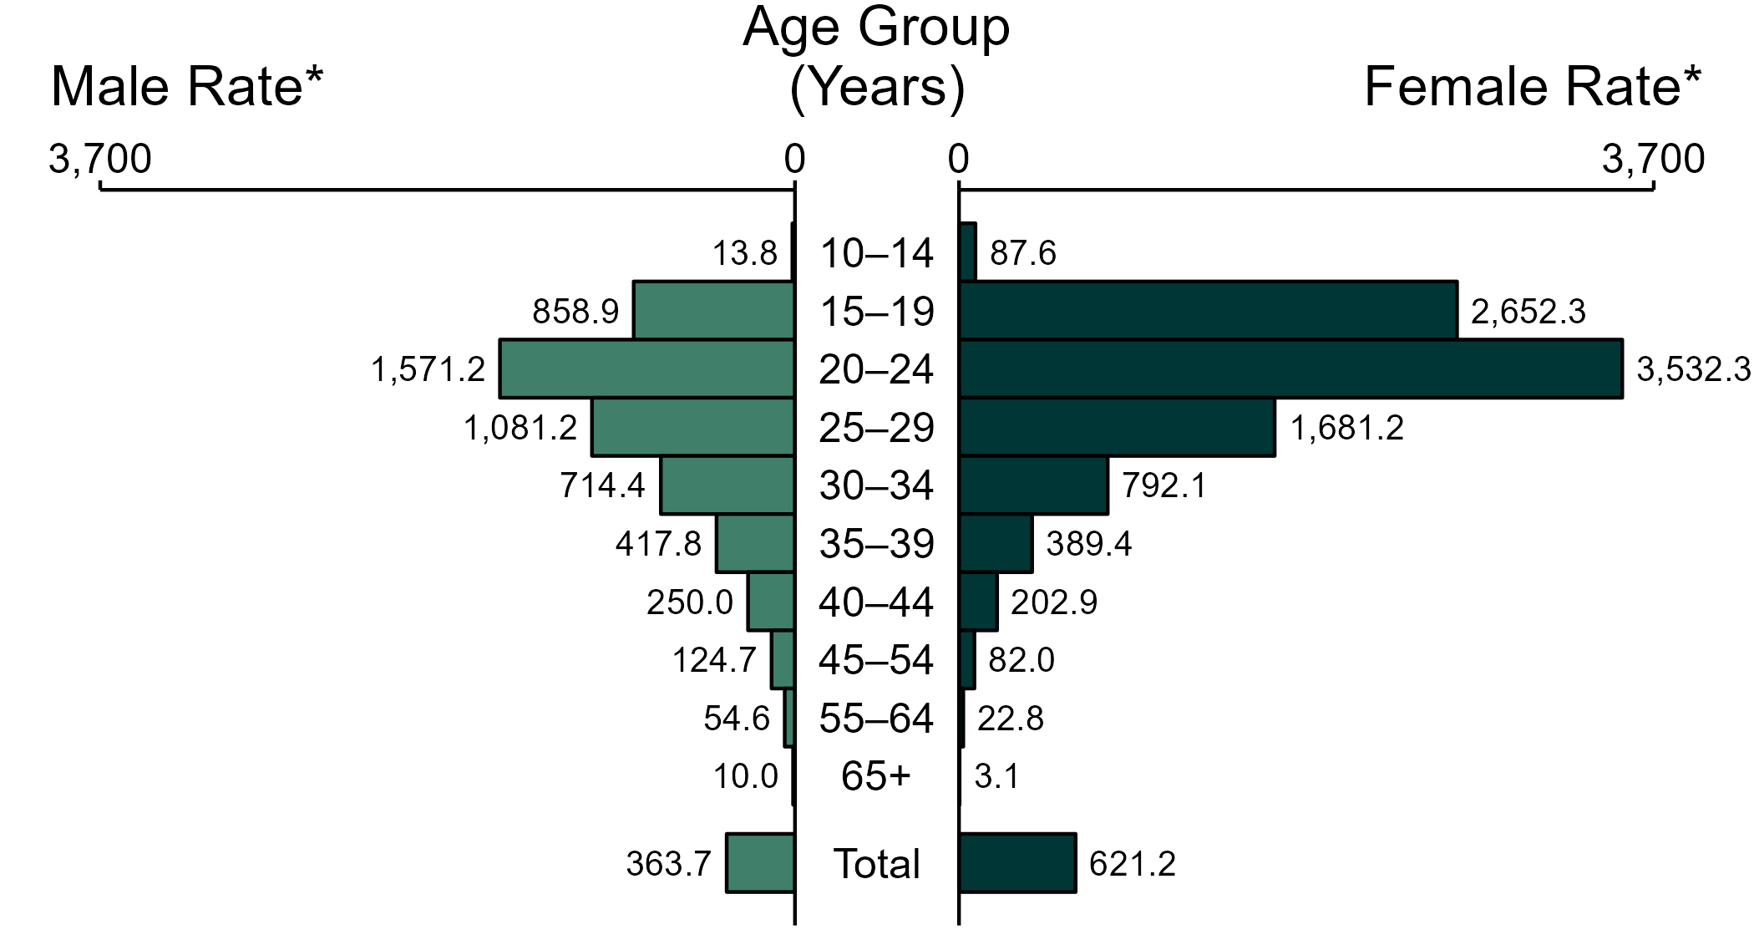
Chlamydia — Rates of Reported Cases by Age Group and Sex, United States, 2022
* Per 100,000
NOTE: Total includes cases of all ages, including those with unknown age.
Notes:
In 2022, the rate of reported chlamydia was higher among women (621.2 per 100,000) compared to men (363.7 per 100,000).
Among women, those aged 20 to 24 years had the highest rate of reported cases of chlamydia (3,532.3 per 100,000), followed by women aged 15 to 19 years (2,652.3 per 100,000) and women aged 25 to 29 years (1,681.2 per 100,000). Among men, those aged 20 to 24 years also had the highest rate of reported cases of chlamydia (1,571.2 per 100,000), followed by men aged 25 to 29 years (1,081.2 per 100,000) and men aged 15 to 19 years (858.9 per 100,000).
This report includes data from years that coincide with the COVID-19 pandemic, which introduced uncertainty and difficulty in interpreting STI surveillance data. See Impact of COVID-19 on STIs for more information.
See Technical Notes (https://www.cdc.gov/std/statistics/2022/technical-notes.htm) for information on chlamydia case reporting. Table A1 (https://www.cdc.gov/std/statistics/2022/tables/a1.htm) provides information on unknown, missing, or invalid values of select variables.
Data for all figures are available at https://www.cdc.gov/std/statistics/2022/data.zip. The file “CT - Rates by Age Group and Sex (US 2022).xlsx” contains the data for the figure presented on this slide.

Slide 3
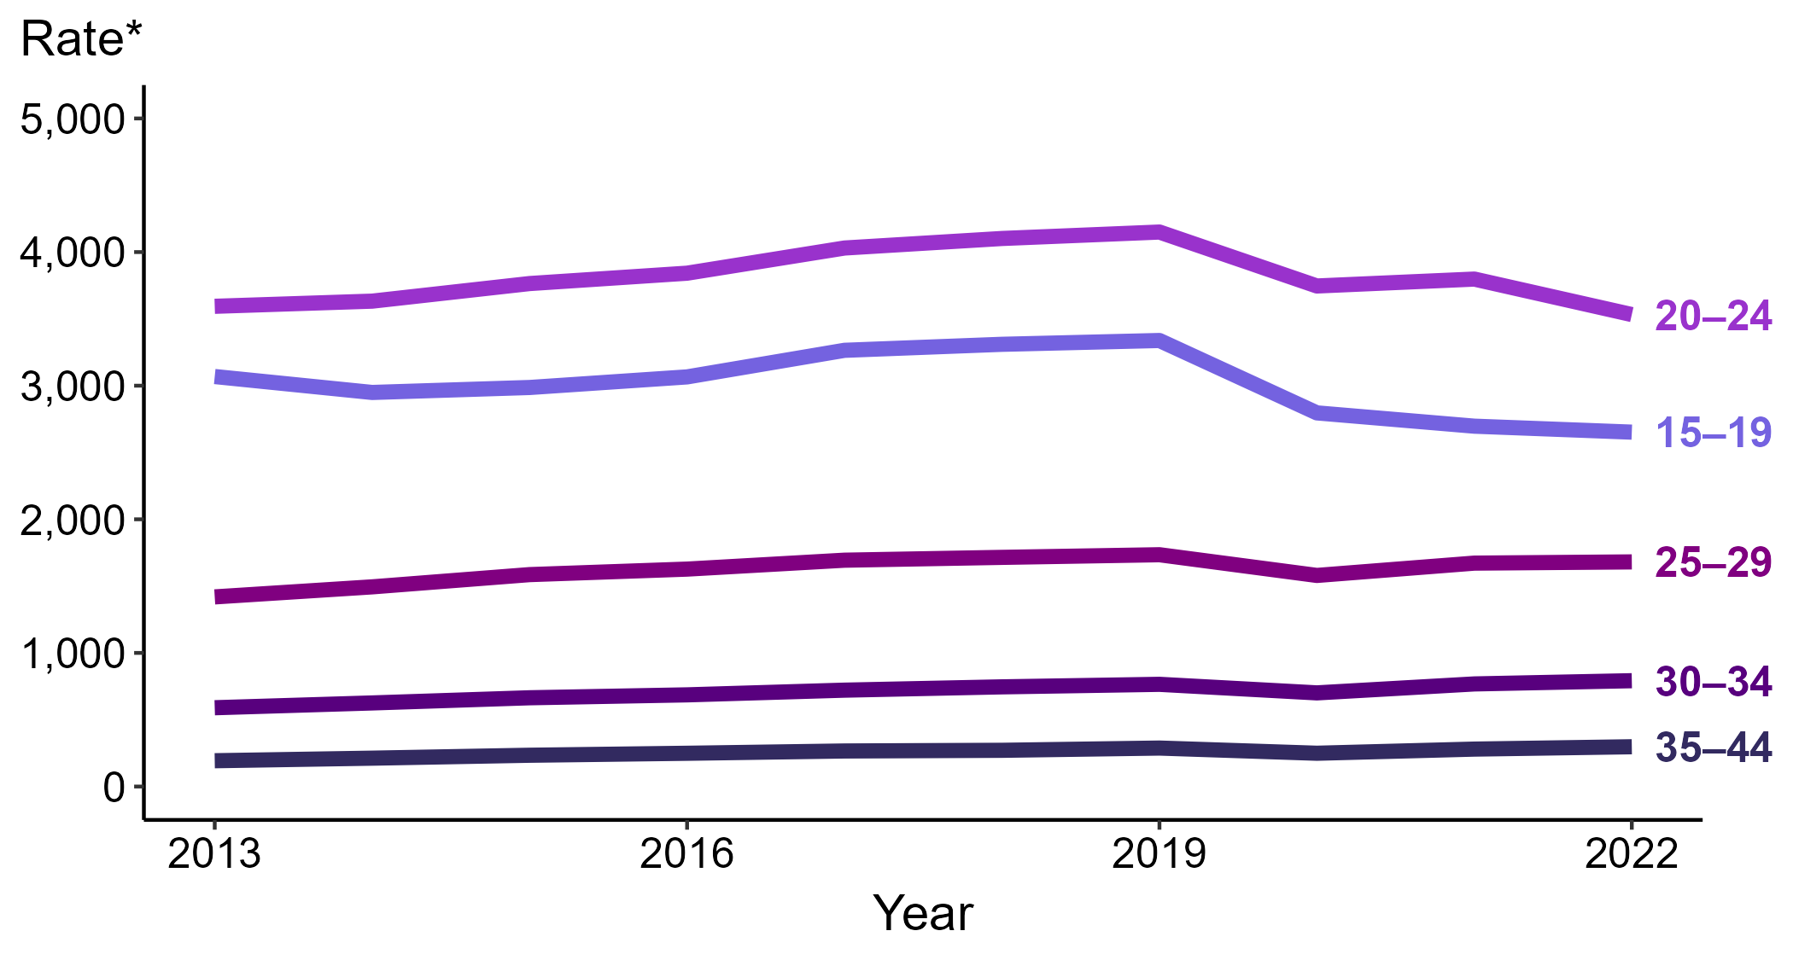
Chlamydia — Rates of Reported Cases Among Women Aged 15–44 Years by Age Group, United States, 2013–2022
* Per 100,000
Notes:
Among women aged 15 to 44 years in 2022, those aged 20 to 24 years had the highest rate of reported cases of chlamydia (3,532.3 cases per 100,000; 7.0% decrease from 2021), followed by those aged 15 to 19 years (2,652.3 cases per 100,000; 1.7% decrease from 2021), those aged 25 to 29 years (1,681.2 cases per 100,000; <1.0% change from 2021), those aged 30 to 34 years (792.1 cases per 100,000; 3.2% increase from 2021), and those aged 35 to 44 years (297.7 cases per 100,000; 6.3% increase from 2021).
This report includes data from years that coincide with the COVID-19 pandemic, which introduced uncertainty and difficulty in interpreting STI surveillance data. See Impact of COVID-19 on STIs for more information.
See Technical Notes (https://www.cdc.gov/std/statistics/2022/technical-notes.htm) for information on chlamydia case reporting. Table A1 (https://www.cdc.gov/std/statistics/2022/tables/a1.htm) provides information on unknown, missing, or invalid values of select variables.
Data for all figures are available at https://www.cdc.gov/std/statistics/2022/data.zip. The file “CT - Rates Women 15-44 Years by Age Group (US 2013-2022).xlsx” contains the data for the figure presented on this slide.

Slide 4
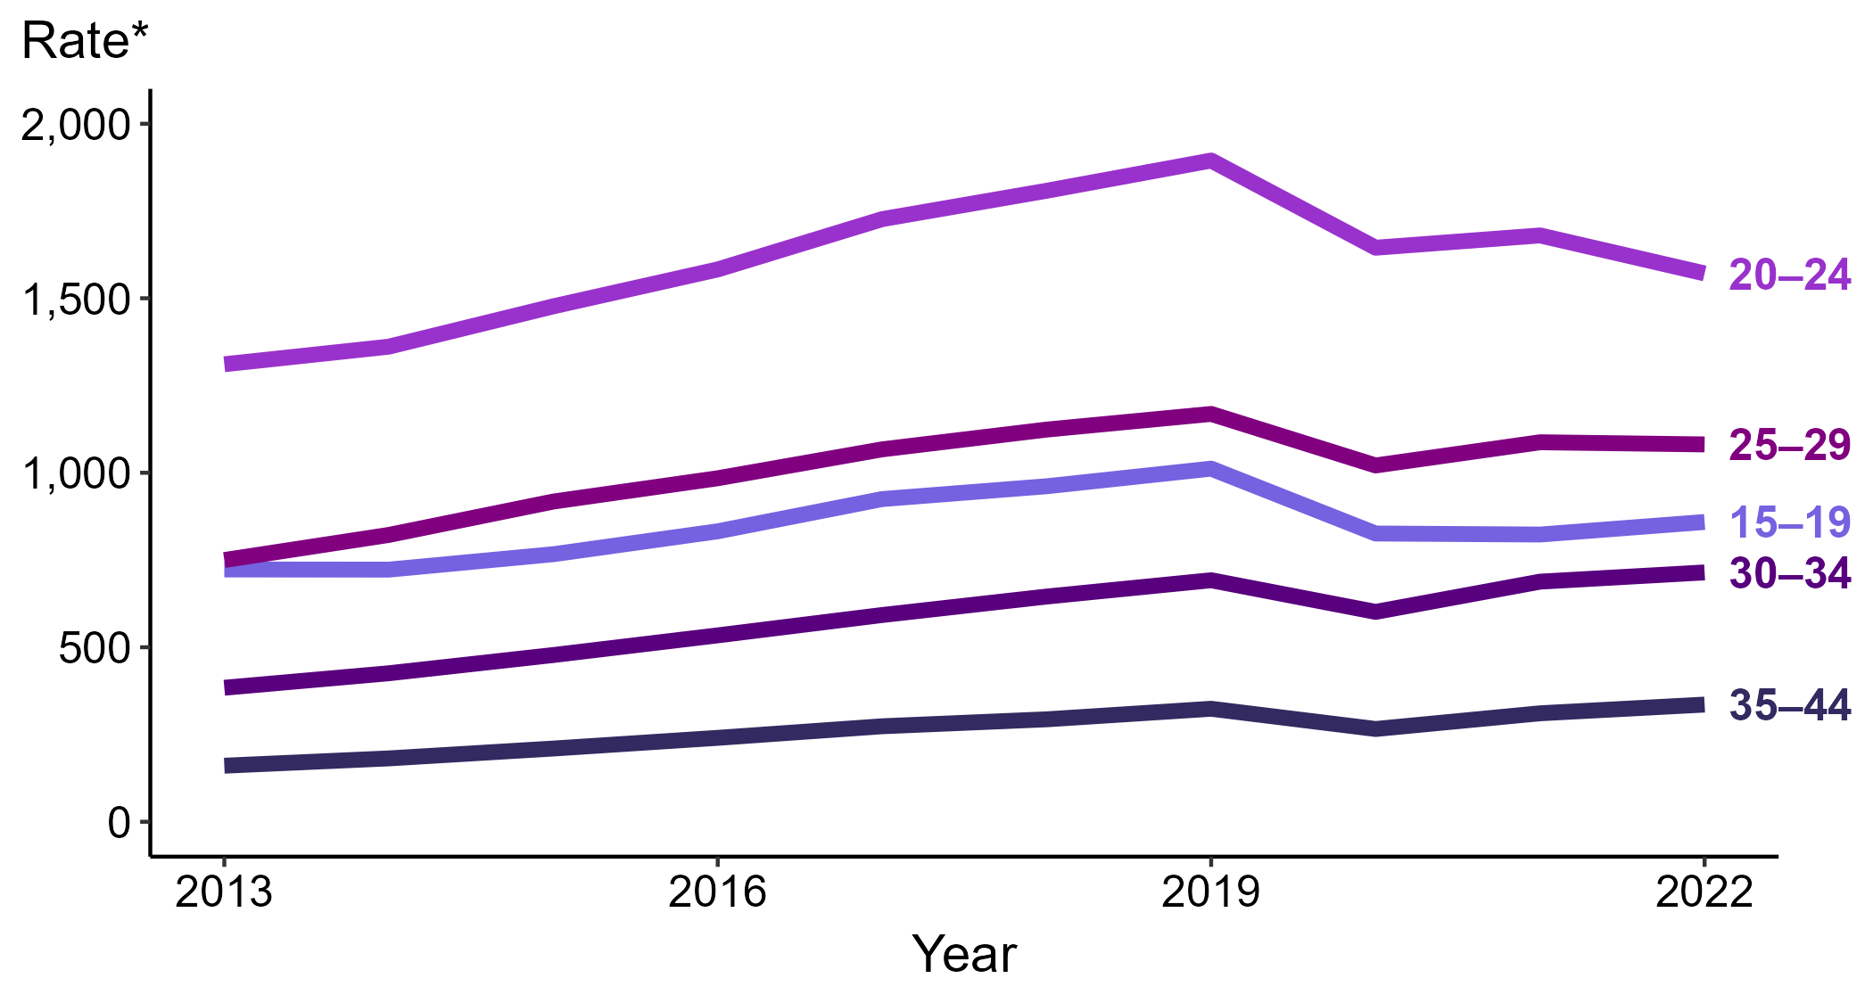
Chlamydia — Rates of Reported Cases Among Men Aged 15–44 Years by Age Group, United States, 2013–2022
* Per 100,000
Notes:
Among men aged 15 to 44 years in 2022, those aged 20 to 24 years had the highest rate of reported cases of chlamydia (1,571.2 cases per 100,000; 6.5% decrease from 2021), followed by those aged 25 to 29 years (1,081.2 cases per 100,000; <1.0% change from 2021), those aged 15 to 19 years (858.9 cases per 100,000; 4.4% increase from 2021), those aged 30 to 34 years (714.4 cases per 100,000; 3.8% increase from 2021), and those aged 35 to 44 years (335.7 cases per 100,000; 8.0% increase from 2021).
This report includes data from years that coincide with the COVID-19 pandemic, which introduced uncertainty and difficulty in interpreting STI surveillance data. See Impact of COVID-19 on STIs for more information.
See Technical Notes (https://www.cdc.gov/std/statistics/2022/technical-notes.htm) for information on chlamydia case reporting. Table A1 (https://www.cdc.gov/std/statistics/2022/tables/a1.htm) provides information on unknown, missing, or invalid values of select variables.
Data for all figures are available at https://www.cdc.gov/std/statistics/2022/data.zip. The file “CT - Rates Men 15-44 Years by Age Group (US 2013-2022).xlsx” contains the data for the figure presented on this slide.

Slide 5
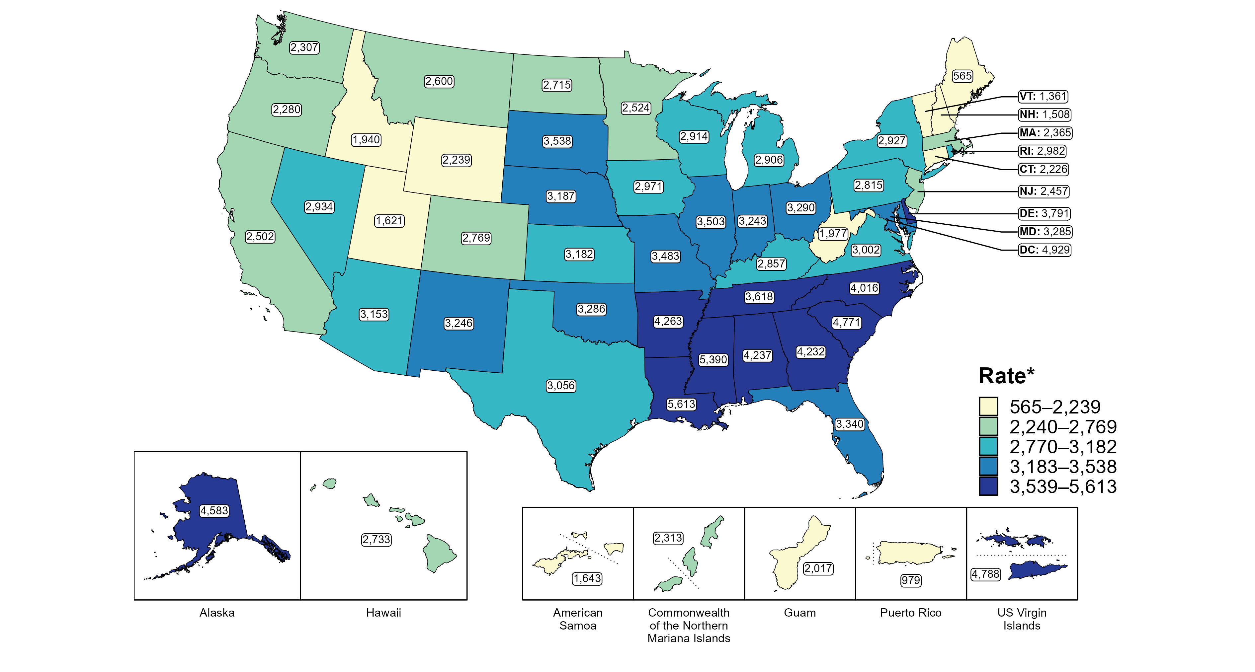
Chlamydia — Rates of Reported Cases Among Women Aged 15–24 Years by Jurisdiction, United States and Territories, 2022
* Per 100,000
Notes:
In 2022, rates of reported chlamydia among women aged 15 to 24 years ranged by state from 565 cases per 100,000 women aged 15 to 24 years in Maine to 5,613 cases per 100,000 women aged 15 to 24 years in Louisiana. The rate of reported chlamydia in the District of Columbia was 4,929 per 100,000 women aged 15 to 24 years.
Among US territories, rates of reported chlamydia ranged from 979 cases per 100,000 women aged 15 to 24 years in Puerto Rico to 4,788 cases per 100,000 women aged 15 to 24 years in the US Virgin Islands.
This report includes data from years that coincide with the COVID-19 pandemic, which introduced uncertainty and difficulty in interpreting STI surveillance data. See Impact of COVID-19 on STIs for more information.
See Technical Notes (https://www.cdc.gov/std/statistics/2022/technical-notes.htm) for information on chlamydia case reporting and on interpreting reported rates in US territories. Table A1 (https://www.cdc.gov/std/statistics/2022/tables/a1.htm) provides information on unknown, missing, or invalid values of select variables.
Data for all figures are available at https://www.cdc.gov/std/statistics/2022/data.zip. The file “CT - Rates Women 15-24 Years by Jurisdiction (US and Terr 2022).xlsx” contains the data for the figure presented on this slide.

Slide 6
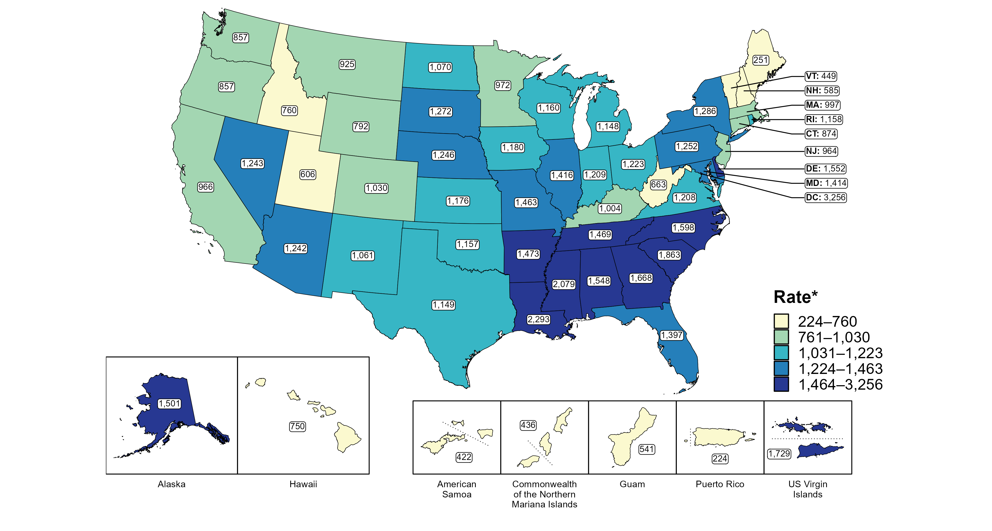
Chlamydia — Rates of Reported Cases Among Men Aged 15–24 Years by Jurisdiction, United States and Territories, 2022
* Per 100,000
Notes:
In 2022, rates of reported chlamydia among men aged 15 to 24 years ranged by state from 251 cases per 100,000 men aged 15 to 24 years in Maine to 2,293 cases per 100,000 men aged 15 to 24 years in Louisiana. The rate of reported chlamydia in the District of Columbia was 3,256 per 100,000 men aged 15 to 24 years.
Among US territories, rates of reported chlamydia ranged from 224 cases per 100,000 men aged 15 to 24 years in Puerto Rico to 1,729 cases per 100,000 men aged 15 to 24 years in the US Virgin Islands.
This report includes data from years that coincide with the COVID-19 pandemic, which introduced uncertainty and difficulty in interpreting STI surveillance data. See Impact of COVID-19 on STIs for more information.
See Technical Notes (https://www.cdc.gov/std/statistics/2022/technical-notes.htm) for information on chlamydia case reporting and on interpreting reported rates in US territories. Table A1 (https://www.cdc.gov/std/statistics/2022/tables/a1.htm) provides information on unknown, missing, or invalid values of select variables.
Data for all figures are available at https://www.cdc.gov/std/statistics/2022/data.zip. The file “CT - Rates Men 15-24 Years by Jurisdiction (US and Terr 2022).xlsx” contains the data for the figure presented on this slide.

Slide 7
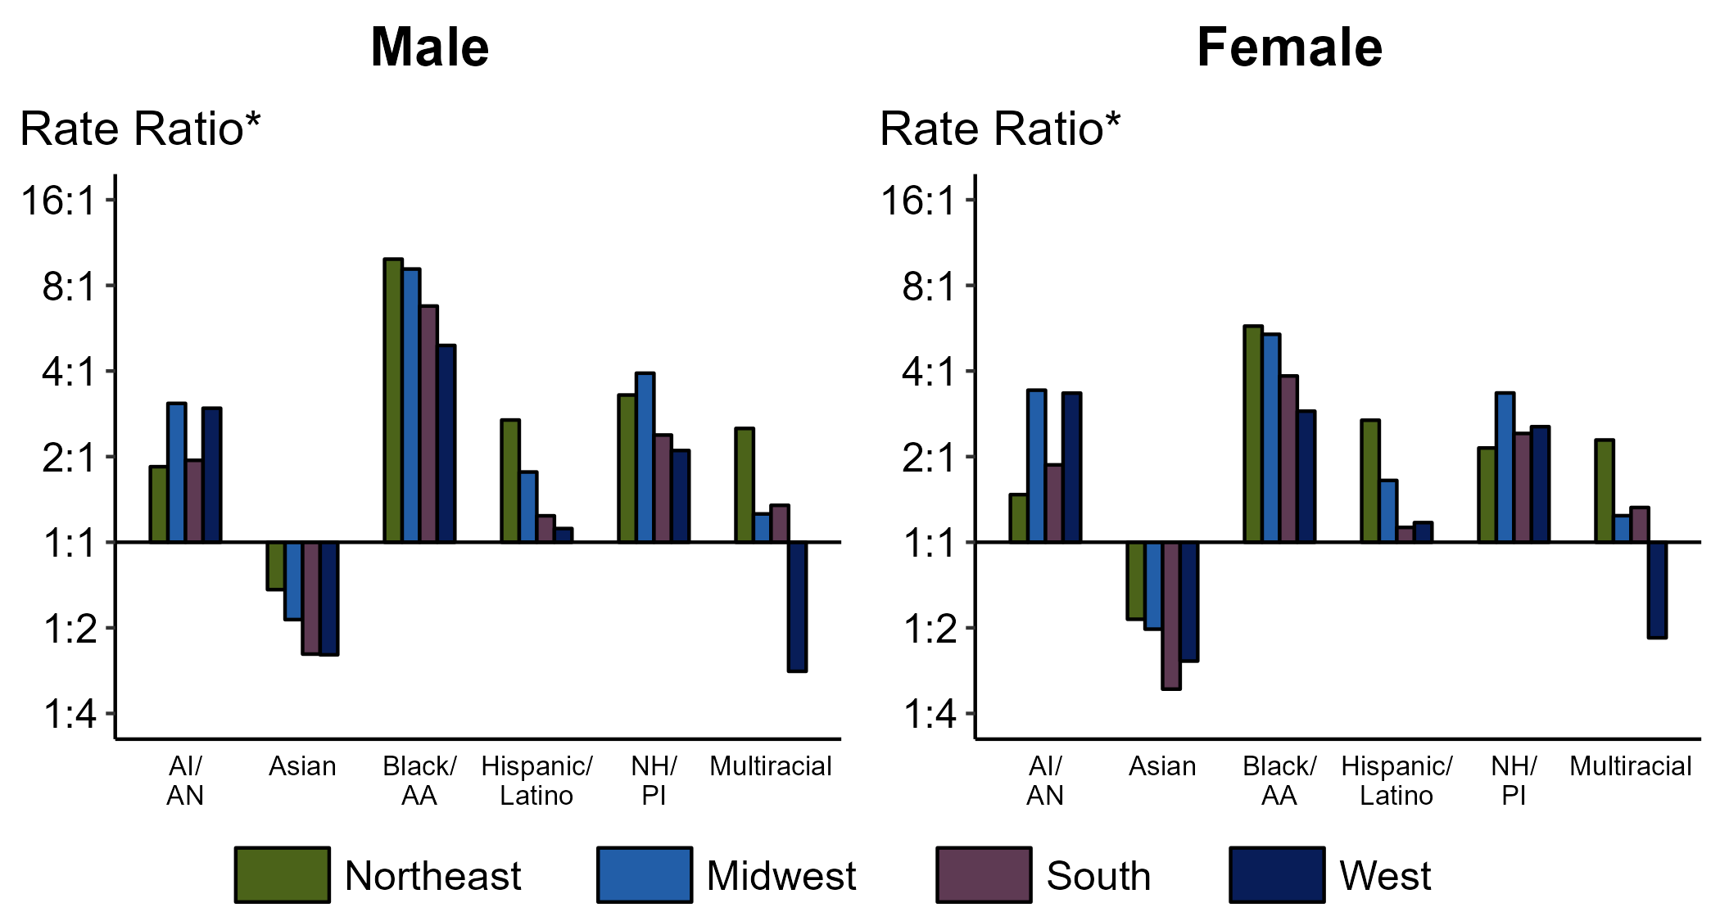
Chlamydia — Ratios of Rates of Reported Cases Among Persons Aged 15–24 Years by Sex, Race/Hispanic Ethnicity, and Region, United States, 2022
* For the rate ratios, non-Hispanic White persons are the referent population. Y-axis is log scale.
ACRONYMS: AI/AN = American Indian or Alaska Native; Black/AA = Black or African American; NH/PI = Native Hawaiian or other Pacific Islander
Notes:
Among men and women aged 15-24 years, rate ratios of rates of reported chlamydia by race/Hispanic ethnicity (using non-Hispanic White persons as the referent population) varied by region in 2022. Among men aged 15-24 years, the greatest rate ratio was in the Northeast where the rate of reported chlamydia among non-Hispanic Black men was 9.9 times the rate among non-Hispanic White men. Among women aged 15-24 years, the greatest rate ratio was in the Northeast where the rate of reported chlamydia among non-Hispanic Black women was 5.8 times the rate among non-Hispanic White women.
This report includes data from years that coincide with the COVID-19 pandemic, which introduced uncertainty and difficulty in interpreting STI surveillance data. See Impact of COVID-19 on STIs for more information.
See Technical Notes (https://www.cdc.gov/std/statistics/2022/technical-notes.htm) for information on chlamydia case reporting, race/Hispanic ethnicity categorization, and reporting of race/Hispanic ethnicity for STI cases. Table A1 (https://www.cdc.gov/std/statistics/2022/tables/a1.htm) provides information on unknown, missing, or invalid values of select variables.

Slide 8
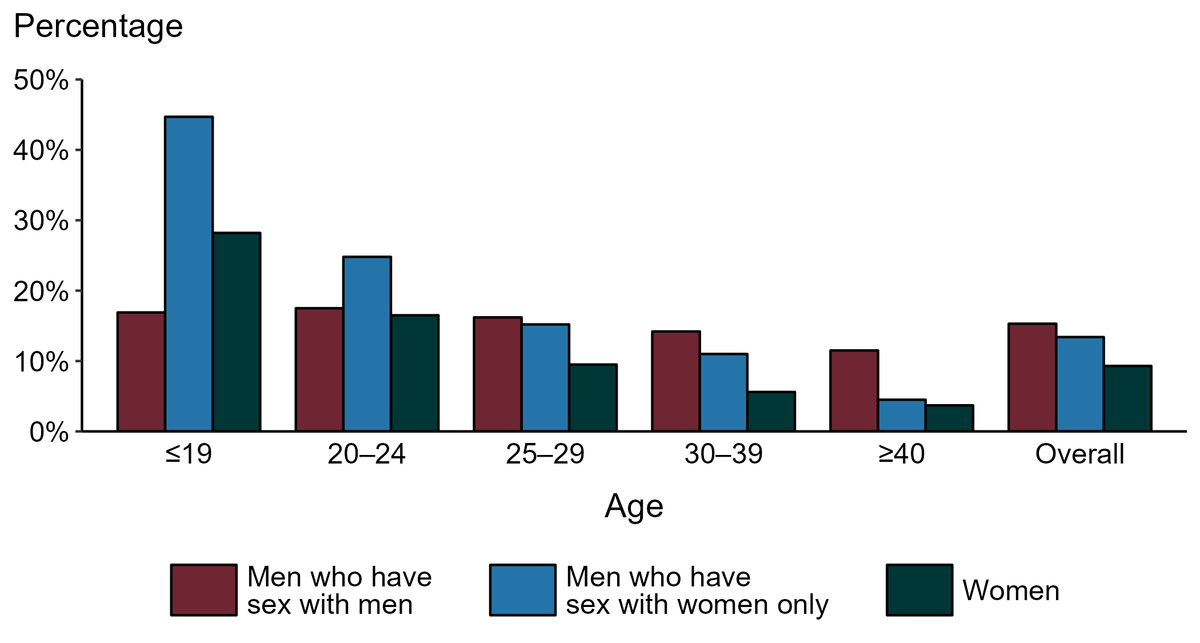
Chlamydia — Proportion of STD Clinic Patients Testing Positive by Age Group, Sex, and Sex of Sex Partners, STD Surveillance Network (SSuN), 2022
NOTE: Results are based on 49,665 unique patients in 10 participating jurisdictions (Baltimore City, California [excluding San Francisco], Columbus, Florida, Indiana, Multnomah County, New York City, Philadelphia, San Francisco, and Washington) with known sex of sex partners attending SSuN STD clinics who were tested ≥1 times for chlamydia in 2022.
Notes:
Among patients accessing care in participating STD clinics in the STD Surveillance Network (SSuN) who were tested for chlamydia in 2022 and had known sexual orientation or sex of sex partners, 15.3% of gay, bisexual and other men who have sex with men (MSM), 13.4% of men who have sex with women only (MSW), and 9.3% of women were found to be positive. The proportion testing positive for chlamydia varied by sex and sex of sex partners, as well as by age group. The highest proportion of patients testing positive were MSW aged 19 years and younger (44.7%). Of note, adolescent patients represent a relatively small subgroup of the clinic population and changes in the number of events in the numerator or a small denominator may lead to substantial fluctuations from year to year. Hence, data should be interpreted with caution.
This report includes data from years that coincide with the COVID-19 pandemic, which introduced uncertainty and difficulty in interpreting STI surveillance data. See Impact of COVID-19 on STIs for more information.
See Technical Notes (https://www.cdc.gov/std/statistics/2022/technical-notes.htm) for information on SSuN methodology.

Slide 9
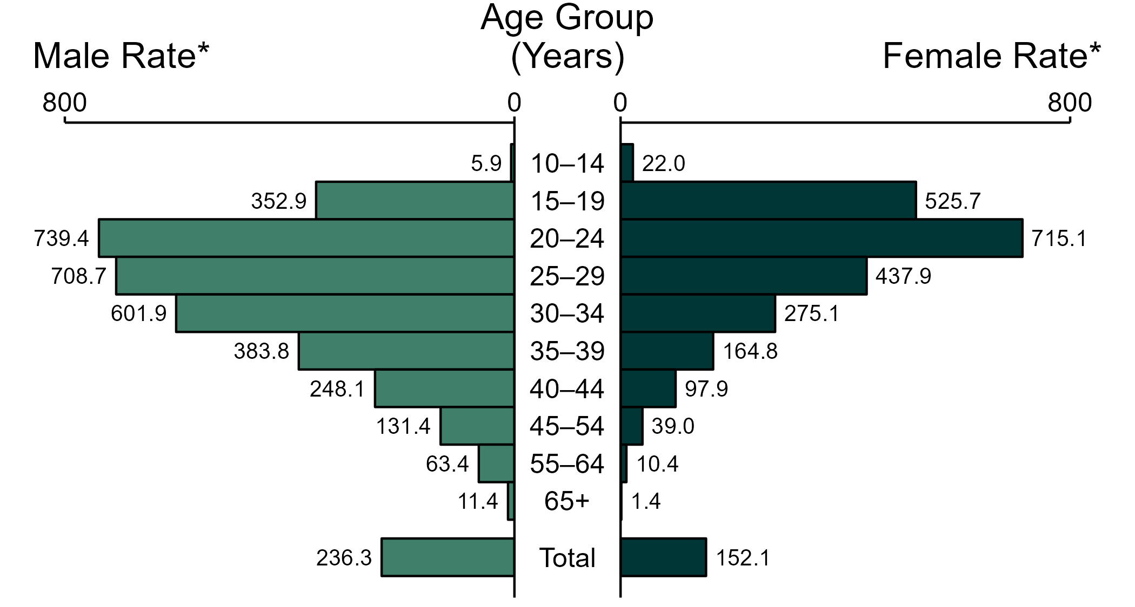
Gonorrhea — Rates of Reported Cases by Age Group and Sex, United States, 2022
* Per 100,000
NOTE: Total includes cases of all ages, including those with unknown age.
Notes:
In 2022, the rate of reported gonorrhea was higher among men (236.3 per 100,000) compared to women (152.1 per 100,000).
Among men, those aged 20 to 24 years had the highest rate of reported cases of gonorrhea (739.4 per 100,000), followed by men aged 25 to 29 years (708.7 per 100,000) and men aged 30 to 34 years (601.9 per 100,000). Among women, those aged 20 to 24 years also had the highest rate of reported cases of gonorrhea (715.1 per 100,000), followed by women aged 15 to 19 years (525.7 per 100,000) and women aged 25 to 29 years (437.9 per 100,000).
This report includes data from years that coincide with the COVID-19 pandemic, which introduced uncertainty and difficulty in interpreting STI surveillance data. See Impact of COVID-19 on STIs for more information.
See Technical Notes (https://www.cdc.gov/std/statistics/2022/technical-notes.htm) for information on gonorrhea case reporting. Table A1 (https://www.cdc.gov/std/statistics/2022/tables/a1.htm) provides information on unknown, missing, or invalid values of select variables.
Data for all figures are available at https://www.cdc.gov/std/statistics/2022/data.zip. The file “GC - Rates by Age Group and Sex (US 2022).xlsx” contains the data for the figure presented on this slide.

Slide 10
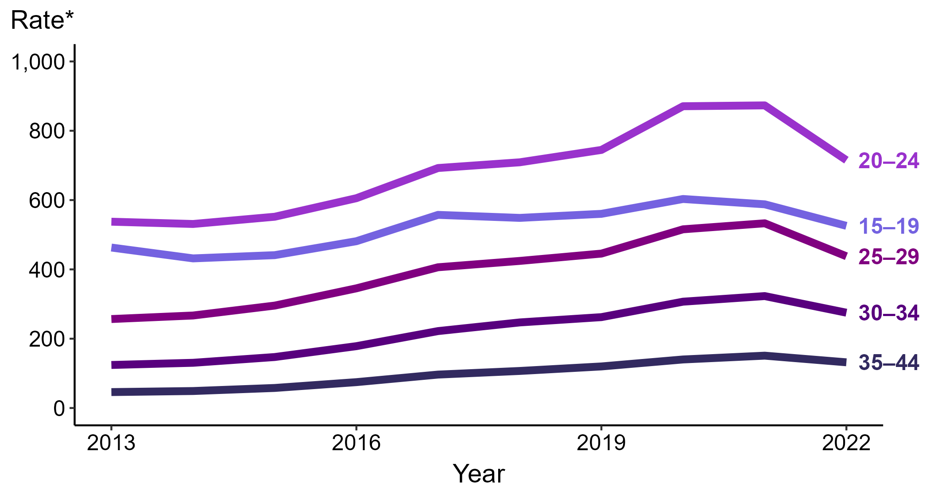
Gonorrhea — Rates of Reported Cases Among Women Aged 15–44 Years by Age Group, United States, 2013–2022
* Per 100,000
Notes:
Among women aged 15 to 44 years in 2022, those aged 20 to 24 years had the highest rate of reported cases of gonorrhea (715.1 cases per 100,000; 18.1% decrease from 2021), followed by those aged 15 to 19 years (525.7 cases per 100,000; 10.6% decrease from 2021), those aged 25 to 29 years (437.9 cases per 100,000; 17.8% decrease from 2021), those aged 30 to 34 years (275.1 cases per 100,000; 14.8% decrease from 2021), and those aged 35 to 44 years (131.9 cases per 100,000; 12.6% decrease from 2021).
This report includes data from years that coincide with the COVID-19 pandemic, which introduced uncertainty and difficulty in interpreting STI surveillance data. See Impact of COVID-19 on STIs for more information.
See Technical Notes (https://www.cdc.gov/std/statistics/2022/technical-notes.htm) for information on gonorrhea case reporting. Table A1 (https://www.cdc.gov/std/statistics/2022/tables/a1.htm) provides information on unknown, missing, or invalid values of select variables.
Data for all figures are available at https://www.cdc.gov/std/statistics/2022/data.zip. The file “GC - Rates Women 15-44 Years by Age Group (US 2012-2022).xlsx” contains the data for the figure presented on this slide.

Slide 11
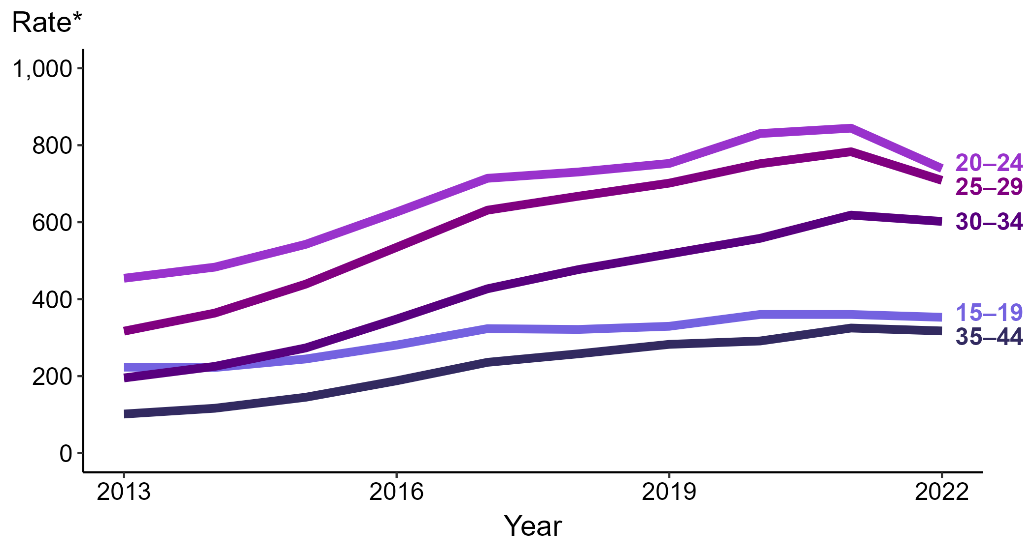
Gonorrhea — Rates of Reported Cases Among Men Aged 15–44 Years by Age Group, United States, 2013–2022
* Per 100,000
Notes:
Among men aged 15 to 44 years in 2022, those aged 20 to 24 years had the highest rate of reported cases of gonorrhea (739.4 cases per 100,000; 12.4% decrease from 2021), followed by those aged 25 to 29 years (708.7 cases per 100,000; 9.5% decrease from 2021), those aged 30 to 34 years (601.9 cases per 100,000; 2.7% decrease from 2021), those aged 15 to 19 years (352.9 cases per 100,000; 2.0% decrease from 2021), and those aged 35 to 44 years (317.4 cases per 100,000; 2.3% decrease from 2021).
This report includes data from years that coincide with the COVID-19 pandemic, which introduced uncertainty and difficulty in interpreting STI surveillance data. See Impact of COVID-19 on STIs for more information.
See Technical Notes (https://www.cdc.gov/std/statistics/2022/technical-notes.htm) for information on gonorrhea case reporting. Table A1 (https://www.cdc.gov/std/statistics/2022/tables/a1.htm) provides information on unknown, missing, or invalid values of select variables.
Data for all figures are available at https://www.cdc.gov/std/statistics/2022/data.zip. The file “GC - Rates Men 15-44 Years by Age Group (US 2012-2022).xlsx” contains the data for the figure presented on this slide.

Slide 12
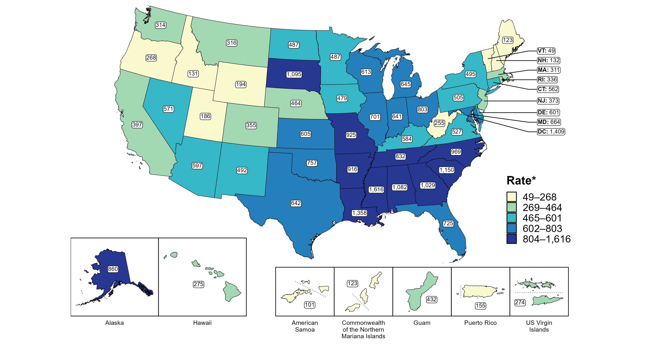
Gonorrhea — Rates of Reported Cases Among Women Aged 15–24 Years by Jurisdiction, United States and Territories, 2022
* Per 100,000
Notes:
In 2022, rates of reported gonorrhea among women aged 15 to 24 years ranged by state from 49 cases per 100,000 women aged 15 to 24 years in Vermont to 1,616 cases per 100,000 women aged 15 to 24 years in Mississippi. The rate of reported gonorrhea in the District of Columbia was 1,409 per 100,000 women aged 15 to 24 years.
Among US territories, rates of reported gonorrhea ranged from 101 cases per 100,000 women aged 15 to 24 years in American Samoa to 432 cases per 100,000 women aged 15 to 24 years in Guam.
This report includes data from years that coincide with the COVID-19 pandemic, which introduced uncertainty and difficulty in interpreting STI surveillance data. See Impact of COVID-19 on STIs for more information.
See Technical Notes (https://www.cdc.gov/std/statistics/2022/technical-notes.htm) for information on gonorrhea case reporting and on interpreting reported rates in US territories. Table A1 (https://www.cdc.gov/std/statistics/2022/tables/a1.htm) provides information on unknown, missing, or invalid values of select variables.
Data for all figures are available at https://www.cdc.gov/std/statistics/2022/data.zip. The file “GC - Rates Women 15-24 Years by Jurisdiction (US and Terr 2022).xlsx” contains the data for the figure presented on this slide.

Slide 13
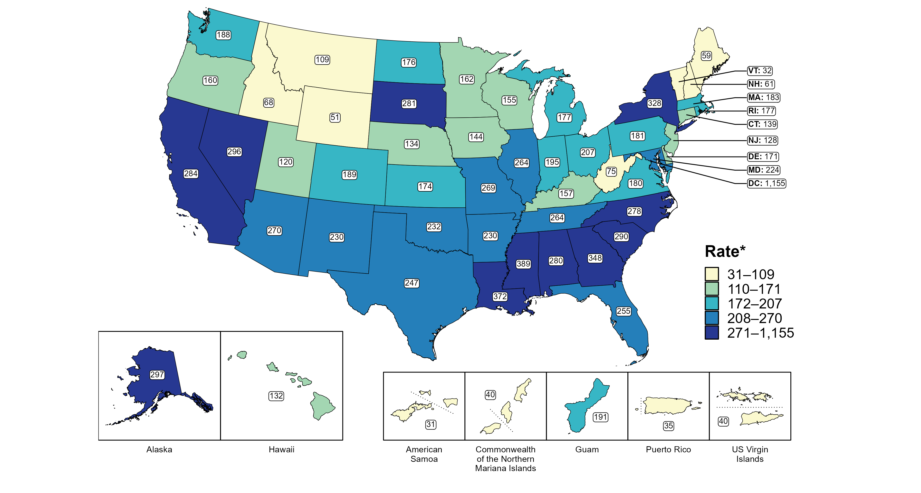
Gonorrhea — Rates of Reported Cases Among Men by State, United States and Territories, 2022
* Per 100,000
Notes:
In 2022, rates of reported gonorrhea among men ranged by state from 32 cases per 100,000 men in Vermont to 389 cases per 100,000 men in Mississippi. The rate of reported gonorrhea in the District of Columbia was 1,155 per 100,000 men.
Among US territories, rates of reported gonorrhea ranged from 31 cases per 100,000 men in American Samoa to 191 cases per 100,000 men in Guam.
This report includes data from years that coincide with the COVID-19 pandemic, which introduced uncertainty and difficulty in interpreting STI surveillance data. See Impact of COVID-19 on STIs for more information.
See Technical Notes (https://www.cdc.gov/std/statistics/2022/technical-notes.htm) for information on gonorrhea case reporting and on interpreting reported rates in US territories. Table A1 (https://www.cdc.gov/std/statistics/2022/tables/a1.htm) provides information on unknown, missing, or invalid values of select variables.
Data for all figures are available at https://www.cdc.gov/std/statistics/2022/data.zip. The file “GC - Rates Men by Jurisdiction (US and Terr 2022).xlsx” contains the data for the figure presented on this slide.

Slide 14
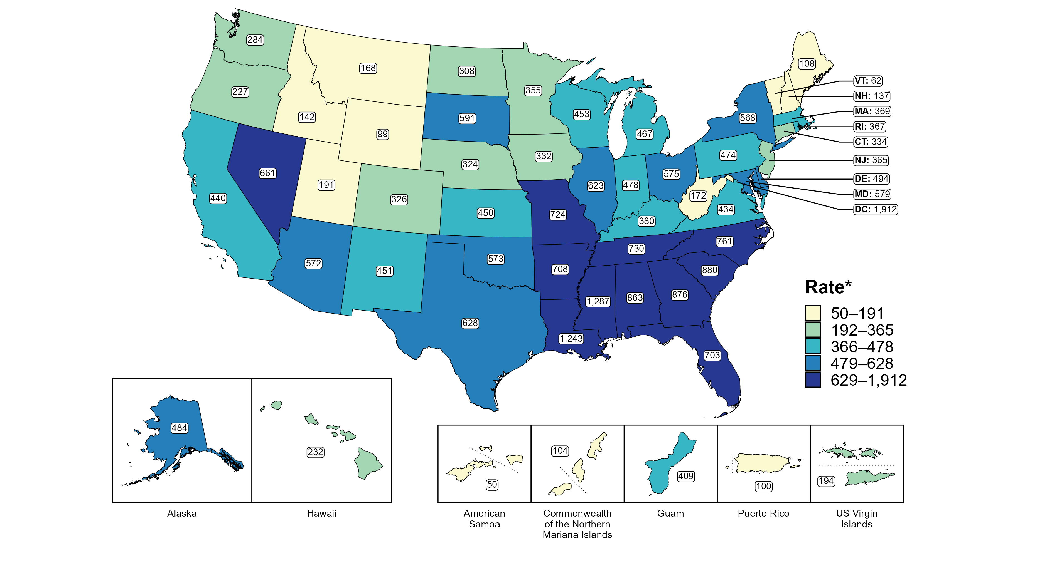
Gonorrhea — Rates of Reported Cases Among Men Aged 15–24 Years by Jurisdiction, United States and Territories, 2022
* Per 100,000
Notes:
In 2022, rates of reported gonorrhea among men aged 15 to 24 years ranged by state from 62 cases per 100,000 men aged 15 to 24 years in Vermont to 1,287 cases per 100,000 men aged 15 to 24 years in Mississippi. The rate of reported gonorrhea in the District of Columbia was 1,912 per 100,000 men aged 15 to 24 years.
Among US territories, rates of reported gonorrhea ranged from 50 cases per 100,000 men aged 15 to 24 years in American Samoa to 409 cases per 100,000 men aged 15 to 24 years in Guam.
This report includes data from years that coincide with the COVID-19 pandemic, which introduced uncertainty and difficulty in interpreting STI surveillance data. See Impact of COVID-19 on STIs for more information.
See Technical Notes (https://www.cdc.gov/std/statistics/2022/technical-notes.htm) for information on gonorrhea case reporting and on interpreting reported rates in US territories. Table A1 (https://www.cdc.gov/std/statistics/2022/tables/a1.htm) provides information on unknown, missing, or invalid values of select variables.
Data for all figures are available at https://www.cdc.gov/std/statistics/2022/data.zip. The file “GC - Rates Men 15-24 Years by Jurisdiction (US and Terr 2022).xlsx” contains the data for the figure presented on this slide.

Slide 15
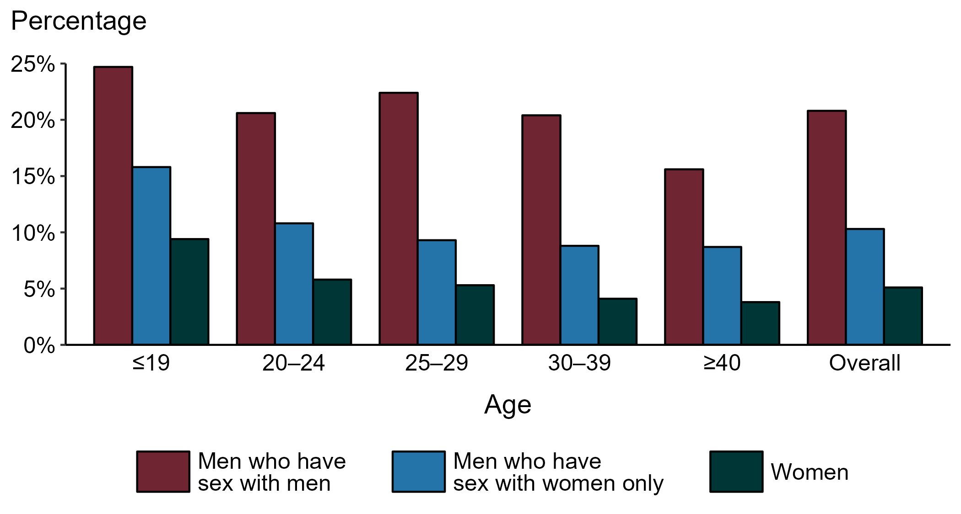
Gonorrhea — Proportion of STD Clinic Patients Testing Positive by Age Group, Sex, and Sex of Sex Partners, STD Surveillance Network (SSuN), 2022
NOTE: Results are based on 49,726 unique patients in 10 participating jurisdictions (Baltimore City, California [excluding San Francisco], Columbus, Florida, Indiana, Multnomah County, New York City, Philadelphia, San Francisco, and Washington) with known sex of sex partners attending SSuN STD clinics who were tested ≥1 times for gonorrhea in 2022.
Notes:
Among patients accessing care in participating STD clinics in the STD Surveillance Network (SSuN) who were tested for gonorrhea in 2022, 20.8% of gay, bisexual, and other men who have sex with men (MSM), 10.3% of men who have sex with women only (MSW), and 5.1% of women were positive. The proportion of STD clinic patients who tested positive for gonorrhea varied by sex and sex of sex partners, as well as by age group. MSM were noted to have higher proportions of testing positive in all age groups when compared to women and MSW. Of note, adolescent patients represent a relatively small subgroup of the clinic population and changes in the number of events in the numerator or a small denominator may lead to substantial fluctuations from year to year. Hence, data should be interpreted with caution.
This report includes data from years that coincide with the COVID-19 pandemic, which introduced uncertainty and difficulty in interpreting STI surveillance data. See Impact of COVID-19 on STIs for more information.
See Technical Notes (https://www.cdc.gov/std/statistics/2022/technical-notes.htm) for information on SSuN methodology.

Slide 16
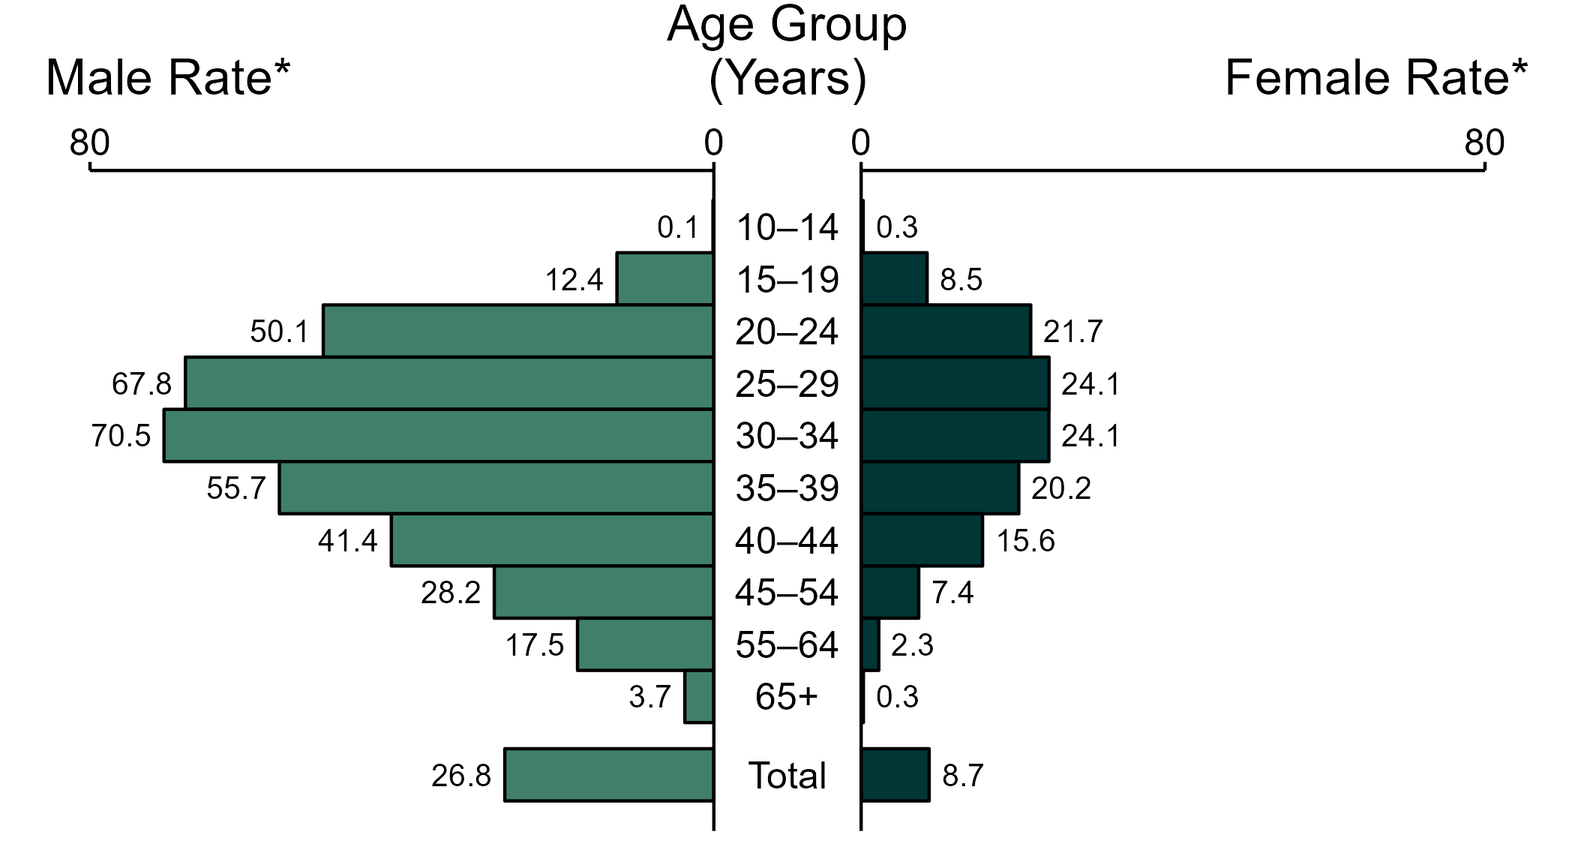
Primary and Secondary Syphilis — Rates of Reported Cases by Age Group and Sex, United States, 2022
* Per 100,000
NOTE: Total includes cases of all ages, including those with unknown age.
Notes:
In 2022, the rate of reported primary and secondary (P&S) syphilis was higher among men (26.8 per 100,000) compared to women (8.7 per 100,000).
Among men, those aged 30 to 34 years had the highest rate of reported cases of P&S syphilis (70.5 per 100,000), followed by men aged 25 to 29 years (67.8 per 100,000) and men aged 35 to 39 years (55.7 per 100,000). Among women, those aged 25 to 29 years and 30 to 34 years had the highest rate of reported cases of P&S syphilis (24.1 per 100,000), followed by women aged 20 to 24 years (21.7 per 100,000) and women aged 35 to 39 years (20.2 per 100,000).
This report includes data from years that coincide with the COVID-19 pandemic, which introduced uncertainty and difficulty in interpreting STI surveillance data. See Impact of COVID-19 on STIs for more information.
See Technical Notes (https://www.cdc.gov/std/statistics/2022/technical-notes.htm) for information on syphilis case reporting. Table A1 (https://www.cdc.gov/std/statistics/2022/tables/a1.htm) provides information on unknown, missing, or invalid values of select variables.
Data for all figures are available at https://www.cdc.gov/std/statistics/2022/data.zip. The file “PS Syphilis - Rates by Age Group and Sex (US 2022).xlsx” contains the data for the figure presented on this slide.

Slide 17
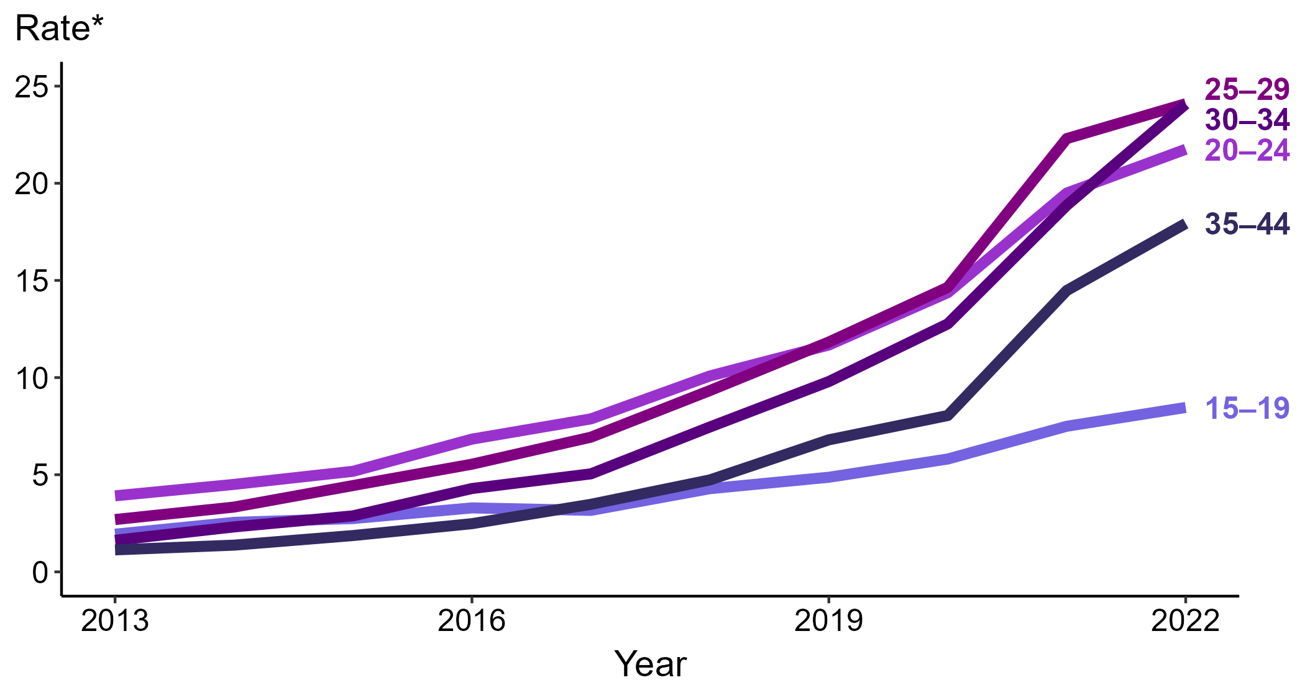
Primary and Secondary Syphilis — Rates of Reported Cases Among Women Aged 15–44 Years by Age Group, United States, 2013–2022
* Per 100,000
Notes:
Among women aged 15 to 44 years in 2022, those aged 25 to 29 years and 30 to 34 years had the highest rate of reported cases of primary and secondary syphilis (24.1 cases per 100,000; 8.1% increase for those aged 25 to 29 and 27.5% increase for those aged 30 to 34 from 2021), followed by those aged 20 to 24 years (21.7 cases per 100,000; 11.3% increase from 2021), those aged 35 to 44 years (17.9 cases per 100,000; 23.4% increase from 2021), and those aged 15 to 19 years (8.5 cases per 100,000; 13.3% increase from 2021).
This report includes data from years that coincide with the COVID-19 pandemic, which introduced uncertainty and difficulty in interpreting STI surveillance data. See Impact of COVID-19 on STIs for more information.
See Technical Notes (https://www.cdc.gov/std/statistics/2022/technical-notes.htm) for information on syphilis case reporting. Table A1 (https://www.cdc.gov/std/statistics/2022/tables/a1.htm) provides information on unknown, missing, or invalid values of select variables.
Data for all figures are available at https://www.cdc.gov/std/statistics/2022/data.zip. The file “PS Syphilis - Rates Women 15-44 Years by Age Group (US 2013-2022).xlsx” contains the data for the figure presented on this slide.

Slide 18
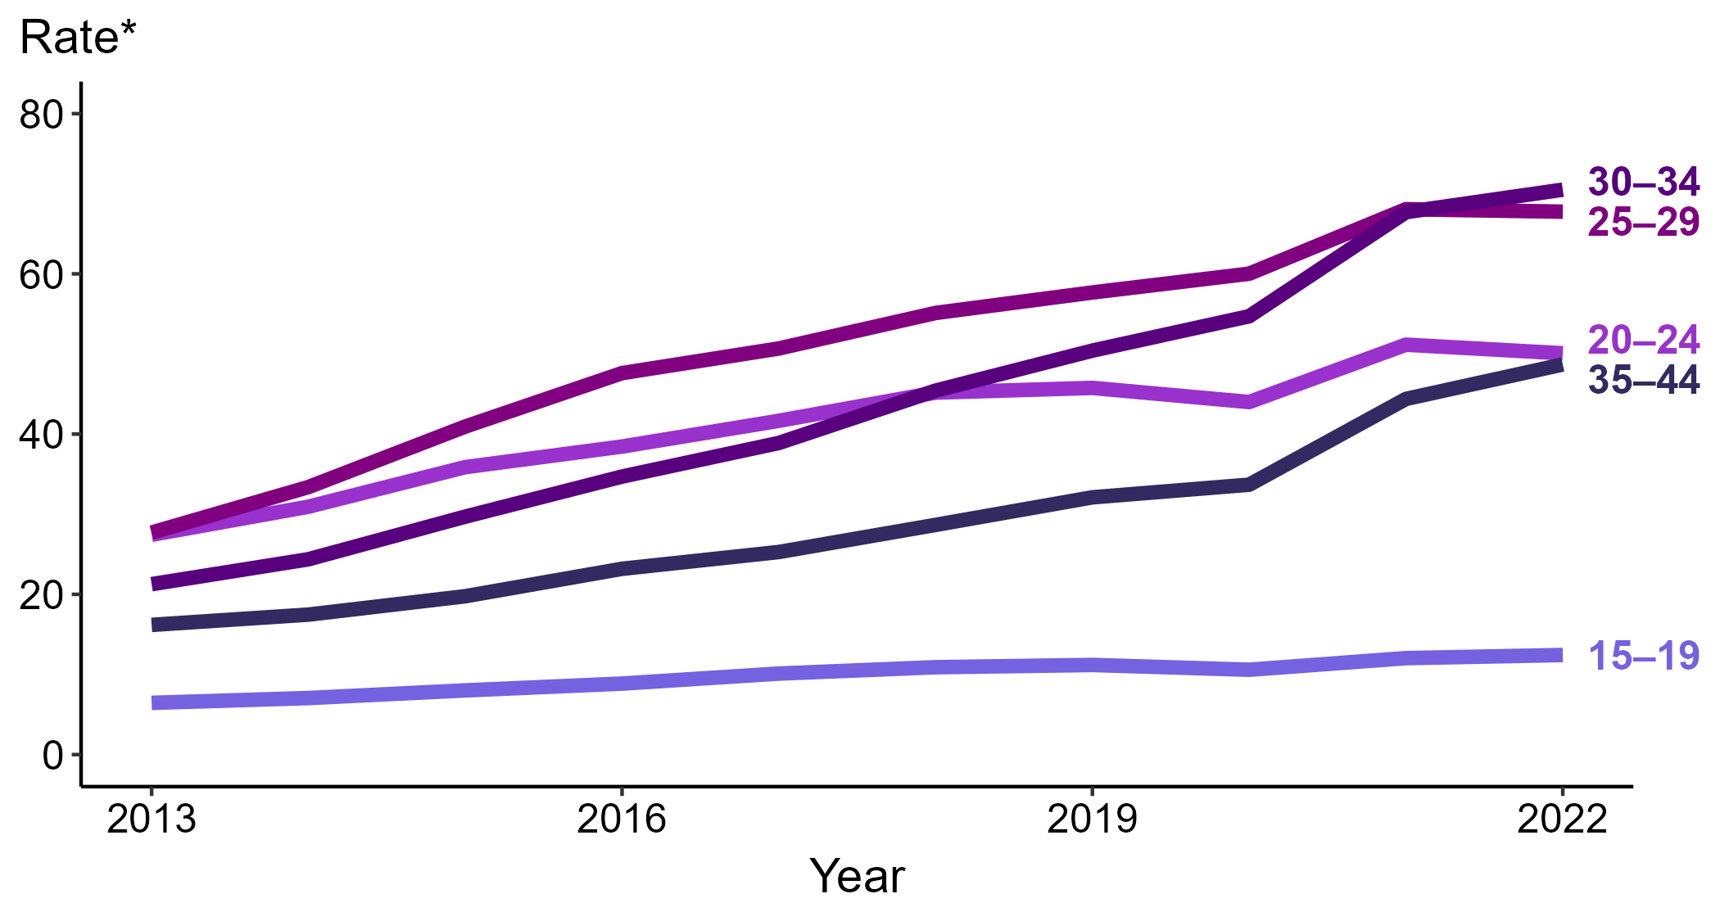
Primary and Secondary Syphilis — Rates of Reported Cases Among Men Aged 15–44 Years by Age Group, United States, 2013–2022
* Per 100,000
Notes:
Among men aged 15 to 44 years in 2022, those aged 30 to 34 years had the highest rate of reported cases of primary and secondary syphilis (70.5 cases per 100,000; 4.1% increase from 2021), followed by those aged 25 to 29 years (67.8 cases per 100,000; <1.0% change from 2021), those aged 20 to 24 years (50.1 cases per 100,000; 2.1% decrease from 2021), those aged 35 to 44 years (48.7 cases per 100,000; 9.7% increase from 2021), and those aged 15 to 19 years (12.4 cases per 100,000; 3.3% increase from 2021).
This report includes data from years that coincide with the COVID-19 pandemic, which introduced uncertainty and difficulty in interpreting STI surveillance data. See Impact of COVID-19 on STIs for more information.
See Technical Notes (https://www.cdc.gov/std/statistics/2022/technical-notes.htm) for information on syphilis case reporting. Table A1 (https://www.cdc.gov/std/statistics/2022/tables/a1.htm) provides information on unknown, missing, or invalid values of select variables.
Data for all figures are available at https://www.cdc.gov/std/statistics/2022/data.zip. The file “PS Syphilis - Rates Men 15-44 Years by Age Group (US 2013-2022).xlsx” contains the data for the figure presented on this slide.

Slide 19
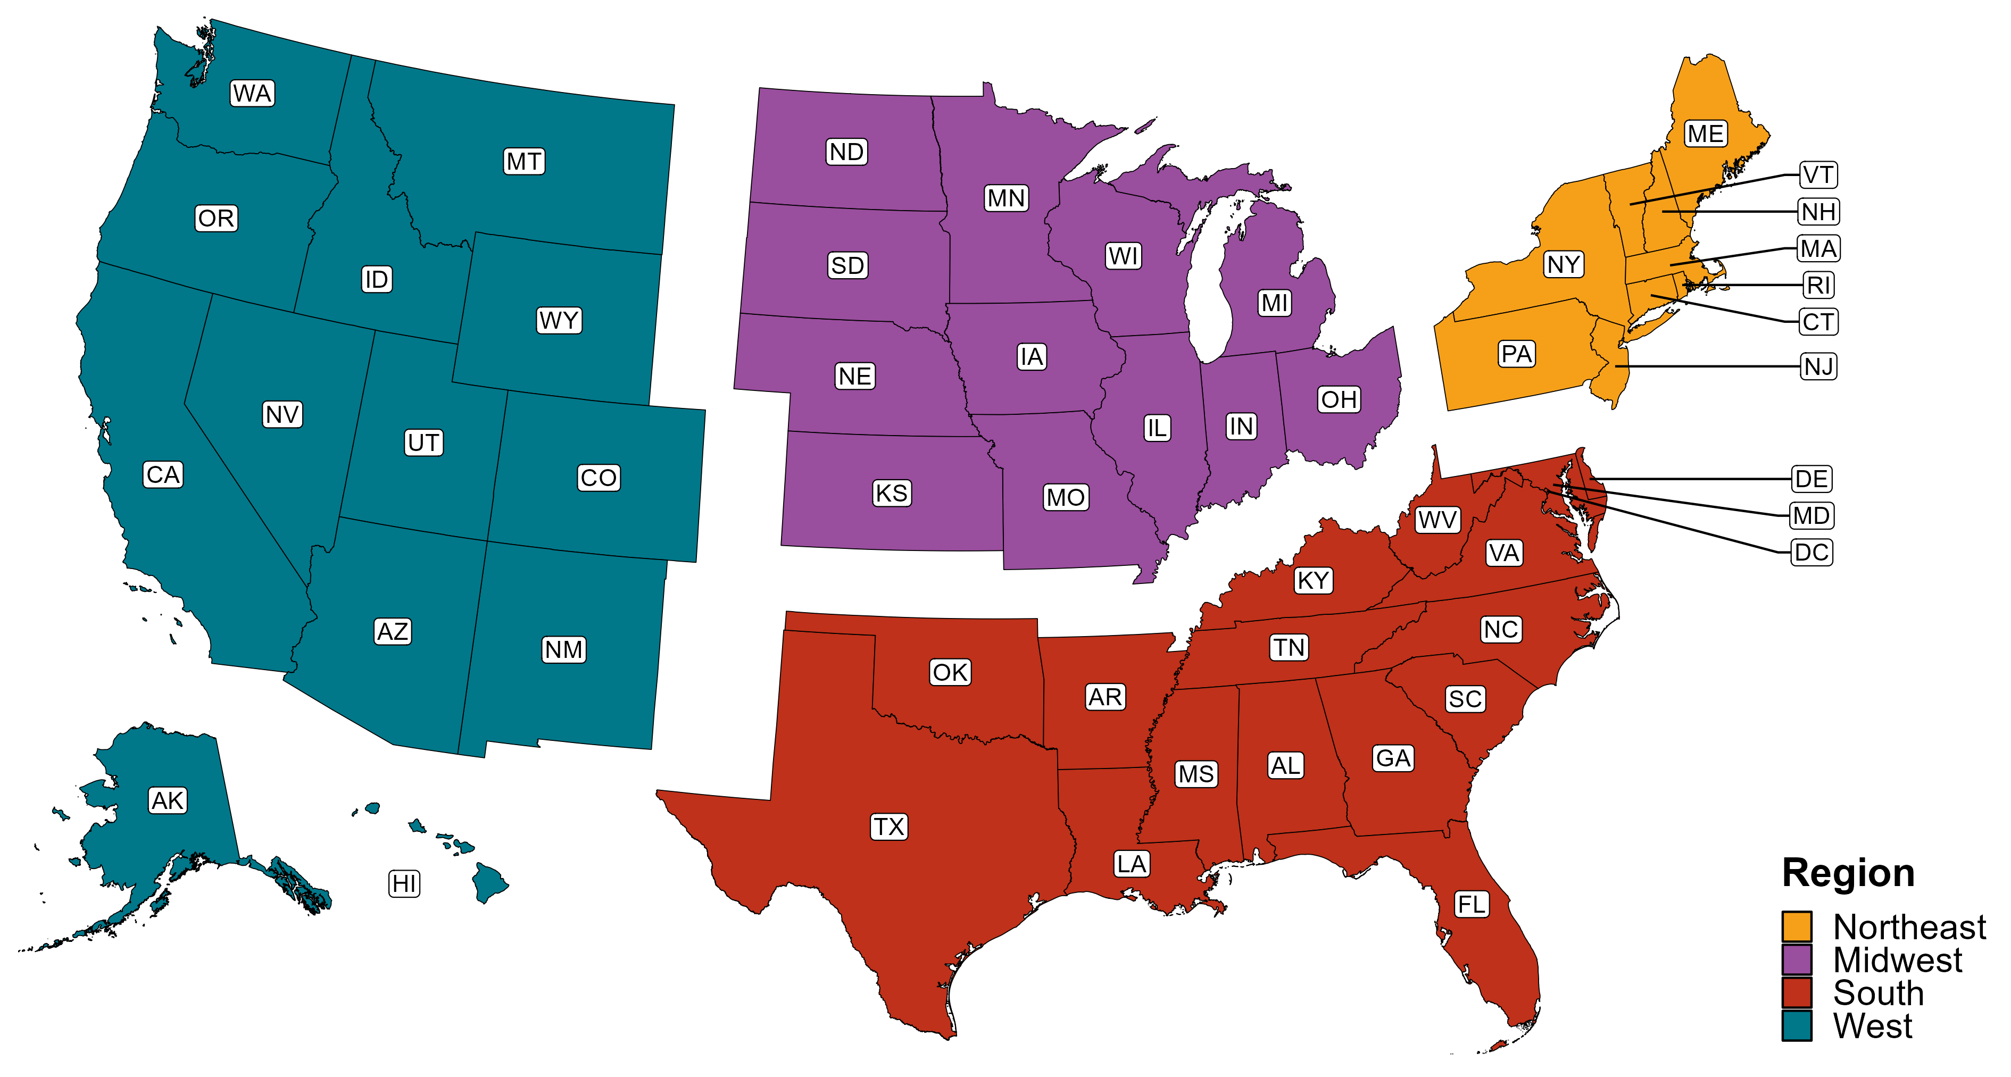
Reference Map of US Census Regions

