Slide 1
Sexually Transmitted Infections
Surveillance 2022
Antibiotic Resistant Gonorrhea
Notes:
This slide set was prepared by the Division of STD Prevention, National Center for HIV, Viral Hepatitis, STD, and TB Prevention (NCHHSTP), Centers for Disease Control and Prevention (CDC). These slides display trends for STIs in the United States through 2022. Data presented include case notifications provided to CDC through the National Notifiable Diseases Surveillance System (NNDSS) and data collected through projects and programs that monitor STIs in various settings, including the STD Surveillance Network (SSuN), and the Gonococcal Isolate Surveillance Project (GISP).
For more information on data sources, data collection and reporting practices, and case definitions, please see the Technical Notes, available at https://www.cdc.gov/std/statistics/2022/technical-notes.htm.
All data points for figures presented in these slides are available at https://www.cdc.gov/std/statistics/2022/data.zip.
NOTE: This slide set is in the public domain. You may reproduce these slides without permission; however, citation as to source is appreciated.
Centers for Disease Control and Prevention. Sexually Transmitted Infections Surveillance 2022. Atlanta: U.S. Department of Health and Human Services; 2024.
You are also free to adapt and revise these slides; however, you must remove the CDC name and logo if changes are made.

Slide 2
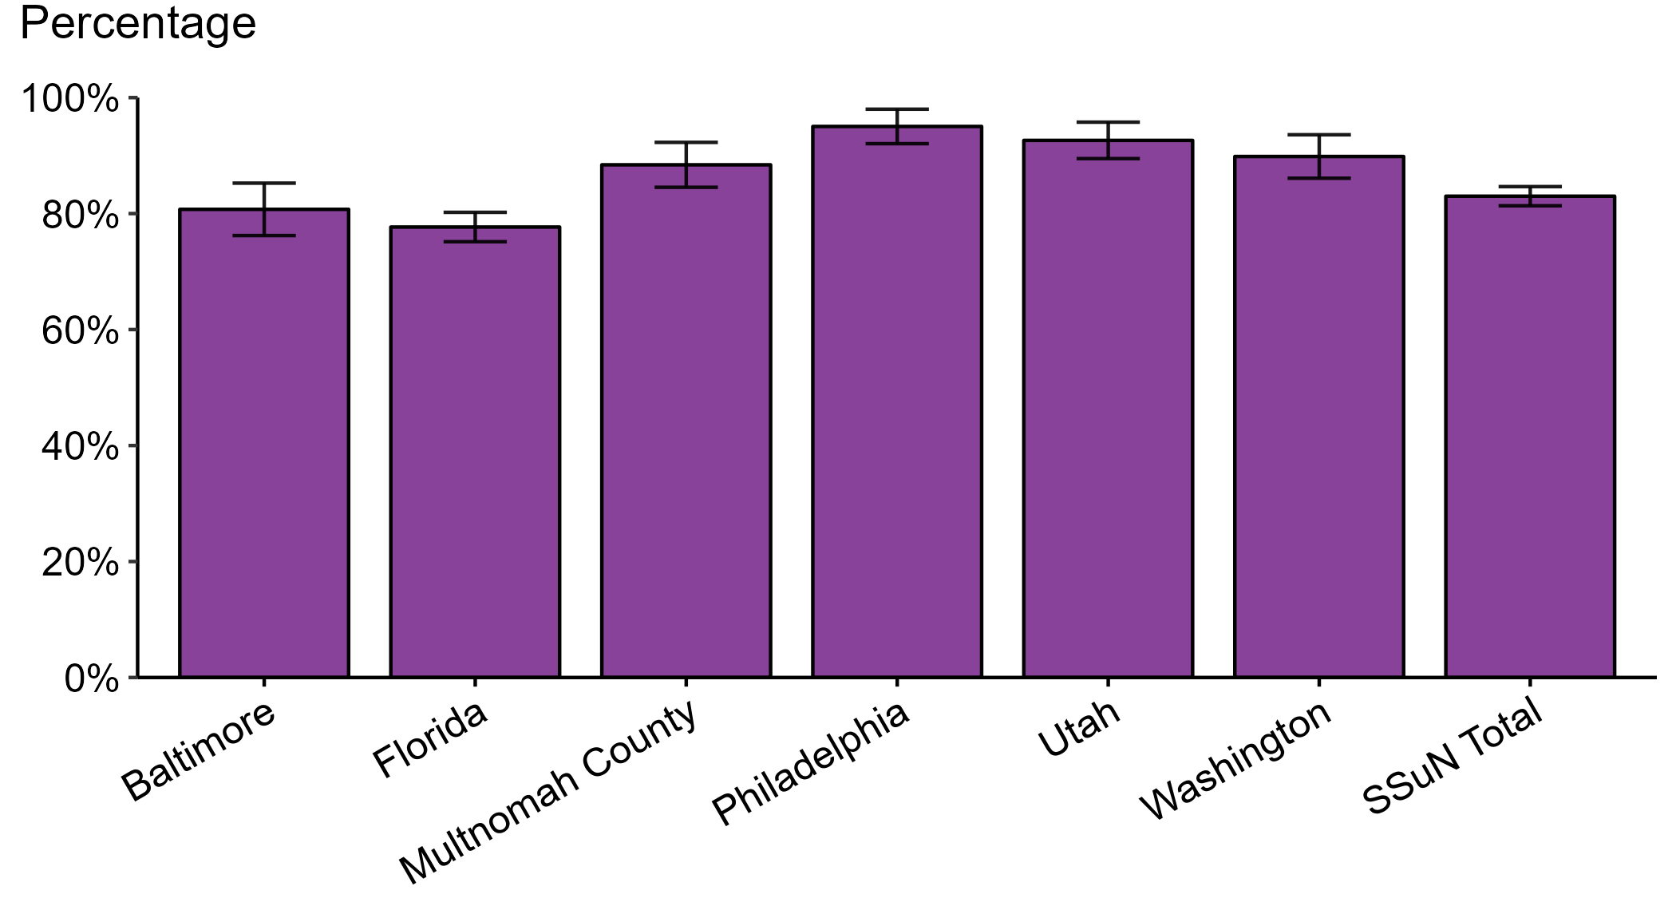
Gonorrhea — Estimated Proportion of Cases Treated with Recommended Regimen by Jurisdiction, STD Surveillance Network (SSuN), 2022
NOTE: Includes SSuN jurisdictions with treatment and dosage data ascertained for at least 80% of sampled, investigated cases. In 2022, the recommended treatment for uncomplicated gonorrhea was ceftriaxone 500 mg, intramuscular.
Notes:
In 2022, Philadelphia reported the highest estimated proportion of gonorrhea cases treated with the recommended regimen and Florida reported the lowest proportion of cases treated with the recommended regimen among jurisdictions participating in SSuN that met the inclusion criteria. Overall, the proportion of cases treated with the recommended regimen was 83.0% in 2022.
This report includes data from years that coincide with the COVID-19 pandemic, which introduced uncertainty and difficulty in interpreting STI surveillance data. See Impact of COVID-19 on STIs for more information.
See Technical Notes (https://www.cdc.gov/std/statistics/2022/technical-notes.htm) for information on SSuN methodology.

Slide 3
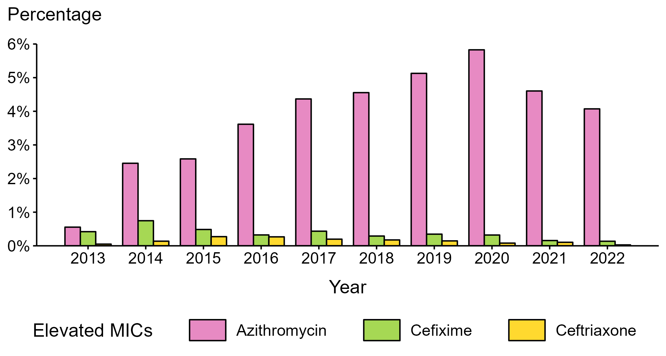
Neisseria gonorrhoeae — Percentage of Isolates with Elevated Minimum Inhibitory Concentrations (MICs) to Azithromycin, Cefixime, and Ceftriaxone, Gonococcal Isolate Surveillance Project (GISP), 2013–2022
NOTE: Elevated MICs = Azithromycin: ≥ 2.0 μg/mL; Cefixime: ≥ 0.25 μg/mL; Ceftriaxone: ≥ 0.125 μg/mL
Notes:
During 2013 to 2022, the percentage of Neisseria gonorrhoeae isolates collected in STD clinics participating in GISP that exhibited elevated ceftriaxone minimum inhibitory concentrations (MICs), defined as ≥ 0.125 µg/mL, ranged from <0.1% in 2022 to 0.3% in 2015. The percentage decreased over the period, from 0.1% in 2013 to <0.1% in 2022. The percentage of isolates with elevated cefixime MICs (≥ 0.25 µg/mL) ranged from 0.1% in 2022 to 0.7% in 2014, decreasing over the period from 0.4% in 2013 to 0.1% in 2022. In addition, the percentage of isolates with elevated azithromycin MICs (≥ 2.0 µg/mL) ranged from 0.6% in 2013 to 5.8% in 2020. Over the period, the percentage increased from 0.6% in 2013 to 4.1% in 2022.
This report includes data from years that coincide with the COVID-19 pandemic, which introduced uncertainty and difficulty in interpreting STI surveillance data. See Impact of COVID-19 on STIs for more information.
See Technical Notes (https://www.cdc.gov/std/statistics/2022/technical-notes.htm) for information on GISP methodology.
Data for all figures are available at https://www.cdc.gov/std/statistics/2022/data.zip. The file “NG - Percentage of Isolates with Elevated MICs (GISP 2013-2022) .xlsx” contains the data for the figure presented on this slide.

Slide 4
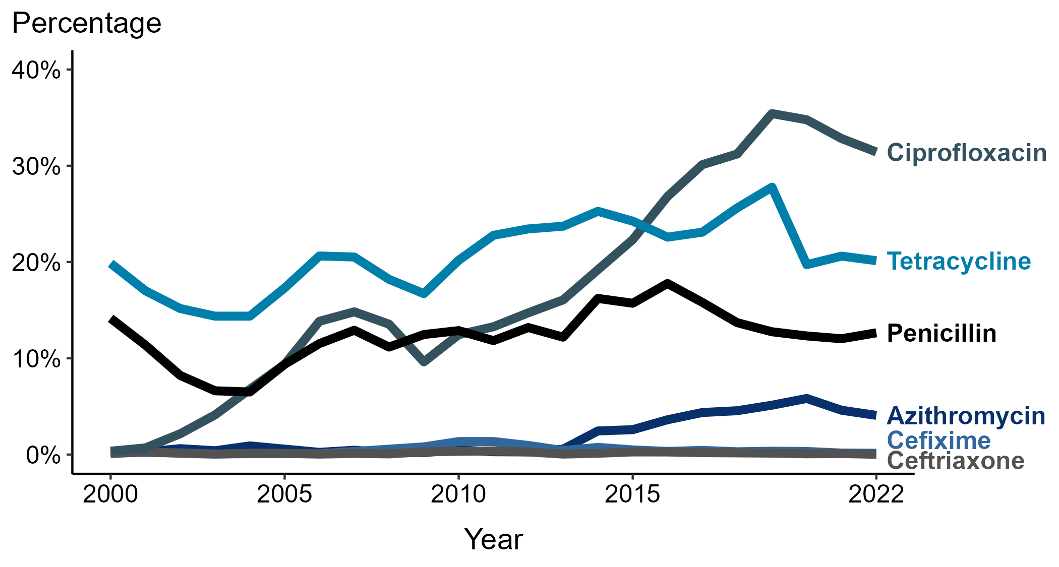
Neisseria gonorrhoeae — Prevalence of Tetracycline, Penicillin, or Ciprofloxacin Resistance* or Elevated Cefixime, Ceftriaxone, or Azithromycin Minimum Inhibitory Concentrations (MICs)†, by Year — Gonococcal Isolate Surveillance Project (GISP), 2000–2022
* Resistance: Ciprofloxacin: MIC ≥ 1.0 µg/mL; Penicillin: MIC ≥ 2.0 µg/mL or Beta-lactamase positive; Tetracycline: MIC ≥ 2.0 µg/mL
† Elevated MICs: Azithromycin: MIC ≥ 1.0 µg/mL (2000–2004); ≥ 2.0 µg/mL (2005–2022); Ceftriaxone: MIC ≥ 0.125 µg/mL; Cefixime: MIC ≥ 0.25 µg/mL
NOTE: Cefixime susceptibility was not tested in 2007 and 2008.
Notes:
In 2022, 31.4% of Neisseria gonorrhoeae isolates collected in STD clinics participating in GISP were resistant to ciprofloxacin, 20.1% to tetracycline, and 12.6% to penicillin.
This report includes data from years that coincide with the COVID-19 pandemic, which introduced uncertainty and difficulty in interpreting STI surveillance data. See Impact of COVID-19 on STIs for more information.
See Technical Notes (https://www.cdc.gov/std/statistics/2022/technical-notes.htm) for information on GISP methodology.
Data for all figures are available at https://www.cdc.gov/std/statistics/2022/data.zip. The file “NG - Prevalence of Resistance or Elevated MICs to Specific Antimicrobials by Year (GISP 2000-2022).xlsx” contains the data for the figure presented on this slide.

Slide 5
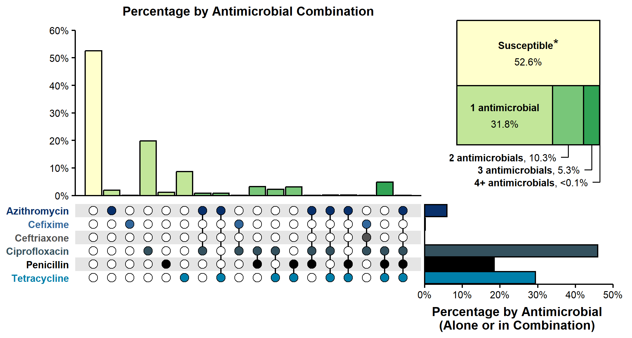
Resistance or Elevated Minimum Inhibitory Concentration (MIC) Patterns of Neisseria gonorrhoeae Isolates to Antimicrobials, Gonococcal Isolate Surveillance Project (GISP), 2022
* Susceptible category includes isolates with penicillin (or Beta-lactamase negative), tetracycline, and ciprofloxacin MIC values that are not considered resistant (i.e., susceptible and intermediate resistant) based on Clinical & Laboratory Standards Institute criteria and isolates with ceftriaxone, cefixime, and azithromycin MIC values that are not considered elevated based on GISP “alert” values.
NOTE: Elevated MIC = Ceftriaxone: MIC ≥ 0.125 μg/mL; Cefixime: MIC ≥ 0.25 μg/mL; Azithromycin: MIC ≥ 2.0 μg/mL. Resistance = Tetracycline: MIC ≥ 2.0 μg/mL; Ciprofloxacin: MIC ≥ 1.0 μg/mL; Penicillin: MIC ≥ 2.0 μg/mL or Beta-lactamase positive. In the figure, a filled circle reflects resistance or elevated MIC to a specific antimicrobial; only antimicrobial combinations with non-zero percentages are shown.
Notes:
In 2022, 52.6% of Neisseria gonorrhoeae isolates collected through GISP were susceptible to the six antimicrobials tested. Almost half (45.4%) were resistant to at least one of three antimicrobials (tetracycline, penicillin, or ciprofloxacin). An additional 2.0% of isolates were susceptible to those antimicrobials, but had elevated minimum inhibitory concentrations (MICs) to ceftriaxone, cefixime, or azithromycin. Overall, 10.3% of isolates demonstrated resistance or elevated MICs to two antimicrobials tested; 5.3% demonstrated resistance or elevated MICs to three antimicrobials tested; and <0.1% (one isolate) demonstrated resistance to four or more antimicrobials tested.
This report includes data from years that coincide with the COVID-19 pandemic, which introduced uncertainty and difficulty in interpreting STI surveillance data. See Impact of COVID-19 on STIs for more information.
See Technical Notes (https://www.cdc.gov/std/statistics/2022/technical-notes.htm) for information on GISP methodology.
Data for all figures are available at https://www.cdc.gov/std/statistics/2022/data.zip. The file “NG - Resistance or Elevated MIC Patterns of NG Isolates to Antimicrobials (GISP 2022).xlsx” contains the data for the figure presented on this slide.

Slide 6
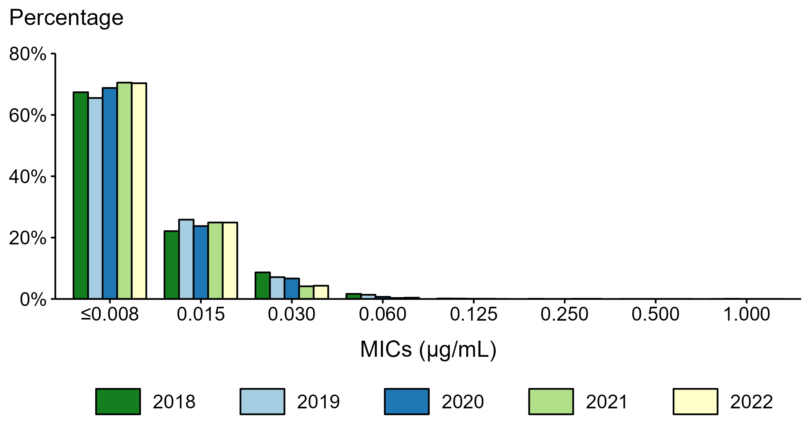
Neisseria gonorrhoeae — Distribution of Ceftriaxone Minimum Inhibitory Concentrations (MICs) by Year, Gonococcal Isolate Surveillance Project (GISP), 2018–2022
Notes:
During 2018 to 2022, 65.5–70.5% of all tested Neisseria gonorrhoeae isolates collected in STD clinics participating in GISP had a ceftriaxone minimum inhibitory concentration value ≤0.008 µg/mL, and 99.8–99.9+% had a minimum inhibitory concentration value <0.125 µg/mL.
This report includes data from years that coincide with the COVID-19 pandemic, which introduced uncertainty and difficulty in interpreting STI surveillance data. See Impact of COVID-19 on STIs for more information.
See Technical Notes (https://www.cdc.gov/std/statistics/2022/technical-notes.htm) for information on GISP methodology.
Data for all figures are available at https://www.cdc.gov/std/statistics/2022/data.zip. The file “NG - Distribution of Ceftriaxone MICs by Year (GISP 2018-2022).xlsx” contains the data for the figure presented on this slide.

Slide 7
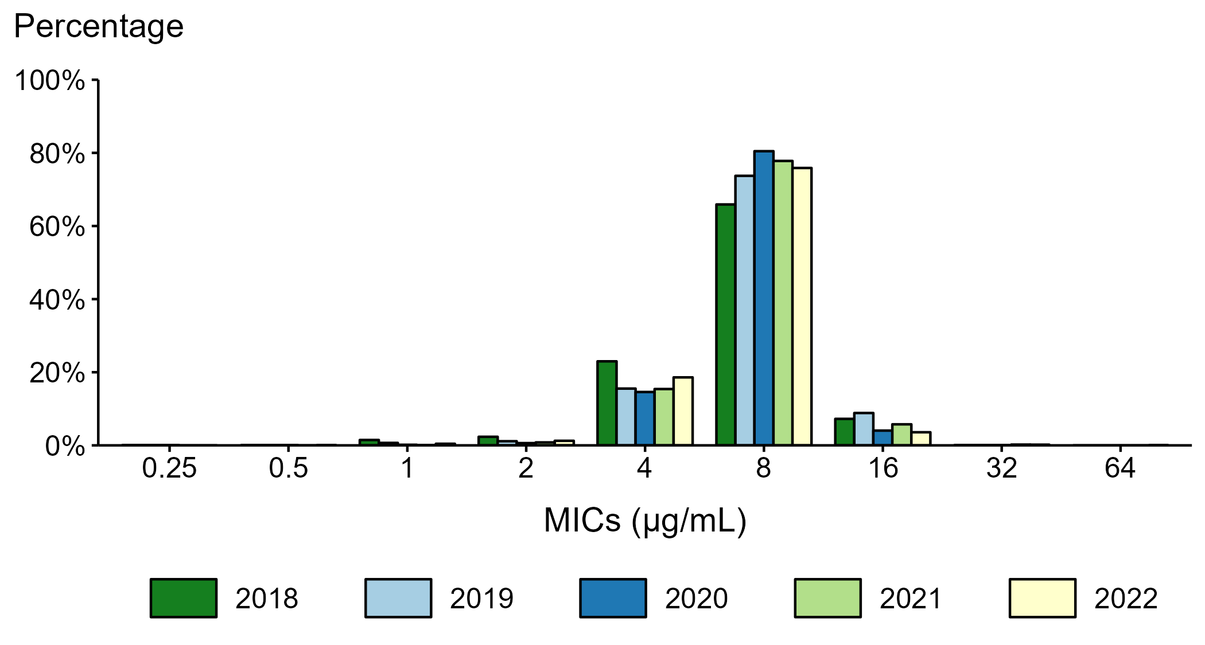
Neisseria gonorrhoeae — Distribution of Gentamicin Minimum Inhibitory Concentrations (MICs) by Year, Gonococcal Isolate Surveillance Project (GISP), 2018–2022
NOTE: Beginning in 2018, the antibiotic susceptibility testing range for gentamicin was expanded from MICs of 1 µg/mL–32 µg/mL in previous years to 0.25 µg/mL–64 µg/mL.
Notes:
During 2018 to 2022, 65.9–80.5% of all tested Neisseria gonorrhoeae isolates collected in STD clinics participating in GISP had a gentamicin minimum inhibitory concentration value of 8 µg/mL. In 2022, 0.2% of all tested Neisseria gonorrhoeae isolates had a gentamicin minimum inhibitory concentration above 16 µg/mL.
This report includes data from years that coincide with the COVID-19 pandemic, which introduced uncertainty and difficulty in interpreting STI surveillance data. See Impact of COVID-19 on STIs for more information.
See Technical Notes (https://www.cdc.gov/std/statistics/2022/technical-notes.htm) for information on GISP methodology.
Data for all figures are available at https://www.cdc.gov/std/statistics/2022/data.zip. The file “NG - Distribution of Gentamicin MICs by Year (GISP 2018-2022).xlsx” contains the data for the figure presented on this slide.

Slide 8
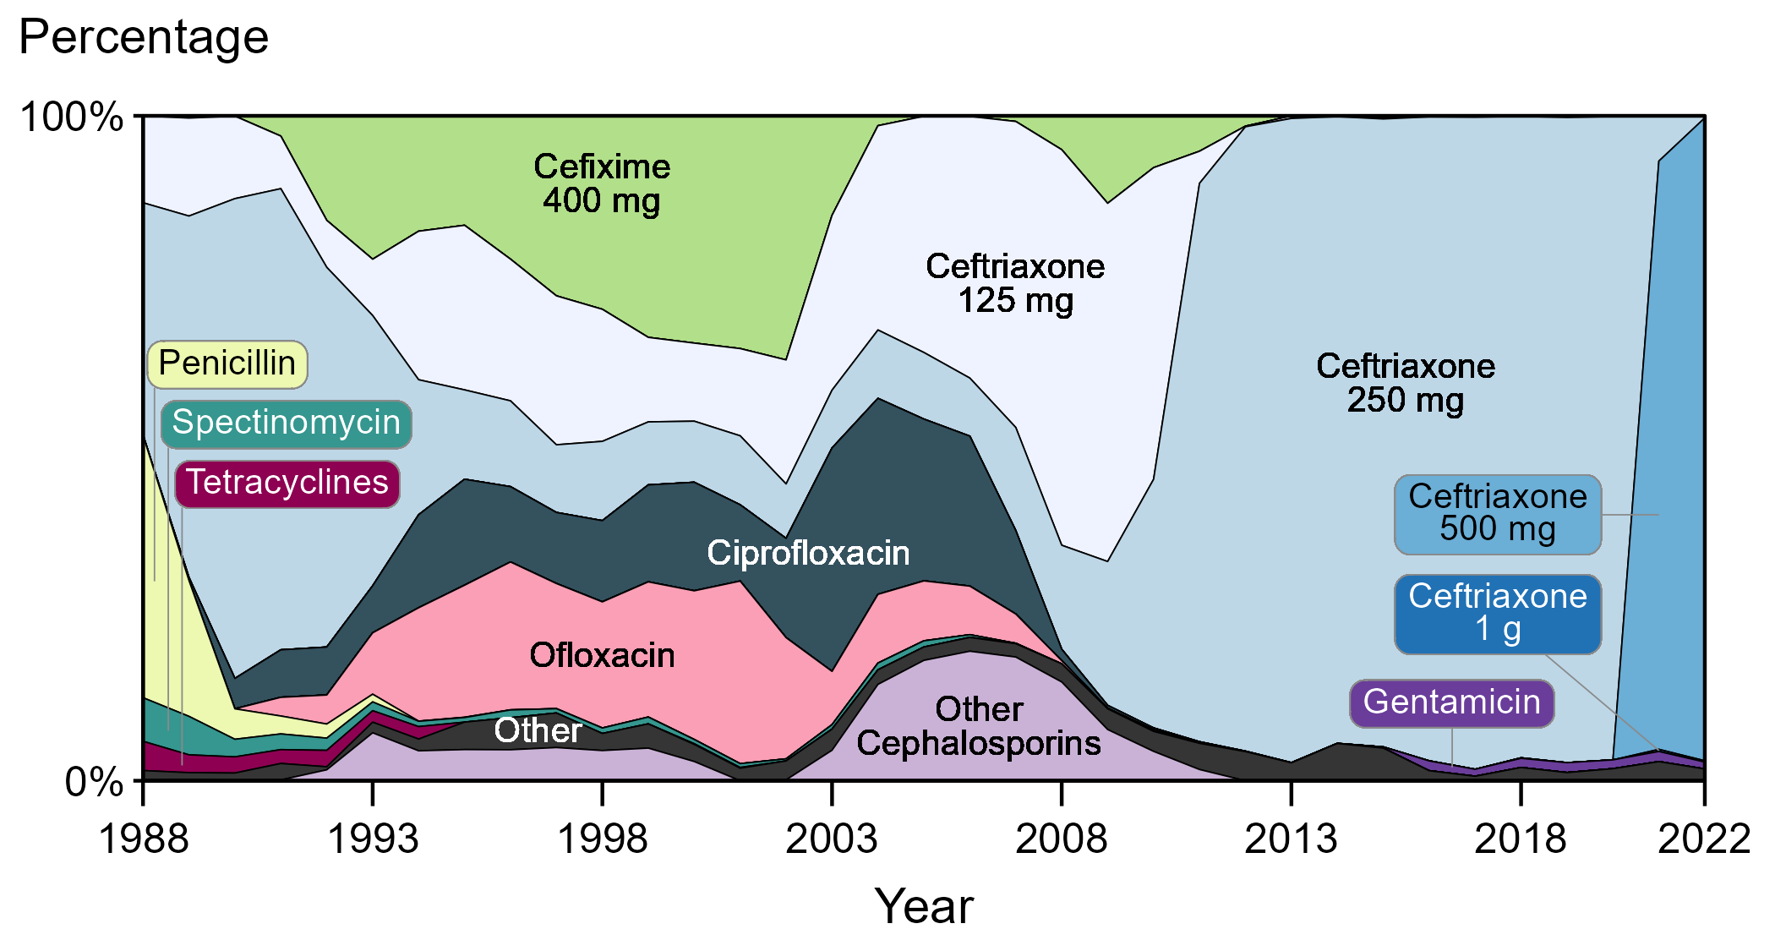
Distribution of Primary Antimicrobial Drugs Used to Treat Gonorrhea Among Participants, Gonococcal Isolate Surveillance Project (GISP), 1988–2022
NOTE: In 2022, Cefixime 800 mg (0.1%) and Ceftriaxone 1 g (0.2%) each represented less than one percent of primary antimicrobial drugs used to treat gonorrhea among GISP participants and may not be visible in this figure.
Notes:
In 2022, 97.0% of GISP participants were treated with ceftriaxone, 96.7% with 500 mg and 0.2% with 250 mg and 1 g, respectively. Participants treated with gentamicin 240 mg increased from 0.2% in 2015 to a maximum of 1.5% in 2016, 2019, and 2021, with 1.0% of patients treated with gentamicin in 2022. (Note that percentages in text may not sum as expected due to rounding.)
Results for 2022 are based on data obtained from participants in all participating GISP jurisdictions except for Pittsburgh due to missing data.
This report includes data from years that coincide with the COVID-19 pandemic, which introduced uncertainty and difficulty in interpreting STI surveillance data. See Impact of COVID-19 on STIs for more information.
See Technical Notes (https://www.cdc.gov/std/statistics/2022/technical-notes.htm) for information on GISP methodology.
Data for all figures are available at https://www.cdc.gov/std/statistics/2022/data.zip. The file “GC - Distribution of Primary Antimicrobial Drugs Used to Treat GC (GISP, 1988-2022).xlsx” contains the data for the figure presented on this slide.

Slide 9
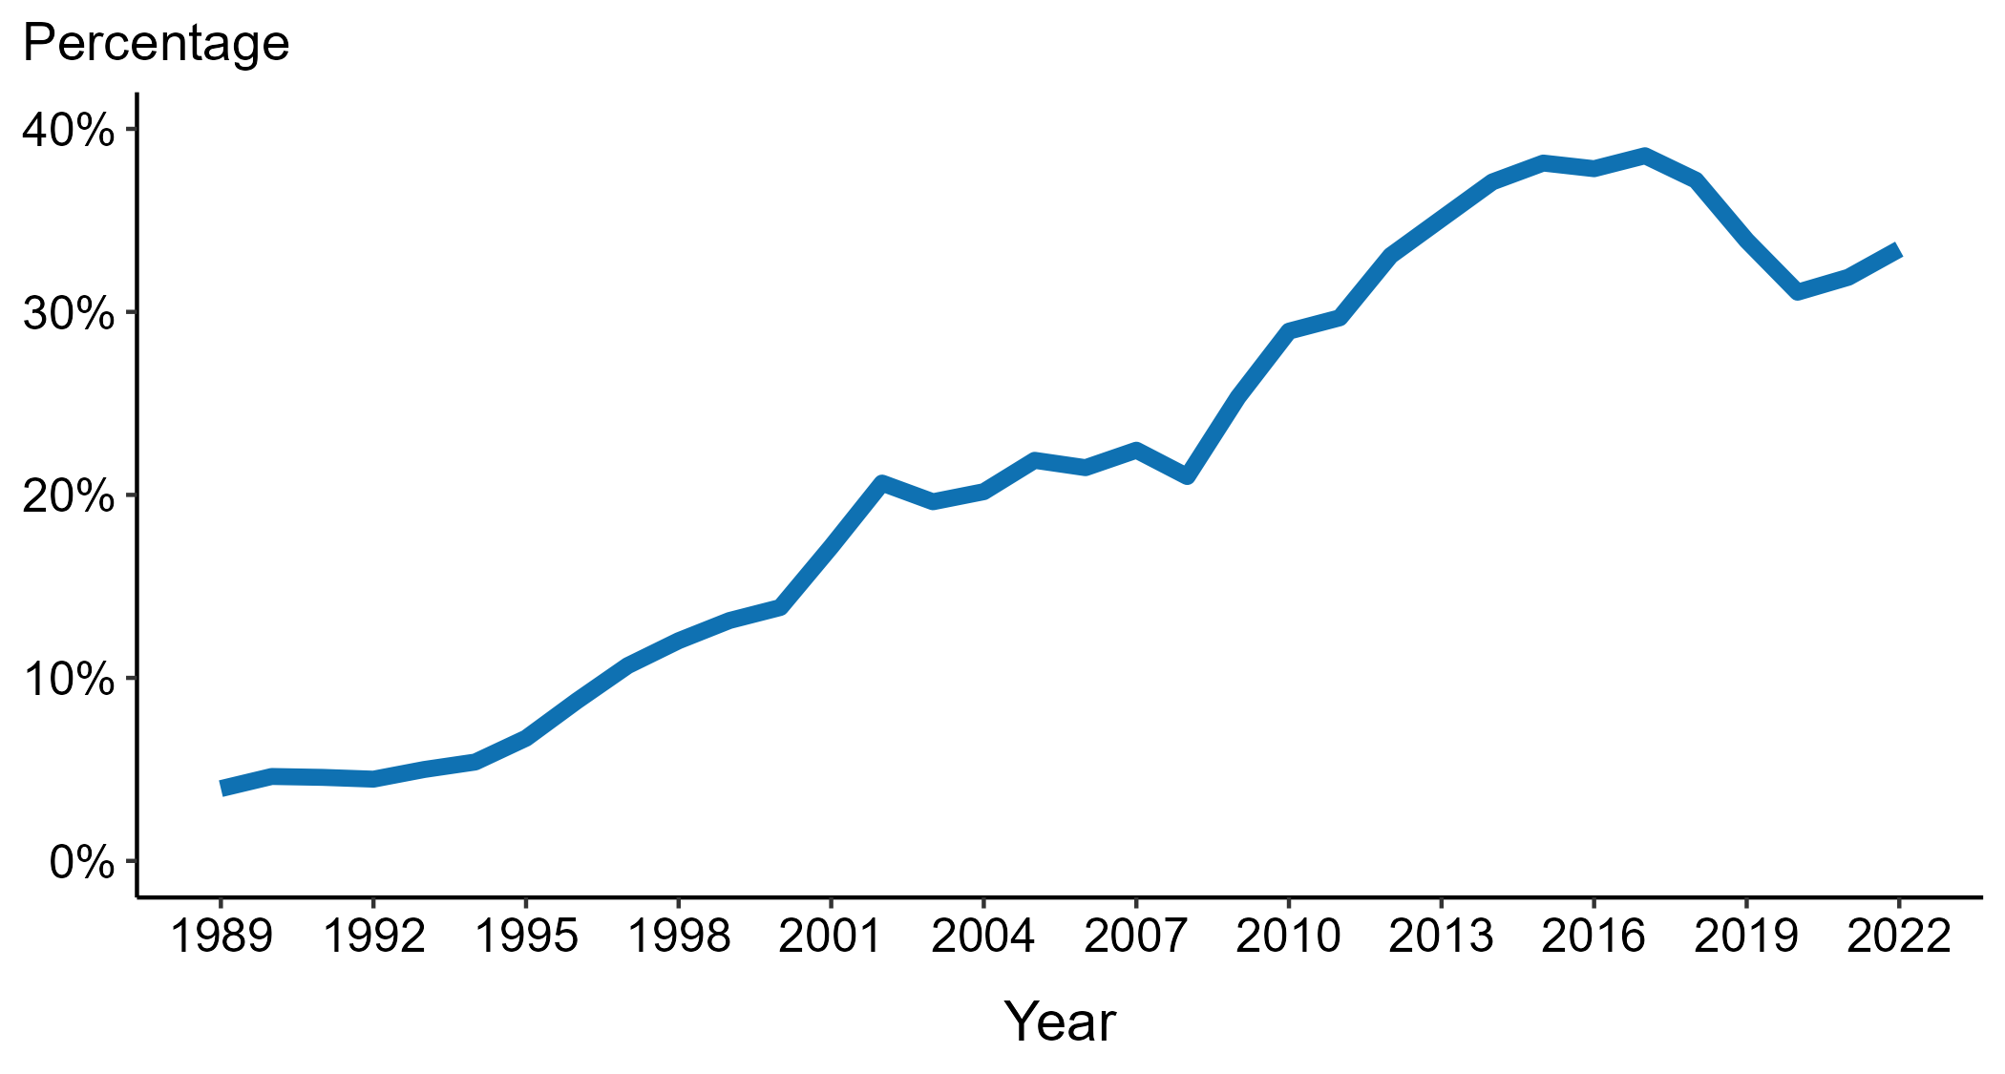
Neisseria gonorrhoeae — Percentage of Urethral Isolates Obtained from MSM Attending STD Clinics, Gonococcal Isolate Surveillance Project (GISP), 1989–2022
ACRONYMS: MSM = Gay, bisexual, and other men who have sex with men
Notes:
Overall, the proportion of Neisseria gonorrhoeae isolates collected in selected STD clinics participating in GISP that were from gay, bisexual and other men who have sex with men increased steadily from 3.9% in 1989 to a high of 38.5% in 2017. In 2022, this proportion was 33.4%.
Results for 2022 are based on data obtained from participants in all participating GISP jurisdictions except for Pittsburgh due to missing data.
This report includes data from years that coincide with the COVID-19 pandemic, which introduced uncertainty and difficulty in interpreting STI surveillance data. See Impact of COVID-19 on STIs for more information.
See Technical Notes (https://www.cdc.gov/std/statistics/2022/technical-notes.htm) for information on GISP methodology.
Data for all figures are available at https://www.cdc.gov/std/statistics/2022/data.zip. The file “NG - Percentage of Urethral Isolates from MSM Attending STD Clinics (GISP, 1989-2022).xlsx” contains the data for the figure presented on this slide.

Slide 10
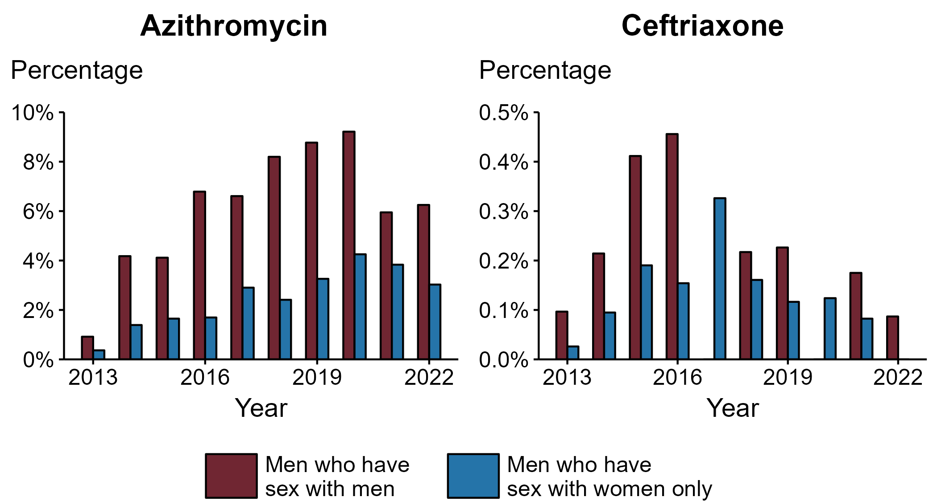
Neisseria gonorrhoeae — Percentage of Urethral Isolates with Elevated Minimum Inhibitory Concentrations (MICs) to Azithromycin* and Ceftriaxone† by Sex and Sex of Sex Partners, Gonococcal Isolate Surveillance Project (GISP), 2013–2022
* Elevated Azithromycin MIC: ≥ 2.0 µg/mL
† Elevated Ceftriaxone MIC: ≥ 0.125 μg/mL
Notes:
In 2022, the proportion of Neisseria gonorrhoeae isolates collected in GISP with elevated azithromycin minimum inhibitory concentrations (MICs) (≥ 2.0 µg/mL) was higher in isolates from gay, bisexual and other men who have sex with men (MSM) than from men who have sex with women only (MSW). For azithromycin, 6.2% of isolates from MSM had elevated MICs compared to 3.0% in MSW. For ceftriaxone, the proportion of isolates with elevated ceftriaxone MICs (≥ 0.125 µg/mL) was higher at 0.1% in MSM compared to 0.0% in MSW.
Results for 2022 are based on data obtained from participants in all participating GISP jurisdictions except for Pittsburgh due to missing data.
This report includes data from years that coincide with the COVID-19 pandemic, which introduced uncertainty and difficulty in interpreting STI surveillance data. See Impact of COVID-19 on STIs for more information.
See Technical Notes (https://www.cdc.gov/std/statistics/2022/technical-notes.htm) for information on GISP methodology.
Data for all figures are available at https://www.cdc.gov/std/statistics/2022/data.zip. The file “NG - Percentage of Urethral Isolates with Elevated MICs to AZM and CRO by Sex and Sex of Sex Partners (GISP 2013-2022).xlsx” contains the data for the figure presented on this slide.

Slide 11
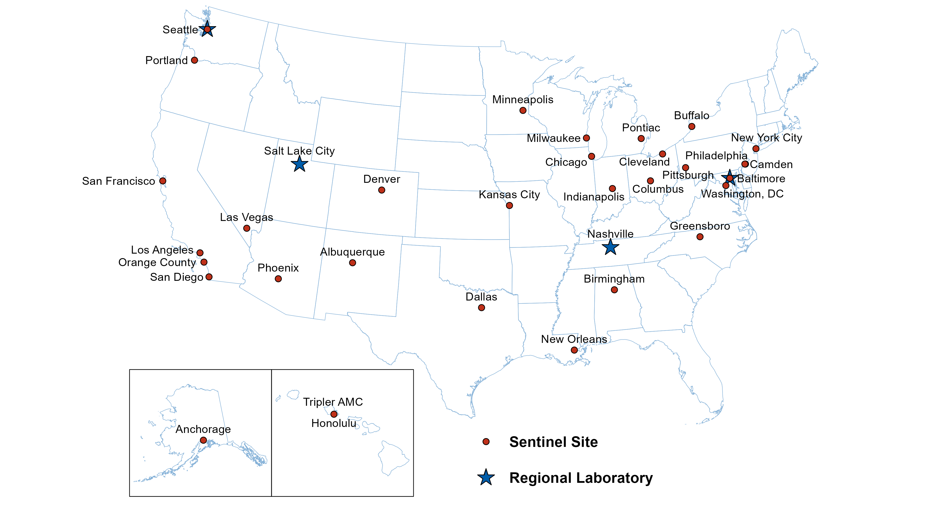
Location of Participating Sentinel Sites and Regional Laboratories, Gonococcal Isolate Surveillance Project (GISP), 2022
NOTE: Baltimore and Seattle are both sentinel sites and regional laboratories.
Notes:
See Technical Notes (https://www.cdc.gov/std/statistics/2022/technical-notes.htm) for information on GISP methodology.

Slide 12
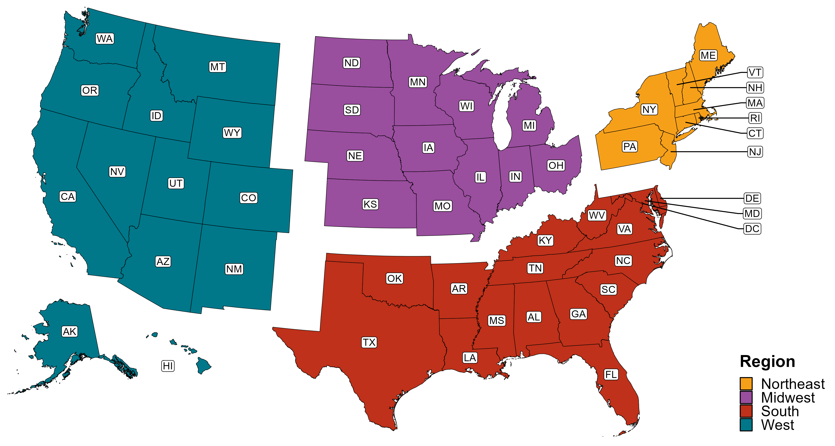
Reference Map of US Census Regions

