Slide 1
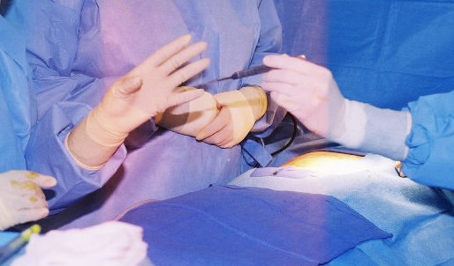
If you sustain a needlestick or sharps injury:
Wash the wound immediately with soap and water
Flush splashes with water
Seek prompt treatment
Report the incident as soon as possible!
Discuss the risk of infection based on the circumstances of the injury
Insert facility logo here
For more information contact [insert name]: ext. 9999

