Slide 1
NNDSS eSHARE January Webinar
January 16, 2024
Office of Public Health Data, Surveillance, and Technology

Slide 2
Agenda
NNDSS Updates and Announcements
What Jurisdictions Need to Know for 2024
Questions and Answers

Slide 3
NNDSS Updates and Announcements
Hang Nguyen, MS
Office of Public Health Data, Surveillance, and Technology

Slide 4
Title
Text here
4

Slide 5
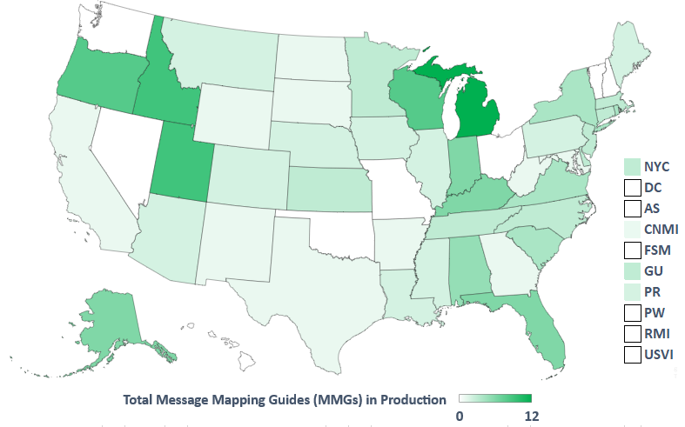
Total Message Mapping Guide (MMG) in Production 2023
Status as of 1/17/2023
5

Slide 6
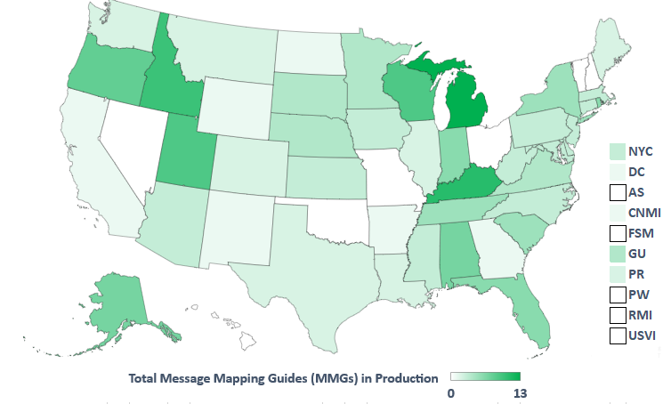
Total Message Mapping Guide (MMG) in Production 2024
Status as of 1/16/2024
6

Slide 7
2024 Changes to NNDSS What Jurisdictions Need to Know
Sara Johnston, MPH
Office of Public Health Data, Surveillance, and Technology

Slide 8
Topics
Changes based on CSTE position statements
New NNDSS diseases and conditions
Conditions with revised surveillance case definitions
No event code changes
New or retired event codes
Other position statement update
Event code reminder: CP-CRE
CSTE case surveillance data standardization efforts
Annual NNDSS data reconciliation process

Slide 9
Changes to NNDSS based on approved Council of State and Territorial Epidemiologists (CSTE) position statements

Slide 10
New NNDSS Conditions* - MMWR◊ Year 2024
Disease/Condition | Nationally Notifiable? | Event Code
Cronobacter, invasive infection among infants | Yes | 13060
Congenital cytomegalovirus infection | No | 13050
Congenital cytomegalovirus disease | No | 13051
Toxoplasmosis | No | 13070
Congenital toxoplasmosis | No | 13071
Toxoplasmosis, active primary infection | No | 13072
Toxoplasmosis, reactivation disease | No | 13073
Toxoplasmosis, past infection/unable to classify | No | 13074
*CDC is seeking Office of Management and Budget Paperwork Reduction Act (OMB PRA) approval to receive case notifications for these conditions.
◊ Morbidity and Mortality Weekly Report – refer to MMWR Weeks Calendar.

Slide 11
Invasive Cronobacter infection among infants
Event code 13060
Case definition CSTE PS 23-ID-03
Establishes new nationally notifiable condition
Confirmed, probable, suspect
Notification timeframe: immediately notifiable, urgent (within 24 hours)
Submission options
HL7 Generic Case Notification version 2 message mapping guide (GenV2 MMG) (preferred)
Alternates: GenV1, NEDSS Base System (NBS) master message, NETSS file
Additional data: System for Enteric Disease Response, Investigation, and Coordination (SEDRIC)
NNDSS publication case classification
Weekly and annual tables
Confirmed, probable
Low incidence verification

Slide 12
Have a Cronobacter reporting exception? Contact CDC!
If you have not already alerted CDC, email edx@cdc.gov if:
Cronobacter is not reportable due to state law or regulation
Data on Cronobacter are unable to be sent to CDC or are unavailable

Slide 13
Congenital cytomegalovirus (cCMV)
Event codes
13050 – Congenital cytomegalovirus infection
13051 – Congenital cytomegalovirus disease
Case definition CSTE PS 23-ID-02
Establishes new condition under standardized surveillance
Confirmed, probable
Submission options
HL7 GenV2 MMG (preferred)
Alternates: GenV1, NBS master message, NETSS file
NNDSS publication case classification
Not published; NNDSS does not publish conditions under standardized surveillance

Slide 14
Toxoplasmosis
Event codes
13070 – Toxoplasmosis – confirmed, probable
13071 – Congenital toxoplasmosis – confirmed, probable
13072 – Toxoplasmosis, active primary infection – confirmed, probable
13073 – Toxoplasmosis, reactivation disease – confirmed, probable
13074 – Toxoplasmosis, past infection/unable to classify – confirmed
12020 – Toxoplasmosis *Retired
Case definition CSTE PS 23-ID-08
Establishes new condition under standardized surveillance
Submission options
HL7 GenV2 MMG (preferred)
Alternates: GenV1, NBS master message, NETSS file
NNDSS publication case classification
Not published; NNDSS does not publish conditions under standardized surveillance

Slide 15
Two ways to report non-congenital toxoplasmosis
Toxoplasmosis 13070
For health departments that don’t have the capacity to further classify
OR
Use one of three subtypes: active primary infection (13072); active reactivation disease (13073); or past infection or unable to classify (13074)
For health departments with the capacity and resources to conduct additional surveillance

Slide 16
Revised Case Definitions - MMWR Year 2024 No changes to event codes
Disease/Condition | Nationally Notifiable? | Event Code
Hepatitis B, acute | Yes | 10100
Hepatitis B, chronic | Yes | 10105
Mumps | Yes | 10180
Poliomyelitis, paralytic | Yes | 10410
Varicella (chickenpox) | Yes | 10030

Slide 17
Hepatitis B
Changes or updates indicated by bold
Event code
10100 – Hepatitis B, acute – confirmed, probable
10105 – Hepatitis B, chronic – confirmed, probable
Case definition CSTE PS 23-ID-05
Aggregates acute and chronic position statements into a single document
Clarifies distinction from perinatal hepatitis B cases
Improves sensitivity and specificity of acute hepatitis B case classifications and ability to confirm chronic cases
Modifies probable case classification for chronic hepatitis B
Creates probable case classification for acute hepatitis B
Notification timeframe: routine
Submission options: HL7 Hepatitis MMG (preferred)
Alternates: NBS master message, NETSS file
NNDSS publication case classification
Weekly and annual tables (new for chronic)
Confirmed, probable

Slide 18
Mumps
Changes or updates indicated by bold
Event code 10180
Case definition CSTE PS 23-ID-06
Updates clinical, laboratory, and epidemiologic linkage criteria
Removes requirement of symptoms from confirmed case classification
Notification timeframe: routine
Submission options
HL7 Mumps MMG (preferred)
Alternates: NBS master message, NETSS file
NNDSS publication case classification
Weekly and annual tables
Confirmed, probable (update: removes unknown)

Slide 19
Poliomyelitis, paralytic
Changes or updates indicated by bold
Event code 10410
Case definition CSTE PS 23-ID-07
Adds laboratory component for confirmed classification
Removes probable classification
Notification timeframe: immediately notifiable, urgent (24 hours)
Submission options: HL7 GenV2 MMG (preferred)
Alternates: GenV1, NBS master message, NETSS file
NNDSS publication case classification
Weekly and annual tables
Confirmed

Slide 20
Varicella (chickenpox)
Changes or updates indicated by bold
Event code 10030
Case definition CSTE PS 23-ID-09
Updates clinical, laboratory, and epidemiologic linkage criteria
Updates healthcare record criteria for case reporting
Notification timeframe: routine
Submission options
HL7 Varicella version 2 MMG (preferred)
Alternates: HL7 Varicella v1 MMG, NBS master message, NETSS file
NNDSS publication case classification
Weekly and annual tables
Confirmed, probable

Slide 21
Revised Case Definitions - MMWR Year 2024 Changes to event codes (1 of 2)
Disease/Condition | Nationally Notifiable? | Event Code
Anaplasmosis | Yes | 11090
Ehrlichia chaffeensis infection | Yes | 11088
Ehrlichia ewingii infection | Yes | 11089
Ehrlichia muris eauclairensis infection* | Yes | 11092
Ehrlichia infection, other spp. or unspeciated* | Yes | 11093
Ehrlichiosis/anaplasmosis, undetermined | Retired | 11091
*CDC is seeking Office of Management and Budget Paperwork Reduction Act (OMB PRA) approval to receive case notifications for these conditions.

Slide 22
Anaplasmosis
Changes or updates indicated by bold
Event code 11090
11091 – Ehrlichiosis/anaplasmosis, undetermined *Retired
Case definition CSTE PS 23-ID-01
Now distinct from ehrlichiosis
Updates laboratory and clinical evidence
Notification timeframe: routine
Submission options: HL7 Lyme and Tickborne Rickettsial Diseases MMG (preferred)
Alternates: HL7 GenV2 with case report form, GenV1, NBS master message, NETSS
NNDSS publication case classification
Annual tables (no longer in weekly)
Confirmed, probable

Slide 23
Ehrlichiosis
Changes or updates indicated by bold
Event codes
11088 – Ehrlichia chaffeensis infection – confirmed
11089 – Ehrlichia ewingii infection – confirmed
11092 – Ehrlichia muris eauclairensis infection – confirmed *New
11093 – Ehrlichia infection, other spp. or unspeciated – confirmed or probable *New
11091 – Ehrlichiosis/anaplasmosis, undetermined *Retired
Case definition CSTE PS 23-ID-04
Now distinct from anaplasmosis
Updates laboratory and clinical evidence
Only report at species level if molecular testing is performed
Confirmed, probable, suspect
Notification timeframe: routine
Submission options: HL7 Lyme and Tickborne Rickettsial Diseases MMG (preferred)
Alternates: HL7 GenV2 with case report form, GenV1, NBS master message, NETSS
NNDSS publication case classification
Annual tables (no longer in weekly)
Confirmed, probable

Slide 24
Revised Case Definitions - MMWR Year 2024 Changes to event codes (2 of 2)
Disease/Condition | Nationally Notifiable? | Event Code
Zika virus disease, non-congenital | Yes | 50223
Zika virus disease, congenital | Yes | 50224
Zika virus infection, non-congenital | No, retired | 50221
Zika virus infection, congenital | No, retired | 50222

Slide 25
Zika virus
Changes or updates indicated by bold
Event code
50223 – Zika virus disease, non-congenital
50224 – Zika virus disease, congenital
50221 – Zika virus infection, non-congenital *Retired
50222 – Zika virus infection, congenital *Retired
Case definition CSTE PS 23-ID-10
Updates laboratory, clinical, and epidemiologic linkage criteria
Removes Zika virus infection from nationally notifiable conditions list
Confirmed, probable
Notification timeframe: routine
Submission options: HL7 Arboviral MMG
Alternate: ArboNET
NNDSS publication case classification
Non-congenital: weekly and annual tables
Congenital: annual only

Slide 26
Additional position statement update

Slide 27
Neonatal abstinence syndrome (NAS)
Event code: None
Case definition 23-MCH-01
Condition under standardized surveillance
Updated for clarity in interpretation, consistency in reporting across jurisdictions, and to address concerns identified during implementation
CDC is not routinely requesting case data (not nationally notifiable)
Jurisdictions funded to report data should report cases to the CDC Division of Birth Defects and Infant Disorders (DBDID)
NNDSS tables will not include NAS cases

Slide 28
Event code reminder: carbapenemase-producing carbapenem-resistant Enterobacteriaceae (CP-CRE) retiring

Slide 29
Carbapenemase-Producing Organism (CPO) Implementation Plans, for 2023 and 2024
MMWR Year 2023: transition year
NNDSS weekly tables will publish confirmed cases as “CPO, total” for:
Carbapenemase-producing carbapenem-resistant Enterobacteriaceae (CP-CRE) (event code 50244)
CPO, clinical (event code 50270)
CPO, screening (event code 50271)
MMWR Year 2024: CP-CRE event code (50244) retired
CP-CRE case notifications will error out
MMWR Year 2024: full implementation year for CPO
Confirmed cases for CPO clinical (50270), CPO screening (50271), and CPO total displayed in NNDSS weekly tables

Slide 30
Resources
NNDSS website: https://ndc.services.cdc.gov/event-codes-other-surveillance-resources/
2024 Resources
NNDSS Event Code List
PHIN VADS Value Set for Event Code List
MMWR Weeks Calendar
Notification Requirements
Letter to State and Territorial Epidemiologists
Reporting Exceptions for National Notifiable Diseases
NNDSS Case Definitions: https://ndc.services.cdc.gov/
2024 updates to be posted soon
CSTE Position Statement Archive: www.cste.org/general/custom.asp?page=PositionStatements
Direct links included throughout this presentation
30

Slide 31
Data standardization

Slide 32
CSTE/CDC case surveillance data standardization efforts
Hospitalization
Travel history
Pregnancy
Industry and occupation
Sexual orientation and gender identity
Immunization history
Exposure/risk/underlying conditions
Death
Signs/symptoms/clinical manifestations
Identifiers (case/event-related/laboratory)
Laboratory
Medication/treatment
Race/ethnicity/tribal affiliation
Reporting source
Disability
Additional social determinants of health

Slide 33
Be part of the future of case notification
Sign-up for a Data Element Specific Team, using the Smartsheet link.
Contact Becky Lampkins (CSTE) at blampkins@cste.org with any questions.

Slide 34
NNDSS annual data reconciliation process

Slide 35
CDC will continue to use the new and improved portal for data reconciliation
Review and approval within Message Validation, Processing, and Provisioning System (MVPS) portal
CDC continuing to gather feedback and make improvements
Any substantive changes will be in collaboration with jurisdictions and CDC programs
Continue to use tools within MVPS throughout the year
Monitor messages
Correct discrepancies

Slide 36
Q & A

Slide 37
Thank you!
Next NNDSS eSHARE: February 20, 2024
Subscribe to Case Surveillance News
Access NNDSS’ Technical Resource Center
Email edx@cdc.gov for technical help
Learn about case surveillance modernization

