Slide 1

NNDSS eSHARE
June Special Session Webinar
Division of Health Informatics and Surveillance
June 28, 2022

Slide 2

Agenda
  NNDSS Updates & Announcements
  Modernizing the NBS Platform
  Questions and Answers

Slide 3
NNDSS Updates & Announcements
Michele Hoover, MS
Data Standardization and Assistance Team
Center for Surveillance, Epidemiology, and Laboratory Services

Slide 4
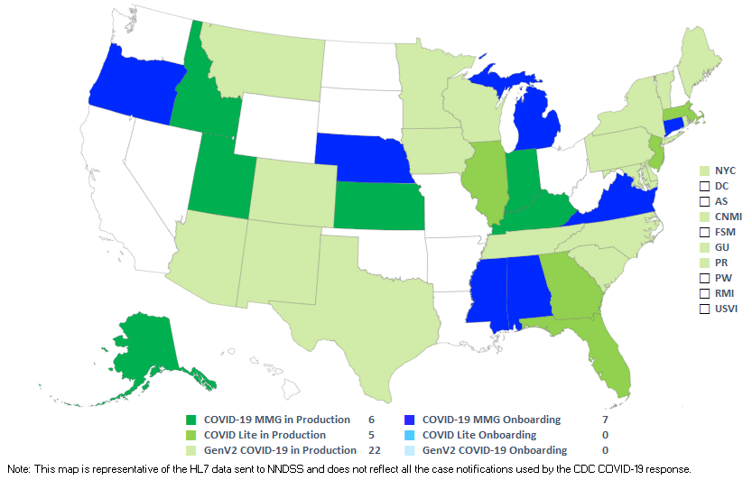
COVID-19 HL7 Data Implementation In-progress
Status as of 6/28/2022
4

Slide 5
Case Surveillance Modernization Efforts
Sara Johnston
NNDSS Program Lead
Center for Surveillance, Epidemiology, and Laboratory Services

Slide 6
Modernizing The NBS Platform
Advancing next-generation case surveillance
June 28, 2022
Jennifer Layden, MD, PHD
Deputy Director, DDPHSS
Emory Meeks
Chief, Information Systems Branch (ISB), DHIS

Slide 7
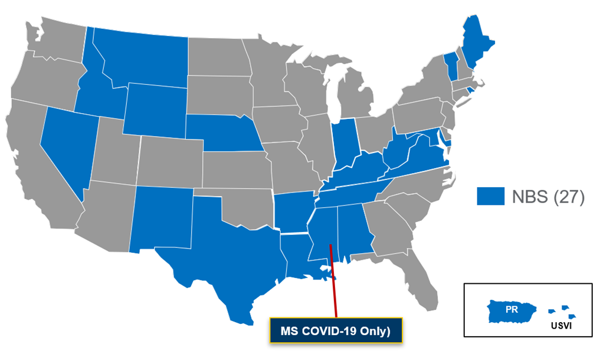
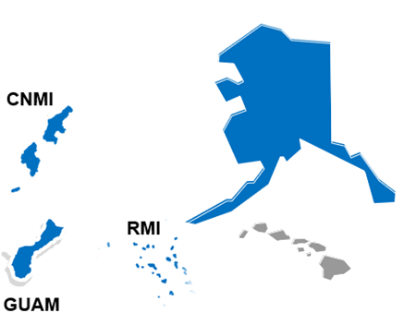

What is NBS?
Helps local, state, and territorial public health departments:
  manage their reportable disease data
  send case notifications to CDC
Is a free platform for jurisdictions
Used by 27 health departments

Slide 8
CDC Leadership’s Commitment
Opportunity to strengthen surveillance across the entire public health data infrastructure
Support through funding and collaboration to drive innovation
Benefits across public health through new technical standards, best practices, and lessons learned for improving other systems

Slide 9
What is Driving NBS Modernization?
CDC assessed NBS in 2021
CDC also worked with the US Digital Service team to conduct listening sessions with current NBS users
CDC used findings to develop high-level goals

Slide 10
Goals for Modernization
An integrated disease surveillance system that
Delivers timely, accurate, and actionable data to CDC and State, Territorial, Local, and Tribal (STLT) jurisdictions
Advances STLT users' disease surveillance goals
Offers an intuitive and easy-to-use interface
Evolves to meet public health needs
Promotes an open, standards-based public health data ecosystem

Slide 11
Multi-year Modernization Goals
Foundations, Ease of deployment, Cloud pilot​ | Ingestion​ | Reporting burden​
Reduce operating burden on jurisdictions, increase performance, deliver new features faster. | Increase the timeliness, quality, and utility of data coming into NBS ​ | Reduce reporting burden by making NBS the single disease surveillance and reporting system ​ ​
Data access​ | Tools for frontline users​ | Workflow automation​
Increase the timeliness, accuracy, and completeness of data available to epidemiologists. ​ | Support frontline users’ activities through more flexible and efficient case investigation and management tools, support outbreak detection and management​ | Leverage technology to automate task for NBS users.

Slide 12

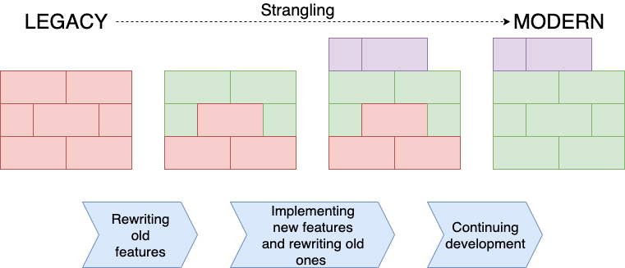



Timeline
At least 3 years to transition current system to modernized technology and architecture
Modernizing NBS incrementally so jurisdictions can benefit as soon as the first incremental release
Legacy NBS
Incremental releases over time
Modern NBS
Legacy Component
Rewritten old feature in new technology
New feature in new technology
Picture source: https://blog.fingo.pl/strangler-pattern-how-to-strangle-your-legacy-system/

Slide 13

Benefits For Every Jurisdiction
NBS modernization will both leverage and contribute to building blocks
NBS aims to be a leading example for disease surveillance
  Providing a model for improving other systems
  Sharing lessons learned with all jurisdictions
Direct benefit to jurisdictions using NBS

Slide 14
Next Steps
  Expand resources, both contract and full-time employees (FTEs), to support NBS modernization
  Explore future options for expanding NBS’ capabilities such as:
    Offering jurisdictions the option to use a multi-tenant, CDC-hosted version of NBS in the cloud
    Adding support for additional conditions (e.g. HIV, Lead)
  Engage with jurisdictions, CDC programs, and key partners continually for their feedback as we move forward with modernizing NBS

Slide 15
Contact Info
  If you have any questions or feedback, please contact nbs@cdc.gov

Slide 16



Thank you!
See you on July 19, 2022
Subscribe to
Case Surveillance News
Access NNDSS Technical Resource Center
For more information, contact CDC
1-800-CDC-INFO (232-4636)
TTY: 1-888-232-6348 www.cdc.gov
Email edx@cdc.gov for Technical Help or to Onboard HL7 Message Mapping Guides
The findings and conclusions in this report are those of the authors and do not necessarily represent the official position of the Centers for Disease Control and Prevention.

