Slide 1
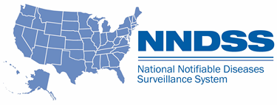
National Notifiable Diseases Surveillance System (NNDSS) eSHARE January Webinar
Center for Surveillance, Epidemiology, and Laboratory Services
Division of Health Informatics and Surveillance
January 18, 2022

Slide 2

Agenda
Agenda
  NNDSS Updates and Announcements
  What States Need to Know for 2022!
  Highlights from the 2022 Letter to State Epidemiologists
  Questions and Answers
2
2

Slide 3
NNDSS Updates and Announcements
Center for Surveillance, Epidemiology, and Laboratory Services
Michele Hoover, MS
Data Standardization and Assistance Team
Center for Surveillance, Epidemiology, and Laboratory Services
Delicia Carey, PhD
Case-based Surveillance Operations Team
Center for Surveillance, Epidemiology, and Laboratory Services

Slide 4

4
Updates: COVID-19 Message Mapping Guide (MMG)
  New: The PHIN Vocabulary Access and Distribution System (VADS) COVID-19 case notification view has been updated
    Version 11 is now the most up-to-date version
    Includes one new additional value to Manufacturers of vaccines (MVX)
    Includes one new additional value to Vaccine Type (NND)
COVID-19 v1.1 MMG: https://ndc.services.cdc.gov/mmgpage/covid-19-message-mapping-guide/
PHIN VADS Case View version 11: https://phinvads.cdc.gov/vads/ViewView.action?id=4C1D5ED3-AB57-EC11-81A7-005056ABE2F0

Slide 5
URL Redirects
URL Redirects on NNDSS Website
New NNDSS website officially launched May 2021
URL redirects created and stored on legacy NNDSS website
URL redirects allow reader to be taken to content on new NNDSS website when reader accesses the same content on old website
URL redirects created to prevent readers from getting “404-Page not found” error when clicking on old link
Currently, maintaining two sites (legacy site and new dynamic content website)
5

Slide 6
Plan
Plan
Deactivate the URL redirects and retire the legacy NNDSS website by end of January 2022
6

Slide 7
URL Changes
URL Changes for Select Resources
Resource | Old Website | New Website
NNDSS Website | https://wwwn.cdc.gov/nndss/ | https://www.cdc.gov/nndss/
Infectious-data tables— Using and Interpreting Data | https://wwwn.cdc.gov/nndss/infectious-tables.html | https://www.cdc.gov/nndss/data-statistics/infectious-tables/index.html
Surveillance Case Definitions | https://wwwn.cdc.gov/nndss/conditions/ | https://ndc.services.cdc.gov/
Technical Resource Center | https://wwwn.cdc.gov/nndss/downloads.html | https://www.cdc.gov/nndss/trc/
Readers’ Guides *for data tables 2019–current |  | https://www.cdc.gov/nndss/docs/Readers-Guide-WONDER-Tables-20210421-508.pdf
*for data tables 2016–2018 | https://wwwn.cdc.gov/nndss/document/Users_guide_WONDER_tables_cleared_final.pdf | https://ndc.services.cdc.gov/wp-content/uploads/Users_guide_WONDER_tables_cleared_final.pdf
*for data tables 2006–2015 | https://wwwn.cdc.gov/nndss/document/guide_to_interpreting_provisional_and_finalized_nndss_data_tables.pdf | https://ndc.services.cdc.gov/wp-content/uploads/ProvisionalNationaNotifiableDiseasesSurveillanceData20100927.pdf

Slide 8
February 2022
Beginning February 2022
Will need to access resources via the new NNDSS website at https://www.cdc.gov/nndss/ to avoid getting broken links/“404-Page not found” errors
8

Slide 9

Moving forward – transition slide

Slide 10
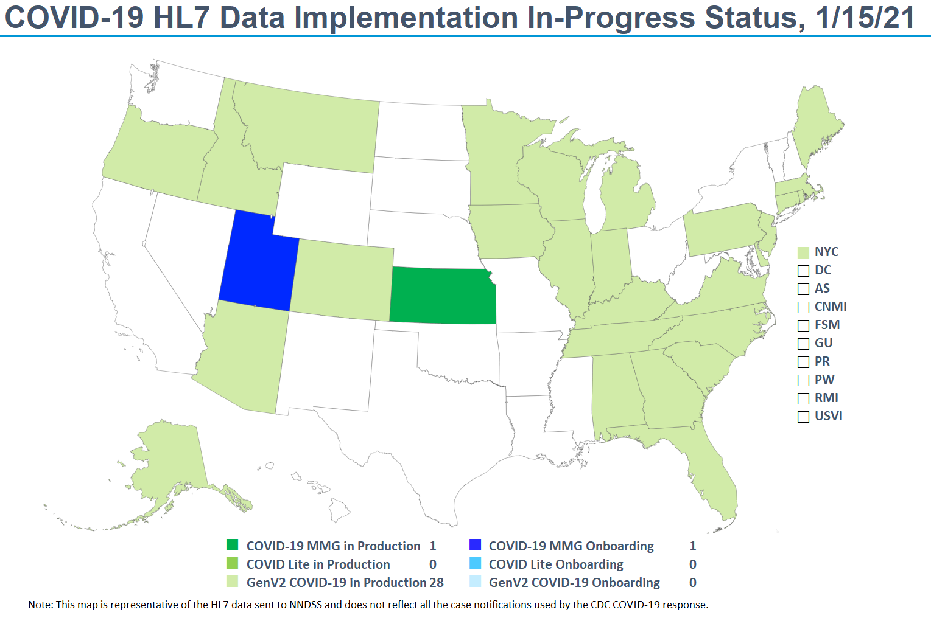
Plan
10

Slide 11
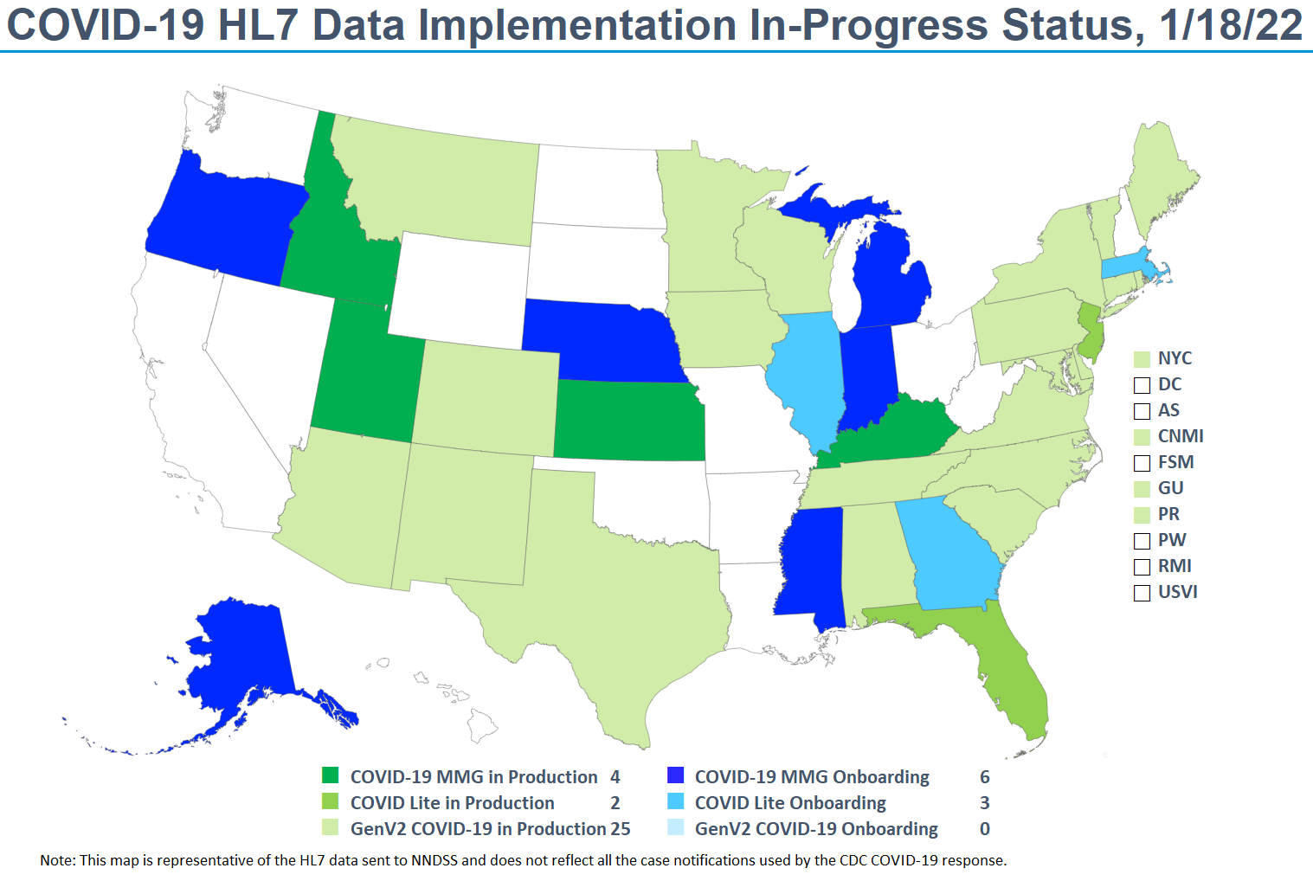
Plan
11

Slide 12
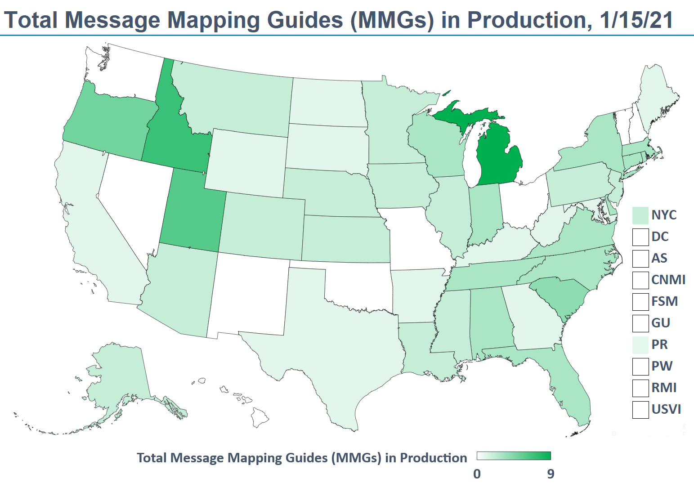
Plan
12

Slide 13
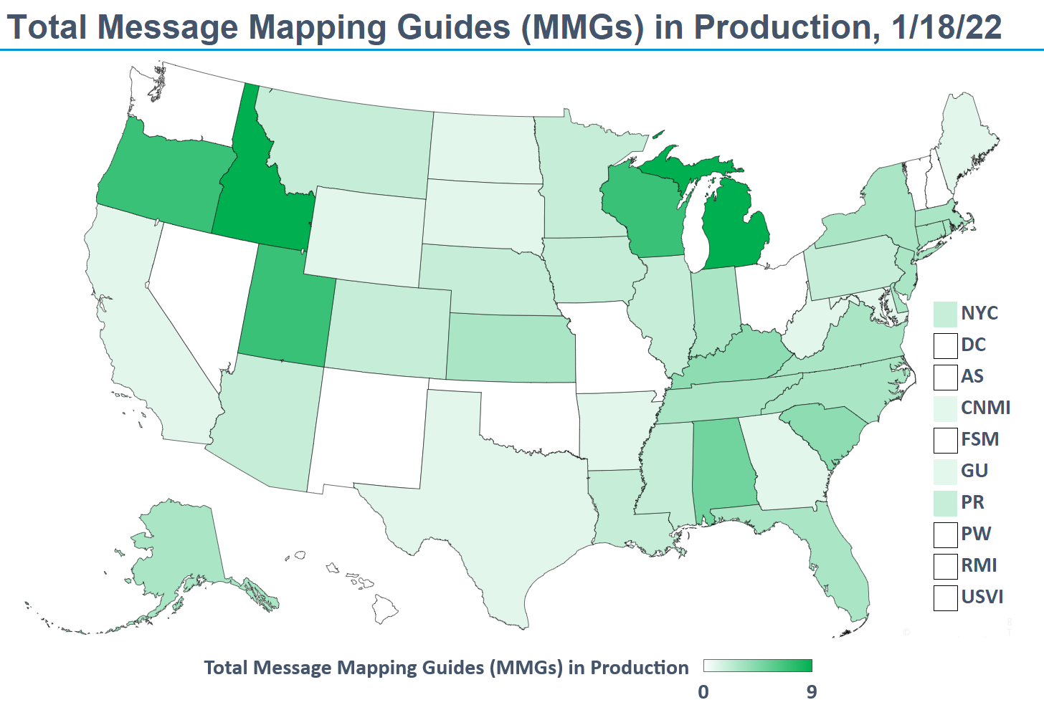
Plan
13

Slide 14
14
Kudos to Jurisdictions Onboarding in 2021!
Message Mapping Guide | Jurisdictions
Arboviral | Alaska, Kansas, Massachusetts
Babesiosis and Trichinellosis | Idaho, Wisconsin
Foodborne and Diarrheal Diseases | Oregon
Generic v2 | Guam, CNMI
Hepatitis | New Jersey
STD and Congenital Syphilis | Alabama, Kentucky, Wisconsin
Tuberculosis and Latent Tuberculosis Infection | Oregon

Slide 15
What States Need to Know for 2022!
Center for Surveillance, Epidemiology, and Laboratory Services
Michele Hoover, MS
Data Standardization and Assistance Team
Center for Surveillance, Epidemiology, and Laboratory Services

Slide 16


16
At a Glance: Message Mapping Guides Status
  Open for General Onboarding
    COVID-19
    Arboviral
    Babesiosis
    Malaria
    Trichinellosis
    Lyme and Tickborne Rickettsial Diseases (TBRD)
    STD and Congenital Syphilis (CS)
    Tuberculosis and Latent Tuberculosis Infection (LTBI)
    Hepatitis*
*New Hepatitis v2.0 guide coming in 2022

Slide 17

17
At a Glance: MMG Status (cont’d)
  Coming in 2022
    Healthcare-Associated Infections, Multidrug Resistant Organism (HAI-MDRO)
    Foodborne and Diarrheal Diseases (FDD)
    Respiratory and Invasive Bacterial Diseases (RIBD)
    Vaccine Preventable Diseases (VPDs): Mumps, Pertussis, and Varicella
    VPDs: Measles, Rubella, and Congenital Rubella Syndrome
  Piloting in 2022
    Carbon Monoxide Poisoning (CO)
    Bacterial Special Pathogens: Brucellosis, Hansen’s disease, and Leptospirosis
    Hepatitis v2.0

Slide 18
Highlights: 2022 Letter to State Epidemiologists
Center for Surveillance, Epidemiology, and Laboratory Services
Ruth Jajosky, DMD, MPH
Lead, Case-Based Surveillance Operations Team
Center for Surveillance, Epidemiology, and Laboratory Services
Sara Johnston, MPH
NNDSS Program Lead
Center for Surveillance, Epidemiology, and Laboratory Services

Slide 19
NNDSS Case Definition Updates

Slide 20
2021 CSTE Position Statements
2021 CSTE Position Statements to be Implemented in 2022
  Updated case definitions for four nationally notifiable diseases
    COVID-19 (implemented September 1, 2021)
    Chlamydia trachomatis infection
    Lyme disease
    Viral hemorrhagic fever
  Updated case definition for 1 condition under standardized surveillance
    Acute flaccid myelitis (case definition revision)
  Added a condition under standardized surveillance
    Alpha-gal syndrome (new condition and case definition)
20

Slide 21
COVID-19
COVID-19 (21-ID-02; event code 11065)
  Updates case definition
    Updates clinical criteria
    Refines and expands laboratory criteria to include genomic sequencing
    Updates epidemiologic linkage criteria and close contact definition
    Specifies criteria to distinguish a new case from an existing case
    Clarifies probable case definition for cases with no laboratory evidence
    Acknowledges testing in non-traditional settings
  Publication criteria include confirmed, probable, and total cases once in NNDSS tables
21

Slide 22
Slide22
Chlamydia trachomatis (21-ID-06; event code: 10274)
  Adds new clinical and laboratory criteria to distinguish cases of chlamydia that are lymphogranuloma venereum (LGV) from chlamydia cases that are not LGV
    STD MMG v1.1 added a complications repeating group to distinguish between LGV and non-LGV infections
    STD MMG v1.2, to be released, updates value set in repeating group to align with the changes to the case definition
  Only confirmed cases of chlamydia infection will be published in the weekly and annual 2022 tables

Slide 23
Slide23
Lyme disease (21-ID-05; event code 11080)
  Differentiates case classification criteria based on incidence
    High-incidence jurisdiction: average Lyme disease incidence of ≥10 confirmed cases per 100,000 population for a period of three consecutive years
    Low-incidence jurisdiction: all others
  Increases specificity within probable case definition by removing “other physician diagnosis”
  Recategorizes single-titer IgG immunoblot as presumptive laboratory evidence
  Updates and expands laboratory criteria
    Updates serologic criteria
    Adds polymerase chain reaction and direct detection of Borrelia burgdorferi in tissue
  Data for confirmed, probable, and totals will continue to be published in the NNDSS annual tables

Slide 24
Slide24
Viral hemorrhagic fever (21-ID-04; multiple event codes)
  Modifies the definition of fever from >40ºC to ≥ 38ºC/100.4ºF
  Amends epidemiologic linkage criteria for exposure
  Confirmed and suspect cases of viral hemorrhagic fever will be published in the 2022 weekly and annual NNDSS tables
  Adds Chapare virus (event code: 11649)
Event Code | Event Name | Event Code | Event Name
11649 | Chapare virus | 11632 | Lassa fever
11640 | Crimean-Congo hemorrhagic fever | 11644 | Lujo virus
11630 | Ebola hemorrhagic fever | 11637 | Machupo hemorrhagic fever
11648 | Guanarito hemorrhagic fever | 11631 | Marburg fever
11638 | Junín hemorrhagic fever | 11639 | Sabia-associated hemorrhagic fever

Slide 25
Slide25
Acute flaccid myelitis (21-ID-02; event code: 11120)
  Suspect case classification criteria now include supportive laboratory/imaging criteria
  Added criteria for case ascertainment to allow for reporting suspect cases identified post-mortem
  Confirmed case now includes persons who died without an MRI, but have evidence of myelitis on autopsy
  Can be sent using GenV2, but AFM-specific data sent via
    AFM REDCap project
    Secure file transfer portal
    Secure email
    Fax

Slide 26
Slide26
Alpha-gal syndrome (21-ID-07; event code: 50269)
  Creates a standardized case definition with confirmed, probable, and suspect criteria
  Intended for jurisdictions that want to include as reportable or to conduct pilot studies or targeted surveillance
  Can be used to help inform clinicians of the estimated burden and trends in their region
  Can be sent to CDC via available NNDSS format pending Office of Management and Budget approval

Slide 27
Updates: NNDSS Data Processing Redesign

Slide 28
Slide28
Improvements to Message, Validation, Processing, and Provisioning System (MVPS)
  All case notification types (HL7, NETSS, and NBS master message) available
  Additional functionality allows users to:
    Delete a case or batch of cases through the user interface
    Provide verification for select low-incidence conditions
    Review case counts
    Download line lists of data to streamline reconciliation
  Coming this year: new annual reconciliation functionality
    Reconciliation reports on-demand through the MVPS portal
    Jurisdiction users can lock data and indicate when ready for approval
    New STD Manager and State Epidemiologist roles in MVPS will allow sign-off on the locked data to finalize for the year, replacing the process of emailing tables for signature

Slide 29

Slide29
Resources
  See November 2021 eSHARE for MMG Roundup
  The 2022 State Epi Letter and 2022 Event Code List can be found on the NNDSS Event Codes & Other Surveillance Resources webpage
  Case definitions can be found at NNDSS Case Definitions
  Message mapping guide information for implementation can be found at https://ndc.services.cdc.gov/message-mapping-guides/
  To request technical assistance, join an onboarding cohort, or participate as a pilot for a new MMG, please email the CDC Electronic Data Exchange mailbox at edx@cdc.gov

Slide 30

Open Discussion

Slide 31

Next NNDSS Webinar: September 21, 2021
Subscribe to the monthly NNDSS newsletter, Case Surveillance News
Access the NNDSS Technical Resource Center
Email edx@cdc.gov to request NNDSS technical assistance or begin onboarding HL7 message mapping guides
Next NNDSS eSHARE:
February 15, 2022 (more details coming soon)

