Slide 1

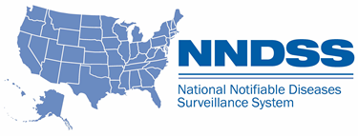
National Notifiable Diseases Surveillance System (NNDSS) eSHARE October Webinar
Center for Surveillance, Epidemiology, and Laboratory Services
Division of Health Informatics and Surveillance
October 19, 2021

Slide 2

Agenda
Agenda
  NNDSS Updates and Announcements
  Overview of Malaria, Babesiosis, and Trichinellosis HL7 Case Notification Messages
      Kimberly Mace, Division of Parasitic Diseases and Malaria, CDC
      Megan Swanson, Division of Parasitic Diseases and Malaria, CDC
      Lauren Ahart, Division of Parasitic Diseases and Malaria, CDC
  Questions and Answers
2
2

Slide 3
NNDSS Updates and Announcements
Center for Surveillance, Epidemiology, and Laboratory Services
Sara Johnston, MPH
NNDSS Program Lead
Center for Surveillance, Epidemiology, and Laboratory Services

Slide 4
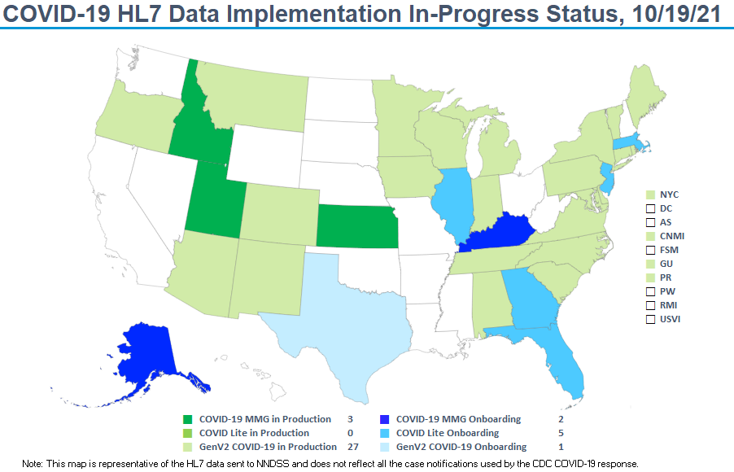

stat

Slide 5
5
Updated COVID-19 Message Mapping Guide (MMG)
  Version 1.1 most current
  New: The PHIN Vocabulary Access and Distribution System (VADS) COVID-19 case notification view has been updated
    Version 10 is now the most up-to-date version
    Includes four new additional values to Lab Test Type (COVID-19)
    Includes three new additional values to Vaccine Type (NND)
COVID-19 v1.1 MMG: https://ndc.services.cdc.gov/mmgpage/covid-19-message-mapping-guide/
PHIN VADS Case View version 10: https://phinvads.cdc.gov/vads/ViewView.action?id=9F8D5823-D517-EC11-81A3-005056ABE2F0

Slide 6
6
Reminder: 2020 Reconciliation Timeline
10/20/2021 Last day for jurisdiction to
Request NNDSS Data Management and Reporting (DMR) specialist to “lock” their STD and non-STD data as final
Confirm or update 2020 reporting exceptions
DMR will send a set of updated reconciliation tables for final review by the jurisdiction
After final review, DMR emails final counts for State/Territorial Epidemiologist signature.
11/15/2021 Last day for State/Territorial Epidemiologists to email final signature reports back to CDC.
Last day for jurisdictions to submit final 2020 NNDSS aggregate COVID-19 case counts.
Spring 2022 Publish the final 2020 NNDSS tables on CDC WONDER

Slide 7
Process for Final 2020 NNDSS COVID-19 Data
  Final 2020 NNDSS data for COVID-19 will not be reconciled
  Jurisdictions provide aggregate counts for the 2020 annual NNDSS publication
    Provide counts for confirmed and probable cases
    Enter into web form hosted on the CDC Epi Info™ Secure Web Survey system
  Excel worksheet with instructions will help you prepare your data
  NNDSS team emailed Epi Info™ web form link to State/Territorial Epidemiologist
  State/Territorial Epidemiologist will sign off on the aggregate counts in Epi Info™
  Deadline for submitting data and “sign off” is Monday, November 15, 2021
  Email questions to edx@cdc.gov with subject line “2020 final NNDSS COVID-19 data”
7

Slide 8


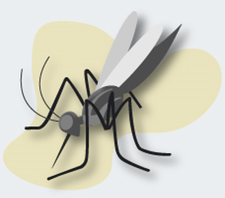
Overview of Malaria, Babesiosis, and Trichinellosis MMG Implementation and Onboarding
Division of Parasitic Diseases and Malaria
Kimberly Mace, PhD
Kathrine Tan, MD, MPH
Susan Montgomery, DVM, MPH
Megan Swanson, MPH
Lauren Ahart, MPH
Amy Peplinski, MS

Slide 9
Malaria, Babesiosis, and Trichinellosis MMG Implementation and Onboarding Overview
New option: onboard these three conditions as a group
  If possible, onboard two or more conditions at the same time
  If a jurisdiction has no or few cases, or if the condition is not reportable in the jurisdiction, an abridged onboarding is available
Benefits:
  Efficiency: consolidation of onboarding activities
  Credit toward completing up to 3 of the 5 guides required annually for Epidemiology and Laboratory Capacity Health Information Systems
  Decrease reporting burden: moving to HL7 will end the requirement to send paper case report forms (CRFs) or Excel files for case reporting
9

Slide 10
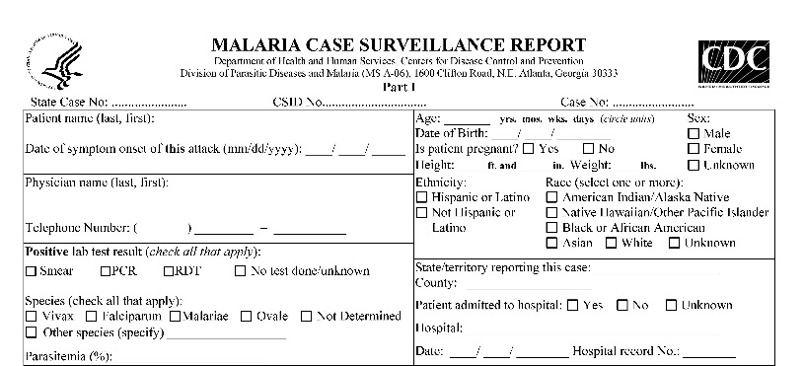
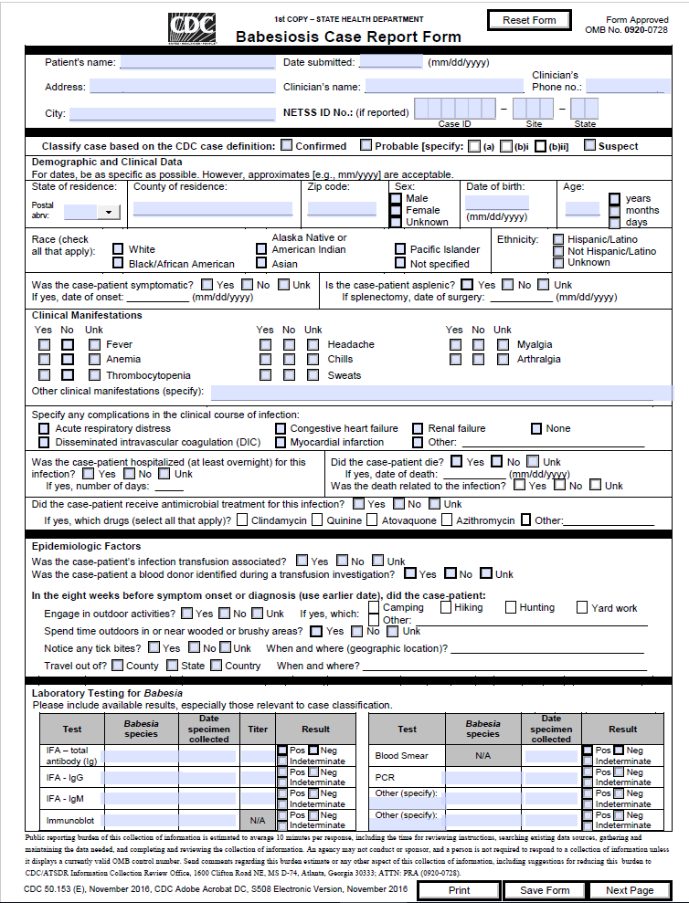
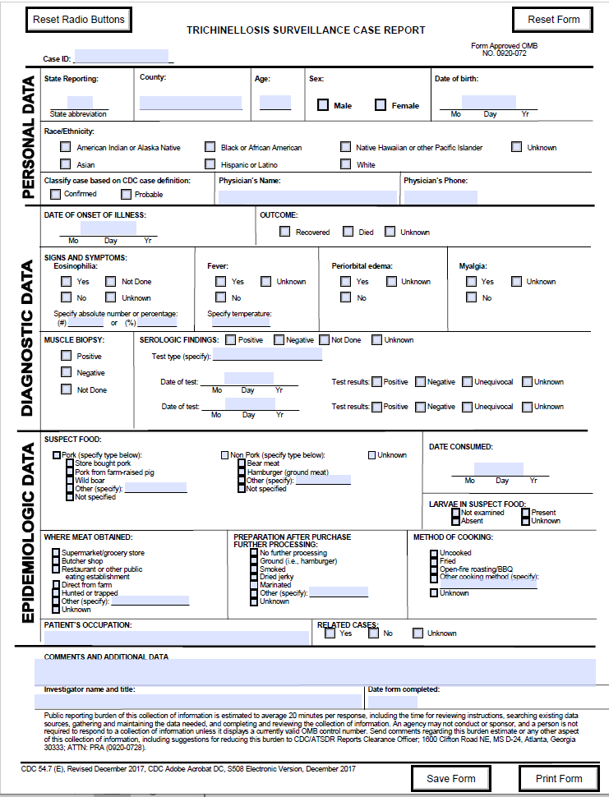
Reporting Malaria/Babesiosis/Trichinellosis
Diagnostic and symptom data are critical
GenV2 data are not sufficient
Not all data elements (DEs) are required for all cases, but please build as many as possible into the surveillance system so reports are not systematically limited
CDC receives case information from
  State and local health departments
  NNDSS
  CDC laboratories*
  Hospitals, clinicians*
  Armed Forces Health Service*
  CDC clinicians*
* Malaria only
10

Slide 11
Malaria HL7 Case Notification Messages
Kimberly Mace, PhD
Kathrine Tan, MD, MPH
Malaria Branch, Division of Parasitic Diseases and Malaria

Slide 12
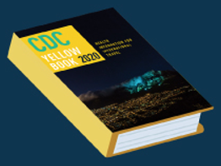
CDC Domestic Malaria Program
Write and update prevention, diagnosis and treatment guidelines
Support clinicians providing care to malaria patients:
  Malaria hotline for clinical assistance
  Provide the medication for severe malaria, artesunate, when the commercial product is unavailable
  Division of Parasitic Diseases diagnostic assistance: DPDx
Provide prevention information to travelers
Conduct outreach for education of providers and the public on malaria
Conduct surveillance on cases of malaria diagnosed in the U.S.
Collaborate with state health departments to investigate:
  Deaths attributable to malaria
  Cases from unusual routes of transmission
  Rare local outbreaks
12

Slide 13
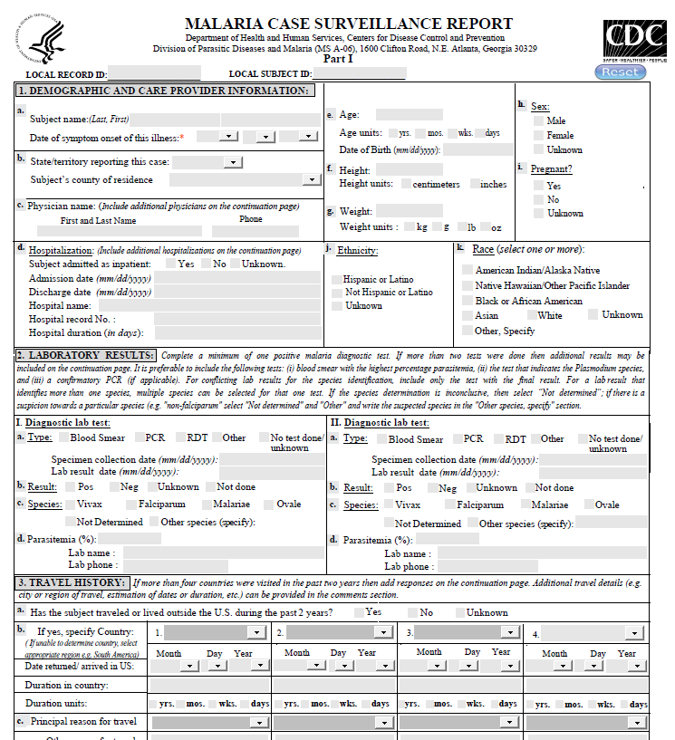
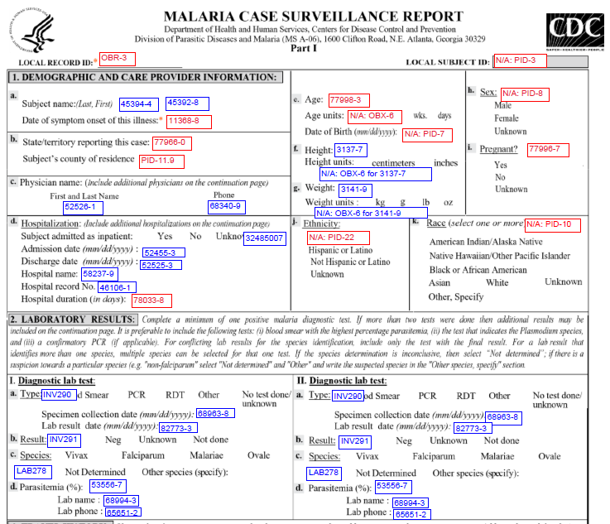
Malaria electronic Case Report Form (eCRF)
CRF was updated to align with the MMG
*Adobe fillable PDF
Electronic data sync with CDC malaria program data management system
  Secure FTP
  Secure email
Annotated version for mapping to MMG
New eCRF will be released in 2021
Please reach out if you have questions
Please do not print, fax or mail the eCRF
*For optimal functionality, do not use other pdf viewers
13

Slide 14
GenV2 Data Elements Important to CDC Malaria Program
DE Name and Identifier | Notes and Justification
Country of Birth (DEM126) | Provides information about the risk factors for malaria.
Country of Usual Residence (INV501) | Approximately 25% of malaria cases diagnosed in the U.S. are among non-U.S. residents. The malaria program requests that all cases diagnosed in the U.S. be reported via NNDSS. Use INV501 to indicate residence status.
Hospitalization Admission Date (INV128), Discharge Date (INV133), & Hospitalization Duration (INV134) | Hospitalization data elements are also included as a repeating block in the malaria MMG. Please use the GenV2 DEs for the most recent hospitalization and the Malaria MMG hospitalization DEs if there is a previous hospitalization for the current illness.
Pregnancy Status (INV178) | Malaria can cause severe illness in pregnant women, so reporting pregnancy status is important for surveillance in this risk group.
Reporting County (NOT113) | This DE is important for case follow-up and to better understand where the patient was diagnosed and treated.
Comment (INV886) | This DE allows for the documentation of additional pertinent information, especially for cases under further investigation.
See Frequently Asked Questions and Answers for the Malaria Case Notification Message Mapping Guide
14

Slide 15

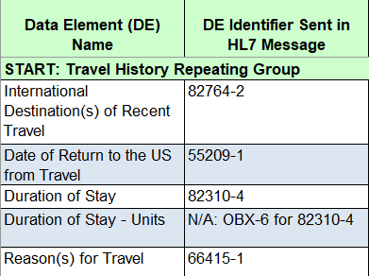
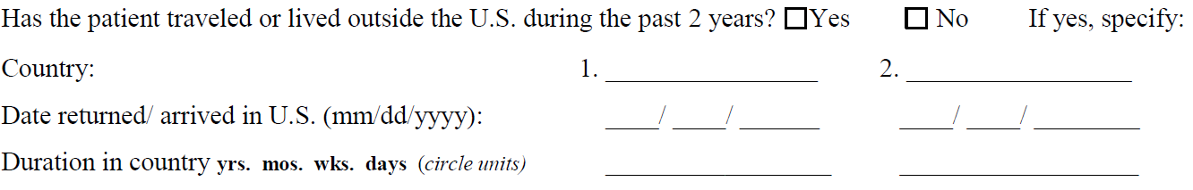
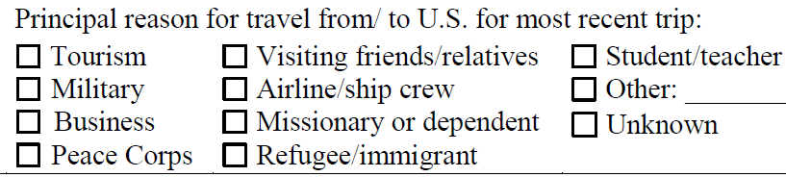
Repeating Blocks
Physician Name and Number
Hospitalization
Previous Illness
Treatment
Travel History
Specimen Type
Laboratory Testing
*Occupation and Industry
Part II. Adverse Event & Part II. Medications
*not specific to malaria/optional
15

Slide 16
New Data Elements
DE Name & Identifier | Notes and Justification
Hospitalization Discharge Date (52525-3) | Please provide the hospitalization discharge date, if available. This information is useful to understand the timeliness of care.
Specimen Collection Date/Time (68963-8), Lab Result Date/Time (82773-3) | If known, please indicate the specimen collection and lab results date/time. This information is useful to understand the timeliness of diagnosis.
Date Treatment or Therapy Started (86948-7), Stopped (63939-3), Duration (67453-1) | The treatment dates will provide information on the timeliness of malaria treatment. If the precise date is unknown, then leave blank and provide the treatment/therapy duration.
Medication Start Date (91381-4) and Stop Date (91382-2), Medication Duration (91383-0) | Part II (4-week follow-up). These are new DEs in the optional part of the malaria paper case report form, which assists in the evaluation of antimalarial adverse events. This section should only be completed if the subject had an adverse event to an antimalarial.
CSID (INV965) | CDC specimen ID number from the 50.34 lab form. Will facilitate record linkage across epidemiological and lab sources.
See Frequently Asked Questions and Answers for the Malaria Case Notification Message Mapping Guide
16

Slide 17
Updated Value Sets
Section | DE Name and Identifier | Notes and Justification
Travel history repeating block | Reason(s) for Travel (66415-1) | Added “Medical/Relief response.” Value set updated to include this commonly reported reason for travel.
Specimen block elements | Specimen Type (66746-9) | Added “Images.” Images are sent to CDC for telediagnosis assistance.
Chemoprophylaxis Questions | Chemoprophylaxis Medication(s) (INV931) | Added “Arakoda (tafenoquine).” This medication was FDA approved for malaria chemoprophylaxis in 2019.
Treatment questions | Treatment Information (55753-8) | Added “Krintafel (tafenoquine)” and "Arakoda (tafenoquine).” Krintafel was FDA approved for malaria treatment in 2019. It is possible that Arakoda (which has the same active ingredient with a different dosage) could be used for treatment.
17
See Frequently Asked Questions and Answers for the Malaria Case Notification Message Mapping Guide

Slide 18
Key Implementation Points—General
A subsequent episode of malaria is counted as an additional case, unless there is a treatment failure within 4 weeks of initial presentation
Send partial dates with YYYY being the minimally acceptable value
  Onset date
  Travel history
For urgent cases, submit the Part 1 case report immediately
  Cryptic (no valid travel history)
  Transfusion transmitted
  Congenital
  Fatal
For standard cases, submit the case report after the Part 2, 4-week follow-up is completed
18

Slide 19
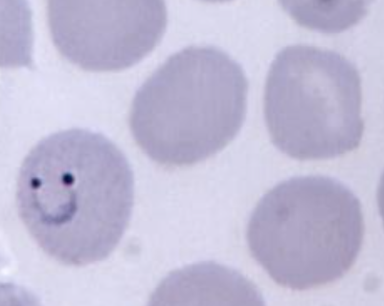
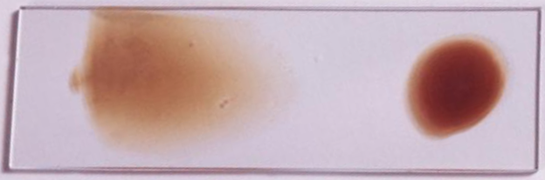
Key Implementation Points—Multiple Labs
Complete a minimum of one positive malaria diagnostic test
  Confirmed cases: Microscopy, PCR
  Suspected cases: RDT+ only
  Nonstandard tests: IFA, Quest Diagnostics: non-differentiating malaria/Babesia/other blood parasites
It is preferable to include the following:
  Blood smear with the highest percentage parasitemia
  The test that indicates the Plasmodium species
  A confirmatory PCR with species determined (if applicable)
Plasmodium species:
  If labs have conflicting results, report only the test with the true result
    For species determination, PCR is more reliable than microscopy
    Reference lab results are more reliable than those from a hospital or clinic lab
  Select multiple species for mixed infections where more than one species is detected
  If there is a suspicion toward a particular species (e.g. "non-falciparum“) select "Not determined" and "Other" and then write “non-falciparum” in the "Other species, specify" section
19

Slide 20
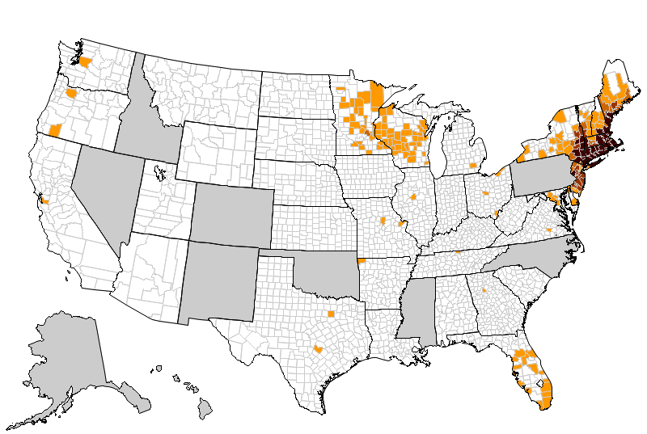
Babesiosis Background and Implementation
Number of reported cases of babesiosis, by county of residence – 40 states, 2019
Megan Swanson, MPH
Parasitic Diseases Branch, Division of Parasitic Diseases and Malaria

Slide 21
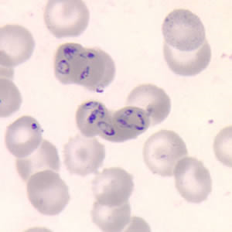
CDC Babesiosis Program
Babesiosis is a tickborne intraerythrocytic parasite endemic in parts of the United States, especially the Northeast and upper Midwest, but does occur elsewhere
Conduct surveillance and data analyses on cases of babesiosis reported in the U.S.
Provide prevention information and technical assistance to health care providers
Collaborate with state/jurisdictional health departments and other federal agencies upon request to investigate:
  Deaths attributable to babesiosis
  Cases arising from unusual routes of transmission
21

Slide 22
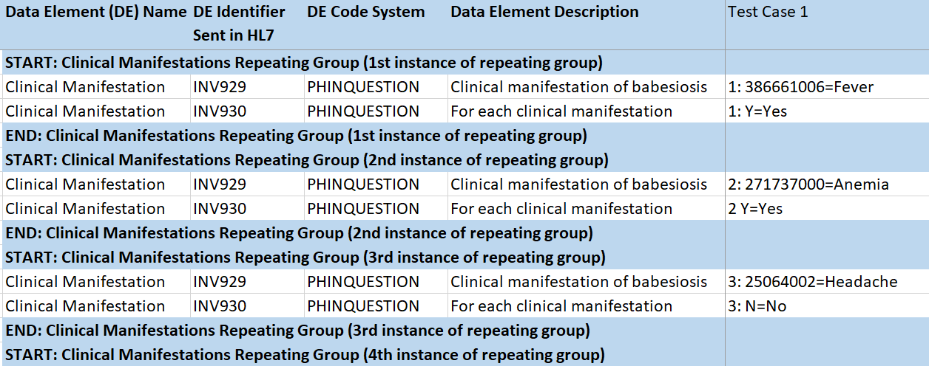
MMG Changes: Babesiosis Repeating Data Elements
  Physician
  Date of Previous Illness
  Clinical Manifestation
  Blood Transfusion/Donation
  Tick Bite
  Travel History
  Industry and Occupation
  Interpretive Laboratory
22

Slide 23
Data Elements
Key elements to include:
  All priority 1 GenV2
  The following babesiosis-specific data elements
    Symptomatic
    Clinical Manifestation
    Clinical Manifestation Indicator
    Test Type
    Test Result
Considerations for lab data mapping
  Test Type element: test names in local systems may differ from MMG names; for mapping questions contact CDC for assistance
23
See Frequently Asked Questions and Answers for the Babesiosis Case Notification Message Mapping Guide

Slide 24
Data Element Specification—Special Cases
Blood Transfusion Cases
  These cases are of public health importance; please report all available blood transfusion variables. If your jurisdiction does not include these data elements in their HL7 message, provide this information via the comment field.
Fatality Cases
  Please report all available death data to allow for accurate death rate calculations.
Congenital cases
  These cases are of public health importance; please report all available mother variables for the child’s case. If your jurisdiction does not include these data elements in their HL7 message, provide this information via the comment field or secure methods to the CDC babesiosis program along with the mother’s case ID (value for OBR-3 “Local Record ID”).
24

Slide 25
Data Element Specifications—Special Cases (cont.)
Assessment of Possible Babesiosis Case in Low-incidence States
  Please provide travel data as applicable to assist with the assessment of transmission in low-incidence states.
    If the patient’s state of residence is not known to have vectorborne transmission of babesiosis, assess the subject’s travel to known endemic states (Connecticut, Massachusetts, Minnesota, New Jersey, New York, Rhode Island, and Wisconsin).
    If no travel to endemic areas, consider the case locally acquired.
Case with an Unusual Test Type Reported
  If a patient is tested with an unusual test type, enter it in the other test field or contact the program if you have any questions.
  These include parasitic cultures, FISH tests, and combination tests (ex. Quest Diagnostics: non-differentiating microscopy test for malaria/Babesia/other blood parasites).
25

Slide 26
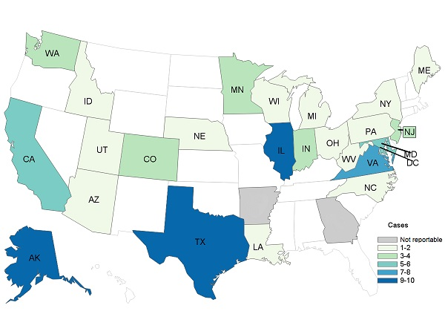
Trichinellosis Background and Implementation
Number of reported cases of trichinellosis, by state of residence, 2011-2015
Lauren Ahart, MPH
Parasitic Diseases Branch, Division of Parasitic Diseases and Malaria

Slide 27
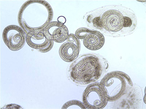
CDC Trichinellosis Program
Trichinellosis is a foodborne illness caused by the parasite Trichinella found in the United States and worldwide
From 2011–2015, 16 cases were reported per year on average in the U.S.
CDC receives and processes CRFs and compiles data for surveillance reports, which inform food safety practices and prevention messaging
The CDC program collaborates with jurisdictions to conduct investigations and provide technical assistance
27

Slide 28
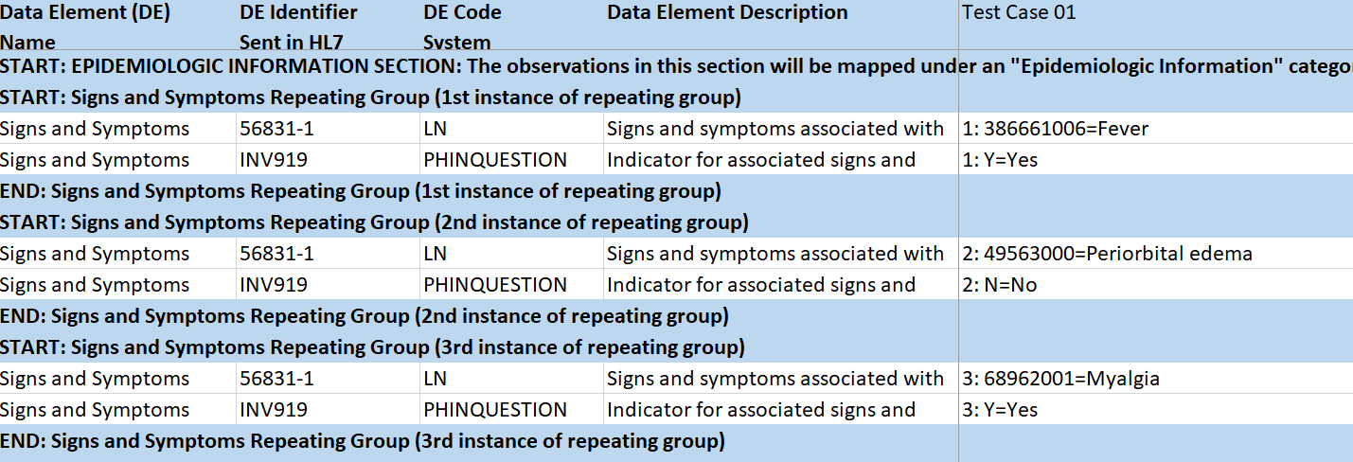
Trichinellosis Repeating Data Elements
Signs and Symptoms
Travel History
Food Exposure History
Occupation and Industry
Epidemiology Laboratory
28

Slide 29
Data Element Specifications
Key data elements for trichinellosis: all priority 1 in GenV2
Additional GenV2 data elements for trichinellosis surveillance:
    Other Race Text
    Country of Birth
    Pregnancy Status
    Diagnosis Date
    Duration of Hospital Stay in Days
    Legacy Case Identifier
    Case Disease Imported Code
    Imported Country
    Imported State
    Imported City
    Country of Exposure
    State or Province of Exposure
    Binational Reporting Criteria
    Reporting County
29
See Frequently Asked Questions and Answers for the Trichinellosis Case Notification Message Mapping Guide

Slide 30

Onboarding Overview for Malaria, Babesiosis, and Trichinellosis Message Mapping Guides

Slide 31
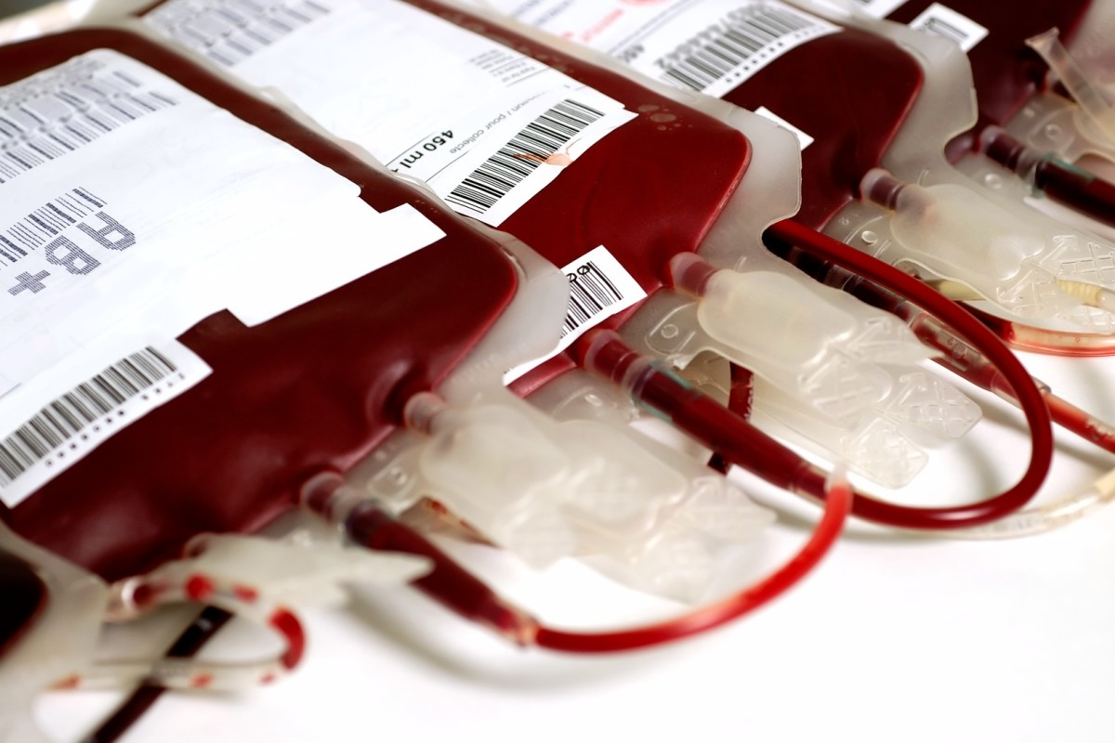
Onboarding Considerations for All Three MMGs
If a jurisdiction has few or no current-year cases, prepare to send historic data for validation during onboarding
If there are variables not captured in your jurisdiction’s electronic surveillance system that are priority 1 on the MMG (and cannot be implemented before onboarding), please reach out to the program or edx@cdc.gov for options
31

Slide 32
General Onboarding Considerations
Pre-onboarding
  Review the FAQ documents to obtain additional guidance related to key data elements for malaria, babesiosis, and trichinellosis surveillance.
  Each disease-specific MMG and GenV2 outline data elements that are critical for surveillance.
  The jurisdiction implementation spreadsheet will be reviewed by the program to assess data element alignment with the national surveillance activities.
  Please submit the legacy data during pre-onboarding.
Onboarding Cutover to Production
  Year-to-date data will be compared to the legacy format data (paper forms or eCRFs) for year(s) that have not been finalized.
32

Slide 33

Malaria, Babesiosis, and Trichinellosis
Onboarding Timeline
Open for general onboarding anticipated by end of October 2021
Contact edx@cdc.gov if interested in being in a cohort
If ready to onboard malaria, babesiosis and trichinellosis, please send onboarding package to edx@cdc.gov with the subject: [Jurisdiction name]: [Malaria, Babesiosis, Trichinellosis] Onboarding Package
      Example: “ID: Malaria, Babesiosis, Trichinellosis MMG Onboarding Package”
33

Slide 34
CDC Malaria, Babesiosis, and Trichinellosis Program Resources
Parasitic Disease Branch: Technical assistance requests for programmatic subject matter experts (SME):
  By email: parasites@cdc.gov
  By phone: (404) 718-4745
Malaria Clinical Consultation Hotline: 770-488-7788 Mon–Fri, 9 am–5 pm EST After hours: 770-488-7100
For program questions contact:
  Malaria: Kimberly Mace, igd3@cdc.gov, malariasurveillance@cdc.gov
  Babesiosis: Megan Swanson, qek6@cdc.gov
  Trichinellosis: Lauren Ahart, nox7@cdc.gov
Note: Frequently asked questions and answers for these case notification message mapping guides will be available at https://ndc.services.cdc.gov/message-mapping-guides/.
34

Slide 35
Questions?
edx@cdc.gov

Slide 36


Next NNDSS Webinar: September 21, 2021
Subscribe to the monthly NNDSS newsletter, Case Surveillance News
Access the NNDSS Technical Resource Center
Email edx@cdc.gov to request NNDSS technical assistance or begin onboarding HL7 message mapping guides
Next NNDSS eSHARE:
November 16, 2021 (more details coming soon)

Slide 37

Happy Fall!!!

Slide 38
Appendix

Slide 39
Malaria Extra: Key Implementation Points—Parasitemia
Response should be a numeric value between 0.01 – 100.
Example:
    Two infected erythrocytes out of 2000 counted = 0.1% parasitemia and the response should be 0.1
      Extracellular gametocytes should not be counted for the percentage parasitemia.
39

Slide 40
Malaria Extra: Key Implementation Points—Justification for the Collection of Personally Identifiable Information
The malaria program requests that all cases are completely reported (as much as possible) including PII elements (e.g., name and date of birth)
OMB approval: 0920-0728
HL7 messages and MVPS conforms to data security measures
Facilitates clinical support
  Access to artesunate
  Diagnostic services through CDC labs
Accurate surveillance:
  Reconciliation of multiple reports for a case (e.g., DPDx and DOH/PHL)
  De-duplicate CRFs (e.g., CRFs sent from clinic and from State-DOH)
Management of malaria relapses for long-term follow-up
40

