Slide 1

National Notifiable Diseases Surveillance System (NNDSS) eSHARE September Webinar
Center for Surveillance, Epidemiology, and Laboratory Services
Division of Health Informatics and Surveillance
September 21, 2021

Slide 2

Agenda
Agenda
  NNDSS Updates and Announcements
  Improvements to the HL7 Message Mapping Guide (MMG) Onboarding Process
  Questions and Answers
2
2

Slide 3
NNDSS Updates and Announcements
Center for Surveillance, Epidemiology, and Laboratory Services
Michele Hoover, MS
Data Standardization and Assistance Team
Center for Surveillance, Epidemiology, and Laboratory Services
Sara Johnston, MPH
NNDSS Program Lead
Center for Surveillance, Epidemiology, and Laboratory Services

Slide 4
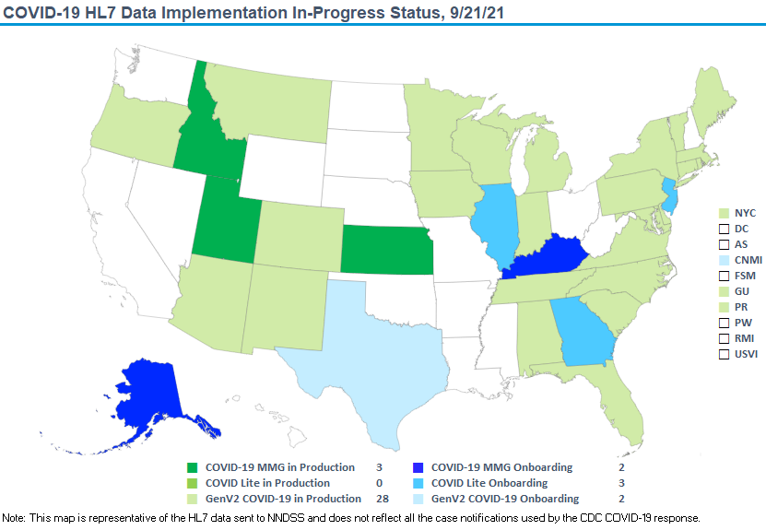

stat

Slide 5
Updated COVID – 19 MMG
Updated COVID-19 MMG
  Version 1.1 most current
  Uses the Version 9 PHIN Vocabulary Access and Distribution System (VADS) Case View
  Adds three data elements
    Previously Infected Individual (Yes/No/Unknown; nonrepeating); CDC priority 1
    Previous State Case Number (text; repeating element); CDC priority 1
    WGS ID Number (text; part of lab repeat); CDC priority 2
COVID-19 v1.1 MMG: https://ndc.services.cdc.gov/mmgpage/covid-19-message-mapping-guide/
PHIN VADS Case View version 9: https://phinvads.cdc.gov/vads/ViewView.action?id=F7DBD780-2301-EC11-81A3-005056ABE2F0

Slide 6

6
2020 Updated Reconciliation Timeline
10/20/2021 Last day for jurisdiction to
Request NNDSS Data Management and Reporting (DMR) specialist to “lock” their STD and non-STD data as final
Confirm or update 2020 reporting exceptions
DMR will send a set of updated reconciliation tables for final review by the jurisdiction
After final review, DMR emails final counts for State/Territorial Epidemiologist signature.
11/15/2021 Last day for State/Territorial Epidemiologists to email final signature reports back to CDC.
Last day for jurisdictions to submit final 2020 NNDSS aggregate COVID-19 case counts.
Spring 2022 Publish the final 2020 NNDSS tables on CDC WONDER

Slide 7
Process for Final 2020 NNDSS COVID-19 Data
  Final 2020 NNDSS data for COVID-19 will not be reconciled
  Jurisdictions provide aggregate counts for the 2020 annual NNDSS publication
    Provide counts for confirmed and probable cases
    Enter into web form hosted on the CDC Epi Info™ Secure Web Survey system
  Excel worksheet with instructions will help you prepare your data
  NNDSS team will email Epi Info™ web form link to State/Territorial Epidemiologist
  State/Territorial Epidemiologist will sign off on the aggregate counts in Epi Info™
  Deadline for submitting data and “sign off” is Monday, November 15, 2021
7

Slide 8

Reminder: Message Validation, Processing, and Provisioning System (MVPS) Portal Open Forum
  NNDSS is offering its final Q&A session to further assist jurisdictions with changes to MVPS
  September 28, 2021 – 4:00pm EDT

Slide 9
Improvements to the HL7 MMG Onboarding Process
Center for Surveillance, Epidemiology, and Laboratory Services
Danielle Tack, DVM, MPVM, DACVPM
Lead, Data Standardization and Assistance Team
Center for Surveillance, Epidemiology, and Laboratory Services

Slide 10
Project Goals

Slide 11

11
Streamlined Onboarding Process
  Data submitted by jurisdictions are based on the final NNDSS HL7 MMG requirements
  CDC programs can be confident in the data that they receive

Slide 12

12
Data-driven Improvements
  Ensure consistent and efficient timelines
  Minimize resource use for jurisdictions
  Prevent data loss and issues for CDC programs

Slide 13

13
Clear Expectations
  Refined MMG onboarding process clearly defines:
    Roles and responsibilities of
      NNDSS onboarding specialists
      Jurisdictions
      CDC programs
      Technical assistance partners
    Shared goals, expectations, and timelines
    Phases of implementation and
    associated stages

Slide 14

14
Reduced Onboarding Time
  4 months (~140 days) to onboard a single MMG using current process.
  Focus on gaining efficiencies to
  reduce review time.

Slide 15
Proposed Changes

Slide 16

MMG Implementation Overview
CURRENT
16

Slide 17
MMG Implementation Overview
CURRENT
UPDATED
MMG Implementation Process
PRE-ONBOARDING
ONBOARDING:
3 Stages
ROUTINE NOTIFICATIONS
17

Slide 18
High-Level NNDSS Onboarding Overview
Jurisdiction Test Environment
MVPS Secure Onboarding Environment
Stage 1
Test Messages
Stage 2
Limited Production Messages
Jurisdiction Production Environment
MVPS Production Environment
Stage 3
Year-To-Date (YTD) Production Messages
18

Slide 19

19
Pre-onboarding & Onboarding Initiation
  Pre-onboarding
    Jurisdiction mapping and system updates
    Association of Public Health Laboratories (APHL) Cohorts and/or individual technical
    assistance
  Onboarding Initiation
    Packet sent to edx@cdc.gov with Subject: “[Jurisdiction name]: [MMG name] Onboarding Package”
      Example: “CA: FDD MMG Onboarding Package”
    APHL review, validation, and feedback of test messages and artifacts
    Onboarding kick-off call scheduled

Slide 20
High-Level NNDSS Onboarding Overview
Jurisdiction Test Environment
MVPS Secure Onboarding Environment
Stage 1
Test Messages
Stage 2
Limited Production Messages
Jurisdiction Production Environment
MVPS Production Environment
Stage 3
YTD Production Messages
20

Slide 21

21
Stage 1: Test Messages
  Establish a mutually agreed upon onboarding timeline during the Onboarding Kickoff call
    Considers standard turnaround times, jurisdiction system type, staffing, etc.
    Clear expectations for how and when jurisdictions move forward in onboarding process
  Test message review

Slide 22
High-Level NNDSS Onboarding Overview
Jurisdiction Test Environment
MVPS Secure Onboarding Environment
Stage 1
Test Messages
Stage 2
Limited Production Messages
Jurisdiction Production Environment
MVPS Production Environment
Stage 3
YTD Production Messages
22

Slide 23
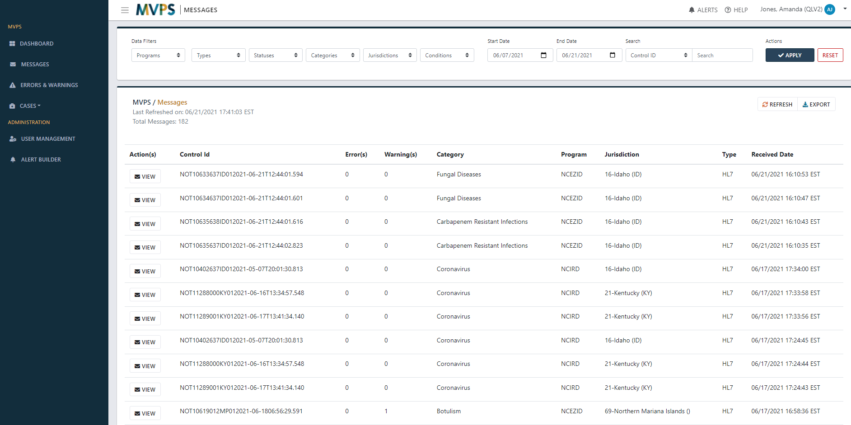
23
Stage 2: Limited Production
  Review larger batches of limited production data for systematic issues
  Designate specific case scenarios for complicated or rare issues
  During kickoff, set clear expectations and timelines for program feedback

Slide 24
High-Level NNDSS Onboarding Overview
Jurisdiction Test Environment
MVPS Secure Onboarding Environment
Stage 1
Test Messages
Stage 2
Limited Production Messages
Jurisdiction Production Environment
MVPS Production Environment
Stage 3
YTD Production Messages
24

Slide 25

25
Stage 3: Year-to-Date
  Jurisdictions’ production data in new format
  Onboarding specialists with programs
    assess for case number alignment
    no errors and major warnings
  Throughout YTD phase, onboarding specialists
    monitor messages for errors and major warnings
    facilitate any feedback

Slide 26
High-Level NNDSS Transition to Routine Notifications
MVPS Dashboard for New HL7 Messages
Jurisdiction Production Environment
Onboarding (O)
MVPS Production Environment
YTD Production Messages
Hig
Routine Notifications
Production (P)
26

Slide 27
High-Level NNDSS Transition to Routine Notifications
MVPS Dashboard for New HL7 Messages
Jurisdiction Production Environment
Onboarding (O)
MVPS Production Environment
YTD Production Messages
Routine Notifications
Production (P)
27

Slide 28
High-Level NNDSS Transition to Routine Notifications
MVPS Dashboard for GenV2 to Condition-Specific Guide
Jurisdiction Production Environment
Production (P)
MVPS Production Environment
YTD Production Messages
Routine Notifications
Production (P)
28

Slide 29
29
Timeline
  2021:
    End of June: DRAFT process document shared with programs
    End of August: Incorporated program feedback
    September: Share updated DRAFT process document with jurisdictions
    October 22: Jurisdiction feedback due to CDC
      Send to edx@cdc.gov
      Subject: “Updated Onboarding Process”
    Early November: Incorporate feedback and continue discussions as needed to finalize process
  2022:
    January: Start using updated process

Slide 30
Questions?
edx@cdc.gov

Slide 31

Next NNDSS Webinar: September 21, 2021
Subscribe to the monthly NNDSS newsletter, Case Surveillance News
Access the NNDSS Technical Resource Center
Email edx@cdc.gov to request NNDSS technical assistance or begin onboarding HL7 message mapping guides
Next NNDSS eSHARE:
October 19, 2021 (more details coming soon)

