Slide 1
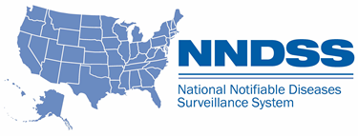
National Notifiable Diseases Surveillance System (NNDSS) eSHARE August Webinar
Center for Surveillance, Epidemiology, and Laboratory Services
Division of Health Informatics and Surveillance
August 24, 2021

Slide 2

Agenda
Agenda
  NNDSS updates and announcements
  2020 reconciliation process
  New line lists available in the Message Validation, Processing, and Provisioning System (MVPS)
  2020 NNDSS aggregate coronavirus disease 2019 (COVID-19) request
  Questions
2

Slide 3
NNDSS Updates and Announcements
Center for Surveillance, Epidemiology, and Laboratory Services
Danielle Tack, DVM, MPVM, DACVPM
Lead, Data Standardization and Assistance Team
Center for Surveillance, Epidemiology, and Laboratory Services

Slide 4
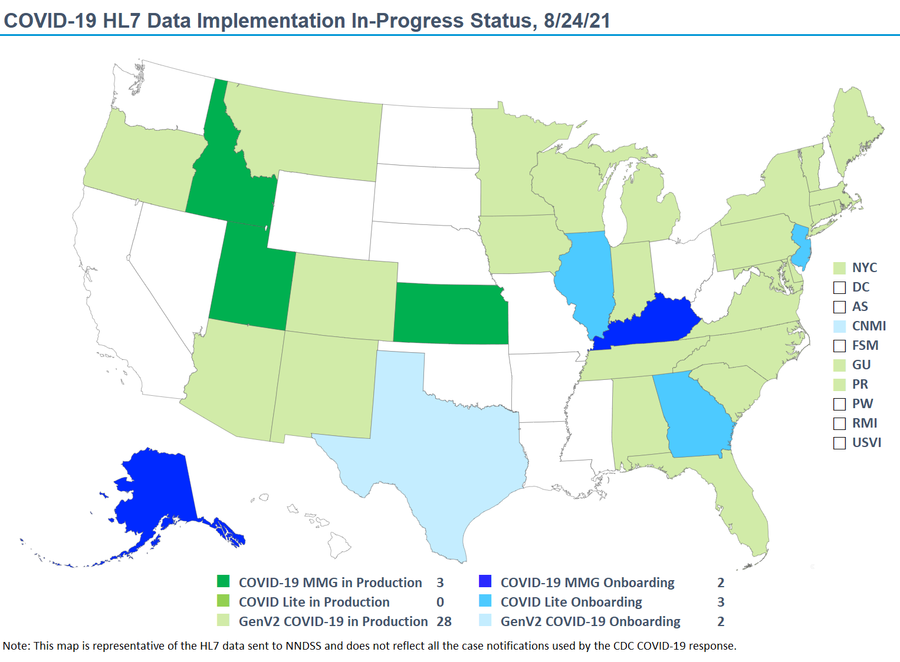

stat

Slide 5
PHIN VADS Case View version 9: https://phinvads.cdc.gov/vads/ViewView.action?id=F7DBD780-2301-EC11-81A3-005056ABE2F0
Signs and Symptoms (COVID-19): https://phinvads.cdc.gov/vads/ViewValueSet.action?id=F536C648-DBFA-EB11-81A2-005056ABE2F0
Lab Test Type (COVID-19): https://phinvads.cdc.gov/vads/ViewValueSet.action?id=F3FCA5F0-DAFA-EB11-81A2-005056ABE2F0
Vaccine Type (NND): https://phinvads.cdc.gov/vads/ViewValueSet.action?id=0EA29DDB-8FFE-EB11-81A2-005056ABE2F0
Manufacturers of vaccines (MVX): https://phinvads.cdc.gov/vads/ViewValueSet.action?id=EA41E4FE-035D-4033-BF90-C95101AA0A0D
Updates: Coronavirus Disease 2019 (COVID-19) MMG
  NEW: The PHIN Vocabulary Access and Distribution System COVID-19 Case Notification View has been updated
      Version 9 is now the most up-to-date version
      Includes six additional values to Signs and Symptoms (COVID-19)
      Includes an additional value to Lab Test Type (COVID-19)
      Includes two additional values to Vaccine Type (NND)
      Includes two additional values to Manufacturers of vaccines (MVX)

Slide 6

MVPS Portal Open Forums
MVPS Portal Open Forums
  NNDSS is offering Q&A sessions to further assist jurisdictions with changes to MVPS
  Please be on the lookout for additional details and teleconference information
    Open Forum 1: September 1, 2021 – 3:00pm EDT
    Open Forum 2: September 16, 2021 – 4:30pm EDT
    Open Forum 3: September 20, 2021 – 3:30pm EDT
    Open Forum 4: September 28, 2021 – 4:00pm EDT

Slide 7
Reconciliation Process for the National Notifiable Infectious Diseases and Conditions Annual Tables, 2020
Center for Surveillance, Epidemiology, and Laboratory Services
Ruth Jajosky, DMD, MPH
Lead, Case-Based Surveillance Operations Team
Center for Surveillance, Epidemiology, and Laboratory Services
Diana Onweh, Deborah Adams, Alan Schley
Data Management & Reporting (DMR) Team
Case-Based Surveillance Operations Team
Center for Surveillance, Epidemiology, and Laboratory Services
Melissa Pagaoa, MPH
Lead, Data Management Team
National Center for HIV, Viral Hepatitis, STD, and TB Prevention

Slide 8
2020 Reconciliation Process Topics:
  Overview of the 2020 reconciliation process
  Steps for finalizing NNDSS data
  Steps for finalizing sexually transmitted disease (STD) data
  2020 reconciliation data tables
  Questions
8

Slide 9
What is NNDSS Reconciliation?
  Process to finalize case counts for the previous year
    Agreement between reporting jurisdiction database and CDC NNDSS database
  Guidance provided:
    State/Territorial Epidemiologist letter and 2020 production calendar
    State reporter letter with:
      Reconciliation tables (1–13) with instructions for reviewing tables
      Unformatted reconciliation data in Excel workbook
      Week-ending calendar
      2020 NNDSS event code list
  Final steps: State or Territorial Epidemiologist signs-off on final counts
9

Slide 10
2020 Reconciliation Production Calendar
08/20/2021 State/Territorial Epidemiologist reconciliation letter with production calendar
08/23/2021 Reconciliation Kick-off: Data Management & Reporting Team (DMR) starts sending reconciliation packets to State/Territorial Epidemiologist/reporters
08/24/2021 eSHARE Webinar: Reconciliation Process for NNDSS Annual Tables, 2020
09/24/2021 ArboNet database closed
Pediatric flu mortality and novel flu database closed
Animal rabies database closed
STD database closed
Varicella morbidity and mortality database closed
Tuberculosis database closed
10

Slide 11
2020 Reconciliation Production Calendar (cont’d)
10/01/2021 Last day for jurisdictions to request DMR to “lock” their STD and non-STD data as final
Last day for jurisdictions to confirm or update their 2020 reporting exceptions
DMR sends a set of updated reconciliation tables for final review by the jurisdiction
After final review, DMR emails final counts to State/Territorial Epidemiologists for signatures
10/29/2021 Last day for State/Territorial Epidemiologists to email final signature reports back to CDC
Last day for jurisdictions to submit final 2020 NNDSS aggregate COVID-19 case counts
10/29/2021 NNDSS database CLOSED (final) for all jurisdictions
03/18/2022 Publish the final 2020 nationally notifiable infectious diseases tables on CDC WONDER
11

Slide 12
Steps for Finalizing NNDSS Data
Steps for Finalizing NNDSS Data

Slide 13
Step 1: Reconciliation Kick-Off
DMR sends out reconciliation packets that include:
  Overview of changes and guidelines for this year
  Production calendar
  Week-ending calendar for 2020 and 2021
  Abbreviated event code list for 2020
  Instructions for reviewing reconciliation tables
  Reconciliation tables 1–13
13

Slide 14
Step 2: Data Reconciliation
  Ensure necessary staff have MVPS portal access through Secure Access Management Services (SAMS)
    Jurisdiction Data Manager sends e-mail to edx@cdc.gov with subject "New MVPS User Access"
  Use reconciliation tables and the MVPS portal line lists to compare CDC totals/data with totals/data from jurisdiction system(s)
  Send case notification updates to correct differences
    National Electronic Telecommunications System for Surveillance (NETSS):
      send complete Year-to-Date (YTD) files (STD, non-STD) by placing files into your SAMS "YTD" folder
      YTD files must contain complete data for each year represented in the file
    HL7/NEDSS Base System (NBS): send case notification updates
14

Slide 15
Step 2: Data Reconciliation (cont’d)
  Use the MVPS portal to review transactional and case summary data
    Extract line lists using the MVPS portal
  Request new set of reconciliation tables from DMR as needed
  Resolve transmission issues
    Check to see if you have an expired PHIN Messaging System (PHINMS) digital certificate
    If yes, contact the PHINMS Help Desk at PHINtech@cdc.gov
  Contact your DMR specialist if you need additional assistance
15

Slide 16
Final Steps: Finalizing Data and State Epi Sign-off
  Let DMR specialist know when totals are accepted as final
    “Lock” STD conditions as final
    “Lock” non-STD conditions as final
    After locking 2020 data, subsequent updates will be accepted but not included in locked totals unless jurisdiction requests to “unlock” their data
    When jurisdiction requests DMR to "lock" their data again, the additional updates will be included
  Confirm or update your 2020 reporting exceptions
  DMR sends new set of reconciliation tables for final review by jurisdiction; after confirmation, final summary report is sent to State/Territorial Epidemiologist for signature.
16

Slide 17
Assistance with Reconciliation
Guidance documents will be available for viewing within the MVPS portal
DMR specialists
  Deborah Adams (daa2@cdc.gov): AL, AK, CA, HI, KS, ME, MA, MN, MO, NE, NC, ND, NYC, OR, PR, SC, VT, VA
  Diana Onweh (onw1@cdc.gov): AR, CO, CT, GA, ID, IA, IL, IN, LA, MD, MI, MS, NH, NV, PA, TN, TX, WA, WY​
  Alan Schley (aso7@cdc.gov): AZ, DE, FL, KY, MT, NJ, NM, NY, OH, OK, RI, SD, UT, DC, WV, WI, territories
17

Slide 18
2020 Data Reconciliation Tips
  Work with CDC programs to finalize your case counts
  Use the MVPS portal to review your 2020 low incidence conditions that require special verification; send case notification updates to correct data as appropriate
18

Slide 19
Steps for Finalizing Sexually Transmitted Diseases
Steps for Finalizing
Sexually Transmitted Diseases

Slide 20
Sexually Transmitted Diseases
  Division of STD Prevention (DSTDP) sends out 4th quarter reports to jurisdictions the week of August 16
  Deadline for “final” STD 2020 data: September 24, 2021
    Jurisdictions are encouraged to send data before deadline
  After jurisdiction STD programs inform DMR that final STD 2020 data were sent to CDC, DMR will send updated reconciliation tables to jurisdictions
  Jurisdiction STD programs will confirm/revise numbers and request DMR to lock data
  DSTDP will perform quality assurance processes based on locked data and send final sign-off letters to jurisdictions
20

Slide 21
Sexually Transmitted Diseases (cont’d)
  Deadline for STD Program Manager and State/Territorial Epidemiologist to return final, approved sign-off letters to DSTDP: October 29, 2021
  STD Contact: Alesia Harvey
    aharvey@cdc.gov; 404-639-8196
21

Slide 22
Sexually Transmitted Diseases (cont’d)
  Table 4 – Race/Ethnicity by Disease
    The STD program collects Office of Management & Budget (OMB) race categories (select all that apply) in the program-specific variables
    The race/ethnicity data presented in the table and line list do not reflect these data. STD data default to 9 (unknown)
  Table 11 – Import Status by Disease
    STD program has modified this variable and the data are captured in the program-specific variables
    The data presented in reconciliation report and line list do not reflect this; default to “unknown”
22

Slide 23
2020 Reconciliation Data Tables
2020 Reconciliation Data Tables

Slide 24
2020 Reconciliation Tables for
National Notifiable Infectious Diseases
Table 1 Case count by receiving system and disease
Table 2 Case count by case status classification and disease
Table 3 Case count by month and disease
Table 4 Case count by race/ethnicity and disease
Table 5 Case count by age group (years) and disease
Table 6 Case count by sex and disease
Table 7 Case count by Morbidity and Mortality Weekly Report (MMWR) week and disease
Table 8 Case count by reporting county and disease
Table 9 Case count by Genv2-based HL7 "county of residence" and disease
Table 10 Case count by outbreak status by disease
Table 11 Case count by import status by disease
Table 12 Case count by disease and reporting exception [diseases that are "not
reportable" or where data are "unavailable"]
Table 13 Case count for retired event codes
Excel Workbook Tables 1–11 in machine-readable format
24

Slide 25
Reporting Exceptions
  Excludes cases from counts if condition is not reportable in jurisdiction; the NNDSS tables display “N” if condition is not reportable
  Excludes cases from counts if data are incomplete or unavailable in jurisdiction; the NNDSS tables display “U” if data are unavailable
  Ensures appropriate denominators for rates are included
  For the Year 2020:
    The NNDSS tables “N” indicators are currently assigned based on reporting exceptions finalized during last year’s reconciliation
    For annual statistics, DMR will incorporate finalized 2020 reporting exceptions as confirmed by jurisdictions during reconciliation
25

Slide 26
Table 12. State-Specific Case Count by
Disease and Reporting Exception
DISEASE | EVENT | REPORTING EXCEPTION (cases not printed) | CASES REC’D
Babesiosis, total | 12010 | Not Reportable | 1
Babesiosis, confirmed | 12010 | Not Reportable | 0
Babesiosis, probable | 12010 | Not Reportable | 1
Hantavirus infection (non-HPS) | 10610 | Not Reportable | 0
Leptospirosis | 10390 | Not Reportable | 2
Q fever, chronic | 10258 | Data Unavailable | 0
Information on notifiable conditions that are not reportable or
do not have data available for the jurisdiction
26

Slide 27
Table 2. State-Specific Case Count by
Case Status and Disease
DISEASE | EVENT | UNKNOWN STATUS | SUSPECT STATUS | PROBABLE STATUS | CONFIRMED STATUS | PRINT TOTAL | TOTAL REPORTED TO CDC
Anthrax | 10350 | 0 | 0 | 0 | 1 | 1 | 1
Babesiosis, Total | 12010 | 0 | 0 | 1 | 2 | 3 | 3
Babesiosis, confirmed | 12010 | 0 | 0 | 0 | 2 | 2 | 2
Babesiosis, probable | 12010 | 0 | 0 | 1 | 0 | 1 | 1
Botulism, foodborne | 10530 | 0 | 0 | 0 | 0 | 0 | 0
Botulism, infant | 10540 | 0 | 0 | 0 | 10 | 10 | 10
Botulism, other (wound/unspecified) | 10550 | 0 | 0 | 4 | 5 | 5 | 9
Brucellosis | 10020 | 0 | 0 | 1 | 16 | 17 | 17
Campylobacteriosis | 11020 | 0 | 0 | 1,781 | 1,131 | 2,912 | 2,912
Candida auris, clinical | 50263 | 0 | 0 | 0 | 0 | 0 | 0
Carbapenemase-prod Carbapenem-res (CP-CRE) | 50244 | 0 | 0 | 0 | 0 | 0 | 0
Chancroid | 10273 | 0 | 0 | 0 | 1 | 1 | 1
Chlamydia trachomatis infection | 10274 | 0 | 0 | 896 | 119,862 | 120,758 | 120,758
Cholera | 10470 | 0 | 0 | 0 | 0 | 0 | 0
Coccidioidomycosis | 11900 | 0 | 0 | 0 | 0 | 0 | 0
27

Slide 28
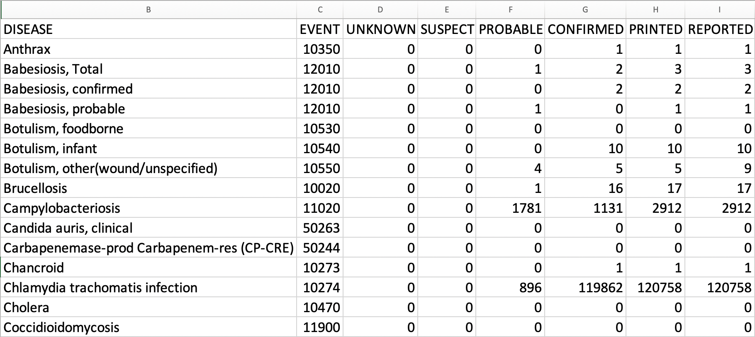
Example: Unformatted Excel Workbook, Table 2
28

Slide 29
New Line List Available in MVPS
Center for Surveillance, Epidemiology, and Laboratory Services
Sara Johnston, MPH
NNDSS Program Lead
Center for Surveillance, Epidemiology, and Laboratory Services

Slide 30

Line List for Reconciliation
  Line list can be downloaded from MVPS containing all data elements in the emailed reconciliation reports
  MVPS provides secure delivery
    Line list contains personally identifiable information (PII)
    Only download on devices approved by your public health agency
  Jurisdiction can match line list to an export from the surveillance system to confirm:
    CDC has all the correct cases
    Each case’s characteristics match (e.g., sex = male in both systems)
30

Slide 31
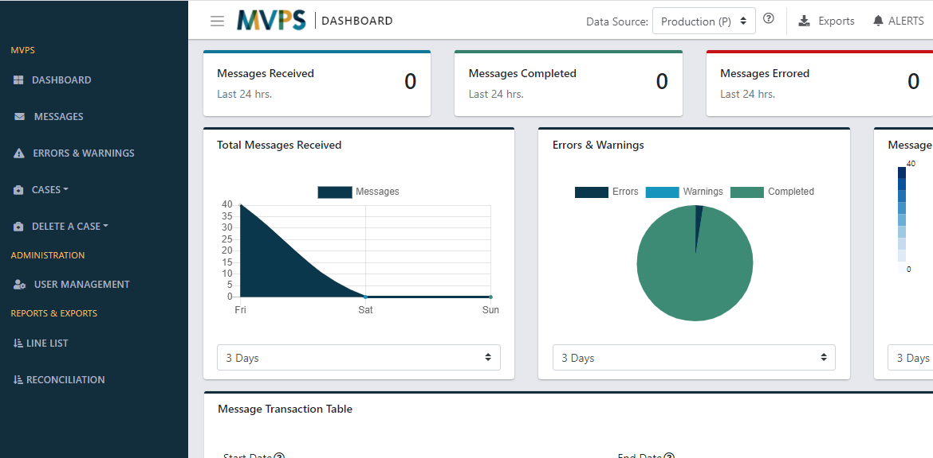
New Reports & Exports Section
3
  Line List – Download line list with all data elements in emailed reconciliation tables
  Reconciliation – 2020 reconciliation resources
  Exports – Place to retrieve downloaded line lists
1
2
31

Slide 32
2020 NNDSS Aggregate COVID-19 Data Request
Center for Surveillance, Epidemiology, and Laboratory Services
Ruth Jajosky, DMD, MPH
Lead, Case-Based Surveillance Operations Team
Center for Surveillance, Epidemiology, and Laboratory Services

Slide 33
Process for 2020 NNDSS COVID-19 Data
  Final 2020 NNDSS data for COVID-19 will not be reconciled
  CDC will collect aggregate case counts for confirmed and probable cases
  CDC will provide an Excel worksheet with instructions to help you prepare your data
  CDC will send an email to the State/Territorial Epidemiologists with the link to the Epi Info™ web form to enter the data
  State/Territorial Epidemiologists will sign off on the aggregate counts in Epi Info™
  CDC will use the aggregate counts in the 2020 annual NNDSS tables
33

Slide 34
COVID-19 Data for the 2020 Annual NNDSS Tables
  2020 final NNDSS COVID-19 aggregate data are needed for confirmed and probable cases among U.S. residents for:
    Total cases in jurisdiction
    Month (based upon MMWR weeks)
    Age group
    Sex
    *Race and Hispanic ethnicity
  States send data for all the above categories
  U.S. territories send only total confirmed and probable cases
  NNDSS will collect counts for unknown or missing demographic and month data
*Race and ethnicity will be collected in a combined table but will be presented separately in the published NNDSS tables. (See next slide.)
34

Slide 35
Combined Race and Ethnicity Categories
  Cross tabulations of the following race categories with each of the Hispanic ethnicity values (Hispanic, non-Hispanic, and unknown/missing Hispanic ethnicity) are as follows:
    Native American or Alaska Native
    Black or African American
    White
    Asian
    Native Hawaiian or Other Pacific Islander
    Other or multi-race
    Unknown or missing race
35

Slide 36
Race Categories
  These race categories are different from race in the NETSS* record layout:
    Asian and Native Hawaiian or Other Pacific Islander are separate categories
  If a person has multiple races, only count the case under the “Other or multi-race” category
  In the 2020 NNDSS tables, race and ethnicity data will be presented separately, just as they appear in the 2019 NNDSS annual tables
*NETSS: National Electronic Telecommunications System for Surveillance
36

Slide 37
Epi Info™ Web Form for 2020 Final NNDSS COVID-19 Aggregate Data
  To allow for secure data entry, CDC will provide a unique Epi Info™ web form link to each State/Territorial Epidemiologist
  Enter requested data into the form and ensure the State or Territorial Epidemiologist reviews and approves the data
    Coordinate within your jurisdiction on who should enter aggregate 2020 COVID-19 data into the form
    Different people can enter different components of the data, but only one person can enter at a time
      If multiple people enter data at the same time, one person may overwrite the changes of another
    After the data entry is complete, the State or Territorial Epidemiologist can use the link to the Epi Info™ form to review, approve, and submit the final 2020 NNDSS COVID-19 data
37

Slide 38
Epi Info™ Web Form
  Remember: while the link can be shared, only one person at a time can enter data in the form!
  Do not click the “Submit” button until all data have been entered, reviewed, and approved by the State/Territorial Epidemiologist
  Email edx@cdc.gov with a subject line “2020 final NNDSS COVID-19 data” if you have questions or prematurely submit the data and need to reopen the form
38

Slide 39
CDC Review of Final Counts
  CDC review of final counts will include:
    Comparing submitted 2020 NNDSS COVID-19 aggregate data to:
      Aggregate case counts submitted by jurisdictions to the response (or pulled from websites)
      Line level data sent through NNDSS and/or CSV upload to DCIPHER
    Identifying potential data entry errors or transposition of data across fields
  In the Epi Info™ web form, enter the name and email of the person CDC should contact for questions
39

Slide 40
Timeline for the 2020 Final NNDSS COVID-19 Aggregate Data
  By Friday, October 29, 2021
    Jurisdictions should enter their data into the Epi Info™ web form
    State/Territorial Epidemiologist should approve the case counts for the 2020 NNDSS COVID-19 data in the Epi Info™ web form
    The finalized information and sign-off should be submitted through the Epi Info™ web form
40

Slide 41
Questions?
Questions?

Slide 42

Next NNDSS Webinar: September 21, 2021
Subscribe to the monthly NNDSS newsletter, Case Surveillance News
Access the NNDSS Technical Resource Center
Email edx@cdc.gov to request NNDSS technical assistance or begin onboarding HL7 message mapping guides
Next NNDSS eSHARE:
September 21, 2021 (more details coming soon)

