Slide 1
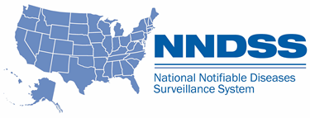
Special Session:
National Notifiable Diseases Surveillance System (NNDSS) eSHARE August Webinar
Center for Surveillance, Epidemiology, and Laboratory Services
Division of Health Informatics and Surveillance
August 10, 2021

Slide 2

Agenda
Agenda
  NNDSS Updates and Announcements
  New NNDSS Data Processing and Message Validation, Provisioning, and Processing System (MVPS) Enhancements
  Questions and Answers

Slide 3
NNDSS Updates and Announcements
Center for Surveillance, Epidemiology, and Laboratory Services
Michele Hoover, MS
Data Standardization and Assistance Team

Slide 4
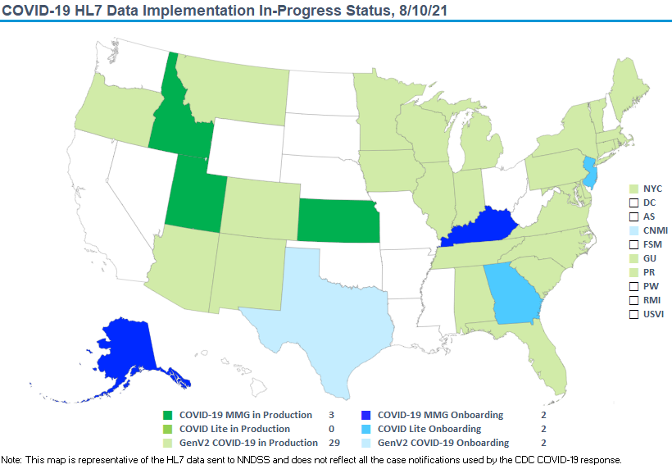

COVID-19 HL7 Data Implementation In-Progress Status, 8/10/21
COVID-19: Coronavirus Disease 2019

Slide 5
Reminder: COVID-19 Message Mapping Guide
  New: The PHIN Vocabulary Access and Distribution System (VADS) COVID-19 case notification view has been updated
    Version 8 is now the most up-to-date version
    Includes three new additional values to Lab Test Type (COVID-19)
PHIN VADS Case View version 8: https://phinvads.cdc.gov/vads/ViewView.action?id=32B71754-72DE-EB11-81A1-005056ABE2F0
Lab Test Type (COVID-19): https://phinvads.cdc.gov/vads/ViewValueSet.action?id=91389745-4EDB-EB11-81A1-005056ABE2F0

Slide 6
New NNDSS Data Processing and MVPS Enhancements
Center for Surveillance, Epidemiology, and Laboratory Services
Sara Johnston, MPH
Ruth Ann Jajosky, DMD, MPH
Andrew Kuehl, MIT, PMP

Slide 7
Topics
  Expanded MVPS functionality and how to access the MVPS portal
  Navigating the MVPS portal (Demo)
  Changes to National Electronic Telecommunication System for Surveillance (NETSS) year-to-date (YTD) file processing
  New low-incidence case verification process
  New case deletion functionality
  MVPS user roles and management

Slide 8
MVPS Will Process All NNDSS Data Streams
MVPS receives case notification messages from jurisdictions, performs data validations, and makes the data available to CDC programs
Jurisdictions use MVPS to view and monitor their case notification submissions
  Currently: MVPS processes Health Level 7 (HL7) data
  August 14 (Go Live): MVPS will process all incoming NNDSS messages for 2020 and 2021*
    HL7
    Legacy HL7
    NEDSS Base System (NBS) master message
    NETSS files
* Excluding legacy tuberculosis and arboviral disease messages

Slide 9
How Will MVPS Be Used?
Use the MVPS portal to do the following:
  View case notification data from all sources in one location.
  Review case counts, messages, and errors.
  Verify cases for low incidence conditions before publication.
  Delete cases or groups of cases (if jurisdiction cannot transmit deletion).
  Perform reconciliation; State Epidemiologist approves annual data (starting next year).
MVPS will be the source for weekly and annual NNDSS publications.

Slide 10
Rollout for MVPS Enhancements
August 2021
    Go-Live, August 14
    Reconciliation eSHARE webinar, August 24
September 2021
    Open Forum Q&A sessions, watch for emails/appointments
New job aids to support transition
  Job aids available for new functionality (linked with eSHARE and in MVPS Help)
  New user guides available soon in MVPS Help

Slide 11
Additional People May Need Access to MVPS
Each jurisdiction should identify at least two Jurisdiction Data Managers (DMs)
To add jurisdiction users:
  DM sends jurisdiction user contact information to EDX mailbox (edx@cdc.gov) with the subject “New MVPS User Access”
  Jurisdiction user receives an invitation email from CDC's Secure Access Management System (SAMS) with a link to MVPS*
  DM assigns jurisdiction user permissions and access to conditions in MVPS
*Additional SAMS identity verification may be required for some jurisdiction users. See March 2021 eSHARE for additional information on obtaining SAMS access for MVPS.

Slide 12
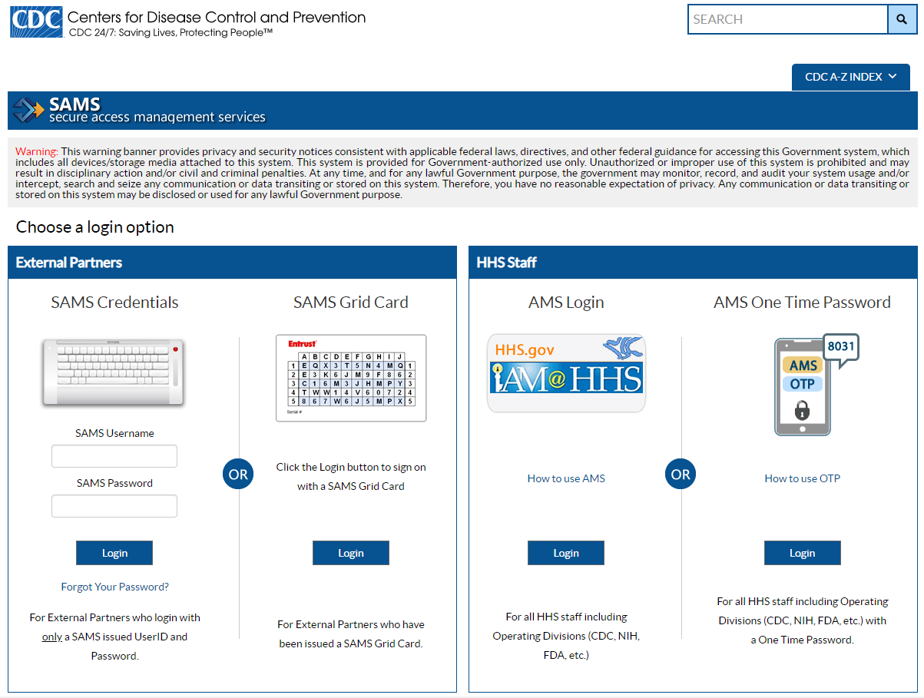
How to Log into the MVPS Portal
Step 1: Access MVPS via SAMS using either link below and enter your SAMS credentials
https://sams.cdc.gov or
https://mvps.cdc.gov

Slide 13
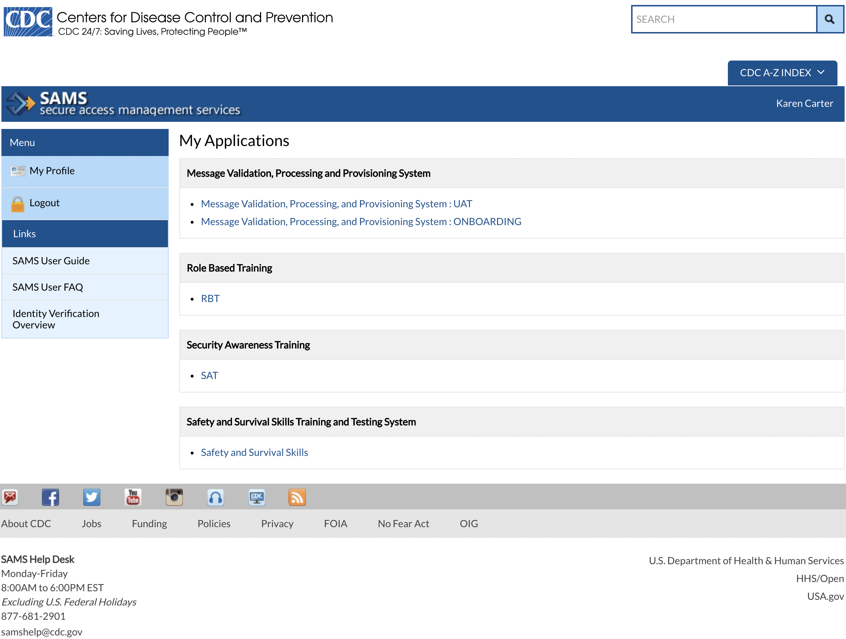
Select MVPS Link
Step 2:
In SAMS, select the MVPS link from list of “My Applications”

Slide 14
Navigating the MVPS Portal (Demo)
Navigating the MVPS Portal (Demo)

Slide 15
Important Activities for Jurisdiction Users
  The MPVS portal provides a visual interface for users to:
    Monitor case notification submissions within MVPS
    Identify data quality issues
    Perform various functions to verify and reconcile data

Slide 16
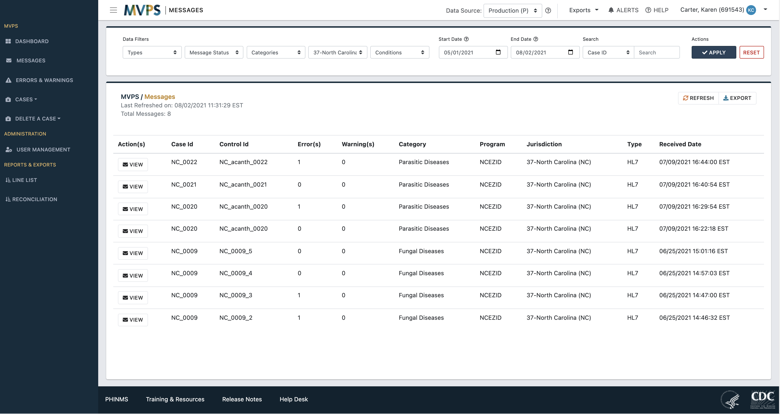

Recognize the MVPS Portal Framework
1
Top Navigation Bar
Left Menu Bar
Main View*
  Filters
  Search results
Footer Bar
a
b
2
3
*Note: Visibility limited by role-based permissions, default is 3 days
4

Slide 17

Use the Top Navigation Bar Features
User Name (Number)
1
2
3
4
5
6
7
8
Top left:
Menu toggle (on/off)
MVPS logo
Page title
Top right:
Data Source toggle
Exports
Alerts
Help
User options

Slide 18
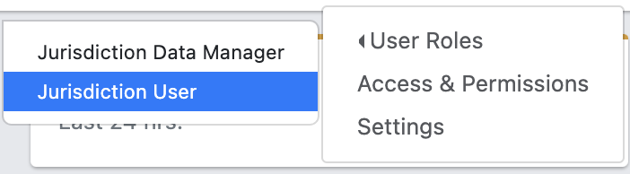
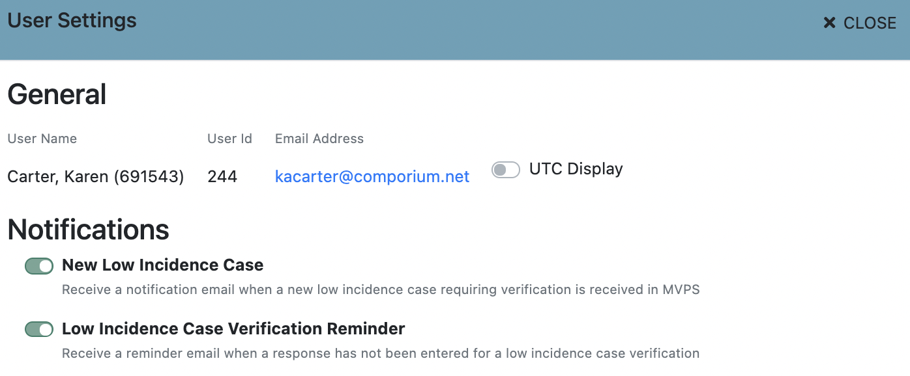
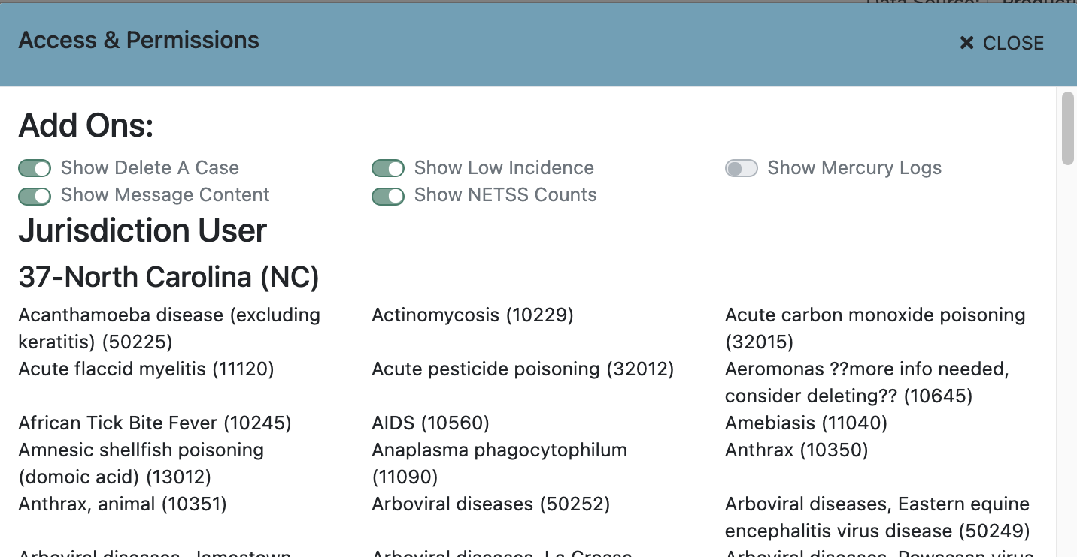
View User Role(s), Access and Permissions, and Settings
1
1
2
3
3
Jane Doe 123 jane@dph.gov
2

Slide 19
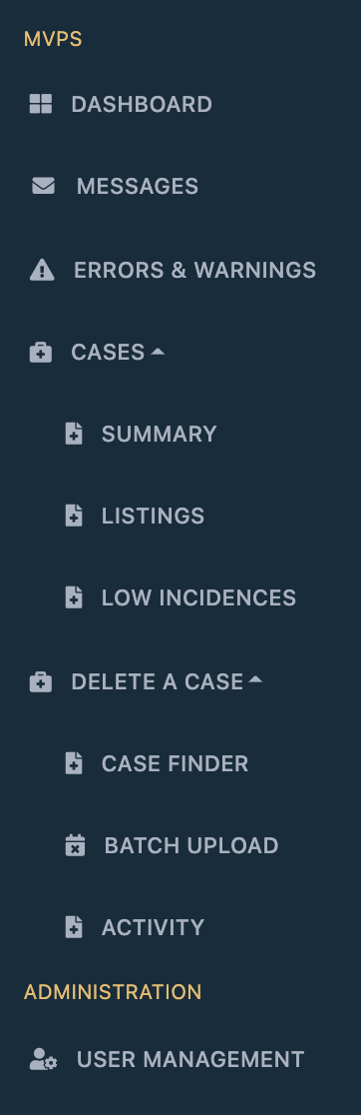
Links on the Left Menu Bar
1
Links all users can access
Permission-based links (assigned by Data Manager)
2

Slide 20
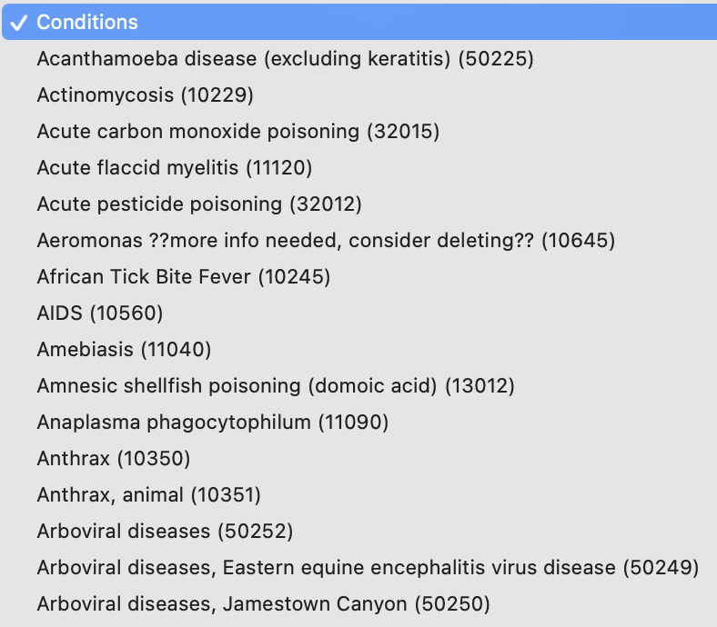
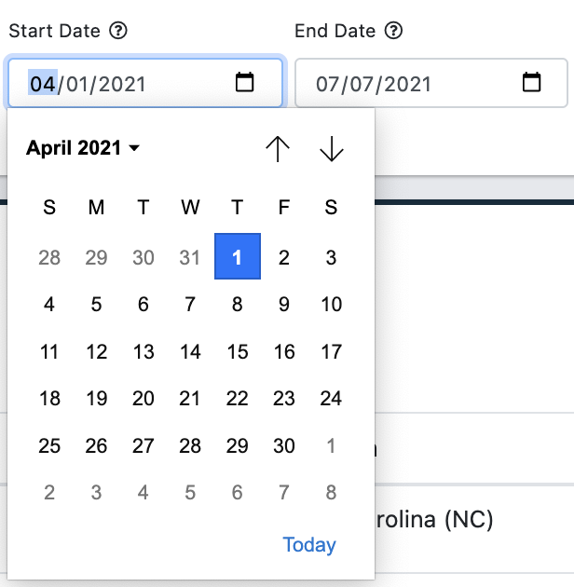
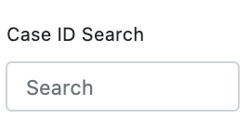
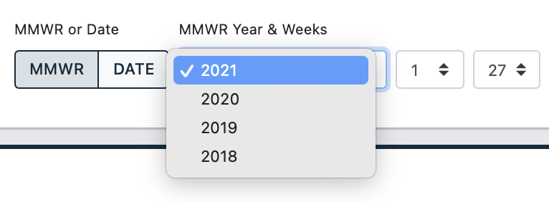
Use Filters to Customize Search Results
Unique group of filters pinned at the top of most pages in the portal
Filter settings do not automatically carry over to another page
Filter formats:
  Drop-down menu
  Date range
  ID search field
  Morbidity and Mortality Weekly Report (MMWR) year and week range
1
2
4
3

Slide 21
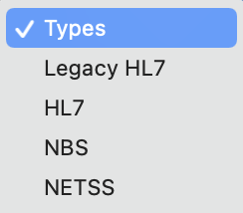
Use “Types” to Filter Search Results by Case Notification Format
  Most screens in the portal include a new “Types” drop-down menu filter to enable users to sort and view data by case notification format
  Message and case counts on the MVPS portal will automatically display all data types
  Errors and warnings will appear for all message types except for Legacy HL7

Slide 22
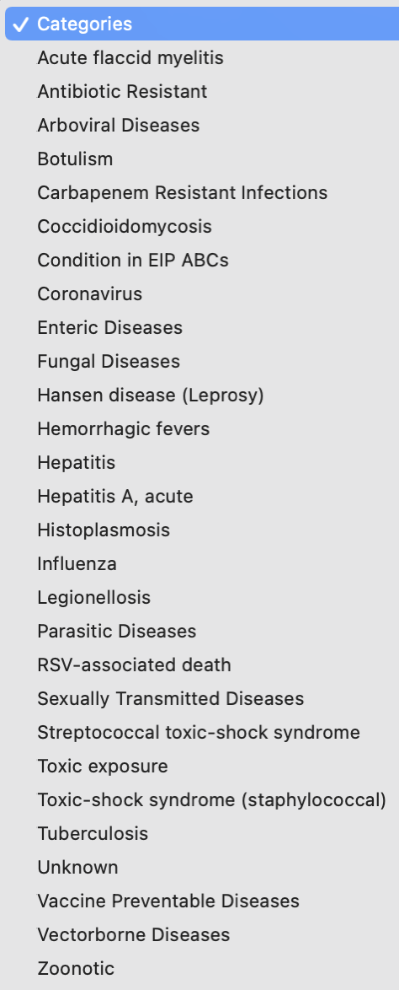
Use “Categories” to Filter Search Results by a Set of Conditions
Filter format: drop-down menu
Limited by permissions
Available on Messages and Case Listings pages

Slide 23
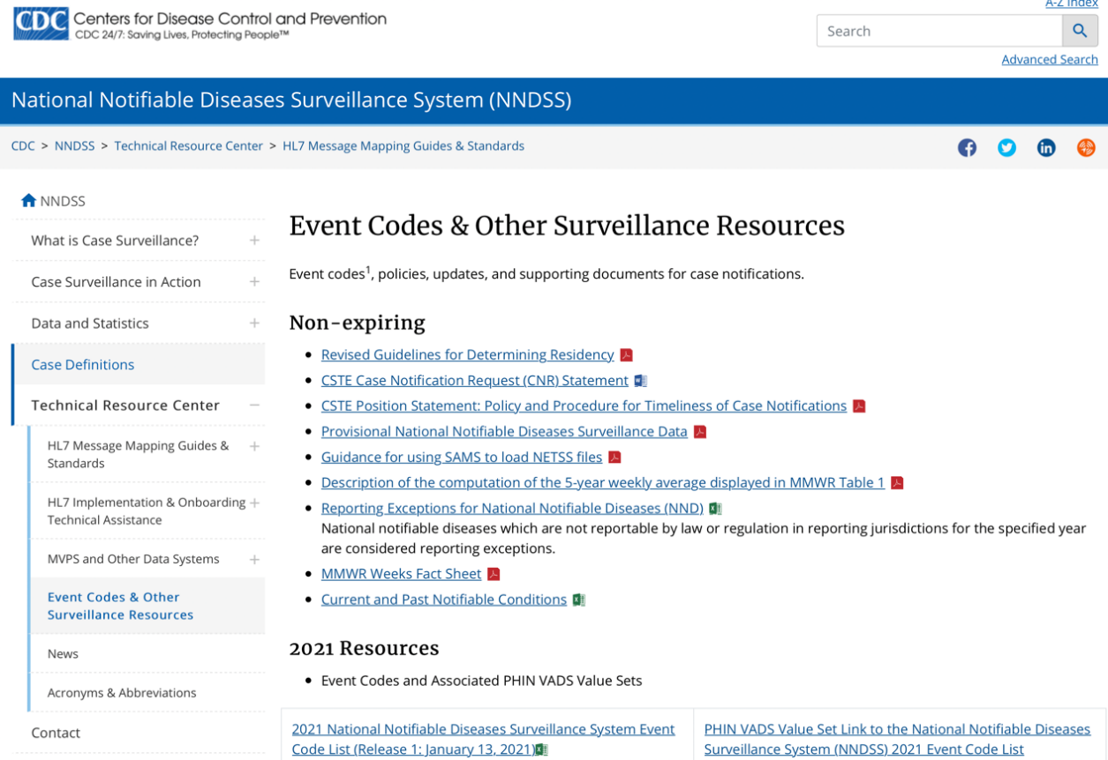
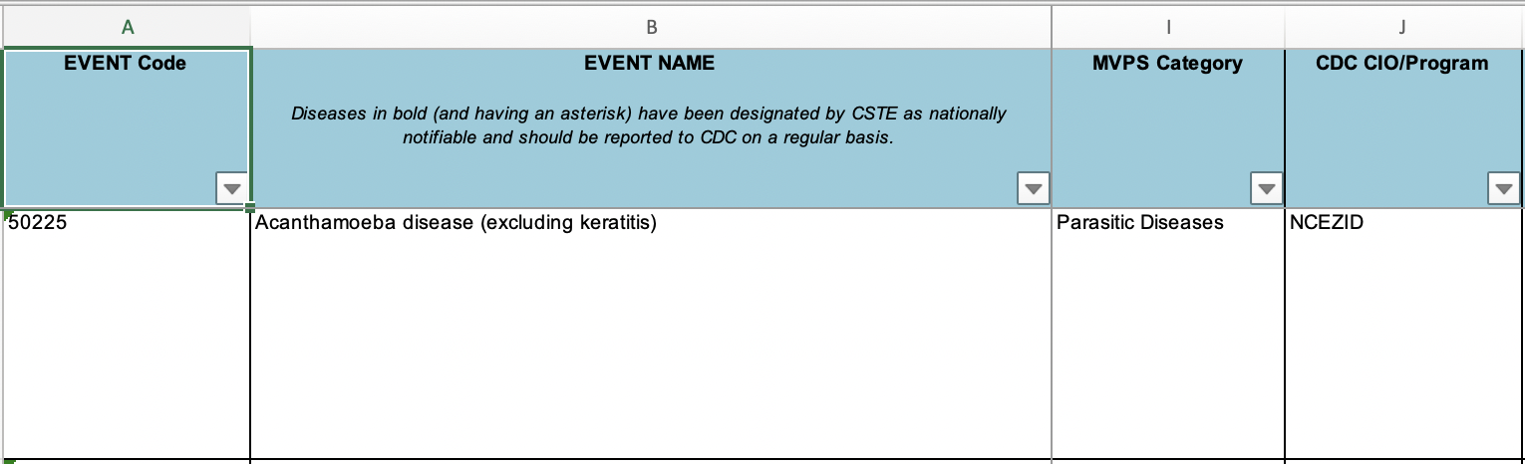
How MVPS Associates Conditions to Categories
Access the current (2021) NNDSS Event Code List on the NNDSS website under “Event Codes & Other Surveillance Resources” in the “Technical Resource Center”
Column I shows the MVPS Category for a condition
1
2

Slide 24
Menu Links Accessible by All Users*
  Dashboard home page
  Messages page
  Errors and Warnings page
  Case Summary page
  Case Listings page
*

Slide 25
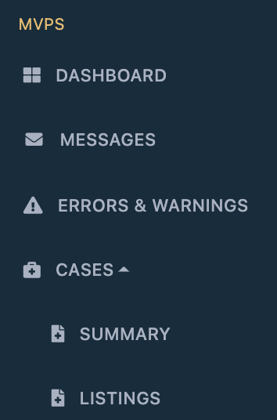
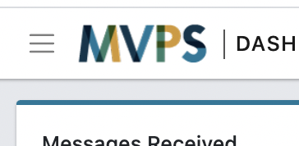
Use the Left Menu Bar to Navigate to the Dashboard Home Page (or Click “MVPS” on the Top Left)

Slide 26
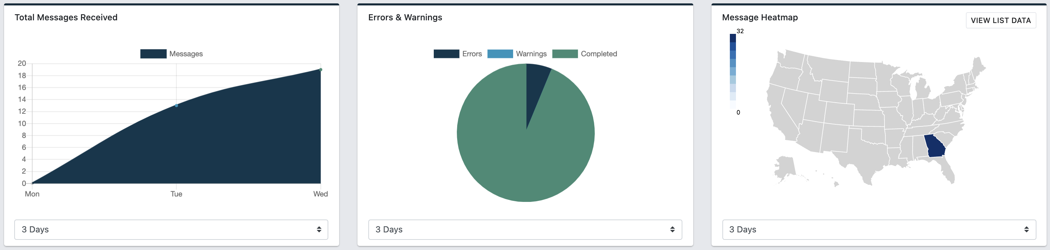
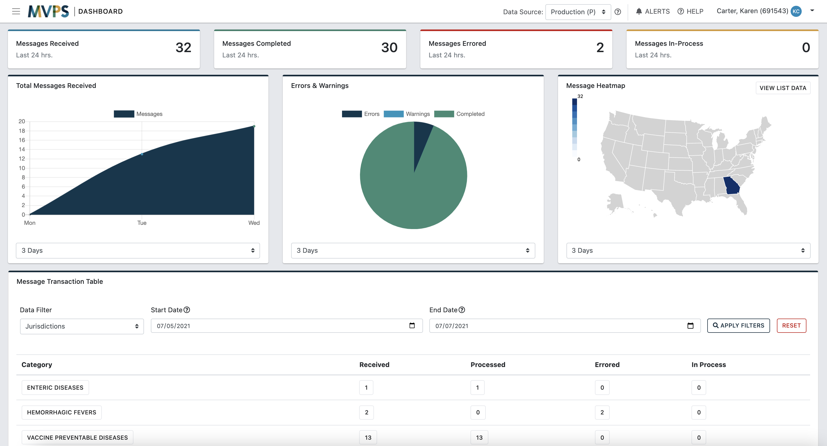
View Recent Message Activity on the Dashboard Home Page
1
2
1
Message activity over the past 24 hours
Message activity over the past three days (default)
2

Slide 27
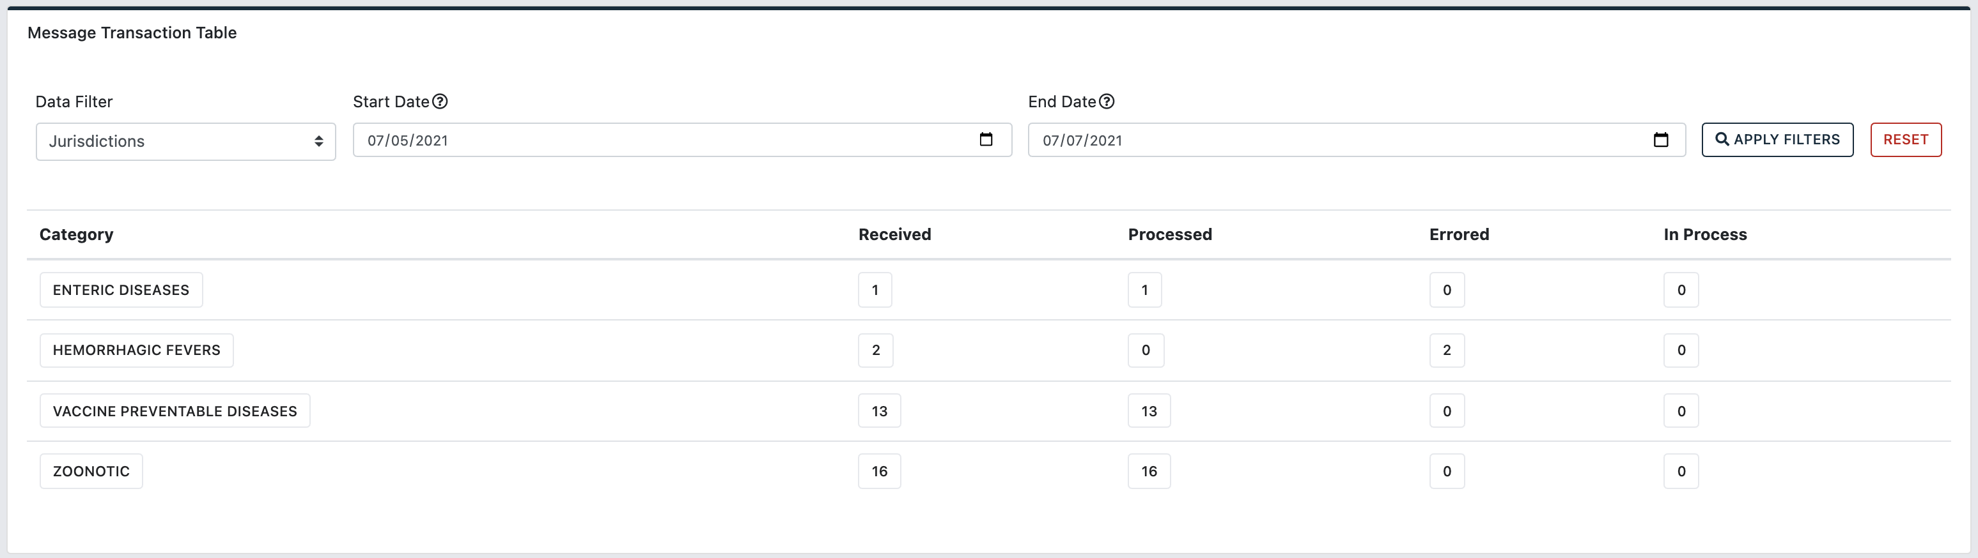
View Message Counts by Condition on the Message Transaction Table (Dashboard Home Page cont.)
3
Message activity by category of conditions over the past three days are default start/end dates
  Adjust “Start Date” and “End Date” filters to change the date range
3

Slide 28
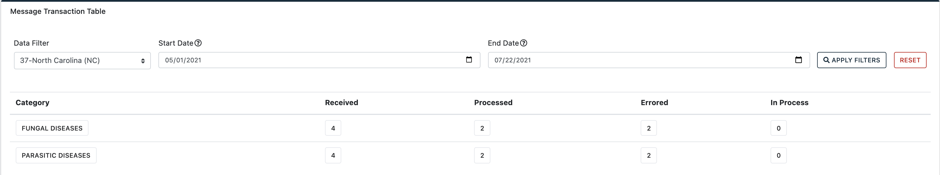
On the Message Transaction Table, Click Any Box to View a List of Messages for the Parameter (Column, Row)

Slide 29
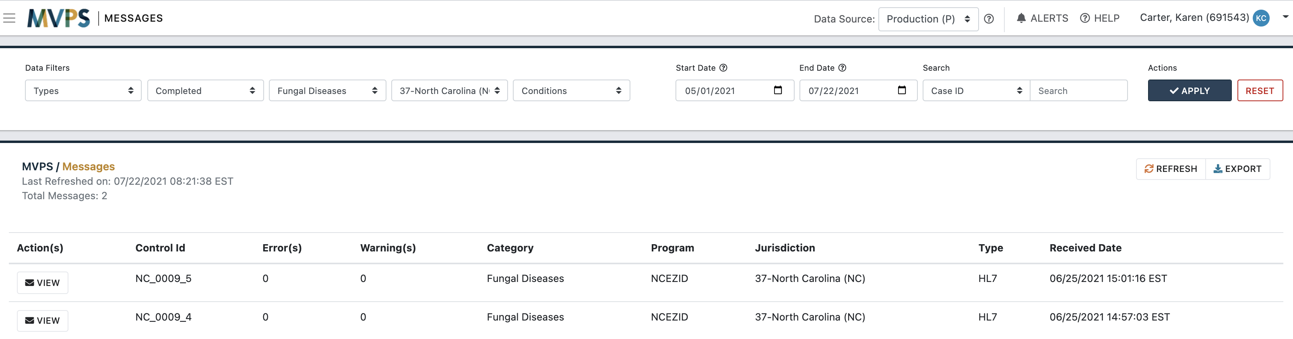

On the Messages page, a List of Messages for the Parameters Selected Will Display

Slide 30
Use the Left Menu Bar to Navigate to the Messages Page

Slide 31
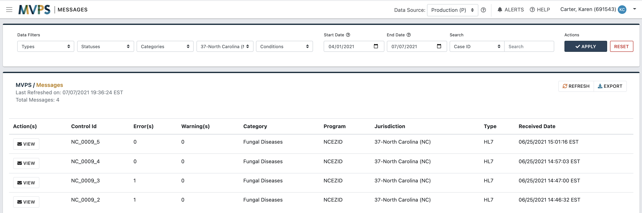
View Recent Message Activity on the Messages Page

Slide 32
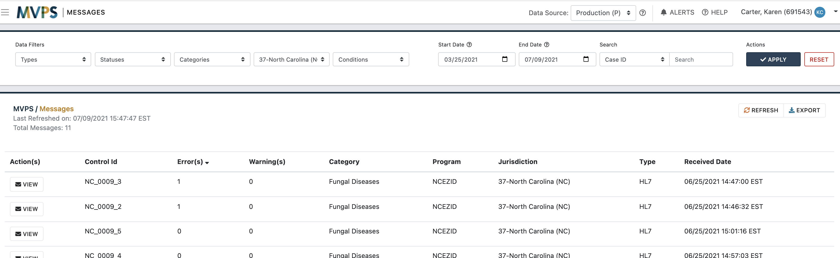
Click the Error(s) Column Heading to Sort Messages by Number of Errors

Slide 33
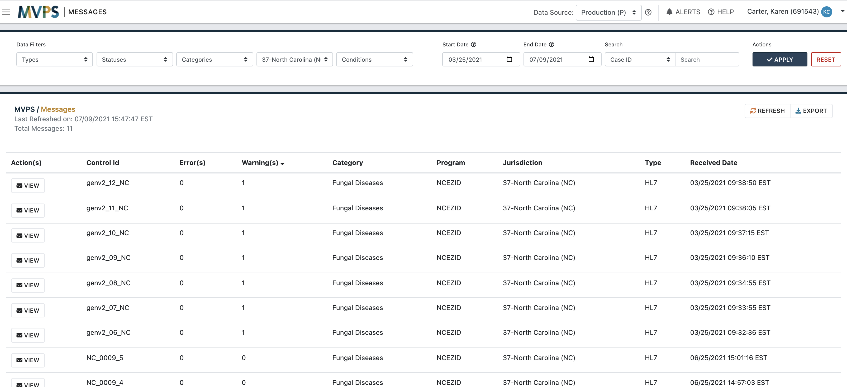
Click the Warning(s) Column Heading to Sort Messages by Number of Warnings

Slide 34
Select the “VIEW” Button to View More Information about a Message

Slide 35
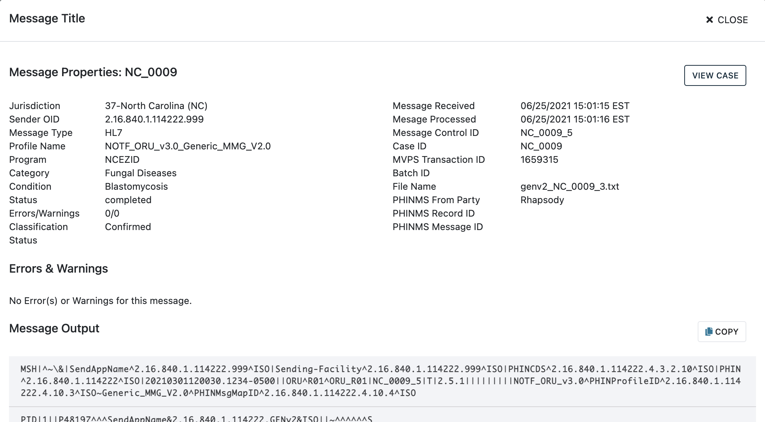
Next, the Message Properties Window Will Display
  MVPS Transaction ID is a unique ID assigned to all messages or transactions
  At the bottom, Message Output shows the raw message received.
  Note: NBS master message content appears in the NETSS format and legacy HL7 is currently unavailable.

Slide 36
Select the “VIEW CASE” Button to View More Information about the Case

Slide 37
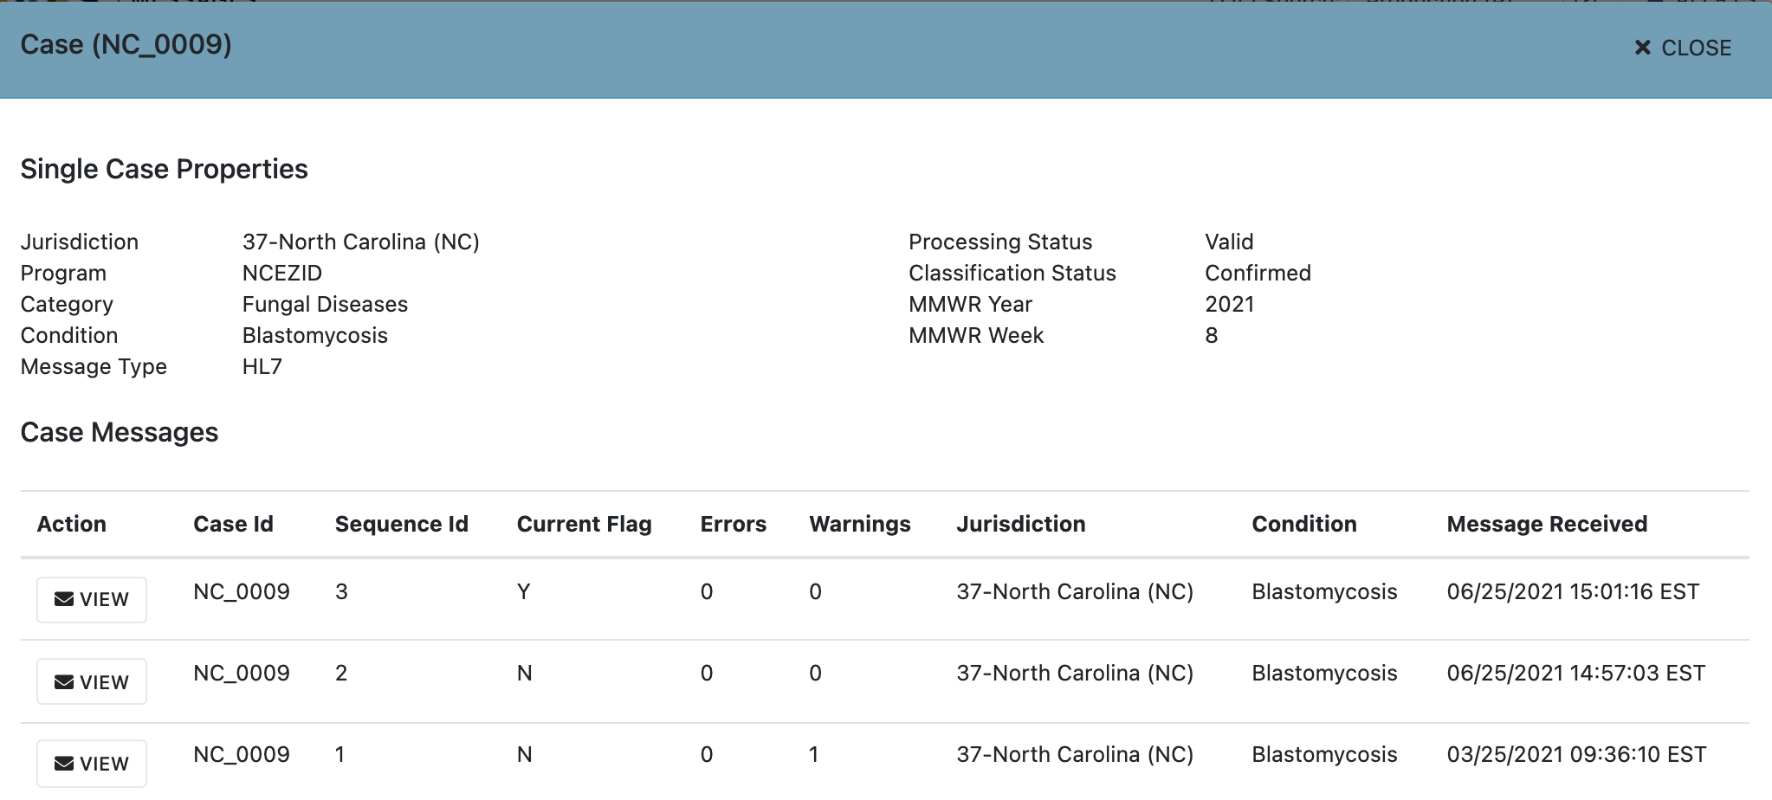
Next, the Case Properties Window Will Display

Slide 38
On the Case Properties Window, View the Message History for the Case
  Current Flag column:
    “Y” (current valid message)
    “N” (non-current valid message)
    “E” (errored message)
    Note: If the message with the highest sequence number is “E,” then the latest update for the case did not process successfully.

Slide 39
Use the Left Menu Bar to Navigate to the Errors & Warnings Page

Slide 40
What is an Error or Warning?
  MVPS performs structural, vocabulary, and business rule validations on messages
  When a validation check fails, MVPS issues an error or warning
  An error occurs when:
    Required data elements are missing or invalid.
    There are major systematic issues that cause the messages to be unreadable by MVPS.
    The data received do not make sense.

Slide 41
Difference between an Error and Warning
  An error:
    Stops the processing of a message (will not be updated in the MVPS database or provisioned to CDC programs)
    Should be corrected by transmitting an amended update message
  A warning:
    Is caused by less severe issues, such as an invalid value in a field that is not required
    Provides useful information to the sender about data quality and does not prevent the processing of a message or the provisioning of data to CDC programs

Slide 42
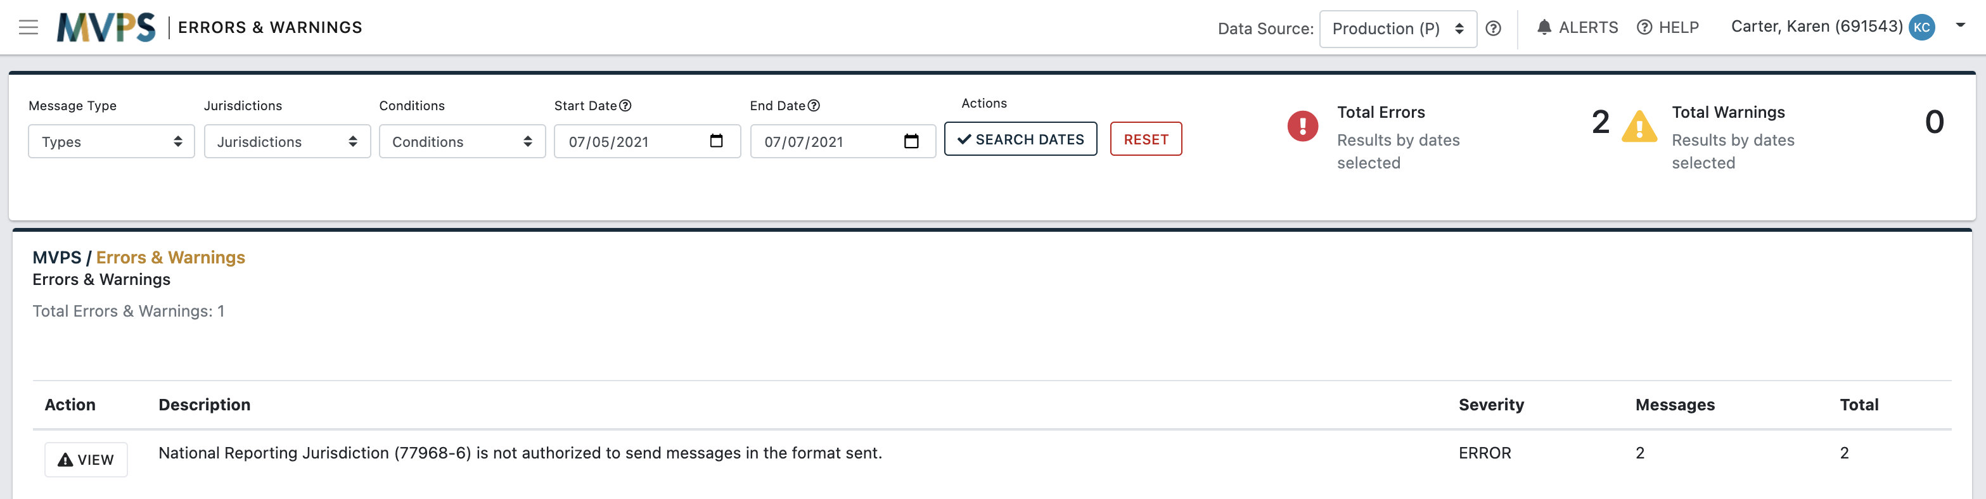
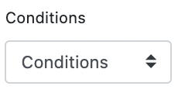
View the Data by Errors or Warnings across All Conditions on the Errors & Warnings Page

Slide 43
Select the “VIEW” Button next to an Error or Warning to View More Information

Slide 44
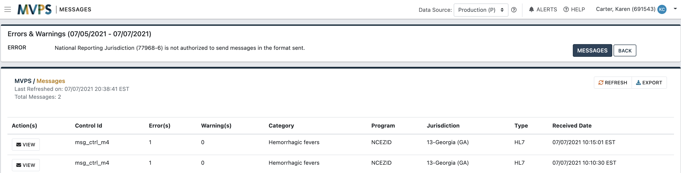
Next, a List of all Messages for the Error or Warning Will Display

Slide 45
Select the “VIEW” Button next to a Message to View More Information

Slide 46
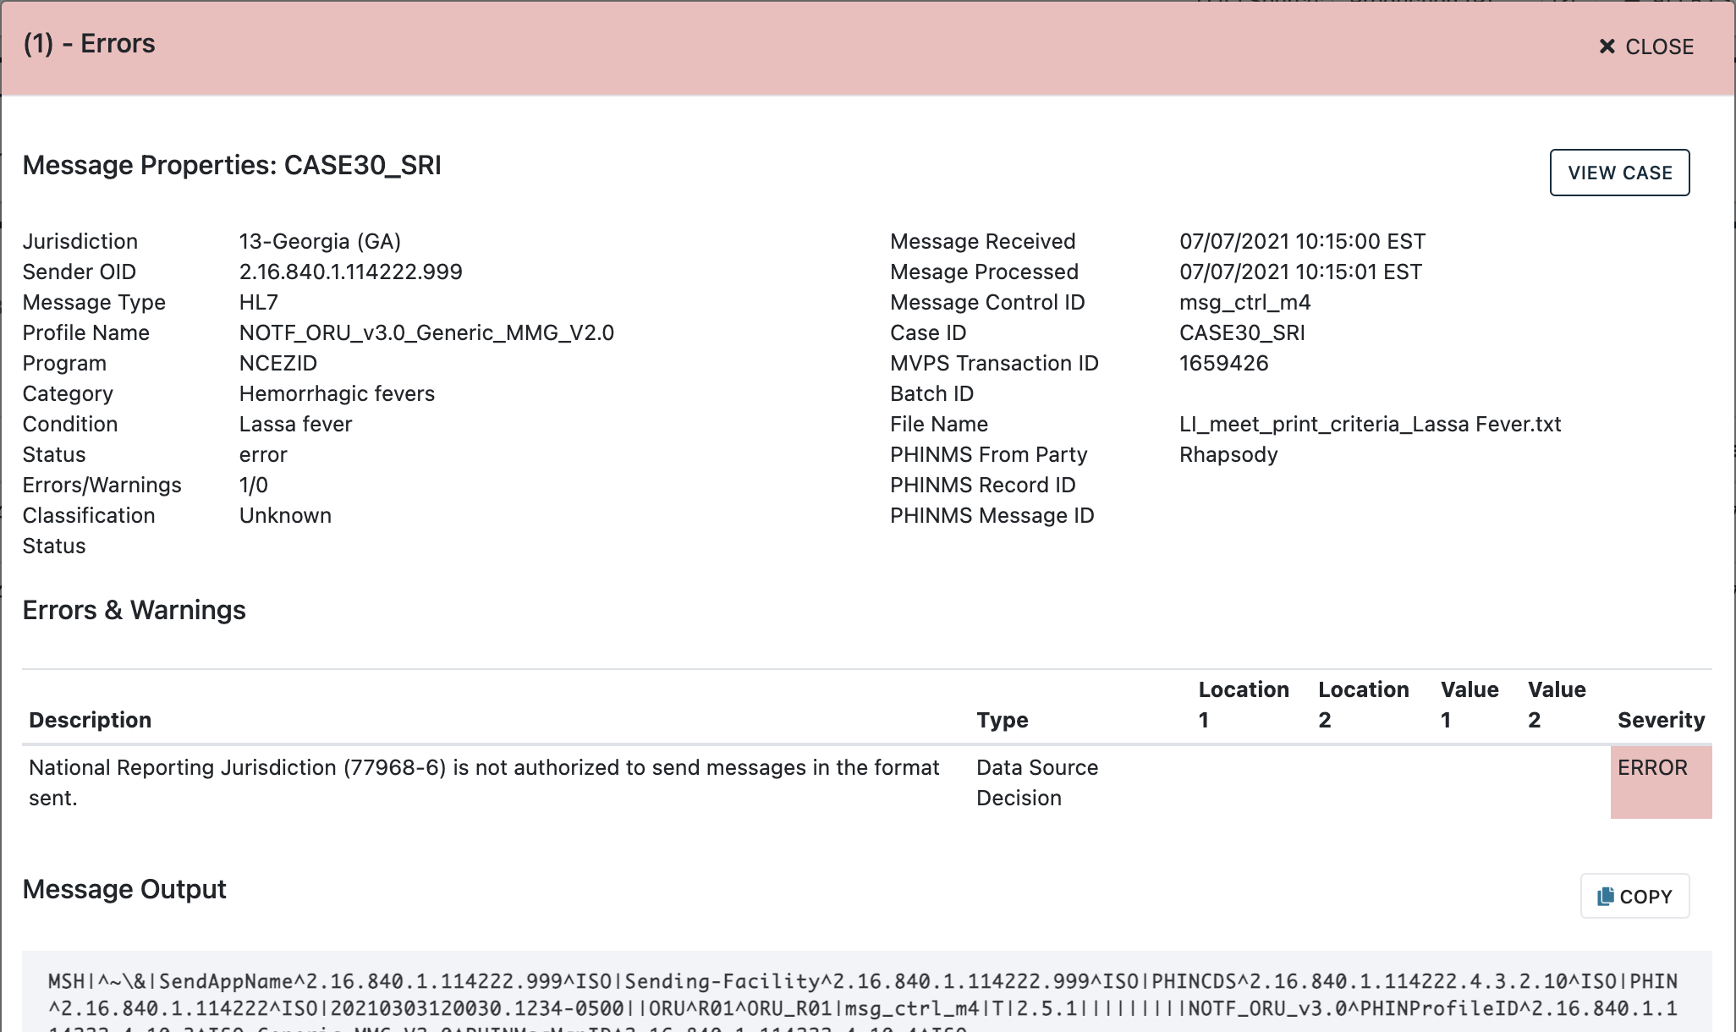
Next, Message Details on the Message Properties Window Will Display, including the Error Description

Slide 47
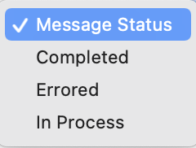
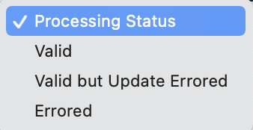
Use Filters to View Errored Messages or Cases in Search Results on other Pages in the MVPS Portal
  The Message Status drop-down menu on the Messages page enables users to search messages by “Error”
  The Processing Status drop-down menu on the Case Listings page enables users to search cases by “Errored” or “Valid but Update Errored”

Slide 48
Use the Left Menu Bar to Navigate to Cases, then Select the Summary Page

Slide 49
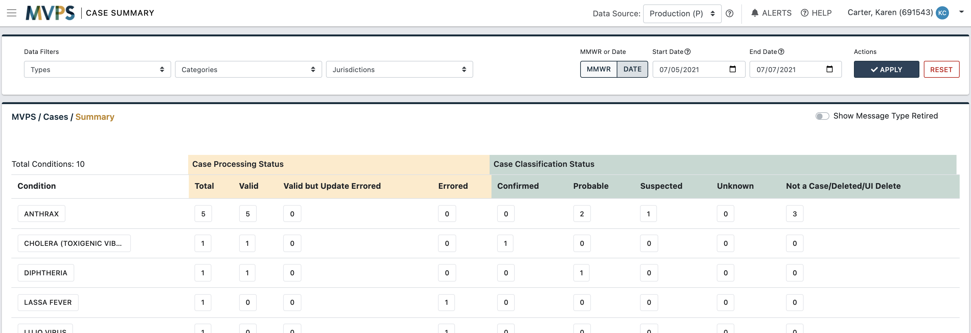
View Case Counts by Condition on the
Case Summary Page

Slide 50
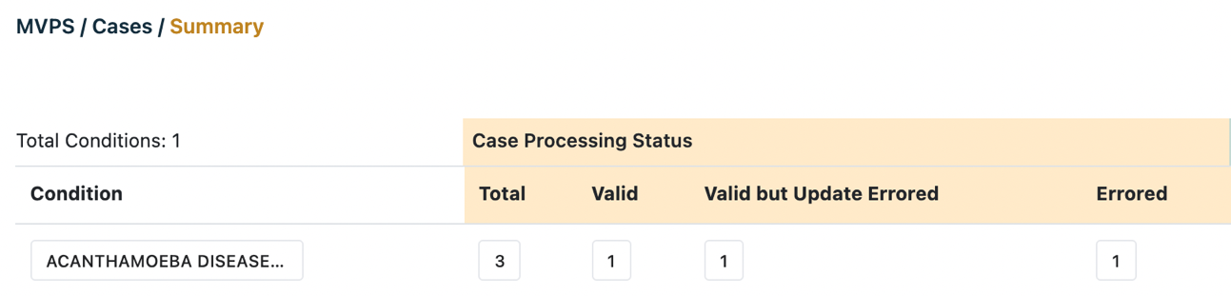
Review Case Counts by Case Processing Status
Total—Number of cases that have been processed, includes Valid, Valid but Update Errored, and Errored
Valid—Number of cases where the current message for the case is valid (has no errors)
Valid but Update Errored—Number of cases where there has been at least one valid message, but the most recent message is errored (Current Flag=E)
Errored—Number of cases where no valid messages have been received (all of the messages for the case have errored)

Slide 51
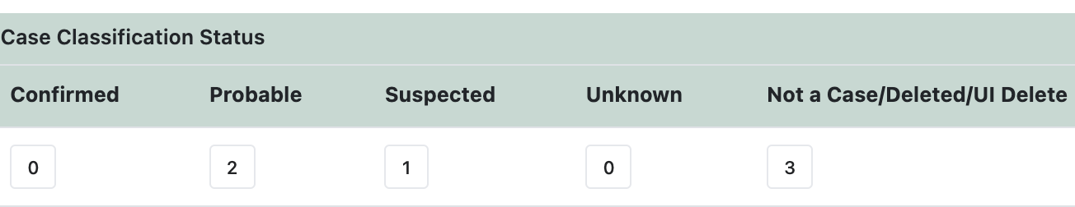
Review Case Counts by Case Classification Status
Cases that were Valid or Valid but Update Errored appear in the case classification status counts
The case classification status is determined by the sending jurisdiction and is included in every case notification message

Slide 52
Review Case Counts by Case Classification Status (cont.)
The Not a Case/Deleted case classification column has case counts for:
  Message deletes (transmitted by the jurisdiction)
    NETSS “D” records
    HL7 delete messages
      Case classification status = “Not a Case” and OBR-25 = X
      Case classification status = “Not a Case” and OBR-25 = C
      OBR-25 = X, with any case classification status
  Non-message deletes (MVPS portal functionality/processing)
    Manually deleted through the MVPS portal; “UI Deleted”
    Removed because case omitted from NETSS year-to-date file; “NETSS YTD Deleted”

Slide 53
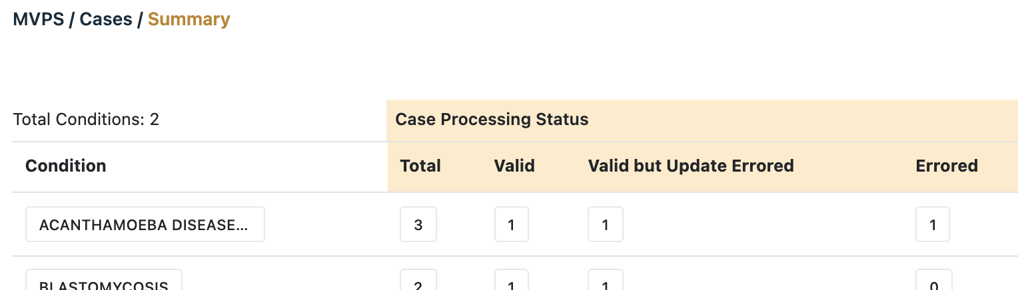
Click any Box on the Case Summary Table to View a List of Cases for the Parameters (Column/Row)

Slide 54
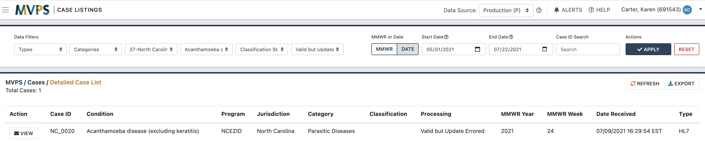

Next, a List of Cases on the Case Listings Page for the Parameters Selected Will Display
Click the “VIEW” button to view more information about the case

Slide 55
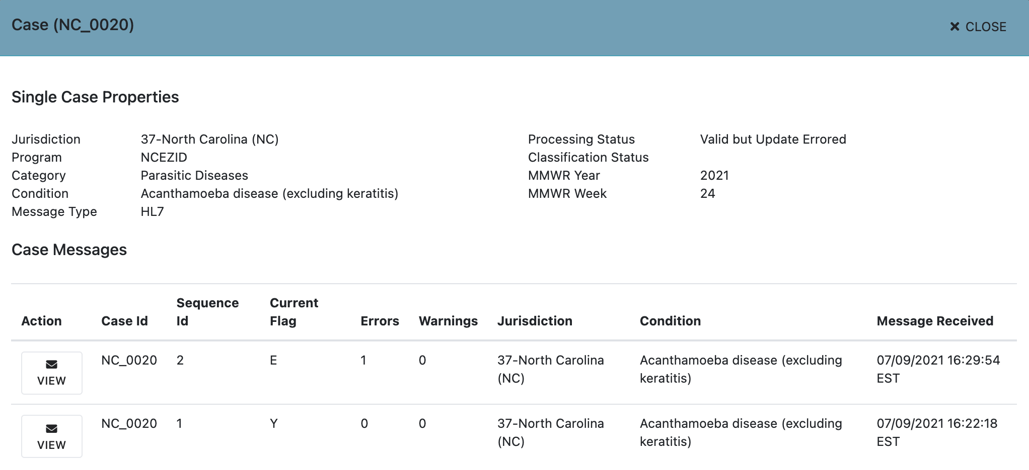
Next, the Case Properties Window Will Display, which shows the History of Message Transactions for the Case

Slide 56
Use the Left Menu Bar to Navigate to Cases, then Select the Listings Page

Slide 57
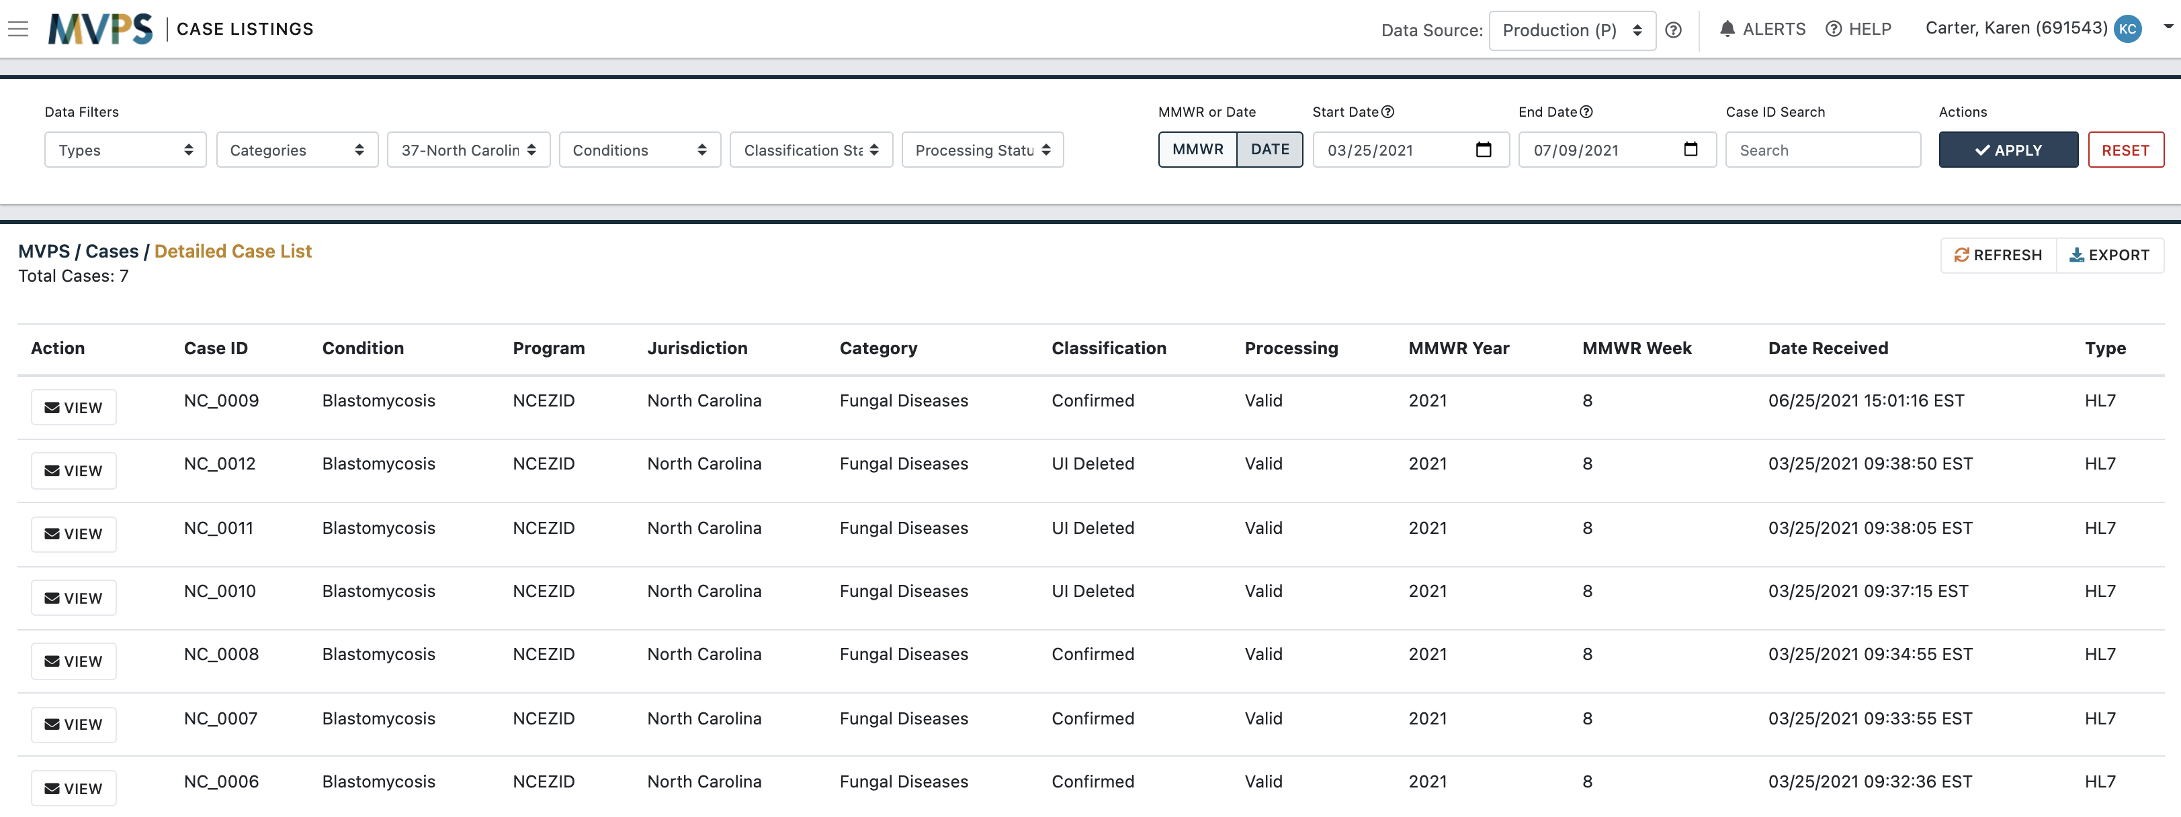

View Case Activity (Listed by Case ID) on the
Case Listings Page

Slide 58
Select the “VIEW” Button next to a Case to View More Information

Slide 59
Next, Case Details on the Case Properties Window Will Display

Slide 60
Click the “VIEW” Button next to a Message to View More Information

Slide 61
Next, Message Details on the Message Properties Window Will Display

Slide 62
Select the “VIEW CASE” Button to Return to the Case Properties Window

Slide 63
To Close the Window and Return to the Case Listings Page, Click the “CLOSE” Button or Click Outside the Window

Slide 64
For More Information about
“Navigating the MVPS Portal”
  See new “user guide” topics available soon in MVPS Help

Slide 65
Changes to NETSS YTD File Processing
Changes to NETSS YTD File Processing

Slide 66
Submitting NETSS Files
  Two types of NETSS files
    Weekly (incremental update)—adds, updates, or deletes cases
    Year-to-Date (YTD) (cumulative update)—replaces everything sent for the year
  Both are submitted through SAMS Secure Data Exchange (SDX)*
    Have the same format
    Submitted to different SAMS folders
    Jurisdictions may send multiple files for different sets of conditions; e.g., STDs in one file, VPDs in another file
  MVPS processing is based on the SAMS Weekly or YTD folder
    It is important to upload NETSS data to the proper folder
*Guide to the SDX upload process available on NNDSS site: Guidance for using SAMS to load NETSS files

Slide 67
Automated Processing of NETSS YTD Files*
  MVPS processing follows these steps: If all records in the NETSS file have the same MMWR year value,
    MVPS finds all event codes represented in the NETSS YTD file
    For any event codes included in the NETSS YTD file,
        MVPS assumes the file contains all cases for the year
        Any previously reported cases that are not included in the NETSS YTD file will be deleted
  If multiple MMWR years are represented in a NETSS YTD file, MVPS will treat the records as though there is a separate file for each MMWR year (and follow the steps outlined above)
  *Applies only to NETSS YTD records, not to other data formats

Slide 68
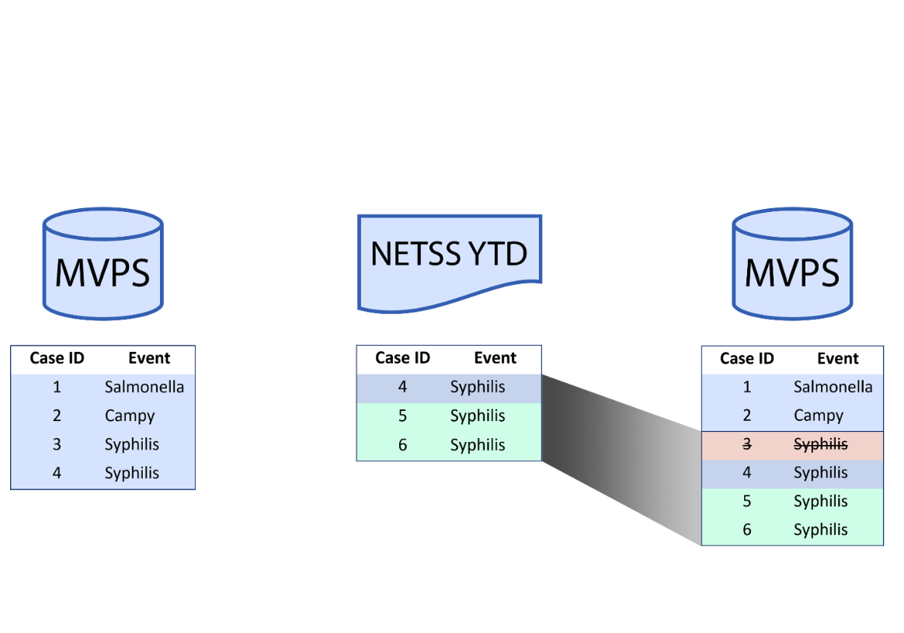
NETSS YTD Processing Uses Event Codes Present in the File
  Example 1: STD program sends NETSS YTD file (impacts only events in the file)
  Only syphilis events are included in the NETSS YTD file; therefore, only syphilis cases updated or deleted

Slide 69
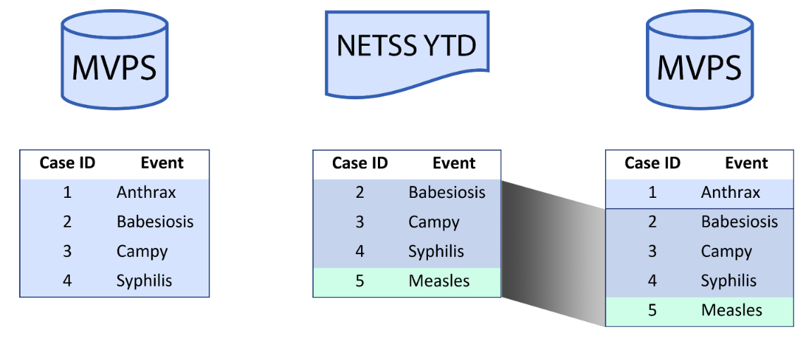
NETSS YTD Processing Cannot Delete All Cases for an Event Code
  Example 2: Jurisdiction sends NETSS YTD file for all events (full current snapshot)
  No anthrax cases are included in the YTD file; therefore, the previous anthrax case is not deleted
  To delete the anthrax case, the jurisdiction should send a delete record or use the “Delete a Case” feature in the MVPS portal

Slide 70
Troubleshooting NETSS YTD Files
Issue | Why it happened | What you should do
Accidental deletion of cases | Weekly file uploaded to YTD folder | Submit a YTD file (in the YTD SAMS folder) as soon as possible
 | Multiple years present in YTD file, including partial data for one year | Submit complete YTD files, one for each MMWR year, as soon as possible
Case omitted from YTD file with the intention of deleting it from MVPS, but it was not deleted | MVPS processing no longer allows jurisdictions to remove all cases for an event code through the YTD process | Send NETSS “delete” records for event codes where all cases should be deleted (or use “Delete a Case” feature in the MVPS portal if unable to send delete records)

Slide 71
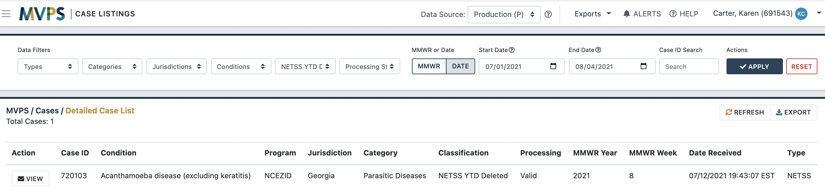

MVPS Portal Display for a Case Deleted as a Result of NETSS YTD File Processing
  On the Case Listings page, use filters such as the classification status of “NETSS YTD Deleted” (make sure the start and end dates encompass the date the NETSS YTD file was sent)
  To further confirm the status of the case, click the “VIEW” button
1
2

Slide 72
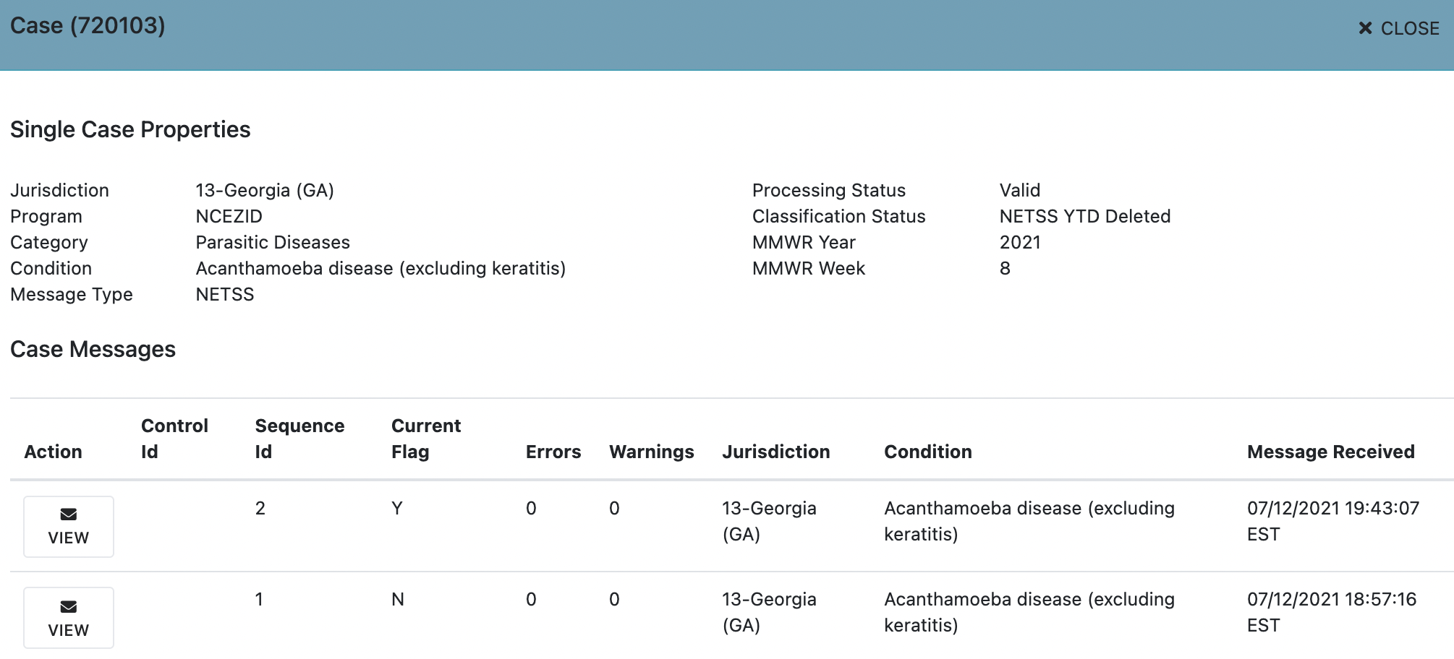
Next, the Case Properties Window Will Display
  The Classification Status will indicate “NETSS YTD Deleted”
  To further confirm the status of the case, click the “VIEW” button for the current record (Current Flag=Y)
1
2

Slide 73
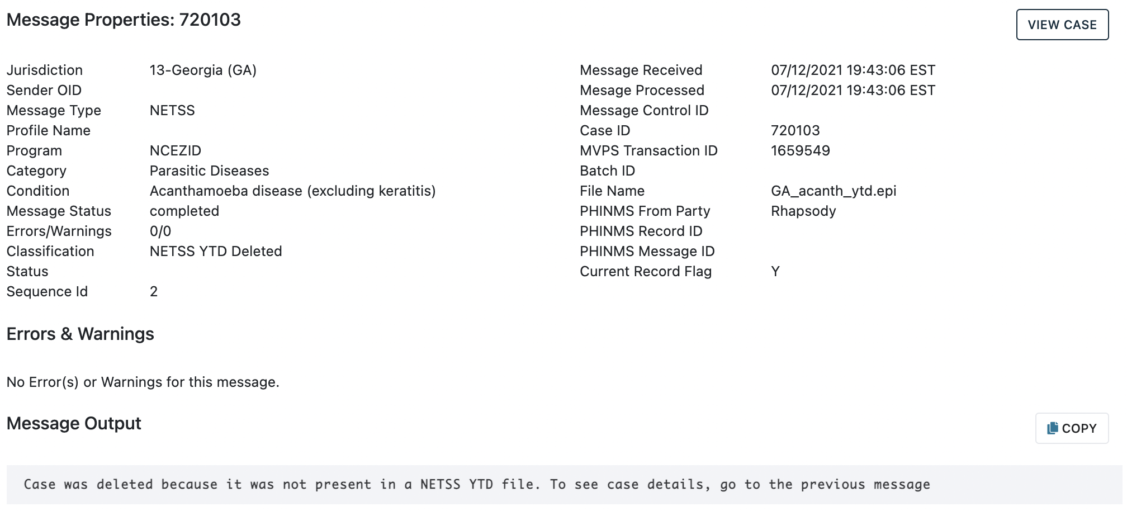
Next, the Message Properties Window Will Display
  The Classification should indicate “NETSS YTD Deleted”
  The Message Output should also indicate “Case was deleted because it was not present in a NETSS YTD file.”
1
2

Slide 74
New Low Incidence Case Verification
New Low-Incidence Case Verification

Slide 75
Overview of Low-Incidence Case Verification
  Cases for low-incidence conditions are verified before publishing
    Provisional case notifications could be a sentinel event
    Unusual condition could be an error
    Implemented at Council of State and Territorial Epidemiologists (CSTE) request (CSTE Position Statement 03-ID-11)
  Current process: CDC manually emails jurisdictions and CDC programs to confirm case and condition
  New process: MVPS will automate notification; verification will be done through MVPS portal
    Automated email sent to jurisdiction to notify of new case needing verification
    CDC NNDSS team will follow up if no action after 2 weeks

Slide 76
MVPS Will Apply Criteria for Low-Incidence Case Verification
  Cases will appear in the MVPS Low Incidences page if they meet the following criteria:
    Designated as needing low-incidence case verification*
    Reportable in the jurisdiction for the year it was reported
    Meets the case classification status criteria for publication in the NNDSS tables**
Note: Some low-incidence conditions require verification by both the jurisdiction and CDC program; others require verification by the jurisdiction only
*See “Verification Procedures” column in NNDSS Event Code lists
**See "Print Criteria" column in NNDSS Event Code lists

Slide 77
New Process to Verify a Low-Incidence Case
  Once CDC receives a low-incidence case, MVPS will automatically trigger an email to the jurisdiction to:
    Inform the jurisdiction that CDC received a low-incidence case
    Request the jurisdiction to verify the case within the MVPS portal
    Provide the condition name, event code, and Case ID

Slide 78
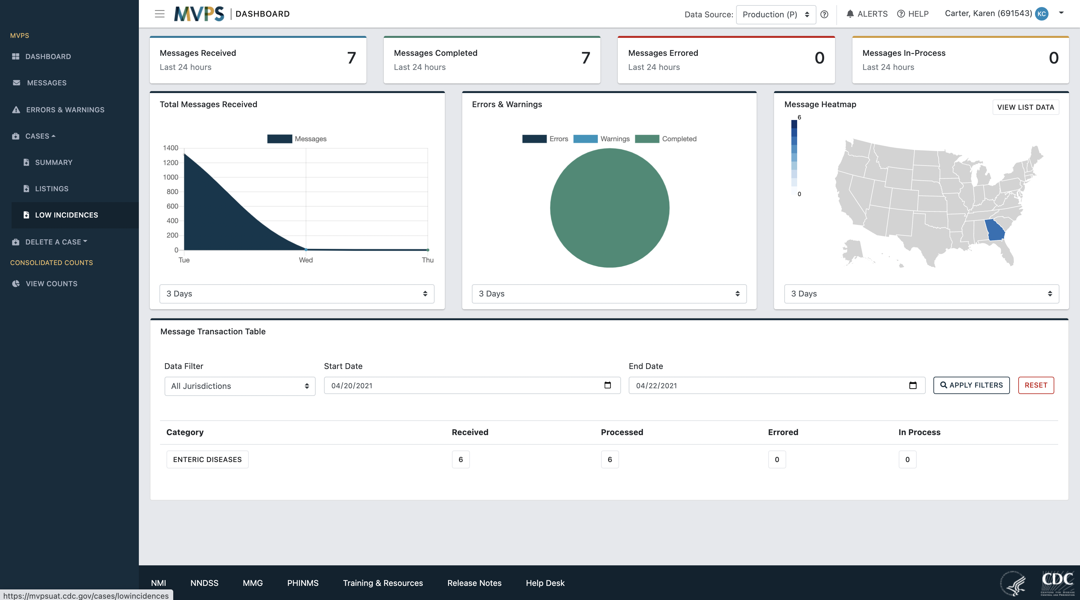
Step 1: Find the Low Incidences Menu Link*
*Your Jurisdiction Data Manager
must give you permission to view the “Low Incidences” feature

Slide 79
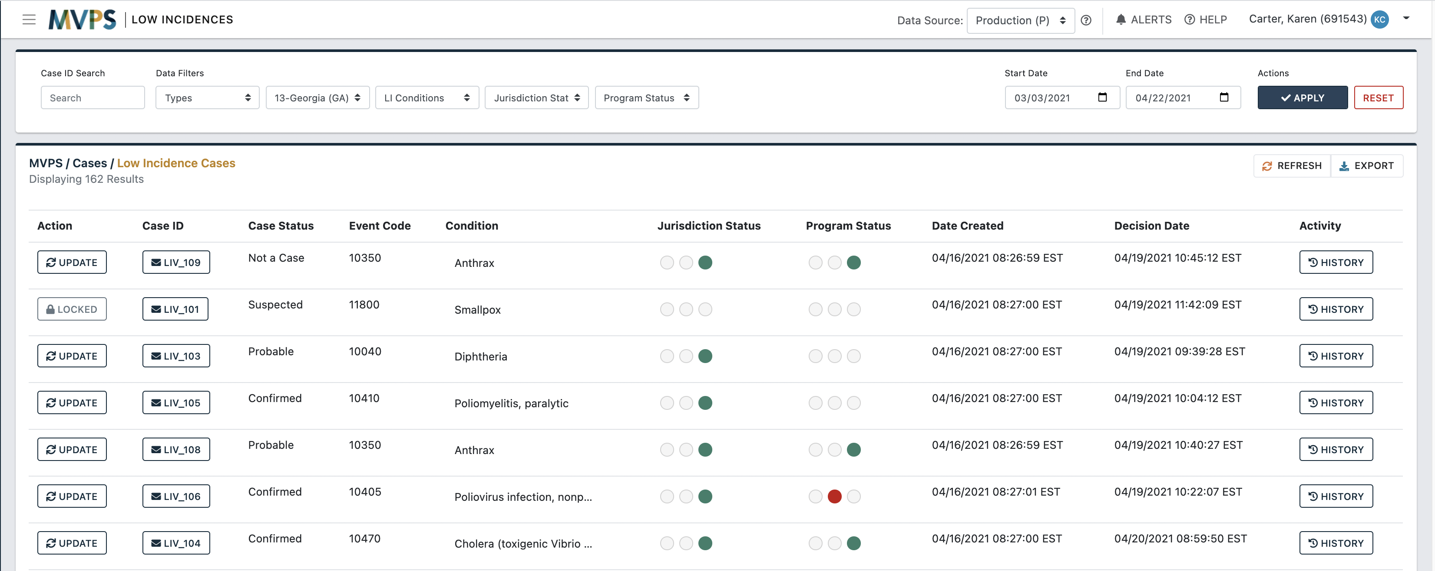

Step 2: Filter to Find a Low-Incidence Case to Verify
Use filters to find cases that are awaiting your verification. Information in email notification can be used in your filter selections
Select “APPLY” to apply filters. “RESET” returns filters to default settings
1
2

Slide 80
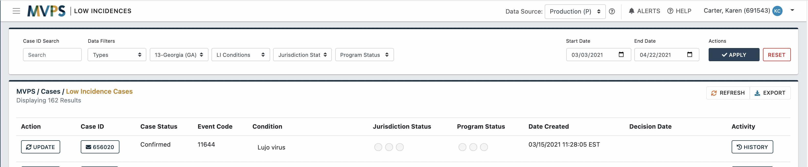
Step 3: Provide a Verification Response
Cases awaiting verification will show nothing under the Jurisdiction Status column
Select the “UPDATE” button next to a case to enter a response
1
2

Slide 81

Step 4: Use Pop-up Window to Indicate Verification Status
Select a verification response and provide a comment (both are required):
Under Investigation: Indicates you are not ready to decide whether the case should be published until more investigation is done
Do Not Publish: Indicates you do not approve the case for publication in the NNDSS tables
Approved: Indicates you approve the case for publication in the NNDSS tables

Slide 82

Step 4a: Case Under Investigation Response
Under Investigation will be indicated by the left bubble filled in (in dark blue) under the Jurisdiction Status column
Tip: Roll your cursor over the bubble to see the response status

Slide 83

Step 4b: Case Do Not Publish Response
Do Not Publish will be indicated by the middle bubble filled in (in red) under the Jurisdiction Status column
Tip: Roll your cursor over the bubble to see the response status

Slide 84

Step 4c: Case Approval Response
Approved will be indicated by the right bubble filled in (in green) under the Jurisdiction Status column
Tip: Roll your cursor over the bubble to see the response status

Slide 85

Additional Features on the Low Incidences Page
Case ID: click to view the case and information about the message
REFRESH: click to update the data viewed on the page, based on current filters
EXPORT: click to export the data into a .csv file
HISTORY: click to view jurisdiction and CDC verification responses, comments, and the decision about publication (if there is one)
2
3
1
4

Slide 86
Verification Response Decisions
  Jurisdiction verification response is treated as the final decision
    If the jurisdiction’s response is different from the CDC program’s response, the jurisdiction’s response will override the program’s response
  Case Updates
    After the verification response decision, continue to send case updates, such as sending a delete record if case was sent in error
  Status Change
    If case data change and low-incidence case verification criteria are no longer met, MVPS will remove the case from the low-incidence workflow

Slide 87
New Case Deletion Functionality
New Case Deletion Functionality
(for jurisdictions that can’t transmit a “delete”)

Slide 88
Delete Cases through the MVPS Portal only if No Other Options are Available
  Jurisdictions should NOT use the new MVPS “Delete a Case” feature if they can:
    Send a message with a case classification status of “Not a Case” (HL7 or NBS MM)
    Send a delete message (HL7 with OBR-25=X or NETSS with RECTYPE=D)
    Omit the case from a NETSS YTD file

Slide 89

Select the Delete a Case Menu Link*
*Your Jurisdiction Data Manager
must give you permission to view the “Delete a Case” feature

Slide 90

Use the Case Finder Link to Delete One or More Cases
The Delete a Case menu provides three options:
CASE FINDER – Use the Case Finder page to find and delete one or more cases
BATCH UPLOAD – Use the Batch Upload page to upload and delete a group of cases at one time; all cases must be of the same message type (e.g., HL7, NETSS)
ACTIVITY – Use the Activity page to check the deletion status of cases using the MVPS “Delete a Case” feature

Slide 91


Step 1: On the Case Finder page, Find Case(s) for Deletion by Case ID
Use filters to search by Case ID at the top of the page
  Verify the correct date received start and end dates
Select the “APPLY” button to view cases based on your filters, or select the “RESET” button to return to the default Case Finder page display
A
B

Slide 92

Step 2: Indicate Case(s) for Deletion
Use the checkboxes underneath the Action column to select one or more cases for deletion
Select the “MARK DELETE A CASE” button to mark the selected case(s) for deletion
B
A

Slide 93

Step 3: Confirm Case(s) to be Deleted
Next, you will see the “CONFIRM: DELETE A CASE” window
Add a comment (comment is required, explain why you are using the “Delete a Case” feature)
Select the “CONFIRM” button to delete the case(s)
A
B
C

Slide 94

Use the Batch Upload Link to Delete a Group of Cases
The Delete a Case menu provides three options:
CASE FINDER – Use the Case Finder page to find and delete one or more cases
BATCH UPLOAD – Use the Batch Upload page to upload and delete a group of cases at one time; all cases must be of the same message type (e.g., HL7, NETSS)
ACTIVITY – Use the Activity page to check the deletion status of cases using the MVPS “Delete a Case” feature

Slide 95


Create a .csv File for Batch Deletion
  To delete a group of cases you will need to create and upload a .csv file
    Use a spreadsheet or notepad application with one case listed per line
    Only one message type can be deleted at a time using this method
  For HL7 and NBS: list case IDs, one case per row
  For NETSS: list case ID, SITE, and MMWR year value, one case per row (one value in each column or values comma separated with no spaces)
Example 1: .csv file format
(for HL7 and NBS)
Example 2: .csv file format (for NETSS only)
XX_0001
XX_0002
XX_0003
XX_0004
987601,S01,21
987602,S01,21
987603,S01,21
987604,S01,21

Slide 96

Step 1: Upload—Upload Your Batch to Get Started
Browse for or drag and drop your file
Choose the message type from the drop-down menu
Select the “+Add” button
A
B
C

Slide 97

Step 2: Processing
Step 2: Processing—Matching Uploaded Case IDs with Current System Cases
After Step 1: Upload, MVPS processes the batch, as indicated on the Step 2: Processing column
You will see an MVPS-assigned Batch ID and your .csv file name
Depending on the size of your .csv file, it may take a while for the batch to process
No action is required by the user in this step

Slide 98

Step 3: Review—Most Recent Case ID Batches to be Reviewed and Marked
After the batch finishes in Step 2: Processing, review the results on the Step 3: Review column
You will see the number of cases matched or not matched in the MVPS database
Select the “VIEW MATCHES” button for more information
It is important to either mark cases for deletion or cancel the batch and not leave the batch “In Process.”

Slide 99


Step 4: Toggle between “MATCHES” and “UNMATCHED REQUESTS” to View Case IDs

Slide 100
Step 5a: Select the “MARK ALL” Button to Mark Matched Cases for Deletion

Slide 101

Step 5a (cont.): Confirm Case(s) to be Deleted
Next, you will see the “CONFIRM: DELETE A CASE” window
Add a comment (comment is required, explain why you are using the “Delete a Case” feature)
Select the “CONFIRM” button to delete the case(s)
A
B
C

Slide 102
Step 5b: Select the “CANCEL BATCH“ Button to Cancel the Batch

Slide 103

Step 5b (cont.): Confirm the Batch Cancellation
Next, you will see the “CONFIRM: DELETE A CASE” window
Add a comment (comment is required, explain why you are using the “Delete a Case” feature)
Select the “CONFIRM” button to delete the case(s)
A
B
C

Slide 104

Use the Activity Link to Check the Deletion Status of Cases
The Delete a Case menu provides three options:
CASE FINDER – Use the Case Finder page to find and delete one or more cases
BATCH UPLOAD – Use the Batch Upload page to upload and delete a group of cases at one time; all cases must be of the same message type (e.g., HL7, NETSS)
ACTIVITY – Use the Activity page to check the deletion status of cases using the MVPS “Delete a Case” feature

Slide 105

Step 1: View Cases Submitted for Deletion
MVPS assigns a unique Batch ID to each uploaded file or Case Finder delete
To view information for a particular batch, select the “VIEW DETAILS” button
To determine whether case ID(s) were found (matched and/or deleted) in MVPS, select the “VIEW CASES” button
A
B
C
Jane Doe (123)

Slide 106

Step 2: View Matched Cases
Toggle between the “MATCHES” and “UNMATCHED REQUESTS” pages to view Case IDs that were found or not found in the MVPS database
On the Matches page, you can view the status of any matched Case IDs; select the “VIEW” button to review case records
A
B

Slide 107

Next, the Case Properties Window Will Display
  The Classification Status will indicate “UI Deleted”
  To further confirm the status of the case, click the “VIEW” button for the current record (Current Flag=Y)
A
B

Slide 108

Next, the Message Properties Window Will Display
  The Classification should indicate “UI Deleted”
  The Message Output should also indicate “Message was deleted via the UI Delete.”
A
B

Slide 109
MVPS User Roles & Management
MVPS User Roles and Management
(for Jurisdiction Data Managers)

Slide 110
MVPS Jurisdiction Roles and Responsibilities
Jurisdiction Data Manager | Jurisdiction User | State/Territorial Epidemiologist | STD Manager
Will have permissions for new features, such as “delete a case” and “low-incidence case verification” Works with CDC to set up new MVPS users Adds or edits jurisdiction user access to conditions and permissions for additional features | Accesses data for one or more conditions through the MVPS portal Receives permissions for additional features in MVPS as assigned by the MVPS Jurisdiction Data Manager | Assigned to all conditions In MVPS, signs off on final tables for all conditions during annual data reconciliation (starting next year) | Assigned to STD conditions In MVPS, signs off on STD final tables during annual data reconciliation (starting next year)

Slide 111

New User Management Features in the MVPS Portal
On the User Management page (link on the Left Menu Bar available to Jurisdiction Data Managers only):
New SETTINGS/NOTIFICATIONS feature
New State/Territorial Epi role
New STD Manager role
123 jane@dph.gov Doe Jane None 37-NorthCarolina(NC)
1
123
2
3

Slide 112
Enable Access to New Functionality
On the User Management page for a selected user, select the “SETTINGS/NOTIFICATIONS” button
123 jane@dph.gov Doe Jane None 37-NorthCarolina(NC)
1
123

Slide 113

Enable Access to New Functionality (cont.)
Next, you will see the Settings/Notifications sidebar (indicated at right)
Under Settings, toggle-on optional features in MVPS
Under e-mail Notifications, toggle-on “New Low Incidence Case” and/or “Low Incidence Case Verification Reminder”
Select the “CLOSE” button to save the changes
1
3
2

Slide 114
Check User Role(s), Access and Permissions, and Settings
1
1
2
3
3
Jane Doe 123 jane@dph.gov
2

Slide 115
User Roles and Default Permissions in the MVPS Portal
MVPS Portal—Default Permissions | Jurisdiction Data Manager | Jurisdiction User | State Epi | STD Manager
User Management (Assigning Conditions and Permissions in MVPS) | X
All Conditions | * |  | X | STD Only
Delete a Case | X
Low-incidence Case Verification | X
Reconciliation Sign-off (All Conditions) |  |  | X
Reconciliation Sign-off (STD only) |  |  |  | X
*Jurisdictions need Data Managers to cover all conditions but can split up conditions among DMs (e.g., STD Manager)

Slide 116
Questions?
Questions?

Slide 117

Next NNDSS eSHARE: August 24, 2021, 3:00 PM – 4:00 PM EDT
Subscribe to the monthly NNDSS newsletter, Case Surveillance News
Access the NNDSS Technical Resource Center
Email edx@cdc.gov to request NNDSS technical assistance or onboarding
Next NNDSS eSHARE:
August 24, 2021, 3:00 PM – 4:00 PM EDT

