Slide 1

NNDSS eSHARE May Webinar
Division of Health Informatics and Surveillance
May 18, 2021

Slide 2

Agenda
Welcome and Announcements
Introduction to the New NNDSS Website
Other NNDSS-Related Updates
Questions and Answers

Slide 3
NNDSS Updates and Announcements
Michele Hoover, MS
Lead, State Implementation and Technical Assistance

Slide 4
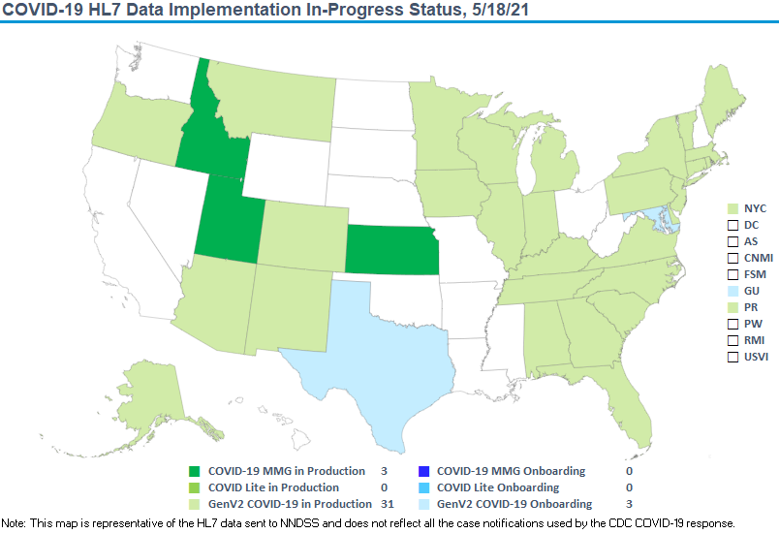

COVID-19 HL7 Data Implementation In- Progress

Slide 5
Updates: Coronavirus Disease 2019 Message Mapping Guide
NEW: The PHIN Vocabulary Access and Distribution System (VADS) Coronavirus Disease 2019 (COVID-19) Case Notification View has been updated:
    Version 7 is the latest version
    Adds laboratory tests to Lab Test Type (COVID-19)
    Adds an additional vaccine to Vaccine Type
PHIN VADS Case View version 7: https://phinvads.cdc.gov/vads/ViewView.action?id=37B081A8-0DA2-EB11-819E-005056ABE2F0
Lab Test Type (COVID-19): https://phinvads.cdc.gov/vads/ViewValueSet.action?id=64656320-49A1-EB11-819E-005056ABE2F0
Vaccine Type: https://phinvads.cdc.gov/vads/ViewValueSet.action?id=4F16180A-48A1-EB11-819E-005056ABE2F0

Slide 6
NNDSS Website Redesign:
New Look-and-Feel, Same Great Resources
Lisa Bastin, MA
Associate Director for Communication Science
Division of Health Informatics and Surveillance

Slide 7
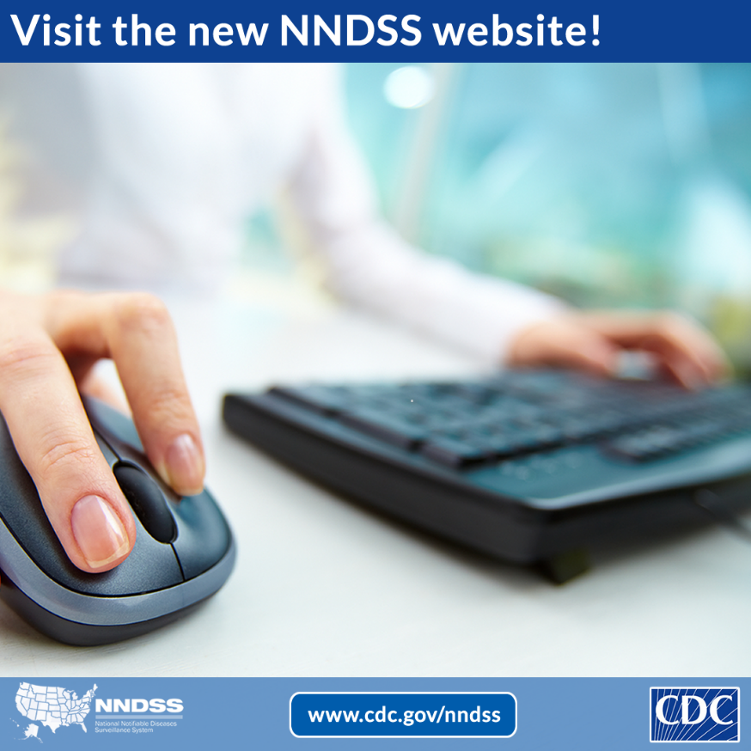
Goals
Make it easier for audiences to:
  Learn about case surveillance and its importance
  Access case definitions
  Find technical resources
  Get news and updates in the Case Surveillance News newsletter (formerly NMI Notes).

Slide 8
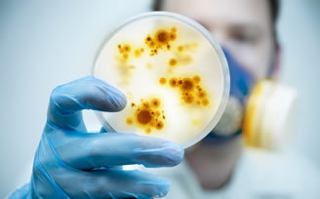
New Features
Overview of case surveillance and NNDSS, including printable and video resources
Success stories of case surveillance in action
Data to help inform public health action
Searchable library of case definitions and notifiable conditions lists

Slide 9
Technical Resource Center
HL7 message mapping guides and standards
Implementation and onboarding information
Event codes and other surveillance resources
Data systems
News and updates
Acronyms and abbreviations

Slide 10
Demo
www.cdc.gov/nndss

Slide 11
Update Your Bookmarks!
New URL: www.cdc.gov/nndss
Questions or Feedback?
surveillancepractice@cdc.gov

Slide 12
New MMG versions
Danielle Tack, DVM, MPVM, ACVPM
Team Lead, Data Standardization and Assistance Team

Slide 13
Versioning Updates – All guides
New version reflected in last digit (e.g., v1.0.3)
Updated web links and URLs
  Introduction
  Data Element tabs
Updated revision history
NO IMPACT
on message content
or structure

Slide 14
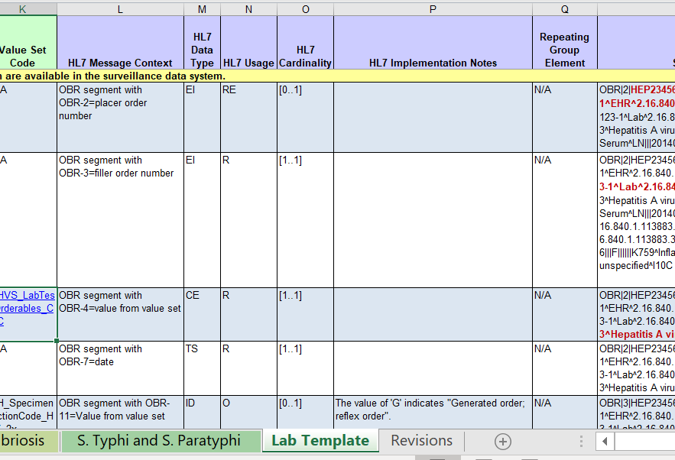
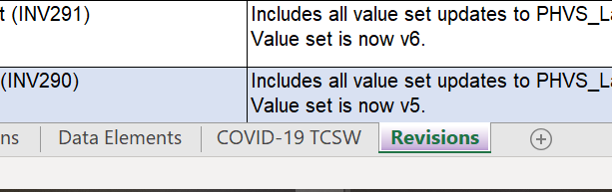
Condition-Specific Guides
Removal of lab template tab or
data elements
Test case scenario worksheet update
  format only (5)
  test case scenario content (2)
Revision history updated

Slide 15
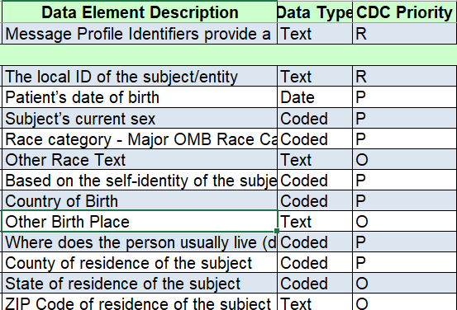
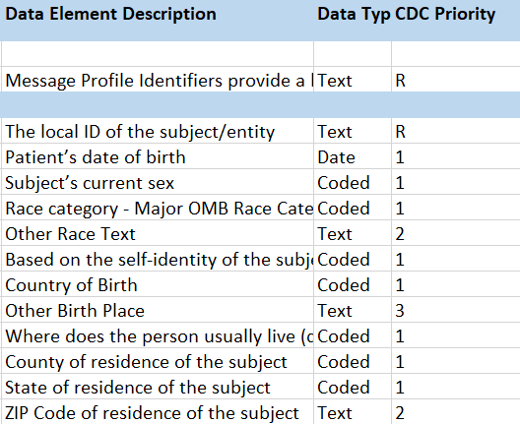
Generic v2.0.1
CDC prioritization format*
  OLD: R, P, O
  NEW: R, 1, 2, 3
Various other formatting updates e.g.,
  test case scenario worksheet tab
  language alignment with other guides
Revision history updates
*Please refer to the February 2020 eSHARE for additional information

Slide 16
NNDSS-Related Updates
Sara Johnston, MPH
NNDSS Program Lead

Slide 17

Open Discussion

Slide 18
Subscribe to monthly NNDSS newsletter (Case Surveillance News) at https://www.cdc.gov/nndss/trc/news/index.html
Access the NNDSS Technical Assistance and Training Resource Center at
https://www.cdc.gov/nndss/trc/index.html
Request NNDSS technical assistance or onboarding at
edx@cdc.gov
Next NNDSS eSHARE is July 20, 2021 – details to come at
https://www.cdc.gov/nndss/trc/onboarding/eshare.html

