Slide 1
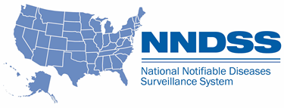
NNDSS eSHARE March Webinar
Division of Health Informatics and Surveillance
March 16, 2021

Slide 2

Agenda
Welcome and Announcements
Obtaining Secure Access Management Services (SAMS) Level 2 Access for Message Validation, Processing, and Provisioning System (MVPS) Dashboard Data Managers and Users
Updates to STD and Congenital Syphilis HL7 Case Notification Messages
Questions and Answers

Slide 3
NNDSS Updates and Announcements
Michele Hoover, MS
Lead, State Implementation and Technical Assistance

Slide 4
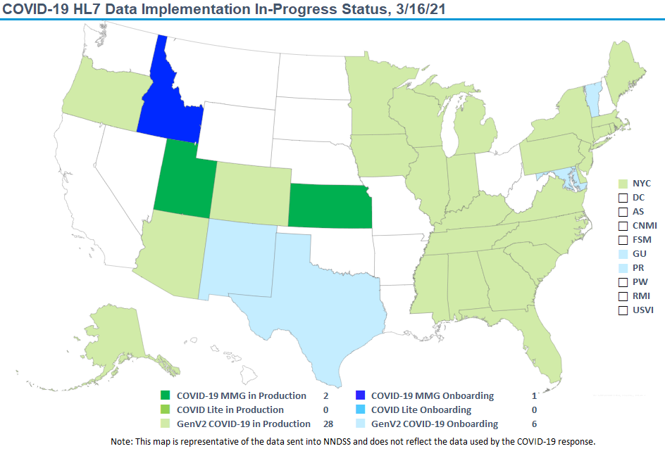

COVID-19 HL7 Data Implementation In- Progress

Slide 5
Updates: Coronavirus Disease 2019
Message Mapping Guide
NEW: The PHIN Vocabulary Access and Distribution System (VADS) Coronavirus Disease 2019 (COVID-19) Case Notification View has been updated:
    Version 5 is the latest version
    Adds laboratory tests, including “SARS-CoV-2 (COVID-19) variant [Type] in Specimen by Sequencing” to
    Lab Test Type (COVID-19)
    Adds additional results specific to variants to Lab Test Interpretation (VPD)

Slide 6
Issues with NETSS Unique Case Identifiers
CDC is not able to capture all cases being sent due to duplicate National Electronic Telecommunications System for Surveillance (NETSS) IDs
  NETSS is limited to a 6-digit Case ID
  Deduplication performed using: Case ID, Site ID, Year, and State
  Many states have surpassed 999999 for 2020 or 2021
May impact all disease conditions
Potential resolution: If Site ID is not already used in a meaningful way, include additional characters from the full case ID in Site ID.
  Site ID can contain up to 3 characters
Would need to send a year-to-date file to replace previous records

Slide 7
Current NETSS Submission
                NETSS Record – Unique Cases
Jurisdiction’s Case ID Site Year State
Case ID (6 digit) (3 char) (2 digit) (2 digit)
AB100123456 123456 S01 20 04
AB101123456 123456 S01 20 04

Slide 8
Updated NETSS Submission
                NETSS Record – Unique Cases
Jurisdiction’s Case ID Site Year State
Case ID (6 digit) (3 char) (2 digit) (2 digit)
AB100123456 123456 100 20 04
AB101123456 123456 101 20 04

Slide 9
Obtaining SAMS Level 2 Access for
Data Managers and Users
Calvin Hightower, MPA
Information Technology Specialist

Slide 10
Objective
At the end of this topic, participants will understand how to obtain access to MVPS
Review of New MVPS Enhancements and SAMS Security
Next Steps for Jurisdictions
SAMS Identity Proofing Process
MVPS Access

Slide 11
2021 MVPS Enhancements
  Consolidated processing of NNDSS data (HL7, legacy HL7, NEDSS Base System [NBS] Master Message, and NETSS)
  Fully automated data processing (timely, accurate data)
  Additional MVPS Portal features for jurisdictions:
    Review message-level transactions, case counts, and errors
    Verify cases for certain rare (low-incidence) conditions (new workflow)
    Delete individual cases or groups of cases (new workflow)
    Perform reconciliation comparisons directly with NNDSS database (new workflow for State Epi approval of annual data)
  MVPS becomes the source for weekly and annual NNDSS publication

Slide 12
MVPS Security
To access the MVPS Portal, all jurisdiction users must go through two security stages:
Stage 1—Authentication via SAMS
  SAMS is used to validate and authenticate users for access to CDC systems, including MVPS
  SAMS Level 2 is required to access MVPS
Stage 2—Authorization for MVPS
  Once a user is authorized to access MVPS, they will see a link for MVPS under “Applications” in SAMS

Slide 13
Next Steps for Jurisdictions
By March 31, 2021, jurisdiction identifies at least 2 MVPS jurisdiction data managers (DMs) and sends contact information to CDC Electronic Data Exchange (EDX) mailbox (edx@cdc.gov)
Step 1
DMs obtain SAMS Level 2 access and authorization to MVPS
Step 2
DMs generate list* of MVPS jurisdiction users and send contact/role information to EDX mailbox (edx@cdc.gov)
*Note: The list
for Step 3 should include all jurisdiction users who need MVPS access, regardless of their current SAMS access level.
Step 3
New MVPS jurisdiction users obtain SAMS Level 2 access and authorization to MVPS
Step 4
DMs assign user permissions and access to condition(s)
Step 5

Slide 14
After the jurisdiction user contact/role information is sent to edx@cdc.gov:
If a jurisdiction user is new to SAMS, the user will receive an invitation email from SAMS requesting primary and secondary forms of ID to complete the proofing process
If a jurisdiction user has SAMS Level 1 access, the user will receive an email from SAMS requesting a secondary form of ID to complete the proofing process
If a jurisdiction user has SAMS Level 2 access, the user will be added to MVPS with no additional proofing needed
Note: The SAMS Administrator will look up your SAMS account status and initiate the correct process for you.

Slide 15
For a jurisdiction user who is new to SAMS or has SAMS Level 1 access:
The jurisdiction user will receive an email from SAMS-no-reply@cdc.gov with the subject, “U.S. Centers for Disease Control (CDC): SAMS Partner Portal - Identity Verification Request”
This email contains guidelines for the identity proofing process to facilitate an initial request or upgrade to SAMS Level 2 access:
  The jurisdiction user must complete the proofing form as described and upload the form, along with any supporting/proofing ID documents, through the link provided
  The email also provides options for mailing or faxing the proofing form

Slide 16
Proofing ID Guidelines for SAMS (Level 2)
Proofing IDs must be unexpired; consistency is important
  Confirm your photo ID includes your address. If not, an additional ID is required to confirm your address
  Confirm that your name and address (on your primary and secondary IDs) match the name and address used to register with SAMS. If not, an additional ID is required to confirm your name and/or address.
  Additional IDs may include utility bill, paycheck stub, voter registration card, marriage license, etc.
Scanned or photocopied proofing IDs must be legible

Slide 17
Complete SAMS Level 2 Proofing in 30 Days
From the time SAMS access is requested, the requestor has 30 days to complete the SAMS Level 2 proofing process (submit proofing application and proof of ID)
  If a jurisdiction user does not complete the SAMS proofing process within 30 days, a new request may be initiated by the jurisdiction data manager
  If there are any issues with proofing documents, the 30-day timeframe may be extended to complete the SAMS proofing process
  For questions or issues with this process, email edx@cdc.gov for further assistance

Slide 18
Final Steps for MVPS Access
Once a jurisdiction user has been granted SAMS Level 2* access, the SAMS help desk sends an email to the jurisdiction user with the MVPS link, indicating that MVPS access has been provided
In the MVPS Portal, the jurisdiction data manager must assign the jurisdiction user’s MVPS role and access to condition(s)
*Note: If a jurisdiction user is new to SAMS or has SAMS Level 1, this occurs after the jurisdiction user’s SAMS Level 2 proofing documents are received and approved, and the SAMS proofing process is complete.

Slide 19
Questions?

Slide 20
Updates to STD and Congenital Syphilis MMGs
Melissa Pagaoa, MPH
Data Management Team Lead
March 16, 2021
Alejandro Pérez, MPH
Health Scientist

Slide 21
Intro to Guides

Slide 22
Release of 4 Updated MMGs
STD v.1.0.2
STD v.1.1.0
Congenital Syphilis v.1.0.1
Congenital Syphilis v.1.1.0
Which MMG should jurisdictions use?
  If in production or well into pre-onboarding, adopt STD v.1.0.2 and Congenital Syphilis v.1.0.1 now, adopt STD v.1.1.0 and Congenital Syphilis v.1.1.0 when time allows
  If in early phases of pre-onboarding or have not started pre-onboarding, use STD v.1.1.0 and Congenital Syphilis v.1.1.0

Slide 23
General Updates

Slide 24
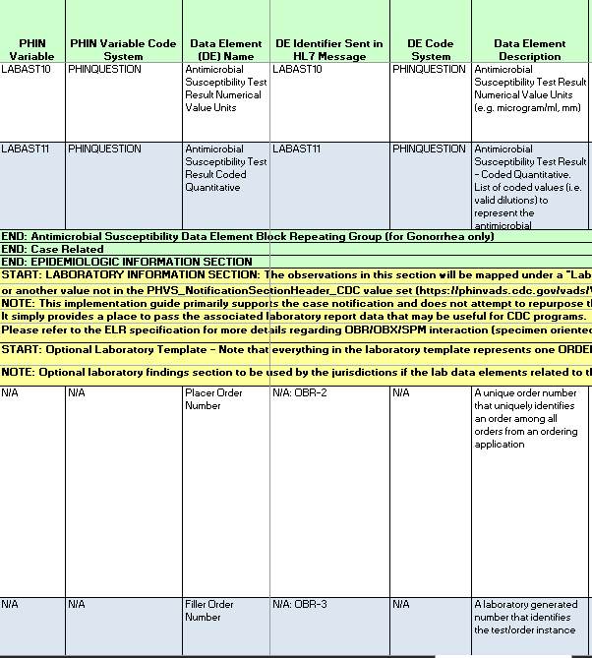
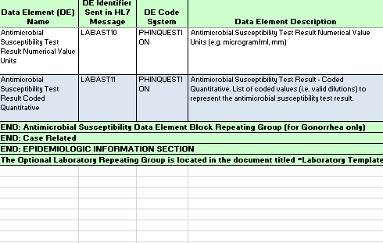
Removal of Lab Template
STD v1.0.1 & CS v1.0
All new STD & CS MMGs

Slide 25
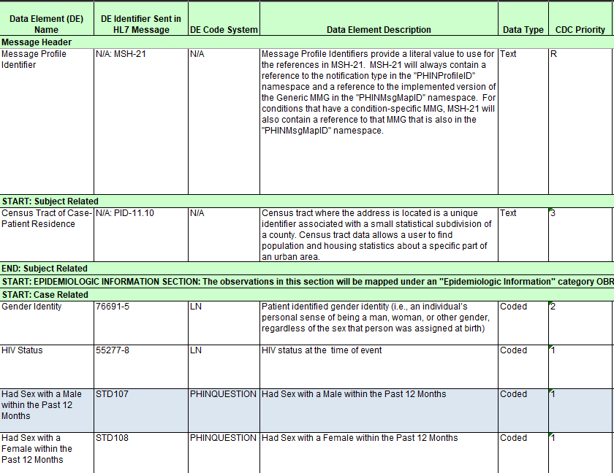
Updated CDC Priorities
R – Required
  This data element is
  mandatory for sending
  a message.

Slide 26
Updated CDC Priorities
Priority 1
  Highest priority for reporting
  Data collection
  system should be modified
  to collect Priority 1 data
  elements.
  These are required for onboarding.

Slide 27
Updated CDC Priorities
Priority 2
  High priority data element that will support national surveillance activities
  If this data element is not currently collected or cannot be sent, please plan to update jurisdiction’s data collection system.

Slide 28
Updated CDC Priorities
Priority 3
  Lower priority data element that should be considered for inclusion in the surveillance system and case notification, when relevant.

Slide 29
STD v1.0.2 & CS v1.0.1

Slide 30
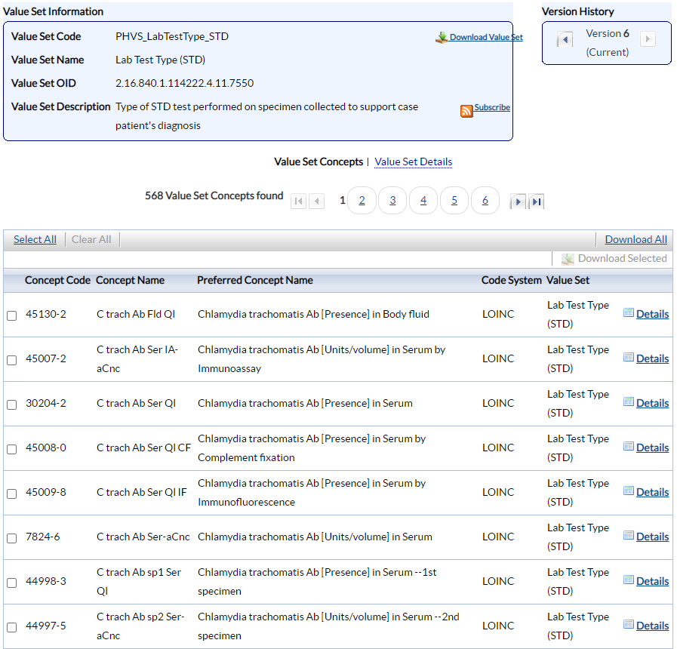
Updated Value Sets – Example: Lab Test Type
30

Slide 31
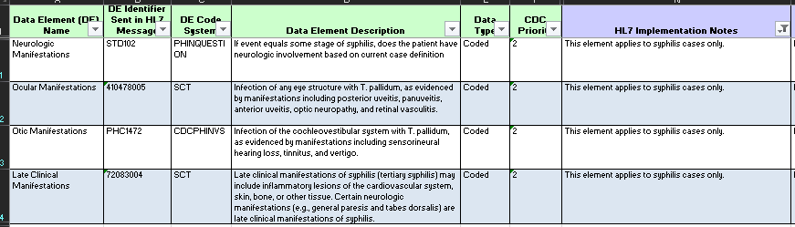
Updated HL7 Implementation Notes

Slide 32
STD v1.1.0 MMG

Slide 33
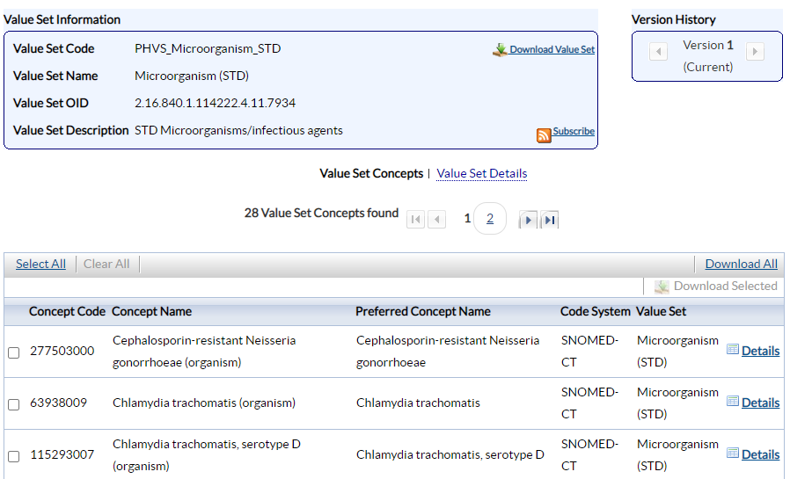
Added Data Element – Example: Organism Name

Slide 34
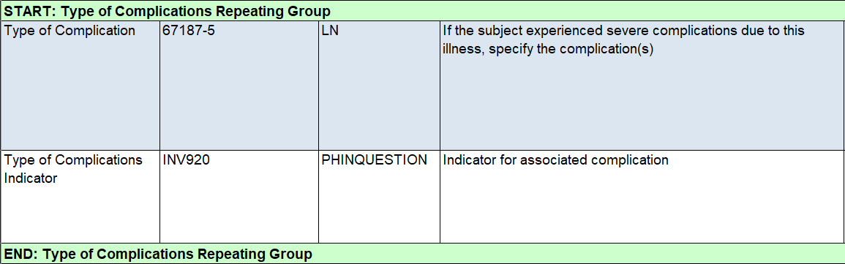
Added Complications Repeating Block

Slide 35
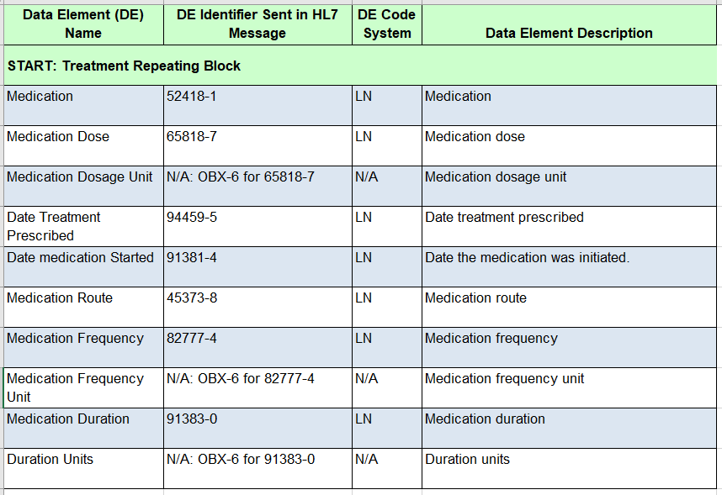
Added Treatment Repeating Block

Slide 36
Congenital Syphilis v1.1.0 MMG

Slide 37
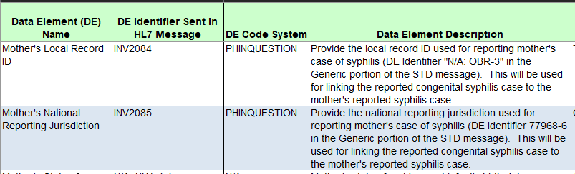
Linking Maternal Syphilis and Infant Congenital Syphilis Cases

Slide 38
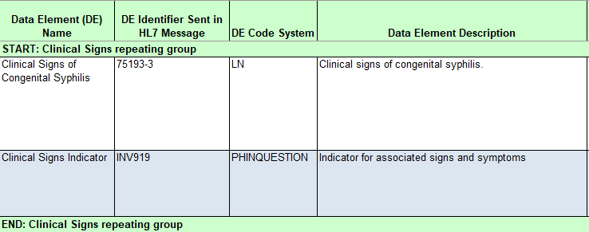
Clinical Signs Repeating Group

Slide 39
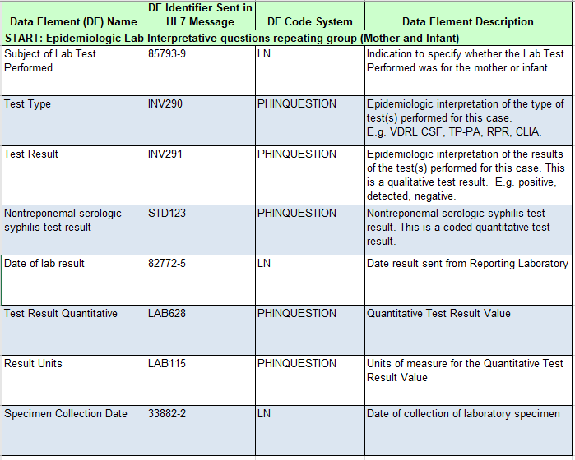
Epidemiologic Lab Interpretative Repeating Group

Slide 40
Crosswalk Documents

Slide 41
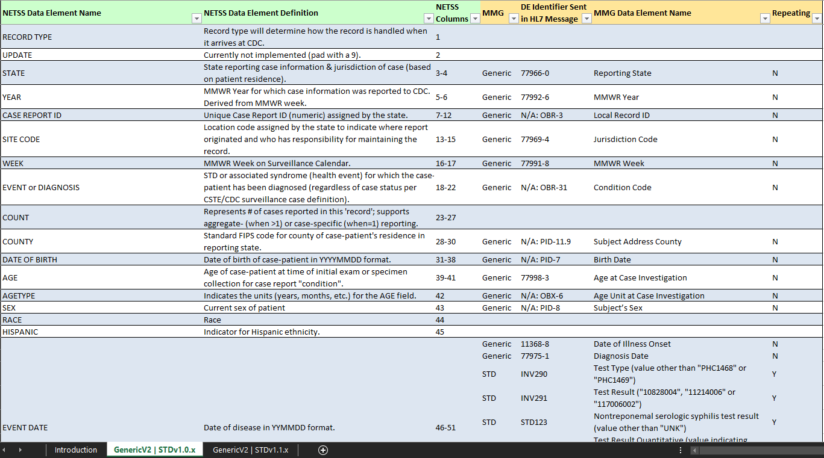
STD - NETSS to MMG Crosswalk

Slide 42
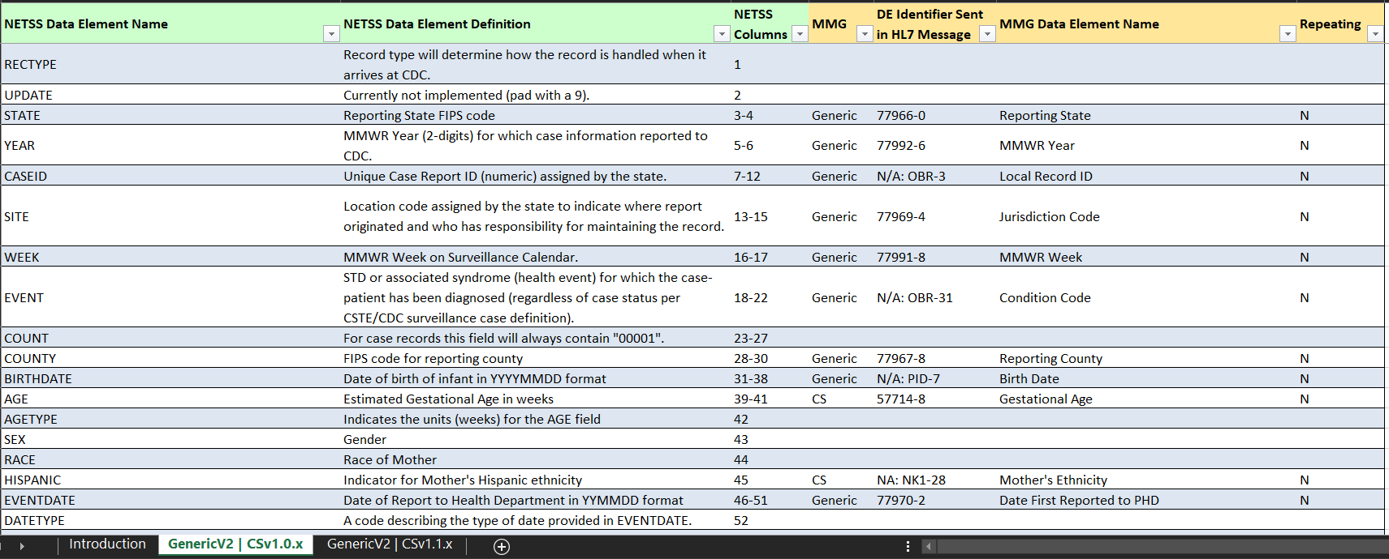
Congenital Syphilis - NETSS to MMG Crosswalk

Slide 43
Questions?
Melissa Pagaoa: mpagaoa@cdc.gov
Alejandro Perez: aperez@cdc.gov

Slide 44
Subscribe to monthly NNDSS newsletter (NMI Notes) at
https://www.cdc.gov/nndss/trc/news/
Access the NNDSS Technical Resource Center at
https://www.cdc.gov/nndss/trc/
Request NNDSS technical assistance or onboarding at
edx@cdc.gov
Next NNDSS eSHARE is April 20, 2021 – details to come at
https://www.cdc.gov/nndss/trc/onboarding/eshare.html

