Slide 1
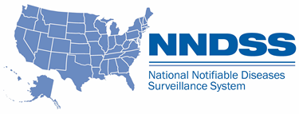
NNDSS eSHARE February Webinar
Division of Health Informatics and Surveillance
February 23, 2021

Slide 2

Agenda
Welcome and Announcements
Vaccine History in Case Notifications
Overview of New NNDSS Data Processing Redesign and Message Validation, Processing, and Provisioning System (MVPS) Enhancements
Questions and Answers

Slide 3
NNDSS Updates and Announcements
Michele Hoover, MS
Lead, State Implementation and Technical Assistance

Slide 4
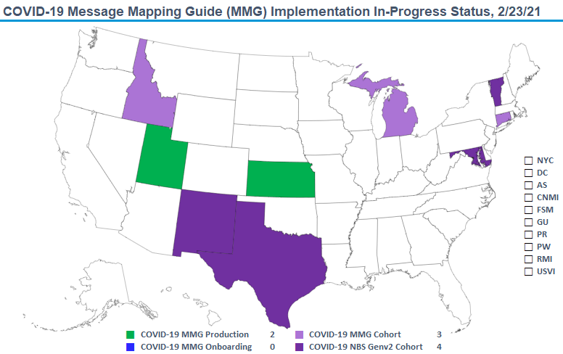

COVID-19 MMG Implementation In-Progress Status Jan 19, 2021

Slide 5
Updates: STD/Congenital Syphilis (CS) MMGs
STD V1.1.0
  New Data Elements: 14
  Data Elements with Name Change: 2
STD Value Sets (V1.1.0 & V1.0.2)
  Lab Test Type (STD), Lab Test Result Qualitative (NND), Organism Identified AST (STD), Specimen Source (STD), Drugs Used (STD)
CS V1.1.0
  New Data Elements: 7
  Data Elements with Name Change: 2
CS Value Sets (V1.1.0 & V1.0.1)
  Test Type (Syphilis), Lab Test Result Qualitative (NND), Country

Slide 6
Updates: Coronavirus Disease 2019 (COVID-19) MMG
NEW: The PHIN Vocabulary Access and Distribution System COVID-19 Case Notification View has been updated
    Version 4 is now the most up-to-date version
    Adds an additional vector vaccine to Vaccine Type
    Adds an additional reason for Reason Not Vaccinated Per ACIP Recommendations (PHVS_VaccineNotGivenReasons_CDC)

Slide 7
Vaccine History and Case Notifications for
COVID-19 Case Data
Amanda Jones
NNDSS Liaison Team Member
Data, Analytics & Visualization Task Force

Slide 8

Vaccine History in COVID-19 Case Notifications
Submission Options
  Full COVID-19 MMG
  COVID Lite (Generic v2.0 + vaccine history from COVID-19 MMG)
  CSV upload using the updated January 2021 CSV template
MMG = Message Mapping Guide
CSV = Comma Separated Value

Slide 9
Options to Submit COVID-19 Vaccination History
 | COVID-19 MMG | COVID Lite | CSV (1/2021)
Message Profile Identifier | COVID-19 MMG | COVID-19 MMG | N/A
Data Elements (DEs) | GenV2 DEs + COVID-19 DEs | GenV2 DEs + COVID-19 Vaccine History DEs | COVID-19 MMG in a flattened format
Onboarding Required? | Yes – edx@cdc.gov | Yes – edx@cdc.gov | Yes – eocevent333@cdc.gov
Note: When sending notifications using only the generic v2.0 MMG, the MMG will not include vaccine information and uses the message profile identifier for the generic v2.0 MMG.

Slide 10
Contact Us
Contact edx@cdc.gov with any questions or to communicate interest in onboarding with the COVID-19 MMG, COVID Lite, or the GenV2 MMG
To submit COVID data using the CSV format, please contact eocevent333@cdc.gov
For more information on submitting COVID line-level data or to access the current CSV format, please visit this site: https://www.cdc.gov/coronavirus/2019-ncov/php/reporting-pui.html
For more information about reporting using an MMG, please visit this site: https://ndc.services.cdc.gov/message-mapping-guides/

Slide 11
Update on 2020 NNDSS Annual Reconciliation
Sara Johnston, MPH
NNDSS Program Manager

Slide 12
NNDSS Annual Reconciliation for 2020 Data
2020 data reconciliation will be done in the MVPS Portal
  Jurisdictions will view and extract the line list and aggregate tables from MVPS
  Jurisdictions can work at their own pace (will still have a deadline)
  State Epidemiologist sign-off process will be in MVPS
Timeline
  June 2021: Jurisdictions receive training and have access to line list and aggregate tables in MVPS
  September 30, 2021: Jurisdiction deadline for sign-off on final data

Slide 13
Overview of New NNDSS Data Processing and MVPS Enhancements
Sara Johnston, MPH
NNDSS Program Manager

Slide 14
Objective
OBJECTIVE
At the end of this overview, participants will understand upcoming changes to NNDSS data processing and new functionality in MVPS
Part 1: Introduction to the New NNDSS Data Processing and MVPS Enhancements
Part 2: New MVPS Functionality
Part 3: MVPS Roles, Responsibilities and Access

Slide 15
Part 1: Intro to New NNDSS Data Processing
Part 1: Introduction to the New NNDSS Data Processing and MVPS Enhancements
Topics:
Introduction to MVPS
NNDSS Modernization Initiative (NMI)
Overview of the New NNDSS Data Processing
Data Process Flow

Slide 16
Introduction to MVPS
Introduction to MVPS
MVPS receives case notification messages from jurisdictions (states, NYC, DC, and territories), performs data validations, and makes the data available to CDC programs for public health surveillance
Jurisdictions use MVPS to view and monitor their case notification submissions
MVPS currently processes HL7 data and provides
  processing status (messages received, errors and warnings)
  case counts (by condition)

Slide 17
New NNDSS Data Processing
New NNDSS data processing as part of
the NNDSS Modernization Initiative (NMI)
HL7 MMGs and Onboarding
MVPS
Incorporate legacy data processing
  Legacy HL7, NEDSS Base System (NBS) Master Message, National Electronic Telecommunications System for Surveillance (NETSS)
  Retire NNDSS SAS process

Slide 18
Overview of New NNDSS Data Processing
Overview of the New NNDSS Data Processing and
MVPS Enhancements Processing
Consolidates processing of NNDSS data (HL7, legacy HL7, NBS Master Message, and NETSS) into MVPS and provides:
  Additional visibility of NNDSS data
  A unified perspective of NNDSS data (all case counts)
  Enhanced automation and increased timeliness of NNDSS data processing at CDC
  Additional functionality in the MVPS Portal, including reconciliation and other new workflows
MVPS becomes the source for weekly and annual NNDSS publication

Slide 19
Data Process Flow
DATA SOURCE
PROCESSING & VALIDATION
MVPS PORTAL
View case counts, messages,
and errors
All data sources supported
HL7
via PHINMS
View Case Notification Data
MVPS
Perform Structural, Vocabulary & Business
Rule Validation
Generate Error and Warning Messages
Determine Unique Case and Current Record
NETSS
via SAMS
Verify Cases Before Publication
Verify cases for certain rare conditions
Delete Cases
Legacy HL7
via PHINMS
Delete individual case or groups of cases
Integrated Systems
Structural & Content Validation
Perform Reconciliation
Compare case counts and select data elements
State Epi approves annual data
NBS Master Messages (XML)
via PHINMS

Slide 20
Part 2: New MVPS Functionality
Topics:
Review Case Notification Data
Verify Cases Before Publication
Delete Cases
Perform Reconciliation
Summary of New NNDSS Data Processing Benefits

Slide 21
MVPS Portal: Review Case Notification Data
Current Process
New Process
MVPS Portal (functions):
Messages received and processed
Errors and warnings
Case counts summarized by:
  Case classification status
  Processing status
Supported Message format:
HL7
Supported Message formats:
HL7
NETSS
NBS Master Message
Legacy HL7

Slide 22
Using the MVPS Portal:
MVPS Portal: Verify Cases Before Publication
Current Process
New Process
Verifying certain low incidence conditions for publication in the NNDSS tables is a manual process
Current process involves emails or phone calls between the reporting jurisdiction and the CDC
Verifying certain low incidence conditions for publication in the NNDSS tables is an automated process
Jurisdiction users with the appropriate access may verify or reject cases *
Jurisdiction users also will be able to see any approvals or rejections by the CDC programs
* Jurisdictions will be required to verify cases in MVPS. The jurisdiction Data Manager (DM) will assign this permission to appropriate users.

Slide 23
MVPS Portal: Delete Cases
Current Process
New Process
If jurisdictions determine the need to delete or rescind a case, they can delete by sending a specific message or excluding from a NETSS year-to-date file
The same processes for delete messages are used
For jurisdictions unable to send a delete message, users with the appropriate access may delete cases using the MVPS Portal *
* The jurisdiction Data Manager will assign this permission to appropriate users.

Slide 24
MVPS Portal: Perform Reconciliation
Current Process
New Process
Mostly manual and annual process; takes place over several months (typically March through June)
Begins with packets emailed to jurisdictions, which include:
  Stratified tables by month, Morbidity and Mortality Weekly Report Week, race/ethnicity, age group, sex, county, case classification status, outbreak status, import status
  Case-level line list for non-STD data
  Other information
Requires back-and-forth email or phone call requests for new tables between jurisdiction and CDC
Ends with emailed sign-off by State Epidemiologist
Allows jurisdictions continuous access to the data needed for reconciliation
Simplified process because discrepancies can be discovered and corrected as they happen
Includes on-demand reports with line lists and data tables
Jurisdiction will be able to freeze processing of the previous year’s data during reconciliation
State Epidemiologist approves final annual data in the MVPS Portal

Slide 25
Summary of New NNDSS Data Processing Benefits
All NNDSS data processed in one place
Fully automated data processing
  Provides timely, accurate data
Additional MVPS Portal features for jurisdictions
  Review message-level transactions
  Review of case counts
  Workflow for case notifications requiring verification
  Deletion of cases
  Reconciliation comparisons directly with the NNDSS database and workflow for State Epidemiologist approval of annual data

Slide 26
Part 3: MVPS Roles, Responsibilities & Access
Topics:
MVPS Security
MVPS Roles & Responsibilities
Timeframe for Assigning Jurisdiction Data Managers
Next Steps for Jurisdictions

Slide 27
MVPS Security
To access the MVPS Portal, all jurisdiction users must go through
two stages of security:
Stage 1 - Authentication via CDC Secure Access Management System (SAMS)
  SAMS is a CDC system used to validate and authenticate users for access to CDC systems, including MVPS
  SAMS Level 2 access is required
Stage 2 - Authorization for the MVPS Application
  The MVPS application is assigned as a link in SAMS (under ‘Applications’)

Slide 28
MVPS Jurisdiction Roles and Responsibilities
MVPS Jurisdiction Data Managers* | MVPS Jurisdiction User | State Epidemiologist or Designee
Assigned to all conditions; may manage different sets of conditions (e.g., STD) Will have permissions for new functionality, such as “case delete” and “low incidence case verification” Works with CDC to set up new users Adds or edits jurisdiction user access to conditions and permissions for additional functionality | Accesses data for one or more conditions through the MVPS Portal Receives permissions to additional functions in MVPS as assigned by the MVPS Jurisdiction Data Manager | Assigned to all conditions In MVPS, signs off on final tables for annual data reconciliation
* The Jurisdiction Data Manager will be the person who implements the activities listed above and does not need to be the person in the jurisdiction who approves access and permissions.

Slide 29
Timeframe for Assigning Jurisdiction Data Managers
Each jurisdiction will need to identify MVPS Jurisdiction Data Managers by March 31, 2021
  Send names and contact information to the EDX mailbox (edx@cdc.gov )
If no MVPS Jurisdiction Data Managers are assigned by March 31st, an NNDSS representative will reach out to the State Epidemiologist and/or contacts for NETSS to assist with identifying assignees for this role

Slide 30
Next Steps for Jurisdictions
Jurisdiction identifies at least 2 MVPS Jurisdiction Data Managers and sends contact information to the CDC Electronic Data Exchange (EDX) mailbox (edx@cdc.gov)
Step 1
DMs obtain SAMS Level 2 access and authorization to MVPS Application
Step 2
DMs generate list of MVPS jurisdiction users and send contact information to EDX mailbox (edx@cdc.gov)
Step 3
New MVPS jurisdiction users obtain SAMS Level 2 access and authorization to MVPS Application
Step 4
DMs assign user permissions and access to condition(s)
Step 5

Slide 31
Questions?

Slide 32
Subscribe to monthly NNDSS newsletter (NMI Notes) at https://www.cdc.gov/nndss/trc/news/
Access the NNDSS Technical Resource Center at
https://www.cdc.gov/nndss/trc/
Request NNDSS technical assistance or onboarding at
edx@cdc.gov
Next NNDSS eSHARE is March 16, 2021 – details at
https://www.cdc.gov/nndss/trc/onboarding/eshare.html

