Slide 1
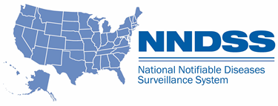
NNDSS eSHARE January Webinar
Division of Health Informatics and Surveillance
January 19, 2021

Slide 2
Agenda
Welcome and Announcements
State Panel Discussion, Part 2: Using Immunization Information Systems (IIS) to Enhance Disease Surveillance and Investigations During the Response
Connecticut, Virginia, and Washington State
Questions and Answers

Slide 3
National Notifiable Diseases Surveillance System (NNDSS) Updates and Announcements
Michele Hoover, MS
Lead, State Implementation and Technical Assistance

Slide 4
Data Modernization Learning Community
Kickoff Call: January 26, 2021, at 3:00 PM ET
1 hour call, monthly on the 4th Tuesday
Calls will include
Overview of practical data modernization resources
Peer presentations of successes and challenges
Collaborative opportunities and activities
Questions? Please contact Lura Daussat at ldaussat@taskforce.org
Save the Date!

Slide 5
NNDSS Annual Reconciliation for 2020 Data
2020 data reconciliation will be done in the Message Validation, Processing, and Provisioning System (MVPS) Portal
Jurisdictions will view and extract the line list and aggregate tables from MVPS
Jurisdictions can work at their own pace (will still have a deadline)
State Epi sign-off process will be in MVPS
Timeline
June 2021: Jurisdictions receive training and have access to line list and aggregate tables in MVPS
September 30, 2021: Jurisdiction deadline for sign-off on final data

Slide 6
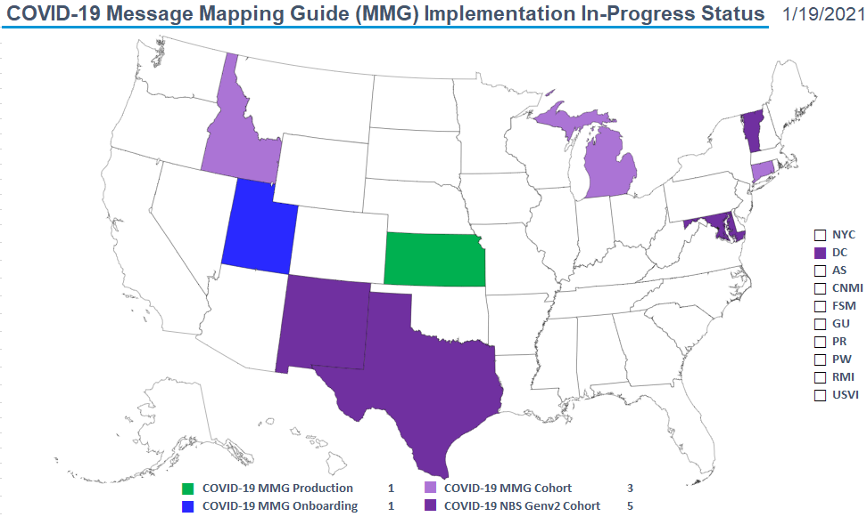
COVID-19 MMG Implementation In-Progress Status Jan 19, 2021

Slide 7
Recent Updates to COVID-19 Message Mapping Guide (MMG) Value Sets
Due to the evolving nature of COVID-19 vaccines and lab testing, impacted value sets will be updated regularly. The COVID-19 Case Notification View PHIN VADS link will be updated routinely to reflect changes.
Links to updated value sets include:
PHVS_VaccineType_NND
PHVS_LabTestType_COVID-19
Manufacturers of vaccines (MVX)
For more information, visit the MMGs and Artifacts webpage:
https://ndc.services.cdc.gov/message-mapping-guides/.

Slide 8
Vaccine History in COVID-19 Case Notifications
Options
Full COVID-19 MMG
Generic v2 MMG + vaccine history from COVID-19 MMG
DCIPHER/HHS Protect CSV upload using the updated January 2021 CSV template

Slide 9
State Panel Discussion, Part 2: Using Immunization Information Systems (IIS) to Enhance Disease Surveillance and Investigation During the Response

Slide 10
State Panelists
Connecticut Department of Public Health
Nancy L. Barrett
Virginia Department of Health
Rebecca Early
Washington State Department of Health
Chas DeBolt

Slide 11
Topics for Discussion
Surveillance Process
Use of vaccine information in COVID-19 case surveillance activities
Identification and prioritization of ineffective vaccines (breakthrough cases)
Impact of the availability of vaccine information on case/contact prioritization
Quality of data (timeliness, completeness, and accuracy) from the IIS and impact on surveillance efforts
Impact on Systems
Methods of linking immunization information system data to case surveillance data
Need for automated methods to match person information between the immunization registry and the surveillance system (due to the volume of COVID-19 vaccinations and COVID-19 cases and contacts, individual immunization registry lookups may not be efficient)
Data volume impact on electronic processes and resources needed to run automated jobs (computing power, ensuring timeliness)

Slide 12
Open Discussion

Slide 13
Subscribe to monthly NNDSS newsletter (NMI Notes) at https://www.cdc.gov/nndss/trc/news/
Access the NMI Technical Resource Center at
https://www.cdc.gov/nndss/trc/
Request NMI technical assistance or onboarding at
edx@cdc.gov
Next NMI eSHARE is February 23, 2021 – details at
https://www.cdc.gov/nndss/trc/onboarding/eshare.html

