Slide 1

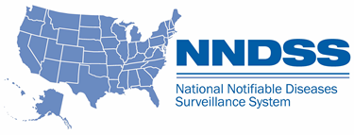
NNDSS Modernization Initiative (NMI):
December eSHARE Webinar
Division of Health Informatics and Surveillance
December 15, 2020

Slide 2

Agenda
Welcome and Announcements
State Panel on Using Immunization Information Systems (IIS) to Enhance Disease Surveillance and Investigations During the Response
  California, North Dakota, Oregon, Washington State, and Wisconsin
Questions and Answers

Slide 3
NMI Updates and Announcements
Michele Hoover, MS
Lead, State Implementation and Technical Assistance

Slide 4


Complimentary Access to Experian and LexisNexis
CSTE to offer complimentary access to LexisNexis through March 2021 and Experian through May 2021.
  To assist in collecting personal identifiers for case investigations or contact tracing during the COVID-19 pandemic.
There will be no cost to the public health agency to obtain access through CSTE.
If you are interested in obtaining access to LexisNexis and/or Experian through CSTE, please contact Subal Virk at svirk@cste.org to receive application instructions.
Please note: There are a limited number of accounts available that will be provided on a first-come,
first-served basis.

Slide 5
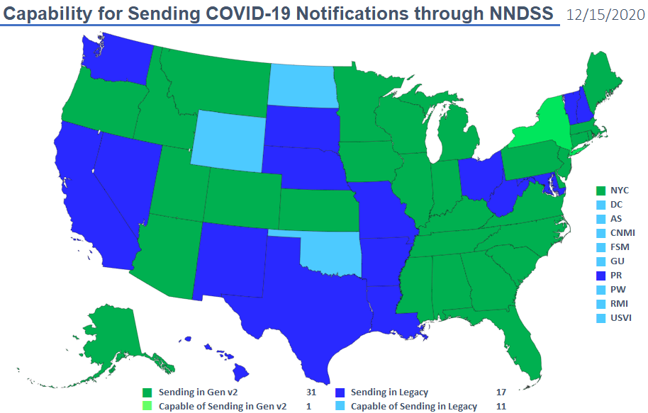
Highest MMG Implementation Status

Slide 6
COVID-19 MMG Implementation In-Progress Status Dec 15, 2020
NH
WA
VT
ME
AK
MT
ND
MN
MA
OR
WI
NY
RI
ID
SD
MI
WY
CT
IA
PA
NJ
NYC
CA
NE
OH
DE
HI
NV
IL
IN
WV
UT
VA
DC
MD
CO
KS
MO
KY
NC
TN
OK
AR
SC
AZ
NM
MS
AL
GA
TX
LA
COVID-19 MMG Onboarding Total of 2 (state)
FL
PR
COVID-19 MMG Cohort Total of 3 (states)
COVID-19 NBS Gen v2 Cohort Total of 5 (4 states + DC)

Slide 7
Data Modernization Learning Community
Kickoff Call: January 26, 2021, at 3:00 PM ET
1 hour call, monthly on the 4th Tuesday
Calls will include
  Overview of practical DM resources
  Peer presentations of successes & challenges
  Collaborative opportunities & activities
Save the Date!

Slide 8

Who should participate?
Data Modernization Leads
Look for an email invitation soon that will include:
  Link to register for the call series via Zoom
  Link to join Basecamp for online engagement and collaboration
Mark your calendars for January 26, 2021, at 3:00 PM ET
Questions? Please contact Lura Daussat at ldaussat@taskforce.org

Slide 9
State Panel Discussion: Using Immunization Information Systems(IIS) to Enhance Disease Surveillance and Investigation During the Response

Slide 10
State Panelists
California Department of Public Health
  Cynthia Yen
North Dakota Department of Health
  Mary Woinarowicz
Oregon Health Authority - Division of Public Health
  Michelle Barber and Heather Crawford
Washington State Department of Health
  Chas DeBolt
Wisconsin Department of Health Services
  Amy Bittrich, Misty Johnson, and Christopher Steward

Slide 11

Topics for Discussion
Staff Resources and Capacity
Tools and Resources Used
Approach
Lessons Learned

Slide 12

Open Discussion

Slide 13

Subscribe to monthly NNDSS newsletter (NMI Notes) at
https://www.cdc.gov/nndss/trc/news/
Access the NNDSS Technical Resource Center at
https://www.cdc.gov/nndss/trc/
Request NNDSS technical assistance or onboarding at
edx@cdc.gov
Next NMI eSHARE is January 19, 2021 – details at
https://www.cdc.gov/nndss/trc/onboarding/eshare.html

