Slide 1

NNDSS Modernization Initiative (NMI):
September eSHARE Webinar
Division of Health Informatics and Surveillance
September 15, 2020

Slide 2

Agenda
Welcome and Announcements
Sending Healthcare Worker Status in Gen V2 COVID-19 Case Notifications
Clarifying Expectations for ELC C2:Data Modernization Initiative (DMI) Assessment and Plan
Questions and Answers

Slide 3
NMI Updates
Michele Hoover, MS
Lead, State Implementation and Technical Assistance

Slide 4
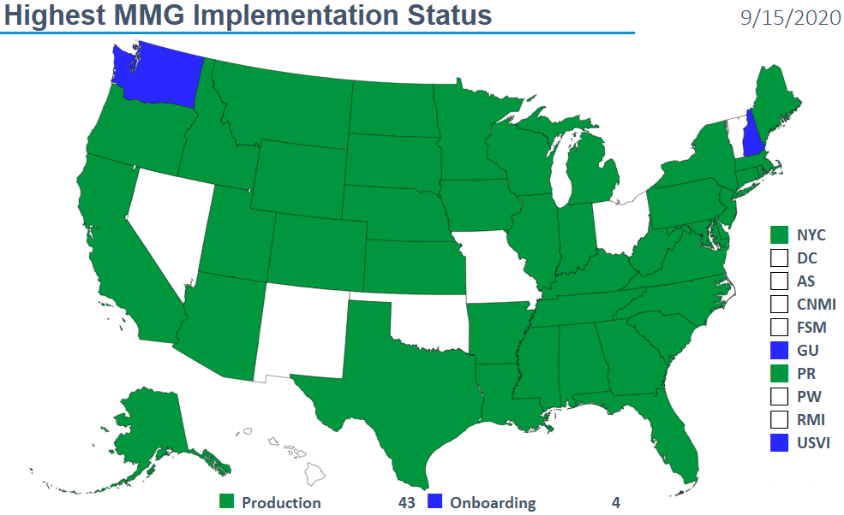
Highest MMG Implementation Status

Slide 5
Sending Healthcare Worker Status in Gen V2 COVID-19 Case Notifications
Natalie Raketich and John Park
APHL Technical Assistance Team
Jennifer Johnson
NBS Team
Michele Hoover
CDC Onboarding Team

Slide 6
Prioritized Core Case Data Elements (GenV2)
Discussed on August call:
  While the case volume remains high, can send COVID-19 notifications using data elements available without case investigation (i.e., information typically found in electronic laboratory reports)
  These notifications can be sent via GenV2, legacy NNDSS messages, or CSV
The prioritized core case data elements (right) are all discrete data elements in the GenV2 MMG, except for Healthcare worker status
Healthcare worker status (can be sent in GenV2 comments)

Slide 7
Healthcare Worker Status
Case Patient a Healthcare Worker (223366009) is an element in the COVID-19 MMG but is not a discrete data element in the GenV2 MMG
Proposed solution = send details for this variable using the GenV2 “Comment” element (77999-1):
Case Patient a Healthcare Worker? | How to send in GenV2 “Comment”
Yes | HCWYes
No | HCWNo
Unknown | HCWUnknown

Slide 8
GenV2 Comment Data Element
Optional, text (TX) data element in GenV2 MMG
May Repeat = No
If a jurisdiction is already sending the GenV2 Comment element with true comments about the case including the CDC 2019-nCoV ID, use a delimiter like “;” sending both responses

Slide 9
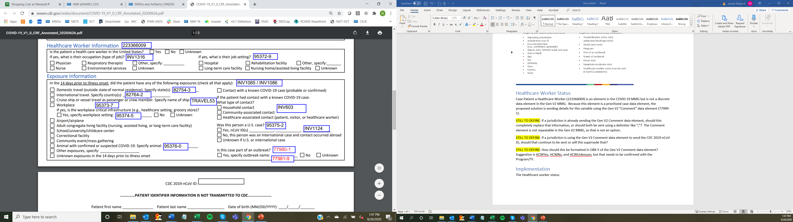
Implementation
The Healthcare worker variable from the COVID-19 Case Report Form (CRF) is shown below
If implemented this way in the PHA surveillance system, data transformations will likely be necessary to get the information in the case notification message

Slide 10
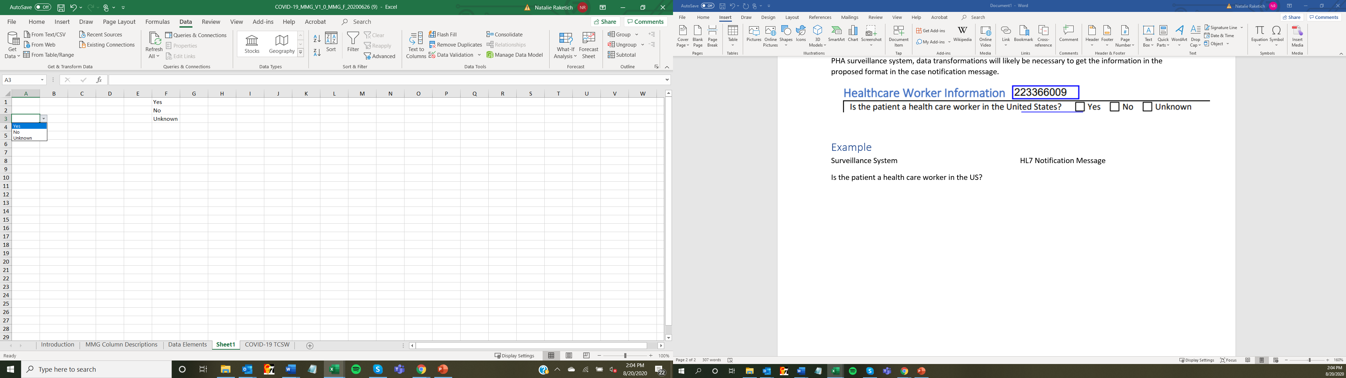
Transformation Needed
Surveillance System
Is the patient a healthcare
worker in the United States?
HL7 Notification Message
OBX|XX|TX|77999-1^Comment^LN||HCWYes||||||F

Slide 11
Options for Implementation
Sample code and configuration are provided whether you are using the template route or scripting it in a mapper filter
  Template route: Update the NMI_MAPPING_DEFINITION table and the NMI_LOCAL_LOOKUP. Sample code to place in the custom code section provided
  Mapper route: Entries in a lookup table to return values and sample code provided for reference

Slide 12
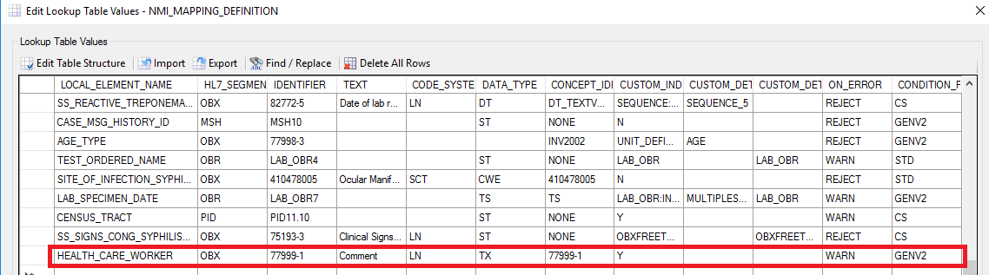
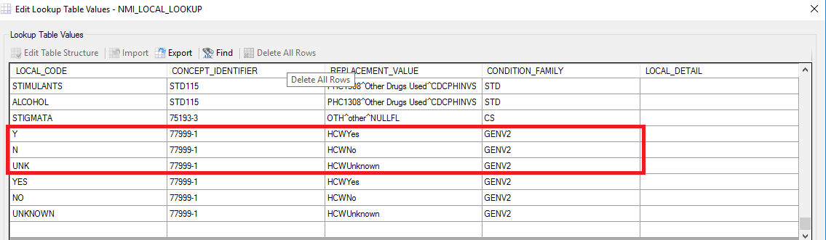
Demo on the Update-Template Route
NMI_MAPPING_DEFINITION
NMI_LOCAL_LOOKUP

Slide 13
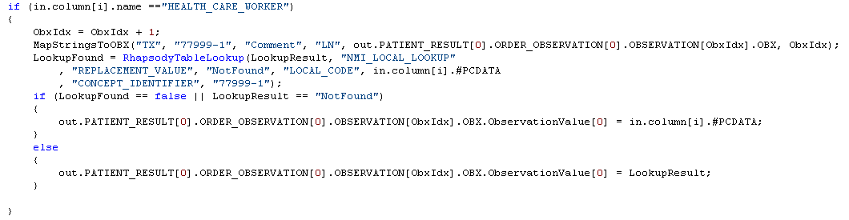
Demo on the Update-Template Route
CustomCaseMessage
Replace with HL7 Code

Slide 14
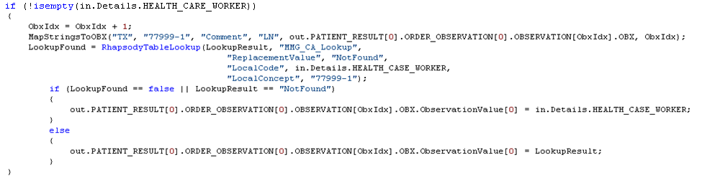
Demo on the Update- Sample Mapper Code

Slide 15

NBS Jurisdictions -
Sending Healthcare Worker Status in Comments
NBS jurisdictions can send healthcare worker status in the notification comments to CDC using a generic v2 HL7 message
  Note that comments cannot be sent in NBS master message
We will discuss in detail on upcoming NBS Subject Matter Expert (SME) Call/NBS User Group (NUG) calls
If your jurisdiction is interested in onboarding for COVID using Generic v2, please submit a ticket in NBS Central and we will work with you to complete pre-onboarding activities

Slide 16
NBS Jurisdictions -
Sending Healthcare Worker Status in Comments
Changes to implement this change will include the following:
  Adding NND metadata to the healthcare worker status field (NBS540 if using standard NBS page) to send as ‘comments’ in the case notification message
  Will provide a new Rhapsody NND route in an NBS patch release
Instructions and scripts will be posted on NBS Central

Slide 17
Ready to Send Production Messages
Public health jurisdictions who have onboarded for the Generic V2 MMG and would like to start sending Healthcare Worker Status data for COVID-19 cases should follow this process:
Jurisdiction sends email to the CDC Electronic Data Exchange email inbox (edx@cdc.gov), stating they would like to start sending the new data
Jurisdiction transmits one case with the new data to MVPS Production
CDC Onboarding team verifies the message and sends a confirmation email to the jurisdiction
Jurisdiction starts sending the new data in their routine transmission

Slide 18
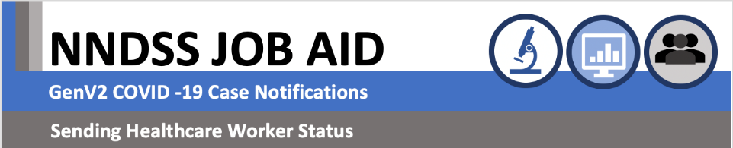
Tip Sheet Coming Soon

Slide 19
Clarifying Expectations for ELC C2:DMI Assessment and Plan

Slide 20
Clarifying Expectations for C2 DMI Assessment and Plan
Elisabeth Krow-Lucal, PhD, MPH
Epidemiologist – Data Modernization Initiative Implementation Team
Center for Surveillance, Epidemiology and Laboratory Services (CSELS)
Centers for Disease Control and Prevention

Slide 21
Public Health Data Modernization C2
Support public health jurisdictions to:
  Maintain, improve, and modernize the approach to acquire, manage, share, and use data for public health action
  More effectively detect, respond, prevent, and control diseases and conditions to protect the public health and safety of the American people

Slide 22

Strategies
Understand, coordinate, and lead data modernization efforts in the jurisdiction
Lead and coordinate efforts in health jurisdiction
Document and understand workforce, data, and health information system needs and opportunities

Slide 23

Strategies (2)
Accelerate data and health information system modernization
  Implement workforce enhancements
  Accelerate improvements to data quality, exchange, management, and use

Slide 24
Public Health Data Modernization C2 Strategies and Outcomes
Outcomes
Strategies
Short-term
Intermediate
Long-term
Understand, coordinate, and lead data modernization efforts in the jurisdiction
  Lead and coordinate data modernization efforts in health jurisdiction
  Document and understand workforce, data, and health information system needs and opportunities
Improved awareness and understanding of the current status, gaps, and opportunities related to workforce, data, and health information systems
Increased use of information to make public health decisions
Improved data coverage, quality, and timeliness
Accelerate data and health information system modernization
  Implement workforce enhancements to accelerate data modernization
  Accelerate improvements to data quality, exchange, management, and use
Early improvements to workforce capabilities, and data and health information systems and processes
Established and maintained world-class data and analytics
Established and maintained public health workforce
Improved translation of data into actionable information

Slide 25
Performance measures – short term
Completed assessment and identified opportunities using recommended tool or equivalent in first 90 days of award
  If yes, provide summary of key finding and opportunities identified
  If no, describe barrier and challenges to completing the assessment

Slide 26
90-day Assessment: November 1
Identify lead for data modernization efforts in jurisdiction
Assess current state of data and health information systems and service
Identify opportunities for modernization and improved interoperability
Assess workforce capacity and gaps of jurisdiction’s data science capability
Note: We know that many of you may be concerned about this short timeline. If you have concerns about completing your assessment by Nov 1, please reach out to us at EDX@cdc.gov (ELC team)

Slide 27
What is the assessment data used for?
Results of assessments will be used:
  By CDC and some of the public health partners to inform options for TA
  By the jurisdictions to revise or update their workplan as needed
  Results of assessment will be shared – format TBD
For the rest of the year, jurisdictions will implement what they described in their workplan
  CDC will be working on hosting webinars and other assistance
  Potential workshop for jurisdictions to share experiences
November 1
December 1
Complete assessment
CDC compiles results
Preliminary results shared with jurisdictions
Revise workplan and implement activities
Participate in webinars and other TA

Slide 28
General expectations of assessment
Not expected to assess all workforce, data, and health information systems in the jurisdiction
Look at needs and opportunities at different levels
Consider what are priority activities for each strategy
  Are there groups that are doing things well that you want to adapt/expand?
  Are there groups that are struggling in one or more of these areas?
Short term goals should build towards longer term goals

Slide 29
Needs and Opportunities
Needs
  Gaps or issues that need to be addressed
  Barriers or bottlenecks that limit effectiveness
Opportunities
  Consider the competency areas listed in the C2 appendix 1 – which are the most important to address for your staff or in your jurisdiction?
    E.g. Analysis, assessment, and evaluation
  Consider the core capacities listed in the C2 appendix 2 – which are the most important to address for systems improvement?
    E.g. Data exchange between integrated surveillance information system and information systems
  How can you improve your competencies and core capacities?

Slide 30
Training needs
Encourage you to think about moving from skills to area competencies
Consider organizational capacity and how to address those needs
Try to match training and development needs with organizational and/or system improvement priorities

Slide 31
Ways to start thinking about the assessment
Talk to others in your jurisdiction
  Many different assessments may have already been done by different groups
Catalog of data resources
https://www.cdc.gov/surveillance/dmi/index.html
  Existing data by jurisdiction on needs and opportunities from previous assessments
Use ELC REDCap C2 form questions (coming soon) as a guide
Ask for help
  ELC team (EDX@cdc.gov)

Slide 32
ELC C2 REDCap questions as a guide
The goals of these questions are:
  To help guide jurisdictions in initial thinking about and planning for helpful data modernization activities
  To help CDC understand shared gaps/opportunities to be able to provide TA or resources
    E.g. access to trainings, webinars, telephone consultations, onsite short-term assistance, other resources

Slide 33
Draft REDCap questions (1)
Based on information you have on current capabilities, what are the 3 most important immediate (1-2 years) needs in each strategy component?
  Workforce
  Data
  Health information systems

Slide 34
Draft REDCap questions (2)
What are the 3 most important opportunities for improvement in each strategy component?
Consider things you are planning to improve, rather than aspirational opportunities

Slide 35
Draft REDCap questions – for discussion (1)
What additional information or resources would be required to assess needs and opportunities in the DMI strategy components?

Slide 36
Draft REDCap questions – for discussion (2)
What types of assistance can CDC, partner organizations, or other jurisdictions provide to help you meet these needs?

Slide 37
Resources
Others in your jurisdiction
ELC C2 Data Modernization Award
  ELC C2: Data Modernization CDC Project Description
  Project C2 Appendix 1: Workforce Competencies
  Project C2 Appendix 2: Examples – Systems and Data Exchange – Core Capacities
  ELC C2: Data Modernization Application information
CDC Data Catalog of Resources - https://www.cdc.gov/surveillance/dmi/index.html
  Excel version will be distributed by email
ELC team – EDX@cdc.gov

Slide 38
Discussion questions
What additional information or resources would be required to assess needs and opportunities in the DMI strategy components?
What types of assistance can CDC, partner organizations, or other jurisdictions provide to help you meet these needs?

Slide 39

Q & A

Slide 40
Subscribe to monthly NMI Notes news updates at
https://www.cdc.gov/nndss/trc/news/
Access the NNDSS Technical Resource Center at
https://www.cdc.gov/nndss/trc/
Request NNDSS technical assistance or onboarding at
edx@cdc.gov
Next NNDSS eSHARE is October 20, 2020 – details to come at
https://www.cdc.gov/nndss/trc/onboarding/eshare.html

Slide 41
Appendix: Additional C2:DMI Information

Slide 42

Short-Term Outcomes
Improved awareness and understanding of the current status, gaps, and opportunities
Workforce capabilities
Data infrastructure and IT
Interoperability and data sharing
Intra-jurisdiction and inter-jurisdiction coordination

Slide 43
Short-Term Outcomes (2)
Efforts will increase
Data science workforce capabilities
Information exchange among stakeholders to support data modernization
Access to shared services
Access to assistance to support data modernization

Slide 44
C2 DMI Strategy Components
Workforce capabilities and coordination including:
    Data science, epidemiology, and laboratory science capabilities
    Training and development programs
  Data quality, completeness, and timeliness including:
    Coverage of surveillance data
    Data quality and completeness
    Timeliness of data and reporting
  Health information systems, data sharing, and interoperability including:
    Electronic data exchange
    Interoperability and data sharing
    Use of shared services that support data modernization

Slide 45
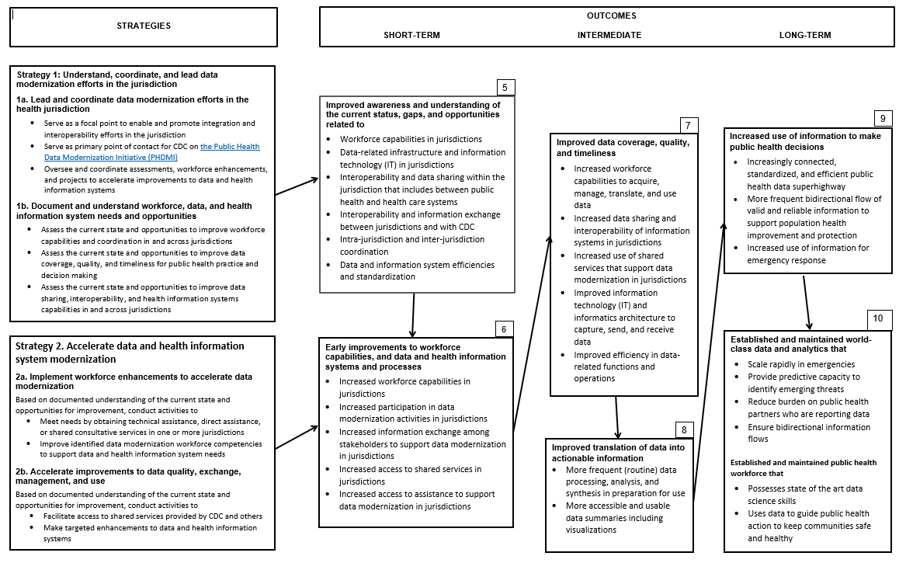
Full logic model

