Slide 1
NNDSS Modernization Initiative (NMI): August eSHARE Webinar
Division of Health Informatics and Surveillance
August 18, 2020

Slide 2
Agenda
Welcome and Announcements
Core Data for COVID-19 Case Notifications
Walkthrough: The New MVPS Dashboard
Questions and Answers

Slide 3
NMI Updates
Michele Hoover, MS
Lead, State Implementation and Technical Assistance

Slide 4
Value Set Updates to Arboviral MMG
Arboviral MMG has been updated to v1.3.1
Race Category (DEM152) has a new value set, adding “Unknown” value.
Ethnic Group (DEM155) has a new value set, adding “Unknown” and “Other” values.
METS has been updated to validate against the new value sets.
Arboviral MMG View in PHINVADS has been updated with:
New Race Category and Ethnic Group value sets, and
Recent additions to the Country of Birth (DEM126), Country of Usual Residence (INV501), and Imported Country (INV153) values sets.

Slide 5
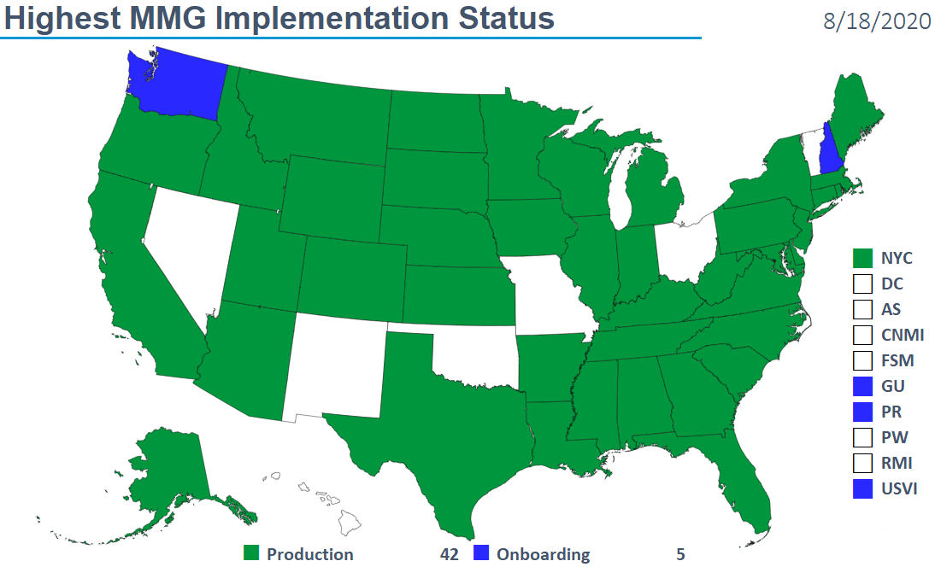
Highest MMG Implementation Status

Slide 6
COVID-19 Case Notifications

Slide 7
Importance of Case Surveillance
Measure disease burden
Characterize epidemiology
demographics, clinical, and risk factors,
exposure and contact history, and
course of clinical illness and care received
Inform public health action

Slide 8
Challenges in COVID-19 Case Surveillance
The current case report form has ~130 data elements covering
Extensive exposure information (e.g., cruise ship or vessel travel; household contacts)
Clinical course, symptoms, care received, medical and social history
Molecular and serologic testing
Currently, millions of COVID-19 cases in United States
Majority of cases initiated by laboratory reporting
Burden on public health staff to do full case investigations
Low levels of completeness for most of the requested data elements.

Slide 9
Completeness of Data Reported (July 16, 2020)
Indicator | National (mean) | States (range)
Age | 99.8% | 97.1%–100%
Sex | 98% | 0.1%–100%
Race/Ethnicity | 48% | 0%–88%
Hospitalization | 45% | 0%–100%
ICU admission* | 33% | 0%–100%
Death | 49% | 0%–100%
Any medical condition | 20% | 0%–100%
Chronic lung disease | 12% | 0%–100%
*Percent with ICU admission status among those who were hospitalized

Slide 10
Minimal Requested Data Elements for COVID-19 Case Notifications to CDC
Tier 1 (high case volume)
Data elements available without case investigation
Use GenV2 or legacy NNDSS messages or CSV for case notification
Continue with current data feed, if preferred
Tier 2 (routine notification when case volume is manageable)
Options: CSV for existing Case Report Form, GenV2 plus CSV, or GenV2 plus COVID-19 MMG
Focus on high priority data elements (e.g., vaccine history, symptoms)

Slide 11
Prioritized Core Case Data Elements (GenV2)
Majority ELR-Based Data Elements
Requires Additional Data Collection
Reporting jurisdiction
Jurisdiction case ID
Case classification (e.g., confirmed, probable)
Report date, MMWR week and year
Date of birth
Age
Sex
Ethnicity
Race
County
State
Hospitalization status (and admission/discharge date)
Death (and date)
Pregnant
Part of an outbreak
Name of outbreak
Onset date
Symptom resolution date
Healthcare worker status (can be sent in GenV2 comments)

Slide 12
Minimal Requested Data Elements for COVID-19 Case Notifications to CDC
Prioritizing core data elements that are needed for national response
Case notification does not affect
data that state, territorial, tribal, and local jurisdictions collect on their own for surveillance, public health investigations, or contact tracing
Technical Assistance and other resources targeted at implementation of GenV2 and COVID-19 MMG, as jurisdictions are ready
Other surveillance systems and special studies will continue to serve the vital role of obtaining detailed, complete information about the impact of COVID-19 in select populations.

Slide 14
Walkthrough: The New MVPS Dashboard
Andrew Kuehl, MIT, PMP
MVPS Project Lead

Slide 15
MVPS Portal – Why?
Improved performance
Improved usability
Case Counts
Case Errors
Advanced Filtering
Target roll-out early September

Slide 16
MVPS Portal – New Code
.Net Core 3.1, Blazor Server
Full stack C# development
Reduced resource skillsets
Faster development cycle

Slide 17
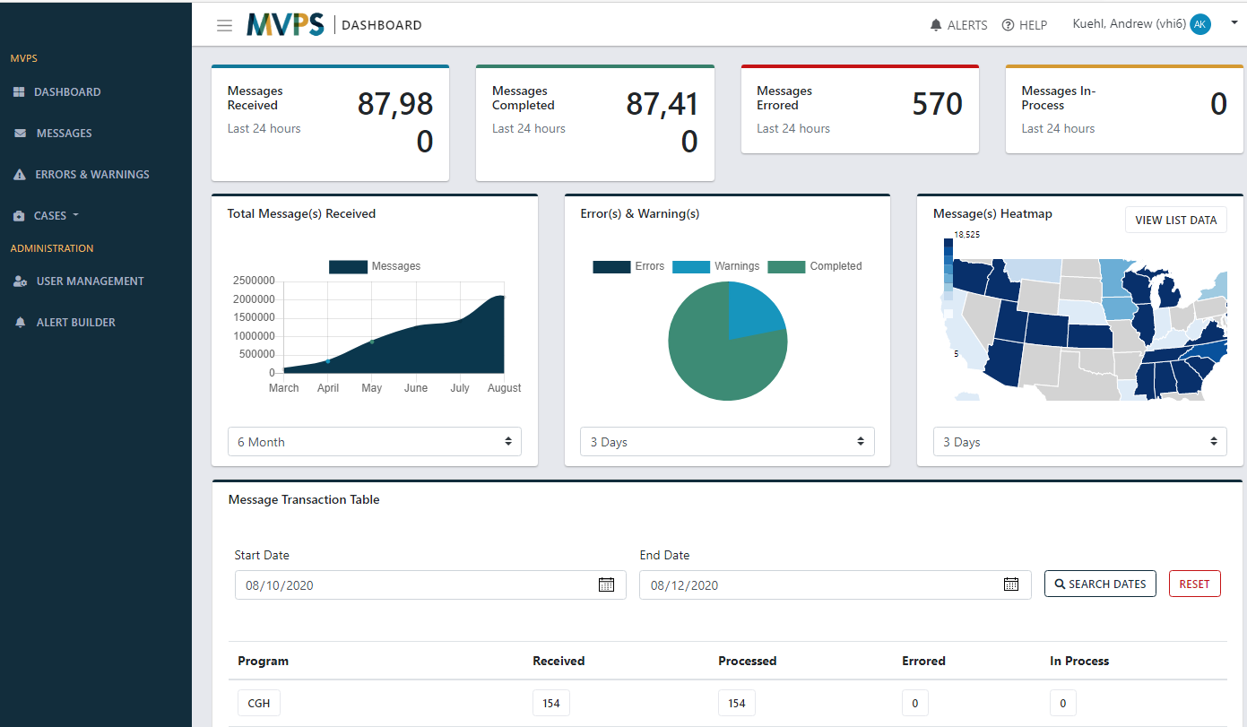
MVPS Portal – Dashboard Landing

Slide 18
MVPS Portal – Messages

Slide 19
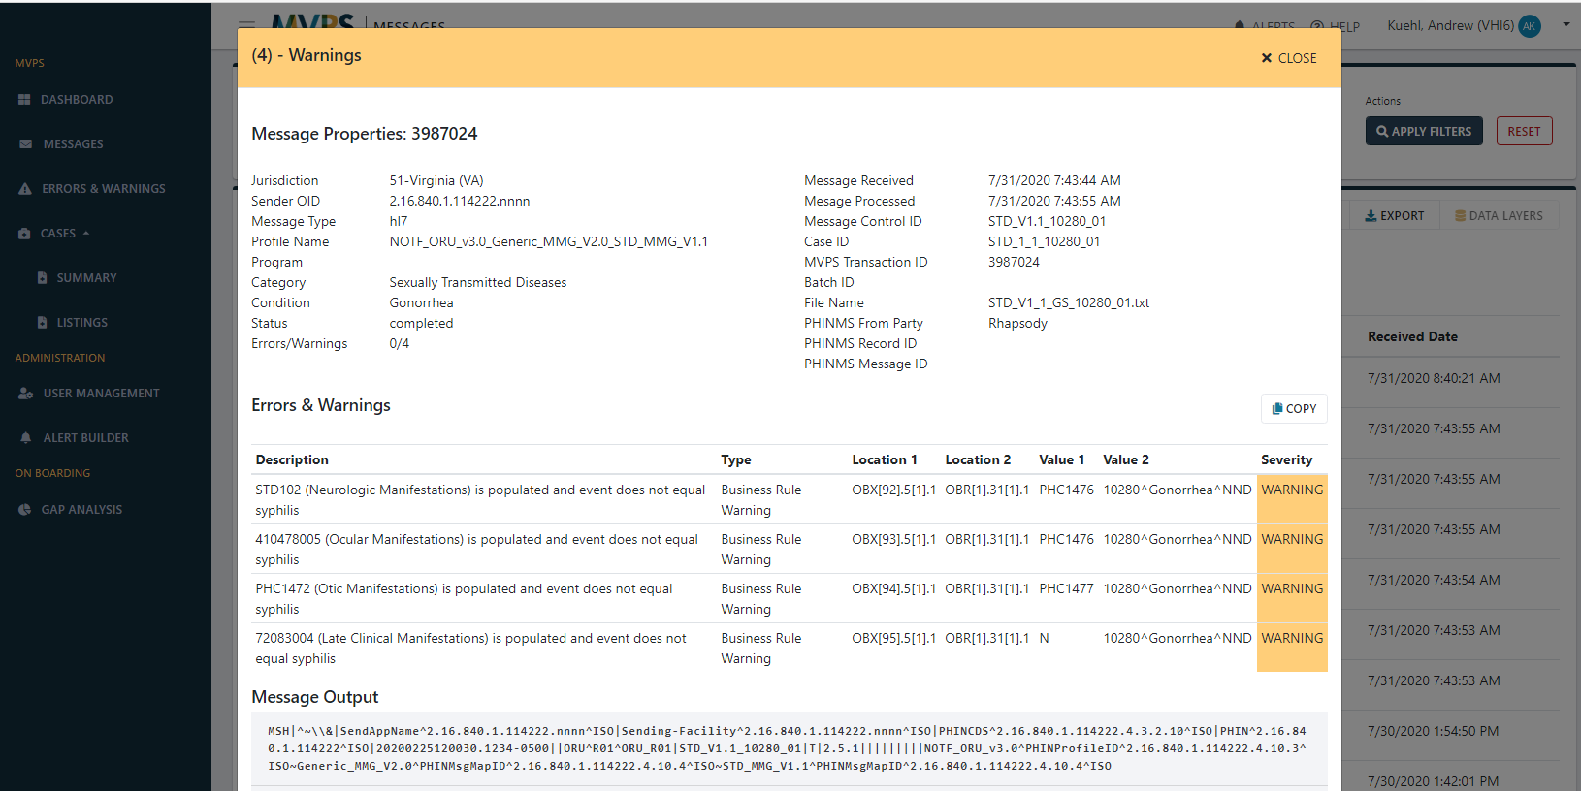
MVPS Portal – Message Detail

Slide 20
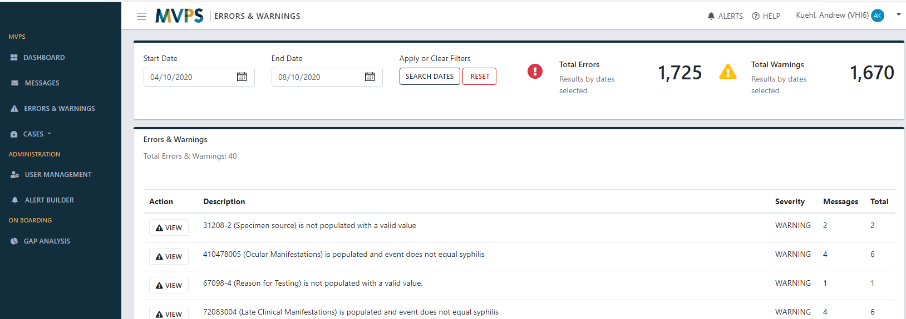
MVPS Portal – Errors & Warnings

Slide 21
MVPS Portal – Case Summary

Slide 22
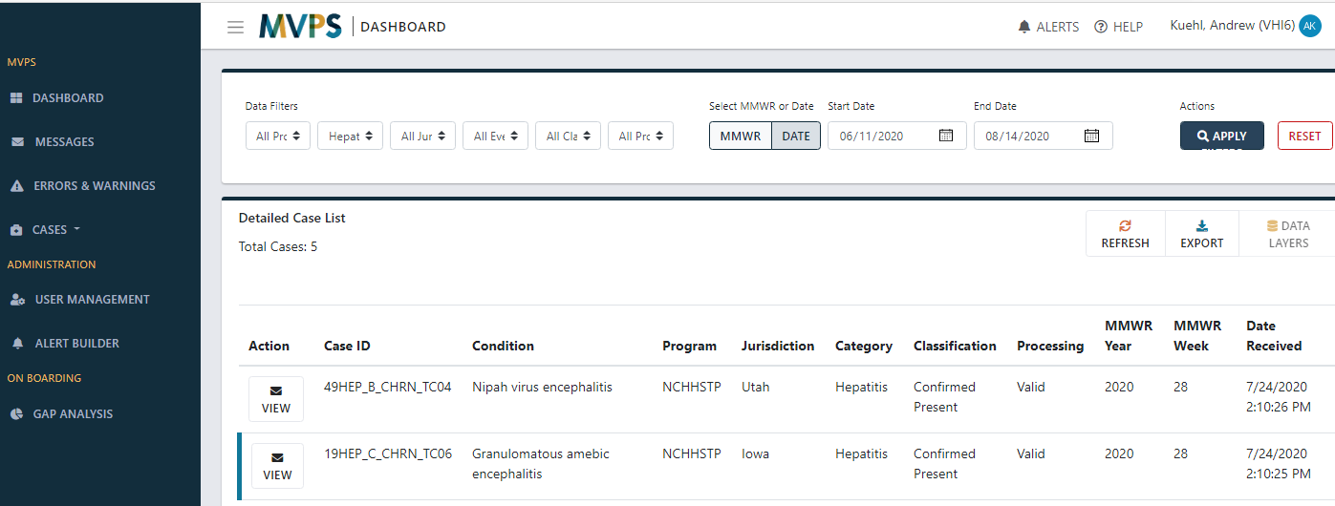
MVPS Portal – Case Listing

Slide 23
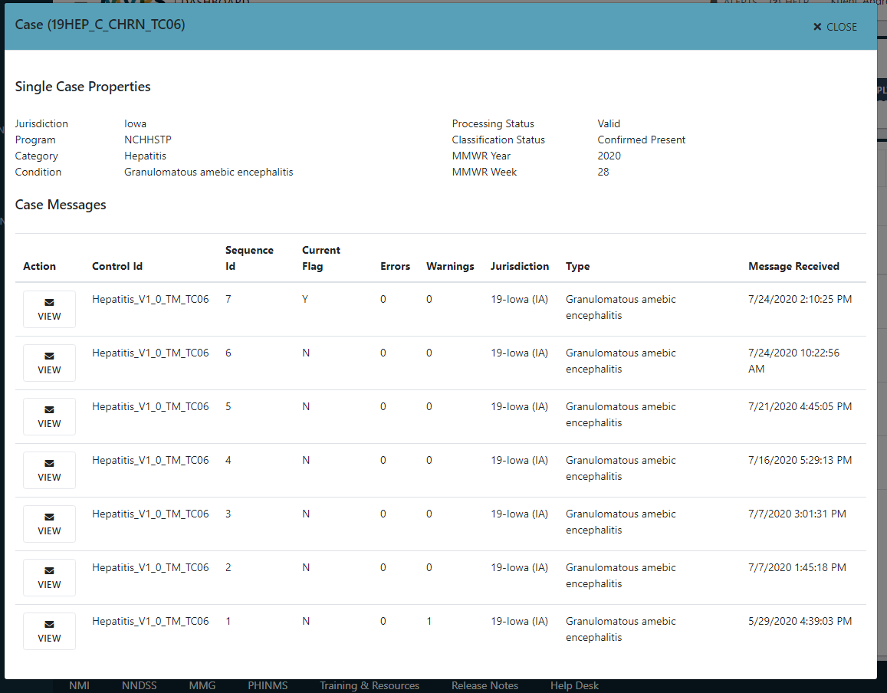
MVPS Portal – Case Detail

Slide 24
MVPS Portal – Alerts

Slide 25
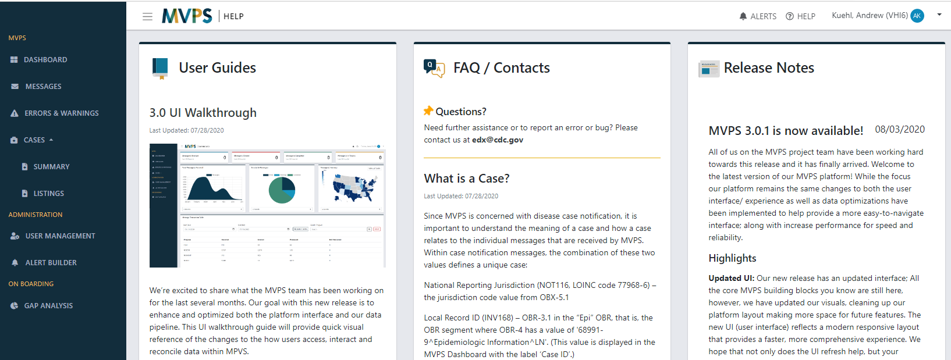
MVPS Portal – Help

Slide 26
MVPS Portal – What’s next?
Testing throughout August
Target roll-out early September
In-development for early 2021
Mark a case ‘Not a Case’
Low Incidence Verification
Reconciliation

Slide 27
Q & A

Slide 28
Subscribe to monthly NNDSS newsletter (NMI Notes) at https://www.cdc.gov/nndss/trc/news/
Access the NNDSS Technical Resource Center at
https://www.cdc.gov/nndss/trc/
Request NNDSS technical assistance or onboarding at
edx@cdc.gov
Next NMI eSHARE is September 15, 2020 – details at
https://www.cdc.gov/nndss/trc/onboarding/eshare.html

