Slide 1

NNDSS Modernization Initiative (NMI):
April eSHARE Webinar
Division of Health Informatics and Surveillance
April 21, 2020

Slide 2

Agenda
Welcome and Announcements
NNDSS Support of CDC COVID-19 Response
Update on 2019 NNDSS Data Reconciliation Process
Answers to SAMS Secure Data eXchange (SAMS SDX) Questions
Questions and Answers

Slide 3
NMI Updates and Timeline
Michele Hoover, MS
Lead, State Implementation and Technical Assistance

Slide 4
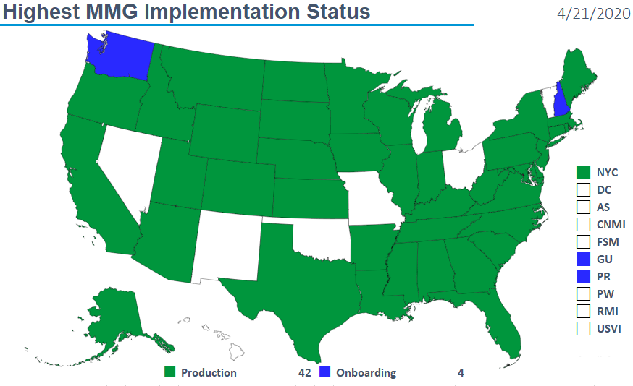
Highest MMG Implementation Status

Slide 5
Finalized Guides
Onboarding Open to All | Onboarding For Pilots Only
Arboviral v1.3 | Babesiosis/Trichinellosis
Gen v2 | FDD
Hepatitis | HAI MDRO
Malaria | Lyme/TBRD
STD/CS | Mumps, Pertussis, and Varicella
 | TB/LTBI
4/21/2020

Slide 6
NNDSS HL7 Message Mapping Guide Estimated Timeline
4/14/2020

Slide 7
NNDSS Support of CDC COVID-19 Response
Lesliann Helmus, MSPH, CHTS-CP
Associate Director for Surveillance
Michele Hoover, MS
Lead, State Implementation and Technical Assistance

Slide 8
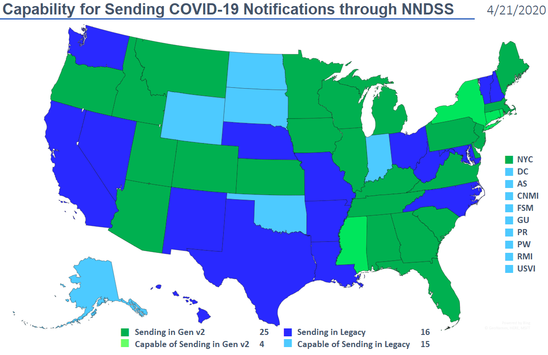
Highest MMG Implementation Status

Slide 9
CSTE Interim Position Statement (Interim-20-ID-01)
CSTE approved interim position statement entitled “Standardized surveillance case definition and national notification for 2019 novel coronavirus disease (COVID-19).”
Notification includes confirmed and probable cases.
Case definition will be posted on the CDC website soon: https://www.cdc.gov/coronavirus/2019-nCoV.
Position Statement is available on CSTE website now: https://cdn.ymaws.com/www.cste.org/resource/resmgr/2020ps/interim-20-id-01_covid-19.pdf.

Slide 10
Sending COVID-19 Cases to NNDSS
On 4/7/2020, CDC EOC State Coordination Team provided information to public health partners regarding initiating case reporting in NNDSS.
No test messages or onboarding process with NNDSS needed when you add this new event code (11065) to an existing data feed.
Please send an email to edx@cdc.gov when you transmit your first case so we can verify it was received properly.
Data is now being provisioned to CDC programs daily – send case notifications more often than once a week.
Please send all cases meeting a COVID-19 case definition.

Slide 11
NNDSS Provisioning Full Case IDs
To accommodate NETSS limitations, case IDs are truncated in processing.
New processes have been implemented to provision full case ID from GenV2, GenV1 and NBS Master Message.
Full case ID sent by jurisdictions will be available
  In reconciliation line lists
  in MVPS Dashboard
CDC programs can use this full case ID for matching with data from other systems that include the NNDSS case ID.
Reduces the risk of confusion from any duplicate IDs (from truncation)

Slide 12
For More Information…
Epidemiology of COVID-19 and public health guidance can be found at: https://www.cdc.gov/coronavirus/2019-nCoV/.
Questions regarding NNDSS submissions can be sent to edx@cdc.gov.

Slide 13
Update on 2019 NNDSS Data Reconciliation Process
Deborah A. Adams
Data Operations Team

Slide 14
2019 NNDSS Annual Data Reconciliation
Shift in Dates Due to COVID-19 Response

Slide 15
Answers to
SAMS Secure Data eXchange (SAMS SDX)
Questions
Diana Onweh
Data Operations Team

Slide 16
SAMS SDX: Frequently Asked Questions
Question 1: I don’t have a NETSS upload STD activity for my state. Do I need one to send STD data files?
Answer: No, you don’t. If you previously used your EPI upload activity to send all your files, please continue to do that.
Question 2: After I upload a file, do I park it in the Weekly/YTD folder or leave it in the default folder?
Answer: After uploading your file to the SAMS application, you must add the uploaded file to either the “Weekly” or “YTD” folder for the NNDSS team to retrieve it.
Question 3: I am able to upload my NETSS weekly file to SAMS but I can’t figure out what to do to load or process the file. What’s the next step?
Answer: Select the “Weekly” or “YTD” folder and add the file using the upload, drag and drop, or browse functionality. After your file has been added to the correct folder you’re done!

Slide 17
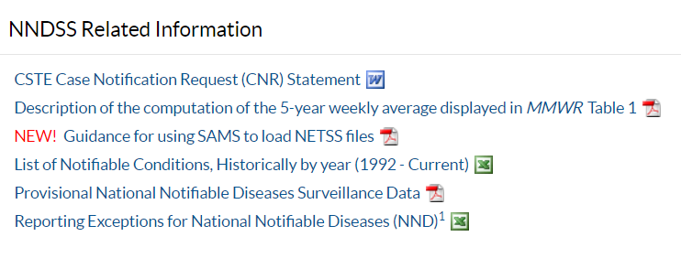
SAMS SDX: Frequently Asked Questions cont’d
Question 4: How do I know that CDC has received my file?
Answer: NNDSS processing will pick up files from SAMS once per hour. Once your file has been retrieved it will no longer appear in the “Weekly” or “YTD” folder. If your file doesn’t disappear after a full hour has elapsed, contact the Data Operations Team (DOT) representative for your state.
Question 5: Why am I not getting the status reports I used to get?
Answer: The e-mail address of the specific person uploading the file is no longer accessible. Your DOT representative will work with you to identify one primary e-mail recipient for each SAMS activity (EPI, STD, etc.), and that person will begin to receive the automated status reports.
For more information, please go to:
https://ndc.services.cdc.gov/event-codes-other-surveillance-resources/.

Slide 18

Q & A

Slide 19
Subscribe to monthly NNDSS newsletter (NMI Notes) at
https://www.cdc.gov/nndss/trc/news/
Access the NNDSS Technical Resource Center at
https://www.cdc.gov/nndss/trc/
Request NNDSS technical assistance or onboarding at
edx@cdc.gov
Next NNDSS eSHARE is May 19, 2020 – details to come at
https://www.cdc.gov/nndss/trc/onboarding/eshare.html

Slide 20
Appendix

Slide 21
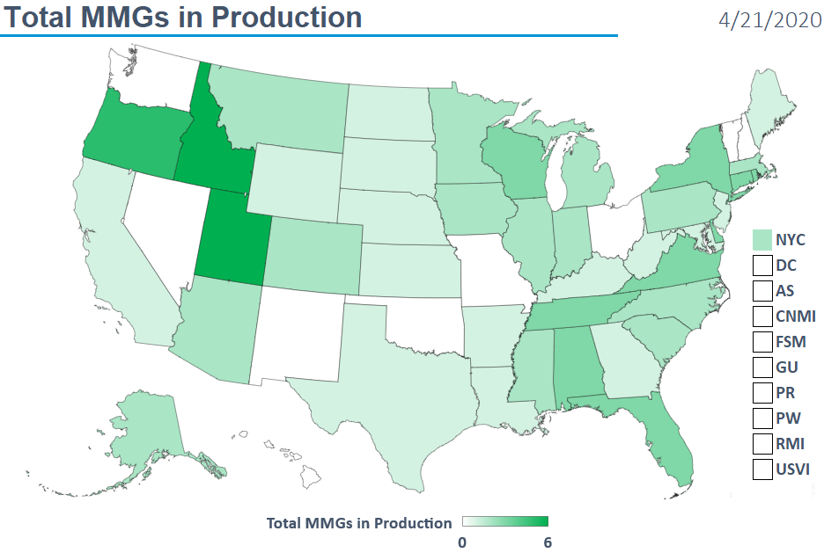
Total MMGs in Production

Slide 22
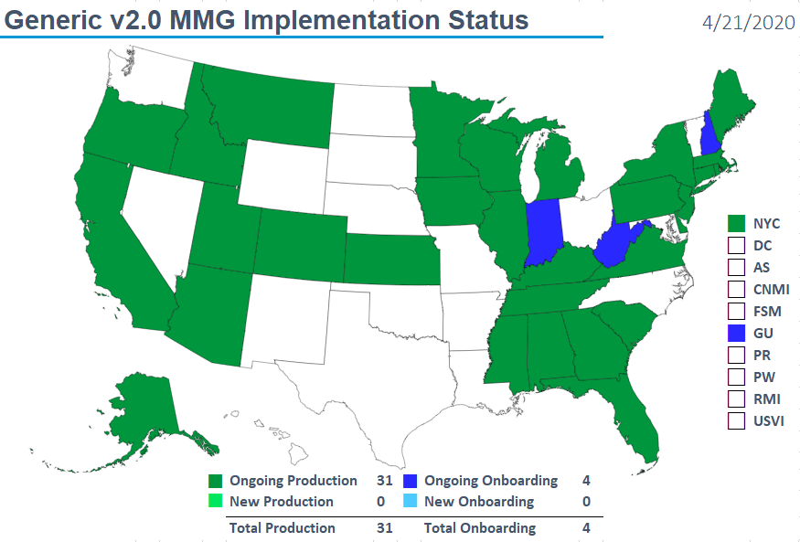
Generic v2.0 MMG Implementation Status

Slide 23
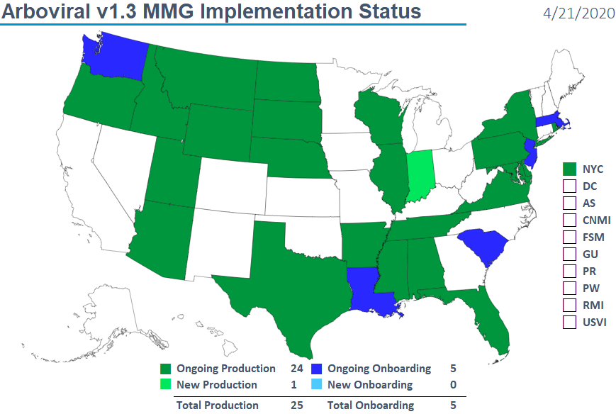
Arboviral v1.3 MMG Implementation Status

Slide 24
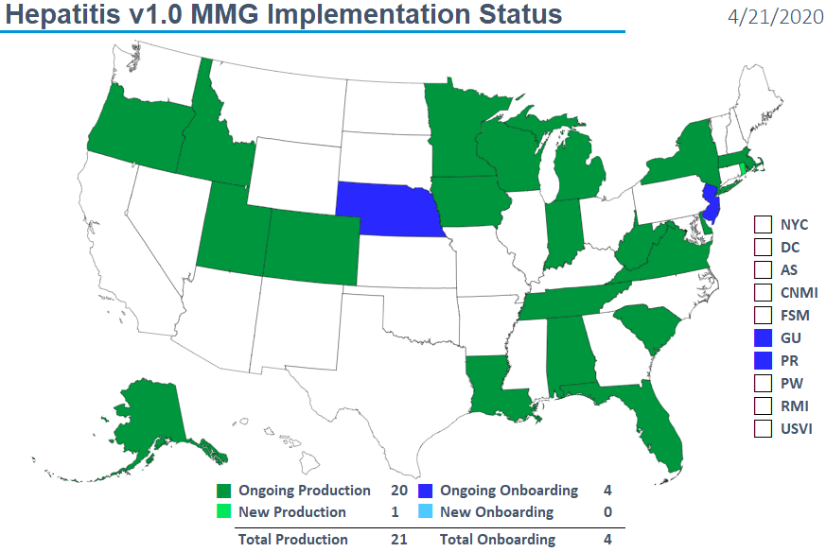
Hepatitis v1.0 MMG Implementation Status

