Slide 1


NNDSS Modernization Initiative (NMI):
March eSHARE Webinar
Division of Health Informatics and Surveillance
March 17, 2020

Slide 2

Agenda
Welcome and Announcements
Important Changes to SAMS
NNDSS Data Reconciliation Process for 2020
Questions and Answers

Slide 3
NMI Updates and Timeline
Lesliann Helmus, MSPH, CHTS-CP
Associate Director for Surveillance
Michele Hoover, MS
Lead, State Implementation and Technical Assistance

Slide 4
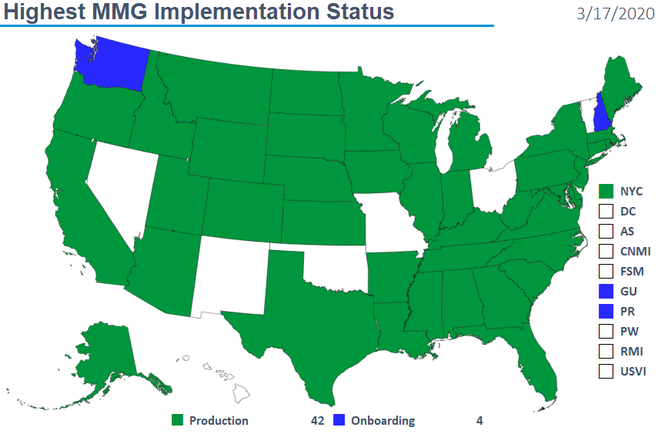
Highest MMG Implementation Status

Slide 5
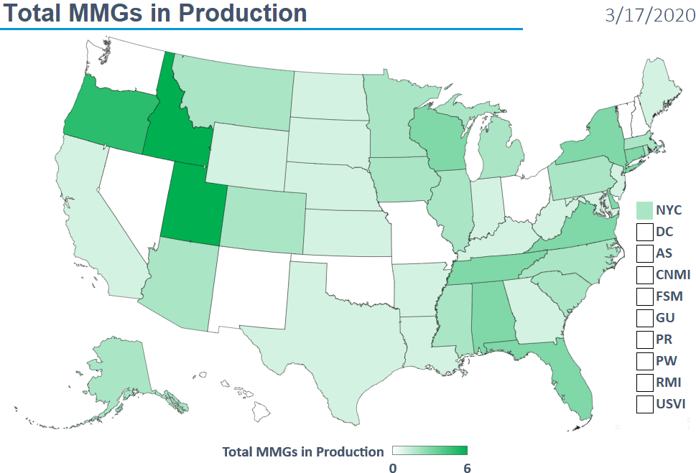
Total MMGs in Production

Slide 6
Finalized Guides
Onboarding Open to All | Onboarding For Pilots Only
Arboviral v1.3 | Babesiosis/Trichinellosis
Gen v2 | FDD
Hepatitis | HAI MDRO
 | Lyme/TBRD
 | Malaria
 | Mumps, Pertussis, and Varicella
 | STD/CS
 | TB/LTBI
3/17/2020

Slide 7
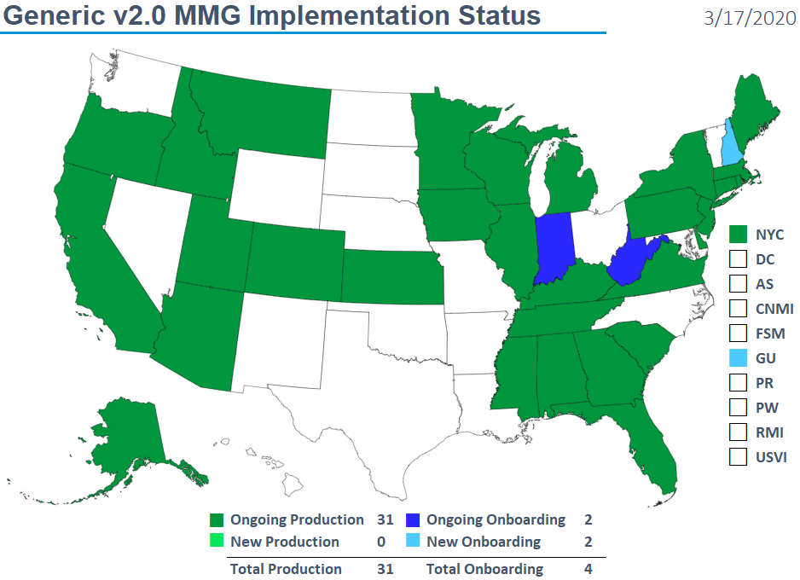
Generic v2.0 MMG Implementation Status

Slide 8
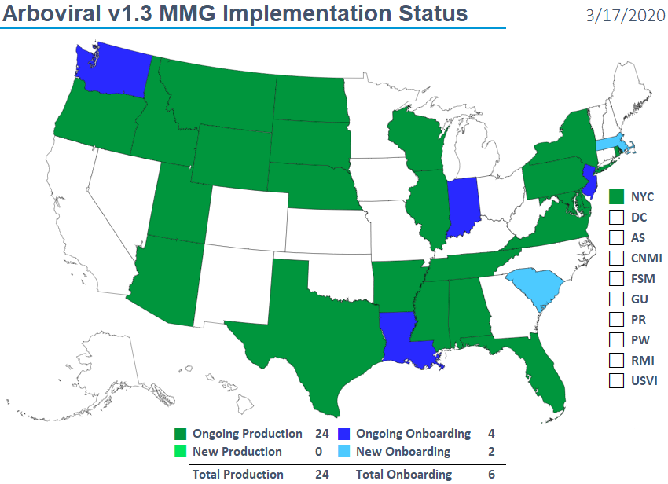
Arboviral v1.3 MMG Implementation Status

Slide 9
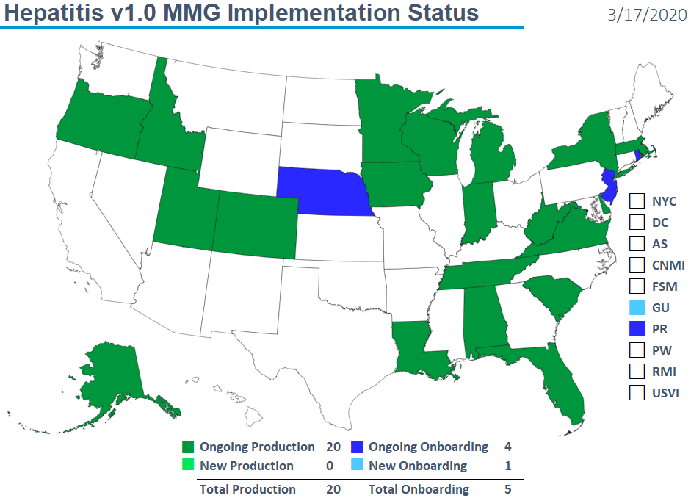
Hepatitis v1.0 MMG Implementation Status

Slide 10
NNDSS HL7 Message Mapping Guide Estimated Timeline
3/10/2020

Slide 11
Important Changes to SAMS:
SAMS NETSS Secure File Transfer migration to
SAMS Secure Data eXchange (SAMS SDX)
Andrew Kuehl, MIT, PMP
MVPS Project Lead

Slide 12
SAMS NETSS Secure File Transfer Migration
SAMS NETSS Secure File Transfer Tool is being replaced by SAMS Secure Data eXchange (SAMS SDX)
SAMS SDX will require slightly different NETSS upload process
Cutover date is Thursday, March 26, 2020
Instructions were sent to all NETSS users the week of March 9th
12

Slide 13
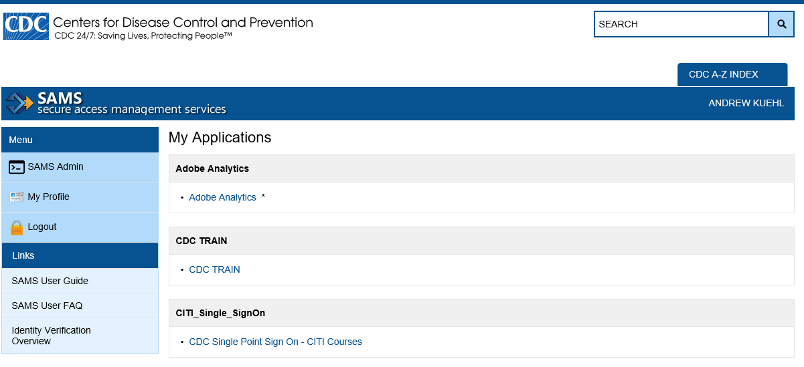
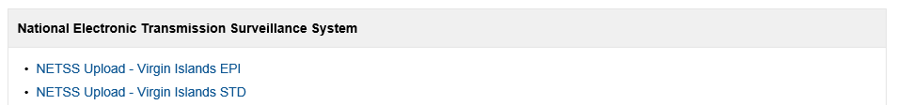
Current SAMS Activities
13

Slide 14
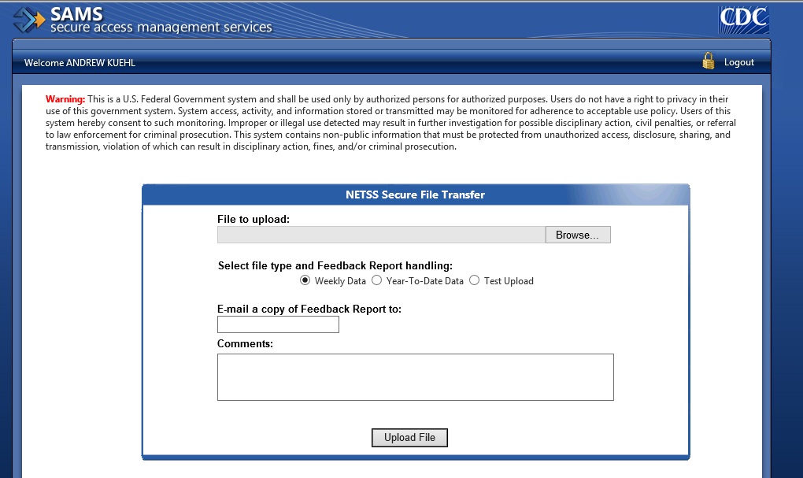
Current SAMS upload form
14

Slide 15
SAMS Activities Remain the Same
15

Slide 16
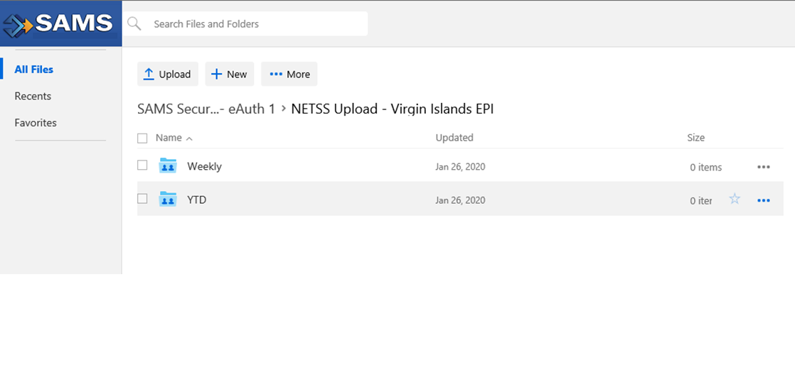
New SAMS SDX Upload
Very Important to select the appropriate folder for NETSS file type
16

Slide 17
Next Steps
Instructions were sent to all NETSS users the week of March 9th
Cutover date is Thursday, March 26, 2020
Email questions to edx@cdc.gov
17

Slide 18
Preparing to Reconcile 2019 Data
Deborah A. Adams
Yvette Dominique, MS, PMP
Division of Health Informatics and Surveillance

Slide 19
What is NNDSS Reconciliation?
Process to finalize case counts for the previous year
  Agreement between reporting jurisdiction database and CDC NNDSS database
CDC provides tables with counts to be printed in the NNDSS tables
  Based on surveillance case definitions, case status classifications, print criteria
Reconciliation packet includes:
  Summary Production Calendar
  Week-ending calendar
  Reconciliation tables with instructions for use
  Detailed listing of all non-STD cases
Final steps: State or territory epidemiologist signs-off on final counts

Slide 20
Data Reconciliation Timeline
March
April-May
States/territories transmit updates on 2019 cases to CDC
June
NNDSS emails final reports to State/Territorial Epidemiologist for signature
NNDSS emails reconciliation packets to state/territorial reporters
Jurisdictions obtain and process any outstanding 2019 case reports
6/25/2020: State/Territorial Epidemiologists’ last day to return approved reports to CDC
6/30/2020: NNDSS 2019 Reconciliation Database closed
5/31/2020: Last day for states/territories to transmit 2019 FINAL year-to-date data files and updates
States/territories work with CDC programs to address any outstanding issues

Slide 21
2019 Reconciliation Data Tables

Slide 22
2019 Reconciliation Tables for
National Notifiable Infectious Diseases
Table 1 State-specific case count by system status and disease
Table 2 State-specific case count by case status classification and disease
Table 3 State-specific case count by month and disease
Table 4 State-specific case count by race/ethnicity and disease
Table 5 State-specific case count by age group (years) and disease
Table 6 State-specific case count by sex and disease
Table 7 State-specific case count by MMWR week and disease
Table 8 State-specific case count by ‘Reporting county’ and disease
Table 9 State-specific case count by MVPS ‘County of residence’ PID-11.9
Table 10 State-specific outbreak status by disease
Table 11 State-specific import status by disease
Table 12 State-specific case count by disease and ‘reporting exception’ [diseases that are ‘Not Reportable’ or where data are ‘Unavailable’]
Table 13 State-specific case count for retired event codes
Line List State-specific ‘case-level line list’ for non-STD data by disease (includes original NBS &
HL7 case ids)
Note: Tables 1-11 will also be sent in an Excel format

Slide 23
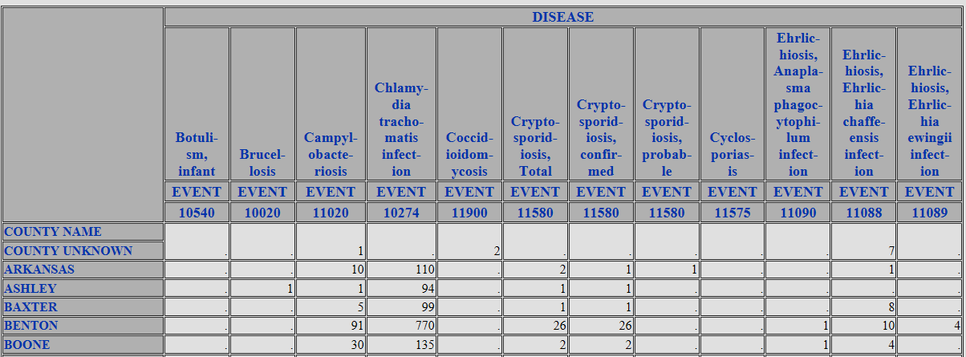
TABLE 8: STATE-SPECIFIC CASE COUNT BY REPORTING COUNTY AND DISEASE
TABLE 9: STATE-SPECIFIC CASE COUNT BY COUNTY OF RESIDENCE AND DISEASE
CDC programs use the county data for analysis.

Slide 24
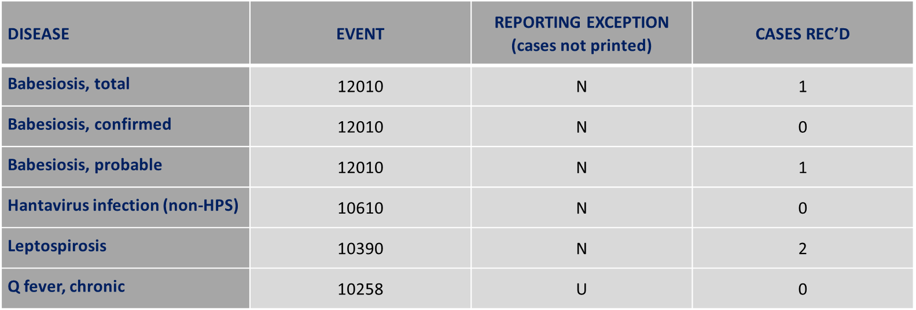
TABLE 12: STATE-SPECIFIC CASE COUNT BY DISEASE AND REPORTING EXCEPTION
Information on notifiable conditions that are not reportable or
do not have data available for the jurisdiction.

Slide 25
TABLE 13: STATE-SPECIFIC CASE COUNT FOR RETIRED EVENT CODES BY DISEASE
DISEASE | RETIRED EVENT | CASES REC’D | 2019 EVENT
Streptococcal, disease, inv. Group A | 11710 | 980 | This condition is not nationally notifiable, but is part of the Active Bacterial Core Surveillance (ABCs) activity
Streptococcal, disease, inv. Group B | 11715 | 2,034 | This condition is not nationally notifiable, but is part of the Active Bacterial Core Surveillance (ABCs) activity
Please update your system to use 2019 event codes for 2019 data.

Slide 26
What States Should Know

Slide 27
Reconciliation Tips
  Start the process early ☺.
  Designate an assigned point person by March 17, 2020.
  Notify your NNDSS Data Operations Team (DOT) representative:
      Deborah Adams (daa2@cdc.gov)
      Diana Onweh (onw1@cdc.gov)
      Alan Schley (aso7@cdc.gov)
  Check to make sure your PHINMS digital certificate is up to date. For questions, please contact the PHIN Help Desk at PHINTech@cdc.gov.
  You may request a detailed line list at any time.

Slide 28
2019 Summary Production Calendar for National Notifiable Infectious Disease Tables
2019 Summary Production Calendar
National Notifiable Infectious Disease Tables
2/28 | State/Territorial Epidemiologist 2019 reconciliation letter and timeline mailed
3/16 | Final timeline emailed to CDC Programs
3/16 | MVPS, PHINMS, CDS, and NBS notified that the 2019 reconciliation has begun
3/20 | Generation of reconciliation reports and emailing to state/territorial reporters begins
4/24 | STD database closed
4/28 | Jurisdictions’ last day transmitting 2019 data as part of their weekly NETSS transmissions
5/22 | CDC Programs reminded to review data before final tables are sent to jurisdictions
5/29 | ArboNet database closed
5/31 | Ped Flu and Novel Flu database closed
5/31 | Rabies, animal and human database closed
5/31 | Varicella morbidity and mortality databased closed
5/31 | Deadline: Last day for state/territory to transmit/update the 2019 FINAL data
6/15 | Distribution of FINAL counts to State/Territorial Epidemiologists for signatures begins
6/25 | Deadline: Last day for State/Territorial Epidemiologist to return signature reports to CDC
6/30 | Tuberculosis database closed
6/30 | Finalized NNDSS SAS database CLOSED at CDC
11/13 | Final 2019 NNDSS Tables published on CDC WONDER

Slide 29


Q & A

Slide 30
Subscribe to monthly NMI Notes news updates at
https://www.cdc.gov/nndss/trc/news/
Access the NNDSS Technical Resource Center at
https://www.cdc.gov/nndss/trc/
Request NNDSS technical assistance or onboarding at
edx@cdc.gov
Next NNDSS eSHARE is April 21, 2020 – details to come at
https://www.cdc.gov/nndss/trc/onboarding/eshare.html

