Slide 1

NNDSS Modernization Initiative (NMI):
February eSHARE Webinar
Division of Health Informatics and Surveillance
February 18, 2020

Slide 2

Agenda
Welcome and Announcements
Sending COVID-19 Case Data to NNDSS
New Strategy for Data Element Prioritization
Important Changes to SAMS
Other NNDSS Related Information
Questions and Answers

Slide 3
NMI Updates and Timeline
Sara Imholte Johnston, MPH
NNDSS Program Manager
Michele Hoover, MS
Lead, State Implementation and Technical Assistance

Slide 4
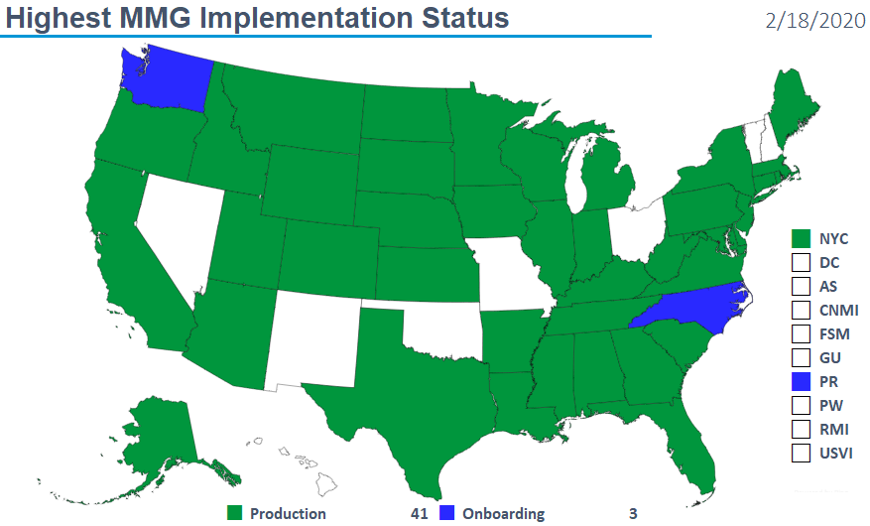
Highest MMG Implementation Status
Notes:
2/11/20: KY New to Prod for Gen V2

Slide 5
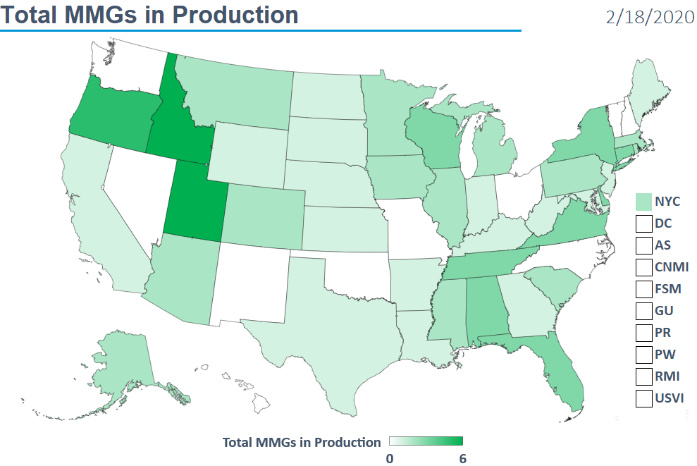
Total MMGs in Production
Notes:
Noted here are those jurisdictions with 5 and 6 guides implemented/in production:
UT and ID with 6 MMGs in Prod
OR with 5 MMGs in Prod

Slide 6
Finalized Guides
Onboarding Open to All | Onboarding For Pilots Only | Onboarding On Hold
Arboviral v1.3 | Babesiosis | Mumps
Gen v2 | CS | Pertussis
Hepatitis | FDD | Varicella
 | HAI MDRO
 | Lyme/TBRD
 | Malaria
 | STD
 | TB/LTBI
 | Trichinellosis
2/18/2020
Notes:
Pilot states are onboarding for the messages in the middle column. We’re please that MI just joined ID as the second state to onboard for Malaria and CO just joined as the first state to onboard for HAI MDRO.
STD and CS have moved beyond the pilots and began onboarding a set of states that have been ready and waiting for quite a while. Soon we expect to open onboarding for STD and CS to everyone.
We also expect to open onboarding for Mumps, Pertussis and Varicella to everyone very soon.

Slide 7
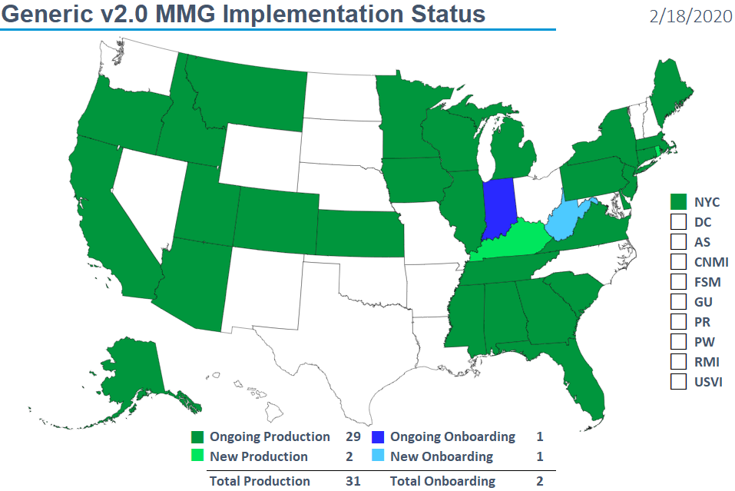
Generic v2.0 MMG Implementation Status
Notes:
Updates since previous eSHARE held on 1/21/2020:
1/31/20: WV New to Onboarding Gen V2
2/11/20: KY New to Prod for Gen V2
2/11/20: RI New to Prod for Gen V2

Slide 8
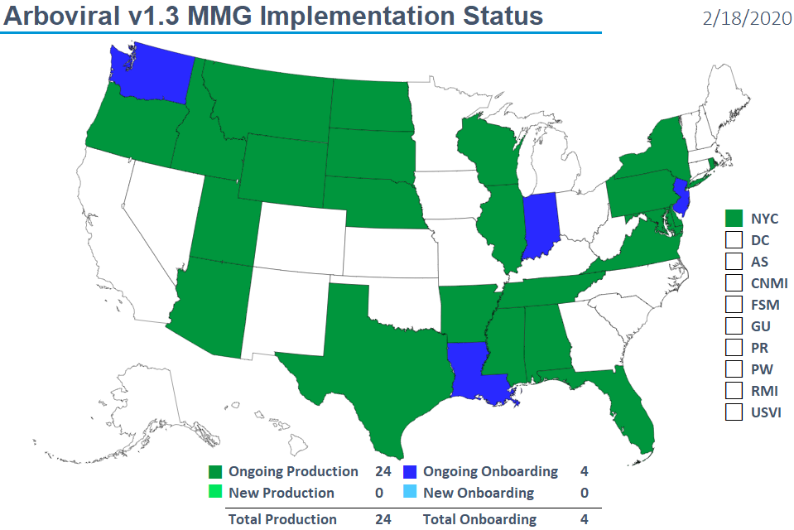
Arboviral v1.3 MMG Implementation Status
Notes:
Updates since previous eSHARE held on 1/21/2020:
No updates

Slide 9
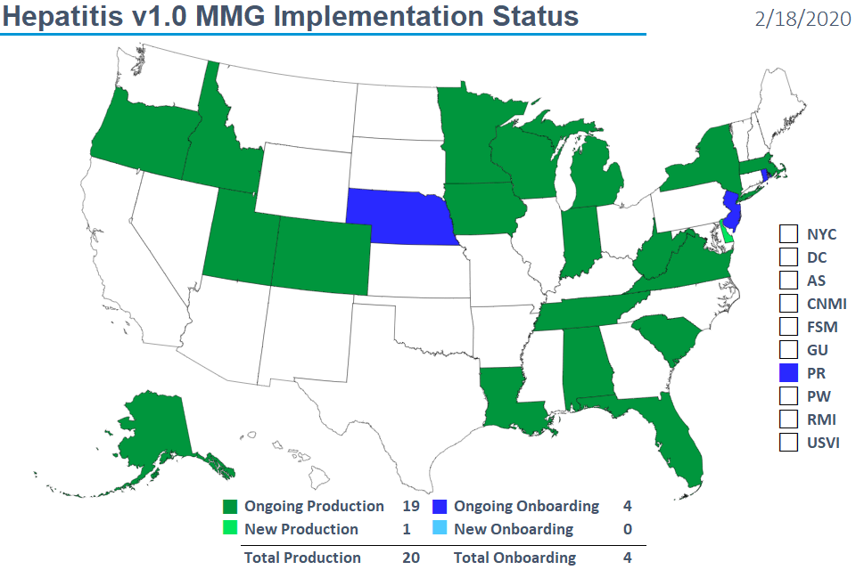
Hepatitis v1.0 MMG Implementation Status
Notes:
Updates since previous eSHARE held on 1/21/2020:
1/29/20: DE New to Prod for Hep

Slide 10

NNDSS HL7 Message Mapping Guide Estimated Timeline
Notes:
May need update

Slide 11
Sending COVID-19 Case Data to NNDSS
Sara Imholte Johnston, MPH
NNDSS Program Manager

Slide 12
NNDSS is Now Receiving COVID-19 Data
CDC has assigned event code 11065 for sending COVID-19 case notifications.
  Please update your system to include this condition and event code.
It is imperative that the HL7 Local Record ID (OBR-3) or the NETSS Case ID be included with any additional data for case information sent to CDC in any format.
Please include CDC COVID-19 case identifier.
CDC will use these NNDSS case notifications for case counts and basic case information.
Additional-specific information (e.g.; clinical data, laboratory results, travel history) will be collected through other methods and will be combined with NNDSS data by CDC.

Slide 13
Sending COVID-19 Cases to NNDSS
No test messages or onboarding process with NNDSS is needed when you add this new event code to an existing data feed.
Please send an email to edx@cdc.gov when you transmit your first case so we can verify it was received properly.
Please send confirmed cases. You do not need to send Persons Under Investigations (PUIs) through NNDSS at this time.
Currently, there are no case definitions for COVID-19, but they will be posted on the CDC website when available: https://www.cdc.gov/coronavirus/2019-nCoV.

Slide 14
For More Information…
Epidemiology of COVID-19 information and public health guidance can be found at: https://www.cdc.gov/coronavirus/2019-nCoV/.
Questions regarding NNDSS submissions can be sent to edx@cdc.gov.

Slide 15
New Strategy for Data Element Prioritization
Bill Morrill, MPH
Division of Health Informatics and Surveillance

Slide 16
Background
MMGs currently have a column for CDC Priority, indicating Required, Preferred and Optional
Programs have created data element prioritization documents to clarify their expectations
Feedback from the CSTE NMI Evaluation Workgroup identified challenges with implementing these priorities
  The meanings of the priorities were not the same across programs
  Priority lists were not available when the MMGs were published
  Jurisdictions did not have an opportunity to provide feedback on the priorities

Slide 17
New CDC Priority Category Definitions
Required – This data element is mandatory for sending a message. If the required data element is not present, the message will be rejected. The required data elements alone are not sufficient for national surveillance purposes.
Priority 1 – Highest priority for reporting. These data elements are critical for national surveillance activities. Jurisdiction’s data collection system should be modified to collect Priority 1 data elements. If this data element is not currently collected and available to send, please discuss with the CDC Program whether you can onboard without that element being available and included in the messages. Some CDC programs may request a plan addressing future inclusion of these data elements, if not able to collect and transmit at onboarding.
Priority 2 – High priority data element that will support national surveillance activities. If this data element is not currently collected and available to send, please plan to update jurisdiction’s data collection system. Some CDC programs may request a plan addressing future inclusion of these data elements, if not able to collect and transmit at onboarding.
Priority 3 – Lower priority data element that should be considered for inclusion in the surveillance system and case notification. Please send if currently collected in the system.

Slide 18
Implications for including New Data Element Priorities in MMGs
Inclusion of the new priorities will become standard practice for all new MMGs
Generic V2 MMG will have one set of priorities, which can’t be customized by each program
MMGs currently in development will be the first to include the updated priorities, including:
  Carbon monoxide poisoning
  Bacterial special pathogens (anthrax, brucellosis, Hansen’s disease and leptospirosis)
New versions of already finalized guides will transition to the new priorities
Guides preparing to open for general onboarding may incorporate new priorities into MMGs or use updated stand-alone Data Element Prioritization documents

Slide 19
Important Changes to SAMS:
SAMS NETSS Secure File Transfer migration to
SAMS Secure Data eXchange (SAMS SDX)
Andrew Kuehl, MIT, PMP
MVPS Project Lead

Slide 20
SAMS NETSS Secure File Transfer Migration
SAMS NETSS Secure File Transfer Tool is being replaced by SAMS Secure Data eXchange (SAMS SDX)
SAMS SDX will require slightly different NETSS upload process
Cutover date is Thursday, March 26, 2020
Instructions will be sent to all users in advance
20

Slide 21
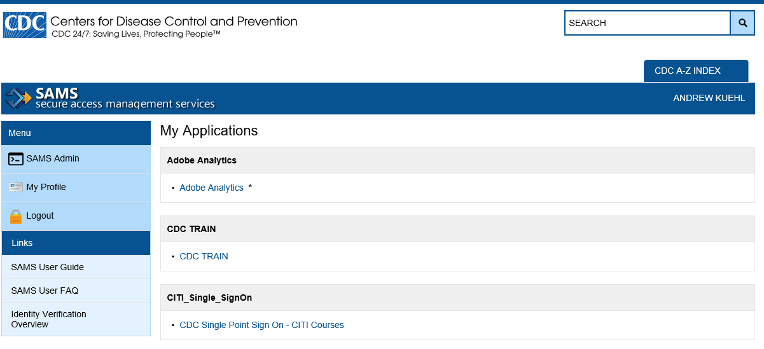
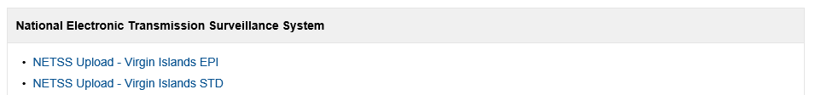
Current SAMS Activities
21

Slide 22
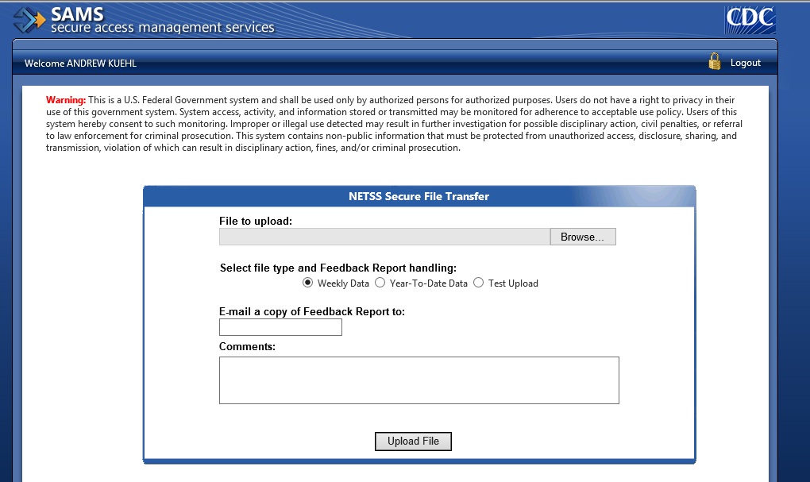
Current SAMS upload form
22

Slide 23
SAMS Activities Remain the Same
23

Slide 24
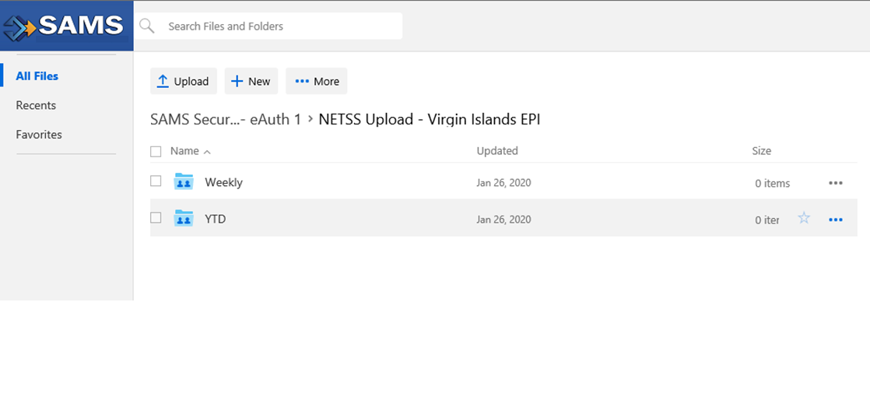
New SAMS SDX Upload
Very Important to select the appropriate folder for NETSS file type
24

Slide 25
Next Steps
Instructions will be sent to all NETSS users at least 2 weeks before cutover
Review on the March 17th eSHARE webinar
Cutover date is Thursday, March 26, 2020
Email questions to edx@cdc.gov
25

Slide 26
Other NNDSS Related Information
Sara Imholte Johnston, MPH
NNDSS Program Manager

Slide 27
2019 CSTE Position Statements to be Implemented in 2020
Updated case definitions for 6 nationally notifiable diseases
  Hepatitis C acute
  Hepatitis C chronic
  Legionellosis
  Pertussis
  Plague
  Spotted Fever Rickettsiosis
Updated case definition for 1 condition under standardized surveillance:
  Acute flaccid myelitis (case definition revision);
Added a condition under standardized surveillance:
  Blastomycosis (new condition and case definition)
Updated case definition for 1 FoodNet condition:
  Yersinosis, non-pestis

Slide 28
Send C. auris and CP-CRE starting with 2019 data
It is not too late to send case notifications for the following for the entire 2019 surveillance year.
  Candida auris, clinical, which is nationally notifiable (event code 50263);
  Candida auris colonization/screening, which is under standardized surveillance but is not nationally notifiable (event code 50264); and
  Carbapenemase-producing carbapenem-resistant Enterobacteriaceae (CP-CRE), which is nationally notifiable (event code 50244). (Note: Do not send other types of CRE using this event code.)
Included in 2019 the NNDSS tables if received before end of reconciliation.

Slide 29
CP-CRE versus CRE
Carbapenemase-producing carbapenem-resistant Enterobacteriaceae (CP-CRE), is nationally notifiable (event code 50244). (Note: Please do not send other types of CRE using this event code).
  Jurisdictions should send notifications for this condition through NNDSS using the Generic V2 message or one of the legacy messages (NETSS, Generic V1, or NBS Master Message) until they have been approved to send the HAI MDRO message.
CRE is not nationally notifiable. Only jurisdictions in the MuGSI project should submit this data to CDC. (Note: Please do not send CRE cases for MuGSI using the CP-CRE event code).
For further information on CP-CRE and CRE, please contact Jennifer Huang (uzo0@cdc.gov).
Send any additional questions about NNDSS submissions to edx@cdc.gov.

Slide 30
Changes to Event Codes in 2020
Removed from the event code list due to delay in implementing the MMG for the MuGSI project (only certain jurisdictions participate):
  Carbapenem-resistant Enterobacteriaceae (CRE) (50120)
    (Note: See the previous slide for information on sending CP-CRE)
  Carbapenem-resistant Acinetobacter baumannii (CRAB) (50260)
  These conditions should not be sent through NNDSS at this time.

Slide 31
Recent Updates to Finalized MMG Value Sets
Generic value sets: June 2019 – December 2019
Lab Template: April 2019 – October 2019
FDD: September 2019
TB: September 2019 – December 2019
STD: May 2019
VPD Guides: May 2019 – October 2019
Note: Updates contain timeframe of value set changes

Slide 32
Recent Updates to Finalized MMG Value Sets
Generic value sets:
  Birth Country 12/17/2019
  Country 12/01/2019, Manufacturers of vaccines 12/01/2019
  Nationally Notifiable Event Code (Generic) 06/14/2019
  Lab Template:
  Ordered test (PHVS_LabTestOrderables_CDC) 10/02/2019
  Lab Test Result Name (PHVS_LabTestName_CDC) 10/02/2019
  Specimen (PHVS_Specimen_CDC) 04/15/2019
  Body Site (PHVS_BodySite_CDC) 04/15/2019
  Microorganism (PHVS_Microorganism_CDC) 09/01/2019
Note: Updates contain date of value set change

Slide 33
Updates to Value Sets continued:
Condition-specific value sets for Final guides:
  TB
    Medication (TB) 10/16/2019
    Epidemiological Risk Factors (TB) 09/16/2019
    Lab Test Interpretation (TB) 09/16/2019
    Susceptibility Test Type (TB) 12/04/2019
  STD
    Lab Test Type (STD) 05/16/2019
Note: Updates contain date of value set change

Slide 34
Updates to Value Sets continued:
Condition-specific value sets for Final guides:
  FDD
    Organism (FDD) 09/04/2019
  VPD Guides
    Vaccine Event Information Source (NND) 05/29/2019
    Type of Long Term Care Facility 09/16/2019
    Type of Correctional Facility 09/16/2019
    Lab Test Interpretation (VPD) 10/20/2019
    Lab Test Interpretation (Varicella) 10/20/2019
    Lab Test Name (Mumps) 09/01/2019
Note: Updates contain date of value set change

Slide 35
For Additional Information…
The 2020 State Epi Letter can be found on the NNDSS Event Codes & Other Surveillance Resources webpage.
Annual NNDSS Event Code Lists are available at https://ndc.services.cdc.gov/event-codes-other-surveillance-resources/.
Value Set Updates are available on the NNDSS Event Codes & Other Surveillance Resources webpage at
https://ndc.services.cdc.gov/event-codes-other-surveillance-resources/.
January 21, 2020 eSHARE presentation is now available at https://www.cdc.gov/nndss/trc/onboarding/eshare.html.

Slide 36

Q & A

Slide 37
Subscribe to monthly NMI Notes news updates at
https://www.cdc.gov/nndss/trc/news/
Access the NNDSS Technical Resource Center at
https://www.cdc.gov/nndss/trc/
Request NNDSS technical assistance or onboarding at
edx@cdc.gov
Next NNDSS eSHARE is March 17, 2020 – details to come at
https://www.cdc.gov/nndss/trc/onboarding/eshare.html

