Slide 1

NNDSS Modernization Initiative (NMI):
Overview of Respiratory Invasive Bacterial Diseases (RIBD) HL7 Case Notification Messages
Division of Health Informatics and Surveillance
December 17, 2019

Slide 2

Agenda
Welcome and Announcements
NMI Updates and Timeline
Implementing the Message Mapping Guides
Overview of RIBD HL7 Case Notification Messages
  Sandy Roush, National Center for Immunization and Respiratory Diseases (NCRID), CDC
  Megan Light, National Center for Emerging and Zoonotic Infectious Diseases (NCEZID), CDC
Questions and Answers

Slide 3
NMI Updates and Timeline
Sara Imholte Johnston, MPH
NNDSS Program Manager
Michele Hoover, MS
Lead, State Implementation and Technical Assistance

Slide 4
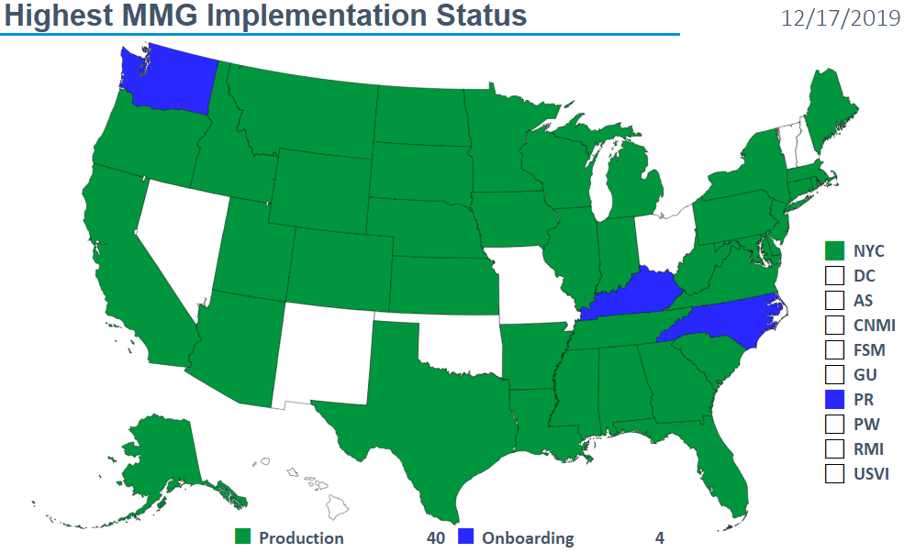
Highest MMG Implementation Status

Slide 5
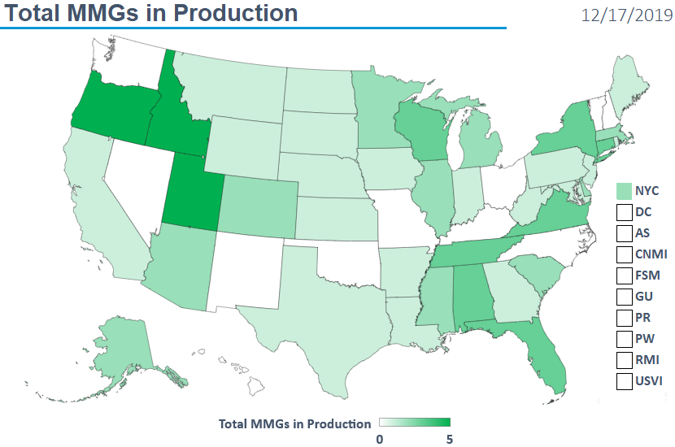
Total MMGs in Production

Slide 6
Finalized Guides
Onboarding Open to All | Onboarding For Pilots Only | Onboarding On Hold
Arboviral v1.3 | Babesiosis | Mumps
Gen v2 | CS | Pertussis
Hepatitis | FDD | Varicella
 | Lyme/TBRD
 | Malaria
 | STD
 | TB/LTBI
 | Trichinellosis
12/17/2019

Slide 7
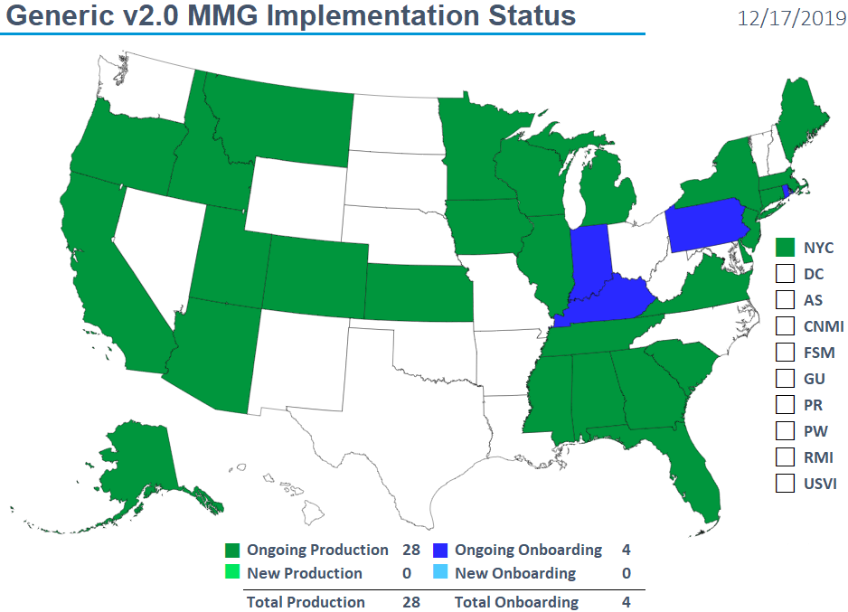
NMI Implementation Status Oct 15, 2019

Slide 8
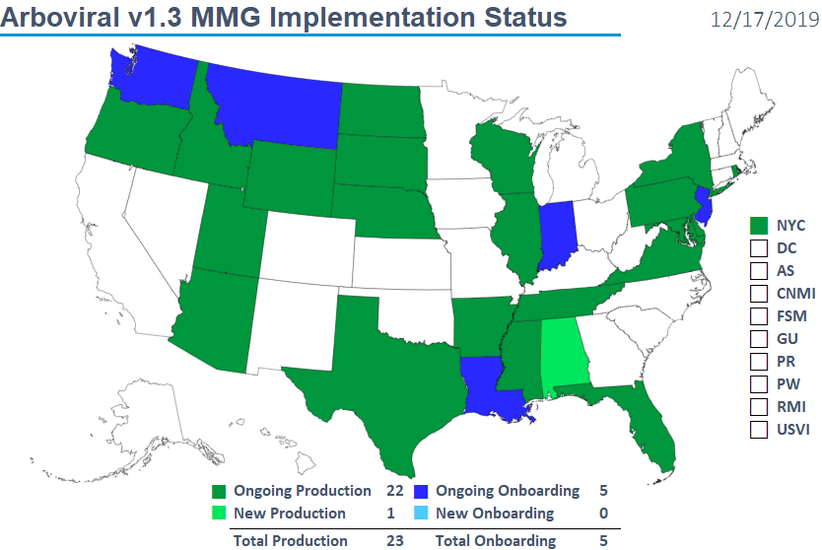
Arboviral v1.3 MMG Implementation Status

Slide 9
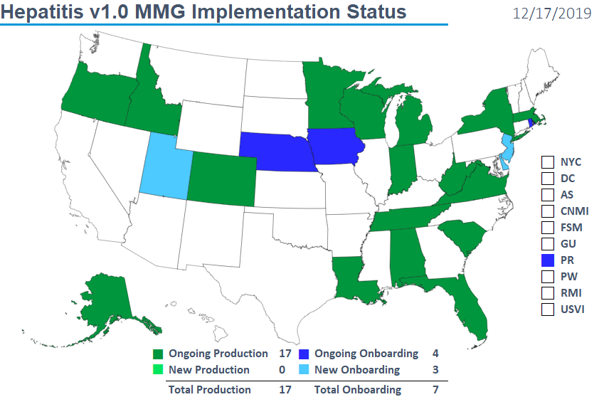
Hepatitis v1.0 MMG Implementation Status

Slide 10
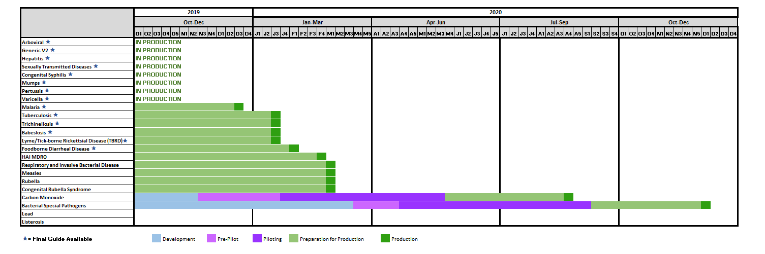
NNDSS HL7 Message Mapping Guide Estimated Timeline

Slide 11
Implementing the
Message Mapping Guides
Michele Hoover, MS
Lead, State Implementation and Technical Assistance

Slide 12
Starting from the Beginning...
Engage stakeholders
  Engage both informaticians and epidemiologists.
  “Engage early and often.”
Strongly recommend using Implementation Spreadsheet for documentation of gap analysis and data crosswalk.
  This spreadsheet or a similar resource is one requirement of onboarding.

Slide 13
Gap Analysis
Includes comparing:
  data collected in state surveillance system,
  data submitted to CDC previously, including how it was sent,
  data requested in the MMG.
Helps identify
  if updates to the surveillance system are needed,
  if data needs to be translated to populate the HL7 message correctly,
  if additional data needs to be collected for cases.
See resources on the Technical Assistance and Training Resource Center webpage Implementing All Other Conditions: Pre-Onboarding.

Slide 14
Implementation
Maintain or improve on data submitted through previous methods.
Ensure all data elements previously submitted to the CDC Programs through any legacy methods can be collected in the state surveillance system and sent in the HL7 message.
Request Technical Assistance for additional help by emailing edx@cdc.gov.

Slide 15
Respiratory Invasive Bacterial Diseases (RIBD) HL7 Case Notification Messages
H. influenzae, N. meningitidis, Invasive S. pneumoniae, Legionellosis, Psittacosis,
Group A Streptococcus, Group B Streptococcus, Neonatal Sepsis

Slide 16
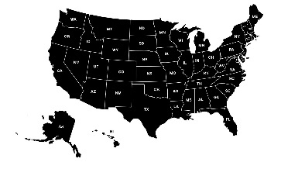
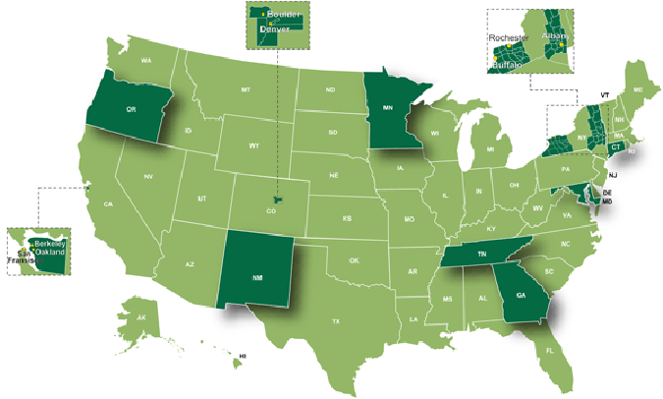
Respiratory Invasive Bacterial Diseases
Message Mapping Guide (RIBD MMG) Overview
Guide for all jurisdictions sending data elements via HL7 for five nationally notifiable conditions (NNDSS)
  Includes H. influenzae, N. meningitidis, Invasive S. pneumoniae, Legionellosis, Psittacosis
  Contains NNDSS data elements
  Contains additional subset of data elements sent by EIP sites only to ABCs
Guide for Active Bacterial Core Surveillance (ABCs) jurisdictions for both NNDSS and non-NNDSS conditions
  Includes GAS, GBS, neonatal expanded infections, and neonatal sepsis
Designed to be used in conjunction with Generic v2 MMG

Slide 17

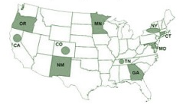
RIBD MMG includes…
Condition/ Surveillance Project | NNDSS Data Elements (All states, NYC, DC) | ABCs Variables (EIP ABCs sites ONLY)
Haemophilus influenzae | X | X
Meningococcal disease (Neisseria meningitidis) | X | X
Invasive pneumococcal disease | X | X
Legionellosis | X
Psittacosis | X
Group A Streptococcus |  | X
Group B Streptococcus |  | X
Neonatal Expanded Infection Surveillance |  | X
Neonatal Sepsis Surveillance |  | X

Slide 18
RIBD MMG Structure
Non-ABCs States
Generic V2 MMG
H flu
Legionellosis
RIBD MMG
RIBD message
IPD
Psittacosis
N mening
ABCs States
ABCs H flu
ABCs GBS
Generic V2 MMG
RIBD MMG
ABCs IPD
Legionellosis
RIBD message
ABCs N mening
Psittacosis
ABCs GAS

Slide 19
Overview and Guidance:
RIBD NNDSS
Surveillance Office
  Sandy Roush
NCIRD Surveillance Data Email Box: NCIRDsurvData@cdc.gov
H. influenzae, N. meningitidis
Amy Blain
Invasive Pneumococcal Disease
  Ryan Gierke
Legionellosis
  Al Barskey
Psittacosis
  Miwako Kobayashi

Slide 20
Context of NNDSS Data Collected for H. influenzae, N. meningitidis, Invasive S. pneumoniae, Legionellosis, Psittacosis
NCIRD currently receives all NNDSS data in NETSS format
  Core and extended data were developed in mid 1990’s
Important changes in epidemiology and laboratory testing since 1990’s:
  New vaccines and target populations (e.g., invasive pneumococcal disease)
  New lab testing (e.g., PCR)
  Changing epidemiology (e.g., herd immunity)
Surveillance requirements have changed to support science and program
  Investigations, interventions, policies to understand and address changes
  Data collection interface(s) to collect relevant required data to support national prevention programs (e.g., legionellosis)

Slide 21
Harmonization Results for Disease Specific MMGs by Condition*
 | TOTAL** | VACCINE | LAB | EPI | CLINICAL
CONDITION | % Harmonized | % Harmonized | % Harmonized | % Harmonized | % Harmonized
Mumps | 83 | 100 | 92 | 92 | 29
Pertussis | 68 | 100 | 92 | 27 | 26
Varicella | 75 | 100 | 89 | 67 | 41
Measles | 87 | 88 | 85 | 100 | 81
Rubella | 88 | 100 | 100 | 68 | 80
Congenital rubella syndrome | 58 | 84 | 96 | 28 | 13
H. influenzae | 95 | 100 | 100 | 87 | 100
N. meningitidis | 89 | 100 | 93 | 79 | 100
Invasive S. pneumoniae | 95 | 100 | 88 | 100 | 100
Legionellosis | 40 | N/A | 100 | 19 | N/A
Psittacosis | 65 | N/A | 85 | 36 | 80
AVERAGE | 77% | 97% | 93% | 64% | 69%
RANGE | 40%‒95% | 84%‒100% | 85%‒100% | 19%‒100% | 13%‒100%
* Data do not include Gen V2 variables.
** ”Total” column also contains variables which do not fit within the four categories on this slide (e.g., system variables)

Slide 22
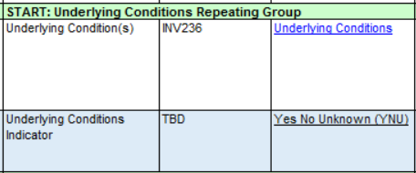
RIBD MMG Components
Repeating groups are generally used for:
Underlying conditions
Antibiotics
Vaccine History
Lab interpretive diagnostic
  Repeats once for each test result
  Relatively standardized across the guide, with pathogen-specific exceptions (e.g. Serotype, Serogroup)
Industry and occupation
Antimicrobial susceptibility testing
AIDS
Yes
Asthma
No
…repeat blocks as needed

Slide 23
NCIRD Data Element Priorities - H. influenzae, N. meningitidis, Invasive S. pneumoniae, Legionellosis, Psittacosis
“NCIRD Data Element Priorities_RIBD v20191114” provides NCIRD priorities including “highest” (1), “high” (2), and “lower”(3)
Program considers priorities when assessing implementation spreadsheets
For “highest” and “high” priority data element marked “not collected,” jurisdiction provides plan for future collection/transmission of the data element in HL7 case notifications
  e.g., “jurisdiction will update systems/transmission by month/year,” “jurisdiction will work with NCIRD to request/identify resources to support the activities that would be required to provide this information”

Slide 24
NCIRD Data Element Priority Examples - H. influenzae, N. meningitidis, Invasive S. pneumoniae, Legionellosis, Psittacosis
Hospitalized (Generic V2.0)
  “Optional” CDC priority in GenV2, however, the priority for NCIRD is “Highest.”
  Important for monitoring severity and outcome.
Vaccination History Repeating Group
  “Highest” and “high” priority data elements for all NCIRD VPDs.
  Linkage to IIS encouraged for several high/optional priority elements (e.g., lot number).
VPD RC Linkage
  3 data elements: reference laboratory, patient identifier, and specimen identifier.
  Can be used to link VPD RC test results with NNDSS cases.

Slide 25
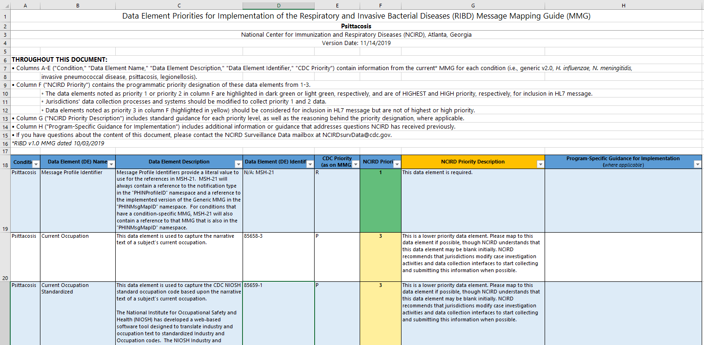
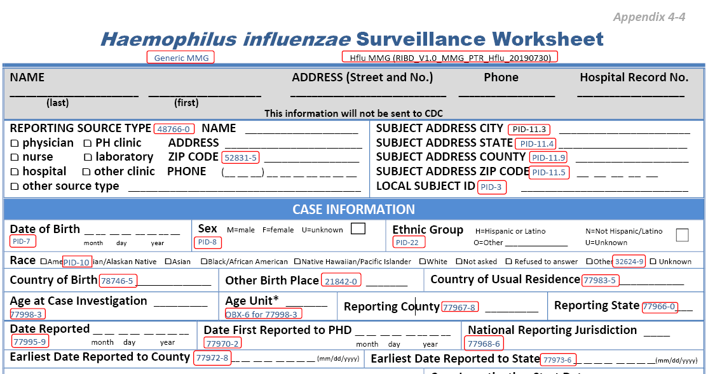
NCIRD Materials/Guidance – H. influenzae, N. meningitidis, Invasive S. pneumoniae, Legionellosis, Psittacosis
Data Element Priorities Spreadsheet
  Available on the NNDSS Message Mapping Guides webpage when the final MMG is posted
NCIRD Surveillance Worksheets
  Available on Surveillance Manual Appendices webpage and from NCIRD program
  Annotations reference MMG data element identifiers

Slide 26
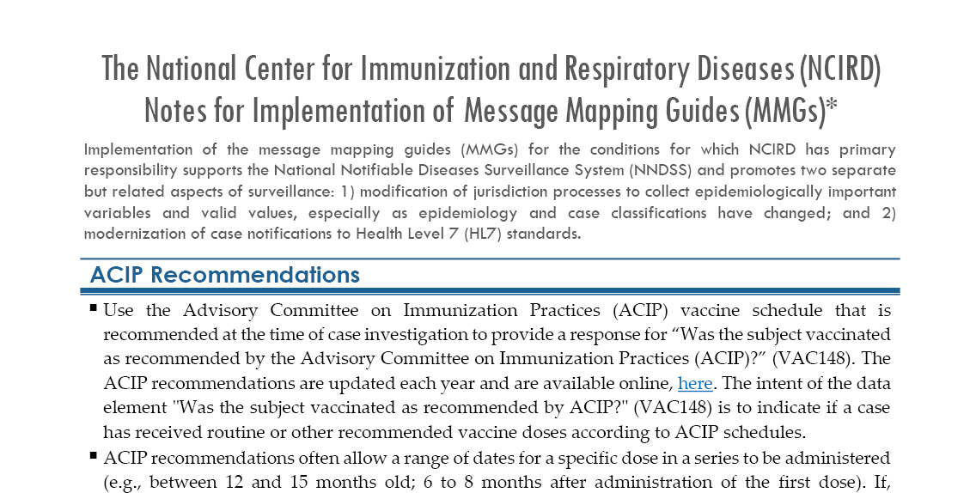
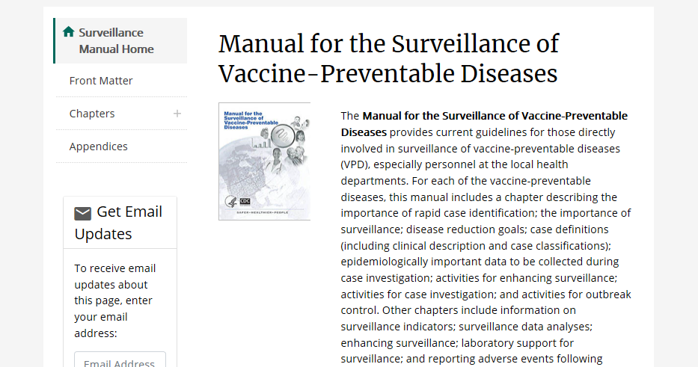
NCIRD Materials/Guidance
NCIRD Materials/Guidance – H. influenzae, N. meningitidis, Invasive S. pneumoniae, Legionellosis, Psittacosis (continued)
NCIRD RIBD Onboarding Welcome Packet
  Checklist for onboarding NCIRD MMGs
  Resources for VPD Surveillance Staff
  “Notes for Implementation”
  NCIRD Data Element Priority List
Other Resources
  Manual for the Surveillance of Vaccine-Preventable Diseases, accessible via CDC webpage
  NCIRD Surveillance webpage

Slide 27
Overview and Guidance
RIBD ABCs
ABCs Director
  Melissa Arvay
EIP IT
  Megan Light
ABCs Coordinators and Data Managers
Olivia Almendares
Amy Blain
  Yunmi Chung
  Ryan Gierke
  Jennifer Onukwube Okaro

Slide 28
Active Bacterial Core Surveillance (ABCs)
Component of Emerging Infections Program (EIP)
  Network of state health departments and their partners
  Used for surveillance, prevention, and control of emerging infectious diseases
ABCs sites should use the following tabs in the RIBD MMG:
  ABCs GAS
  ABCs GBS
  ABCs Hflu
  ABCs N mening
  ABCs IPD
  Psittacosis
  Legionellosis

Slide 29
Active Bacterial Core Surveillance (ABCs) (Continued)
Keys for implementation
  Data elements are based on current ABCs variables and value sets
  Continue to abide by current ABCs protocols and guidance documents
  Lab repeating block mimics CRF and is used in case classification algorithm at CDC
Reusing value sets
  Value sets are designed flexibly to apply across conditions
  ABCs valid values are those included on ABCs report forms
Supporting documents
  Annotated Forms: EIP ABCs Core Case Report Form, GAS Supplemental Form, IPD Form, Neonatal Sepsis Form, Neonatal Infection Expanded Tracking Form
  Crosswalk MMG
  NeXT and NNS guidance on Introduction tab

Slide 30
Thank you Slide
Thank you!
Questions and Discussion

Slide 31
Subscribe to monthly NMI Notes news updates at
https://www.cdc.gov/nndss/trc/news/
Access the NNDSS Technical Resource Center at
https://www.cdc.gov/nndss/trc/
Request NNDSS technical assistance or onboarding at
edx@cdc.gov
Next NNDSS eSHARE is January 21, 2020 – details at
https://www.cdc.gov/nndss/trc/onboarding/eshare.html

