Slide 1
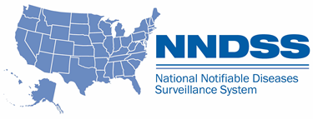
NNDSS Modernization Initiative (NMI):
Overview of Lyme/TBRD HL7 Case Notification Messages and Other NNDSS-Related Information
Division of Health Informatics and Surveillance
October 15, 2019

Slide 2

Agenda
Welcome and Announcements
What’s New in Release 4 of the 2019 NNDSS Event Code List
  Ruth Jajosky, Division of Health Informatics and Surveillance, CDC
Overview of Lyme/TBRD HL7 Case Notification Messages
  Amy Schwartz, Division of Vector-Borne Diseases, CDC
  Kristen Nichols-Heitman, Division of Vector-Borne Diseases, CDC
Questions and Answers

Slide 3
NMI Updates and Timeline
Sara Imholte Johnston, MPH
NNDSS Program Manager
Michele Hoover, MS
Lead, State Implementation and Technical Assistance

Slide 4
NMI Implementation Status Oct 15, 2019
NH
WA
VT
ME
AK
MT
ND
MN
MA
OR
WI
NY
RI
ID
SD
MI
WY
CT
IA
PA
NJ
NYC
CA
NE
OH
DE
HI
NV
IL
IN
WV
UT
VA
DC
MD
CO
KS
MO
KY
NC
TN
OK
AR
SC
AZ
NM
MS
AL
GA
TX
LA
FL
PR
Onboarding Total of 6 (states)
Production Total of 39 (38 states + NYC)

Slide 5
Finalized Guides
Onboarding Open to All | Onboarding For Pilots Only | Onboarding On Hold
Arboviral v1.3 | Babesiosis | Mumps
Gen v2 | CS | Pertussis
Hepatitis | FDD | Varicella
 | Lyme/TBRD
 | Malaria
 | STD
 | TB/LTBI
 | Trichinellosis
10/15/2019

Slide 6
Piloting Status
Message Mapping Guides (MMGs) | Piloting | States Piloting
RIBD | 3 | GA, KS, OR
Lyme/TBRD | 5 | FL, ID, IL, MI, OR
HAI MDRO | 3 | CO, MI, OR
Measles/Rubella/CRS | 4 | AL*, AZ, FL, OR
Total # of Individual States | 10 | AL, AZ, CO, FL, GA, ID, IL, KS, MI, OR
* Measles Only
10/15/2019

Slide 7
NNDSS HL7 Message Mapping Guide Estimated Timeline

Slide 8
Bridged Race Files
Provides estimated populations used in rates based on “old” race categories
NCHS will stop having Bridged Race population estimates produced
  No-longer needed by NCHS for vital records data; Planned to stop with 2018 estimates
  New plan as of June 2019:
    Release postcensal vintage estimates for 2019
    Release intercensal estimates for 2010-2020
NNDSS planning
  Currently use with NETSS-formatted race categories and single year age groups
  2021 NNDSS data: May use 2020 estimates (often use previous year’s estimates now)
  2022 and later years: Evaluate amount of data from jurisdictions sending NETSS files and consider strategies
Jurisdictions using these files should plan for transition

Slide 9
Retiring Summary Records
Some jurisdictions used to send counts of cases (rather than case-level data)
Good time to retire:
  Territories implementing integrated surveillance systems
  Only a few other jurisdictions sending summary records (6 animal rabies, 1 Hansen’s disease, 1 novel influenza A, 1 varicella, 1 pertussis)
  Plan to discontinue with the 2019 data but will continue to work with territories and jurisdictions sending animal rabies summary records
NNDSS and CDC programs are coordinating with these jurisdictions
Jurisdictions should not plan to use summary records in the future
Considering mechanism for summary counts in an emergency situation

Slide 10
NNDSS Process Redesign
Data from jurisdictions comes in to NNDSS in multiple formats:
  NETSS messages
  NBS master messages
  older versions of HL7 MMGs (e.g. Varicella, TB, Gen v1)
  newer versions of HL7 MMGs
There are currently different systems and processes for the NNDSS data, including DMB, CDS and a SAS process.
Goal: consolidate and automate NNDSS data processing into the MVPS system and database
Interactions you may have had with CDC regarding NNDSS data are going to be built into the MVPS system for jurisdictional users to manage.

Slide 11
New MVPS functionality will include:
Dashboard of records and cases sent to CDC, including by condition and case classification
Process for verification of a report of a low incidence condition
Ability to manually ‘delete’ a reported case when the jurisdiction is unable to send a delete record
Management of the end of year data reconciliation process:
  Download reconciliation tables on the fly (with up-to-date data)
  Download line list with additional data elements
  State Epi sign off on the final data tables

Slide 12
Timeline
Our goal is to complete system changes with enough time to roll out the new year end data reconciliation process this spring (2019 data)
If functionality is not ready in time to provide adequate communication and training to all jurisdictions, we will use the normal method for reconciliation and use the new method in MVPS for the 2020 data in spring of 2021

Slide 13
What’s New in
Release 4 of the 2019 NNDSS Event Code List and Other Related Information
Ruth Jajosky, DMD, MPH
Surveillance Operations Team Lead

Slide 14
Demonstration
What’s New in Release 4 of the 2019 NNDSS Event Code List
Information presented can be located at: https://ndc.services.cdc.gov/wp-content/uploads/2021/02/National_Notifiable_Diseases_Surveillance_System_Event_Code_List_2019_v4_20191031.xlsx
See Appendix for summary of “What’s New in Release 4 of the 2019 NNDSS Event Code List”

Slide 15
Implementing the
Message Mapping Guides
Michele Hoover, MS
Lead, State Implementation and Technical Assistance

Slide 16
Starting from the Beginning...
Engage stakeholders
  Engage both informaticians and epidemiologists.
  “Engage early and often.”
Strongly recommend using Implementation Spreadsheet for documentation of gap analysis and data crosswalk.
  This spreadsheet or a similar resource is one requirement of onboarding.

Slide 17
Gap Analysis
Includes comparing:
  data collected in state surveillance system,
  data submitted to CDC previously, including how it was sent,
  data requested in the MMG.
Helps identify
  if updates to the surveillance system are needed,
  if data needs to be translated to populate the HL7 message correctly,
  if additional data needs to be collected for cases.
See resources on the Technical Assistance and Training Resource Center webpage Implementing All Other Conditions: Pre-Onboarding.

Slide 18
Implementation
Maintain or improve on data submitted through previous methods.
Ensure all data elements previously submitted to the CDC Programs through any legacy methods can be collected in the state surveillance system and sent in the HL7 message.
Request Technical Assistance for additional help by emailing edx@cdc.gov.

Slide 19
Implementing the
Lyme and Tickborne Rickettsial Diseases
Message Mapping Guide
Amy Schwartz, MPH
Epidemiologist
Kristen Nichols Heitman, MPH
Epidemiologist
Division of Vector-Borne Diseases
National Center for Emerging and Zoonotic Infectious Diseases

Slide 20
Background

Slide 21
Lyme Disease: Background
Lyme disease: a nationally notifiable condition since 1991
  5th–6th most common of all notifiable conditions
  Often 2nd or 3rd most common in high-incidence states
CDC receives Lyme disease surveillance data from jurisdictions and tabulates annually to describe national trends
  Disease-specific “extended record” contains clinical and laboratory fields in addition to core NNDSS variables
  Content and format of extended record hasn’t been updated to match current disease and informatics standards

Slide 22
Recent Summary of Lyme Disease Surveillance Data
208,834 confirmed & 66,755 probable cases reported during 2008–2015
~60% of confirmed case records contained indication of ≥1 clinical manifestation necessary for confirmed status
3% of probable records contained indication of confirmatory clinical manifestations, suggestive of data transmission or case classification issues
While transmitted successfully for some records, others contain mixtures of letters, numbers, or symbols, but most fields are empty.

Slide 23
Tickborne Rickettsial Diseases (TBRD): background
Rocky Mountain spotted fever (RMSF) has been nationally notifiable since the 1920s. In 2010, the category was expanded to Spotted Fever Rickettsiosis (SFR) and captures cases caused by all spotted fever group Rickettsiae.
Ehrlichiosis became nationally notifiable in 1999. In 2008, the ehrlichiosis case definition split into four categories:
  Ehrlichia chaffeensis infection
  Ehrlichia ewingii infection
  Anaplasma phagocytophilum infection
  Undetermined ehrlichiosis/anaplasmosis

Slide 24
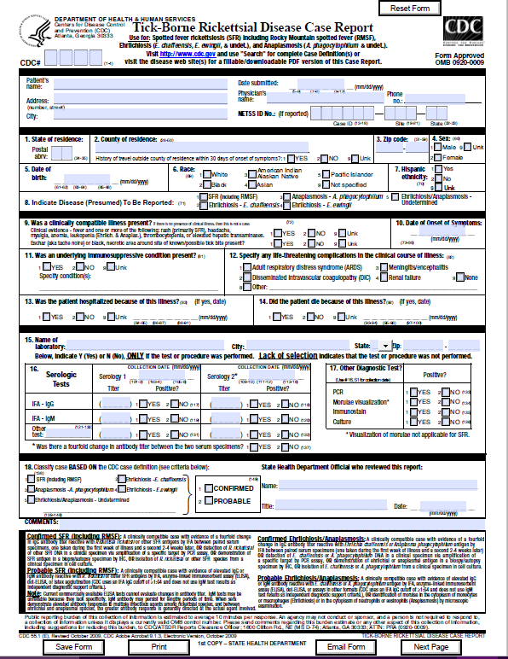
TBRD Surveillance Data
National Notifiable Diseases Surveillance System (NNDSS)
  Only basic demographic data are currently received
Supplemental data are currently collected by jurisdictions using the one-page TBRD case report form (CRF)
  Clinical, laboratory, and case outcome data
Data used to report national trends and influence public health policy and provider practices

Slide 25
Rickettsial disease trends (2000–2017)
NNDSS data: https://www.cdc.gov/nndss/data-statistics/infectious-tables/index.html

Slide 26
MMG Overview

Slide 27
Why Implement the Lyme and Tickborne Rickettsial Diseases MMG?
Will make complete data available to CDC programs much sooner to help identify increases in frequency and geographic expansion of diseases
Extensive time and resources are devoted to capturing clinical details and laboratory test information; yet, limitations in data transmission hinder ability to use data to influence public health policy and recommendations at CDC
Opportunity to improve data transmission and consolidate data streams to reduce burden on jurisdictions in reporting cases
MMGs allow jurisdictions to map variables that CDC can receive and compile electronically
Lead to the retirement of the Lyme disease extended record and TBRD paper case report form

Slide 28
MMG Overview
Updates the current message being used to facilitate Lyme disease data transmission
Allows for TBRD-specific data elements to be transmitted electronically to CDC for the first time
Allows data elements to be sent using HL7 messaging
Gen V2 Data Elements
Lyme Disease Data Elements
Lyme HL7
message
Gen V2 Data Elements
Tickborne Rickettsial Diseases Data Elements
TBRD HL7
message

Slide 29
MMG Overview: Lyme Disease Data Elements Layout
Lyme data elements tab includes 4 repeating groups
  Clinical Manifestations
  Antibiotics/Treatment
  Occupation and Industry
  Epidemiology Laboratory
Value sets for most data elements

Slide 30
Guidance for Lyme disease Clinical Manifestations Repeating Group
Clinical Manifestations in value set
Complete a repeating group response for each clinical manifestation in the value set
Atrioventricular block
Bell’s Palsy
Other cranial neuritis
Encephalitis
Encephalomyelitis
Erythema migrans
Arthritis
Lymphocytic meningitis
Radiculoneuropathy
“Atrioventricular block”
Yes/No/Unknown
“Bell’s Palsy”
Yes/No/Unknown

Slide 31
MMG Overview: TBRD Data Elements Layout
TBRD data elements tab includes 6 repeating groups
  Clinical Manifestation
  Antibiotics/Treatment
  Occupation and Industry
  Epidemiology Laboratory Repeating Group
  Travel History
  Tick Bite
Value sets for most data elements

Slide 32
How Will TBRD Data Elements Differ After this MMG is Implemented?
New data elements
  Clinical manifestations broken into symptoms
  Exposure history
  Treatment information
  Questions about history of blood transfusions/donations and organ transplants
Addition of valid values
  Valid values were added to improve data transmission (e.g. antibiotics, clinical signs and symptoms, laboratory variables)

Slide 33
Coming soon

Slide 34
Lyme and TBRD Priority List
Lists variables from Lyme and TBRD MMG and GenV2 MMG
Some variables required by GenV2 for transmission
Ranks the priority of the variable to the program
Can affect onboarding
1= Highest priority for reporting; onboarding should be postponed if jurisdiction's system is not able to transmit this variable
2= Strong preference to have this reported; requires further discussion and may delay onboarding if not transmitted
3= Optional, can onboard without this variable, but program would like the jurisdiction to consider adding at a later date
N/A= Program does not use this data
Gray Box= Data for this variable is required for transmission according to GenV2

Slide 35
Lyme and TBRD MMG FAQ
Lyme and TBRD MMG FAQ document will be posted to NNDSS MMG website
  Will answer frequently asked questions related to the guides
  Intended to assist IT staff and epidemiologists when implementing the MMG

Slide 36
For More Information…
Please contact CDC’s Division of Vector-Borne Diseases:
Lyme: Amy Schwartz, MPH
  ltp9@cdc.gov
TBRD: Kristen Nichols Heitman, MPH
  wwd7@cdc.gov
For general questions, please contact edx@cdc.gov.

Slide 37

Q & A

Slide 38
Subscribe to monthly NMI Notes news updates at
https://www.cdc.gov/nndss/trc/news/
Access the NNDSS Technical Resource Center at
https://www.cdc.gov/nndss/trc/
Request NNDSS technical assistance or onboarding at
edx@cdc.gov
Next NNDSS eSHARE is November 19, 2019 – details at
https://www.cdc.gov/nndss/trc/onboarding/eshare.html

Slide 39
Appendix—What’s New in Release 4 of the 2019 NNDSS Event Code List and Other Information

Slide 40
The “Preferred New HL7 Message” Column
Displays the name of the preferred HL7 message for submitting case notifications for the listed condition.
    Column header includes the URL to the finalized Message Mapping Guides on the NNDSS website
Replaces the “Preferred Mechanism” column in previous releases of the Event Code List, which displayed the name of the Message Mapping Guides with version numbers, needed to construct a message.

Slide 41
The “Alternative Message” Column
Displays the name of the message (and case report form, if applicable) to use, until the preferred new HL7 message is implemented.
In Release 4, it indicates when a Generic message or a Generic message with a case report form can be used, until the transition to the preferred new HL7 message.
    Column header includes the URL to the finalized Message Mapping Guides on the NNDSS website
Replaces the “Alternative Mechanism” column in previous releases of the Event Code List, which included information about whether a legacy Message Mapping Guide could be used, until the jurisdiction transitioned to the Preferred Mechanism.

Slide 42
Additional Changes
“Nationally Notifiable” column indicates whether a condition is nationally notifiable or not.
    Removed bolding and asterisks associated with condition names in the “Event Name” column, meant to indicate a nationally notifiable condition
Removed the term “MMWR” in the “Verification Procedures” column, since we are no longer publishing the NNDSS tables in the MMWR.
The Generic v2 ONLY subset of the Event Code Lists has been retired.
    Filter the list to find which conditions can use the Generic messages by itself

Slide 43
Additional Information
The same list of conditions are in Releases 3 and 4 of the 2019 code list.
The HL7 Case Notification Resources MMG and Artifacts section of the NNDSS website includes information on which versions of the finalized Message Mapping Guides are available to use and which is the preferred version, if more than one version is posted for the same MMG.
We will plan for quarterly releases of the event code list, if needed, to ensure information is updated.
We are moving management of the Event Code List to a database, to support the NNDSS data processing redesign project and to potentially improve the delivery of information about event code changes to you.
  For now, still published in spreadsheet

