Slide 1
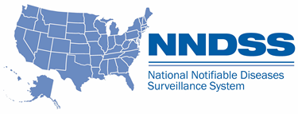
NNDSS Modernization Initiative (NMI): Overview of Foodborne and Diarrheal Diseases HL7 Case Notification Messages
Division of Health Informatics and Surveillance
May 21, 2019

Slide 2

Agenda
Welcome and Announcements
Overview of Foodborne and Diarrheal Diseases HL7 Case Notification Messages
  Mike Hughes, Division of Foodborne, Waterborne, and Environmental Diseases, CDC
Questions and Answers

Slide 3
NMI Updates and Timeline
Lesliann Helmus, MSPH, CHTS-CP
Associate Director for Surveillance
Michele Hoover, MS
Lead, State Implementation and Technical Assistance

Slide 4

Announcements:
MQF functionality is now in METS and MQF is being decommissioned.
CSTE hosted webinar on Carbon Monoxide is set for July 22, 2019, 3:30 PM-4:30 PM. Keep a look out for the official invite.
Notes:
Over the last several months, CDC has been working to retire MQF and place that functionality into METS, having one source for validating messages. MQF functionality will be phased out….

Slide 5
Conditions Added to Generic v2 Only
CDC received approval from the Office of Management and Budget (OMB) to receive case notifications for the following conditions:
  Candida auris, clinical (event code 50263),
  Candida auris, colonization/screening (event code 50264),
  Carbapenemase-Producing Carbapenem-Resistant Enterobacteriaceae (CP-CRE) (event code 50244),
  Carbon Monoxide Poisoning (event code 32016), and
  Respiratory Syncytial Virus-Associated Deaths (event code 11646).
Please send notifications to CDC for all 2019 cases of the above conditions. Use the generic v2 message mapping guide until disease-specific message mapping guides are available.
CDC will post an updated 2019 NNDSS Event Code List on the NNDSS Event Codes & Other Surveillance Resources web page.

Slide 6

Reminder:
Please upgrade to PHIN Messaging System (PHINMS) v3.1 by June 30th, if you have not already done so.
Installation and other guidance documents are available on the PHIN website at https://www.cdc.gov/phin/tools/phinms/installation.html

Slide 7
NMI Implementation Status May 21, 2019
NH
WA
VT
ME
AK
MT
ND
MN
MA
OR
WI
NY
RI
ID
SD
MI
WY
CT
IA
PA
NJ
NYC
CA
NE
OH
DE
HI
NV
IL
IN
WV
UT
VA
DC
MD
CO
KS
MO
KY
NC
TN
OK
AR
SC
AZ
NM
MS
AL
GA
TX
LA
Piloting Total of 1 (state)
FL
PR
Onboarding Total of 7 (states)
Production Total of 37 (36 states + NYC)

Slide 8
Piloting Status
Message Mapping Guides (MMGs) | Piloting | States Piloting
TB/LTBI | 3 | AZ, GA, OR
Malaria | 4 | CT, ID, FL, MI
Trichinellosis | 3 | FL, MI, WI
Babesiosis | 4 | CT, FL, MI, WI
RIBD | 3 | GA, KS, OR
Lyme/TBRD | 5 | FL, ID, IL, MI, OR
HAI MDRO | 3 | CO, MI, OR
Measles/Rubella/CRS | 4 | AL*, AZ, FL, OR
Total # of Individual States | 12 | AL, AZ, CO, CT, FL, GA, ID, IL, KS, MI, OR, WI
* Measles Only
5/21/2019

Slide 9
NNDSS HL7 Message Mapping Guide Estimated Timeline

Slide 10
Implementing the Foodborne and Diarrheal Diseases Message Mapping Guide
Michele Hoover, MS
Lead, State Implementation and Technical Assistance

Slide 11
Starting from the Beginning...
Engage stakeholders
  Engage both informaticians and epidemiologists.
  “Engage early and often.”
Strongly recommend using Implementation Spreadsheet for documentation of gap analysis and data crosswalk.
  This spreadsheet or a similar resource is one requirement of onboarding.

Slide 12
Gap Analysis
Includes comparing:
  data collected in state surveillance system,
  data submitted to CDC previously, including how it was sent,
  data requested in the MMG.
Helps identify
  if updates to the surveillance system are needed,
  if data needs to be translated to populate the HL7 message correctly,
  if additional data needs to be collected for cases.
See resources on the Technical Assistance and Training Resource Center webpage Implementing All Other Conditions: Pre-Onboarding.

Slide 13
Implementation
Maintain or improve on data submitted through previous methods.
Ensure all data elements previously submitted to the CDC Programs through any legacy methods can be collected in the state surveillance system and sent in the HL7 message.
Request Technical Assistance for additional help by emailing edx@cdc.gov.

Slide 14
New Approach for Implementing the FDD Guide
4 conditions
1 guide
All conditions
3 guides
4 conditions
1 guide
OR
Phased Approach:
Step 1. Implement 4 conditions
Step 2. Implement other 4 conditions
By using this approach, the jurisdiction will be credited with implementing 2 guides.
All-Inclusive Approach:
Step 1. Implement all 8 conditions
By using this approach, the jurisdiction will be credited with implementing 3 guides.
Note: Implementation order of the FDD tabs is up to the jurisdiction.

Slide 15
Overview: Foodborne and Diarrheal Diseases
HL7 Case Notification Messages
Mike Hughes
National Surveillance Team
Enteric Diseases Epidemiology Branch
Division of Foodborne, Waterborne, and Environmental Diseases
National Center for Emerging Zoonotic Infectious Diseases
Centers for Disease Control and Prevention

Slide 16
Overview and General Guidance
Foodborne and Diarrheal Diseases HL7 Case Notification Messages

Slide 17
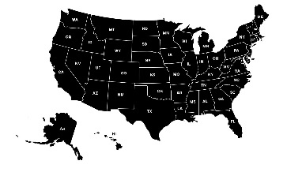
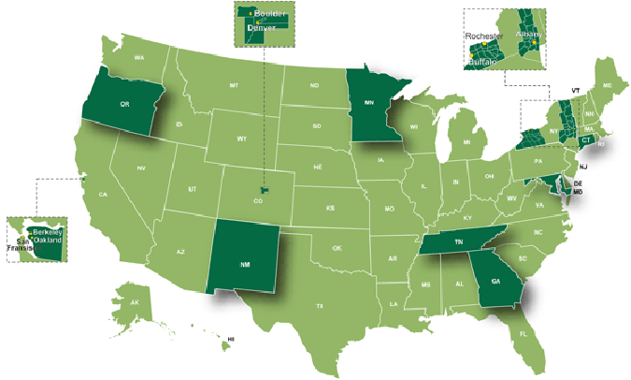
Foodborne and Diarrheal Diseases Message Mapping Guide (FDD MMG) Overview
    Guide for all jurisdictions sending data elements via HL7 for multiple nationally notifiable conditions
      STEC, salmonellosis, shigellosis, campylobacteriosis, cryptosporidiosis, cyclosporiasis, cholera/vibriosis, typhi/paratyphi infection
    Contains subset of data elements sent by EIP sites only to FoodNet
      Includes HUS, listeriosis, yersiniosis, and from select sites ETEC
Designed to be used in conjunction with Generic v2 MMG
Conditions not in the FDD MMG: listeriosis, botulism

Slide 18
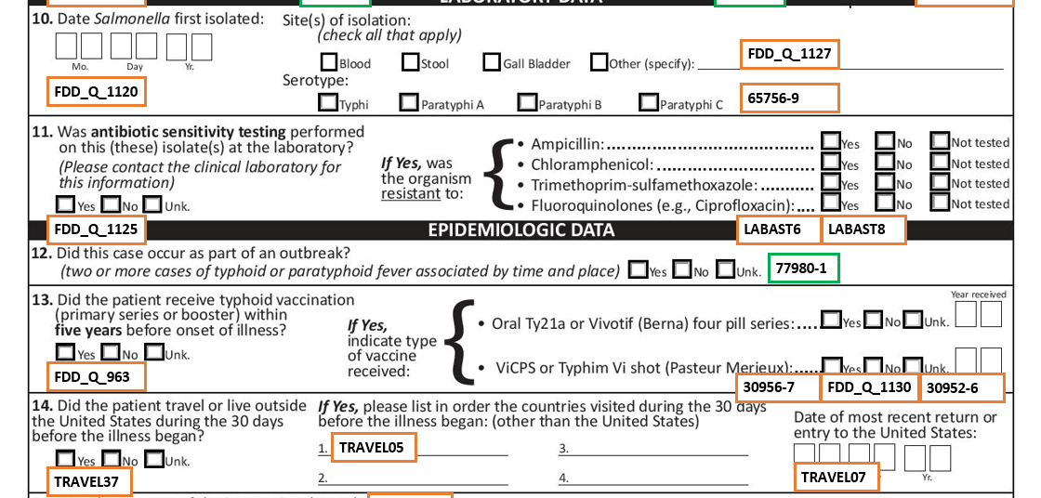
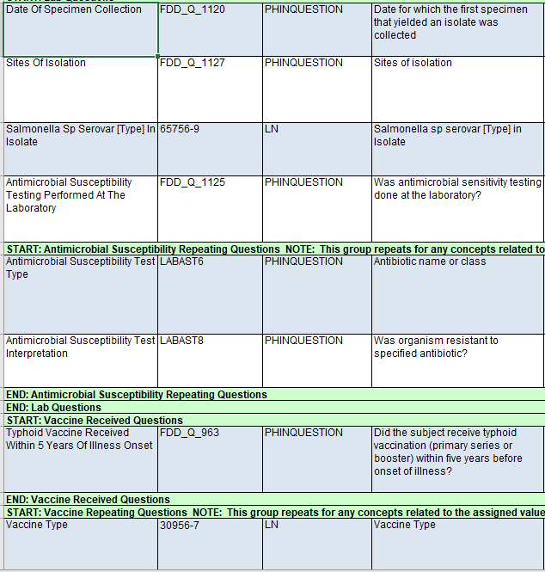
Context of foodborne, waterborne, and parasitic disease surveillance
Some CDC surveillance systems rely on:
  1) “legacy” modes of data transmission (e.g. paper case report forms (CRFs), .CSVs) and
  2) basic demographic and clinical information supplied by public health surveillance partners via NNDSS
Multiple CDC programs involved: Enteric bacterial, waterborne, parasitic
Effort to standardize vocabulary, data elements, data structure
FDD MMG consists of data elements from CRFs and position statements, where available

Slide 19
Transition from legacy transmission to HL7
CDC programs designated “high priority” data elements.
They are essential in order to cease legacy data transmission.
High priority designation was based on:
  1) Existing surveillance i.e. critical information currently in case reports
  2) Data elements designated by CSTE for national transmission
  3) Epidemiologic need (e.g. risk factors and clinical manifestation)

Slide 20
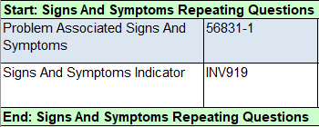
General guidance: Repeating groups
Generally used for:
Signs and symptoms
Antibiotics (before or current illness)
Exposures (e.g. Travel)
Lab interpretive diagnostic
Industry and occupation
Antimicrobial susceptibility testing
Example: Signs and symptoms (STEC)
Repeat 3x for each symptom
“Diarrhea”
Yes/No/Unknown
“Bloody Diarrhea”
Yes/No/Unknown
“Abdominal Pain”
Yes/No/Unknown
Notes:
‘No’s are important

Slide 21
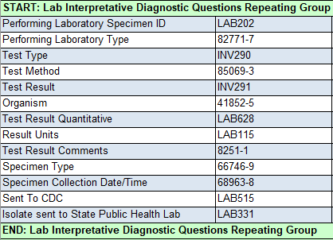
General guidance: Lab interpretative section
Laboratory interpretive repeating group is essential to foodborne and waterborne disease surveillance
Most tabs have a laboratory interpretative section
  Repeats once for each diagnostic test result
  Exception: COVIS repeats once per specimen
Standardized across the guide, it consists of ~18 data elements
Data element priorities might differ by program
  For example, national typhoid form contains specimen source, specimen date, and serotype. Therefore, these data elements are high priority for this condition.
Notes:
The lab template is yet another tab, but is not intended to be the primary way to transmit lab information. It can still be implemented and service to augment the interpretive repeating group.

Slide 22
Program-Specific Guidance
Foodborne and Diarrheal Diseases HL7 Case Notification Messages

Slide 23
Cholera and Vibriosis
Reflects the information currently collected on the Cholera and Other Vibrio Illness Surveillance (COVIS) System case report form.
Aim to maintain completeness of data in transition from legacy to HL7
Key differences:
  Data elements in laboratory, clinical, and seafood investigation section are designed as repeating groups
    Seafood investigations require identifier to link investigation to traceback
  Value sets are included for variables that in previous versions of the COVIS form were free text
    Examples: Vibrio species, type of seafood investigated

Slide 24
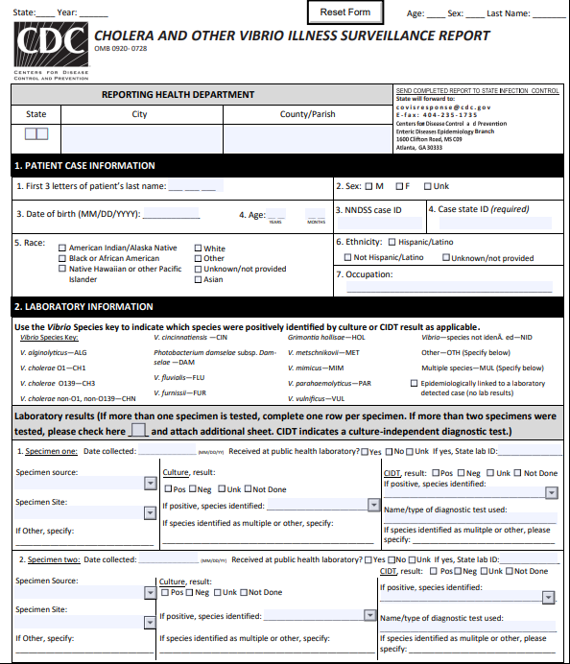
Cholera and Vibriosis (Continued)
HL7 message for cholera and vibriosis should include:
  Case Patient information
  Laboratory results for culture and culture-independent diagnostic testing
  Clinical information including signs and symptoms, past medical history, antibiotic use
  Travel history
  Seafood and water exposures
  Seafood investigation and traceback information
  Cholera exposure information, as appropriate
Notes:
To summarize, all of the information currently collected on the COVIS case report form

Slide 25
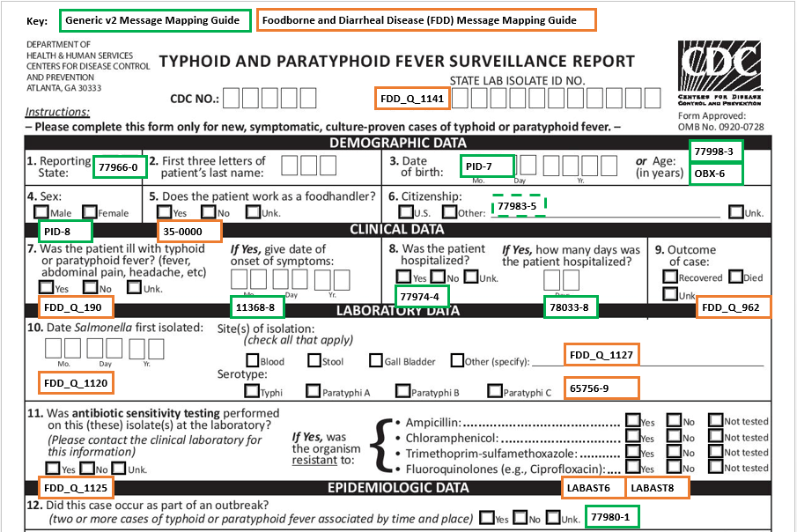
S. Typhi and S. Paratyphi Infection
Reflects information collected for National Typhoid and Paratyphoid Fever Surveillance (Legacy name)
Aim to maintain completeness of data in transition from legacy to HL7
  Annotated case report form is available
  State can stop sending CRFs once sending new HL7 messages
Send confirmed cases (See Position Statement 18-ID-08)

Slide 26
S. Typhi and S. Paratyphi Infection (Continued)
HL7 message for S. Typhi and S. Paratyphi Infection should include:
  State Lab Isolate ID Number (FDD_Q_1141)
  Clinical information including signs and symptoms*
  Antimicrobial susceptibility testing*
  Vaccine history*
  Travel history*
  Specimen collection and serotype*
  *Repeating groups
Key differences:
  Use Date of Specimen Collection (FDD_Q_1127) instead of isolation date
  Use Country of Usual Residence (INV501 in Gen v2) instead of citizenship
Notes:
Use abx from the form: ampicillin, chloramphenicol, trimethoprim/sulfa, fluoroquinolones

Slide 27
Cyclosporiasis
Confirmed & Probable cases nationally notifiable since January 1999 (See Position Statement 09-ID-04)
Legacy systems the MMG will replace:
  Cyclosporiasis National Hypothesis Generating Questionnaire (CNHGQ)
    8-page questionnaire used for surveillance during “outbreak season” (May–August); data submitted electronically via Epi Info or paper-based PDF
  Cyclosporiasis Case Report Form (CRF)
    2-page questionnaire used for national surveillance outside “outbreak season” (September–April); data submitted via paper-based PDF

Slide 28
Cyclosporiasis (Continued)
Priority data elements that are most essential for guiding cyclosporiasis epi investigations and retiring legacy systems:
  Signs and Symptoms
  Travel History
  Food Exposure History sections
  Events History and Ill Contacts sections
  Epidemiology Laboratory section
Notes:
Data elements that are most essential for guiding cyclosporiasis epi investigations and retiring legacy systems:
Signs and Symptoms to assess for clinical compatibility
Travel History to determine whether the infection was likely acquired domestically and warrants further investigation
Food Exposure History sections to aid in cluster/outbreak identification and investigation (sources of food inside and outside the home, such as grocery stores and restaurants)
Events History and Ill Contacts sections to aid in cluster/outbreak identification and investigation
Epidemiology Laboratory section (testing methods and results, laboratory type)

Slide 29
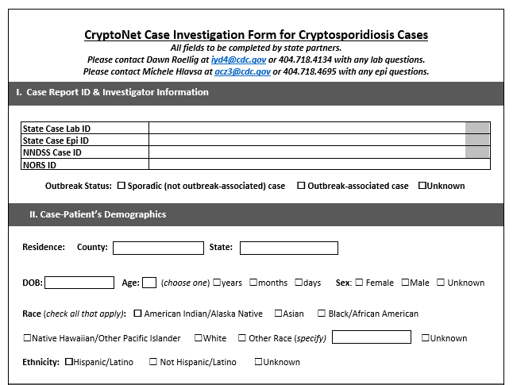
Cryptosporidiosis
Data elements reflect CryptoNet case investigation form
Transition to also collecting exposure data to advance understanding of Cryptosporidium transmission
  Genotypes and species can have unique host ranges
    Need molecular characterization to distinguish
    Can provide insight into possible exposures
  Important exposures
    Contaminated recreational water, drinking water, or food
    Infected people or animals

Slide 30
Cryptosporidiosis (Continued)
HL7 message for Cryptosporidiosis should include:
  Repeating groups:
    Recreational water
    Drinking Water
    Raw or Unpasteurized Product
    Animal Exposure
      Preferred values (FDD_Q_32): Calf, Cow, Kid, Goat, Sheep, Lamb
    Large Gathering
    Children in Childcare
  Non-repeating groups:
    Animal Manure Contact Within 14 Days Before Symptom Onset (FDD_Q_919)
    Visit Animal Environment Within 14 Days Before Symptom Onset (FDD_Q_925)
    Sexual Contact Within 14 Days Before Symptom Onset (FDD_Q_923)
    Performing Laboratory Specimen ID (LAB202)

Slide 31
Shiga toxin-producing E. coli
Supports STEC Initiative
  Collection and transmission of standard information: demographic, exposure, clinical, and outcome data
  Link with sequencing data to detect outbreaks and more rapidly identify shared exposures among cases
  Pair epi with genetic information to better understand risk factors for severe disease
Submit confirmed and probable cases
No legacy case surveillance or national case report form
  Sample annotated case report form is available
Data elements defined by CSTE (See Position Statement 13-ID-01)

Slide 32
Shiga toxin-producing E. coli (Continued)
HL7 message for STEC should include:
  PulseNet ID (FDD_Q_1140)
  Probable – Lab (FDD_Q_1109), Probable – Epi (FDD_Q_1110)
  Signs and symptoms
    Preferred values: Diarrhea, bloody diarrhea, abdominal cramps
  Food exposures (e.g. ate ground beef, ate romaine lettuce)
  Exposure window – 7 days, or specify otherwise
  Lab interpretive diagnostic repeating group
Notes:
Food exposure details if you can

Slide 33
Salmonellosis, shigellosis, and campylobacteriosis
FDD MMG tabs currently have very few data elements
Enhanced surveillance planning ongoing for salmonellosis
Prioritize data elements normally sent to Laboratory Enteric Disease Surveillance (LEDS) and PulseNet
  Organism (41852-5)
  Performing Laboratory Specimen ID (LAB202)
  Performing Laboratory Type (82771-7)
  Salmonella Serogroup (FDD_Q_902)
Notes:
These tabs currently have few data elements, as there is no existing enhanced epi surveillance data collection.
Enhanced surveillance planning is ongoing for salmonellosis.
Please prioritize DEs normally sent to LEDS and Pulsenet. To highlight a few critical ones:
Organism – this includes subtyping/species/serotype information
Specimen ID will aid linking with PulseNet and other lab systems.
Performing lab type allows us to compare the MMG data with our legacy systems.
Salmonella also has a serogroup field, to complement the serotype info that you might send in Organism field.

Slide 34
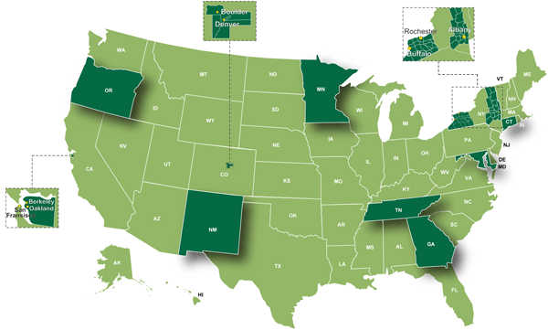
Foodborne Diseases Active Surveillance Network (FoodNet)
Collaboration among CDC, 10 state health departments, USDA-FSIS, and FDA
Component of Emerging Infections Program (EIP)
Laboratory-based active surveillance for Campylobacter, Cyclospora, Listeria, Salmonella, Shiga toxin-producing E. coli (STEC), Shigella, Yersinia, and Vibrio; pediatric hemolytic uremic syndrome; for select sites Enterotoxogenic E.coli
Collects information on:
  Clinical outcomes
  Antibiotic use
  Outbreak
15% of U.S. population
(48 million people)
  Travel
  Exposures
  Laboratory
Notes:
In case anyone is not familiar with FoodNet. The Foodborne Disease Active Surveillance Network (or FoodNet) is a collaboration among CDC, 10 state health departments, USDA-FSIS, and FDA and is a component of CDC’s Emerging Infections Program. The surveillance area covers 15% of the population or approximately 48 million people. We conduct active, laboratory-based surveillance for 8 pathogens and pediatric HUS in order to provide reliable data for tracking incidence over time. As mentioned earlier not only do FoodNet sites report on most conditions listed in the FDD, but also those not included such as HUS, Listeria, Yersinia, and for a few sites Enterotoxogenic E.coli reports. For HUS this is restricted to GenV2.
FoodNet collects a lot of program-specific information above and beyond what was traditionally collected for some of the nationally notifiable conditions, including clinical outcomes, antibiotic use, travel, outbreak, exposures, and laboratory testing details such as test type and negative results from reflex CX. This sometimes can cause confusion as some of the other tabs may have similar, but not the exact same questions. However, often where this occurs FoodNet is NOT collecting the additional variables STEC is the best example where FoodNet does not collect exposure information, but the national tab does.

Slide 35
Foodborne Diseases Active Surveillance Network (FoodNet) (Continued)
Key for implementation
  Prioritization is based on current FoodNet variables and value sets
  Laboratory repeating block critical for FoodNet surveillance
  Must maintain current data quality
Overlap with national programs
  Where there are data elements in common with other programs, map the most specific values
  Defer to FoodNet guidance when mapping the laboratory repeating group
FoodNet guidance documents address
  Nuances in reporting
  Mapping from FoodNet variables to MMG fields
Notes:
Key things to note that are unique to FoodNet for implementation. All of the fields on the FoodNet tab are currently mapped to a FoodNet variable we now receive from sites. We have added prioritization as some fields are associated with data cleaning and/or have been put on hold for the current year.
As mentioned previously, we are a laboratory-based surveillance system, so the importance of the lab repeat section for FoodNet sites can’t be emphasized enough as this is the core of our surveillance and it is critical that we maintain our current data quality with the transition.
Some information collected on the FoodNet tab is also found on the other tabs. Where the fields are the same, but value sets or priorities vary the most specific value should be what is mapped to. Also, the FoodNet lab repeat for FoodNet sites is the default, the fields required for submitting laboratory data will enable CDC to transform as needed to meet requirements in other tabs.
Finally, FoodNet has developed some draft guidance documents to address nuances in reporting translating how we currently collect information should be entered using the MMG format as well as developed a document that maps current FoodNet fields to fields in the MMG as many of our current fields do not map 1:1 with the MMG.

Slide 36
Resources for HL7 Implementation
Foodborne and Diarrheal Diseases HL7 Case Notification Messages

Slide 37

Resources
ELC Cooperative Agreement
  ELC funding strategy: Grantees can request staff, system enhancements, etc. to electronically collect and transmit routine surveillance data.
National surveillance SME support
  Annotated case report forms
NNDSS Technical Resource Center:
  cdc.gov/nndss/trc/index.html
Notes:
To note: ELC applications for the current funding cycle were submitted on May 10th

Slide 38
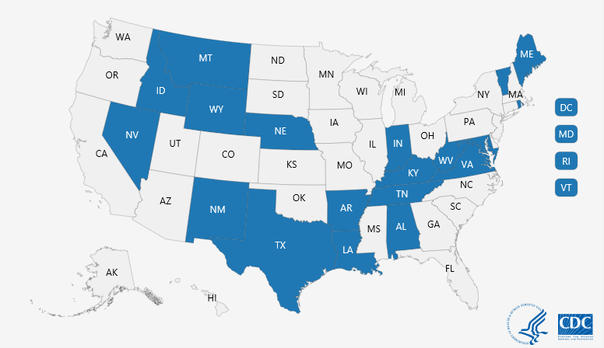
Resources Continued:
NBS Page Builder Templates
Page builder templates will be developed for all conditions in the FDD MMG
Page templates will be released once they are completed following review by surveillance community
Get involved: NEDSS Base System SME calls
Questions: edx@cdc.gov

Slide 39
Conclusion
Gap analysis
  Tool to compare the data elements in the MMG to your agencies surveillance system
  Occurs early in the onboarding process
Goals
  Advance understanding of disease burden and transmission
  Support multistate outbreak investigations with common data elements reported across different jurisdictions
Notes:
Implementation spreadsheet
Patient and lab data used together to monitor burden of illness associated with certain genetic information such as serogroups, serotypes, and sequence types

Slide 40
Federal Surveillance Partners
Division of Foodborne, Waterborne, and Environmental Diseases
  Katie Fullerton
Enteric Diseases
  Mike Hughes
  Mike Judd
  Erin Stokes
  Karen Wong
FoodNet
  Kelly Barrett
  Danielle Tack
Parasitic Diseases
  Cody Bennett
  Shannon Casillas
Waterborne Diseases
  Jennifer Cope
  Michele Hlavsa
  Zach Marsh
  Ariana Perez

Slide 41
Contact for More Information
CSELS/Division of Health Informatics and Surveillance:
edx@cdc.gov
Division of Foodborne, Waterborne, and Environmental Diseases:
National: Mike Hughes (wuw8@cdc.gov)
FoodNet: Danielle Tack (dot7@cdc.gov)

Slide 42

Questions and Answers
Text x

Slide 43
Subscribe to monthly NMI Notes news updates at
https://www.cdc.gov/nndss/trc/news/
Access the NNDSS Technical Resource Center at
https://www.cdc.gov/nndss/trc/
Request NNDSS technical assistance or onboarding at
edx@cdc.gov
Next NNDSS eSHARE is July 16, 2019 – details at
https://www.cdc.gov/nndss/trc/onboarding/eshare.html

Slide 44
Appendix

Slide 45
S. Typhi and S. Paratyphi Infection (Continued)
New condition codes acceptable in HL7 messages:
  50267: Salmonella enterica Typhi infection (S. Typhi infection)
  50266: Salmonella enterica serotypes Paratyphi A, B (tartrate negative), and C (S. Paratyphi) infection
  50265: Salmonellosis (excluding S. Typhi infection and S. Paratyphi infection)
Retired codes:
  10240: Typhoid fever (caused by Salmonella Typhi)
  50236: Paratyphoid fever (caused by Salmonella serotypes Paratyphi A, Paratyphi B [tartrate negative], and Paratyphi C
  50242: Salmonellosis (excluding paratyphoid fever and typhoid fever)
*National notifiable disease event code changes for Typhi and Paratyphi Infection based upon 2018 Council of State and Territorial Epidemiologists position statement revising the case definitions.

Slide 46
General guidance: Gen v2
Many data elements are common across the national surveillance programs:
  Local subject ID
  Local record ID
  Reporting state
  State of residence
  Subject’s sex
  Age at case investigation
  Age unit at case investigation
  Subject hospitalized
  Subject died
  Outbreak indicator
  Outbreak name
Notes:
When mapping and assembling an HL7 message, defer first to what is required by MMG informatics standards, i.e. everything in the guide labelled as ‘R’ = required. Then refer to documentation provided by the programs with data elements listed by priority.

