Slide 1
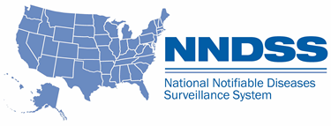
NNDSS Modernization Initiative (NMI): Data Reconciliation Processes for 2019 and Walkthrough of MVPS Dashboard Case Count View
Access the NNDSS Technical Resource Center at
https://www.cdc.gov/nndss/trc/
Subscribe to monthly NMI Notes news updates at
https://www.cdc.gov/nndss/trc/news/
March 19, 2019 Division of Health Informatics and Surveillance

Slide 2

Agenda
Welcome and Announcements
NNDSS Data Reconciliation Process for 2019
  Deborah Adams, CDC
  Yvette Dominique, CDC
Walkthrough of MVPS Dashboard Case Count View
  Andrew Kuehl, CDC
Questions and Answers

Slide 3
Announcements
The Epidemiology Laboratory and Capacity (ELC) FY2019 NOFO is now posted on Grants.gov!
Similar to last year, template resources are available within the REDCap ELC Application and Monitoring Portal for 2019-2020.
Applicants should submit their completed FY2019 ELC NOFO Application via Grants.gov and upload a courtesy copy to REDCap by Friday, May 10, 2019 at 11:59 PM EST.
Notes:
In order to submit courtesy copy to REDCap access to REDCap will be needed. If you have access to any ELC REDCap project, you will have access to the ELC Application and Monitoring Portal 2019-2020.

Slide 4
NMI Updates and Timeline
Lesliann Helmus, MSPH, CHTS-CP
Associate Director for Surveillance
Michele Hoover, MS
Lead, State Implementation and Technical Assistance

Slide 5
NMI Implementation Status March 19, 2019
NH
WA
VT
ME
AK
MT
ND
MN
MA
OR
WI
NY
RI
ID
SD
MI
WY
CT
IA
PA
NJ
NYC
CA
NE
OH
DE
HI
NV
IL
IN
WV
UT
VA
DC
MD
CO
KS
MO
KY
NC
TN
OK
AR
SC
AZ
NM
MS
AL
GA
TX
LA
Piloting Total of 1 (state)
FL
PR
Onboarding Total of 7 (states)
Production Total of 34 (33 states + NYC)

Slide 6
Piloting Status
Message Mapping Guides (MMGs) | Piloting | States Piloting
TB/LTBI | 4 | AZ, CT, GA, OR
Malaria | 3 | CT, FL, MI
Trichinellosis | 3 | FL, MI, WI
Babesiosis | 4 | CT, FL, MI, WI
RIBD | 3 | GA, KS, OR
Total # of Individual States | 8 | AZ, CT, FL, GA, KS, MI, OR, WI
03/19/19

Slide 7
NNDSS HL7 Message Mapping Guide Estimated Timeline

Slide 8
Preparing to Reconcile 2018 Data
Deborah A. Adams
Yvette Dominique, MS, PMP
Center for Surveillance, Epidemiology and Laboratory Services
Centers for Disease Control and Prevention

Slide 9
What is NNDSS Reconciliation?
Process to finalize case counts for the previous year
  Agreement between reporting jurisdiction database and CDC NNDSS database
CDC provides tables with counts to be printed in the NNDSS tables
  Based on surveillance case definitions, case status classifications, print criteria
Reconciliation packet includes
  Summary Production Calendar
  week-ending calendar
  reconciliation tables with instructions for use
  detailed listing of all non-STD cases
Final steps: State or territory epidemiologist signs-off on final counts

Slide 10
Data Reconciliation Timeline
March
April-May
States/territories transmit updates on 2018 cases to CDC
June
NNDSS emails final reports to State/Territorial Epidemiologist for signature
NNDSS emails reconciliation packets to State/Territorial Reporters
Jurisdictions obtain and process any outstanding 2018 case reports
6/30/19: State/Territorial Epidemiologists’ last day to return approved reports to CDC
6/30/19: NNDSS 2018 Reconciliation Database closed
5/31/19: Last day for states/territories to transmit 2018 FINAL year-to-date data files and updates
States/territories work with CDC programs to address any outstanding issues
3/28/19: Webinar on reconciliation process with State/Territorial Reporters

Slide 11
Lessons Learned from Reconciliation Process

Slide 12
Lessons Learned Conference Calls
Conducted in December 2018
Identified process improvements for NNDSS annual data reconciliation activities and operations
Included eight reporting jurisdictions
  Arkansas
  California
  District of Columbia
  Louisiana
  Missouri
  Oklahoma
  Texas
  Virginia
Notes:
As part of DHIS”s dedication to continuous process improvement, the Data Processing Team (DPT) and the Program Evaluation Branch (PEB) conducted lessons learned with Arkansas, California, DC, Louisiana, Missouri, Oklahoma, Texas and Virginia.
These states were selected because they are in different phases of the transition to the new MMGs and have had different experiences during the 2018 reconciliation.

Slide 13
Recommendations
Health Jurisdictions:
  Start close-out process with local health departments sooner
  Assign a point person to coordinate NNDSS reconciliation
Data Operations:
  Provide reconciliation tables more than once a year (e.g., quarterly or biannually)
  Incorporate additional data elements to facilitate local follow-up
  Periodically send reminders during reconciliation
  Hold webinar to review timeline and share helpful information

Slide 14
Recommendations (cont’d)
MVPS:
  Enhance information available on Dashboard to help with reconciliation (e.g., counts of messages sent, diseases and conditions, etc.)
CDC programs:
  Increase communications between programs and jurisdictions throughout the year
  Quarterly reports help identify missing cases and quality issues sooner
  Validate/update disease-specific points-of-contact for jurisdictions
  Quick responses are appreciated
Data transmission:
  Closer tracking of large transmissions
CDC overall:
  Provide jurisdictions with more/real-time access to data sent to CDC
  Quick responses to questions about data and numbers are very helpful

Slide 15
2018 Reconciliation Data Tables

Slide 16
2018 Reconciliation Tables for
National Notifiable Infectious Diseases
Table 1 State-specific case count by system status and disease
Table 2 State-specific case count by case status classification and disease
Table 3 State-specific case count by month and disease
Table 4 State-specific case count by race/ethnicity and disease
Table 5 State-specific case count by age group (years) and disease
Table 6 State-specific case count by sex and disease
Table 7 State-specific case count by MMWR week and disease
Table 8 State-specific case count by Reporting county and disease
Table 9 State-specific case count by MVPS ‘County of residence’ PID-11.9 (NEW)
Table 10 State-specific outbreak status by disease
Table 11 State-specific import status by disease
Table 12 State-specific case count by disease and reporting exception [diseases that are ‘Not Reportable’ or where data are ‘Unavailable’] (NEW)
Table 13 State-specific case count for retired event codes (NEW)
Line List State-specific case-level line list for non-STD data by disease (includes original NBS &
HL7 case ids)
Excel Workbook Tables 1-11 in machine-readable format

Slide 17
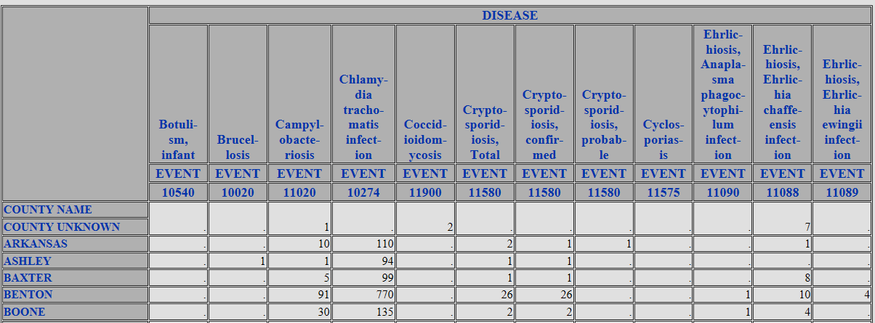
TABLE 8: STATE-SPECIFIC CASE COUNT BY REPORTING COUNTY AND DISEASE

Slide 18
TABLE 9: STATE-SPECIFIC CASE COUNT BY COUNTY OF RESIDENCE AND DISEASE

Slide 19
TABLE 12: STATE-SPECIFIC CASE COUNT BY DISEASE AND REPORTING EXCEPTION
DISEASE | EVENT | REPORTING EXCEPTION (cases not printed) | CASES REC’D
Babesiosis, total | 12010 | N | 1
Babesiosis, confirmed | 12010 | N | 0
Babesiosis, probable | 12010 | N | 1
Hantavirus infection (non-HPS) | 10610 | N | 0
Leptospirosis | 10390 | N | 2
Q fever, chronic | 10258 | U | 0
Information on notifiable conditions that are not reportable or
do not have data available for the jurisdiction.

Slide 20
TABLE 13: STATE-SPECIFIC CASE COUNT FOR RETIRED EVENT CODES BY DISEASE
DISEASE | RETIRED EVENT | CASES REC’D | 2018 EVENT
Salmonellosis | 11000 | 0 | 50236,50242
Streptococcus pneumoniae, non-drug resistant, <5 years | 11717 | 1 | 11723
Streptococcus pneumoniae, drug-resistant, all age groups | 11720 | 2 | 11723
Vibrio spp., non-toxigenic, other or unspecified | 11540 | 3 | 11545
Vibrio parahaemolyticus | 11541 | 1 | 11545
Vibrio vulnificus | 11542 | 2 | 11545
Please update your system to use 2018 event codes for 2018 data.

Slide 21
What States Should Know

Slide 22
Reconciliation Tips
Have an assigned point person and communicate that to your state support representative on the NNDSS Data Operations Team (DOT).
Start the process early ☺.
Check to make sure your digital PHINMS certificate and/or your PHINMS software is up to date.
You may request a detailed line list at any time.

Slide 23
2018 Summary Production Calendar
National Notifiable Infectious Disease Tables
01/31/2019 HIV Diagnoses database closed
02/22/2019 Data Coordinator emails State/Territorial Epidemiologist letter with production calendar
02/22/2019 Influenza-associated pediatric mortality database closed
02/22/2019 Novel Influenza A Virus database closed
03/01/2019 Deadline: State/Territorial Epidemiologists respond to letter and timeline
03/18/2019 Data Operations Team (DOT) begins e-mailing reconciliation packets to State/Territorial Reporters
03/28/2019 Webinar on 2018 Reconciliation process with state/territorial reporters
04/26/2019 STD database closed
05/31/2019 Rabies database closed
05/07/2019 Last day for States/Territories to transmit 2018 data as part of their weekly NETSS files
05/31/2019 HIV Diagnoses database closed
05/31/2019 Varicella morbidity and mortality database closed
05/31/2019 Last day for States/Territories to transmit 2018 FINAL year-to-date data files and updates
06/10/2019 DOT begins e-mailing FINAL reports to State/Territorial Epidemiologist for FINAL signature
06/30/2019 Deadline: State/Territorial Epidemiologists’ last day to return FINAL signature reports
06/30/2019 TB database closed
06/30/2019 ARBONET database closed
06/30/2019 NNDSS 2018 Reconciliation database CLOSED
10/31/2019 Publish the FINAL 2018 Nationally Notifiable Infectious Diseases tables on CDC WONDER

Slide 24
MVPS Dashboard Case Count View
Andrew Kuehl, MIT, PMP
MVPS Project Lead

Slide 25
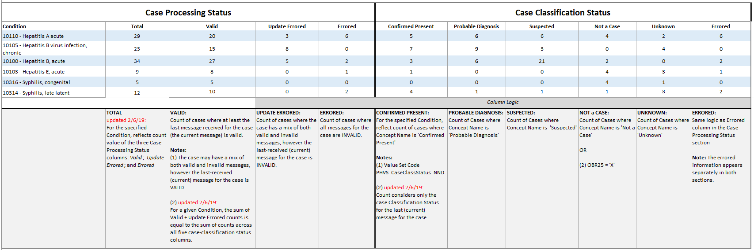
Case Counts:
Logic Associated With Case Processing Status and Case Classification Status Values
t

Slide 26
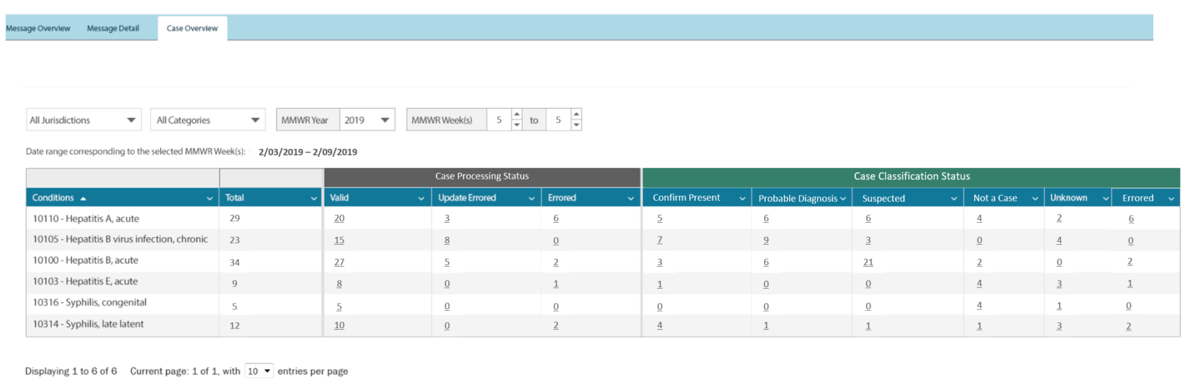
MVPS Case Counts—Case Overview Tab: Mockup Snapshot Reflecting Design Revisions*
REVISIONS as of 3/11/2019
Please note, this mockup snapshot intends to reflect current proof-of-concept design, based on iterative requirements/design discussions.
The following aspects shown on this mockup snapshot are not reflected on the working InVision mockup (https://projects.invisionapp.com/share/52Q5NVKA8N6#/screens).
Table values align with expected column logic (as described on the Case Counts Logic slide)
Case Classification Status column ordering reflects logical case progression
Total column moved from the Case Processing Status section
Errored column added to the Case Classification Status section

Slide 27

Questions and Answers

Slide 28
Subscribe to monthly NMI Notes news updates at
https://www.cdc.gov/nndss/trc/news/
Access the NNDSS Technical Resource Center at
https://www.cdc.gov/nndss/trc/
Request NNDSS technical assistance or onboarding at
edx@cdc.gov
Next NNDSS eSHARE is April 16, 2019 – details at
https://www.cdc.gov/nndss/trc/onboarding/eshare.html

