Slide 1

NNDSS Modernization Initiative (NMI): Introducing Cohorts—a New Efficient Approach to HL7 Case Notification Technical Assistance
Access the NNDSS Technical Resource Center at
https://www.cdc.gov/nndss/trc/
Subscribe to monthly NMI Notes news updates at
https://www.cdc.gov/nndss/trc/news/
February 19, 2019 Division of Health Informatics and Surveillance

Slide 2

Agenda
Welcome and Announcements
New Efficient Approach to HL7 Case Notification Technical Assistance: Cohorts
  Laura Carlton, APHL
  Heather Houston, APHL
Hot Topic: Finding Coding System Codes in PHIN VADS
  Melinda Thomas, CDC
Questions and Answers

Slide 3
NMI Updates and Timeline
Lesliann Helmus, MSPH, CHTS-CP
Associate Director for Surveillance
Michele Hoover, MS
Lead, State Implementation and Technical Assistance

Slide 4
Announcements
Message Quality Framework (MQF) validation tool functionality has been fully incorporated into the Message Evaluation and Testing Service (METS) tool.
Jurisdictions should start using METS for validation of all HL7 NNDSS messages: https://mets.cdc.gov/
  This includes the Arboviral v1.3 message.

Slide 5
Announcements (Continued)
Based on lessons learned during onboarding, two guidance documents have been developed to assist states with Arboviral MMG implementation:
  Surveillance information for reporting of arboviral diseases
  Data element priority list for the Arboviral v1.3 MMG
These documents will be posted to the NNDSS MMG & Artifacts webpage soon.
CDC will be hosting a supplemental eSHARE webinar focusing on Arboviral v1.3 MMG implementation on Monday, March 4, 2019, 3-4 pm ET.

Slide 6
Reminder!
Please change your event codes
  For 2019 cases, use 2019 event codes.
  For 2018 cases, continue to use 2018 event codes.
Note: When new event codes are released, please use current year event codes. Avoid waiting until prior year’s codes are closed out.
  Annual NNDSS Event Code Lists available at https://ndc.services.cdc.gov/event-codes-other-surveillance-resources/
Notes:
January 2019 eSHARE covered event code changes in more depth.

Slide 7
NMI Implementation Status Feb 19, 2019
NH
WA
VT
ME
AK
MT
ND
MN
OR
NY
MA
ID
SD
WI
RI
WY
MI
CT
IA
PA
NJ
NYC
CA
NE
OH
DE
HI
NV
IL
IN
WV
UT
VA
DC
MD
CO
KS
MO
KY
NC
TN
OK
AR
SC
AZ
NM
MS
AL
GA
TX
LA
Piloting Total of 1 (states)
FL
PR
Onboarding Total of 5 (states)
Production Total of 34 (33 states + NYC)

Slide 8
Onboarding and Production Status
Message Mapping Guides (MMGs) | Onboarding |  | In Production
Arboviral v1.3 | 5 | IL, IN, MS, PA, WA | 16 | AR, AZ, DE, FL, ID, MD, ND, NE, NY, OR, RI, SD, TN, TX, UT, WI
Gen v2 | 2 | GA, IN | 24 | AK, AL, AZ, CA, CO, CT, DE, FL, IA, ID, IL, KS, MA, MI, MN, MS, NJ, NY, NYC, OR, SC, UT, VA, WI
Hepatitis | 1 | IN | 15 | AK, AL, FL, ID, LA, MA, MI, MN, NY, OR, SC, TN, VA, WI, WV
STD | 4 | ID, MI, NC, OR
Congenital Syphilis | 4 | ID, MI, NC, OR
Mumps | 1 | UT
Pertussis | 1 | UT
Varicella | 1 | UT
Total # of Individual States | 11 | GA, ID, IL,IN, MI, MS, NC, OR, PA, UT, WA | 34 | AK, AL, AR, AZ, CA, CO, CT, DE, FL, IA, ID, IL, KS, LA, MA, MD, MI, MN, MS, ND, NE, NJ, NY, NYC, OR, RI, SC, SD, TN, TX, UT, VA, WI, WV
Note: States highlighted in GREEN were either onboarding or approved for production since January 15, 2019.
The 5 FDD MMG pilot sites (FL, MI, MN, NY, OR) are preparing for onboarding but have not been engaged yet.
2/19/19

Slide 9
Piloting Status
Message Mapping Guides (MMGs) | Piloting | States Piloting
TB/LTBI | 4 | AZ, CT, GA, OR
Malaria | 3 | CT, FL, MI
Trichinellosis | 3 | FL, MI, WI
Babesiosis | 4 | CT, FL, MI, WI
RIBD | 3 | GA, KS, OR
Total # of Individual States | 8 | AZ, CT, FL, GA, KS, MI, OR, WI
02/19/19

Slide 10
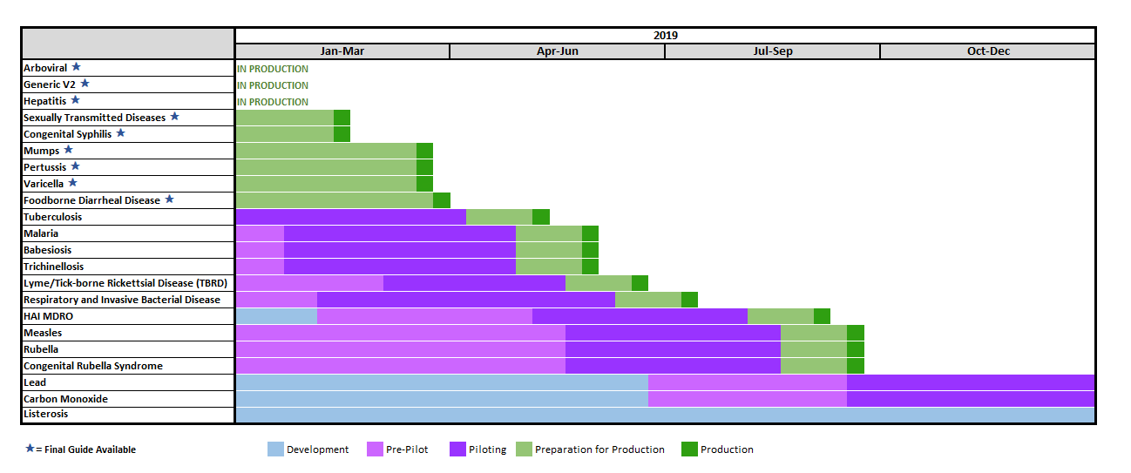
NNDSS HL7 Message Mapping Guide Estimated Timeline

Slide 11
NMI Project
Introducing Cohorts—A New Efficient Approach to HL7 Case Notification Technical Assistance
February 19, 2019

Slide 12
NMI Technical Assistance Overview
Laura Carlton
  NMI TA supports public health agencies (PHAs) to implement HL7 case notifications. The TA team offers expertise and reusable tools in:
  Project management and business analysis: Identify resources, risks and dependencies, develop schedule, and manage implementation.
  Data standards expertise and workflow analysis: Work closely with PHA surveillance and IT staff to harmonize surveillance system terminology to incorporate data standards.
  Technical architecture expertise: Identify system architecture and capabilities, and develop and implement technical solutions that address data exchange needs.

Slide 13
Evolution of APHL Technical Assistance
Original TA model successfully delivered TA one-on-one with partners.
  Designed to provide focused, often in-person support through an entire implementation with one partner
  Effective “Full service” TA
With increasing variety of projects and goals, APHL developed different models for delivering TA.
  Focus on level of service provided, with a variety of options for type of expertise & method of interaction
  Allows selection of TA models that will most effectively achieve project goals
  Multiple TA models may be used within a project for different activities

Slide 14
t
NMI Technical Assistance Process:
Primary Owner of Process
TA Validation: METS
TA Validation: Structure & Content
Pilot Site Addresses Errors
Updated HL7 Messages Generated
TA Validation: Resolve issues until all errors corrected
APHL
TA TEAM
CDC
01. Initial Call
04. Data Extract Updated
t
02. TA Kickoff Call
05. HL7 Message Created
03. Gap Analysis Finalized
06. Transport
Set Up
07. TA Validation
METS, Structure, & Content
TA Complete!
Onboarding & Production Cutover
14
Notes:
A little bit about our Tech assistance process. The first couple of boxes are during our planning process. The gap analysis phase is really where we identify any potential data gaps and how to resolve them. Updating the data extract process, where we work to ensure that all the data coming out covers all the data elements contained in the MMGs. We’ll use that data extract to start building messages in Rhapsody. Creating the test messages that will prepare us for validation, where we’ll make that all the test messages pass all the content checks, structure checks, and architecture checks. & then we’ll get to Step 7—TA validation, which is an iterative process that will involve addressing any errors in generated messages. We’ll work with you in a collaborative process to address any issues and provide feedback and answer any questions that come up. From there, we’ll do a warm hand off to the CDC MVPS onboarding team, and will be available during the onboarding process if any issues arise.

Slide 15
Summary of TA Model Characteristics
 | Cohort | Hands-on | Guided Impl. | Targeted | Independent
Tools & Resources | Yes | Yes | Yes | Possible | Yes
PM Support | Yes | Yes | Yes | Possible | No
Tech & Vocab Support | Yes | Yes | Limited | Possible | No
Group Level TA | Yes | No | Yes | Possible | No
Individual TA | Focused | Yes | No | Yes | No

Slide 16
Cohort Approach – Benefits for Public Health Agencies
Multiple PHAs are working towards the same goal in the same timeframe
  Cohort allows knowledge sharing and peer support across agencies
  Raising issues and questions – and getting answers – in a group environment is beneficial for all participants
Efficient provision of “Full Service” TA
  Consolidated weekly meetings
  CDC SMEs are able to participate in cohort meetings
  Increased availability of APHL SMEs for focused working sessions

Slide 17
Project Support - Cohort Approach
Heather Houston
The cohort will proceed through the implementation process together using regularly scheduled weekly meetings to prepare for upcoming implementation steps, assess progress, and discuss issues.
  Focused working sessions will be scheduled as needed with SMEs
We will track any issues that cannot be resolved immediately on the calls through the NMI Issue tracking spreadsheet, meeting with CDC CSELS and Program to resolve any outstanding questions.
For the Pilot MMGs, maintain a log of any identified defects to map to the updated Final MMG for resolution.
Notes:
Each cohort will hold weekly meetings on an agreed upon day and time.
We focus each session on progress over the last week, addressing any issues, and expectations over the next week.
We will capture and track any issues identified. While most items are addressed during the meeting, occasionally items do need to go to the NMI work group for CDC CSELS and Program discussion. The Issue Tracker captures the discussion and resolution. This information is available to the cohort for view
For Pilot Cohorts, we maintain a log of any defects identified in the Pilot Test Ready MMG for resolution in the Final MMG.

Slide 18
Timeline per MMG
Group 4 Readiness Assessment
This may shift based on when CDC is ready to start the group implementation process
Group 4
Group 3 Readiness Assessment
Group 3
Group 2 Readiness Assessment
Group 2
Group 1 Readiness Assessment
Group 1
Pilot Group Readiness Assessment
Pilot Group
Each group will contain 4-6 jurisdictions.
The groups will have staggered starts with a planned start every 4 weeks for a 4 month period.
The Cohorts begin with a Readiness Assessment, group selection, and cohort group start.
States that have not finished at the group end will be pushed into the next group for completion.
Weekly calls established for each group beginning after the Readiness Assessment and group kickoff
Notes:
This slide shows the timeline and how Cohort Groups are stacked for a MMG.
Each group will contain 4-6 jurisdictions.
The Groups for final guides will be staggered to start every 4 weeks.
We recognize that things can come up during the cohort implementation, causing a jurisdiction to fall behind. If the jurisdiction does not finish with their cohort, they will be moved to the next cohort for completion.

Slide 19
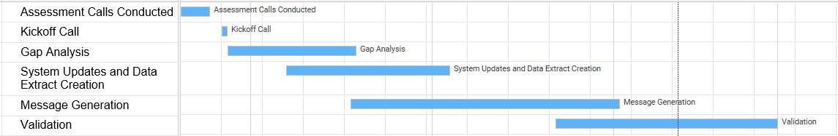
Cohort Approach – Sample Timeline
Timeline is developed based on the complexity of the MMG.
If it is a Pilot guide cohort, the UAT and Final Guide Update Implemented activities are included.
Sample Timeline
Notes:
This is a sample timeline for a Cohort.
You may notice that several activities are overlapping. This allows jurisdictions to move to the next step without having any lulls in momentum.
For example, a jurisdiction may complete their Gap Analysis and Implementation Spreadsheet within the first week or 2 and have it submitted to the TA team for review. They can begin working on their system CR submissions and updates to go through their internal review process.
If this is a Pilot Guide implementation, UAT and Final Guide Updates Implemented activities are included in the cohort schedule.

Slide 20
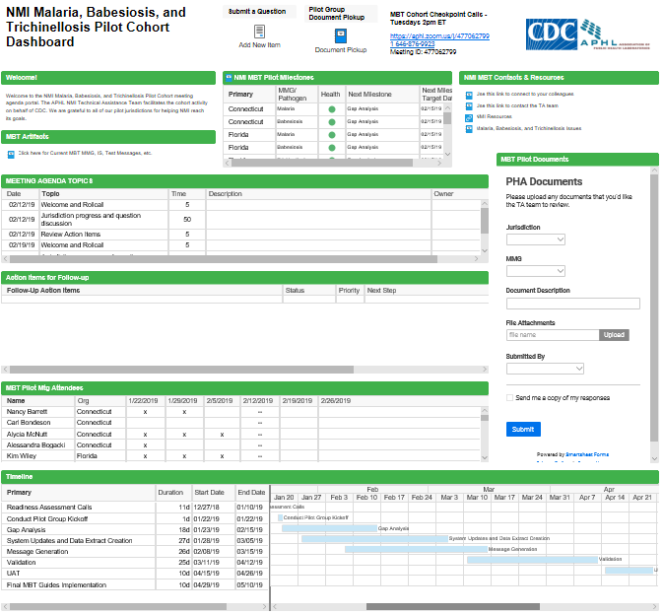
Cohort Approach - Dashboard
Cohorts are managed through a Smartsheet dashboard as a central location for the cohorts to access information.
The dashboard tracks items such as:
  Meeting information
  Timeline
  Project health
  Document review and feedback
  Questions and responses
Notes:
Cohorts are managed through a Smartsheet Dashboard as a central location for the group to access information
The Dashboard is secure and access is limited to those participating in the cohort.

Slide 21
Cohort Approach - Dashboard
Have a question outside of a meeting? Submit the question here
Central location to access Cohort Materials such as links to MMG, Implementation Spreadsheet, Test Cases, etc.
Agendas for each meeting and notes for previous meetings
Project Health and Next Milestones
Notes:
Linking to the NNDSS MMG & Artifacts webpage

Slide 22
Cohort Approach - Dashboard
Action Items for Follow-up. Most items are answered during the meeting. This list captures any items for follow-up
Meeting attendees tracking
Cohort schedule listing activities and timeline

Slide 23
Cohort Approach - Dashboard
Links to lists with the PHAs participating and the TA Team contact information.
Link to the NMI Technical Assistance and Training Resource Center Website.
Link to the Issue List capturing any major items and resolution for the MMG.
Collect documents with feedback from TA review
Submit documents such as the Implementation Spreadsheet here for review by the TA team

Slide 24
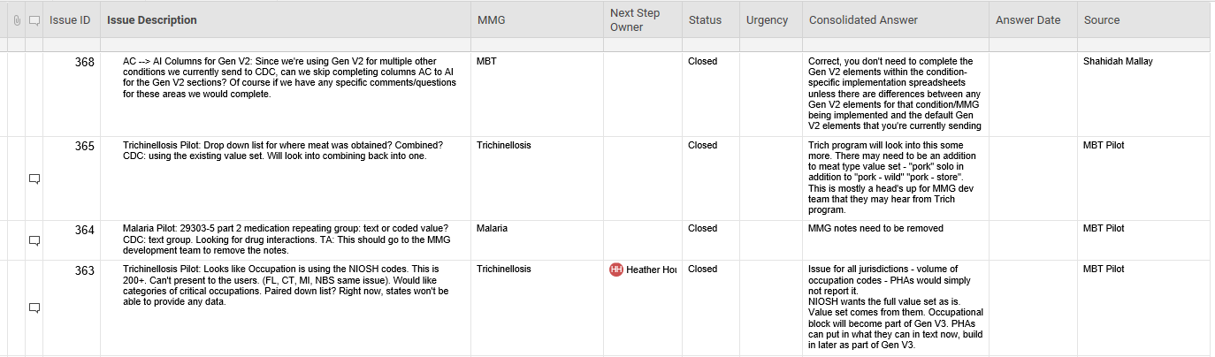
Cohort Approach - Dashboard
Issue discussion is tracked in the comments box
Issue documented for review by Program and CSELS NMI Teams
Consolidated answers for the issue

Slide 25
Cohort Approach – Meeting Structure
Cohorts meet weekly as a group
Attendees include Jurisdiction Program SMEs and Technical staff, APHL TA Staff, and CDC Program representatives
During the meeting, we do a round robin to discuss the Jurisdiction status and answer any questions
At the end of each meeting, goals are established for the next meeting.
  Sample goals for the first few meetings:
    2/14: Begin Gap Analysis (GA), load in progress Implementation Spreadsheet (IS)/GA to team site for TA review, answer any questions
    2/21: Ask questions to continue working through the GA
    2/28: Load in progress IS/GA to team site for TA review, answer any questions
Notes:
Cohorts will meet weekly on an agreed upon day and time. The same day and time each week.
Attendees include the Jurisdictions (including Program EPIs, Informatics, and Surveillance staff), the APHL TA staff, and CDC Program representatives for the MMG.
During each meeting, we discuss status and any questions the jurisdiction and program have for the group.
At the end of each meeting, we review the timeline, discuss goals, and talk about any helpful information for the next meeting and next steps in the process.
Here are some sample meeting goals for the first couple of meetings in the Cohort.

Slide 26

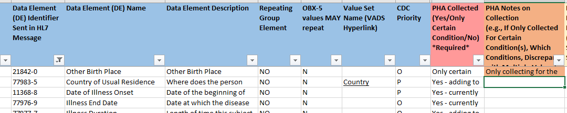
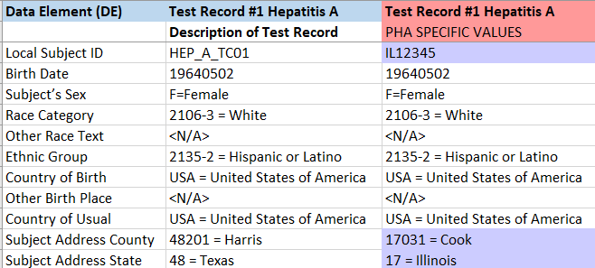
Implementation Support
Gap analysis & Implementation Spreadsheet
HL7 Message Creation & Validation
Test Case Scenario Worksheet
MSH|^~\&|SendAppName^2.16.840.1.114222.nnnn^ISO|…
PID|1||GenV2_TC01^^^SendAppName&2.16.840.1.114222.. OBR|1|""|GenV2_TC01^SendAppName^2.16.840.1.114222.. OBX|1|ST|32624-9^Other Race Text^LN||Apache||||||F…
OBX|2|CWE|78746-5^Country of Birth^LN||USA^United St…
OBX|3|CWE|77983-5^Country of Usual Residence^LN||USA.
Not actually IL data, just used as an example
Notes:
Jurisdictions in our cohorts receive implementation support from the APHL TA team
We’ll help you complete your gap analysis, answering or tracking down the answer to your questions during that process, and make sure your implementation spreadsheet is complete and ready for CDC onboarding. The Implementation Spreadsheet helps to remove any assumptions from the message creation.
We can help you create your HL7 messages for those jurisdictions that need assistance (including providing our template Rhapsody route), and will, in additional METS validation, validate your HL7 test messages once those are ready
We’ll also review your Test Case Scenario Worksheet, and compare that with your HL7 test messages to make sure that is complete and ready for CDC onboarding

Slide 27
Pilot and Final Guide Cohorts
Task | Jan | Feb | Mar | Apr | May | Jun | Jul | Aug | Sep | Oct | Nov | Dec
TB – Pilot
MBT – Pilot
RIBD – Pilot
Gen V2 – Final Cohort 1
Cohorts in Planning:
Lyme/TBRD – Pilot
Measles, Rubella, CRS – Pilot
Listeriosis – Pilot
Gen V2 – Final Cohort 2
STD – Final Cohort 1
STD – Final Cohort 2
HAI MDRO (CPC) – Pilot
Additional Final Guide Cohorts to be formed
(AZ, CT, GA, OR)
(CT, FL, MI, UT, WI)
(KS, GA, OR)
(HI, ND, SD, WA - Maven)
(TBD)
(TBD)
(TBD)
(TBD)
(TBD)
(TBD)
(TBD)
Interested in joining a cohort? Email edx@cdc.gov to join.
Kickoff mtg
Notes:
The top have of the chart shows Cohorts, both final guide and pilot guides, in progress. The note
The bottom half of the chart shows upcoming planned cohorts for both final guides and pilot guides.
After meeting internally including Program EPIs, Informatics, and Surveillance staff, if you have any interest in joining any of the upcoming cohorts, please email edx@cdc.gov to relay your interest.
If you don’t see a cohort for a guide you are interested in, request it through the edx email. We are working on cohorts for each MMG and love to hear about interest to move those cohorts to the top of the list.

Slide 28
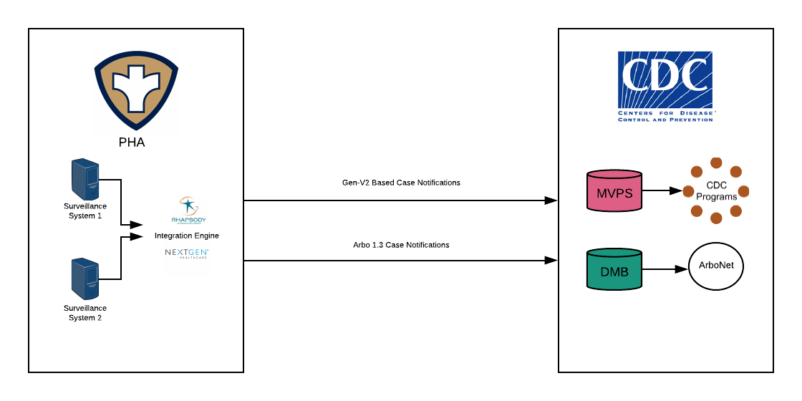
NMI Overview
9 Final MMGs | Gen V2 , Hep, Arbo, STD, CS, Mumps, Pertussis, Varicella, FDD
9 Pilot MMGs | TB/LTBI, Malaria, Babesiosis, Trichinellosis, RIBD, Lyme/Tickborne, Rubella, CRS, Measles
Dev MMGs | Many more MMGs in development!
HL7 2.5.1 | Case Notification Messages
Notes:
There are currently 9 final guides and 9 pilot guides.
CDC is working on finalizing additional guides.
Again, we are working on cohorts for each MMG and love to hear about interest for a particular guide.

Slide 29
Anticipated Timeline for Upcoming Pilots
Message Mapping Guides (MMGs) | Piloting | UAT | Production
Lyme and TBRD | March 2019 | August 2019 | September 2019
HAI MDRO | May 2019 | August 2019 | September 2019
Rubella | May 2019 | August 2019 | September 2019
Measles
Congenital Rubella Syndrome
Interested in piloting any of these guides?
Please let us know by sending an email to edx@cdc.gov.
Notes:
Upcoming pilots include Lyme/TBRD starting in March, HAI MDRO starting in May, Rubella, Measles, and CRS will be piloted as a group started in May also.

Slide 30
Key Contacts
APHL
  Laura Carlton, Sr. Specialist Informatics
  Heather Houston, NMI Project Manager
  Natalie Raketich, Terminologist
  John Park, Systems Integration Expert
  Melanie Kourbage, NMI Project Manager
  Amanda Santander, Business Analyst
CDC EDX edx@cdc.gov

Slide 31
Hot Topic: Finding Coding System Codes in PHIN VADS
Melinda Thomas, MPH
State Implementation and Technical Assistance
Center for Surveillance, Epidemiology and Laboratory Services
Centers for Disease Control and Prevention

Slide 32
Coding System Codes for NNDSS HL7 Messages
In the NNDSS HL7 messages, a coding system code is sent in the third component of a coded field (e.g., OBX-3.3, OBX-5.3).
The coding system codes can be either an Object Identifier (OID) or a coding system abbreviation.
If using the OID, make sure you are using the number for the appropriate coding system, not the one for the value set.
OBX|1|CWE|77990-0^Case Class Status Code^2.16.840.1.113883.6.1||410605003^Confirmed Present^2.16.840.1.113883.6.96||||||F
or
OBX|1|CWE|77990-0^Case Class Status Code^LN||410605003^Confirmed Present^SCT||||||F

Slide 33
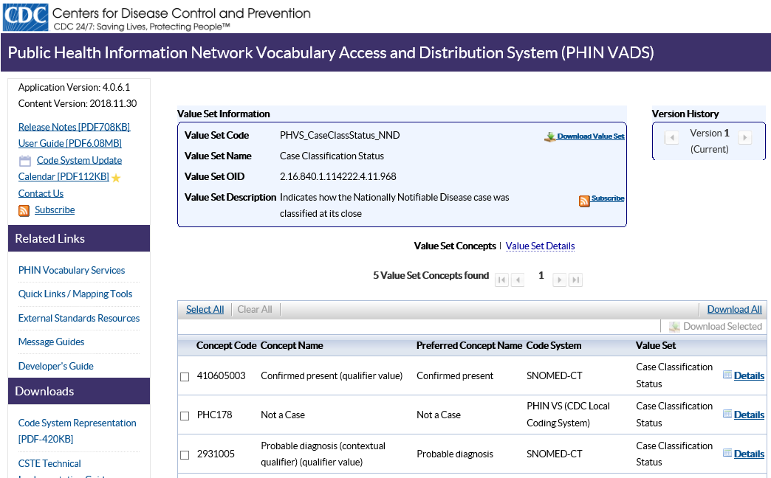
PHIN Vocabulary Access and Distribution System (VADS)
https://phinvads.cdc.gov/

Slide 34
PHIN Vocabulary Access and Distribution System (VADS)
This is not the OID you’re looking for.
https://phinvads.cdc.gov/

Slide 35
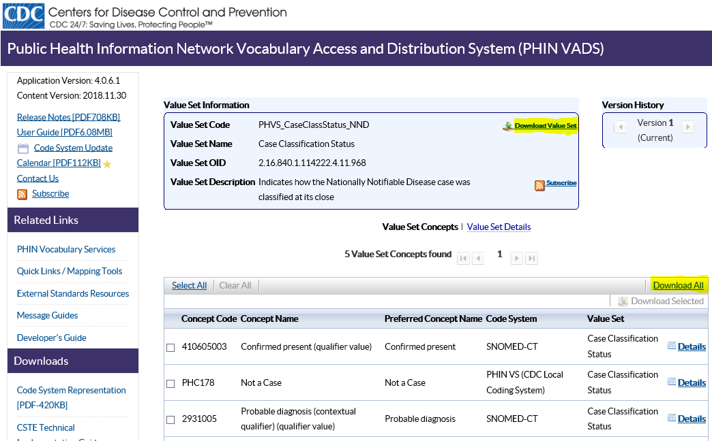
Download PHIN VADS Value Set

Slide 36
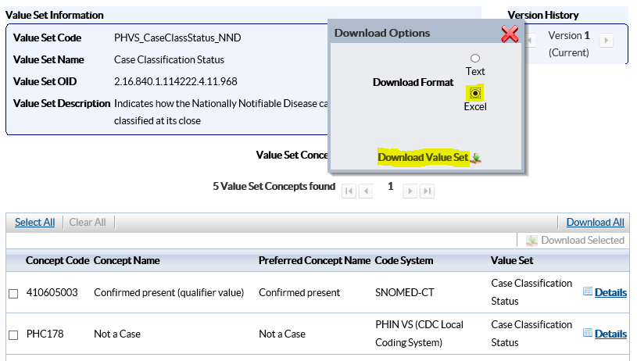
Download PHIN VADS Value Set

Slide 37
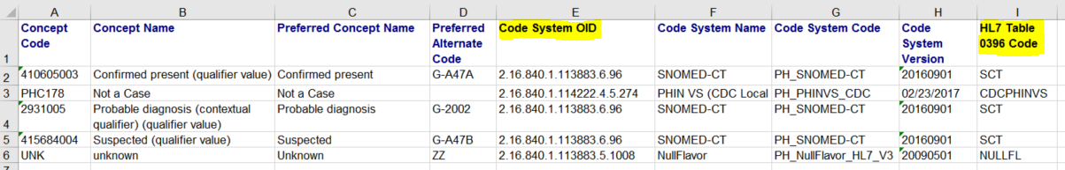
Coding System Code for PHIN VADS Value Set
OBX|1|CWE|77990-0^Case Class Status Code^2.16.840.1.113883.6.1||410605003^Confirmed Present^2.16.840.1.113883.6.96||||||F
or
OBX|1|CWE|77990-0^Case Class Status Code^LN||410605003^Confirmed Present^SCT||||||F

Slide 38

Questions and Answers

Slide 39
Subscribe to monthly NMI Notes news updates at
https://www.cdc.gov/nndss/trc/news/
Access the NNDSS Technical Resource Center at
https://www.cdc.gov/nndss/trc/
Request NNDSS technical assistance or onboarding at
edx@cdc.gov
Next NMI eSHARE on Arboviral v1.3 MMG Implementation
is March 4, 2019 – details coming soon

