Slide 1
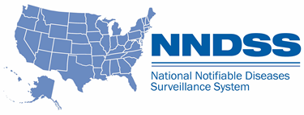
NNDSS Modernization Initiative (NMI): NNDSS Changes Resulting from CSTE Positions Statements and Implications for Sending Case Notifications
Access the NNDSS Technical Resource Center at
https://www.cdc.gov/nndss/trc/
Subscribe to monthly NMI Notes news updates at
https://www.cdc.gov/nndss/trc/news/
January 15, 2019 Division of Health Informatics and Surveillance

Slide 2
Agenda
Welcome and Announcements
NMI 2018 Accomplishments and 2019 Plans
Highlights from the 2019 Letter to State Epidemiologists
2019 Event Code List Updates
MMG Value Set Updates
Questions and Answers

Slide 3
NMI 2018 Accomplishments and 2019 Plans
Lesliann Helmus, MSPH, CHTS-CP
Associate Director for Surveillance
Michele Hoover, MS
Lead, State Implementation and Technical Assistance

Slide 4
NMI Implementation Status Jan 1, 2018
NH
WA
MT
VT
ME
AK
ND
MN
OR
NY
MA
ID
SD
WI
RI
WY
MI
CT
IA
PA
NJ
NYC
CA
NE
OH
DE
HI
NV
IL
IN
WV
UT
VA
DC
MD
CO
KS
MO
KY
NC
TN
OK
AR
SC
AZ
NM
MS
AL
GA
TX
LA
Piloting Total of 4 (states)
FL
PR
Onboarding Total of 5 (4 states + NYC)
Production Total of 20 (states)

Slide 5
NMI Implementation Status Jan 1, 2019
NH
WA
VT
ME
AK
MT
ND
MN
OR
NY
MA
ID
SD
WI
RI
WY
MI
CT
IA
PA
NJ
NYC
CA
NE
OH
DE
HI
NV
IL
IN
WV
UT
VA
DC
MD
CO
KS
MO
KY
NC
TN
OK
AR
SC
AZ
NM
MS
AL
GA
TX
LA
Piloting Total of 1 (states)
FL
PR
Onboarding Total of 7 (states)
Production Total of 32 (31 states + NYC)

Slide 6
Production Status
Message Mapping Guides (MMGs) | In Production | States in Production
Arboviral v1.3 | 15 | AR, AZ, DE, FL, ID, MD, ND, NE, NY, OR, RI, SD, TN, TX, WI
Gen v2 | 21 | AK, AL, CA, CO, DE, FL, IA, ID, IL, KS, MA, MI, MN, MS, NY, NYC, OR, SC, UT, VA, WI
Hepatitis | 14 | AK, AL, FL, ID, LA, MA, MI, MN, NY, OR, TN, VA, WI, WV
Total # of Individual States | 32 | AK, AL, AR, AZ, CA, CO, DE, FL, IA, ID, IL, KS, LA, MA, MD, MI, MN, MS, ND, NE, NY, NYC, OR, RI, SC, SD, TN, TX, UT, VA, WI, WV
Note: States colored GREEN were approved for production during 2018.
01/15/19

Slide 7
Onboarding Status
Message Mapping Guides (MMGs) | Onboarding | States Onboarding
Arboviral v1.3 | 5 | IL, MS, PA, UT, WA
Gen v2 | 5 | AZ, CT, GA, IN, NJ
Hepatitis | 2 | IN, SC
STD | 4 | ID, MI, NC, OR
Congenital Syphilis | 4 | ID, MI, NC, OR
Mumps | 1 | UT
Pertussis | 1 | UT
Varicella | 1 | UT
Total # of Individual States | 15 | AZ, CT, GA, ID, IL, IN, MI, MS, NC, NJ, OR, PA, SC, UT, WA
01/15/19

Slide 8
Piloting Status
Message Mapping Guides (MMGs) | Piloting | States Piloting
FDD | 5 | FL, MI, MN, NY, OR
TB/LTBI | 4 | AZ, CT, GA, OR
Malaria | 2 | FL, MI
Trichinellosis | 3 | FL, MI, WI
Babesiosis | 4 | CT, FL, MI, WI
RIBD | 3 | GA, KS, OR
Total # of Individual States | 10 | AZ, CT, FL, GA, KS, MI, MN, NY, OR, WI
1/15/19

Slide 9
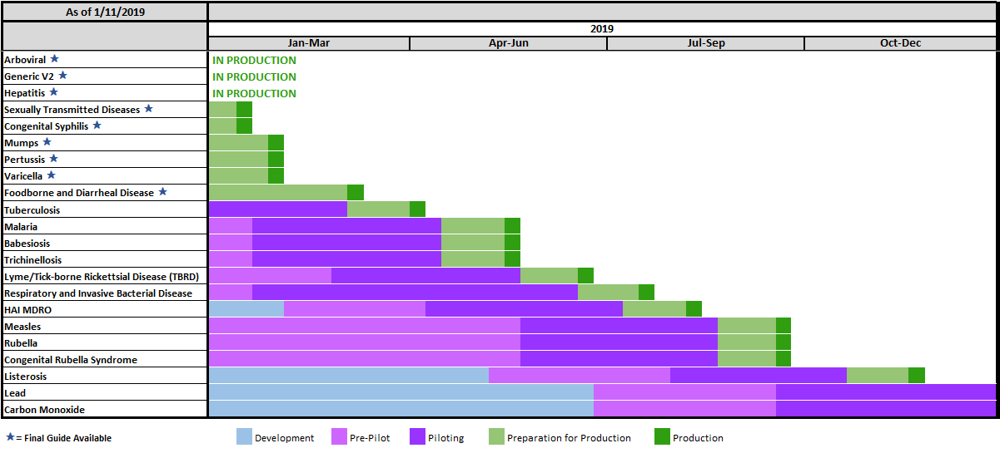
NNDSS HL7 Message Mapping Guide Estimated Timeline

Slide 10
Highlights from the 2019 Letter to State Epidemiologists
Ruth Jajosky, DMD, MPH
Center for Surveillance, Epidemiology and Laboratory Services
Centers for Disease Control and Prevention
Notes:
The State Epi letter is not just for State Epidemiologists. It is meant to be shared with all the surveillance and informatics staff in each jurisdiction. The letter is posted on the “Downloads and Resources’ page of the NNDSS web site, so everyone has easy access to the letter.

Slide 11
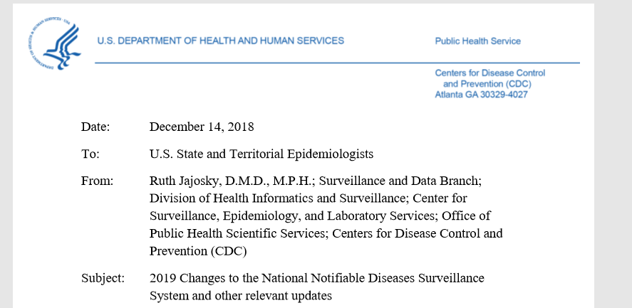
2019 Letter to State Epidemiologists
The 2019 State Epi Letter was distributed on 12/18/18.
The full letter can be found on the NNDSS Event Codes & Other Surveillance Resources webpage.
Annual NNDSS Event Code Lists available at https://ndc.services.cdc.gov/event-codes-other-surveillance-resources/.

Slide 12
2018 CSTE Position Statements to be Implemented in 2019
Nine position statements were approved:
One new nationally notifiable disease (Candida auris, clinical)
Case definition revisions for 7 nationally notifiable diseases:
Carbon monoxide poisoning
Diphtheria
Hepatitis A viral infection, acute
Salmonella Typhi infection and Salmonella Paratyphi infection
Yellow fever
Listeriosis -- CSTE incurred a delay in finalizing this position statement, hence there will be a delay in implementing this position statement
Two conditions were placed under standardized surveillance, but not designated nationally notifiable: Candida auris, colonization/screening; Respiratory syncytial virus-associated mortality.
One condition placed under standardized surveillance for which only FoodNet sites are requested to send data to CDC (Yersiniosis, non-pestis).
Notes:
This slide is a high-level overview of the position statements approved in 2018. On the next slides, I will mention some notable information related to selected position statements.

Slide 13
Changes in 2019 (1 of 6)
Candida auris, clinical (18-ID-05)
Position statement 18-ID-05 updates the consensus case definition CSTE approved in 2017 (17-ID-03) to reflect changes in performance characteristics of laboratory tests used to identify C. auris.
Pending Office of Management and Budget Approval (OMB PRA) in early 2019; Generic v2 MMG will be used until a disease-specific MMG is available.
New event code for MMWR year 2019 = 50263
Retired event code at the end of MMWR year 2018 = 50243
Carbon Monoxide (CO) Poisoning (18-EH-01)
Revises four tiers of surveillance activities to two tiers and provides case definitions for the tiers
Tier 1 refers to the process of healthcare providers or institutions submitting basic information about cases of CO poisoning to governmental agencies.
Cases may also be identified by secondary analysis of administrative or syndromic surveillance algorithms where individual information is available for follow-up.
Tier 2 is based upon secondary analysis of administrative data without access to personal identifiers.
Pending Office of Management and Budget Approval (OMB PRA) in early 2019; Generic v2 MMG will be used until a disease-specific MMG is available.
New event code for MMWR year 2019 = 32016
Notes:
Note that event codes that are retired at the end of a year, such as 2018, can continue to be reported for that year, but cannot be used to report cases in the next year, such as 2019

Slide 14
Changes in 2019 (2 of 6)
Diphtheria (18-ID-03)
Case definition describes confirmed and suspect case classifications (there is no longer a probable category).
Toxin-producing C. diphtheriae cases from any anatomic site should be reported to CDC as confirmed.
Cases of lab-confirmed non-toxin producing C. diphtheriae (respiratory or non-respiratory) should not be reported as diphtheria cases.
Negative lab results may be sufficient to rule-out a diagnosis of diphtheria; however, clinicians should carefully consider any potential impact of antimicrobial treatment on lab results, the patient’s vaccination status, and recent travel to a country with endemic diphtheria in assessing the likelihood of toxin-producing C. diphtheriae.
PCR and matrix assisted laser desorption/ionization-time of flight mass spectrometry (MALDI-TOF) diagnostics for C. diphtheriae, when used alone, do not confirm toxin production. These tests should always be combined with a test that confirms toxin production, such as the Elek test.

Slide 15
Changes in 2019 (3 of 6)
Hepatitis A, acute (18-ID-07)
Modifies the national surveillance case definition by incorporating nucleic amplification tests into the laboratory criteria.
The 2012 case definition (based upon 11-ID-02) included only IgM antibody to hepatitis A as the laboratory criteria.
2019 lab criteria include an IgM antibody to hepatitis A and nucleic amplification tests.
Yellow fever (18-ID-04)
The revision addresses changes in diagnostic testing and the possible occurrence of yellow fever vaccine-associated viscerotropic disease.
Request for immediate notification has been removed; now designated routinely notifiable.

Slide 16
Changes in 2019 (4 of 6)
S. Typhi infection (18-ID-08)
Represents an infection with Salmonella enterica serotype Typhi.
Confirmed cases require isolation of the S. Typhi organism from a clinical specimen.
Probable cases require clinically compatible illness in a person with either presumptive laboratory evidence or with a epi linkage.
Presumptive laboratory evidence is based upon detection of the organism using culture-independent diagnostic tests.
New event code for MMWR year 2019 for S. Typhi infection = 50267
Retired event code at the end of MMWR year 2018 for Typhoid fever (caused by S. Typhi) = 10240

Slide 17
Changes in 2019 (5 of 6)
S. Paratyphi infection (18-ID-08)
Classifies infection with Salmonella enterica serotypes Paratyphi A, B (tartrate negative) and C as S. Paratyphi infection rather than salmonellosis.
Confirmed cases require isolation of the S. Paratyphi organism from a clinical specimen.
Probable cases require clinically compatible illness in a person with either presumptive laboratory evidence or with a epi linkage.
Presumptive laboratory evidence is based upon detection of the organism using culture-independent diagnostic tests.
New event code for MMWR year 2019 for S. Paratyphi infection = 50266
New event code for MMWR year 2019 for Salmonellosis (excluding S. Paratyphi infection and S. Typhi infection) = 50265
Retired event code for MMWR year 2018 for Paratyphoid fever (caused by Salmonella serotypes Paratyphi A, B [tartrate negative] and C) = 50236
Retired event code for MMWR year 2018 for Salmonellosis (excluding paratyphoid fever and typhoid fever) = 50242

Slide 18
Changes in 2019 (6 of 6)
Conditions under standardized surveillance:
Candida auris, colonization/screening
CDC Program is interested in receiving data for this condition
Submitted OMB PRA request to receive data for this condition
New event code for MMWR year 2019 = 50264
Respiratory Syncytial Virus-Associated Mortality
CDC Program is interested in receiving data for this condition
Submitted OMB PRA request to receive data for this condition
New event code for MMWR year 2019 = 11646

Slide 19
2019 NNDSS Event Codes List Updates
Andreea Bealle, MPH
Center for Surveillance, Epidemiology and Laboratory Services
Centers for Disease Control and Prevention

Slide 20
2019 Retired NNDSS Event Codes
Retired Event Name | Retired Event Code | Date Retired | Current Event Name | Current Event Code | Type of Surveillance
Paratyphoid fever (caused by Salmonella serotypes Paratyphi A, Paratyphi B [tartrate negative], and Paratyphi C | 50236 | 12/31/2018 | Salmonella enterica serotypes Paratyphi A, B (tartrate negative) and C (S. Paratyphi) infection | 50266 | NNDSS
Typhoid fever (caused by Salmonella Typhi) | 10240 |  | Salmonella enterica Typhi (S. Typhi) infection | 50267 | NNDSS
Salmonellosis (excluding paratyphoid fever and typhoid fever) | 50242 |  | Salmonellosis (excluding S. Typhi infection and S. Paratyphi infection) | 50265 | NNDSS
Candida auris | 50243 | 12/31/2018 | Candida auris, clinical* | 50263 | NNDSS
 |  |  | Candida auris, colonization/screening* | 50264 | SS
Acute carbon monoxide poisoning | 32015 | 12/31/2018 | Carbon Monoxide Poisoning* | 32016 | NNDSS
*Please do not transmit data for condition until CDC has received Office of Management and Budget approval.
Notes:
SS meaning under standardized surveillance
NNDSS meaning nationally notifiable

Slide 21
Changes to NNDSS Event Codes, as of January 2019
Code | Condition | Changes | Type of Surveillance
11565 | Yersiniosis (non-pestis) | Added (non-pestis) to the condition name; new case definition | EIP only
11646 | Respiratory Syncytial Virus-Associated Deaths* | Condition under standardized surveillance; new case definition | SS
10040 | Diphtheria | Updated print criteria to confirmed (removed probable and unknown); case definition revision | NNDSS
10660 | Yellow fever | The request for immediate notifications has been removed; case definition revision | NNDSS
10110 | Hepatitis A, acute | Added case definition revision, 2019 to the notes; case definition revision | NNDSS
In Support of Message Mapping Guides
50120 | Carbapenem-resistant Enterobacteriaceae (CRE) | Healthcare-associated Infections of Multi-Drug Resistant Organism MMG | EIP only
50244 | Carbapenemase-producing carbapenem-resistant Enterobacteriaceae (CP-CRE) * | Healthcare-associated Infections of Multi-Drug Resistant Organism MMG | NNDSS
50260 | Carbapenem Resistant Acinetobacter baumannii (CRAB) | Healthcare-associated Infections of Multi-Drug Resistant Organism MMG | EIP only
50261 | Neonatal sepsis | Respiratory and Invasive Bacterial Diseases MMG | EIP only
50259 | Streptococcal disease, invasive, group A | Respiratory and Invasive Bacterial Diseases MMG | EIP only
50260 | Streptococcal disease, invasive, group B | Respiratory and Invasive Bacterial Diseases MMG | EIP only
11566 | Enterotoxigenic E.coli (ETEC) | FDD MMG | EIP only
*Please do not transmit data for condition until CDC has received Office of Management and Budget approval.
Notes:
EIP meaning Emerging Infection Program sites

Slide 22
MMG Value Set Updates
Bill Morrill
Center for Surveillance, Epidemiology and Laboratory Services
Centers for Disease Control and Prevention

Slide 23
Recent Updates to Finalized MMG Value Sets
Value set updates to the Generic v2.0 MMG (impacts all messages):
Birth Country, Country, and County
Case Transmission Mode: Added “Droplet transmission”
Condition-specific value sets for Final guides:
VPD guides (Mumps, Pertussis, Varicella)
Manufacturers of vaccines: Updated to reflect Immunization Program’s list
Case Detection Method: Added “Laboratory Reported”
Lab Test Interpretation: Added “Vaccine type strain" and “Wild type strain"
Complications (Mumps): Added "Oophoritis", "Mastitis", and "Pancreatitis"
Arboviral v1.3
Virus Type: Added Bourbon virus, Alkhurma virus, and Heartland virus
Lab Test Type: Added Arboviral antigen
MMGs available on the NNDSS Technical Resource Center at https://ndc.services.cdc.gov/message-mapping-guides/.

Slide 24
Implications for Sending Case Notifications
Use new event codes for all 2019 cases.
For 2018 cases, continue to use 2018 event codes.
Jurisdictions should update surveillance systems with updated value sets.
For each MMG published on the HL7 Resource Center, the “PHIN VADS links to the case notification views” link displays all of the updated value sets for a condition.

Slide 25
Questions and Answers

Slide 26
Subscribe to monthly NMI Notes news updates at https://www.cdc.gov/nndss/trc/news/
Access the NNDSS Technical Resource Center at
https://www.cdc.gov/nndss/trc/
Request NNDSS technical assistance or onboarding at
edx@cdc.gov
Next NNDSS eSHARE is February 19, 2019 – details to come at
https://www.cdc.gov/nndss/trc/onboarding/eshare.html

