Slide 1
NNDSS Modernization Initiative (NMI): Implementation Spreadsheet Updates, STD and CS MMG Refresher, and Walkthrough of MVPS Dashboard Enhancements
Access the NNDSS Technical Resource Center at
https://www.cdc.gov/nndss/trc/
Subscribe to monthly NMI Notes news updates at
https://www.cdc.gov/nndss/trc/news/
October 16, 2018 Division of Health Informatics and Surveillance

Slide 2
Agenda
Welcome and Announcements
Updates: Implementation Spreadsheet
Natalie Raketich, APHL
STD and CS MMG Refresher on Implementing HL7 Case Notification Messages
Mark Stenger, Division of STD Prevention, National Center for HIV/AIDS, Viral Hepatitis, STD, and TB Prevention (NCHHSTP), CDC
Walkthrough of MVPS Dashboard Enhancements
Andrew Kuehl and Jay Schroeder, CDC
Questions and Answers

Slide 3
NMI Progress and Timeline
Lesliann Helmus, MSPH, CHTS-CP
Associate Director for Surveillance
Michele Hoover
Lead, State Implementation and Technical Assistance

Slide 4
NMI Implementation Status Oct 16, 2018
NH
WA
VT
ME
AK
MT
ND
MN
OR
NY
MA
ID
SD
WI
RI
WY
MI
CT
IA
PA
NJ
NYC
CA
NE
OH
DE
HI
NV
IL
IN
WV
UT
VA
DC
MD
CO
KS
MO
KY
NC
TN
OK
AR
SC
AZ
NM
MS
AL
GA
TX
LA
Piloting Total of 2 (states)
FL
PR
Onboarding Total of 4 (states)
Production Total of 31 (30 states + NYC)

Slide 5
Onboarding Status
Message Mapping Guides (MMGs) | Onboarding | States Onboarding | In Production | States in Production
Arboviral v1.3 | 5 | IL, MS, NE, UT, WA | 14 | AR, AZ, DE, FL, ID, MD, ND, NY, OR, RI, SD, TN, TX, WI
Gen v2 | 3 | AL, GA, NH | 19 | AK, CA, CO, DE, FL, IA, ID, IL, KS, MA, MI, MN, MS, NY, NYC, OR, SC, UT, WI
Hepatitis | 4 | CA, MA, SC, WI | 12 | AK, AL, FL, ID, LA, MI, MN, NY, OR, TN, VA, WV
STD | 2 | MI, OR
Congenital Syphilis | 2 | MI, OR
Total # of Individual States | 14 | AL, CA, GA, IL, MA, MI, MS, NE, NH, OR, SC, UT, WA, WI | 31 | AL, AK, AR, AZ, CA, CO, DE, FL, IA, ID, IL, KS, LA, MA, MD, MI, MN, MS, ND, NY, NYC, OR, RI, SC, SD, TN, TX, UT, VA, WI, WV
10/16/18

Slide 6
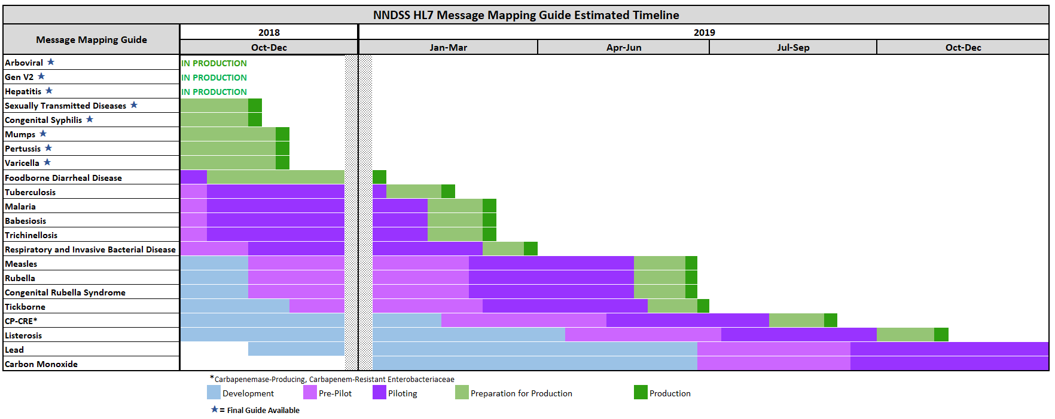
text

Slide 7
Updated Implementation Spreadsheets
Natalie Raketich, MPH
APHL NMI Technical Assistance Terminologist

Slide 8
One-Stop Shop
Implementation Spreadsheet
Gen v2 MMG
Condition-specific MMG
Case Notification Message Structure Specification/Profile
State Case Reporting Forms and Mappings to Surveillance System Fields

Slide 9
NMI Implementation Process and Tools
Data Fields
Date of Birth
MMG Fields
DEM115:Birthdate
DEM152: Race Category
PID|1||5276074529^^^MDCH&2.16.840.1.114222.4.1.3660&ISO||~^^^^^^S||19600101|F||2106-3^Caucasian^CDCREC~1002-5^American Indian^CDCREC|^^ANN ARBOR^26^48105^USA^^^26161|||||||||||2135-2^Hispanic or Latino^CDCREC|||||||20141031
Race
Ethnicity
DEM113: Subject’s Sex
Gender
DEM155: Ethnic Group
....
....
Surveillance System
Implementation Spreadsheet
HL7 Text File

Slide 10
Implementation Spreadsheet Updates
Formerly, all Gen v2 MMGs consolidated
Now broken into separate, MMG-specific docs
Gen V2 elements still included in each MMG-specific version

Slide 11
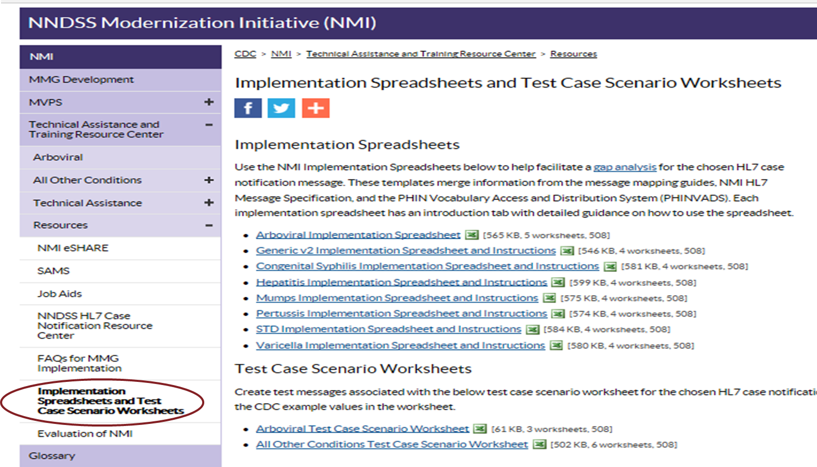
Implementation Spreadsheet Updates
Formerly, all Gen v2 MMGs consolidated

Slide 12
Gen V2 elements
Complete Gen v2 elements in the Gen v2 implementation spreadsheet
“Default” Gen v2 entries
Complete Gen v2 elements in condition-specific implementation spreadsheets if:
Differences from Gen v2 elements for this condition/condition family
Jurisdiction’s first Gen v2 MMG implementation

Slide 13
Gen V2 Implementation Spreadsheet

Slide 14
MMG-specific Implementation Spreadsheet

Slide 15
Tabs/Content
Read Me
Introduction and Instructions
Datatypes
Provides Datatype definitions as specified in the PHIN Messaging Guide for Case Notification_v3.0
Compiles segment definition tables and MMG-specified data elements
Revision Log
Tab Descriptions
Column Descriptions
Provides a history of changes made to the implementation template
Condition/MMG
Provides space for jurisdictions to document gap analysis and mappings

Slide 16
Implementation Spreadsheet
Required for CDC onboarding
Column AA = Required
Column AB = Conditionally required

Slide 17
Column AA = Required

Slide 18
Column AB = Conditionally Required
If PHA Collected = Only certain conditions
Examples:
Hep B Acute only
Only collected during…
Local question captures…
Will only send when response is Yes, do not collect No or Unknown

Slide 19
NMI Technical Assistance Overview
NMI TA provides both onsite and remote support to public health agencies (PHAs) to implement HL7 case notifications. The TA team offers expertise in HL7 messaging, vocabulary and integration engines, and transport utilities.
Project management and business analysis: Identify needed resources, risks, and dependencies for electronic messaging.
Data standards expertise and workflow analysis: Work closely with PHA surveillance and IT staff to harmonize surveillance system terminology to incorporate data standards.
Technical architecture expertise: Develop and implement technical solutions that address data exchange needs.

Slide 20
Onboarding STD and Congenital Syphilis Message Mapping Guides – We’re Finally Here!!
Surveillance and Data Management Branch
Division of STD Prevention
NMI eSHARE Call – October 16, 2018

Slide 21
Key Implementation Points – STD & CS MMGs
For reporting purposes using the congenital syphilis MMG, the ‘infant’ is the patient reported in the core GenV2 part of the record
maternal and infant modifiers for lab data variables are available in the CS MMG to indicate source of laboratory data
Addition of provisionally approved sexual orientation and gender identity (SOGI) variables
Programs are strongly encouraged to report SOGI if available in local surveillance data for OMB evaluation/renewal

Slide 22
Key Implementation Points – STD and CS MMGs
Multiple anatomic sites of infection for chlamydia and gonorrhea should be reported using the laboratory interpretive repeating group, this allows multiple laboratory findings for the condition being reported.
The Specimen Source (LAB165) is needed for gonorrhea and useful for chlamydia.
For syphilis, coded titers are preferred – in addition to the qualitative results.
For gonorrhea, an antimicrobial susceptibility repeating group has been added.
Use of the lab template is optional for the STD & CS MMGs.

Slide 23
Key Implementation Points – Onboarding
STD Program would like jurisdictions to document all data element mapping in their onboarding spreadsheets, especially recoding from local values to PHIN VADS vocabularies
Jurisdictions should be sure to include their state STD program in the onboarding meetings, mapping, gaps analysis and testing
CDC STD Program SMEs will be available throughout the onboarding process

Slide 24
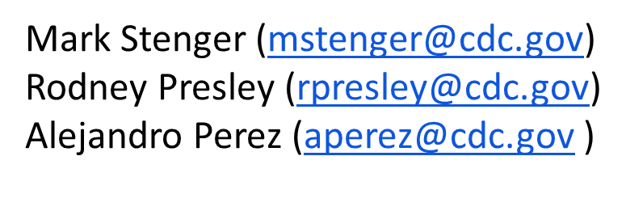

Slide 25
Walkthrough of MVPS Dashboard Enhancements
Andrew Kuehl, MIT, PMP
MVPS Project Lead
Jay Schroeder, MBA, PMP, TOGAF, PSM
MVPS Requirements Lead

Slide 26
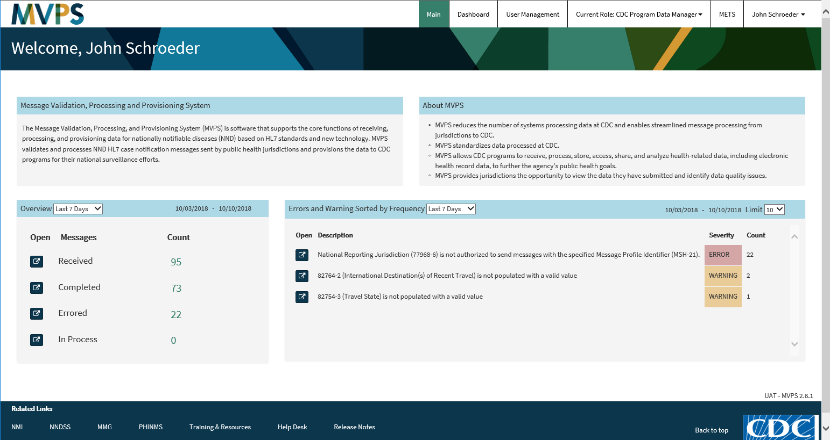
t

Slide 27
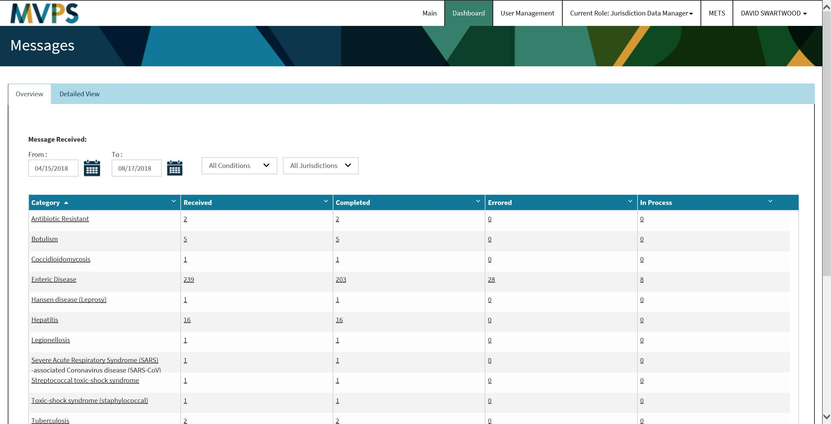
test

Slide 28
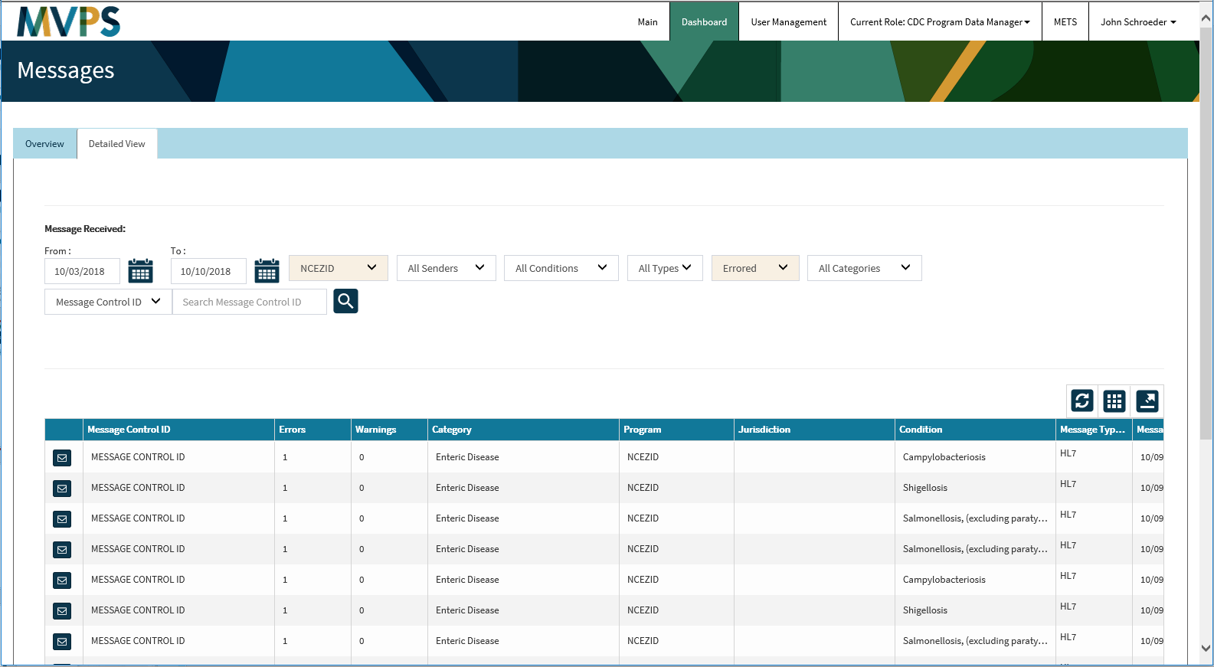
t

Slide 29
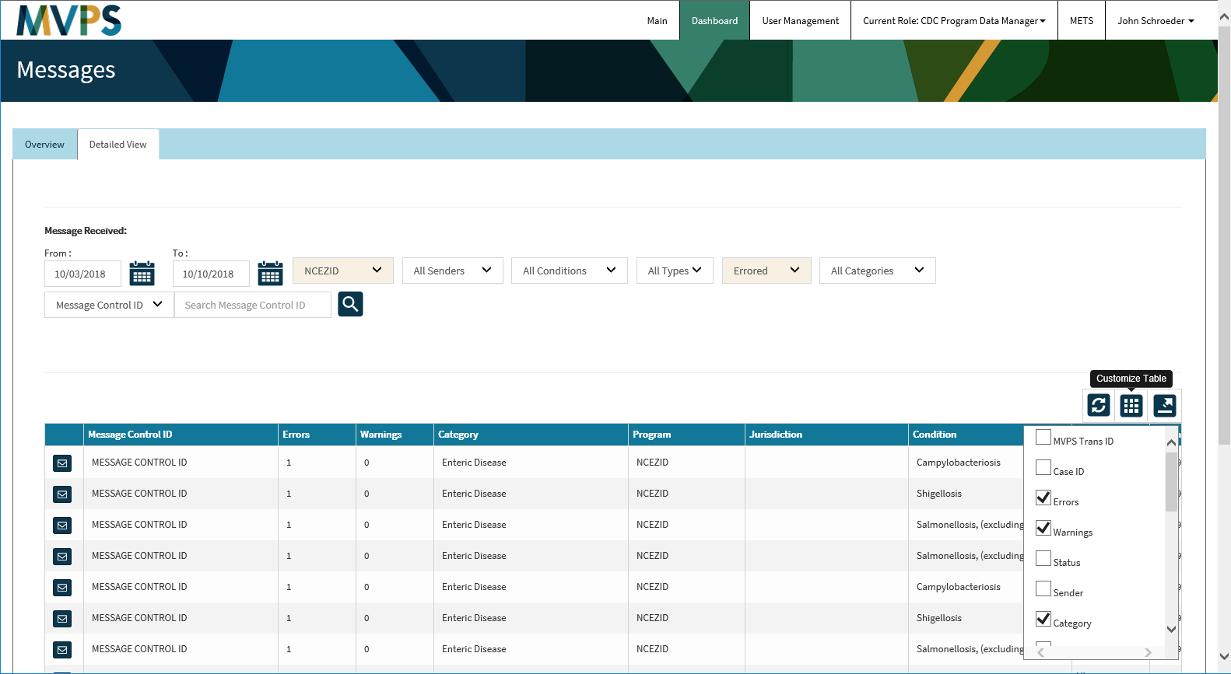
t

Slide 30
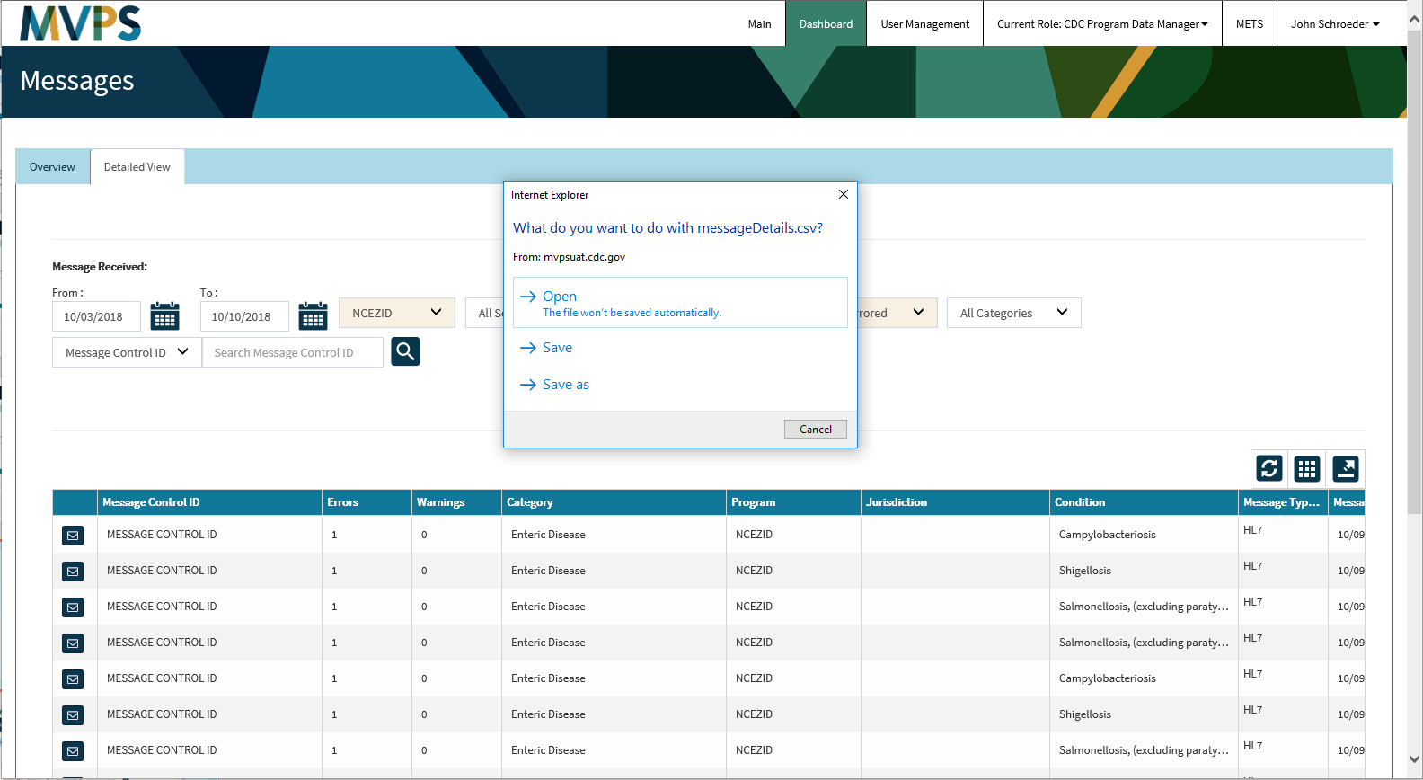
t

Slide 31
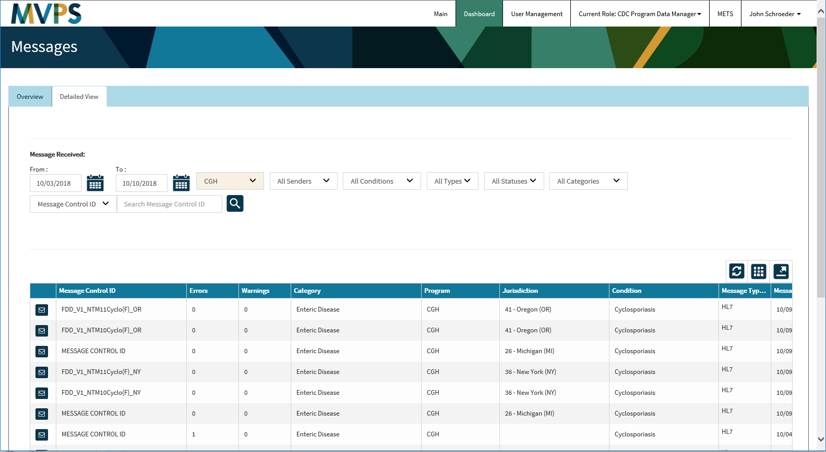
t

Slide 32
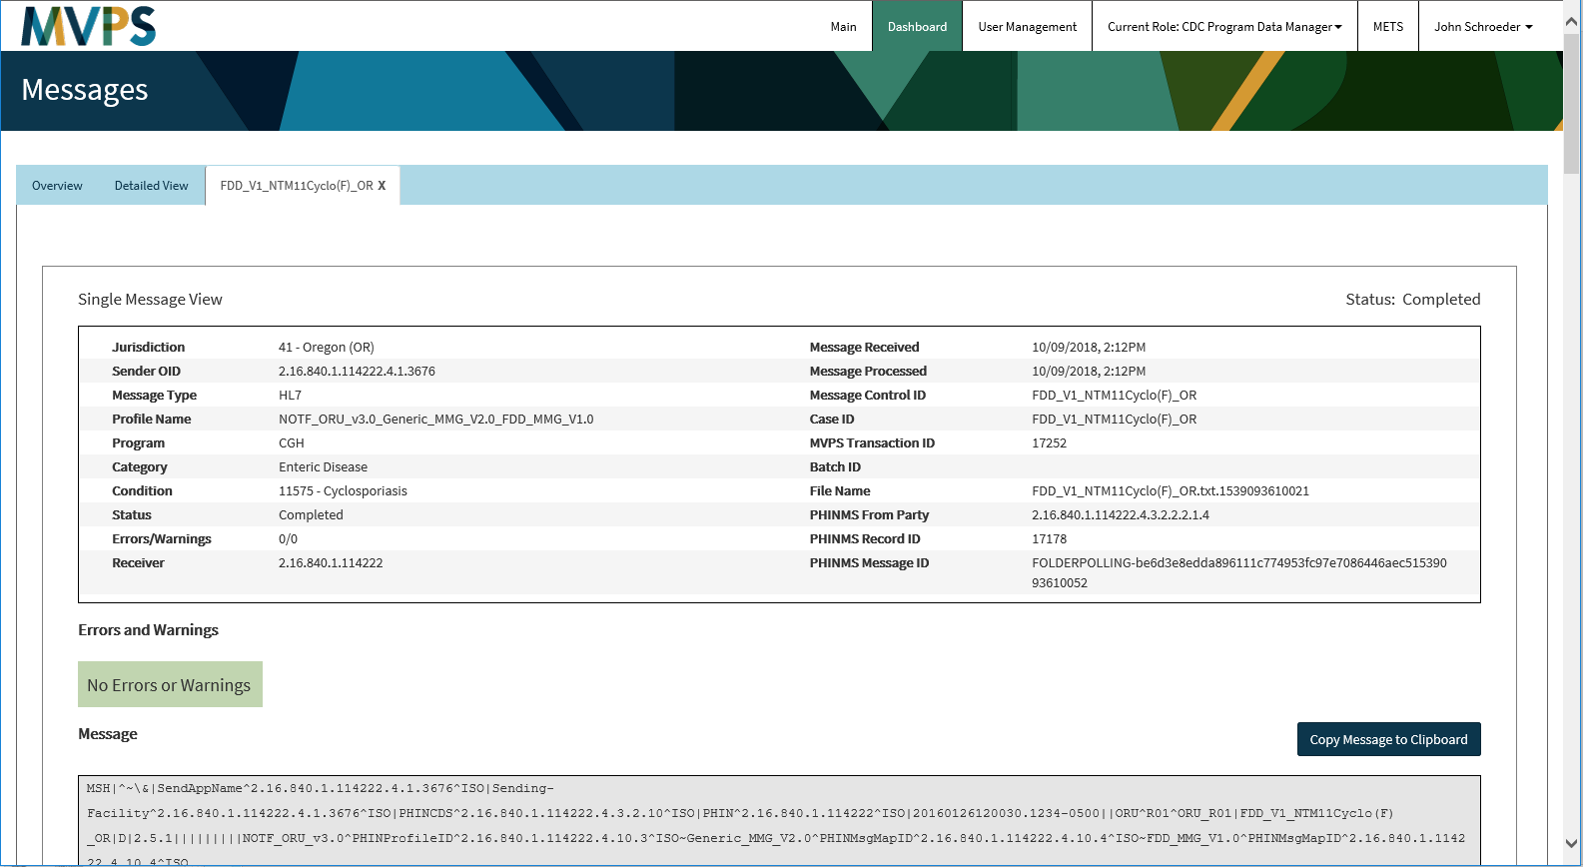
t

Slide 33
t

Slide 34
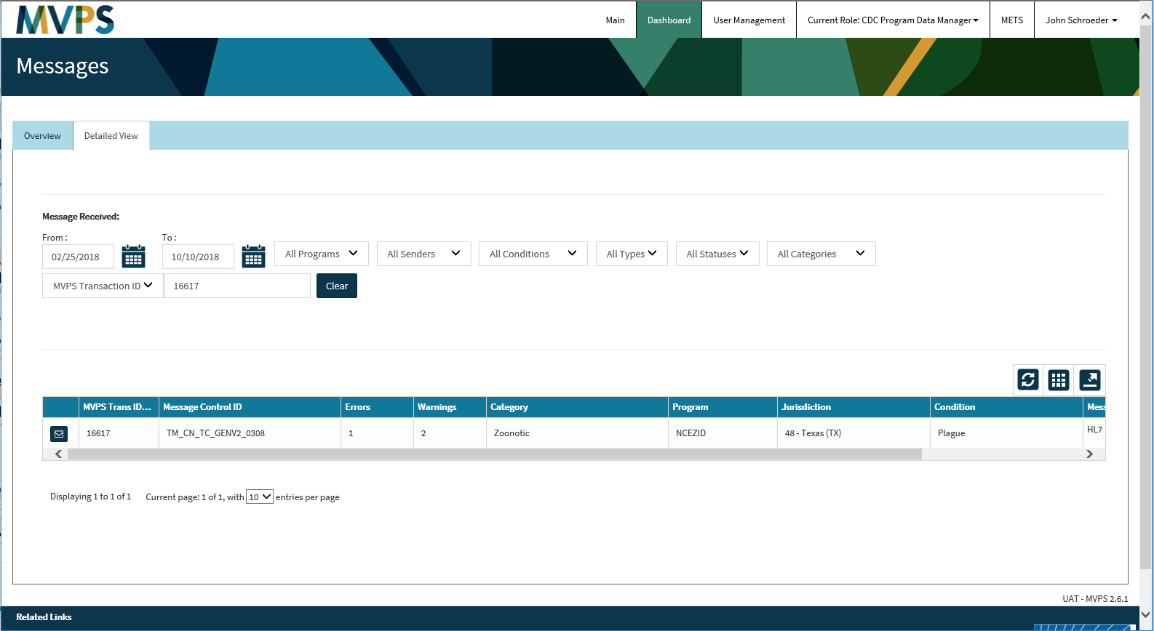
t

Slide 35
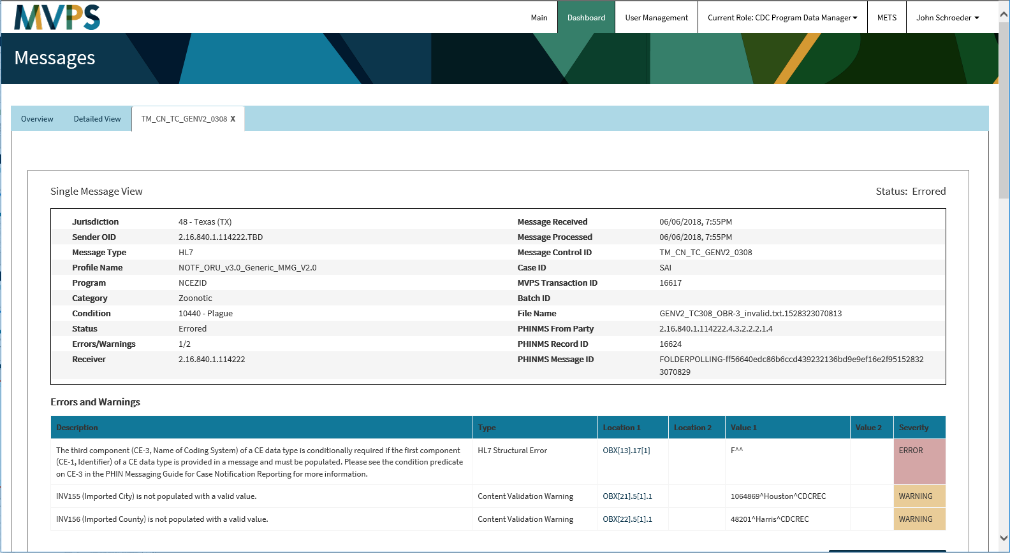
t

Slide 36
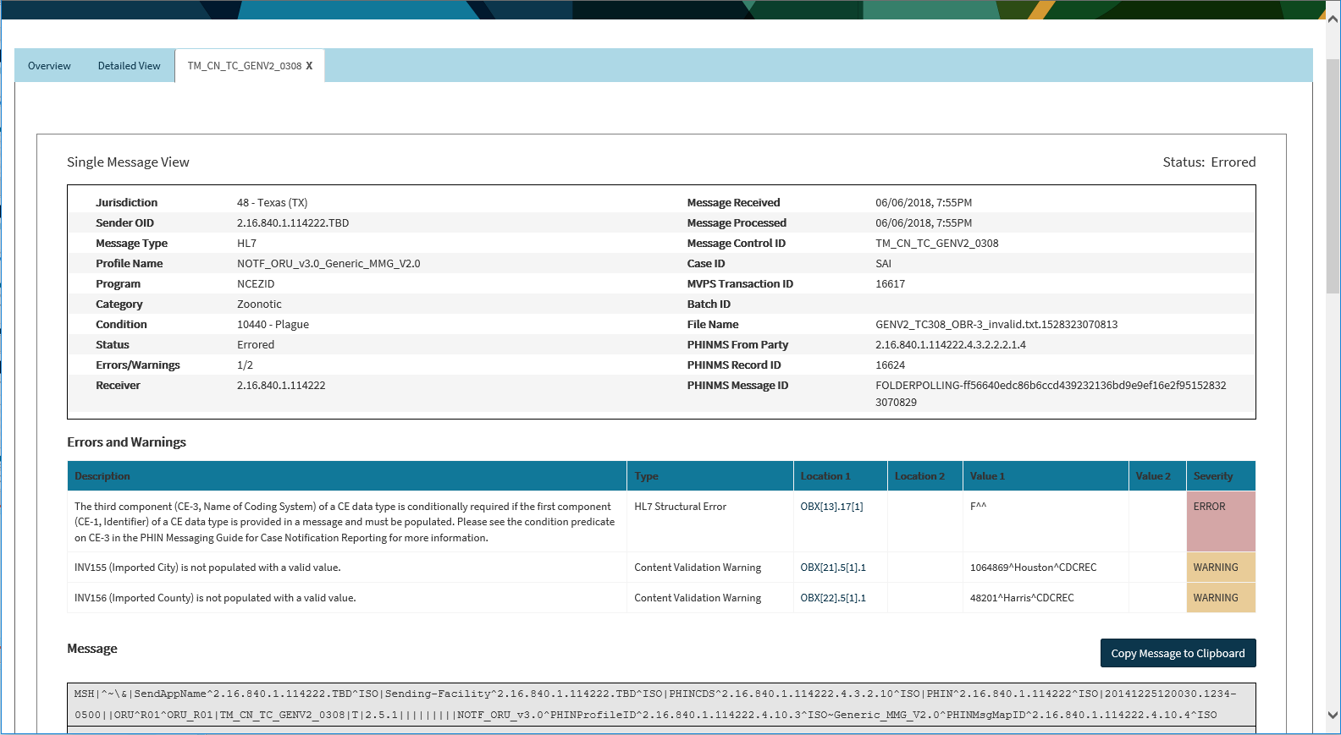
t

Slide 37
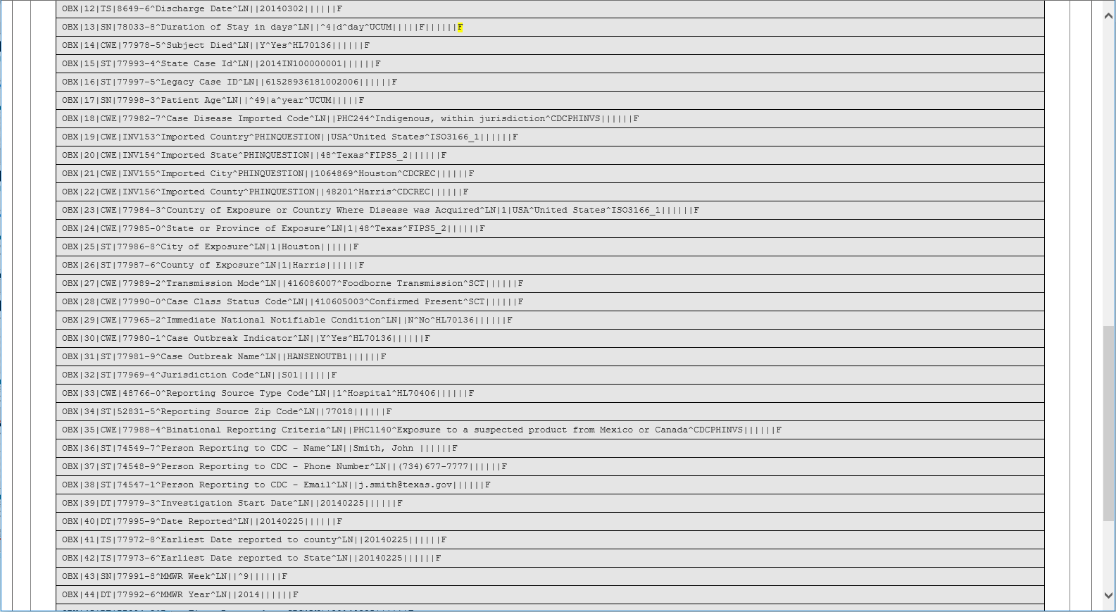
t

Slide 38
t

Slide 39
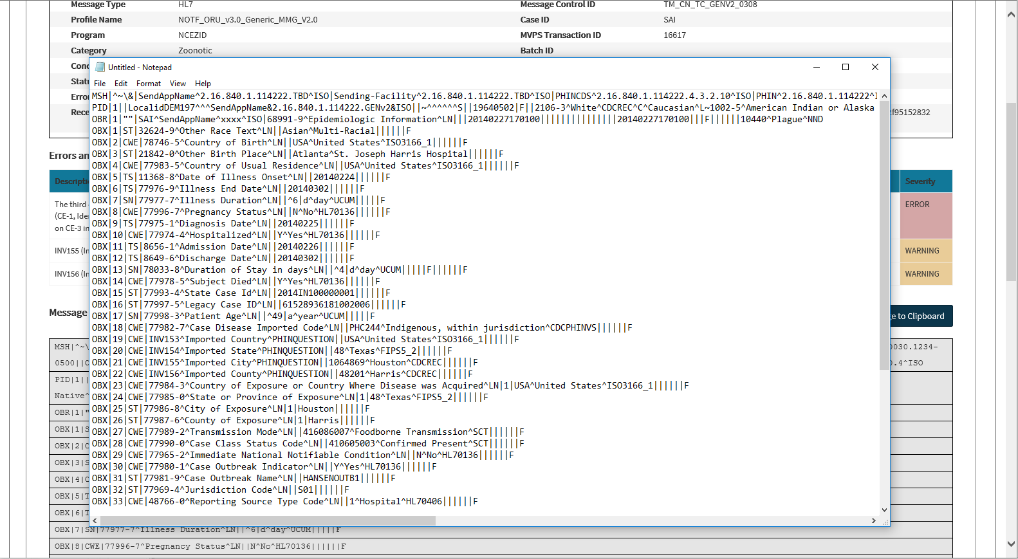
t

Slide 40
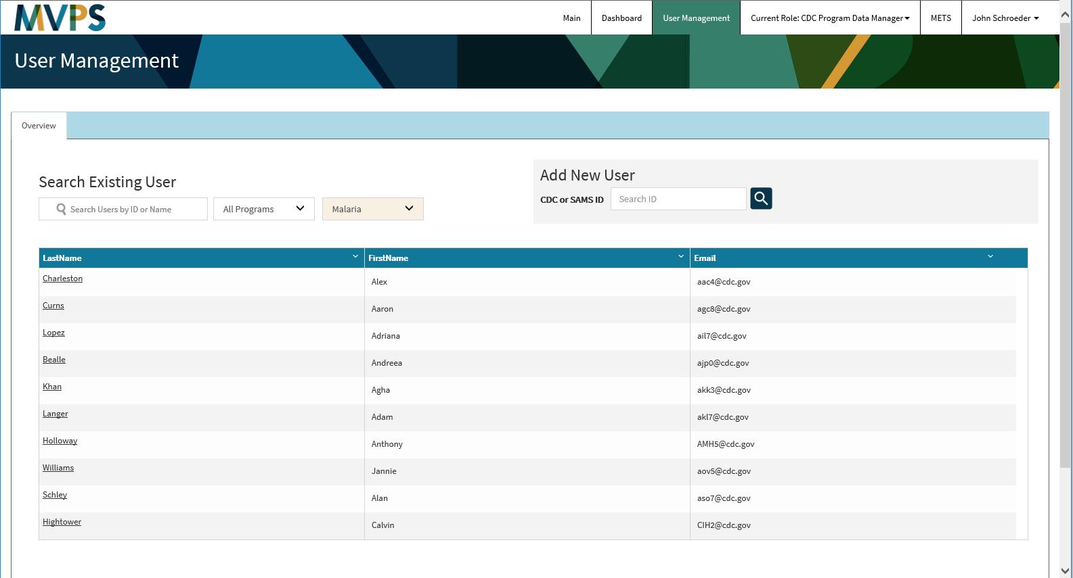
t

Slide 41
t

Slide 42
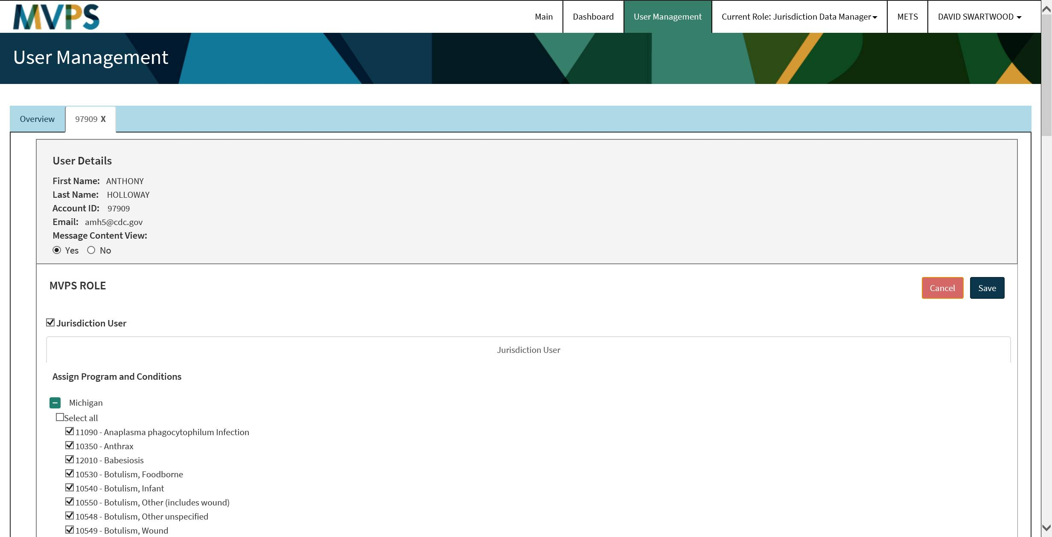
t

Slide 43
Questions and Answers

Slide 44
Subscribe to monthly NMI Notes news updates at https://www.cdc.gov/nndss/trc/news/
Access the NNDSS Technical Resource Center at
https://www.cdc.gov/nndss/trc/
Request NNDSS technical assistance or onboarding at
edx@cdc.gov
Next NNDSS eSHARE is November 27, 2018 – details to come at
https://www.cdc.gov/nndss/trc/onboarding/eshare.html

