Slide 1

NNDSS Modernization Initiative (NMI): Highlights from 2018 PHI Conference and Walkthrough of the New Technical Assistance and Training Resource Center
Access the NNDSS Technical Resource Center at
https://www.cdc.gov/nndss/trc/
Subscribe to monthly NMI Notes news updates at
https://www.cdc.gov/nndss/trc/news/
September 18, 2018 Division of Health Informatics and Surveillance

Slide 2

Agenda
Welcome and Announcements
NNDSS Highlights from the 2018 PHI Conference
  Laura Carlton, APHL
  Lesliann Helmus, Michele Hoover, and Loretta Foster, CDC
Walkthrough of the New Technical Assistance and Training Resource Center
  Patricia Joseph, CDC
Questions and Answers

Slide 3
NMI Progress and Timeline
Lesliann Helmus, MSPH, CHTS-CP
Associate Director for Surveillance
Michele Hoover
Lead, State Implementation and Technical Assistance

Slide 4
NMI Implementation Status Sept 18, 2018
NH
WA
MT
VT
ME
AK
ND
MN
OR
NY
MA
ID
SD
WI
RI
WY
MI
CT
IA
PA
NJ
NYC
CA
NE
OH
DE
HI
NV
IL
IN
WV
UT
VA
DC
MD
CO
KS
MO
KY
NC
TN
OK
AR
SC
AZ
NM
MS
AL
GA
TX
LA
Piloting Total of 2 (states)
FL
PR
Onboarding Total of 3 (states)
Production Total of 31 (30 states + NYC)

Slide 5
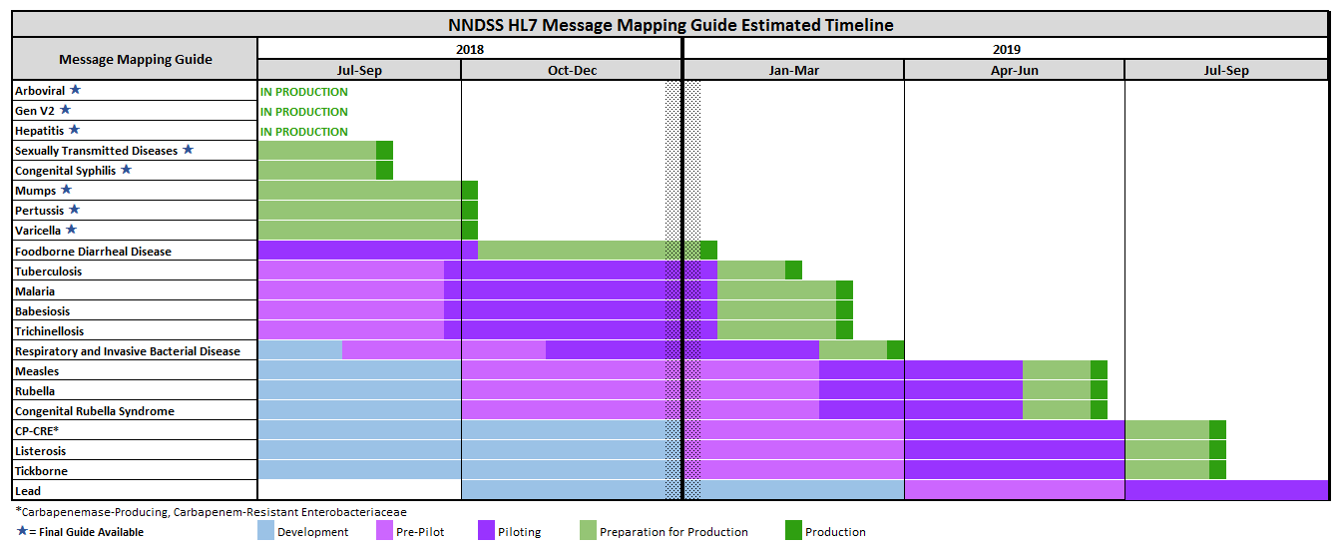
NNDSS HL7 Message Mapping Guide Estimated Timeline

Slide 6

Reminder!
Epidemiology and Laboratory Capacity Health Information Systems Cooperative Agreement recipients must send production data for at least five more message mapping guide (MMG) by August 1, 2019.
Please allow several weeks for onboarding.
Onboard for these now:
Arboviral 1.3
Generic v2
Hepatitis
STD
Congenital Syphilis
Onboard for these soon:
Mumps
Pertussis
Varicella

Slide 7
Highlights from the NMI PHI Workshop
Things to Keep in Mind
Laura Carlton, Sr. Specialist Informatics
A

Slide 8
PHI 2018: NMI Message Mapping Guide Implementation Technical Assistance Workshop
Workshop Objective: Facilitate peer-to-peer knowledge sharing on MMG implementation and onboarding experiences.
Panelists from 8 states shared:
  Tips and Best Practices
  Barriers and Challenges
  Lessons Learned
Technical Assistance Teams from APHL, CDC & NBS provided input on common ‘gotchas.’

Slide 9
Tips and Hints – Overall Approach
NMI HL7 implementation is much more than just “replacing your NETSS feed” – plan on needing to make changes to your Case Report Form, your surveillance system, your extract, and your case notification process.

Slide 10
Tips and Hints – Project Team
Plan to work as a team across informatics and program teams.
Get people involved early and keep communication open.
Talk to your peers!

Slide 11
Tips and Hints – Planning Ahead
Think down the line! Review all MMGs before designing solutions and making decisions; plan for the future.
Make a plan for Gen V2 elements that are handled differently across CRFs, systems, and for elements that have different value sets across MMGs.

Slide 12
Tips and Hints – Mapping Decisions
Decide on mapping approaches when elements don’t align 1:1.
Free text is a challenge – can’t code to standard code sets easily.
Some questions are similar. Some MMGs capture raw data and interpretive data. Be ready to make decisions on handling these situations: ask a question in several ways? Map all to one question? Use calculations to transform data?

Slide 13
Tips and Hints - System
Understand how things happen in your system: how to merge cases, change condition code, change case status, and rescind cases. Identify and test all ways that a case status can change to not a case.
Find the outliers – unusual situations – and create test cases to understand how your system responds.
Clearly indicate the cases you want CDC to count. Retain message history (case IDs and other required fields) to delete or rescind cases.

Slide 14
Tips and Hints - Troubleshooting
Determine the appropriate mechanism for transporting messages to CDC and understand the different environments to send to at CDC.
Define approach for post-production troubleshooting and identifying missing messages.

Slide 15
Resources to Help
Newly Redesigned NNDSS Training Resource Center
Implementation Guidebook
Message Mapping Guides
Test Scenarios
Test Messages
FAQs
https://www.cdc.gov/nndss/trc/index.html

Slide 16
Implementation Spreadsheet Updates
Formerly all Gen v2-based MMGs consolidated.
Now broken into separate, MMG-specific docs.
Gen V2 elements still included in each MMG-specific version.

Slide 17
Additional Highlights from 2018 PHI Conference
Lesliann Helmus, MSPH, CHTS-CP
Associate Director for Surveillance
Michele Hoover
Lead, State Implementation and Technical Assistance
Loretta Foster, MPH
Epidemiologist

Slide 18
Intro to the MMG Authoring Tool
What is the tool?
  Web-based application
  Automates components of MMG production
  Utilizes microservice architecture
  Leveraged multiple CDC foundation services
What does the tool do?
  Facilitates harmonization and standardization of data elements
  Decreases the time and resources needed to develop an MMG
  Increases MMG transparency and document sharing
  Standardizes the MMG format and HL7 references within the guide

Slide 19
Harmonization and Standardization of Data Elements
Review
MMGAT Repository
All currently in data elements currently used in an MMG
Reuse
MMGAT Guide Layout
Pull in exact copies of data elements from other MMGs
Request
Public Health Vocabulary SDOs
Fewer requests made over time

Slide 20
New MMG Development Process
Decrease in MMG Development Time
  Previous MMG Development was Approximately 8.5 Months
  New Development is Approximately 4.5 Months
    Process Piloted on the Trichinellosis and Tuberculosis MMGs
Combined MMG Development Phases to Reduce Time
  Maintained Emphasis on External Review
Utilizes the Technology Afforded by MMGAT
  Automation of MMGs, Test Scenarios, and Test Messages
  Transparency of Documentation and Easier Sharing of Information
Increased Emphasis on Program Involvement
*Note* MMG Development Time refers to only the creation of the MMG document not development of the MMG in the receiving system

Slide 21
Public Health Rhapsody User Group
Purpose: Designed for PH Rhapsody Users to share their projects, experiences, resources, ask questions, etc.
Complex topics have included: Java script filters, NMI mapping/table look-ups, integration with HIEs.
  Addressed more practical questions like, how to configure a route to handle multiple versions of HL7 for ELR? How to make do with a limited number of licenses?
PH Rhapsody User Group meets the 3rd Thursday of each month at 1pm ET.
  Next call: September 20, 2018. Users are required to register for the meetings each month.
For additional information contact the host, Michelle Barber, Oregon Health Authority, at (971) 673-1111 or via email at michelle.barber@state.or.us.

Slide 22
Walkthrough: The New Technical Assistance and Training Resource Center
Patricia Joseph
Center for Surveillance, Epidemiology, and Laboratory Services
Centers for Disease Control and Prevention

Slide 23
Walkthrough: NMI Technical Assistance and Training Resource Center
Homepage
Arboviral Implementation and Onboarding
All Other Conditions Implementation and Onboarding
Technical Assistance
Resources

Slide 24
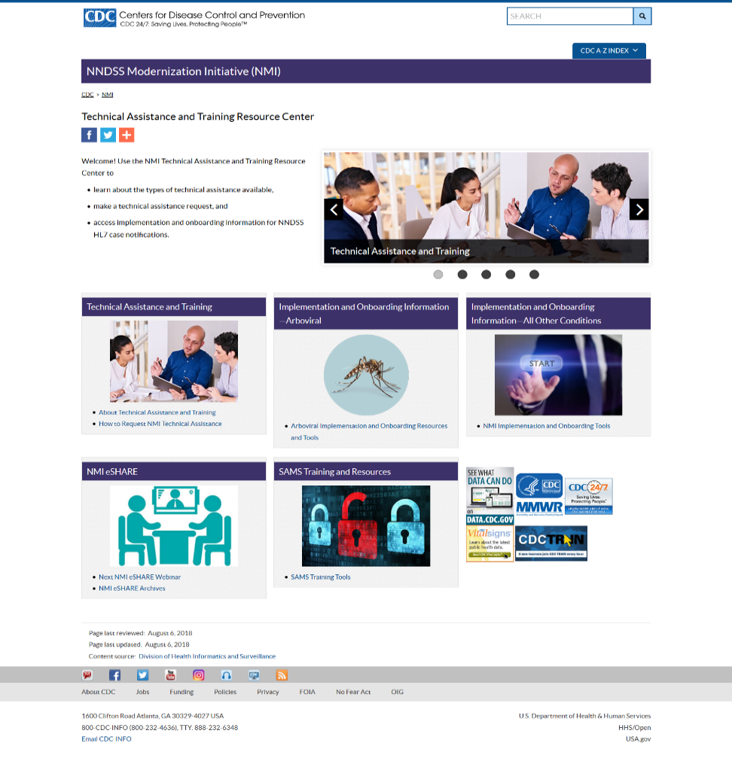
NMI Technical Assistance and Training Resource Center: Homepage - Old
Notes:
https://www.cdc.gov/nndss/trc/index.html

Slide 25
NNDSS Technical Resource Center: Homepage
Easy navigation to the three main topics of interest (arboviral implementation, all other conditions implementation, and technical assistance).
Added a resources area: eSHARE, SAMS access information, job aids, and more.
https://www.cdc.gov/nndss/trc/index.html
Notes:
https://www.cdc.gov/nndss/trc/index.html

Slide 26
NNDSS Technical Resource Center:
Arboviral Implementation
Moved & highlighted the step-by-step implementation instructions found in an eSHARE presentation to near the top of the page for easy access.
https://www.cdc.gov/nndss/trc/onboarding/arboviral.html
Notes:
https://www.cdc.gov/nndss/trc/onboarding/arboviral.html

Slide 27
NNDSS Technical Resource Center:
All Other Conditions Implementation and Onboarding Tools
New look & feel of the implementation process content
  Implementation process landing page with clickable arrows that move users through the 4 phases of the process
Landing page for each phase of the process with step-by-step instructions:
  Pre-onboarding
  Onboarding
  Cutover to Production
  Production
https://www.cdc.gov/nndss/trc/onboarding/overview.html
Notes:
https://www.cdc.gov/nndss/trc/onboarding/arboviral.html

Slide 28
NNDSS Technical Resource Center:
Technical Assistance
Expanded the Technical Assistance information into four components:
  About Technical Assistance
  Areas of Technical Assistance
  Models of Technical Assistance
  What Happens During a Technical Assistance Call
https://www.cdc.gov/nndss/trc/onboarding/technical-assistance.html
Notes:
https://www.cdc.gov/nndss/trc/onboarding/index.html

Slide 29
NNDSS Technical Resource Center:
Resources Roundup
Organized tools and resources into buckets of information for users to easily access:
Message Mapping Guides Arboviral Implementation Spreadsheet Arboviral Test Case Scenario Worksheet All Other Conditions Implementation Worksheet All Other Conditions Test Case Scenario Worksheet SAMS Training and Resources | METS PHINMS PHIN VADS Value Sets NNDSS eSHARE Job Aids Guidebooks
https://www.cdc.gov/nndss/trc/index.html
Notes:
https://www.cdc.gov/nndss/trc/index.html

Slide 30
Questions, Comments, Feedback?
Send to edx@cdc.gov with subject line “NMI Technical Assistance and Training Resource Center Feedback”

Slide 31

Questions and Answers

Slide 32
Subscribe to monthly NMI Notes news updates at
https://www.cdc.gov/nndss/trc/news/
Access the NNDSS Technical Resource Center at
https://www.cdc.gov/nndss/trc/
Request NNDSS technical assistance or onboarding at
edx@cdc.gov
Next NNDSS eSHARE is October16, 2018 – details at
https://www.cdc.gov/nndss/trc/onboarding/eshare.html

