Slide 1
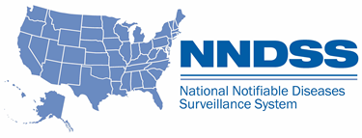
NNDSS Modernization Initiative (NMI): Walkthrough of Mumps, Pertussis, and Varicella HL7 Case Notification Messages
Access the NNDSS Technical Resource Center at
https://www.cdc.gov/nndss/trc/
Subscribe to monthly NMI Notes news updates at
https://www.cdc.gov/nndss/trc/news/
August 28, 2018 Division of Health Informatics and Surveillance

Slide 2
Agenda
Welcome and Announcements
Walkthrough of Mumps, Pertussis, and Varicella Case Notification Messages
Sandy Roush, National Center for Immunization and Respiratory Diseases (NCIRD), CDC
High Level Overview of the NCIRD Data Element Priority List for Mumps, Pertussis, and Varicella
Sandy Roush, NCIRD, CDC
State Panel on Barriers, Challenges, and Lessons Learned While Piloting Mumps, Pertussis, and Varicella HL7 Case Notification Messages
Florida, Michigan, New York City, Oregon, South Carolina, and Utah

Slide 3
NMI Updates and Timeline
Lesliann Helmus, MSPH, CHTS-CP
Associate Director for Surveillance
Michele Hoover
Lead, State Implementation and Technical Assistance

Slide 4
NMI Implementation Status Aug 24, 2018
NH
WA
MT
VT
ME
AK
ND
MN
OR
NY
MA
ID
SD
WI
RI
WY
MI
CT
IA
PA
NJ
NYC
CA
NE
OH
DE
HI
NV
IL
IN
WV
UT
VA
DC
MD
CO
KS
MO
KY
NC
TN
OK
AR
SC
AZ
NM
MS
AL
GA
TX
LA
Piloting Total of 2 (states)
FL
PR
Onboarding Total of 5 (states)
Production Total of 29 (28 states + NYC)

Slide 5
Onboarding Status
Message Mapping Guides (MMGs) | Onboarding | States Onboarding | In Production | States in Production
Gen v2 | 3 | AL, CO, NH | 18 | AK, CA, DE, FL, IA, ID, IL, KS, MA, MI, MN, MS, NY, NYC, OR, SC, UT, WI
Hepatitis | 4 | CA, LA, SC, WI | 11 | AK, AL, FL, ID, MI, MN, NY, OR, TN, VA, WV
Arboviral v1.3 | 2 | NE, WA | 14 | AR, AZ, DE, FL, ID, MD, ND, NY, OR, RI, SD, TN, TX, WI
Total # of Individual States | 9 | AL, CA, CO, LA, NE, NH, SC, WA, WI | 29 | AL, AK, AR, AZ, CA, DE, FL, IA, ID, IL, KS, MA, MD, MI, MN, MS, ND, NY, NYC, OR, RI, SC, SD, TN, TX, UT, VA, WI, WV
08/24/18

Slide 6
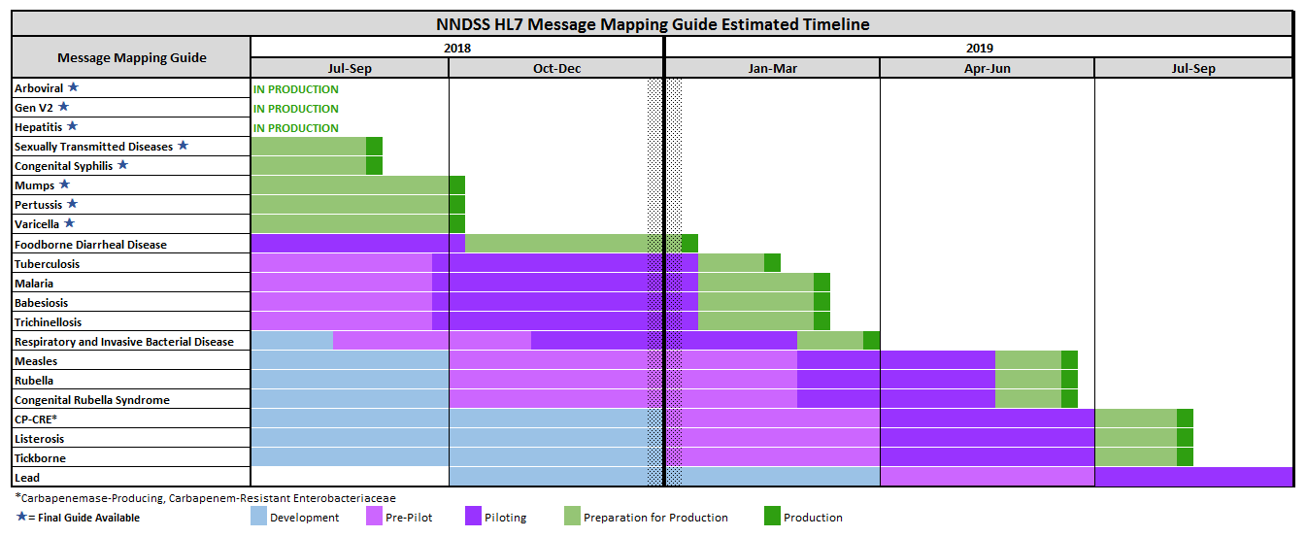
NNDSS HL7 Message Mapping Guide Estimated Timeline

Slide 7
Reminder!
Epidemiology and Laboratory Capacity Health Information Systems Cooperative Agreement recipients must send production data for at least five more message mapping guide (MMG) by August 1, 2019.
Please allow several weeks for onboarding.
Onboard for these now:
Arboviral 1.3
Generic v2
Hepatitis
Onboard for these soon:
STD
Congenital Syphilis
Mumps
Pertussis
Varicella

Slide 8
Apply for SAMS
Jurisdictions will need Secure Access Management Services (SAMS) Level 2 access to use the Message Validation, Processing, and Provisioning System (MVPS).
Users With SAMS Level 2 Access:
The MVPS SAMS Application Administrator will activate the MVPS link on SAMS for users with the appropriate SAMS access.
Users Without SAMS Level 2 Access:
Jurisdictions may request SAMS access by emailing edx@cdc.gov with subject line: SAMS Request Initiation.
Jurisdictions will need to identify a designated proofing agent (authorized badged CDC staff or notary public) to sign and complete the final SAMS application.
SAMS access is free.
Please allow at least 1 full week to receive access.
Please review the MVPS SAMS Guide, found on the NNDSS Technical Assistance SAMS Training and Resources Page at https://www.cdc.gov/nndss/trc/data-systems/sams.html, for additional information.

Slide 9
Mumps, Pertussis, and Varicella HL7 Case Notification Messages
August 28, 2018 eSHARE Webinar
Surveillance Office
Sandy Roush, Hannah Fast, Christine Miner
Mumps
Nakia Clemmons, Adria Lee, Susan Redd
Pertussis
Amanda Faulkner, Amy Blain
Varicella
Adriana Lopez, Jessica Leung
Contact Information:
Sandra W. Roush, MT, MPH
Surveillance Officer
National Center for Immunization and Respiratory Diseases
Centers for Disease Control and Prevention
phone: 404-639-8741
sroush@cdc.gov
National Center for Immunization and Respiratory Diseases (NCIRD)
August 2018 eSHARE

Slide 10
Context of NNDSS Data Collected for Mumps, Pertussis, and Varicella
NNDSS data currently received by NCIRD programs is NETSS format, whether from NBS or non-NBS jurisdictions
NETSS format includes core and extended data developed in mid 1990’s
Important changes in epidemiology and laboratory testing since 1990’s:
New vaccines and target populations (e.g., Tdap, 3rd mumps dose)
New lab testing (e.g., PCR)
Changing epidemiology (e.g., waning immunity, herd immunity)
Surveillance requirements have changed to support science and program
Investigations, interventions, policies to understand and address changes
Data collection interface to collect relevant required data

Slide 11
NMI Message Mapping Guide (MMG) Development for NCIRD Conditions
Disease-specific MMGs are needed for 15 of the 19 nationally notifiable conditions (NNCs) for which NCIRD has primary responsibility
3 are in pilot testing: mumps, pertussis, varicella
8 have development underway: measles, rubella, Congenital Rubella Syndrome, invasive S. pneumoniae*, H. influenzae*, N. meningitidis*, legionellosis*, psittacosis*
4 are in the requirements gathering phase: diphtheria, tetanus, pediatric influenza deaths, novel influenza A
The remaining 4 NNCs use only the Generic V2 MMG:
Polio (paralytic), polio virus infection (nonparalytic), SARS, and STSS
* These 5 conditions are included in the Respiratory and Invasive Bacterial Disease (RIBD) MMG

Slide 12
Harmonization Results for Disease Specific MMGs by Condition*
 | TOTAL** | VACCINE | LAB | EPI | CLINICAL
CONDITION | % Harmonized | % Harmonized | % Harmonized | % Harmonized | % Harmonized
Mumps | 83 | 100 | 92 | 92 | 29
Pertussis | 68 | 100 | 92 | 27 | 26
Varicella | 75 | 100 | 89 | 67 | 41
Measles | 87 | 88 | 85 | 100 | 81
Rubella | 88 | 100 | 100 | 68 | 80
Congenital Rubella Syndrome | 58 | 84 | 96 | 28 | 13
H. influenzae | 95 | 100 | 100 | 87 | 100
N. meningitidis | 89 | 100 | 93 | 79 | 100
Invasive S. pneumoniae | 95 | 100 | 88 | 100 | 100
Legionellosis | 40 | N/A | 100 | 19 | N/A
Psittacosis | 65 | N/A | 85 | 36 | 80
AVERAGE | 77% | 97% | 93% | 64% | 69%
RANGE | 40%‒95% | 84%‒100% | 85%‒100% | 19%‒100% | 13%‒100%
* Data do not include Gen V2 variables.
** ”Total” column also contains variables which do not fit within the four categories on this slide (e.g., system variables)

Slide 13
Notes for Implementation – Mumps, Pertussis, and Varicella
Dates:
As noted in MMGs, please send dates in YYYYMMDD format.
Measures and Unit Pairs (e.g., temperature and temperature units):
It is sound practice to capture both a measure and the units, and NCIRD encourages these practices. However, if the units are not available, then measure can be sent with an “Unknown” value for units until system interface is updated.
Travel-Related Questions:
Travel questions often do not have a specific timeframe; this was done to harmonize the question within and among MMGs. Thus, use epidemiologic discretion in mapping this information, applying time frames relevant to the condition (e.g., for mumps cases, use recent travel dates within the exposure period).
ACIP Recommendations:
Use the current guidance/recommendations
Detection Method/Transmission Setting:
NCIRD has received recommendations for additional values (e.g., lab and provider reported). Change requests will be vetted broadly with jurisdictions.

Slide 14
NCIRD Data Element Priorities
The Excel document titled, “NCIRD Data Element Priority_Mumps, Pertussis, Varicella,” includes GenV2, mumps, pertussis, and varicella MMGs
Many comments/guidance in columns G,H and I are similar across the individual guides, although pathogen-specific guidance is also included as needed
Column F presents the NCIRD priority for jurisdiction consideration of implementation and edits to data collection interface
Within “preferred” data elements in the MMG, NCIRD has further prioritized highest priority and high priority
Within “optional” data elements, most are NCIRD lowest priority, but there are exceptions

Slide 15
NCIRD Data Element Priority_Mumps, Pertussis, Varicella – Spreadsheet Examples
Hospitalized, Generic v2 (row 30)
On MMG, CDC priority is optional. However, NCIRD’s priority is 1 (very high priority), because this information is important specifically for mumps, pertussis, and varicella.
Total Cough Duration, Pertussis (row 176)
Until jurisdictions are able to collect total cough duration in days, it can be sent using structured number format in a way that corresponds to the case definition (e.g., >=14 or <14).
VPD RC Linkage (rows 215-217)
3 data elements: reference laboratory, patient identifier, and specimen identifier
Can be used to link VPD RC test results with NNDSS cases
Vaccination History Repeating Group (rows 231-239)
This section is of very high priority for all VPDs.
NCIRD is aware that some data will be missing for some cases.
A few of the variables (e.g., lot number) are specifically for inclusion from IIS.
Industry and Occupation Repeating Group (rows 208-211)
Lower priority for NCIRD, but will be important to build in for future guides

Slide 16
Thank you!
Questions and Discussion

Slide 17
Barriers, Challenges, and Lessons Learned while Piloting the Mumps, Pertussis, and Varicella HL7 Case Notification Messages
Florida Department of Health
Michigan Department of Health & Human Services
New York City Department of Health & Mental Hygiene
Oregon Health Authority Public Health Division
South Carolina Division of Public Health
Utah Department of Health

Slide 18
State Panelists
Florida Department of Health
Kim Wiley
Michigan Department of Health and Human Services
Carolina Fulper and Ed Hartwick
New York City Department of Health & Mental Hygiene
Robert Arciuolo and Beth Isaac
Oregon Health Authority Public Health Division
June Bancroft, Michelle Barber, and Juventila Liko
South Carolina Division of Public Health
Greg Fowler
Utah Department of Health
Bree Barbeau, Rachelle Boulton, Jeffrey Eason, and Doug McGowan
.

Slide 19
Panel Topics
Mapping
Data Elements
Best Practices and Lessons Learned
Technical Assistance

Slide 20
Questions and Answers

Slide 21
Subscribe to monthly NMI Notes news updates at https://www.cdc.gov/nndss/trc/news/
Access the NNDSS Technical Resource Center at
https://www.cdc.gov/nndss/trc/
Request NNDSS technical assistance or onboarding at
edx@cdc.gov
Next NNDSS eSHARE is September18, 2018 – details at
https://www.cdc.gov/nndss/trc/onboarding/eshare.html

