Slide 1
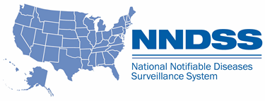
NNDSS Modernization Initiative (NMI):
A Cornucopia of NNDSS Information
Subscribe to monthly NMI Notes news updates at
https://www.cdc.gov/nndss/trc/news/index.html!
Access the NNDSS Technical Resource Center at
https://www.cdc.gov/nndss/trc/index.html!
November 21, 2017 Division of Health Informatics and Surveillance

Slide 2

Agenda
Welcome
Announcements
NNDSS Modernizing Data Access and Availability: Transition of NNDSS Data from MMWR to the NNDSS Data and Statistics Web Site
Additional information to assist with planning and use of NNDSS Data elements
Questions and Answers

Slide 3
Update on NMI Timeline
Early December 2017 – Message Validation, Processing, and Provisioning System update (MVPSu) implementation
February 2018 – Ready to receive STD and congenital syphilis messages
April 2018 – Ready to receive mumps and pertussis messages
June 2018 – Ready to receive varicella and FDD messages
Work continues on other message mapping guides (MMGs)
  Malaria
  Babesiosis
  Measles
  Rubella
  Congenital Rubella Syndrome
  Trichinellosis
  Respiratory and Invasive Bacterial Diseases
  CP-CRE
  TB

Slide 4
New MMG Pilot Sites
  Pilot sites for the Mumps, Pertussis, Varicella, and Foodborne and Diarrheal Disease (FDD) message mapping guides have been identified.
  Mumps, Pertussis, and Varicella: Florida, Kansas, Michigan, Louisiana, New York City, Oregon, and Utah
  FDD: Michigan, Minnesota, New York, and Oregon

Slide 5
NNDSS Modernizing Data Access and Availability: Transition of NNDSS Data from MMWR to the NNDSS Data and Statistics Web Site
Andreea Bealle, MPH
Health Scientist
Division of Health Informatics and Surveillance
Center for Surveillance, Epidemiology, and Laboratory Services
Centers for Disease Control and Prevention

Slide 6
Goal
To improve usability, availability, quality, and timeliness of surveillance data at CDC as part of the CDC Surveillance Strategy
To make more data available in a more timely manner
To provide a one-stop shop for users to find information about the data and links to weekly and annual notifiable disease data
To allow MMWR to focus on publishing scientific and actionable surveillance reports

Slide 7
Annual Data
NNDSS annual data tables transitioned from MMWR to NNDSS Data and Statistics web page on November 3, 2017
  Links to infectious disease tables (2016 data) available in PDF, HTML and TXT hosted on the WONDER platform
  Transition of the MMWR “Front matter” to the NNDSS website:
    How the data are collected, reported and finalized
    Publication criteria
    List of notifiable diseases by year

Slide 8
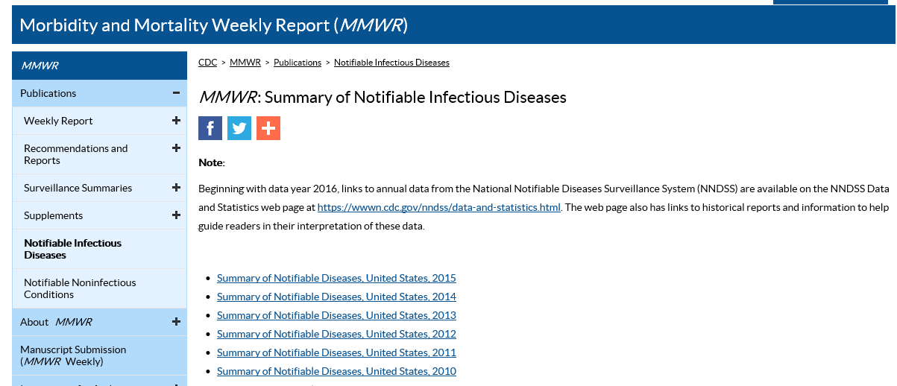
MMWR Transition
New link to 2016 Annual Data
Prior year summaries; 2015 last annual summary published in MMWR

Slide 9
Weekly Data
Expected to transition in January 2018
NNDSS Data and Statistics web page will
  Provide links to weekly data tables available in PDF, HTML, TXT hosted on the CDC WONDER platform
  Include Figure 1 comparing selected notifiable diseases with historical data

Slide 10
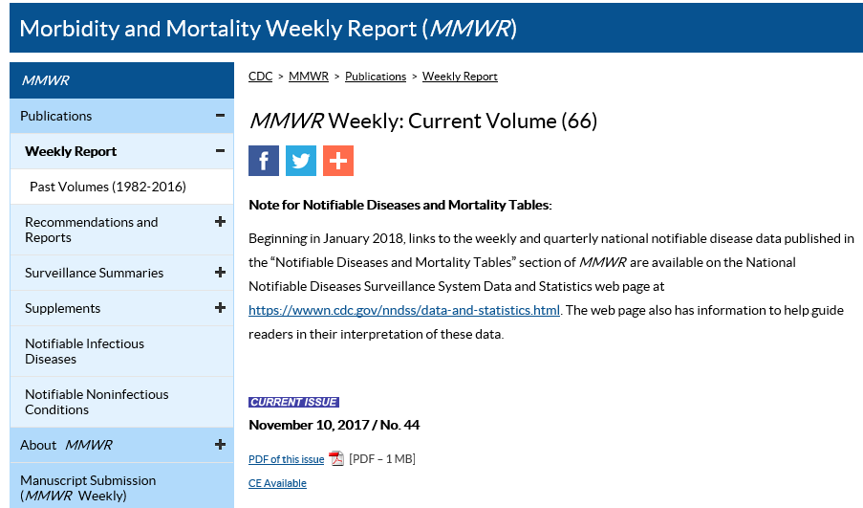
MMWR Transition of Weekly Data
Note about upcoming weekly tables transition

Slide 11
NNDSS Data and Statistics Web Site Overview
How to navigate to it
How to find the data links

Slide 12
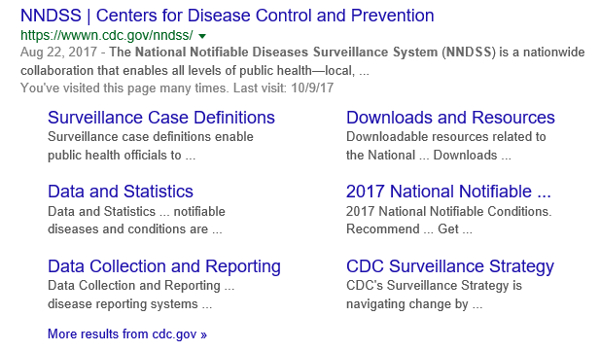
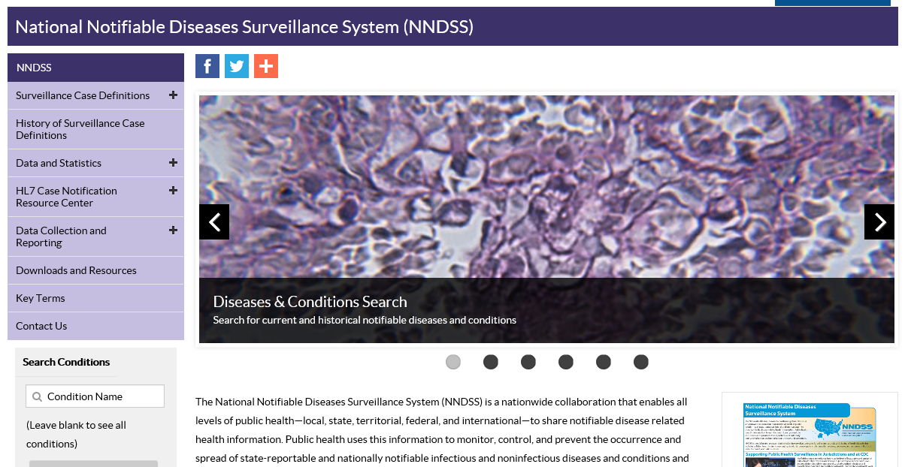
Google Search or Menu Link
Notes:
To find the new NNDSS data and statistics page – you can either find in Google – it’s been indexed as a sub-header above, or go to the home page for NNDSS and find it on the left hand navigation which has been reorganized (more details on reorganization?)

Slide 13
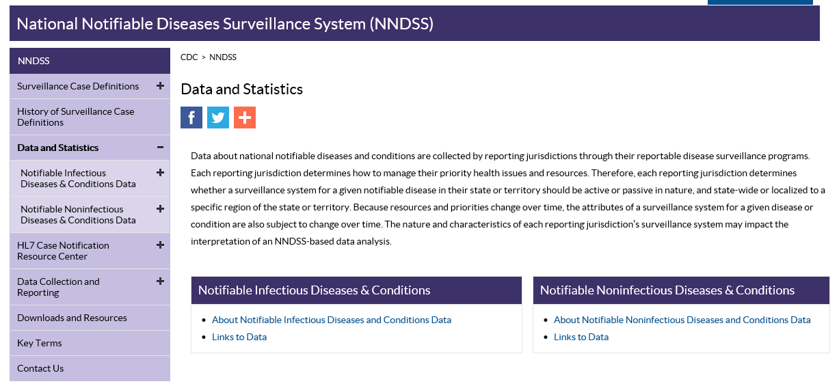
NNDSS Data and Statistics Page Redesign
Notes:
The NNDSS data and Statistics Page has been redesigned to provide a quick access to Infectious and Non infectious data and information about the data.

Slide 14
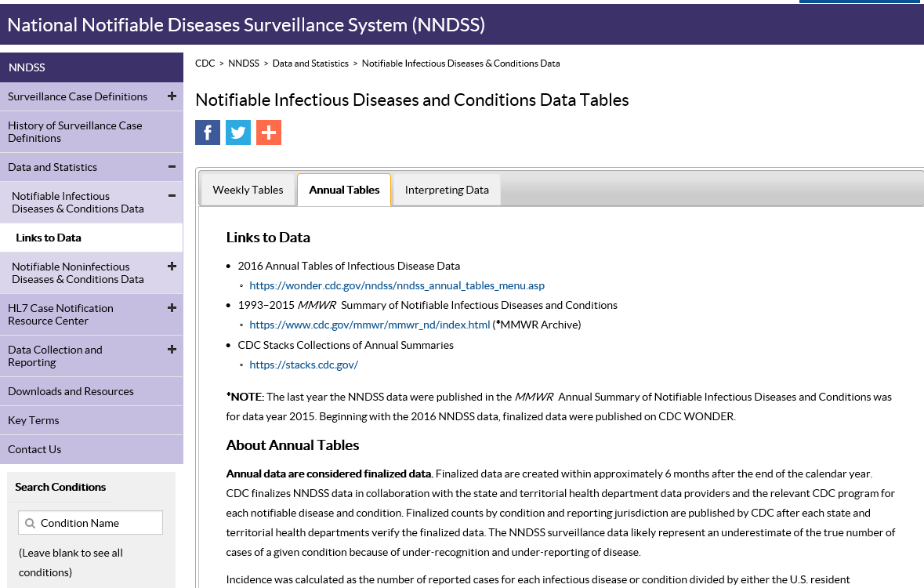
Annual Data – NNDSS web site
Jump to CDC WONDER
Notes:
For notifiable infectious diseases and conditions, we have Weekly tables, Annual tables, and an Interpreting data section for more information. Each tab presents the links to the data on top, and information about the tables at the bottom.

Slide 15
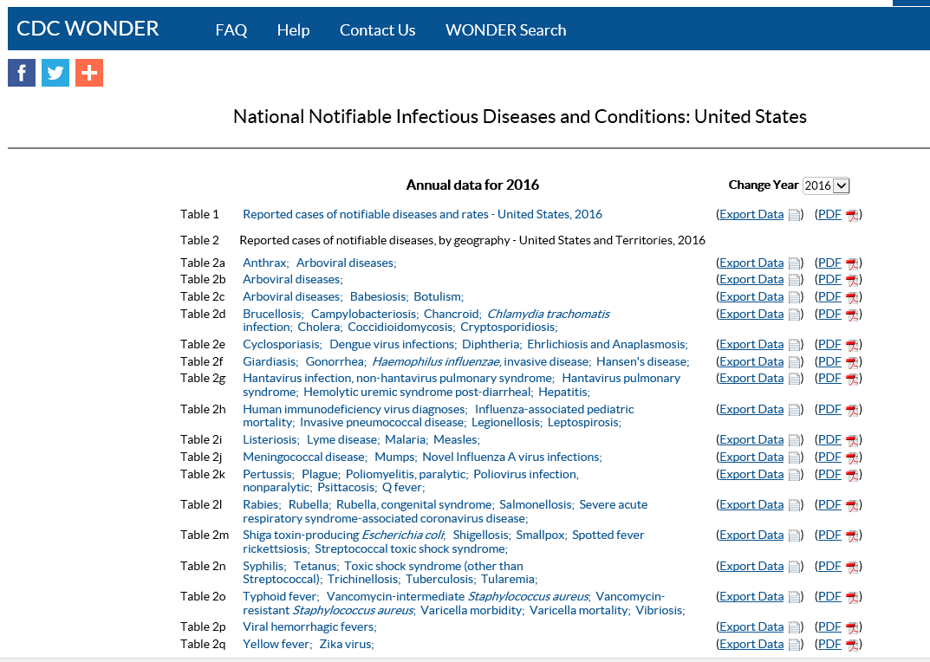
Annual Data – Hosted on CDC WONDER platform
Access annual tables from 2016 onward

Slide 16
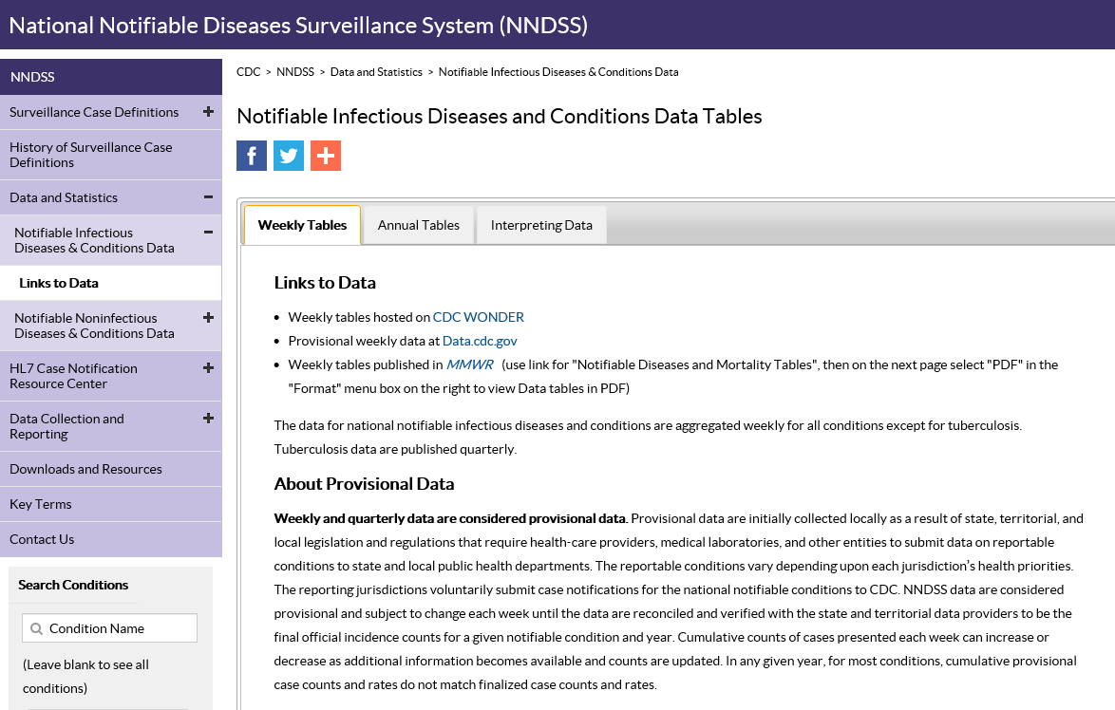
Weekly Data
Notes about interpreting the data for the reader
Link to CDC WONDER for the tables

Slide 17
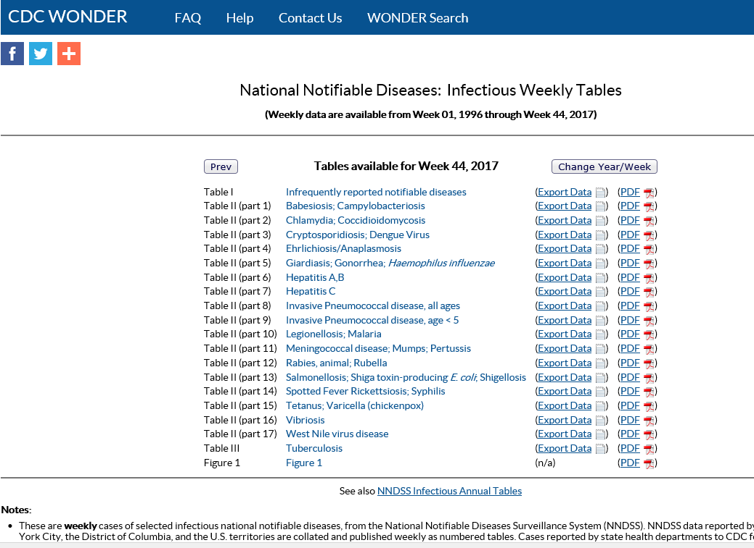
Weekly Data – Hosted on CDC WONDER
See historical tables
Development site snapshot
Notes:
When this new representation of the Infectious weekly cases tables goes live, PDFs of the tables will be provided along with the Figure 1 in PDF format. There will also be a handy link back to the Annual tables.

Slide 18
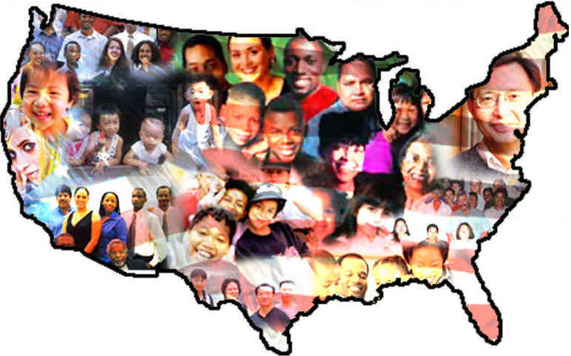
Binational Case Variable in NNDSS
Corey M. Peak, ScD, MSc
cpeak@cdc.gov
619-692-8052
EIS Officer
United States – Mexico Unit
Division of Global Migration and Quarantine
National Center for Emerging and Zoonotic Infectious Diseases
Division of Global Migration and Quarantine

Slide 19
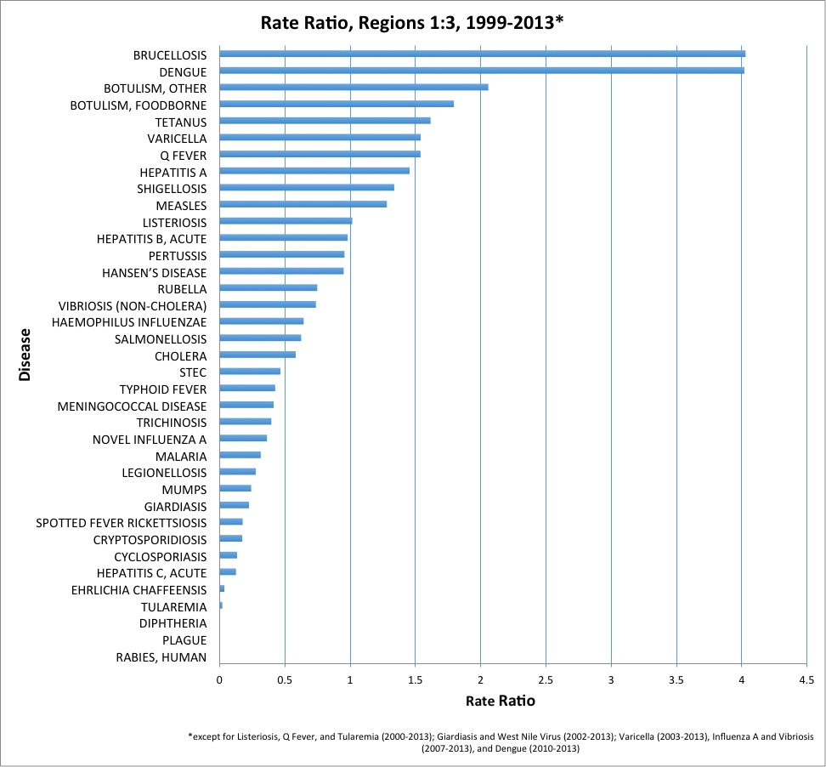
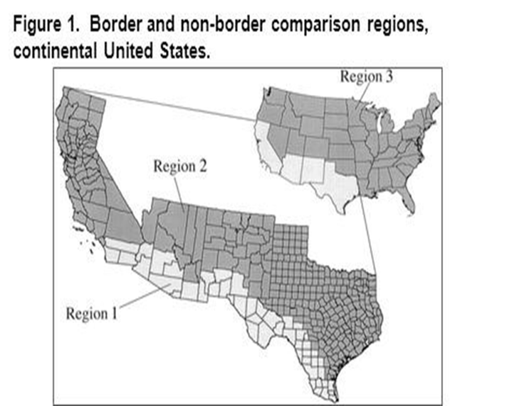
Higher Incidence of Many Diseases Along U.S.-Mexico Border
Source: NNDSS
19
Slide Credit: K Kohl

Slide 20
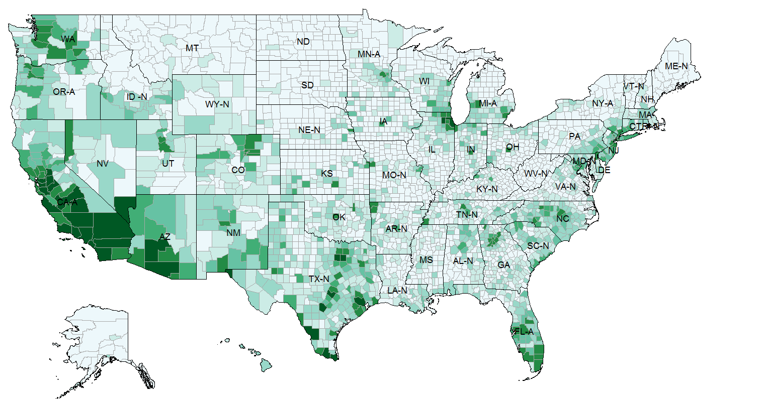
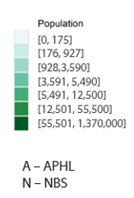
Binational Burden of Disease is a National Challenge beyond the Border Region
Mexican-born Population in the United States by County
Total: 11,605,524
Source: American Community Survey 5-year Data (2009-2013)
APHL: Association of Public Health Laboratories NBS: NEDSS Base System
20
Slide Credit: K Kohl

Slide 21
Binational Case Variable Definition
2013 CSTE Position Statement
A data field identifies a case as binational when it meets one or more of the following criteria:
  Potentially exposed while in Mexico or Canada
  Potentially exposed by a resident of Mexico or Canada
  Resident of Canada or Mexico
  Has case contacts in or from Mexico or Canada
  Exposure to suspected product from Canada or Mexico
  Other situations that may require binational notification or coordination of response (e.g., a measles outbreak without known cross-border contacts in a border community or state; exposure to an exported product from the U.S. to Canada or Mexico)
CSTE: Council of State and Territorial Epidemiologists
21

Slide 22
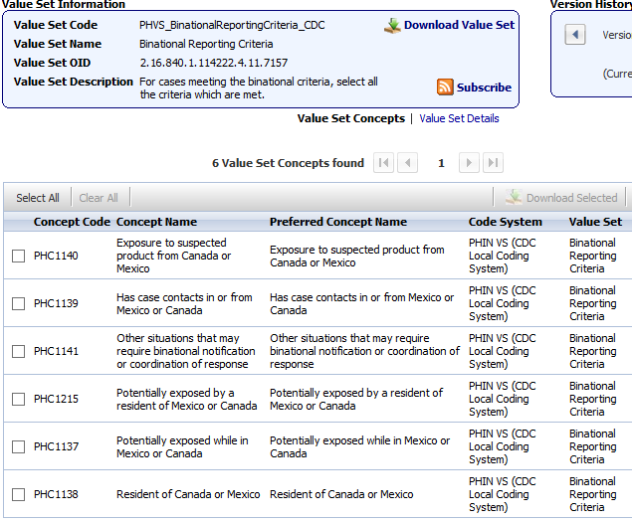
Binational Reporting Criteria in
Generic v2 Message Mapping Guide
Binational Reporting Criteria data element (77988-4)
22
Slide Credit: K Kohl

Slide 23
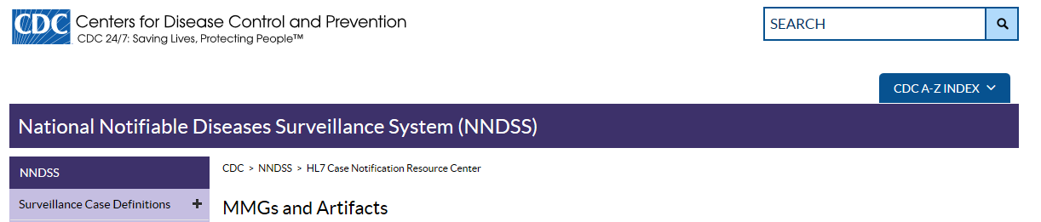
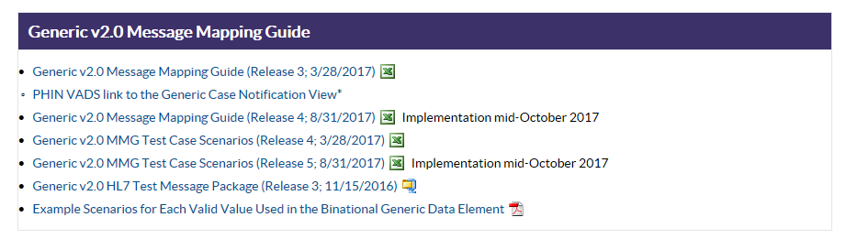
Example Scenarios (Job Aid)
Available Online
https://wwwn.cdc.gov/nndss/document/ExampleScenariosforEachValidValueUsedInBinationalGenericDataElement.pdf
23

Slide 24
Having disease-specific data
by exposure in/from Mexico or Canada
is critical for
- targeted prevention
- culturally appropriate outreach
24
Slide Credit: K Kohl

Slide 25
Evidence from an Early Adopter: Arizona
Binational Variable in use by Arizona since 2010 for:
  Office of Border Health investigation of infectious disease reports
  Flagging cases for binational coordination
  Generating reports of the binational burden of disease
CDC U.S. – Mexico Unit
  Compiling database to look at burden and trends
  Identification of outbreaks
  Resource advocacy
25

Slide 26
Resource Guide
CSTE Position Statement (13-SI-02) with Binational Case Variable Definition can be found here: https://cdn.ymaws.com/www.cste.org/resource/resmgr/PS/13-SI-02.pdf
Example scenarios for each Binational Case Variable criteria can be found here: https://ndc.services.cdc.gov/wp-content/uploads/2021/02/ExampleScenariosforEachValidValueUsedInBinationalGenericDataElement.pdf
For questions about NNDSS Generic variables, please email your question to: NNDSSweb@cdc.gov
For questions about the Binational Case Variable criteria, please email your question to: usmunotify@cdc.gov
26

Slide 27
Acknowledgements
CDC DGMQ
  Katrin Kohl
  Kathleen Moser
  Maureen Fonseca-Ford
Arizona Department of Health Services
  Mariana Casal
  Ken Komatsu
NNDSS
  Lesliann Helmus
  Ruth Jajosky
Infectious Disease Surveillance Leadership Council
  Bob Pinner
  Nishant Zachariah
CDC EIS Program
  Wences Arvelo
  Eric Pevzner
27

Slide 28
Incorporating
Country of Usual Residence
Data Element
Lesliann Helmus, MS, CHTS-CP
NNDSS Program Manager
Division of Health Informatics and Surveillance
Center for Surveillance, Epidemiology, and Laboratory Services
Centers for Disease Control and Prevention

Slide 29
Country of Usual Residence Data Element
Requested by CSTE position statement 11-SI-04 (revised guidance for determining residency)
  Used to identify individuals whose usual place of residence is not the US (based on census criteria)
  Aligns ‘numerators’ with census-derived ‘denominators’
  Indicates that cases in non-residents should not be included in state counts or rates but used to understand disease burden and sources of exposure
“Country of Usual Residence” (77983-5) was incorporated into GenV2 message
In 2018, NNDSS tables will not stratify on US residence
Plan to begin stratifying on US residence in 2019 NNDSS tables

Slide 30
Country of Usual Residence – Current Guidance
Please continue to use the criteria you have been using to determine whether to transmit notifications on foreign residents until we are prepared to stratify NNDSS tables based on non-US residence
Ensure that you are transferring cases in residents of other states/territories to those states/territories
Ensure that your surveillance systems include the “country of usual residence” data element
Consider having it default to UNITED STATES (code: USA)
Train surveillance staff to complete “country of usual residence”

Slide 31
Data Elements Used to
Define Unique Case
Change with MVPS update
Lesliann Helmus, MS, CHTS-CP
NNDSS Program Manager
Division of Health Informatics and Surveillance
Center for Surveillance, Epidemiology, and Laboratory Services
Centers for Disease Control and Prevention

Slide 32
Change in Unique Case ID with MVPS update
Applies to HL7 messages that are based on GenV2
Goes into effect with MVPSu (early Dec)
NMI will use Local Record ID (INV168 in OBR-3) + National Reporting Jurisdiction (77968-6) (i.e., we will no longer include Date First Electronically Submitted (NOT103 in OBR-7))
Benefit to jurisdictions – fewer “duplicate” cases
Algorithm checking for same ID for multiple cases or case with multiple IDs
Please ensure that the Local Record ID is unique within your jurisdiction, e.g.
  If system re-uses identifiers annually, add year indicator (e.g., year case created)
  If multiple surveillance systems are used, add system indicator
  If sub-jurisdictions use their own systems, add a system or sub-jurisdiction indicator
  If migrating between systems, incorporate original Local Record ID in Legacy Case ID field in new system

Slide 33
Questions and Answers

Slide 34
Subscribe to monthly NMI Notes news updates at https://www.cdc.gov/nndss/trc/news/index.html!
Access the NNDSS Technical Resource Center at https://www.cdc.gov/nndss/trc/index.html!
Request NMI technical assistance or onboarding at
edx@cdc.gov!
Next NMI eSHARE is January 16, 2018–details at https://www.cdc.gov/nndss/trc/onboarding/eshare.html!

