Slide 1
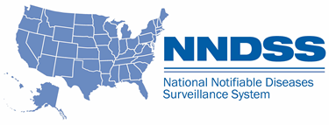
NNDSS Modernization Initiative (NMI): Capturing Industry and Occupation Surveillance Data
Subscribe to monthly NMI Notes news updates at
https://www.cdc.gov/nndss/trc/news/index.html!
Access the NNDSS Technical Resource Center at
https://www.cdc.gov/nndss/trc/index.html!
July 18, 2017 Division of Health Informatics and Surveillance

Slide 2

Agenda
Welcome
Presentation of New Industry and Occupation Message Mapping Guide Template
Demonstration of NIOSH Industry and Occupation Computerized Coding System (NIOCCS) Tool
State’s Perspective on Collecting Industry and Occupation Data
Hot Topic: Unique Identifiers for Cases in Disease Notifications
General Questions and Answers

Slide 3
New Industry and Occupation Template for Message Mapping Guides
Ruth Jajosky, DMD, MPH
Office of Public Health Scientific Service
Division of Health Informatics and Surveillance
Center for Surveillance, Epidemiology, and Laboratory Services
Centers for Disease Control and Prevention

Slide 4
Industry and Occupation Template for Message Mapping Guides (MMGs)
Purpose: To facilitate NIOSH’S and Programs’ exploration of potential relationships between specific diseases/conditions and specific occupations and/or industries.
Current Status: Incorporating the template into MMGs, starting with Mumps, Pertussis, and Varicella MMGs.
Next Steps:
- Continue incorporating the template into future MMGs
- DHIS and NIOSH will engage in ongoing collaborations to facilitate discussions with the jurisdictions related to the feasibility of data collection and usefulness of the data. The template may be revised based upon these findings.
- Eventually incorporate template into the Generic v.3 MMG

Slide 5
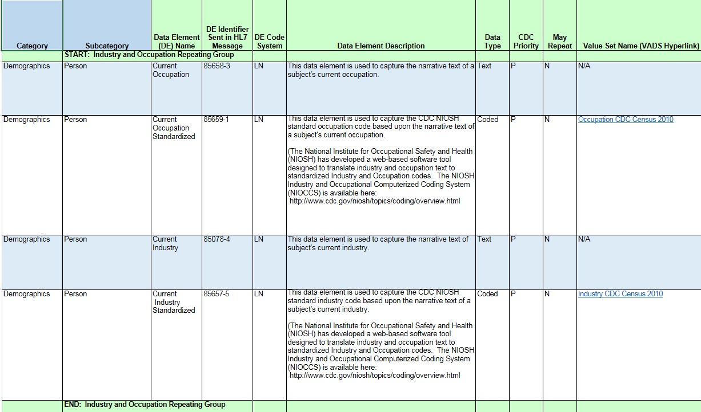
Industry and Occupation Template

Slide 6
Demonstration of NIOSH Industry and Occupation Computerized Coding System (NIOCCS) Tool
Pam Schumacher
Technical Information Specialist
Surveillance Branch, DSHEFS,
National Institute for Occupational Safety and Health (NIOSH)

Slide 7
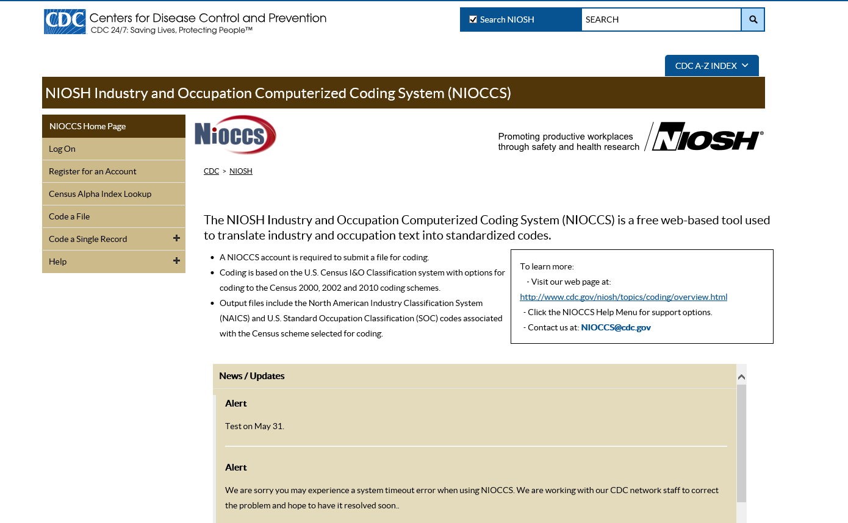
NIOCCS website screenshot

Slide 8
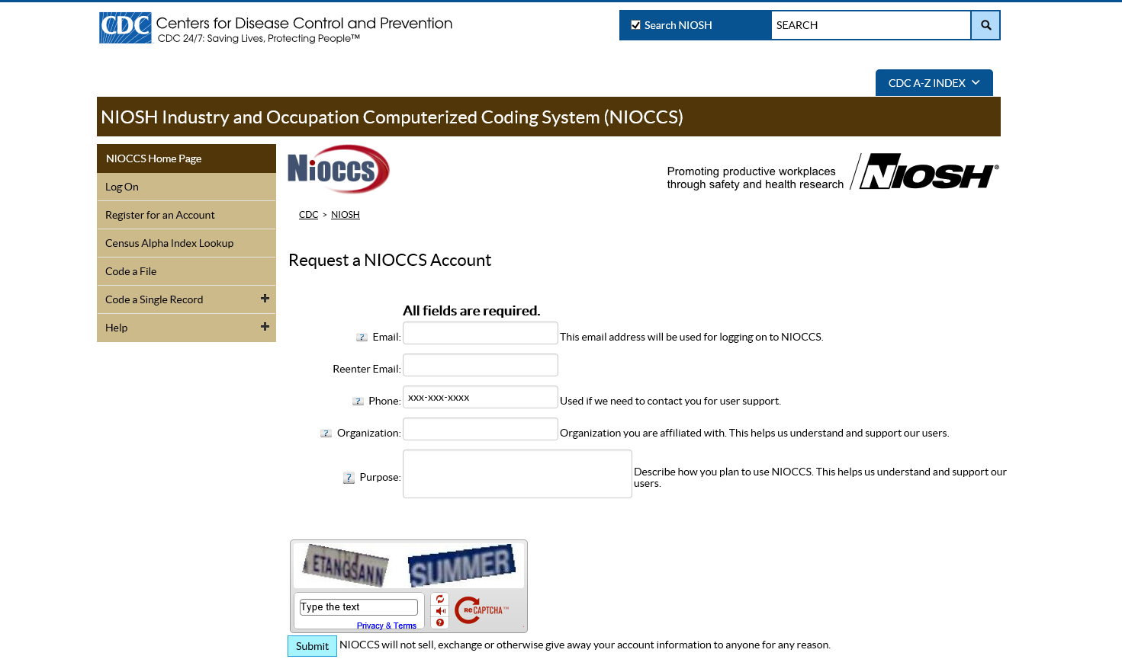
NIOCCS website screenshot 2

Slide 9
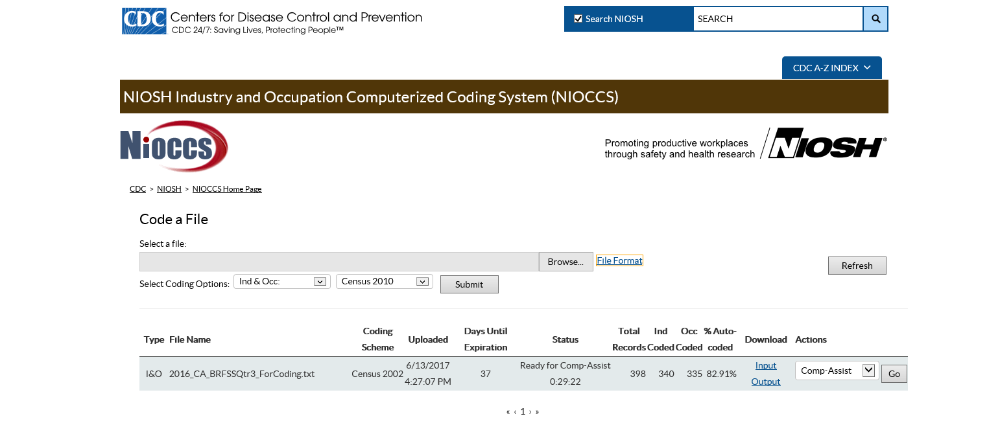
NIOCSS website screenshot 4

Slide 10
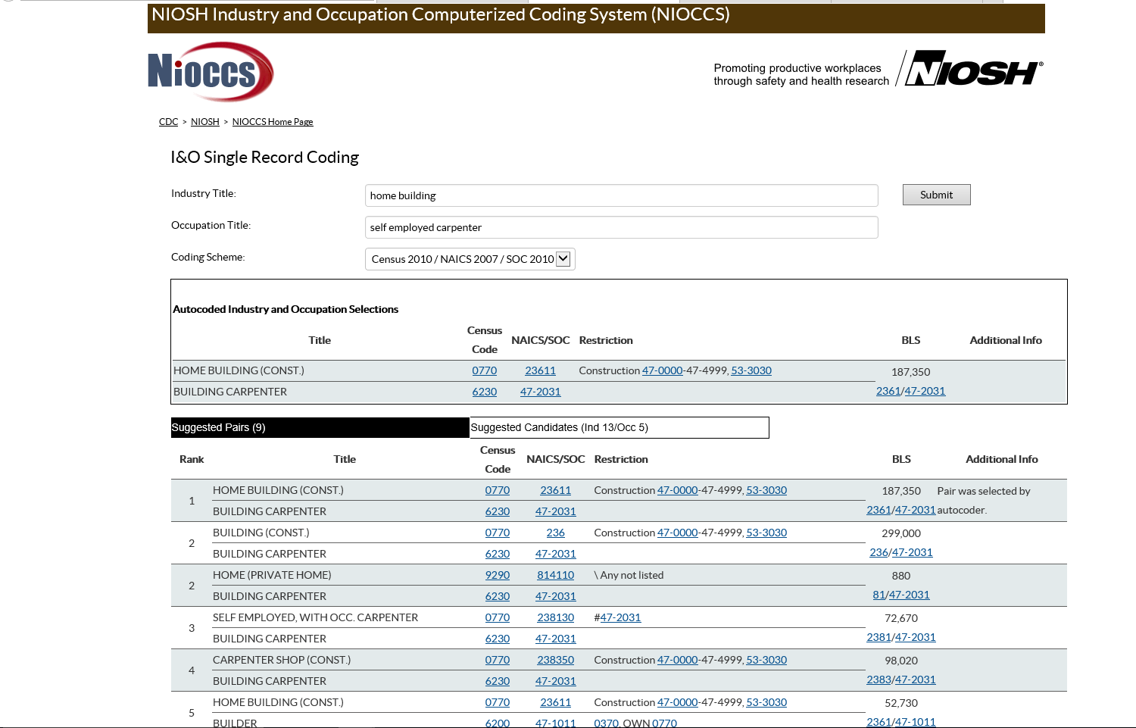
NIOCSS website screenshot 5

Slide 11
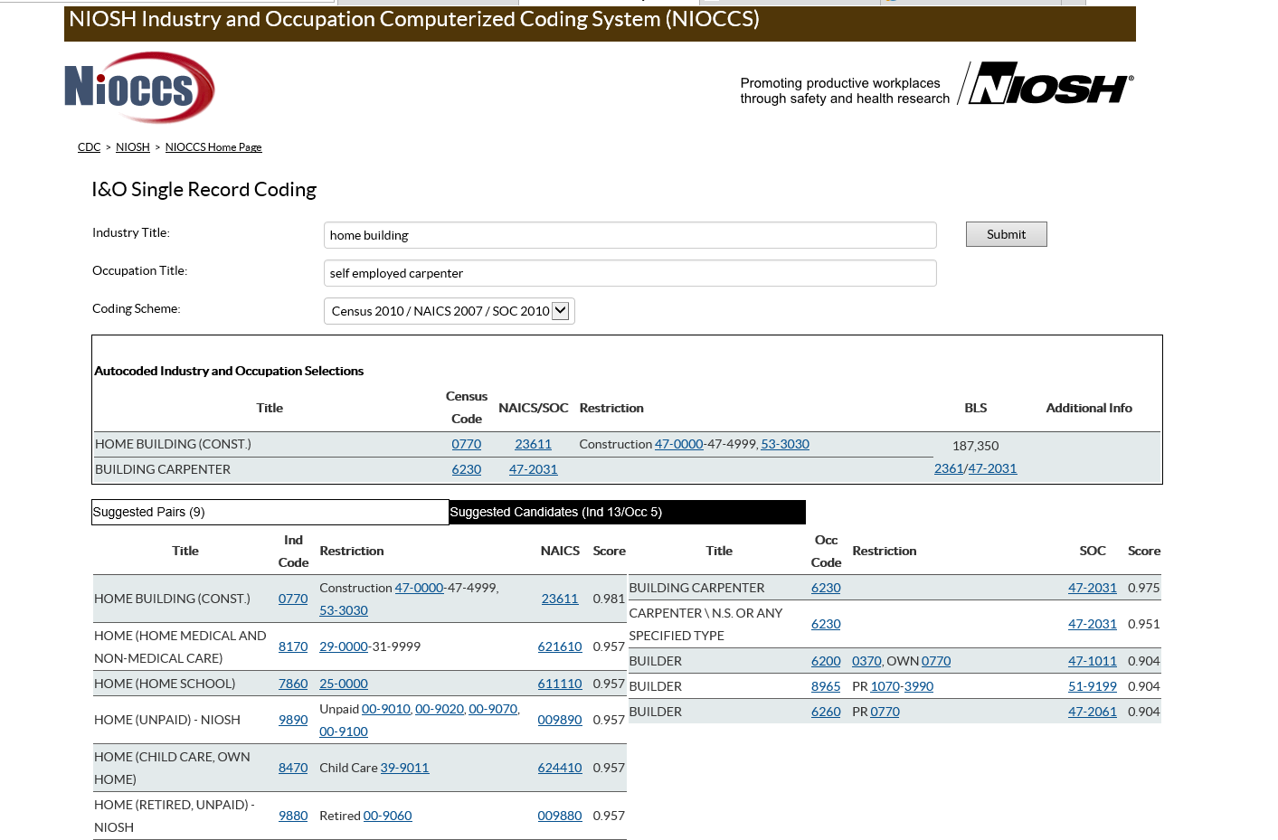
NIOCSS website screenshot 6

Slide 12

NIOCSS website screenshot 7
Incorporating Occupation Data into an Integrated Surveillance System:
Collaboration between Infectious Disease & Occupational Health
T. Scott Troppy, MPH, PMP
Office of Integrated Surveillance and Informatics Services
Bureau of Infectious Disease and Laboratory Sciences

Slide 13
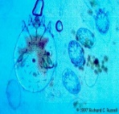

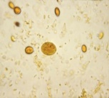
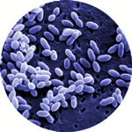
MAVEN Features
Complete data capture in single integrated system across BIDLS
  co-infection analysis
ELR/ eCR interface
Real-time information sharing
Automated triage of information
  streamlined case investigation and surveillance
Contact investigations
Outbreak response
Ability to capture occupation information
Notes:
It allow for complete data capture in single integrated system across multiple programs within the Bureau of Infectious Disease.
It is a person based system- a person’s demographic information is in the system once and may linked to multiple disease events. Disease events have event time periods associated with them that determine whether a new piece of information is associated with the existing or is a new infection.
The system is flexible and allows us to tailor question packages by disease so we can ask someone with gonorrhea about sexual risk history and for brucellosis about exposure to livestock

Slide 14
Milestones
MAVEN (Massachusetts Virtual Epidemiologic Network)
  2006-07: vaccine preventable, zoonotic, viral hepatitis, general epidemiology and enteric diseases, TB case management
  2009-10: H1N1 response, on- call, rabies, outbreak management, RIHP module
  2011-13: ESPnet integration, Communication events
  2014-15: STI Module, Food Protection Program Modules, Vibrio, HIV Phase I and II, Ebola
  2016: Zika, HIV Phase III, data and legal requests
  2017: infection preventionists
  Over 600 active users
    State: BIDLS, DHCSQ, DMF and BEH
    >95% of local boards of health
    Clinical Practitioner Role (proof of concept)
Notes:
Initially: 4 workflows, 4 reports
Currently: ~100

Slide 15
Occupation Process
Occupation “Process”
Initiated discussion in 2007 with Occupational Health Surveillance Program
  inform Occupational Health Surveillance Program, Division of Health Care Safety & Quality, and Environmental Health of cases of relevance for potential risk
    Tularemia/Landscaper, Enteric/Food handler, Animal Exposures/Veterinary
Update current reference code list for occupation list
Notes:
We have a reference code list in MAVEN but also have a free text option by using Other (Specify) to capture those occupations not in the list.

Slide 16
Developing a New
Occupation List
Used CPS* to identify most common occupations and industries in MA
  Added or removed occupations based on MAVEN and CPS data
  Identified occupation groups that needed more or less specificity
    e.g., Farming (2 digit code-major group) vs Medical professions (6 digit codes-detailed occupation)
Assigned SOC⁺ codes
* Current Population Survey
⁺ Standard Occupational Classification

Slide 17
Distribution of Occupations in Massachusetts – CPS 2013
Occupation | %
Office and administrative support occupations | 12.3
Management occupations | 10.9
Sales and related occupations | 9.1
Education, training, and library occupations | 7.3
Business and financial operations occupations | 6.4
Healthcare practitioner and technical occupations | 5.9
Food preparation and serving related occupations | 5.4
Construction and extraction occupations | 4.5
Personal care and service occupations | 4.3
Transportation and material moving occupations | 4.1
Computer and mathematical science occupations | 4.1
Occupation | %
Building and grounds cleaning and maintenance occupations | 3.8
Healthcare support occupations | 3.0
Arts, design, entertainment, sports, and media occupations | 2.7
Installation, maintenance, and repair occupations | 2.3
Community and social service occupations | 2.2
Architecture and engineering occupations | 2.1
Life, physical, and social service occupations | 2.0
Protective service occupations | 1.8
Legal occupations | 1.7
Farming, fishing, and forestry occupations | 0.2
Armed Forces | 0.0
Notes:
Talk about MA workers

Slide 18
Implementing updated reference list in MAVEN
May 2014 – updated occupation reference list for the new Foodborne Illness Complaint model
March 2015 – updated reference list for MAVEN core product to apply to all models and disease product codes
Notes:
Foodborne important

Slide 19
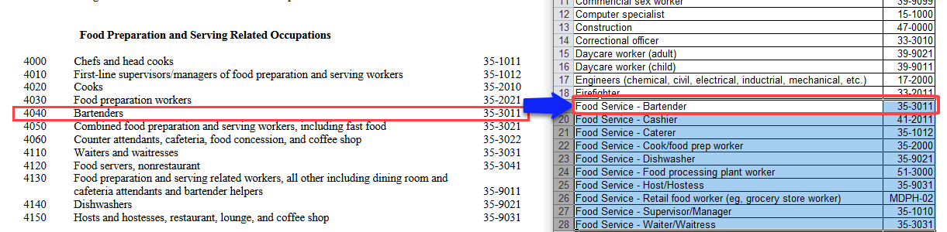
Standard Occupational Classification (SOC)
SOC list
Reference
List (MAVEN)
Notes:
There is no official code for Retail food worker – we need more information to code retail food worker to the SOC so we created our own code. We wanted to keep it simple so we only have one code currently.
Helpful to code for analysis

Slide 20
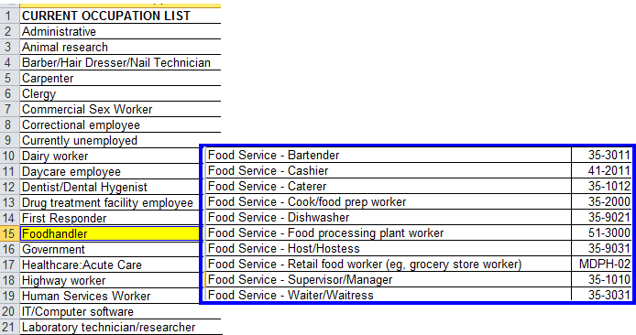
Foodhandler Changes
Original (1)
Updated (10)

Slide 21
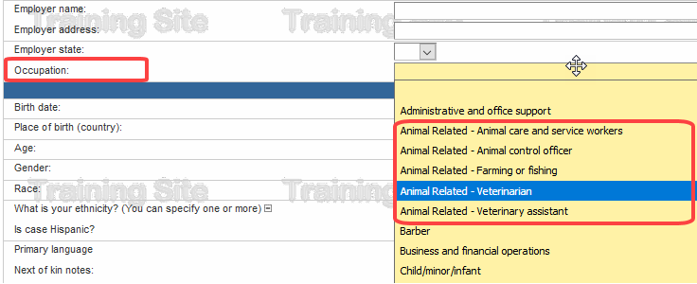
Occupation Groups for
Animal Related (MAVEN)

Slide 22
Data Analysis
Occupation

Slide 23

Occupation Data Analysis
Occupation Data Analysis
Enteric Cases (April 2015-December 2016)
Total enteric events from MAVEN (April 2015-December 2016) N=8,688
Excluded cases w/o occupation info 2,725 (31%)
Missing
Occupation field completed
N=5,963 (69%)
Child (943)
Student (606)
Unemployed (540)
Retired (919)
Excluded non-working cases 3008 (35%)
“Other – please specify”
1,224 (14.4%)
Excluded cases with non-specific info 267 (3%)
Unknown (188)
Other – non-specified (79)
Working cases with text to code
2,688 (31%)
Excluded cases that can’t be coded 421(5%)
Not enough info to code to MDPH list or SOC (421)
Enteric cases with occupation for analysis
2,267 (26%)
Data Source: MAVEN, April 2015 – Dec 2017
Notes:
There were 2,725 cases that did not have any text in the occupation field.
We looked at the “occupation” field and “occupation – specify” and excluded non-working cases (3,008). There were 1,224 cases of “occupation = other”; we looked at the “occupation – specify” field and found that of these, 40 were unemployed and 3 were retired.
There were 188 cases that said “unknown” in the “occupation” field and 79 cases of “occupation – specify” that didn’t have any specific information to be able to use.
That left 2,688 working cases with text to be coded – 1,507 were cases that had the occupation originally selected from the MDPH pick list and 1,181 were “occupation = other” that needed to be coded to the MDPH pick list and SOC. NOTE: any cases that had the occupation originally selected from the MDPH pick list was automatically cross-walked to SOC.
We ran NIOCCS and also manually coded cases to SOC. There were 421 cases that could not be coded to SOC and could not be coded to the MDPH pick list.
There were then 2,267 cases that could be analyzed.

Slide 24
Occupational Data Analysis 2
Occupation Data Analysis
Enteric Cases (April 2015-December 2016)
Working cases with useable text
N=2,688
Excluded cases that can’t be coded 421 (16%)
Coded to SOC only by NIOCCS 307 (11%)
Coded to SOC only manually 145 (5%)
SOC coding
Cases with coded occupation text for analysis
2,267 (84%)
MDPH pick list only
114 (4%)
Code to MDPH pick list & SOC 1,701 (63%)
Code to SOC only 452 (17%)
Code to MDPH pick list 1,815 (68%)
Code to SOC
2,153 (80%)
Data Source: MAVEN, April 2015 – Dec 2017
Notes:
Any case where the occupation was chosen from the DPH pick list was automatically assigned an SOC code.
We then applied NIOCCS to the “Occupation – specify” field, setting NIOCCS at MEDIUM. We manually coded additional cases. We have not finished manually reviewing / coding cases, so the number of cases we are able to assign a 2-digit SOC code to may increase. We ran 873 cases through NIOCCS as a batch – about 35% were coded by NIOCCS in this batch process. In the future we will se the sensitivity to HIGH and re-run these cases through NIOCCS and see how many we are able to code.
We were able to code 2,267 cases. 1701 were coded to the MDPH pick list (and thus to SOC). An additional 114 were coded only to the MDPH pick list. (The pick list had limitations, and it was not possible to code all to SOC.) An additional 452 were assigned an SOC code, but could not be matched with an option on the MDPH pick list.
This left us with 1,815 cases that could be assigned to the MDPH pick list and 2,153 cases that could be assigned a 2-digit SOC code.
OF THE WORKING CASES WITH TEXT IN THE OCCUPATION FIELD, 80% COULD BE CODED TO SOC AT THE 2-DIGIT LEVEL (WITHOUT INDUSTRY INFORMATION BEING AVAILABLE). ADDITIONAL CODING AND ANALYSIS IS NEEDED TO DETERMINE THE NUMBER OF CASES THAT CAN BE CODED TO 4 AND 6-DIGIT SOC CODES.

Slide 25
Distribution of Occupation within Enteric Diseases by MDPH Occupation Group, N=1,815
Data Source: MAVEN, April 2015 – Dec 2017

Slide 26
Distribution of Occupation within Enteric Diseases by SOC Occupation Group, N=2,153
Data Source: MAVEN, April 2015 – Dec 2017

Slide 27
Enteric Disease Events
Mechanisms to improve completeness of Occupation variable

Slide 28
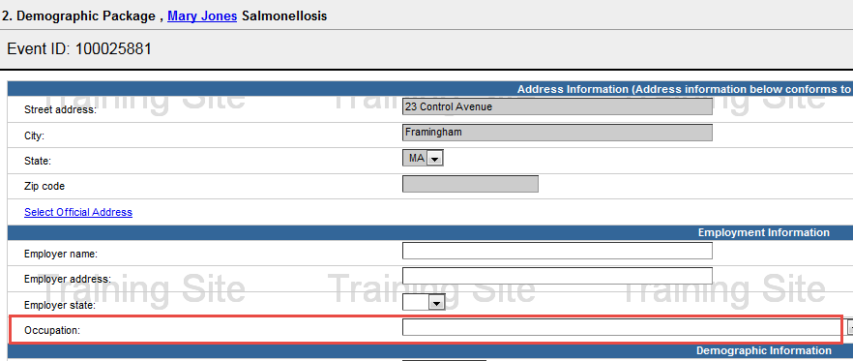
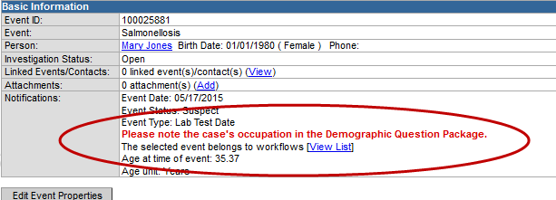
Concerns for Salmonellosis
For Salmonellosis and other enteric diseases, the following concern was developed: “Please note the case’s occupation in the Demographic Question Package.”
color-coded reminders to complete information specific to a disease event
implemented in 2013 for all enteric disease events

Slide 29
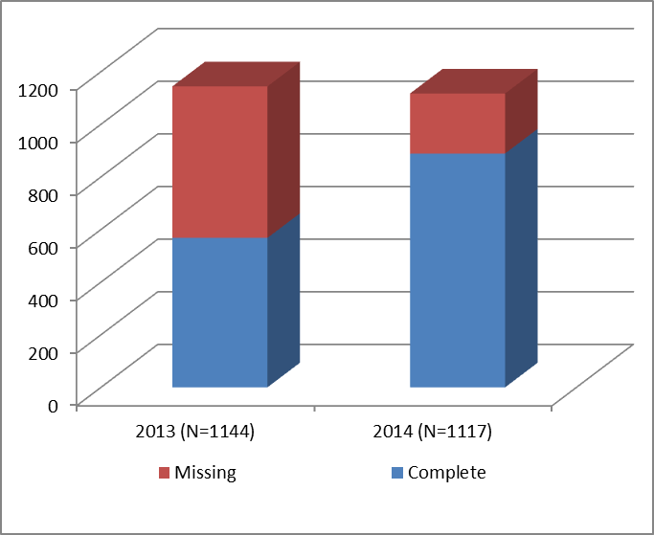
Salmonellosis
Completeness of Occupation information between 2013 and 2014
20%
N=228
50%
N=576
Odds Ratio:3.95; 95% Confidence Interval: 3.28, 4.76;
p-value <0.0001
Number of Confirmed Cases
Events in 2014 were 4 times more likely to have Occupation completed compared to events in 2013

Slide 30
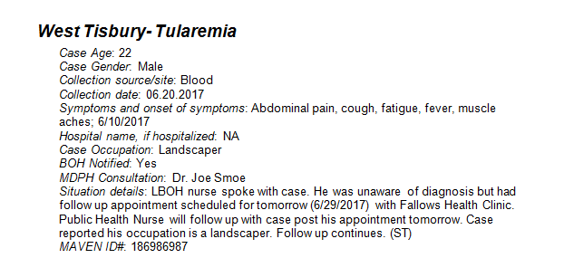
Manual Process
Tularemia/Landscaper – daily Epi-of-the-day notes reviewed by surveillance staff and then notify OHSP

Slide 31
Next Steps
Create additional variables in MAVEN to identify potential work related risk
Incorporate OHSP into MAVEN workflows to identify cases of relevance
Extract data for OHSP on an on-going basis for review and analysis
Use data to identify emerging hazards and occupations at risk
Work with OHSP to develop prevention material where relevant
Determine process for updating reference code list when needed

Slide 32
More Information
More information
Scott Troppy
Bureau of Infectious Diseases and Laboratory Sciences
scott.troppy@state.ma.us
617-983-6819
Angela Laramie
Massachusetts Occupational Health Surveillance Program
angela.Laramie@state.ma.us
617-624-5641

Slide 33
Hot Topic: Proposed Change to Unique Case Identifier in Disease Notifications sent to MVPS
Lesliann Helmus, MS, CHTS-CP
NNDSS Program Manager
Division of Health Informatics and Surveillance
Center for Surveillance, Epidemiology, and Laboratory Services
Centers for Disease Control and Prevention

Slide 34
NNDSS approaches to Unique Case ID
NNDSS approaches to Unique Case ID
System/Message | Data Elements
NETSS | CaseID + State + Site ID + MMWR Year
NBS Master Message | Local Record ID + State Code
Old HL7 messages | Local Record ID + State Code
MVPS | Local Record ID + National Reporting Jurisdiction + Date first electronically submitted
* CaseID and Local Record ID both represent the case identifier in the jurisdiction surveillance system
Presumed benefits of including “Date first electronically submitted”:
Historically, some states re-used case IDs from year to year
States with multiple surveillance systems could conceivably have two cases with the same ID
Observed drawbacks based on experience with ~25 states:
Some states have had difficulty sending the value reliably (failures resulted in numerous duplicates)
Many surveillance systems were not designed to capture and store this value
Extensive programming may be required to capture and store
It is difficult to maintain the value when states migrate data to a new surveillance system
Notes:
Note: We may include botulism in the FDD MMG, but since this isn’t definite, I thought I’d mention that it is under consideration but not list those conditions on the slide.

Slide 35
Proposed strategy
Proposed strategy
Recommended change:
  Use Local Record ID + National Reporting Jurisdiction as unique case ID in MVPS
  Remove Date first electronically submitted from MVPS calculation of unique case identifier
  Hold jurisdictions responsible for ensuring that Local Record ID is unique within jurisdiction
Considerations for states:
  If system re-uses identifiers annually: add year indicator (e.g., year case created)
  If multiple surveillance systems are use: add system indicator
  If sub-jurisdictions use their own systems: add a system or sub-jurisdiction indicator
  If migrating between systems: incorporate original Local Record ID in Legacy Case ID field in new system
Thoughts?
Notes:
Note: We may include botulism in the FDD MMG, but since this isn’t definite, I thought I’d mention that it is under consideration but not list those conditions on the slide.

Slide 36
Upcoming eSHARE Webinars
August 15
  Panel Presentation of States Onboarded to MVPS to Discuss Barriers, Challenges, and Lessons Learned.

Slide 37
Questions and Answers

Slide 38
Additional Questions?
Subscribe to monthly NMI Notes news updates at https://www.cdc.gov/nndss/trc/news/index.html!
Access the NNDSS Technical Resource Center at https://www.cdc.gov/nndss/trc/index.html!
Request NMI technical assistance or onboarding at
edx@cdc.gov!
Next NMI eSHARE is August 15, 2017–details at https://www.cdc.gov/nndss/trc/onboarding/eshare.html!

