Slide 1
NMI eSHARE: Implementation Preparation 101
New Webinar Information:
Conference Number: 1-877-668-4490
Participant Code: 799 765 273
WebEx meeting: https://cste.webex.com/cste/k2/j.php?MTID=td0a9a37ae49940a935f1a688f38cc40d
-Enter your name and email address
-Enter the session password: nmi1234
-Click "Join Now"
NOTE: Session will be recorded and posted on the NNDSS eSHARE website: https://www.cdc.gov/nndss/trc/onboarding/eshare.html.
Subscribe to monthly NMI Notes news updates at https://www.cdc.gov/nndss/trc/news/index.html!
February 21, 2017 Division of Health Informatics and Surveillance

Slide 2

Agenda
Welcome and Introductions
Announcements:
  Launch of NMI Technical Assistance and Onboarding
  Planned Refinements to Message Validation, Processing, and Provisioning System (MVPSu)
  NMI Timeline
  New Conditions Added to Generic v2 Only Message Mapping Guide (MMG)
Implementation Preparation 101
Hot Topic: MVPS Reconciliation
Questions and Answers

Slide 3
Launch of NMI Technical Assistance and Onboarding
Request Technical Assistance:
  Send email to edx@cdc.gov.
  Use “NMI Technical Assistance Request” as subject line.
  Include brief description of assistance needed.
  NMI Technical Assistance Team will reach out to you for additional information.
Request for Onboarding:
  Send email to edx@cdc.gov.
  Use “[Your PHA] NMI Onboarding Package for [MMG]” as subject line.
  Include information requested for onboarding package (available in NMI Public Health Agency Onboarding Guidebook on online NMI Technical Assistance and Training Resource Center).
  NMI Onboarding Team will reach out to you for additional information.

Slide 4
Refinements to Message Validation, Processing, and Provisioning System
CDC is making updates to MVPS (“MVPS Classic” “MVPSu”).
Changes will
  improve code manageability, development efficiency, and flexibility;
  replace some difficult-to-support software; and
  redesign processing database.

Slide 5
Expected Timeline for NMI
Generic v2 and Hepatitis expected to migrate to MVPSu in late July 2017.
MVPSu ready to receive STD and Congenital Syphilis data in October 2017.
MVPSu ready to receive Mumps and Pertussis data in December 2017.
MVPSu ready to receive Varicella data in February 2018.
Work continues on other MMGs.
NMI is creating re-usable data element blocks and templates, where possible.

Slide 6
Conditions Added to Generic v2 Only
2017 NNDSS Event Code List and Conditions to Use Generic v2 Only List will be updated to include:
    Cyclosporiasis (event code 11575)
    Trichinellosis (event code 10270)
    Malaria (event code 10130)
      States must continue to send Malaria case reports to the National Malaria Surveillance System (NMSS) until they have onboarded the Malaria MMG.
NMI will announce when MVPS is ready to accept these conditions.

Slide 7
NMI HL7 Case Notification Message Implementation Preparation 101
Tools, Resources, and First Steps
Laura Carlton, Sr. Specialist Informatics, APHL

Slide 8
Objectives for Today
Walk Through Tools and Resources
CDC resource centers
Closer Look at First Steps
What to review
What to gather
Who to involve
What To Watch Out For
Things to think about as you get ready
Decisions you’ll need to make, things you’ll need to know
NMI HL7 Case Notification Implementation Guidebook
NMI Technical Assistance and Training Resource Center
NNDSS HL7 Case Notification Resource Center

Slide 9
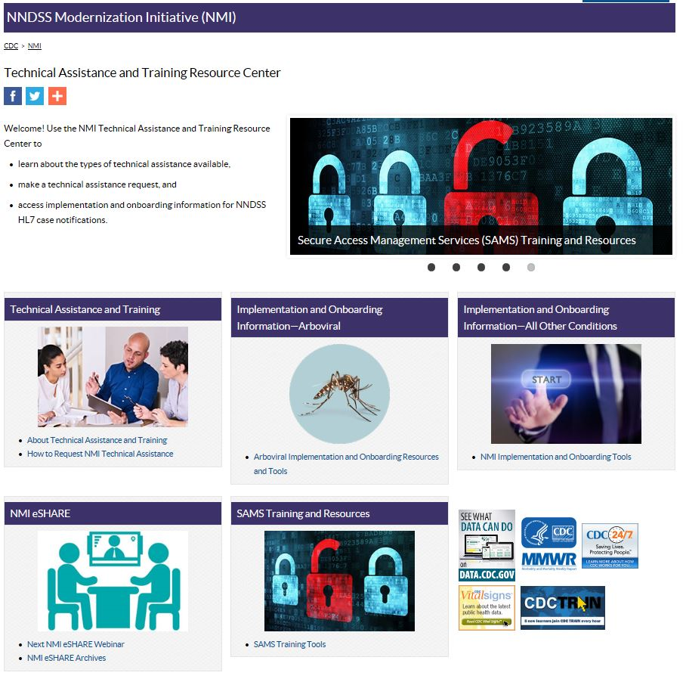
Screenshot of the NMI Technical Assistance and Resource Center

Slide 10
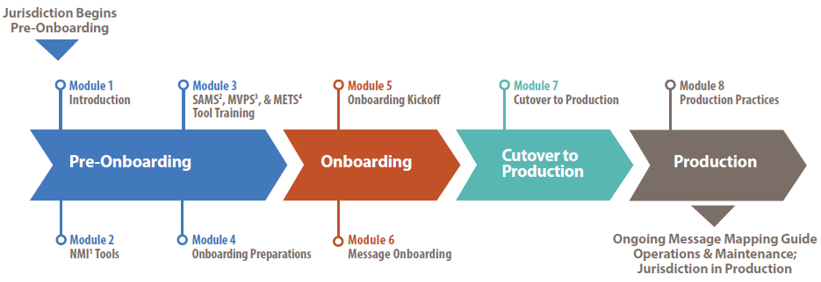
NNDSS Technical Resource Center
Contains tools and guidance to help you through the entire NMI implementation process from pre-onboarding to production.
https://www.cdc.gov/nndss/trc/index.html

Slide 11
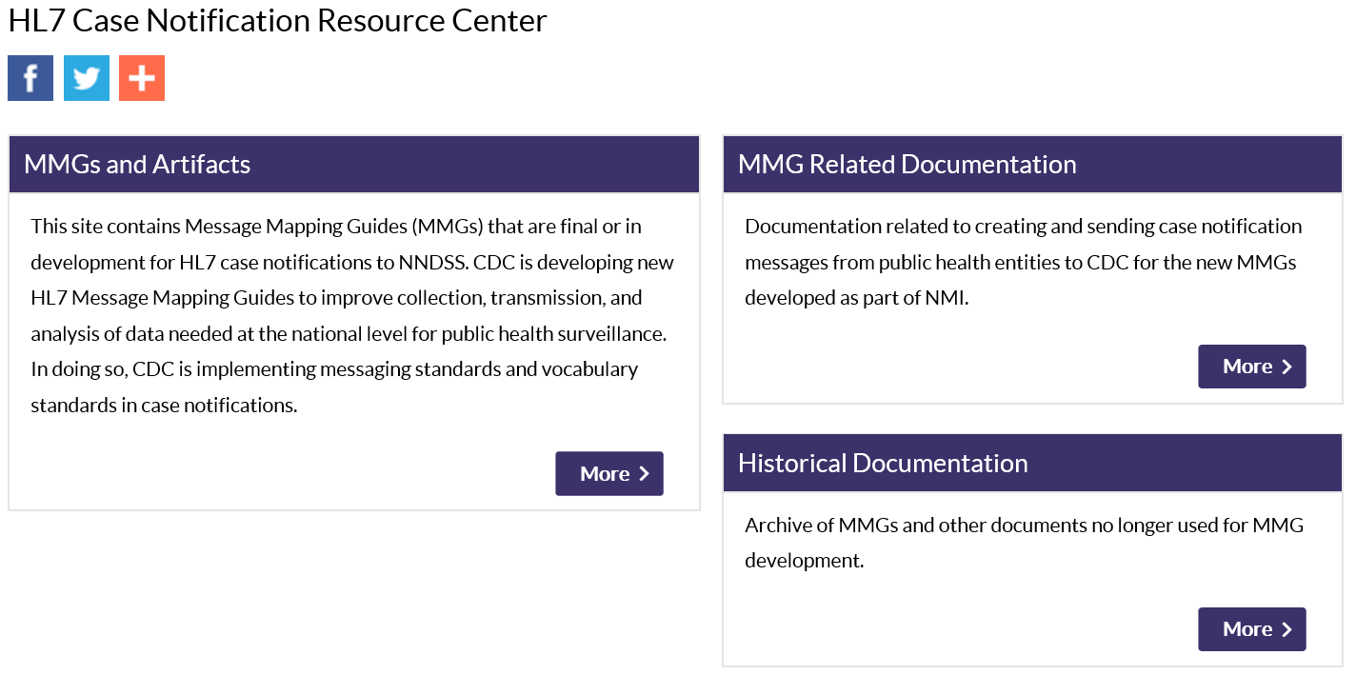
HL7 Case Notification Resource Center
https://www.cdc.gov/nndss/trc/index.html

Slide 12

NMI Tools and Resources
HL7 Case HL7 Implementation & Onboarding Technical Assistance
  PHIN Messaging System (PHINMS) Message Guide
  MMGs and Artifacts
  PHIN Messaging Guide
  MMG FAQs
NNDSS Technical Resource Center
  NMI HL7 Case Notification Implementation Guidebook
  NMI Public Health Agency Onboarding Guidebook
  Arboviral Implementation and Onboarding Information
  Secure Access Management Services (SAMS) Training
  NMI eSHARE
  Technical Assistance

Slide 13
NMI HL7 Case Notification Implementation Guidebook
What is it for?
Serves as a planning resource and guide for public health agency teams about the NMI case notification implementation process
Walks through general steps and considerations (these may vary by system)
Who is it for?
Surveillance system coordinators
Program subject matter experts
IT staff

Slide 14
NMI HL7 Case Notification Implementation Guidebook
Process objectives and milestones
Who needs to be involved
How to get ready
Things to consider
Best practices
Additional tools and resources
(e.g., NMI Infrastructure Assessment)

Slide 15

How To Get Ready
Organizational groundwork
System preparation
Planning considerations

Slide 16
Gather Resources
Identify which MMGs and conditions you will be implementing.
  Generic v2, Hepatitis, and Arboviral v1.3 MMGs are currently available for onboarding.
Collect important documents and templates.
  These may vary depending on system.
  Consider both local and CDC artifacts.
Identify your team:
  disease subject matter experts;
  surveillance system coordinators;
  integration engine and/or database administrators;
  network administrators; and/or
  programmatic, technical, and management leadership.

Slide 17

Level Set
Having everyone involved from the start is key to a successful implementation.
With all players at the table, discuss objectives, roles and responsibilities.
  Designate an NMI Project Champion
  to ensure buy-in, resource allocation.
  Ensure that all required staff resources
  understand objectives and are
  committed to success.

Slide 18
System Considerations
  Does your test environment mirror your production environment?
  How do you generate your case notifications?
  How do you put them into HL7?
  Are you able to send by using PHINMS?
  Is PHINMS available in the test environment to send test messages?
  Can PHINMS in the production environment send messages to MVPS onboarding and MVPS production during onboarding process?

Slide 19
Planning: Timing Considerations
Are there any major system changes planned within the next year?
When are key resources available?
Are there any budget or contractual issues to consider?

Slide 20
Planning Considerations
  Are data transformations needed?
  Are data elements for a case in multiple surveillance systems?
  Have you allowed time for message building and validation?
  Can the system support new and legacy reporting methods?
  How will you document processes and data transformations?

Slide 21

Know Before You Go…
Understand your system:
Is a notification sent when a case is updated?
What happens when you delete a case?
If you change case status to not a case, is a notification sent?
What happens when you merge cases?
Can you tell if a notification has been sent on a case?
Know how to find the right data when they may be in different systems or formats:
How to access lab findings?
How to access vaccination information?
How do you decide which data elements to map to the MMG?
Do you need to transform data elements or values to be consistent with the standards used in the MMG?

Slide 22

Make It Work!
Check to ensure that unique identifiers for a case are consistent.
  National reporting jurisdiction (NOT116, 77968-6)
  Local Record ID (INV168, in OBR-3)
  Date first electronically submitted (NOT103 in OBR-7)
Send case notifications.
  During the investigation, when do you trigger the case notification?
  Can you send notifications daily?
  Who needs to know that a case notification was sent?
  When and how will they be notified?
  Who will check the MVPS Dashboard?
  Who will be responsible for fixing and re-transmitting messages?
  Do you archive sent messages in case you need to retransmit?

Slide 23
States Using CDC-Developed NEDSS Base System (NBS)
Use the following tools provided by the NBS team:
  NBS Nationally Notifiable Disease (NND) Onboarding FAQ document to help with planning,
  NBS Page Builder Template (to be used in place of data extraction/mapping/transformation/message creation),
  Implementation Spreadsheet (pre-populated with standard mappings), and
  NBS Standard NND Rhapsody Route.
Use NBS release 5.0 or higher.
  NBS 5.0 includes PHINMS Service/Action Pair configurability, which ensures that messages go to proper location during and after onboarding.
Submit support ticket to NBSCentral to discuss implementing the appropriate page(s) in your system.

Slide 24
NMI Contact Information
Send questions and inquiries to edx@cdc.gov.
To request NMI Technical Assistance:
  Use “NMI Technical Assistance Request” as the subject line and include a brief description of assistance needed.
To start NMI Onboarding:
  Submit onboarding package and use “[Your PHA] NMI Onboarding Package for [MMG]” as the subject line.

Slide 25
Reconciliation Process for Morbidity and Mortality Weekly Report (MMWR) Annual Summary of Notifiable Infectious Diseases and Conditions – United States, 2016
Yvette Dominique, MS, PMP, Data Processing Team Lead
Deborah Adams, Data Operations Team (DOT) Project Lead
Diana Onweh, Data Operations Team
Alan Schley, Data Operations Team
Surveillance and Data Branch
Division of Health Informatics and Surveillance

Slide 26
Overview
Purpose:
  Reconcile counts in CDC NNDSS database with jurisdiction counts
Guidance provided:
  State epidemiologist letter and summary production calendar
  State reporter letter with
    summary production calendar
    reconciliation tables (1–13) with instructions for reviewing tables
    week-ending calendar
    2016 NNDSS Event Code List
    unformatted data in Excel workbook
  If needed, jurisdictions can request case-level line lists

Slide 27
2016 Tentative MMWR Summary Production Calendar
03/06/17 Data Coordinator emails State Epidemiologist letter with timeline calendar
03/17/17 Data Team begins generating/emailing reconciliation reports to State Reporters
03/24/17 Deadline: State Epidemiologist responds to letter and timeline
03/??/17 Rabies Program office database closed
04/??/17 STD Program office database closed
05/??/17 Varicella Program office database closed
05/02/17 States’ last day transmitting 2016 data as part of their weekly transmissions
05/30/17 States’ last day transmitting 2016 FINAL year-to-date data files
06/05/17 Data Team begins emailing FINAL counts to State Epidemiologists for FINAL signatures
06/24/17 Deadline: State Epidemiologists fax FINAL signatures on the report back to CDC
06/??/17 TB Program office database closed
06/??/17 Influenza-associated Pediatric Mortality Program office database closed
06/??/17 Novel Influenza A Virus Program office database closed
06/30/17 NNDSS SAS database FINAL
07/??/17 ArboNet Program office database closed
10/25/17 Publish FINAL 2016 Reports of Nationally Notifiable Infectious Diseases Early Release Table

Slide 28
Reconciliation Reports
The NND event codes have been added to all 13 (.html) reconciliation reports.
DISEASE | EVENT | UNKNOWN | SUSPECT | PROBABLE | CONFIRMED | MMWR PRINT | TOTAL REPORTED
 |  | STATUS | STATUS | STATUS | STATUS | TOTAL | TO CDC
Anthrax | 10350 | 0 | 0 | 0 | 0 | 0 | 0
Babesiosis, Total | 12010 | 0 | 0 | 0 | 4 | 4 | 4
Babesiosis, confirmed | 12010 | 0 | 0 | 0 | 4 | 4 | 4
Babesiosis, probable | 12010 | 0 | 0 | 0 | 0 | 0 | 0
Botulism, Total | 10360 | 0 | 0 | 0 | 1 | 1 | 1
Botulism, foodborne | 10530 | 0 | 0 | 0 | 0 | 0 | 0
Botulism, infant | 10540 | 0 | 0 | 0 | 1 | 1 | 1
Botulism, other(wound/unspecified) | 10550 | 0 | 0 | 0 | 0 | 0 | 0
Brucellosis | 10020 | 0 | 0 | 2 | 1 | 3 | 3
Campylobacteriosis | 11020 | 0 | 0 | 250 | 1,206 | 1,456 | 1,456
Chancroid | 10273 | 0 | 0 | 0 | 0 | 0 | 0
Chlamydia trachomatis infection | 10274 | 0 | 1 | 6 | 45,320 | 45,327 | 45,327
Cholera | 10470 | 0 | 0 | 0 | 1 | 1 | 1
Coccidioidomycosis | 11900 | 0 | 0 | 2 | 29 | 29 | 31
Cryptosporidiosis, Total | 11580 | 0 | 0 | 69 | 314 | 383 | 383
Cryptosporidiosis, confirmed | 11580 | 0 | 0 | 0 | 314 | 314 | 314
Cryptosporidiosis, probable | 11580 | 0 | 0 | 69 | 0 | 69 | 69
Cyclosporiasis | 11575 | 0 | 0 | 0 | 3 | 3 | 3
Diphtheria | 10040 | 0 | 0 | 0 | 0 | 0 | 0

Slide 29
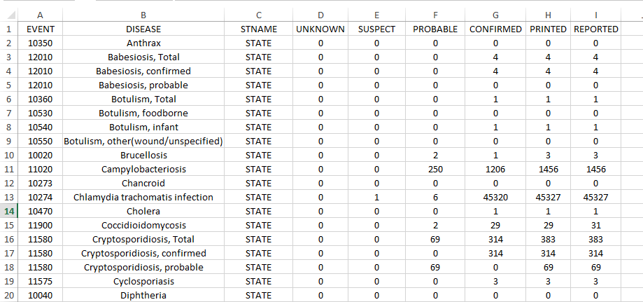
2016 Unformatted Excel Workbook
Data from each report will be provided in an unformatted Excel workbook.

Slide 30
Reporting Exceptions
Excludes cases from counts if condition is not reportable in jurisdiction.
Avoids implying low level of disease when condition is not reportable.
Ensures appropriate denominators for rates.
MMWR “N” indicator shows condition is not reportable in a state.
For Year 2016:
  Is using information collected early in 2016 for MMWR “N” indicators.
  Council of State and Territorial Epidemiologists’ 2016 State Reportable Conditions Assessment (SRCA) data are currently in quality assurance.
  For annual statistics, DOT will incorporate finalized 2016 SRCA results (if available).
For Year 2017:
  MMWR “N” indicators currently assigned based on 2016 reporting exceptions.
  In March states will receive spreadsheet requesting 2017 reporting exceptions.
  For annual statistics, DOT will incorporate 2017 SRCA results (if available).

Slide 31
Questions and Answers

Slide 32
Additional Questions?
Additional Questions?
Email EDX@cdc.gov
Subscribe to monthly NMI Notes news updates at https://www.cdc.gov/nndss/trc/news/index.html!

