Slide 1
NMI eSHARE: Updated Process for Generic v2 and Hepatitis Implementation and Onboarding
New Webinar Information:
Conference Number: 1-877-668-4490
Participant Code: 790 833 009
WebEx meeting: https://cste.webex.com/cste/k2/j.php?MTID=t885fd9fce82c4cb8811132672efe24ce
-Enter your name and email address
-Enter the session password: nmi1234
-Click "Join Now"
NOTE: Session will be recorded and posted on the NMI eSHARE website: https://www.cdc.gov/nndss/trc/onboarding/eshare.html.
Subscribe to monthly NMI Notes news updates at https://www.cdc.gov/nndss/trc/news/index.html!
November 17, 2016 Division of Health Informatics and Surveillance

Slide 2

Agenda
Welcome and Introductions
Hot Topic: Update on Recent Message Validation, Processing, and Provisioning System (MVPS) User Acceptance Testing (UAT)
  Lesliann Helmus, CDC
Refresher on Message Evaluation and Testing Service (METS) and MVPS Dashboard
  Ariel Powell, CDC
Updated Process for Generic v2 and Hepatitis Case Notification Implementation and Onboarding
  Michele Hoover, CDC
Questions and Answers

Slide 3
Update on Recent MVPS User Acceptance Testing
Lesliann Helmus, MS, CHTS-CP
NNDSS Program Manager
Division of Health Informatics and Surveillance
Center for Surveillance, Epidemiology, and Laboratory Services
Centers for Disease Control and Prevention

Slide 4
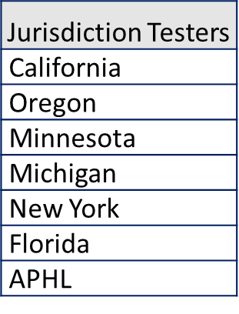
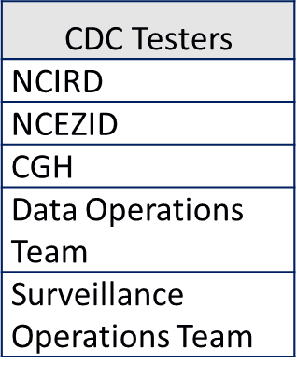
MVPS UAT Overview and Participation
Second round of MVPS User Acceptance Testing
  Addressed Generic v2 and Hepatitis processing and provisioning
  Conducted from Monday, October 31–Wednesday, November 9, 2016.
MVPS UAT participants
  Jurisdiction Testers: 17
  CDC Testers: 19

Slide 5
Volume of Processed Messages and Test Results
Messages processed by MVPS
MVPS test team messages uploaded to MVPS: More than 300
Jurisdiction messages sent to MVPS: 74
Distribution of Completed Test Scripts by Functionality
Testers | METS |  | MVPS Dashboard |  |  | MVPS Data Provisioning
 | User Interface | Message Processing | User Management | User Interface | Message Processing | General Provisioning Test | Advanced Provisioning Test
Jurisdiction Testers | 13 | 13 | 9 | 14 | 20 | N/A | N/A
CDC Testers | N/A | N/A | 2 | 15 | 9 | 3 | 3

Slide 6
Summary of UAT Results
Total number of potential issues and enhancements raised by testers: 182
  Duplicate issues and enhancements: 77
  Unique issues and enhancements: 105
Non-defects: 86
    Enhancement requests: 29
    Test script errors: 19
    Issues raised that could not be replicated by the MVPS team: 38
Defects: 18
    New defects found during UAT: 6
    Defects identified by MVPS team prior to UAT: 12
* Upon further review, 1 previously identified issue was misinterpreted by the MVPS team and is not considered a defect (as of 11/18/16). This perceived issue was identified by the MVPS team prior to UAT and is functioning according to the system requirements. There are now 18 confirmed defects (instead of the 19 defects communicated on 11/17/18).

Slide 7
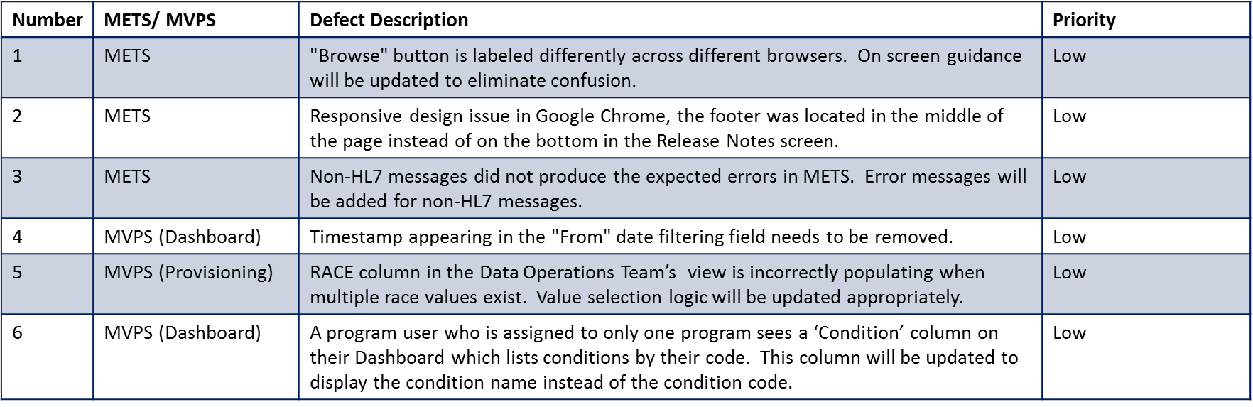
New Defects Found During UAT Classified as Low Priority
6 unique defects were found by UAT participants.
Further details will be provided in the UAT Summary Report.

Slide 8
Message Transmission Issues
End-to-end testing identified problems with the transmission of messages from jurisdictions to MVPS.
Key findings:
  Enhancements to the PHIN Messaging System (PHINMS) will help prepare for heavy volume.
  It is important for jurisdictions to understand their message generation and transmission processes.
  Data elements that identify a unique case need to be consistent when updates are sent.

Slide 9

Hot Topic
Overview of MVPS
Ariel Powell
Message Validation, Processing, and Provisioning System
Division of Health Informatics and Surveillance
Center for Surveillance, Epidemiology, and Laboratory Services
Centers for Disease Control and Prevention

Slide 10
Overview of MVPS
Message Validation, Processing, and Provisioning System (MVPS)
A system that validates and processes nationally notifiable disease (NND) case notification messages sent by jurisdictions and provisions the data to CDC programs.
Message Evaluation and Testing Service (METS)
A tool that validates and provides feedback on messages that will be submitted to MVPS based on required standards.
MVPS Drivers
Data Collaboration
Timely and Accurate Data
Streamlined Data Collection
The system will provide submitting jurisdictions the ability to view the data they have submitted and identify data quality issues.
The system will allow CDC programs to analyze health-related data, including electronic health record data, to further the agency’s public health goals.
MVPS reduces the number of systems processing data at CDC and allows for streamlined message processing from jurisdictions to CDC.

Slide 11
MVPS Roles
There are 2 roles within MVPS: Jurisdiction Data Manager and Data User
Jurisdiction and Condition Assignments in MVPS
Users can only access data for the conditions and jurisdictions that they are assigned by the MVPS Support Manager or Data Manager within MVPS.
Data Manager Role
Can view messages and message details through the MVPS Dashboard.
Can add authorized users to MVPS.
Can add and/or edit users and assign their conditions.
Data User Role
Can view messages and message details through the MVPS Dashboard.

Slide 12
Apply for SAMS
  Jurisdictions will require Secure Access Management Services (SAMS) Level 2 access to use MVPS.
  Users With SAMS Level 2 Access:
  The MVPS SAMS Application Administrator will activate the MVPS link on SAMS for users with the appropriate SAMS access.
  Users Without SAMS Level 2 Access:
  Jurisdictions may request SAMS access by emailing edx@cdc.gov with Subject line: SAMS Request Initiation.
  Jurisdictions will need to identify a Designated Proofing Agent (authorized badged CDC staff or notary public) to sign and complete the final SAMS application.
  SAMS access is free.
  Please allow at least 1 full week to receive access.
  Please review the MVPS SAMS Guide, found on the NNDSS Technical Resource Center SAMS Training Tools Page at https://www.cdc.gov/nndss/trc/data-systems/sams.html, for additional information.

Slide 13
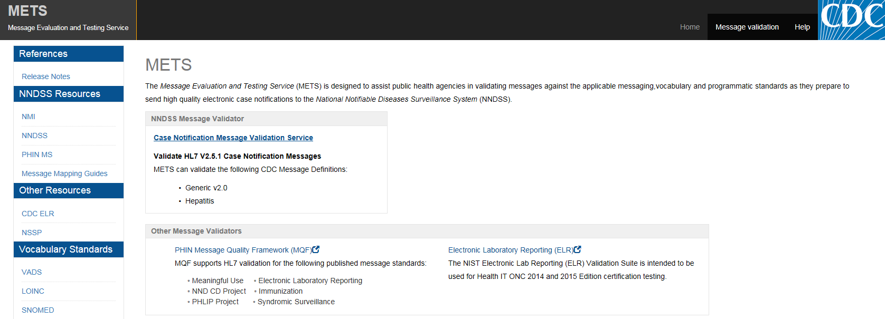
METS Orientation
https://mets.cdc.gov

Slide 14
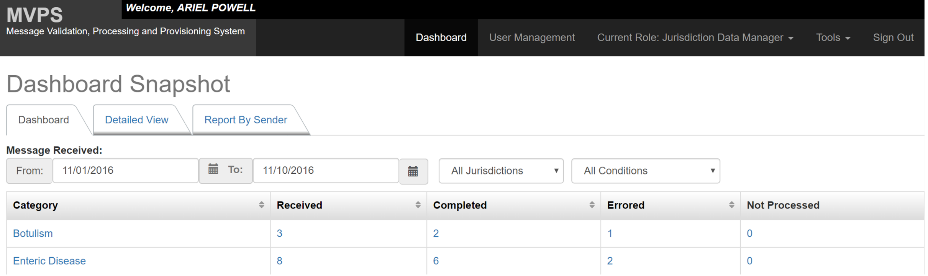
MVPS Orientation: Dashboard Snapshot

Slide 15
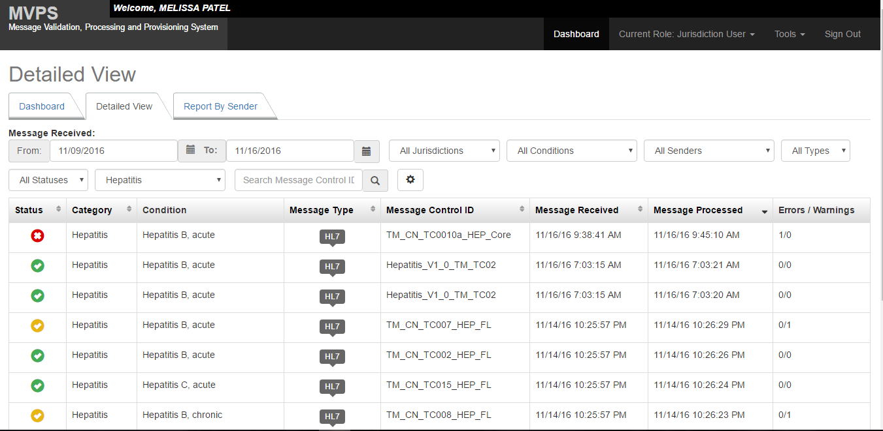
MVPS Orientation: Detailed View

Slide 16
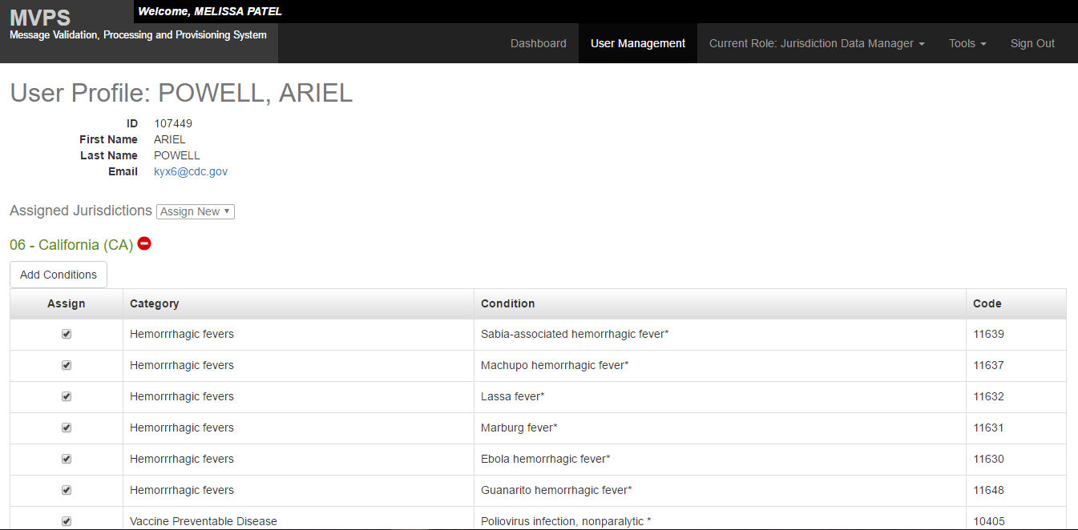
MVPS Orientation: User Management

Slide 17
Hot Topic
Updated Process for Generic v2 and Hepatitis Case Notification Implementation and Onboarding
Michele Hoover, MS Calvin Hightower, MPA
Trevor Hsu, MPH Melinda Thomas, MPH
NMI State Implementation and Technical Assistance Team
Division of Health Informatics and Surveillance
Center for Surveillance, Epidemiology, and Laboratory Services
Centers for Disease Control and Prevention

Slide 18
What is Onboarding?
Onboarding is the process used to make a smooth and fast transition from sending older case notifications to the new HL7 format.
Onboarding will help CDC ensure that
  data submitted to MVPS are based on the final National Notifiable Diseases Surveillance System (NNDSS) HL7 MMG requirements and
  CDC programs can be confident in the quality of the data that they receive.

Slide 19
Expectations for Onboarding
CDC expects to be ready to receive case notifications through MVPS in December for:
  Generic v2
  Hepatitis.
CDC is receiving Arboviral v1.3 case notifications from select pilot jurisdictions and expects to be able to receive case notifications from other jurisdictions in January 2017. Please note that MVPS is not used for Arboviral messages.
Onboarding tools and resources will be available soon at the online NMI Technical Assistance and Training Resource Center.
All state-reportable diseases that are nationally notifiable for each MMG will be onboarded at the same time.
Note: The estimated time for onboarding is 1–2 weeks.

Slide 20

NMI Jurisdiction Onboarding
MVPS Onboarding
Jurisdiction Begins Pre-Onboarding
Module 1 Introduction
Module 3
SAMS ², MVPS ³, & METS ⁴
Tool Training
Module 5 Onboarding Kickoff
Module 7
Cutover to Production
Module 8
Production Practices
Pre-Onboarding
Onboarding
Cutover to Production
Production
Module 2 NMI ¹ Tools
Module 4
Onboarding Preparations
Module 6
Message Onboarding
Ongoing Message Mapping Guide Operations & Maintenance; Jurisdiction in Production
¹ NMI (National Notifiable Diseases Surveillance System Modernization Initiative)
² SAMS (Secure Access Management Services)
³ MVPS (Message Validation, Processing, and Provisioning System)
⁴ METS (Message Evaluation and Testing Service)

Slide 21
Overview: Pre-Onboarding
NMI Technical Assistance Tools
  Onboarding Guidebook
  Implementation Spreadsheet—required for onboarding
  Test Case Scenario Worksheet—required for onboarding
  Technical Assistance and Implementation Guidebook
  Request for Technical Assistance
SAMS, MVPS, and METS Tool Training (https://www.cdc.gov/nndss/trc/data-systems/sams.html)

Slide 22
Pre-Onboarding: Onboarding Preparations Overview
Obtain SAMS Level 2 Access for all users who will need access to the MVPS Dashboard.
Request technical assistance if needed.
Review onboarding tools and resources.
Complete required documents for onboarding.
Prepare test messages.
Validate test messages in METS.
Send email to edx@cdc.gov to initiate onboarding.
Notes:
-states with SAMS level 1 users that they have to reapply for level 2. Remind states that all users have to have level 2 access.

Slide 23
Pre-Onboarding: Onboarding Preparations
To initiate the onboarding process, the jurisdiction will send an email to EDX@cdc.gov that indicates or includes the following:
  Completed all required trainings (SAMS, MVPS), are able to access MVPS Dashboard, and have identified a Data Manager role in MVPS.
  Provided stakeholder roles and contact information.
  Identified NNDSS diseases that are state reportable for the guide to be onboarded.
  Completed required section of the implementation spreadsheet.
  Completed test case scenario worksheet with jurisdiction-specific data.
  Validated that test messages have been created and passed METS with no errors.

Slide 24
Pre-Onboarding: Onboarding Preparations (cont.)
The CDC onboarding specialist will review the submitted materials and enter them into the onboarding tracking tool.
The CDC onboarding specialist will send an email to the jurisdiction to do the following:
  Clarify or ask for additional information regarding the materials submitted.
  Invite the jurisdiction to participate in an onboarding kickoff that will occur by email or conference call.
  Provide a timeframe to start the onboarding process.

Slide 25
Onboarding: Kickoff
The jurisdiction and CDC will participate in an onboarding kickoff to do the following:
  Review steps for onboarding.
  Resolve any questions or issues with documentation from the onboarding package.
  Review expectations for stakeholders.
  Identify expected timeframe for onboarding.
  Schedule time to send test messages to onboarding environment.
  Provide PHINMS onboarding service action pair (will come from CDC to jurisdiction).

Slide 26
Onboarding: Test Message Validation
  The jurisdiction and CDC onboarding specialist will ensure that PHINMS is configured with the appropriate service action pair to the MVPS onboarding environment.
  The jurisdiction will send 7–10 test messages to the MVPS onboarding environment.
  The jurisdiction and CDC onboarding specialist will confirm that test messages have arrived through the MVPS Dashboard.
  The CDC onboarding specialist and program subject matter expert will review and validate test messages.

Slide 27
Cutover to Production: System Check
The jurisdiction will send a limited set of production messages to the MVPS onboarding environment to ensure that no problems emerge because of the move from the test environment to production.
The CDC onboarding specialist and program review the production messages and provide either
    feedback to address any problems identified or
    instructions to begin sending production messages.
Once approved, the CDC onboarding specialist provides PHINMS service action pair for the MVPS production environment.

Slide 28
Cutover to Production: Moving into Production
The CDC onboarding specialist will send an email to the jurisdiction that outlines these steps to retire legacy transmissions.
      Schedule a date for cutting over to production.
      Send year-to-date transmission through the legacy system for Morbidity and Mortality Weekly Report (MMWR) year(s) that have not been finalized.
      Send those same year-to-date messages, for MMWR year(s) that have not been finalized, to the MVPS production environment.
      Freeze sending notifications until case count is validated by CDC.
      CDC sends email to start sending production messages to MVPS.
      Turn off legacy feed for newly onboarded conditions.
      Jurisdiction is in production!

Slide 29
Production Best Practices
  Jurisdictions should send case notification messages as soon as they are ready.
  Jurisdictions should notify edx@cdc.gov of any issues they identify with METS or MVPS. The MVPS Operations and Maintenance team will address these issues.
  CDC programs will work with jurisdictions to address and resolve data issues.

Slide 30
How Will Onboarding be Different for MVPS than for Legacy Systems?
Communication regarding MVPS onboarding are coordinated through one email address: EDX@cdc.gov.
Jurisdictions will validate test messages by using METS.
Jurisdictions will send test messages directly to MVPS.
CDC will use a new tracking tool to help monitor, evaluate, and coordinate the onboarding process.
Technical assistance will be available to jurisdictions to help address issues.

Slide 31
MVPS Implementation: Resources
Final message mapping guides (MMGs), test case scenarios, and test messages (available on the NNDSS Technical Resource Center).
PHIN Notification Message Specification Profile v3.0
METS validation tool
November NMI eSHARE slides on updated process for Generic v2 and Hepatitis implementation and onboarding through MVPS—coming soon!
NMI implementation spreadsheet —coming soon!
NMI test case scenario worksheet —coming soon!

Slide 32
Arboviral v1.3 Implementation: Resources
Arboviral v1.3 MMG, test case scenarios, and test messages (available on the NNDSS Technical Resource Center).
PHIN Notification Message Specification Profile v2.0
Message Quality Framework (MQF) validation tool
October NMI eSHARE slides on Arboviral v1.3 implementation and onboarding
Arboviral v1.3 implementation spreadsheet —coming soon!
Arboviral v1.3 test case scenario worksheet—coming soon!

Slide 33
Questions and Answers

Slide 34
Additional Questions?
Additional Questions?
Email EDX@cdc.gov
Subscribe to monthly NMI Notes news updates at https://www.cdc.gov/nndss/trc/news/index.html!

