Slide 1
NNDSS Modernization Initiative (NMI) eSHARE:
CDC Surveillance Data Platform and Benefits to NMI
Conference Number: 800-779-9623
Participant Code: 9740330
NOTE: Adobe Connects Audio is not available.
Join the Adobe Connects meeting at: https://virtualsepd.adobeconnect.com/nmieshare/.
Click “Enter as a Guest,” provide your name, and click “Enter Room.”
Subscribe to monthly NMI Notes news updates at https://www.cdc.gov/nndss/trc/news/index.html!
September 15, 2016 Division of Health Informatics and Surveillance

Slide 2

Agenda
Welcome and Introductions
CDC Surveillance Data Platform (SDP)
  Teresa Kinley, MSCS, PMP, FAC P/PM III
Potential SDP Benefits to NMI
  Lesliann Helmus, MS, CHTS-CP
Hot Topic: Arboviral Update—Zika Event Codes
  Michele Hoover, MS
Questions and Answers

Slide 3
Surveillance Data Platform
Surveillance Data Platform (SDP)
with Shared Services Initiative
Teresa Kinley, MSCS, PMP, FAC P/PM III
SDP IT Program Manager
Center for Surveillance, Epidemiology, and Laboratory Services
Centers for Disease Control and Prevention

Slide 4
Agenda
CDC Surveillance Strategy
Overview of the Surveillance Data Platform Initiative
How Partners Can Get Involved
4

Slide 5
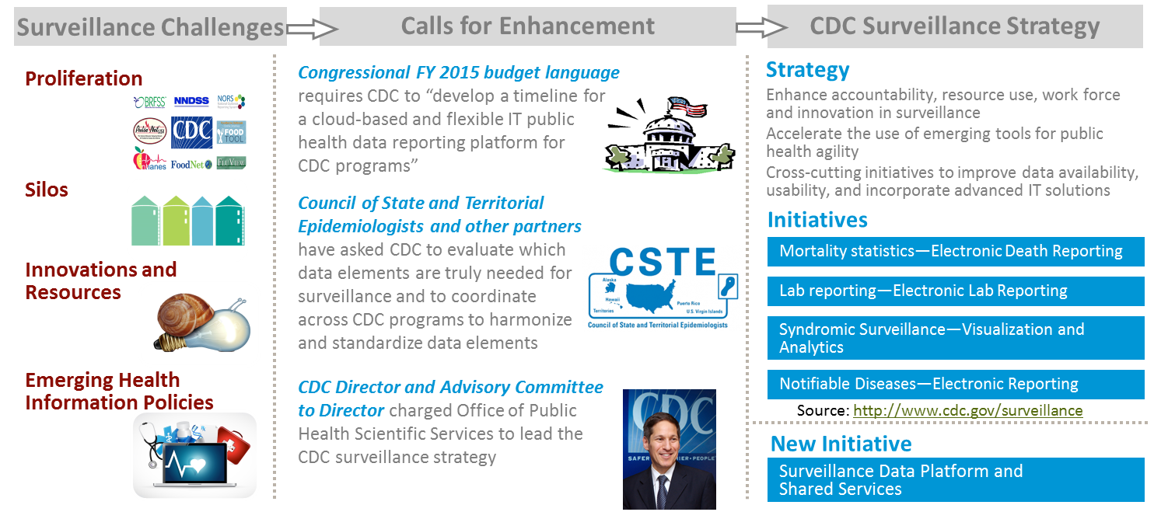
CDC Surveillance Strategy Initiated in 2014 To Improve Public Health Data Surveillance Capabilities
5
5
Notes:
The CDC Surveillance Strategy is led by OPHSS with charge from CDC Director and mandate from the Congress. The Vision for the Strategy is to have efficient systems that put the right data and information in the right hands the right time in the right format to take effective public health action
…

Slide 6



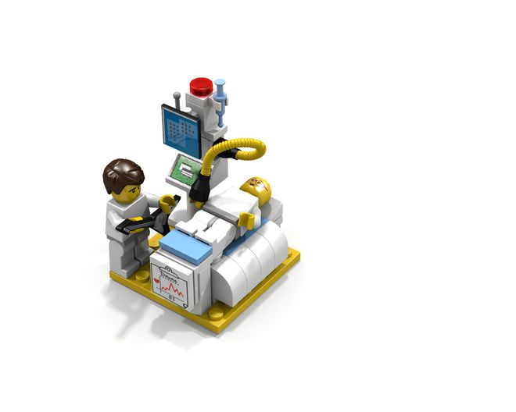
An Illustration:
Single Purpose Systems vs. Composable Shared Services
The Present
Services are designed for particular uses; not always shared
The Future (Vision)
Reusable services that can be assembled and re-assembled
for multiple public health uses
The Past
Single purpose systems
SDP builds the foundation for a future in which CDC scientists assemble services to create new capabilities in near real time, allowing a more agile response to public health emergencies
6
Notes:
Beyond the initial value and efficiencies of shared services, the Surveillance Data Platform builds the foundation for a future in which CDC scientists could assemble services to create new capabilities in near real time, allowing a more agile response to public health emergencies.
Services would be available to enable access to specific data elements, cleanse and validate the data, integrate data sources, perform analytics, and generate visualizations of the data, allowing scientists to respond to the public health threat.
In addition, if data could be shared across programs, it could result in unprecedented discoveries while investigating public health threats.
Goals of IT Shared Services
Improve the timeliness and quality of data received electronically by CDC and made available to CDC public health programs
Improve the cost efficiency of developing and maintaining surveillance activities
Reduce the number of independent, stand-alone systems
Reduce the reporting burden on external partners to share public health data and information with CDC
Reduce the length of time from determining surveillance data of interest, receiving data electronically, provisioning to programs and being able to act with data

Slide 7
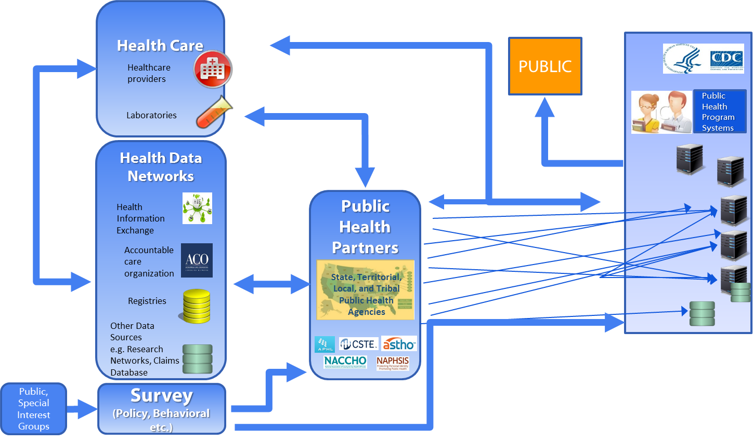

Current Surveillance Data Flow
Current Surveillance Data Flow
Public

Slide 8
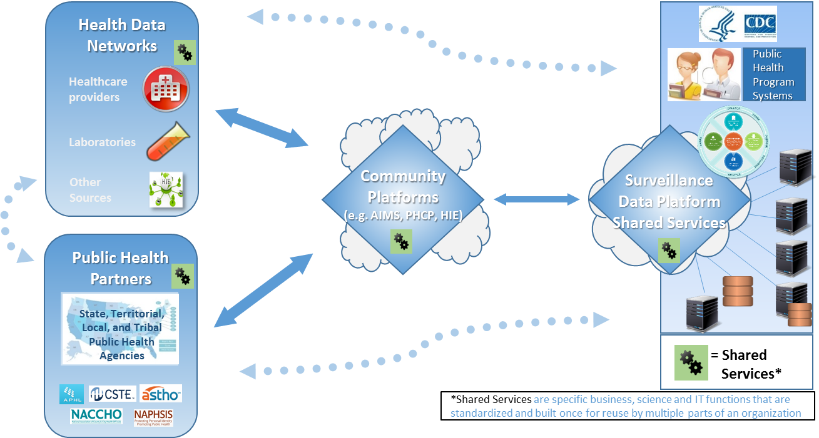
Vision for Surveillance Data Flow
8
Notes:
Emphasize community platforms include HIEs; create pathway to CDC

Slide 9

SDP Vision and Mission
Vision
Exchange Data. Share Tools. Drive Public Health Action.
Mission
Develop platform of services for internal and external partners that:
  Reduces unnecessary burden on internal and external partners
  Improves efficiency in data services
  Enhances the ability to collect, prepare, analyze, and share data
9
Notes:
Key terms defined.
Platform
Virtual environment that makes services available to users
Services
People, process, or technology that fulfills a need or request that is reusable and measureable
Shared Services
People, process, or technology that fulfills a common need or request that is used by more than one CDC Program, enabled to be sharable, scalable, and standardized. This includes shared governance of the shared service

Slide 10
Definitions
Platform
  Virtual environment that makes services available to users
Services
  People, process, or technology that fulfills a need or request that is reusable and measureable
Shared Services
  People, process, or technology that fulfills a common need or request that is used by more than one CDC program or partner, enabled to be sharable, scalable, and standardized
10

Slide 11
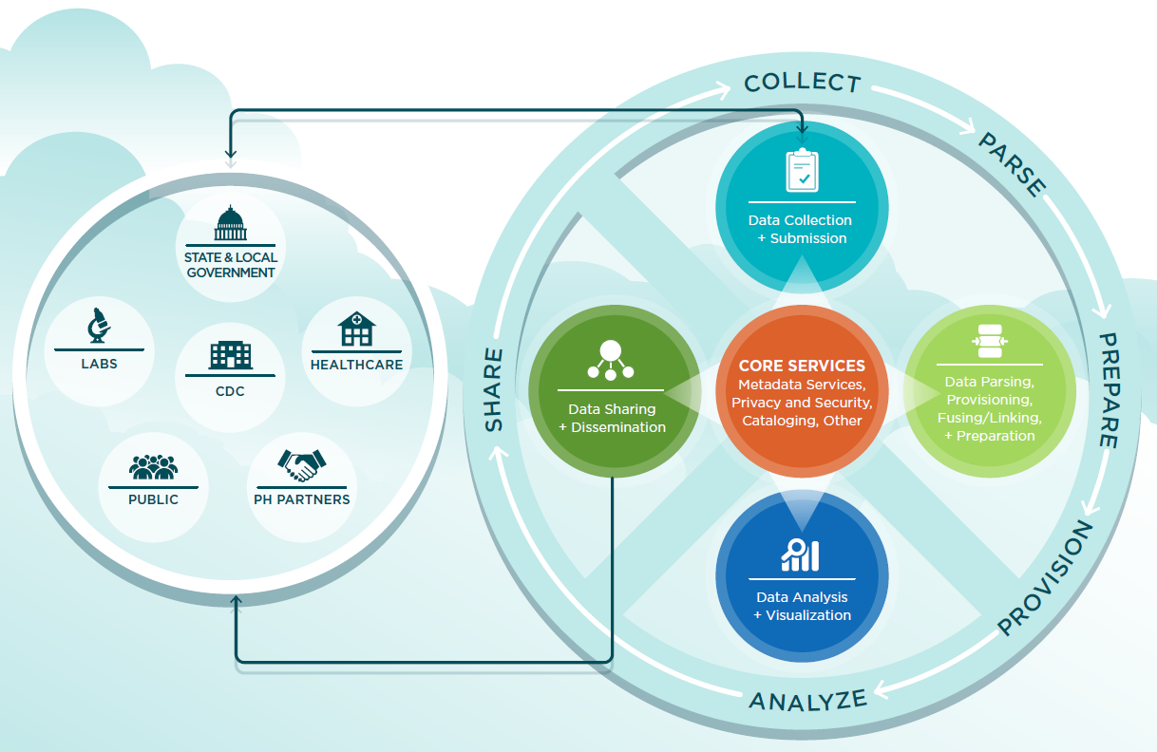
SDP Shared Services Concept Model
Notes:
Surveillance life cycle process – SDP offering tools to support over time; collecting data on behalf of current programs; data not being stored; your data not the platform’s; data moving more efficiently.
A common platform that provides shared services for CDC and public health partners
Platform
Virtual environment that makes services available to users
Services
People, process, or technology that fulfills a need or request that is reusable and measureable
Shared Services
People, process, or technology that fulfills a common need or request that is used by more than one CDC program or partner, enabled to be sharable, scalable, and standardized

Slide 12
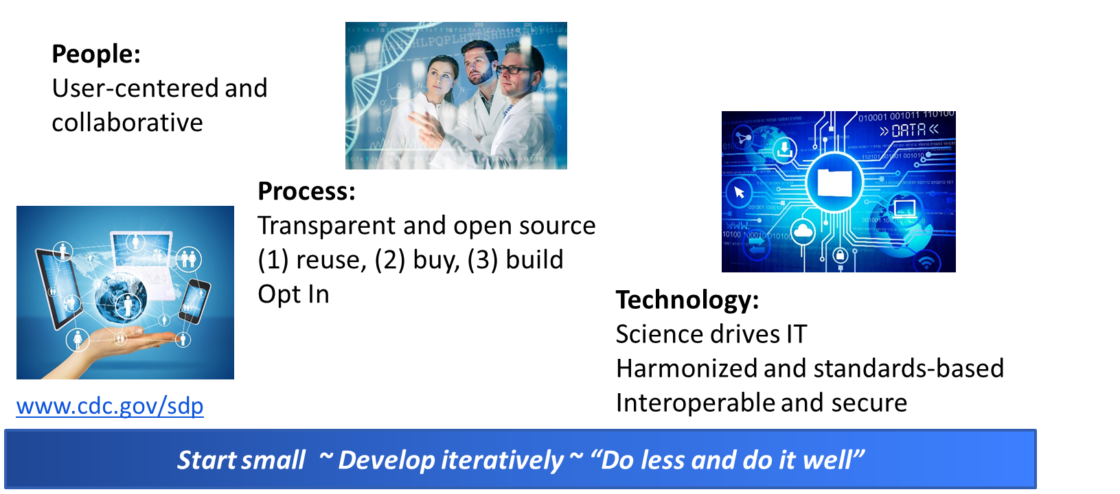
SDP Design Principles: How We Will Operate
Notes:
(without order)
Science drives IT, IT supports science- The scientific and public health needs of CDC programs should set the strategic direction for IT activities and capabilities. For each potential service, ask “does the service address programs data needs?”
Be selective in what is chosen for development, and do it well-Incrementally build small, modular services to demonstrate increasing value. Incremental pieces will work better together than apart. Keep roadmap and list of prioritized services in mind, while designing small units well.
User-centered-Users are engaged throughout the design, building and use of services on the platform. Customer-services approach that exceeds user experience expectations. For each potential service, ask “Who are the users for this proposed service? How are they involved in service development? Will it meet their needs?”
Data can be integrated, if desired-Data and information used by platform services is able to be integrated (e.g., across programs, across systems, with supplemental data from additional sources). Services and clear documentation make integration easier.
Standards based -Design of platform and services should reuse standards when applicable and appropriate.
Interoperable -Services support interoperability (e.g., using open application programming interfaces (APIs) when applicable and appropriate to reduce barriers for reuse).
Collaborative, transparent, open development and decision making-Consensus drives decision making with high communication and clear documentation for platform users and participants. Services meet cross-agency needs from at least two different public health programs. Documentation and engagement through all levels of platform.
Commitment to communicate with stakeholders-Part of open development is constant, clear communication for each user type (e.g., executive, program user, partner user, etc.). Stakeholders would need to be defined for each service or activity to ensure complete and effective communication.
Reuse, Buy, Build-Order of preference: (1) reuse a service that exists, (2) buy off the shelf software for a service, (3) build the service
Privacy & Security compliant-Security is integrated at all stages of design and development to protect privacy.
People choose to use (not forced to use) – “Opt in”-Marketplace of services that programs select the appropriate, useful services to connect to their surveillance programmatic work and improve their public health impact.
Tool optionality-Provide the tools and services that users need and request, rather than force users to adjust to a single tool.
Quality-Balance between scope, timeliness, and quality with emphasis on high quality to exceed user expectations.
Sustainability-Having the appropriate resources (financial, human, etc.) to maintain services built as well as to support additional services as they are needed.
Flexibility and scalability-Ability to customize and adjust functionality and performance to meet user expectation and respond to public health emergencies.
No loss of data (Lossless)-All data should be lossless in that complete records sent by one party should be available to the other appropriate parties. This means both having an accurate total count of records as well as having an accurate level of completeness with each record.

Slide 13


Surveillance Data Platform Draft Design
Surveillance Programs
Surveillance Programs
• • •
• • • • • • • • • • •
• • •
• • •
• •
• • •
Existing Services
Existing Services on Other Platforms
Shared Service
Shared Service
• • •
•
Adapter
SDP Platform
Open Source Container Cluster Manager
Container Mgt Apps
• • •
Container Mgt Apps
• • •
Container Mgt Apps
CoreOS
CoreOS
CoreOS
Compute Servers (virtual)
13
Notes:
Started development; draft design; wiki to comment; developing iteratively
Kubernetes is the open source software container cluster manager
The unit of execution within Kubernetes is the pod – a pod is a collection of containers that share some resources; they have a single IP and can share volumes
Calico enables secure IP communication between virtual machines, containers
Docker – automates deployment of Linux applications inside software containers
Flannel – networking technology used to connect Linux containers
Kubelets run pods – the kubelet takes a set of pod specs

Slide 14
SDP Design Part 1: What are the Critical Service Needs?
Based on internal landscape analysis (of CDC) and initial research with partners*
Data collection
and submission
Processing and harmonization
Data
aggregation
& enrichment
Analytics
Reporting
and
visualization
Decision
making and
intervention
Files are submitted to programs in many standards with variable reliability
Little cross-program collaboration on data elements and responses
Data aggregation takes place between select programs on an ad-hoc basis
Difficulty analyzing across data sources as result of varying data standards and upstream quality
Non-standard reference data usage across and even within programs; time consuming repetitive charts creation
Key decision makers burdened by data processing work
We seek public health partner input for all phases!
14

Slide 15
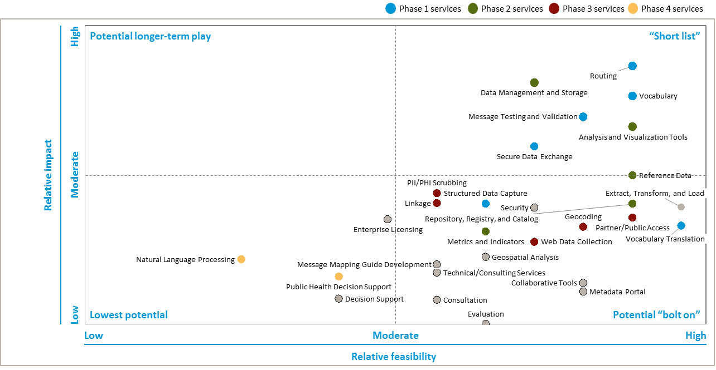
SDP Design Part 2: How Can We Prioritize Service Needs?
Unit of measure
Impact scores include input from:
  17 surveillance program deep-dives with input on services
  24 service prioritization survey responses
Total impact score is weighted 50% survey, 50% deep-dive
Note: Bubble positions slightly adjusted for readability
Source: Interviews with program managers, landscape analysis survey

Slide 16
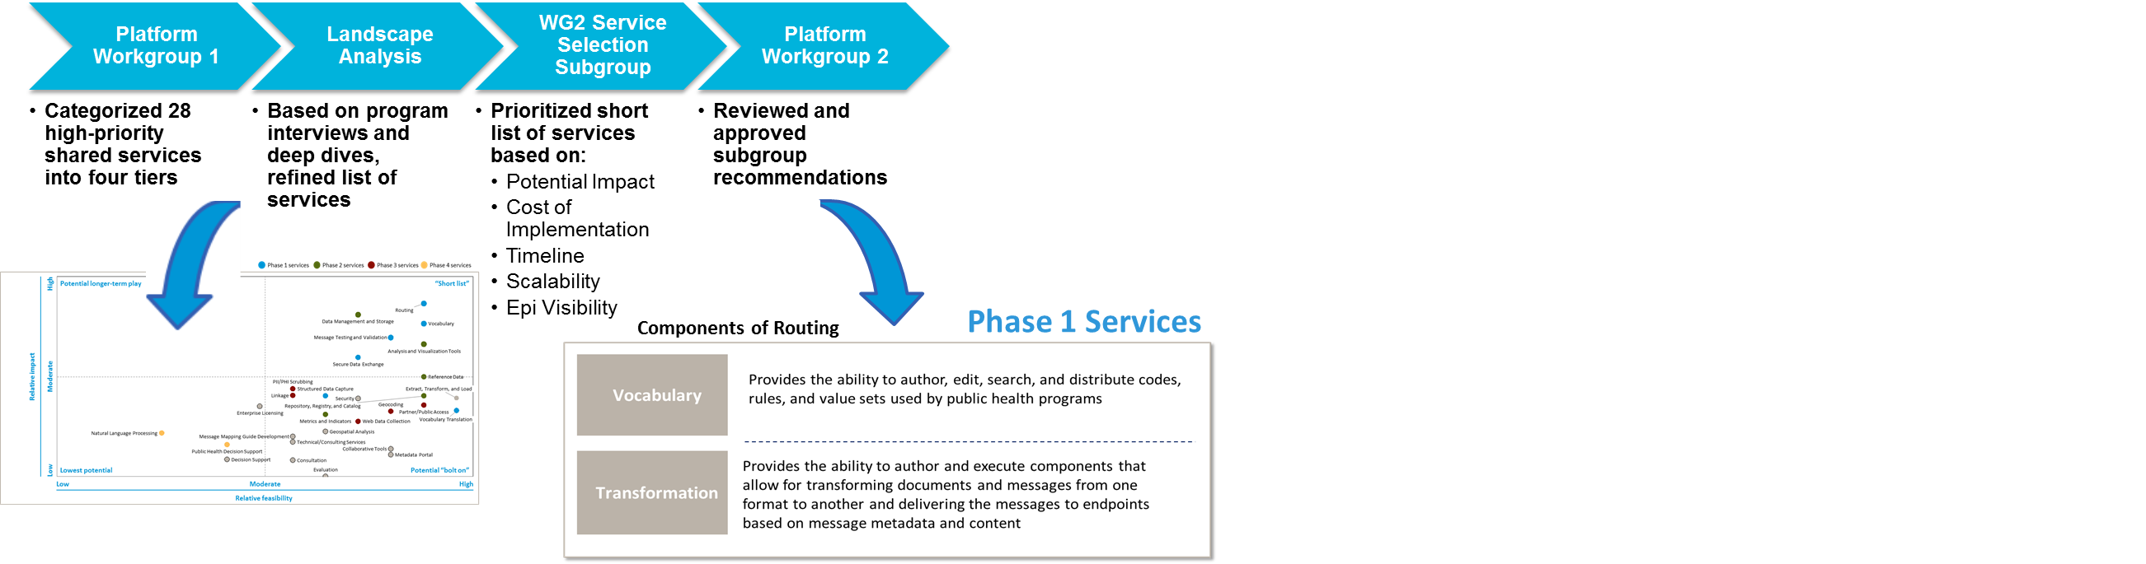
Phase 1 Service Selection Process….and Result

Slide 17

How Will SDP with Shared Services Make an Impact Over Time?
How Will SDP with Shared Services Make an Impact Over Time?
“
“
We think NLP [natural language processing] could be helpful, but no one has been able to articulate how it would work
“
I’m turning to open source tools outside of CDC because there is nothing internally to help me
“
Each month, I spend a ton of time exporting the same data into Excel to make the same charts
I spend at least half my time chasing data rather than performing the analysis that excites me
”
”
”
”
Phase IV: Invest in services to become CDC’s beacon of innovation
Phase 2: Automate repetitive analysis and visualizations
Phase III: Develop any remaining services to provide end-to-end solutions
Phase I: Alleviate time it takes for epis to receive clean data
Services
  Routing
  Vocabulary
  Transformation
  Secure data exchange
  Metrics and indicators
  Visualization
  Reference data
  Repository, registry and catalog
  Web data collection
  Linkage
  Public and partner access
  Natural language processing
  Machine learning
  Open source SDKs
Epi’s time
Epi’s time
Impact for CDC and external epis
  Enhance flexibility to spin up new programs and provide end-to-end solutions
  Transform not only the way surveillance is done, but the analysis that can be performed
Program lifecycle
Current
  Epi’s time moves from data collection and formatting to data analysis for public health action
Future

Slide 18

SDP Development Drives to Multiple Phases of Solutions
We seek public health partner input for all phases!
Future phases:
Transform through innovation
Phase II:
Expand services to reduce burden
Phase I:
Streamline core
processes
In phase 2 and beyond: We’ll invite you to help us test and share services.
In phase 1: Your suggestions for services are requested.
18
Notes:
Phase I: Streamline core processes
Solve basic data flow issues
Services include:
Routing
Vocabulary
Data validation
Phase II: Digitally enable end users – expand services to reduce burden
Make data analysis and visualization easier
Services include
More input streams from external partners harmonized
Master data management
Visualization
Metrics and indicators
Reference data
Future phases: Transform through innovation
Allow programs to build end-to-end systems using shared services
Create opportunities for transformative technologies to improve surveillance
Services may include machine learning, natural language processing, SDKs

Slide 19

Let’s Continue the Conversation
Let’s Continue the Conversation
LEARN MORE:
CDC SDP Web Site: http://www.cdc.gov/sdp
CDC SDP SharePoint Site: https://esp.cdc.gov/sites/csels/OPHSS/SDP
CDC Surveillance Strategy: http://www.cdc.gov/surveillance
BECOME PART OF OUR PROCESS:
Become part of our agile development process: https://github.com/CDCgov/SDP
Tweet #CDCSDP
JOIN OUR COMMUNITY – REGISTER FOR OUR LISTSERV!
Address your email to: LIST@CDC.GOV
Keep Subject heading blank
Write SUSCRIBE CDCL-SDP first name last name
Remove any other items from the email (including your signature) and send
After you receive your confirmation, don’t forget to confirm!
Email surveillanceplatform@cdc.gov if you have questions
CONTACT US:
Brian Lee
brian.lee@cdc.gov
Teresa Kinley
tkinley@cdc.gov
Suzette Stoutenburg
sstoutenburg@cdc.gov

Slide 20

Potential SDP Benefits to NNDSS Modernization Initiative
Potential SDP Benefits to
NNDSS Modernization Initiative
Lesliann Helmus, MS, CHTS-CP
National Notifiable Diseases Surveillance System (NNDSS) Program Manager
Division of Health Informatics and Surveillance
Center for Surveillance, Epidemiology and Laboratory Services
Centers for Disease Control and Prevention

Slide 21
Potential SDP Benefits to NMI
Benefits to NMI not expected in the near term but will become available as platform services expand
Possible transformation and routing benefits could include:
  Message Validation, Processing, and Provisioning System (MVPS) using services available on the platform
  One centralized place for states to send data
  One message with NNDSS and programmatic data for a case
    Core surveillance data on case delivered to NNDSS
    Extended disease-specific data on case delivered to CDC program

Slide 22
Potential SDP Benefits to NMI (cont.)
Possible vocabulary benefits could include:
  Enhancements to current vocabulary capability and services
  Newer technology and better sustainability
  More service-oriented approach to support vocabulary
  More support for data elements with their linkages to value sets
  Tracking of harmonized data elements to facilitate message mapping guide (MMG) development
  Continued availability of “views” for MMG value sets, with subscription service for updates

Slide 23
Hot Topic
Hot Topic:
Arboviral Update—Zika Event Codes
Michele Hoover, MS
NMI State Implementation and Technical Assistance Lead
Division of Health Informatics and Surveillance
Center for Surveillance, Epidemiology and Laboratory Services
Centers for Disease Control and Prevention

Slide 24
Arboviral Update: New Zika Event Codes
CDC is implementing the June 2016 CSTE position statement 16-ID-01 about Zika virus disease and Zika virus infection.
There are four new Zika virus disease and infection categories:
  Zika virus disease, non-congenital (event code: 50223)
  Zika virus disease, congenital (event code: 50224)
  Zika virus infection, non-congenital (event code: 50221)
  Zika virus infection, congenital (event code: 50222).
CDC will update the NNDSS website to include the four new Zika virus disease and infection case definitions.
  CDC will maintain the previous Zika case definitions from February 2016 on the NNDSS website.

Slide 25
Arboviral Update: New Zika Event Codes (cont.)
CDC can now accept case notifications for the four new Zika event codes.
  Jurisdictions should continue to transmit arboviral data by their currently approved method (Arboviral v1.2 HL7 case notifications or ArboNET).
CDC will accept data using the two previous Zika event codes as well as the four new event codes until December 31, 2016.
By December 31, 2016, jurisdictions should implement the four new Zika case definitions and reclassify all previously reported 2016 cases according to the new case definitions.
Starting January 1, 2017, CDC will accept data for 2016 and 2017 cases using only the four new Zika event codes.

Slide 26
Arboviral Update: MMG Updates and Onboarding
CDC has updated and posted the Arboviral v1.3 MMG, test scenarios, and test messages to the NNDSS Technical Resource Center at https://ndc.services.cdc.gov/conditions/.
  Addition of four Zika event codes to the 2016 and 2017 Event Code Lists
  Lab Test Type (INV290) - Value set has been updated
  Addition of two data elements: Morbidity and Mortality Weekly Report (MMWR) Year and MMWR Week (starting in 2017)
  Date of Illness Onset (INV137) is required for 2016; preferred in 2017

Slide 27
Arboviral Update: Onboarding
CDC is reaching out to specific jurisdictions to assess readiness to onboard Arboviral v1.3 HL7 case notifications in 2016.
All other jurisdictions should be prepared to onboard in January 2017.

Slide 28
Questions and Answers

Slide 29
Additional Questions?
Additional Questions?
Email EDX@cdc.gov
Subscribe to monthly NMI Notes news updates at https://www.cdc.gov/nndss/trc/news/index.html!

Slide 30
Surveillance Data Platform Appendix

Slide 31
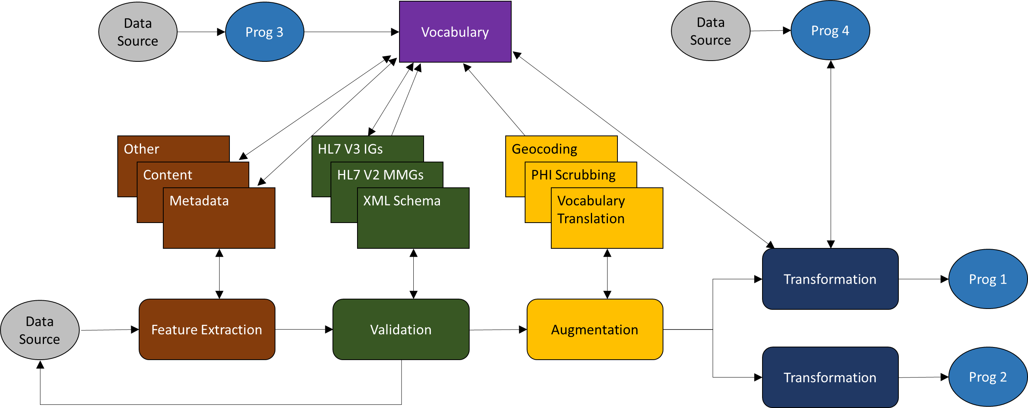
Notional Routing Flow
Unit of measure
31
Notes:
Observation: Routing is a choreography of component services rather than a single service
Any non-trivial route consists of several steps
Need services to choreograph before building a choreography
Individual component services are useful in their own right even without overarching choreography
Recommendations
Decompose routing into component services
Select two routing components for inclusion in SDP Phase 1

Slide 32
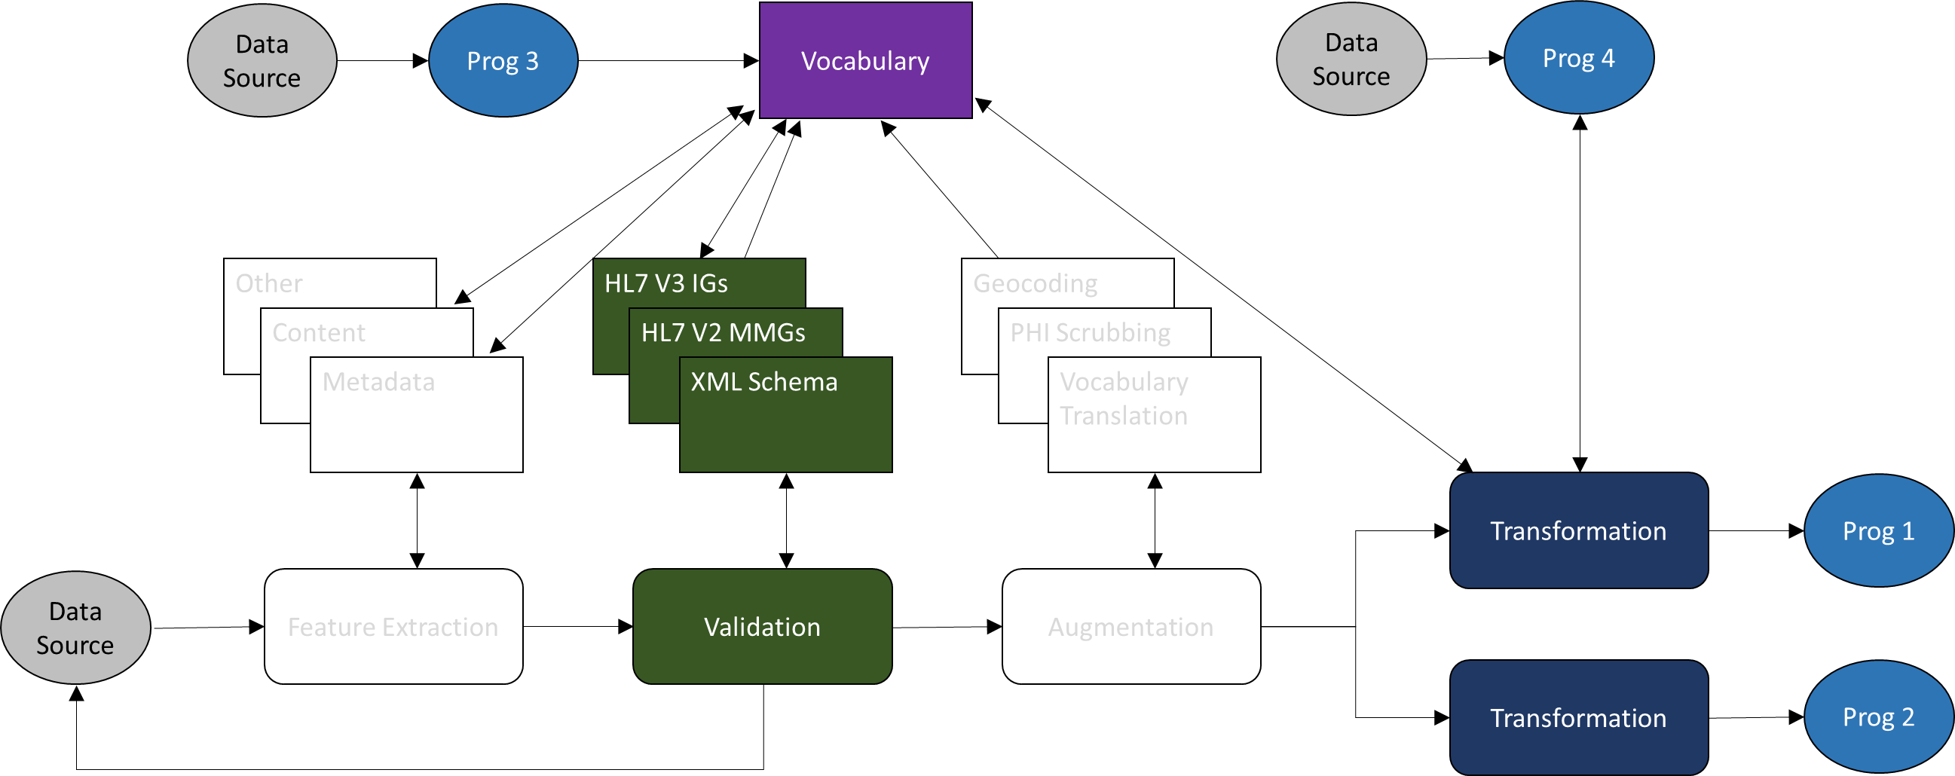
Notional Routing Flow: Initial SDP Services
Unit of measure
32

Slide 33
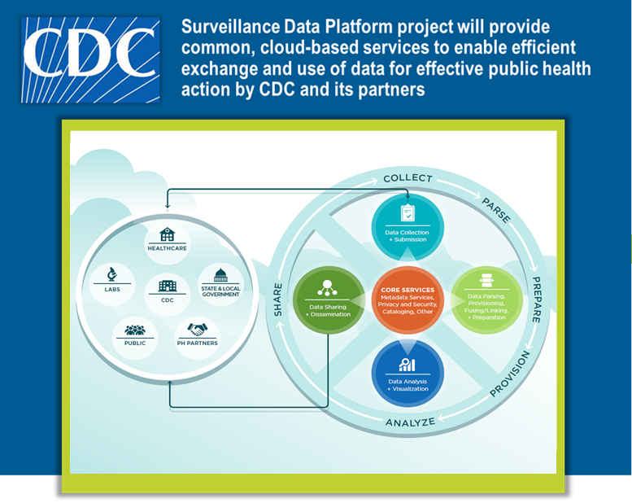
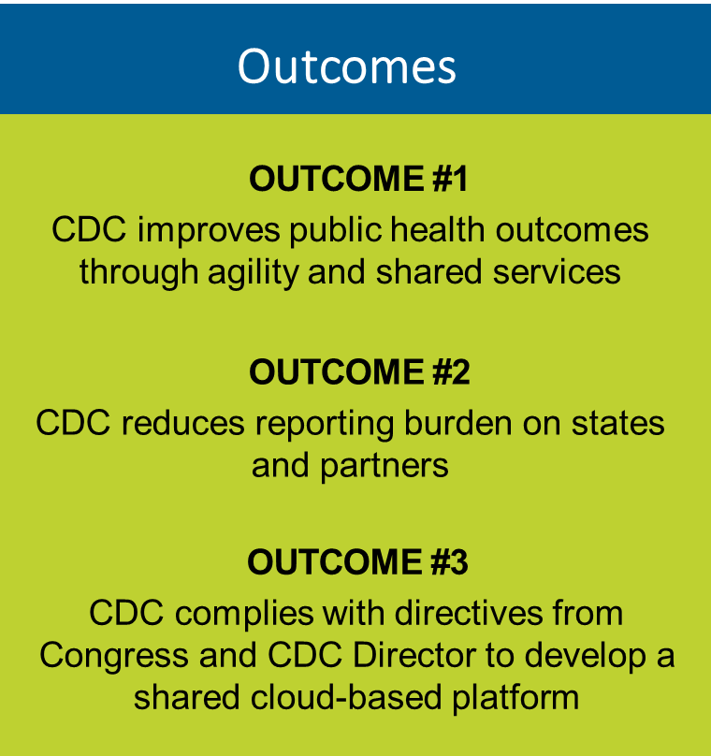
Enhancing Population Health and Well-Being:
Engineering a Common Platform and Shared Services
33
Notes:
6 Goals for Shared Services Platform
Improve the timeliness and quality of data received electronically by CDC and made available to CDC public health programs;
Improve the cost efficiency of developing and maintaining surveillance activities;
Improve the bidirectional interoperability of CDC surveillance activities with EHR and other Health IT systems;
Reduce the number of independent, stand-alone systems;
Reduce the reporting burden on external partners to share public health data and information with CDC; and
Reduce the length of time from determining surveillance data of interest, receiving data electronically, provisioning to programs and being able to act with data.

Slide 34
Initial Services Identified for Phase I
Routing
  Choreography of component services that provide specific functions along the routing pathway from source to destination system
  Results in single point of contact for reporting partners to submit data
Vocabulary
  Provides the ability to author, edit, search, and distribute codes, rules, and value sets used by public health programs
Transformation
Provides the ability to author and execute components that allow for transforming documents and messages from one format to another and delivering the messages to endpoints based on message metadata and content
34
Notes:
Landscape analysis findings

Slide 35
Platform Workshop
Platform Workgroup Identified Initial Set of Tiered Shared Services
Tier 1 | Tier 2 | Tier 3 | Tier 4
Routing | Enterprise Licensing | Analysis and Visualization Tools | Collaborative Tools
Secure Data Exchange | Message Testing and Validation | Consultation | Decision Support
Security | Partner and Public Access to Data | Data Collection Tools | Evaluation
 | PII and PHI Scrubbing | Data Management and Storage | Geospatial Analysis
 | Reference Data | Extract, Transform, Load | Linkage
 | Repository, Registry, and Catalog | Geocoding | Metadata Portal
 | Vocabulary | Message Mapping Guide Development | Metrics and Indicators
 |  | Vocabulary Translation | Natural Language Processing
 |  |  | Public Health Decision Support
 |  |  | Technical Assistance and Consultative Services
35
Notes:
Large set prioritized CDC wide; CDC wide subgroup identified priorities based on feasibility and impact; focusing on first 2; roadmap for others
Analysis and Visualization Tools
Provide coordinated procurement and access to multiple analysis and visualization tools in a consistent and easy to use manner. Provide systematic method of evaluating and prioritizing new and emerging tools demanded by CDC scientists for inclusion in tools available. Provide guidance and assistance with use of tools. Example tools include SAS, R, R-Shiny, Tableau, Excel.
Collaborative Tools
Web conferencing and meeting software to assist in communication, coordination, development and use of services. Existing services include SharePoint, Skype/Lync, AdobeConnect.
Consultation
Human resources to provide support for activities such as balloting, standards development, help-desk. This may have potential linkages to the Technical Assistance and Consultative Services service but was determined by the workgroup to be different enough to keep as separate services
Data Management and Storage
Extraction, transformation and loading of data across CDC. Transforming of data from one format to another. Review and curation of data for quality checking and analysis. Secure and encrypted data storage. Example services include Consolidated Statistical Platform (CSP).
Decision Support
Systematic sharing of feedback, guidelines and quality improvement tools in both human readable and machine readable formats. Used by variety of external users including healthcare, immunization registries, cancer registries. Implementation of decision support tools could also help increase data completeness and accuracy.
Enterprise Licensing
Coordinate and procure licensing, and provide training and support, for use by states and other partners of integration engine and other commonly used software products for states to process and send data to CDC. Existing products include OrionHealth Rhapsody. May include open source products that require support, such as Mirth.
Evaluation
Ongoing evaluation of platform services and other surveillance activities checking service requirements against performance measures. Includes both evaluation within a service and across services.
Extract, Transform and Load (ETL)
Provisioning of data for access and use by users. Making data available in the appropriate location and format for use by epidemiologists, statisticians, and other users. Transforming of data and data sets from one format to another based on user preference and need, including combining, separating and creating views of data. Ensures lossless access to all data sent by jurisdiction and required by programing including both total number of records submitted as well as all fields submitted for each record. Supports import from and export to common data standards, formats and systems (e.g. SQL, SAS, R, XML, RDF, CSV, JSON). Support adapters for transforming to/from formats supported by public health software vendors (e.g. Atlas, Maven) to send and receive messages. Existing services include BizTalk, Mirth, Rhapsody.
Geocoding
Convert and clean addresses into geographic coordinates for mapping and spatial analysis. Provide geographic lookup services to identify census tract, zip code, city, county by address or coordinates. Provide access to external partners for use within public health systems as well as internal CDC usage.
Geospatial Analysis
Enterprise geospatial information system data access and sharing. Enables sharing of data layers and subscription service of maps, data, imagery and analytics. Allows asynchronous sharing of processed datasets and analysis from multiple programs and stakeholders. Provides easy search and discovery of geospatial data and services. Comparable and convertible methods. Example services include GRASP.
Linkage
Connecting data sets and data records based on simple direct matches, probabilistic matches. Supports use of cryptographic hashes for linking without revealing PII/PHI. Support applications and training (e.g., LinkPlus).
Message Mapping Guide Development
Consultative service to assist programs to identify necessary data elements and create clear documentation and message standards that define the layout, structure and content of messages. While terminology is specific to HL7, message mapping guides apply to any service or activity that requires a defined data dictionary and message format for exchange. Output of service includes both human understandable and machine understandable guides. Manages changes to guides through a versioning process. Existing services include the NNDSS Modernization Initiative Message Mapping Guide activity.
Message Testing and Validation
Review and validate incoming public health surveillance data, messages and documents for validity by confirming syntax, semantics and adherence to defined logical rules. Allows for definition of validation rules per message and topic. Allows for direct customization of rules by investigator and/or public health program. Supports messages using defined data standards (e.g., HL7, CDA, FHIR) as well as ad hoc (e.g., CSV, XML, JSON). Includes web-based testing harnesses to allow submitters to prepare for onboarding by self-assessing against structure, vocabulary and business rules. Example services include Message Validation and Provisioning System (MVPS), Message Quality Framework (MQF), Message Evaluation and Testing Service (METS).
Metadata Portal
Web site that allows for authoring and lookup of metadata related to data or platform services. Potential linkage to the Repository, Registry and Catalog service.
Metrics and Indicators
Repository of small-area descriptors (e.g., population counts, socioeconomic and health indicators, environmental hazards, crime and safety, etc.)
Natural Language Processing
An example application could include machine code occupation and industry information pulled from unstructured industry and occupation text that returns standard codes. Example applies to cause of death and cancer pathology. Another example would be to implement a multi-lingual Semantic Analysis Service to support contextual search and query of large unstructured textual products or databases. This capability could be used to process FOIA requests, filter e-mails and documents; provide contextual analysis of databases or social media, or do automatic redaction of sensitive reports or textual products. Support real-time risk communication of messaging. Potential to analyze Electronic Medical Records for indicators or patterns. Example services include Vital Stats' Validation and Edits Web Service (VIEWS).
Partner and Public Access to Data
Easy to access data sets published by public health programs in variety of formats. Each data set is described and searchable. Easy to use dashboards, reports, web-based analytic tools providing both aggregate and granular data. Supports both data sets and reports. Existing tools include Socrata (e.g., data.CDC.gov, chronicdata.cdc.gov), WONDER, WISQARS.
PII and PHI Scrubbing
Automatically identify and redact potentially identifying or sensitive information. Note: machine learning techniques may be duplicative with NLP service above. Example services include MITRE Identification Scrubber Toolkit (MUST).
Public Health Decision Support
Ability to remotely invoke/access case definitions and other public health algorithms. Ability to process message and data specific business rules for use in validation, transformation, routing, linking and other purposes. Case calculation using configurable case definitions by disease, public health program or jurisdiction.
Reference Data
Facilitated access and use of reference data sets (e.g., numerator, denominator, acquired, or public data sets). Coordinate best practices and standards for denominator data sets used by public health programs. Provide accessible denominator data sets used by programs, including commonly used data sets such as Census (e.g., MSA, FIPS, DateState County, RaceAgeYear). Include predetermined indicators. Allow for authoring and review of denominator data sets.
Repository, Registry and Catalog
Metadata and master data management. Directory of all data elements used by platform services. Collects form, template and data collection instrument definitions. Supports data consistency across applications and messages. Question bank of harmonized and non-harmonized questions and data elements linked to data set, service, and surveillance activity. Includes data and messaging standards. Includes source code and issue tracking metadata (e.g., Jira, TFS, Github).
Routing
Moving of data to location based on defined rules. Allows for single data submission to be sent to appropriate program or group within CDC based on data type, data content or other defined rules. When combined with ETL services, can move subsets of larger messages to provide only the data of interest to a particular program or area within CDC. Example services include APHL Informatics Messaging Services (AIMS) Hub.
Secure Data Exchange
Transport of data and information, reliably, from a diverse set of sending partners over the public internet using appropriate security and encryption to protect data in transit and at rest. No proprietary software should be required by sending party. Able to support common transmission types and protocols. Serve as a data receiver that supports multiple formats and transport protocols. Data is then made available to appropriate follow on service for routing, processing or storage. Existing services include PHINMS, Direct Project, SAMS File Upload, Secure FTP.
Security
Identity proofing and authenticating users and/or systems to allow them to access other services. While this is also a design principle for the platform and services, this is a dependency to almost all other services within platform that require restricted access. FIPS 140-2 validated symmetric key encryption capability for web and mobile devices with automated key management to allow for encryption of data by partners and other services. Includes authorization, key management. Existing services include CDC SAMS, OCISO Incident Response, OCISO Security Assessment and Authorization
Structured Data Capture (Data Collection Tools)
Support of the ONC Structured Data Capture initiative to access templates that contain structured data within an Electronic Health Record, automatically populate template with existing common data elements from the EHR, collect data from a user in addition to the common data elements and transmit the completed form to the appropriate organization. Allows a standardized method for data collection from EHR and deployment of relevant public health forms to EHR.
Technical Assistance and Consultative Services
Assistance to CDC and partners in use of services, tools and data. Example services include Security Awareness Training. Provides email and telephone support to triage problems and provide limited technical assistance. Provide support metrics for other service usage.
Vocabulary
Online authoring, editing, searching and distributing public health system codes, rules and value sets. Connect with and link to existing standards (e.g., ICD, LOINC, SNOMED) through NLM/VSAC. Web-based access with both human and machine understandable interfaces. Versioning of all material. Notification and subscription to monitor changes. Allows programs to know whether standards exist for how questions are asked and answered so new options are only created if needed (or not available). Common lexicon for surveillance efforts, types, activities frequency, sources, data and partner information. Ability to develop schema files and transmission services using common code sets. Existing services include PHINVADS, NHSN, NLM Value Set Authority Center.
Vocabulary Translation
Automatic translation between different vocabularies and value sets. Includes automatic transformation of medical billing codes to standard formats.
Web Data Collection (Data Collection Tools)
Form-based data collection through a web site. Supports ability for investigators to design and publish instruments to partners for data entry. Data exported in common standard for analysis in variety of tools (e.g., SAS, R). Example services include EpiInfoWeb, REDCap

Slide 36
Engage CDC Programs through Robust Governance
Surveillance Leadership Board
Propose engagement with external partners through the PUC
Report and Recommend
SDP Platform Workgroup 2.0
Strategic Direction
Project Team
Platform User Collaborative (PUC)
Capability
Surveillance Review Panel
Architecture Review Panel
Critical Contributing Partner Panel
Subgroup(s)
Science
Technical
Business
Specialized subgroups form as needed to address key questions
36
Notes:
Focus on PUC. Seeking outside input.
Governance continues the existing momentum of the Platform Workgroup to provide insight and review to the platform throughout the initial phase. A new workgroup will be formed under the SLB including expertise in surveillance, technology and business services. CDC wide initiative – provide guidance and prioritization. From external perspective, emphasize lots of programs working together inclusively.

Slide 37
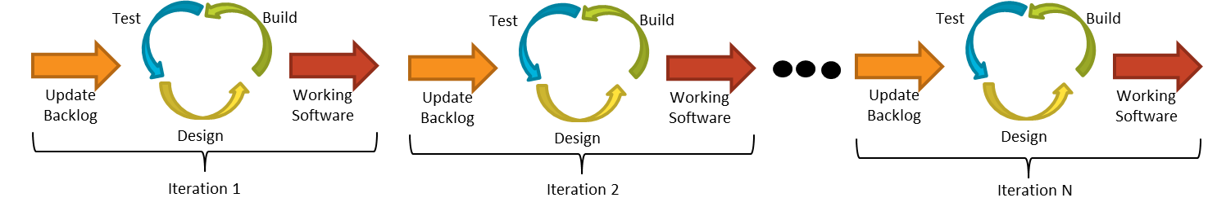
Agile Requirements Support Adaptive Development
Agile requirements definition is based on shared understanding
Levels of requirements abstraction with just-in-time evolution of detail
  Upfront, high-level requirements (Epics and Features) define broad scope of the effort and build the program backlog of capabilities to implement
  Product Owner helps to groom and re-prioritize backlog over time, which informs sequence of capability delivery
  Each iteration, team breaks down enough requirements into more detailed user stories to deliver functionality for that sprint
37

Slide 38
Routing Consists of Component Services
(not a single service)
Observation: Routing is a choreography of component services rather than a single service
  Any non-trivial route consists of several steps
  Need services to choreograph before building a choreography
  Individual component services are useful in their own right even without overarching choreography
Recommendations
  Decompose routing into component services
  Select two routing components for inclusion in SDP Phase 1
38

