Slide 1
eSHARE Webinar:
Roundtable: Jurisdictions’ Experience in Preparing for NMI HL7 Case Notification Implementation
Conference Number: 800-779-9623
Participant Code: 9740330
NOTE: Adobe Connects Audio is not available.
Join the Adobe Connects meeting at: https://virtualsepd.adobeconnect.com/nmieshare/. Click “Enter as a Guest,” provide your name, and click “Enter Room.”
June 16, 2016

Slide 2
Agenda
  Welcome and Introductions
Hot Topic: Vocabulary Access and Distribution System (VADS) Views and Subscription Service
Roundtable: Jurisdictions’ Experience in Preparing for National Notifiable Diseases Surveillance System Modernization Initiative (NMI) HL7 Case Notification Implementation
Questions

Slide 3
Hot Topic:
VADS Views and Subscription Service

Slide 4
Agenda
Message mapping guides (MMGs) and artifacts
MMG views
VADS Hot Topics
Download a view
View or subscribe to MMG view

Slide 5
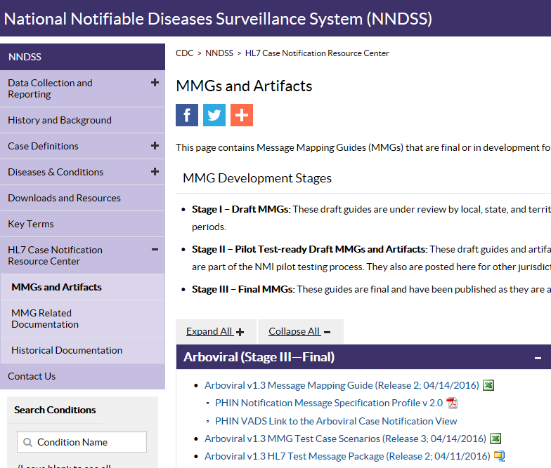
MMGs and Artifacts
https://ndc.services.cdc.gov/message-mapping-guides/
Notes:
Artifacts Needed for Implementation:
MMG Artifacts: https://ndc.services.cdc.gov/message-mapping-guides/
MMG
Test Scenario (TS)
Test Messages (TMs)
Frequently Asked Questions (FAQs)
Event Code List: https://ndc.services.cdc.gov/event-codes-other-surveillance-resources/
Message Specification: https://ndc.services.cdc.gov/event-codes-other-surveillance-resources/

Slide 6
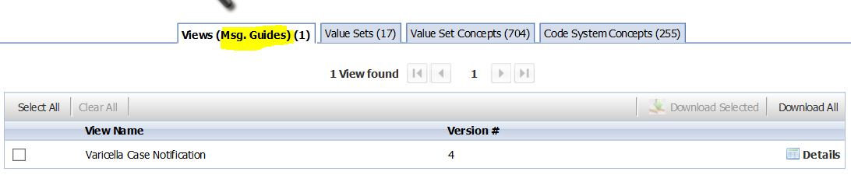
MMG Views
Value sets are groupings of concepts.
Views are groupings of value sets to be used in MMGs.
Views are versioned.
Views do not have object identifiers (OIDs).
View name represents the MMG.
VADS: https://phinvads.cdc.gov/vads/SearchVocab.action
Notes:
Information on Views
How to use/download them
How to subscribe to RSS updates

Slide 7
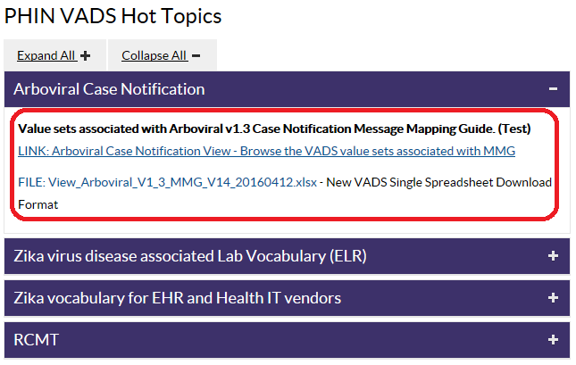
Arboviral in VADS Hot Topics
When a new MMG is published in VADS, it will be posted in Hot Topics with a link and additional information.
VADS: https://phinvads.cdc.gov/vads/SearchVocab.action

Slide 8
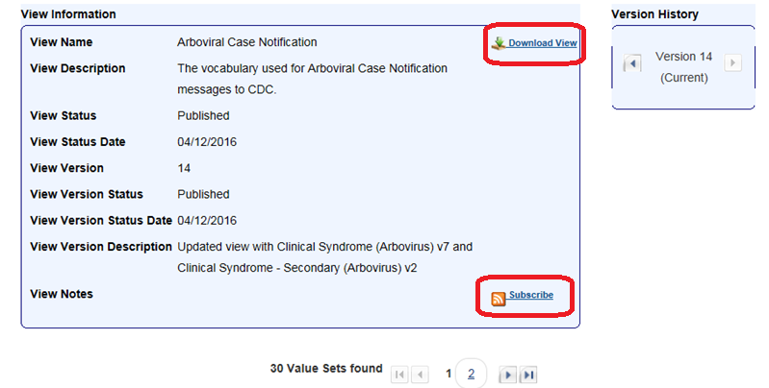
Arboviral MMG View in VADS
Click here to download the view (Excel or Text format)
Click the Subscribe button to subscribe to future updates by using RSS feeds.
1
2
Most recent version of the view:
https://phinvads.cdc.gov/vads/ViewView.action?name=Arboviral Case Notification
Notes:
A view is a collection of value sets for a guide.
The latest Arboviral MMG View (version 14) is in PHIN VADS: https://phinvads.cdc.gov/vads/ViewView.action?name=Arboviral Case Notification
You can download the view into Excel or Text files.
You can view or subscribe to the view updates

Slide 9
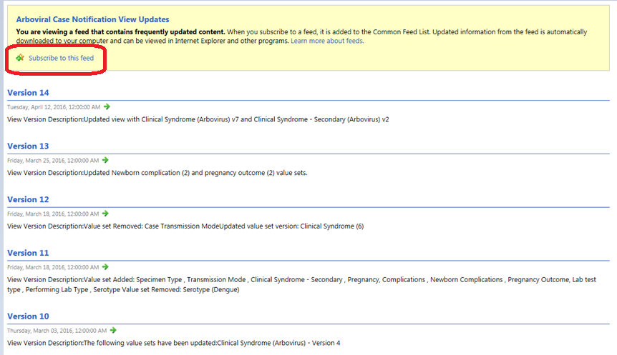
View or Subscribe to Arboviral MMG View Changes
Shows the list of versions, in reverse date order, with a summary of the changes
Click “Subscribe to this feed” to enable the RSS feed on Internet Explorer.
Notes:
You can view or subscribe to the view updates

Slide 10
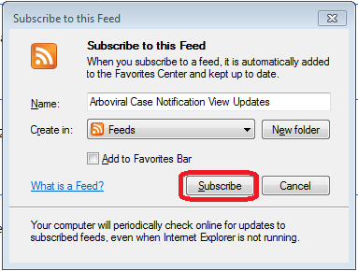
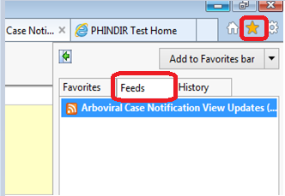
Subscribe to MMG View Changes
This pop-up box notifies you that a new feed will be added to your browser.
If desired, you can rename the RSS feed and choose an alternate location, i.e., Favorites or Bookmark Bar.
The feed will be located in the “Feeds” section of your Favorites by default.
For more information:
RSS Information: https://en.wikipedia.org/wiki/RSS
Configuring Outlook for RSS: https://support.office.com/en-us/Search/results?query=introduction+to+RSS

Slide 11
Roundtable: Jurisdictions’ Experience in Preparing for NMI HL7 Case Notification Implementation

Slide 12
Roundtable Participants
Erin Holt Coyne, Tennessee Department of Health
Andrew Smith, Louisiana Department of Health
Sarah Solarz, Minnesota Department of Health
Tamara Hennessy-Burt, California Department of Public Health

Slide 13
NBS and NMI Implementation
Erin Holt Coyne, Tennessee Department of Health
Andrew Smith, Louisiana Department of Health

Slide 14
Discussion
How NEDSS Base System (NBS) Page Builder works to send case notifications
How NBS jurisdictions collaborate to build and share pages and implement case notifications

Slide 15
How NBS Page Builder Works to Send Case Notifications
Page Builder
    User-enabled functionality based on role-based permissions
    Development and implementation of condition-specific pages within NBS
    Meta-data driven; used to generate case notifications
    Other condition-specific formats like XML (Arbovirals)
    MMG formats
    Master Messages
    Page templates can be imported, exported (for sharing)
    Pages can be built by vendor and shared or built locally and shared

Slide 16
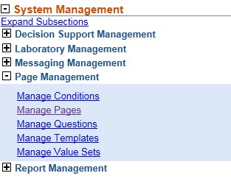
Page Builder
Create value sets
Create questions
Create pages
Manage template pages

Slide 17
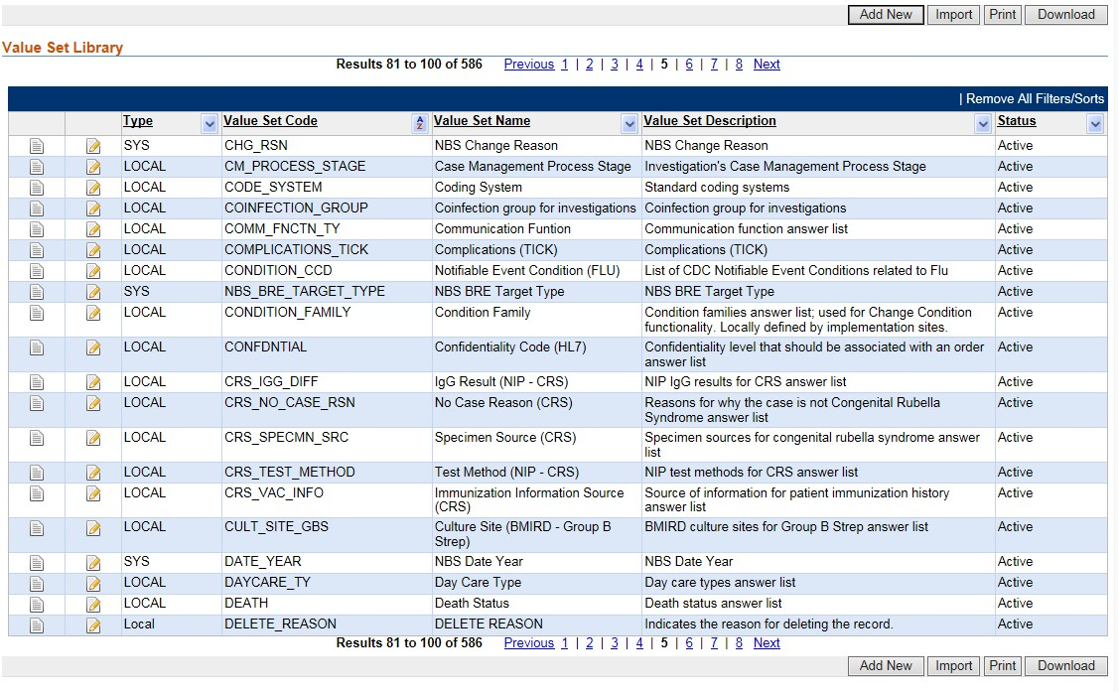
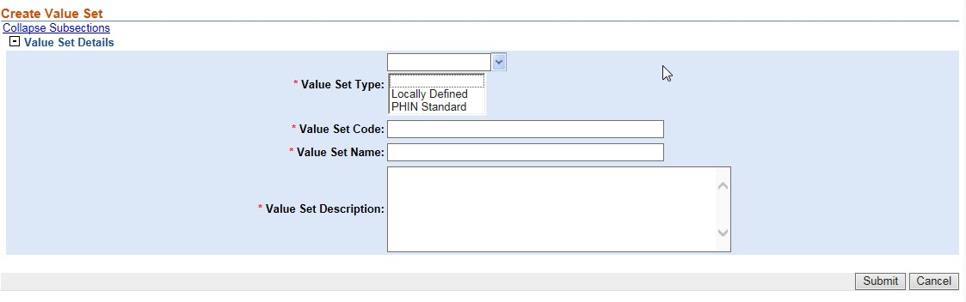
Value Sets

Slide 18
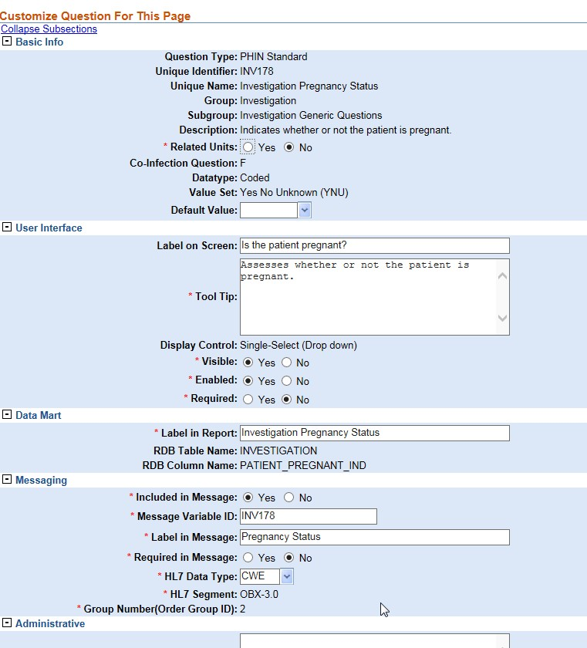
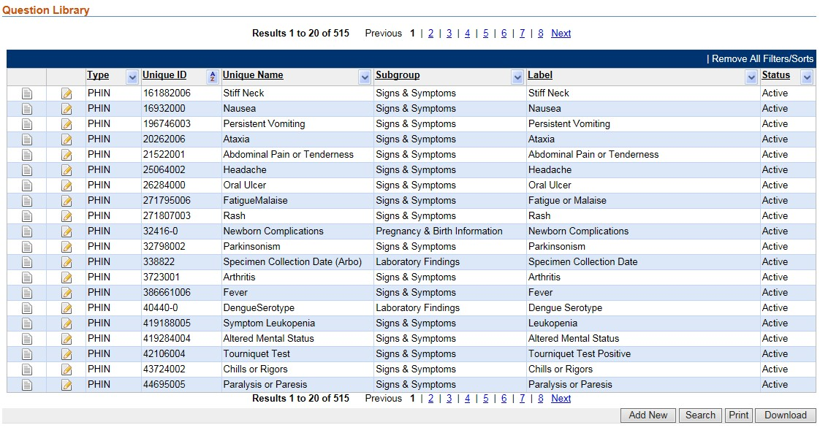
Questions

Slide 19
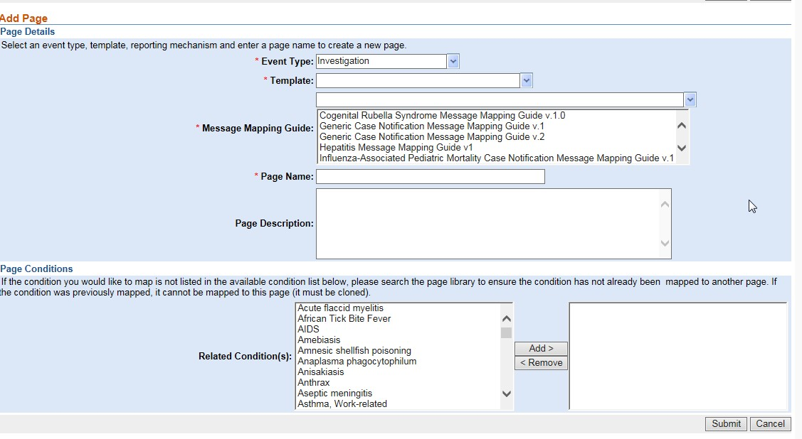
Pages
Pages can be condition specific or can be for groups or families of conditions.
Pages can be built for investigations, contact records, interview records, and congenital syphilis reports.
Notes:
Investigation
Interview
Contact record
Congenital sphy. report

Slide 20
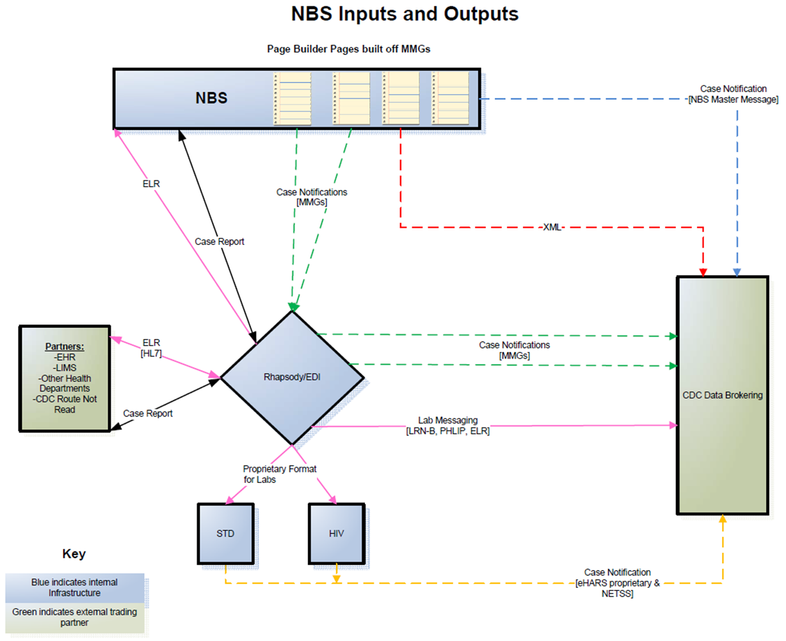
NBS Inputs and Outputs

Slide 21
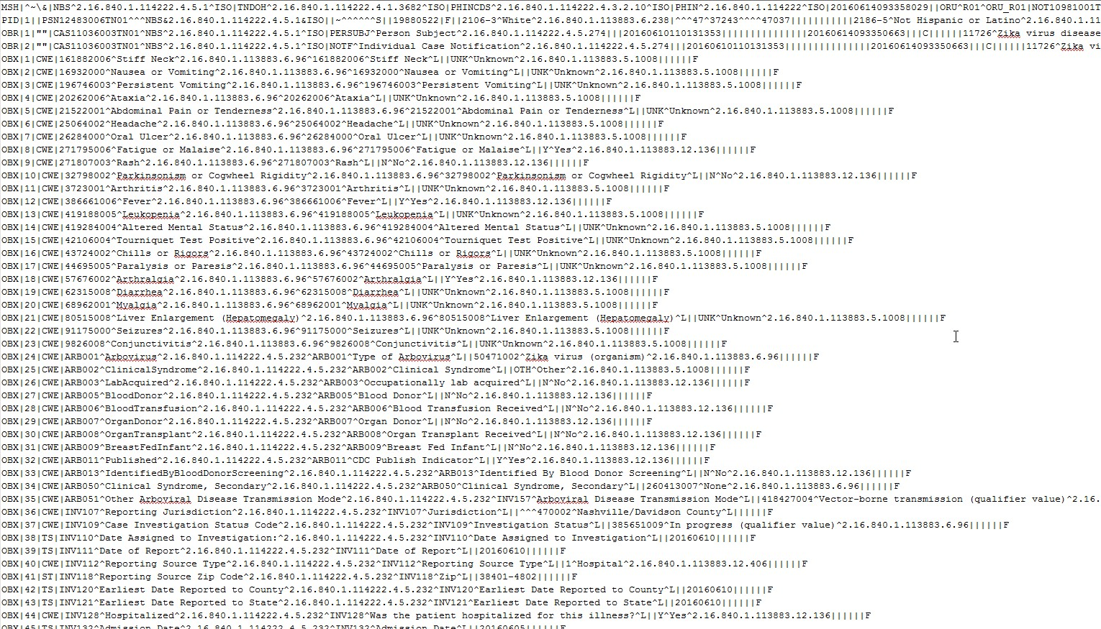
NBS Output for Notification

Slide 22
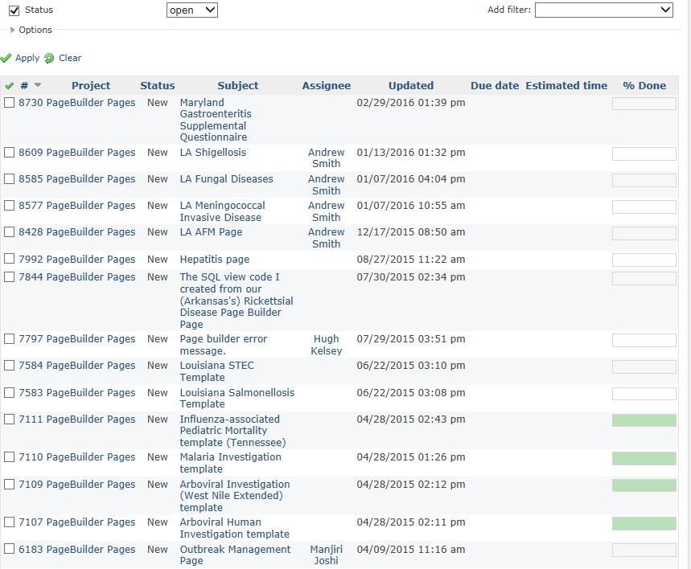
Collaboration to Build and Share Pages
NUG—NBS User Group
NBS Subject Matter Expert (SME) Calls
NBS Central
    Collaborative space
  Can upload and download pages
Involves entire NUG community as interested:
    CDC
    NBS vendor
    Jurisdiction NBS coordinator
    Jurisdictional SMEs

Slide 23
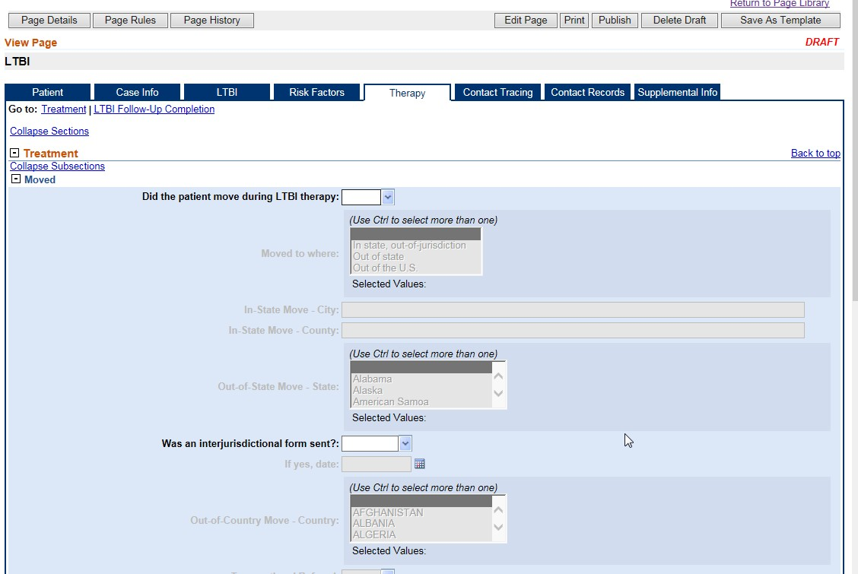
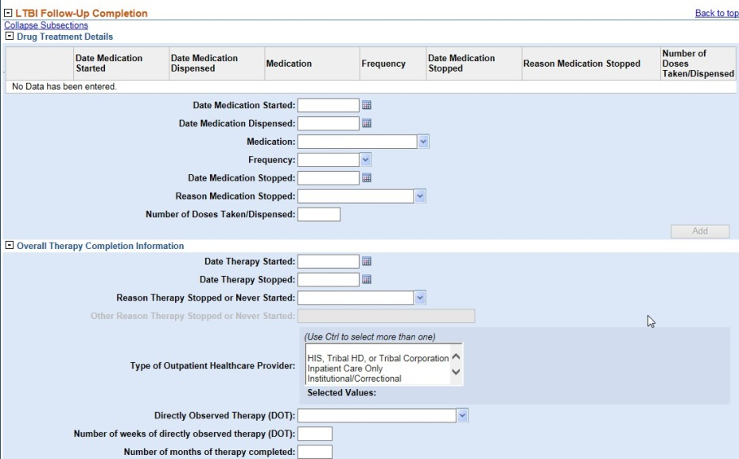
Collaboration to Build and Share Pages
Example: TB Infection
  User group formed
  Met regularly
  Included people from TB programs
  Page built by vendor based on user requirements
  Implemented locally with local tailoring
Examples:
  Blood Lead
  Food-Borne
  STD

Slide 24
Minnesota’s Approach to NMI Data Extract Process Using Maven
Sarah Solarz,
Minnesota Department of Health

Slide 25
Why a Data Warehouse?
Unable to modify Maven to directly generate HL7 ourselves
Unable to modify the Maven operational database to capture data when messages were created/sent
Wanted more control over the HL7 messages should things change in the future
Wanted Rhapsody connection to the data warehouse rather than the operational database

Slide 26
Components Used
Maven existing functionality of denormalized tables
Association of Public Health Laboratories-developed Rhapsody route to handle the translation and HL7 formatting
Message history table in data warehouse to determine status of New, Update, Delete
Data warehouse that captures Rhapsody errors
Database scripts in the data warehouse that process and copy data

Slide 27
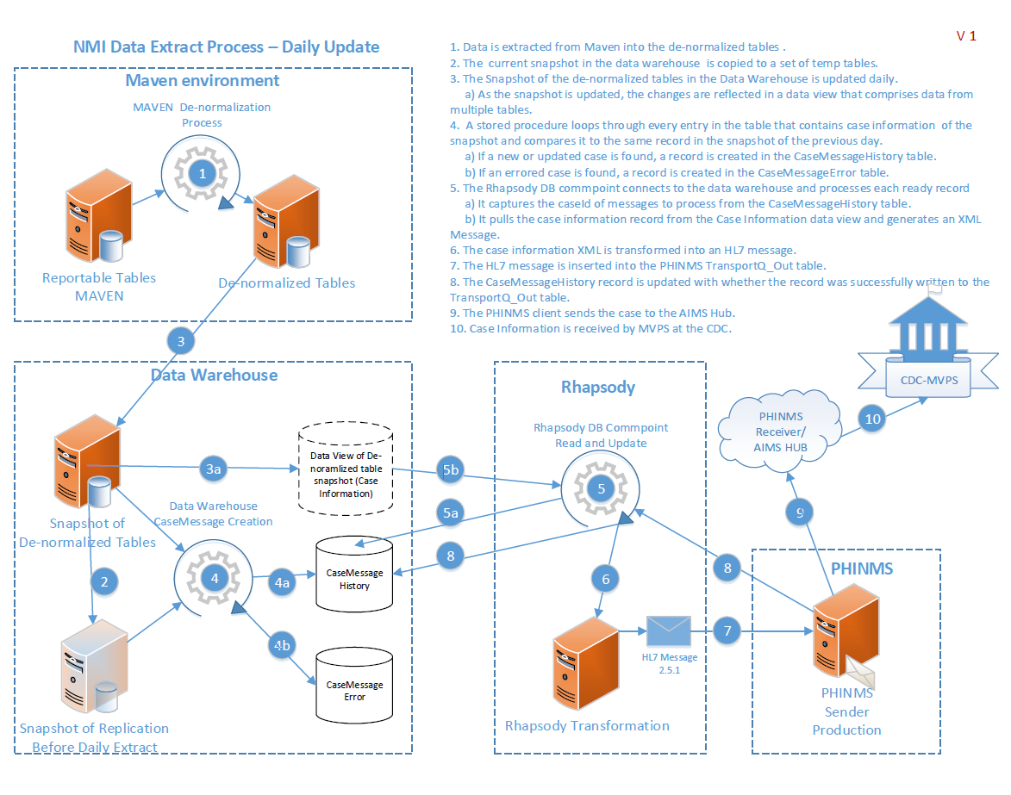
NMI Data Extract Process – Daily Update

Slide 28
Things to Consider
This approach will require Maven administrators, database administrators, Rhapsody developers, and PHIN Messaging System (PHIN MS) (or other transport) developers.
Because the translation occurred in Rhapsody, the MN denormalized tables cannot be directly applied to other Maven users.
There will be state to state variance on data collection.
We did not change how we collect data but, rather, tried to send what we had to match to the MMG.
This approach may be challenging to directly apply to other Maven users.

Slide 29
California’s Approach to Preparing for NMI Case Notification Implementation
Tamara Hennessy-Burt,
California Department of Public Health

Slide 30
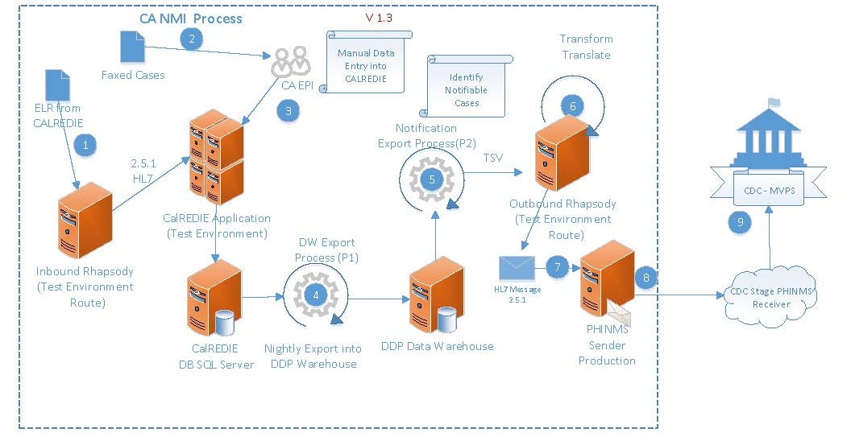
Technical Architecture Diagram

Slide 31
Data Warehouse Solution
Problem: Not all local health jurisdictions in California use the CalREDIE surveillance platform.
Solution: The Data Warehouse!

Slide 32
Technical Architecture Diagram—With EDEJs
EDEJ
EDEJ
EDEJ

Slide 33
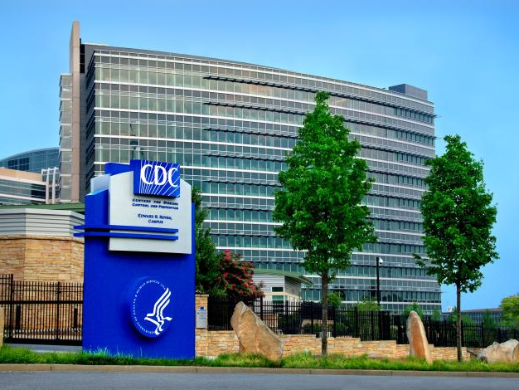
Questions? Email EDX@cdc.gov

