Slide 1
eSHARE Webinar:
Jurisdiction Onboarding Process for the
Message Validation, Processing, and Provisioning System
New Conference Number: 800-779-9623
New Participant Code: 9740330
NOTE: Adobe Connects Audio is not available.
Join the Adobe Connects meeting at: https://virtualsepd.adobeconnect.com/nmieshare/. Click “Enter as a Guest,” provide your name, and click “Enter Room.”
April 21, 2016

Slide 2
Agenda
  Welcome and Introductions
  Overview of Jurisdiction Onboarding Process for the Message Validation, Processing, and Provisioning System (MVPS)
Hot Topics
Questions

Slide 3
Overview of Jurisdiction
Onboarding Process for MVPS

Slide 4
NMI Life Cycle
NMI Life Cycle
Program Evaluation of Data Elements
Message Mapping Guide (MMG) Development
MMG Finalized and MVPS Finalized
Onboarding of Jurisdictions
MMG Piloted and
MVPS Developed
(Used for ~ 3 years)

Slide 5
What is Onboarding?
Onboarding is the process CDC will use to ensure that
  jurisdictions transmit data to MVPS that are based on the final National Notifiable Diseases Surveillance System (NNDSS) HL7 MMG requirements and
  CDC programs are confident in the quality of the data that they receive.
Pre-Onboarding
Onboarding
Cutover to Production
Production

Slide 6
Expectations for Onboarding
Jurisdictions are expected to onboard all state-reportable diseases that are nationally notifiable for each MMG.
Diseases covered by each MMG:
  Generic v2 = 52
  Hepatitis = 7
  Arboviral v1.3 = 29
  Sexually Transmitted Diseases = 8
  Congenital Syphilis = 1
  Mumps = 1
  Pertussis = 1
* 2016 NNDSS Event Code List and 2016 Conditions to Use Generic v 2.0 Only List are available at
https://ndc.services.cdc.gov/event-codes-other-surveillance-resources/.

Slide 7

NMI Jurisdiction Onboarding
NMI Jurisdiction Onboarding
Jurisdiction Begins Pre-Onboarding
Module 1 Introduction
Module 3
SAMS², MVPS³, & METS⁴
Tool Training
Module 5 Onboarding Kickoff
Module 7
Cutover to Production
Module 8 Production Practices
Pre-Onboarding
Onboarding
Cutover to Production
Production
Module 2 NMI¹ Tools
Module 4
Onboarding Preparations
Module 6
Message Onboarding
Ongoing Message Mapping Guide Operations & Maintenance; Jurisdiction in Production
¹ NMI (National Notifiable Diseases Surveillance System Modernization Initiative)
² SAMS (Secure Access Management Services)
³ MVPS (Message Validation, Processing, and Provisioning System)
⁴ METS (Message Evaluation and Testing Service)

Slide 8
Overview of Pre-Onboarding
Introduction to Technical Assistance
NMI Technical Assistance Tools
  Technical Assistance and Implementation Guidebook
  Implementation Spreadsheet and Instructions
  Test Case Message Document and Instructions
  Onboarding Guidebook
  Request for Technical Assistance
SAMS, MVPS, and METS Tool Training (https://www.cdc.gov/nndss/trc/data-systems/sams.html)
Onboarding Preparations

Slide 9
Pre-Onboarding: Onboarding Preparations (1 of 2)
To initiate the onboarding process, the jurisdiction will send an email to EDX@cdc.gov that includes a package of materials that confirm the following:
  Completed implementation spreadsheet.
  Identified any NNDSS diseases that are not state reportable for the guide that the jurisdiction will onboard.*
  Completed test-scenario document with jurisdiction-specific data.
  Completed test messages, and they have passed METS with no errors.
  Completed all required trainings (SAMS, MVPS) and able to access MVPS Dashboard.
  Set Jurisdiction Data Manager role in MVPS.
  Provided stakeholder roles and contact information.
  Confirmed ability to do one-time send of year-to-date data.
* 2016 NNDSS Event Code List and 2016 Conditions to Use Generic v 2.0 Only List are available at https://ndc.services.cdc.gov/event-codes-other-surveillance-resources/.

Slide 10
Pre-Onboarding: Onboarding Preparations (2 of 2)
The CDC onboarding specialist will review the submitted materials and enter them into the onboarding tracking tool.
The CDC onboarding specialist will send an email to the jurisdiction to do one of the following:
  Clarify or ask for additional information regarding the materials submitted.
  Invite the jurisdiction to participate in an onboarding kickoff that will occur by email or conference call.
  Provide a timeframe to start the onboarding process.
Notes:
Assessing a jurisdiction’s readiness
per test scenario document
Onboarding team acknowledges receipt of materials & shares test scenario document with Program SME. – risks multiple jurisdictions

Slide 11
Onboarding: Kickoff
The jurisdiction and CDC will participate in an onboarding kickoff to do the following:
  Review steps for onboarding.
  Resolve any questions or issues with documentation from the onboarding package.
  Review expectations for stakeholders.
  Identify expected timeframe for onboarding.
  Schedule time to send test messages to onboarding environment.
  Provide PHIN Messaging System (PHIN MS) onboarding service action pair (will come from CDC to jurisdiction).
Notes:
Lead by Onboarding Specialist (formerly PHIN SME).
Participants: CDC Program, Program Epi, Responsible Integrated Surveillance system, Data manager, etc.
Onboarding specialist meets with jurisdiction contacts:
Review steps for onboarding
Discuss any questions or issues with documentation from onboarding package
Review expectations for stakeholders
Identify expected timeframe for onboarding
Onboarding team notifies program and PHINMS when state is ready to send test messages.
Jurisdiction sends all test messages per MMG to MVPS onboarding.
Jurisdiction confirms message receipt in MVPS & notifies MVPS onboarding liaison.
Onboarding team reviews test messages (criteria TBD).
Refer to Technical Assistance if messages do not meet criteria.
Onboarding team notifies programs when messages are ready for program review.
Program liaison reviews test messages:
Check data against jurisdiction test scenario document.
Additional review criteria TBD.
Issues/questions to onboarding team.
Program approves jurisdiction for production & notifies onboarding team.
Onboarding team notifies jurisdiction, shares instructions for moving to production & shares PHINMS service/action pair for MVPS production environment.
Jurisdiction prepares for production:
Setup & ping MVPS production environment
Migrate code from test to production system
Jurisdiction sends one production message to MVPS production environment. [Note – this may shift to ~1 week to onboarding environment, pending further discussion & investigation into state system capabilities.]
Onboarding specialist confirms successful receipt and processing of production message.
Onboarding specialist notifies jurisdiction to turn on production feed and send year-to-date data (one time only).

Slide 12
Onboarding: Message Onboarding
  The jurisdiction and CDC onboarding specialist will ensure that PHIN MS is configured with the appropriate service action pair to the MVPS onboarding environment.
  The jurisdiction will send 7–10 test messages to the MVPS onboarding environment.
  The jurisdiction and CDC onboarding specialist will confirm that test messages have arrived through the MVPS Dashboard.
  The CDC onboarding specialist and program subject matter expert will review and validate test messages.

Slide 13
Cutover to Production (1 of 2)
The CDC onboarding specialist will provide the jurisdiction with the PHIN MS service action pair for the MVPS production environment.
The jurisdiction will send one production message to the MVPS production environment to test connection.
The CDC onboarding specialist will review the production message and provide either
  feedback to address any problems identified or
  instructions to begin sending production messages.

Slide 14
Cutover to Production (2 of 2)
The CDC onboarding specialist will send an approval email to the jurisdiction that outlines these steps to retire legacy transmissions and start sending production messages:
      Schedule a date for cutting over to production.
      Send year-to-date messages that include all non-reconciled Morbidity and Mortality Weekly Report (MMWR) messages through the legacy system.
      Send those same year-to-date messages that include all non-reconciled MMWR messages to the MVPS production environment.
      Start sending production messages to MVPS.
Notes:
we would want them to send through the old method first and then retransmit the same information to MVPS.

Slide 15
Production: Best Practices
  Jurisdictions should send case notification messages as soon as they are ready.
  Jurisdictions should notify edx@cdc.gov of any issues they identify with METS or MVPS. The CDC operations and maintenance team will address these issues.
  CDC programs will work with jurisdictions to address and resolve data issues.

Slide 16
How Will Onboarding Be Different with MVPS?
Jurisdictions will have one uniform email to contact CDC about MVPS onboarding: EDX@cdc.gov.
Jurisdictions will validate test messages by using METS.
Jurisdictions will send test messages directly to MVPS.
CDC will use a new tracking tool to help monitor, evaluate, and coordinate the onboarding process.
Technical assistance will be available to jurisdictions to help address issues.
Note: The estimated time for onboarding is 1–2 weeks.

Slide 17

Coming Soon
NMI Technical Assistance and Training Resource Center

Slide 18
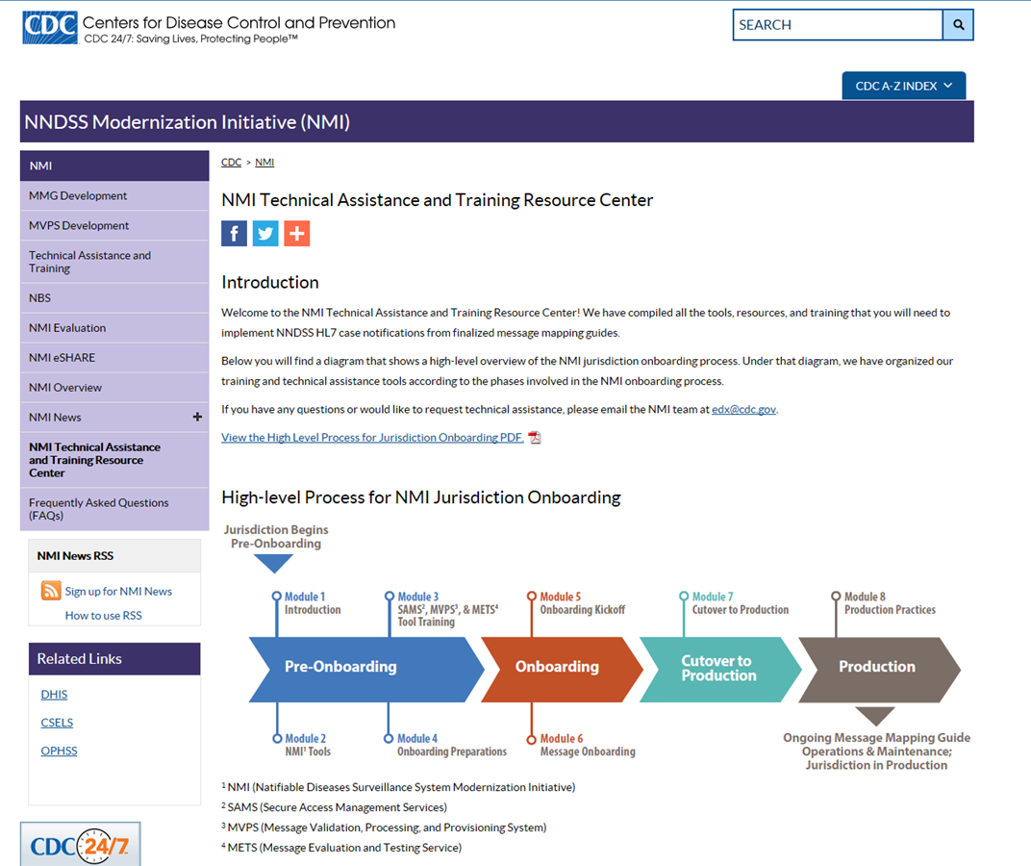
NMI Technical Assistance and Training Resource Center Website

Slide 19
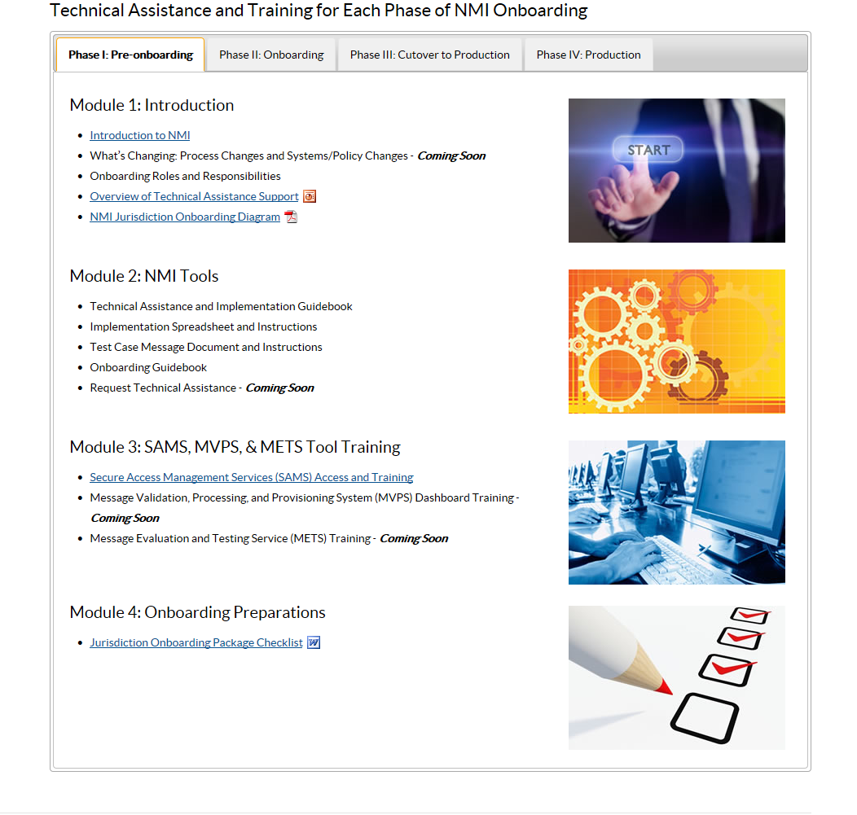
Technical Assistance and Training for Each Phase of NMI Onboarding

Slide 20
Hot Topics

Slide 21
Questions?

Slide 22
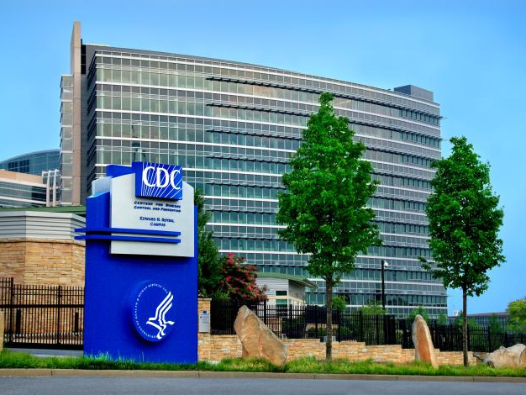
Questions? Email EDX@cdc.gov

