Slide 1
Special eSHARE Webinar:
Overview of Arboviral v1.3
Message Mapping Guide and Implementation
New Conference Number: 888-972-4312
Participant Code: 7650657
NOTE: Adobe Connects Audio is not available.
Join the Adobe Connects meeting at: https://virtualsepd.adobeconnect.com/nmieshare/. Click “Enter as a Guest,” provide your name, and click “Enter Room.”
April 14, 2016

Slide 2
Agenda
  Welcome and Introductions - Michele Hoover
  Overview of Arboviral v1.3 Message Mapping Guide (MMG) - Jenni Puyenbroek
  Onboarding for Arboviral Case Notifications - Michele Hoover
Technical Assistance for Arboviral Case Notifications - Michele Hoover
Information and Support for ArboNET - Craig Mincic
Questions
Notes:
Collaborative effort between Arboviral Program and those staff working on NNDSS.

Slide 3
Abroviral v1.3 MMG Implementation Timeline
Arboviral (v1.3) Message Mapping Guide including data elements pending Office of Management and Budget Paperwork Reduction Act (OMB PRA) posted: March 31, 2016
OMB PRA approval received for all data elements in v1.3: April 13, 2016
Updated Arboviral (v1.3) MMG posted to NNDSS website*: April 14, 2016
Message Quality Framework (MQF) updated to test the new message: April 2016
CDC systems ready to accept the new messages: June 2016
*https://ndc.services.cdc.gov/message-mapping-guides/

Slide 4
Overview of Arboviral v1.3
Message Mapping Guide

Slide 5
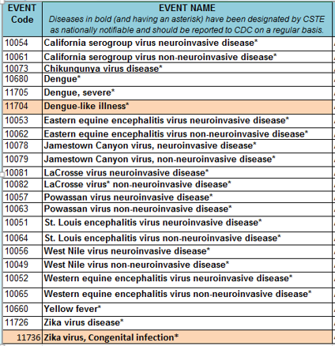
Nationally Notifiable Conditions That Can Be Sent via Arboviral v1.3 MMG
CDC will notify jurisdictions when the National Notifiable Diseases Surveillance System (NNDSS) is ready to receive data for Dengue-like illness and Zika virus, congenital infection, which are highlighted in the list to the right.
2016 Event Code List: https://ndc.services.cdc.gov/wp-content/uploads/2021/02/Nationally_Notifiable_Conditions_that_only_use_GenV2_MMG_2016_Release3_20160817.xlsx
PHIN Vocabulary Access and Distribution System (PHIN VADS) Value Set for 2016 Event Code List: https://phinvads.cdc.gov/vads/ViewValueSet.action?oid=2.16.840.1.114222.4.11.1015
Notes:
Arboviral v1.3 MMG Event Codes (NNDSS website and PHIN VADS)
CDC will notify jurisdictions when NNDSS is ready to receive the data for “Dengue-like illness” and “Zika virus, congenital infection”

Slide 6
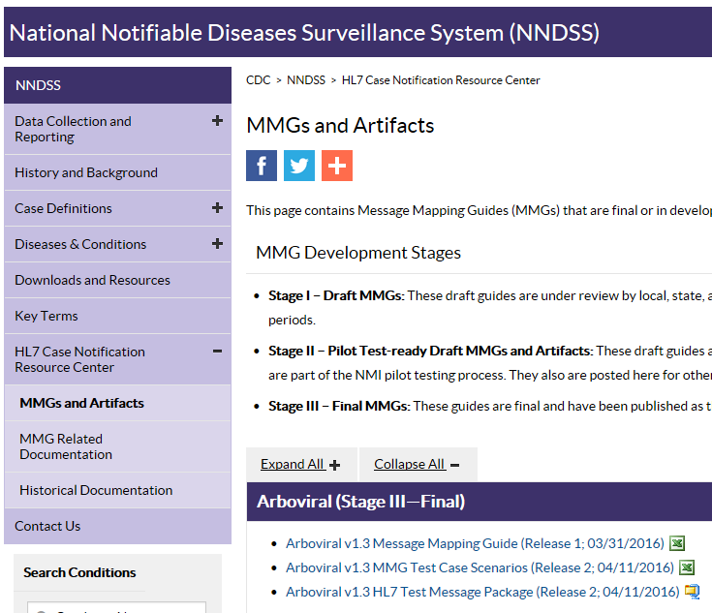
Artifacts Needed for Implementation of Arboviral v1.3 MMG
MMG and Artifacts:
Arboviral v1.3 Message Mapping Guide
Test Case Scenario
Test Messages Used for Onboarding
Frequently Asked Questions
https://ndc.services.cdc.gov/message-mapping-guides/
Event Code List: https://ndc.services.cdc.gov/event-codes-other-surveillance-resources/
PHIN Message Specification (v2.0): https://ndc.services.cdc.gov/wp-content/uploads/2021/02/phin-notification-message-specification-profile-v-2.0.pdf
Notes:
Artifacts Needed for Implementation:
MMG Artifacts: https://ndc.services.cdc.gov/message-mapping-guides/
MMG
Test Scenario (TS)
Test Messages (TMs)
Frequently Asked Questions (FAQs)
Event Code List: https://ndc.services.cdc.gov/event-codes-other-surveillance-resources/
Message Specification: https://ndc.services.cdc.gov/event-codes-other-surveillance-resources/

Slide 7
Differences from Arboviral v1.2 MMG
Multiple tabs for 508 compliance (no merged cells)
Introduction
  References
  Additional notes:
    Conveying unknown
    Data elements pending OMB PRA approval*
MMG Column Descriptions
  Data Element (DE) Code System
  ArboNET Variable ID
  Migration notes from Arboviral v1.2 MMG
Data Elements
Revisions
*This label will be removed from the MMG, since we now have OMB PRA approval to receive all the data elements in the Arboviral 1.3 MMG
Notes:
Differences from Arboviral 1.2 MMG
Multiple tabs for 508 compliance (no merged cells)
Introduction tab
References
Additional notes:
Conveying unknown
Data elements pending OMB approval
MMG Column Descriptions
DE Code System: Code system from which the data element identifier is drawn (e.g. PHINQUESTION, LOINC, CDCPHINVS, SNOMED-CT). This reference is sent in the message for those observations that map as CE (Coded Element) or CWE (Coded With Exceptions) datatypes in the message.
ArboNET Variable ID: ArboNET variable ID would help the jurisdictions transitioning from ArboNET.
Migration notes from Arboviral v1.2 MMG: Migration notes for those jurisdictions already sending Arboviral data to the CDC using the Arboviral 1.2 MMG
Data Elements
Revisions

Slide 8
Case IDs Important for Arboviral
Case Notification
Data Element | Data Element Use for Case Notification
State Case ID (INV173) | Usually optional for HL7 case notifications, but required for Arboviral case notifications Used by Arboviral program to uniquely identify a case If a case is initially sent via ArboNET and then an update is sent to this same case via HL7, this value must be the same as the unique case ID sent via ArboNET to prevent a duplicate case being added to the CDC database.
Local Record ID (INV168) | Unique identifier in your system for a case (usually system-generated) Required in an HL7 case notification Used by NNDSS to uniquely identify a case
Sample Scenario: Initial case notification via ArboNET with update via HL7
Initial Notification via ArboNET
StateID (INV173) = 2016-GA-012
Local Record ID (INV168) = N/A
Result: The Arboviral program is able to match the case previously sent via ArboNET with the update provided via HL7 based on the matching State Case IDs.
Updated Notification via HL7
State Case ID (INV173) = 2016-GA-012
Local Record ID (INV168) = CAS10035005GA01
Notes:
Data elements used for Case Notification to uniquely identify the case

Slide 9
Case IDs Important for Arboviral
Case Notification (continued)
If a case has not been previously sent via ArboNET, it is acceptable to send the same value for both State Case ID (INV173) and Local Record ID (INV168), or to send any other unique state case identifier.
Once a case has been transmitted to CDC, however, neither ID should be altered/changed, or this will result in duplicate case counting at CDC.
Sample Scenario: No case notification via ArboNET; initial case notification via HL7 indicates one ID for Local Record ID and updated notification indicates the same ID.
Initial Notification via HL7
State Case ID (INV173) = CAS10035005GA01
Local Record ID (INV168) = CAS10035005GA01
Result: The Arboviral program and NNDSS are able to match the case data because the State Case IDs are the same across notifications, resulting in the creation of one case in their case databases.
Updated Notification via HL7
State Case ID (INV173) = CAS10035005GA01
Local Record ID (INV168) = CAS10035005GA01
Notes:
Data elements used for Case Notification to uniquely identify the case

Slide 10
Removed Data Elements
Removed 38 data elements
  Risk factors
  Lab testing by
  Non-lab acquired
  Infected in utero
    In v1.3 MMG, “Infected in Utero (Congenital)” is part of the value set associated with “Other Arboviral Transmission mode.”
  Acute flaccid paralysis (AFP)
    In v1.3 MMG, “AFP” is part of the “Clinical Syndrome” value set.

Slide 11
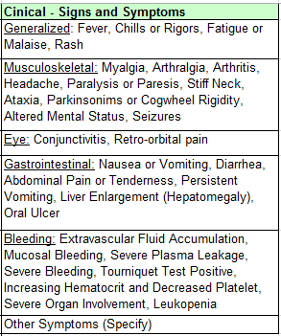
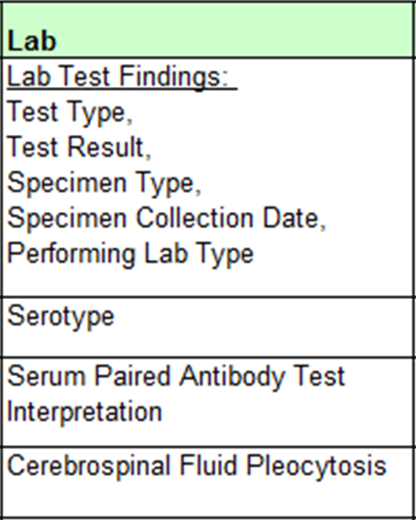

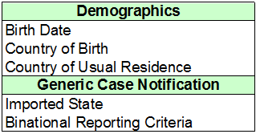
New Data Elements (1 of 2)
Added 50 data elements
Notes:
New data elements
Clinical – Signs and Symptoms
Lab
Generic Case Notification (from Gen V2)

Slide 12
New Data Elements (2 of 2)
Pregnancy and newborn data elements
  Mother’s last menstrual period before delivery
  Pregnancy complications
  Pregnancy outcome
  Newborn complications
  Mother-infant case ID linkage
Other Arboviral disease transmission mode
  Valid values – sexual, in-utero (transplacental), perinatal (intrapartum)
Notes:
New data elements related to pregnancy and newborn

Slide 13
Updated Data Elements
Race category – allows multiple (may repeat = Y)
Clinical syndrome data element update
  Arboviral v1.2 MMG “Clinical Syndrome” data element has been labeled as “Clinical Syndrome (Primary)” and the value set has been updated.
  Added “Clinical Syndrome (Secondary)” data element with a value set that is a subset of the “Clinical Syndrome (primary)” value set.
(a) Clinical Syndrome (Primary)
(b) Clinical Syndrome (Secondary)
Asymptomatic
Febrile illness
Meningitis
Encephalitis – including meningoencephalitis
Acute flaccid paralysis
Guillain-Barre syndrome
Hepatitis/jaundice
Multi-system organ failure
Other clinical
Other neuroinvasive presentation
Dengue
Dengue-like illness
Severe dengue
Unknown
Congenital infection
None
Meningitis
Encephalitis – including meningoencephalitis
Acute flaccid paralysis
Guillain-Barre syndrome
Hepatitis/jaundice
Multi-system organ failure
Other clinical
Other neuroinvasive presentation
Notes:
Updated data elements
Race category
Clinical Syndrome split into primary/secondary

Slide 14
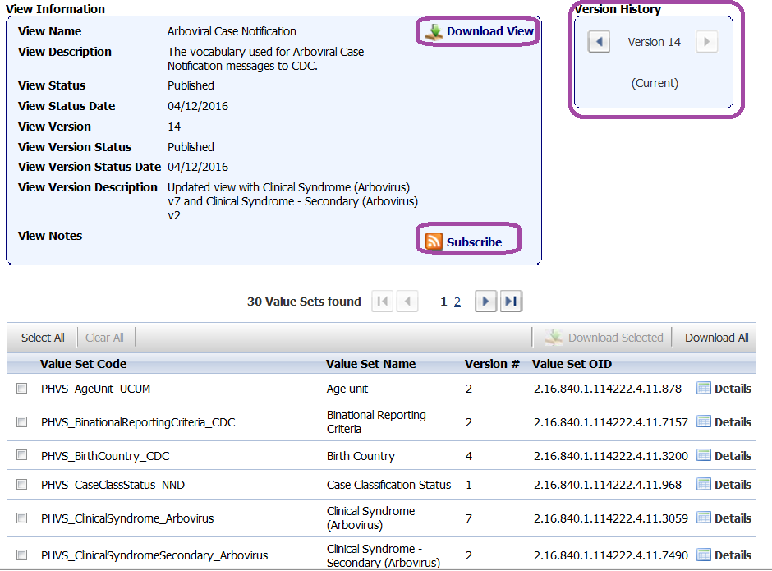
Arboviral MMG View in PHIN VADS
Most recent version of the view:
https://phinvads.cdc.gov/vads/ViewView.action?name=Arboviral Case Notification
Notes:
A view is a collection of value sets for a guide.
The latest Arboviral MMG View (version 13) is in PHIN VADS: https://phinvads.cdc.gov/vads/ViewView.action?name=Arboviral Case Notification
You can download the view into Excel or Text files.
You can view or subscribe to the view updates

Slide 15
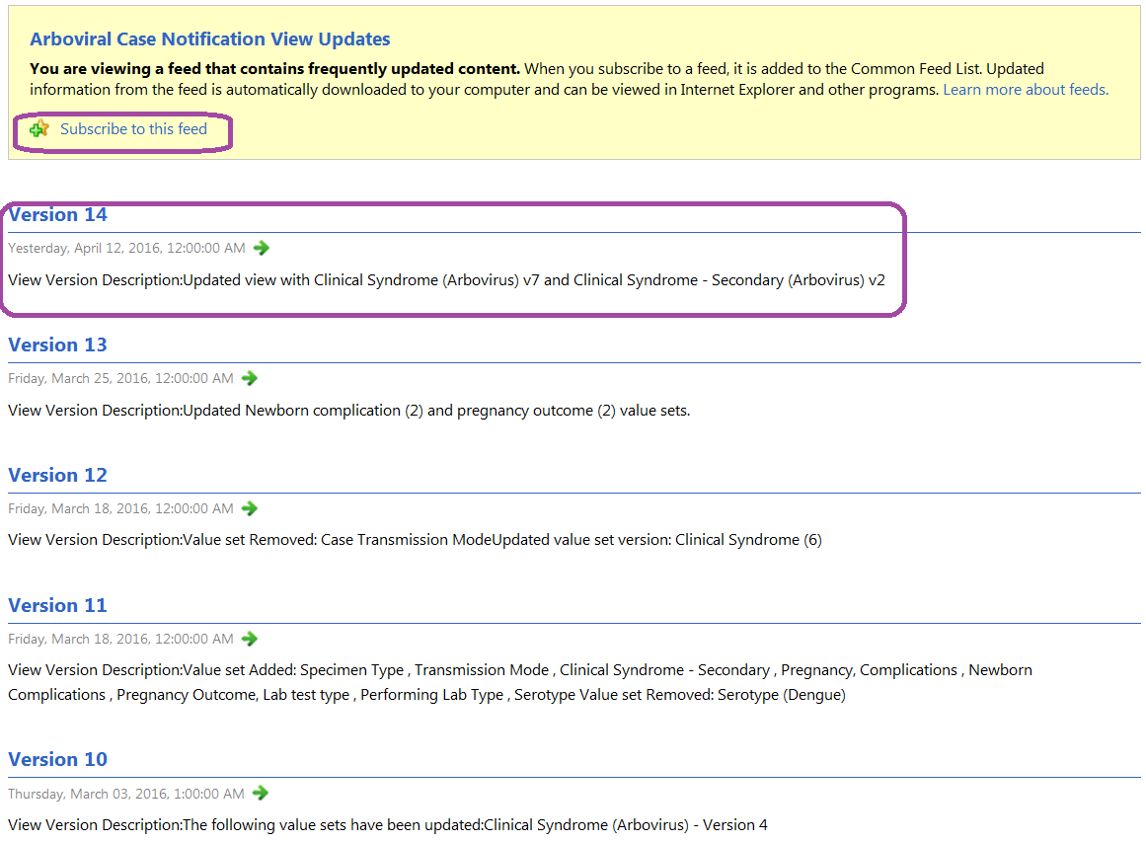
View or Subscribe to Arboviral MMG View Changes
Notes:
You can view or subscribe to the view updates

Slide 16
NNDSS Implementation of
Interim CSTE Position Statement #16-ID-01
Position Statement: Zika Virus Disease and Congenital Zika Virus Infection Interim Case Definition and Addition to the National Notifiable Diseases List
In collaboration with the CDC Arboviral program:
  Created a combined Zika virus disease and Zika virus, congenital infection national case definition web page
    Expect to post by the end of April
      Zika virus disease will no longer appear as a subcategory of Arboviral diseases
  Updated Morbidity and Mortality Weekly Report NNDSS weekly Table 1 to include Zika virus disease and Zika virus, congenital infection
    Expect to post updated Table 1 the week of 4/25
      Data for Zika virus, congenital infection will be published in June 2016, after the data quality review assessment period
Link to Council of State and Territorial Epidemiologists (CSTE) Zika virus interim position statement: https://www.cste2.org/docs/Zika_Virus_Disease_and_Congenital_Zika_Virus_Infection_Interim.pdf

Slide 17
Onboarding for Arboviral Case Notifications
Notes:
The process discussed today is an updated streamlined version of the onboarding used for the legacy systems.

Slide 18
Onboarded Jurisdictions Updating from
HL7 Arboviral MMG v1.2 to v1.3
Update test and production systems by using Arboviral v1.3 MMG.
Create test messages identified for jurisdictions updating from Arboviral v1.2 to v1.3.
Use Message Quality Framework (MQF) to validate messages.
Send email to EDX@cdc.gov to notify CDC that you are ready to send test messages.
  Onboarding specialist will contact you to schedule a time to send test messages to staging environment.
  Onboarding specialist will provide PHIN Messaging System (PHIN MS) service action pair to send test message suite to staging environment.
Onboarding specialist and program subject matter expert (SME) validate test messages.
Onboarding specialist provides email approval to go into production.
Notes:
Test messages for this group will be designed to test those things that have changed in the 1.3 message
DMB will work with jurisdictions to correct minimal errors – if larger issue will refer to APHL.

Slide 19
Jurisdictions Sending
Initial HL7 Arboviral v1.3 messages (1 of 2)
Use Association of Public Health Laboratories (APHL) tools and resources* to map Arboviral v1.3 MMG data elements.
Update test and production systems using Arboviral v1.3 MMG.
Create test messages using all test messages.
Use MQF to validate messages.
Send email to EDX@cdc.gov to notify CDC that you are ready to send test messages.
  Include APHL implementation spreadsheet and test case scenario document.
  Onboarding specialist will contact jurisdiction to schedule a time to send test messages to staging environment.
  Onboarding specialist will provide PHIN MS service action pair to send test message suite to staging environment.
* Available soon under NNDSS Technical Resource Center at https://www.cdc.gov/nndss/trc/index.html.

Slide 20
Jurisdictions Sending
Initial HL7 Arboviral v1.3 Messages (2 of 2)
Onboarding specialist and program SME validate test messages.
Onboarding specialist provides the jurisdiction with the PHIN MS service action pair for the production environment to begin the process to cutover to production.
Send one production message to the production environment.
Onboarding specialist validates the production message.
Onboarding specialist provides email approval to go into production.

Slide 21
Technical Assistance for Arboviral Case Notifications

Slide 22
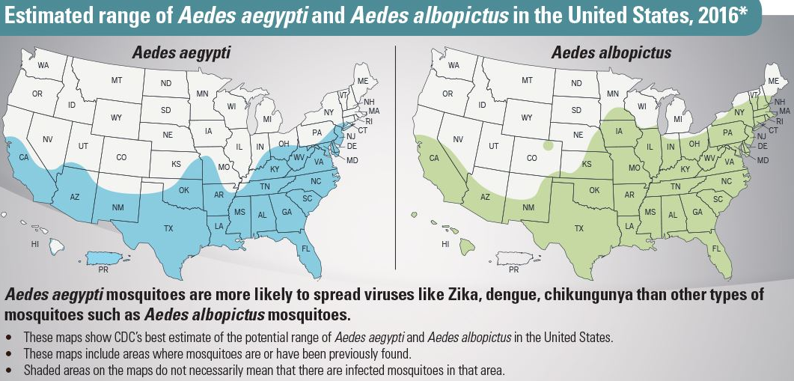
Vector Surveillance and Control
http://www.cdc.gov/vitalsigns/zika/infographic.html
http://www.cdc.gov/zika/vector/index.html
Notes:
These maps DO NOT show
· Exact locations or numbers of mosquitoes living in an area
· Risk or likelihood that these mosquitoes will spread viruses
These maps show
· CDC’s best estimate of the potential range of Aedes aegypti and Aedes albopictus in the United States
· Areas where mosquitoes are or have been previously found

Slide 23
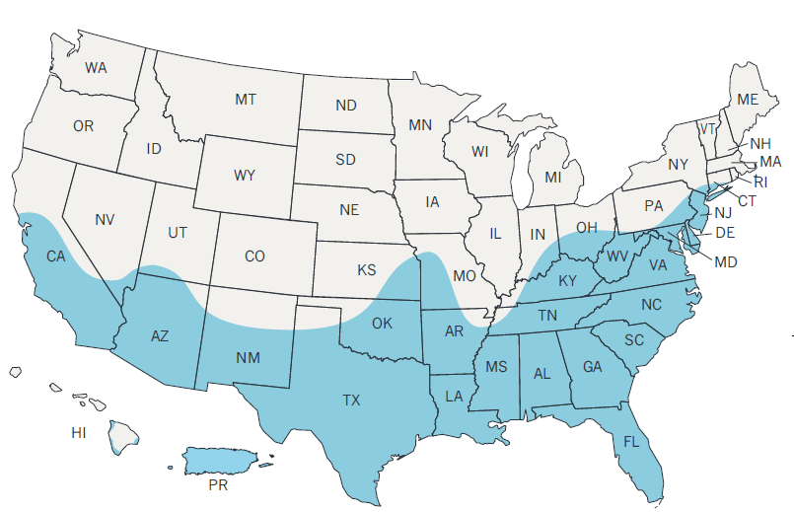
Technical Assistance Prioritization
Areas in blue
  Higher number of cases
  Higher risk of transmission
Upgrade from Arboviral v1.2 to v1.3 MMG
NEDSS Base System
(NBS) jurisdictions
Other jurisdictions
http://www.cdc.gov/zika/geo/united-states.html
An overview of NMI Technical Assistance is available in the 2/18/16 NMI eSHARE archives at: https://www.cdc.gov/nndss/trc/onboarding/eshare.html.
Notes:
Will open up TA to other jurisdictions early summer
Overview of TA process for ARBO is included in the Appendix

Slide 24
Information and Support for
ArboNET

Slide 25
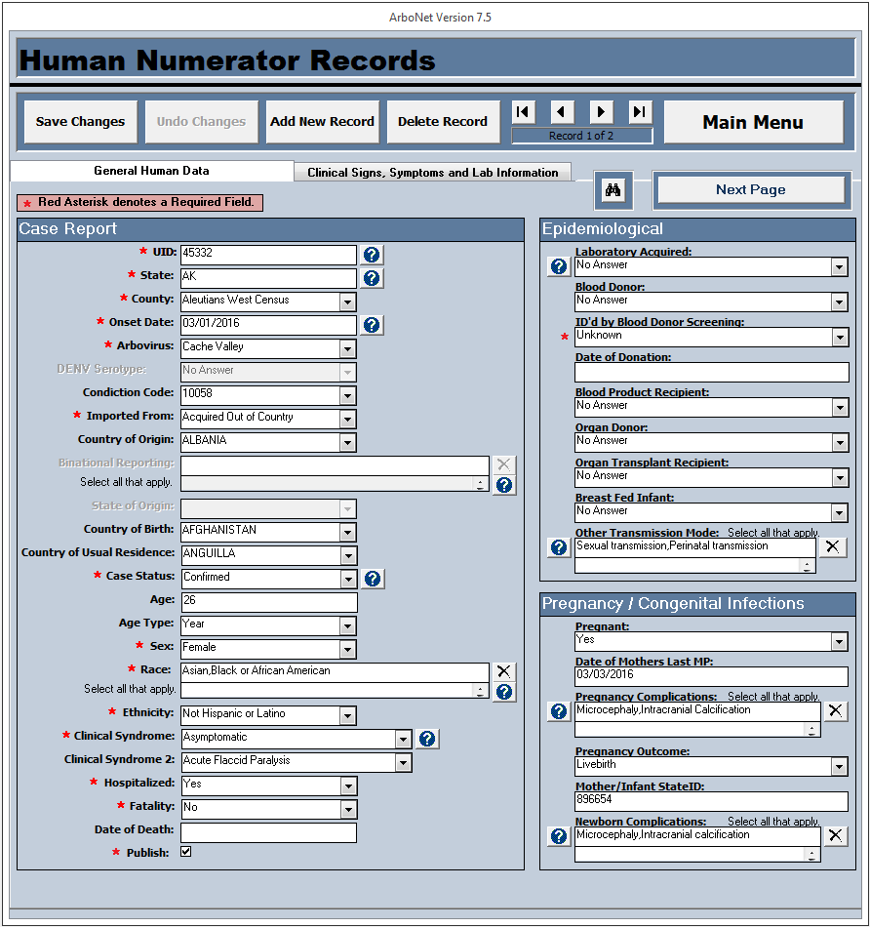
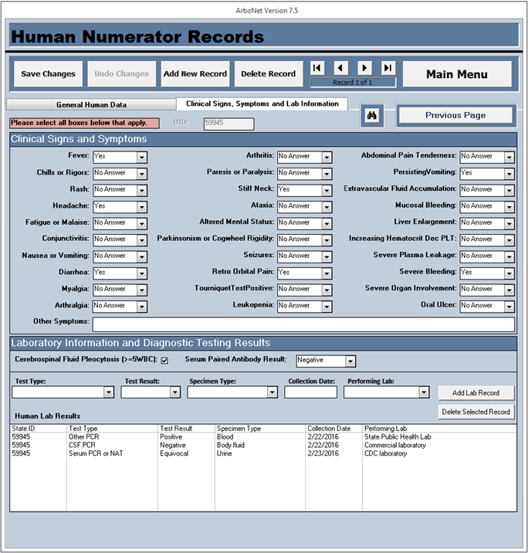
ArboNET Access Application Prototype
New look forms and controls
Lab information – listing of lab records associated with current case
Multi-select variables

Slide 26
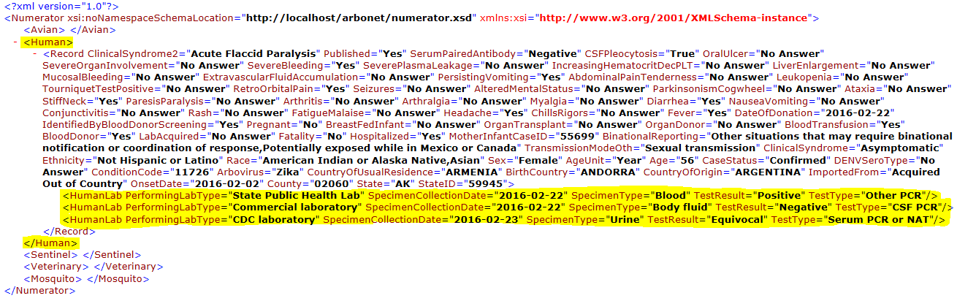
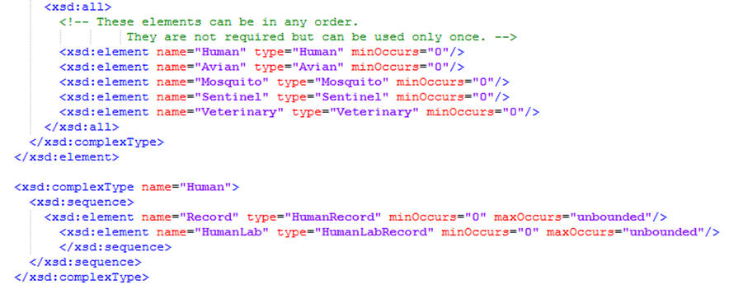
ArboNET Access and Online XML Structure
XML File Structure
XSD File Structure

Slide 27
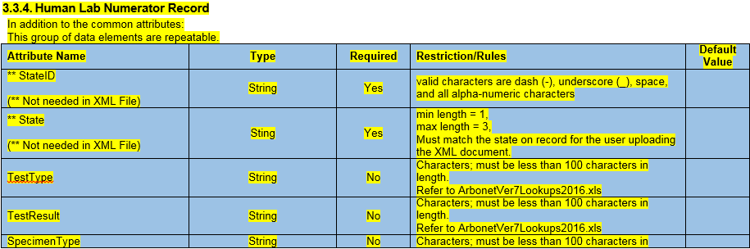

ArboNET Access and Online Alignment & Schema Artifacts
ArboNET’s artifacts that will be distributed to NNDSS and jurisdictions
Subset of the XML schema document, which is in line with NNDSS

Slide 28
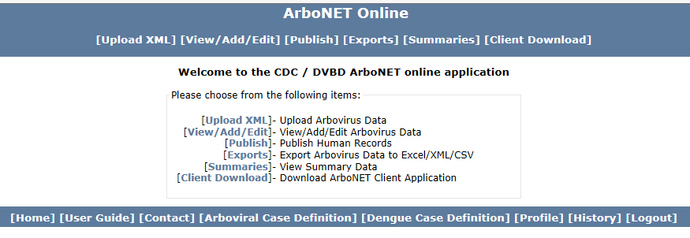
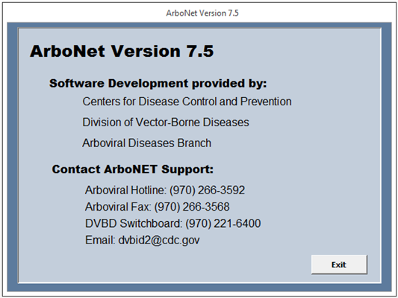
ArboNET Online Information and Support
https://wwwn.cdc.gov/arbonet/Login.aspx

Slide 29
Questions?

Slide 30
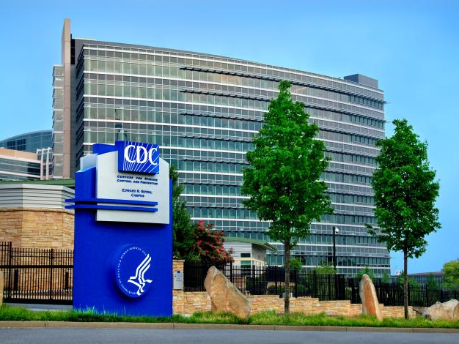
Other questions? Email EDX@cdc.gov

Slide 31
Appendix

Slide 32
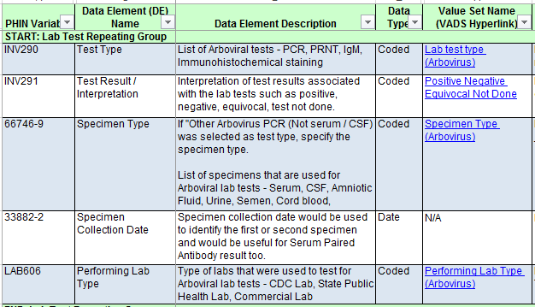
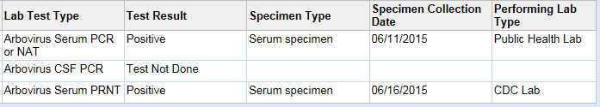
Lab Data Elements
Repeating Group Example

Slide 33
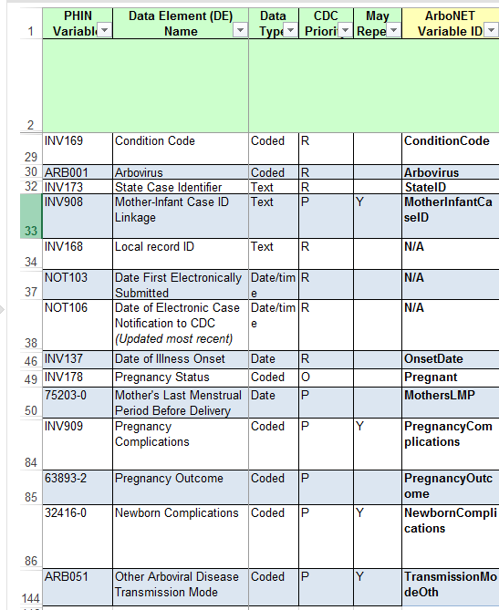
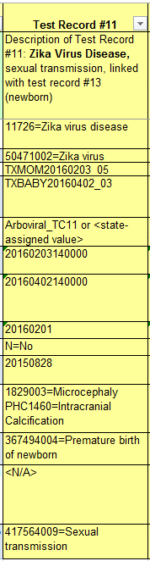
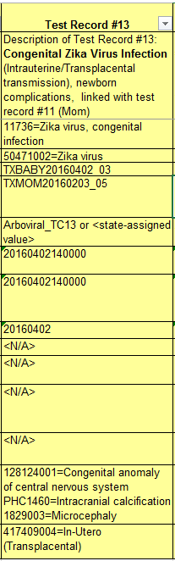
Test Record to Illustrate Zika Virus Disease (Mom) and Congenital Zika Virus Infection Newborn)

Slide 34
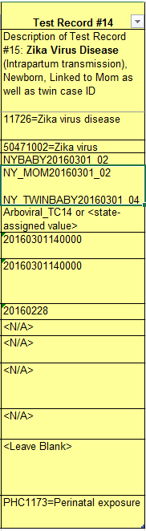
Test Record to Illustrate Zika Virus Disease (Newborn) with Intrapartum Transmission (Perinatal Exposure)

Slide 35
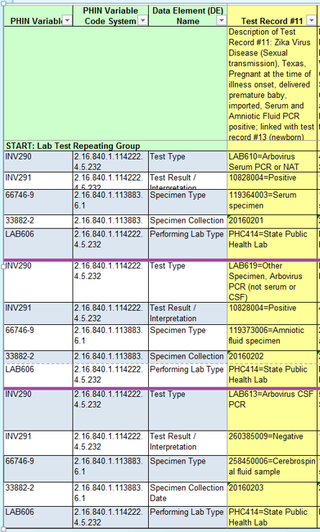
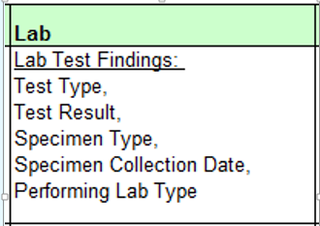
Test Record to Illustrate Lab Repeating Group

Slide 36
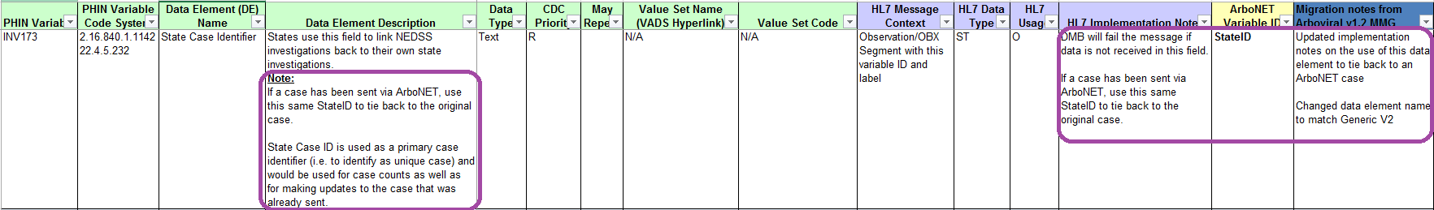
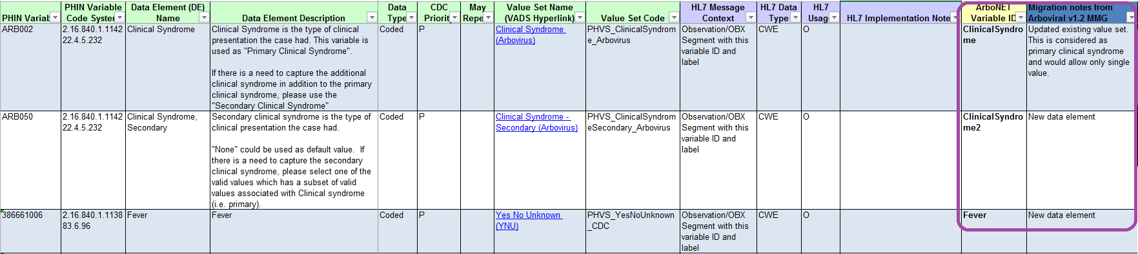
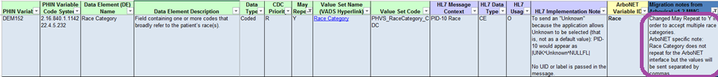
MMG Data Elements – Example Changes
Notes:
Example Changes from the Arboviral v1.2 MMG
New data elements
Updated value sets
Updated HL7 Implementation Notes

Slide 37
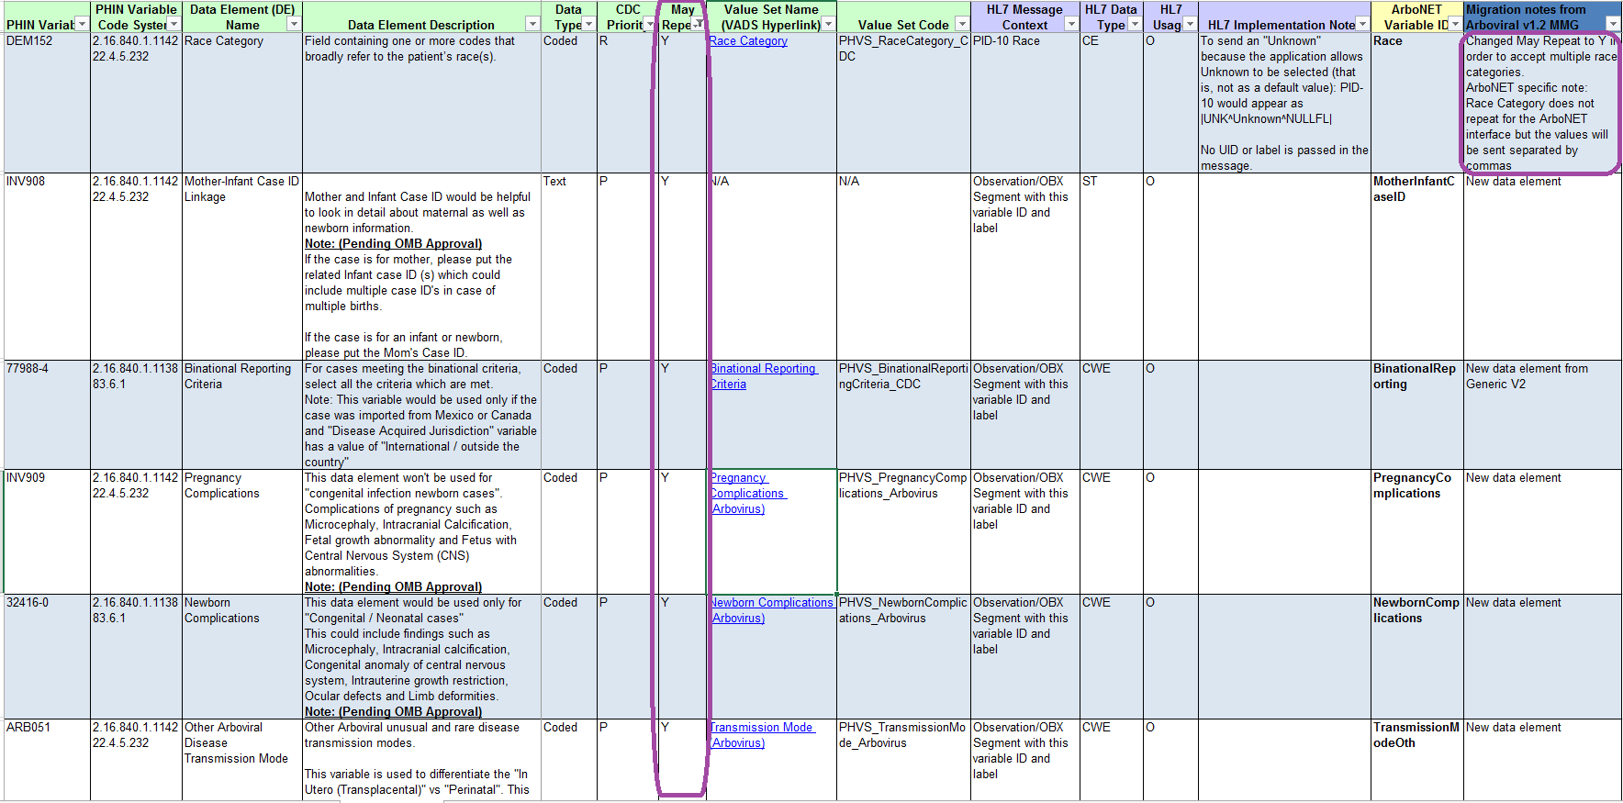
MMG Data Elements – Repeating Data Elements
Notes:
May Repeat = Indicates whether the response to the data element may repeat (multi-select/select all that apply). “Y” indicates that the field may repeat. If the response does not repeat, the field is not populated or contains "N". When a data element repeats, the values are sent in the same field with the instances separated by a tilde (~). Data elements that repeat require special processing.

Slide 38
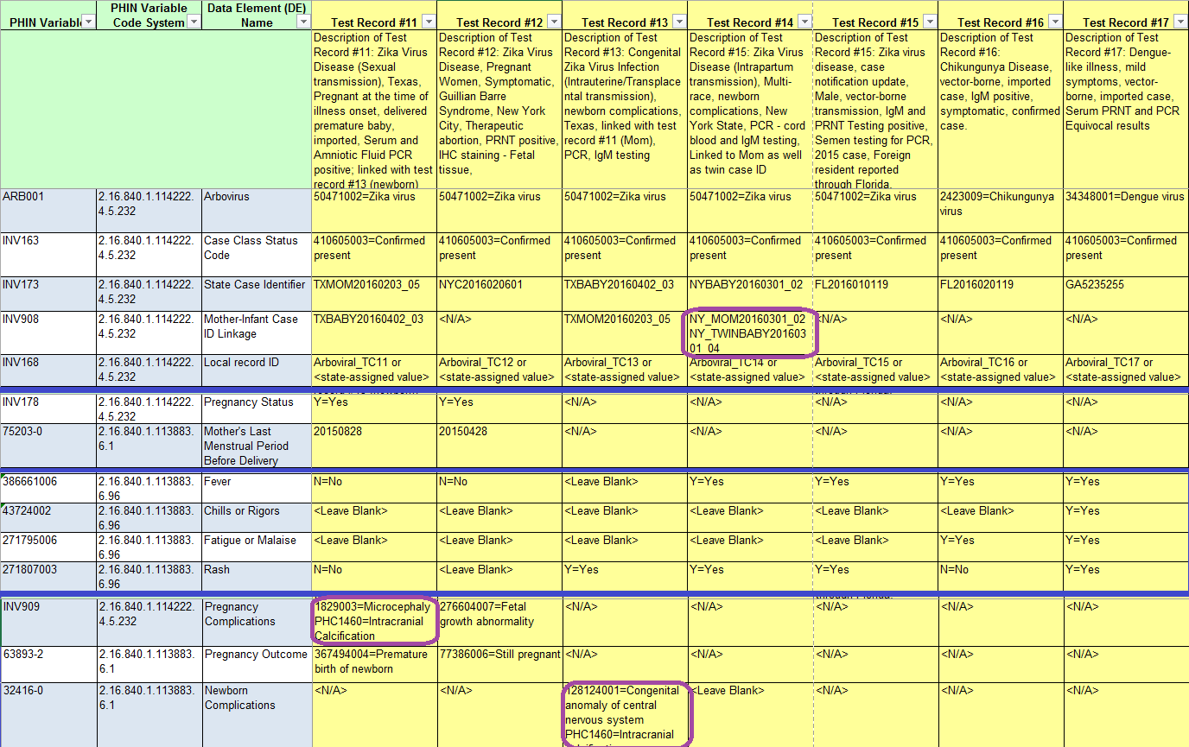
Test Record to Illustrate Repeating Data Elements
Notes:
Test Scenario (TS) document
When May Repeat = Y, the test scenario may have multiple data in one cell
<N/A> will be used for data elements that are not applicable to the test case
If not a congenital case, there won’t be newborn complications
If not female that is or was pregnant, there won’t be pregnancy complications or outcome
Mother-Infant Case ID Linkage
If the subject is the mother, the link is to the infant(s)
If the subject is an infant, the link is to the mother

Slide 39
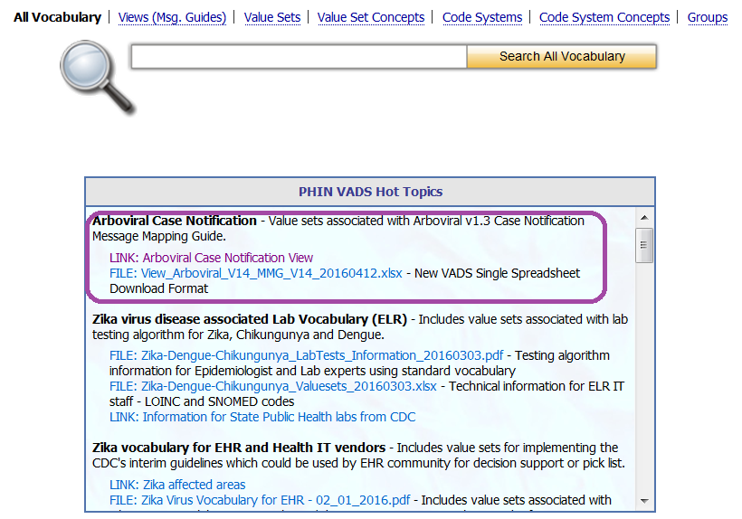
Arboviral in PHIN VADS Hot Topics

Slide 40
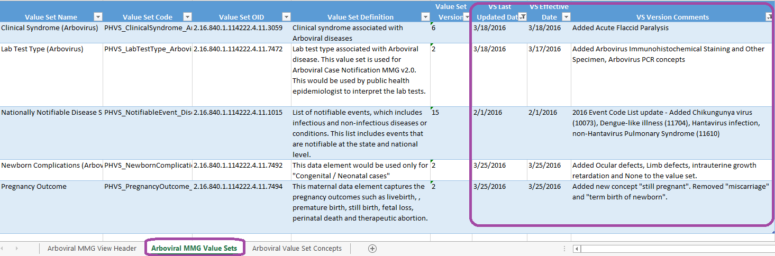
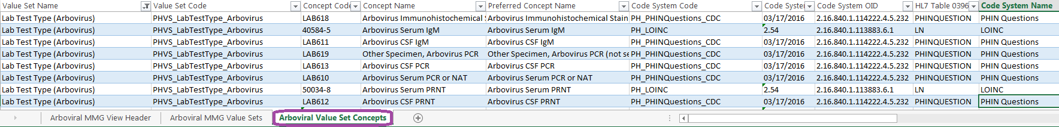
Arboviral MMG Enhanced View Export File
Notes:
We are providing an enhanced view export file for the Arboviral MMG.
It has 3 tabs:
Arboviral MMG View Header – metadata about the view
Arboviral MMG Value Sets – metadata about the value sets in the view
Arboviral Value Set Concepts – metadata about the concepts in all the value sets in the view

Slide 41
NMI Technical Assistance Process
NMI Technical Assistance Process Arboviral v1.3 MMG:
Primary Owner of Process
APHL
TA TEAM
CDC
01. Initial Call
04. Data Extract Updated
TA Validation: MQF
TA Validation: Content
Pilot State Addresses Errors
Updated HL7 Messages Generated
TA Validation: Resolve issues until all errors corrected
09. Onboarding
02. TA Kickoff Call
05. HL7 Message Created
10. Test Case Message Suite &
1 Week of Production Data sent to Staging
03. Gap Analysis Finalized
06. Transport
Set Up
07. TA Validation
MQF & Content
08. DMB Validation of Business Rules
11 Production Cutover

