Slide 1
Special eSHARE Webinar: Overview of ELR vocabulary associated with Zika, dengue, and chikungunya viruses New Conference Number: 888-972-4312 Participant Code: 7650657 Join the Adobe Connects meeting sign-in as “Guest” at: https://virtualsepd.adobeconnect.com/nmieshare
March 3, 2016

Slide 2
Agenda
Welcome and Introductions
CDC diagnostic testing guidance for Zika, chikungunya, and dengue viruses and associated electronic laboratory reporting (ELR) vocabulary
Demonstration for downloading the ELR vocabulary from the CDC vocabulary server (PHIN VADS)
Questions and Answers

Slide 3
Zika Virus, Lab Testing, and ELR
Jerry Sable,
Association of Public Health Laboratories

Slide 4
Aedes Aegypti
Aedes aegypti
transmits dengue, chikungunya, Zika virus...

Slide 5
Laboratory Criteria for Case Classification of Zika Virus Infection
Polymerase Chain Reaction (PCR)
detection of Zika virus RNA
in serum, cerebrospinal fluid (CSF), urine, saliva, amniotic fluid, placenta, umbilical cord, or fetal tissue
or
Immunohistochemical stain (IHC)
detection of Zika virus antigen in tissues by IHC
most likely done on autopsy specimens or maternal placenta
or
Serology
IgM antibody in serum, CSF, or amniotic fluid
Confirmed by neutralizing antibody assay
CSTE Interim Position Statement on Zika_Virus_Disease_and_Congenital_Zika_Virus

Slide 6
Zika virus Testing Algorithm
Molecular testing ¹
(<7 days after symptom onset)
Antibody testing ¹
(≥ 4 days after symptom onset)
(real-time) PCR for Zika virus
Zika virus IgM EIA
Positive:
Zika virus confirmed
Negative:
Perform Ab testing ²
Positive:
Presumptive Zika virus
Negative ³
Confirm with Ab neutralization (PRNT)
¹ There is extensive cross-reactivity in Flavivirus serologic assays. For samples collected <7 days after illness onset, molecular testing should be performed first.
² Specimen must be ≥ 4 days after symptom onset.
³ Negative IgM tests during the first week of illness should be repeated on a convalescent sample 2–3 weeks after symptom onset.

Slide 7
Tiered Algorithm for Arbovirus Detection for Suspected Cases of Chikungunya, Dengue, or Zika
(Testing only performed if patient symptomatic and travel history indicates travel to affected area).
Molecular testing ¹
(<7 days after symptom onset)
Antibody testing ¹
(≥ 4 days after symptom onset)
RT-PCR / NS1
dengue
(Real time) PCR
Zika
(Real time) PCR
chikungunya virus
IgM
dengue
IgM
Zika
IgM
chikungunya virus
Positive:
dengue
virus confirmed
Negative:
Perform
antibody
testing ²
Positive:
Zika
virus confirmed
Negative:
Perform
antibody
testing ²
Positive:
chikungunya
virus confirmed
Negative:
Perform
antibody
testing ²
Positive:
presumptive
dengue
virus ³
Negative
Positive:
presumptive
Zika
virus ³
Negative
Positive:
presumptive
chikungunya
virus
Negative
PRNT ⁴
PRNT ⁴
PRNT ⁴
¹ Due to extensive cross-reactivity in flavivirus serological assays, for samples collected <7 days post illness onset, molecular detection should be performed first.
² Perform if sample ≥ 4 days after symptom onset
³ Extensive cross-reactivity would be expected in samples from DENV/ZIKV circulation areas. A positive IgM assay with either antigen should be confirmed by using PRNT against both ZIKV and DENV as well as any other flaviviruses (e.g. SLEV, ZIKV, WNV, etc.) that might be found in that geographic area (including travel areas).
⁴ PRNT should include any flavivirus (e.g. SLEV, ZIKV, WNV, etc.) that might be found in that geographic area (including travel areas).

Slide 8
Zika Testing in Asymptomatic Pregnant Women
Antibody testing ¹
Serum collected 2–12 weeks post travel
Zika virus IgM EIA
Positive:
Perform dengue IgM
Negative
Positive:
Unspecified flavivirus infection
Negative:
Probable ZIKV ³
No further
follow up
PRNT (neutralizing Ab) ^{2,3}
¹ For women living in areas with ongoing transmission, refer to Updated Interim Guidelines for Health Care Providers Providing Care for Pregnant Women and Women of Reproductive Age During Ongoing Zika Virus Transmission - United States, 2016 for timing of sample collection.
² Extensive cross-reactivity would be expected in samples from DENV/ZIKV circulation areas. A positive IgM assay with both antigens should be followed up by using PRNT against both ZIKV and DENV as well as any other flavivirus (e.g., SLEV, ZIKV, WNV, etc.) that might be found in that geographic area (including travel areas). Depending on previous flavivirus exposure, resolution of infecting flavivirus may not be possible.
³ Follow-up care should be undertaken as specified in the Interim Guidelines for Pregnant Women During a Zika Virus Outbreak - United States, 2016.

Slide 9
LOINC Codes for Zika virus PCR
Code | Concept Name | Preferred Name
79190-5 | ZIKV RNA XXX Ql PCR | Zika virus RNA [Presence] in unspecified specimen by probe and target amplification method
request | DENV & ZIKV & CHIKV RNA Ser/Plas Ql PCR | Dengue virus & Zika virus & chikungunya virus RNA [Presence] in serum or plasma PCR
request | DENV & ZIKV & CHIKV RNA CSF Ql PCR | Dengue virus & Zika virus & chikungunya virus RNA [Presence] in CSF PCR

Slide 10
LOINC Codes for Zika Virus Serology
Code | Concept Name | Preferred Name
IgM antibody (detection)
80618-2 | ZIKV IgM CSF EIA-aCnc | Zika virus IgM Ab [Units/volume] in Cerebral spinal fluid by Immunoassay
80619-0 | ZIKV IgM Ser EIA-aCnc | Zika virus IgM Ab [Units/volume] in Serum by Immunoassay
request | ZIKV IgM CSF Ql EIA | Zika virus IgM Ab [Threshold] in Cerebral spinal fluid by Immunoassay
request | ZIKV IgM Ser Ql EIA | Zika virus IgM Ab [Threshold] in Serum by Immunoassay
Antibody neutralization (confirmation)
80620-8 | ZIKV NAb Titr Ser Nt | Zika virus neutralizing antibody [Titer] in Serum by Neutralization test
80621-6 | ZIKV NAb Titr CSF Nt | Zika virus neutralizing antibody [Titer] in Cerebral spinal fluid by Neutralization test
request | ZIKV NAb Titr Ser Ql Nt | Zika virus neutralizing antibody [Threshold] in Serum by Neutralization test
request | ZIKV NAb Titr CSF Ql Nt | Zika virus neutralizing antibody [Threshold] in Cerebral spinal fluid by Neutralization test
80622-4 | ZIKV NAb sp1 Titr Ser Nt | Zika virus neutralizing antibody [Titer] in Serum by Neutralization test --1st specimen
80623-2 | ZIKV NAb sp2 Titr Ser Nt | Zika virus neutralizing antibody [Titer] in Serum by Neutralization test --2nd specimen
80624-0 | ZIKV NAb sp1 Titr CSF Nt | Zika virus neutralizing antibody [Titer] in Cerebral spinal fluid by Neutralization test --1st specimen
80625-7 | ZIKV NAb sp2 Titr CSF Nt | Zika virus neutralizing antibody [Titer] in Cerebral spinal fluid by Neutralization test --2nd specimen

Slide 11
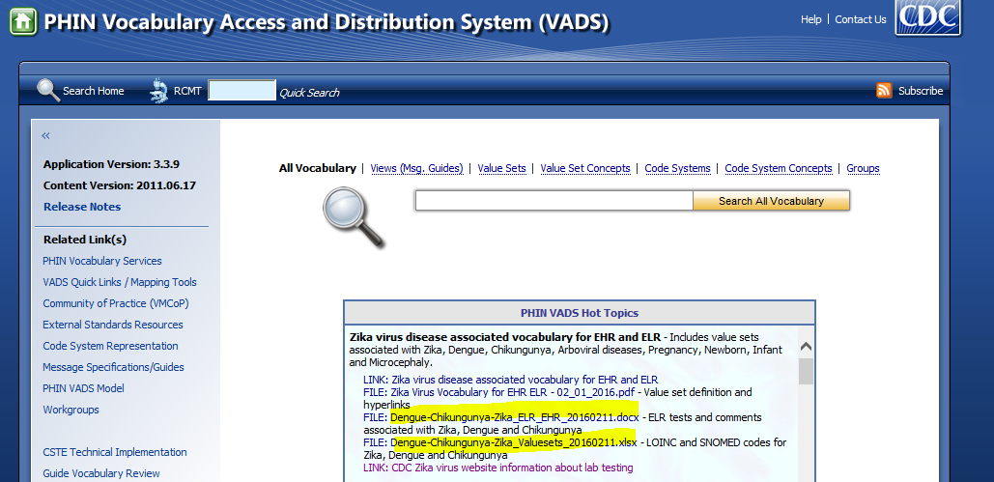
PHIN VADS ELR Vocabulary Download Information
PHIN VADS URL: http://phinvads.cdc.gov
Download the file from the PHIN VADS Hot Topics section:
Dengue-Chikungunya-Zika_LabTests_Information.pdf

Slide 12
Reportable Condition Mapping Tables (RCMT)
RCMT
filter
Reportable
Clinical Lab
Non reportable
RCMT tables identify lab data of public health interest
http://phinvads.cdc.gov
http://www.cdc.gov/ehrmeaningfuluse/rcmt.html

Slide 13
Reportable Condition Mapping Tables (RCMT)
RCMT
filter
Reportable
Clinical Lab
Non reportable
RCMT tables identify lab data of public health interest
TB
STD
Test results
RCMT
Foodborne
Hepatitis
etc.
Routing test results within a public health agency
http://phinvads.cdc.gov
http://www.cdc.gov/ehrmeaningfuluse/rcmt.html

Slide 14
Questions

Slide 15
Demonstration for Downloading the ELR Vocabulary from PHIN VADS
Jannie Williams – PHIN VADS Project Manager
Cole Downing – PHIN VADS Team
Center for Surveillance, Epidemiology, and Laboratory Services
Notes:
VADS Overview
Searching and Downloading Zika Related Content

Slide 16
PHIN VADS Overview
PHIN VADS is the Public Health Information Network Vocabulary Access and Distribution System.
PHIN VADS is used to support electronic lab reporting and case notification messaging.
PHIN VADS is the primary public health vocabulary distribution portal for the public health community.
https://phinvads.cdc.gov/vads/SearchVocab.action
Notes:
Public Health Information Network Vocabulary Access and Distribution System (PHIN VADS)
PHIN VADS is used to support Electronic Lab Reporting and Case notification Messaging.
PHIN VADS is the primary public health vocabulary distribution portal for the public health community.

Slide 17
Accessing VADS
PHIN VADS Web Browser - Provides the end user with access to the system via a standard Internet connection.
https://phinvads.cdc.gov/vads/SearchVocab.action
Notes:
PHIN VADS Web Browser - Provides the end user with access to the system via a standard internet connection

Slide 18
Overview
Navigating Hot Topics to find and download useful information for Zika, chikungunya, dengue and RCMT.
How to download the Zika-related ELR vocabulary – Value Set Downloading.
How to get support from PHIN VADS and CDC Vocabulary team.
Notes:
Summary
Navigating Hot Topics to find and download useful information for Zika, Chikungunya, Dengue and RCMT.
How to download the Zika related ELR vocabulary – Value Set Downloading
How to get support from PHIN VADS and CDC Vocabulary team.

Slide 19
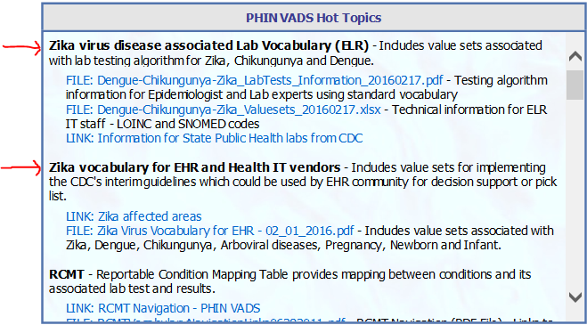
Zika in Hot Topics
Hot Topics - place where users can find important links and downloads relevant to Public Health.
Information on Zika-related content for ELR and electronic health records (EHR) can be found here.
Hot Topics is located on the PHIN VADS homepage (hyperlink below).
https://phinvads.cdc.gov/vads/SearchVocab.action
Notes:
Hot Topics - place where users can find important links and downloads relevant to Public Health.
Information on Zika related content for ELR and EHR can be found here.
Hot Topics is located on the PHIN VADS homepage. (hyperlink below)

Slide 20
RCMT
Reportable Condition Mapping Table
The RCMT provides mappings between reportable conditions and their associated LOINC laboratory tests and SNOMED results.
RCMT helps identify incoming Health Level Seven International (HL7) ELR messages that are related to reportable conditions and also facilitates the routing of ELR messages to appropriate public health programs (e.g., tuberculosis and malaria).
http://www.cdc.gov/EHRmeaningfuluse/rcmt.html

Slide 21
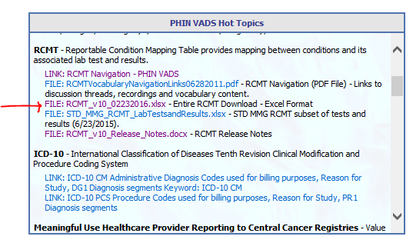
RCMT Download File
The RCMT download file contains all the condition codes, their value sets, and their concepts.
It can be found and downloaded here (red arrow).
Notes:
The RCMT download file contains all the condition codes, their value sets and their concepts.
It can be found and downloaded here. (red arrow)

Slide 22
RCMT Download File 1st Tab
The first tab in the file contains links to all the value sets in RCMT.
You can filter by Condition name. In this screenshot it is filtered by Zika.
Notes:
The first tab in the file contains links to all the value sets in RCMT
The second tab contains all the conditions codes and their value set concepts along with other metadata.
You can filer by Condition name. In this screenshot it is filtered by Zika
(add text to distinguish value set types lab vs result)

Slide 23
RCMT Download File 2nd Tab
The second tab contains all the conditions codes and their value set concepts along with other metadata.
You can filter any of the fields. In this screenshot “Condition Name” is filtered by Zika.
Notes:
The second tab contains all the conditions codes and their value set concepts along with other metadata.
You can filter any of the fields. In this screenshot Condition Name is filtered by Zika

Slide 24
RCMT Download File 2nd Tab
The Blue fields: Reportable conditions (Code, Name, & Code System).
The Green field: distinguishes the value sets as “Associated Lab Tests & Associated Lab Test Results.”
The Yellow fields: contain all the value set names, concept codes, and concept names.
Notes:
The Blue fields - Reportable conditions (Code, Name & Code System)
The Green field – distinguishes the value sets as Associated Lab Tests & Associated Lab Test Results
The Yellow fields - contain all the value set names, concept codes and concept names

Slide 25
RCMT Navigation
To search RCMT you can either enter search text in the highlighted box or click “RCMT.”
Zika
https://phinvads.cdc.gov/vads/ViewCodeSystemConcept.action?oid=2.16.840.1.114222.4.5.274&code=RCMT
Notes:
To search RCMT you can either enter search text in the highlighted box or click “RCMT”

Slide 26
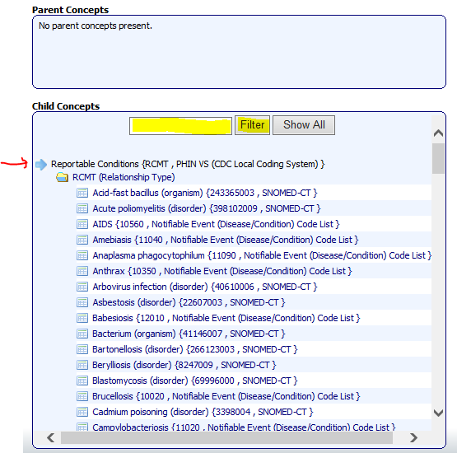
RCMT Navigation
If you click “RCMT” from the menu bar of the PHIN VADS homepage, the RCMT hierarchy will be displayed.
Here you will see the RCMT parent concept and all its children concepts (i.e., reportable condition codes).
You can either click on a condition code from the scroll down box or you can search by entering text in the search box highlighted and click “filter.”
Notes:
If you click “RCMT” from the menu bar of the homepage, the RCMT hierarchy will be displayed.
Here you will see the RCMT parent concept and all its children concepts (i.e. Reportable condition codes).
You can either click on a condition code from the scroll down box or you can search by entering text in the search box highlighted and click “filter”

Slide 27
RCMT Navigation
If you enter “Zika” as search text and click “Filter,” the condition code for Zika virus disease will be displayed.
Next, click on the condition code to display associated value sets.
Notes:
If you enter “zika” as search text and click filter, the condition code for Zika virus disease will be displayed.
Next click on the condition code to display associated value sets.

Slide 28
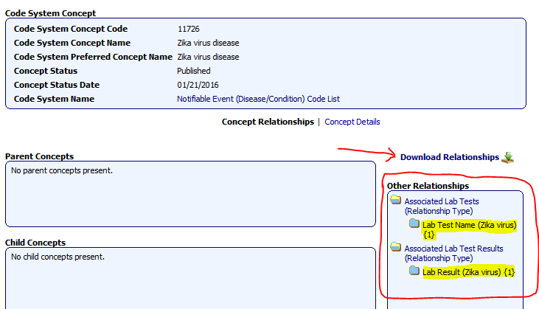
RCMT Navigation
This is the code system concept page for Zika virus disease. On the right side you will see the Value Sets under “Other Relationships.”
Here you will find Associated Lab Tests and Associated Lab Test Results for the RCMT condition you select from the RCMT Hierarchy.
These value sets are related to Zika virus. At the top you will see the concept metadata for the condition code.
Notes:
This is the code system concept page for Zika virus disease. On the right side you will see the Value Sets under “Other Relationships.”
Here you will find Associated Lab Tests and Associated Lab test Results for the RCMT condition you select from the RCMT Hierarchy.
These value sets are related to Zika virus. At the top you will see the concept metadata for the condition code.

Slide 29
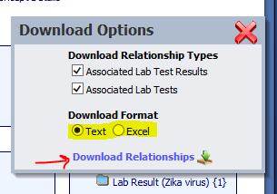
RCMT - Downloading Value Sets
There are two ways to download the value sets:
1) The first is to click the “Download Relationships” button from the code system concept page.
Choose a download format using the radio buttons in the pop-up window.
Click “Download Relationships.”
Notes:
There are two ways to download the value sets:
The first is to click the “Download Relationships” button from the code system concept page.
Choose a download format using the radio buttons in the pop up window.
Click “Download Relationships”

Slide 30
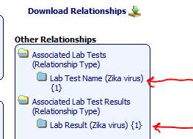
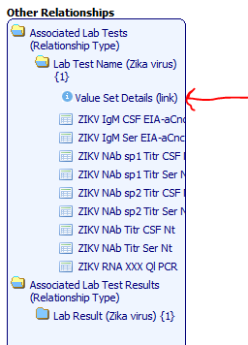
RCMT - Downloading Value sets
2) The second way to download value sets from RCMT is to click on the Value Set links in the “Other Relationships” box.
The folder will open displaying all the value set concepts.
Click on “Value Set Details (link).”
Notes:
The second way to download value sets from RCMT is to click on the Value Set links in the “Other Relationships” box.
The folder will open displaying all the value set concepts.
Click on “Value Set Details (link)”

Slide 31
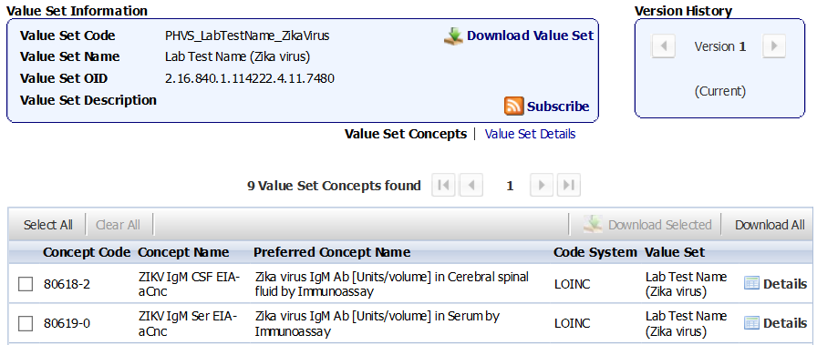
RCMT – Value Set Information
1
2
3
5
4
This window displays the value set metadata.
Click “Value Set Details” for even more metadata.
This button will bring up the download window from previous slide.
Same process – choose format – click download.
This window displays the version of the value set you are viewing.
You can click the back arrow to see previous value set versions.
This pane displays the value set concept data.
Click the subscribe button to be notified when a value set is updated in PHINVADS.
Notes:
This window displays the value set metadata.
Click “Value Set Details” for even more metadata
This button will bring up the download window from previous slide.
Same process – choose format – click download
This window displays the version of the value set you are viewing.
You can click the back arrow to see previous VS versions
This pane displays the value set concept data.
Click the subscribe button to be notified when a value set is updated in PHINVADS

Slide 32
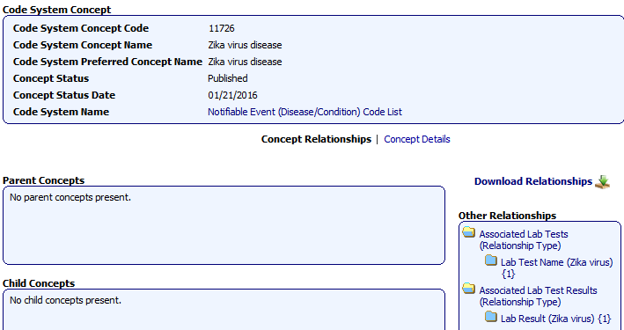
RCMT – Zika Virus Disease
This is the condition code page for Zika virus.
You can get to this page by searching RCMT or using the link found below.
https://phinvads.cdc.gov/vads/ViewCodeSystemConcept.action?oid=2.16.840.1.114222.4.5.277&code=11726
Notes:
This is the condition code page for Zika virus.
You can get to this page by searching RCMT or using the link found below.

Slide 33
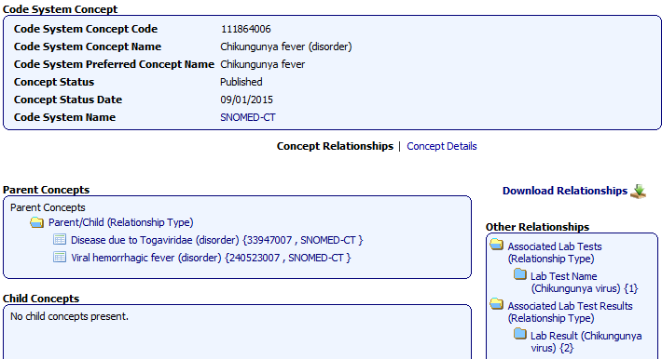
RCMT – Chikungunya Fever
This is the condition code page for chikungunya fever.
You can get to this page by searching RCMT or using the link found below.
https://phinvads.cdc.gov/vads/ViewCodeSystemConcept.action?oid=2.16.840.1.113883.6.96&code=111864006
Notes:
This is the condition code page for Chikungunya fever.
You can get to this page by searching RCMT or using the link found below.

Slide 34
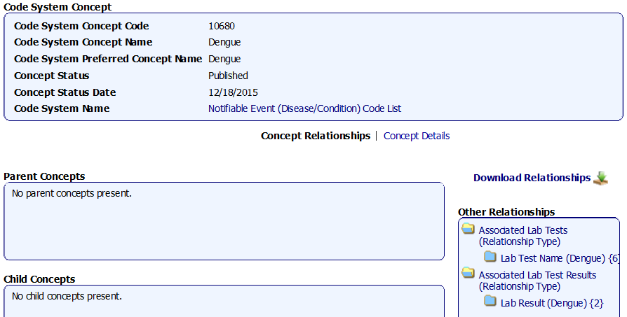
RCMT – Dengue
This is the condition code page for dengue.
You can get to this page by searching RCMT or using the link found below.
https://phinvads.cdc.gov/vads/ViewCodeSystemConcept.action?oid=2.16.840.1.114222.4.5.277&code=10680
Notes:
This is the condition code page for dengue.
You can get to this page by searching RCMT or using the link found below.

Slide 35
PHIN VADS Live Demo
https://phinvads.cdc.gov/vads/SearchHome.action

Slide 36
PHIN VADS Support
For support from PHIN VADS and CDC Vocabulary team please send an email to PHINVS@CDC.GOV.

Slide 37
Questions

