Slide 1
NMI Technical Assistance Overview
NMI eSHARE Webinar
February 18, 2016

Slide 2
Speakers
Michele Hoover
  CDC Public Health Advisor, National Notifiable Diseases Surveillance System (NNDSS) Modernization Initiative (NMI) Team Lead
Laura Carlton
  APHL NMI Technical Assistance (TA) Project Manager
Gretl Glick
  APHL NMI Technical Assistance Project Coordinator

Slide 3
Objective
Understand the NMI Technical Assistance Process
NMI TA Messaging and Vocabulary Resources
Objective
Terminology and Mapping Tools
NMI Technical Assistance Process
Overview
Other Resources
Introduce NMI Technical Assistance Tools and Resources
NMI Technical Assistance Approach
Technology Tools

Slide 4
NMI: The Big Picture
NNDSS Modernization Initiative
Part of the CDC Surveillance Strategy
Provide more comprehensive, timely, and higher quality data than ever before for public health decision making through the CDC Message Validation, Processing, and Provisioning System (MVPS)
Implement HL7 messaging according to Message Mapping Guides (MMGs), and phase out current data streams
Notes:
Key points – writing into the CDC surveillance strategy. Coming out of known need to update NNDSS & make more efficient.

Slide 5
Message Validation, Processing, and Provisioning System
MVPS is software that will validate and process nationally notifiable disease data (NND) messages sent by jurisdictions and will provision the data to CDC programs.
MVPS Benefits:
Provides streamlined message processing at CDC.
Provides data standardization.
Furthers the CDC’s public health goals through enhanced data provisioning.
Allows jurisdictions to view submitted data in the MVPS Dashboard and identify data quality issues.

Slide 6
NMI Technical Assistance Overview
  NMI TA provides both onsite and remote support to public health agencies (PHAs) to implement HL7 case notifications. The TA team offers expertise in HL7 messaging, vocabulary and integration engines, and transport utilities.
  Project management and business analysis: Identify needed resources, risks, and dependencies for electronic messaging.
  Data standards expertise and workflow analysis: Work closely with PHA surveillance and IT staff to harmonize surveillance system terminology to incorporate data standards.
  Technical architecture expertise: Develop and implement technical solutions that address data exchange needs.

Slide 7


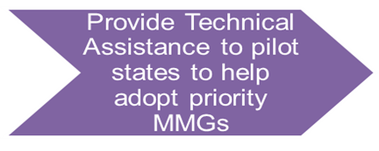
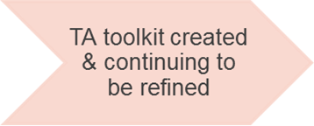
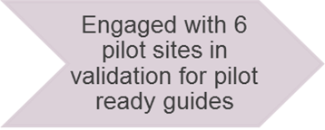
NMI: Components
Planning to expand TA to additional pilot sites & state requests

Slide 8
Technical Assistance Support
Plan
Stakeholder engagement
Infrastructure assessment
Implement
Terminology mapping
HL7 message route
Validation
HL7 validation (structure, terminology, and logic)
Content validation (data)
Implementation plan
Transport mechanism
Gap analysis
Ready for Production
Onboarding
Knowledge transfer
Cutover to production
Message Evaluation and Testing Service (METS)
Notes:
Laura

Slide 9
NMI Technical Assistance Process
NMI Technical Assistance Process:
Primary Owner of Process
TA Validation: METS
TA Validation: Structure & Content
Pilot Site Addresses Errors
Updated HL7 Messages Generated
TA Validation: Resolve issues until all errors corrected
APHL
TA TEAM
CDC
01. Initial Call
04. Data Extract Updated
02. TA Kickoff Call
05. HL7 Message Created
03. Gap Analysis Finalized
06. Transport
Set Up
07. TA Validation
METS, Structure, & Content
TA Complete!
Onboarding & Production Cutover
Notes:
Gretl

Slide 10
NMI TA Milestones:

Slide 11
NMI Technical Assistance Models
On-site
In-person TA meeting
Virtual
No in-person meeting
Continued support and communication through to production
Hybrid
In-person TA meeting
Entire TA team onsite 2–3 days
Provide in-depth support on all aspects of project
Continued virtual support through to production
Provide detailed support for a specified gap or need
1 or 2 TA members onsite for 2–3 days
Continued virtual support through to production
Provide overarching support for all other areas
Webinars, teleconference, and other means will be used to communicate
Rolling support for any issues that arise (no particular pain point or identified need)
Templates, standardized information, checklists and other tools

Slide 12
On-site TA Support Examples
Michigan and Oregon Departments of Health
  Completed terminology mapping
  Started building test messages for validation
California Department of Health
  Assessed technical architecture
  Designed NMI message route
  Started terminology mapping
  Installed Rhapsody route

Slide 13
Virtual TA Support Examples
Florida Department of Health
  Terminology mapping (>1 surveillance system)
  Mirth support
  Test message validation
New York Department of Health
  Terminology mapping
  Rhapsody route
  Test message validation

Slide 14
Hybrid TA Support Example
Minnesota Department of Health:
  Initial site visit
    Assessed technical architecture and designed NMI message route
    MAVEN, data warehouse, Rhapsody components
  Virtual support
    Completed terminology mapping and test case data
    Developed data warehouse requirements
    Developed Rhapsody route
  Follow-up site visit
    Implemented and tested data warehouse/Rhapsody route
    Build test messages for validation

Slide 15
NMI TA Resources: Reusable Tools
Templates, standardized information, checklists, and other reusable tools that were developed during piloting soon will be available on the NMI web site to guide all jurisdictions through message implementation. These tools are adaptable for future MMGs to help support a common approach to meeting the goals of NMI including:
NMI Guidebook
NMI Implementation Template
Compiled NMI Test Case Scenarios and jurisdiction-specific documentation
HL7 Message Creation Rhapsody or Mirth Route and Mapping Tables

Slide 16
NMI TA Guidebook
Outlines the NMI TA process, steps, and tools for MMG implementation
  Orients and sets expectations for jurisdictions using TA
  Serves as guidance for jurisdictions implementing independently
Includes resources for jurisdictions to develop vocabulary and messaging capabilities and gain a better understanding of NMI

Slide 17
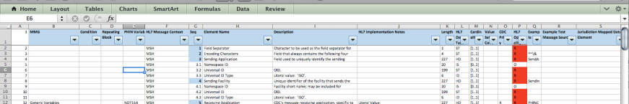
NMI Implementation Template
Implementation Spreadsheet
Gen V2 MMG
Condition-specific MMG
Case Notification Message Structure Specification/Profile
State Case Reporting Forms and Mappings to DSS fields

Slide 18
Test Case Scenarios
Each MMG has a specific set of test cases that jurisdictions will need to complete to be ready for onboarding
TA team has compiled these test scenarios for NMI validation process into a single document
  Captures jurisdiction-specific values populating test messages to assist with validation
  Allows CDC programs to know what to expect in messages from a specific jurisdiction
Organized by PHIN Variable IDs and test scenarios grouped by MMG
  Additional PHIN variable-related metadata

Slide 19
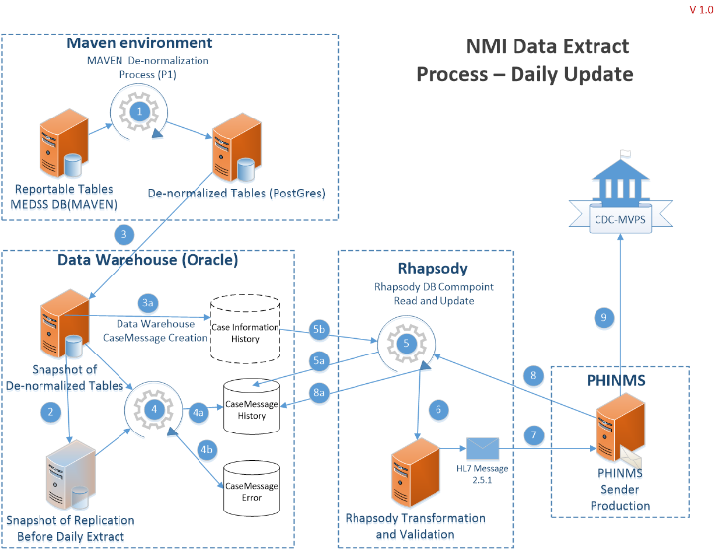
Technical Design Assistance:
Notes:
John Park

Slide 20
NMI: Ongoing Technical Assistance
Any jurisdiction may request technical assistance for help implementing MMGs published in Stage 3 final status.
Pilot jurisdictions will receive technical assistance to ensure that they are ready for onboarding.
The CDC Onboarding team may refer jurisdictions to the TA team if jurisdictions need additional help.

Slide 21
NMI: Request Technical Assistance
Coming Summer 2016!
  CDC expects NMI Technical Assistance to be available in summer 2016. When TA is available, jurisdictions should take the following steps to request technical assistance:
    Fill out the NMI Readiness Assessment (to be available on the NMI website).
    Send the completed assessment to EDX@cdc.gov with “NMI TA request” in the subject.
  CDC will review the request and assign technical assistance based on certain criteria.
Notes:
Criteria: The level of effort needed to fulfill the request
Readiness and time frame indicated by jurisdiction
Schedule and availability of TA team members
Number of MMGs and NND conditions converting to HL7
Volume of Notifications

Slide 22
APHL NMI Team
APHL NMI Technical Assistance Team
Gretl Glick – Project Coordinator
Riki Merrick– Lead Terminologist
Susan Downer - Terminologist
John Park– Technical Architect
APHL Leadership
Patina Zarcone - Director, Informatics Program
Linda Cohen – Manager, Informatics Program
Laura Carlton – Sr. Specialist, Informatics Program
Notes:
Laura

Slide 23
Join Us: March 2016 NMI eSHARE Call
Topic: Overview of NMI Implementation and Technical Assistance Tools
When: 3:00 PM EST; March 17, 2016
Where:
  Adobe Connects Webinar Link: https://virtualsepd.adobeconnect.com/nmieshare/
  Conference Number: 1-888-972-4312
  Participant Code: 7650657

Slide 24

Thank You
Thank You!
Questions?
Notes:
Thank You

