Slide 1
Healthy People 2020 Progress Review:
Social Determinants of Health and
Lesbian, Gay, Bisexual, and
Transgender Health
February 5, 2015

Slide 2
Karen B. DeSalvo, MD, MPH, MSc
Acting Assistant Secretary for Health
U.S. Department of Health and Human Services
February 5, 2015

Slide 3

Progress Review
Agenda and Speakers
Chair
Karen B. DeSalvo, MD, MPH, MSc, Acting Assistant Secretary for Health U.S. Department of Health and Human Services
Presentations
Don Wright, MD, MPH, Deputy Assistant Secretary for Disease Prevention and Health Promotion
Irma Arispe, PhD, Associate Director, National Center for Health Statistics
Pamela Hyde, J.D., Administrator, Substance Abuse and Mental Health Services Administration
Leandris Liburd, PhD, MPH, MA, Director, Office of Minority Health and Equity, Centers for Disease Control and Prevention
RADM Sarah Linde, MD, Chief Public Health Officer, Health Resources and Services Administration
Community Highlight
Christopher Brown, MBA, MPH, Director of Health and Mental Health Services, Los Angeles LGBT Center
3

Slide 4
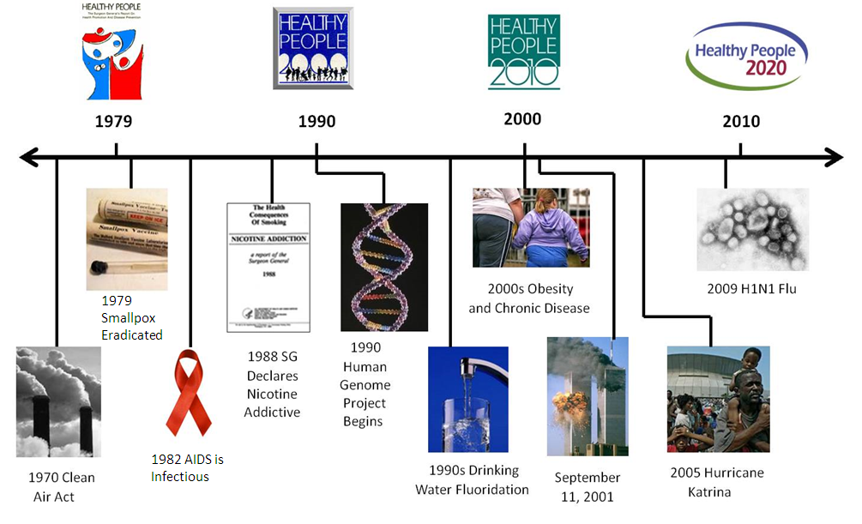
Healthy People
Remains Relevant

Slide 5
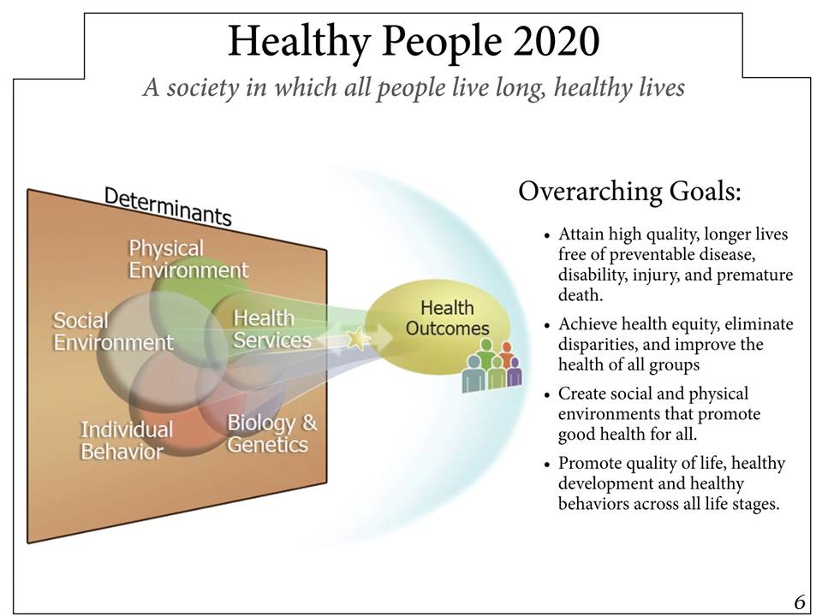
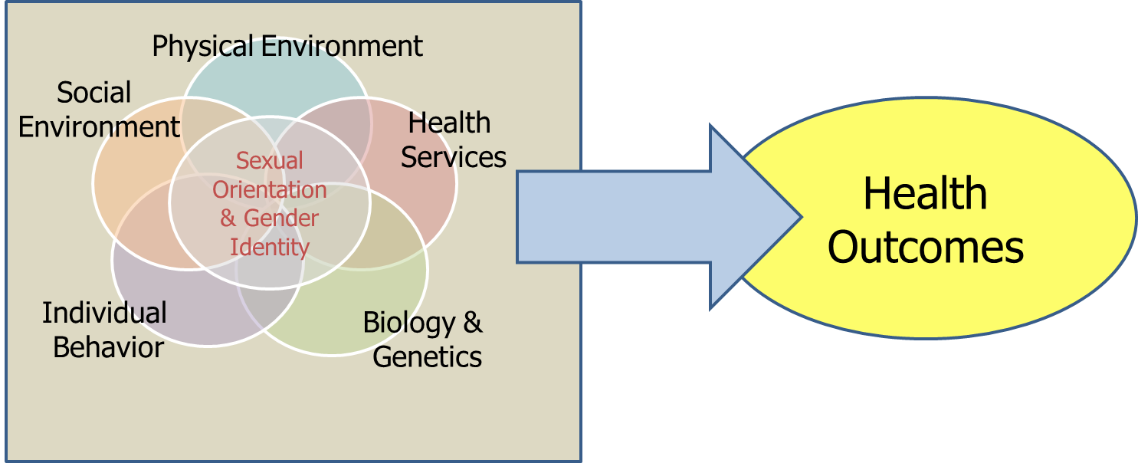
Healthy People’s Vision
5

Slide 6
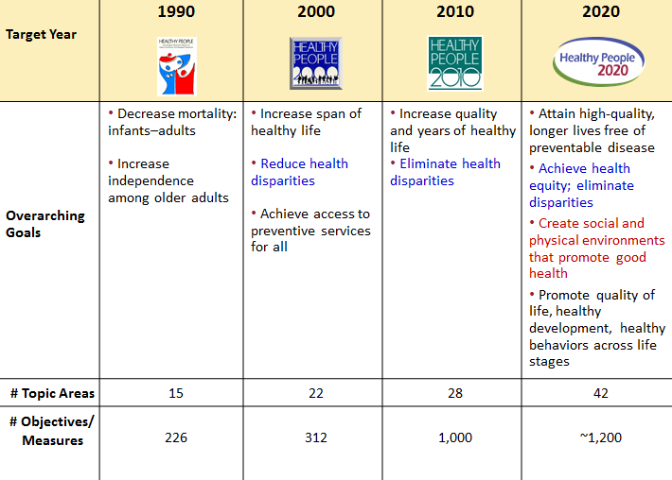
Evolution of Healthy People

Slide 7
Healthy People 2020’s
Definition of Health Disparity
A health disparity is a particular type of health difference that is closely linked with social, economic, and/or environmental disadvantage.
Health disparities adversely affect groups of people who have systematically experienced greater obstacles to health based on:
  ▪ Racial or ethnic group ▪ Cognitive, sensory, or ▪ Religion physical disability ▪ Socioeconomic status ▪ Sexual orientation or
  ▪ Gender gender identity
  ▪ Age ▪ Other characteristics
  ▪ Mental health historically linked to ▪ Geographic location discrimination or exclusion
SOURCE: http://www.healthypeople.gov/2020/about/foundation-health-measures/Disparities
7

Slide 8
Healthy People 2020’s
Definition of Health Equity
The attainment of the highest level of health for all people.
Achieving health equity requires:
    Elimination of health and health care disparities
    Valuing everyone equally
    Focused and ongoing societal efforts to address avoidable inequalities including injustices
      Historical
      Contemporary
SOURCE: http://www.healthypeople.gov/2020/about/foundation-health-measures/Disparities
8

Slide 9
Definition of Cultural Competence
Cultural competence describes the ability of an individual or organization to interact effectively with people of different cultures to produce positive change.
Practitioners must understand the cultural context of their target community, and have the willingness and skills to work within this context.
SOURCE: http://captus.samhsa.gov/prevention-practice/strategic-prevention-framework/cultural-competence
9

Slide 10

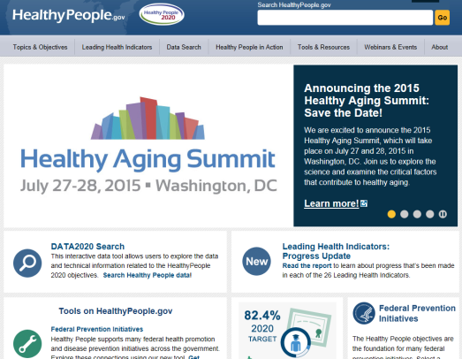

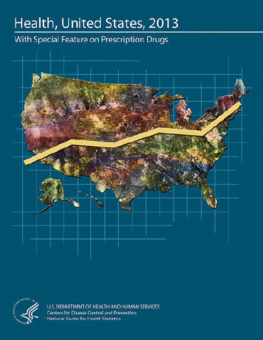

HHS initiatives that address disparities, health equity, and cultural competence
Healthy People 2020
National Partnership for Action to End Health Disparities
National Prevention Strategy
Health, United States
National Healthcare Quality and Disparities Report

Slide 11
Don Wright, MD, MPH
Deputy Assistant Secretary for Health
Director, Office of Disease Prevention and Health Promotion
U.S. Department of Health and Human Services
February 5, 2015

Slide 12
Healthy People 2020
Overarching Goals
    Attain high-quality, longer lives free of preventable disease, disability, injury, and premature death
    Achieve health equity, eliminate disparities, and improve the health of all groups
    Create social and physical environments that promote good health for all
    Promote quality of life, healthy development, and healthy behaviors across all life stages
12

Slide 13

Progression of SDOH & LGBT from issues to Topic Areas
Healthy People 2010 (HP2010)
      Objectives related to SDOH included in HP2010, such as increase high school graduation rates
      LGB populations established in the data template for population-based objectives
      Healthy People 2010 LGBT Companion Document published, identified 29 specific HP2010 objectives salient to LGBT populations
13

Slide 14
Progression of SDOH & LGBT from issues to Topic Areas continued
      Healthy People 2020
        SDOH and LGBT Health established as new topic areas
        SDOH and LGBT Health objectives established
        Social Determinants highlighted as a Leading Health Indicator
        HP2020 Spotlight on Health Webinar featuring Transgender Health (May 2012)
        HP2020 Spotlight on Health Webinar featuring SDOH (April 2013)
14

Slide 15
Healthy People 2020
Social Determinants of Health (SDOH) Topic Area
A “place-based” approach
Social determinants over the life course
Prioritization of 5 key determinants and associated factors
Each determinant interacts with the other four
All affect the health of the individual
15

Slide 16
Healthy People 2020
SDOH Conceptual Model and
Priority Issues
Neighborhood/Built Environment:
Quality of housing
Crime and violence
Environmental conditions
Access to healthy foods
Education:
High school graduation rates
Enrollment in higher education
Early childhood education/development
Language/literacy
Economic Stability:
Poverty
Employment
Housing stability
Food insecurity
Health and Health Care:
Access to health services
Access to primary care
Health literacy
Social and Community Context:
Social cohesion
Perceptions of discrimination and equity
Civic participation
Incarceration/institutionalization
16

Slide 17
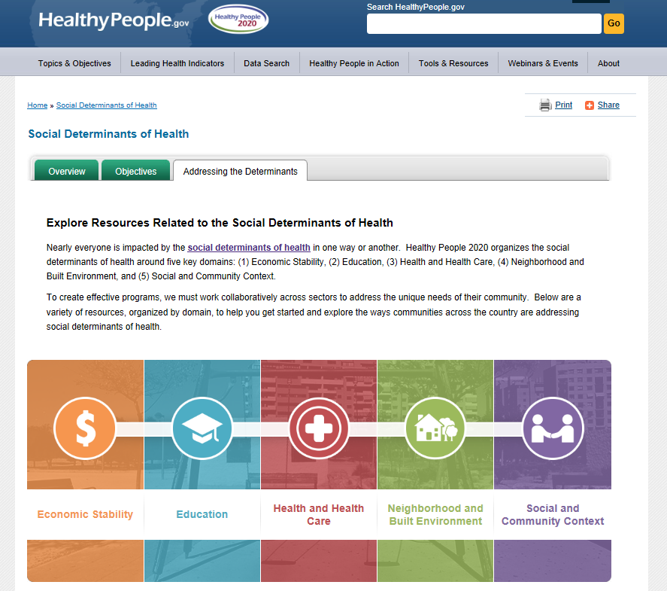
Healthy People 2020
SDOH Resource Portal
17

Slide 18
HP2020 & LGBT Health
Drive action to develop data systems used to monitor Healthy People 2020 objectives which collect standardized data that identify
  Lesbian
  Gay
  Bisexual
  Transgender populations
18

Slide 19
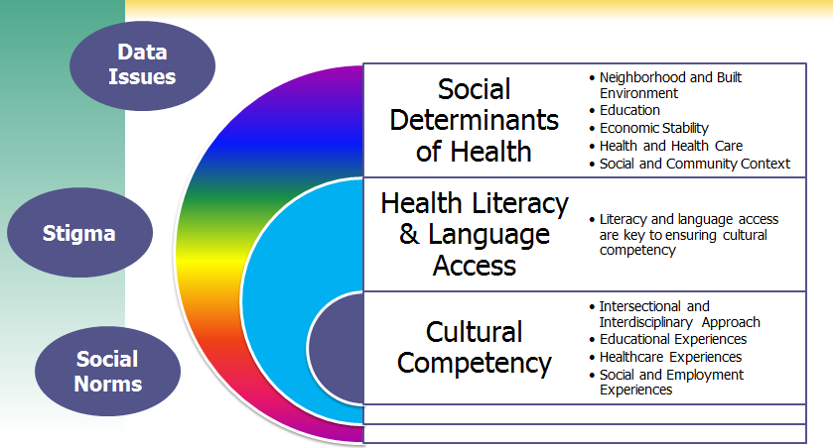
Progress Review Thematic Overview
19

Slide 20
Irma Arispe, PhD
Associate Director, National Center for Health Statistics Centers for Disease Control and Prevention
February 5, 2015

Slide 21
Presentation Overview
Tracking the Nation’s Progress
Lesbian, Gay, Bisexual, and Transgender (LGBT) Health
Social Determinants of Health (SDOH)
  Health and Health Care
  Education
  Economic Stability
  Social and Community Context
  Neighborhood and Built Environment
Viewing LGBT Health through the Social Determinants Lens
21

Slide 22
Tracking the Nation’s Progress
2 HP2020 Measurable Lesbian, Gay, Bisexual and Transgender Health Objectives:
  0 Targets met
  1 Improving
  1 Little or No change
  0 Getting worse
26 HP2020 Measurable Social Determinants of Health Objectives*:
  4 Targets met
  4 Improving
  10 Little or No change
  0 Getting worse
  8 Informational
NOTES: *The 26 SDOH objectives include those specific to SDOH as well as some which are located in other topic areas. LGBT Health has 2 Developmental objectives. Measurable objectives are defined as having at least one data point currently available, and anticipate at least 1 additional data point throughout the decade to track progress. Informational objectives are a subset of measurable objectives that do not have a target. Developmental objectives lack baseline data and targets.
22

Slide 23
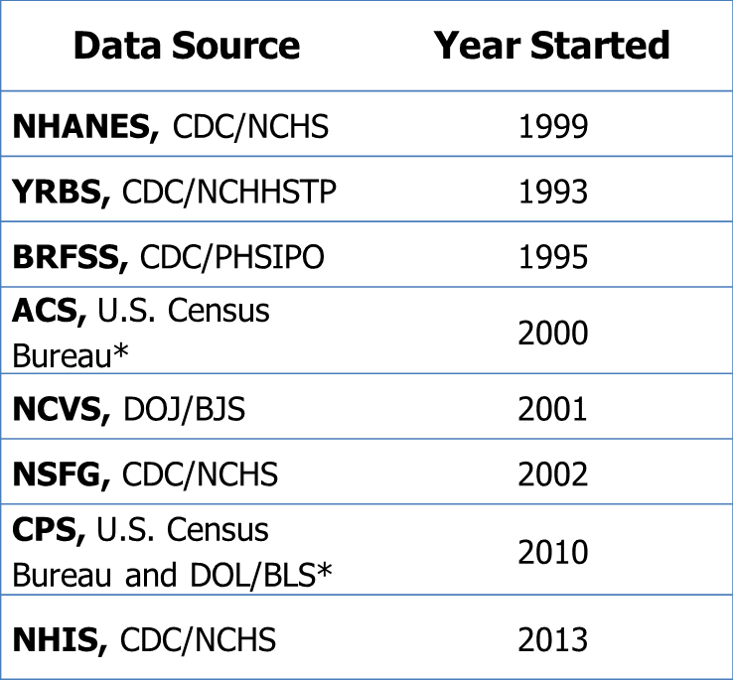
HP2020 Data Systems That Collect Any Lesbian, Gay, or Bisexual Data
Number
HP2020 Target: 12
Year
NOTES: Surveys counts are cumulative. Sexual orientation refers to the identity term that someone may choose such as lesbian, gay, or bisexual. *Data collection systems from the Census Bureau measure same-sex couple households, but do not directly collect data on sexual orientation.
Obj. LGBT-1.1
Increase desired
SOURCE: Healthy People 2020 Database In-House System, CDC/NCHS.

Slide 24
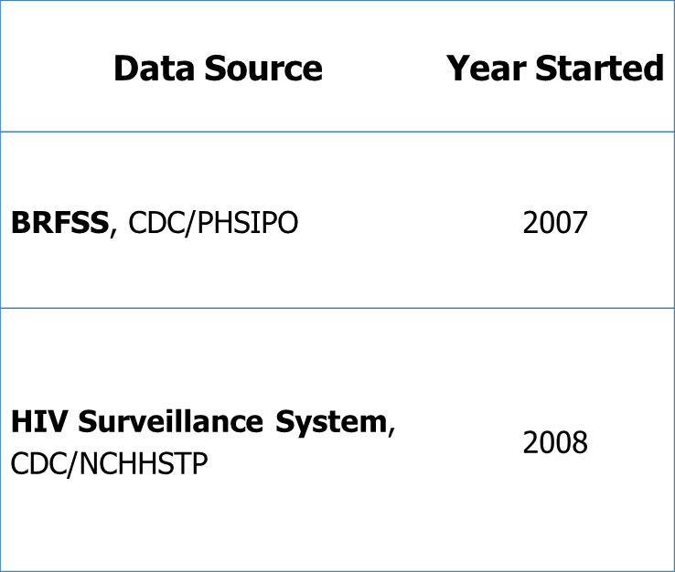
HP2020 Data Systems That Collect Any Gender Identity Data
Number
HP2020 Target: 4
Year
NOTES: Gender Identity refers to the concept that someone may not identify with the sex assigned at birth. Those who have a gender identity that is not in alignment with their sex assigned at birth may choose to identify as transgender, gender non-conforming, or gender queer.
Obj. LGBT-1.3
Increase desired
SOURCE: Healthy People 2020 Database In-House System, CDC/NCHS.

Slide 25
Sexual Orientation in the U.S., Ages 18–44
Population | NHIS, 2013 | NSFG, 2006–2010
Straight | 97.1% (0.18) | 94.6% (0.3)
Lesbian/Gay | 1.9% (0.15) | 1.5% (0.1)
Bisexual | 1.1% (0.12) | 2.6% (0.2)
NOTES: Column totals may not sum to 100% due to rounding. Numbers in parentheses indicate standard errors.
25
SOURCES: National Health Interview Survey (NHIS), CDC/NCHS; National Survey of Family Growth (NSFG), CDC/NCHS.

Slide 26
Same-Sex Couple Households, U.S.
Percent
NOTE: I = 95% confidence interval. Same-sex households include those who identified a spouse, unmarried partner, non-relative with a relationship, or as a housemate/roommate with a relationship. The denominator for these estimates includes all households. U.S. Census Bureau also reports on same-sex households through the American Community Survey.
SOURCE: Current Population Survey (CPS), U.S. Census Bureau and DOL/BLS.

Slide 27
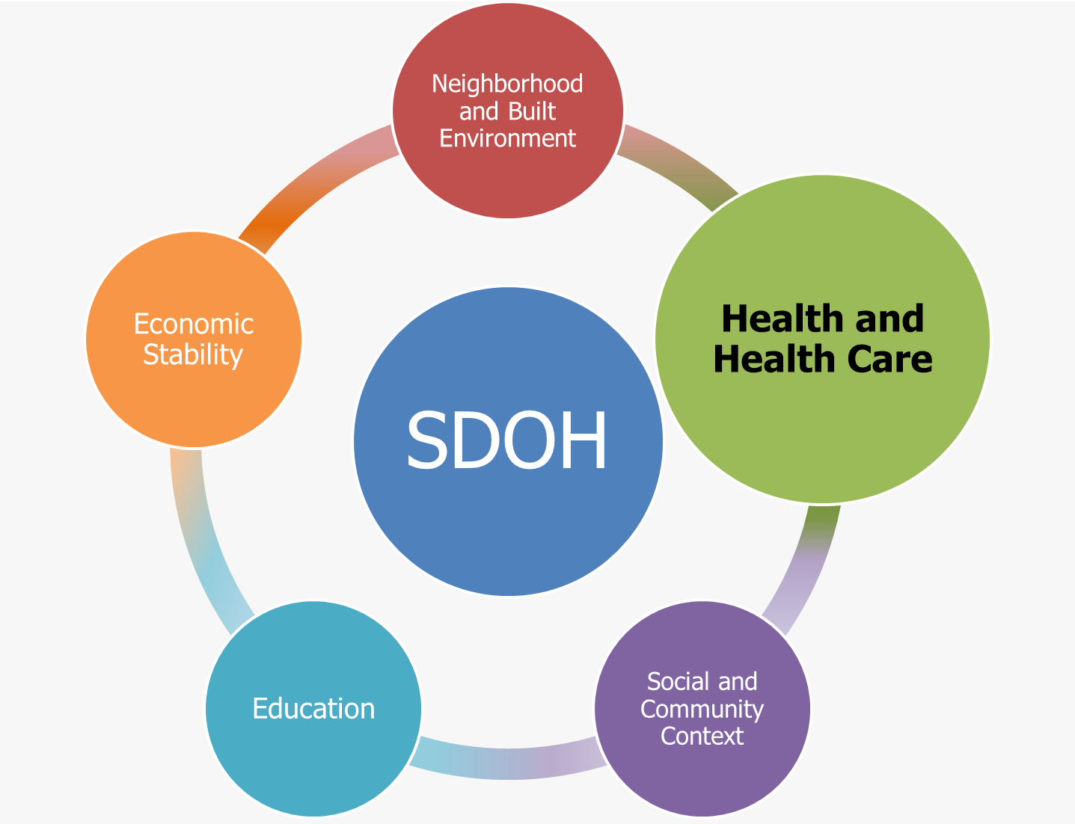
.

Slide 28
Adults Without Health Insurance
Ages 18–64 Years, 2013*
Early Release Estimates**
Percent
Both Sexes
NOTES: = 95% confidence interval. *Final data. **Early release estimates are not final and are for the population age 18-64. Final 2013 and early release 2014 estimates are not directly comparable.
I
SOURCE: National Health Interview Survey (NHIS), CDC/NCHS.

Slide 29
Usual Source of Care, Adults
Ages 18–64 Years, 2013
Increase desired
HP2020 Target: 89.4%
Both Sexes
NOTES: = 95% confidence interval. Usual source of care is defined as a health care provider, clinic, or health center, not including the emergency room, where a person goes for health care.
I
Obj. AHS-5.3
SOURCE: National Health Interview Survey (NHIS), CDC/NCHS.

Slide 30
Five or More Alcoholic Drinks*, Adults Ages 18 Years and Over, 2013
Both Sexes
Male
Female
NOTES: = 95% confidence interval. *Five or more alcoholic drinks in 1 day at least once in the past year.
I
SOURCE: National Health Interview Survey (NHIS), CDC/NCHS.

Slide 31
Current Cigarette Smoking,
Adults Ages 18 Years and Over, 2013
HP2020 Target: 12.0%
Decrease desired
Both Sexes
NOTES: = 95% confidence interval. Data are for persons who have smoked at least 100 cigarettes in their lifetimes and currently report smoking every day or some days. Data are age adjusted to the 2000 standard population.
I
SOURCE: National Health Interview Survey (NHIS), CDC/NCHS.
Obj. TU-1.1

Slide 32
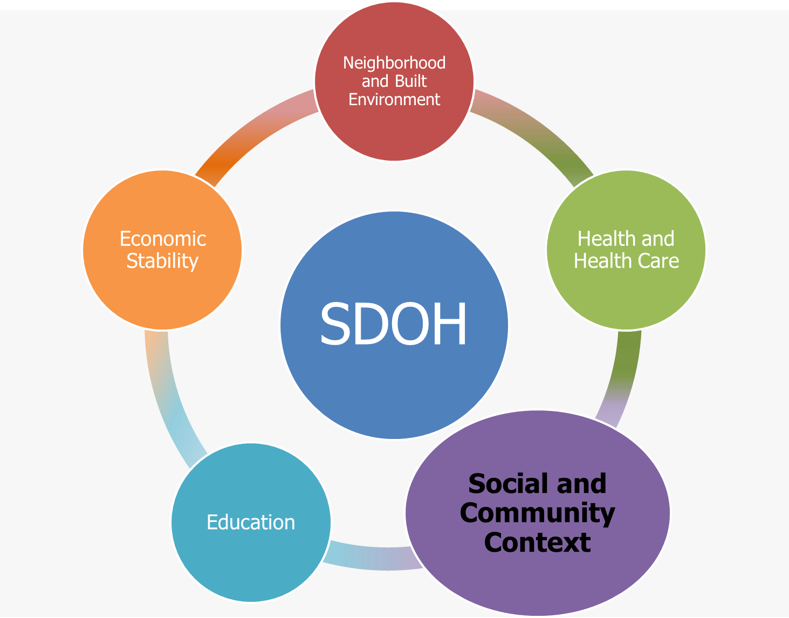
.

Slide 33
Adolescents Who Have an Adult* In Their Lives with Whom They Can Talk About Serious Problems, Ages 12–17 Years, 2013
HP2020 Target: 83.2
Increase desired
Percent
NOTE: *Adults are parents, guardians, or other adults. Data on race and Hispanic origin are collected separately. The categories Black and White exclude persons of Hispanic origin. Persons of Hispanic origin may be any race. American Indian includes Alaska Native.
SOURCE: National Survey on Drug Use and Health (NSDUH), SAMHSA.
Obj. AH-3.1

Slide 34
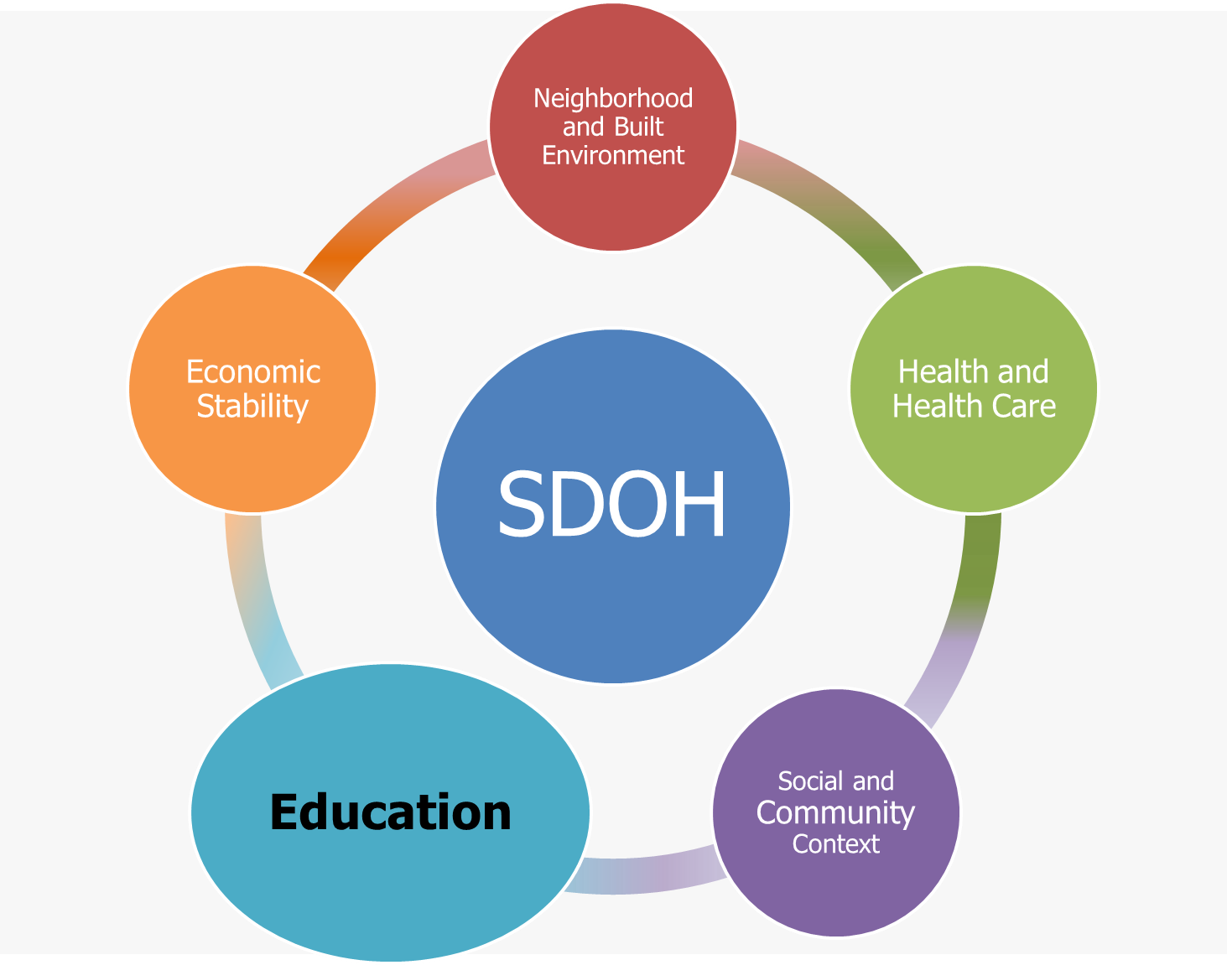
.

Slide 35
High School Completers Enrolled in 4-Year College the October Immediately Following High School
Percent
White
Total
Hispanic
Black
Year
NOTE: Objective SDOH-2 is being tracked for informational purposes and does not have a target. Data on race and Hispanic origin are collected separately. Black and White exclude persons of Hispanic origin. Persons of Hispanic origin may be any race. Enrollment in college, as of October of each year, is for individuals ages 16–24 who completed high school during the preceding 12 months. High school completion includes General Educational Development (GED) certificate recipients.
SOURCE: Current Population Survey (CPS), U.S. Census Bureau and DOL/BLS.
Obj. SDOH-2

Slide 36
Educational Attainment for Same-Sex Couples
Percent
Householder has Bachelor’s Degree
Both Partners have Bachelor’s Degree
Year
NOTE: I = 95% confidence interval. Educational attainment is collected for those age 25 and over.
SOURCE: American Community Survey (ACS), U.S. Census Bureau.

Slide 37
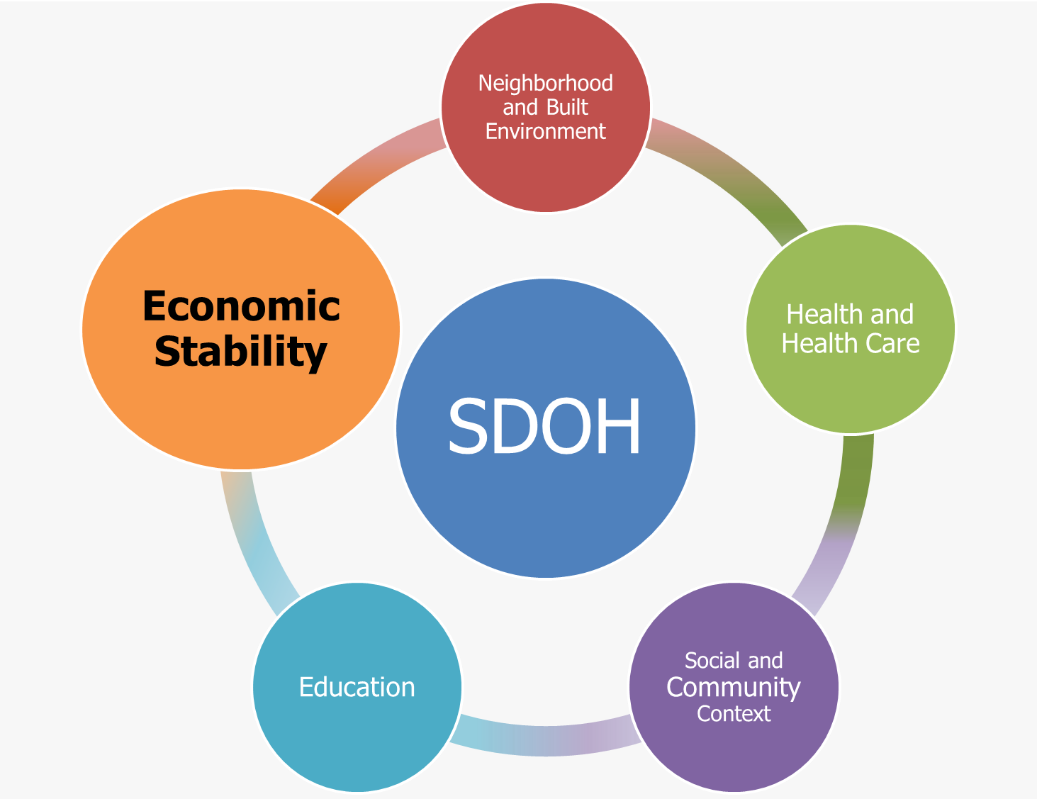
.

Slide 38
Proportion of People Living in Poverty, 2013
Marital Status
Percent
NOTE: I = 95% confidence interval. The denominator for these estimates includes all households This objective is being tracked for informational purposes and does not have a target.
Obj. SDOH-3.1
SOURCE: Current Population Survey (CPS), U.S. Census Bureau and DOL/BLS.

Slide 39
Both Partners Currently Employed Persons 15 Years and Over, 2013
Percent
Opposite-Sex Couples
Same-Sex Couples
NOTES: I = 95% confidence interval. Data are for persons 15 years and over who identified as the householder, and indicated a partnership status. Beginning with 2013 data products ACS tables reflect edit/processing changes which show same-sex married couples along with all married couples. Tables that have a line for "married couples" will include same-sex married couples, unless otherwise noted, and the marital status for those adults will be shown as "now married" or "married, spouse present."
SOURCE: American Community Survey (ACS), U.S. Census Bureau.

Slide 40
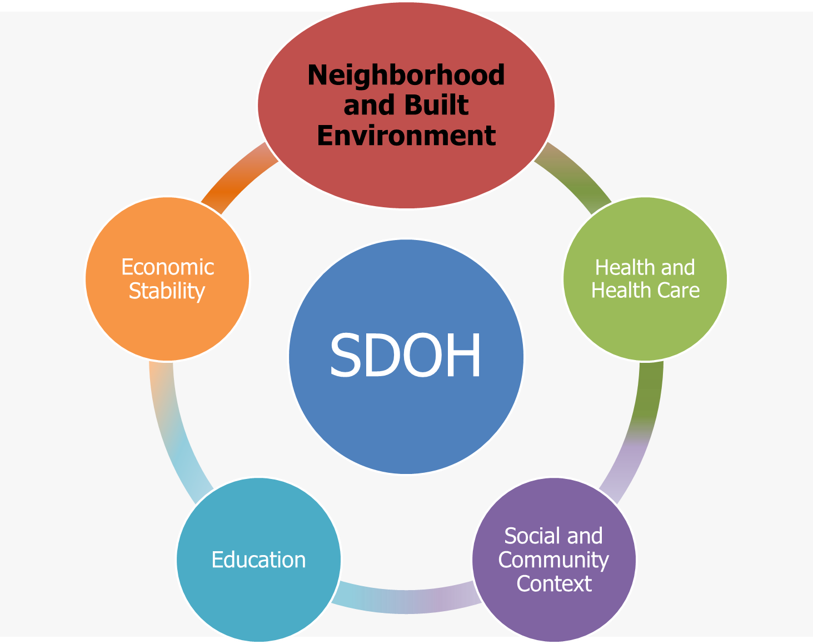
.

Slide 41
Homicides, 1999–2012
Male
HP2020 Target: 5.5
Total
Female
  NOTES: Data are for ICD-10 codes *U01-*U02, X85-Y09, Y87.1 reported as underlying cause of death and are age adjusted to the 2000 standard population.
SOURCE: National Vital Statistics System—Mortality (NVSS-M), CDC/NCHS.
Obj. IVP-29
Decrease desired

Slide 42
Exposure to Violence, Children
Ages 0–17 Years, 2011
Percent
HP2020 Target: 52.9%
Age (years)
NOTES: I = 95% confidence interval. The National Survey of Children’s Exposure to Violence measures children’s exposure to violence in the home, school, and community across all age groups from birth to age 17, and it is the first attempt to measure the cumulative exposure to violence over the child’s lifetime. Children and their adult caregivers were asked about incidents of violence that children suffered and witnessed
themselves and about other related crime and threat exposures, such as theft or burglary from a child’s household, being in a
school that was the target of a credible bomb threat, and being in a war zone or an area where ethnic violence occurred.
Obj. IVP-42
Decrease desired
SOURCE: National Survey of Children’s Exposure to Violence (NatSCEV), DOJ/OJJDP.

Slide 43
Threatened or Injured with a Weapon on School Property, Students in Grades 9–12, 2001–2009
Percent
NOTES: I = Upper and lower range of median estimate. YRBS is part of CDC’s Youth Risk Behavioral Surveillance System. These data are collected from 7
states and 6 metropolitan areas and are not nationally representative. These data reflect any fights on school property. Data are for high school students
who reported on their sexual orientation. *Not sure category captures those students who are currently questioning their sexual orientation.
SOURCE: Centers for Disease Control and Prevention. Sexual Identity, Sex of Sexual Contacts, and Health-Risk Behaviors Among Students in Grades 9—12
—Youth Risk Behavior Surveillance, Selected Sites, United States, 2001-2009. MMWR Early Release 2011;60[June, 6].

Slide 44
Key Takeaways—LGBT
The number of data systems used to track HP2020 objectives that ask any question on or for LGB populations is increasing.
The number of data systems used to track HP2020 objectives that ask any question on or for transgender populations has not increased.

Slide 45
Key Takeaways—SDOH
Health and Health Care
  Between 2013 and the first 6 months of 2014, the percentage of persons ages 18 to 64 years without health insurance decreased.
  For 2013, there was no difference in insurance coverage for LGB populations compared to straight populations.
  Though LGB populations have similar rates of access to care there are important differences in health risk behaviors such as drinking and smoking.

Slide 46
Key Takeaways—SDOH
Social and Community Context
  For the nation as a whole, 1 out of 5 children ages 12-17 years does not have an adult they can talk to about serious problems.
Education
  White students had consistently higher rates of college enrollment following high school completion than Black and Hispanic students.
  Almost a third (30%) of couples in same-sex households both have a bachelor’s degree.

Slide 47
Key Takeaways—SDOH
Economic Stability
  Nationally, 15% of the population lives at or below the poverty threshold.
  Women are more likely to be living in poverty than men, regardless of relationship status.
Neighborhood and Built Environment
  Overall, the homicide rate is currently meeting the HP2020 target.
  Children’s cumulative exposure to violence increases with age.
  Rates of being threatened or injured with a weapon on school property were higher for LGB and questioning youth compared to straight youth.

Slide 48

Pamela Hyde, J.D.
Administrator
Substance Abuse and Mental Health
Services Administration
February 5, 2015

Slide 49
Overview
LGBT identity data collection
LGBT inclusion in grants and contracts
Programs addressing LGBT health
Cultural competence
Programs addressing social determinants of health
Disparity Impact Statements
49

Slide 50
LGBT Identity Data Collection
Surveillance data
  NSDUH
    same-sex couple behavioral health (current)
    LGB identity (2015): sexual identity and attraction
Discretionary reporting (program monitoring)
  Common Data Platform (2015)
    sexual identity, attraction, and behavior
50

Slide 51
LGBT Inclusion in Grants and Contracts
SAMHSA Policy for LGBT Inclusion
  FY 2012: include sexual and gender minority populations in services grants template
Appendix: “applicants are asked to address access, use and outcomes for subpopulations, which can be defined by the following factors:
  By race
  By ethnicity
  By gender (including transgender), as appropriate
  By sexual orientation (i.e., lesbian, gay, bisexual), as appropriate.”
51

Slide 52
Programs Addressing LGBT Health
Center for Mental Health Services (CMHS)
  Garrett Lee Smith (GLS) Youth Suicide Prevention Grants
  Children’s Mental Health Initiative
Center for Substance Abuse Prevention (CSAP)
  Center for the Application of Prevention Technologies (CAPT)
52

Slide 53
Programs Addressing LGBT Health continued
Center for Substance Abuse Treatment (CSAT)
  HIV portfolio includes focus on MSM and LGBT women
  Addition Technology Transfer Center: updating curriculum on substance abuse treatment for LGBT people
Cross-Center Programs and Initiatives
  Minority Aids Initiative Continuum of Care (CoC) Pilot grant
53

Slide 54
Cultural competence
LGBT Training Curricula for Behavioral Health and Primary Care Practitioners
A Practitioner’s Resource Guide: Helping Families to Support Their LGBT Children
LGBTQ Youth and Sexual Abuse: Information for Mental Health Professionals
ACA Enrollment Assistance for LGBT Communities
54

Slide 55
Programs Addressing Social Determinants of Health
Employment: Transforming Lives Through Supported Employment
Housing: Cooperative Agreement to Benefit Homeless Individuals
Schools and Community Environment: Safe Schools/Healthy Students – Project AWARE
Criminal Justice: Grants to Expand Substance Abuse Treatment Capacity in Adult Tribal Healing to Wellness Courts and Juvenile Drug Courts
55

Slide 56
Disparity Impact Statements
Stimulate a systems change process by:
Creating a more strategic focus on racial, ethnic and LGBT populations in SAMHSA investments
Using a data-informed quality improvement approach to reduce these subpopulation disparities in SAMHSA programs;
Utilizing this secretarial priority to influence how SAMHSA does it work, e.g., its grant-making operations, and uses its GPRA data
56

Slide 57
Leandris Liburd, PhD, MPH
Director, Office of Minority Health and Health Equity
Office of the Director
Centers for Disease Control and Prevention
February 5, 2015

Slide 58
Overview of CDC’s Role in
LGBT Health
Examples of areas to promote LGBT health:
  Support improvements in national representative data
  Engage LGBT partners in discussions of disease prevention and health promotion
  Fund national awareness campaigns
  Increase capacity of health departments and clinics to conduct targeted prevention initiatives
  Fund tailored community-based approaches and interventions for LGBT populations
58

Slide 59
LGBT-Specific Activities:
Examples
Surveillance
Awareness Campaigns
Funding Announcements
Cultural Competence
Social Determinants of Health
59

Slide 60
Surveillance
National HIV Behavioral Surveillance System
National Health Interview Survey (NHIS)
National Adult Tobacco Survey (NATS)
National Intimate Partner and Sexual Violence Survey
Behavioral Risk Factor Surveillance System
Youth Risk Behavior Survey
  Includes questions about sexual orientation relating to sexual risk behavior, smoking cessation and partner violence.

Slide 61
Awareness Campaigns
Act Against AIDS
  Focuses on raising awareness of HIV risk and promoting partnerships among organizations serving gay and bisexual men, African Americans and Hispanic/Latinos
Reasons/Razones
  First national targeted effort to encourage HIV testing among Hispanic/Latino gay and bisexual men
Let’s Stop HIV Together
  Raises awareness about the impact of HIV and fights stigma by focusing on the real lives of people living with HIV
Tips from former Smokers
  Added LGBT advertisement and information materials for targeted promotion
61

Slide 62
Funding Announcements
Young Men who Have Sex with Men and Young Transgender of Color Funding Announcement
Community Approaches to Reducing Sexually Transmitted Diseases
  Examples of Funding Opportunity Announcements (FOAs) that specifically target multiple GBT populations
62

Slide 63
Culturally Competent Programs
Evaluating home grown HIV prevention interventions for African American and Hispanic/Latino Men who have Sex with Men (MSM)
Development and Testing of an HIV Prevention Intervention Targeting Black Men who have Sex with Men and Women (MSMW)
  Evaluating HIV behavioral interventions that have been developed for African American and Hispanic/Latino MSM and increasing the proportion of racial and ethnic minorities with HIV who are linked to and engaged in culturally-competent care
63

Slide 64
Social Determinants of Health
Increasing HIV Prevention and Care Service Delivery among Health Centers Serving High HIV Prevalence Jurisdictions.
Care and Prevention in the United States (CAPUS) Demonstration Project
Enhancing HIV Mobilization among Organizations Serving Gay, Bisexual and other Men who have Sex with Men (MSM).
  Structural interventions focusing on mobilizing MSM to improve sexual health, and addressing policy barriers in state health departments and health centers.
64

Slide 65
Summary of HHS LGBT Report –
CDC Components
(CDC) included a question on sexual orientation in National Health Interview Survey in 2013.
  Based on a year of data collection, CDC issued its first report entitled “Sexual Orientation and Health among U.S. Adults: National Health Interview Survey, 2013.”
In collaboration with CDC’s Division of Reproductive Health, the Office of Population Affairs has developed and released clinical recommendations, “Providing Quality Family Planning Services” to include transgender populations.
Clarified that its National Breast and Cervical Cancer Early Detection Program is available to eligible transgender women and men.
65

Slide 66
Looking to the Future
Enhancements to internal guidance and support for the inclusion of LGBT SDOH in all Funding Opportunity Announcements
Broadening use of questions related to sexual orientation in all of CDCs surveillance systems
Training of CDC staff in areas such as SDOH, cultural competence and health equity
66

Slide 67

Healthy People (HP) 2020 Progress Review Webinar
Social Determinants of Health
and LGBT Health:
The HRSA Perspective
Sarah R. Linde, M.D.
Rear Admiral, U.S. Public Health Service
Chief Public Health Officer
Health Resources and Services Administration (HRSA)
February 5, 2015

Slide 68
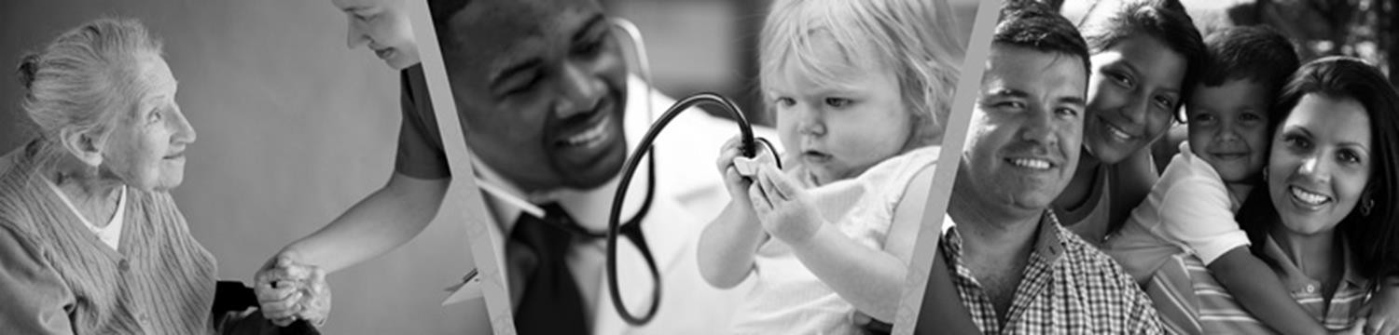
HRSA Mission
To improve health and
achieve health equity through
access to quality services,
a skilled health workforce and
innovative programs

Slide 69
HRSA Strategic Plan
Improve Access to Quality Health Care and Services
Strengthen the Health Workforce
Build Healthy Communities
Improve Health Equity
69

Slide 70
Goal 4: Improve Health Equity
Subgoals
a. Reduce disparities in quality of care across populations and communities
b. Monitor, identify and advance evidence-based and promising practices to achieve health equity
70

Slide 71
Goal 4: Improve Health Equity
Subgoals
c. Leverage our programs and policies to further integrate services and address the social determinants of health
d. Partner with diverse communities to create, develop, and disseminate innovative community-based health equity solutions, with a particular focus on populations with the greatest health disparities
71

Slide 72
Access and Workforce
Health Centers
Ryan White HIV/AIDS Program
National Health Service Corps
Workforce training
72

Slide 73
Access and Workforce
Maternal and Child Health
Rural health care
Federal organ procurement system
Poison Control Centers
340B low-cost drug program
73

Slide 74
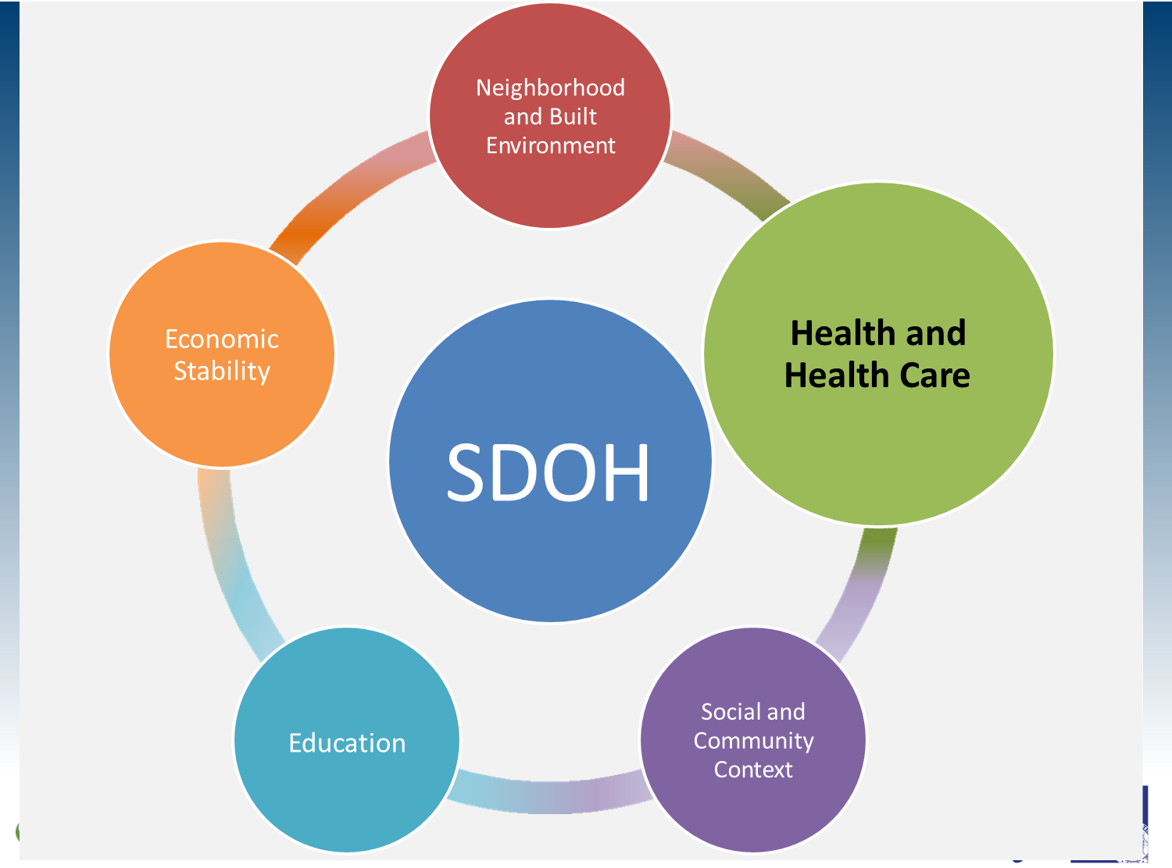
Social Determinants of Health (SDOH)

Slide 75
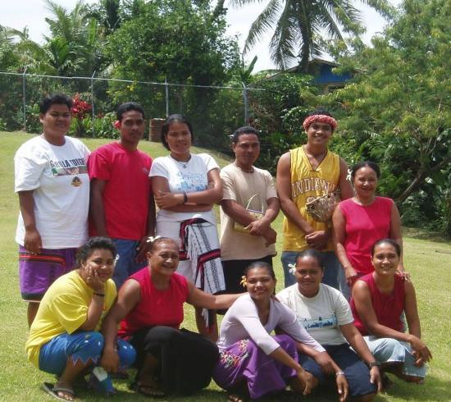
Health Center Model
Located in or serve a high need community
Governed by a community board
Provide comprehensive primary care services
Provide enabling services:
case management referrals translation/interpretation transportation eligibility assistance health education health literacy outreach
Provide services available to all
Meet other performance and accountability requirements
75

Slide 76

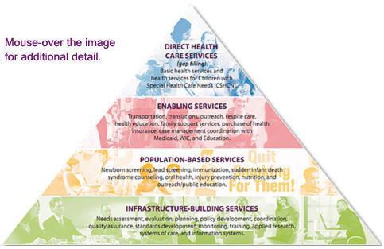

Maternal and Child Health
Notes:
Many of HRSA’s other programs also provide enabling services and address social determinants of health.
Shown here, the Title V Maternal and Child Health Block Grant is envisioned as a pyramid with 4 tiers of services and levels of funding that provide comprehensives services for mothers and children.
You can see that enabling services is one of those tiers.
The pyramid also displays the uniqueness of the MCH block grant which is the only federal program that consistently provides services at all levels of the pyramid.

Slide 77
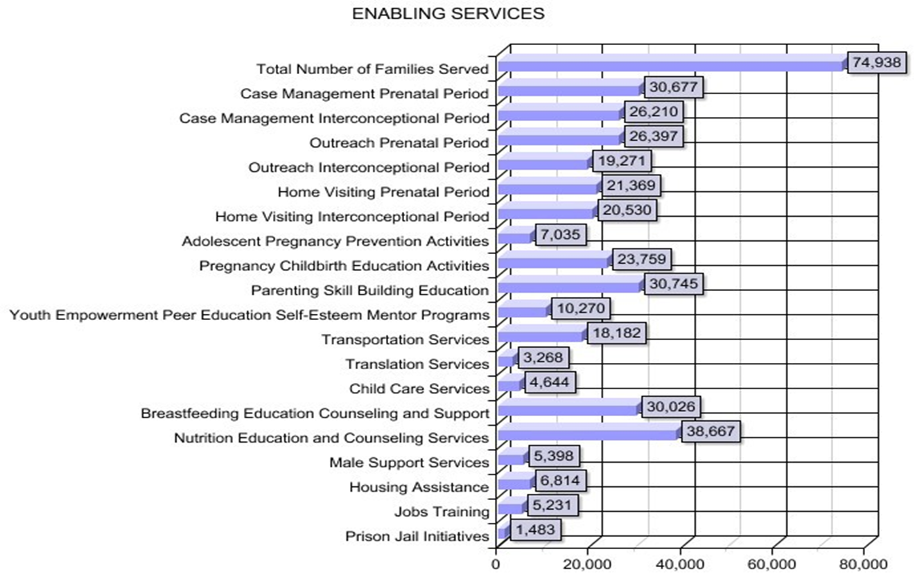
Healthy Start

Slide 78

Ryan White HIV/AIDS Program
Core Services
Outpatient ambulatory/medical
Early intervention (Part A & B)
Home health care
Home/community-based services
Medical case management
Substance abuse: outpatient
Support Services
Case management (nonmedical)
Pediatric Assessment/ early intervention
Emergency financial assistance
Food bank/home delivered meals
Health education/risk reduction
Housing services
Legal services
Medical transportation services
Outreach services
Permanency planning
78

Slide 79

SDOH and LGBT Health
Legal discrimination in access to health insurance, employment, housing, marriage, adoption, and retirement benefits
Lack of laws protecting against bullying in schools
Lack of social programs for youth, adults & elders
Shortage of health care providers who are knowledgeable and culturally competent in LGBT health
79

Slide 80

SDOH and LGBT Health
Safe schools, neighborhoods, and housing
Access to recreational facilities and activities
Availability of safe meeting places
Access to health services
80

Slide 81

LGBT Health Disparities
Suicide and other mental health issues
Tobacco, alcohol, and drug use
Cancer Screening
Infectious Diseases
Overweight/Obesity
Insurance Coverage
Homelessness
Victimization/Bullying
81

Slide 82

HRSA and LGBT Health
Grants and Contracts
Policy
Workforce Development
Data and Measurement
Stakeholder Outreach
Public Education and Communication
82

Slide 83


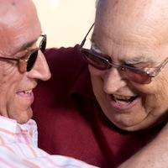
Grants and Contracts
83

Slide 84

Grants and Contracts
Ryan White Program
Special Projects of National Significance
  Enhancing Access to and Retention in Quality HIV Care for Transgender Women of Color
  Culturally Appropriate Interventions of Outreach, Access and Retention among Latino/a Populations
Secretary’s Minority AIDS Initiative
  Improving Recruitment and Retention for Black MSM, ages 13-24
84

Slide 85



Policy
85

Slide 86





Workforce Development

Slide 87

Data Collection
Sexual Orientation
NHSC Participant Satisfaction Survey (2013, 2014)
NURSE Corps Participant Satisfaction Survey (2014)
Health Center Patient Survey (2014)
Gender Identity
Health Center Patient Survey (2014)
Clients served by the Ryan White HIV/AIDS Program (since 2000)
  CARE Act Data Report
  Ryan White Data Report
  Ryan White Services Report
87

Slide 88



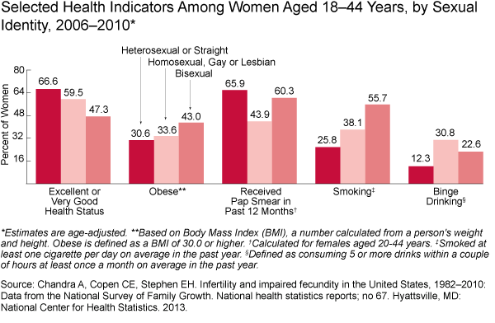
Data Collection
WOMEN'S HEALTH USA 2013
http://mchb.hrsa.gov/whusa13/dl/pdf/whusa13.pdf
88

Slide 89







Stakeholder Outreach

Slide 90

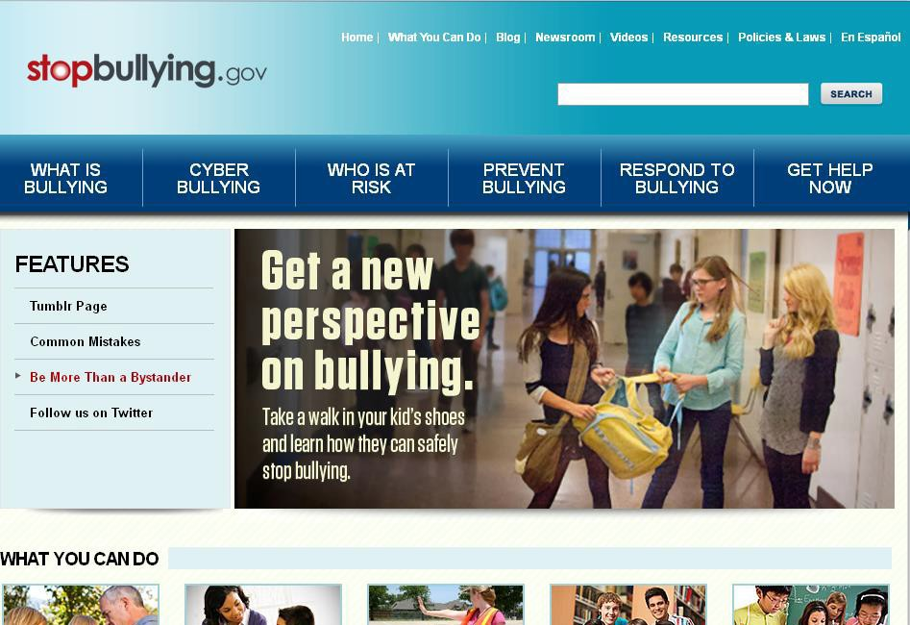
Public Education and Communication Bullying

Slide 91

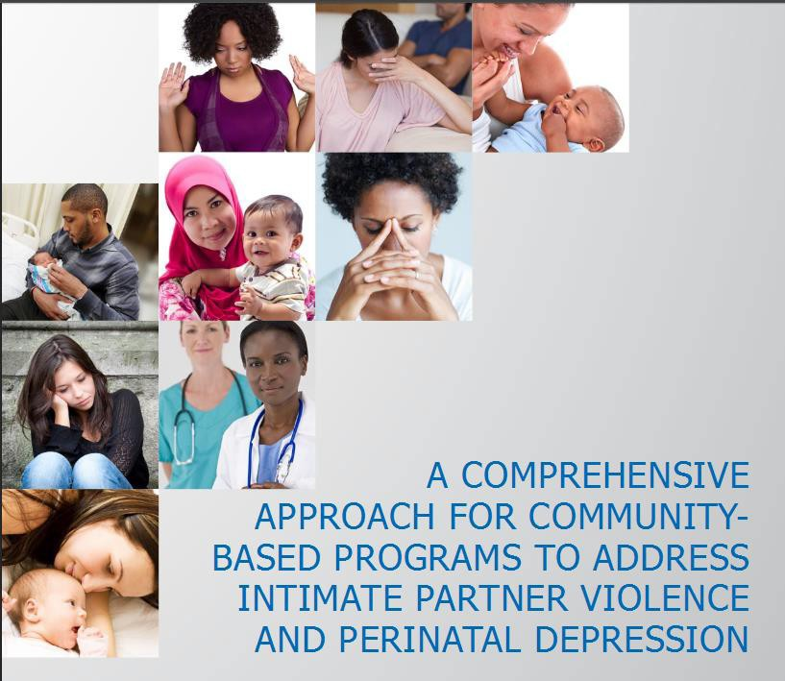
Intimate Partner Violence
91

Slide 92
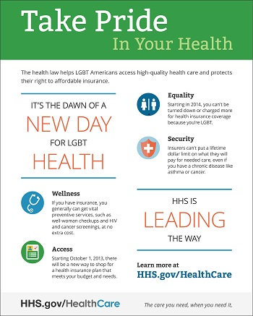
Resources
http://www.hrsa.gov/lgbt/
http://www.hhs.gov/lgbt/
92

Slide 93

Quote
“The health of the individual is almost inseparable from the health of the larger community. And the health of each community and territory determines the overall health status of the Nation”
Source: Koh; A 2020 vision for healthy people. N Engl J Med 2010
93

Slide 94

Friendly Reminder
Open enrollment for health insurance under the Affordable Care Act ends February 15
Visit http://www.healthcare.gov today
94

Slide 95
Thank You
Thank You!
Sarah R. Linde, M.D.
RADM U.S. Public Health Service
Chief Public Health Officer
Health Resources and Services Administration
slinde@hrsa.gov
301-443-2216
95

Slide 96
The Evolution of Culturally Competent Transgender Services
Christopher Brown, MBA, MPH
Director, Health and Mental Health Services

Slide 97

Overview
History of the Center and Services Areas
Social and Health Disparities with Transgender Persons in California
History of Transgender Services at the Center
Services Provided
  Medical
  Behavioral Health
  Social Services and Housing
Client Experiences
Challenges
Initiating Change
Resources

Slide 98

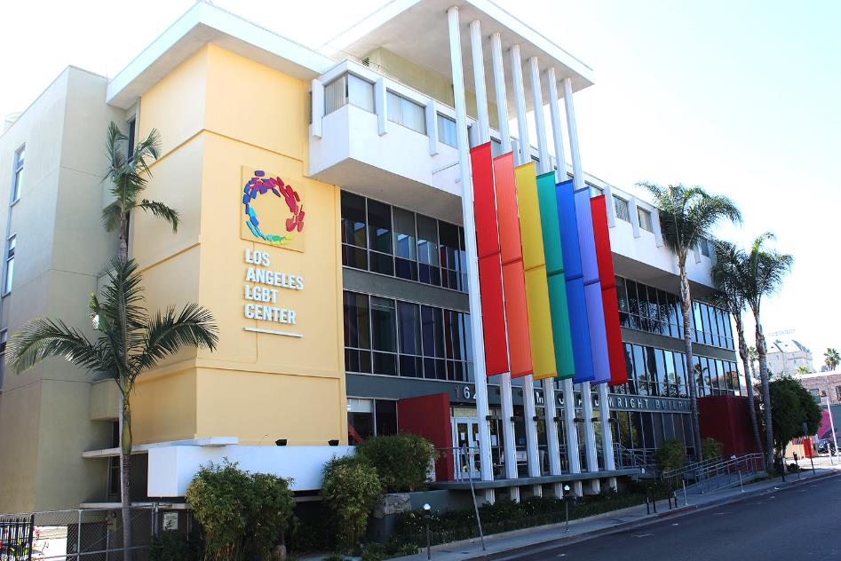
Photo of LA LGBT Center

Slide 99
History of the Los Angeles LGBT Center
1969 Gay Community Services Center began
1993 Jeffrey Goodman Special Care Clinic opened
1985 Nation’s largest HIV testing and care clinic established
1974 Center obtained non-profit status, after appealing the original denial from the IRS. First US organization to have “gay” in its name.
1971 Center opens Men’s VD Clinic

Slide 100
History of the Los Angeles LGBT Center
2009 Became a Federally Qualified Health Center (FQHC) Look-Alike
2015
-Employ 450 staff and have more than 3,000 volunteers
-Provide approximately 42,000 client encounters each month
-Deliver more than 2,000 sexual health visits each month
2011 Began youth suicide prevention project and LGBT foster care initiative
-Provide primary care services to more than 4,000 clients
-Provide 50 beds of emergency, transitional- and independent-living housing for at-risk youth
2013 Obtained full FQHC status and 330 grant

Slide 101

Center Service Departments

Slide 102
Transgender Social and Health Disparities in California
In L.A. County, an estimated 15% of transgender women are living with HIV
  48% of Black trans women are HIV positive
  27% of Native American trans women are HIV positive
    --L.A. County Transgender Population Estimates 2012
70% of the transgender community reports experiencing workplace harassment or discrimination directly related to their gender identity
Transgender respondents are twice as likely to be living below the poverty line of $10,400 when compared to the general population
1 in 5 respondents have been homeless since they first identified as transgender
30% of the community reports postponing care for illness or preventive care due to disrespect or discrimination from doctors or other health care providers
    --The State of Transgender California: Results from the 2008 California Transgender Economic Health Survey

Slide 103
History of Transgender Services
2005 Domestic Violence Legal Advocacy Project
2015
-Social and Legal Services provider to more than 650 clients
-THP serving more than 700 transgender clients in Northern and Southern California, Nevada, and Arizona
- 67% 20-39 years old
- 63% people of color
1988 Anti-Violence Project and Legal Services
2009 “Soft” opening of the Transgender Health Program (THP) with a part-time provider serving about 100 clients
2008 Transgender Economic Empowerment Project

Slide 104

Trans services
Medical Services
Social and Legal Services
Behavioral Health Services
Trans
Services
Trans
Services

Slide 105
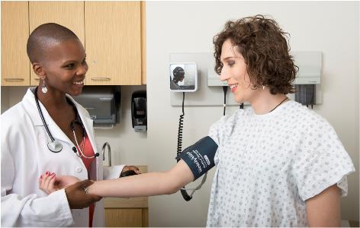
Medical Services
Informed consent model of care
Welcome video for new clients
Ongoing primary care services/routine health maintenance
  Culturally competent Pap/prostate screening
Hormone management
Pre-operative medical assessment
Post-operative assessment, care and monitoring
Medications (on-site pharmacy)
Appropriate referrals

Slide 106
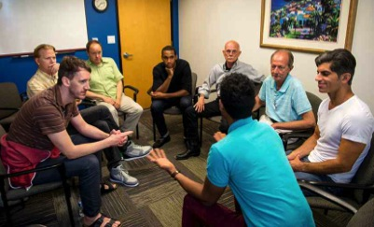
Behavioral Health Services
New clients meet with psychologist to greet and assess psychosocial needs
Warm hand-off to medical provider
Individual therapy
Group therapy (weekly MTF and FTM groups)
Substance abuse services
Genital Reassignment Surgery (GRS) letter-writing protocol
Capacity-building initiative/provider consultation group

Slide 107
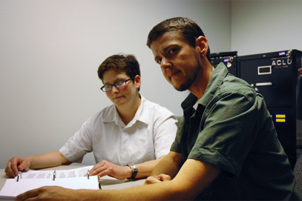
Social Services and Housing
Case management
Legal services
Anti-Violence Project
Emergency, transitional and independent-living housing
Employment services
Cultural competency assistance
Transition assistance

Slide 108
Client Experiences
30-year-old MTF from Nevada (travels 290 miles)
History of:
  high blood pressure, substance abuse, suicide attempts
  negative experiences with health care providers
In 2010, after a recent suicide attempt, she began receiving care at the Center:
  trans-specific individual and group substance abuse and mental health services
  primary care and hormone maintenance services
Client is currently stable, seen once a year

Slide 109
Client Experiences
19-year-old FTM client from Oklahoma
Came to drop-in youth center for food and emergency shelter
Client received transition support and accessed many Center services including:
  mental health counseling and substance abuse services
  primary care and hormone therapy
  legal name-change assistance
  GED program and job placement
He is now in Center’s transitional living program, attending community college, and working part time. He plans to major in social work.

Slide 110

Challenges
Lack of local and national data
A-Z cultural competency (parking lot to check out)
Overcoming service provider apprehension
Electronic health record (EHR)
  mismatched legal/insurance name and gender identity
  disconnect with physiology and pre-generated medical tests and reference lab values
Meeting unique needs of clients
  surgery and specialty care referrals
  medications on insurance formularies

Slide 111

Initiating Change
Community engagement in planning, policy and advocacy
Networking with LGBT organizations
Federally supported technical assistance providers
Federal and state requirements and standards of care
Collecting and reporting of LGBT health statistics
Incorporate LGBT variables into EHR platforms
Cultural and medical competence is of utmost importance

Slide 112
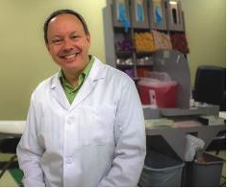
Resources
National Center for Transgender Equality
  http://transequality.org
Transgender Law Center
  http://transgenderlawcenter.org
Los Angeles LGBT Center
  http://www.lalgbtcenter.org/transgender_people
  Contact: Lisa Kimsey, lkimsey@lalgbtcenter.org

Slide 113
Roundtable Discussion
Please take a moment to fill out our brief survey

Slide 114
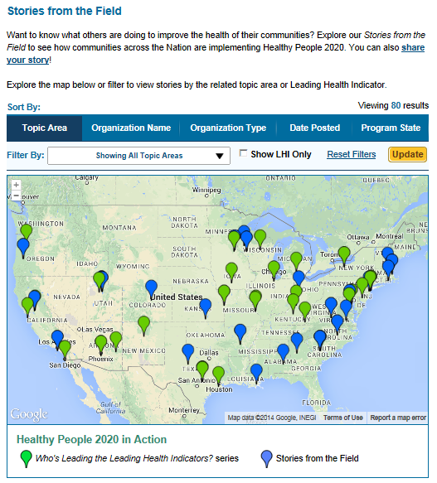
Healthy People 2020
Stories from the Field
A library of stories highlighting ways organizations across the country are implementing Healthy People 2020
Healthy People in Action
http://www.healthypeople.gov/2020/healthy-people-in-action/Stories-from-the-Field

Slide 115



2015 Healthy Aging Summit Registration is Open!
  July 27-28, 2015 in Washington, DC
  State of the Science meeting
  Social Determinants of Health Framework
ODPHP encourages all sectors to submit abstracts online through 11:59 p.m. EST, Monday, February 9
To get the most current information visit www.2015HealthyAgingSummit.org and follow us @gohealthypeople #HealthyAging2015
Notes:
ODPHP, along with our Summit co-sponsor the American College of Preventive Medicine (ACPM), is pleased to announce that the 2015 Healthy Aging Summit will be held on July 27-28 in Washington, D.C. at the Omni Shoreham Hotel.
This State of the Science meeting will focus on evidence and data to understand how preventive services contribute to healthy aging and quality of life. The Summit uses the Healthy People 2020 Social Determinants of Health framework allowing participants to identify “upstream” influences on healthy aging.
The goals for the Summit are:
Explore the science on healthy aging;
Identify knowledge gaps that need to be filled;
Promote the role of prevention and preventive services in improving quality of life in later years; and
Mobilize action to improve the delivery of care for those aging in place or in transition.
All sessions will be required to support at least one of the Summit goals.
The Summit tracks have been developed with input from multiple sectors and thought leaders. Summit tracks reflect the SDOH framework:
Social and Community Context
Quality of Life
Health and Health Care
Neighborhood and Built Environment
There are a number of priority areas noted within each Summit track. These can be found on the Summit’s website: www.2015HealthyAgingSummit.org

Slide 116
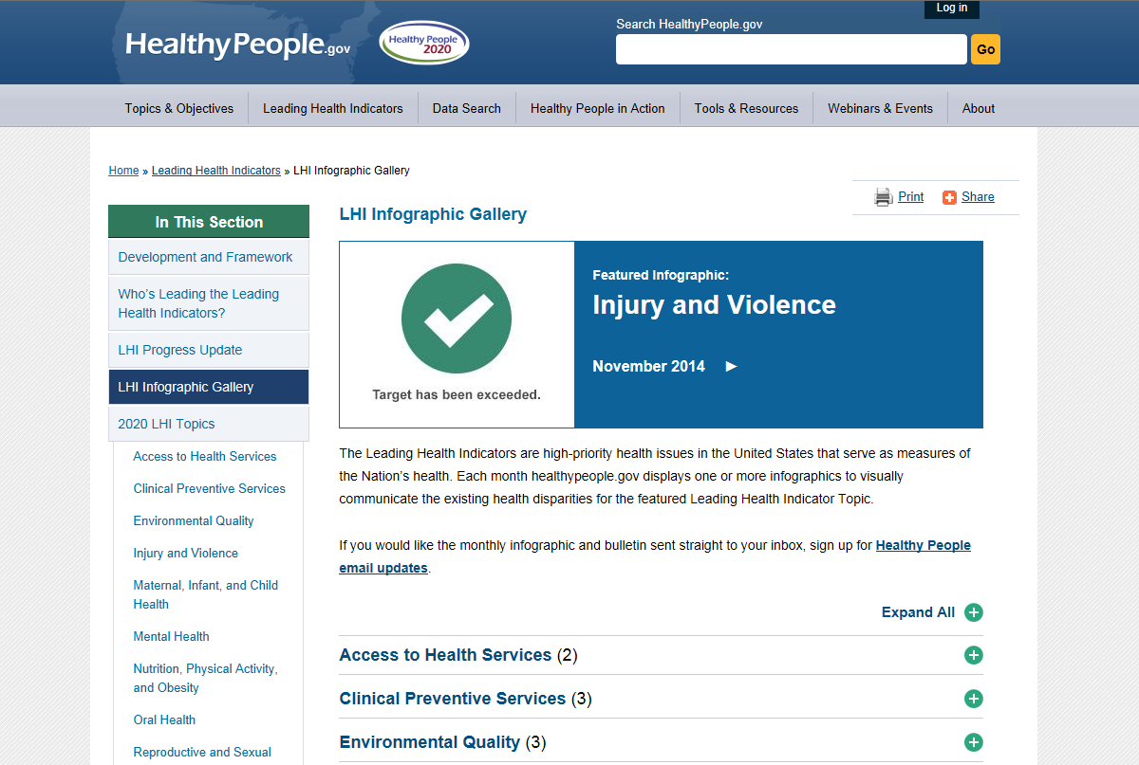
LHI Infographic gallery
www.healthypeople.gov/2020/leading-health-indicators/LHI-Infographic-Gallery

Slide 117
Healthy People 2020
Progress Review Planning Group
  Chipper Dean (SAMHSA/CBHSQ)
  Gem Daus (HRSA)
  Emily DeCoster (HRSA)
  George Roberts (CDC/OMHHE)
  Julio Dicent Taillepierre (CDC/OMHHE)
  Francisco Sy (NIH/NIMHD)
  Stan Lehman (CDC/OD)
  Minh Wendt (HHS/OMH)
  Lenee Simon (HHS/OASH)
  Susan Queen (HHS/ASPE)
  Suzanne Haynes (HHS/OWH)
  Rebecca Hines (CDC/NCHS)
  David Huang (CDC/NCHS)
  Leda Gurley (CDC/NCHS)
  Christina Dragon (CDC/NCHS)
  Carter Blakey (HHS/ODPHP)
  Allison Roper (HHS/ODPHP)
  Emmeline Ochiai (HHS/ODPHP)
  Debbie Hoyer (HHS/ODPHP)
  Theresa Devine (HHS/ODPHP)
  Yen Luong (HHS/ODPHP)

Slide 118




Stay Connected
Web healthypeople.gov
Email healthypeople@hhs.gov
Twitter @gohealthypeople
LinkedIn Healthy People 2020
YouTube ODPHP (search “healthy people”)
Join the Healthy People Listserv & Consortium
Notes:
118

