Slide 1




Protecting Our Lungs
Notes:
Over the past decade, there has been a significant increase in the number of youths using Electronic Cigarette (e-cigarettes) to vape. While it was originally believed that these products were safer than their paper counterparts, new data suggest that these products have several harmful chemicals and side effects, including addiction, that could impact the respiratory health of those who use them.
Note: These slides are made possible by the David J. Sencer CDC Museum Public Health Academy. https://www.cdc.gov/museum/education/lessons/

Slide 2
Terms to Know
 | people who help collect data for research projects conducted by professional scientists
 | a highly addictive chemical found in tobacco
 | a device that heats a liquid to the point where it becomes a vapor; it is then inhaled
 | a substance designed to be used in an e-cigarette; it can contain harmful additives
 | an urge to do something that is hard to control or stop
 | the science of protecting and improving the health of people and their communities
 | the inhaling of a vapor created by an electronic cigarette or other vaping devices
Word Bank
e-cigarette aerosol
nicotine
addiction
e-cigarette
public health
vaping
citizen scientist
Notes:
Terms to know:
Citizen scientists: people — young or old — who help collect data for research projects conducted by professional scientists
Bacteria: microscopic living organisms that can be found everywhere; some bacteria are good for your body, while other types can be very harmful
Food recall: an action by a food manufacturer to protect us from food that might cause health problems due to contamination; when food is recalled, it is removed from the shelves
Contamination: when bacteria or other harmful microorganisms spoil food; it is a common cause of food poisoning
Salmonella: bacteria found in the intestines of people and animals; most types of Salmonella cause salmonellosis, which causes diarrhea, fever, and stomach cramps, and sometimes infection in the urine, blood, bones, joints, or the nervous system
Public health: the science of protecting and improving the health of people and their communities
Foodborne illness: any illness resulting from the spoilage of contaminated food, pathogenic bacteria, viruses, or parasites that contaminate food
Escherichia coli (E. coli): bacteria found in the environment, foods, and intestines of people and animals; most strains of E. coli are harmless, while others cause diarrhea, urinary tract infections, respiratory illness, pneumonia, and other illnesses

Slide 3
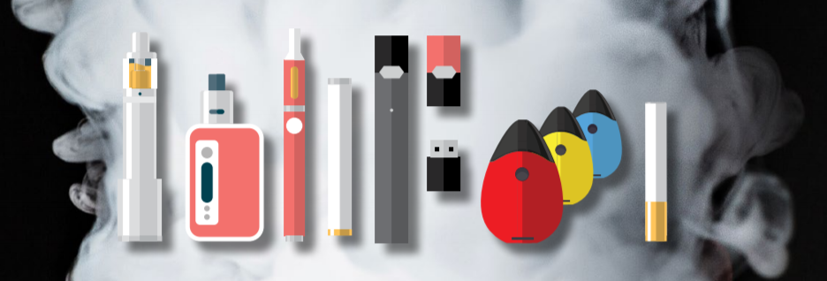
Understanding E-cigarettes
Most e-cigarettes have:
  battery
  heating element
  place to hold a liquid
E-cigarettes produce an aerosol:
  heat up a liquid containing nicotine (can harm brain development) and other harmful chemicals
Vary in name, design
Using an e-cigarette = vaping
Notes:
Most e-cigarettes have a battery, a heating element, and a place to hold a liquid. They produce an aerosol by heating a liquid that usually contains nicotine, which can harm brain development, and other harmful chemicals that help to make the aerosol. E-cigarettes are sometimes called other names and come in a variety of designs. Some e-cigarettes look like regular smoking objects like cigarettes, cigars, or pipes, while others look like everyday items. Using an e-cigarette is sometimes called “vaping.”

Slide 4

Think About It
How do e-cigarettes work?
What types of devices can e-cigarettes resemble?
Why is nicotine dangerous?

Slide 5

Vaping and CDC
1963: first patent for basis of e-cigarettes
2010: multiple e-cigarettes on market
CDC begins tracking vaping statistics:
  1 in 4 high schoolers
  1 in 10 middle schoolers
Notes:
While vaping is a relatively new practice, e-cigarettes have been in existence since the 1960s. In 1963, Herbert A. Gilbert received the first patent for what would be the basis of the current model. It wasn’t until the 21st century that the devices took off. In 2003, Hon Lik, a pharmacist, developed an e-cigarette with the hope that it would help chronic smokers quit. The devices began to spread, and by 2010, multiple types of e-cigarettes were on the market. Initially, most advertisers touted them as a safe alternative to smoking.
Due in part to the flavorings many manufacturers created for e-cigarettes, the number of youths vaping significantly increased. CDC, along with other health organizations, began tracking vaping statistics among youth and determined that 1 in 4 high schoolers and 1 in 10 middle schoolers were vaping on a regular basis. More worrisome was the lack of evidence to support the idea that vaping was a safe way to prevent people from using traditional smoking methods. CDC, along with other health organizations tracks vaping statistics among youth.

Slide 6

Vaping and CDC
Vaping:
  dangerous to users
  harms others with secondhand exposure
Ex: JUUL
  always contains high levels nicotine
  one JUUL pod = nicotine of 20 cigarettes
CDC + US Food and Drug Administration (FDA)
  vaping research, raising awareness, lawmaking
Notes:
Vaping is not only dangerous to users; it also can harm those around the user with secondhand exposure. Users breathe e-cigarette aerosol into their lungs. Bystanders can also breathe in this e-cigarette aerosol when the user exhales it into the air. Many people are unaware of the dangers of vaping. In a study of young users of JUUL, a popular e-cigarette, researchers found that approximately two-thirds of JUUL users aged 15 – 24 did not know that JUUL always contains nicotine. All JUUL e-cigarettes have a high level of nicotine. According to the manufacturer, a single JUUL pod contains as much nicotine as a pack of 20 regular cigarettes.
Lawmakers in countries across the world have expressed concern at the idea of youths not understanding the possible harm that could come from using the devices. CDC has teamed up with other agencies, including the United States Food and Drug Administration (FDA), to support research into vaping, raise awareness about the potential dangers of vaping, and inform policymakers on how to create laws to protect young people from misinformation about vaping. Currently, CDC, FDA, state and local health departments, and other clinical and public health partners are investigating a national outbreak of e-cigarette, or vaping, product use- associated lung injury (EVALI).

Slide 7
Think About It
Why are e-cigarettes more appealing to young people than regular cigarettes?
Why is vaping a public health issue?
What are some organizations the CDC works with to address the dangers of vaping?

Slide 8

From the Expert
https://youtu.be/k1a3xoAfF5g
Notes:
Watch this clip to hear from Dr. Brian King, who works in CDC's Office on Smoking and Health. He discusses e-cigarettes as an emerging public health challenge. Find out what is known about e-cigarettes and the potential long-term health effects of their use among young people and across the broader population. https://youtu.be/k1a3xoAfF5g

Slide 9
Think About It
What issues with vaping did Dr. King present?
Why is it important to find out the long-term effects of vaping?
What role do citizen scientists play in tobacco prevention and control?

Slide 10
Give it a Try
Call to Action!
Create model lungs
Conduct a vaping demonstration
Share your findings
Why do you think participation is important?
Notes:
Why Participate? A Message from CDC
CDC’s Office on Smoking and Health (OSH) is the lead federal agency for comprehensive tobacco prevention and control. Tobacco use is the leading cause of preventable disease, disability, and death in the United States. OSH believes that by implementing programs like its National Tobacco Control Program, they can reduce tobacco-related diseases and deaths by:
Preventing young people from starting to smoke
Promoting quitting among adults and young people
Reducing exposure to secondhand smoke
Identifying and eliminating tobacco-related disparities
You can support these efforts by raising awareness about vaping within your community. More information can be found at
https://www.cdc.gov/chronicdisease/resources/publications/aag/tobacco-use.htm

Slide 11
Design a Lung Model Vaping Demonstration
Define
Define the problem
Research
Do background research
Specify
Specify requirements
Brainstorm
Choose and develop solutions
Build
Build a prototype
Test and redesign
Test
Share
Communicate results
Notes:
The engineering design process allows engineers to develop and test solutions to problems. You can use the process to help determine the best way to demonstrate how vaping can affect the lungs. You will first build the lung model, then you will design a demonstration to show your peers the effects of vaping using your lung model.

Slide 12
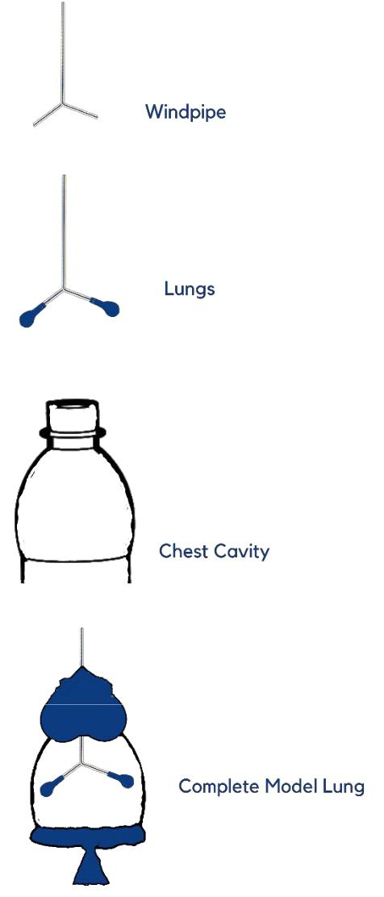
Give it a Try
1. Create a Lung Model
Prepare the windpipe and lungs
Prepare the chest cavity and diaphragm
Complete and test the lung model
Notes:
Tools of the Trade
Your model will give viewers an idea of how the respiratory system works. When you breathe, your diaphragm, a muscle at the bottom of the chest cavity, moves down to create space. Air travels through the nose or mouth down the windpipe and into your lungs. Your lungs remove oxygen from the air and send it into your bloodstream. Your model will need several components:
Windpipe- 2 bendable plastic straws
Lungs- 2 small balloons
Chest cavity- 1 plastic bottle, 16oz or 20oz
Diaphragm- 1 large balloon
You will also need the following:
Scissors
Tape
Clay
Prepare the Windpipe and Lungs
1. Cut one of the straws at the bend. Discard the longer piece.
2. Cut a small slit at the bend of the second straw. Insert the short piece of the first straw into the slit of the second straw. The two straws together should form the shape of a Y.
3. Use glue, tape, or clay to seal the space where the straws connect so that no air can escape.
4. Attach one small balloon to each straw.
Prepare the Chest Cavity and Diaphragm
5. Cut the plastic bottle in half. Discard the bottom half.
6. Place the windpipe and lungs inside the chest cavity (top half of the bottle). The windpipe should stick out of the top of the bottle.
7. Secure the windpipe by molding the clay around the top of the bottle so that the space around the straw is closed. Make sure you do not crush the straw.
8. Cut the top of the large balloon and tie a knot in the neck.
9. Stretch the large balloon around the end of the bottle.
Complete and Test the Model Lung
10. Pull down on the diaphragm (the knotted end of the large balloon). The lungs should inflate.
11. If the lungs do not inflate, check your clay to make sure the top is completely sealed and try again.

Slide 13
Give it a Try
2. Conduct a Vaping Demonstration
Write your script
Sketch your storyboard
Record your demonstration
Notes:
In your demonstration, you will show how e-cigarette aerosols enter the lungs. Using an eyedropper, place 3-4 drops of cooking oil into the top of the straw. Then pull down on the diaphragm to spread the oil into the lungs. The oil will build up in the lungs and will not come out. This shows how vitamin E acetate is found in the lung fluid of people with e-cigarette, or vaping, product use-associated lung injury (EVALI).
For your demonstration, you will need the following:
Your Lung Model
Cooking Oil- the oil serves as vitamin E acetate, which is a harmful substance found in e-cigarette aerosol
Eye Dropper- the eye dropper serves as the e-cigarette
Recording Device- this can be a web camera or a cell phone
Pen and Paper
Write Your Script
Before you record your demonstration, write a script to make sure you include all the important information about the dangers of vaping. Your script should include several parts:
A short explanation about your lung model and explanation of each part of your model
Talking points for your demonstration of the working lung model
A short explanation about what the cooking oil and eye dropper represent
Talking points for your demonstration of vaping using the cooking oil, eye dropper and lung model
Sketch Your Storyboard
A storyboard is a set of sketches that show how a story will be filmed. Think about each part of your script. What will it look like to the viewer?

Slide 14
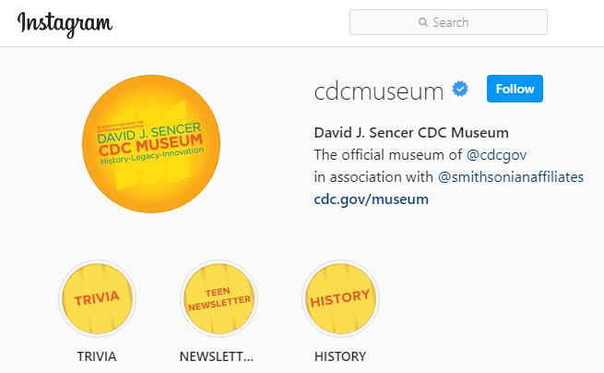
Give it a Try
3. Share Your Findings
Instagram @cdcmuseum
Notes:
The David J. Sencer CDC Museum uses award-winning exhibits and innovative programing to educate visitors about the value of public health and presents the rich heritage and vast accomplishments of CDC. Your demonstration could be a valuable contribution! Share your demonstration with the CDC Museum on Instagram using @CDCmuseum.
As the lead federal agency for comprehensive tobacco prevention and control, CDC uses their Tobacco Free Twitter and Facebook pages to protect the public's health from the harmful effects of tobacco use. You can contribute to their efforts by posting your demonstration to Twitter or Facebook using @CDCTobaccoFree.

Slide 15

Questions?

