Slide 1




COVID-19 Vaccination
Notes:
COVID-19 is a dangerous disease that spreads mainly from person to person through respiratory droplets. COVID-19 vaccination is an important tool to help stop the COVID-19 pandemic.
Note: These slides are made possible by the David J. Sencer CDC Museum Public Health Academy. https://www.cdc.gov/museum/education/lessons/

Slide 2
Terms to Know
 | molecule that is the blueprint for making proteins
 | the average number of people that one person with a virus is likely to infect
 | the trust that patients, their families, and providers have in recommended vaccines
 | a family of viruses characterized by a crown of spikes on the outside
 | when an entire population is resistant to a disease
 | the average number of people that one person with a virus SARS-CoV-2 is likely to with mitigation measures in place
 | cells that fight infection
Word Bank
coronavirus
mRNA
population immunity
reproduction number (R₀)
effective reproduction number (R_{T})
vaccine confidence
white cells
Notes:
Terms to Know
Coronavirus - a family of viruses characterized by a crown of spikes on the outside; examples are respiratory diseases like MERS and SARS, including SARS-CoV-2
mRNA - messenger RNA (mRNA) is the blueprint for making proteins; mRNA naturally forms in the nucleus of a cell when DNA is copied during transcription
Population immunity - when an entire population is resistant to a disease because of high levels of previous infection or vaccination amongst its members
Reproduction number (R₀) - the average number of people that one person with SARS-CoV-2 is likely to infect in a population without any immunity or interventions
Effective reproduction number (R_{t}) - estimate of the average number of people that one person with SARS-CoV-2 is likely to infect in a population with mitigation measures and immunity factors in place
Vaccine confidence - the trust that patients, their families, and providers have in recommended vaccines including development, licensing, manufacturing, and administration
White cells/ Immune cells - cells that fight infection; some examples include macrophages that fight germs and lymphocytes that produce antibodies and attack infected cells

Slide 3
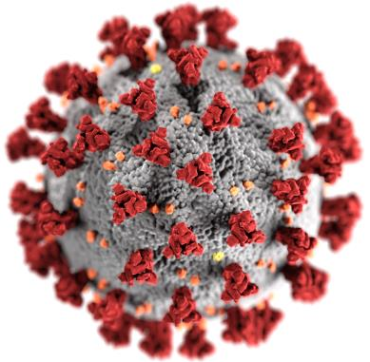
Understanding COVID-19
Coronaviruses are a type of
virus with a crown of spike
proteins sticking out
  There are many types,
  including SARS, MERS,
  and viruses that cause colds
  SARS-CoV-2 is the specific
  coronavirus that causes
  COVID-19
COVID-19 causes respiratory symptoms but can also harm other parts of the body
More than 4.5 million people have died from COVID-19 worldwide
Notes:
Coronaviruses are a large family of viruses that can infect people and many animals, including camels, cattle, cats, and bats. There are many types of coronaviruses, including some that give people a common head or chest cold. Other coronavirus diseases like severe acute respiratory syndrome (SARS) and Middle East respiratory syndrome (MERS) are extremely dangerous but are much less widespread than colds and COVID-19.
COVID-19 most often causes respiratory symptoms that can feel much like a cold, a flu, or pneumonia, but COVID-19 can also harm other parts of the body. Most people who catch COVID-19 have mild symptoms, but some people become severely ill. Older adults and people who have certain underlying medical conditions are at increased risk of severe illness from COVID-19. Hundreds of thousands of people have died from COVID-19 in the United States. Vaccines against COVID-19 are safe and effective.

Slide 4

Think About It
How do you think vaccines prevent illness?
What are some reasons that a person might get a COVID-19 vaccine?
How safe and effective are vaccines against COVID-19?

Slide 5
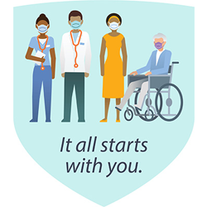
COVID-19 Vaccination and CDC
COVID-19 vaccines help the
body develop immunity to the SARS-CoV-2 virus
Vaccines are safe and effective
Side effects are generally mild
No vaccine is 100% effective
Provide strong protection against serious illness, hospitalization, and death
Notes:
COVID-19 Vaccination and the Centers for Disease Control and Prevention (CDC)
When germs, such as the virus that causes COVID-19, invade our bodies, they attack and multiply. This invasion, called an infection, is what causes illness. Blood contains white or immune cells, which fight infection. The first time a person is infected with the virus that causes COVID-19, it can take several days or weeks for their body to make and use all the germ-fighting tools needed to get over the infection. After the infection, the person’s immune system remembers what it learned about how to protect the body against that disease. COVID-19 vaccines help our bodies develop immunity to the virus that causes COVID-19 without us having to get the illness. CDC’s National Center for Immunization and Respiratory Diseases (NCIRD) works to prevent disease, disability, and death from viral diseases through immunization and other prevention measures. CDC collects information about the vaccines and outbreaks and helps healthcare professionals and health departments develop vaccination programs. CDC also monitors vaccine safety using the v-safe tool to report side effects.
COVID-19 vaccines are safe and effective. Millions of people in the United States have received COVID-19 vaccines, and these vaccines have undergone the most intensive safety monitoring in U.S. history. This monitoring includes using both established and new safety monitoring systems to make sure that COVID-19 vaccines are safe. Results from these monitoring efforts are reassuring. While some people don’t have any side effects after getting a COVID-19 vaccine, many people will have mild side effects after COVID-19 vaccination, like pain or swelling at the injection site, a headache, chills, or fever. These reactions are normal and show the vaccine is working. A small number of people have had a severe allergic reaction (called “anaphylaxis”) after vaccination, but this is extremely rare and when it does happen, vaccination providers have medicines available that they can use to effectively and immediately treat the reaction.
COVID-19 vaccination is an important tool to help stop the COVID-19 pandemic. COVID-19 vaccination helps protect people from getting sick or severely ill with COVID-19 and might also help protect people around them. Some people who are fully vaccinated against COVID-19 will still get sick because no vaccine is 100% effective. Experts continue to monitor and evaluate how often this occurs, how severe their illness is, and how likely a vaccinated person is to spread COVID-19 to others. CDC recommends you get a COVID-19 vaccine as soon as one is available to you. To receive the most protection, people should receive all recommended doses of a COVID-19 vaccine.

Slide 6
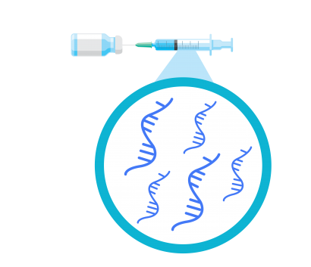
COVID-19 Vaccination and CDC
Vaccines from Pfizer-BioNTech and Moderna are both mRNA vaccines
Vaccine includes mRNA sequence from virus’s spike proteins
Cells produce the spike protein using the instructions from mRNA
Immune system builds antibodies to fight against the spike protein
If person is exposed to SARS-CoV-2 later, the immune system remembers the spike protein and can quickly build antibodies against it
Notes:
How do mRNA vaccines work?
Messenger RNA vaccines—also called mRNA vaccines—are some of the first COVID-19 vaccines authorized for use in the United States. The vaccines from Moderna and Pfizer-BioNTech are examples. mRNA vaccines are a new type of vaccine to protect against infectious diseases. To trigger an immune response, many vaccines put a weakened or inactivated germ into our bodies. Not mRNA vaccines. COVID-19 mRNA vaccines give instructions for our cells to make a harmless piece of what is called the “spike protein.” The spike protein is found on the surface of the virus that causes COVID-19. First, COVID-19 mRNA vaccines are given in the upper arm muscle. Once the instructions (mRNA) are inside the muscle cells, the cells use them to make the protein piece. After the protein piece is made, the cell breaks down the instructions and gets rid of them.
Next, the cell displays the protein piece on its surface. Our immune systems recognize that the protein doesn’t belong there and begin building an immune response and making antibodies, like what happens in natural infection against COVID-19.
At the end of the process, our bodies have learned how to protect against future infection. The benefit of mRNA vaccines, like all vaccines, is those vaccinated gain this protection without ever having to risk the serious consequences of getting sick with COVID-19.
Future mRNA vaccine technology may allow for one vaccine to provide protection for multiple diseases, thus decreasing the number of shots needed for protection against common vaccine-preventable diseases.
Check out this video from Vaccine Makers Project for a more detailed explanation of the components of the immune system that make vaccines work: https://vimeo.com/579667076

Slide 7
Think About It
How is CDC supporting the efforts to vaccinate all Americans against COVID-19?
Why is getting a COVID-19 vaccine important?
How are mRNA vaccines different from most other vaccines?

Slide 8

From the Expert
https://youtu.be/EH_qjp5u030
Notes:
From the Experts:
The National Forum on COVID-19 Vaccine occurred in Feb 2021 as vaccine efforts in the United States were starting to accelerate. The virtual conference aimed to inform public health officials about effective strategies for a data-driven implementation of the nation’s COVID-19 response strategy. Watch the finale video to hear from a variety of public health officials about how to build trust in the vaccines, use data to drive implementation, and optimize access for groups who are most at risk for infection. https://youtu.be/EH_qjp5u030

Slide 9
Think About It
Why is it important to identify vulnerable populations when administering vaccines?
Who are trusted community members who help people make vaccine decisions?
Why are vaccines our best defense against coronavirus?

Slide 10
Give it a Try
Call to Action!
Build a model for population immunity.
Publish your vaccine story.
Share your findings.
Why do you think participation is important?
Notes:
Call to Action
1. Build a model for population immunity. Some individuals are unable to get vaccinated due to age, allergies, immune diseases, or other medical conditions. Build a model and use it to show how population immunity impacts unvaccinated individuals.
2. Publish your vaccine story. Vaccine hesitancy puts everyone at risk as new infections allow mutations to occur, creating new variants. Share your personal stories of how COVID-19 has changed your life and how vaccination may mean a return to normalcy.
3. Share your findings. One of the ways CDC communicates information is through social media. Your story can help CDC communicate the work they have done and are doing to improve the rate of COVID-19 vaccinations across the globe.
Why Participate? A Message from CDC
Vaccine confidence is the trust that patients, their families, and providers have in recommended vaccines, providers who administer vaccines, and processes and policies that lead to vaccine development, licensure or authorization, manufacturing, and recommendations for use. Many factors influence vaccine decision-making, including cultural, social, and political factors; individual and group factors; and vaccine-specific factors.
Most people in the United States are planning to get vaccinated against COVID-19, but some may want more information before seeking vaccination. They may want to know more about COVID-19 vaccines, including the process for developing and authorizing these vaccines and information about their safety and effectiveness. People may also have previous experiences that affect their trust and confidence in the health system, which could affect their decision to get vaccinated.
By taking time to listen to their concerns and answer their questions, you can help people become confident in their decision to get vaccinated. Also, when you decide to get vaccinated and share the reasons why you did, you can have a powerful influence on your family and community. Strong confidence in the vaccines within communities leads to more people getting vaccinated, which leads to fewer COVID-19 illnesses, hospitalizations, and deaths.

Slide 11
Use the Engineering Design Process
Define
Define the problem
Research
Do background research
Requirements
Specify requirements
Brainstorm
Develop solutions
Build
Build a prototype
Test and redesign
Test
Share
Communicate results

Slide 12
Give it a Try
1. Build a Model for Population Immunity
Cut out the 64 vaccine tiles
See how vaccination affects the way a disease moves through a population
  Round 1: 50% vaccinated
  Round 2: 75% vaccinated
Notes:
Build a Model for Population Immunity
Population immunity means that enough people in a community are protected from getting a disease because they’ve already had the disease or because they’ve been vaccinated. Population immunity makes it hard for a disease to spread from person to person. It even protects those who cannot be vaccinated, like newborns or people who are allergic to a vaccine. The percentage of people who need to have protection to achieve population immunity varies by disease. We are still learning how many people have to be vaccinated against COVID-19 before the population can be considered protected.
Print out the vaccine tiles and gameboard on the next two pages. If you don’t have printer access, any double-sided objects (ex: coins, buttons, game pieces) or two different colors of objects will also work (ex: colored paper, building blocks, beads). A checkerboard or chess board works well as a background for this activity.
Cut out all 64 of the vaccine tiles.
Round 1: 50% of the Population is Vaccinated
For Round 1, we will assume that 50% of the population is fully vaccinated. On your gameboard, randomly lay out 32 tiles with the vaccine syringe showing. This represents 32 people who are vaccinated. Lay out the other 32 tiles with the vaccine syringe facing down to represent 32 people who are unvaccinated. Make sure you are using a random distribution of vaccines, not a clump.
Uh-oh! A disease outbreak has occurred. Let’s see what happens to our population. Remove one of the unvaccinated tiles somewhere near the middle of the board. This missing tile represents a person who has been infected.
In this game, any unvaccinated tile that is directly touching an infected tile will also be infected. Remove any unvaccinated tiles touching the top, bottom, left, or right of the infected tile. No diagonal tiles should be removed.
Continue spreading the disease and removing tiles until it can no longer spread.
Count your results and record them in the data table.
How many people were infected?
Of the uninfected people, how many were not vaccinated? This is a measure of the population immunity in a community.
Repeat the experiment 2 more times to see how your results compare.
Calculate the average % infected and % of unvaccinated people who were NOT infected.
Round 2: 75% of the Population is Vaccinated
For Round 2, we will assume 75% of the population is vaccinated. Reset your board so that 48 tiles are showing the vaccine syringe and 16 are not. This represents 48 vaccinated people and 16 unvaccinated people.
Choose an unvaccinated person near the middle of the board and start a new epidemic, following the same rules as before for transmission and removal of tiles.
Count your results and record them in the data table.
Repeat the experiment 2 more times to see how your results compare. Calculate averages.
In this game, the disease has a reproduction value (R₀) of 4 because each infected person would infect 4 other people on average without vaccines. When factors like immunity from vaccination/prior infection or other factors like masks and social distancing are added in, the reproduction rate decreases. This value is known as the effective reproduction value (R_{t}). When R_{t} is less than 1, case numbers will decrease. When it is greater than 1, they increase.

Slide 13
Give it a Try
2. Publish your Vaccine Story
Tell your vaccine story
Describe how the vaccine has impacted you
Convince others to get vaccinated
Share your story with others
Notes:
Publish Your Vaccine Story
COVID-19 has affected all of us in some way. We all want to get back to some sort of normal as quickly as possible, and vaccines are a path to that. Sometimes we get overwhelmed by the sheer magnitude of the COVID-19 pandemic, and it’s easy to forget that real people are being affected.
Decide how you want to share your story. You can make a website, video, digital book, social media post, or any other format that you feel comfortable using. The key feature is to make it personal. This is not about a pandemic that affects the whole world. It’s just about you and your story.
Tell your COVID-19 story.
How has this pandemic affected you personally? What are the mental, physical, and social effects that you have experienced firsthand?
Describe how the vaccine has impacted you.
What does the vaccine mean to you? How has the vaccine changed things? Have your family members been vaccinated? Have you?
Convince others to get vaccinated.
Why is it important to you that others get vaccinated? Keep it hopeful and positive!
Share your story with people you know. Have vaccine conversations with friends, family members, classmates, and others in your life who are unvaccinated. Here are some helpful resources:
Information about COVID-19 vaccines from CDC:
https://www.cdc.gov/coronavirus/2019-ncov/vaccines/index.html
Tips from CDC for talking to others about COVID-19 vaccinations: https://youtu.be/1Mf3ZWmK1wM
How do we know that COVID-19 vaccines are safe?
https://youtu.be/7bBmQaX2k4w
Locating a COVID-19 vaccination site:
https://www.vaccines.gov/
Myths and facts about COVID-19 vaccines
https://www.cdc.gov/coronavirus/2019-ncov/vaccines/facts.html
Examples of vaccination campaigns:
https://youtu.be/oH6dCTtgxbY
https://youtu.be/_JB8IEPqd1o
https://youtu.be/a7Zz4SxhhvA

Slide 14
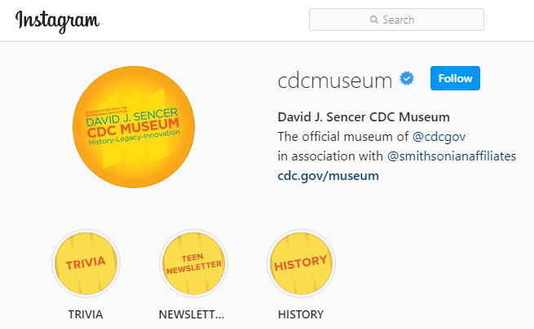
Give it a Try
3. Share Your Findings
Instagram @CDCmuseum
Notes:
Share Your Findings
The David J. Sencer CDC Museum uses award-winning exhibits and innovative programming to educate visitors about the value of public health and presents the rich heritage and vast accomplishments of CDC. Your demonstration could be a valuable contribution! Share your demonstration with the CDC Museum on Instagram using @CDCmuseum.

Slide 15
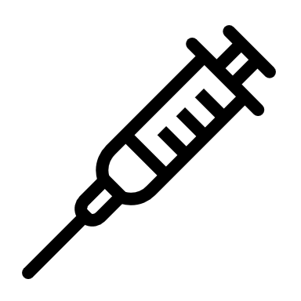
Questions?

