Slide 1




Get the Lead Out
Notes:
Lead is a particularly toxic metal that has been used for everyday items from paints and makeup to coins and plumbing. Disease surveillance and regulations have dramatically reduced the amount of lead in our environment and in our blood over the last 50 years.
Note: These slides are made possible by the David J. Sencer CDC Museum Public Health Academy. https://www.cdc.gov/museum/education/lessons/

Slide 2
Terms to Know
 | chemical reaction between a metal and its environment that causes it to break down into ions
 | difference in health outcome linked with economic, social, or environmental disadvantage
 | science of protecting and improving the health of people and their communities
 | amount of lead in blood, measured in micrograms per deciliter (μg/dL) of blood
 | substance, state, or event which has the potential to adversely affect people's health
 | measure of concentration equal to the mass units of a substance per billion mass units in a sample
 | water pipe that directly connects a larger water main to individual buildings
Word Bank
Blood lead level
Corrosion
Environmental hazard
Health disparity
ppb
Public health
Service line
Notes:
Terms to Know
Blood lead level - amount of lead in blood, measured in micrograms per deciliter (μg/dL) of blood; CDC currently recognizes 3.5 μg/dL as the level of concern for children
Corrosion - chemical reaction between a metal and its environment that causes it to break down into ions and dissolve
Environmental hazards - substance, state, or event which has the potential to adversely affect people's health, including pollution and natural disasters
Health disparity - a particular type of difference in health outcome that is closely linked with economic, social, or environmental disadvantage
ppb - parts per billion; measure of concentration equal to the mass units of a particular substance per billion mass units in a sample
Public health - science of protecting and improving the health of people and their communities
Service line - water pipe that directly connects a larger water main to individual buildings; service lines are privately owned and maintained at owner’s expense

Slide 3
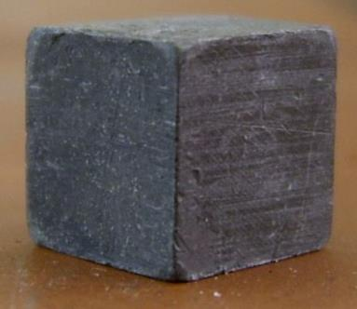

Understanding Lead
Lead is a soft metal that is easy to work with and abundant in the environment
Used throughout recorded history for weapons, medicines, makeup, coins, flavorings, metalwork, and other uses
Lead poisoning can occur when lead is ingested, touched, or inhaled
Lead poisoning causes learning disabilities, behavioral problems, and, at high enough levels, can cause seizures, comas, or death
Damage occurs before symptoms do; early detection is key
No safe level of lead in children has been identified
Blood lead levels above 3.5 μg/dL require medical intervention
Notes:
Lead is easy to work with, abundant in the environment, and has many uses. The ancient Romans had a water and sewer system that used lead pipes extensively, giving us the word plumbing from the Latin word for lead, plumbum. They also used lead for weapons, medicines, makeup, and coins, among other uses. They even added lead compounds directly to food and wine. Unsurprisingly, chronic lead poisoning was common in the Roman Empire, though few connected gout, sterility, and stillbirths back to the lead they were constantly exposed to.
Lead poisoning occurs when a person’s health or body functions are negatively affected by lead contamination in what they eat, drink, touch, or breathe. The dangers of lead poisoning have been known for centuries. Lead poisoning can cause learning disabilities, behavioral problems, and, at very high levels, seizures, comas, or even death. Research has shown that even small amounts of lead can cause neurological damage to people long before any symptoms occur.

Slide 4

Think About It
What are some common reasons that environmental hazards are not addressed?
What kind of work do you think CDC’s National Center for Environmental Health (NCEH) does to address environmental hazards?
Give two examples of health disparities that might result from environmental hazards.

Slide 5
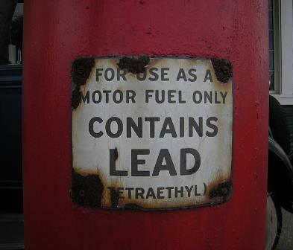
Lead and CDC
Lead in Gasoline
Lead was added to gasoline in 1923
to stop engine knock
Lead was released into atmosphere
through car exhaust, where it was
inhaled, deposited onto soil, and
washed into water sources
In 1970, the Environmental Protection Agency (EPA) was established and began to regulate lead
CDC provided critical blood lead level data from the National Health and Nutrition Examination Survey (NHANES) to convince Congress to regulate lead in gasoline by demonstrating that less lead in gasoline was directly tied to decreasing blood lead levels
Notes:
Lead and the Centers for Disease Control and Prevention (CDC)
Children are particularly vulnerable to lead toxicity because their blood-brain barrier is not fully developed. This means that toxins like lead can enter the brain and cause neurological damage. Lead can also replace calcium in bones, meaning that it can be released from the bones into the blood slowly over time. Protecting children from exposure to lead is important to lifelong good health. No safe blood lead level in children has been identified. Even low levels of lead in blood have been shown to affect learning, ability to pay attention, and academic achievement. While the effects of lead poisoning may be permanent, if caught early there are things parents can do to prevent further exposure and reduce damage to their children’s health. Efforts to protect children have resulted in the removal of many formerly common lead sources in the environment.
Lead in Gasoline
In 1923, automobile manufacturers and gasoline producers began producing fuel that contained tetraethyl lead to improve fuel combustion in the engine and reduce loud engine knock. By this time, the negative health effects of lead were well known. At the plants where the fuel was produced, dozens of workers died or went mad from acute lead poisoning. Without any government agencies to step in, the fuel continued to be produced. Car exhausts continued to emit lead and other pollutants into the environment for decades.
In 1970, the Environmental Protection Agency (EPA) was established to measure, set standards, and regulate pollutants in the environment. Because data showed that Americans had incredibly high blood lead levels, the EPA began issuing lead reduction standards in 1973, and ultimately banned the sale of leaded gas. CDC played an instrumental role in providing scientific evidence to Congress to reinforce the ban on leaded gas in 1980. Through blood samples collected by NHANES (National Health and Nutrition Examination Survey), CDC scientists demonstrated the parallel decreases in blood-lead levels and amounts of lead in gasoline from 1976-80.

Slide 6
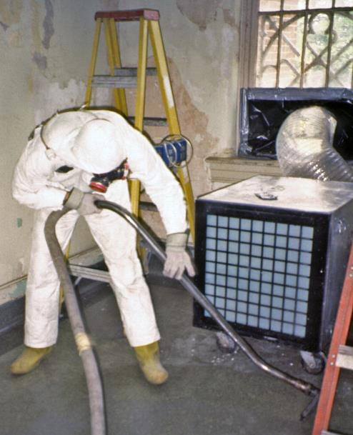
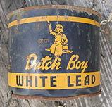
Lead and CDC
Lead in Paint
Lead has been used in paint for
thousands of years
Until the 1940s, paint in the U.S.
was about 50% lead
In the 1960s, citizens demanded safer
housing for children, who often lick
or eat peeling paint chips
CDC began coordinating federal lead-poisoning programs in the 1970s and helped support regulations to remove lead from paint
Childhood Blood Lead Surveillance System began in the 1990s to monitor children’s lead levels
Notes:
Lead in Paint
Lead has been used as a paint pigment for thousands of years. Most interior paints before 1940 contained about 50% lead. The dangers of children eating lead paint from cribs, toys and walls were noted by public health officials as early as the 1930s, and were often linked to problems of people with lower incomes in substandard housing. During the activist 1960s, citizens called for increased government intervention, including community screenings and the banning of lead-based paints in government housing.
CDC Began to coordinate federal lead poisoning programs in the 1970s. In 1971, lead paint was prohibited in all federal buildings as well as those built using government funding. CDC began to coordinate federal lead-poisoning programs in the 1970s. By that time, public health officials realized that the problem was not just limited to people with lower incomes. Any place where lead paint was peeling or chipping from a surface put children at risk. Hand to mouth lead transmission was the most common way that lead entered the blood. CDC’s Childhood Lead Poisoning Prevention Program was established in 1990, funding prevention programs nationwide and creating the Childhood Blood Lead Surveillance System to monitor children for potential negative health effects.

Slide 7

Lead and CDC
Lead from Mining
In 2010, CDC and other public health
organizations travelled to Zamfara
State in Nigeria to investigate an
outbreak in children
Symptoms in children included vomiting, abdominal pains, headaches, seizures, and death
The team observed that many were bringing rocks into homes to mine for gold, thus spreading lead around their homes and village
Safer mining practices were introduced, and contaminated soil was removed
Notes:
Lead from Mining
Mining operations can also produce increased amounts of lead in the air, water, or soil around mines. A team of experts from many public health organizations, including CDC, travelled to Zamfara State in northern Nigeria in 2010 to investigate an outbreak. First, animals had begun to get sick and die; then children began suffering from vomiting, abdominal pain, headaches, and seizures. Investigation showed unsafe levels of lead in most homes and in community wells. Hundreds of children died, and thousands had dangerous blood lead levels.
The team observed the communities and saw many unsafe practices that would expose adults, children, and animals to harmful levels of lead. Zamfara State was agricultural but was also rich in many minerals, including gold. In recent years, many villagers had started mining gold to earn more money. Since most villagers did not wear personal protective equipment while working with the gold ore, they would return home from the mines with lead dust on their clothing. Many villagers would bring rocks inside their homes to extract the gold. These rocks also contained lead, and when the gold was extracted, the lead dust spread throughout the house. Children often helped to grind the gold ore, exposing them to high levels of lead dust.
To treat the outbreak, all the contaminated soil in a village must be removed and replaced. This process is expensive, and many children are still awaiting treatment for lead poisoning because the environment has not yet been cleaned. Additionally, mining is an important part of the local economy, so it cannot be prohibited. Public health education and safer mining practices were introduced to help control the outbreak.

Slide 8

Lead and CDC
Other Sources of Lead
Industrial contamination from workers who wear contaminated clothes home from work
Corrosion of lead pipes in older water systems
Soil contamination from prior lead exposure due to paint, gasoline, or other spills
Imported toys and candies
from countries with less
strict lead regulations
Notes:
Other Sources of Lead
Take-home lead exposure may occur among workers who use lead as part of occupations, such as battery manufacturing, smelting, home renovation, pottery production, and metal recycling. In addition to potentially being exposed to higher levels of lead on the job, these workers can also carry lead home with them on their clothes, tools, hair, and skin, thereby exposing their families.
Drinking water can become contaminated by corrosion of older lead pipes or solder (a metallic substance that is melted and used to hold pipes together). Many water systems are taking action to remove all lead plumbing that is still in service, including many lead service lines.
Lead-based paint spills, leaded gasoline, or industrial sources can contaminate soils. Children who eat dirt or put their hands into their mouths after playing in dirt risk exposure to lead. Soil particles that are brought into the house on shoes, clothing, or pets may also increase exposure.
Imported goods can sometimes pose lead safety hazards. Lead paint is somewhat common on imported toys and jewelry. Food, candies, and spices containing lead have also been found.

Slide 9
Think About It
Why do you think lead poisoning is a health disparity linked to socioeconomic factors?
How was NHANES data useful in supporting the ban of lead from gasoline and fuel?
Why did the Zamfara team educate the villagers rather than shut down the mine?

Slide 10

From the Expert
https://youtu.be/XVMZCqCpYCQ
Notes:
From April 25, 2014–October 15, 2015, approximately 99,000 residents of the City of Flint, MI, were exposed to lead when the drinking water source was switched from the Detroit Water Authority to the Flint Water System (FWS). In December 2015, lead contamination in the FWS was declared a state of emergency and by January 2016, CDC assisted the City of Flint and the State of Michigan to develop a response and recovery plan.
In the video linked below, Dr. Phoebe Thorpe interviews Dr. Mona Hanna-Attisha, whose research exposed the Flint, Michigan water crisis. Learn how lead poisoning in children remains a problem in the United States and how childhood lead exposure can be prevented. https://youtu.be/XVMZCqCpYCQ
For follow up, check out Dr. Hanna-Attisha’s 2019 rousing commencement speech at the Harvard School of Medicine. Listen for a special tribute to Dr. Alice Hamilton, (https://youtu.be/2XY12HZ_-L4) one of the female pioneers of public health and industrial health and safety standards. https://hms.harvard.edu/news/fresh-eyes

Slide 11
Think About It
It took 18 months for the people of Flint, Michigan to convince others that their drinking water was unsafe. Why might this be an example of a health disparity?
Elevated lead levels can affect learning, ability to pay attention, and academic achievement in children. How can these symptoms lead to inequality?
After examining the NCEH website, what environmental health topics surprised you? Why do you think these areas are considered part of public health?

Slide 12
Give it a Try
Call to Action!
Examine historical lead data
Develop a plan to address a public health emergency.
Share your findings.
Why do you think participation is important?
Notes:
Call to Action
In order to understand the risk factors of lead poisoning, it is essential that people know about the historical and current sources of lead exposure. You can help people by following these three steps:
Examine historical lead data. Data from NHANES were used to convince Congress to allow the EPA to regulate the amount of lead in substances like gasoline and paint. Examine historical blood lead level data to see lead’s environmental hazards.
Develop a plan to address a public health emergency. The Flint water crisis caused elevated lead levels in tap water. Examine the timeline of the disaster and make recommendations to address the long-term effects of lead in the tap water.
Share your findings. One of the ways CDC communicates information is through social media. Your demonstrations can help CDC communicate the work they have done and are doing to reduce the rates of lead poisoning in the population.
Why Participate? A Message from CDC
Human health and well-being are strongly affected by the environment in which we live — the air we breathe, the water we drink, and the food and nutrients we eat. CDC’s National Center for Environmental Health (NCEH) plans, directs, and coordinates a program to protect the American people from environmental hazards. Visit their site at https://www.cdc.gov/nceh to discover the wealth of environmental health data and resources to help you monitor and improve your quality of life.

Slide 13
Use the
Public Health Approach
Surveillance
What is the problem?
Risk Factor Identification
What is the cause?
Intervention
What works?
Implementation
How did we do it?
Surveillance
What is the problem?
Risk Factor Identification
What is the cause?
Intervention
What works?
Implementation
How did we do it?
Notes:
The public health approach below is a general method that can be used to study and solve public health problems. While this is a simplified version, it provides a good general framework.
For more detailed information about the public health approach, check out CDC’s Public Health 101 training course. https://www.cdc.gov/training/publichealth101/public-health.html

Slide 14
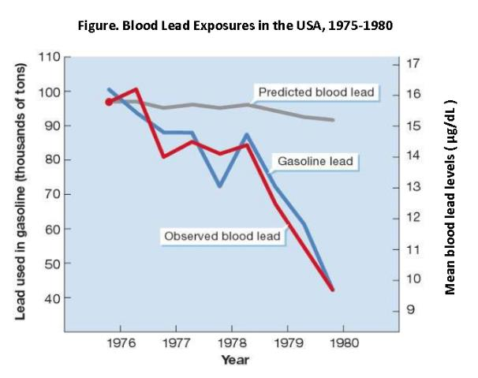
Give it a Try
1. Examine Historical Lead Data
Use data from the National Health and Nutrition Examination Survey (NHANES) to observe changes in blood lead levels over time
  Data Set 1: Blood lead levels 1976-1980
  Data Set 2: Blood lead levels 1999-2016
Look for health disparities
in the data and develop a
plan to address one of them
Notes:
Examine Historical Lead Data
The National Health and Nutrition Examination Survey (NHANES) is a program of studies designed to assess the health and nutritional status of adults and children in the United States. The survey is unique in that it combines interviews and physical examinations. The survey is a major program of the National Center for Health Statistics (NCHS), which is part of CDC. It has the responsibility for producing vital and health statistics for the Nation.
DATA SET 1: BLOOD LEAD LEVELS, 1976-1980
Surveillance (What is the problem?)
The U.S. Environmental Protection Agency (EPA) issued regulations to gradually reduce the amount of tetraethyl lead over time, starting in 1973. CDC responded by adding blood lead level measurements to NHANES to collect surveillance data about its effects. The following data were collected and presented to Congress in hearings regarding the regulation of tetraethyl lead in gasoline. The “Predicted blood lead” line represents the scientists’ prediction for how the blood lead levels of the community would change in response to the reduction of tetraethyl lead in gasoline.
Risk Factor Identification (What is the cause?)
Examine the relationship between gasoline lead and observed blood lead in the surveillance data above. What pattern do you see?
How does the line for predicted blood lead relate to the line for observed lead? What does this mean about the impact of gasoline lead on observed blood lead?
Based on this surveillance data, who is at risk for lead exposure?
Intervention Evaluation (What works?)
As of 2021, CDC recognizes 3.5 μg/dL as the level of concern for lead poisoning. Based on these data, what is the maximum amount of lead that should be in gasoline to reduce blood lead levels so that the entire population is below this level? Justify your answer using data.
Implementation (How did we do it?)
Car manufacturers were ordered to begin building engines to run on unleaded gasoline by 1975, which led to the widespread use of the catalytic converter. Since lead damages catalytic converters, demand for leaded gasoline shrank. In 1996, EPA banned leaded gasoline from all on- road vehicles. The health effects of this ban can be observed through continuing surveillance.
DATA SET 2: BLOOD LEAD LEVELS, 1999-2016
Surveillance (What is the problem?)
NCHS has continued to record blood lead levels in the population through NHANES. The data below show blood lead concentrations for the U.S. population age 1 and older from 1999-2016, broken down by sex, race and ethnicity, and age group.
Risk Factor Identification (What is the cause?)
Exhibit 1. What patterns related to sex did you notice in this graph? What risk factors may be responsible?
Exhibit 2. What patterns related to race and ethnicity did you notice in this graph? What risk factors may be responsible?
Exhibit 3. What patterns related to age did you notice in this graph? What risk factors may be responsible?
Intervention Evaluation (What works?)
Think about the data and the risk factors you have identified. To improve the health of the public, you should start by addressing these health disparities. What are three interventions you would suggest to address these disparities?
Implementation (How did we do it?)
Choose one intervention strategy that will be the most successful based upon your reading and data analysis. How would you implement this intervention?
What challenges do you anticipate in implementation?

Slide 15
Give it a Try
2. Develop a Plan to Address a Public Health Emergency
Read the timeline of the 2014-2016 Flint, Michigan water crisis, where 99,000 residents were exposed to unsafe tap water with high lead levels
Choose a group that was affected by this crisis
Design an intervention and develop an implementation plan for it
Notes:
Develop a Plan to Address a Public Health Emergency
During April 25, 2014–October 15, 2015, approximately 99,000 residents of the City of Flint, Michigan, were exposed to lead when the drinking water source was switched from the Detroit Water Authority to the Flint Water System (FWS). The levels of lead in Flint tap water increased over time as the lead pipes slowly corroded and lead dissolved into the water. CDC – led by the U.S. Department of Health and Human Services (HHS) – assisted the City of Flint and the State of Michigan to develop a response and recovery plan. Here is a brief timeline of events:
Apr 2014 Water in Flint, Michigan is switched from Detroit Water Authority to Flint Water System (FWS) as a cost-saving measure. Residents notice water smells, tastes, and looks funny. Normally, corrosion control chemicals are added to the water, but Flint did not have a proper plan in place when the switch occurred.
Jun 2014 An outbreak of Legionnaires’ disease kills 12 and sickens 87. Legionnaire’s disease is caused by Legionella bacteria and is a symptom of inadequately treated water.
Aug 2014 Fecal coliform bacteria are detected in the water system, and a boil water advisory is issued. This is another sign of poorly treated water. FWS increases the chlorine levels in the water to correct the bacterial contamination.
Oct 2014 General Motors stops using Flint water, as it is corroding engine parts in their factory.
Jan 2015 Flint officials announce the level of trihalomethanes (TTHM) is too high in the water system due to overchlorination, putting them in violation of the Safe Drinking Water Act. The state starts buying bottled water for its government offices.
Apr 2015 Michigan's Department of Environmental Quality (MDEQ) notifies EPA that FWS did not have corrosion controls in place. EPA warns Flint that its anti-corrosion methods are not sufficient and that they may be underestimating lead levels in the water due to poor sampling methods.
Jul 2015 MDEQ spokesperson says, "Let me start here — anyone who is concerned about lead in the drinking water in Flint can relax" in response to growing concern. Officials deny the water is unsafe to drink.
Sep 2015 A team of researchers from Virginia Tech examines water samples from around Flint and finds 17% are above the federal maximum standard of 15 ppb (parts per billion). They also find the water to be 19 times more corrosive than Detroit water. Dr. Mona Hanna-Attisha, working with the researchers from Virginia Tech, examines 1,700 blood samples from Flint children and finds nearly double the numbers of high blood lead levels since the switch to Flint River water. The city recommends use of water filters and begins offering lead tests.
Oct 2015 Further testing shows elevated lead levels in Flint, and the governor offers funding to help address the issues. The city is reconnected to Detroit water. However, the damage to the pipes is done, and they continue to leech metals into the water.
Dec 2015 A state of emergency is declared in Flint by the mayor, governor, and president. Federal agencies can now begin to offer support in the area.
Jan 2016 Bottled water and filters are distributed to all city residents to remove lead and other contaminants.
Jul 2016 Flint’s water tests below the federal action level of 15 ppb for the first time.
Dec 2016 The U.S. Senate authorizes $100 million to address lead contamination in Flint.
After the water crisis, the City of Flint started a program to replace all lead service lines with new copper pipes at no cost to residents using $97 million in funding from state and federal governments. They also continued to supply water and filters to buildings awaiting replacement. Between the improved water quality and repairs to the plumbing infrastructure, the source of lead in Flint’s water has been addressed. However, the problem is not over.
There is evidence that childhood exposure to lead can cause long-term harm. The effects of lead poisoning may be permanent. No safe level of lead exposure in children has been identified. Exposure to lead can seriously harm a child’s health and cause adverse effects such as:
Damage to the brain and nervous system
Slowed growth and development
Learning and behavior problems
Hearing and speech problems
This can cause:
Lower IQ
Decreased ability to pay attention
Underperformance in school
Develop a Plan
Given what occurred with the water in Flint, Michigan, what support does the community need to address the issues brought about by the elevated lead levels in the water? Design a public health intervention strategy that would address the long-term effects of elevated lead levels in Flint’s water. You may find useful resources here: https://www.cdc.gov/nceh/lead
Surveillance (What is the problem?)
What type of data would you like to collect? How will you collect it?
Example: You could conduct phone interviews with people in Flint to assess their needs.
Risk Factor Identification (What is the cause?)
What group would you want to address with your intervention?
Example: You could design an intervention for third graders with low reading or math test scores.
Intervention Evaluation (What works?)
Propose 3-5 intervention strategies that you think could address the issue you have identified.
Example: Provide increased Medicare benefits so that residents of Flint can get medical care.
Implementation (How do we do it?)
Come up with a plan to implement the intervention that you think would be most effective.
Ex: You could secure government funding to open free preschool for all Flint kids.
Success Story: Newark, New Jersey
After elevated levels of lead were found across 30 public schools in Newark, New Jersey, the city began evaluating its water system. The threat of lawsuits and warnings from the EPA pushed the project into quick action. Between March 2019 and August 2021, the city replaced all 23,000 service lines with copper at no cost to homeowners. Listen to Kareem Adeem, the Acting Director of the Newark Department of Water and Sewer, explain the process and how this monumental feat was accomplished so quickly. https://youtu.be/V8hEYFpYsv4

Slide 16
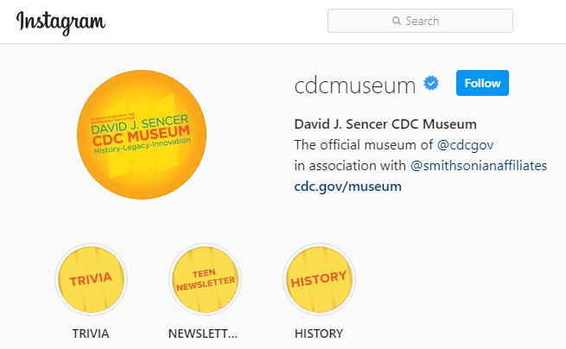
Give it a Try
3. Share Your Findings
Instagram @CDCmuseum
Notes:
Share Your Findings
The David J. Sencer CDC Museum uses award-winning exhibits and innovative programming to educate visitors about the value of public health and presents the rich heritage and vast accomplishments of CDC. Your demonstration could be a valuable contribution! Share your demonstration with the CDC Museum on Instagram using @CDCmuseum.
CDC’s National Center for Environmental Health (NCEH) plans, directs, and coordinates a program to protect the American people from environmental hazards. They promote a healthy environment and prevent premature death, avoidable illness and disability caused by non-infectious, non-occupational environmental and related factors. They are especially committed to safeguarding the health of vulnerable populations – such as children, older adults, and people with disabilities – from certain environmental hazards. Share your work them on Twitter using @CDCEnvironment.

Slide 17

Questions?

