Slide 1

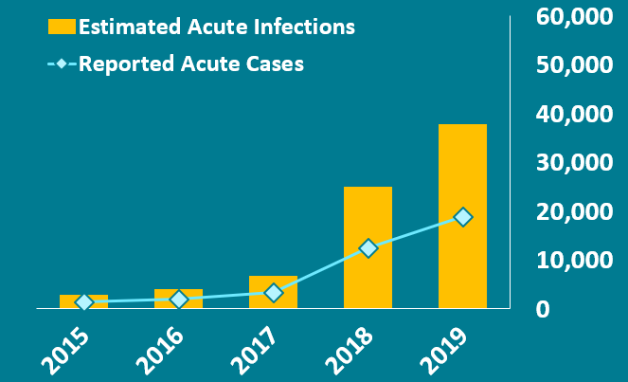
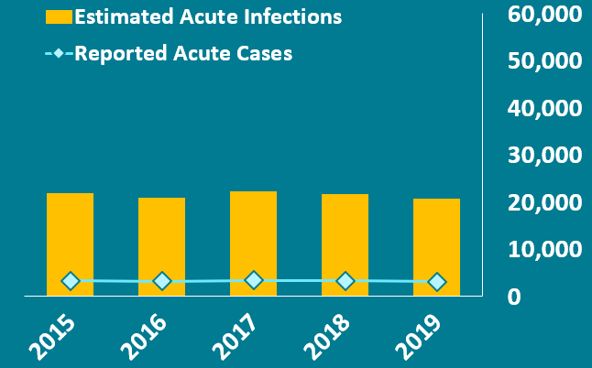
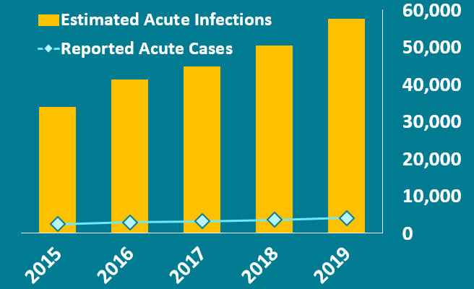
SUMMARY 2019
Viral Hepatitis Acute Infections
HEPATITIS A
 | 18,846 | Acute Cases Reported in 2019
 | 37,700 (26,400- 41,500)* | Acute Infections Estimated in 2019
HEPATITIS B
 | 3,192 | Acute Cases Reported in 2019
 | 20,700 (11,800- 50,800)* | Acute Infections Estimated in 2019
HEPATITIS C
 | 4,136 | Acute Cases Reported in 2019
 | 57,500 (45,500-196,000)* | Acute Infections Estimated in 2019
*95% Bootstrap Confidence Interval

Slide 2
HEPATITIS A, 2019
18,846 | New cases reported | 5.7 | Reported cases per 100,000 population | 37,700* | Acute infections estimated
AT A GLANCE — Hepatitis A in 2019
Hepatitis A incidence increased 1,325% from 2015 through 2019. The increase in 2019 was because of unprecedented person to person outbreaks in 31 states primarily among people who use drugs and people experiencing homelessness.
GROUPS MOST AFFECTED BY HEPATITIS A IN 2019
  By Age†
    20–29 years: 7.9 cases per 100,000 people
    30–39 years: 14.5 cases per 100,000 people
    40–49 years: 10.4 cases per 100,000 people
  By Sex†
    Males: 7.3 cases per 100,000 people
  By Race/ Ethnicity†
    White, Non-Hispanic: 6.8 cases per 100,000 people
  By Risk
    Injection Drug Use (IDU): Among the 10,991 reported cases with IDU information available, 5,017 (46%) reported IDU
*95% Bootstrap Confidence Interval: (26,400– 41,500)
† Indicates groups above the U. S. rate in 2019

Slide 3
ACUTE HEPATITIS B, 2019
3,192 | Acute cases reported | 1.0 | Reported acute cases per 100,000 population | 20,700* | Acute infections estimated
AT A GLANCE — Acute Hepatitis B in 2019
Rates of acute hepatitis B remained low in children and adolescents, likely because of childhood vaccinations. However, more than half of acute hepatitis B cases reported to CDC in 2019 were among persons aged 30–49 years.
GROUPS MOST AFFECTED BY ACUTE HEPATITIS B IN 2019
  By Age†
    30–39 years: 1.8 cases per 100,000 people
    40–49 years: 2.7 cases per 100,000 people
    50–59 years: 1.6 cases per 100,000 people
  By Sex †
    Males: 1.3 cases per 100,000 people
  By Race/Ethnicity†
    White, Non-Hispanic: 1.0 cases per 100,000 people
  By Risk
    Injection Drug Use (IDU): Among the 1,780 reported cases with IDU information available, 631 (35%) reported IDU
*95% Bootstrap Confidence Interval: (11,800– 50,800)
† Indicates groups at or above the U.S. rate in 2019

Slide 4
ACUTE HEPATITIS C, 2019
4,136 | Acute cases reported | 1.3 | Reported acute cases per 100,000 population | 57,500* | Acute infections estimated
AT A GLANCE — Acute Hepatitis C in 2019
Rates of acute hepatitis C increased again in 2019. The highest rates occurred in persons 20–39 years, consistent with age groups most impacted by the nation’s opioid crisis.
GROUPS MOST AFFECTED BY ACUTE HEPATITIS C IN 2019
  By Age†
    20–29 years: 2.9 cases per 100,000 people
    30–39 years: 3.2 cases per 100,000 people
    40–49 years: 1.7 cases per 100,000 people
  By Sex†
    Males: 1.6 cases per 100,000 people
  By Race/Ethnicity†
    American Indian/Alaska Native: 3.6 cases per 100,000 people
  By Risk
    Injection Drug Use (IDU): Among the 1,952 reported cases with IDU information available, 1,302 (67%) reported IDU
*95% Bootstrap Confidence Interval: (45,500– 196,000)
† Indicates groups above the U.S. rate in 2019

