Slide 1

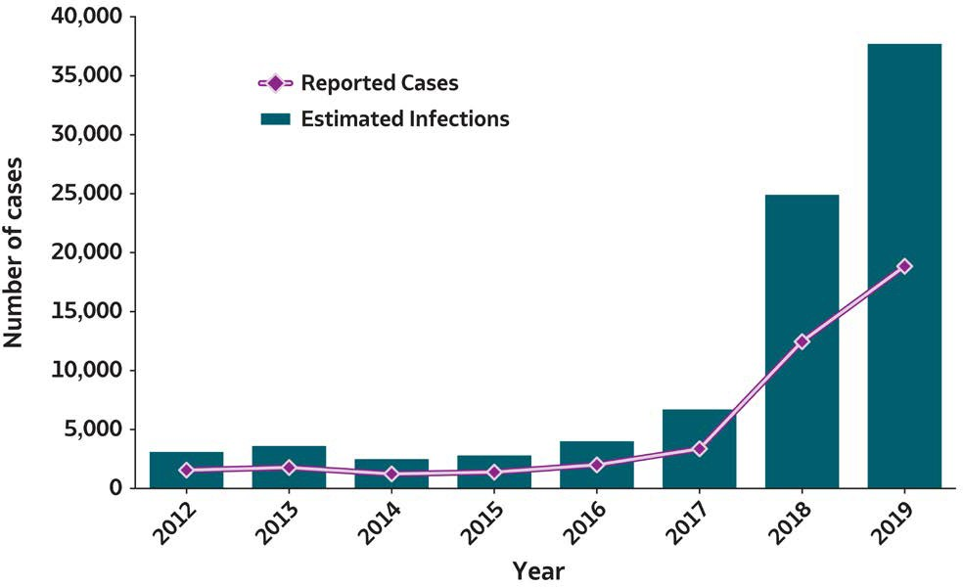

2019 VIRAL HEPATITIS
SURVEILLANCE REPORT
Figure 1.1. Number of reported hepatitis A virus infection cases and estimated infections* — United States, 2012–2019
Hepatitis A | 2012 | 2013 | 2014 | 2015 | 2016 | 2017 | 2018 | 2019
Reported cases | 1,562 | 1,781 | 1,239 | 1,390 | 2,007 | 3,366 | 12,474 | 18,846
Estimated infections | 3,100 | 3,600 | 2,500 | 2,800 | 4,000 | 6,700 | 24,900 | 37,700
Source: CDC, National Notifiable Diseases Surveillance System.
* The number of estimated viral hepatitis infections was determined by multiplying the number of reported cases that met the classification criteria for a confirmed case by a factor that adjusted for underascertainment and underreporting. The 95% bootstrap confidence intervals for the estimated number of infections are displayed in the Appendix.

Slide 2

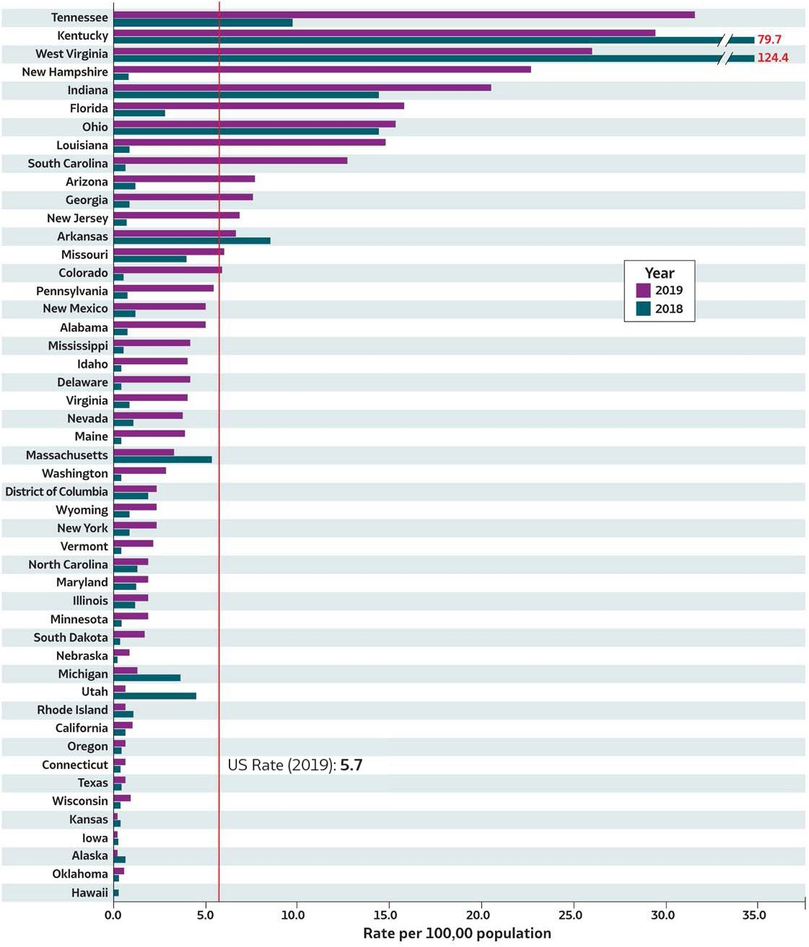
2019 VIRAL H E PAT ITIS
SURVEILLANCE REPORT
Figure 1.2. Rates* of reported hepatitis A†virus infection, by state or jurisdiction — United States, 2018–2019
Source: CDC, National Notifiable Diseases Surveillance System.
* Rates per 100,000
population.
†Reported cases that met the classification criteria for a confirmed case. For the case definition, see https://ndc.services.cdc.gov/conditions/hepatitis-a-acute/.
Only states with rates for 2018 and 2019 are shown. No hepatitis A cases were reported from Montana and North Dakota in 2018.

Slide 3

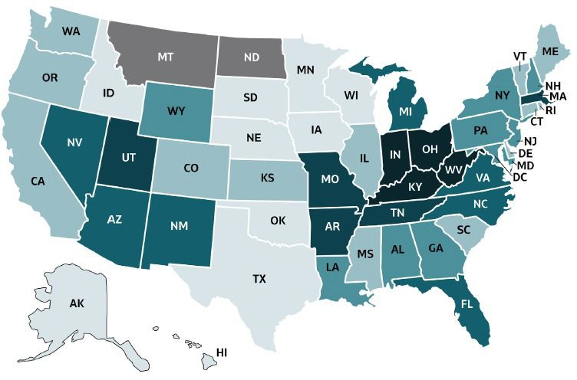

2019 VIRAL HEPATITIS
SURVEILLANCE REPORT
Figure 1.3. Rates of reported hepatitis A virus infection, by state or jurisdiction — United States, 2019
Color Key | Cases/100,000 Population | State or Jurisdiction
 | 0.0-0.6 | AK, CA, CT, HI, IA, KS, ND, OK, OR, RI, TX, UT, WI
 | 0.7-1.4 | MI, MN, MT, NE, SD
 | 1.5-3.0 | DC, IL, MA, MD, NC, NY, VT, WA, WY
 | 3.1-5.5 | AL, DE, ID, ME, MS, NM, NV, PA, VA
 | 5.6-14.8 | AR, AZ, CO, GA, LA, MO, NJ, SC
 | 14.9-31.6 | FL, IN, KY, NH, OH, TN, WV
Source: CDC,National Notifiable Diseases Surveillance System.

Slide 4

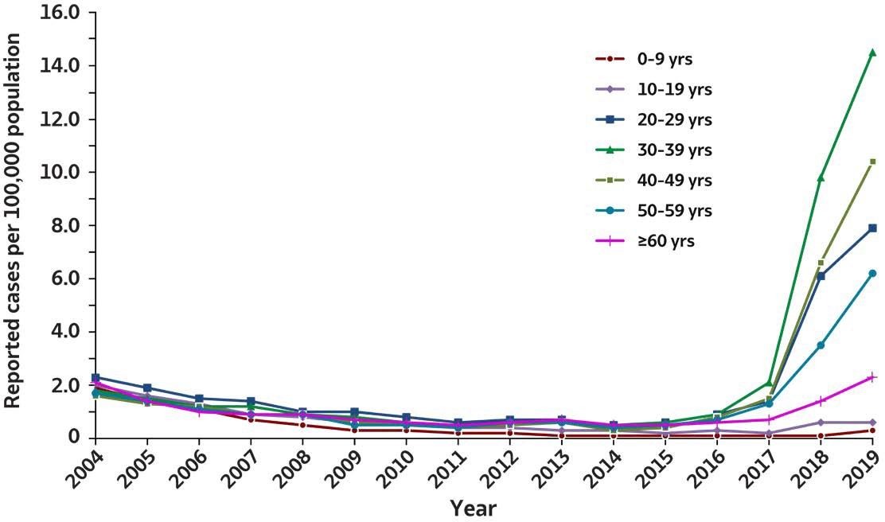

2019 VIRAL H E PAT ITIS
SURVEILLANCE REPORT
Figure 1.4. Rates of reported hepatitis A virus infection, by age group — United States, 2004–2019
Age (years) | 2004 | 2005 | 2006 | 2007 | 2008 | 2009 | 2010 | 2011 | 2012 | 2013 | 2014 | 2015 | 2016 | 2017 | 2018 | 2019
0-9 | 1.9 | 1.4 | 1.1 | 0.7 | 0.5 | 0.3 | 0.3 | 0.2 | 0.2 | 0.1 | 0.1 | 0.1 | 0.1 | 0.1 | 0.1 | 0.3
10-19 | 2.0 | 1.6 | 1.3 | 0.9 | 0.8 | 0.6 | 0.5 | 0.4 | 0.4 | 0.3 | 0.3 | 0.2 | 0.3 | 0.2 | 0.6 | 0.6
20-29 | 2.3 | 1.9 | 1.5 | 1.4 | 1.0 | 1.0 | 0.8 | 0.6 | 0.7 | 0.7 | 0.5 | 0.6 | 0.9 | 1.4 | 6.1 | 7.9
30-39 | 1.8 | 1.5 | 1.2 | 1.2 | 0.9 | 0.8 | 0.6 | 0.5 | 0.5 | 0.7 | 0.5 | 0.6 | 0.9 | 2.1 | 9.8 | 14.5
40-49 | 1.6 | 1.3 | 1.2 | 0.9 | 0.9 | 0.6 | 0.5 | 0.4 | 0.5 | 0.6 | 0.3 | 0.4 | 0.8 | 1.5 | 6.6 | 10.4
50-59 | 1.7 | 1.4 | 1.1 | 0.9 | 0.9 | 0.5 | 0.5 | 0.4 | 0.6 | 0.6 | 0.4 | 0.5 | 0.7 | 1.3 | 3.5 | 6.2
≥60 | 2.1 | 1.4 | 1 | 0.9 | 0.9 | 0.7 | 0.6 | 0.5 | 0.6 | 0.7 | 0.5 | 0.5 | 0.6 | 0.7 | 1.4 | 2.3
Source: CDC,National Notifiable Diseases Surveillance System.

Slide 5

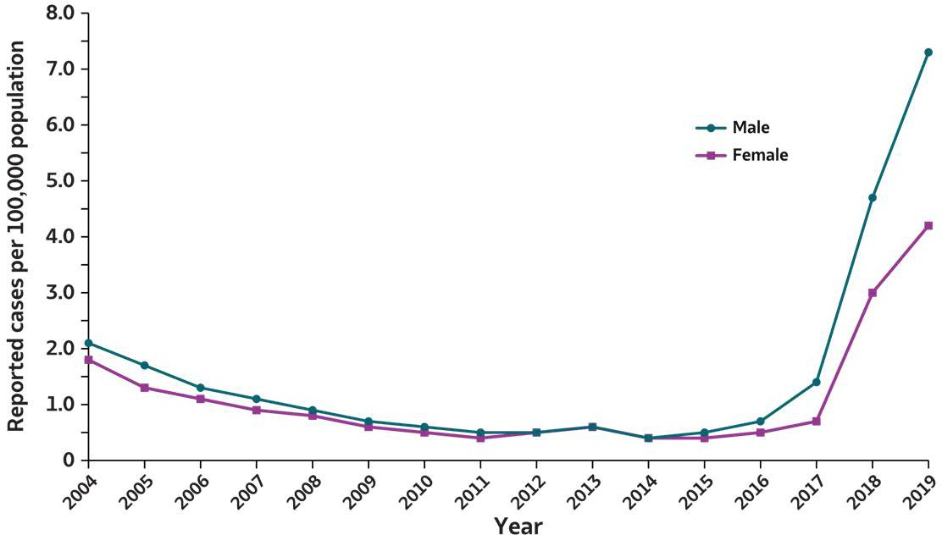

2019 VIRAL H E PAT ITIS
SURVEILLANCE REPORT
Figure 1.5. Rates of reported hepatitis A virus infection, by sex — United States, 2004–2019
Sex | 2004 | 2005 | 2006 | 2007 | 2008 | 2009 | 2010 | 2011 | 2012 | 2013 | 2014 | 2015 | 2016 | 2017 | 2018 | 2019
Male | 2.1 | 1.7 | 1.3 | 1.1 | 0.9 | 0.7 | 0.6 | 0.5 | 0.5 | 0.6 | 0.4 | 0.5 | 0.7 | 1.4 | 4.7 | 7.3
Female | 1.8 | 1.3 | 1.1 | 0.9 | 0.8 | 0.6 | 0.5 | 0.4 | 0.5 | 0.6 | 0.4 | 0.4 | 0.5 | 0.7 | 3.0 | 4.2
Source: CDC,National Notifiable Diseases Surveillance System.

Slide 6
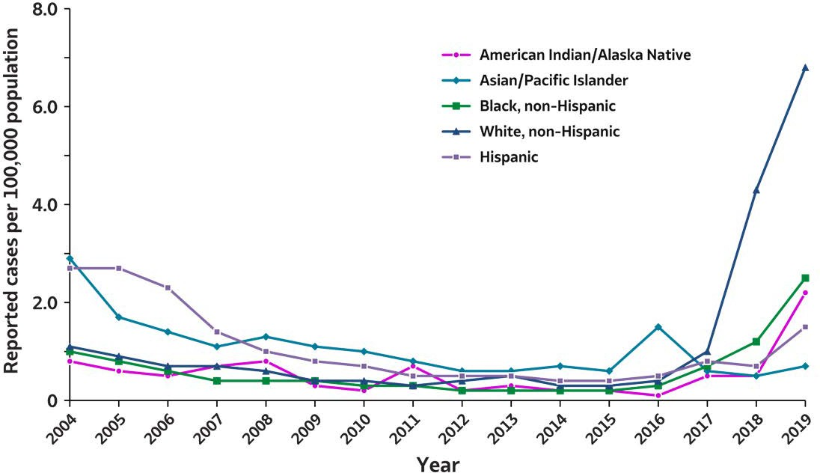
2019 VIRAL H E PAT ITIS
SURVEILLANCE REPORT
Figure 1.6. Rates of reported hepatitis A virus infection, by race/ethnicity — United States, 2004–2019
Race/ Ethnicity | 2004 | 2005 | 2006 | 2007 | 2008 | 2009 | 2010 | 2011 | 2012 | 2013 | 2014 | 2015 | 2016 | 2017 | 2018 | 2019
American Indian/ Alaska Native | 0.8 | 0.6 | 0.5 | 0.7 | 0.8 | 0.3 | 0.2 | 0.7 | 0.2 | 0.3 | 0.2 | 0.2 | 0.1 | 0.5 | 0.5 | 2.2
Asian/ Pacific Islander | 2.9 | 1.7 | 1.4 | 1.1 | 1.3 | 1.1 | 1.0 | 0.8 | 0.6 | 0.6 | 0.7 | 0.6 | 1.5 | 0.6 | 0.5 | 0.7
Black, non-Hispanic | 1.0 | 0.8 | 0.6 | 0.4 | 0.4 | 0.4 | 0.3 | 0.3 | 0.2 | 0.2 | 0.2 | 0.2 | 0.3 | 0.7 | 1.2 | 2.5
White, non-Hispanic | 1.1 | 0.9 | 0.7 | 0.7 | 0.6 | 0.4 | 0.4 | 0.3 | 0.4 | 0.5 | 0.3 | 0.3 | 0.4 | 1.0 | 4.3 | 6.8
Hispanic | 2.7 | 2.7 | 2.3 | 1.4 | 1.0 | 0.8 | 0.7 | 0.5 | 0.5 | 0.5 | 0.4 | 0.4 | 0.5 | 0.8 | 0.7 | 1.5
Source: CDC,National Notifiable Diseases Surveillance System.

Slide 7
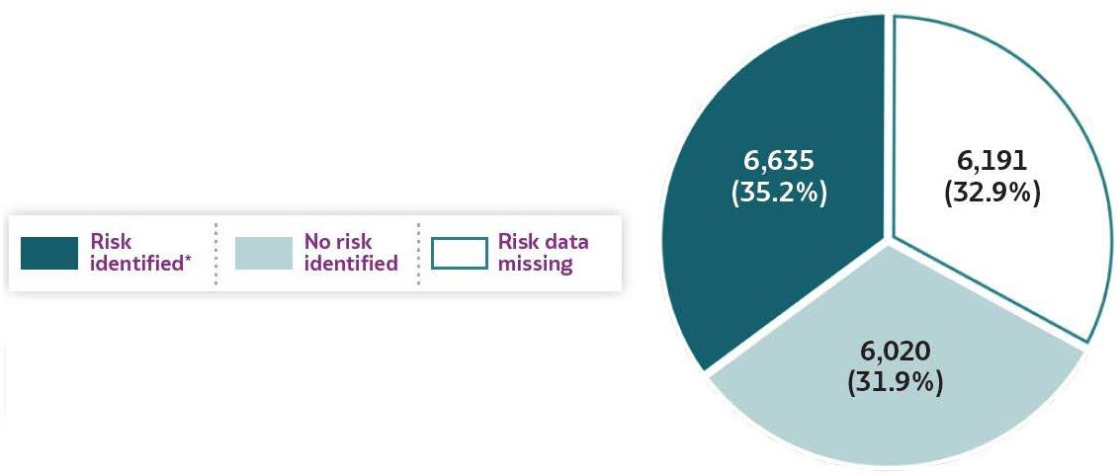
2019 VIRAL H E PAT ITIS
SURVEILLANCE REPORT
Figure 1.7. Availability of information regarding risk behaviors or exposures*† associated with reported cases of hepatitis A virus infection — United States, 2019
Source: CDC,Nationally Notifiable Diseases Surveillance System.
* Case reports with at least one of the following risk behaviors/exposures reported 2–6 weeks prior to symptom onset or documented seroconversion if asymptomatic: 1) injection drug use; 2) sexual, household, or other contact; 3) men who have sex with men; 4) travel to hepatitis A-endemic region.
†Reported cases may include more than one risk behavior/exposure.

Slide 8
2019 VIRAL HEPATITIS
SURVEILLANCE REPORT
Table 1.1. Number and rates* of reported cases† of hepatitis A virus infection, by state or jurisdiction — United States, 2015–2019
State or Jurisdiction | 2015 |  | 2016 |  | 2017 |  | 2018 |  | 2019
 | No. | Rate* | No. | Rate* | No. | Rate* | No. | Rate* | No. | Rate*
Alabama | 23 | 0.5 | 19 | 0.4 | 23 | 0.5 | 38 | 0.8 | 242 | 4.9
Alaska | 4 | 0.5 | 2 | 0.3 | — | — | 1 | 0.1 | 2 | 0.3
Arizona | 54 | 0.8 | 32 | 0.5 | 59 | 0.8 | 77 | 1.1 | 584 | 8
Arkansas | 10 | 0.3 | 13 | 0.4 | 7 | 0.2 | 254 | 8.4 | 203 | 6.7
California | 179 | 0.5 | 229 | 0.6 | 947 | 2.4 | 189 | 0.5 | 256 | 0.6
Colorado | 25 | 0.5 | 22 | 0.4 | 65 | 1.2 | 31 | 0.5 | 333 | 5.8
Connecticut | 9 | 0.3 | 16 | 0.4 | 17 | 0.5 | 15 | 0.4 | 17 | 0.5
Delaware | 2 | 0.2 | 1 | 0.1 | 6 | 0.6 | 7 | 0.7 | 36 | 3.7
District of Columbia | U | U | 4 | 0.6 | 3 | 0.4 | 11 | 1.6 | 15 | 2.1
Florida | 108 | 0.5 | 115 | 0.6 | 261 | 1.2 | 548 | 2.6 | 3,392 | 15.8
Georgia | 30 | 0.3 | 44 | 0.4 | 24 | 0.2 | 84 | 0.8 | 844 | 7.9
Hawaii | 6 | 0.4 | 285 | 20 | 8 | 0.6 | 4 | 0.3 | 1 | 0.1
Idaho | 9 | 0.5 | 7 | 0.4 | 4 | 0.2 | 5 | 0.3 | 75 | 4.2
Illinois | 57 | 0.4 | 71 | 0.6 | 73 | 0.6 | 93 | 0.7 | 185 | 1.5
Indiana | 19 | 0.3 | 18 | 0.3 | 21 | 0.3 | 964 | 14.4 | 1,398 | 20.8
Iowa | 16 | 0.5 | 16 | 0.5 | 9 | 0.3 | 10 | 0.3 | 9 | 0.3
Kansas | 7 | 0.2 | 5 | 0.2 | 6 | 0.2 | 14 | 0.5 | 10 | 0.3
Kentucky | 16 | 0.4 | 9 | 0.2 | 71 | 1.6 | 3,560 | 79.7 | 1,318 | 29.5
Louisiana | 5 | 0.1 | 12 | 0.3 | 8 | 0.2 | 37 | 0.8 | 687 | 14.8
Maine | 8 | 0.6 | 8 | 0.6 | 7 | 0.5 | 9 | 0.7 | 45 | 3.3
Maryland | 19 | 0.3 | 37 | 0.6 | 29 | 0.5 | 52 | 0.9 | 88 | 1.5
Massachusetts | 34 | 0.5 | 64 | 0.9 | 52 | 0.8 | 364 | 5.3 | 204 | 3
Michigan | 51 | 0.5 | 112 | 1.1 | 670 | 6.7 | 299 | 3 | 70 | 0.7
Minnesota | 21 | 0.4 | 15 | 0.3 | 30 | 0.5 | 16 | 0.3 | 76 | 1.3
Mississippi | 2 | 0.1 | 2 | 0.1 | 3 | 0.1 | 13 | 0.4 | 128 | 4.3
Missouri | 9 | 0.1 | 16 | 0.3 | 27 | 0.4 | 243 | 4 | 359 | 5.8
Montana | 2 | 0.2 | 3 | 0.3 | 3 | 0.3 | — | — | 15 | 1.4
Nebraska | 6 | 0.3 | 21 | 1.1 | 4 | 0.2 | 6 | 0.3 | 15 | 0.8
Nevada | 11 | 0.4 | 14 | 0.5 | 19 | 0.6 | 41 | 1.4 | 102 | 3.3
New Hampshire | 2 | 0.2 | 8 | 0.6 | 7 | 0.5 | 12 | 0.9 | 309 | 22.7
New Jersey | 59 | 0.7 | 74 | 0.8 | 71 | 0.8 | 70 | 0.8 | 610 | 6.9
New Mexico | 6 | 0.3 | 4 | 0.2 | 4 | 0.2 | 23 | 1.1 | 104 | 5
New York | 123 | 0.6 | 99 | 0.5 | 218 | 1.1 | 165 | 0.8 | 391 | 2
North Carolina | 45 | 0.4 | 52 | 0.5 | 29 | 0.3 | 103 | 1 | 154 | 1.5
North Dakota | 5 | 0.7 | 2 | 0.3 | — | — | — | — | 4 | 0.5
Ohio | 36 | 0.3 | 36 | 0.3 | 45 | 0.4 | 1,687 | 14.4 | 1,802 | 15.4
Oklahoma | 11 | 0.3 | 11 | 0.3 | 9 | 0.2 | 5 | 0.1 | 13 | 0.3
Oregon | 28 | 0.7 | 15 | 0.4 | 20 | 0.5 | 23 | 0.5 | 27 | 0.6
Pennsylvania | 43 | 0.3 | 62 | 0.5 | 69 | 0.5 | 99 | 0.8 | 696 | 5.4
Rhode Island | 4 | 0.4 | 4 | 0.4 | 6 | 0.6 | 7 | 0.7 | 6 | 0.6
South Carolina | 16 | 0.3 | 21 | 0.4 | 21 | 0.4 | 30 | 0.6 | 662 | 12.9
South Dakota | 2 | 0.2 | 1 | 0.1 | 1 | 0.1 | 1 | 0.1 | 8 | 0.9
Tennessee | 14 | 0.2 | 7 | 0.1 | 6 | 0.1 | 654 | 9.7 | 2,160 | 31.6
Texas | 147 | 0.5 | 139 | 0.5 | 129 | 0.5 | 88 | 0.3 | 159 | 0.5
Utah | 8 | 0.3 | 12 | 0.4 | 159 | 5.1 | 135 | 4.3 | 20 | 0.6
Vermont | 3 | 0.5 | 5 | 0.8 | 2 | 0.3 | 3 | 0.5 | 12 | 1.9
Virginia | 50 | 0.6 | 190 | 2.3 | 46 | 0.5 | 82 | 1 | 309 | 3.6
Washington | 26 | 0.4 | 31 | 0.4 | 28 | 0.4 | 35 | 0.5 | 181 | 2.4
West Virginia | 8 | 0.4 | 15 | 0.8 | 6 | 0.3 | 2,247 | 124.4 | 467 | 26.1
Wisconsin | 9 | 0.2 | 7 | 0.1 | 16 | 0.3 | 15 | 0.3 | 31 | 0.5
Wyoming | 3 | 0.5 | — | — | 18 | 3.1 | 5 | 0.9 | 12 | 2.1
Total | 1,390 | 0.4 | 2,007 | 0.6 | 3,366 | 1 | 12,474 | 3.8 | 18,846 | 5.7
Source: CDC, National Notifiable Diseases Surveillance System.
* Rates per 100,000
population.
†Reported cases that met the classification criteria for a confirmed case. For the case definition, see https:// ndc.services.cdc.gov/conditions/hepatitis-a-acute/.
—: No reported cases. The reporting jurisdiction didnot submit any cases toCDC.
U: Unavailable. The data were unavailable.

Slide 9

2019 VIRAL HEPATITIS
SURVEILLANCE REPORT
Table 1.2. Number and rates* of reported cases† of hepatitis A virus infection, by demographic characteristics — United States 2015–2019
Characteristics | 2015 |  | 2016 |  | 2017 |  | 2018 |  | 2019
 | No. | Rate* | No. | Rate* | No. | Rate* | No. | Rate* | No. | Rate*
Total§ | 1,390 | 0.4 | 2,007 | 0.6 | 3,366 | 1.0 | 12,474 | 3.8 | 18,846 | 5.7
Age (years)
0–9 | 48 | 0.1 | 47 | 0.1 | 40 | 0.1 | 54 | 0.1 | 127 | 0.3
10–19 | 97 | 0.2 | 131 | 0.3 | 86 | 0.2 | 231 | 0.6 | 231 | 0.6
20–29 | 287 | 0.6 | 392 | 0.9 | 659 | 1.4 | 2,763 | 6.1 | 3,582 | 7.9
30–39 | 233 | 0.6 | 391 | 0.9 | 893 | 2.1 | 4,268 | 9.8 | 6,400 | 14.5
40–49 | 164 | 0.4 | 333 | 0.8 | 621 | 1.5 | 2,658 | 6.6 | 4,177 | 10.4
50–59 | 205 | 0.5 | 297 | 0.7 | 554 | 1.3 | 1,509 | 3.5 | 2,635 | 6.2
≥60 | 353 | 0.5 | 409 | 0.6 | 509 | 0.7 | 987 | 1.4 | 1,691 | 2.3
Sex
Male | 726 | 0.5 | 1,107 | 0.7 | 2,209 | 1.4 | 7,497 | 4.7 | 11,824 | 7.3
Female | 662 | 0.4 | 897 | 0.5 | 1,149 | 0.7 | 4,952 | 3.0 | 6,997 | 4.2
Race/ethnicity
American Indian/ Alaska Native | 5.0 | 0.2 | 3.0 | 0.1 | 13 | 0.5 | 15 | 0.5 | 60 | 2.2
Asian/Pacific Islander | 114 | 0.6 | 299 | 1.5 | 124 | 0.6 | 104 | 0.5 | 139 | 0.7
Black, non-Hispanic | 71 | 0.2 | 137 | 0.3 | 303 | 0.7 | 508 | 1.2 | 1,072 | 2.5
White, non-Hispanic | 701 | 0.3 | 865 | 0.4 | 1,979 | 1.0 | 8,670 | 4.3 | 13,709 | 6.8
Hispanic | 219 | 0.4 | 293 | 0.5 | 471 | 0.8 | 413 | 0.7 | 916 | 1.5
Urbanicity¶
Urban | 1,198 | 0.4 | 1,769 | 0.6 | 3,055 | 1.1 | 7,657 | 2.7 | 14,637 | 5.2
Rural | 181 | 0.4 | 182 | 0.4 | 180 | 0.4 | 3,153 | 6.8 | 3,372 | 7.3
HHS Region: Regional Office#
1: Boston | 60 | 0.4 | 105 | 0.7 | 91 | 0.6 | 410 | 2.8 | 593 | 4.0
2: New York | 182 | 0.6 | 173 | 0.6 | 289 | 1.0 | 235 | 0.8 | 1,001 | 3.5
3: Philadelphia | 122 | 0.4 | 309 | 1.0 | 159 | 0.5 | 2,498 | 8.1 | 1,611 | 5.2
4: Atlanta | 254 | 0.4 | 269 | 0.4 | 438 | 0.7 | 5,030 | 7.6 | 8,900 | 13.3
5: Chicago | 193 | 0.4 | 259 | 0.5 | 855 | 1.6 | 3,074 | 5.9 | 3,562 | 6.8
6: Dallas | 179 | 0.4 | 179 | 0.4 | 157 | 0.4 | 407 | 1.0 | 1,166 | 2.7
7: Kansas City | 38 | 0.3 | 58 | 0.4 | 46 | 0.3 | 273 | 1.9 | 393 | 2.8
8: Denver | 45 | 0.4 | 40 | 0.3 | 246 | 2.1 | 172 | 1.4 | 392 | 3.2
9: San Francisco | 250 | 0.5 | 560 | 1.1 | 1,033 | 2.0 | 311 | 0.6 | 943 | 1.8
10: Seattle | 67 | 0.5 | 55 | 0.4 | 52 | 0.4 | 64 | 0.5 | 285 | 2.0
Source: CDC,National Notifiable Diseases Surveillance System.
* Rates per 100,000 population.
†For the case definition, see https://ndc.services.cdc.gov/ conditions/hepatitis-a-acute/.
§ Numbers reported in eachcategory might not addup to the total number of reported cases in ayear because of cases with missing dataor, in the case of race/ethnicity, cases categorized as “Other.”
¶ Urbanicity was categorized according to the 2013 National Center for Health Statistics (NCHS) urban-rural classification scheme for counties and county-equivalent entities (https://www.cdc.gov/nchs/data_access/urban_rural.htm). Large central metropolitan, large fringe metropolitan, medium metropolitan, and small metropolitan counties were grouped as urban.
Micropolitan and noncore counties were grouped as rural.
#US Department of Health and Human Services (HHS) regions were categorized according to the grouping of states andUS territories assigned under eachof the 10 HHS regional offices (https://www.hhs.gov/about/agencies/iea/regional-offices/ index.html). For the purposes of this report, regions with US territories (Regions 2 and 9) contain data from states only.

Slide 10


2019 VIRAL HEPATITIS
SURVEILLANCE REPORT
Table 1.3. Reported risk behaviors or exposures†# among reported cases of hepatitis A virus infection — United States, 2019
Risk behaviors/exposures | Risk identified* | No risk identified | Risk data missing
Injection drug use | 5,017 | 5,974 | 7,855
Sexual contact § | 693 | 6,928 | 11,225
Household contact (non-sexual) § | 563 | 7,058 | 11,225
Other contact § | 773 | 6,848 | 11,225
Menwho have sex with men ¶ | 201 | 2,479 | 9,144
International travel | 159 | 9,836 | 8,851
Source: CDC, Nationally Notifiable Diseases Surveillance System.
* Case reports with at least one of the following risk behaviors/exposures reported 2–6 weeks prior to symptom onset or documented seroconversion
if asymptomatic: 1) injection drug use; 2) sexual, household, or other contact; 3)men who havesex with men; 4) travel to hepatitis A-endemic region.
†Reported cases may include more than one risk behavior/exposure.
#Risk behaviors/exposures datafrom one state was classified as ‘missing’ becauseof errors in reporting.
§ Cases with more than one type of contactreported were categorized accordingto ahierarchy:
1) sexual contact; 2) household contact(nonsexual); and 3) other contactwith hepatitisA case.
¶ A total of 11,824 hepatitis A cases were reported among males in 2019.
Notes:
The number of reported hepatitis A cases by availability of specific risk behavior or exposure in 2019. The categories listed in the first column are injection drug use, sexual contact, household contact (nonsexual), other contact, men who have sex with men, and international travel. The second column displays the number of case reports for which a risk was identified. The third column indicates the number of case reports for which no risk was identified. The fourth column includes the number of case reports for which risk information was missing.

Slide 11

2019 VIRAL HEPATITIS
SURVEILLANCE REPORT
Table 1.4. Number and rates* of deaths with hepatitis A virus infection listed as acause of death† among residents, by demographic characteristics —
United States, 2015–2019
Characteristics | 2015 |  | 2016 |  | 2017 |  | 2018 |  | 2019
 | No. | Rate* (95% CI) | No. | Rate* (95% CI) | No. | Rate* (95% CI) | No. | Rate* (95% CI) | No. | Rate* (95% CI)
Total | 67 | 0.01 (0.01–0.02) | 70 | 0.01 (0.00–0.01) | 91 | 0.02 (0.02-0.03) | 171 | 0.05 (0.04-0.06) | 225 | 0.04 (0.03–0.05
Age (years)
0–44 | 5 | UR§ | 6 | UR§ | 9 | UR§ | 33 | 0.02 (0.01-0.02) | 24 | 0.01 (0.01-0.02)
45–64 | 25 | 0.03 (0.02-0.04) | 33 | 0.04 (0.03-0.06) | 35 | 0.04 (0.03-0.06) | 72 | 0.09 (0.07-0.11) | 118 | 0.14 (0.12-0.17)
≥65 | 37 | 0.08 (0.05-0.11) | 31 | 0.06 (0.04-0.09) | 47 | 0.09 (0.07-0.12) | 66 | 0.13 (0.10-0.16) | 83 | 0.15 (0.12-0.19)
Sex
Male | 38 | 0.02 (0.01-0.03) | 38 | 0.01 (0.01-0.02) | 63 | 0.03 (0.02-0.03) | 115 | 0.07 (0.06-0.08) | 159 | 0.09 (0.07-0.10)
Female | 29 | 0.01 (0.00-0.01) | 32 | 0.01 (0.01-0.02) | 28 | 0.00 (0.00-0.00) | 56 | 0.02 (0.02-0.03) | 66 | 0.04 (0.03-0.05)
Race/ethnicity
White, non-Hispanic | 45 | 0.01 (0.00-0.01) | 50 | 0.02 (0.01-0.02) | 69 | 0.02 (0.02-0.03) | 150 | 0.06 (0.05-0.07) | 194 | 0.09 (0.07-0.10)
Other or not stated | 22 | _{S}¶ | 20 | _{S}¶ | 22 | _{S}¶ | 21 | _{S}¶ | 31 | _{S}¶
Source: CDC, National Center for Health Statistics, Multiple Cause of Death 1999–2019 on CDC WONDER online database. Data are from the 2015–2019 Multiple Cause of Death files and are based on information from all death certificates filed in the vital records offices of the 50 states and the District of Columbia through the Vital Statistics Cooperative Program. Deaths of nonresidents (e.g., nonresident aliens, nationals living abroad, residents of Puerto Rico, Guam, the Virgin Islands, and other US territories) and fetal deaths are excluded. Numbers are slightly lower than previously reported for 2015–2016 because of NCHS standards that restrict
displayed data to US residents. Accessed at http://wonder.cdc.gov/mcd-icd10.html on January 8, 2021. CDC WONDER data set documentation and technical methods can be accessed at https://wonder.cdc.gov/wonder/help/mcd.html#.
* Rates for race/ethnicity, sex, and the overall total are age-adjusted per 100,000 US standard population during 2000 by using the following age group distribution (in years): <1, 1–4, 5–14, 15–24, 25–34, 35–44, 45–54, 55–64, 65–74, 75–84, and ≥85. For age-adjusted death rates, the age-specific death rate is rounded to 1 decimal place before proceeding to the next step in the calculation of age-adjusted death rates for NCHS Multiple Cause of Death on CDC WONDER. This rounding step might affect the precision of rates calculated for small numbers of deaths. Missing data are not included.
†Cause of death is defined as 1 of the multiple causes of death and is based on the International Classification of Diseases, 10th Rev. (ICD-10) codes B15 (hepatitis A).
§UR Unreliable rate: Rates where death counts were <20 were not displayed because of the instability associated with those rates. S¶ Suppressed: CDC WONDER did not have the functionality to calculate rates for the “Other or not stated” race/ethnicity group.

Slide 12
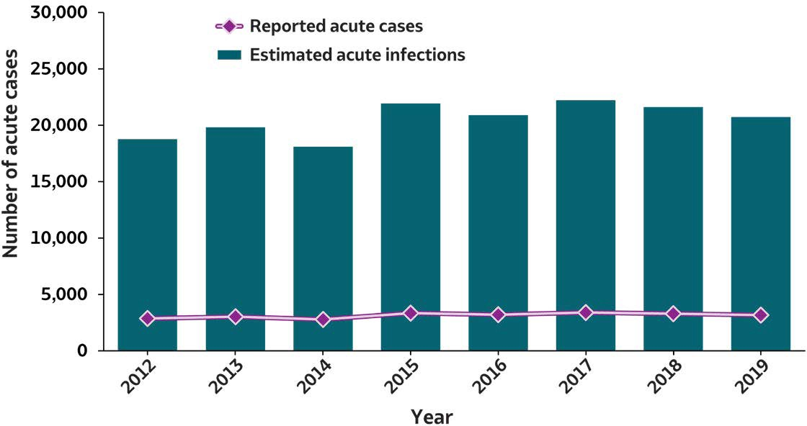

2019 VIRAL H E PAT ITIS
SURVEILLANCE REPORT
Figure 2.1. Number of reported acute hepatitis B virus infection cases and estimated infections* — United States, 2012–2019
Acute Hepatitis B | 2012 | 2013 | 2014 | 2015 | 2016 | 2017 | 2018 | 2019
Reported acute cases | 2,895 | 3,050 | 2,791 | 3,370 | 3,218 | 3,409 | 3,322 | 3,192
Estimated acute infections | 18,800 | 19,800 | 18,100 | 21,900 | 20,900 | 22,200 | 21,600 | 20,700
Source: CDC,National Notifiable Diseases Surveillance System.
* The number of estimated viral hepatitis infections was determined by multiplying the number of reported cases that met the classification criteria for aconfirmed case by afactor that adjusted for underascertainment and underreporting. The 95% bootstrap confidence intervals for the estimated number of infections are displayed in the Appendix.

Slide 13

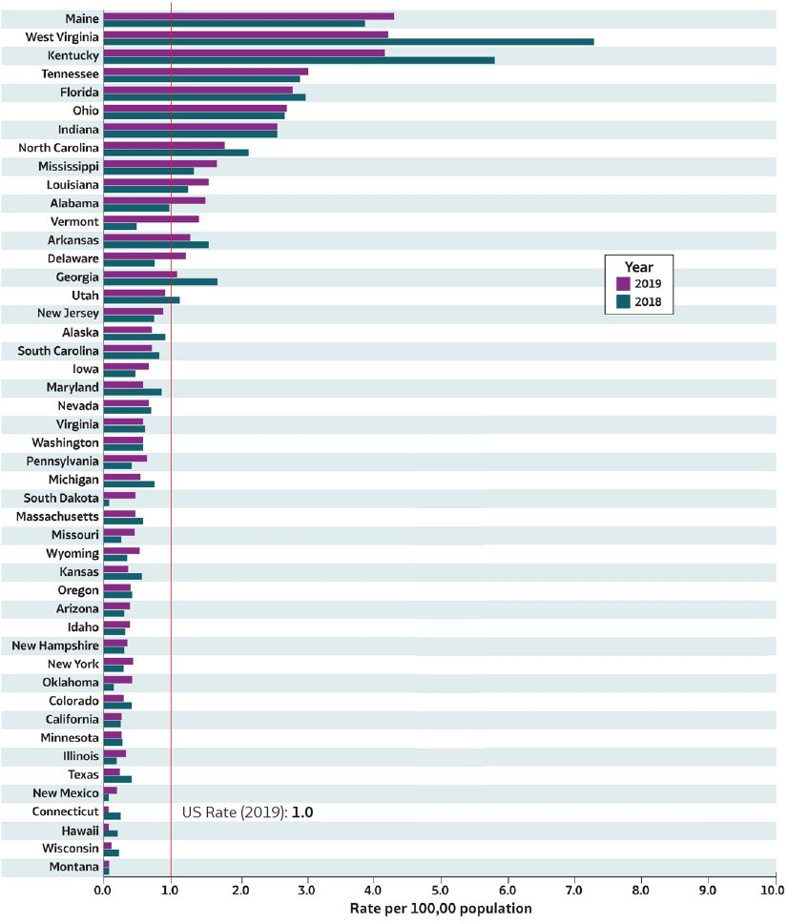
2019 VIRAL H E PAT ITIS
SURVEILLANCE REPORT
Figure 2.2. Rates* of reported acute hepatitis B† virus infection, by state — United States, 2018–2019
Source: CDC,National Notifiable Diseases Surveillance System.
* Rates per 100,000
population.
†Reported cases that met the classification criteria for aconfirmed case. For the case definition, see https:// ndc.services.cdc.gov/conditions/hepatitis-b-acute/.
Only states with rates for 2018 and 2019 are shown. State/ jurisdiction and year for no reported cases: Nebraska (2019), North Dakota (2019); for unavailable data: District of Columbia (2018, 2019), Rhode Island (2018, 2019).

Slide 14
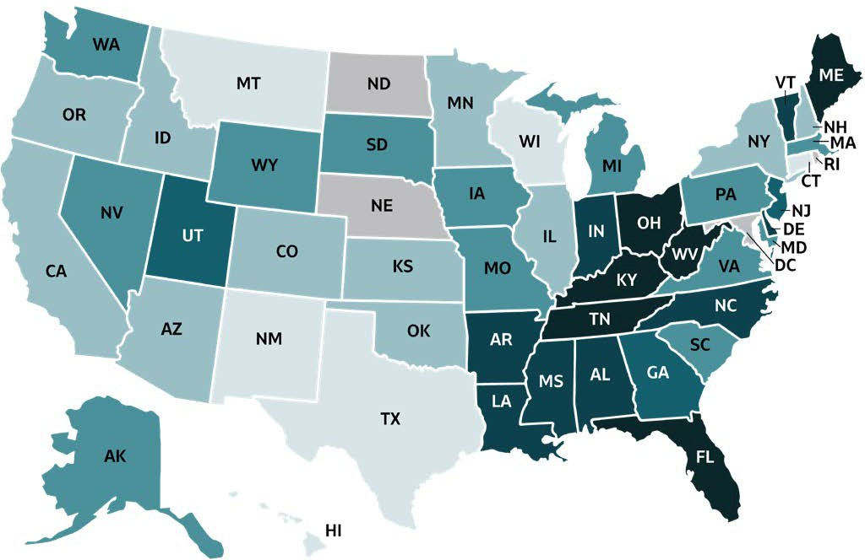
2019 VIRAL HEPATITIS
SURVEILLANCE REPORT
Figure 2.3. Rates of reported acute hepatitis B virus infection, by state or jurisdiction — United States, 2019
 | Colo r Key | Cases/100,00 0 Population | State or Jurisdiction
 |  | 0.0-0.2 | CT, HI, MT, NM, TX,WI
 |  | 0.3-0.4 | AZ, CA, CO, ID, IL, KS, MN, NH, NY, OK, OR
 |  | 0.5-0.8 | AK, IA, MA, MD, MI, MO, NV, PA, SC, SD, VA, WA, WY
 |  | 0.9-1.1 | GA, NJ, UT
 |  | 1.2-2.5 | AL, AR, DE, IN, LA, MS, NC, VT
 |  | 2.6-4.3 | FL, KY, ME, OH, TN, WV
 |  | Data not available | DC, ND, NE, RI
Source: CDC,National Notifiable Diseases Surveillance System.

Slide 15
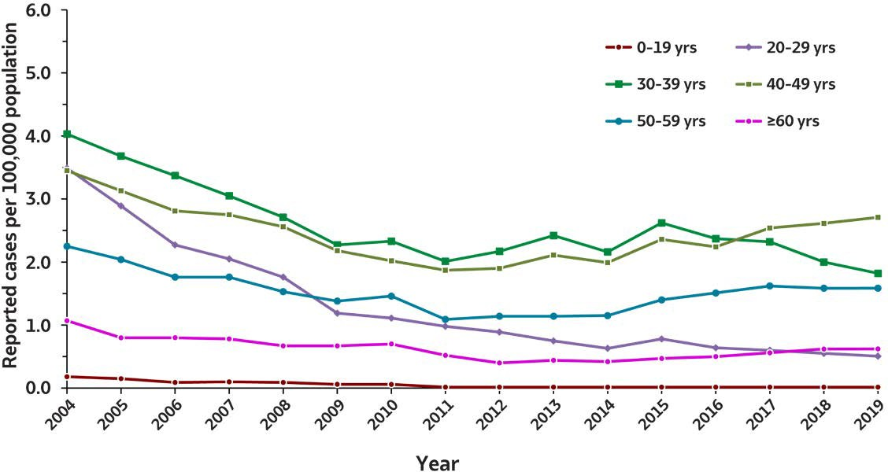

2019 VIRAL H E PAT ITIS
SURVEILLANCE REPORT
Figure 2.4. Rates of reported acute hepatitis B virus infection, by age group
— United States, 2004–2019
Age (years) | 2004 | 2005 | 2006 | 2007 | 2008 | 2009 | 2010 | 2011 | 2012 | 2013 | 2014 | 2015 | 2016 | 2017 | 2018 | 2019
0–19 | 0.2 | 0.2 | 0.1 | 0.1 | 0.1 | 0.1 | 0.1 | 0 | 0 | 0 | 0 | 0 | 0 | 0 | 0 | 0
20–29 | 3.5 | 2.9 | 2.3 | 2.0 | 1.8 | 1.2 | 1.1 | 1.0 | 0.9 | 0.8 | 0.6 | 0.8 | 0.6 | 0.6 | 0.6 | 0.5
30–39 | 4.0 | 3.7 | 3.4 | 3.0 | 2.7 | 2.3 | 2.3 | 2.0 | 2.2 | 2.4 | 2.2 | 2.6 | 2.4 | 2.3 | 2.0 | 1.8
40–49 | 3.4 | 3.1 | 2.8 | 2.7 | 2.6 | 2.2 | 2.0 | 1.9 | 1.9 | 2.1 | 2.0 | 2.4 | 2.2 | 2.5 | 2.6 | 2.7
50–59 | 2.3 | 2.0 | 1.8 | 1.8 | 1.5 | 1.4 | 1.5 | 1.1 | 1.1 | 1.1 | 1.2 | 1.4 | 1.5 | 1.6 | 1.6 | 1.6
≥60 | 1.1 | 0.8 | 0.8 | 0.8 | 0.7 | 0.7 | 0.7 | 0.5 | 0.4 | 0.4 | 0.4 | 0.5 | 0.5 | 0.6 | 0.6 | 0.6
Source: CDC,National Notifiable Diseases Surveillance System.

Slide 16
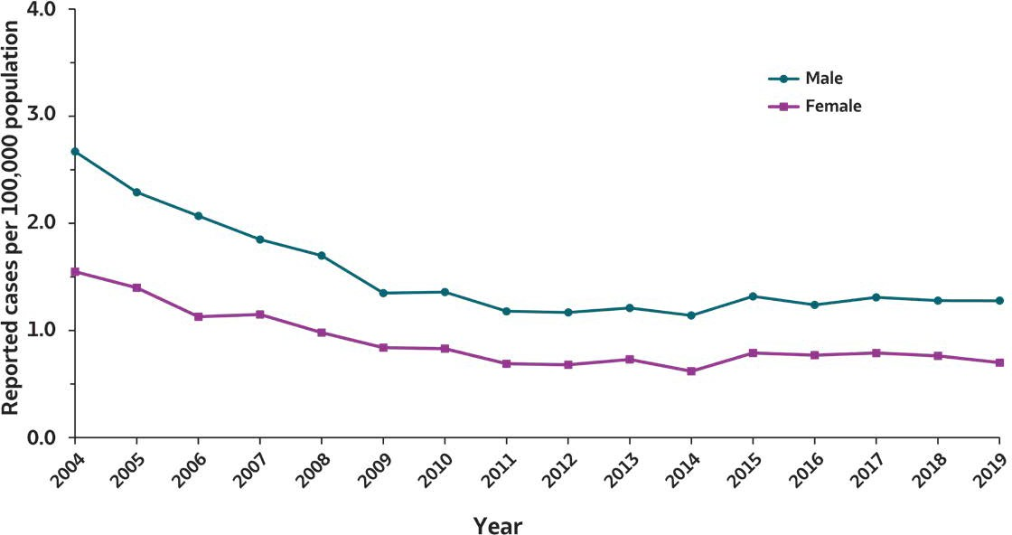
2019 VIRAL HEPATITIS
SURVEILLANCE REPORT
Figure 2.5. Rates of reported acute hepatitis B virus infection, by sex — United States, 2004–2019
Sex | 2004 | 2005 | 2006 | 2007 | 2008 | 2009 | 2010 | 2011 | 2012 | 2013 | 2014 | 2015 | 2016 | 2017 | 2018 | 2019
Male | 2.7 | 2.3 | 2.1 | 1.9 | 1.7 | 1.4 | 1.4 | 1.2 | 1.2 | 1.2 | 1.1 | 1.3 | 1.2 | 1.3 | 1.3 | 1.3
Female | 1.5 | 1.4 | 1.1 | 1.1 | 1.0 | 0.8 | 0.8 | 0.7 | 0.7 | 0.7 | 0.6 | 0.8 | 0.8 | 0.8 | 0.8 | 0.7
Source: CDC,National Notifiable Diseases Surveillance System.

Slide 17
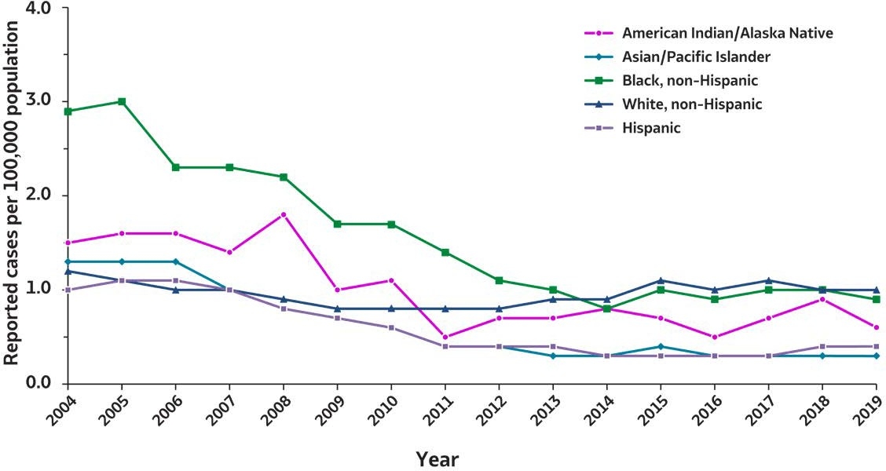

2019 VIRAL H E PAT ITIS
SURVEILLANCE REPORT
Figure 2.6. Rates of reported acute hepatitis B virus infections, by race/ ethnicity — United States, 2004–2019
Race/Ethnicity | 2004 | 2005 | 2006 | 2007 | 2008 | 2009 | 2010 | 2011 | 2012 | 2013 | 2014 | 2015 | 2016 | 2017 | 2018 | 2019
American Indian/ Alaska Native | 1.5 | 1.6 | 1.5 | 1.4 | 1.8 | 1.0 | 1.1 | 0.5 | 0.7 | 0.7 | 0.8 | 0.7 | 0.5 | 0.7 | 0.9 | 0.6
Asian/Pacific Islander | 1.3 | 1.3 | 1.2 | 0.9 | 0.8 | 0.7 | 0.6 | 0.4 | 0.4 | 0.3 | 0.3 | 0.4 | 0.3 | 0.3 | 0.3 | 0.3
Black, non-Hispanic | 2.9 | 3.0 | 2.3 | 2.3 | 2.2 | 1.7 | 1.7 | 1.4 | 1.1 | 0.9 | 0.8 | 1.0 | 0.9 | 1.0 | 1.0 | 0.9
White, non-Hispanic | 1.2 | 1.1 | 1.0 | 1.0 | 0.9 | 0.8 | 0.8 | 0.8 | 0.8 | 0.9 | 0.9 | 1.1 | 1.0 | 1.1 | 1.0 | 1.0
Hispanic | 1.0 | 1.1 | 1.1 | 1.0 | 0.8 | 0.7 | 0.6 | 0.4 | 0.4 | 0.4 | 0.3 | 0.3 | 0.3 | 0.3 | 0.4 | 0.4
Source: CDC,National Notifiable Diseases Surveillance System.

Slide 18
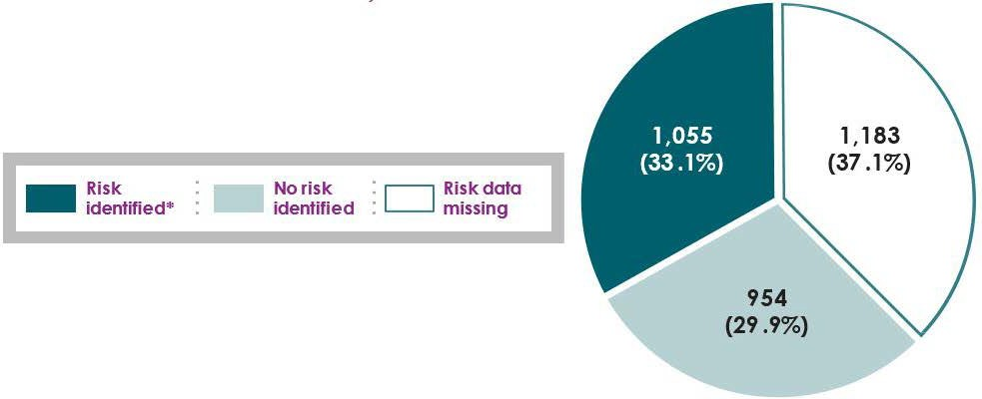
2019 VIRAL H E PAT ITIS
SURVEILLANCE REPORT
Figure 2.7. Availability of information regarding risk behaviors or exposures*† associated with reported cases of acute hepatitis B virus infection — United States, 2019
Source: CDC,Nationally Notifiable Diseases SurveillanceSystem.
* Casereports with at least one of the following risk behaviors/exposures reported 6 weeks to 6 months prior to symptom onset or documented seroconversion if asymptomatic: 1) injection drug use; 2) multiple sexual partners; 3) underwent surgery; 4) men who have sex with men; 5) sexual contact with suspected/confirmed hepatitis B case; 6) sustained apercutaneous injury; 7) household contact with suspected/confirmed hepatitis B case; 8) occupational exposure to blood; 9) dialysis; and 10) transfusion. Reported cases may include more than one risk behavior/exposure.
†Risk behaviors/exposures data from one state was classified as ‘missing’ becauseof errors in reporting.

Slide 19
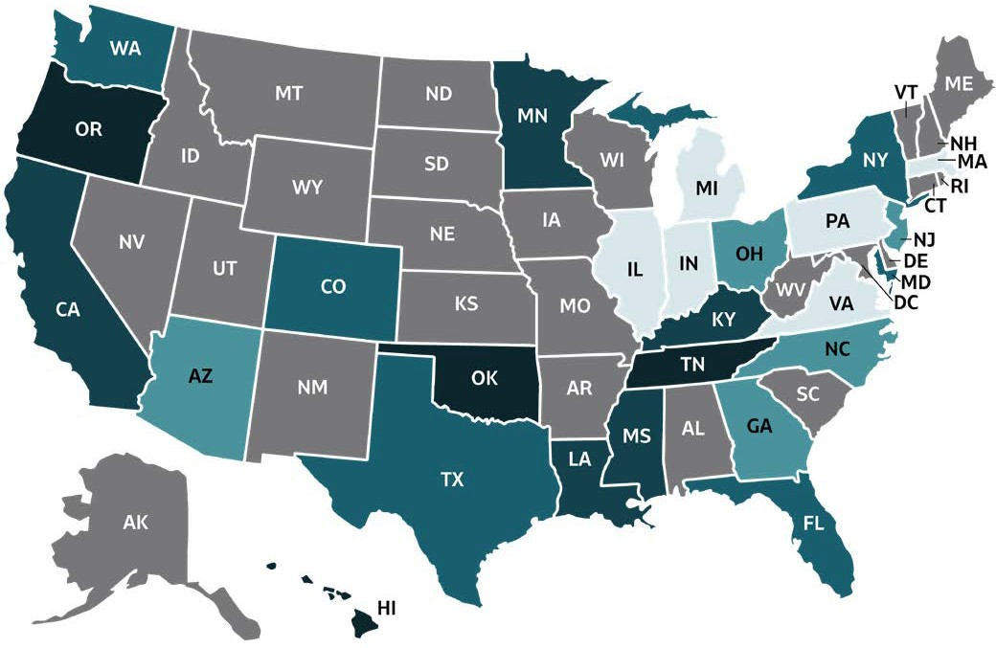

2019 VIRAL HEPATITIS
SURVEILLANCE REPORT
Figure 2.8. Rates* of deaths with hepatitis B virus infection listed as a cause of death† among residents, by jurisdiction — United States, 2019
Colo r Key | Deaths/100,00 0 Population | State or Jurisdiction
 | 0.00-0.29 | IL, IN, MA, MI, PA, VA
 | 0.30-0.40 | AZ, GA, NC, NJ, OH
 | 0.41-0.54 | CO, FL, MD, NY, TX, WA
 | 0.55-0.77 | CA, KY, LA, MN, MS
 | 0.78-1.17 | HI, OK, OR, TN
 | UR | AK, AL, AR, CT, DC, DE, IA, ID, KS, ME, MO, MT, ND, NE, NH, NM, NV, RI, SC, SD, UT, VT, WI, WV, WY
Source: CDC, National Center for Health Statistics, Multiple Cause of Death 1999–2019 on CDC WONDER Online Database. Data are from the 2015–2019 Multiple Cause of Death files and are based on information from all death certificates filed in the vital records offices of the fifty states and the District of Columbia through the Vital Statistics Cooperative Program. Deaths of nonresidents (e.g., nonresident aliens, nationals living abroad, residents of Puerto Rico, Guam, the Virgin Islands, and other U.S. territories) and fetal deaths are excluded. Numbers are slightly lower than previously reported for 2015–2016 due to NCHS standards which restrict displayed data to
U.S. residents. Accessed at http://wonder.cdc.gov/mcd-icd10.html on January 11, 2021. CDC WONDER dataset documentation and technical methods can be accessed at https://wonder.cdc.gov/wonder/help/mcd.html.
* Rates are age-adjusted per 100,000 US standard population in 2000 using the following age group distribution (in years): <1, 1–4, 5–14, 15–24, 25–34, 35–44, 45–54, 55–64, 65–74, 75–84, and ≥85. For age-adjusted death rates, the age-specific death rate is rounded to one decimal place before proceeding to the next step in the calculation of age-adjusted death rates for NCHS Multiple Cause of Death on CDC WONDER. This rounding step may affect the precision of rates calculated for small numbers of deaths. Missing data are not included.
†Cause of death is defined as one of the multiple causes of death and is based on the International Classification of Diseases, 10th Revision (ICD-10) codes B16, B17.0, B18.0, B18.1 (hepatitis B).
UR: Unreliable rates. Death counts that were less than 20 were not displayed due to the instability associated with those rates.

Slide 20

2019 VIRAL HEPATITIS
SURVEILLANCE REPORT
Table 2.1. Number and rates* of reported cases† of acute hepatitis B virus infection, by state or jurisdiction — United States, 2015–2019
State or Jurisdiction | 2015 |  | 2016 |  | 2017 |  | 2018 |  | 2019
 | No. | Rate* | No. | Rate* | No. | Rate* | No. | Rate* | No. | Rate*
Alabama | 101 | 2.1 | 59 | 1.2 | 82 | 1.7 | 48 | 1.0 | 75 | 1.5
Alaska | 3 | 0.4 | 6 | 0.8 | 9 | 1.2 | 7 | 0.9 | 6 | 0.8
Arizona | 25 | 0.4 | 14 | 0.2 | 26 | 0.4 | 23 | 0.3 | 28 | 0.4
Arkansas | 36 | 1.2 | 49 | 1.6 | 46 | 1.5 | 47 | 1.6 | 39 | 1.3
California | 160 | 0.4 | 115 | 0.3 | 126 | 0.3 | 105 | 0.3 | 111 | 0.3
Colorado | 28 | 0.5 | 28 | 0.5 | 32 | 0.6 | 21 | 0.4 | 17 | 0.3
Connecticut | 6 | 0.2 | 7 | 0.2 | 10 | 0.3 | 10 | 0.3 | 3 | 0.1
Delaware | 8 | 0.8 | 3 | 0.3 | 9 | 0.9 | 7 | 0.7 | 12 | 1.2
District of Columbia | U | U | U | U | U | U | U | U | U | U
Florida | 432 | 2.1 | 558 | 2.7 | 588 | 2.8 | 617 | 2.9 | 595 | 2.8
Georgia | 119 | 1.2 | 100 | 1.0 | 106 | 1.0 | 179 | 1.7 | 114 | 1.1
Hawaii | 14 | 1.0 | — | — | — | — | 3 | 0.2 | 1 | 0.1
Idaho | 8 | 0.5 | 6 | 0.4 | 6 | 0.3 | 6 | 0.3 | 7 | 0.4
Illinois | 55 | 0.4 | 37 | 0.3 | 27 | 0.2 | 25 | 0.2 | 43 | 0.3
Indiana | 133 | 2.0 | 146 | 2.2 | 170 | 2.5 | 169 | 2.5 | 170 | 2.5
Iowa | 16 | 0.5 | 10 | 0.3 | 12 | 0.4 | 14 | 0.4 | 24 | 0.8
Kansas | 19 | 0.7 | 21 | 0.7 | 24 | 0.8 | 16 | 0.5 | 11 | 0.4
Kentucky | 162 | 3.7 | 222 | 5.0 | 236 | 5.3 | 260 | 5.8 | 188 | 4.2
Louisiana | 87 | 1.9 | 48 | 1.0 | 73 | 1.6 | 57 | 1.2 | 73 | 1.6
Maine | 9 | 0.7 | 53 | 4.0 | 77 | 5.8 | 52 | 3.9 | 58 | 4.3
Maryland | 40 | 0.7 | 27 | 0.4 | 34 | 0.6 | 53 | 0.9 | 41 | 0.7
Massachusetts | 25 | 0.4 | 31 | 0.5 | 51 | 0.7 | 46 | 0.7 | 37 | 0.5
Michigan | 56 | 0.6 | 45 | 0.5 | 61 | 0.6 | 77 | 0.8 | 64 | 0.6
Minnesota | 19 | 0.3 | 21 | 0.4 | 23 | 0.4 | 16 | 0.3 | 16 | 0.3
Mississippi | 50 | 1.7 | 31 | 1.0 | 44 | 1.5 | 40 | 1.3 | 49 | 1.6
Missouri | 35 | 0.6 | 40 | 0.7 | 31 | 0.5 | 18 | 0.3 | 33 | 0.5
Montana | 4 | 0.4 | 1 | 0.1 | 3 | 0.3 | 1 | 0.1 | 1 | 0.1
Nebraska | 3 | 0.2 | 8 | 0.4 | 10 | 0.5 | 3 | 0.2 | — | —
Nevada | 25 | 0.9 | 22 | 0.7 | 30 | 1.0 | 23 | 0.8 | 23 | 0.7
New Hampshire | — | — | — | — | — | — | 4 | 0.3 | 5 | 0.4
New Jersey | 85 | 0.9 | 59 | 0.7 | 57 | 0.6 | 64 | 0.7 | 78 | 0.9
New Mexico | 2 | 0.1 | 1 | 0.0 | 1 | 0.0 | 2 | 0.1 | 4 | 0.2
New York | 80 | 0.4 | 103 | 0.5 | 81 | 0.4 | 56 | 0.3 | 85 | 0.4
North Carolina | 165 | 1.6 | 170 | 1.7 | 190 | 1.8 | 220 | 2.1 | 187 | 1.8
North Dakota | 2 | 0.3 | 2 | 0.3 | — | — | 2 | 0.3 | — | —
Ohio | 409 | 3.5 | 299 | 2.6 | 285 | 2.4 | 310 | 2.7 | 311 | 2.7
Oklahoma | 37 | 0.9 | 32 | 0.8 | 41 | 1.0 | 6 | 0.2 | 17 | 0.4
Oregon | 24 | 0.6 | 20 | 0.5 | 23 | 0.6 | 18 | 0.4 | 17 | 0.4
Pennsylvania | 61 | 0.5 | 43 | 0.3 | 69 | 0.5 | 61 | 0.5 | 91 | 0.7
Rhode Island | U | U | U | U | U | U | U | U | U | U
South Carolina | 30 | 0.6 | 34 | 0.7 | 40 | 0.8 | 45 | 0.9 | 42 | 0.8
South Dakota | 2 | 0.2 | 2 | 0.2 | 2 | 0.2 | 1 | 0.1 | 5 | 0.6
Tennessee | 243 | 3.7 | 204 | 3.1 | 215 | 3.2 | 192 | 2.8 | 208 | 3.0
Texas | 159 | 0.6 | 156 | 0.6 | 106 | 0.4 | 102 | 0.4 | 69 | 0.2
Utah | 10 | 0.3 | 5 | 0.2 | 18 | 0.6 | 36 | 1.1 | 29 | 0.9
Vermont | 3 | 0.5 | 2 | 0.3 | 1 | 0.2 | 3 | 0.5 | 9 | 1.4
Virginia | 69 | 0.8 | 56 | 0.7 | 61 | 0.7 | 58 | 0.7 | 57 | 0.7
Washington | 34 | 0.5 | 45 | 0.6 | 45 | 0.6 | 51 | 0.7 | 52 | 0.7
West Virginia | 272 | 14.7 | 268 | 14.6 | 212 | 11.7 | 132 | 7.3 | 76 | 4.2
Wisconsin | 5 | 0.1 | 9 | 0.2 | 14 | 0.2 | 14 | 0.2 | 8 | 0.1
Wyoming | U | U | U | U | 2 | 0.3 | 2 | 0.3 | 3 | 0.5
Total | 3,370 | 1.1 | 3,218 | 1.0 | 3,409 | 1.1 | 3,322 | 1.0 | 3,192 | 1.0
Source: CDC,National Notifiable Diseases Surveillance System.
* Rates per 100,000
population.
†Reported cases that met the classification criteria for aconfirmed case. For the case definition, see https://ndc.services.cdc.gov/ conditions/hepatitis-b-acute/.
—: No reported cases. The reporting jurisdiction did not submit any cases to CDC.
N: Not reportable. The disease or condition was not reportable by law, statute, or regulation in the reporting jurisdiction.
U: Unavailable. The datawere unavailable.

Slide 21

2019 VIRAL HEPATITIS
SURVEILLANCE REPORT
Table 2.2. Number and rates* of reported cases† of acute hepatitis B virus infection, by demographic characteristics — United States 2015–2019
Characteristics | 2015 |  | 2016 |  | 2017 |  | 2018 |  | 2019
 | No. | Rate* | No. | Rate* | No. | Rate* | No. | Rate* | No. | Rate*
Total§ | 3,370 | 1.1 | 3,218 | 1.0 | 3,409 | 1.1 | 3,322 | 1.0 | 3,192 | 1.0
Age (years)
0–19 | 19 | 0.0 | 18 | 0.0 | 16 | 0.0 | 27 | 0.0 | 13 | 0.0
20–29 | 348 | 0.8 | 286 | 0.6 | 271 | 0.6 | 249 | 0.6 | 218 | 0.5
30–39 | 1,094 | 2.6 | 1,000 | 2.4 | 998 | 2.3 | 868 | 2.0 | 801 | 1.8
40–49 | 961 | 2.4 | 906 | 2.2 | 1,028 | 2.5 | 1,052 | 2.6 | 1,067 | 2.7
50–59 | 615 | 1.4 | 655 | 1.5 | 700 | 1.6 | 675 | 1.6 | 675 | 1.6
≥60 | 312 | 0.5 | 342 | 0.5 | 395 | 0.6 | 450 | 0.6 | 418 | 0.6
Sex
Male | 2,080 | 1.3 | 1,957 | 1.2 | 2,095 | 1.3 | 2,050 | 1.3 | 2,021 | 1.3
Female | 1,280 | 0.8 | 1,252 | 0.8 | 1,301 | 0.8 | 1,260 | 0.8 | 1,169 | 0.7
Race/ethnicity
American Indian/ Alaska Native | 18 | 0.7 | 14 | 0.5 | 19 | 0.7 | 25 | 0.9 | 15 | 0.6
Asian/Pacific Islander | 67 | 0.4 | 56 | 0.3 | 64 | 0.3 | 55 | 0.3 | 63 | 0.3
Black, non-Hispanic | 398 | 1.0 | 386 | 0.9 | 411 | 1.0 | 405 | 1.0 | 382 | 0.9
White, non-Hispanic | 2,150 | 1.1 | 2,059 | 1.0 | 2,197 | 1.1 | 2,084 | 1.0 | 2,045 | 1.0
Hispanic | 175 | 0.3 | 194 | 0.3 | 196 | 0.3 | 222 | 0.4 | 215 | 0.4
Urbanicity¶
Urban | 2,607 | 1.0 | 2,329 | 0.8 | 2,333 | 0.8 | 2,519 | 0.9 | 2,504 | 0.9
Rural | 631 | 1.4 | 495 | 1.1 | 490 | 1.1 | 589 | 1.3 | 519 | 1.2
HHS Region: Regional Office#
1: Boston | 43 | 0.3 | 93 | 0.7 | 139 | 1.0 | 115 | 0.8 | 112 | 0.8
2: New York | 165 | 0.6 | 162 | 0.6 | 138 | 0.5 | 120 | 0.4 | 163 | 0.6
3: Philadelphia | 450 | 1.5 | 397 | 1.3 | 385 | 1.3 | 311 | 1.0 | 277 | 0.9
4: Atlanta | 1,302 | 2.0 | 1,378 | 2.1 | 1,501 | 2.3 | 1,601 | 2.4 | 1,458 | 2.2
5: Chicago | 677 | 1.3 | 557 | 1.1 | 580 | 1.1 | 611 | 1.2 | 612 | 1.2
6: Dallas | 321 | 0.8 | 286 | 0.7 | 267 | 0.6 | 214 | 0.5 | 202 | 0.5
7: Kansas City | 73 | 0.5 | 79 | 0.6 | 77 | 0.5 | 51 | 0.4 | 68 | 0.6
8: Denver | 46 | 0.4 | 38 | 0.3 | 57 | 0.5 | 63 | 0.5 | 55 | 0.5
9: San Francisco | 224 | 0.4 | 151 | 0.3 | 182 | 0.4 | 154 | 0.3 | 163 | 0.3
10: Seattle | 69 | 0.5 | 77 | 0.6 | 83 | 0.6 | 82 | 0.6 | 82 | 0.6
Source: CDC,National Notifiable Diseases Surveillance System.
* Rates per 100,000 population.
†Reported cases that met the classification criteria for a confirmed case. For the case definition, see https://ndc. services.cdc.gov/conditions/ hepatitis-b-acute/.
§ Numbers reported in eachcategory might not addup to the total number of reported cases in ayear because of cases with missing dataor, in the case of race/ethnicity, cases categorized as “Other.”
¶ Urbanicity was categorized according to the 2013 National Center for Health Statistics (NCHS) urban-rural classification scheme for counties and county-equivalent entities (https://www.cdc.gov/nchs/data_access/urban_rural.htm). Large central metropolitan, large fringe metropolitan, medium metropolitan, and small metropolitan counties were grouped as urban. Micropolitan and noncore counties were grouped as rural.
#US Department of Health and Human Services (HHS) regions were categorized according to the grouping of states andUS territories assigned under eachof the 10 HHS regional offices (https://www.hhs.gov/about/agencies/iea/regional-offices/ index.html). For the purposes of this report, regions with US territories (Region 2 and Region 9) contain data from states only.

Slide 22

2019 VIRAL HEPATITIS
SURVEILLANCE REPORT
Table 2.3. Reported risk behaviors or exposures*† among reported cases of acute hepatitis B virus infection — United States, 2019
Risk behaviors/exposures | Risk identified * | No risk identifie d | Risk data missing
Injection drug use | 631 | 1,149 | 1,412
Multiple sexual partners | 241 | 801 | 2,150
Surgery | 120 | 1,139 | 1,933
Sexual contact § | 92 | 807 | 2,293
Needlestick | 73 | 1,121 | 1,998
Men who have sex with men¶ | 79 | 374 | 1,568
Household contact (non-sexual) § | 17 | 882 | 2,293
Dialysis patient | 34 | 1,258 | 1,900
Occupational | 2 | 1,536 | 1,654
Transfusion | 4 | 1,269 | 1,919
Source: CDC,Nationally Notifiable Diseases Surveillance System.
* Casereports with at least one of the following risk behaviors/exposures reported 6 weeks to 6 months prior to symptom onset or documented seroconversion if asymptomatic: 1) injection drug use; 2) multiple sexual partners; 3) underwent surgery; 4) men who have sex with men; 5)sexual
contact with suspected/confirmed hepatitis B case;
6) sustained apercutaneous injury; 7) household
contact with suspected/confirmed hepatitis B case;
8) occupational exposure to blood; 9) dialysis; and
10) transfusion. Reported cases may include more
than one risk behavior/exposure.
†Risk behaviors/exposures datafrom one state was classified as ‘missing’ becauseof errors in reporting.
§ Cases with more than one type of contact reported were categorized according to a hierarchy: (1) sexual contact; (2) household contact (nonsexual).
¶ A total of 2,471 acute hepatitis Ccases were reported among males in 2019.
Notes:
The number of reported acute hepatitis B cases by availability of specific risk behavior or exposure for 2019. The categories listed in the first column are injection drug use, multiple sexual partners, surgery, sexual contact, needlestick, men who have sex with men, household contact (nonsexual), dialysis patient, occupational, and transfusion. Column two displays the number of case reports for which a risk was identified. Column three lists the number of case reports for which no risk was identified. Column four indicates the number of case reports for which risk information was missing.

Slide 23

2019 VIRAL HEPATITIS
SURVEILLANCE REPORT
Table 2.4. Number of newly reported cases* of perinatal hepatitis B virus infection, by state or jurisdiction — United States, 2019
State or Jurisdiction | Perinatal Hepatitis B
Alabama | 2
Alaska | —
Arizona | —
Arkansas | —
California | 4
Colorado | —
Connecticut | —
Delaware | —
District of Columbia | U
Florida | 1
Georgia | —
Hawaii | —
Idaho | —
Illinois | —
Indiana | —
Iowa | —
Kansas | —
Kentucky | —
Louisiana | —
Maine | 1
Maryland | —
Massachusetts | —
Michigan | —
Minnesota | —
Mississippi | 1
Missouri | —
Montana | —
Nebraska | —
Nevada | —
New Hampshire | —
New Jersey | —
New Mexico | —
New York | 2
North Carolina | 1
North Dakota | —
Ohio | —
Oklahoma | —
Oregon | —
Pennsylvania | 2
Rhode Island | U
South Carolina | —
South Dakota | —
Tennessee | 1
Texas | —
Utah | —
Vermont | —
Virginia | 2
Washington | —
West Virginia | —
Wisconsin | —
Wyoming | —
Total | 17
Source: CDC,National Notifiable Diseases Surveillance System.
* Reported cases that met the classification criteria for aconfirmed case. For case definition, see https://ndc.services.cdc.gov/ conditions/hepatitis-b-perinatal-virus- infection/.
—: No reported cases. The reporting jurisdiction did not submit any cases to CDC.
U: Unavailable. The datawere unavailable.

Slide 24

2019 VIRAL HEPATITIS
SURVEILLANCE REPORT
Table 2.5. Number and rates* of newly reported cases† of chronic hepatitis B virus infection, bystate or jurisdiction — United States, 2019
State or Jurisdiction | No. | Rate*
Alabama | — | —
Alaska | 22 | 3.0
Arizona | 98 | 1.3
Arkansas | N | —
California | — | —
Colorado | 203 | 3.5
Connecticut | N | —
Delaware | 95 | 9.8
District of Columbia | U | —
Florida | 2,283 | 10.6
Georgia | 1,271 | 12.0
Hawaii | U | —
Idaho | 60 | 3.4
Illinois | 543 | 4.3
Indiana | 275 | 4.1
Iowa | 47 | 1.5
Kansas | 25 | 0.9
Kentucky | N | —
Louisiana | 305 | 6.6
Maine | 57 | 4.2
Maryland | 623 | 10.3
Massachusetts | 244 | 3.5
Michigan | 280 | 2.8
Minnesota | 274 | 4.9
Mississippi | N | —
Missouri | 467 | 7.6
Montana | 21 | 2.0
Nebraska | 65 | 3.4
Nevada | U | —
New Hampshire | U | —
New Jersey | 332 | 3.7
New Mexico | 31 | 1.5
New York | 1,355 | 7.0
North Carolina | 522 | 5.0
North Dakota | 44 | 5.8
Ohio | 777 | 6.6
Oklahoma | 191 | 4.8
Oregon | 93 | 2.2
Pennsylvania | 926 | 7.2
Rhode Island | U | —
South Carolina | 173 | 3.4
South Dakota | 15 | 1.7
Tennessee | 735 | 10.8
Texas | N | —
Utah | 79 | 2.5
Vermont | 21 | 3.4
Virginia | 548 | 6.4
Washington | 482 | 6.3
West Virginia | 200 | 11.2
Wisconsin | 54 | 0.9
Wyoming | 23 | 4.0
Total | 13,859 | 5.9
Source: CDC,National Notifiable Diseases Surveillance System.
* Rates per 100,000 population.
†For case definition, see https://ndc.services.cdc.gov/ conditions/hepatitis-b-chronic/.
—: No reported cases. The reporting jurisdiction did not submit any cases to CDC.
N: Not reportable. The disease or condition was not reportable by law, statute, or regulation in the reporting jurisdiction.
U: Unavailable. The datawere unavailable.

Slide 25

2019 VIRAL HEPATITIS
SURVEILLANCE REPORT
Table 2.6. Number and rates* of newly reported cases† of chronic hepatitis
B virus infection, by demographic
characteristics
— United States, 2019
Characteristics | 2019
 | No. | Rate
Total§ | 13,859 | 5.9
Age (years)
0–19 | 265 | 0.5
20–29 | 1,703 | 5.4
30–39 | 3,490 | 11.3
40–49 | 3,020 | 10.7
50–59 | 2,562 | 8.4
≥60 | 2,809 | 5.1
Sex
Male | 7,985 | 7.0
Female | 5,853 | 4.9
Race/ethnicity
American Indian/Alaska Native | 24 | 1.0
Asian/Pacific Islander | 2,119 | 18.9
Black, non-Hispanic | 2,198 | 6.7
White, non-Hispanic | 2,807 | 1.8
Hispanic | 444 | 1.4
Urbanicity¶
Urban | 12,372 | 6.3
Rural | 1,249 | 3.5
HHS Region: Regional Office#
1: Boston | 322 | 3.6
2: New York | 1,687 | 6.0
3: Philadelphia | 2,392 | 7.9
4: Atlanta | 4,984 | 9.1
5: Chicago | 2,203 | 4.2
6: Dallas | 527 | 4.9
7: Kansas City | 604 | 4.3
8: Denver | 385 | 3.1
9: San Francisco | 98 | 1.3
10: Seattle | 657 | 4.6
Source: CDC,National Notifiable Diseases Surveillance System.
* Rates per 100,000 population.
†Reported cases that met the classification criteria for aconfirmed case. For the case definition,
see https://ndc.services.cdc.gov/ conditions/hepatitis-b-chronic/.
§ Numbers reported in each category might not addup to the total number of reported cases in a year because of cases with missing dataor, in the case of race/ethnicity, cases categorized as “Other.”
¶ Urban-rural region was categorized according to the 2013 National Center for Health Statistics (NCHS) urban-rural classification scheme for counties and county- equivalent entities (https://www.cdc. gov/nchs/data_access/urban_rural. htm). Large central metropolitan, large fringe metropolitan,
medium metropolitan, and small metropolitan counties were grouped as urban. Micropolitan and noncore counties were grouped as rural.
#US Department of Health and Human Services Regions (HHS) were categorized according to the grouping of states and US territories assigned under eachof
the 10 HHS regional offices (https:// www.hhs.gov/about/agencies/iea/ regional-offices/index.html). For the purposes of this report, regions
with US territories (Regions 2 and 9) contain datafrom states only.

Slide 26

2019 VIRAL HEPATITIS
SURVEILLANCE REPORT
Table 2.7. Number and rates* of deaths with hepatitis B virus infection listed as a cause of death† among residents, by stateor jurisdiction — United States, 2015–2019
State or Jurisdiction | 2015 |  | 2016 |  | 2017 |  | 2018 |  | 2019
 | No. | Rate* | No. | Rate* | No. | Rate* | No. | Rate* | No. | Rate*
Alabama | 15 | UR§ | 19 | UR§ | 19 | UR§ | 19 | UR§ | 12 | UR§
Alaska | _{S}¶ | UR§ | _{S}¶ | UR§ | _{S}¶ | UR§ | _{S}¶ | UR§ | _{S}¶ | UR§
Arizona | 30 | 0.36 | 29 | 0.34 | 19 | UR§ | 31 | 0.34 | 30 | 0.34
Arkansas | 12 | UR§ | 10 | UR§ | 22 | 0.60 | 17 | UR§ | 16 | UR§
California | 355 | 0.82 | 337 | 0.78 | 346 | 0.80 | 304 | 0.67 | 327 | 0.70
Colorado | 23 | 0.40 | 23 | 0.39 | 32 | 0.51 | 26 | 0.39 | 35 | 0.49
Connecticut | 17 | UR§ | _{S}¶ | UR§ | _{S}¶ | UR§ | 13 | UR§ | _{S}¶ | UR§
Delaware | _{S}¶ | UR§ | _{S}¶ | UR§ | _{S}¶ | UR§ | _{S}¶ | UR§ | _{S}¶ | UR§
District of Columbia | _{S}¶ | UR§ | 11 | UR§ | 12 | UR§ | _{S}¶ | UR§ | _{S}¶ | UR§
Florida | 108 | 0.40 | 98 | 0.36 | 129 | 0.45 | 109 | 0.41 | 111 | 0.40
Georgia | 43 | 0.37 | 35 | 0.30 | 34 | 0.28 | 40 | 0.35 | 44 | 0.35
Hawaii | 13 | UR§ | 26 | 1.50 | 15 | UR§ | 14 | UR§ | 21 | 1.17
Idaho | _{S}¶ | UR§ | _{S}¶ | UR§ | _{S}¶ | UR§ | _{S}¶ | UR§ | _{S}¶ | UR§
Illinois | 30 | 0.21 | 40 | 0.28 | 30 | 0.19 | 31 | 0.20 | 25 | 0.17
Indiana | 21 | 0.27 | 26 | 0.32 | 29 | 0.34 | 16 | UR§ | 21 | 0.26
Iowa | _{S}¶ | UR§ | 16 | UR§ | 15 | UR§ | 19 | UR§ | 11 | UR§
Kansas | _{S}¶ | UR§ | 15 | UR§ | 11 | UR§ | 12 | UR§ | 13 | UR§
Kentucky | 26 | 0.54 | 36 | 0.72 | 35 | 0.75 | 47 | 0.98 | 37 | 0.77
Louisiana | 36 | 0.63 | 26 | 0.49 | 30 | 0.53 | 36 | 0.60 | 31 | 0.55
Maine | _{S}¶ | UR§ | _{S}¶ | UR§ | _{S}¶ | UR§ | _{S}¶ | UR§ | _{S}¶ | UR§
Maryland | 25 | 0.38 | 31 | 0.43 | 31 | 0.43 | 37 | 0.52 | 39 | 0.53
Massachusetts | 46 | 0.54 | 32 | 0.37 | 36 | 0.47 | 28 | 0.36 | 22 | 0.24
Michigan | 35 | 0.29 | 27 | 0.18 | 28 | 0.22 | 33 | 0.25 | 23 | 0.17
Minnesota | 31 | 0.45 | 25 | 0.42 | 21 | 0.30 | 33 | 0.51 | 48 | 0.70
Mississippi | 20 | 0.61 | 22 | 0.64 | 23 | 0.67 | 20 | 0.61 | 25 | 0.72
Missouri | 20 | 0.25 | 13 | UR§ | 19 | UR§ | 24 | 0.31 | 19 | UR§
Montana | _{S}¶ | UR§ | _{S}¶ | UR§ | _{S}¶ | UR§ | _{S}¶ | UR¶ | _{S}¶ | UR§
Nebraska | _{S}¶ | UR§ | _{S}¶ | UR§ | _{S}¶ | UR§ | 10 | UR§ | _{S}¶ | UR§
Nevada | 18 | UR§ | 23 | 0.66 | 13 | UR§ | 20 | 0.51 | 16 | UR§
New Hampshire | _{S}¶ | UR§ | _{S}¶ | UR§ | _{S}¶ | UR§ | _{S}¶ | UR¶ | _{S}¶ | UR§
New Jersey | 48 | 0.45 | 39 | 0.34 | 43 | 0.43 | 41 | 0.39 | 34 | 0.29
New Mexico | _{S}¶ | UR§ | _{S}¶ | UR§ | _{S}¶ | UR§ | _{S}¶ | UR¶ | _{S}¶ | UR§
New York | 115 | 0.50 | 138 | 0.60 | 123 | 0.50 | 115 | 0.47 | 113 | 0.48
North Carolina | 40 | 0.34 | 42 | 0.37 | 36 | 0.29 | 35 | 0.27 | 39 | 0.29
North Dakota | _{S}¶ | UR§ | _{S}¶ | UR§ | _{S}¶ | UR§ | _{S}¶ | UR§ | _{S}¶ | UR§
Ohio | 58 | 0.44 | 44 | 0.34 | 55 | 0.42 | 42 | 0.32 | 49 | 0.36
Oklahoma | 34 | 0.77 | 43 | 0.95 | 40 | 0.95 | 54 | 1.16 | 45 | 0.98
Oregon | 35 | 0.67 | 27 | 0.54 | 29 | 0.52 | 23 | 0.45 | 42 | 0.78
Pennsylvania | 44 | 0.27 | 41 | 0.25 | 35 | 0.20 | 34 | 0.22 | 37 | 0.25
Rhode Island | _{S}¶ | UR§ | _{S}¶ | UR§ | _{S}¶ | UR§ | 11 | UR§ | _{S}¶ | UR§
South Carolina | 22 | 0.35 | 38 | 0.60 | 26 | 0.39 | 26 | 0.42 | 17 | UR§
South Dakota | _{S}¶ | UR§ | _{S}¶ | UR§ | _{S}¶ | UR§ | _{S}¶ | UR§ | _{S}¶ | UR§
Tennessee | 54 | 0.70 | 55 | 0.71 | 63 | 0.83 | 50 | 0.61 | 63 | 0.87
Texas | 130 | 0.43 | 149 | 0.51 | 150 | 0.51 | 119 | 0.40 | 135 | 0.43
Utah | 10 | UR§ | _{S}¶ | UR§ | 11 | UR§ | _{S}¶ | UR§ | _{S}¶ | UR§
Vermont | _{S}¶ | UR§ | _{S}¶ | UR§ | _{S}¶ | UR§ | _{S}¶ | UR§ | _{S}¶ | UR§
Virginia | 25 | 0.26 | 23 | 0.24 | 29 | 0.30 | 28 | 0.28 | 20 | 0.18
Washington | 48 | 0.53 | 47 | 0.55 | 47 | 0.56 | 53 | 0.57 | 50 | 0.54
West Virginia | 21 | 0.89 | 11 | UR§ | 14 | UR§ | 23 | 1.26 | 18 | UR§
Wisconsin | 18 | UR§ | 19 | UR§ | 21 | 0.31 | 19 | UR§ | _{S}¶ | UR§
Wyoming | _{S}¶ | UR§ | _{S}¶ | UR§ | _{S}¶ | UR§ | _{S}¶ | UR§ | _{S}¶ | UR§
Total | 1,707 | 0.46 | 1,690 | 0.45 | 1,727 | 0.46 | 1,649 | 0.43 | 1,662 | 0.42
Source: CDC, National Center for Health Statistics, Multiple Cause of Death 1999–2019 on CDC WONDER Online Database. Data are from the 2015–2019 Multiple Cause of Death files and are based on information from all death certificates filed in the vital records offices of the 50 states and the District of Columbia through the Vital Statistics Cooperative Program. Deaths of nonresidents (e.g., nonresident aliens, nationals living abroad, residents of Puerto Rico, Guam, the Virgin Islands, and otherUS territories) and fetal deathsare excluded.Numbers are slightly lowerthan previouslyreported for 2015–2016 because of NCHS standards that restrict displayed data to US residents.Accessed at http://wonder.cdc.gov/mcd-icd10.htmlon January 11, 2021. CDCWONDER data set documentation and technical methods can be accessed at https://wonder.cdc.gov/wonder/help/mcd.html#.
* Rates are age-adjusted per 100,000 US standard population during 2000 by using the following age group distribution (in years): <1, 1–4, 5–14, 15–24, 25–34, 35–44, 45–54, 55–64, 65–74, 75–84, and ≥85. For age- adjusted death rates, the age-specific death rate is rounded to 1 decimal place before proceeding to the next step in the calculation of age-adjusted death rates for NCHS Multiple Cause of Death on CDC WONDER. This rounding stepmight affect the precision of ratescalculated for small numbers of deaths. Missing data are not included.
†Cause of death is defined as 1 of the multiple causes of death and is based on the International Classification of Diseases,10th Rev. (ICD-10) codes B16, B17.0, B18.0, B18.1 (hepatitis B).
§UR Unreliable rate: Rateswhere death countswere <20 were not displayed because of the instability associated withthose rates.
¶ S Suppressed: Subnational data representing <10 deaths(0–9) are suppressed or CDCWONDER did not havethe functionality to calculate rates.

Slide 27

2019 VIRAL HEPATITIS
SURVEILLANCE REPORT
Table 2.8. Number and rates* of deaths with hepatitis B virus infections listed as acause of death† among residents, by demographic characteristics —
United States, 2015–2019
Characteristics | 2015 |  | 2016 |  | 2017 |  | 2018 |  | 2019
 | No. | Rate* (95% CI) | No. | Rate* (95% CI) | No. | Rate* (95% CI) | No. | Rate* (95% CI) | No. | Rate* (95% CI)
Total | 1,707 | 0.46 (0.44-0.49) | 1,690 | 0.45 (0.43-0.48) | 1,727 | 0.46 (0.44-0.49) | 1,649 | 0.43 (0.41-0.45) | 1,662 | 0.42 (0.40–0.44)
Age (years)
0–34 | 30 | 0.02 (0.01- 0.03) | 39 | 0.03 (0.02-0.04) | 29 | 0.02 (0.01-0.03) | 32 | 0.02 (0.01-0.03) | 45 | 0.03 (0.02–0.04)
35–44 | 118 | 0.29 (0.24-0.34) | 116 | 0.29 (0.23-0.34) | 106 | 0.26 (0.21-0.31) | 122 | 0.3 (0.24-0.35) | 110 | 0.26 (0.21–0.31)
45–54 | 330 | 0.76 (0.68-0.85) | 324 | 0.76 (0.67-0.84) | 323 | 0.76 (0.68-0.85) | 283 | 0.68 (0.60-0.76) | 255 | 0.62 (0.55–0.70)
55–64 | 610 | 1.49 (1.37-1.61) | 576 | 1.39 (1.28-1.50) | 548 | 1.3 (1.20-1.41) | 520 | 1.23 (1.12-1.34) | 502 | 1.18 (1.08–1.29)
65–74 | 382 | 1.39 (1.25-1.53) | 383 | 1.34 (1.20-1.47) | 417 | 1.4 (1.27-1.54) | 422 | 1.38 (1.25-1.52) | 484 | 1.54 (1.40–1.67)
≥75 | 236 | 1.17 (1.02-1.32) | 252 | 1.22 (1.07-1.37) | 303 | 1.43 (1.27-1.59) | 270 | 1.23 (1.08-1.38) | 266 | 1.18 (1.04–1.32)
Sex
Male | 1,270 | 0.7 (0.66-0.74) | 1,231 | 0.67 (0.64-0.71) | 1,275 | 0.7 (0.66-0.74) | 1,191 | 0.65 (0.61-0.69) | 1,248 | 0.66 (0.62–0.70
Female | 437 | 0.21 (0.19-0.23) | 459 | 0.22 (0.20-0.24) | 452 | 0.23 (0.20-0.25) | 458 | 0.22 (0.20-0.24) | 414 | 0.21 (0.19–0.24)
Race/ethnicity
White, non-Hispanic | 805 | 0.28 (0.26-0.30) | 767 | 0.29 (0.27-0.31) | 776 | 0.28 (0.26-0.30) | 760 | 0.27 (0.25-0.29) | 761 | 0.28 (0.26–0.30)
Black, non-Hispanic | 318 | 0.75 (0.67-0.84) | 315 | 0.73 (0.65-0.81) | 320 | 0.74 (0.66-0.83) | 304 | 0.7 (0.62-0.79) | 291 | 0.64 (0.56–0.71)
Hispanic | 136 | 0.32 (0.27-0.38) | 128 | 0.3 (0.25-0.36) | 109 | 0.26 (0.21-0.32) | 122 | 0.28 (0.23-0.33) | 117 | 0.27 (0.21–0.32)
Asian/Pacific Islander | 419 | 2.23 (2.01-2.45) | 454 | 2.38 (2.16-2.60) | 492 | 2.45 (2.23-2.67) | 439 | 2.1 (1.90-2.30) | 463 | 2.10 (1.90–2.29)
American Indian/ Alaska Native | 13 | UR§ | 16 | UR§ | 17 | UR§ | 6 | UR§ | 20 | 0.76 (0.46–1.18)
HHS Region: Regional Office¶
1: Boston | 81 | 0.43 (0.34-0.54) | 56 | 0.28 (0.21-0.37) | 60 | 0.35 (0.27-0.46) | 64 | 0.34 (0.26-0.45) | 43 | 0.22 (0.16–0.30)
2: New York | 163 | 0.48 (0.41-0.56) | 177 | 0.51 (0.43-0.59) | 166 | 0.47 (0.39-0.54) | 156 | 0.44 (0.36-0.51) | 147 | 0.42 (0.35–0.49)
3: Philadelphia | 126 | 0.35 (0.28-0.41) | 118 | 0.32 (0.26-0.38) | 128 | 0.32 (0.27-0.38) | 130 | 0.35 (0.29-0.41) | 126 | 0.32 (0.26–0.38)
4: Atlanta | 328 | 0.43 (0.38-0.48) | 345 | 0.44 (0.39-0.49) | 365 | 0.45 (0.41-0.50) | 346 | 0.45 (0.40-0.50) | 348 | 0.42 (0.38–0.47)
5: Chicago | 193 | 0.32 (0.27-0.36) | 181 | 0.29 (0.25-0.33) | 184 | 0.29 (0.24-0.33) | 174 | 0.28 (0.24-0.33) | 173 | 0.27 (0.23–0.31)
6: Dallas | 220 | 0.5 (0.43-0.56) | 230 | 0.51 (0.44-0.57) | 247 | 0.55 (0.48-0.62) | 230 | 0.47 (0.41-0.53) | 230 | 0.48 (0.42–0.55)
7: Kansas City | 44 | 0.26 (0.19-0.36) | 52 | 0.33 (0.24-0.44) | 50 | 0.29 (0.22-0.39) | 65 | 0.38 (0.29-0.48) | 51 | 0.30 (0.22–0.40)
8: Denver | 42 | 0.35 (0.25-0.47) | 35 | 0.27 (0.19-0.38) | 48 | 0.37 (0.27-0.49) | 34 | 0.25 (0.17-0.35) | 47 | 0.32 (0.23–0.43)
9: San Francisco | 416 | 0.72 (0.65-0.79) | 415 | 0.73 (0.66-0.80) | 393 | 0.69 (0.62-0.76) | 369 | 0.62 (0.56-0.69) | 394 | 0.64 (0.57–0.70)
10: Seattle | 94 | 0.56 (0.45-0.69) | 81 | 0.51 (0.40-0.63) | 86 | 0.52 (0.41-0.64) | 81 | 0.47 (0.37-0.59) | 103 | 0.58 (0.47–0.70)
Source: CDC, National Center for Health Statistics, Multiple Cause of Death 1999– 2019 on CDC WONDER Online Database. Data are from the 2015–2019 Multiple Cause of Death files and are based on information from all death certificates filed in the vital records offices of the 50 states and the District of Columbia through the Vital Statistics Cooperative Program. Deaths of nonresidents (e.g., nonresident aliens, nationals living abroad, residents of Puerto Rico, Guam, the Virgin Islands, and other US territories) and fetal deathsare excluded. Numbers are slightly lower than previously reported for 2015–2016 because of NCHS standards that restrict displayed data to US residents. Accessed at http://wonder.cdc.gov/mcd-icd10.html on January 8, 2021. CDCWONDER data set documentation and technical methods can be accessed at https://wonder.cdc.gov/wonder/help/mcd.html#.
* Rates for race/ethnicity, sex, HHS region, and the overall total are age-adjusted per 100,000 US standard population during 2000 by using the following age group distribution (in years): <1, 1–4, 5–14, 15–24, 25–34, 35–44, 45–54, 55–64, 65–74, 75–84, and ≥85. For age-adjusted death rates, the age-specific death rate is rounded to 1 decimal place before proceeding to the next step in the calculation of age-adjusted death rates for NCHS Multiple Cause of Death on CDCWONDER. Thisrounding step might affect the precision of rates calculated for small numbers of deaths. Missing data are not included.
¶ US Department of Health and Human Services (HHS) regionswere categorized according to the grouping of statesand US territories assigned under each of the 10 HHS regionaloffices (https://www.hhs.gov/about/agencies/iea/regional-offices/index.html).
†Cause of death is defined as 1 of the multiple causes of death and is based on the International Classification of Diseases, 10th Rev (ICD-10) codes B16, B17.0, B18.0, B18.1 (hepatitis B).
UR§ Unreliable rate: Rates where death counts were <20 were not displayed because of the instability associated withthose rates. For the purposes of this report, regionswith US territories (Regions 2 and 9) contain data from statesonly.

Slide 28
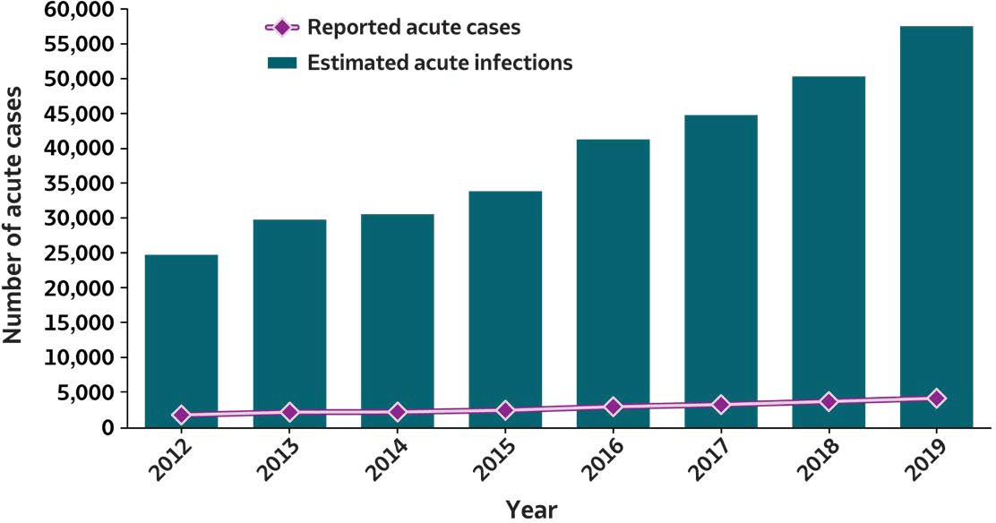
2019 VIRAL H E PAT ITIS
SURVEILLANCE REPORT
Figure 3.1. Number of reported acute hepatitis C virus infection cases and estimated infections* — United States, 2012–2019
Acute Hepatitis C | 2012 | 2013 | 2014 | 2015 | 2016 | 2017 | 2018 | 2019
Reported acute cases | 1,778 | 2,138 | 2,194 | 2,436 | 2,967 | 3,216 | 3,621 | 4,136
Estimated acute infections | 24,700 | 29,700 | 30,500 | 33,900 | 41,200 | 44,700 | 50,300 | 57,500
Source: CDC,National Notifiable Diseases Surveillance System.
*The number of estimated viral hepatitis infections was determined by multiplying the number of reported cases that met the classification criteria for aconfirmed case by afactor that adjusted for underascertainment and underreporting. The 95% bootstrap confidence intervals for the estimated number of infections are displayed in the Appendix.

Slide 29

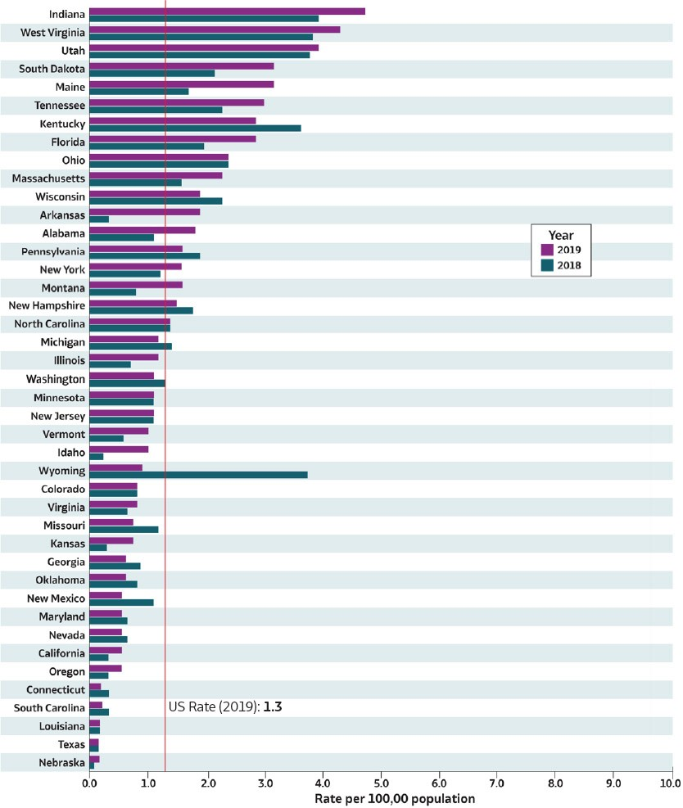
2019 VIRAL H E PAT ITIS
SURVEILLANCE REPORT
Figure 3.2. Rates* of reported acute hepatitis C† virus infections, by state — United States, 2018–2019
Source: CDC, National Notifiable Diseases Surveillance System.
†Reported cases that met the classification criteria for a confirmed case. For the case definition, see https://ndc.services.cdc.gov/ conditions/hepatitis-c-acute/.
Only states with rates for 2018 and 2019 are shown. State/jurisdiction and year for no reported cases: North Dakota (2019), Hawaii (2018); for not reportable condition; Alaska (2018, 2019);
for unavailable data: Arizona (2018, 2019), Delaware (2018, 2019), District of Columbia
(2018, 2019), Iowa (2018, 2019),Mississippi (2018, 2019), Rhode Island (2018, 2019).
* Rates per100,000 population.

Slide 30
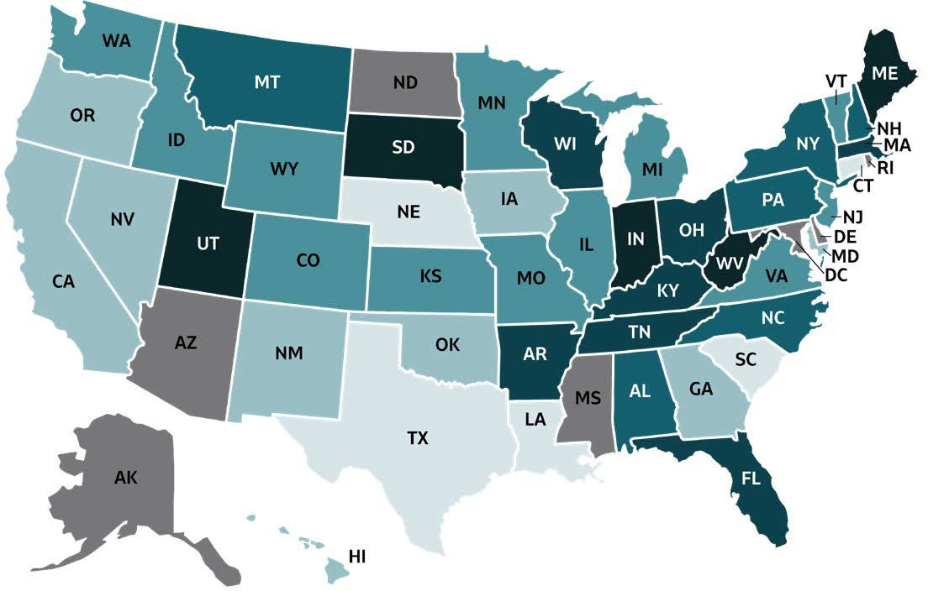

2019 VIRAL HEPATITIS
SURVEILLANCE REPORT
Figure 3.3. Rates of reported acute hepatitis C virus infection, by state or jurisdiction — United States, 2019
Color Key | Cases/100,000 Population | State or Jurisdiction
 | 0.0-0.2 | CT, LA, NE, SC, TX
 | 0.3-0.6 | CA, GA, HI, IA, MD, NM, NV, OK, OR
 | 0.7-1.2 | CO, ID, IL, KS, MI, MN, MO, NJ, VA, VT, WA, WY
 | 1.3-1.8 | AL, MT, NC, NH, NY, PA
 | 1.9-3.0 | AR, FL, KY, MA, OH, TN, WI
 | 3.1-4.8 | IN, ME, SD, UT, WV
 | Data not available | AK, AZ, DC, DE, MS, ND,RI
Source: CDC,National Notifiable Diseases Surveillance System.

Slide 31
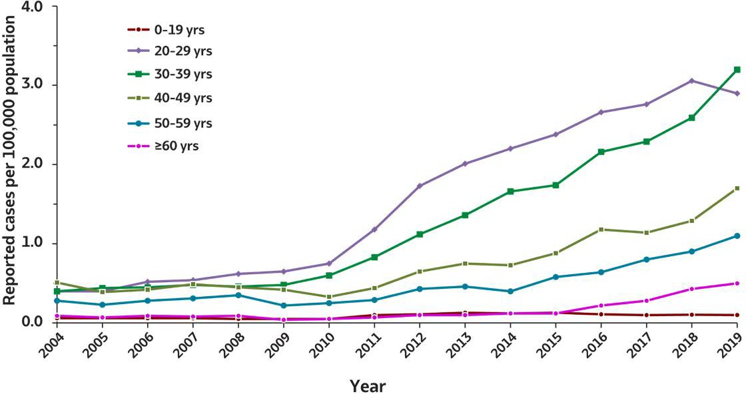
2019 VIRAL H E PAT ITIS
SURVEILLANCE REPORT
Figure 3.4. Rates of reported acute hepatitis C virus infection, by age group
— United States, 2004–2019
Age (years) | 2004 | 2005 | 2006 | 2007 | 2008 | 2009 | 2010 | 2011 | 2012 | 2013 | 2014 | 2015 | 2016 | 2017 | 2018 | 2019
0–19 | 0.1 | 0.1 | 0.1 | 0.1 | 0.0 | 0.0 | 0.1 | 0.1 | 0.1 | 0.1 | 0.1 | 0.1 | 0.1 | 0.1 | 0.1 | 0.1
20–29 | 0.4 | 0.4 | 0.5 | 0.5 | 0.7 | 0.7 | 0.7 | 1.2 | 1.7 | 2.0 | 2.2 | 2.4 | 2.7 | 2.7 | 3.0 | 2.9
30–39 | 0.4 | 0.4 | 0.4 | 0.5 | 0.5 | 0.5 | 0.6 | 0.8 | 1.1 | 1.4 | 1.7 | 1.7 | 2.2 | 2.3 | 2.6 | 3.2
40–49 | 0.5 | 0.4 | 0.4 | 0.5 | 0.5 | 0.4 | 0.3 | 0.4 | 0.6 | 0.7 | 0.7 | 0.9 | 1.2 | 1.1 | 1.3 | 1.7
50–59 | 0.3 | 0.2 | 0.3 | 0.3 | 0.4 | 0.2 | 0.3 | 0.3 | 0.4 | 0.5 | 0.4 | 0.6 | 0.6 | 0.8 | 0.9 | 1.1
≥60 | 0.1 | 0.1 | 0.1 | 0.1 | 0.1 | 0.0 | 0.1 | 0.1 | 0.1 | 0.1 | 0.1 | 0.1 | 0.2 | 0.3 | 0.4 | 0.5
Source: CDC,National Notifiable Diseases Surveillance System.

Slide 32
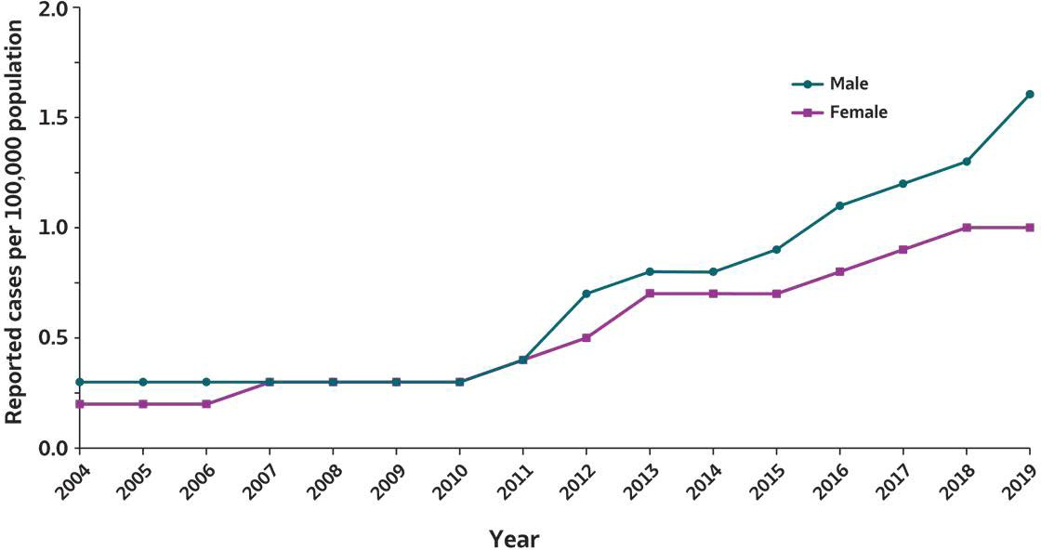
2019 VIRAL H E PAT ITIS
SURVEILLANCE REPORT
Figure 3.5. Rates of reported acute hepatitis C virus infection, by sex — United States, 2004–2019
Sex | 2004 | 2005 | 2006 | 2007 | 2008 | 2009 | 2010 | 2011 | 2012 | 2013 | 2014 | 2015 | 2016 | 2017 | 2018 | 2019
Male | 0.3 | 0.3 | 0.3 | 0.3 | 0.3 | 0.3 | 0.3 | 0.4 | 0.7 | 0.8 | 0.8 | 0.9 | 1.1 | 1.2 | 1.3 | 1.6
Female | 0.2 | 0.2 | 0.2 | 0.3 | 0.3 | 0.3 | 0.3 | 0.4 | 0.5 | 0.7 | 0.7 | 0.7 | 0.8 | 0.9 | 1.0 | 1.0
Source: CDC,National Notifiable Diseases Surveillance System.

Slide 33
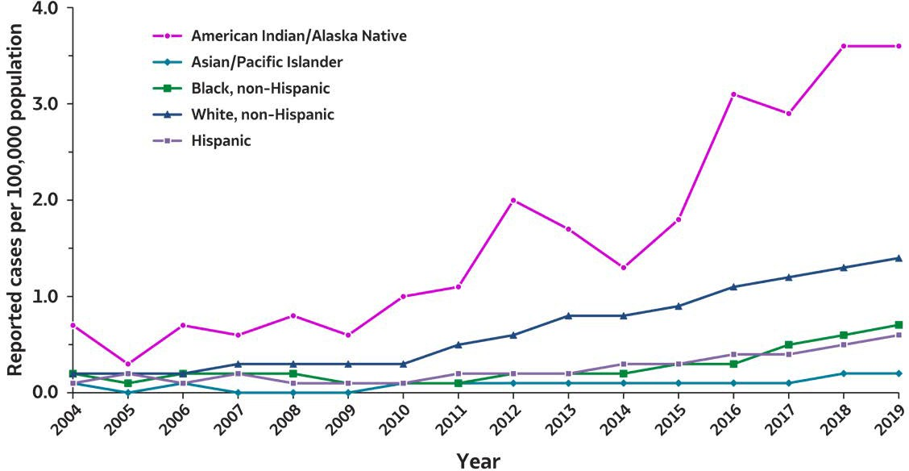

2019 VIRAL H E PAT ITIS
SURVEILLANCE REPORT
Figure 3.6. Rates of reported acute hepatitis C virus infection, by race/ ethnicity — United States, 2004–2019
Race/Ethnicity | 2004 | 2005 | 2006 | 2007 | 2008 | 2009 | 2010 | 2011 | 2012 | 2013 | 2014 | 2015 | 2016 | 2017 | 2018 | 2019
American Indian/ Alaska Native | 0.7 | 0.3 | 0.7 | 0.6 | 0.8 | 0.6 | 1.0 | 1.1 | 2.0 | 1.7 | 1.3 | 1.8 | 3.1 | 2.9 | 3.6 | 3.6
Asian/ Pacific Islander | 0.1 | 0.0 | 0.1 | 0.0 | 0.0 | 0.0 | 0.1 | 0.1 | 0.1 | 0.1 | 0.1 | 0.1 | 0.1 | 0.1 | 0.1 | 0.2
Black, non-Hispanic | 0.2 | 0.1 | 0.2 | 0.2 | 0.2 | 0.1 | 0.1 | 0.1 | 0.1 | 0.2 | 0.2 | 0.3 | 0.3 | 0.5 | 0.6 | 0.7
White, non-Hispanic | 0.2 | 0.2 | 0.2 | 0.2 | 0.3 | 0.3 | 0.3 | 0.5 | 0.6 | 0.8 | 0.8 | 0.9 | 1.1 | 1.2 | 1.3 | 1.4
Hispanic | 0.1 | 0.2 | 0.1 | 0.1 | 0.1 | 0.1 | 0.1 | 0.2 | 0.2 | 0.2 | 0.2 | 0.3 | 0.3 | 0.4 | 0.5 | 0.6
Source: CDC,National Notifiable Diseases Surveillance System.

Slide 34
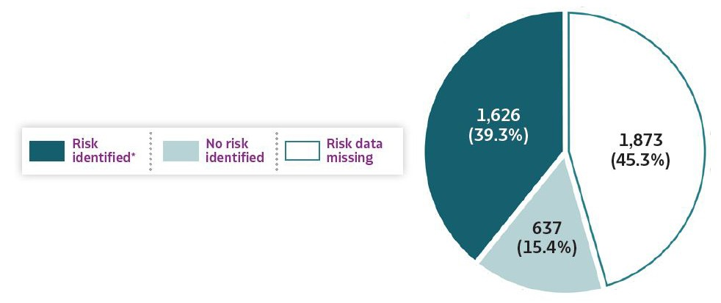
2019 VIRAL H E PAT ITIS
SURVEILLANCE REPORT
Figure 3.7. Availability of information regarding risk behaviors or exposures*† associated with reported cases of acute hepatitis C virus infection — United States, 2019
Source: CDC,Nationally Notifiable Diseases SurveillanceSystem.
* Casereports with at least one of the following risk behaviors/exposures reported 6 weeks to 6 months prior to symptom onset or documented seroconversion if asymptomatic: 1) injection drug use; 2) multiple sexual partners; 3) underwent surgery; 4) men who have sex with men; 5) sexual contact with suspected/confirmed hepatitis Ccase; 6) sustained apercutaneous injury; 7) household contact with suspected/confirmed hepatitis Ccase; 8) occupational exposure to blood; 9) dialysis; and 10) transfusion. Reported cases may include more than one risk behavior/exposure.
†Risk behaviors/exposures data from one state was classified as ‘missing’ becauseof errors in reporting.

Slide 35
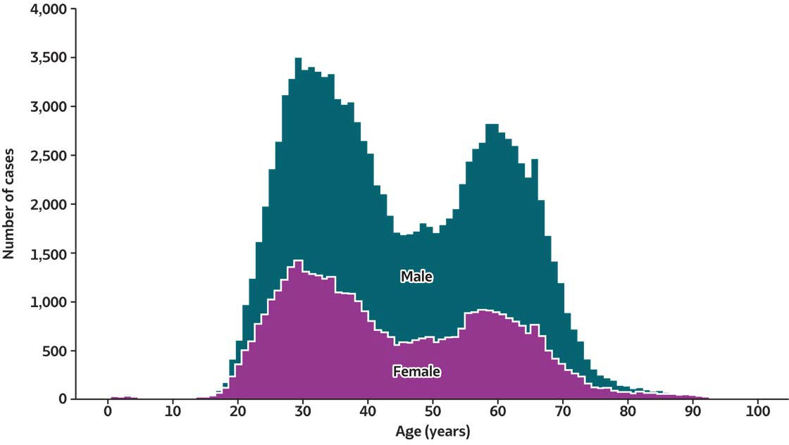
2019 VIRAL H E PAT ITIS
SURVEILLANCE REPORT
Figure 3.8. Number of newly reported* chronic hepatitis C virus infection cases†, by sex and age — United States, 2019
Source: CDC, National Notifiable Diseases SurveillanceSystem.
* During 2019, cases of chronic hepatitis C were either not reportable by law, statute, or regulation; not reported; or otherwise unavailable to CDC from Arizona, Arkansas, California, Delaware, District of Columbia, Hawaii, Indiana, Kentucky, Mississippi, Nevada, North Carolina, Rhode Island, and Texas.
†Only confirmed, newly reported, chronic hepatitis C cases are included. For the complete case definition, see https://ndc.services.cdc.gov/conditions/hepatitis-c-chronic/.

Slide 36
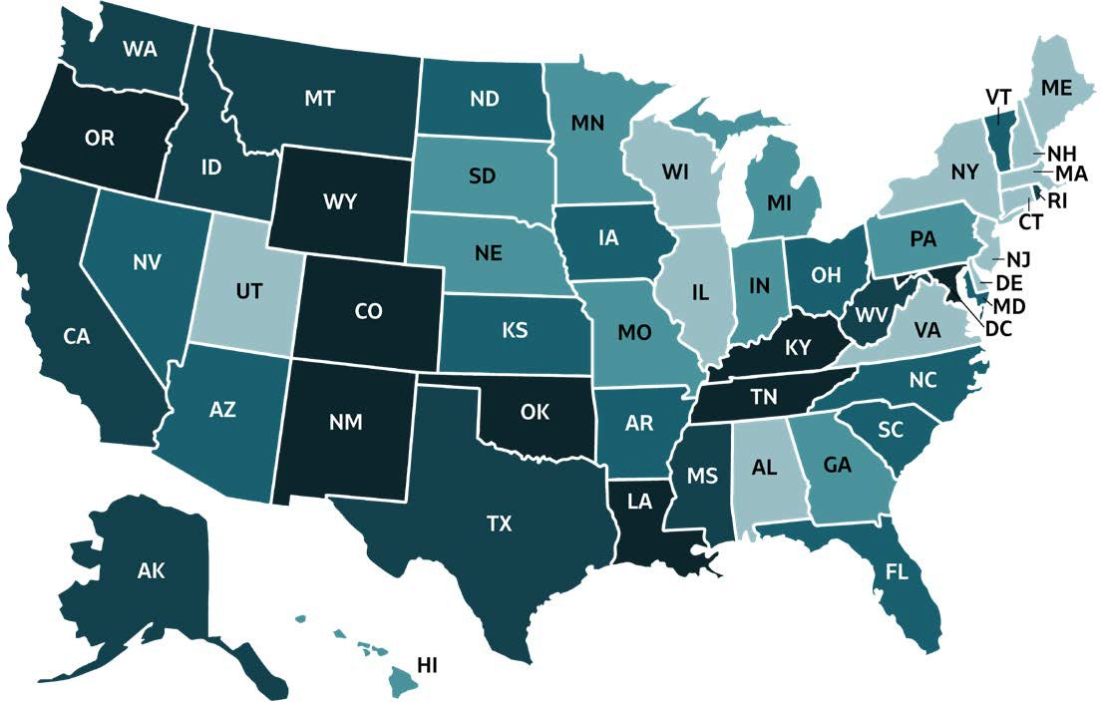
2019 VIRAL HEPATITIS
SURVEILLANCE REPORT
Figure 3.9. Rates* of death† with hepatitis C virus infection listed as a cause of death among residents, by jurisdiction — United States, 2019
Color Key | Deaths/100,000 Population | State or Jurisdiction
 | 0.00-2.30 | AL, CT, DE, IL, MA, ME, NH, NJ, NY, UT, VA, WI
 | 2.31-2.80 | GA, HI, IN, MI, MN, MO, NE, PA, SD
 | 2.81-3.50 | AR, AZ, FL, IA, KS, MD, NC, ND, NV, OH, SC, VT
 | 3.51-5.00 | AK, CA, ID, MS, MT, RI, TX, WA, WV
 | 5.01-10.75 | CO, DC, KY, LA, NM, OK, OR, TN, WY
Source: CDC, National Center for Health Statistics, Multiple Cause of Death 1999–2019 on CDC WONDER Online Database. Data are from the 2015–2019 Multiple Cause of Death files and are based on information from all death certificates filed in the vital records offices of the fifty states and the District of Columbia through the Vital Statistics Cooperative Program. Deaths of nonresidents (e.g., nonresident aliens, nationals living abroad, residents of Puerto Rico, Guam, the Virgin Islands, and other U.S. territories) and fetal deaths are excluded. Numbers are slightly lower than previously reported for 2015–2016 due to NCHS standards which restrict displayed data to US residents. Accessed at http://wonder.cdc.gov/mcd-icd10.html on January 11, 2021. CDC WONDER dataset documentation and technical methods can be accessed at https://wonder.cdc.gov/wonder/help/mcd.html.
* Rates are age-adjusted per 100,000 US standard population in 2000 using the following age group distribution (in years): <1, 1–4, 5–14, 15–24, 25–34, 35–44, 45–54, 55–64, 65–74, 75–84, and ≥85. For age-adjusted death rates, the age-specific death rate is rounded to one decimal place before proceeding to the next step in the calculation of age-adjusted death rates for NCHS Multiple Cause of Death on CDC WONDER. This rounding step may affect the precision of rates calculated for small numbers of deaths. Missing data are not included.
†Cause of death is defined as one of the multiple causes of death and is based on the International Classification of Diseases, 10th Revision (ICD-10) codes B17.1, and B18.2 (hepatitis C).

Slide 37
2019 VIRAL HEPATITIS
SURVEILLANCE REPORT
Table 3.1. Number and rates* of reported cases† of acute hepatitis C, by state or jurisdiction — United States, 2015–2019
State or Jurisdiction | 2015 |  | 2016 |  | 2017 |  | 2018 |  | 2019
 | No. | Rate* | No. | Rate* | No. | Rate* | No. | Rate* | No. | Rate*
Alabama | 70 | 1.4 | 32 | 0.7 | 17 | 0.3 | 52 | 1.1 | 87 | 1.8
Alaska | N | N | N | N | N | N | N | N | N | N
Arizona | U | U | U | U | U | U | U | U | U | U
Arkansas | 2 | 0.1 | — | — | 1 | 0 | 10 | 0.3 | 58 | 1.9
California | 59 | 0.2 | 60 | 0.2 | 103 | 0.3 | 114 | 0.3 | 200 | 0.5
Colorado | 40 | 0.7 | 35 | 0.6 | 42 | 0.7 | 46 | 0.8 | 45 | 0.8
Connecticut | — | — | 17 | 0.5 | 9 | 0.3 | 10 | 0.3 | 7 | 0.2
Delaware | 4 | 0.4 | 25 | 2.6 | 4 | 0.4 | U | U | U | U
District of Columbia | U | U | U | U | U | U | U | U | U | U
Florida | 126 | 0.6 | 236 | 1.1 | 357 | 1.7 | 435 | 2.0 | 616 | 2.9
Georgia | 84 | 0.8 | 93 | 0.9 | 100 | 1.0 | 84 | 0.8 | 61 | 0.6
Hawaii | — | — | — | — | — | — | — | — | 7 | 0.5
Idaho | 4 | 0.2 | 7 | 0.4 | 8 | 0.5 | 4 | 0.2 | 17 | 1.0
Illinois | 31 | 0.2 | 21 | 0.2 | 39 | 0.3 | 93 | 0.7 | 156 | 1.2
Indiana | 138 | 2.1 | 146 | 2.2 | 191 | 2.9 | 266 | 4.0 | 325 | 4.8
Iowa | U | U | U | U | U | U | U | U | 10 | 0.3
Kansas | 22 | 0.8 | 15 | 0.5 | 19 | 0.7 | 13 | 0.4 | 19 | 0.7
Kentucky | 119 | 2.7 | 103 | 2.3 | 83 | 1.9 | 164 | 3.7 | 128 | 2.9
Louisiana | 24 | 0.5 | 5 | 0.1 | 7 | 0.1 | 8 | 0.2 | 8 | 0.2
Maine | 30 | 2.3 | 25 | 1.9 | 21 | 1.6 | 23 | 1.7 | 43 | 3.2
Maryland | 38 | 0.6 | 35 | 0.6 | 32 | 0.5 | 38 | 0.6 | 33 | 0.5
Massachusetts | 249 | 3.7 | 424 | 6.2 | 327 | 4.8 | 110 | 1.6 | 161 | 2.3
Michigan | 83 | 0.8 | 107 | 1.1 | 152 | 1.5 | 142 | 1.4 | 117 | 1.2
Minnesota | 37 | 0.7 | 51 | 0.9 | 57 | 1.0 | 60 | 1.1 | 62 | 1.1
Mississippi | U | U | U | U | U | U | U | U | U | U
Missouri | 8 | 0.1 | 24 | 0.4 | 49 | 0.8 | 74 | 1.2 | 41 | 0.7
Montana | 15 | 1.5 | 20 | 1.9 | 14 | 1.3 | 8 | 0.8 | 17 | 1.6
Nebraska | 8 | 0.4 | 2 | 0.1 | 2 | 0.1 | 2 | 0.1 | 4 | 0.2
Nevada | 12 | 0.4 | 16 | 0.5 | 35 | 1.2 | 19 | 0.6 | 15 | 0.5
New Hampshire | N | N | N | N | 25 | 1.9 | 25 | 1.8 | 20 | 1.5
New Jersey | 130 | 1.5 | 122 | 1.4 | 125 | 1.4 | 96 | 1.1 | 99 | 1.1
New Mexico | 40 | 1.9 | 18 | 0.9 | 16 | 0.8 | 22 | 1.0 | 10 | 0.5
New York | 121 | 0.6 | 179 | 0.9 | 188 | 0.9 | 236 | 1.2 | 306 | 1.6
North Carolina | 144 | 1.4 | 82 | 0.8 | 114 | 1.1 | 149 | 1.4 | 150 | 1.4
North Dakota | — | — | 1 | 0.1 | 1 | 0.1 | 10 | 1.3 | — | —
Ohio | 122 | 1.1 | 187 | 1.6 | 159 | 1.4 | 282 | 2.4 | 281 | 2.4
Oklahoma | 35 | 0.9 | 32 | 0.8 | 46 | 1.2 | 28 | 0.7 | 23 | 0.6
Oregon | 13 | 0.3 | 19 | 0.5 | 35 | 0.8 | 14 | 0.3 | 23 | 0.5
Pennsylvania | 129 | 1.0 | 225 | 1.8 | 224 | 1.7 | 249 | 1.9 | 210 | 1.6
Rhode Island | U | U | U | U | U | U | U | U | U | U
South Carolina | 5 | 0.1 | 10 | 0.2 | 13 | 0.3 | 15 | 0.3 | 9 | 0.2
South Dakota | — | — | 20 | 2.3 | 19 | 2.2 | 19 | 2.2 | 28 | 3.2
Tennessee | 173 | 2.6 | 150 | 2.3 | 142 | 2.1 | 157 | 2.3 | 202 | 3.0
Texas | 48 | 0.2 | 40 | 0.1 | 35 | 0.1 | 46 | 0.2 | 58 | 0.2
Utah | 30 | 1.0 | 76 | 2.5 | 81 | 2.6 | 120 | 3.8 | 127 | 4.0
Vermont | 1 | 0.2 | 5 | 0.8 | 9 | 1.4 | 4 | 0.6 | 6 | 1.0
Virginia | 52 | 0.6 | 43 | 0.5 | 62 | 0.7 | 47 | 0.6 | 70 | 0.8
Washington | 63 | 0.9 | 62 | 0.9 | 52 | 0.7 | 101 | 1.3 | 81 | 1.1
West Virginia | 63 | 3.4 | 94 | 5.1 | 102 | 5.6 | 70 | 3.9 | 79 | 4.4
Wisconsin | 64 | 1.1 | 103 | 1.8 | 94 | 1.6 | 134 | 2.3 | 112 | 1.9
Wyoming | U | U | U | U | 5 | 0.9 | 22 | 3.8 | 5 | 0.9
Total | 2,436 | 0.8 | 2,967 | 1.0 | 3,216 | 1.0 | 3,621 | 1.2 | 4,136 | 1.3
Source: CDC,National Notifiable Diseases Surveillance System.
* Rates per 100,000
population.
† Reported cases that met the classification —: No reported cases. N: Not reportable. The disease or condition was notreportable
criteria for aconfirmed case.For the case The reporting jurisdiction by law, statute, or regulation in the reporting jurisdiction. definition, see https://ndc.services.cdc.gov/ did not submit anycases
conditions/hepatitis-c-acute/. to CDC.
U: Unavailable. The data were unavailable.

Slide 38
2019 VIRAL HEPATITIS
SURVEILLANCE REPORT
Table 3.2. Number and rates* of reported cases† of acute hepatitis C, by demographic characteristics — United States 2015–2019
Characteristics | 2015 |  | 2016 |  | 2017 |  | 2018 |  | 2019
 | No. | Rate* | No. | Rate* | No. | Rate* | No. | Rate* | No. | Rate*
Total§ | 2,436 | 0.8 | 2,967 | 1.0 | 3,216 | 1.0 | 3,621 | 1.2 | 4,136 | 1.3
Age (years)
0–19 | 99 | 0.1 | 86 | 0.1 | 103 | 0.1 | 81 | 0.1 | 63 | 0.1
20–29 | 999 | 2.4 | 1,135 | 2.7 | 1,189 | 2.7 | 1,310 | 3.0 | 1,262 | 2.9
30–39 | 682 | 1.7 | 868 | 2.2 | 937 | 2.3 | 1,070 | 2.6 | 1,347 | 3.2
40–49 | 337 | 0.9 | 452 | 1.2 | 441 | 1.1 | 494 | 1.3 | 664 | 1.7
50–59 | 240 | 0.6 | 264 | 0.6 | 332 | 0.8 | 366 | 0.9 | 442 | 1.1
≥60 | 77 | 0.1 | 141 | 0.2 | 185 | 0.3 | 295 | 0.4 | 358 | 0.5
Sex
Male | 1,334 | 0.9 | 1,627 | 1.1 | 1,775 | 1.2 | 2,012 | 1.3 | 2,471 | 1.6
Female | 1,093 | 0.7 | 1,310 | 0.8 | 1,431 | 0.9 | 1,605 | 1.0 | 1,653 | 1.0
Race/ethnicity
American Indian/ Alaska Native | 39 | 1.8 | 70 | 3.1 | 67 | 2.9 | 83 | 3.6 | 83 | 3.6
Asian/Pacific Islander | 16 | 0.1 | 25 | 0.1 | 23 | 0.1 | 29 | 0.1 | 36 | 0.2
Black, non-Hispanic | 112 | 0.3 | 130 | 0.3 | 202 | 0.5 | 231 | 0.6 | 267 | 0.7
White, non-Hispanic | 1,724 | 0.9 | 2,109 | 1.1 | 2,227 | 1.2 | 2,405 | 1.3 | 2,683 | 1.4
Hispanic | 148 | 0.3 | 191 | 0.3 | 234 | 0.4 | 280 | 0.5 | 350 | 0.6
Urbanicity¶
Urban | 1,812 | 0.7 | 2,227 | 0.8 | 2,397 | 0.9 | 2,782 | 1.0 | 3,275 | 1.2
Rural | 545 | 1.3 | 501 | 1.2 | 485 | 1.1 | 676 | 1.6 | 720 | 1.7
HHS Region: Regional Office#
1: Boston | 280 | 3.2 | 471 | 3.8 | 391 | 2.8 | 172 | 1.2 | 237 | 1.7
2: New York | 251 | 0.9 | 301 | 1.0 | 313 | 1.1 | 332 | 1.2 | 405 | 1.4
3: Philadelphia | 286 | 1.0 | 422 | 1.4 | 424 | 1.4 | 404 | 1.4 | 392 | 1.3
4: Atlanta | 721 | 1.2 | 706 | 1.1 | 826 | 1.3 | 1,056 | 1.7 | 1,253 | 2.0
5: Chicago | 475 | 0.9 | 615 | 1.2 | 692 | 1.3 | 977 | 1.9 | 1,053 | 2.0
6: Dallas | 149 | 0.4 | 95 | 0.2 | 105 | 0.2 | 114 | 0.3 | 157 | 0.4
7: Kansas City | 38 | 0.3 | 41 | 0.4 | 70 | 0.6 | 89 | 0.8 | 74 | 0.5
8: Denver | 85 | 0.8 | 152 | 1.4 | 162 | 1.4 | 225 | 1.9 | 222 | 1.9
9: San Francisco | 71 | 0.2 | 76 | 0.2 | 138 | 0.3 | 133 | 0.3 | 222 | 0.5
10: Seattle | 80 | 0.6 | 88 | 0.7 | 95 | 0.7 | 119 | 0.9 | 121 | 0.9
Source: CDC,National Notifiable Diseases Surveillance System.
* Rates per 100,000 population.
†Reported cases that met the classification criteria for a confirmed case.For the case definition, see https://ndc. services.cdc.gov/conditions/ hepatitis-c-acute/.
§ Numbers reported in eachcategory might not addup to the total number of reported cases in ayear becauseof cases with missing data or, in the caseof race/ethnicity, cases categorized as “Other.”
¶ Urbanicity was categorized according to the 2013 National Center for Health Statistics (NCHS) urban-rural classification scheme for counties andcounty-equivalent entities (https://www.cdc.gov/nchs/data_access/urban_rural.htm). Large central metropolitan, large fringe metropolitan, medium metropolitan, andsmall metropolitan counties were grouped as urban. Micropolitan andnoncore counties were grouped as rural.
#US Department of Health and Human Services (HHS) regions were categorized according to the grouping of states andUS territories assigned under eachof the 10 HHS regional offices (https://www.hhs.gov/about/agencies/iea/regional-offices/index.html). For the purposes of this report, regions with US territories (Regions 2 and 9) contain data from states only.

Slide 39

2019 VIRAL HEPATITIS
SURVEILLANCE REPORT
Table 3.3. Reported risk behaviors or exposures*† among reported cases of acute hepatitis C virus infection — United States, 2019
Risk behaviors/exposures | Risk identified* | No risk identified | Risk data missing
Injection drug use | 1,302 | 650 | 2,184
Multiple sexual partners | 223 | 594 | 3,319
Surgery | 179 | 888 | 3,069
Sexual contact § | 142 | 334 | 3,660
Needlestick | 91 | 886 | 3,159
Men who have sex with men ¶ | 42 | 315 | 2,114
Household contact (non-sexual) § | 36 | 440 | 3,660
Dialysis patient | 61 | 1,249 | 2,826
Occupational | 7 | 1,278 | 2,851
Transfusion | 3 | 1,105 | 3,028
Source: CDC,Nationally Notifiable Diseases Surveillance System.
* Casereports with at least one of the following risk behaviors/exposures reported 6 weeks to 6 months prior to symptom onset or documented seroconversion if asymptomatic: 1) injection drug use; 2) multiple sexual partners; 3) underwent surgery; 4) men who have sex with men; 5)sexual
contact with suspected/confirmed hepatitis Ccase;
6) sustained apercutaneous injury; 7) household
contact with suspected/confirmed hepatitis Ccase;
8) occupational exposure to blood; 9) dialysis; and
10) transfusion. Reported cases may include more
than one risk behavior/exposure.
†Risk behaviors/exposures datafrom one state was classified as ‘missing’ becauseof errors in reporting.
§ Cases with more than one type of contact reported were categorized according to a hierarchy: (1) sexual contact; (2) household contact (nonsexual).
¶ A total of 2,471 acute hepatitis Ccases were reported among males in 2019.

Slide 40
2019 VIRAL HEPATITIS
SURVEILLANCE REPORT
Table 3.4. Number of
State or Jurisdiction | Perinatal Hepatitis C
Alabama | —
Alaska | 2
Arizona | —
Arkansas | 3
California | 15
Colorado | 1
Connecticut | —
Delaware | U
District of Columbia | —
Florida | 20
Georgia | 5
Hawaii | —
Idaho | —
Illinois | 10
Indiana | 14
Iowa | —
Kansas | 2
Kentucky | —
Louisiana | —
Maine | 4
Maryland | —
Massachusetts | 14
Michigan | 11
Minnesota | 5
Mississippi | —
Missouri | —
Montana | —
Nebraska | —
Nevada | 1
New Hampshire | —
New Jersey | 11
New Mexico | —
New York | 1
North Carolina | —
North Dakota | —
Ohio | 41
Oklahoma | —
Oregon | —
Pennsylvania | 20
Rhode Island | U
South Carolina | 2
South Dakota | 2
Tennessee | 16
Texas | N
Utah | 2
Vermont | —
Virginia | 12
Washington | 3
West Virginia | —
Wisconsin | —
Wyoming | —
Total | 217
newly cases* of
reported perinatal
hepatitis C virus infection, by state or jurisdiction —
United States, 2019
Source: CDC,National Notifiable Diseases Surveillance System.
* Reported cases that met the classification criteria for aconfirmed case. For case definition, see https://ndc. services.cdc.gov/conditions/hepatitis-c- perinatal-infection/.
—: No reported cases. The reporting jurisdiction did not submit any cases to CDC.
N: Not reportable. The disease or condition was not reportable by law, statute, or regulation in the reporting jurisdiction.
U: Unavailable. The datawere unavailable.

Slide 41
2019 VIRAL HEPATITIS
SURVEILLANCE REPORT
Table 3.5. Number and rates* of newly reported cases† of chronic hepatitis C virus
infection, by state or jurisdiction — United States,
2019
State or Jurisdiction | No. | Rate*
Alabama | 1,818 | 37.1
Alaska | 957 | 130.8
Arizona | U | U
Arkansas | N | N
California | — | —
Colorado | 2,554 | 44.4
Connecticut | 1,322 | 37.1
Delaware | U | U
District of Columbia | U | U
Florida | 14,328 | 66.7
Georgia | 4,900 | 46.2
Hawaii | U | U
Idaho | 779 | 43.6
Illinois | 4,224 | 33.3
Indiana | N | N
Iowa | 1,173 | 37.2
Kansas | 1,195 | 41.0
Kentucky | N | N
Louisiana | 3,840 | 82.6
Maine | 936 | 69.6
Maryland | 3,163 | 52.3
Massachusetts | 3,092 | 44.9
Michigan | 3,887 | 38.9
Minnesota | 1,021 | 18.1
Mississippi | — | —
Missouri | 4,755 | 77.5
Montana | 900 | 84.2
Nebraska | 615 | 31.8
Nevada | U | U
New Hampshire | 135 | 9.9
New Jersey | 3,358 | 37.8
New Mexico | 2,287 | 109.1
New York | 6,914 | 35.5
North Carolina | N | N
North Dakota | 501 | 65.7
Ohio | 9,511 | 81.4
Oklahoma | 1,942 | 49.1
Oregon | 2,569 | 60.9
Pennsylvania | 10,848 | 84.7
Rhode Island | U | U
South Carolina | 3,817 | 74.1
South Dakota | 455 | 51.4
Tennessee | 8,660 | 126.8
Texas | N | N
Utah | 929 | 29.0
Vermont | 378 | 60.6
Virginia | 5,329 | 62.4
Washington | 4,321 | 56.7
West Virginia | 3,603 | 201.0
Wisconsin | 1,963 | 33.7
Wyoming | 333 | 57.5
Total | 123,312 | 56.7
Source: CDC,National Notifiable Diseases Surveillance System.
* Rates per 100,000 population.
†Reported cases that met the classification criteria for aconfirmed case. For case definition, see https://ndc.services.cdc.gov/conditions/ hepatitis-c-chronic/.
—: No reported cases. The reporting jurisdiction did not submit any cases to CDC.
N: Not reportable. The disease or condition was not reportable by law, statute, or regulation in the reporting jurisdiction.
U: Unavailable. The datawere unavailable.

Slide 42
2019 VIRAL HEPATITIS
SURVEILLANCE REPORT
Table 3.6. Number and rates* of newly reported
cases† of chronic hepatitis C virus
infection, by demographic
characteristics
— United States, 2019
Characteristics | 2019
 | No. | Rate
Total§ | 123,312 | 56.7
Age (years)
0–19 | 951 | 1.8
20–29 | 21,263 | 72.3
30–39 | 31,383 | 109.1
40–49 | 19,035 | 72.1
50–59 | 22,748 | 79.6
≥60 | 26,142 | 50.8
Sex
Male | 79,012 | 73.9
Female | 43,966 | 39.7
Race/ethnicity
American Indian/Alaska Native | 1,657 | 86.7
Asian/Pacific Islander | 755 | 7.1
Black, non-Hispanic | 9,566 | 31.0
White, non-Hispanic | 49,814 | 34.0
Hispanic | 3,913 | 14.1
Urbanicity¶
Urban | 96,039 | 52.1
Rural | 23,022 | 67.7
HHS Region: Regional Office#
1: Boston | 5,863 | 42.5
2: New York | 10,272 | 36.3
3: Philadelphia | 22,943 | 78.6
4: Atlanta | 33,523 | 68.4
5: Chicago | 20,606 | 45.0
6: Dallas | 8,069 | 75.4
7: Kansas City | 7,738 | 54.7
8: Denver | 5,672 | 46.3
9: San Francisco | U | U
10: Seattle | 8,626 | 60.1
Source: CDC,National Notifiable Diseases Surveillance System.
* Rates per 100,000 population.
†Reported cases that met the classification criteria for aconfirmed case. For the case definition,
see https://ndc.services.cdc.gov/ conditions/hepatitis-c-chronic/.
§ Numbers reported in each category might not addup to the total number of reported cases in a year because of cases with missing dataor, in the case of race/ethnicity, cases categorized as “Other.”
¶ Urbanicity was categorized according to the 2013 National Center for Health Statistics (NCHS) urban-rural classification scheme for counties andcounty-equivalent entities (https://www.cdc.gov/ nchs/data_access/urban_rural. htm). Large central metropolitan, large fringe metropolitan,
medium metropolitan, and small metropolitan counties were grouped as urban. Micropolitan and noncore counties were grouped as rural.
#US Department of Health and Human Services (HHS) regions were categorized according to the grouping of states and US territories assigned under eachof
the 10 HHS regional offices (https:// www.hhs.gov/about/agencies/iea/ regional-offices/index.html). For the purposes of this report, regions
with US territories (Regions 2 and 9) contain datafrom states only.
U: datawere unavailable.

Slide 43
2019 VIRAL HEPATITIS
SURVEILLANCE REPORT
Table 3.7. Number and rates* of deaths with hepatitis C listed as a cause of
death† among residents, by state or jurisdiction — United States, 2015–2019
State or Jurisdiction | 2015 |  | 2016 |  | 2017 |  | 2018 |  | 2019
 | No. | Rate* | No. | Rate* | No. | Rate* | No. | Rate* | No. | Rate*
Alabama | 187 | 3.08 | 166 | 2.63 | 188 | 2.97 | 167 | 2.54 | 134 | 2.06
Alaska | 41 | 4.95 | 50 | 5.38 | 38 | 4.38 | 40 | 5.00 | 41 | 4.66
Arizona | 567 | 6.90 | 500 | 5.81 | 480 | 5.45 | 348 | 3.84 | 277 | 3.01
Arkansas | 183 | 5.01 | 184 | 4.91 | 169 | 4.43 | 150 | 3.86 | 134 | 3.45
California | 3,245 | 7.19 | 2,917 | 6.33 | 2,630 | 5.58 | 2,391 | 4.98 | 2,114 | 4.36
Colorado | 362 | 5.51 | 385 | 5.74 | 386 | 5.62 | 387 | 5.48 | 376 | 5.24
Connecticut | 153 | 3.20 | 123 | 2.52 | 130 | 2.61 | 89 | 1.72 | 102 | 2.03
Delaware | 45 | 3.41 | 47 | 3.63 | 49 | 3.80 | 34 | 2.33 | 26 | 2.12
District of Columbia | 101 | 13.93 | 95 | 13.37 | 83 | 11.42 | 70 | 9.40 | 75 | 10.08
Florida | 1,270 | 4.62 | 1,222 | 4.26 | 1,222 | 4.16 | 1,005 | 3.34 | 1,025 | 3.31
Georgia | 396 | 3.26 | 368 | 2.98 | 344 | 2.66 | 326 | 2.46 | 313 | 2.33
Hawaii | 68 | 3.70 | 70 | 3.75 | 67 | 3.48 | 49 | 2.42 | 45 | 2.38
Idaho | 99 | 4.79 | 115 | 5.40 | 84 | 3.82 | 108 | 4.87 | 93 | 4.07
Illinois | 399 | 2.56 | 354 | 2.18 | 288 | 1.72 | 279 | 1.67 | 221 | 1.31
Indiana | 270 | 3.26 | 295 | 3.60 | 269 | 3.16 | 259 | 2.98 | 241 | 2.76
Iowa | 125 | 3.19 | 109 | 2.67 | 122 | 3.01 | 98 | 2.40 | 116 | 2.82
Kansas | 141 | 4.11 | 148 | 4.20 | 141 | 3.83 | 130 | 3.48 | 116 | 3.12
Kentucky | 270 | 5.09 | 269 | 5.05 | 306 | 5.58 | 319 | 5.77 | 267 | 5.08
Louisiana | 396 | 7.15 | 383 | 6.60 | 382 | 6.49 | 352 | 5.92 | 347 | 5.70
Maine | 57 | 3.05 | 40 | 1.87 | 32 | 1.60 | 34 | 1.69 | 23 | 1.31
Maryland | 366 | 4.84 | 327 | 4.32 | 340 | 4.41 | 352 | 4.44 | 282 | 3.48
Massachusetts | 317 | 3.71 | 261 | 2.98 | 267 | 3.00 | 211 | 2.33 | 192 | 2.09
Michigan | 512 | 3.77 | 415 | 3.06 | 368 | 2.61 | 384 | 2.72 | 359 | 2.50
Minnesota | 234 | 3.40 | 240 | 3.28 | 235 | 3.19 | 209 | 2.81 | 199 | 2.65
Mississippi | 162 | 4.57 | 183 | 5.08 | 159 | 4.38 | 141 | 3.70 | 144 | 3.85
Missouri | 275 | 3.50 | 258 | 3.23 | 247 | 3.06 | 244 | 3.09 | 205 | 2.47
Montana | 77 | 5.76 | 75 | 5.71 | 68 | 4.89 | 76 | 5.36 | 54 | 4.02
Nebraska | 82 | 3.60 | 78 | 3.25 | 79 | 3.29 | 72 | 3.26 | 59 | 2.41
Nevada | 173 | 4.80 | 181 | 4.97 | 153 | 4.00 | 140 | 3.59 | 128 | 3.19
New Hampshire | 65 | 3.28 | 68 | 3.57 | 57 | 2.90 | 64 | 3.36 | 44 | 2.28
New Jersey | 400 | 3.52 | 378 | 3.24 | 342 | 2.90 | 309 | 2.64 | 224 | 1.89
New Mexico | 195 | 8.05 | 203 | 8.12 | 175 | 6.70 | 163 | 6.30 | 165 | 6.33
New York | 979 | 3.89 | 789 | 3.06 | 701 | 2.71 | 615 | 2.40 | 556 | 2.12
North Carolina | 532 | 4.19 | 511 | 3.92 | 460 | 3.44 | 426 | 3.11 | 402 | 2.82
North Dakota | 32 | 3.55 | 20 | 2.25 | 23 | 2.88 | 23 | 2.52 | 30 | 3.42
Ohio | 559 | 3.70 | 546 | 3.58 | 541 | 3.48 | 480 | 3.16 | 450 | 2.90
Oklahoma | 510 | 11.02 | 538 | 11.46 | 555 | 11.84 | 534 | 11.00 | 533 | 10.75
Oregon | 514 | 9.68 | 491 | 8.90 | 518 | 9.24 | 466 | 8.03 | 425 | 7.26
Pennsylvania | 726 | 4.18 | 564 | 3.28 | 563 | 3.15 | 417 | 2.37 | 445 | 2.48
Rhode Island | 97 | 7.26 | 89 | 6.57 | 76 | 5.15 | 91 | 6.37 | 57 | 3.79
South Carolina | 294 | 4.67 | 299 | 4.51 | 302 | 4.51 | 259 | 3.70 | 220 | 3.09
South Dakota | 35 | 3.33 | 37 | 3.46 | 29 | 2.56 | 30 | 2.80 | 29 | 2.61
Tennessee | 592 | 7.27 | 482 | 5.89 | 469 | 5.57 | 517 | 6.01 | 491 | 5.77
Texas | 1,996 | 6.72 | 1,886 | 6.12 | 1,888 | 6.03 | 1,708 | 5.30 | 1,383 | 4.20
Utah | 98 | 3.47 | 85 | 2.98 | 68 | 2.29 | 78 | 2.59 | 69 | 2.17
Vermont | 43 | 4.87 | 35 | 3.72 | 40 | 4.44 | 30 | 3.32 | 30 | 2.95
Virginia | 330 | 3.15 | 327 | 3.03 | 290 | 2.68 | 272 | 2.48 | 249 | 2.29
Washington | 651 | 7.06 | 517 | 5.53 | 528 | 5.46 | 466 | 4.76 | 441 | 4.43
West Virginia | 107 | 4.65 | 118 | 4.85 | 116 | 4.94 | 108 | 4.90 | 108 | 4.92
Wisconsin | 208 | 2.78 | 214 | 2.70 | 145 | 1.82 | 151 | 1.90 | 141 | 1.72
Wyoming | 30 | 3.95 | 38 | 4.89 | 41 | 5.50 | 42 | 5.84 | 42 | 5.33
Total | 19,566 | 4.91 | 18,093 | 4.42 | 17,253 | 4.13 | 15,713 | 3.72 | 14,242 | 3.33
Source: CDC, National Center for Health Statistics, Multiple Cause of Death 1999–2019 on CDC WONDER Online Database. Data are from the 2015–2019 Multiple Cause of Death files and are based on information from all death certificates filed in the vital records offices of the 50 states and the District of Columbia through the Vital Statistics Cooperative Program. Deaths of nonresidents (e.g., nonresident aliens, nationals living abroad, residents of Puerto Rico, Guam, the Virgin Islands, and other US territories) and fetal deaths are excluded. Numbers are slightly lower than previously reported for 2015–2016 because of NCHS standards that restrict displayed data to US residents. Accessed at http://wonder.cdc.gov/mcd-icd10.html on January 11, 2021. CDC WONDER data set documentation and technical methods can be accessed at https://wonder.cdc.gov/wonder/help/mcd.html#.
* Rates are age-adjusted per 100,000 US standard population during 2000 by using the following age group distribution (in years): <1, 1–4, 5–14, 15–24, 25–34, 35–44, 45–54, 55–64, 65–74, 75–84, and ≥85. For age-adjusted death rates, the age-specific death rate is rounded to 1 decimal place before proceeding to the next step in the calculation of age-adjusted death rates for NCHS Multiple Cause of Death on CDC WONDER. This rounding step might affect the precision of rates calculated for small numbers of deaths. Missing data are not included.
†Cause of death is defined as 1 of the multiple causes of death and is based on the International Classification of Diseases, 10th Rev. (ICD-10) codes B17.1, and B18.2 (hepatitis C).

Slide 44

2019 VIRAL HEPATITIS
SURVEILLANCE REPORT
Table 3.8. Number and rates* of deaths with hepatitis C virus infection listed as a cause of death† among residents, by demographic characteristics — United States, 2015–2019
Characteristics | 2015 |  | 2016 |  | 2017 |  | 2018 |  | 2019
 | No. | Rate* (95% CI) | No. | Rate* (95% CI) | No. | Rate* (95% CI) | No. | Rate* (95% CI) | No. | Rate* (95% CI)
Total | 19,566 | 4.91 (4.84-4.98) | 18,093 | 4.42 (4.36-4.49) | 17,253 | 4.13 (4.07-4.20) | 15,713 | 3.72 (3.66-3.78) | 14,242 | 3.33 (3.28–3.39)
Age (years)
0–34 | 196 | 0.13 (0.11-0.15) | 164 | 0.11 (0.09-0.13) | 180 | 0.12 (0.10-0.14) | 212 | 0.14 (0.12-0.16) | 170 | 0.11 (0.10–0.13)
35–44 | 592 | 1.46 (1.34-1.58) | 532 | 1.31 (1.20-1.43) | 507 | 1.24 (1.13-1.35) | 499 | 1.21 (1.10-1.31) | 472 | 1.13 (1.03–1.24)
45–54 | 3,659 | 8.47 (8.20-8.75) | 3,026 | 7.07 (6.82-7.32) | 2,556 | 6.03 (5.80-6.27) | 2,040 | 4.90 (4.69-5.11) | 1,676 | 4.10 (3.90–4.30)
55–64 | 9,678 | 23.68 (23.20-24.15) | 9,011 | 21.73 (21.28-22.18) | 8,275 | 19.70 (19.28-20.13) | 7,297 | 17.26 (16.87-17.66) | 6,304 | 14.85 (14.48–15.22)
65–74 | 4,009 | 14.55 (14.10-15.00) | 4,071 | 14.22 (13.78-14.66) | 4,397 | 14.81 (14.38-15.25) | 4,429 | 14.52 (14.10-14.95) | 4,499 | 14.29 (13.87–14.71)
≥75 | 1,431 | 7.08 (6.71-7.45) | 1,288 | 6.25 (5.91-6.59) | 1,329 | 6.28 (5.94-6.61) | 1,235 | 5.63 (5.32-5.94) | 1,117 | 4.95 (4.66–5.24)
Sex
Male | 14,043 | 7.27 (7.15-7.40) | 12,815 | 6.48 (6.36-6.59) | 12,287 | 6.12 (6.01-6.23) | 11,242 | 5.53 (5.42-5.63) | 10,229 | 4.96 (4.86–5.05)
Female | 5,523 | 2.71 (2.63-2.78) | 5,278 | 2.54 (2.47-2.61) | 4,966 | 2.32 (2.26-2.39) | 4,471 | 2.09 (2.02-2.15) | 4,013 | 1.83 (1.77–1.89
Race/ethnicity
White, non-Hispanic | 12,329 | 4.35 (4.27-4.43) | 11,389 | 3.95 (3.88-4.03) | 10,781 | 3.70 (3.63-3.78) | 9,858 | 3.35 (3.28-3.42) | 9,056 | 3.08 (3.01–3.14)
Black, non-Hispanic | 3,602 | 8.13 (7.86-8.40) | 3,360 | 7.42 (7.16-7.68) | 3,262 | 7.03 (6.79-7.28) | 2,978 | 6.31 (6.08-6.54) | 2,646 | 5.44 (5.23–5.65)
Hispanic | 2,737 | 6.48 (6.23-6.74) | 2,510 | 5.76 (5.53-6.00) | 2,399 | 5.29 (5.08-5.51) | 2,190 | 4.64 (4.44-4.84) | 1,865 | 3.84 (3.66–4.02)
Asian/Pacific Islander | 415 | 2.32 (2.09-2.55) | 384 | 2.03 (1.82-2.24) | 368 | 1.86 (1.67-2.05) | 300 | 1.43 (1.27-1.60) | 308 | 1.43 (1.27–1.59)
American Indian/ Alaska Native | 324 | 11.45 (10.18-12.73) | 285 | 9.80 (8.63-10.97) | 299 | 10.24 (9.04-11.44) | 264 | 9.05 (7.93-10.17) | 259 | 8.63 (7.55–9.72)
HHS Region: Regional Office¶
1: Boston | 732 | 3.78 (3.50-4.07) | 616 | 3.10 (2.85-3.35) | 602 | 2.97 (2.72-3.21) | 519 | 2.56 (2.33-2.79) | 448 | 2.15 (1.94–2.36)
2: New York | 1,379 | 3.78 (3.58-3.98) | 1,167 | 3.12 (2.94-3.30) | 1,043 | 2.76 (2.59-2.93) | 924 | 2.48 (2.31-2.64) | 780 | 2.06 (1.91–2.21)
3: Philadelphia | 1,675 | 4.17 (3.96-4.37) | 1,478 | 3.68 (3.48-3.87) | 1,441 | 3.53 (3.35-3.72) | 1,253 | 3.04 (2.87-3.22) | 1,185 | 2.85 (2.68–3.02)
4: Atlanta | 3,703 | 4.53 (4.38-4.68) | 3,500 | 4.18 (4.03-4.32) | 3,450 | 4.03 (3.89-4.16) | 3,160 | 3.60 (3.47-3.72) | 2,996 | 3.36 (3.24–3.49)
5: Chicago | 2,182 | 3.24 (3.11-3.38) | 2,064 | 3.01 (2.88-3.15) | 1,846 | 2.63 (2.51-2.75) | 1,762 | 2.52 (2.40-2.64) | 1,611 | 2.27 (2.15–2.38)
6: Dallas | 3,280 | 7.08 (6.83-7.33) | 3,194 | 6.69 (6.45-6.92) | 3,169 | 6.54 (6.31-6.77) | 2,907 | 5.85 (5.64-6.07) | 2,562 | 5.06 (4.86–5.25)
7: Kansas City | 623 | 3.58 (3.29-3.87) | 593 | 3.31 (3.04-3.59) | 589 | 3.24 (2.97-3.51) | 544 | 3.04 (2.78-3.30) | 496 | 2.67 (2.43–2.92)
8: Denver | 634 | 4.67 (4.30-5.04) | 640 | 4.69 (4.32-5.06) | 615 | 4.38 (4.02-4.73) | 636 | 4.45 (4.09-4.80) | 600 | 4.10 (3.77–4.44)
9: San Francisco | 4,053 | 6.84 (6.63-7.05) | 3,668 | 6.08 (5.88-6.28) | 3,330 | 5.37 (5.19-5.56) | 2,928 | 4.63 (4.46-4.80) | 2,564 | 4.00 (3.84–4.15)
10: Seattle | 1,305 | 7.49 (7.08-7.91) | 1,173 | 6.56 (6.17-6.94) | 1,168 | 6.38 (6.01-6.76) | 1,080 | 5.79 (5.43-6.14) | 1,000 | 5.27 (4.94–5.61)
Source: CDC, National Center for Health Statistics, Multiple Cause of Death 1999–2019 on CDC WONDER Online Database. Data are from the 2015–2019 Multiple Cause of Death files and are based on information from all death certificates filed in the vital records offices of the 50 states and the District
of Columbia through the Vital Statistics Cooperative Program. Deaths of nonresidents (e.g., nonresident aliens, nationals living abroad, residents of Puerto Rico, Guam, the Virgin Islands, and other US territories) and fetal deaths are excluded. Numbers are slightly lower than previously reported for 2015–2016 because of NCHS standards that restrict displayed data to US residents. Accessed at http://wonder.cdc.gov/mcd-icd10.html on January 11, 2021. CDC WONDER data set documentation and technical methods can be accessed at https://wonder.cdc.gov/wonder/help/mcd.html.
* Rates for race/ethnicity, sex, HHS region, and the overall total are age-adjusted per 100,000 US standard population during 2000 by using the following age group distribution (in years): <1, 1–4, 5–14, 15–24, 25–34, 35–44, 45–54, 55–64, 65–74, 75–84, and
≥85. Missing data are not included. For age-adjusted death rates, the age-specific death rate is rounded to 1 decimal place before
proceeding to the next step in the calculation of age-adjusted death rates for NCHS Multiple Cause of Death on CDC WONDER. This rounding step might affect the precision of rates calculated for small numbers of deaths.
†Cause of death is defined as 1 of the multiple causes of death and is based on the International Classification of Diseases, 10th Rev. (ICD-10) codes B17.1, and B18.2 (hepatitis C).
¶§ US Department of Health and Human Services (HHS) regions were categorized according to the grouping of states and US territories assigned under each of the 10 HHS regional offices (https://www.hhs.gov/about/agencies/iea/regional-offices/index.html).
For the purposes of this report, regions with US territories (Regions 2 and 9) contain data from states only.

